Slide 1
Recycling P from residues of captured fish
Møre og Romsdal
county municipality
RESTOR
PERM4 webinar June 2, 2021
Session «Fertiliser properties and user uptake of recycled nutrient materials”
Anne-Kristin Løes

Slide 2
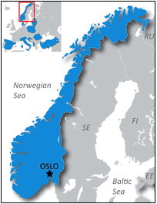
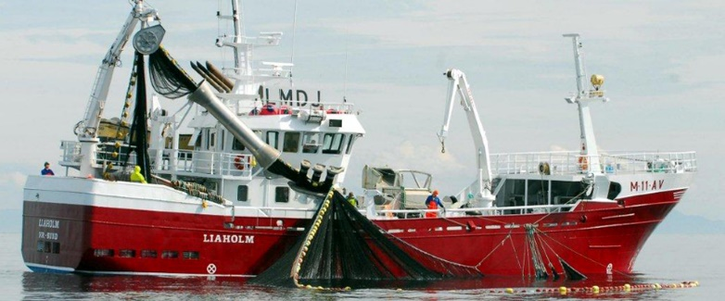
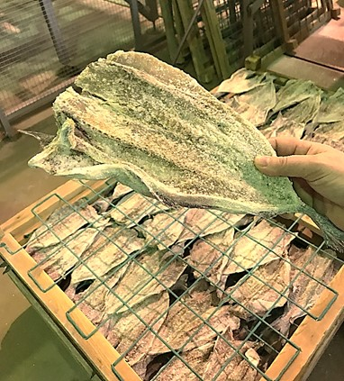
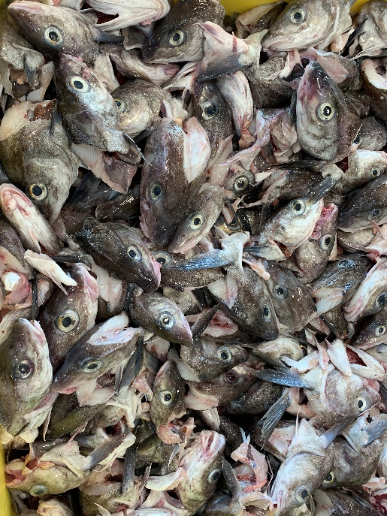
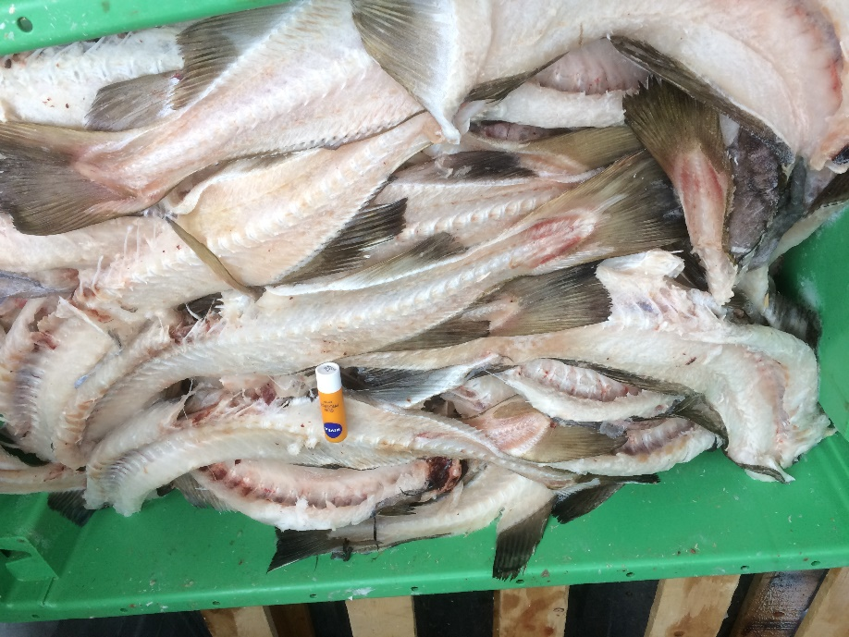
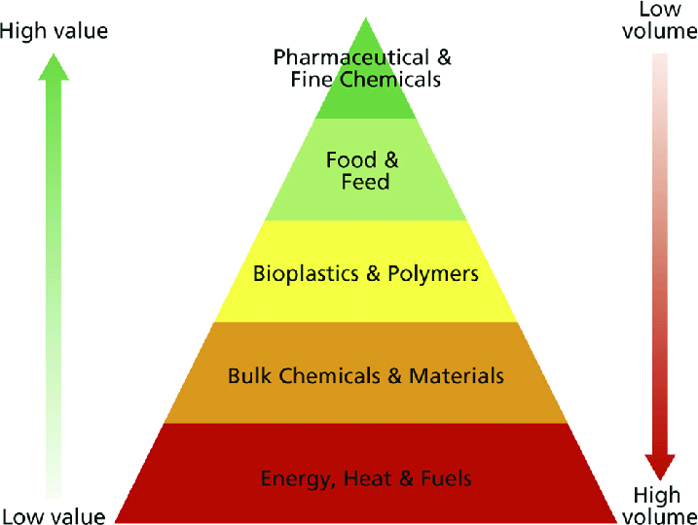
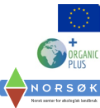
Large volumes of residual materials from captured fish in Norway
Fish capture: 2.5 million tons live weight/year (lean fish, herring ++)
120 000 tons/year from lean fish not utilised
Assuming this «waste» has 30% DM and 10% of P in DM = 3900 tons of P/year
Equals 25% of total domestic P application (mineral + animal fertilisers)
Industry actors prefer the top of the bioeconomy pyramid – costs must be kept low
1 kg P in dog food= 33 Euro
1 kg P in poultry manure = 10 Euro
1 kg P in mineral fertiliser = 4 Euro

Slide 3
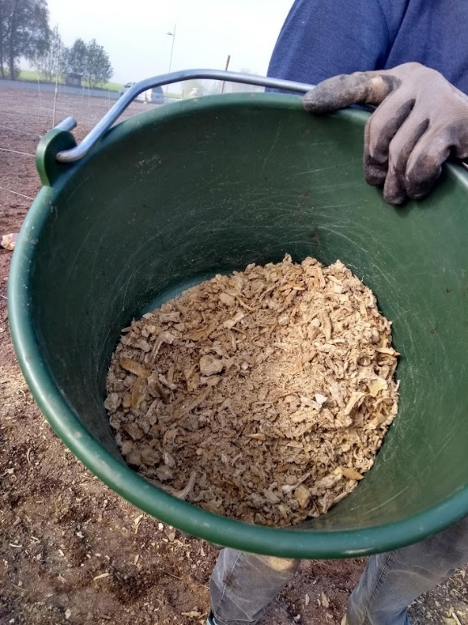
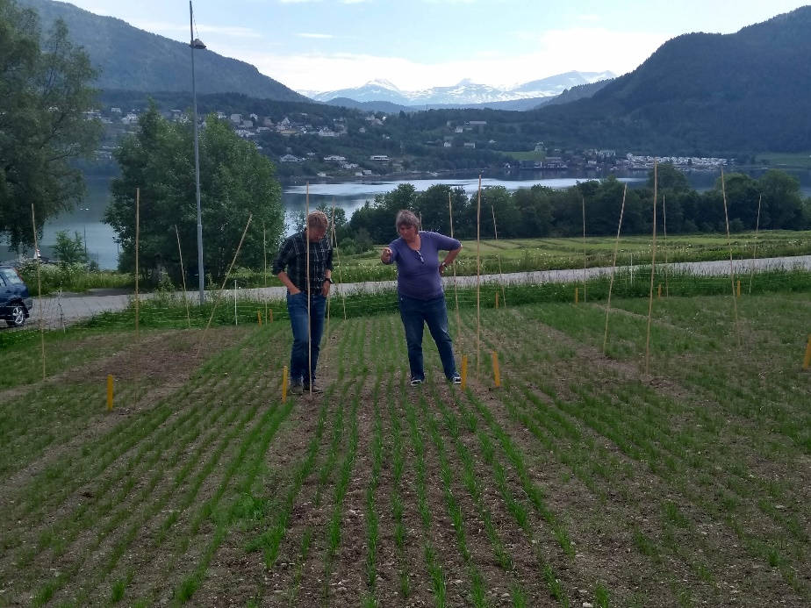
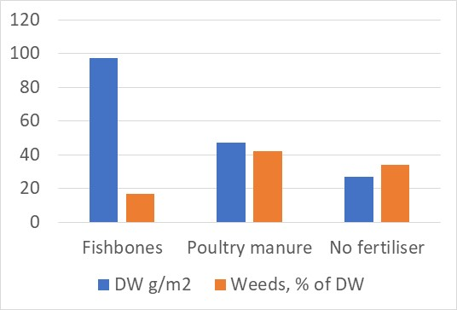
Fish bones rich in P, Ca, N
pH | 4.9
DM, % | 80
N % of DM | 4.1
P % of DM | 9.3
Ca % of DM | 16
K % of DM | 0.1
Mg % of DM | 0.08
S % of DM | 0.2
1st cut of ryegrass , 4 weeks after germination, June 2020
Extremely rapid growth effect (N?) e.g. in ryegrass
Residual growth effect similar to poultry manure (+70% compared with the non-fertilised control)
Soil P-AL doubled (40 to 80 mg/kg) after use of fishbones

