Slide 1
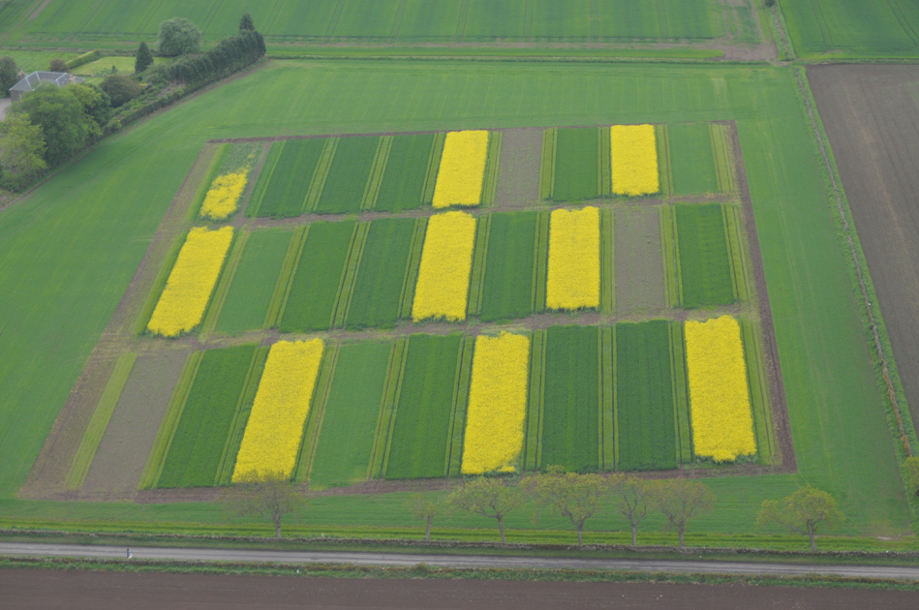
Use of variety mixtures to reduce disease, increase resource-use efficiency resulting and enhance profitability
Workpackage 2:
wheat-based rotations
Adrian C Newton
Notes:
Mixtures can be used to improve resilience of many cropping systems.

Slide 2
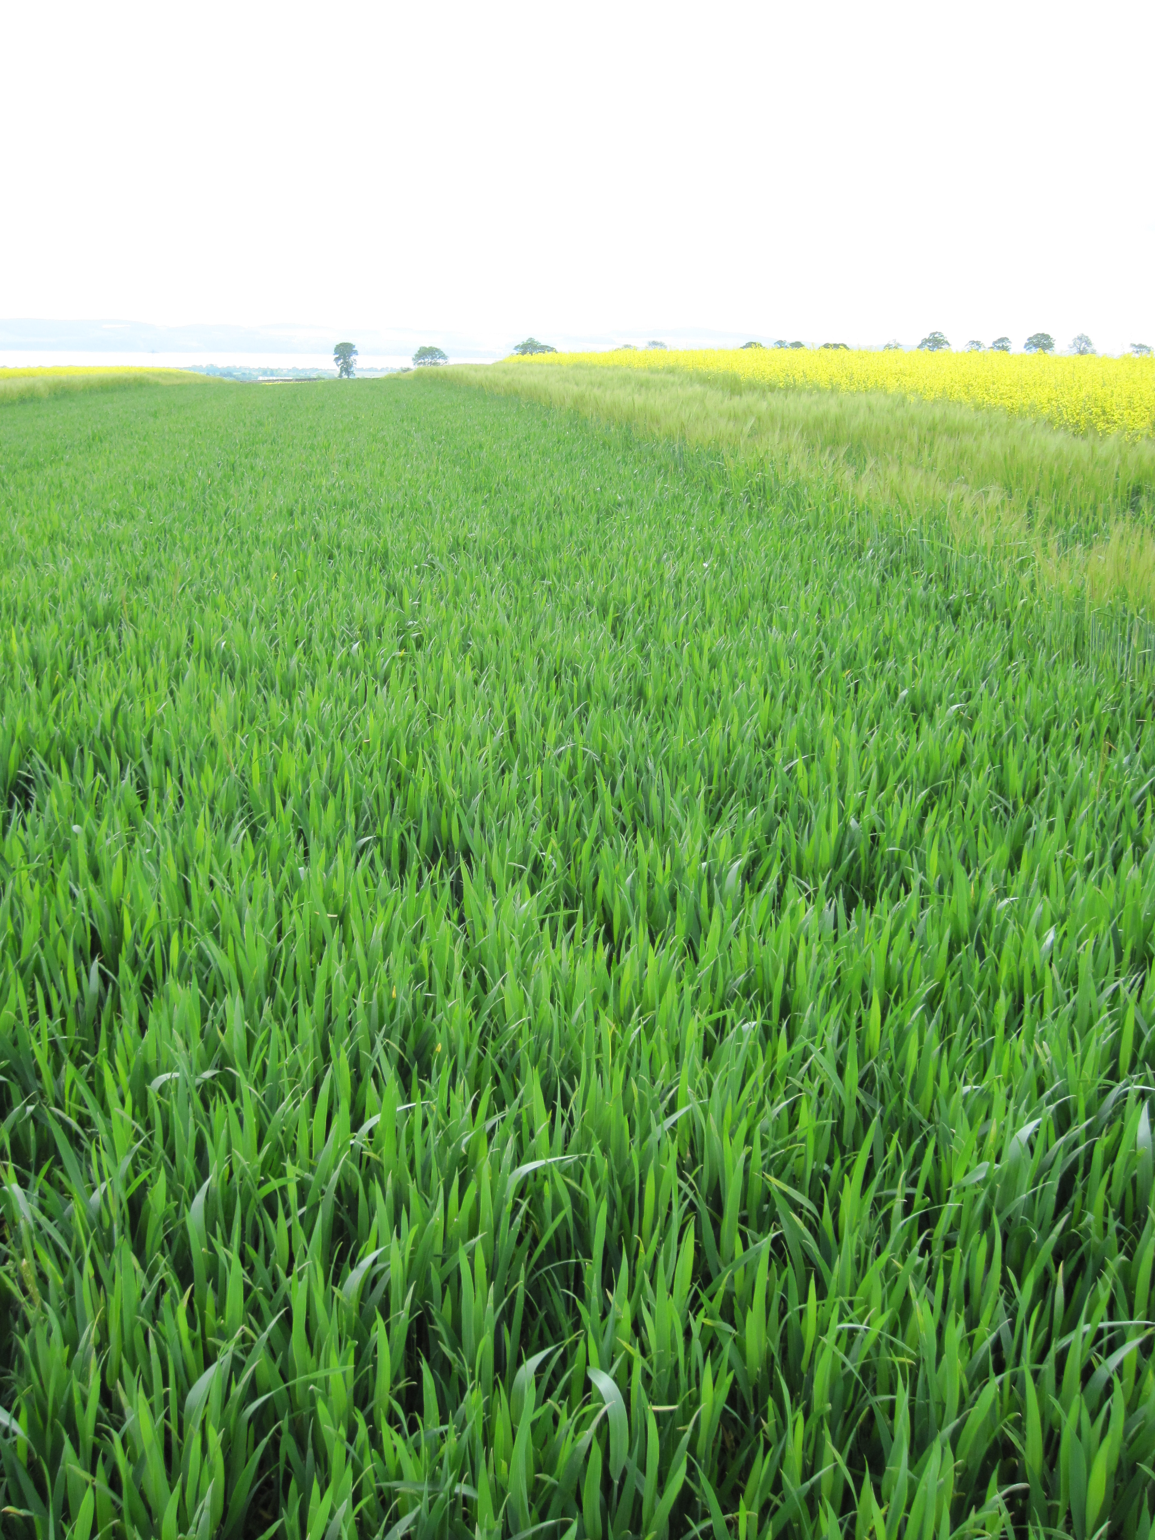
In advanced IPM treatments:
use diverse varieties in conjunction with other agronomic practices such as:
Reduced fungicide dose
Disease forecasting
Resistance elicitors
Reduced seed rate
Reduced herbicide rate
No growth regulator
Reduced tillage
Reduced fertiliser
Notes:
Mixtures are just one agronomic tool that must be used in appropriate combination with others. They facilitate reduction in other inputs and resource use efficiency.
Newton AC, 2014. Tools for IPDM and analysis of “sustainable” crop management in cereals. Proceedings Crop Protection in Northern Britain, 25-26 February 2014, 9-14.

Slide 3
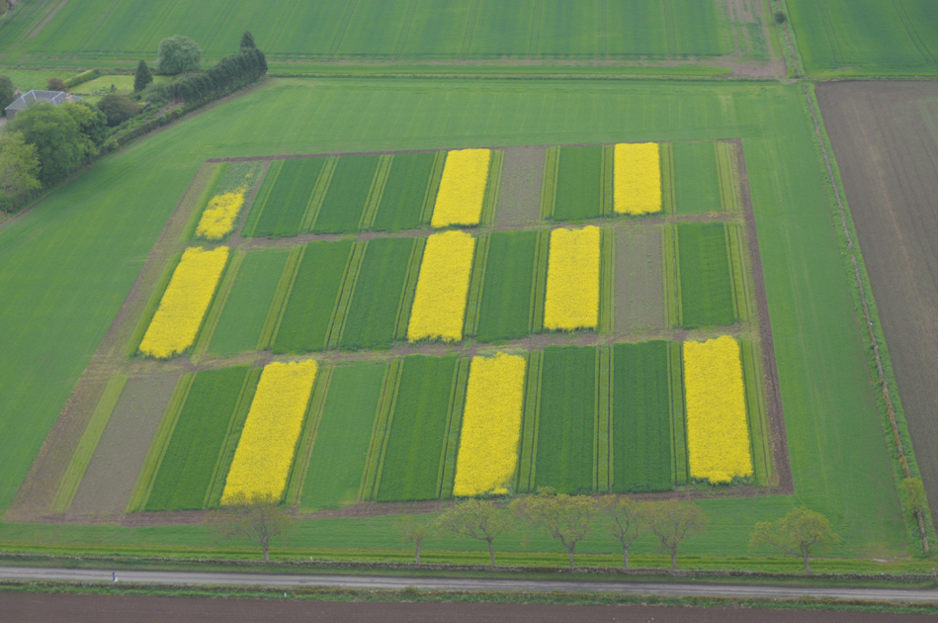
Year 1
Rep 3
Rep 2
Intermediate
Conventional
Rep 1
Advanced
S barley – WW – OSR
WW – WW – OSR
Pea – WW – OSR
Single wheat variety
Three wheat varieties
Eight wheat varieties
Notes:
Mixtures must be carefully designed with the whole cropping system in mind.

Slide 4
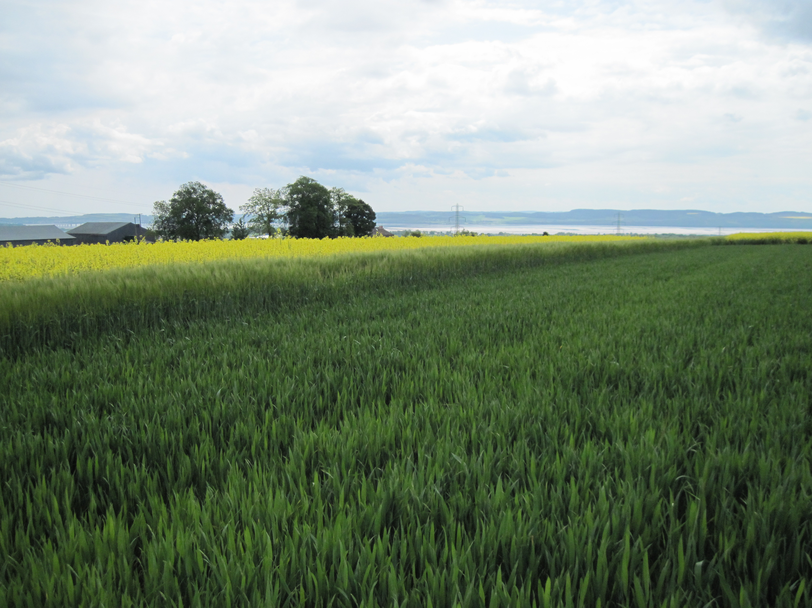
Increased diversity = more yield
Increased diversity = less disease
Notes:
In general, the greater the mixtures complexity, the more disease control and enhanced yield is achieved. Yield enhancement is achieved even when disease is controlled by pesticides.
Newton AC, Ellis RP, Hackett CA, Guy DC, 1997. The effect of component number on Rhynchosporium secalis infection and yield in mixtures of winter barley cultivars. Plant Pathology 46, 930-938.

Slide 5
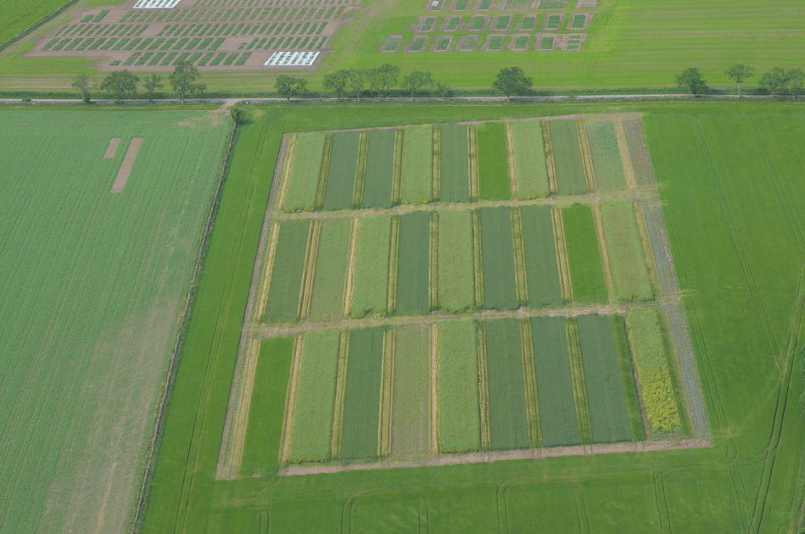
Increased diversity = greater yield sensitivity
(responds more to fertility)
Notes:
Both the mean yield and the yield sensitivity increase in mixtures, and more complex mixtures work best. A sensitivity of >1 = more sensitive to changes in site yield (more responsive to site potential / fertility or better able to exploit high yielding conditions) (Regression coefficient of mean yield of a cultivar at several sites plotted against of all cultivars at the same sites.)
Walters D, Avrova A, Bingham IJ, Burnett FJ, Fountaine J, Havis ND, Hoad SP, Hughes G, Looseley M, Oxley SJP, Renwick A, Topp CFE, Newton AC, 2012. Control of foliar diseases in barley: towards an integrated approach. European Journal of Plant Pathology 133, 33-73.

Slide 6
Suitable for all tillage systems
Zero
Minimum tillage
Disease: AUDPC
Conventional
Compaction
Deep plough
Notes:
Mixtures are not just appropriate for low input systems or particular agronomic practices. They achieve the same proportionate advantages in a wide range of agronomic practices such as different soil cultivation methods.
Newton AC, Guy DC, Bengough AG, Gordon DC, McKenzie BM, Sun B, Valentine T, Hallett PD, 2012. Soil tillage effects on the efficacy of cultivar and their mixtures in winter barley. Field Crops Research 128, 91-100.

Slide 7
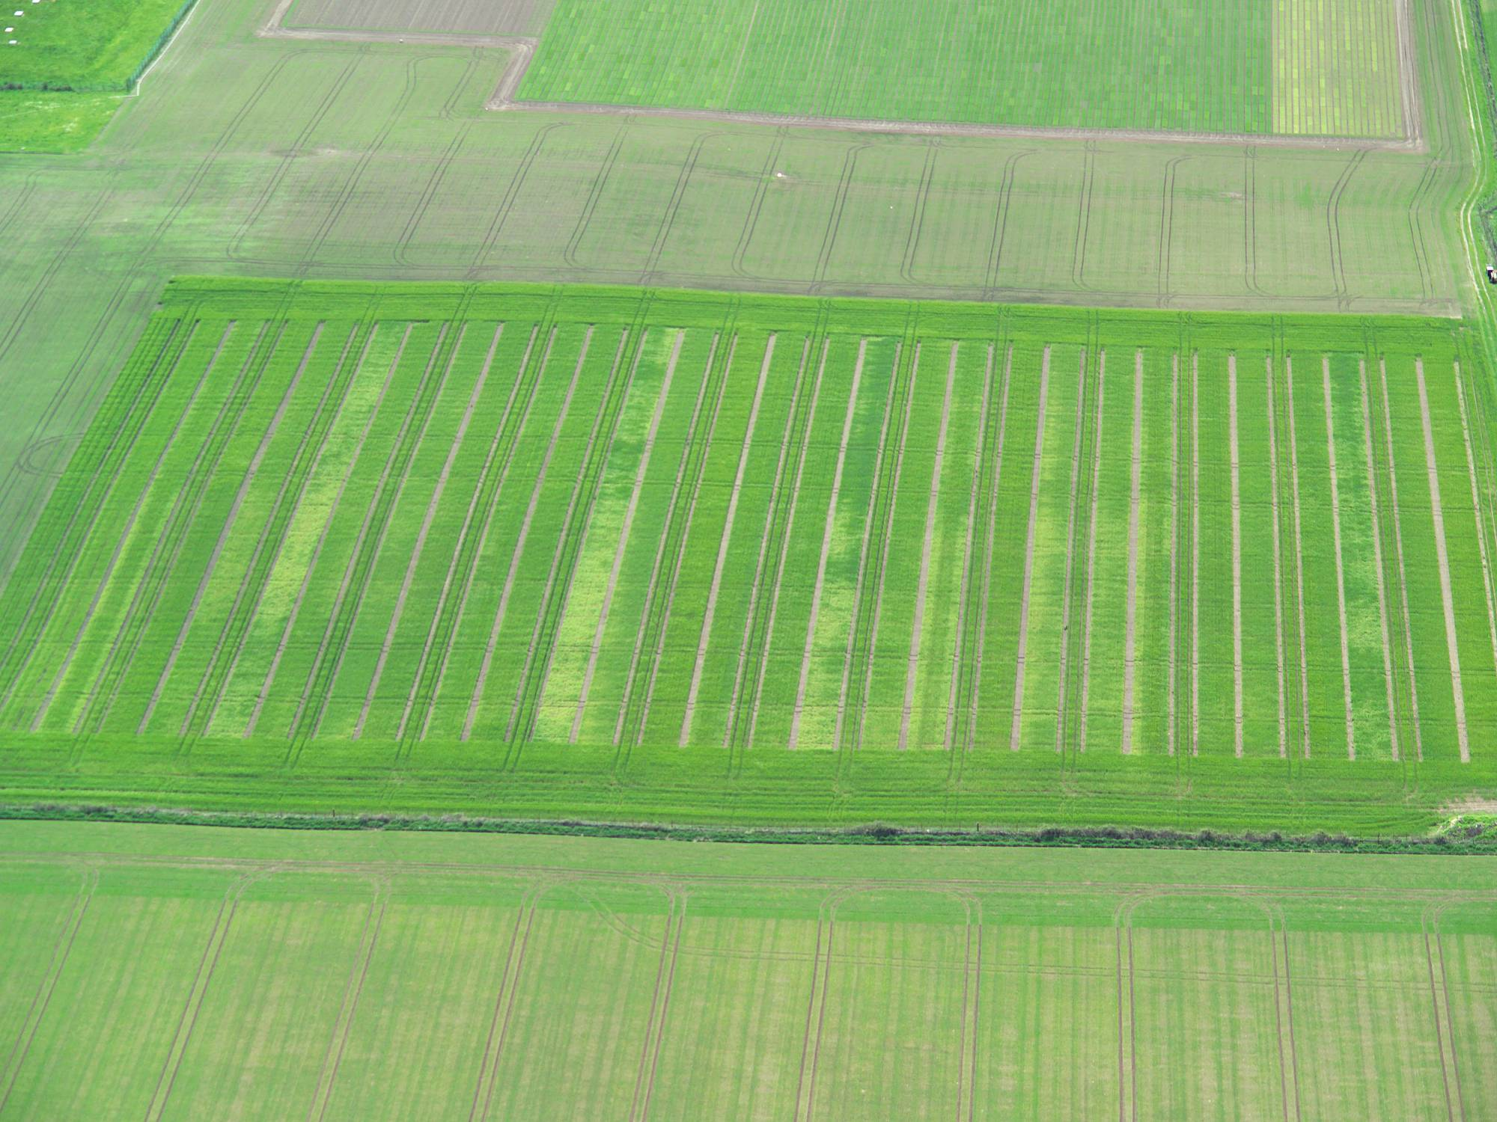
Patchy arrangements in the field
Pe
Pa
Si
Course
Homogeneous
R1
R2
R3
R4
Yield Coarse Homogeneous
mix mix
Mixtures advantage: 2005 +13%*** ns
2006 +17%*** ns
Disease
Mixtures advantage: 2005 -34%*** ns
2007 -58%*** ns
Notes:
A patchy sowing of mixtures components is often more effective for controlling disease and increasing yield than homogeneous mixing. However, different granularities of patchiness may be more effective for different diseases depending on the pathogens responsible and their spore dispersal characteristics.
Newton AC, Guy DC, 2009. The effects of uneven, patchy cultivar mixtures on disease control and yield in winter barley. Field Crops Research 110, 225-228.

Slide 8
Small proportions of a resistant variety have disproportionately large effect on disease reduction (barley data)
Notes:
A relatively small contribution of one component in a mixture can have a disproportionately large contribution to disease reduction. However, relationships with yield are more complex.
Newton AC, Guy DC. The effect of component proportions and canopy structure in cultivar mixtures of barley for disease control (in prep).

Slide 9
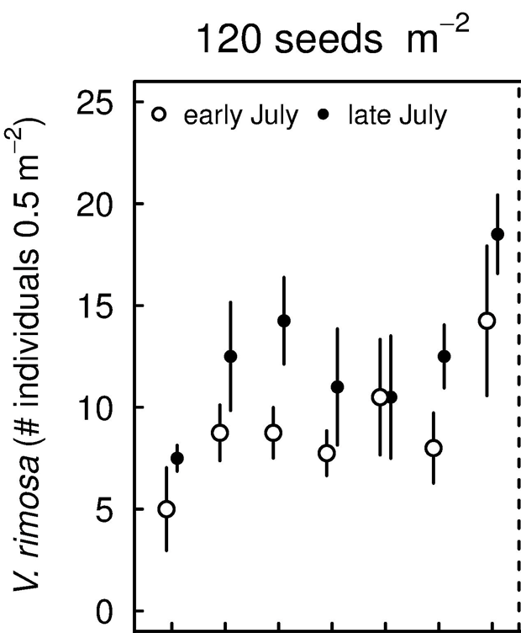
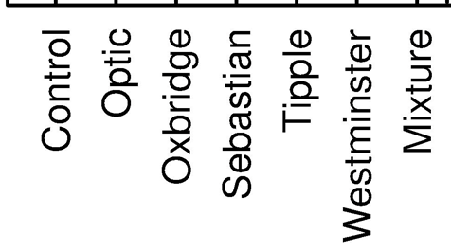
Impact of cultivars and mixtures on a rare weed species
Average number of Valerianella rimosa individuals for the different combinations of barley variety cultivar (including unsown controls and mixtures as cultivars) at 120 seed m⁻².
Notes:
Increasing crop density controls weeds most effectively. However, different weed species respond differentially to density and to the components of the crop in a mixture. These differences ay be exploited to favour some weed species that may have important roles in the food web.
Brooker RW, Karley AJ, Morcillo JL, Newton AC, Pakeman RJ, Schoeb C, 2015. Can crops facilitate rare arable weeds? A case study of Valerianella rimosa. Journal of Applied Ecology (in prep).

Slide 10
Conclusions
Variety mixtures are an important agronomic method that can contribute to Integrated Pest Management
Mixtures contribute to stability and increased resource use efficiency
Mixtures to 76% disease reduction and 17% increase in yield (winter barley data)
The greater the number of components the more disease is reduced
The spatial arrangement, patch size and distribution can affect their efficacy
Resistance components can contribute disproportionately, a 10% proportion of a resistant component accounting for up to 50% disease reduction
Mixtures can help maintain functional diversity amongst weeds
Notes:
Mixtures have many advantages that contribute to cropping system resilience and efficiency.
Newton AC, Begg G, Swanston JS, 2009. Deployment of diversity for enhanced crop function. Annals of Applied Biology 154, 309-322.

