Slide 1
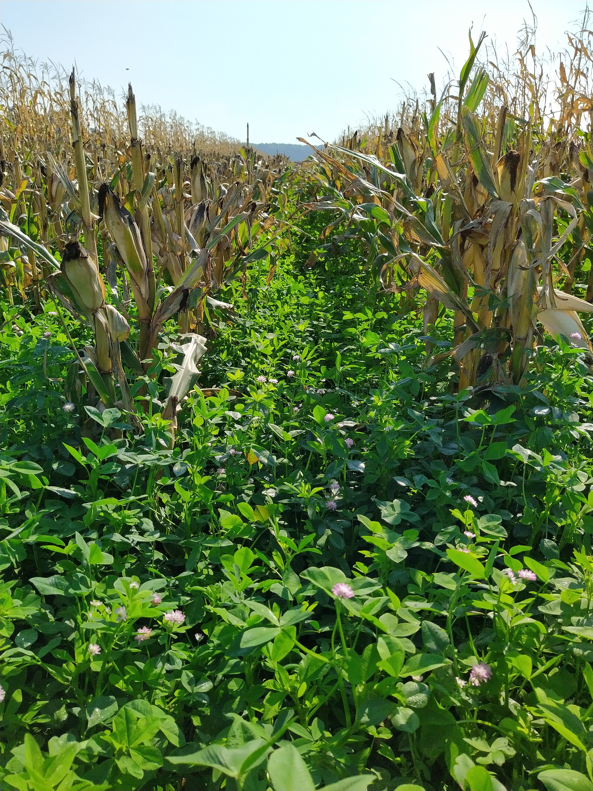
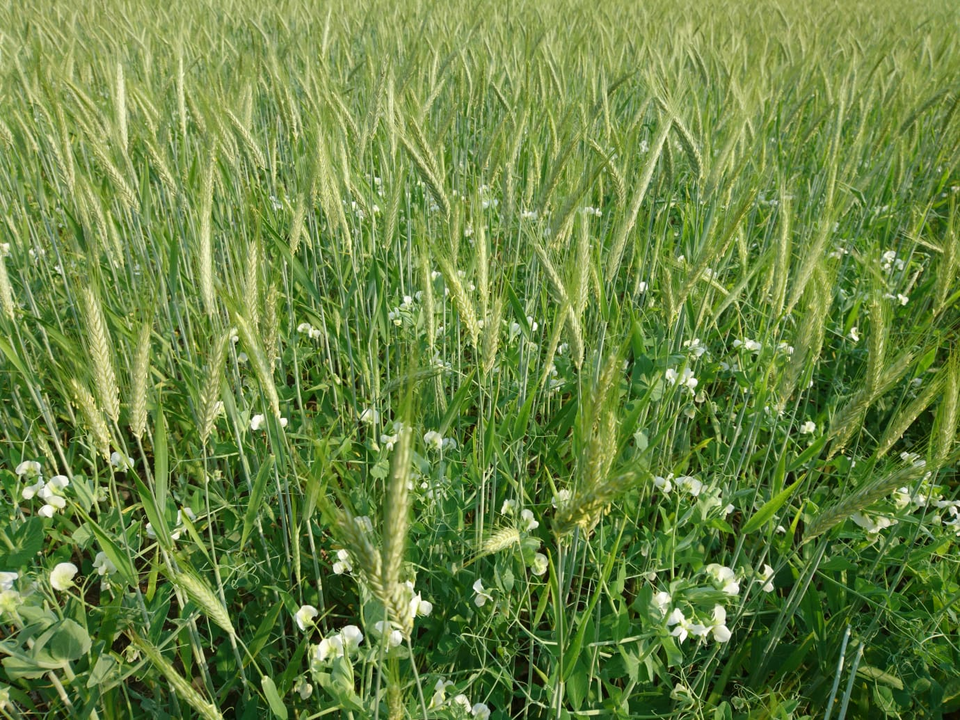
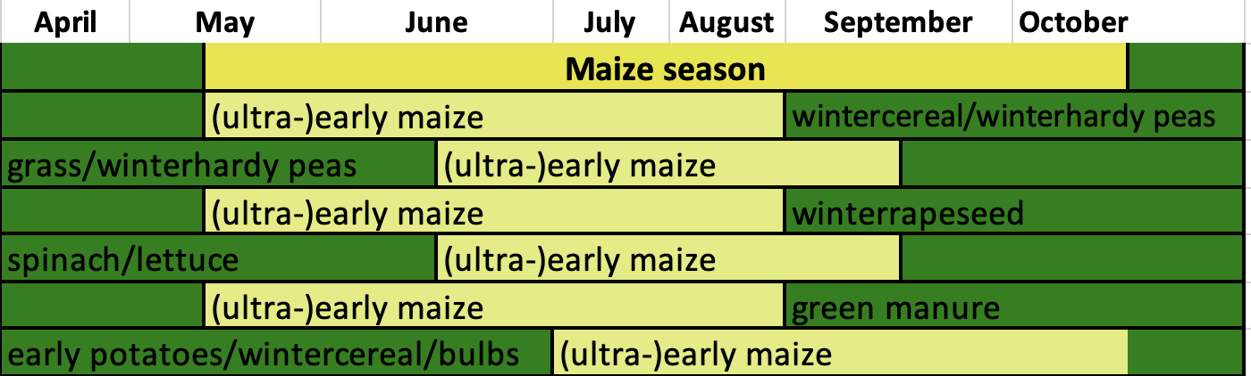
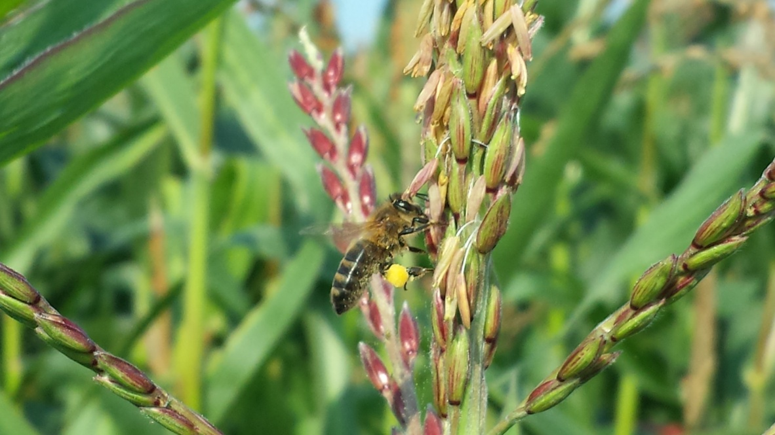
We breed organically (not all on certified soil)
Organic seed productions with
Clover mixture undersow
Wintercrops
Projects on sustainable maize, ‘on the way to chemical free’

Slide 2


Nordic Maize breeding
Small innovative, independent maize breeding company
We started with collecting genetic sources:
Genebanks
Existing varieties
Other maize breeders
Inbredlines hybrids populations
STOP MONOCROPPING

