Slide 1

Analysis of GOVERNANCE models of organic plant breeding initiatives in Europe
III EU LiveSeeding webinar entrepreneurship: Governance and finance models for organic seeds and plant breeding in Europe
10-11 March 2026
Claudia Meier, Lamprecht Nina, Mariateresa Lazzaro
mariateresa.lazzaro@fibl.org
Research Institute of Organic Agriculture FiBL
Notes:
Strengthen the organisational, governance, and financial capacity of existing and emerging organic seed and plant breeding initiatives across Europe
This webinar has the goal to:
Show different governance and financing models currently applied in organic plant breeding organisations and operational contexts.
Explore a wide range of public and private financing mechanisms relevant for small and medium sized actors.
Learn directly from organic seed and plant breeding real-life experiences, illustrating how governance and financing models operate in practice and how they shape organisational sustainability.

Slide 2
Context
Analysis of financing and governance strategies of existing organic plant breeding initiatives (T5.2 of LiveSeeding)
Goal:
Understand governance structures to overcome financial bottlenecks
Objectives:
Map current governance and financing strategies
Assess financial sustainability and other success factors
→ Online survey with 16 selected organic plant breeding initiatives
→ Participatory assessment with WP5 partners, initiatives and wider audience
Notes:
My input is an introduction to the round table in which we will here from 3 different organisation about their governance and the implictaions in their activities.

Slide 3
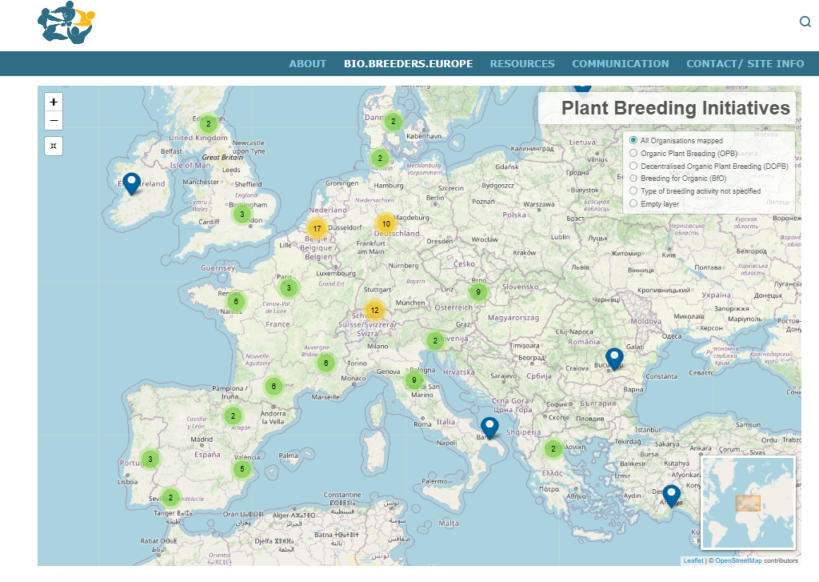
Context
Definitions:
With «breeding» we mean the breeding or development of organic heterogeneous material (OHM) and organic varieties (OV) AND also the conservation or improvement of local, traditional cultivars (OPB, Breeding For Organic not included).
biobreeding.org

Slide 4
What do we mean with GOVERNANCE
Governance model | organizational form, initiator, operational scale, number of employees, type of organization, perceived support from government and community, organizational structure
Decision making | characteristics of decision making, involvement, decision power, decision making processes on financial issues, on breeding and conservation targets, and on values

Slide 5
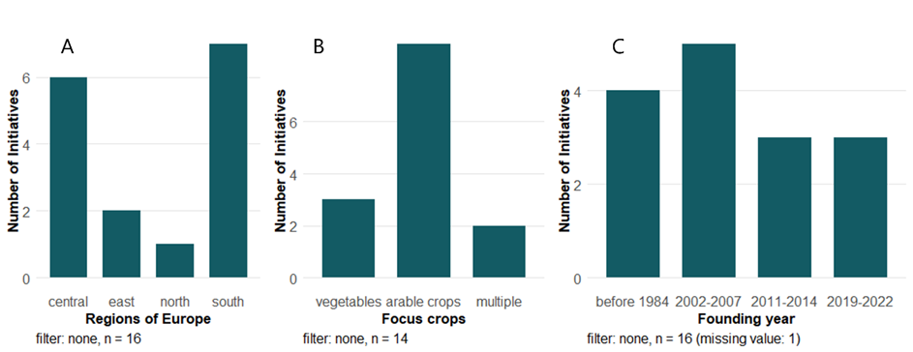
Mapping of governance
16 initiatives participated to the study
ProSpecieRara
Rete Semi Rurali
Les Refardes SCCL
ÖMKi - Research Institute of Organic Agriculture
farmers members of FRAB and Triptolème
Agricultural Institute of Slovenia
AEGILOPS
D'une graine aux autres
Union Bio Semences
Agrologica
Nordic Maize breeding
Dottenfelderhof
Fondazione Seminare il Futuro
SMARTIES.BIO SRL SOC. AGR.
Sementes vivas
Associació de Varietats Locals

Slide 6
Activities

Slide 7
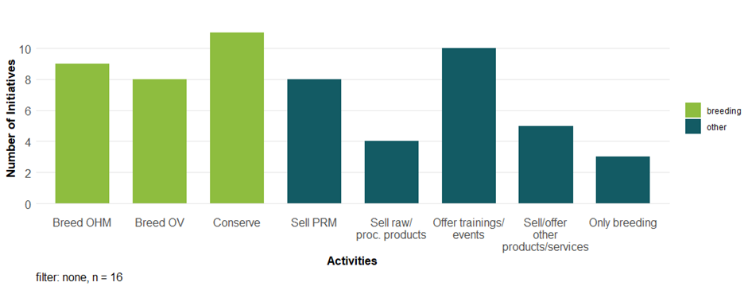
Mapping of governance and financing strategies
Activities
Breeding-related
Other activities
To food processors, retailers, consumers,
cooperatives.
Books on seeds, advisory
Services, support with trials
Directly, via seed companies, food retialer, DIY shops, garden centers, organic feed company, cooperatives.
B1: Which of the following activities applies to your organisation/ initiative?, MP, filter: none; C1: Which other activities apply to your organisation/ initiative?, MP, filter: none.
Notes:
Only three of the sixteen initiatives surveyed work exclusively on cultivar development. Most have a portfolio of activities from which other types of products and services are derived. Examples of these are offering training and information events, selling plant reproductive material, and selling raw or processed products for the feed or food value chain

Slide 8
Governance model

Slide 9
Mapping of governance
Public organisation – typically non-profit, regulated by the government, top-down decision-making, following the interests of the public/ society.
Market initiative – typically for-profit, regulated by the market, top-down decision-making, market-oriented (value creation is market driven).
Grass-root initiative – typically non-profit, bottom-up decision-making, community orientation (value creation is community/ citizens-driven), community based (initiative comes from the community).

Slide 10
Mapping of governance
Governance model
Public actor(s)
State, Government
Governance types
1 - Public organisation - PO
2 - Market initiative - MI
3 - Grass-root initiative - GR
4 – Public-market partnership - PM
5 – Public-grass-root partnership - PGR
6 – Market-grass-root partnership - MGR
7 – Public-market-grass-root partnership - PMG
Top-down
1
Government-regulation
5
4
7
Citizens power
Market-regulation
3
6
2
Community
NGOs, Civil society
Companies
Firms, market
Community based
Market-oriented
Source: Egusquiza et al. (2021), Conceptual and Operational Integration of Governance, Financing, and Business Models for Urban Nature-Based Solutions, Sustainability.

Slide 11
Mapping of governance
Governance model
Public actor(s)
State, Government
Governance types
1 - Public organisation – PO [1]
2 - Market initiative – MI [3]
3 - Grass-root initiative – GR [5]
4 – Public-market partnership – PM [0]
5 – Public-grass-root partnership – PGR [1]
6 – Market-grass-root partnership – MGR [5]
7 – Public-market-grass-root partnership – PMG [1]
Top-down
1
6
Government-regulation
4
8
5
4
7
2
Citizens power
Market-regulation
16
3
13
9
5
10
3
1
6
2
14
Community
NGOs, Civil society
7
12
15
11
Companies
Firms, market
Community based
Market-oriented
Source: Egusquiza et al. (2021), Conceptual and Operational Integration of Governance, Financing, and Business Models for Urban Nature-Based Solutions, Sustainability.
Notes:
the distribution of the 16 OPBI in the governance model triangle, the OPBI clearly accumulate in the bottom part, and particularly in the left corner of the triangle, where the GR are located. Five OPBI were classified as GR, and another five were classified as MGR (mixture between GR and MI). Three OPBI were classified as pure MI, being market-oriented and market-regulated. However, all OPBI classified as MI in this study still show some characteristics of grassroot initiatives, with some being initiated by private actors that emerged from grassroot movements.

Slide 12
Summary governance
Organic Plant Breeding Initiatives (OPBI) are often micro-to small and medium sized entities.
The majority of OPBI surveyed are characterized by grassroots and hybrid grassroots-market governance models
Even the for-profit initiatives included in the study retain characteristics of grassroot movements, with some being initiated by private actors who emerged from such movements

Slide 13
Summary governance
OPBI perceive their environment as collaborative in terms of the network from which they originated and with which they work, rather than the seed sector per se, and they are structured in a non-hierarchical way, with decisions being taken in a participatory manner

Slide 14
Summary governance
Organizational structures influence access to funding
grassroots initiatives often form partnerships with private, for-profit organisations, which could facilitate the distribution of plant reproductive material while the breeding activity remains non-profit.

