Slide 1
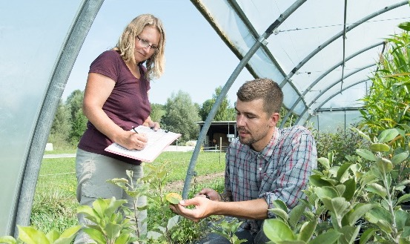
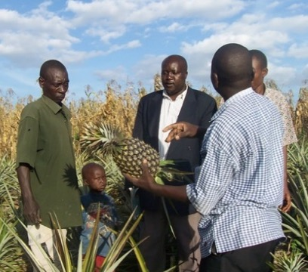
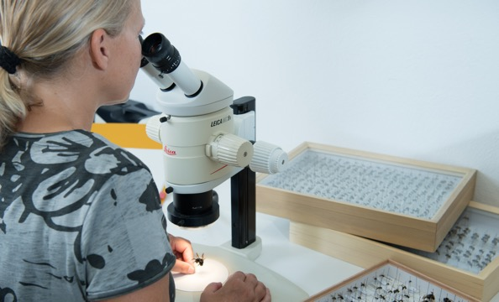
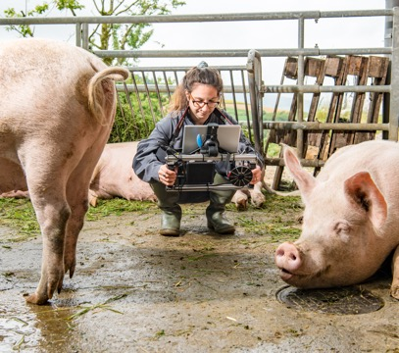
INFOGRAPHICS
The World of Organic Agriculture
Statistics and Emerging Trends 2026
Jan Travnicek, Bernhard Schlatter, Helga Willer
Research Institute of Organic Agriculture FiBL, Frick, Switzerland
February 2026

Slide 2

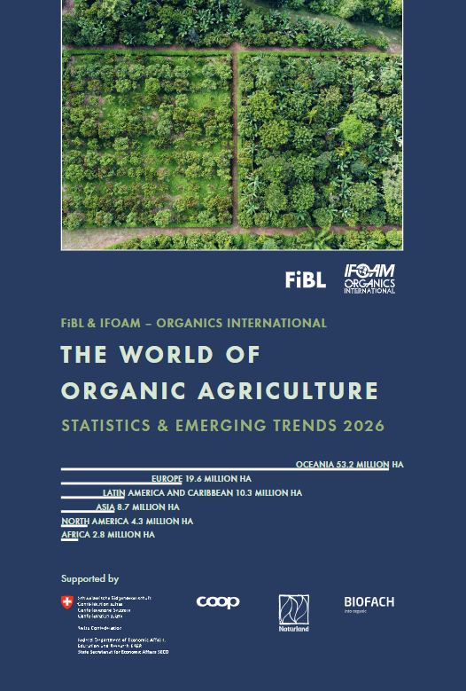
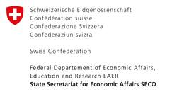


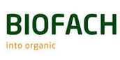

The World of Organic Agriculture 2026
27th edition
Tables, figures, maps - Data 2024
Country and regional reports
Information on markets and policies
www.organic-world.net
www.organic-world.net/yearbook/
yearbook-2026.html
statistics.fibl.org

Slide 3
ENGLISH

Slide 4
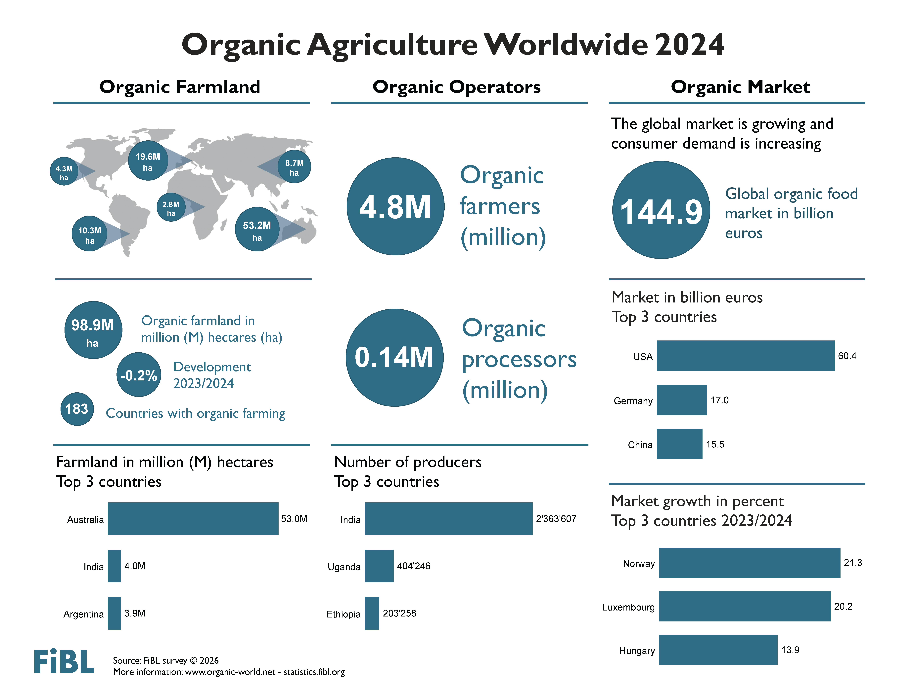

Slide 5
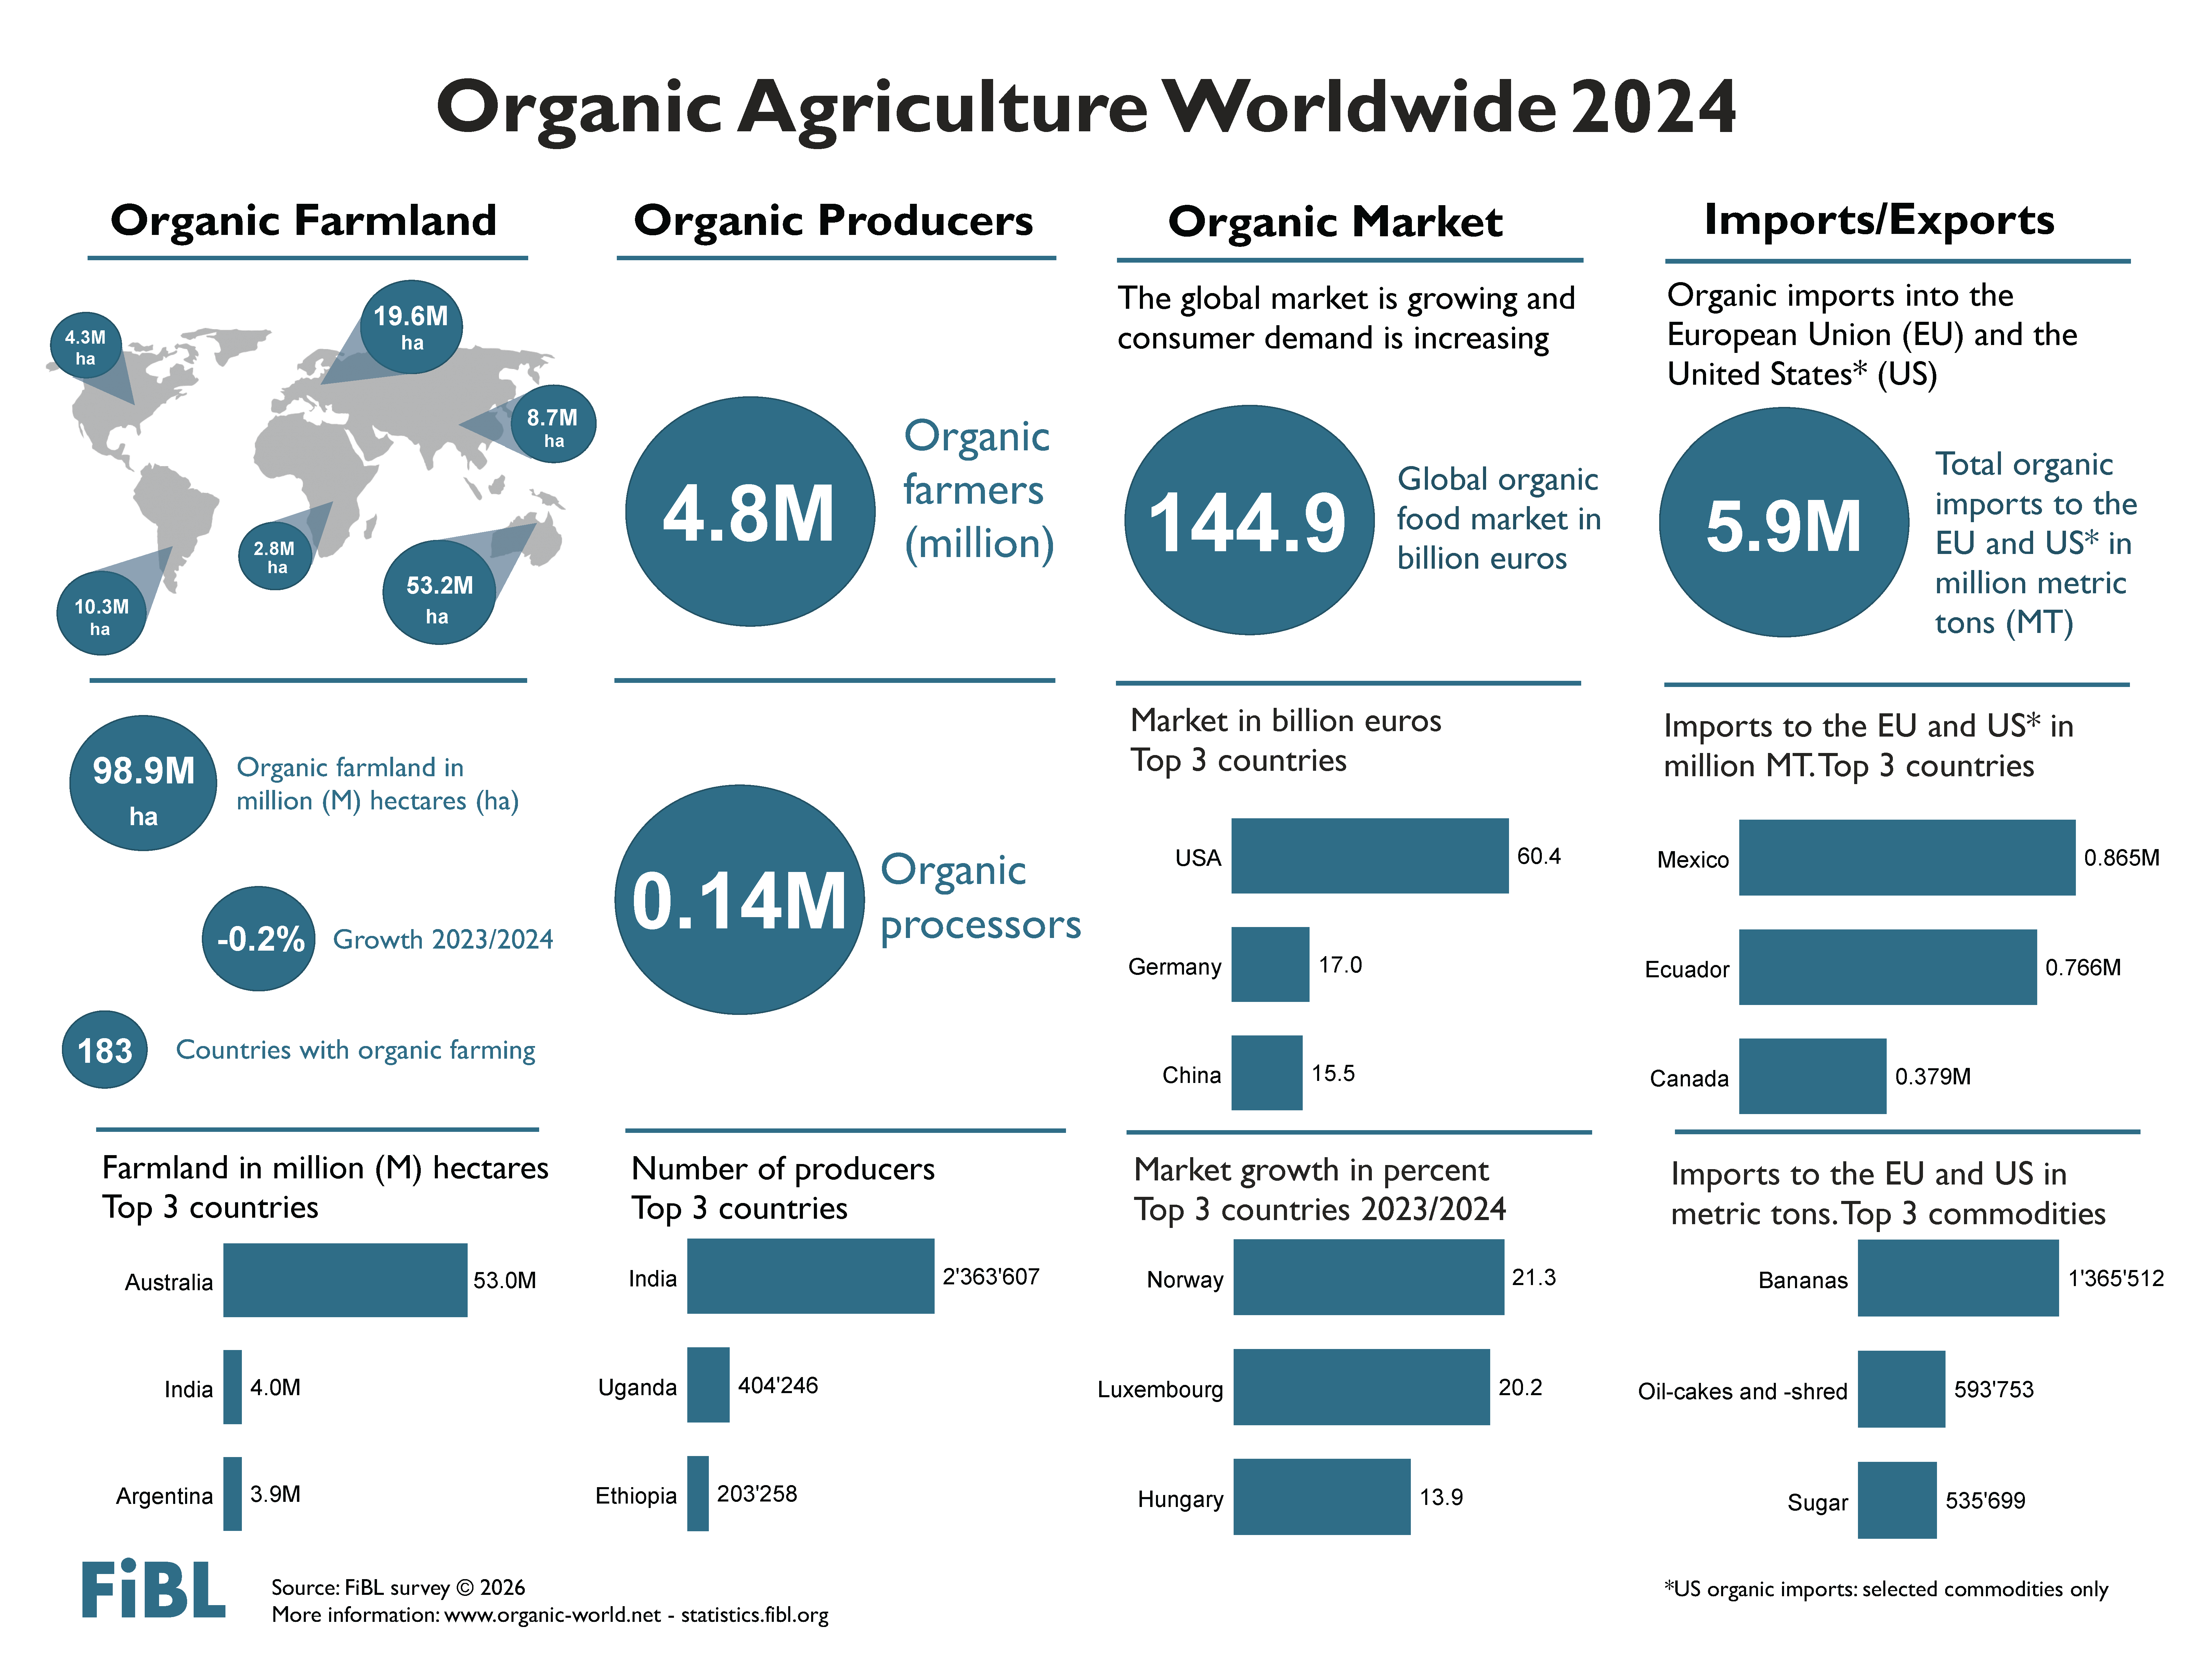

Slide 6
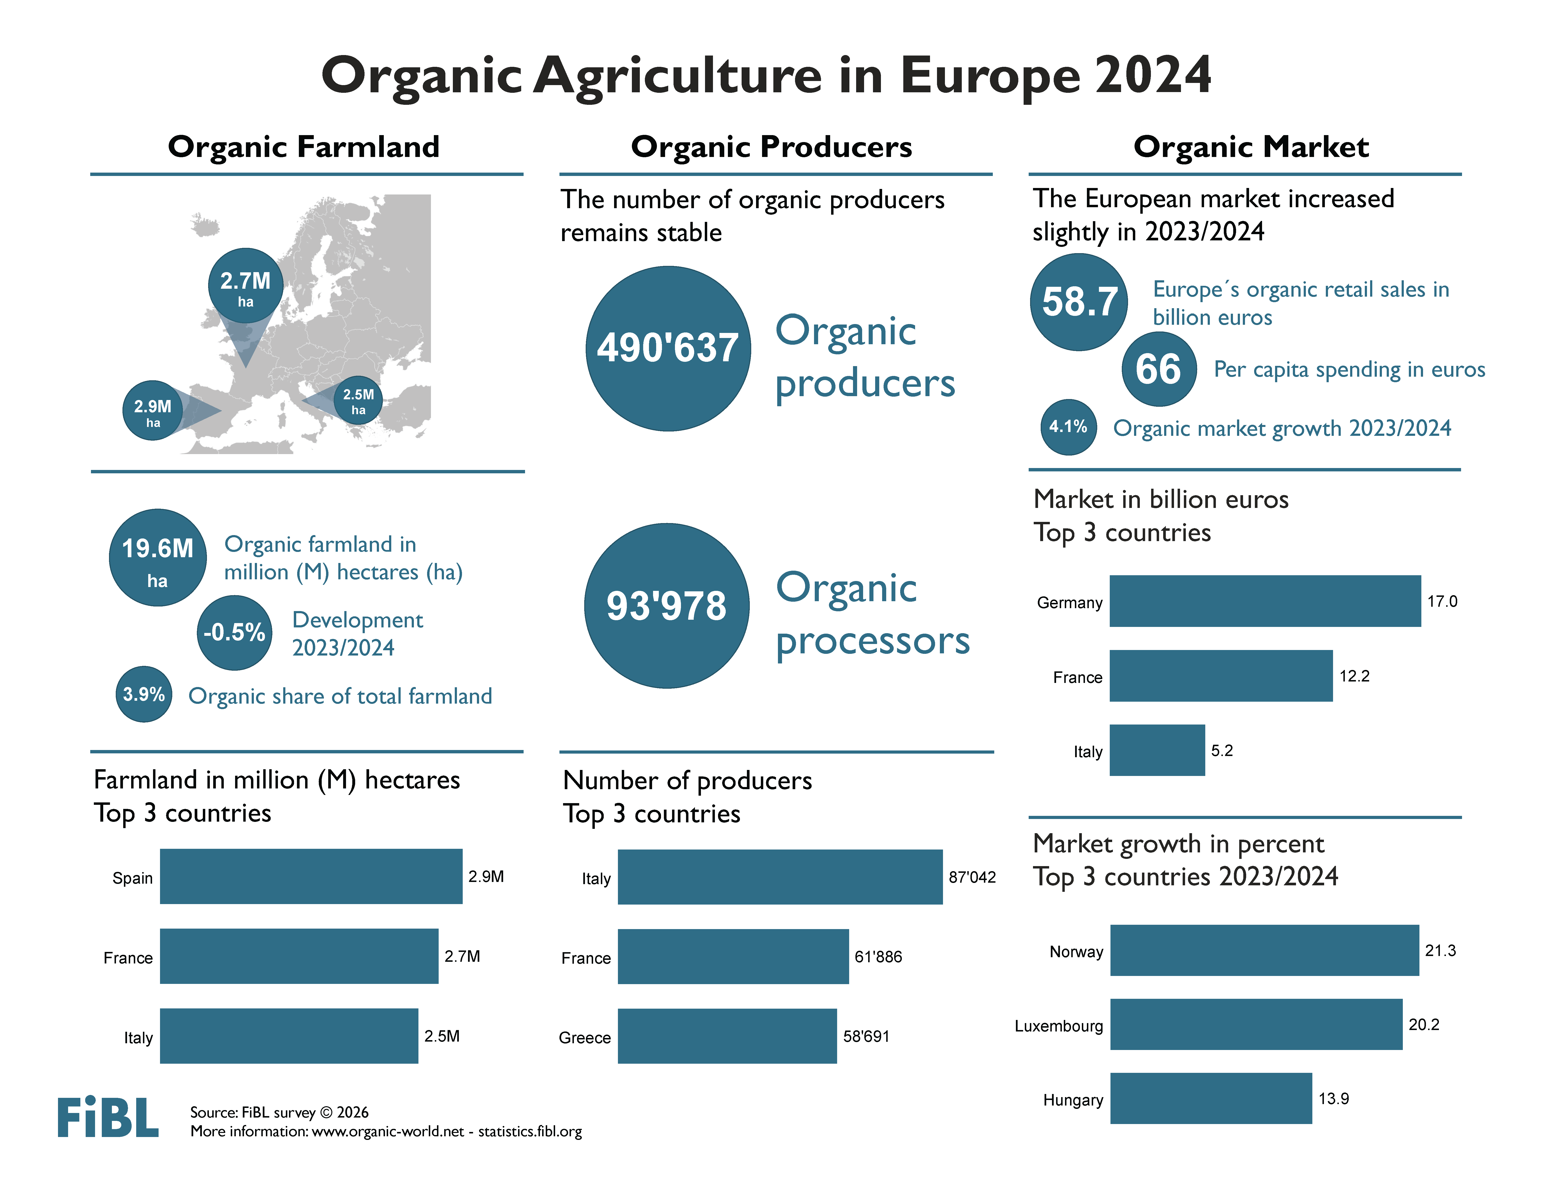

Slide 7
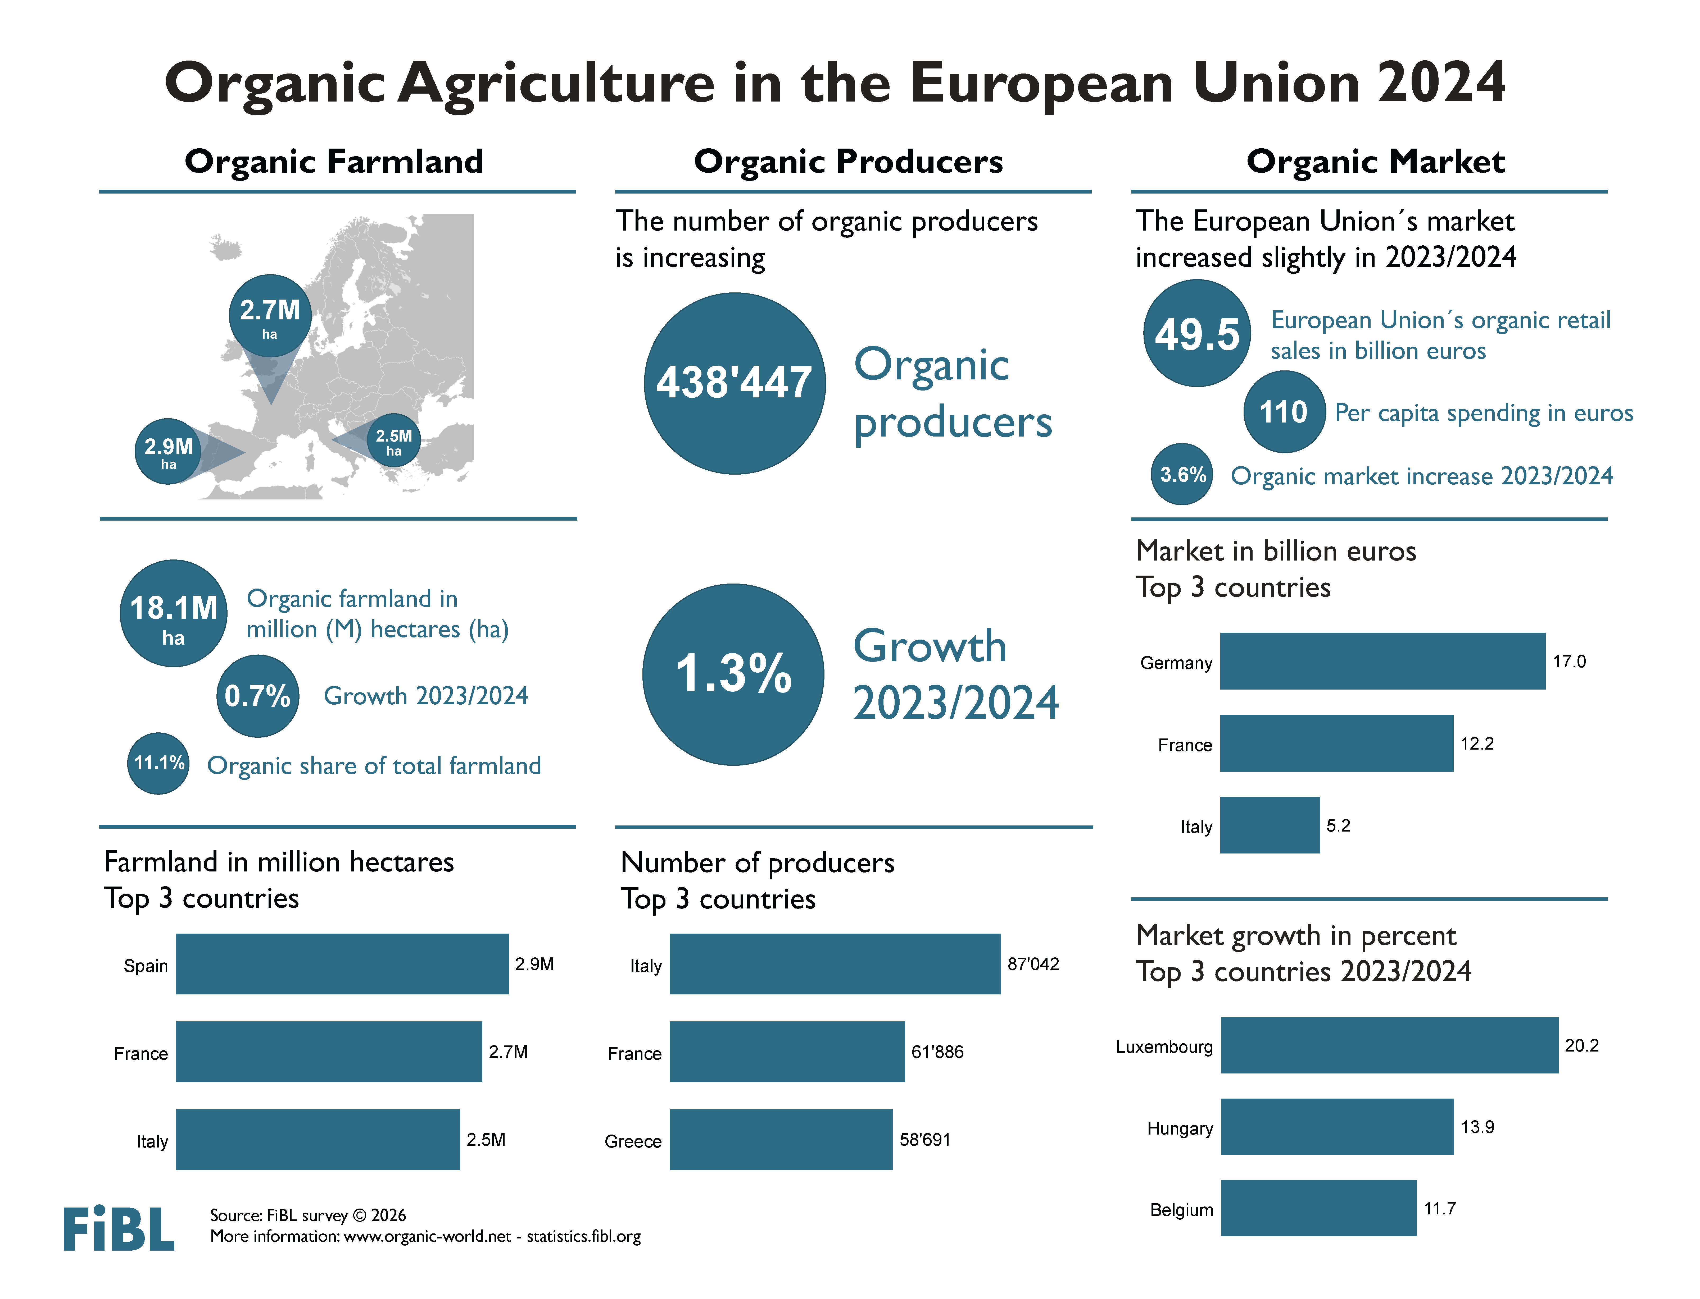

Slide 8
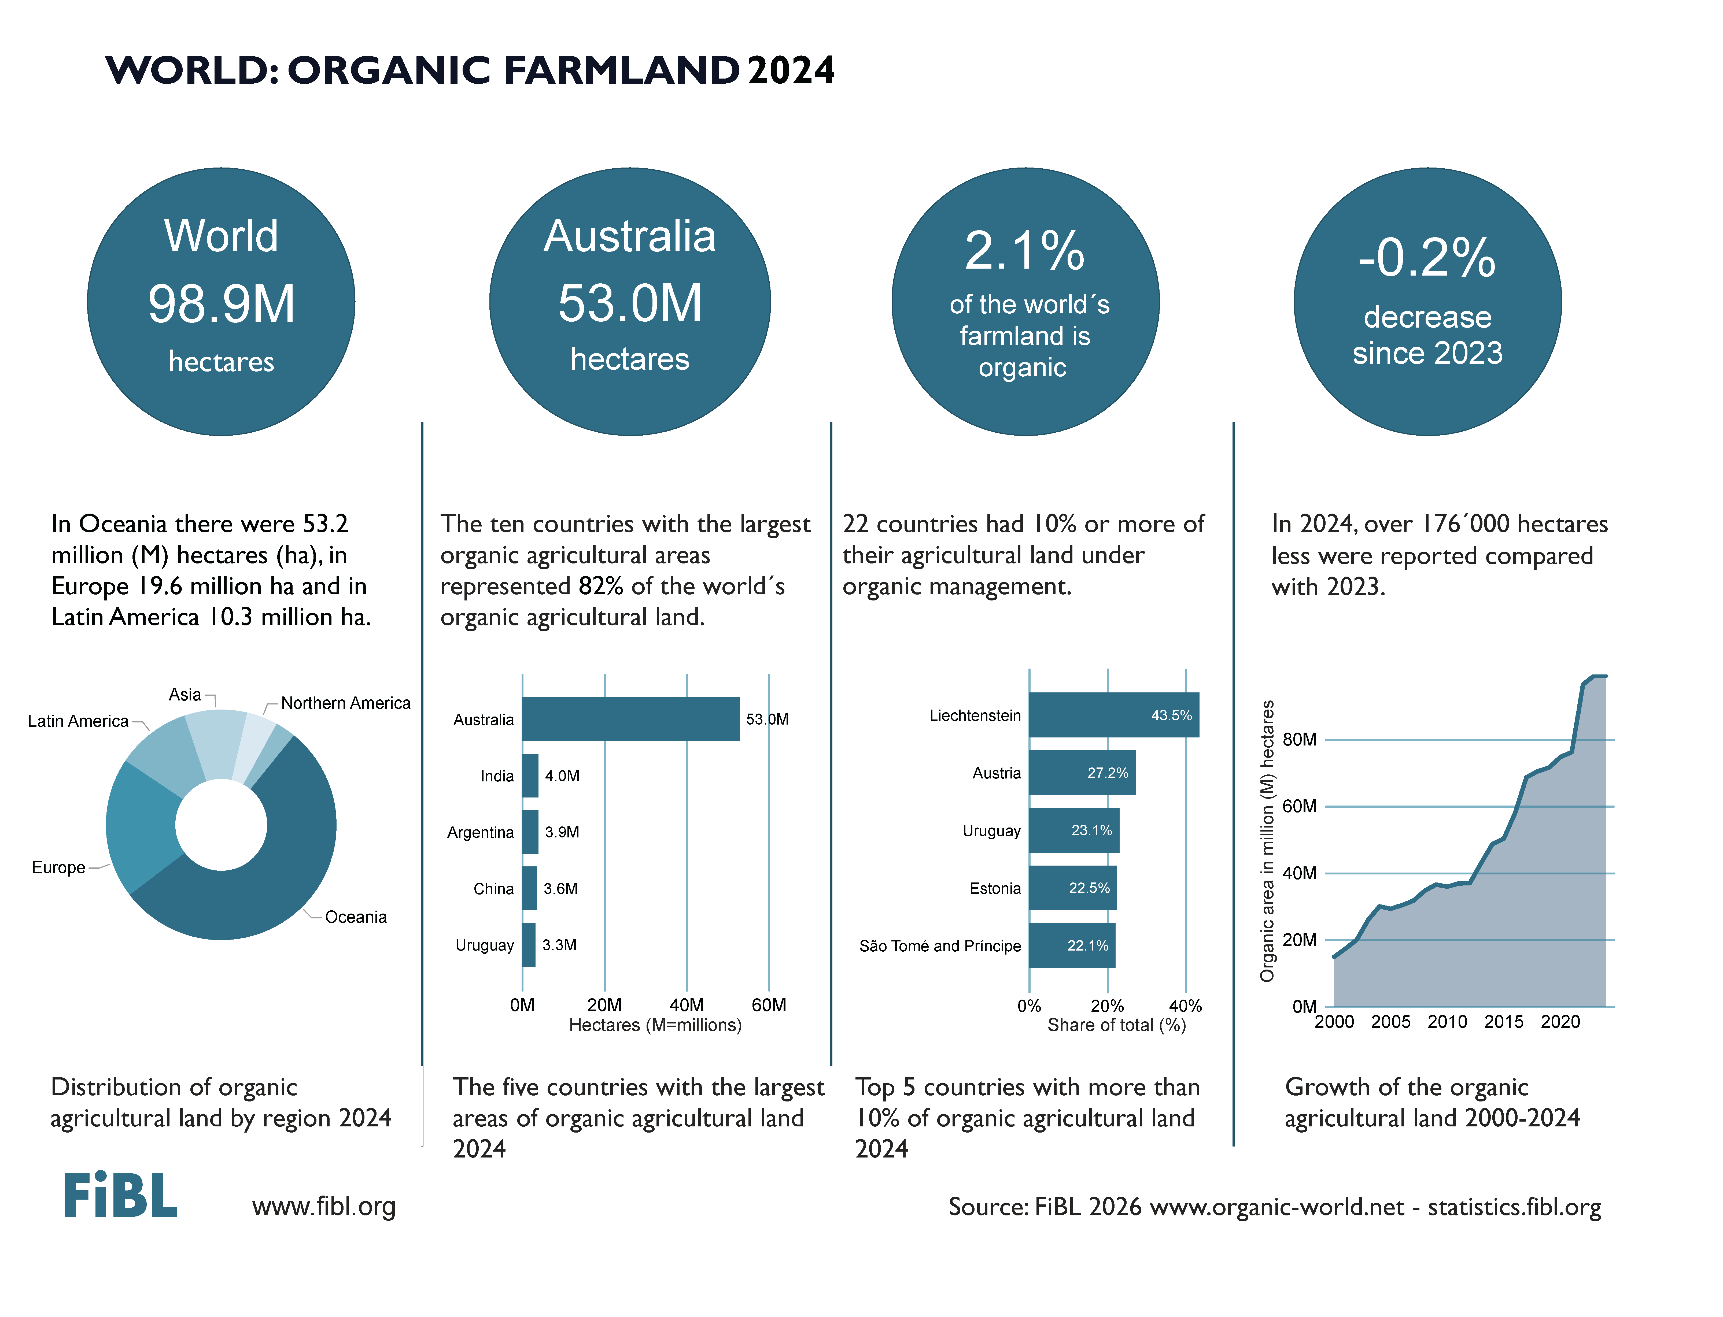

Slide 9
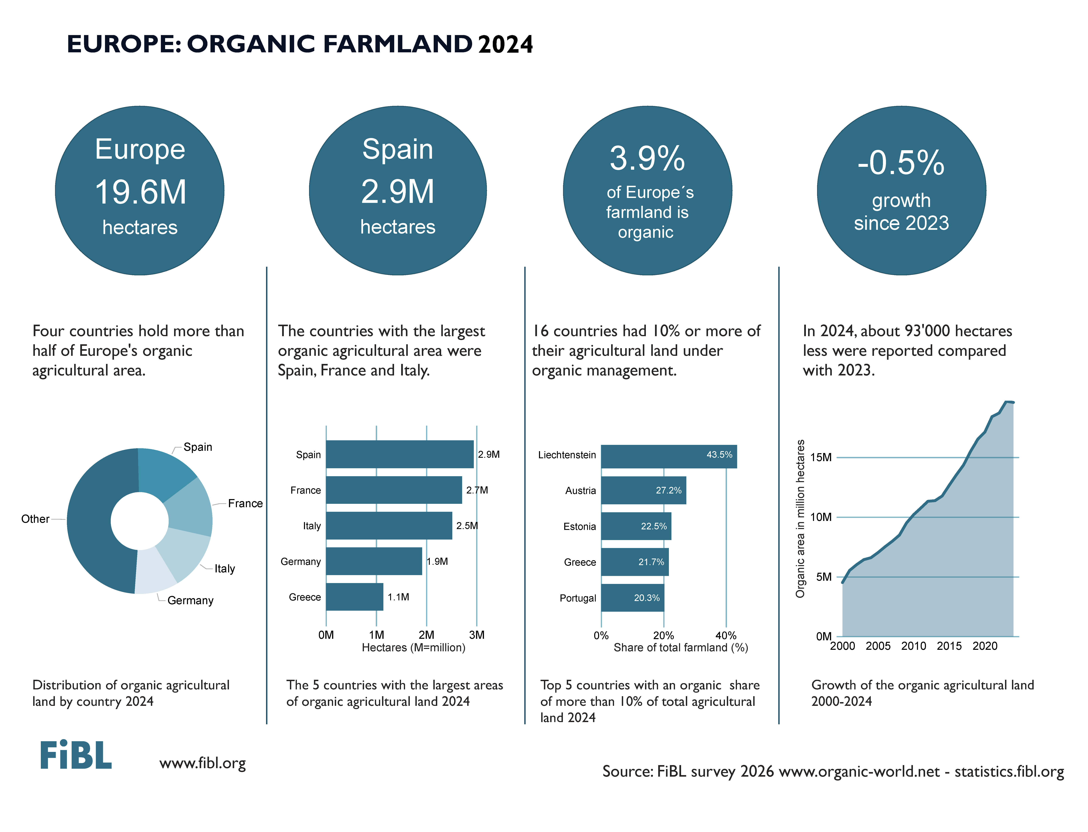

Slide 10
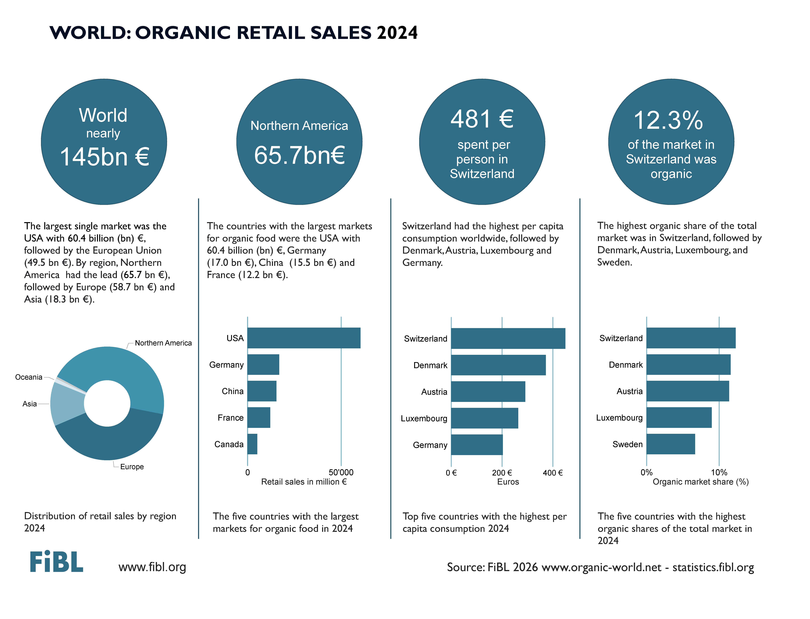

Slide 11
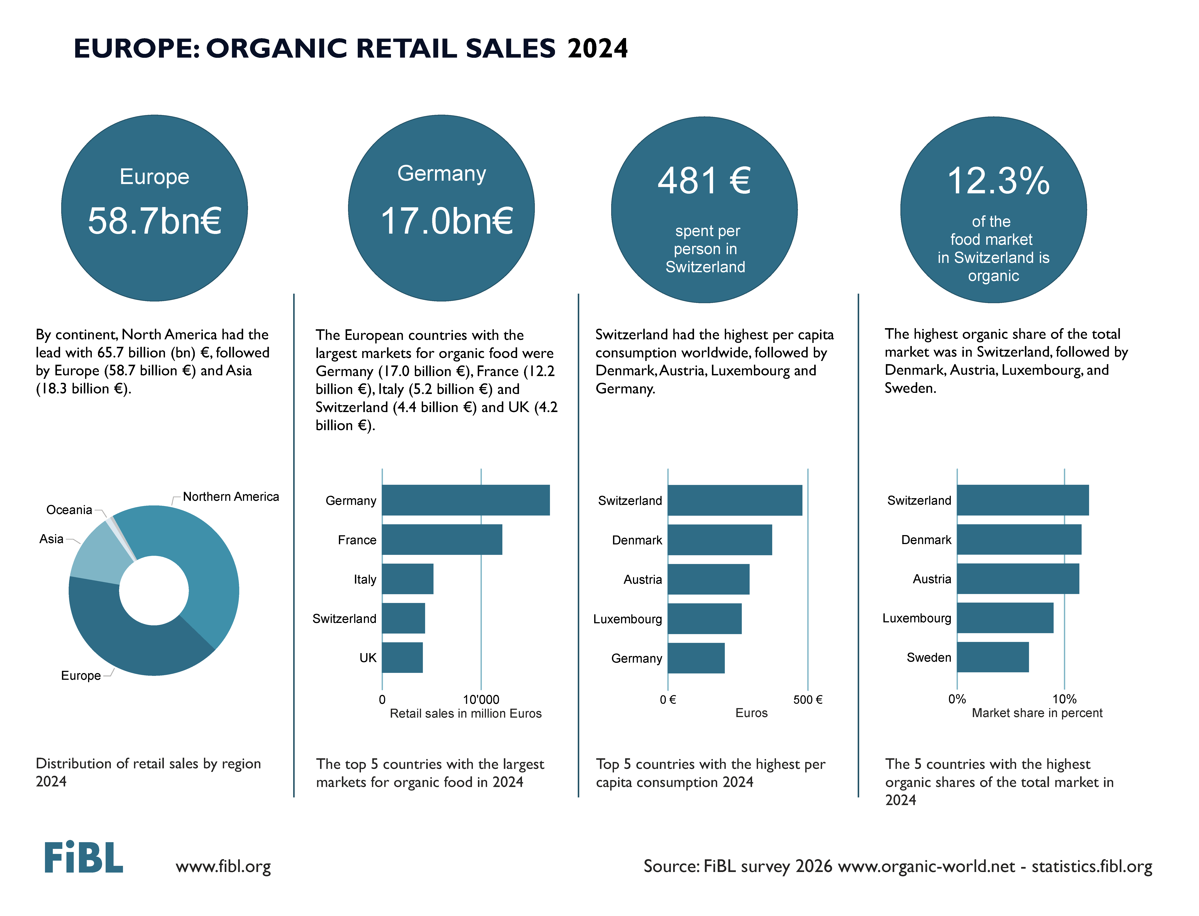

Slide 12
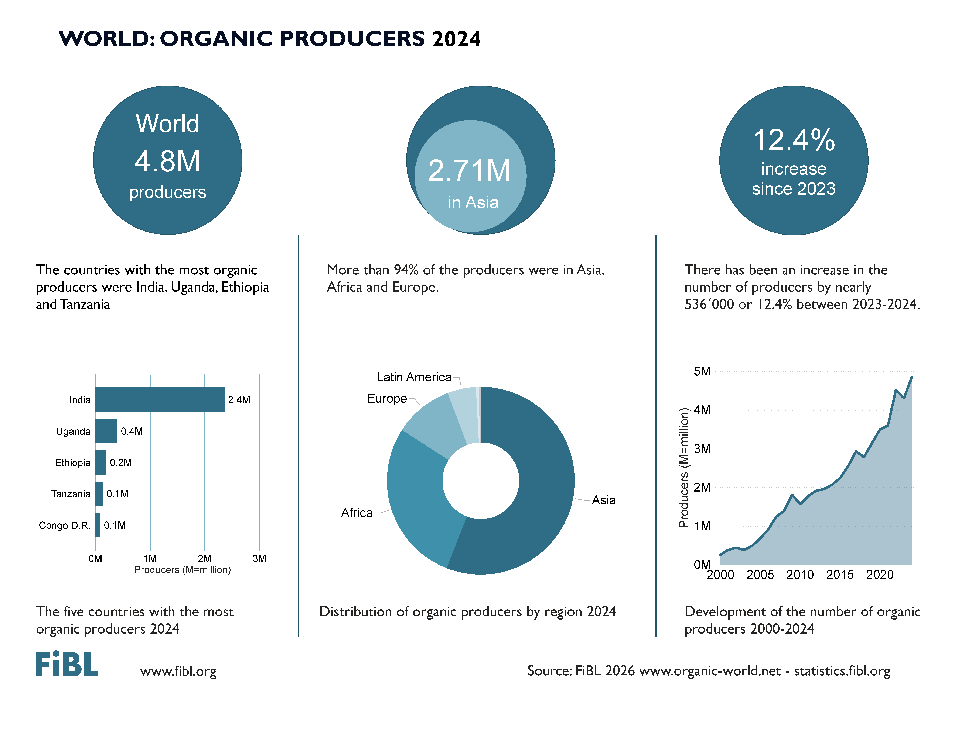

Slide 13
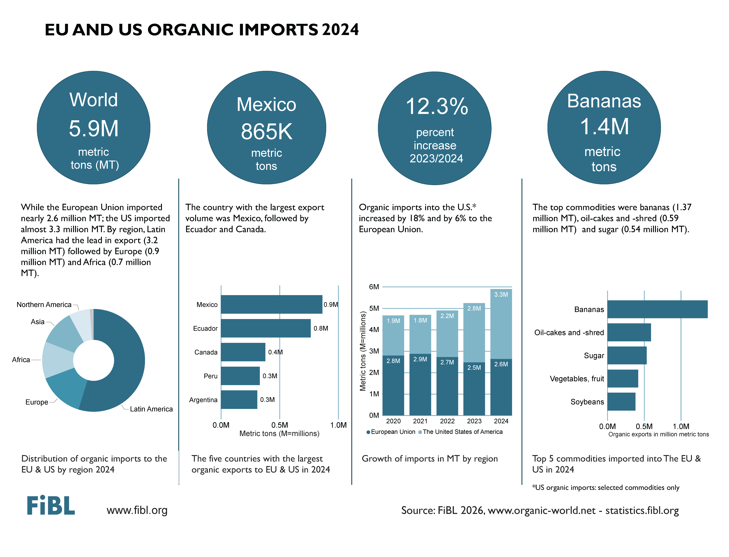

Slide 14
GERMAN - DEUTSCH

Slide 15
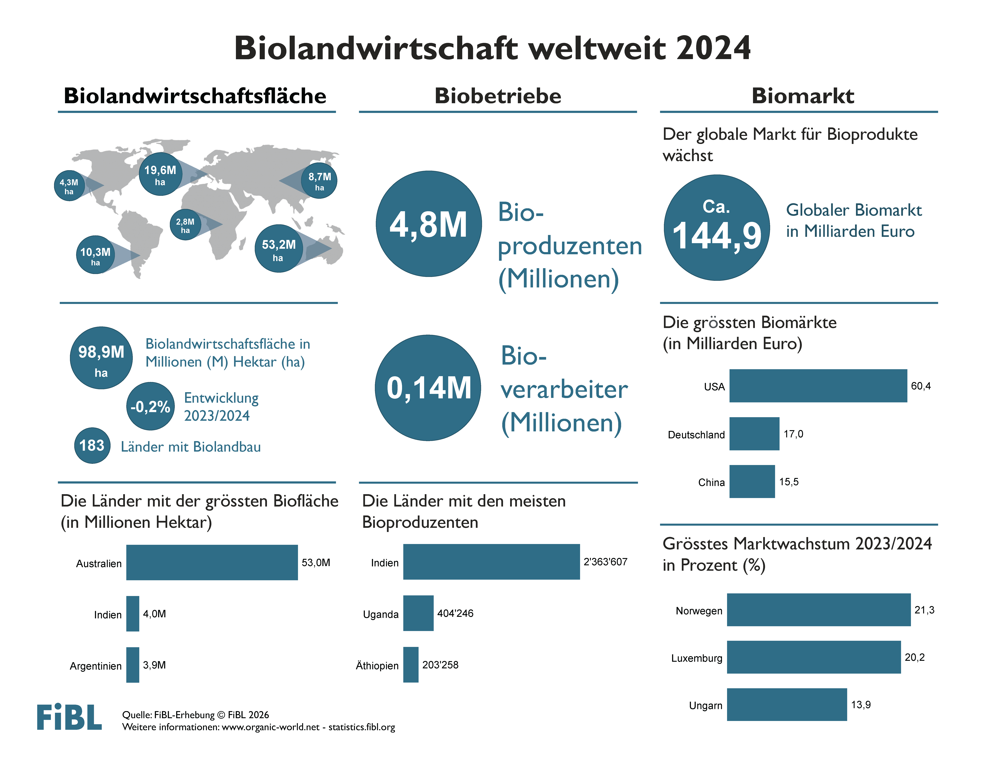

Slide 16
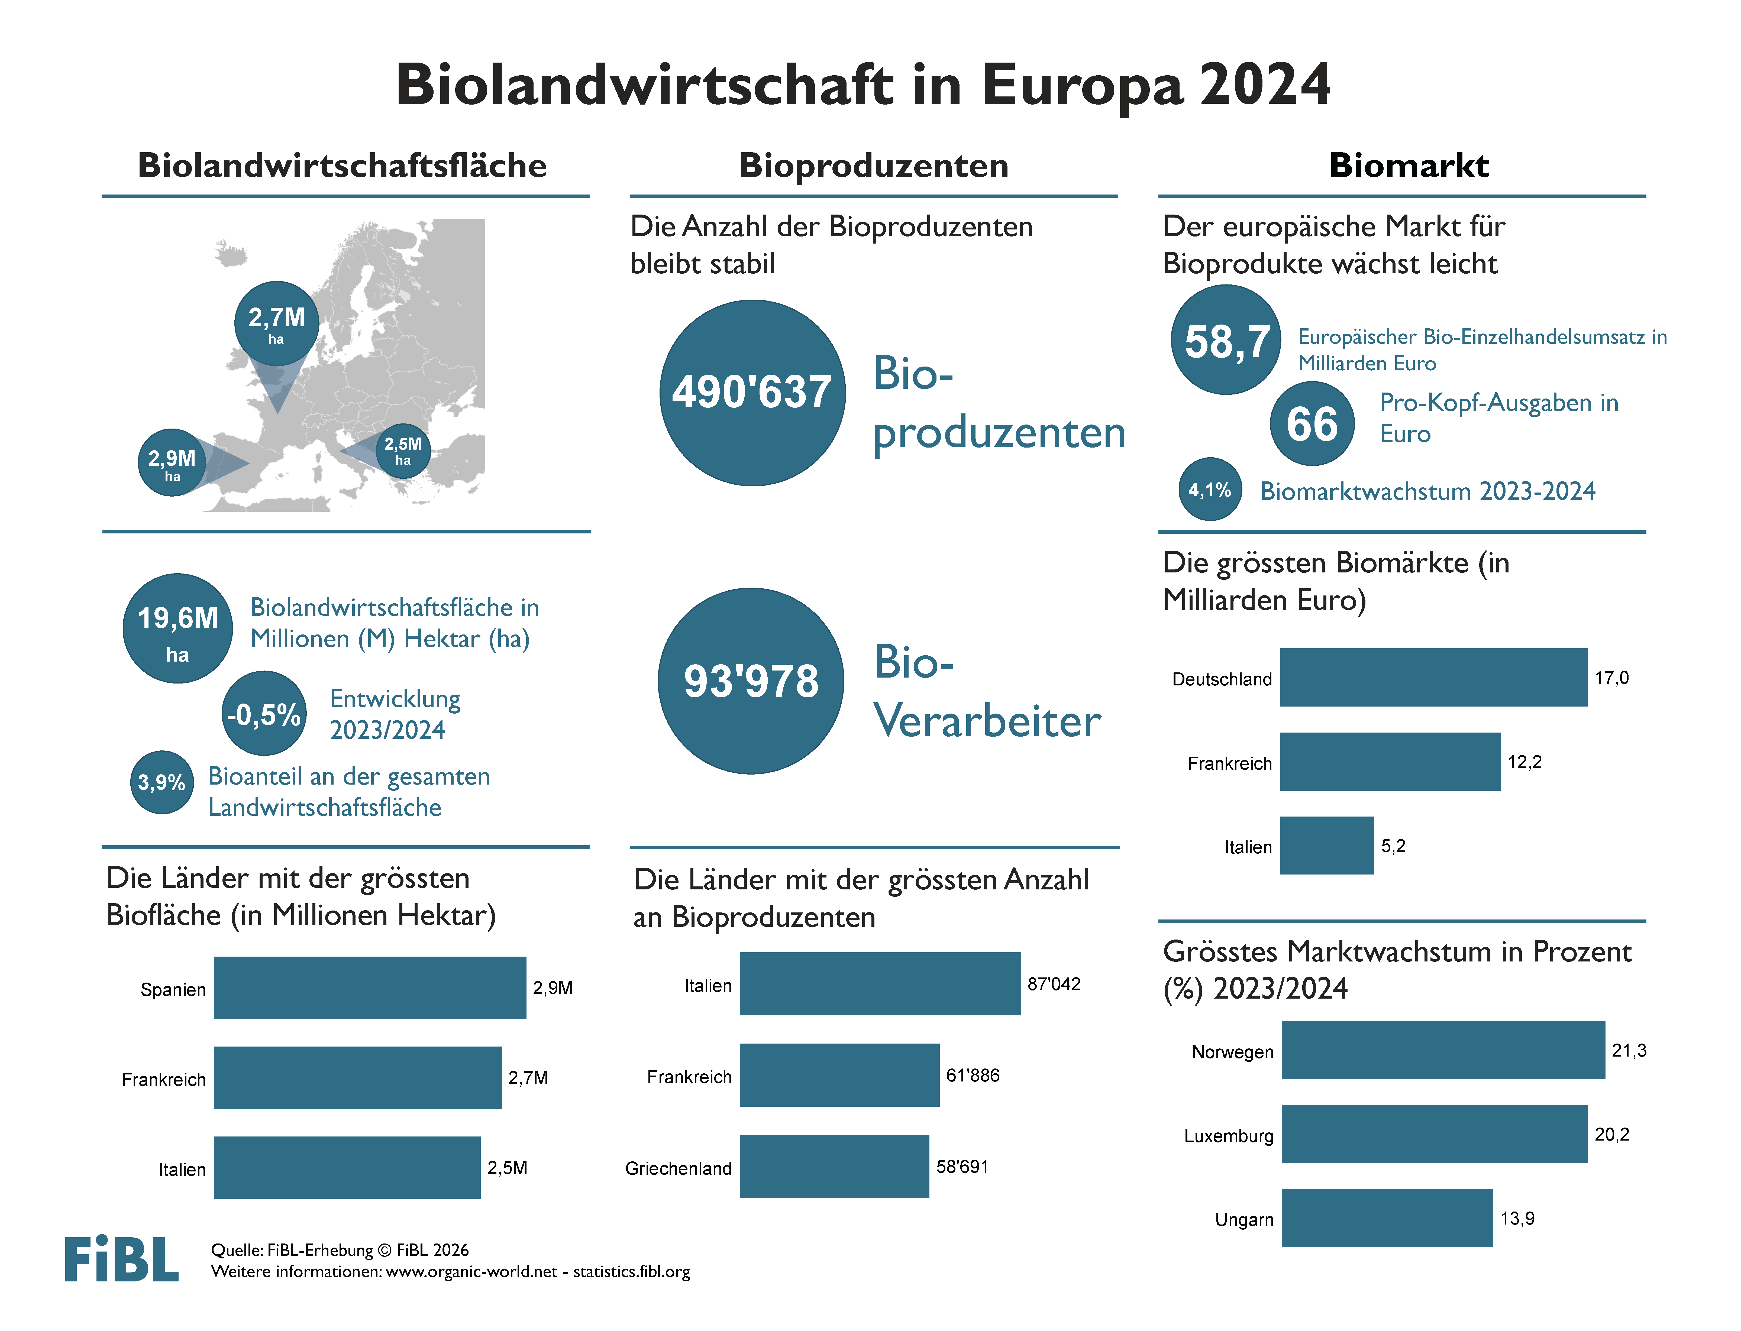

Slide 17
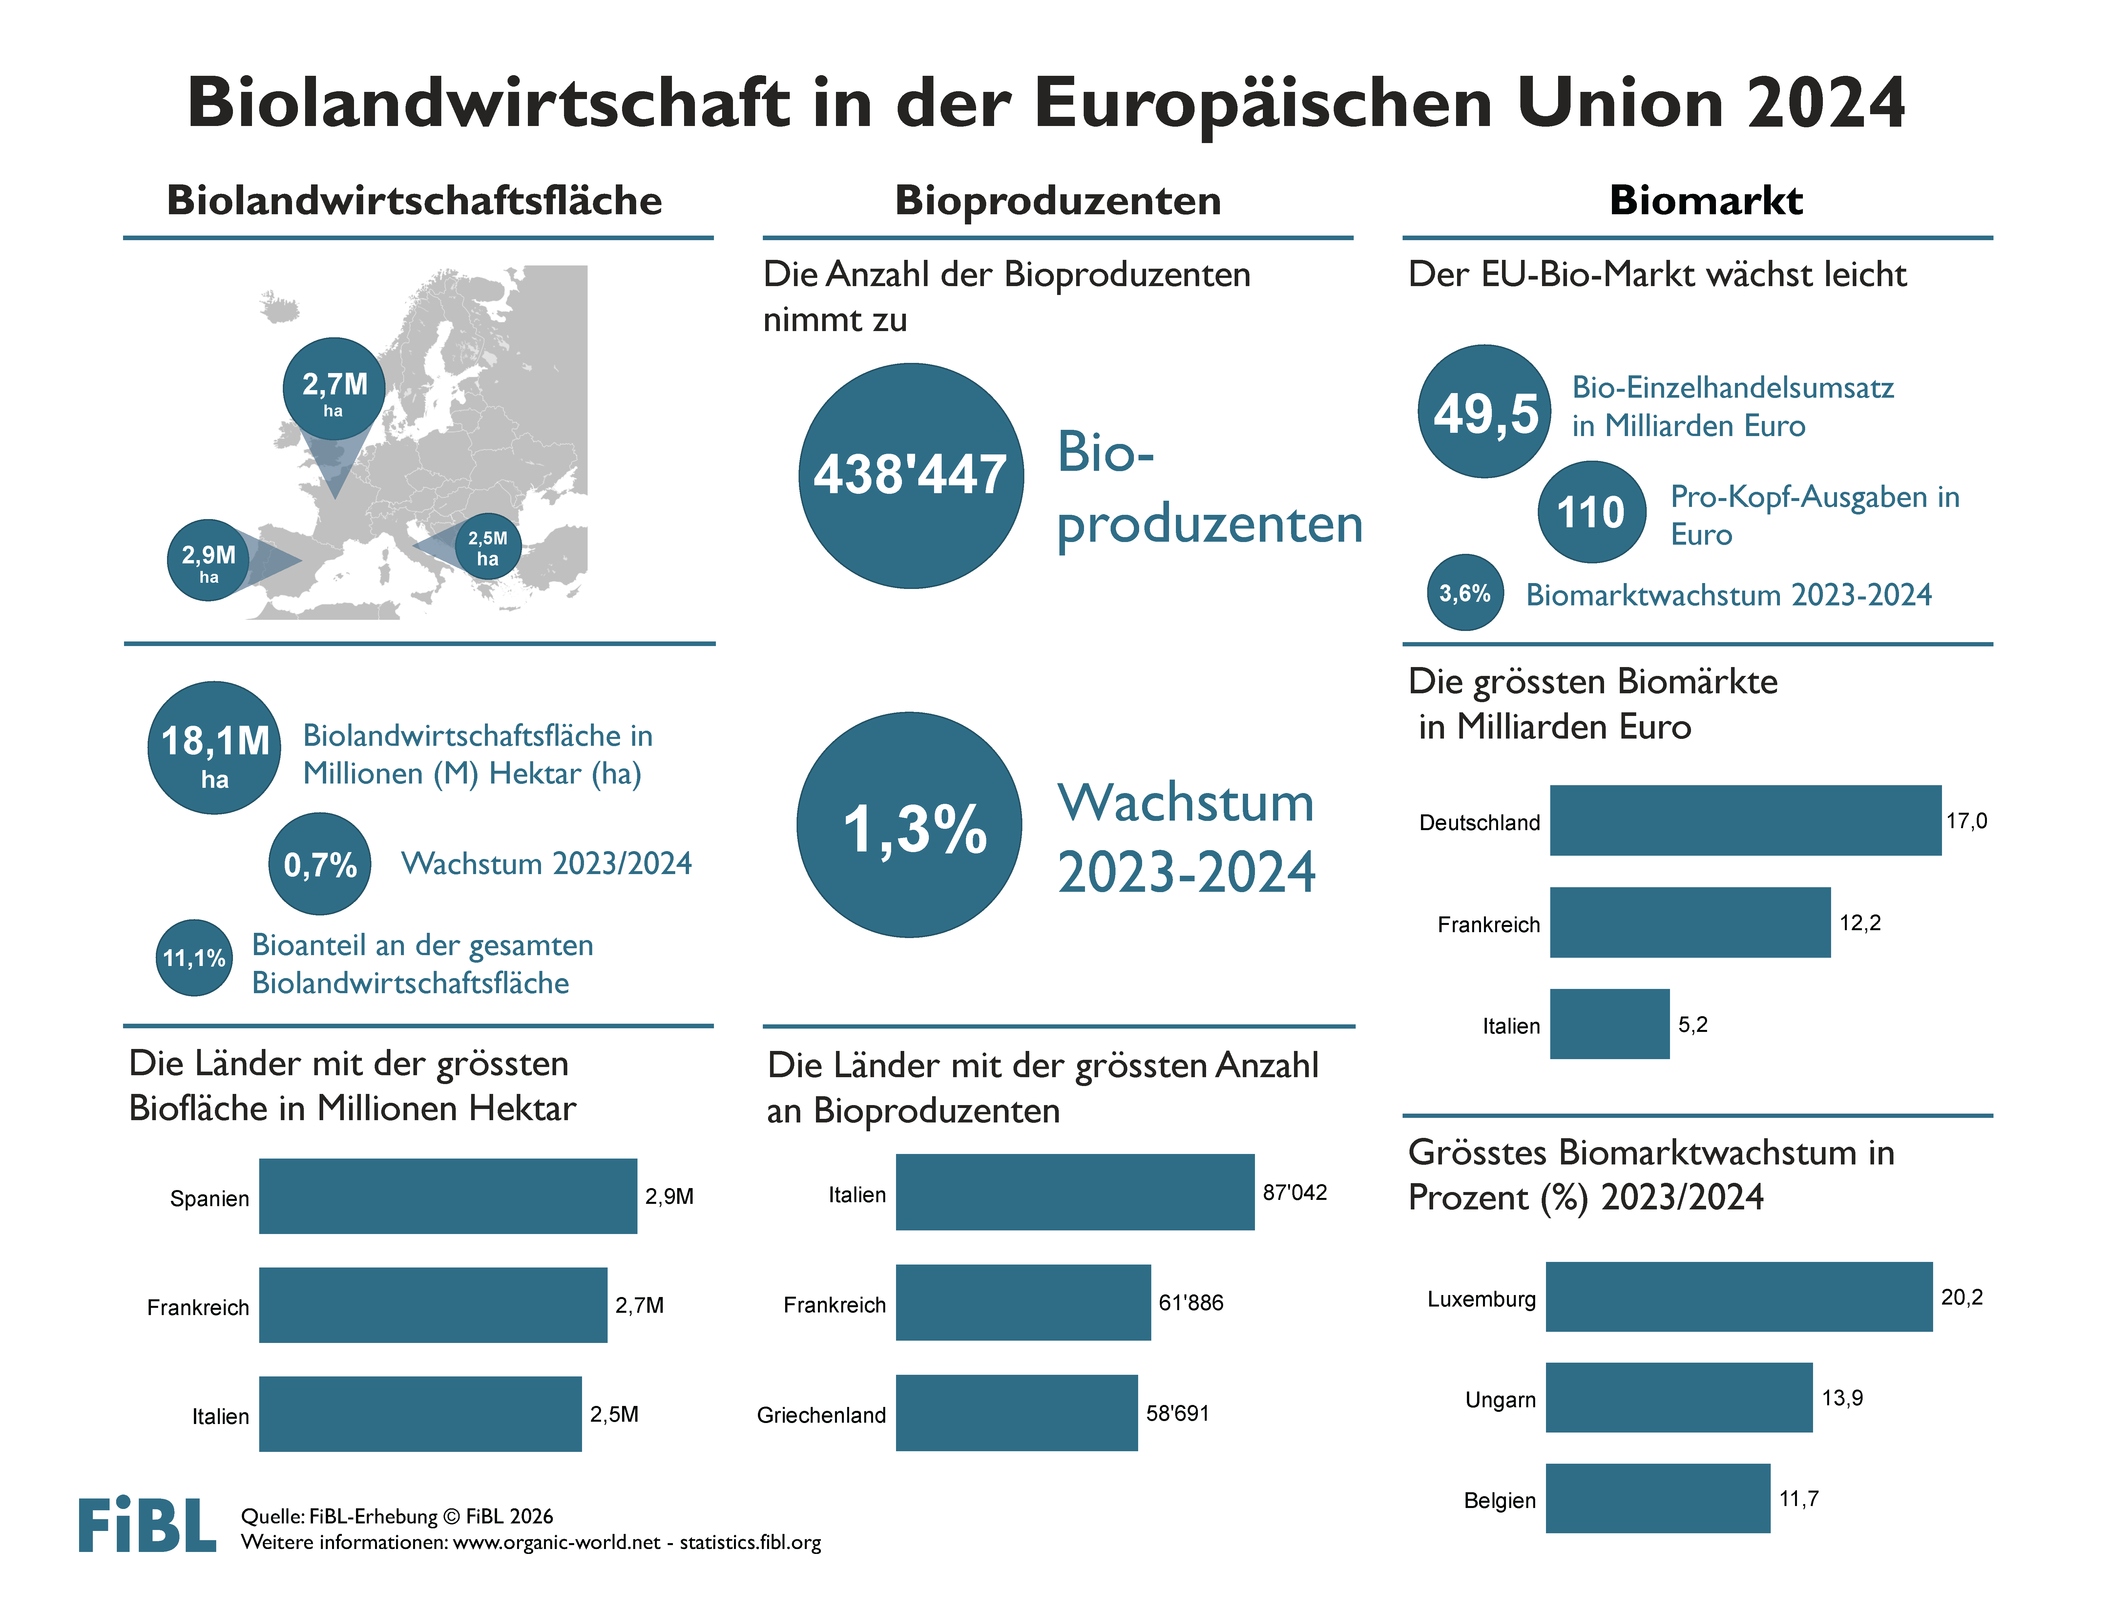

Slide 18
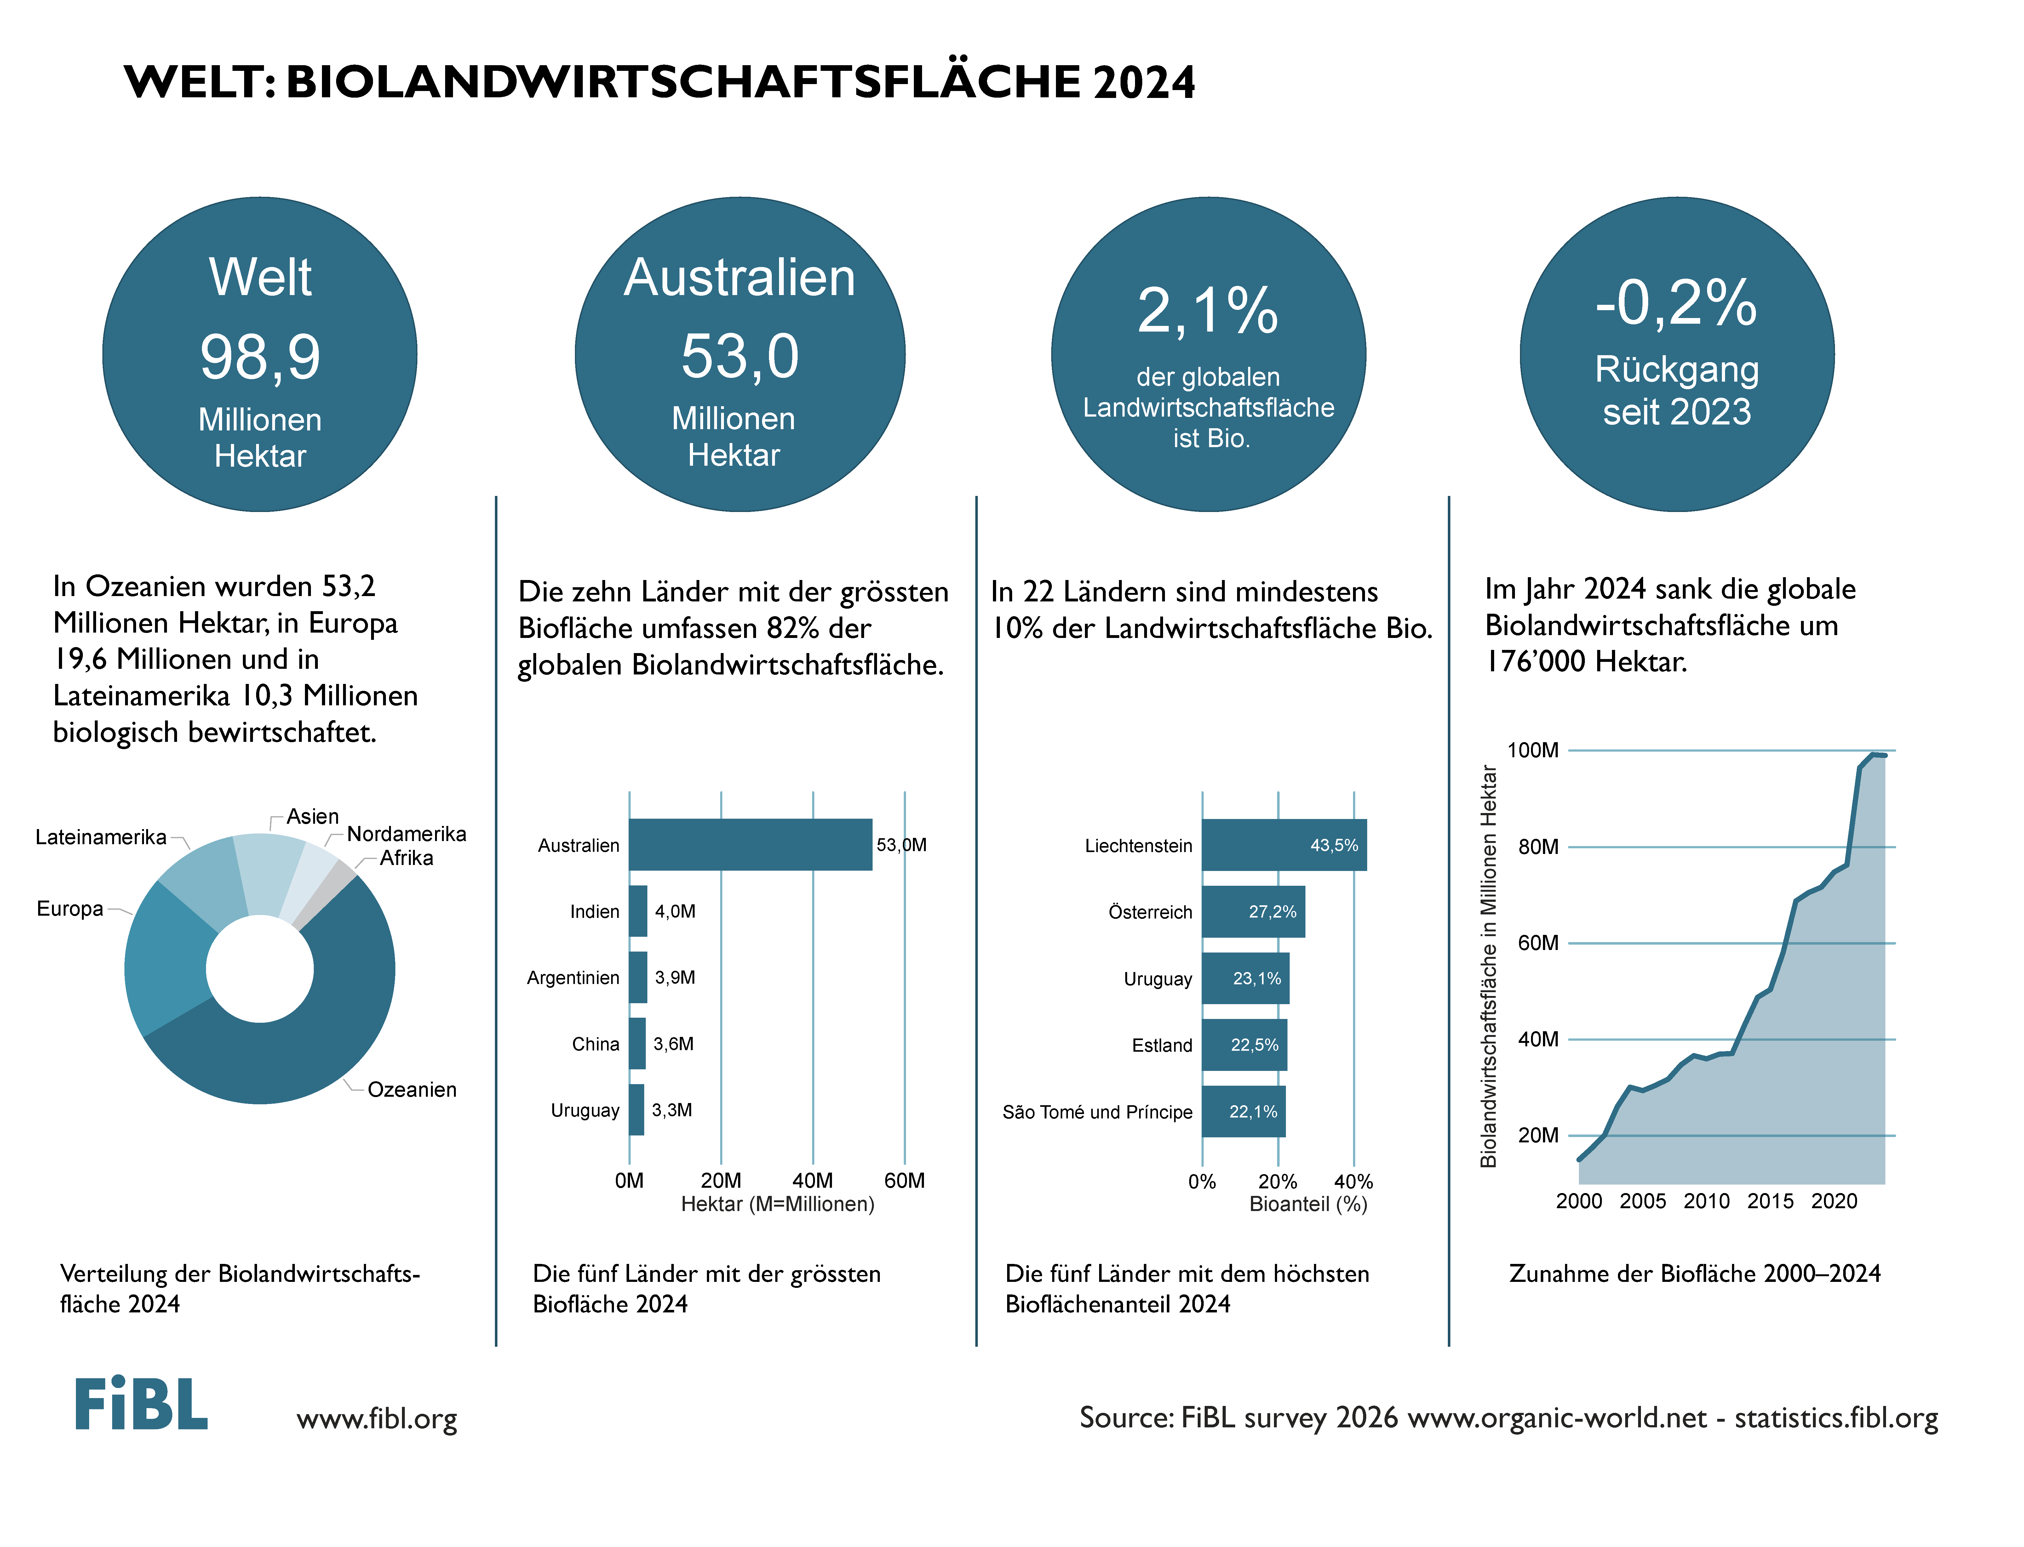

Slide 19
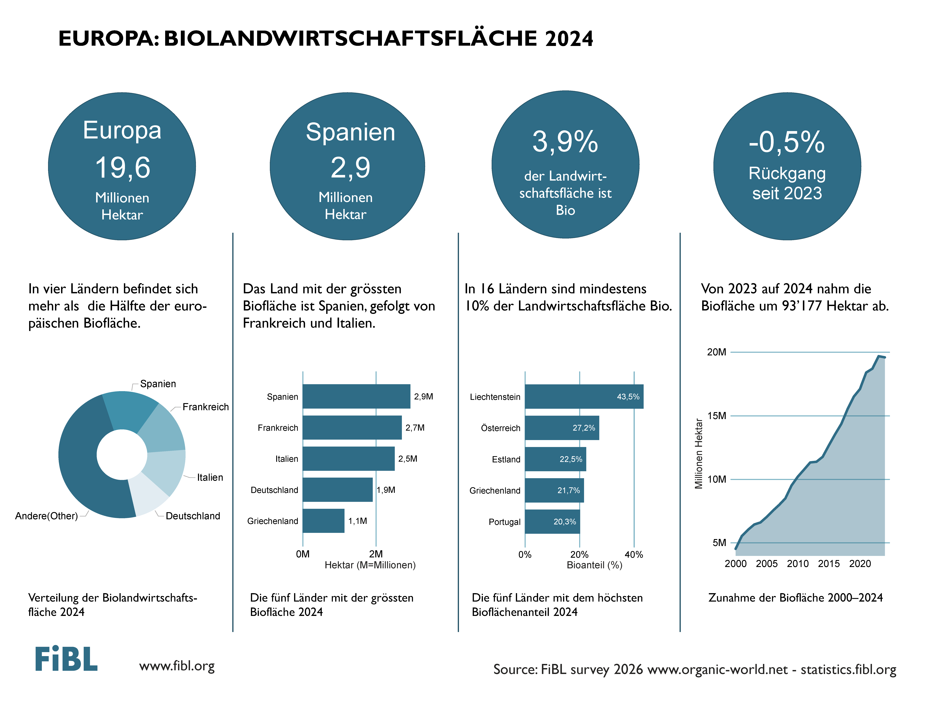

Slide 20
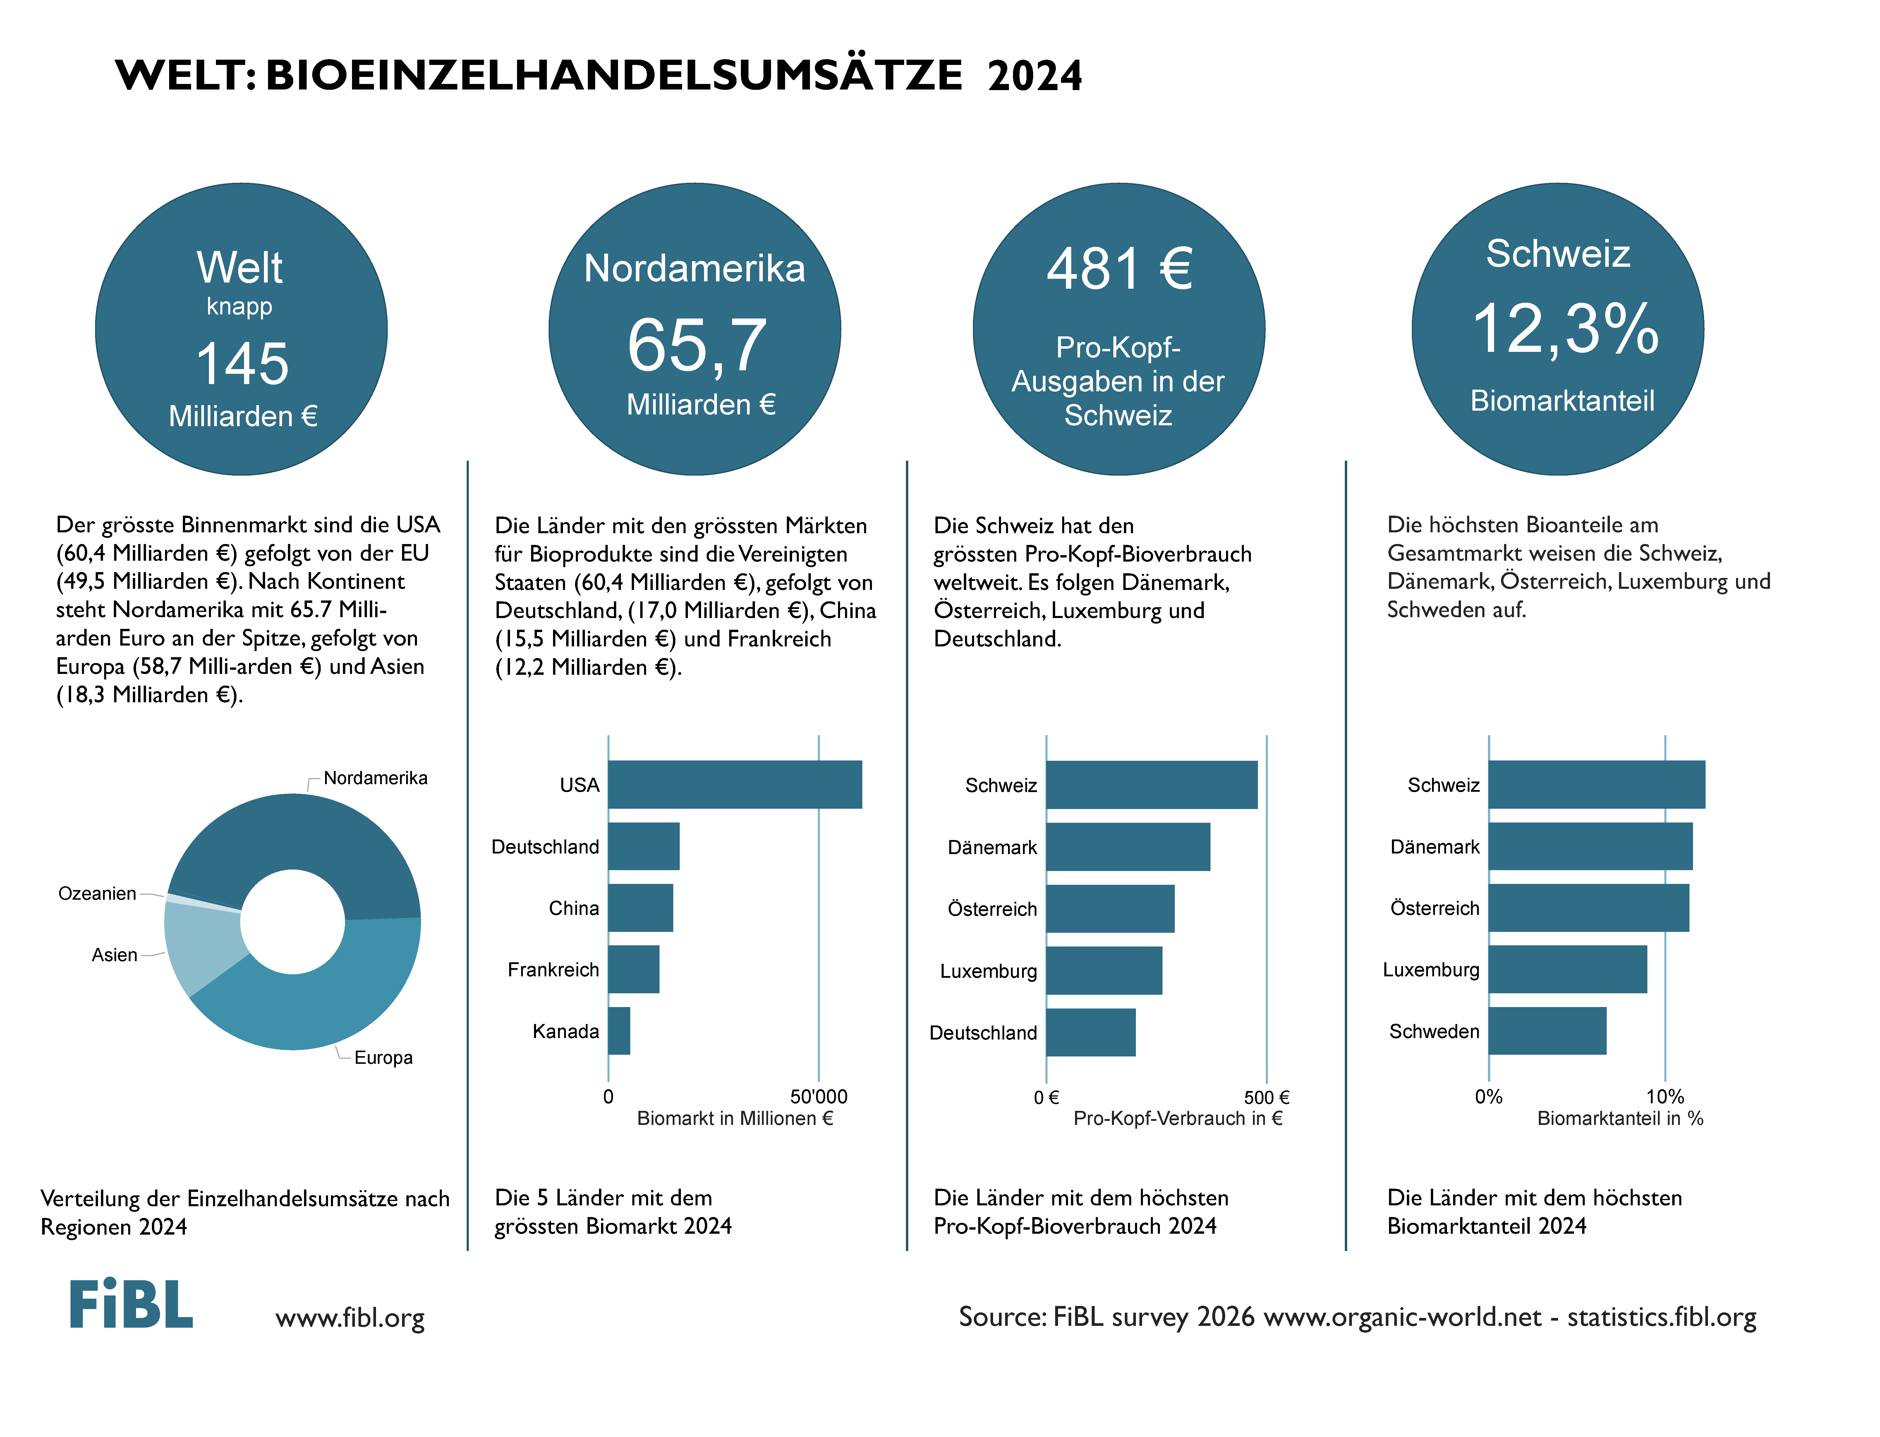

Slide 21
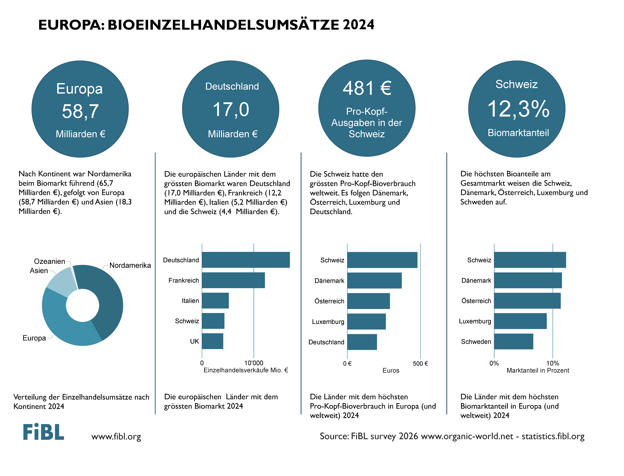

Slide 22
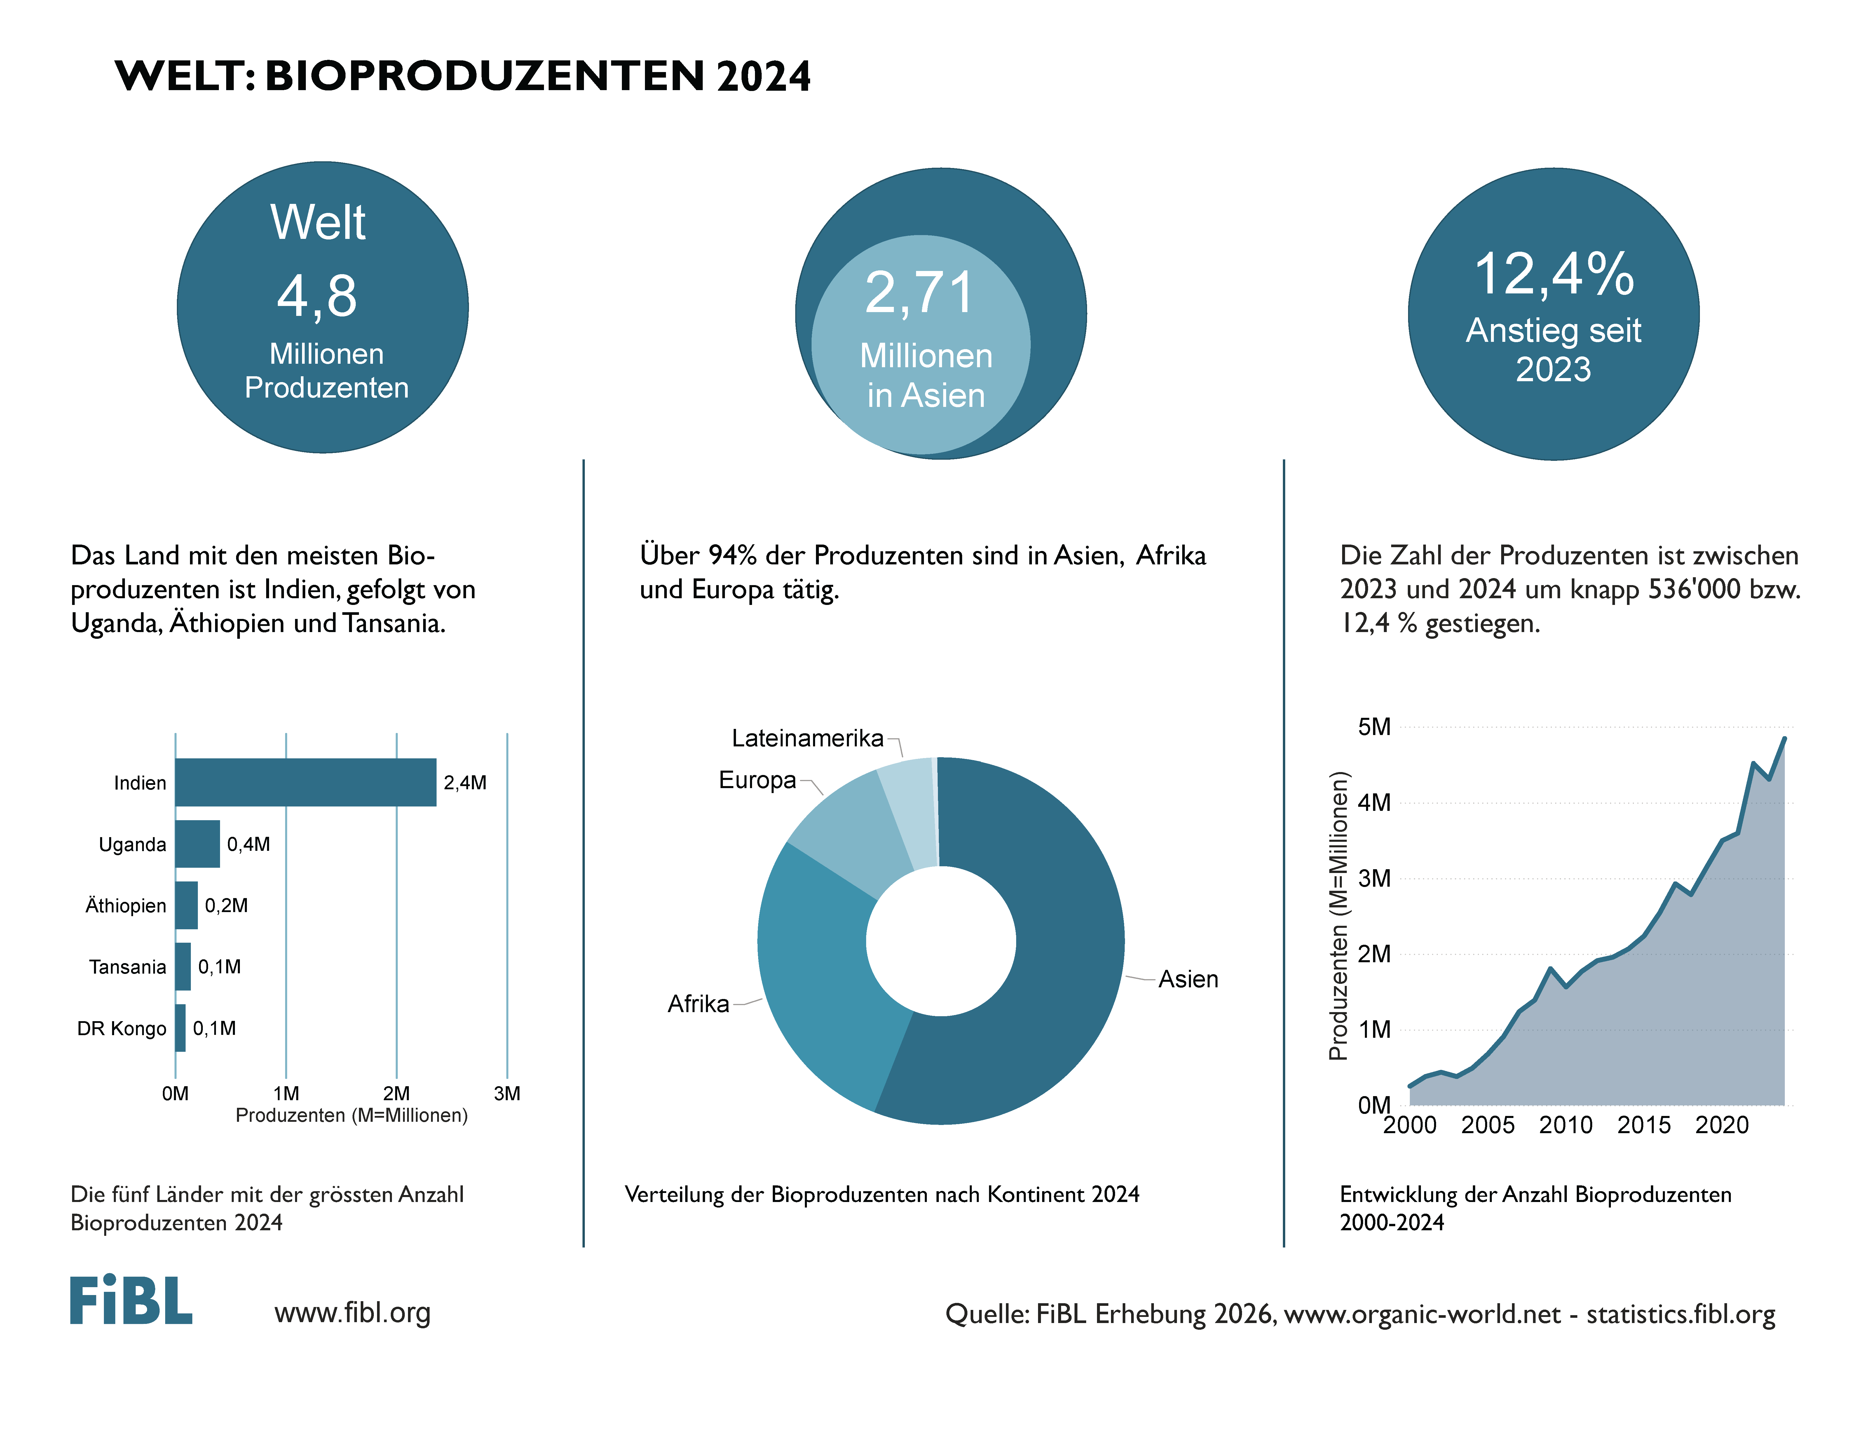

Slide 23
FRENCH - FRANCAIS

Slide 24
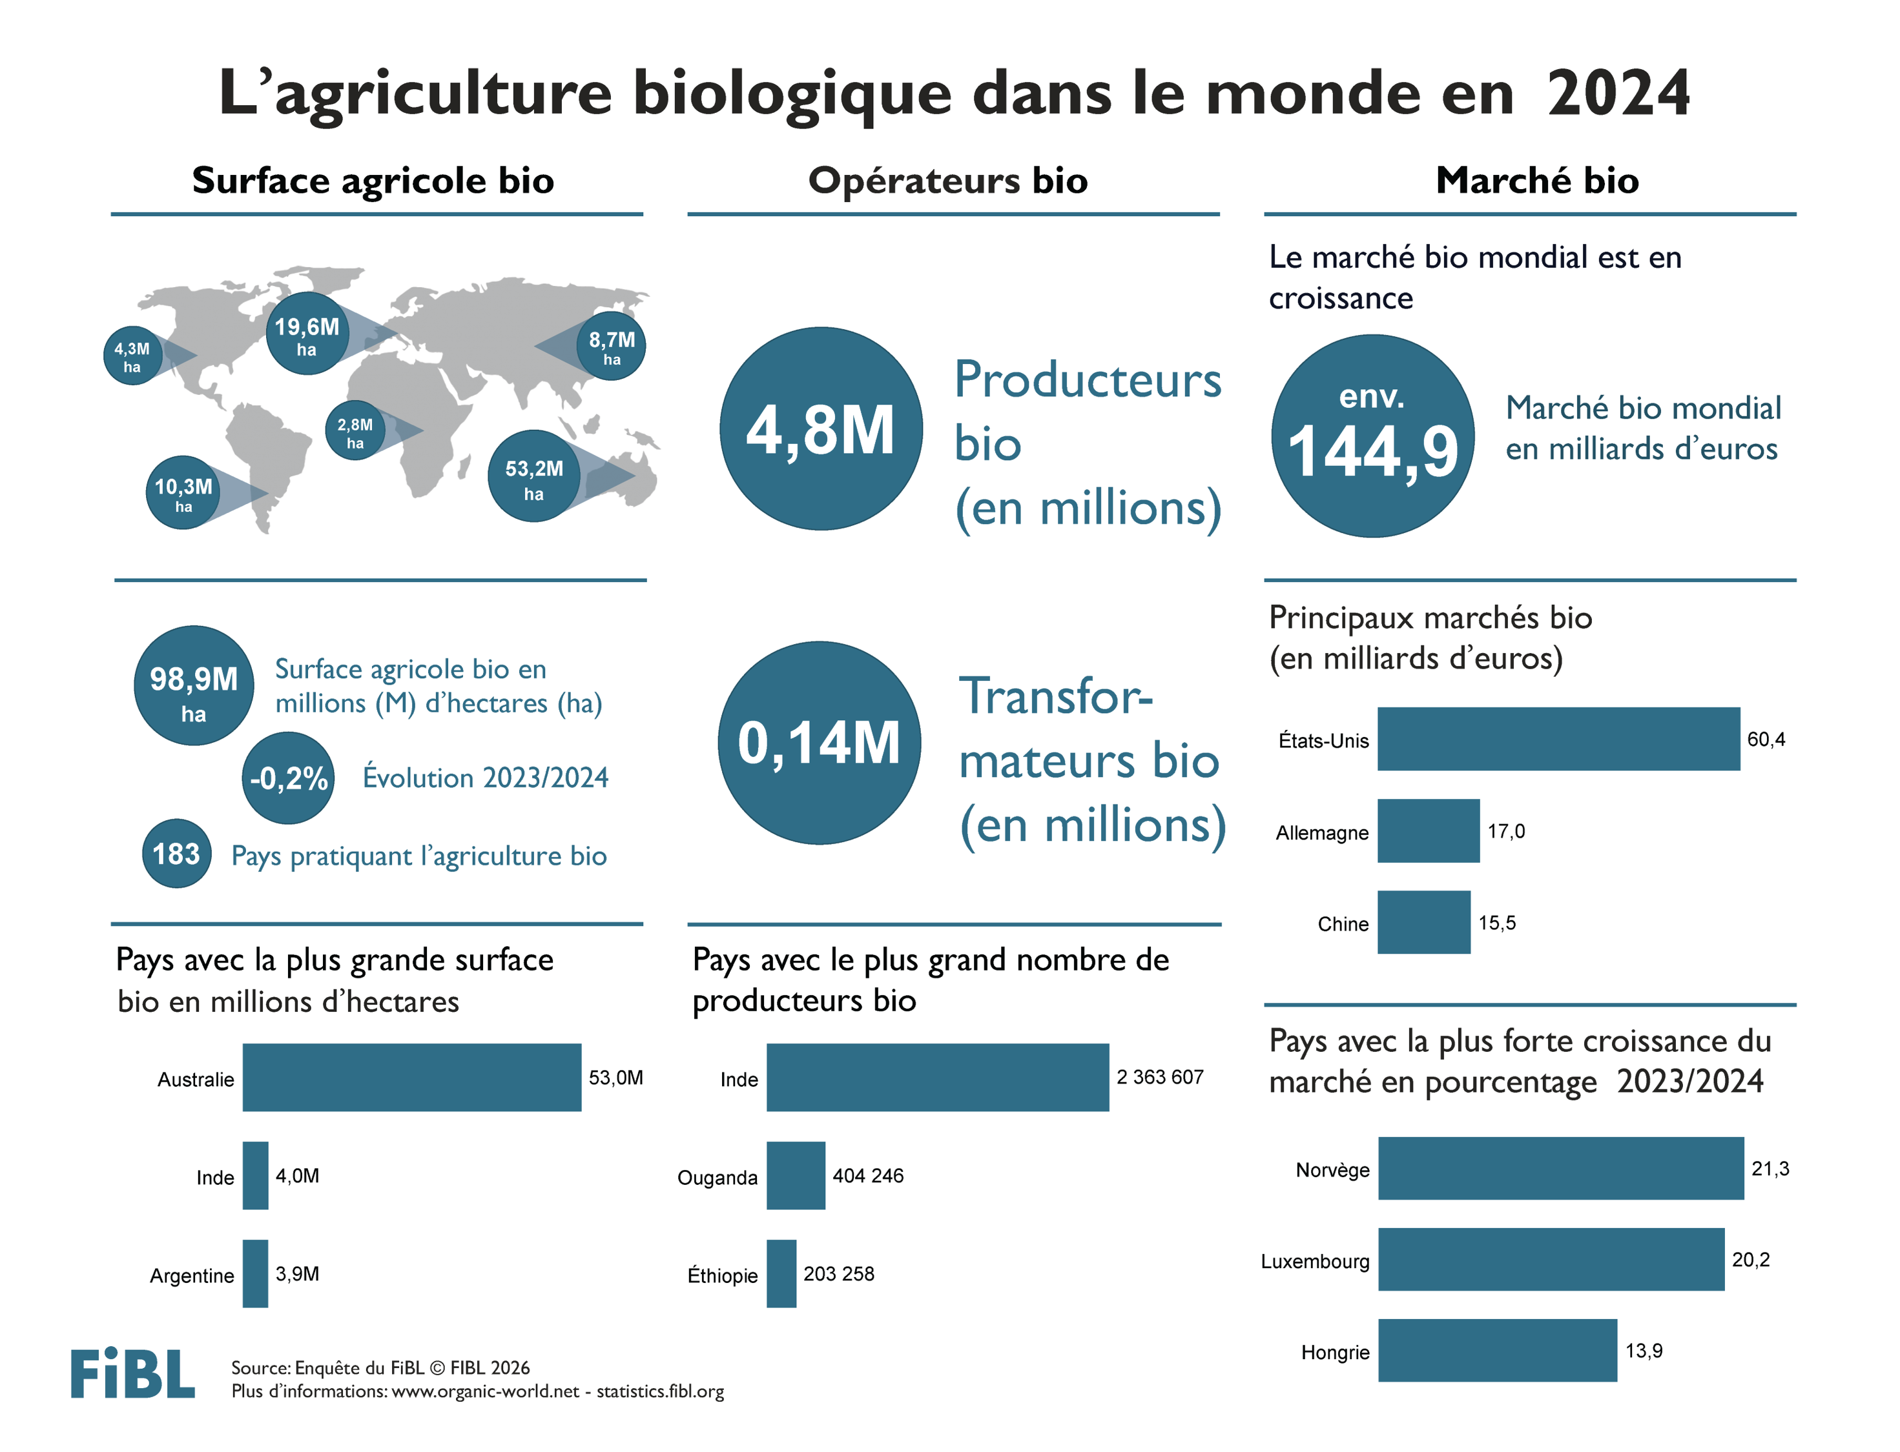

Slide 25
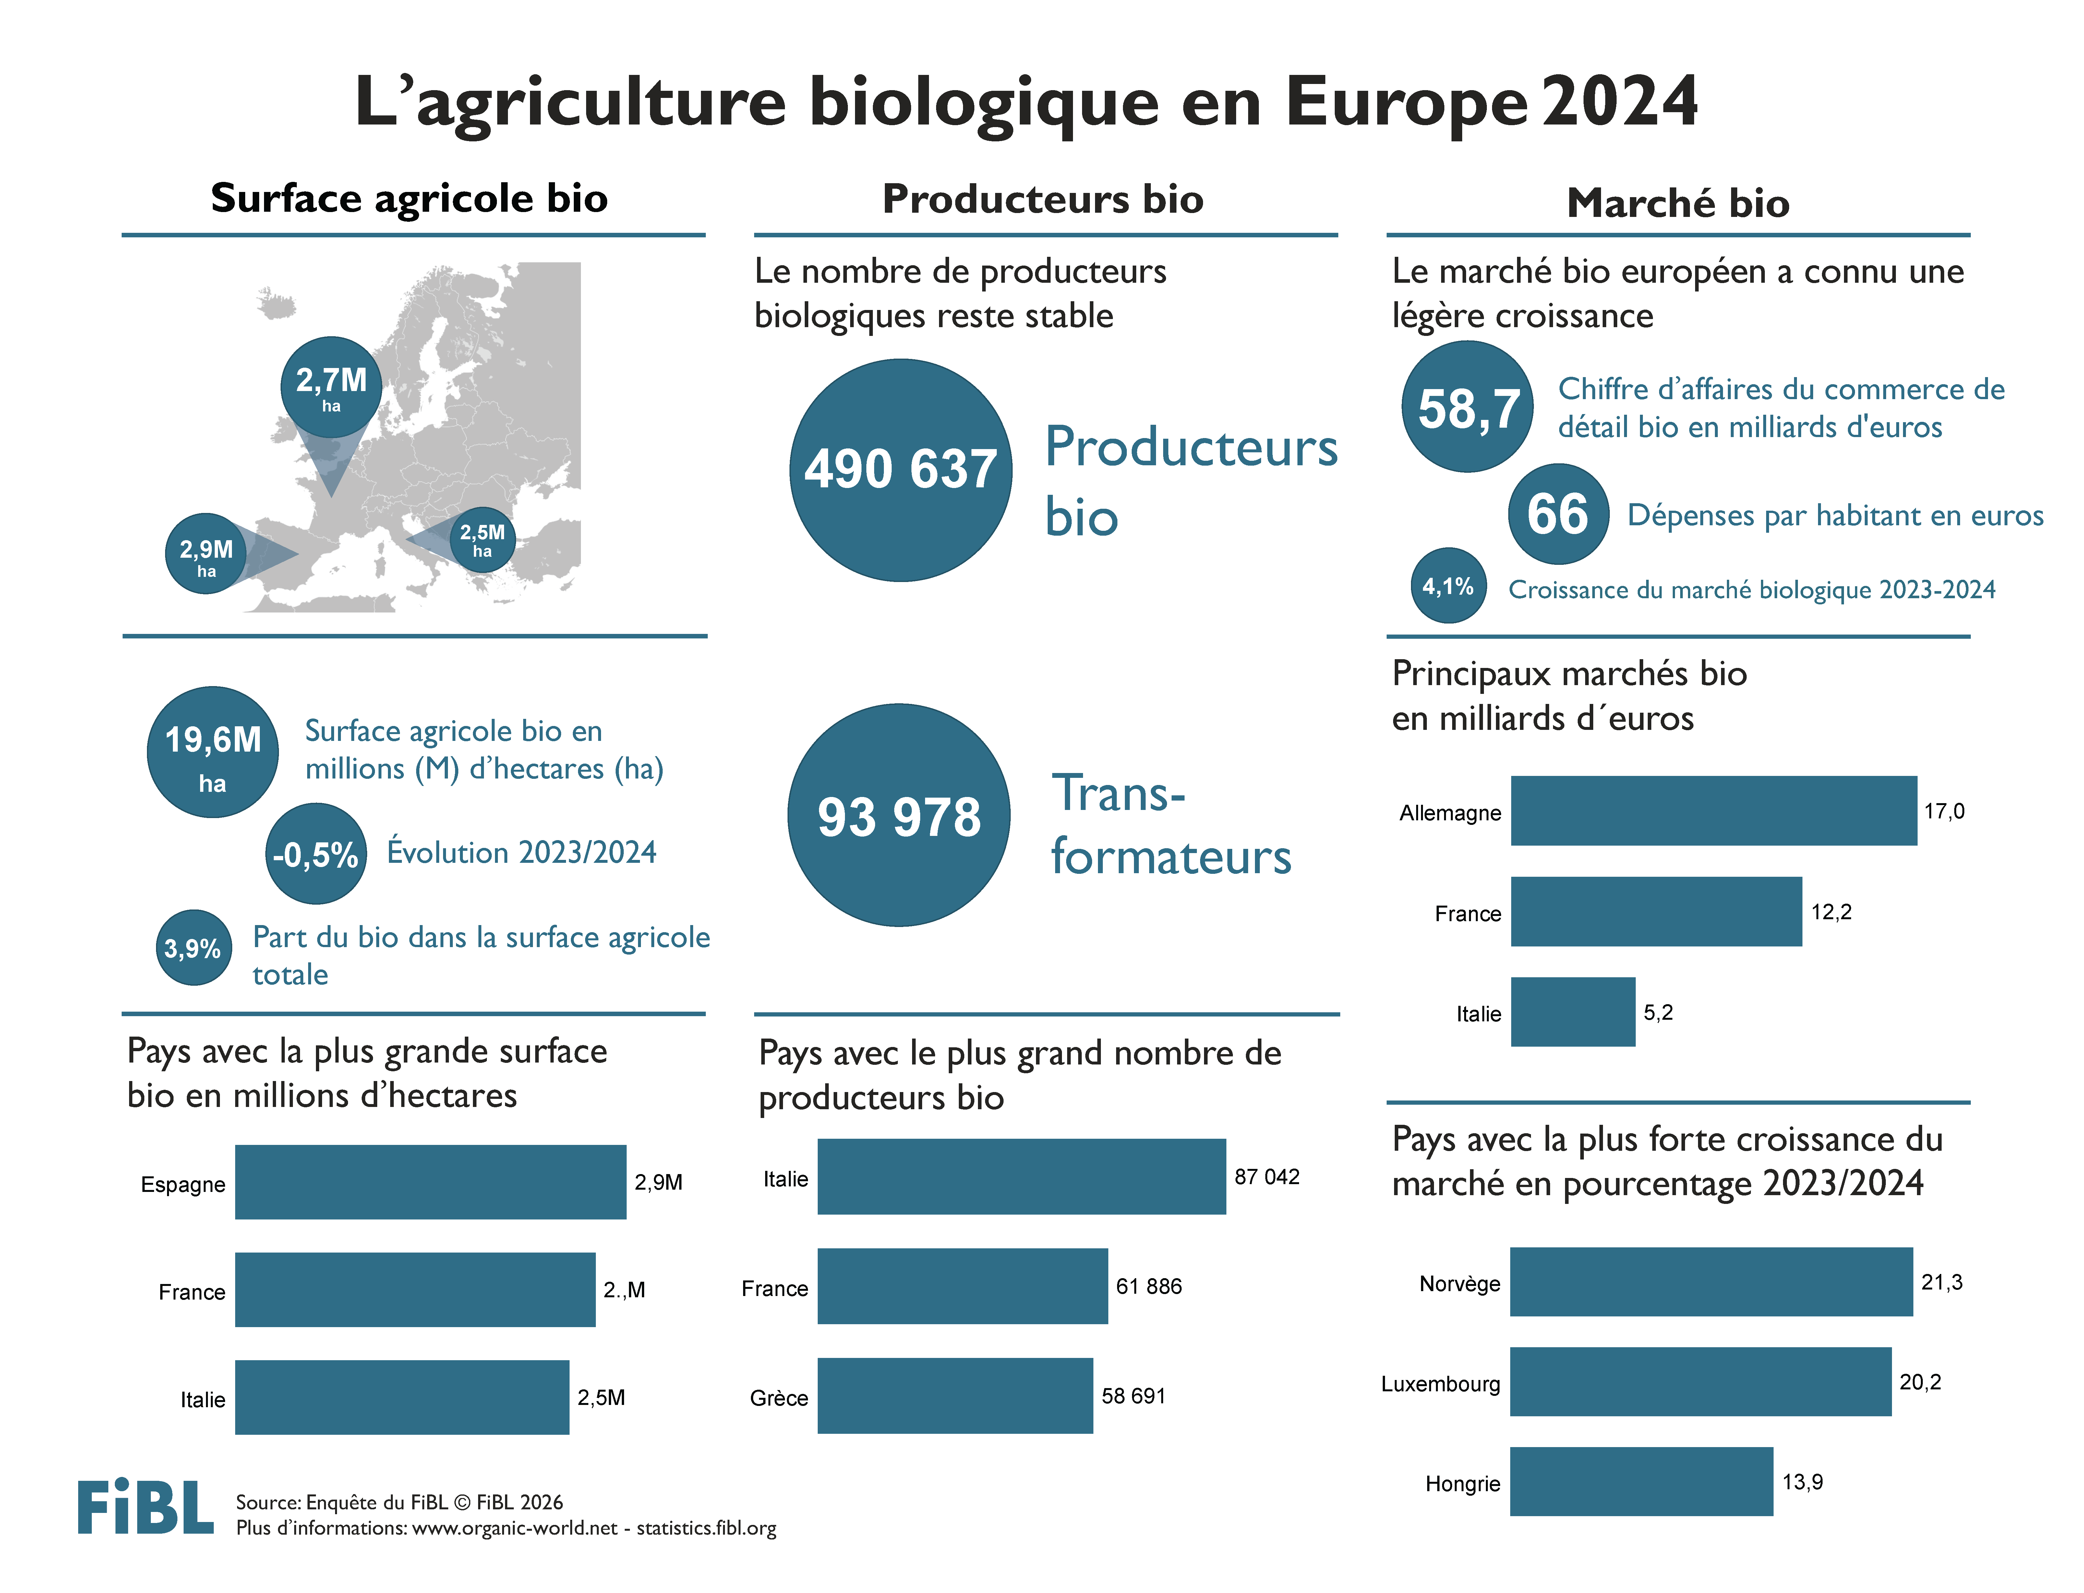

Slide 26
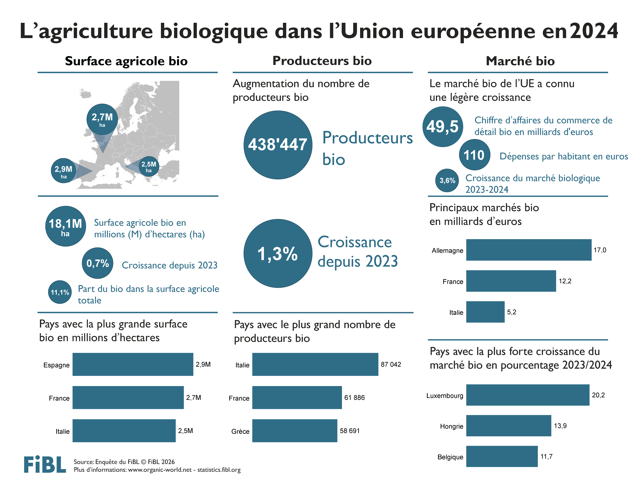

Slide 27


Slide 28
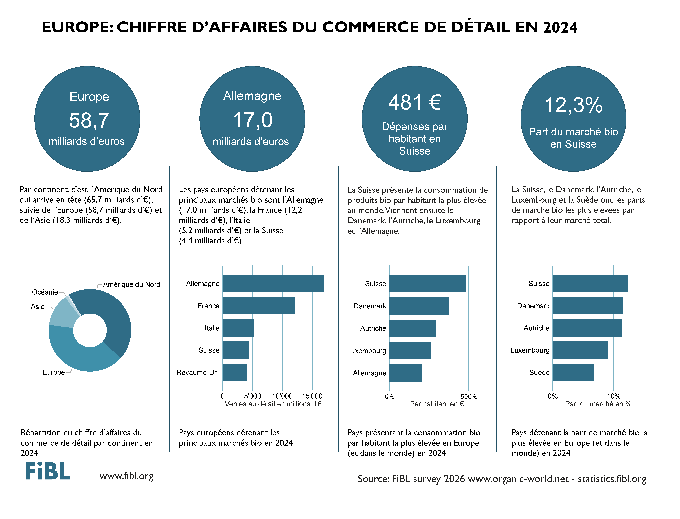

Slide 29
Kontakt
Helga Willer
Forschungsinstitut für biologischen Landbau FiBL
Ackerstrasse 113, 5070 Frick, Schweiz
Tel. +41 79 218 0626
helga.willer@fibl.org
www.fibl.org
www.organic-world.net; statistics.fibl.org
Willer, Helga, Jan Trávníček und Bernhard Schlatter (Hrsg.) (2026): The World of Organic Agriculture. Statistics and Emerging Trends 2026. Forschungsinstitut für biologischen Landbau FiBL, Frick, und IFOAM – Organics International, Bonn.
www.organic-world.net/yearbook/yearbook-2026

