Slide 1
Challenges in communicating about organic seeds & organic breeding
Mariateresa Lazzaro (FiBL Switzerland)
25.02.2025

Slide 2
What motivates consumers to purchase organic
Health concern
(Perception of) quality and taste
Environmental and ecological motives
Drivers of willingness to pay for organic food
Locality
Shopping environment
Shenoy, K. R., Ranjith, V. K., Nayak, S., & Anirvinna, C. (2024). Conceptualizing organic food consumption: A consumer motive perspective. Cogent Social Sciences, 10(1). https://doi.org/10.1080/23311886.2024.2338864
Katt, F., & Meixner, O. (2020). A systematic review of drivers influencing consumer willingness to pay for organic food. Trends in Food Science and Technology, 100(April), 374–388. https://doi.org/10.1016/j.tifs.2020.04.029
Notes:
the majority of consumers believes organic food has health benefits as a result of the restrictions on pesticide and chemical use in organic farming

Slide 3
Motives for buying heirloom vegetable varieties
taste and
potential health-promoting properties
Motives for buying local food
egoistic-hedonic (taste, nutritional value, health)
higher than
altruistic motives (environment, ecology, societal benefits)
Lauterbach, J., & Bantle, C. (2022). “For More Diversity, Better Taste and My Own Health” Exploring Organic Consumers’ Purchasing Motives for Heirloom Vegetable Varieties. Sustainability (Switzerland), 14(7). https://doi.org/10.3390/su14074068

Slide 4
Communication Challenges
The differentiation of varieties should rather be mediated on the basis of taste, appearance and consistency.
Consumer-citizens do not make a direct connection between CULTIVATED DIVERSITY
and the food they eat
Notes:
The choice of variety is not a decisive factor when buying fresh products and even less when buying processed food items;
Indicating the names of plant species (e.g. underutilised and neglected crops) and varieties (e.g. landraces, or cultivars deriving from organic breeding) on food products’ packages is often ineffective;
Communication of variety names (even if enhanced by a targeted promotion campaign to make it effective) can be counter-productive in the long term. Breeding is intended for a continuous delivery of new/adapted varieties bringing in always new varieties;

Slide 5
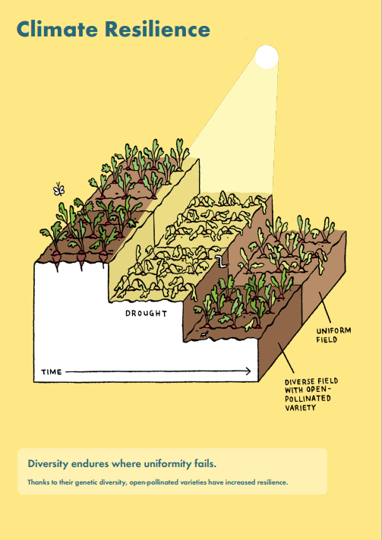
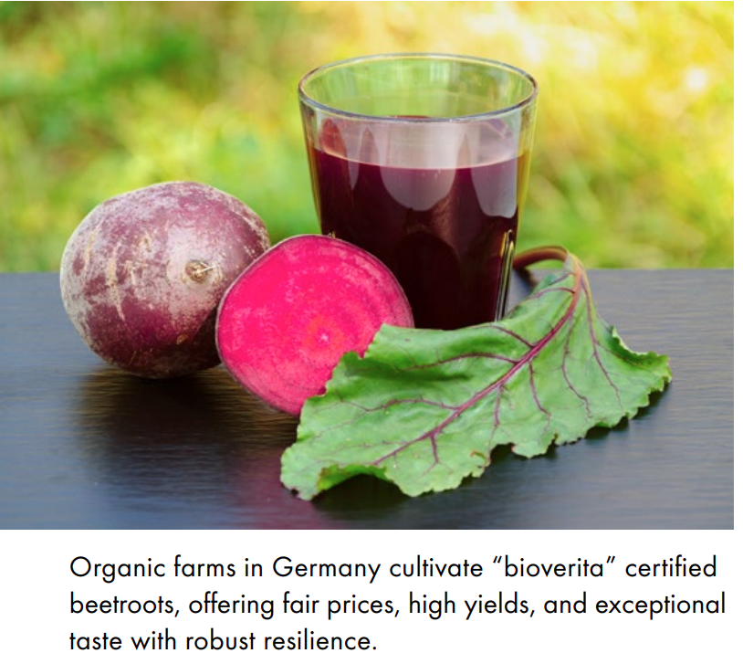

Slide 6
Communication Challenges
Consumer-citizens have highest chance of eating a new species or variety that they had not known before when going to a farmers’ market, eating at a restaurant or buying a vegetable box.
Consumers are rarely aware of the difference between species and variety and, because of this, communicating about genetic diversity is very challenging
Notes:
Communication material to provide additional information in these settings should be promoted

Slide 7
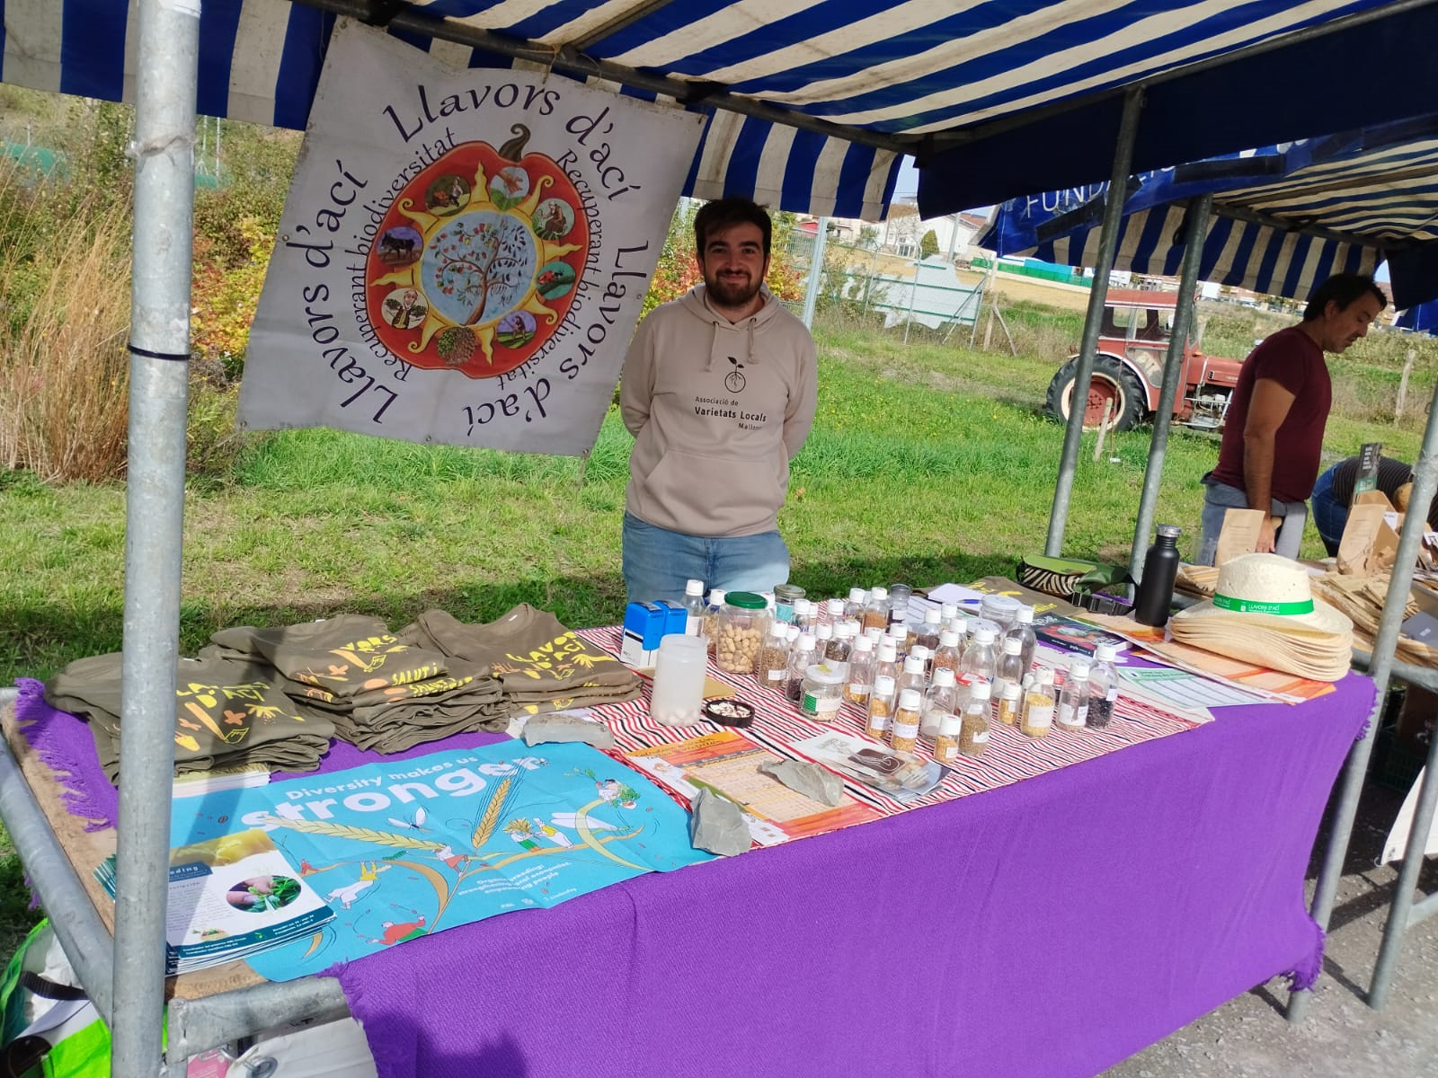
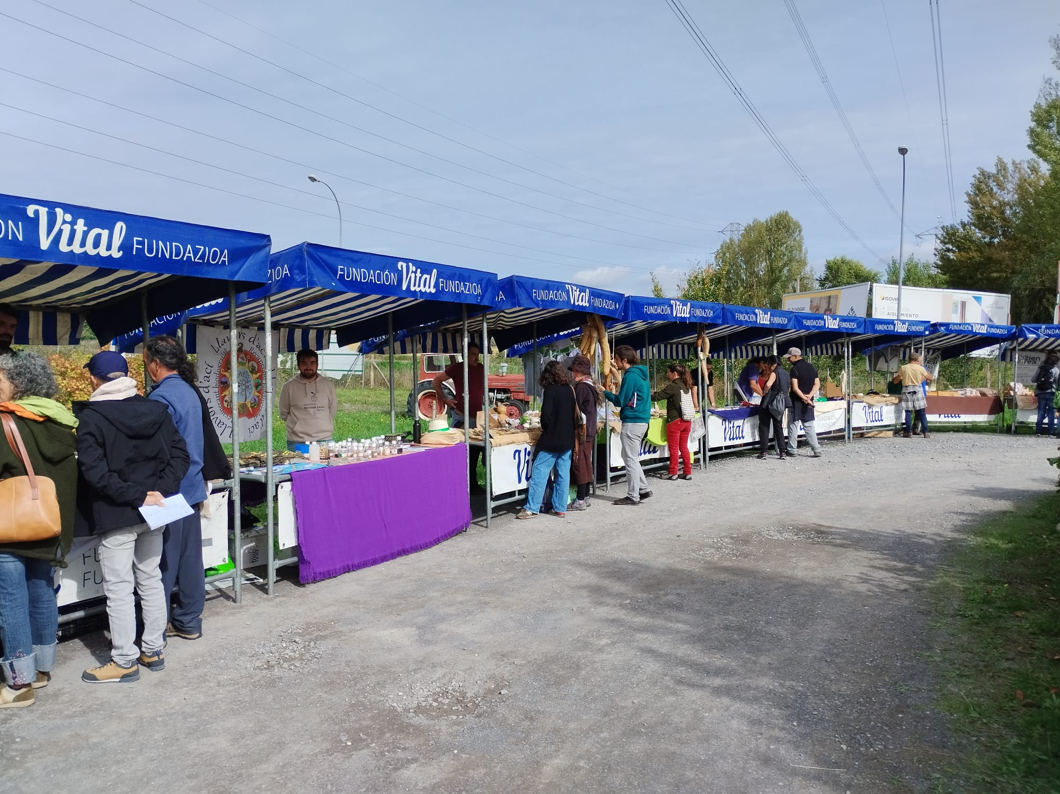

Slide 8
Communication Challenges
When communicating about cultivated diversity, basic information (e.g., “What is a variety/cultivar?”) should be included
Complexity and multidimensionality of the topic (species diversity, genetic diversity, cultivar type, newly developed cultivars vs landraces, different breeding approaches for Organic Varieties/Organic Heterogeneous Material/organic pure lines, Organic Plant Breeding vs Breeding for Organic concepts, breeding vs seed production);

Slide 9
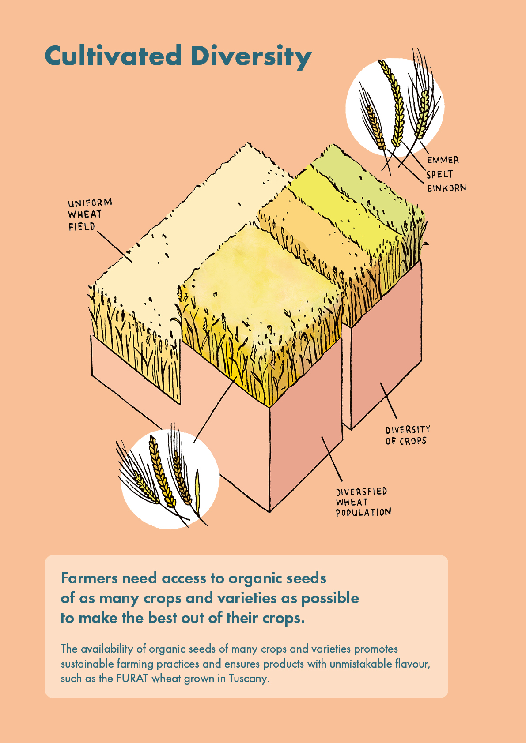
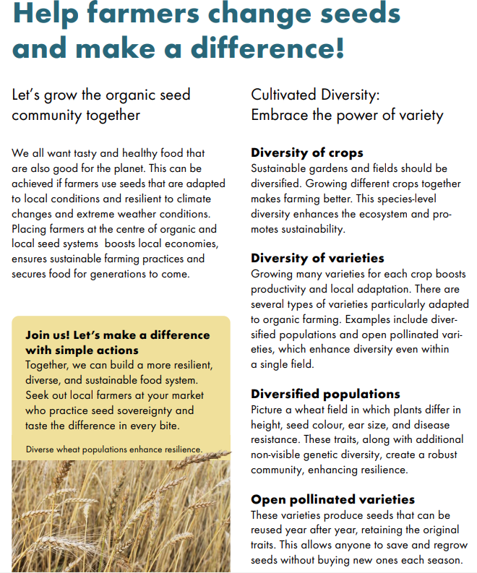

Slide 10
Communication Challenges
Explain clearly how organic breeding is an enabler for organic farming in general, allowing it to reach its full potential, and to better achieve its sustainability goals in practice.
Promote the concept "to each land its seed, to each seed its land".
The topic of seed/breeding difficult to separate from related topics

Slide 11
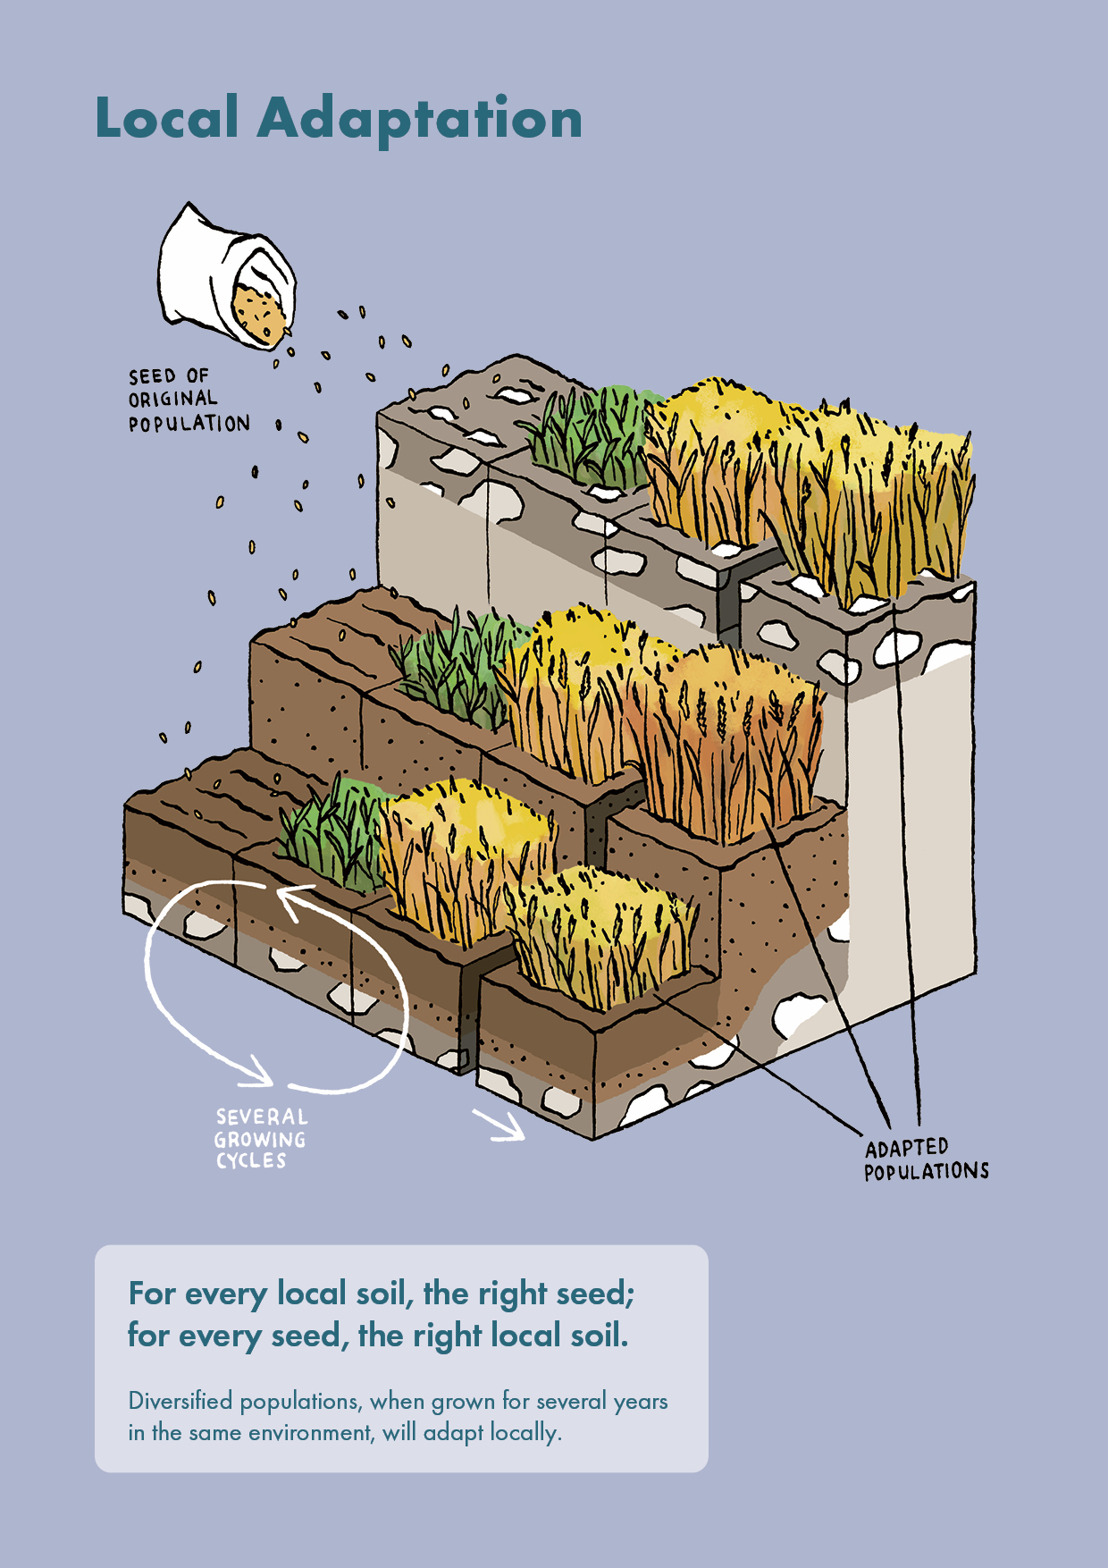
>>climate change adaptation
>> local production

Slide 12
Communication Challenges
Use positively framed messages>> This approach should be well balance in order to avoid to loose credibility
Promote the concept of organic right from the start
Consumer expectation vs actual sector situation
Notes:
Low level of problem awareness and prior knowledge in the target group (consumer expectation vs actual situation the organic seed value chain);
Discrepancy between consumer expectations (only organic inputs used in organic farming, i.e. 100% organic seeds for organic crops) and the actual situation, with the phasing out of non-treated conventional organic seeds not yet achieved;
Discrepancy between the vision for the use of adapted varieties and the actual situation, where conventional varieties are widely used for the majority of organic production

Slide 13
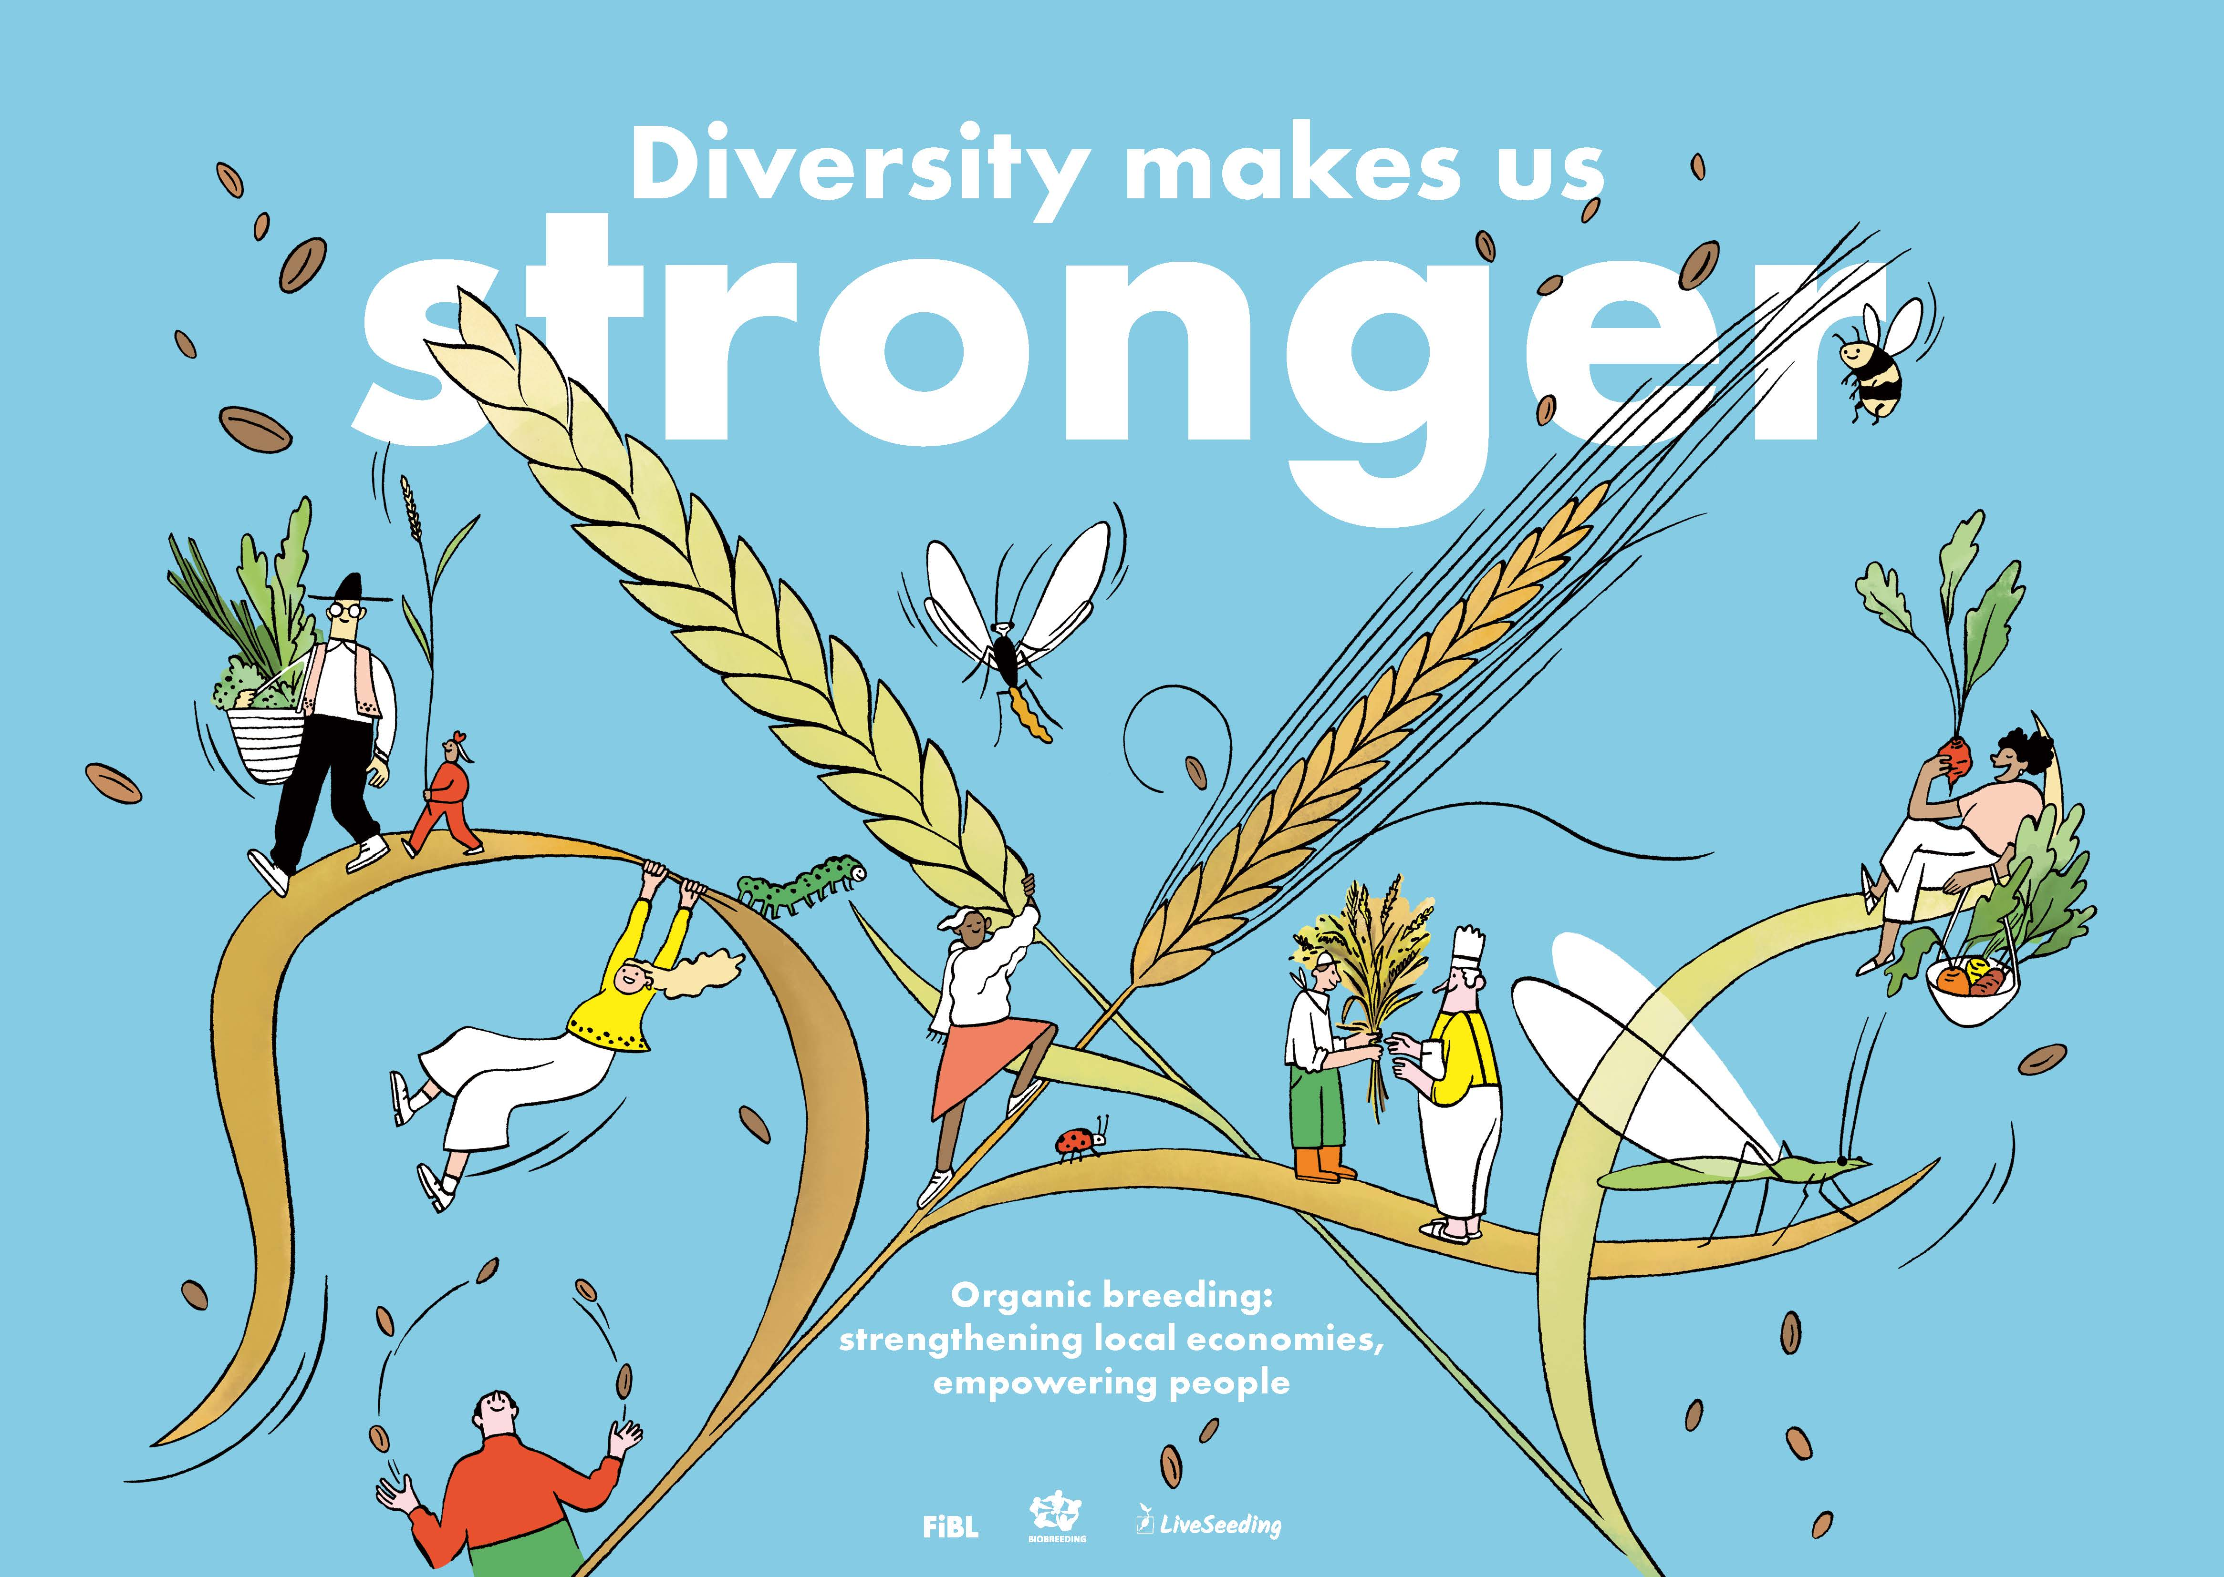

Slide 14
Arguments to present organic plant breeding to consumer-citizens

Slide 15
Arguments to present organic plant breeding to consumer-citizens

Slide 16
Communication and Marketing for organic seeds & organic breeding
Mariateresa Lazzaro (FiBL Switzerland)
25.02.2025

