Slide 1
Ana-Marija Špicnagel, Margareta Đumbir IPS konzalting
T5.4 Future is organic business models for organic seeds and breeding business

Slide 2


Organic and breeding sector

Slide 3

Organic SEED market
EU organic seed market was valued at around 300 million € in 2019 (EC)
2036
organic seeds have to be used for organic farming
Green Deal & Farm2Fork
25 % of the total farmland should be organic
the exact demand and supply of organic seed in the EU are unknown because of a lack of data
the EU organic seed market has been growing steadily, driven by increasing demand for organic products and growing awareness
the use of organic seed is particularly
low in Eastern and Southern European
countries and in the larger and recently converted organic farms
on average the 6-fold amount of organic
seed would need to be produced to reach
100 % organic seed

Slide 4

Organic PLANT BREEDING market
current needs for organic breeding are estimated to be at least
100 million € per year
most breeding initiatives are in Germany, Switzerland, Austria and the Netherlands
organic plant breeding is an established niche in the seed market
available funds have been growing continuously by about 10 % per year, and a total volume of 4-5 million € was recently estimated for the 4 countries mentioned above
most cultivars used in organic agriculture are still derived from conventional plant breeders, even if the seed is produced organically

Slide 5
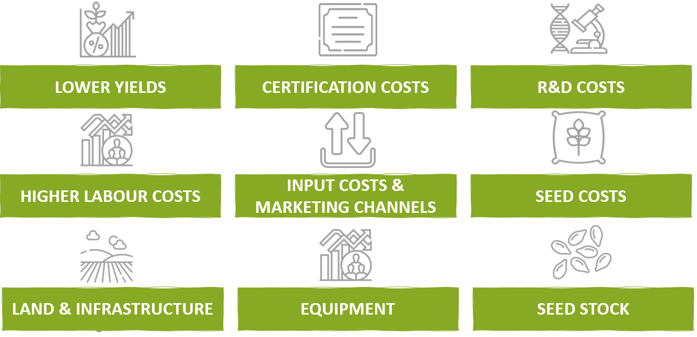
Organic production is more costly due to …

Slide 6

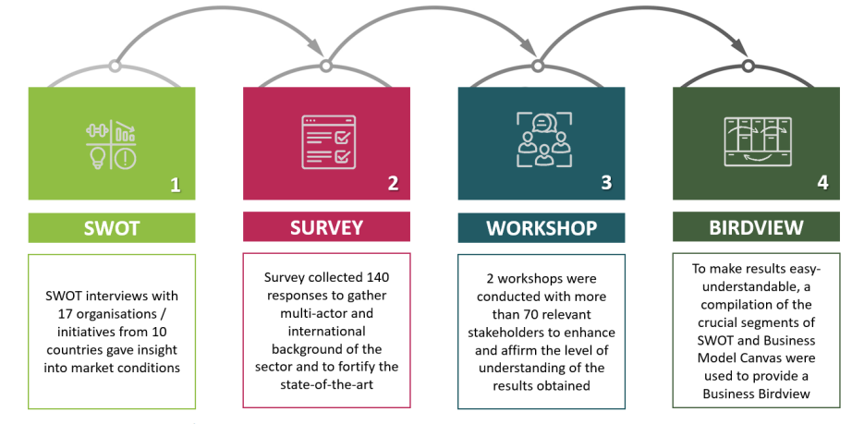
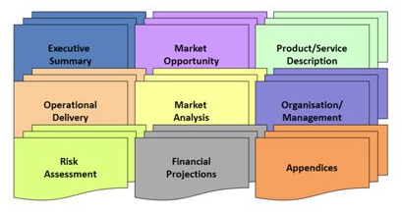
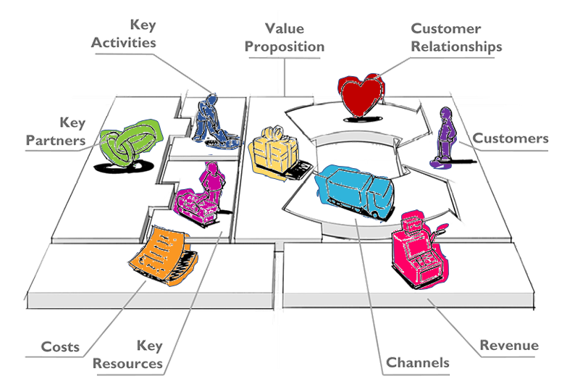
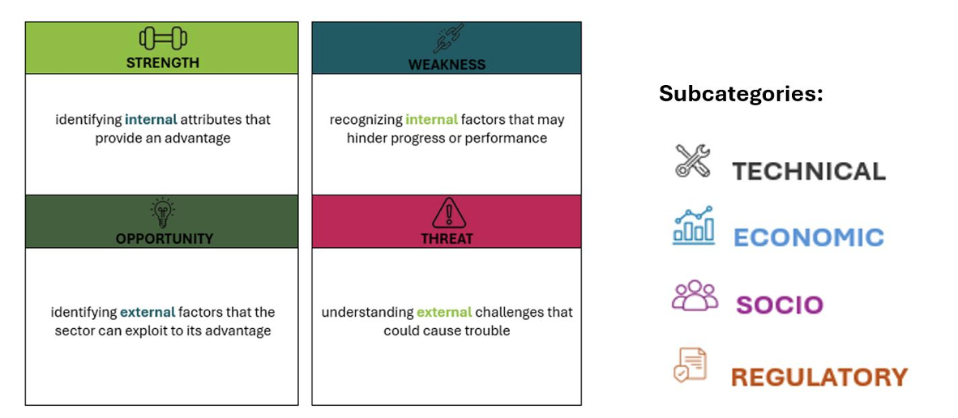
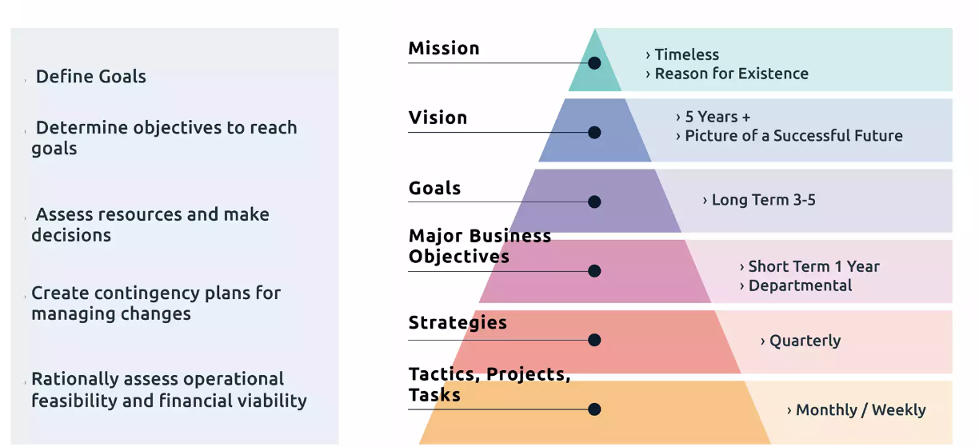
Comprehensive and complex data collection

Slide 7
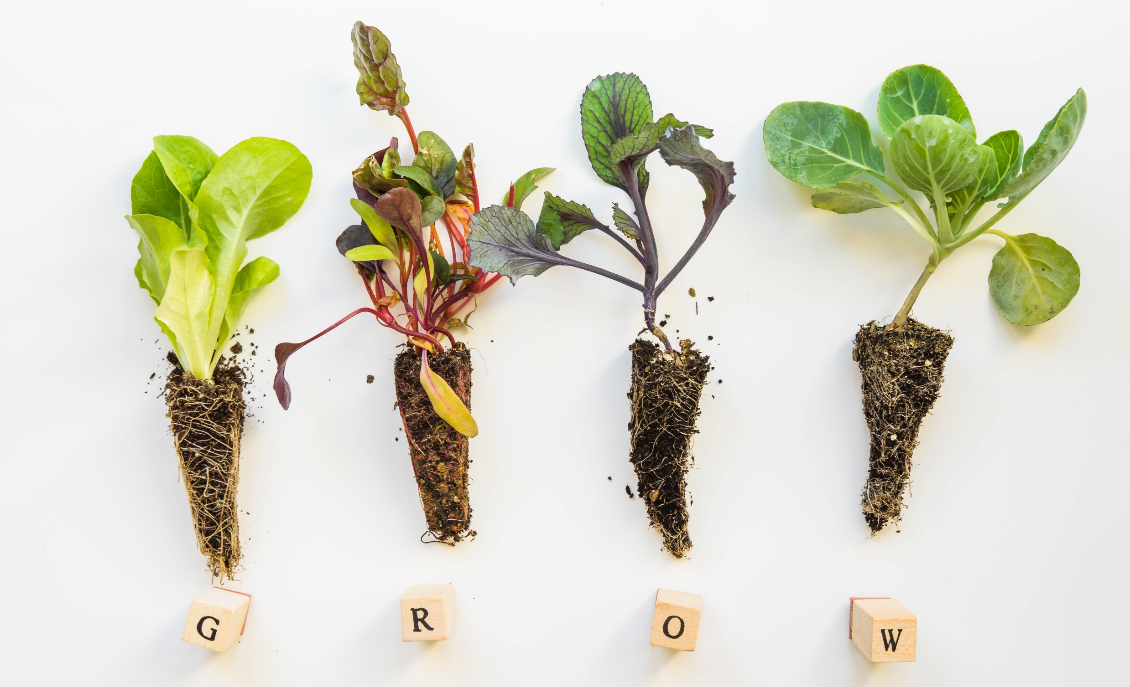
Comprehensive and complex data collection

Slide 8
SWOT analysis
Strategic planning tool for identifying and assessing the internal and external factors that can impact an organisation or project
Simple and flexible
Fosters a better understanding of an organisation’s position in the market
Helps prioritise actions by highlighting areas where the organisation can make the most impact

Slide 9
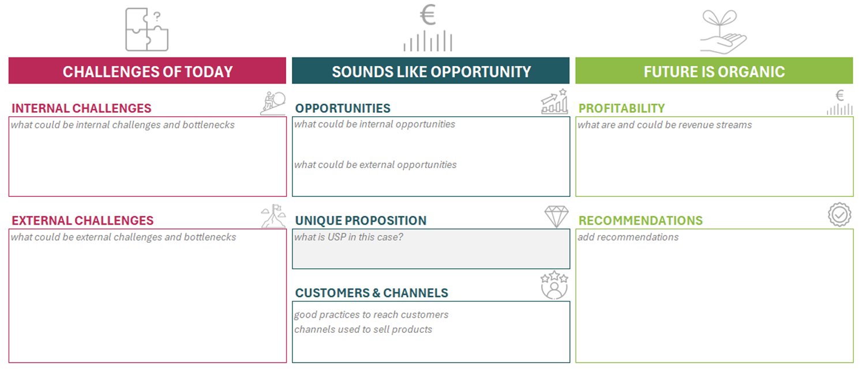
Business Birdview - BB
Innovative tool provides a streamlined, holistic view of a business combining insights from SWOT analysis and the Business Model Canvas
Simplifies complex business analysis, making insights easily digestible for stakeholders and aiding in more informed decision-making

Slide 10
Business Birdview - BB

Slide 11
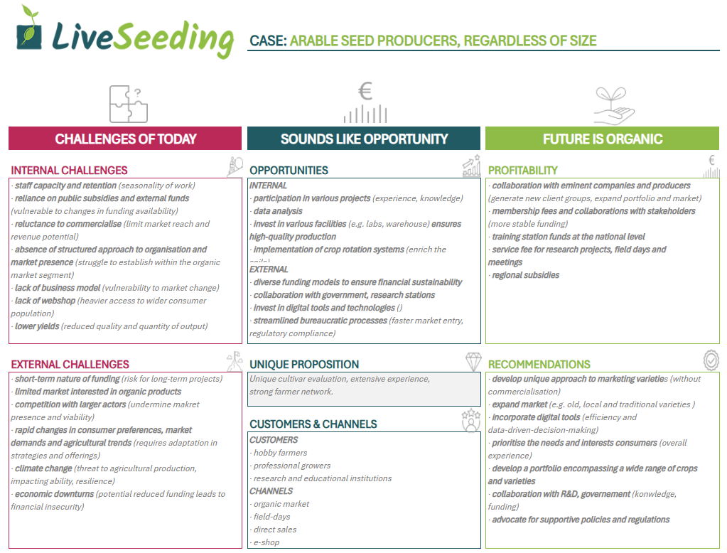
BB example

Slide 12
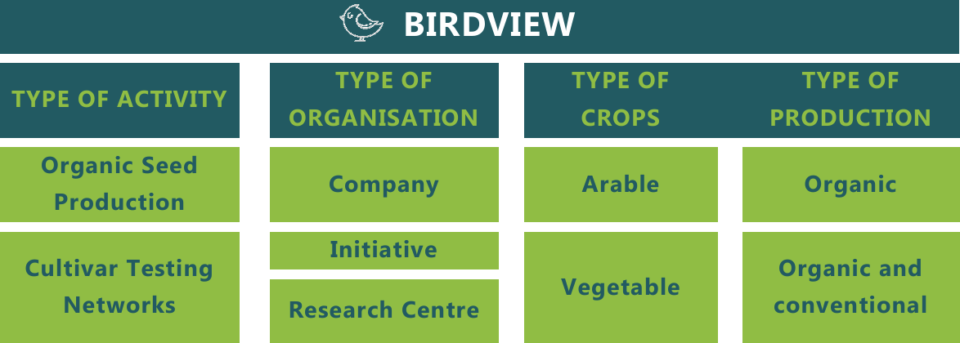
Overview of typologies used for BB
https://liveseeding.eu/deliverables-publications/

Slide 13
BUSINESS TALK
- 13 -

Slide 14

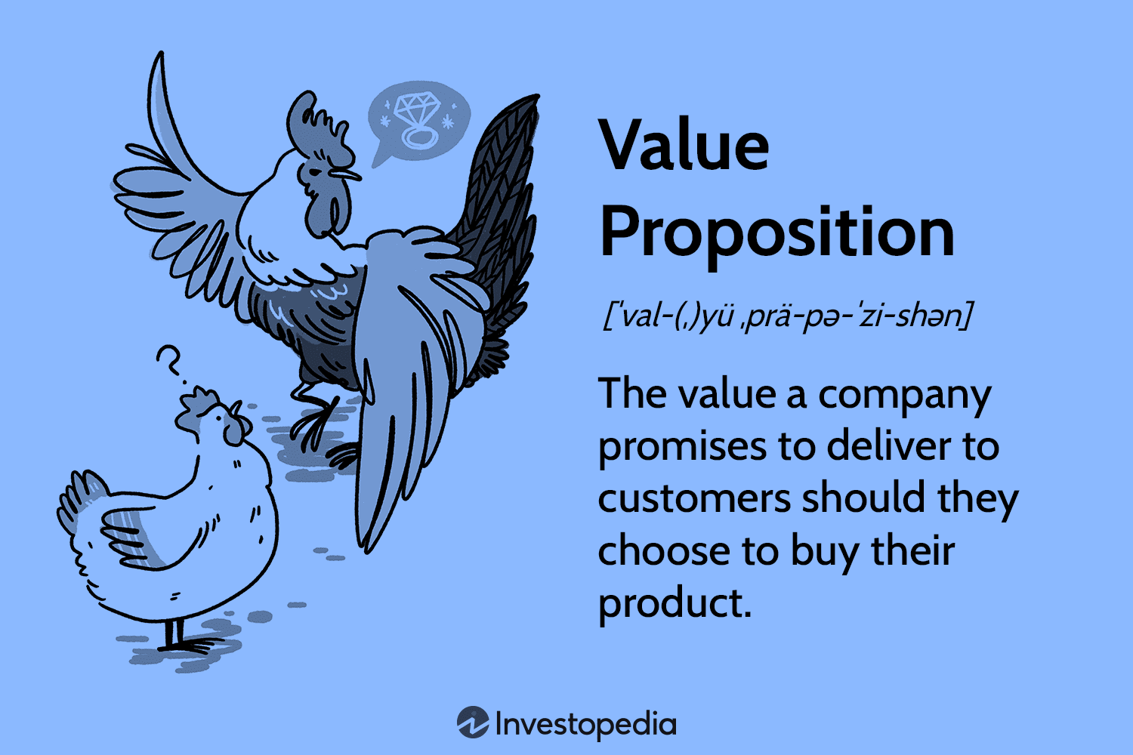

Value proposition
Value proposition is the sum of its various products and services
→ what is the unique factor that makes this business better than another?
Division of value proposition
Quantitative - refers to benefits that can be easily counted (e.g. price, speed).
Qualitative - refers to abstract concepts such as value or experience.

Slide 15
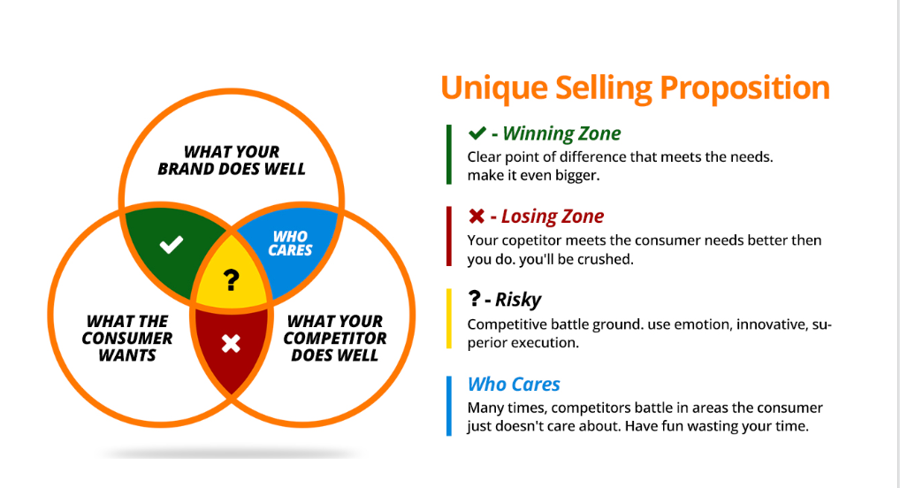
Value proposition
What value do we deliver to the customer?
Which one of our customer’s problems are we helping to solve?
What bundles of products and services are we offering to each Customer Segment?
Which customer needs are we satisfying?
CHARACTERISTICS
newness, performance, customization, design, brand/status, price, cost reduction, risk reduction, accessibility, convenience/usability

Slide 16

Customer Segments
Defines the different groups of people or organizations that a business aims to serve
By defining customer segment clearly, a company can ensure its products and services are aligned with the needs of its most valuable customers, ultimately driving growth and profitability
Key Benefits:
Targeted Marketing
personalized messages that resonate with specific customer groups
Resource Optimization
focus efforts and budget on the most valuable segments
Higher ROI
improved conversion rates through tailored approaches
Enhanced Customer Experience
meeting unique customer needs

Slide 17

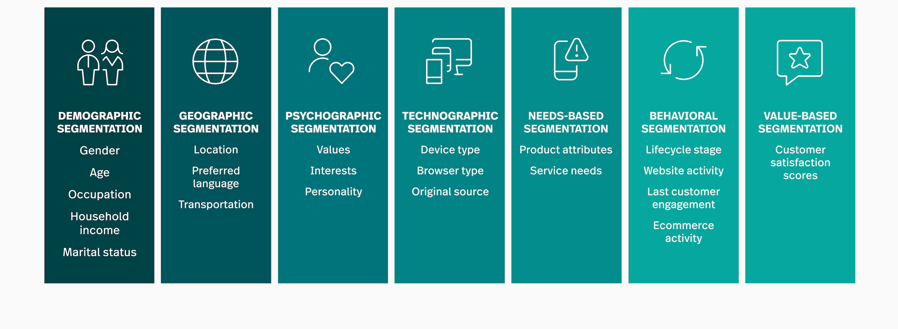
Customer Segments

Slide 18
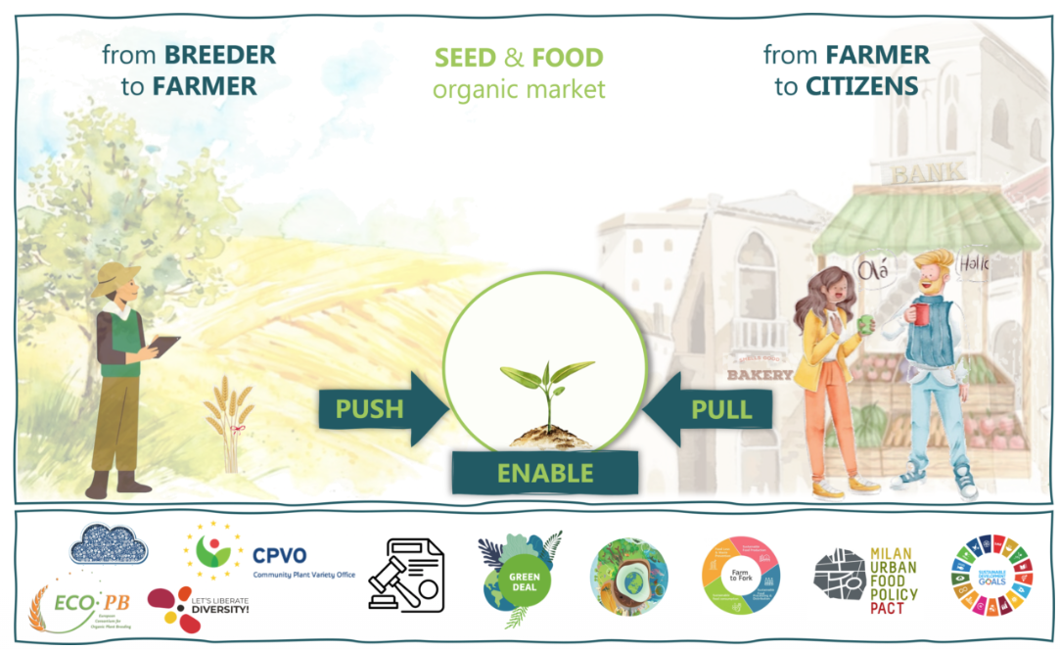
Customer Segments
Who are your customers?
The ratios of different customer types?

Slide 19


Funding opportunities

Slide 20
Costs & revenues
COSTS
This defines the cost of running a business according to a particular model.
Businesses can either be
- cost driven i.e. focused on minimizing investment into the business or
value-driven i.e. focused on providing maximum value to the customer.
REVENUES
When setting up revenue streams, it is important to recognize that an effective price for the product and/or service will be arrived at through the process of elimination.
What are the revenue streams of our company?
Why does it generate profit?
What a customer is willing to pay for?

Slide 21
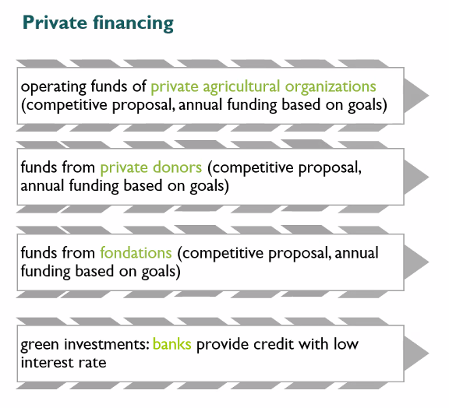
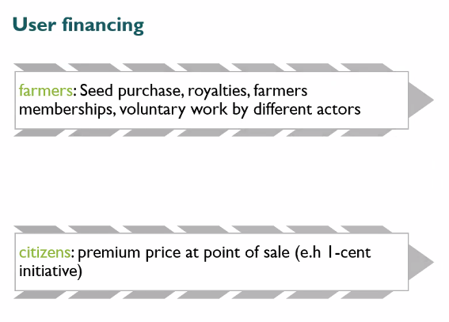
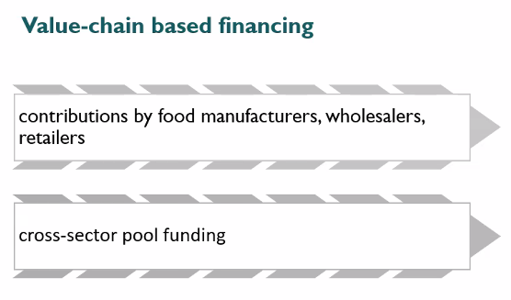
Funding opportunities
What financial sources the organisation is using?
Can be increased by selling seeds, consulting services, workshops and training, educational programs, certification fees

Slide 22
Funding opportunities
What funding opportunities have you been using so far?
What financial challenges are you facing today?

Slide 23


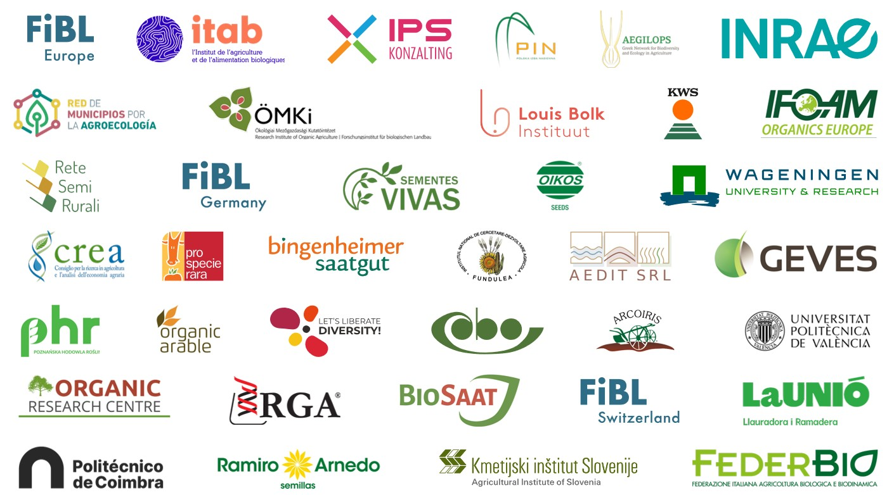







 | LiveSeeding
 | @LiveSeeding
 | LiveSeeding
 | www.liveseeding.eu
Sister project on organic fruit breeding:
www.InnOBreed.eu
Funded by the European Union, the Swiss State Secretariat for Education, Research and Innovation (SERI) and UK Research and Innovation (UKRI). Views and opinions expressed are however those of the author(s) only and do not necessarily reflect those of the European Union or REA, nor SERI or UKRI.

Slide 24

Thank you for your attention!

