Slide 1
Current status of the regulatory review process for the marketing of PRM in the EU
Maria Zintl, IFOAM Organics Europe
February 2025

Slide 2
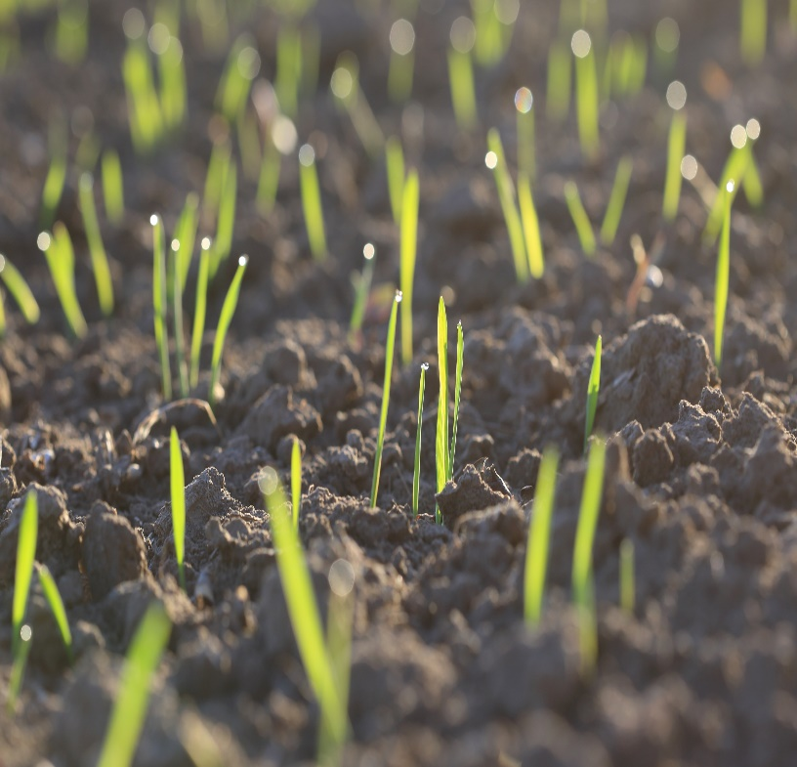
Why will there be a reform of the seed and plant reproductive material legislation?
Old rules on plant reproductive material (‘PRM’) in the EU since the 1960s
Too many directives: on the marketing of cereal seed, of vegetable seed, of seed potatoes…
Idea: a single regulation will replace all directives

Slide 3
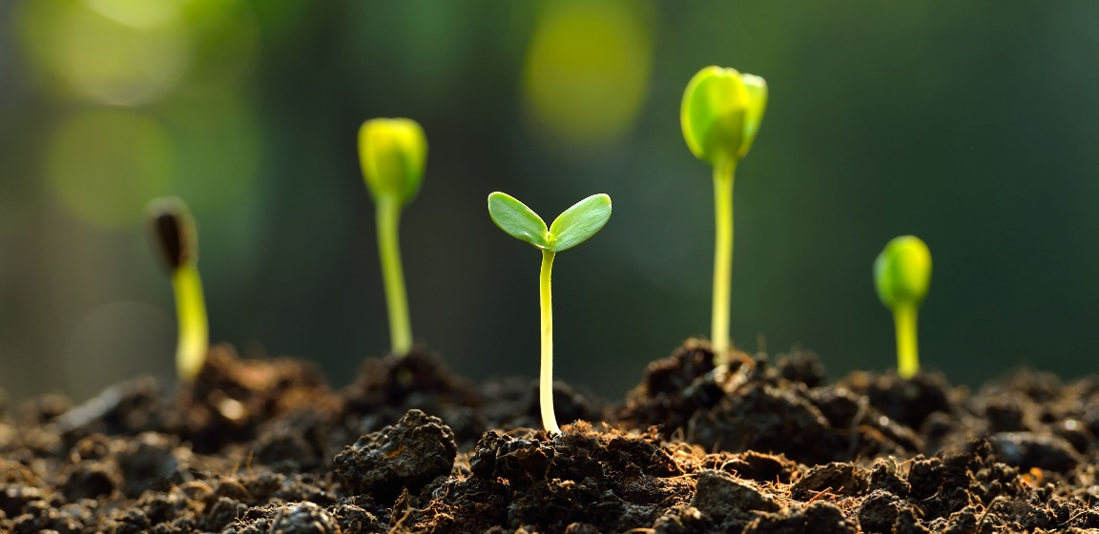
What are the intentions with the new legislation?
high quality PRM
diversity of choice
adapted to current and future climatic conditions
contribute to food security
protection of biodiversity
Sustainability characteristics

Slide 4
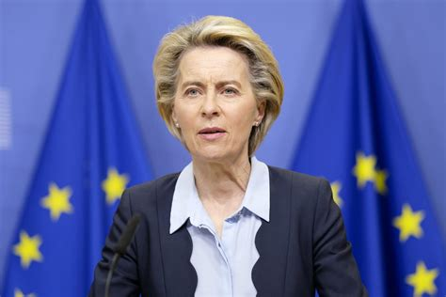

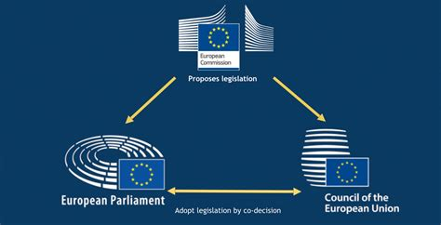
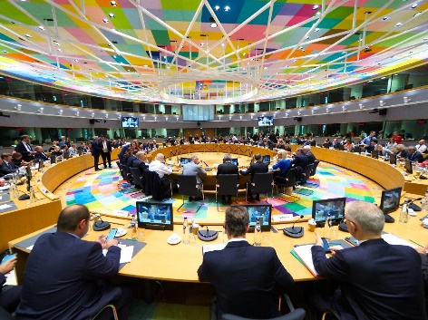
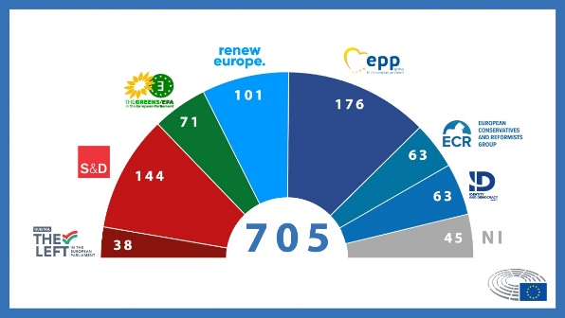


Work in progress at the EU institutions

Slide 5

a closer look at the work in the Council

Slide 6

The Council of the European Union…
… is where the Ministries of every Member State meet and discuss
For the PRM regulation, Ministries of Agriculture
Ministries of Agriculture can be influenced by national stakeholders, such as variety registration and plant health authorities…
… and by YOU

Slide 7
What’s next? And what are some concerns that have been raised?
We currently do not expect that the Council will agree on their position (‘general approach’) in the first half of 2025 (Polish presidency)
We currently believe the Council will find a joint position in the second half of 2025 (Danish Presidency)
Member States do not understand or do not support the concept of Organic Varieties (OV)/ Organic Heterogeneous Material (OHM) / conservation varieties / conservation activities more broadly.
There are still no notification procedures or OHM in place in some Member States.
Member States say that nobody uses the option to register Organic Varieties or notify OHM.
Confusion about differences between Organic Varieties and PRM that has been multiplied under certified organic conditions, and varieties tested under organic conditions.
Risk that provisions for OHM will be weakened.

Slide 8
and what can you do now?
If your OHM notification is not being handled, inform LIVESEEDING
Speak about your conservation activities
Speak about organic PRM
Notify OHM
Showcase who you are, what you do
Register Organic Varieties
Show that all actors and stakeholders in seeds are relevant

Slide 9
Co-decision: The Parliament will be back in the process

Slide 10
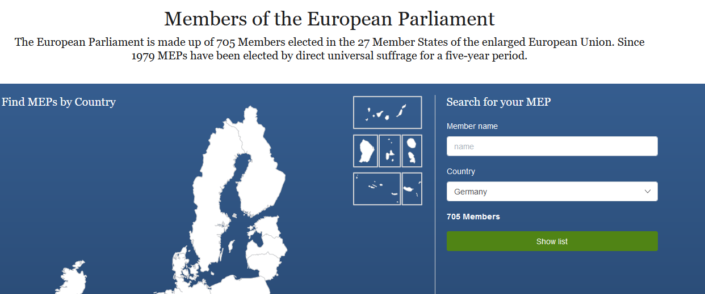
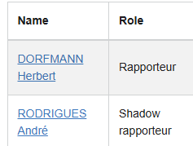
You can contact Members of European Parliament (MEPs)
Reach out to your national MEPs
Advanced search | Search | MEPs | European Parliament
Reach out to rapporteur and shadow rapporteurs who are dedicated to the PRM regulation proposal
Procedure File: 2023/0227(COD) | Legislative Observatory | European Parliament
Carriages preview | Legislative Train Schedule

Slide 11

How is organic plant breeding related to the Organic regulation (EU)2018/848?
  Art. 4: Organic production shall pursue the following general objectives: (…) contributing to a high level of biodiversity, in particular by using diverse plant genetic material, such as organic heterogeneous material and organic varieties suitable for organic production;
  Annex II 1.8.4: For the production of organic varieties suitable for organic production, the organic breeding activities shall be conducted under organic conditions and shall focus on enhancement of genetic diversity, reliance on natural reproductive ability, as well as agronomic performance, disease resistance and adaptation to diverse local soil and climate conditions.
This Photo by Unknown Author is licensed under CC BY-SA

Slide 12
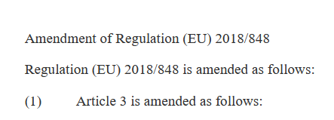

What are threats related to the proposal for the new PRM regulation?
EU Commission’s proposal to open up the organic regulation (EU) 2018/848
Intention:
  Adjust definitions related to PRM
  Regulate ORGANIC HETEROGENEOUS MATERIAL in the PRM regulation
  Widen options for breeding techniques

Slide 13
Thank you! maria.zintl@organicseurope.bio

