Slide 1
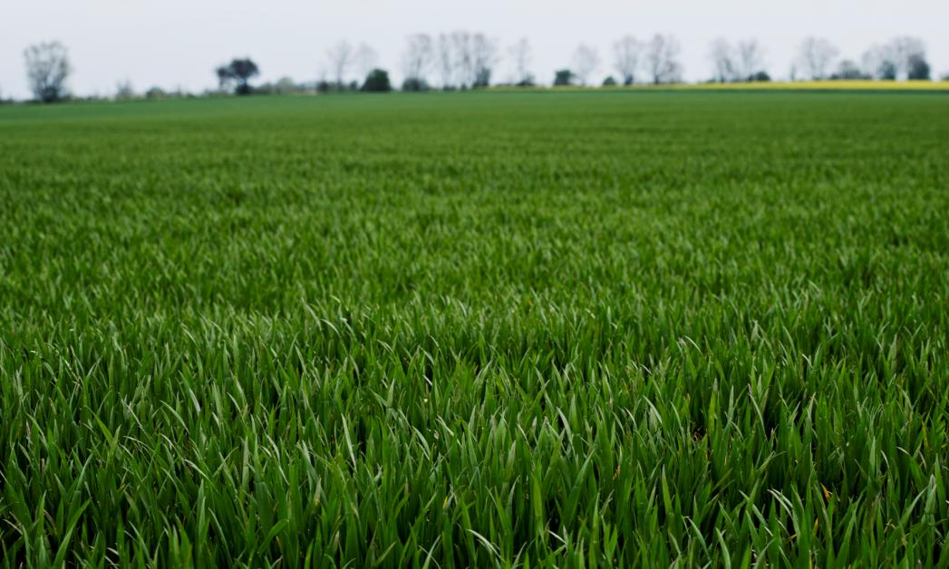





Breeding oat varieties with nematode resistance, high yield and agronomic traits beneficial for organic agriculture
- Oatganic -

Slide 2
OATGANIC- Status 2022
Project start 1-1-2022
Budget: 4.277.500 dkr
  Budget Nordic Seed 2.679.169 dkr
  Budget GUDP 1.598.331dkr

Slide 3
Organic oat in Denmark
Conventional area in ha |  |  |  |  |  |  | Share per crop of total cereal area - conventional
Year | Cereals total | Wheat | Rye | Barley | Oats |  | Year | Wheat | Rye | Barley | Oats
2018 | 1'328'554 | 417'598 | 73'481 | 767'703 | 63'776 |  | 2018 | 31.4% | 5.5% | 57.8% | 4.8%
2019 | 1'270'315 | 559'692 | 110'338 | 555'505 | 37'805 |  | 2019 | 44.1% | 8.7% | 43.7% | 3.0%
2020 | 1'267'170 | 488'600 | 94'991 | 623'311 | 55'283 |  | 2020 | 38.6% | 7.5% | 49.2% | 4.4%
2018-20 | 1'288'680 | 488'630 | 92'937 | 648'840 | 52'288 |  | 2018-20 | 38.0% | 7.2% | 50.2% | 4.0%
Organic area in ha |  |  |  |  |  |  | Share per crop of total ceral area - organic
Year | Cereals total | Wheat | Rye | Barley | Oats |  | Year | Wheat | Rye | Barley | Oats
2018 | 87'746 | 8'202 | 19'219 | 27'597 | 26'014 |  | 2018 | 9.3% | 21.9% | 31.5% | 29.6%
2019 | 103'385 | 13'708 | 36'262 | 27'695 | 18'655 |  | 2019 | 13.3% | 35.1% | 26.8% | 18.0%
2020 | 99'830 | 14'000 | 20'309 | 29'889 | 27'837 |  | 2020 | 14.0% | 20.3% | 29.9% | 27.9%
2018-20 | 96'987 | 11'970 | 25'263 | 28'394 | 24'169 |  | 2018-20 | 12.2% | 25.8% | 29.4% | 25.2%
Organic share per crop
Year | Cereals total | Wheat | Rye | Barley | Oats
2018 | 6.2% | 1.9% | 20.7% | 3.5% | 29.0%
2019 | 7.5% | 2.4% | 24.7% | 4.7% | 33.0%
2020 | 7.3% | 2.8% | 17.6% | 4.6% | 33.5%
2018-20 | 7.0% | 2.4% | 21.0% | 4.3% | 31.8% |  |  |  |  | EUROSTAT | EUROSTAT
1/4 of organic cereals is oat
1/3 of all oat is grown organic

Slide 4
Breeding for organic management
Differences in management
  Lower N availability
  No chemical weed control
    Mechanical control and suppression through crop
  No chemical disease control
    Resistance of varieties
  > Separate testing under organic growing conditions

Slide 5
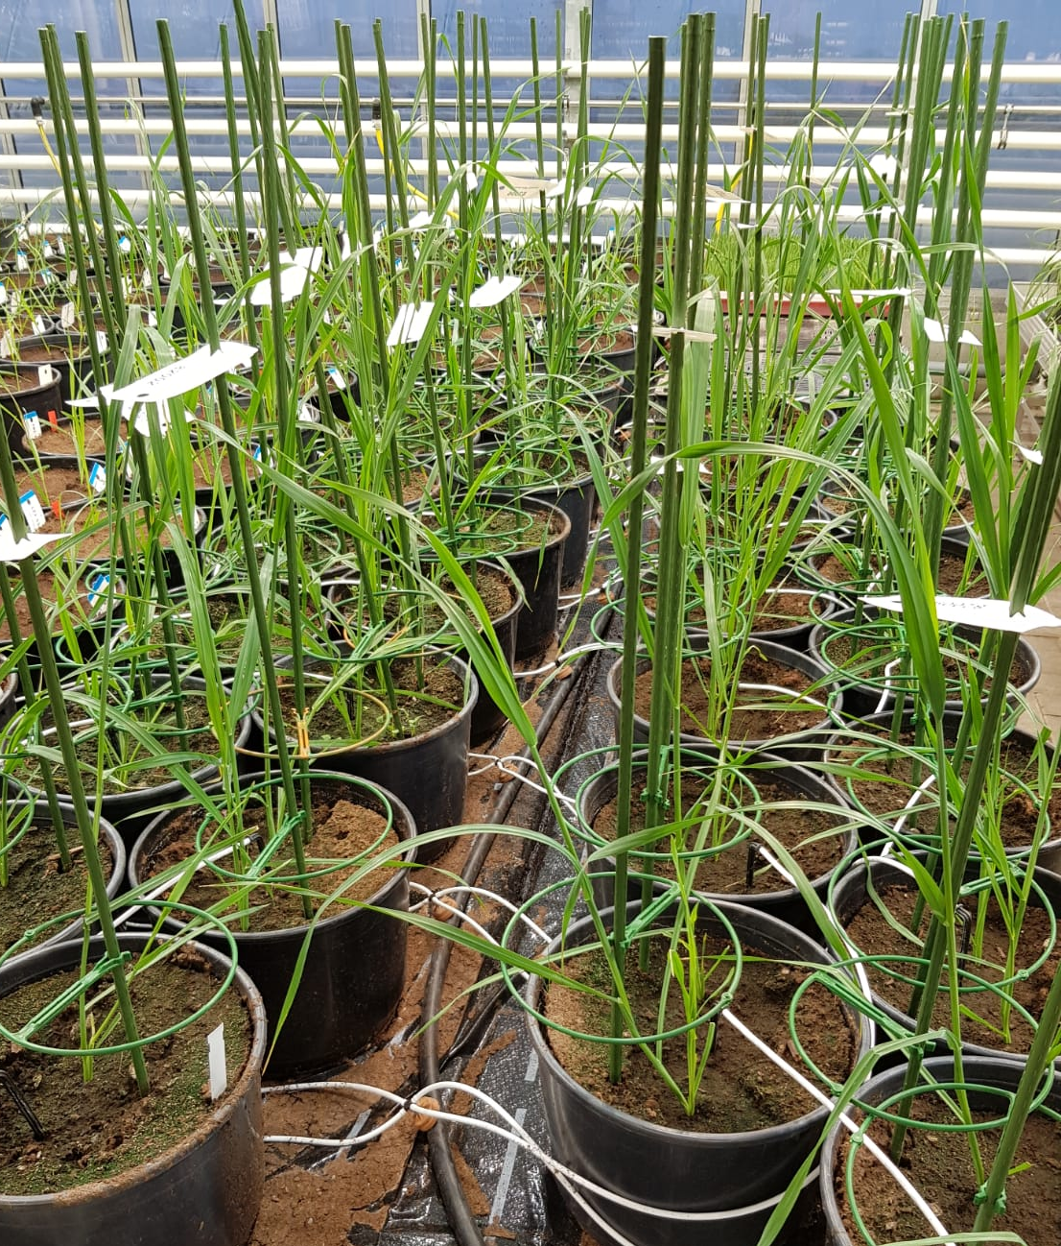
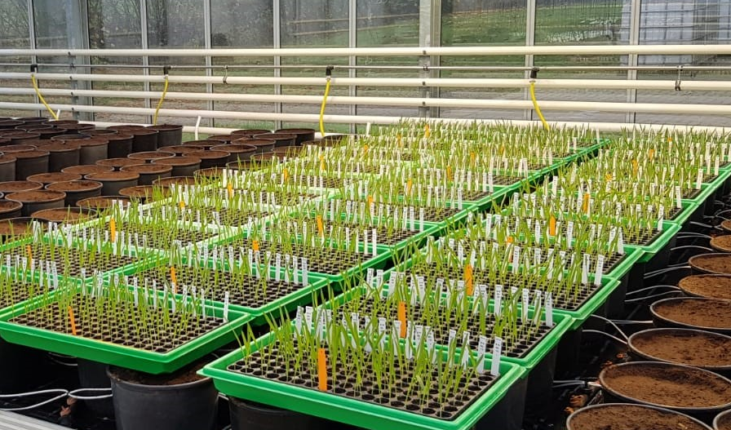
Oat breeding at Nordic seed
Selection of parents with desired characteristics
Hand-crossing in greenhouse
F1 to F4: Propagation in greenhouse
  Single seed descent (SSD)
  3 months per generation
F5:
  Multiplication plots in field
  selection for quality, lodging, earliness
Crossing parents

Slide 6
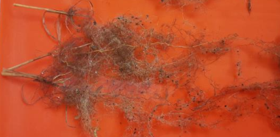
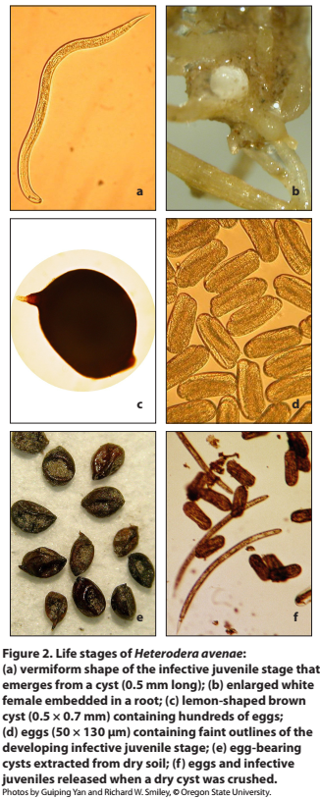
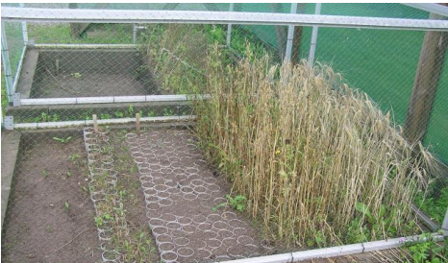
Cereal CYST nematodes (CCN)
Heterodera avenae
Soil-born, built-up over time
Resistance assessed by growing in infected soil and counting cysts on roots
Roots with cysts
Nematode infected soil at Tystofte
Variety | Release | Relative yield | HLW | Mildew resistance | Nematode resistance | Colour
Caddy | 2018 | 101 | 51.3 | 26 | Susceptible | white
Symphony | 2012 | 99 | 50.6 | 20 | Susceptible | white
Delfin | 2016 | 98 | 52.6 | 0 | Susceptible | yellow
Poseidon | 2012 | 98 | 49.5 | 19 | Susceptible | yellow
Dominik | 2003 | 91 | 49.6 | 23 | Resistant | yellow
2020 DK National trials/FUT

Slide 7
Objectives and goals
Nematode resistant variety
Same yield level as non-resistant varieties (+10%)
Adapted to organic growing conditions
  Improved weed suppression and N use efficiency
Improved quality
  Increased protein content
Genomics for nematode resistance and yield prediction
Increase overall productivity and sustainability
Overall reduction in pesticides and N losses

Slide 8
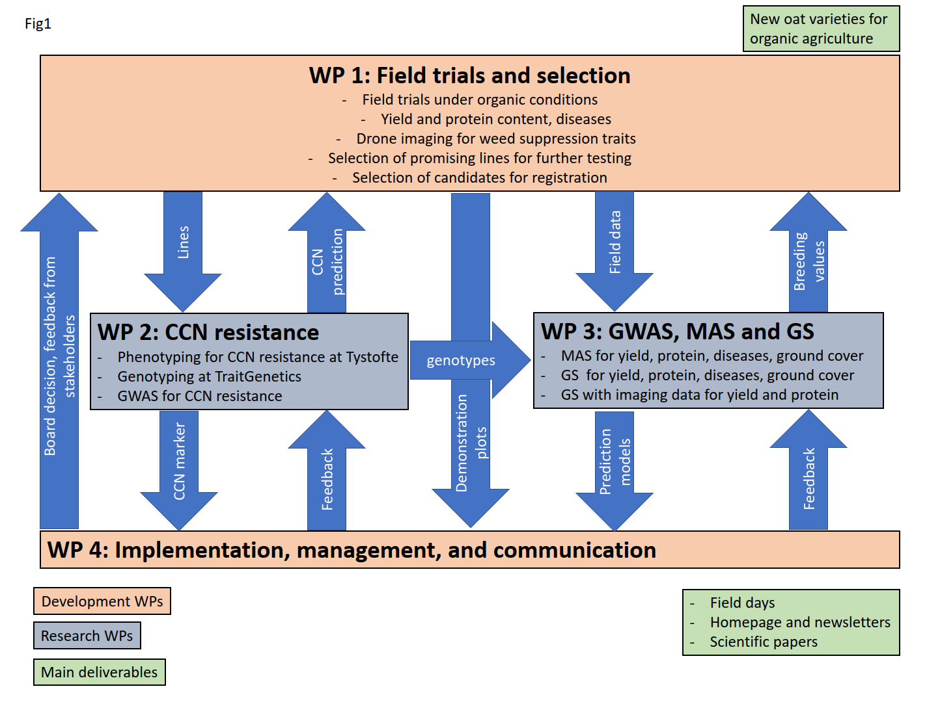
Work packages

Slide 9
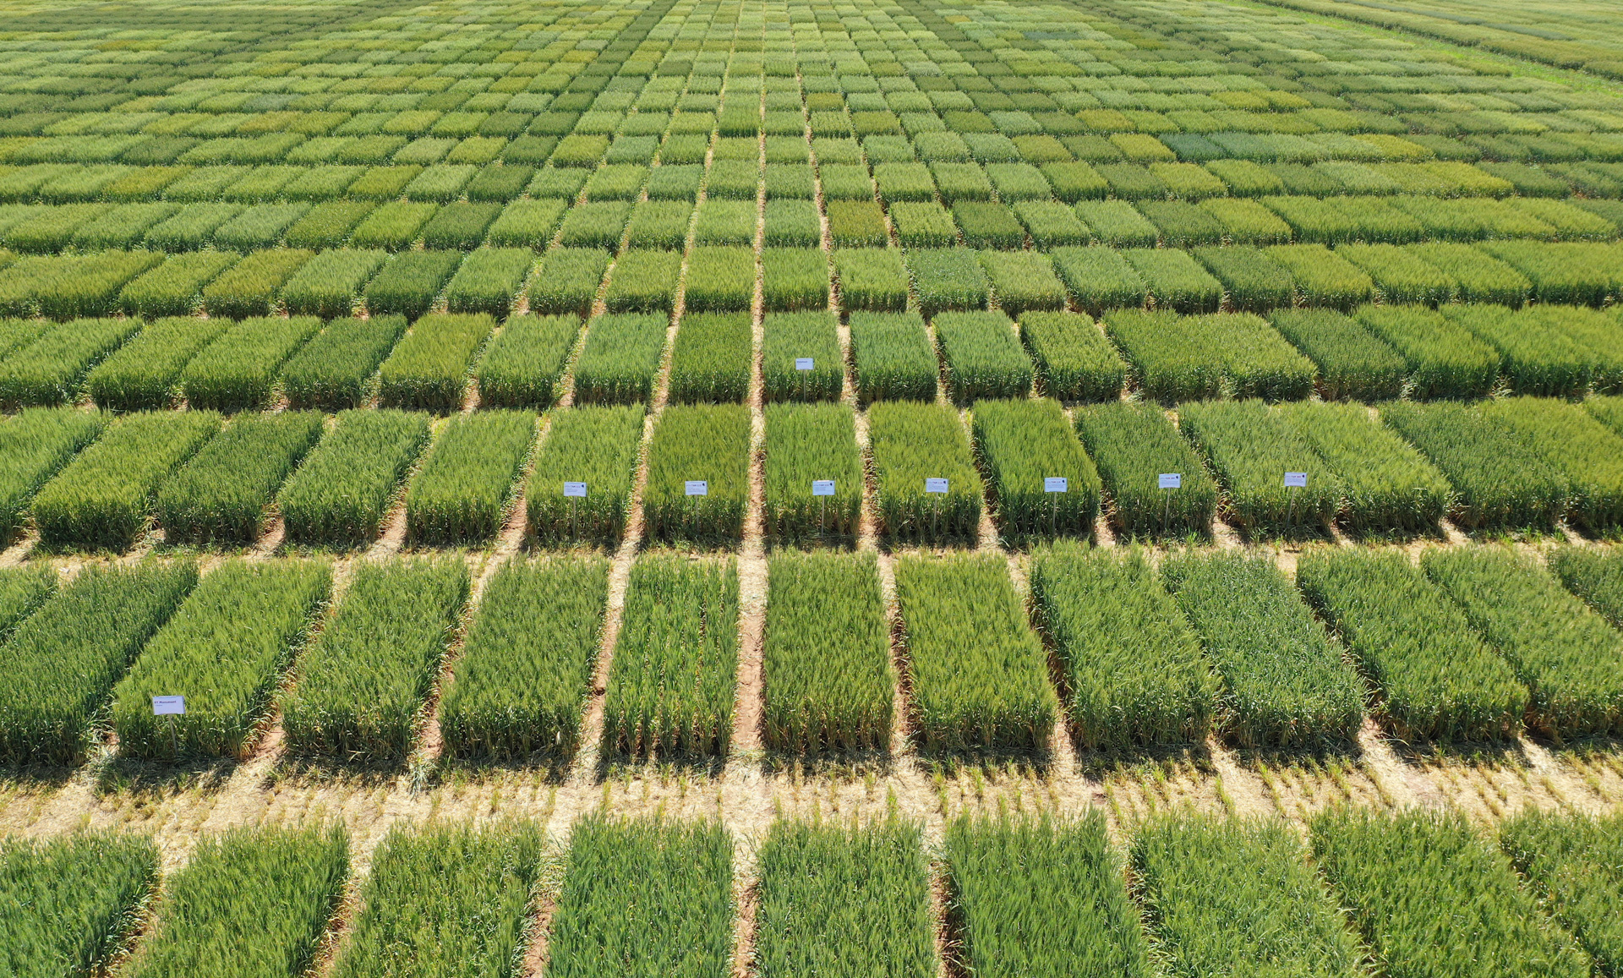
WP1: Field trials
Field trials to assess performance under organic conditions
Material:
  Advanced breeding material (F6 & F7)
Locations
  Organic field in Dyngby (Kreutzfeldt)
  Semi-organic field in Lolland
  Third location (tbd)
Traits
  Assessment for agronomic traits: earliness, height, lodging, ripening
  Drone flights to measure ground cover (NDVI) – weed suppression
  Grain yield and protein content

Slide 10
WP1: milestones and deliverables
Testing of lines under organic conditions
  Field trials
  Nematode resistance
Selection of lines for next generation (F6 to F7)
Selection of lines for registration and submit to Tystofte
Main deliverable: 3 new varieties that are
  Resistant to nematodes
  Improved yield (+10%)
  Well suited for organic agriculture

Slide 11
field trials - 2022
Locations in DK for F7 (NL-1) trials
  Oerting (Kreutzfeld) - organic
  Lolland (Holeby) - conv. & semi-organic - failed (sowing problems)
  Hellevad at Landbo Syd – organic – problematic
  Dyngby - conventional
  Abildgard – conventional
Overall, very high yields!
Location | Manage- ment | Country | nReps | Mean yield (dt/ha) | P-value | h2
Hellevad 18 | Org | DK | 3 | 56 | 0.117 | 0.14
Oerting 24 | Org | DK | 3 | 87 | 0.013 | 0.30
Nienstädt 40 | Semi-organic | DE | 2 | 74 | 0.044 | 0.51
Abildgaard 11 | Conv | DK | 2 | 98 | 0.013 | 0.48
Dyngby 21 | Conv | DK | 2 | 108 | 0.004 | 0.61
Nienstädt 41 | Conv | DE | 2 | 87 | 0.002 | 0.68

Slide 12
Correlation between management
No clear groupings to be detected
  E.g. Oerting (org.) better correlated with conv. experiments
But only one year & low trial quality in some locations
 |  | Organic | Organic | Semi-org. | Conv | Conv | Conv
 |  | Oerting | Hellevad | Nienstädt | Abildgaard | Dyngby | Nienstädt
Organic | Oerting |  | 0.23 | 0.26 | 0.33 | 0.40 | 0.43
Organic | Hellevad | 0.23 |  | 0.01 | 0.38 | 0.09 | 0.13
Semi-org. | Nienstädt | 0.26 | 0.01 |  | 0.27 | 0.26 | 0.49
Conv | Abildgaard | 0.33 | 0.38 | 0.27 |  | 0.20 | 0.37
Conv | Dyngby | 0.40 | 0.09 | 0.26 | 0.20 |  | 0.53
Conv | Nienstädt | 0.43 | 0.13 | 0.49 | 0.37 | 0.53

Slide 13
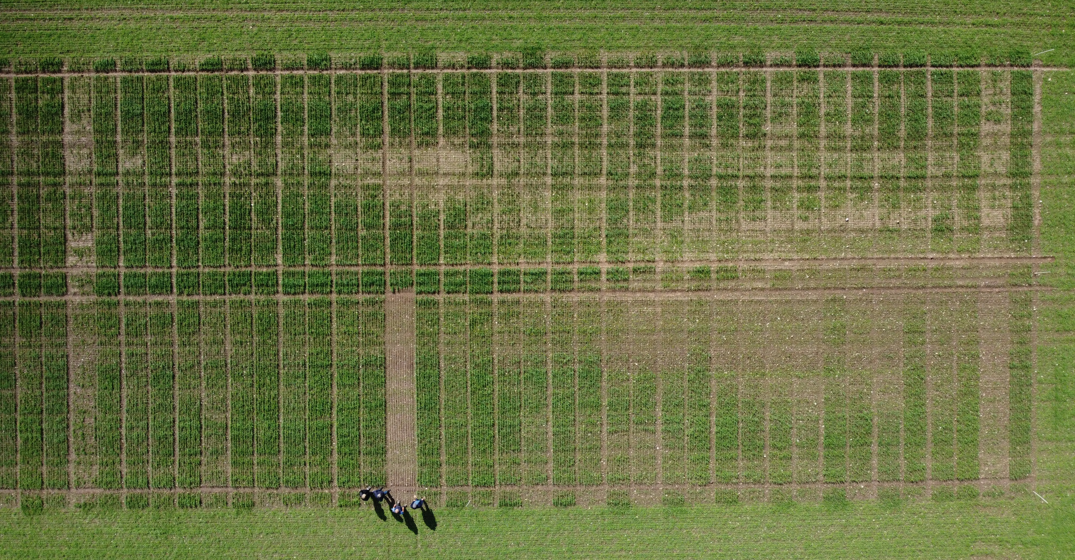
Experiment at hellevad
Very strong field heterogeneity
Soil tests did not show any unusual indications
Yield data only partly usable (P=0.117)

Slide 14
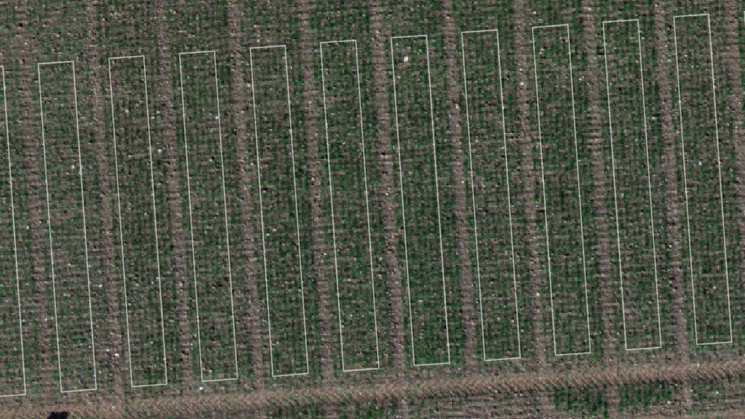
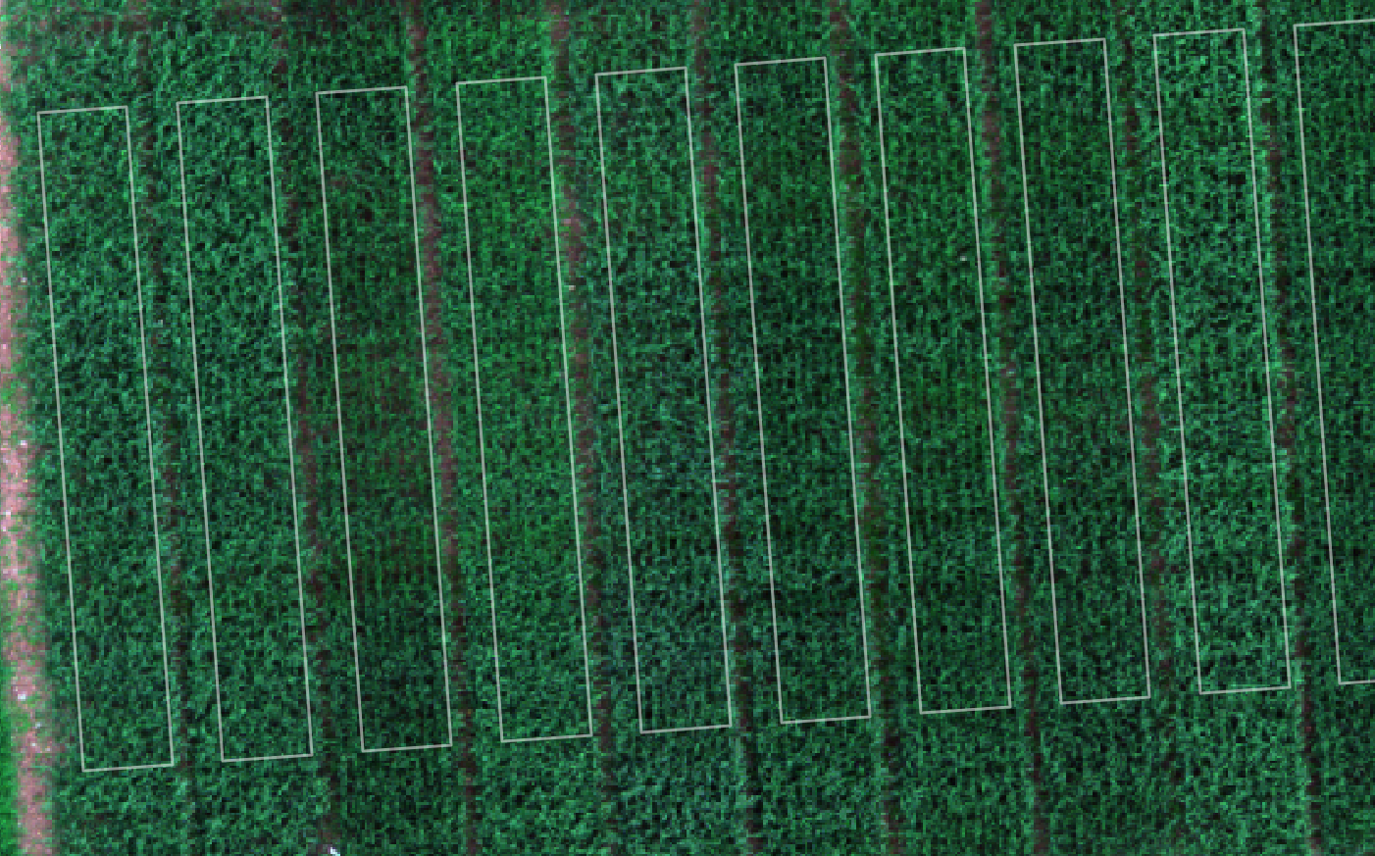
Groundcover by drone
Two flights at two locations
  May 3rd, May 30th
  Dyngby & Oerting
  NDVI, NDRE (Red Edge), Plant Cover (%)
Oerting, May 3rd
Oerting, May 30th

Slide 15
Drone results
NDVI best correlated to grain yield (compared to NDRE, Plant Cover%)
  Both locations and at both flights
Ground cover score (by eye) well correlated to NDVI (r: 0.52 to 0.79)
Late NDVI / ground cover strongly correlated to yield at organic location
Indicating importance of ground cover at organic management
R² to yield | Flight 1 May 3rd | Flight 2 May 30th
Oerting (org) | 0.11 | 0.54
Dyngby | 0.27 | 0.23
R² to yield | Ground cover score 1 | Ground cover score 2
Oerting (org) | 0.10 | 0.41
Dyngby | 0.17 | 0.18

Slide 16
Candidates
 | Relative yield to Blanding |  |  |  |  |  | NDVI 2 | HLW | Heading
Line | Mean | Oerting | Hellevad | Abildgaard | Dyngby | Nienstädt | Oerting | Mean | Dyngby
81910-03 | 106 | 103 | 121 | 104 | 98 | 102 | 0.92 | 52 | 46
81910-10 | 103 | 105 | 106 | 105 | 100 | 102 | 0.92 | 51 | 45
81910-04 | 103 | 105 | 110 | 96 | 104 | 101 | 0.91 | 52 | 45
81919-09 | 103 | 104 | 108 | 100 | 102 | 100 | 0.91 | 50 | 45
81929-05 | 103 | 106 | 107 | 99 | 100 | 101 | 0.92 | 51 | 46
81920-03 | 102 | 109 | 102 | 100 | 97 | 101 | 0.92 | 50 | 47
81929-02 | 102 | 106 | 97 | 96 | 105 | 105 | 0.92 | 52 | 45
81929-04 | 102 | 100 | 98 | 102 | 104 | 104 | 0.90 | 51 | 43
81916-04 | 102 | 104 | 105 | 95 | 101 | 102 | 0.91 | 54 | 45
81929-12 | 101 | 106 | 107 | 95 | 99 | 99 | 0.92 | 52 | 45
81919-10 | 101 | 103 | 109 | 100 | 98 | 94 | 0.91 | 50 | 45
81920-15 | 101 | 104 | 110 | 99 | 94 | 98 | 0.92 | 52 | 47
81910-08 | 101 | 99 | 103 | 96 | 97 | 107 | 0.91 | 50 | 45
81916-10 | 100 | 104 | 106 | 94 | 102 | 94 | 0.91 | 53 | 47
Lion | 100 | 103 | 104 | 101 | 94 | 99 | 0.91 | 53 | 44
Blanding 2022 | 100 | 100 | 100 | 100 | 100 | 100 | 0.90 | 52 | 45
81920-12 | 100 | 106 | 101 | 96 | 97 | 100 | 0.92 | 53 | 44
81915-18 | 100 | 106 | 103 | 97 | 94 | 99 | 0.91 | 50 | 46
81915-17 | 99 | 104 | 103 | 96 | 95 | 95 | 0.90 | 52 | 45
81918-01 | 99 | 100 | 105 | 98 | 97 | 94 | 0.90 | 51 | 46
81929-14 | 99 | 105 | 99 | 94 | 98 | 95 | 0.92 | 50 | 47
81912-03 | 98 | 94 | 111 | 93 | 95 | 95 | 0.90 | 53 | 47
81921-05 | 96 | 95 | 98 | 95 | 97 | 95 | 0.91 | 52 | 48
Dominik | 95 | 95 | 98 | 97 | 92 | 90 | 0.90 | 51 | 49
81922-01 | 93 | 94 | 97 | 89 | 92 | 93 | 0.90 | 49 | 49
Some very promising lines
Almost all are better than Dominik
Lines will be selected for official testing starting 2023

Slide 17
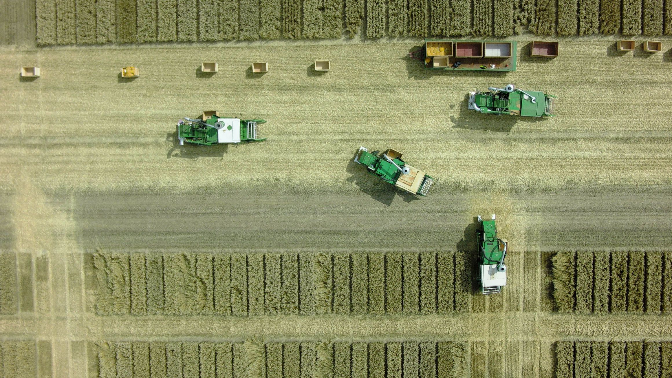

Slide 18
OATGANIC
Nordic seed has before the project start done a few crosses with CCN resistant oat.
We have done inbreeding and selection in this breeding material
This breeding material has been given to the Oatganic project
The first line here from was entered to National List Trials in 2022

Slide 19
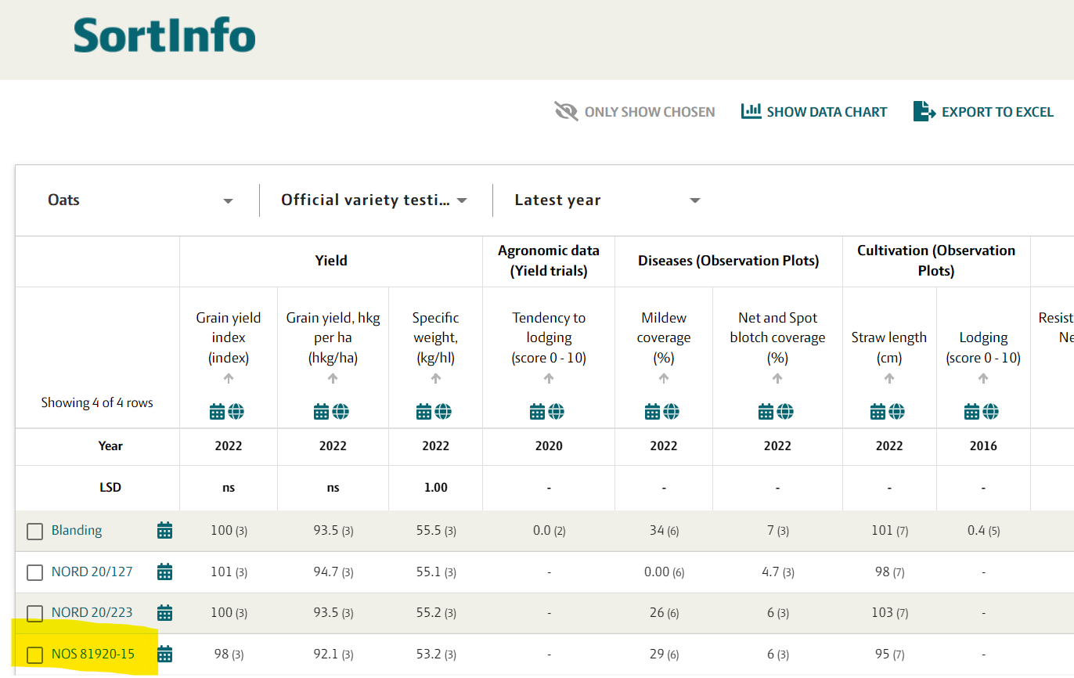
OATGANIC

Slide 20


WP 2 CCN resistance
Jihad Orabi

Slide 21
CCN resistance
1-Number of lines send for phenotyping at Tystofte for nematode resistance and results of these test.’
We have sent 100 lines. They were phenotyped against race and race 1 of Heterodera avenae.
*Resistant line has a maximum 10% the number of cysts of the Susceptible control
**Susceptible line has a minimum 10% the number of cysts of the Susceptible control
2-Number of lines send for genotyping
188 lines were sent for genotyping with Oat 3k SNP array
 | Race 1 | Race 2 | total
Resistant* | 20 | 13 | 13
Susceptible** | 80 | 77 | 77

Slide 22
WP 3 GS and MAS on field data
Genomic breeder Pernille Sarup

Slide 23
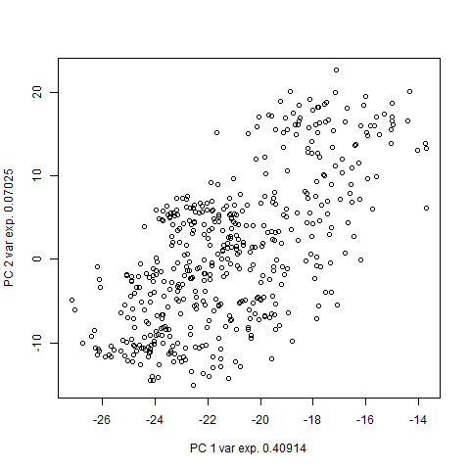
Genetic structure
No major population structure to disturb genomic selection/GWAS

Slide 24
gwas
Field data from WP1 and genotype data from WP2
7 Phenotypes
  Yield, Protein, Heading date, Height, Lodging, Mildew, and HLW
Genotypes
  481 lines, 1145 markers per line
Y = Location_Year_Trial + id(residual) + id_location_year + location_year_subblock + location_year_subblock +error

Slide 25
Phenotypic data
Trait | # plots | mean | SD | Min | Max
Yield | 3431 | 83.16 | 16.66 | 28.6 | 129.8
Protein | 3416 | 12.14 | 1.22 | 7.63 | 16.18
Heading date | 2635 | 47.73 | 10.54 | 32 | 71
Height | 2940 | 104.38 | 12.32 | 65 | 145
Lodging | 1166 | 3.03 | 2.28 | 0 | 9
Mildew | 705 | 4.94 | 1.8 | 1 | 8
HLW | 395 | 54.97 | 1.44 | 48.28 | 58.36

Slide 26
results
Clear and consistent QTL for Mildew resitance

Slide 27
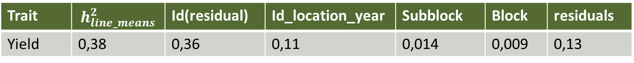
Relative Variance components
Trait | $$h_{line_means}^{2}$$ | Id(residual) | Id_location_year | Subblock | Block | residuals
Yield | 0,38 | 0,36 | 0,11 | 0,014 | 0,009 | 0,13

Slide 28
Relative Variance components
Trait | $$h_{line_means}^{2}$$ | Id(residual) | Id_location_year | Subblock | Block | residuals
Yield | 0,38 | 0,36 | 0,11 | 0,014 | 0,009 | 0,13
Non-additive genetic variation is high, probably a result of few markers for a large genome in oat.

Slide 29
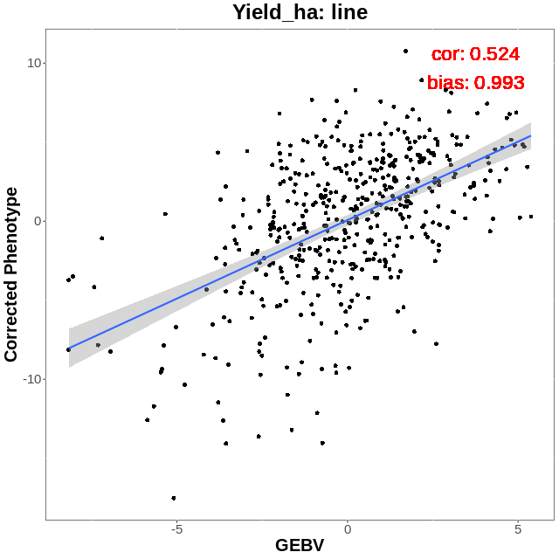
GS in organic oat 2022
We can deselect half the population purely based on genomic breeding values without losing any high yield lines.

Slide 30
GS in organic oat
The data set is still small, prediction accuracies will increase with more data on yearly variation, more lines, and more markers
Statistical models will be under continuous development as data accumulate

Slide 31

Thanks for your attention

