Slide 1
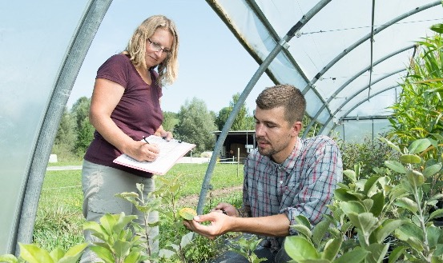
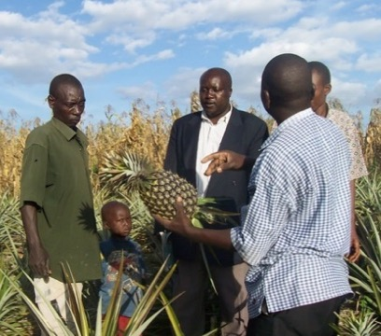
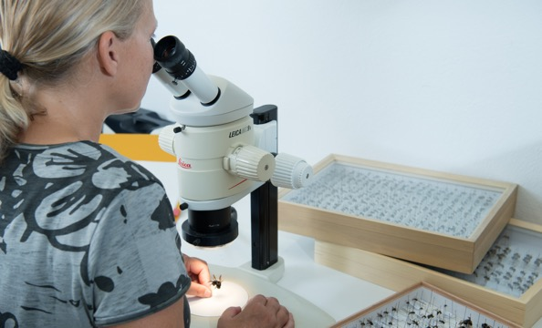
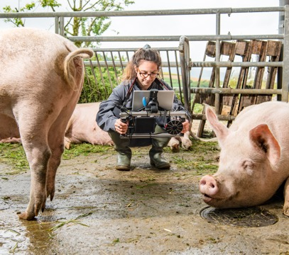
Organic Agriculture Worldwide 2023:
Key results from the FiBL survey on organic agriculture worldwide 2025
Part 2: Organic land use and crops
Jan Trávníček, Bernhard Schlatter and Helga Willer
© FiBL, February 2025

Slide 2
Organic Agriculture Worldwide: Key results from the FiBL survey on organic agriculture worldwide 2025
Part 2: Organic land use and crops
Data compiled by the Research Institute of Organic Agriculture FiBL, Frick, Switzerland, based on national data sources and data from certifiers.
Data as published February 2025 in The World of Organic Agriculture. Statistics and Emerging Trends 2025.* Frick and Bonn, www.organic-world.net
For updates, check www.organic-world.net
This presentation is available online at: https://www.organic-world.net/yearbook/yearbook-2025/presentations.html
Texts and graphs: Helga Willer, Bernhard Schlatter and Jan Trávníček, Research Institute of Organic Agriculture FiBL, Frick, Switzerland
Contact: Helga Willer, helga.willer@fibl.org, Research Institute of Organic Agriculture FiBL, Frick, Switzerland
© Research Institute of Organic Agriculture FiBL, Frick, Switzerland, April 2025
*Citation: Willer, Helga, Bernhard Schlatter and Jan Trávníček (Eds.) (2025): The World of Organic Agriculture. Statistics and Emerging Trends 2025. Research Institute of Organic Agriculture FiBL, Frick, and IFOAM – Organics International, Bonn.
Notes:
FiBL
19.07.2025
www.fibl.org
2

Slide 3
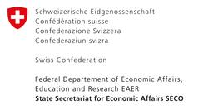

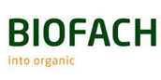
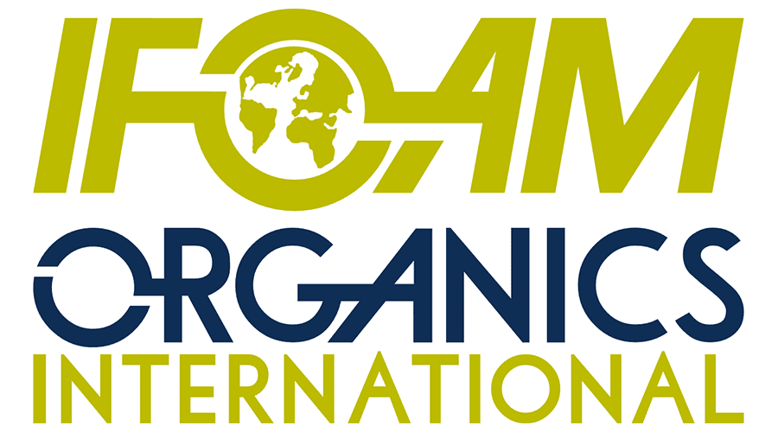
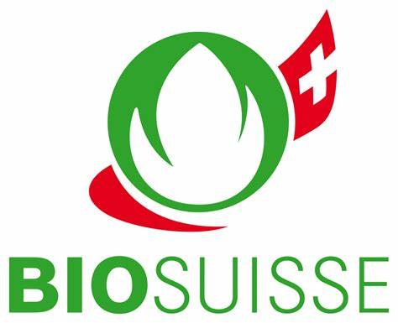
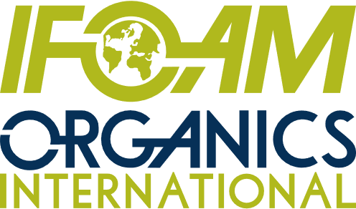
Acknowledgements
The Swiss State Secretariat of
Economic Affairs (SECO)
Coop Sustainability Fund
NürnbergMesse, the organizers of BIOFACH
IFOAM – Organics International
Bio Suisse
More than 200 experts from all parts of the world contributed to the FiBL survey 2025.

Slide 4
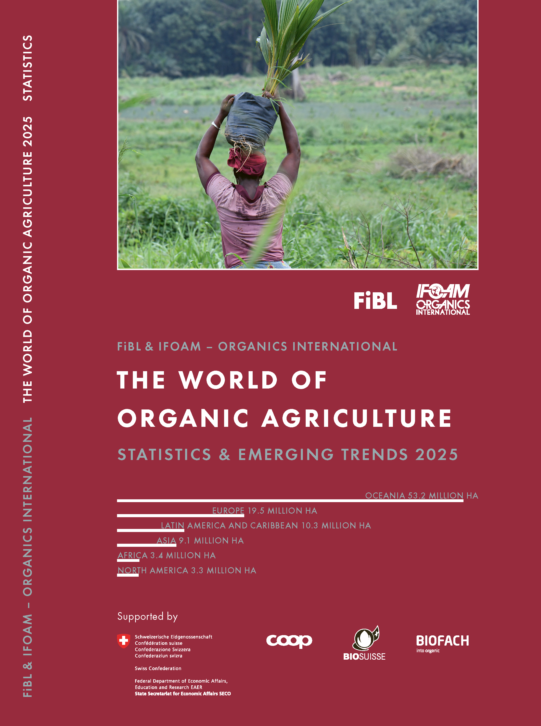

The World of Organic Agriculture 2025
The 26th edition of «The World of Organic Agriculture», was published by FiBL and IFOAM – Organics International in February 2025.
Data tables
Country and continent reports
Markets, standards, policy support
The book can be ordered or downloaded at: https://www.fibl.org/en/shop-en
www.organic-world.net
https://statistics.fibl.org

Slide 5
About this presentation
In three presentations, the key results of the FiBL survey on organic agriculture worldwide 2025 are summarized (data 2023). Apart from the global data, key results on crop and on regional data are presented.
More information is available at www.organic-world.net
The following three presentations are available at https://www.organic-world.net/yearbook/yearbook-2025/presentations.html:
  Part 1: Global data 2023 and survey background
  Part 2: Land use and key crops in organic agriculture 2023
  Part 3: Organic agriculture in the regions 2023

Slide 6
The 26th survey on organic agriculture world-wide
The 26th survey on organic agriculture worldwide was carried out by the Research Institute of Organic Agriculture FiBL in cooperation with partners from all around the world. The results were published jointly by FiBL and IFOAM – Organics International.
The survey was carried out between July 2024 and February 2025.
Data were received from 188 countries.
Data was provided by over 200 country experts (representatives from NGOs, certification bodies, governments, researchers).
The following data was collected: area data (including land use and crop details); producers, other operator types; domestic market values; export and import data; livestock data (animal heads and production in metric tons).
The results are published in the yearbook “The World of Organic Agriculture 2025” and on www.organic-world.net.

Slide 7
Land use in organic agriculture
General land use information was available for 92 percent of the organic agricultural land.
More than two-thirds of the 98.9 million hectares of organic agricultural land in 2023 were grassland/grazing areas (over 68.5 million hectares).
The cropland area (arable land with 16.2 million hectares and permanent crops with 6.7 million hectares) constituted 22.9 million hectares, which was less than a quarter of the organic agricultural land.
While in Oceania and Latin America, permanent grassland/grazing covers a large part of the organic farmland area, in Africa, permanent crops are the most important land use type. In Asia, Europe and North America, arable land is the most important.
The key arable crops were cereals, green fodder from arable land and oilseeds.
For permanent crops, nuts, coffee and olives were the most relevant
All three main land use types increased between 2022 and 2023. The arable crops increased by 6.9 percent, permanent crop by 8.5 percent, and organic grassland/grazing areas by 1.2 percent.

Slide 8
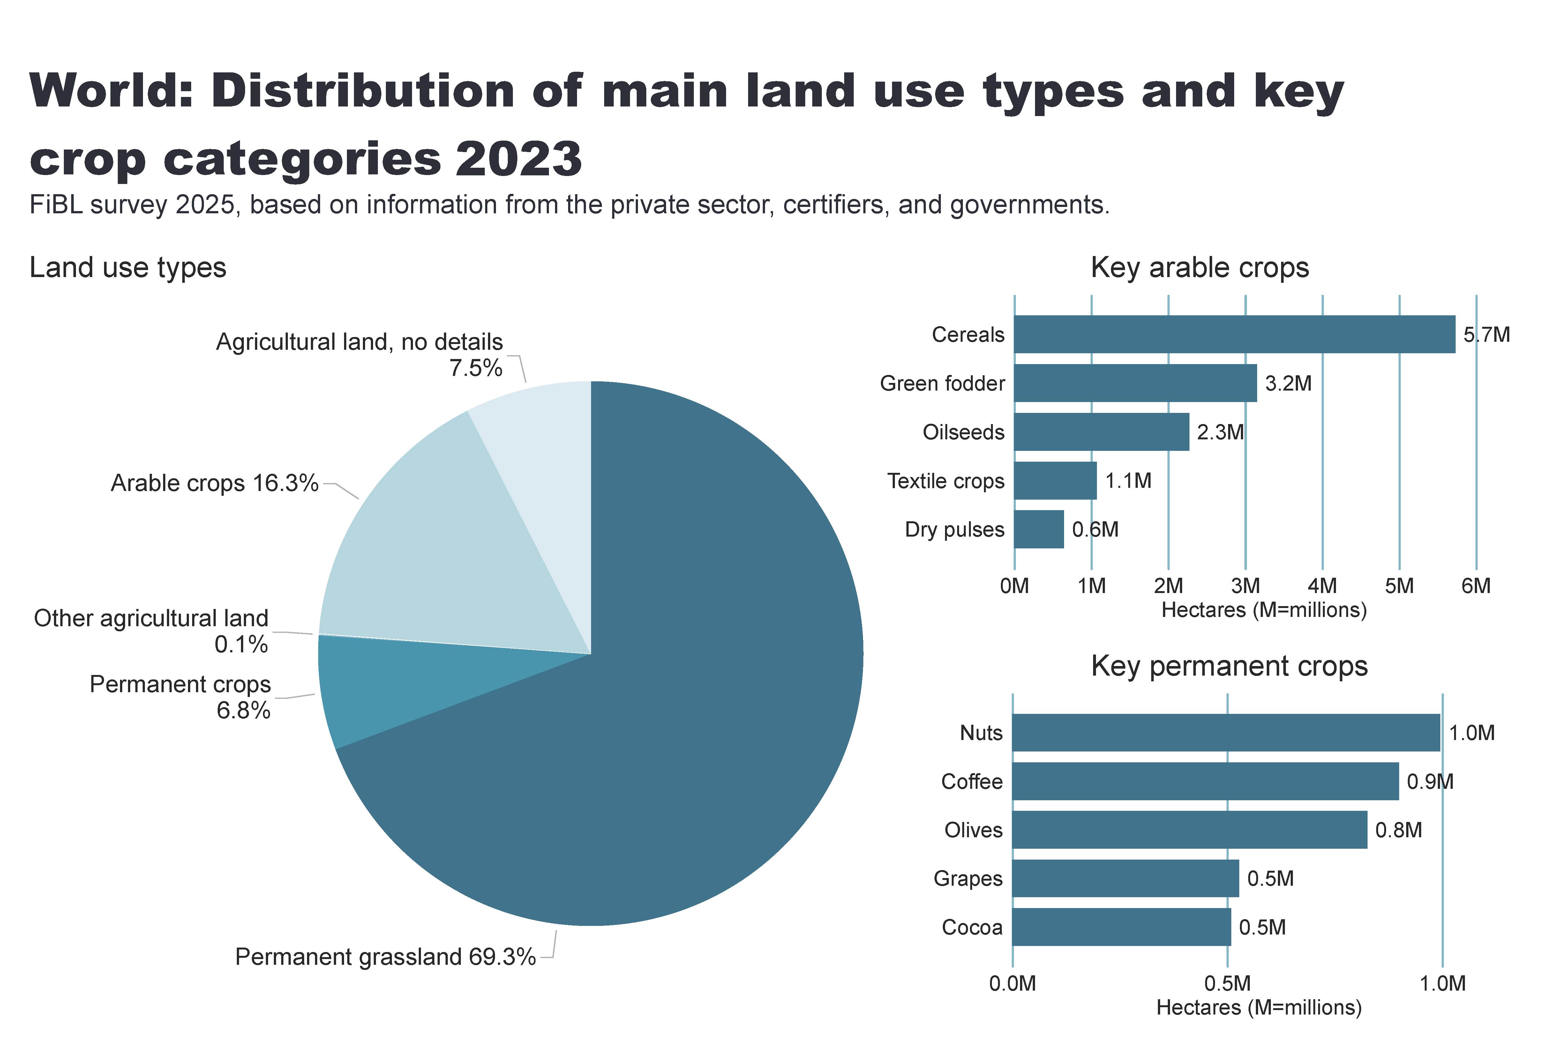
Land_use_world_arable_land1
Notes:
Land use types
No alt text provided
card
No alt text provided
Key arable crops
No alt text provided
Key permanent crops
No alt text provided
textbox
No alt text provided

Slide 9
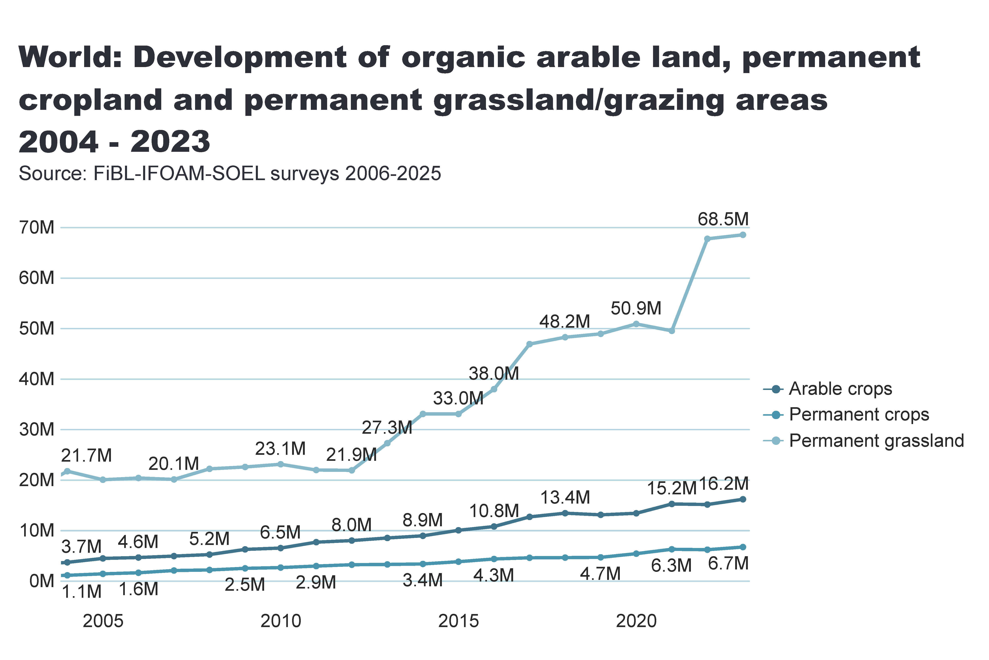
Land_use_world_development
Notes:
card
No alt text provided
lineChart
No alt text provided
textbox
No alt text provided

Slide 10
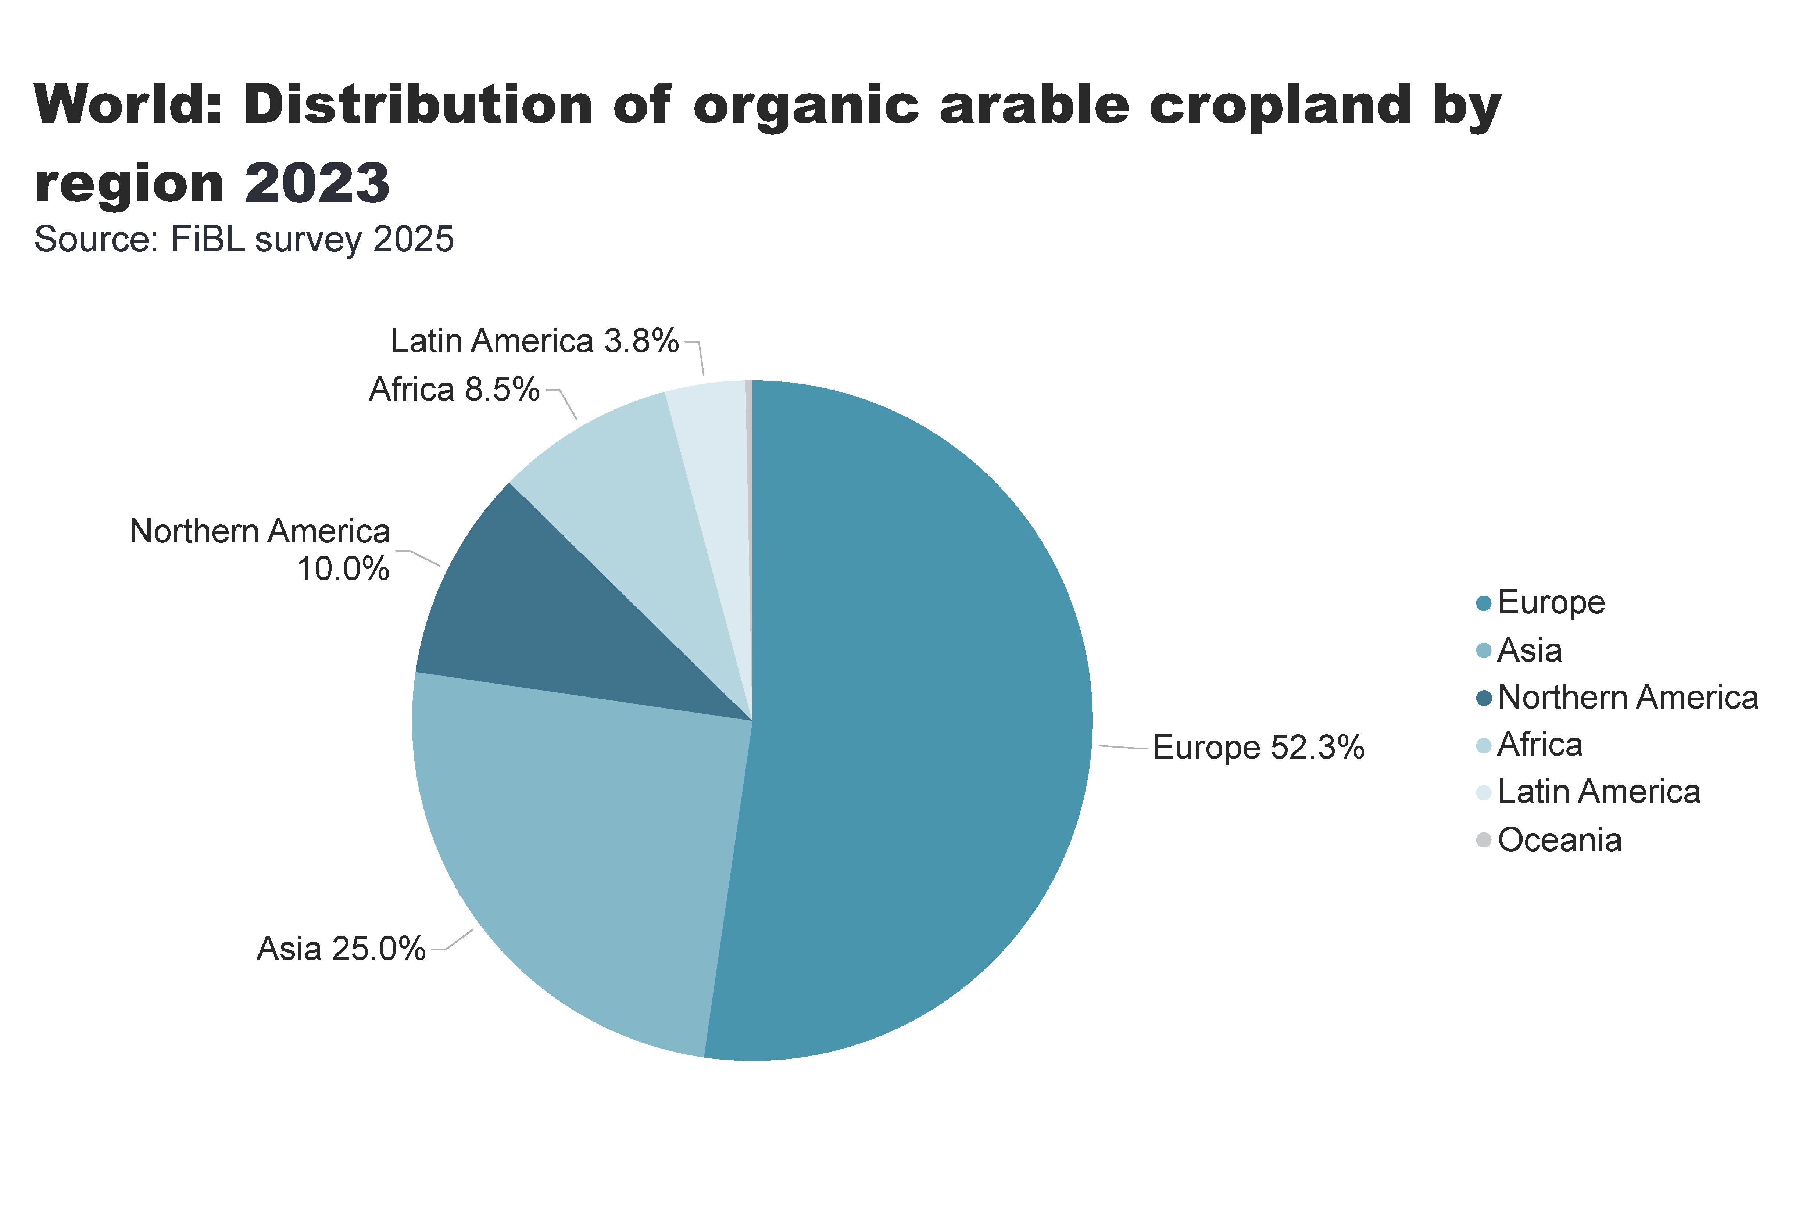
world_arable_land_distribution_by_country
Notes:
pieChart
No alt text provided
card
No alt text provided
textbox
No alt text provided

Slide 11
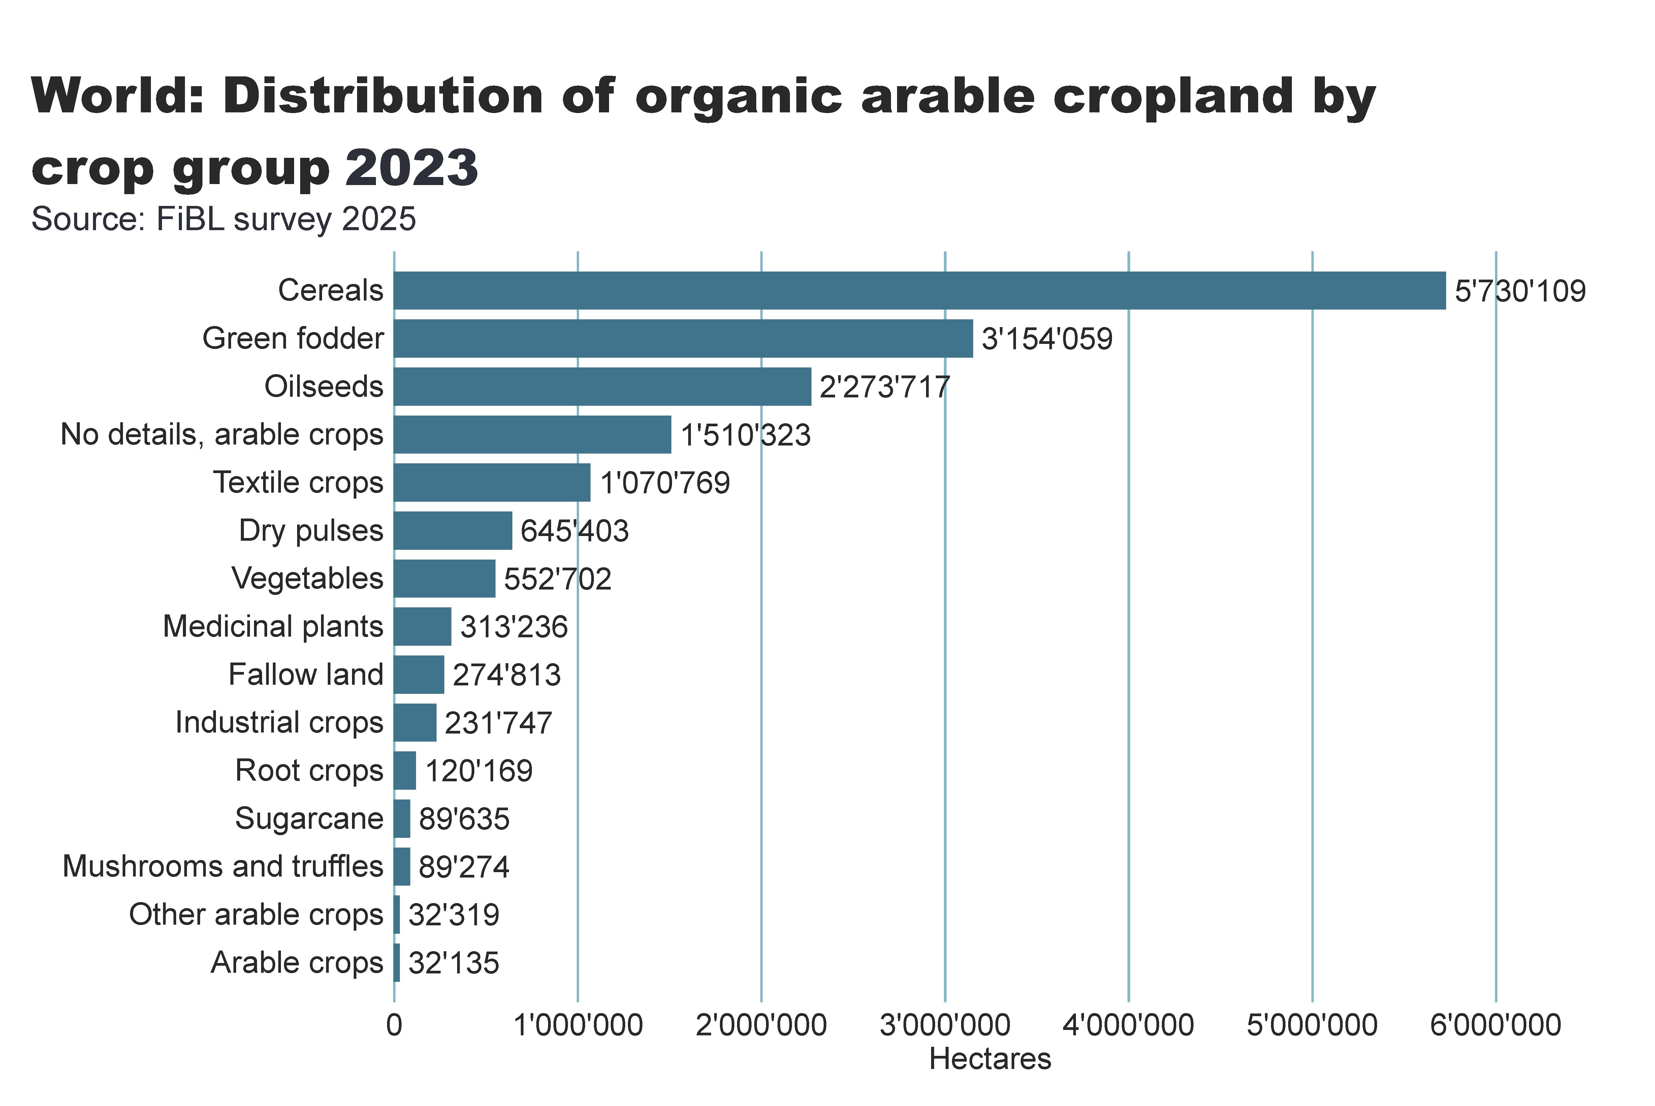
world_arable_land_distribution_by_group
Notes:
clusteredBarChart
No alt text provided
card
No alt text provided
textbox
No alt text provided

Slide 12
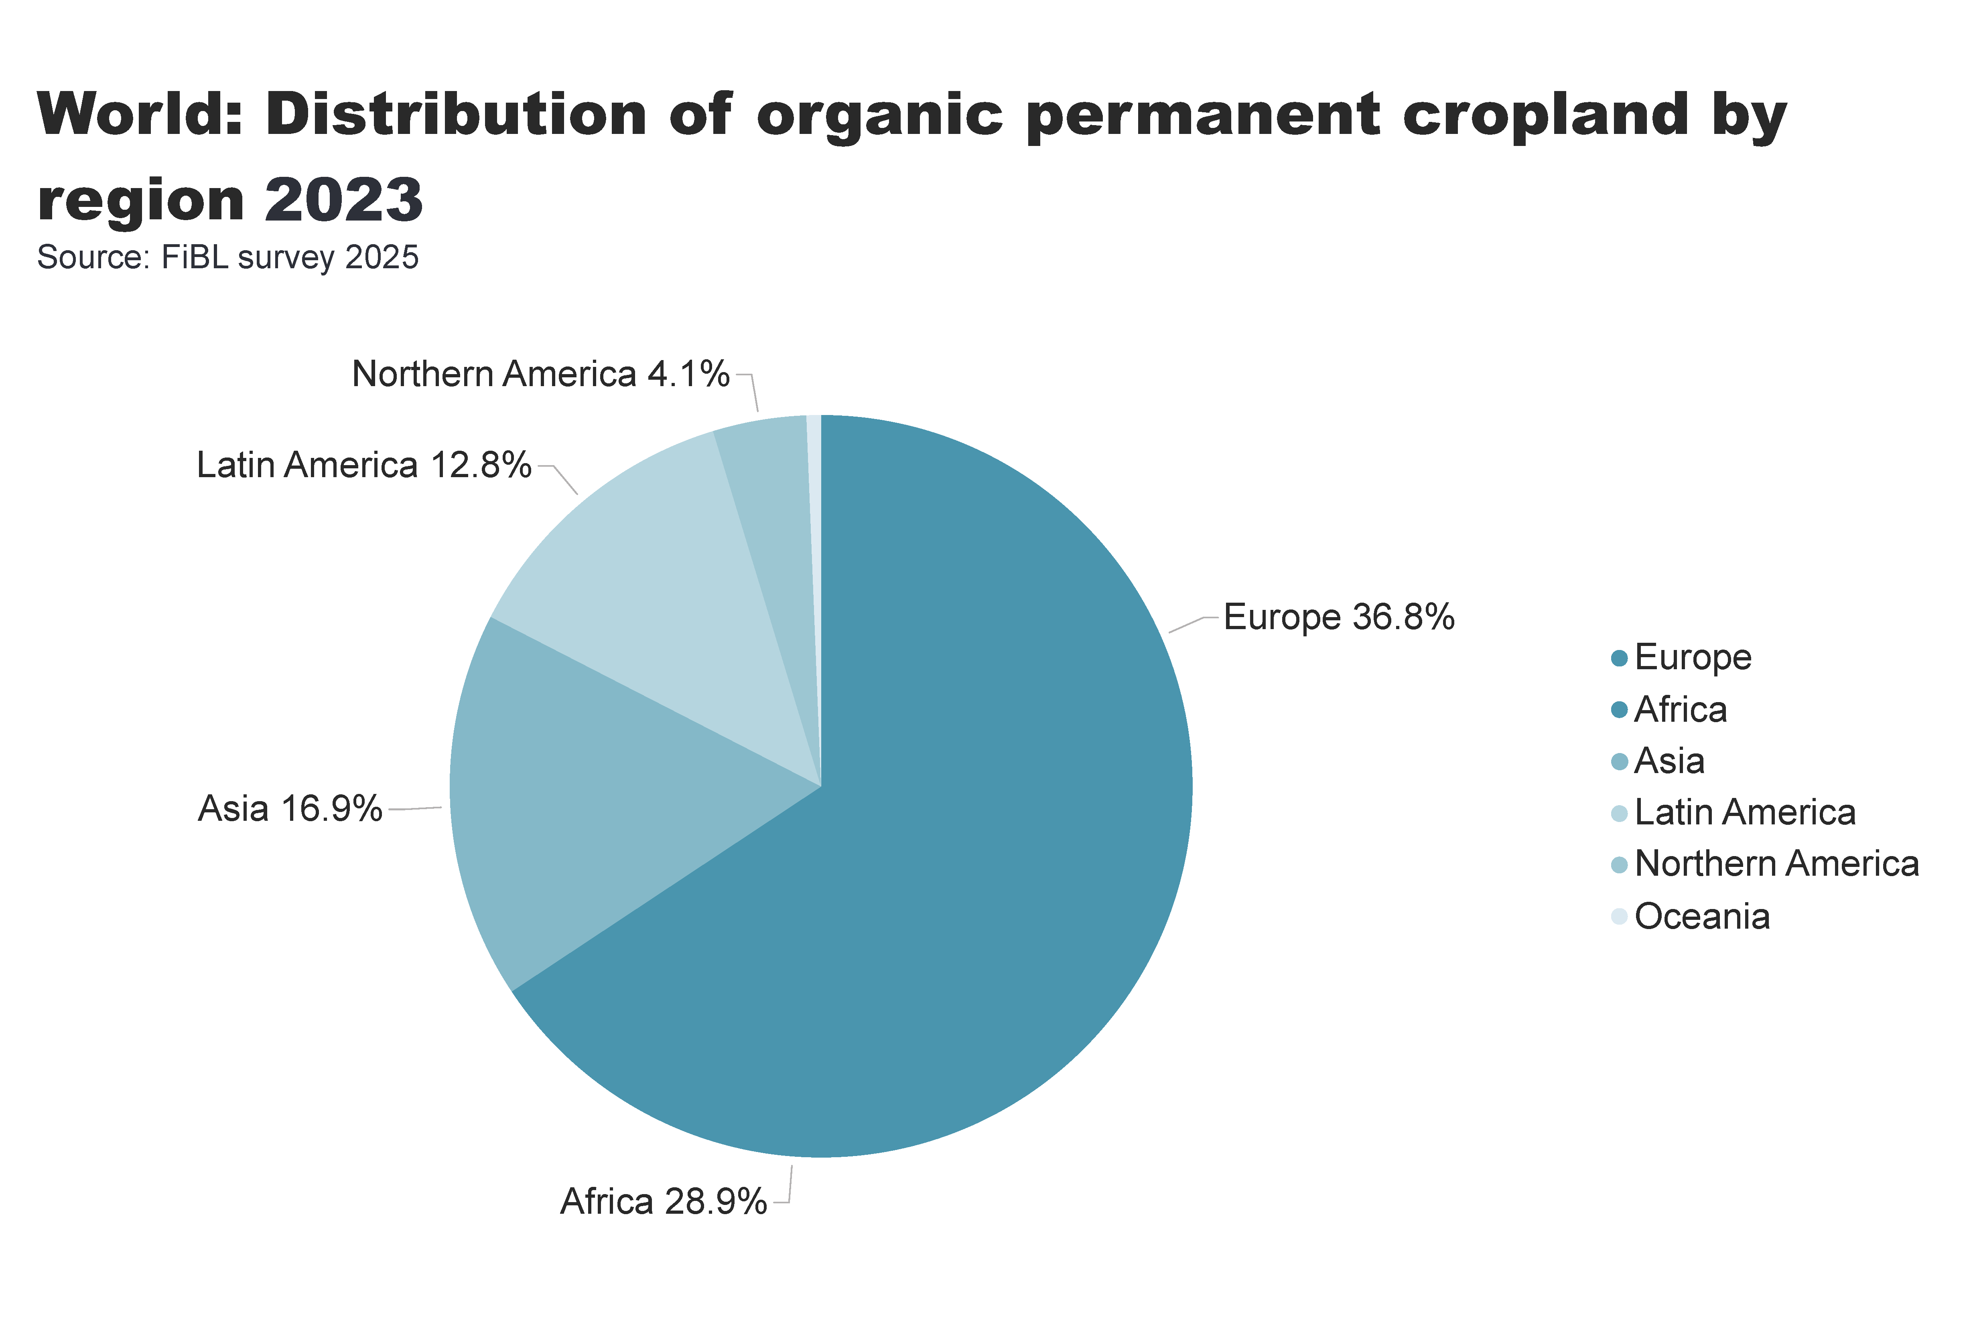
world_perm_land_distribution_by_country
Notes:
pieChart
No alt text provided
card
No alt text provided
textbox
No alt text provided

Slide 13
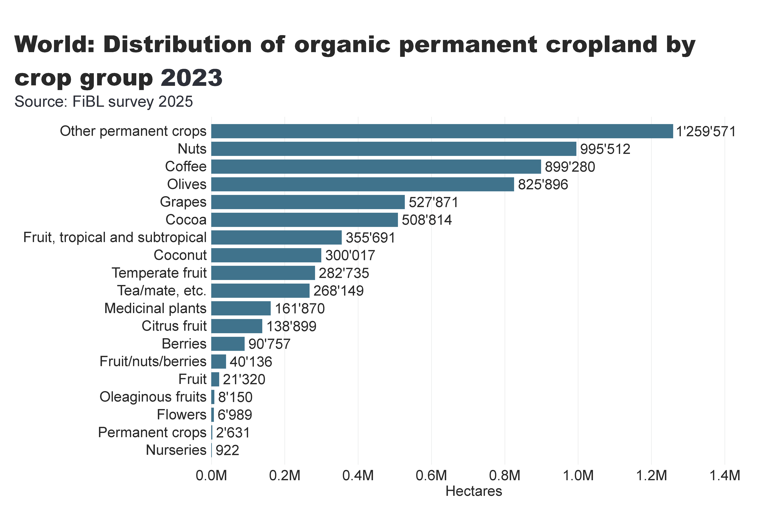
world_perm_land_distribution_by_group
Notes:
clusteredBarChart
No alt text provided
card
No alt text provided
textbox
No alt text provided

Slide 14
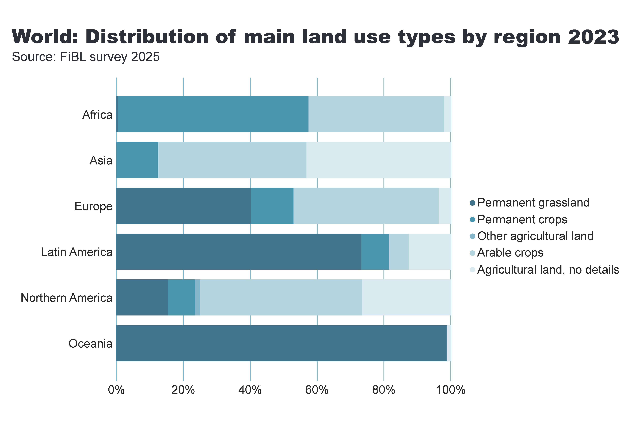
world_land_use_distribution_region
Notes:
hundredPercentStackedBarChart
No alt text provided
card
No alt text provided
textbox
No alt text provided

Slide 15
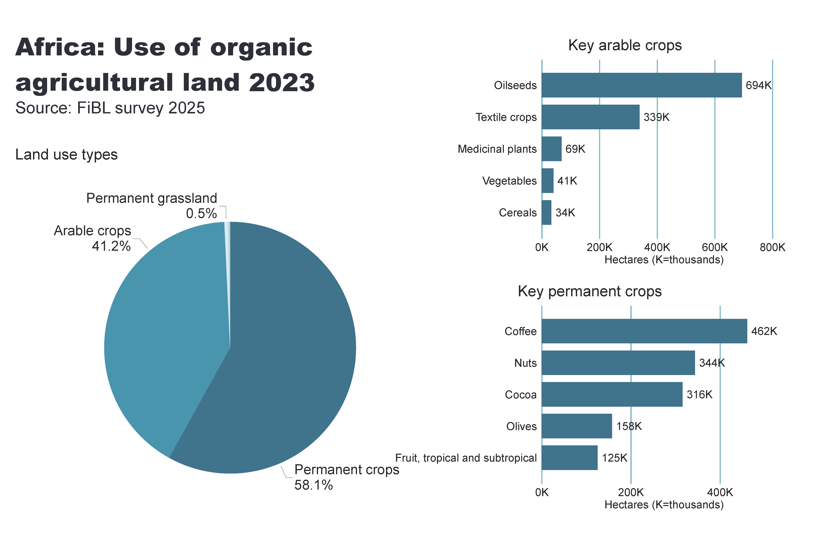
Africa_land_use
Notes:
Land use types
No alt text provided
card
No alt text provided
Key arable crops
No alt text provided
Key permanent crops
No alt text provided
textbox
No alt text provided

Slide 16
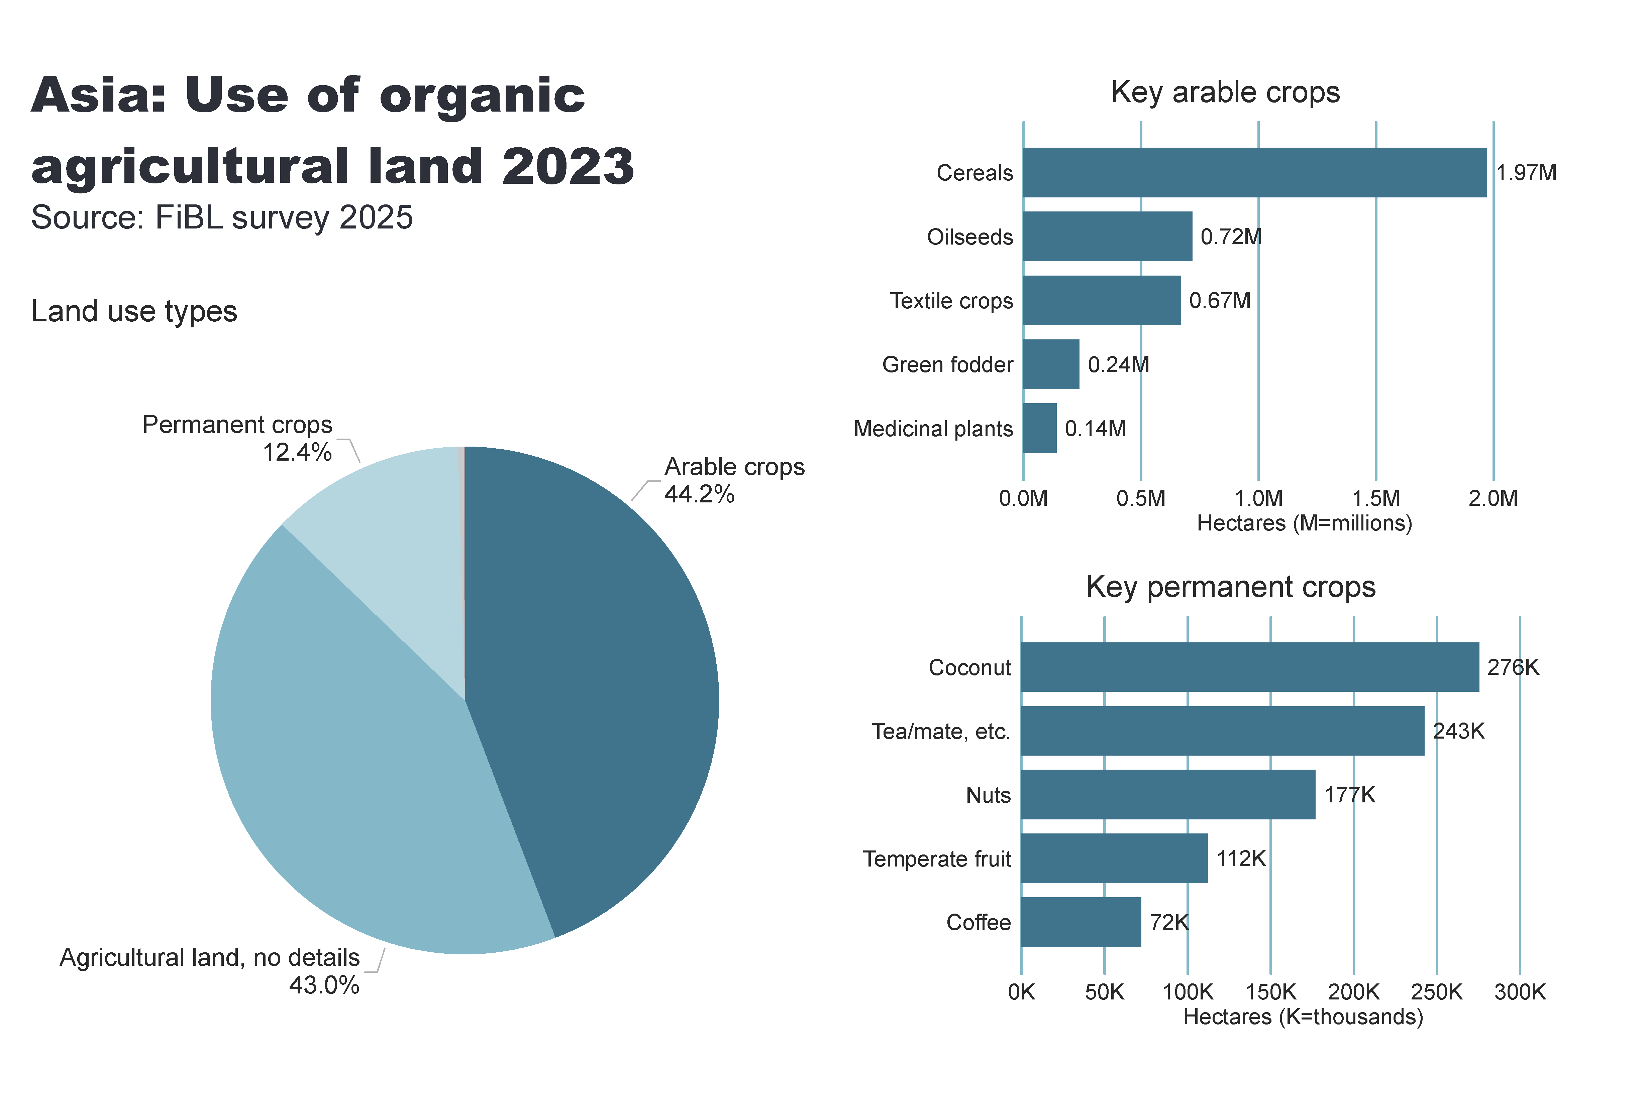
Asia_land_use
Notes:
Land use types
No alt text provided
card
No alt text provided
Key arable crops
No alt text provided
Key permanent crops
No alt text provided
textbox
No alt text provided

Slide 17
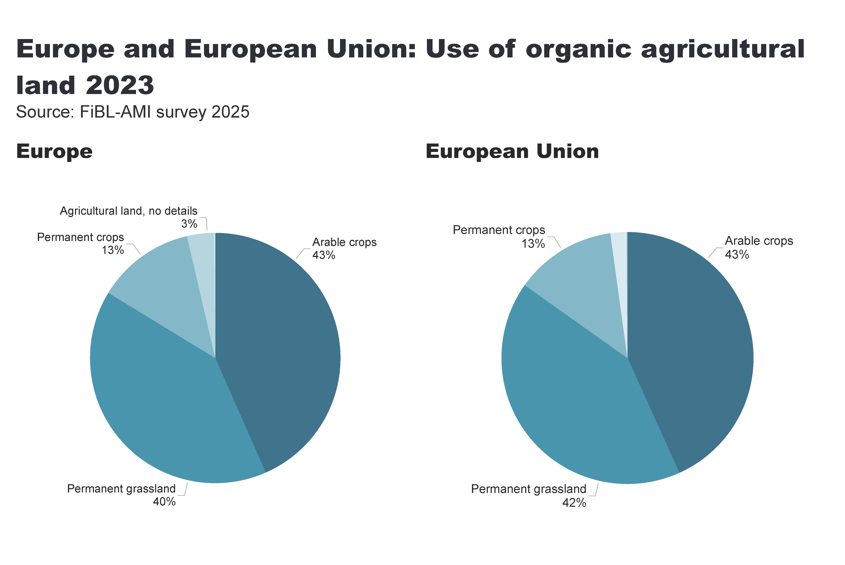
Europe_land_use
Notes:
European Union
No alt text provided
card
No alt text provided
Europe
No alt text provided
textbox
No alt text provided

Slide 18
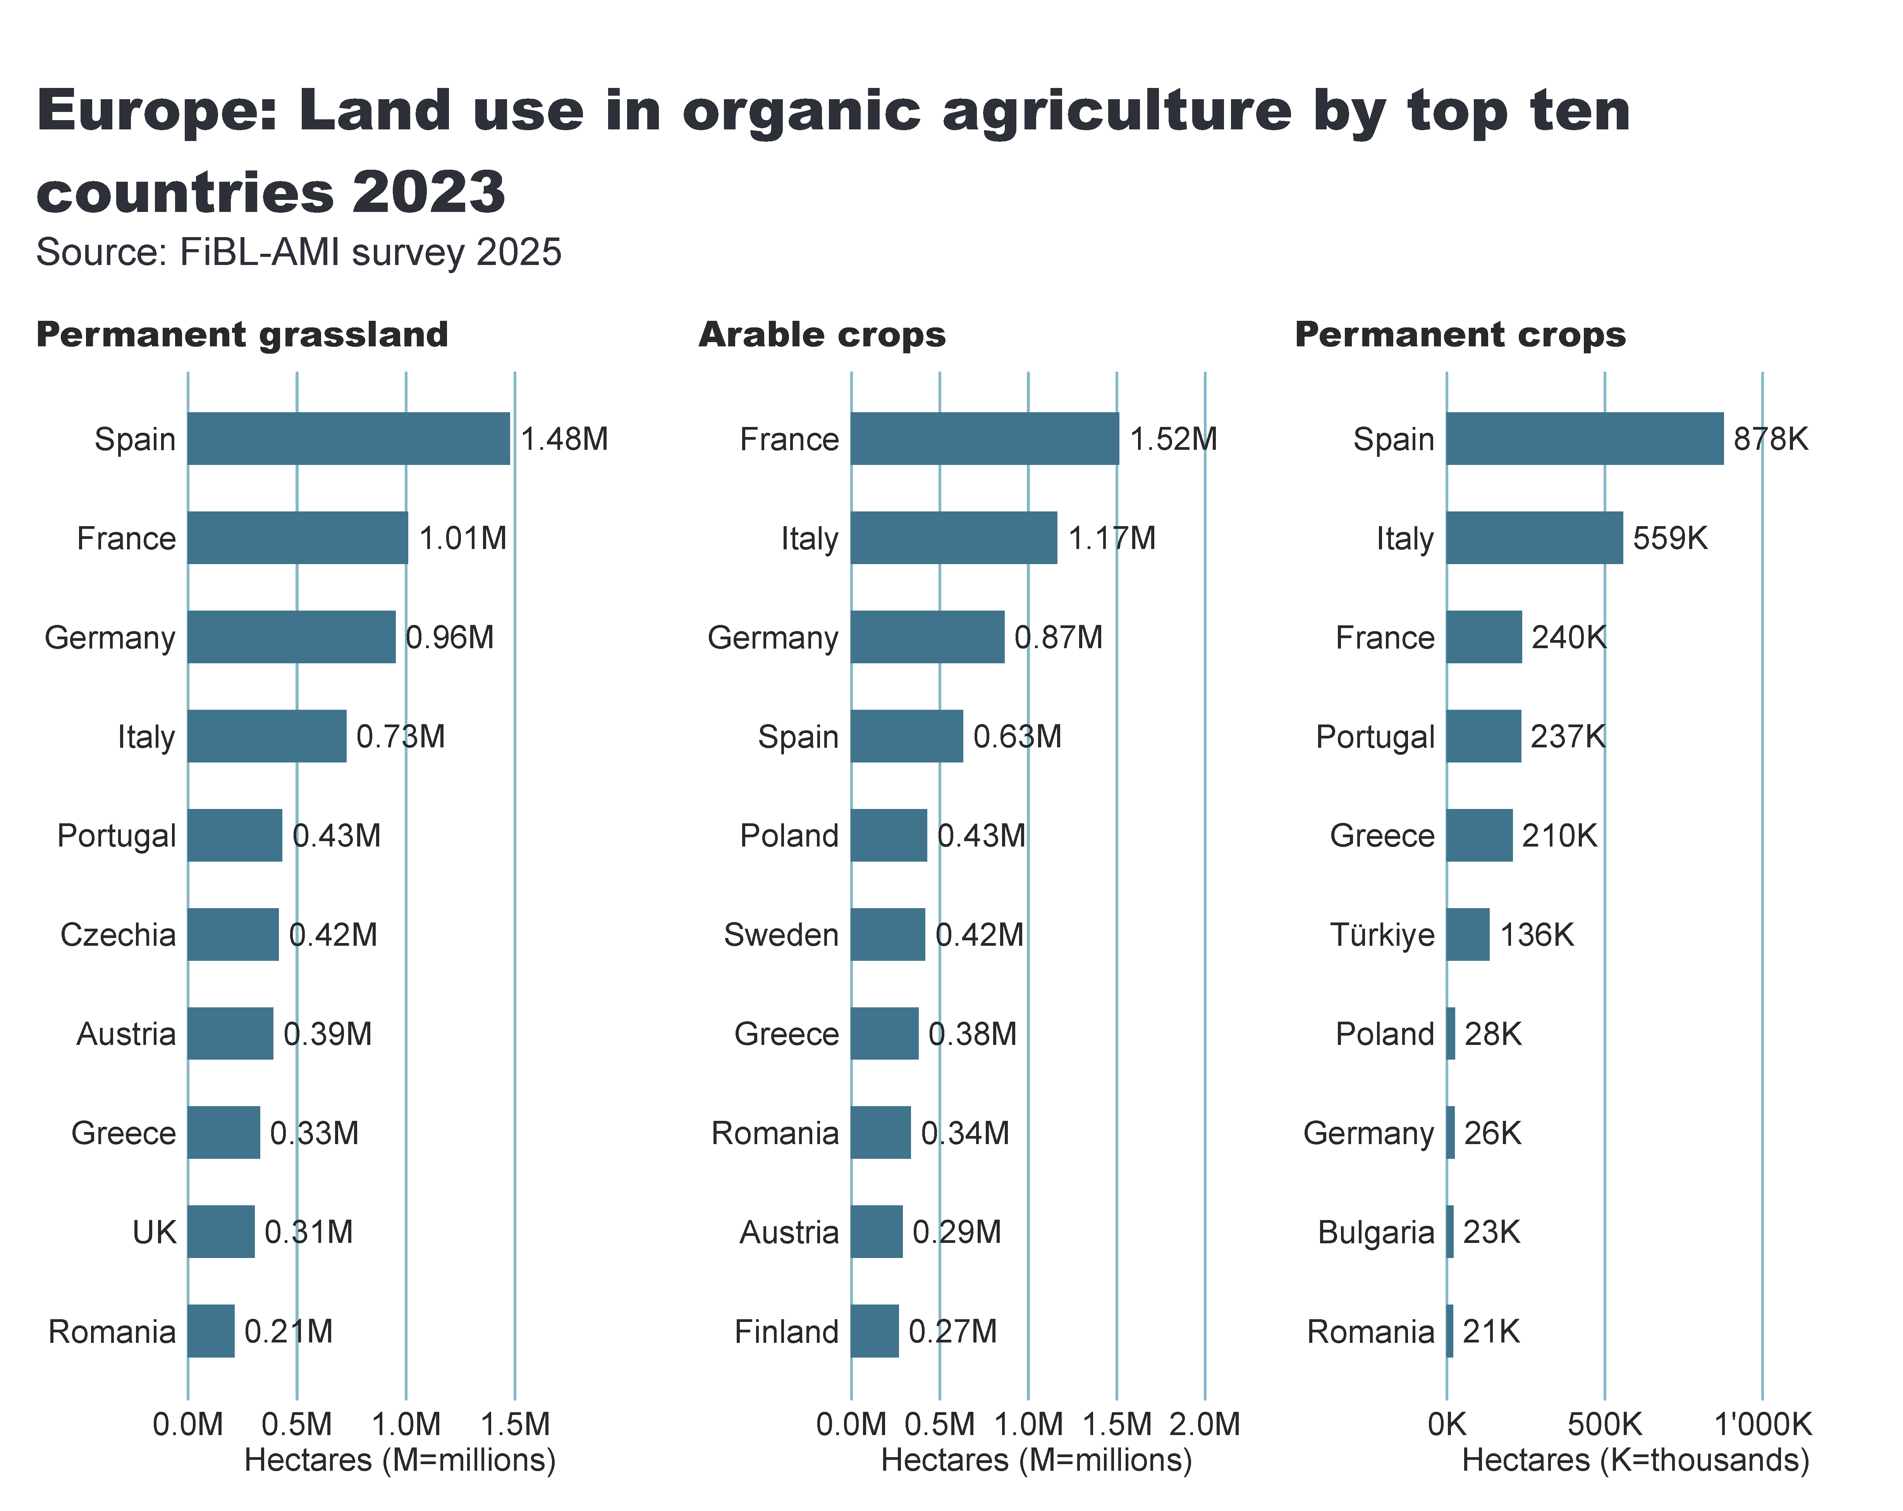
Europe_land_use_by_culture
Notes:
Arable crops
No alt text provided
textbox
No alt text provided
card
No alt text provided
Permanent crops
No alt text provided
Permanent grassland
No alt text provided

Slide 19
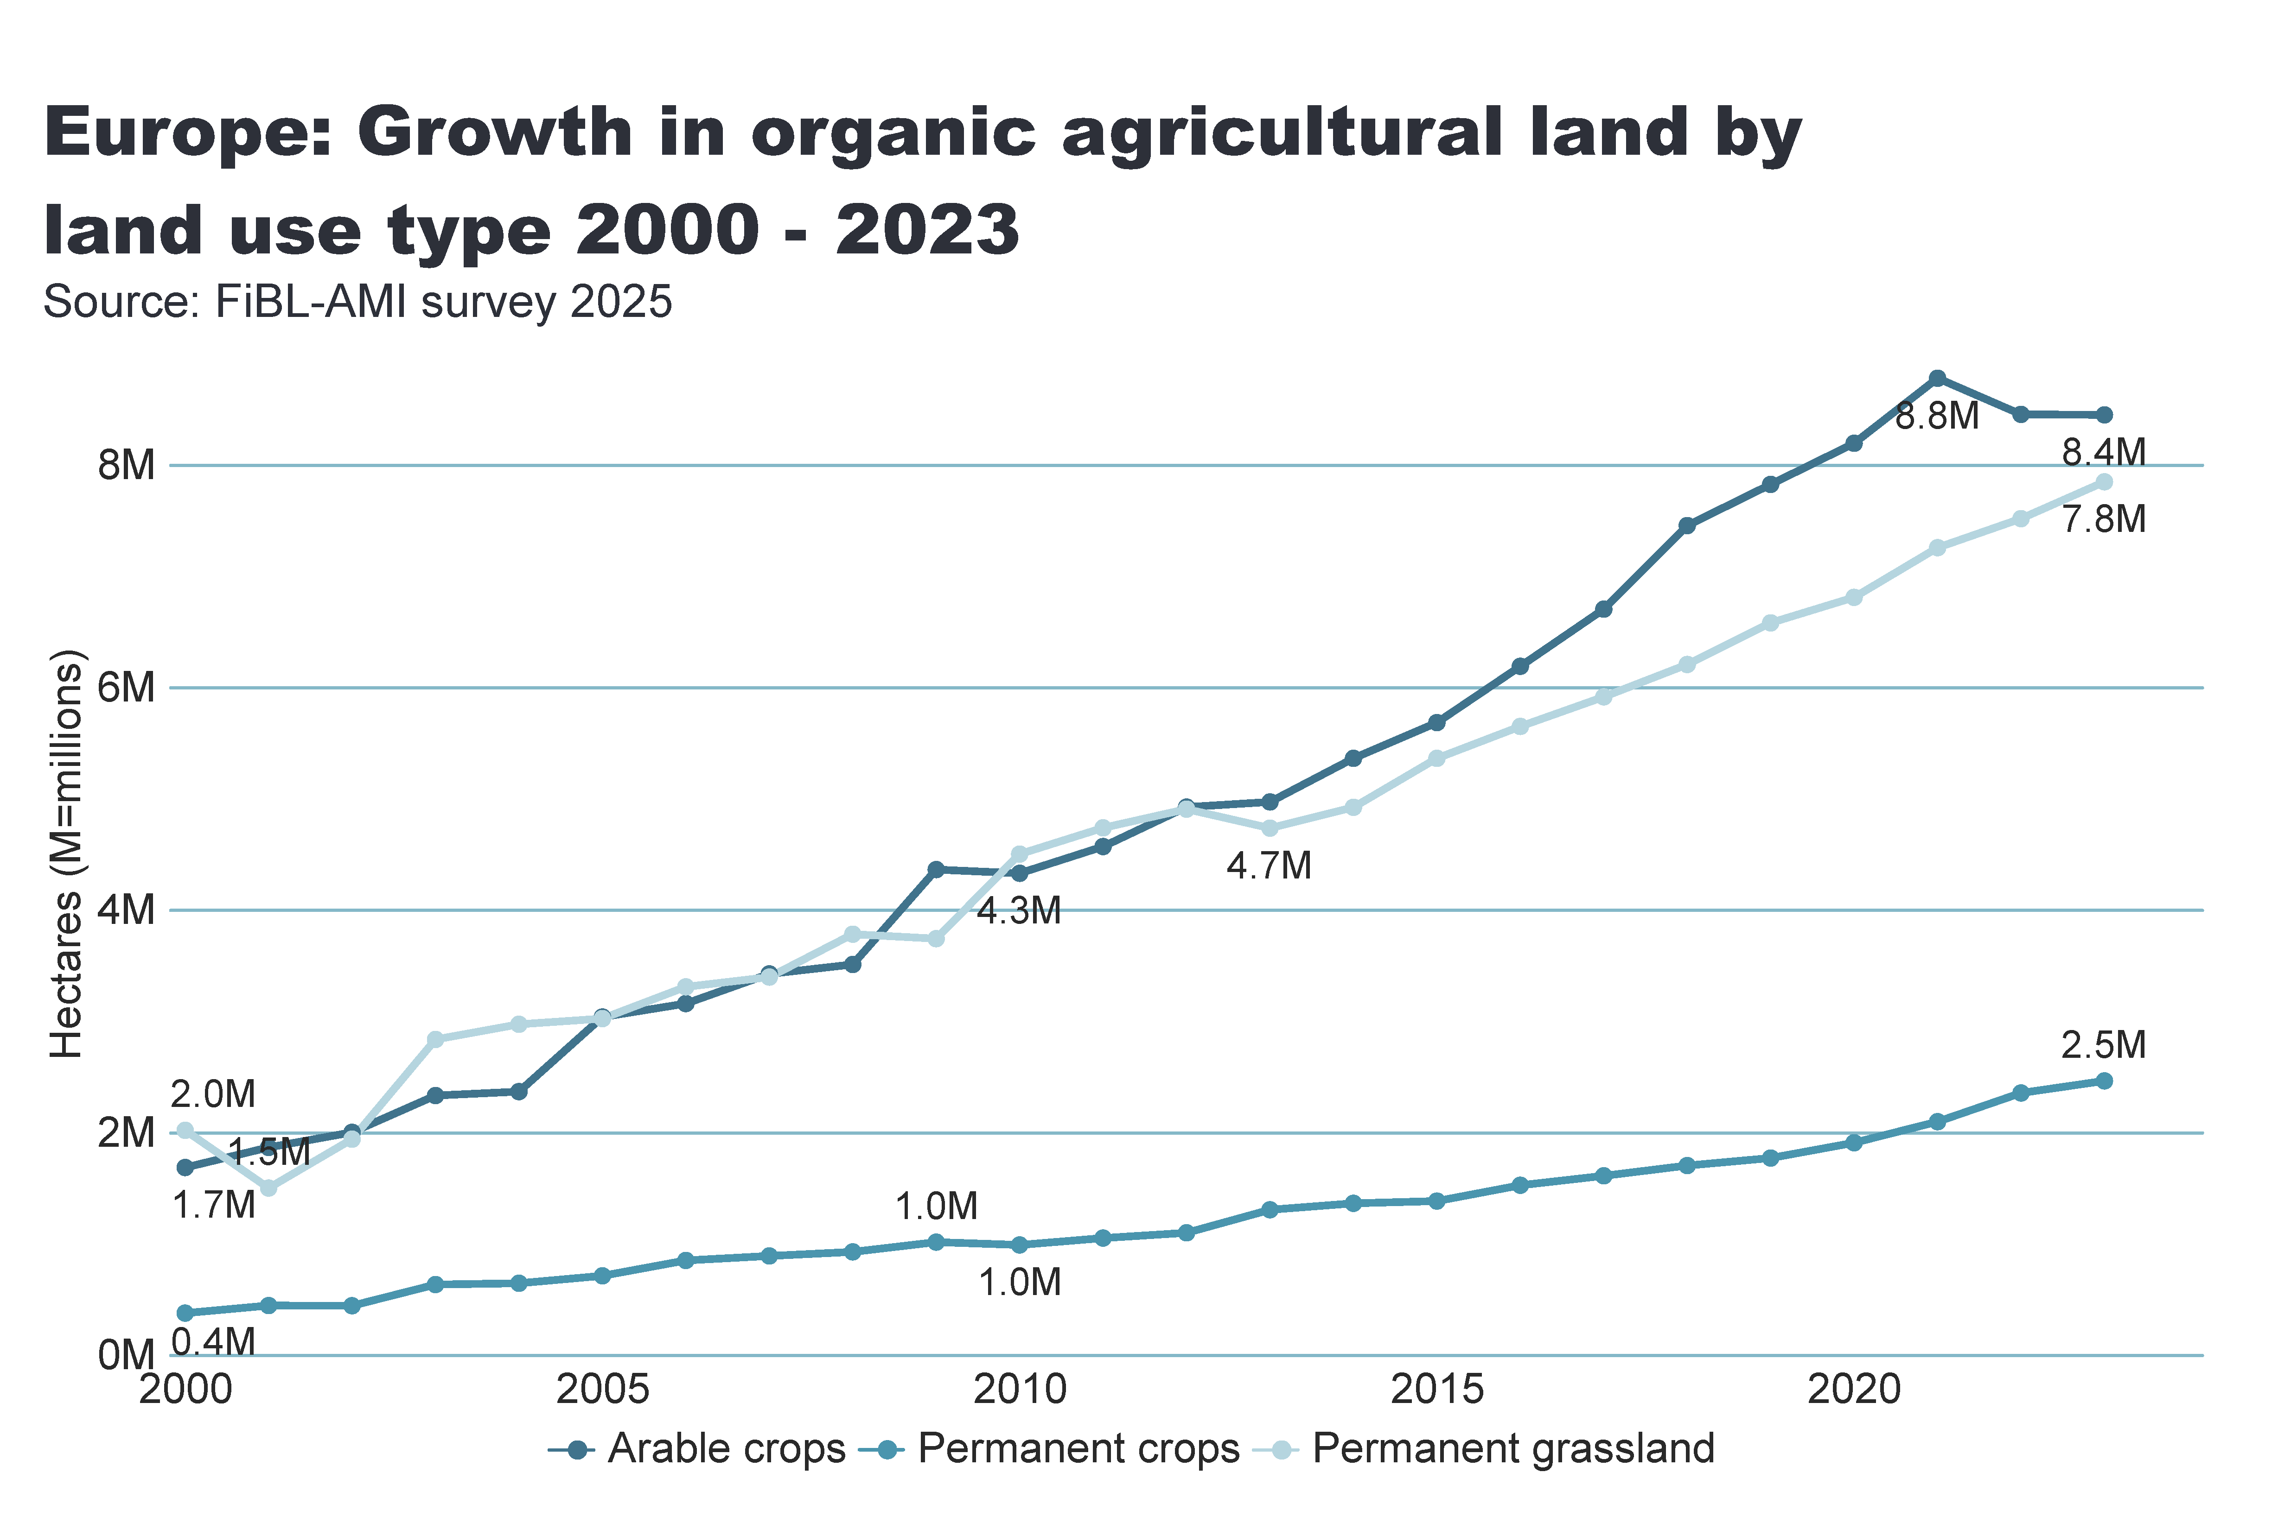
Europe_land_use_development
Notes:
Arable land
No alt text provided
textbox
No alt text provided
card
No alt text provided

Slide 20
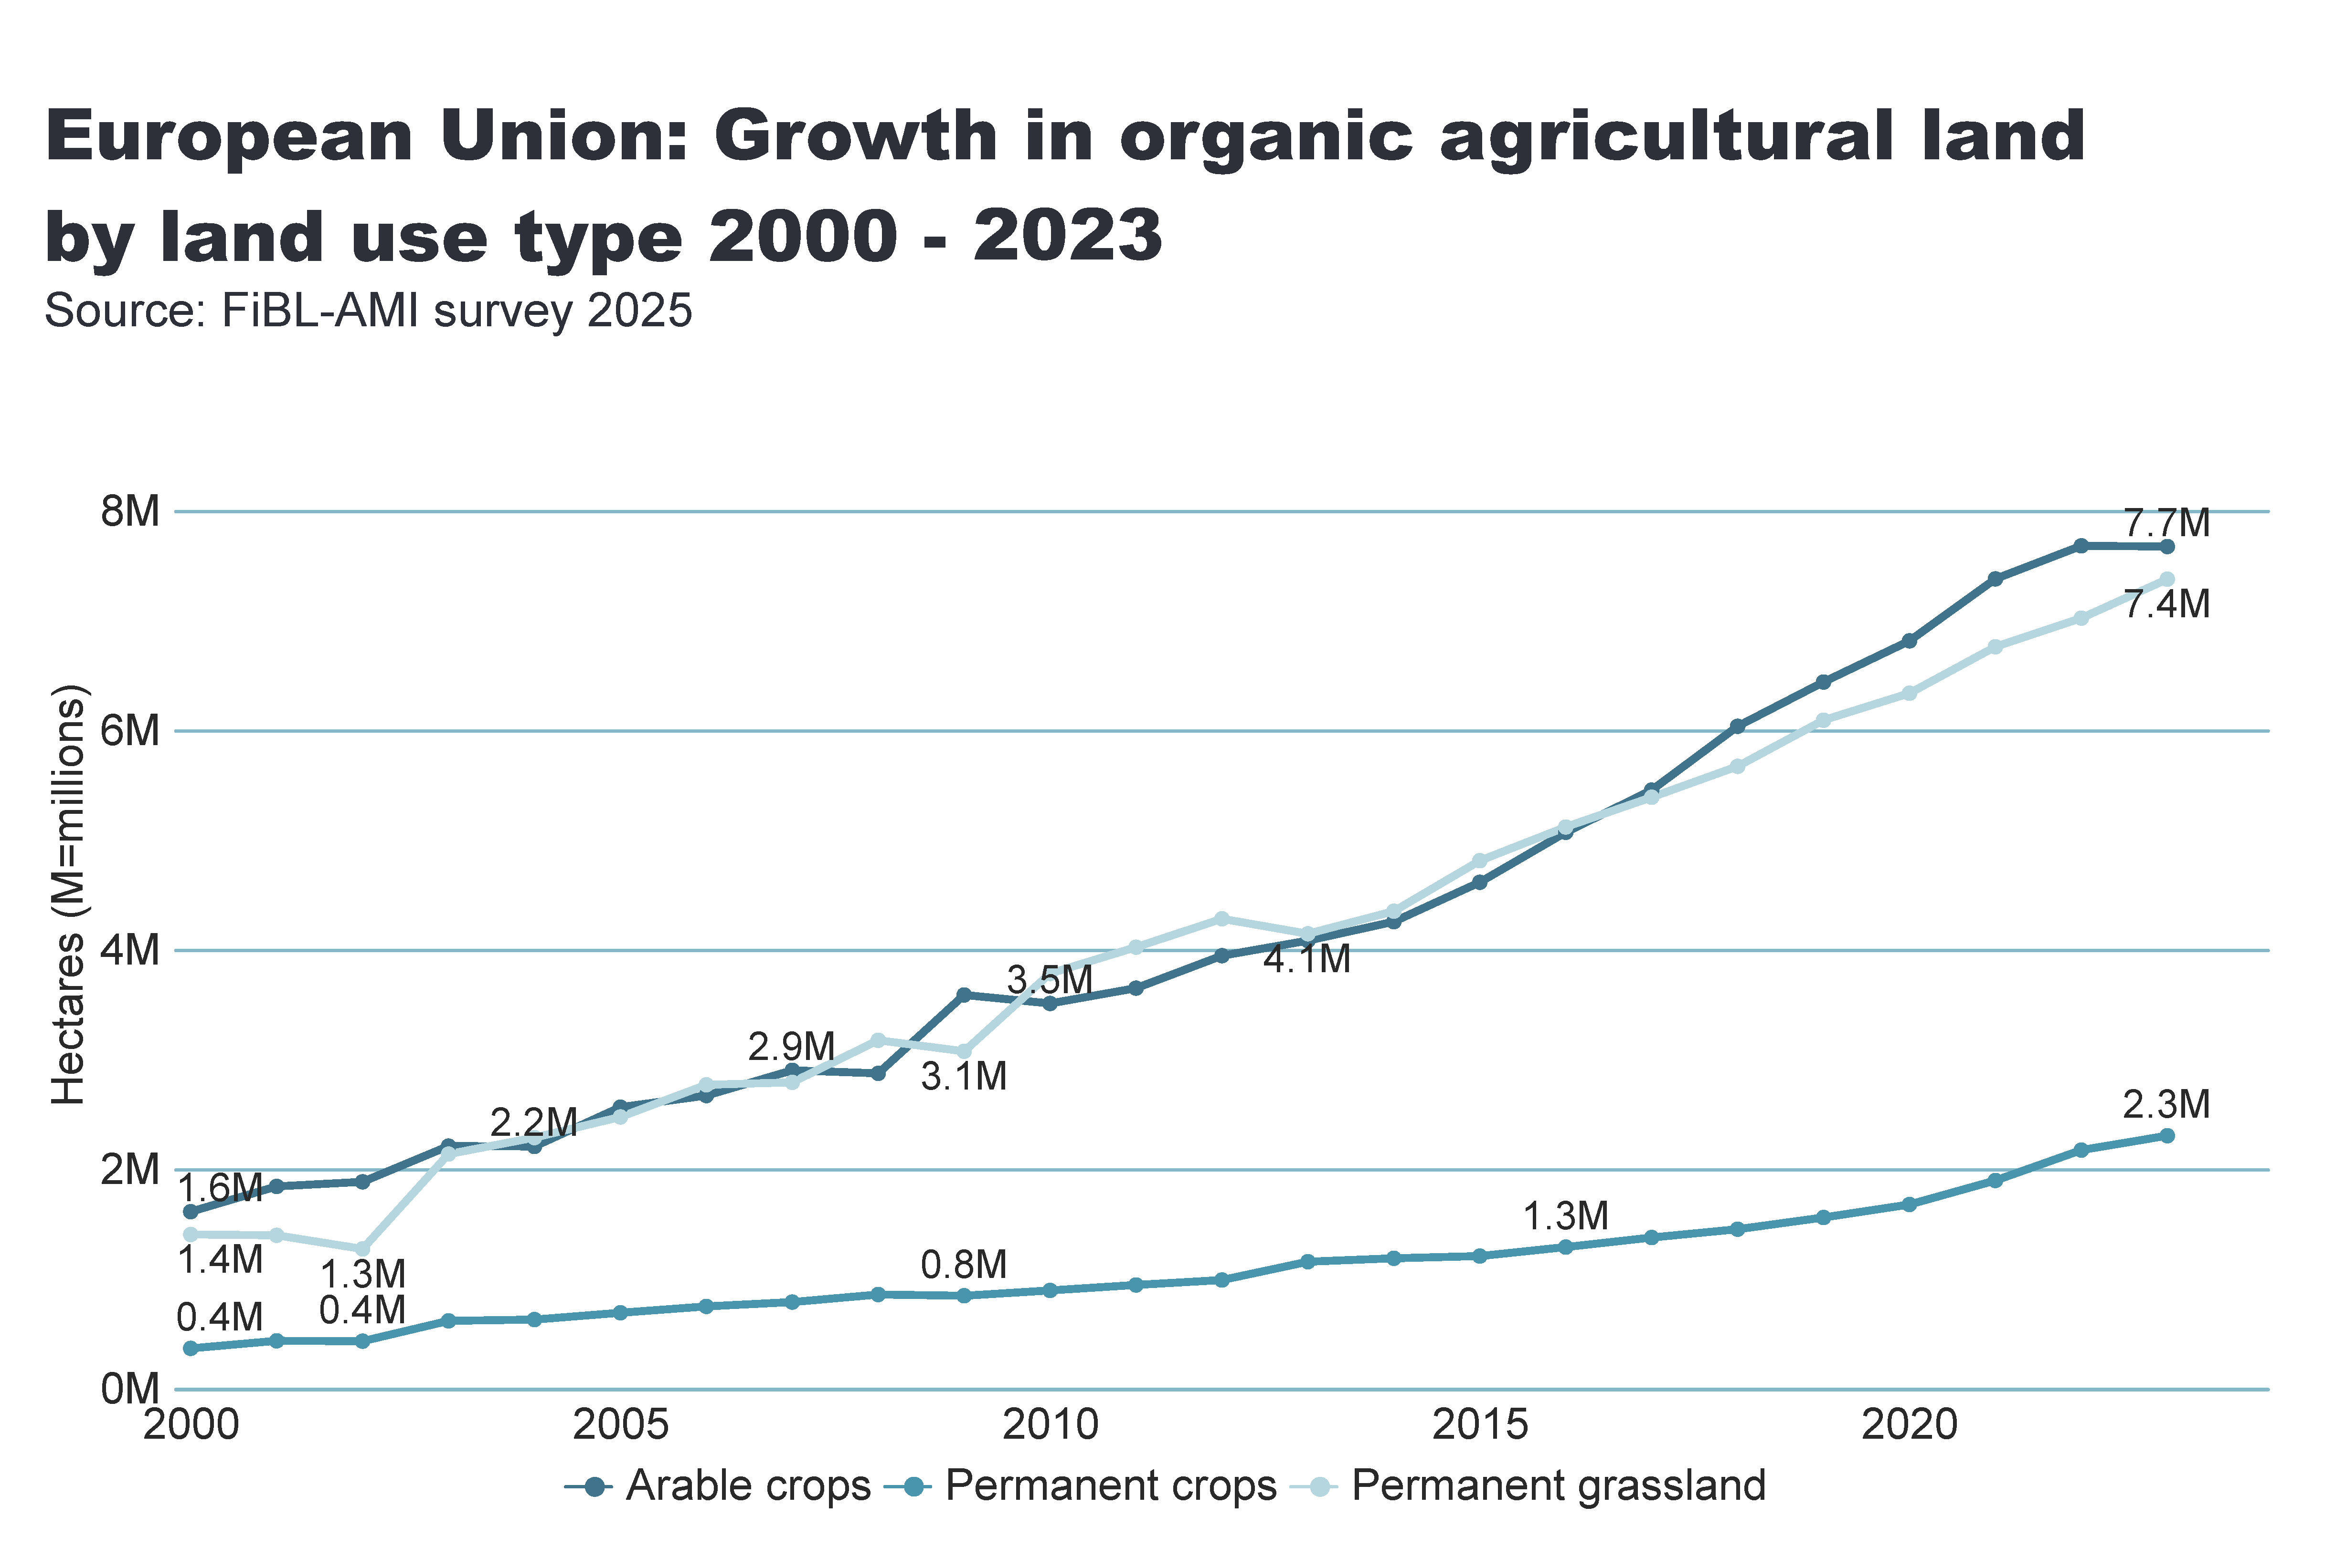
European_Union_land_use_by_culture
Notes:
Arable land
No alt text provided
textbox
No alt text provided
card
No alt text provided

Slide 21
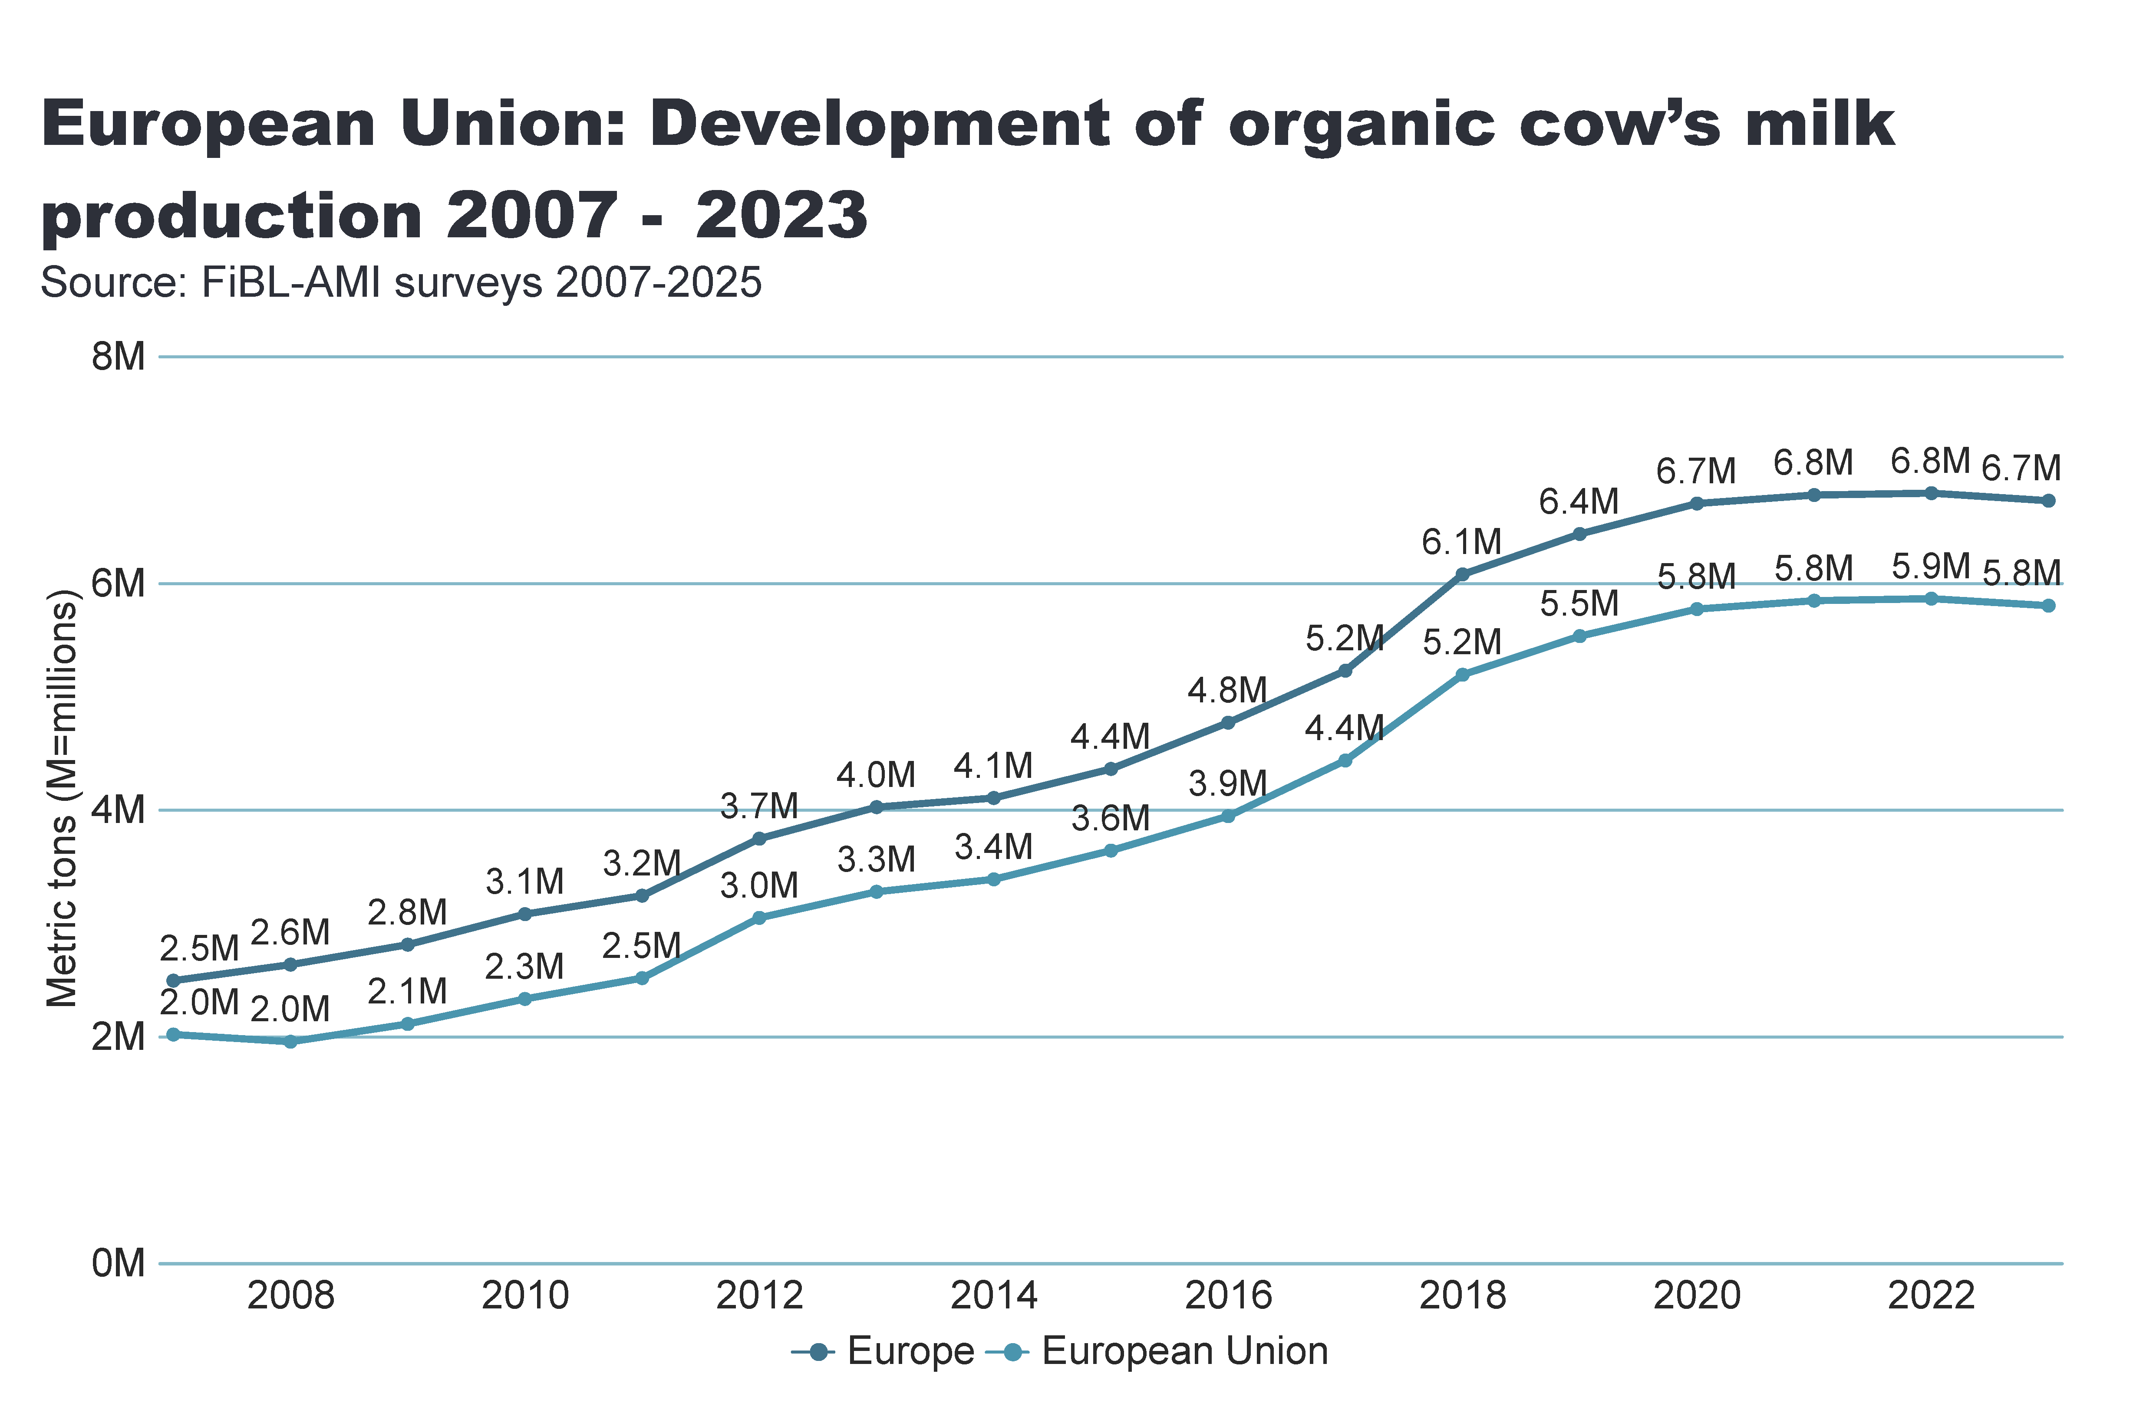
milk
Notes:
Arable land
No alt text provided
textbox
No alt text provided
card
No alt text provided

Slide 22
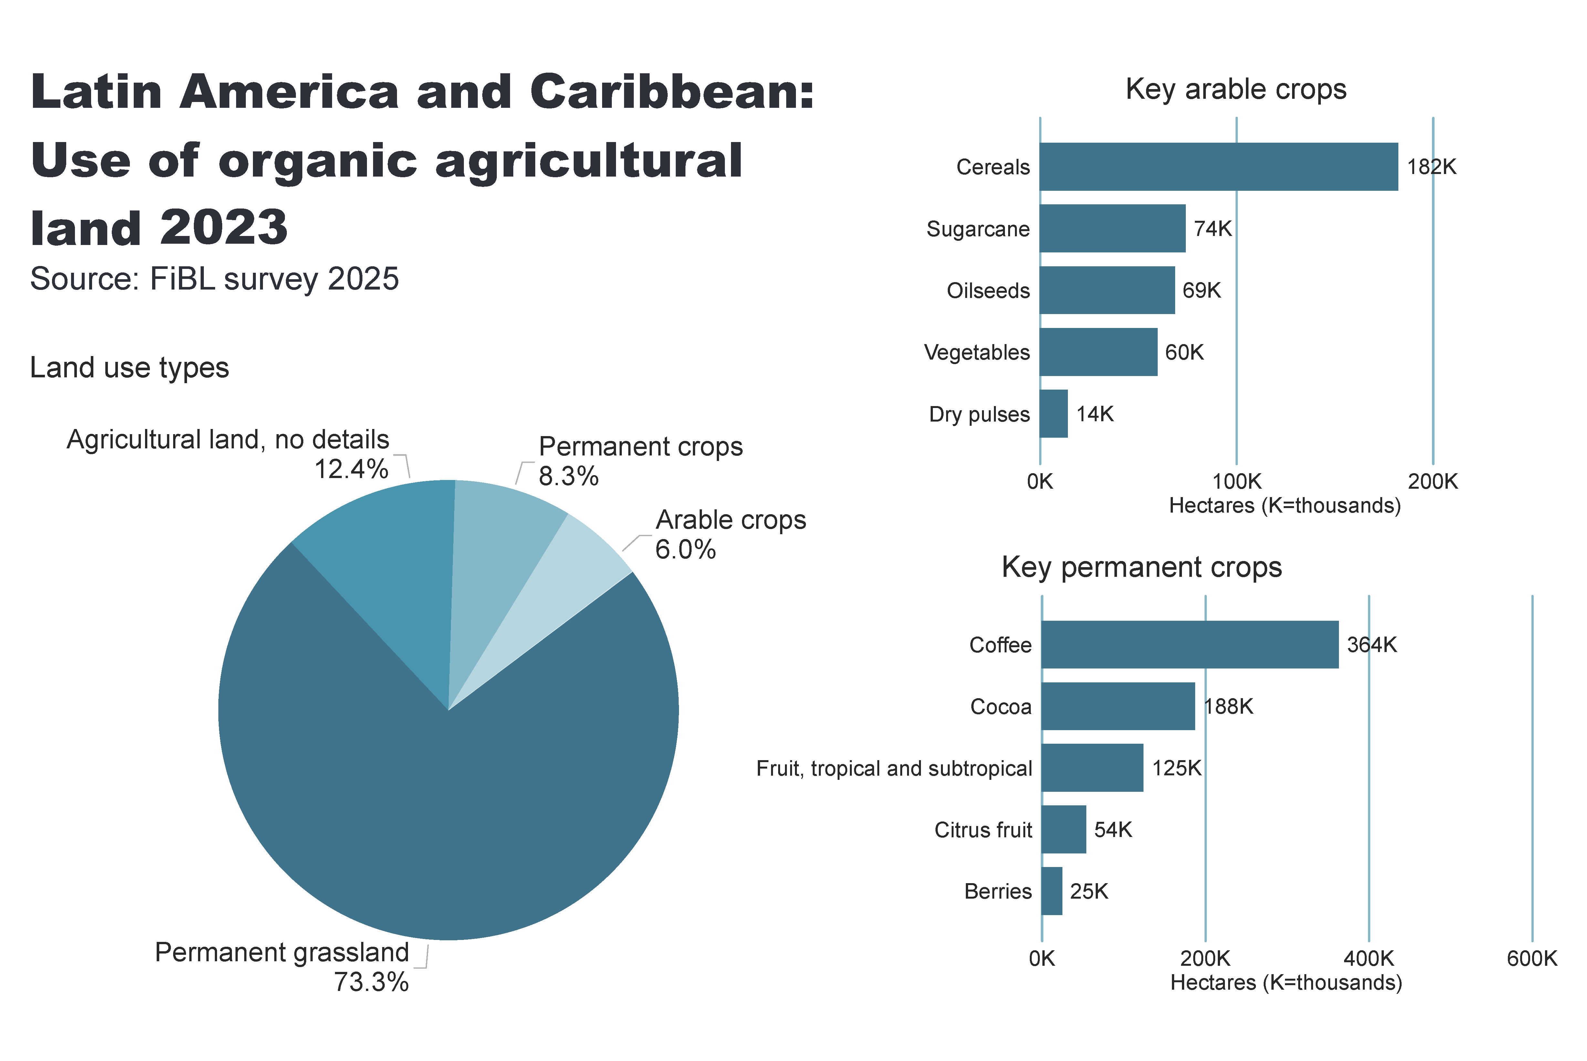
LA_land_use
Notes:
Land use types
No alt text provided
card
No alt text provided
Key arable crops
No alt text provided
Key permanent crops
No alt text provided
textbox
No alt text provided

Slide 23
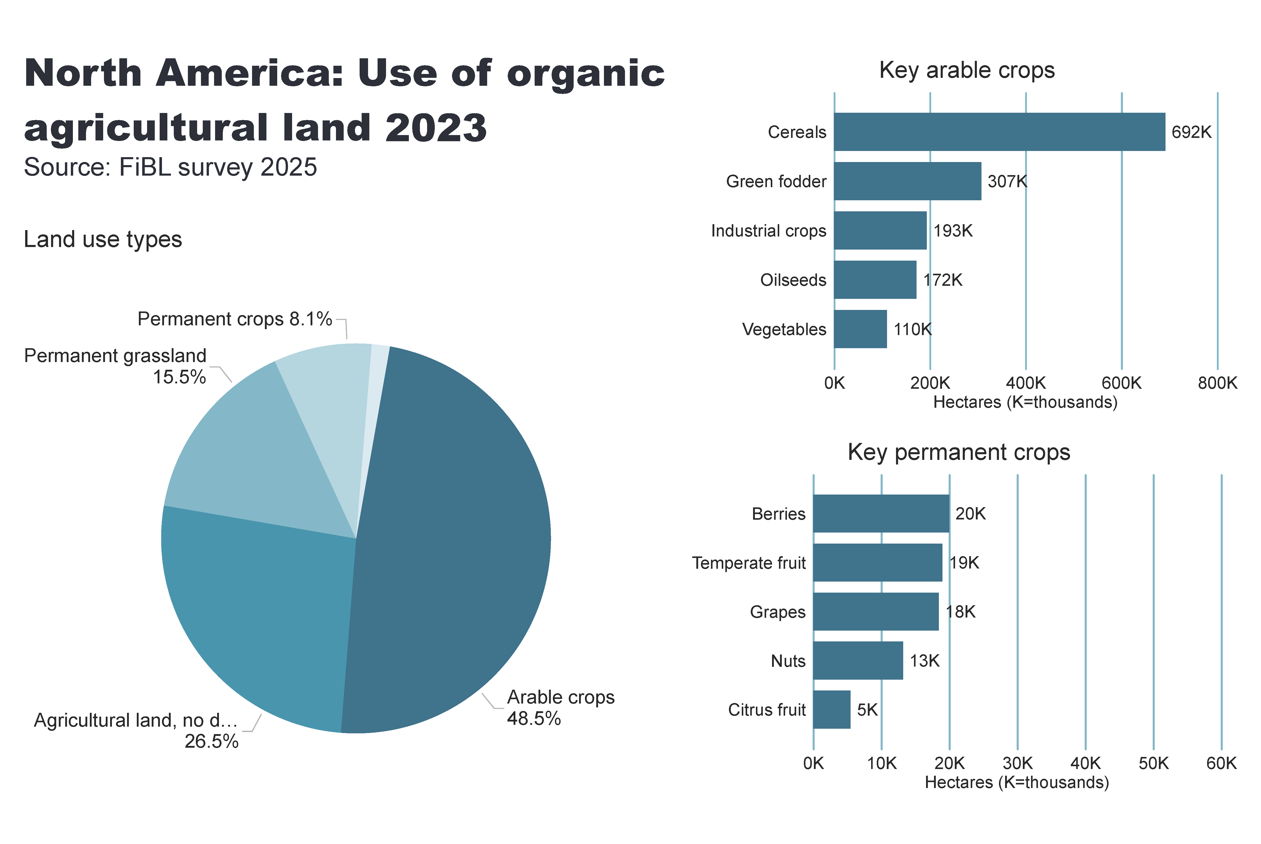
NA_land_use
Notes:
Land use types
No alt text provided
card
No alt text provided
Key arable crops
No alt text provided
Key permanent crops
No alt text provided
textbox
No alt text provided

Slide 24
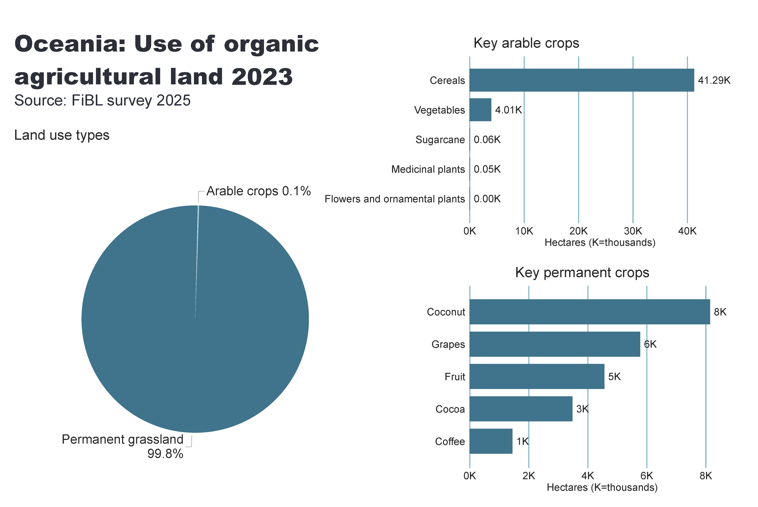
Oceania_land_use
Notes:
Land use types
No alt text provided
card
No alt text provided
Key arable crops
No alt text provided
Key permanent crops
No alt text provided
textbox
No alt text provided

Slide 25
Further organic areas: Wild collection and aquaculture
A collection area (including beekeeping) of 30.2 million hectares was reported in 2023.
The organic wild collection areas are concentrated in Europe, Africa, Asia and Latin America.
The countries with the largest areas are Finland (mainly berries), followed by China and India.
Nuts and medicinal and aromatic plants play the most important role.
There were almost 2.5 million organic beehives in 2023, representing 2.4 percent of the world’s beehives.
A production volume of more than 510’000 metric tons of organic aquaculture was reported in 2023.

Slide 26
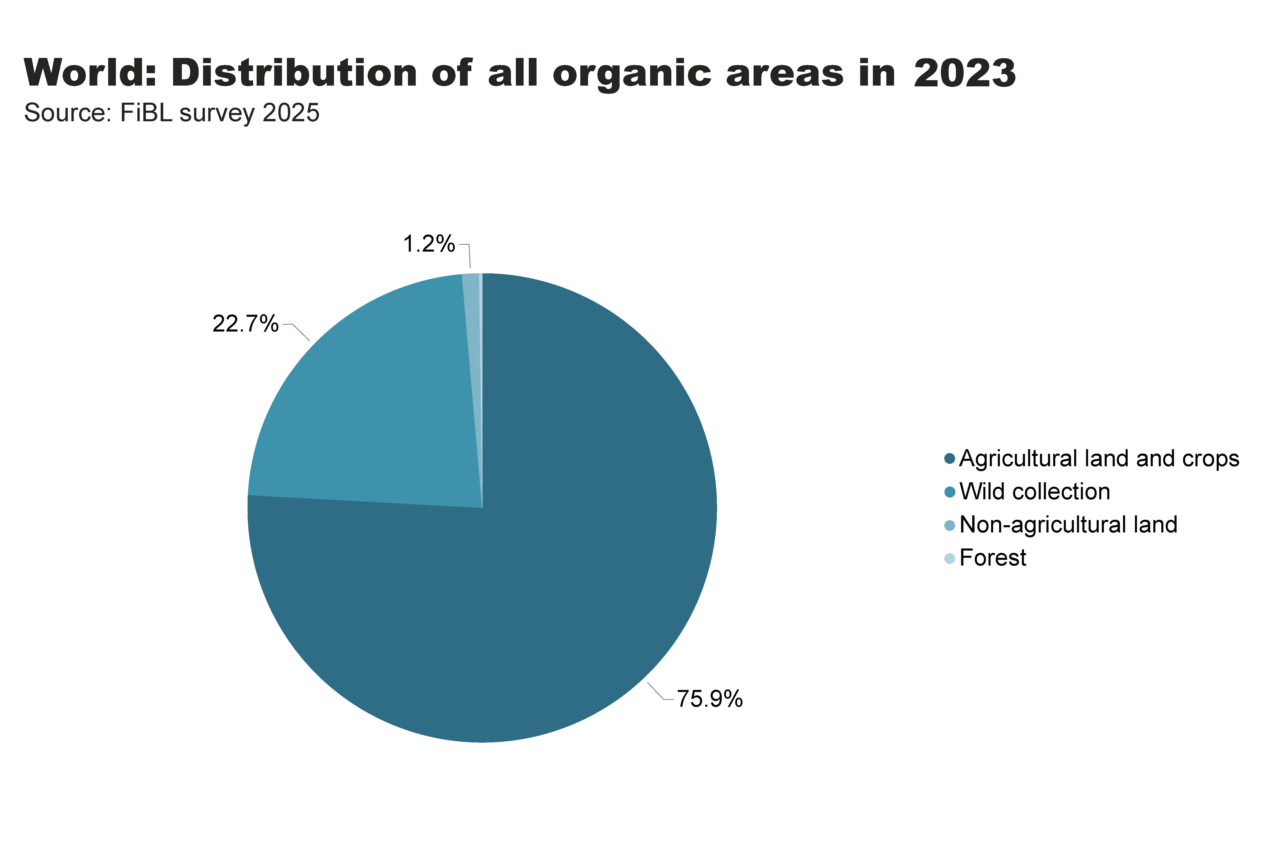
world_land_all_areas
Notes:
textbox
No alt text provided
card
No alt text provided
pieChart
No alt text provided

Slide 27
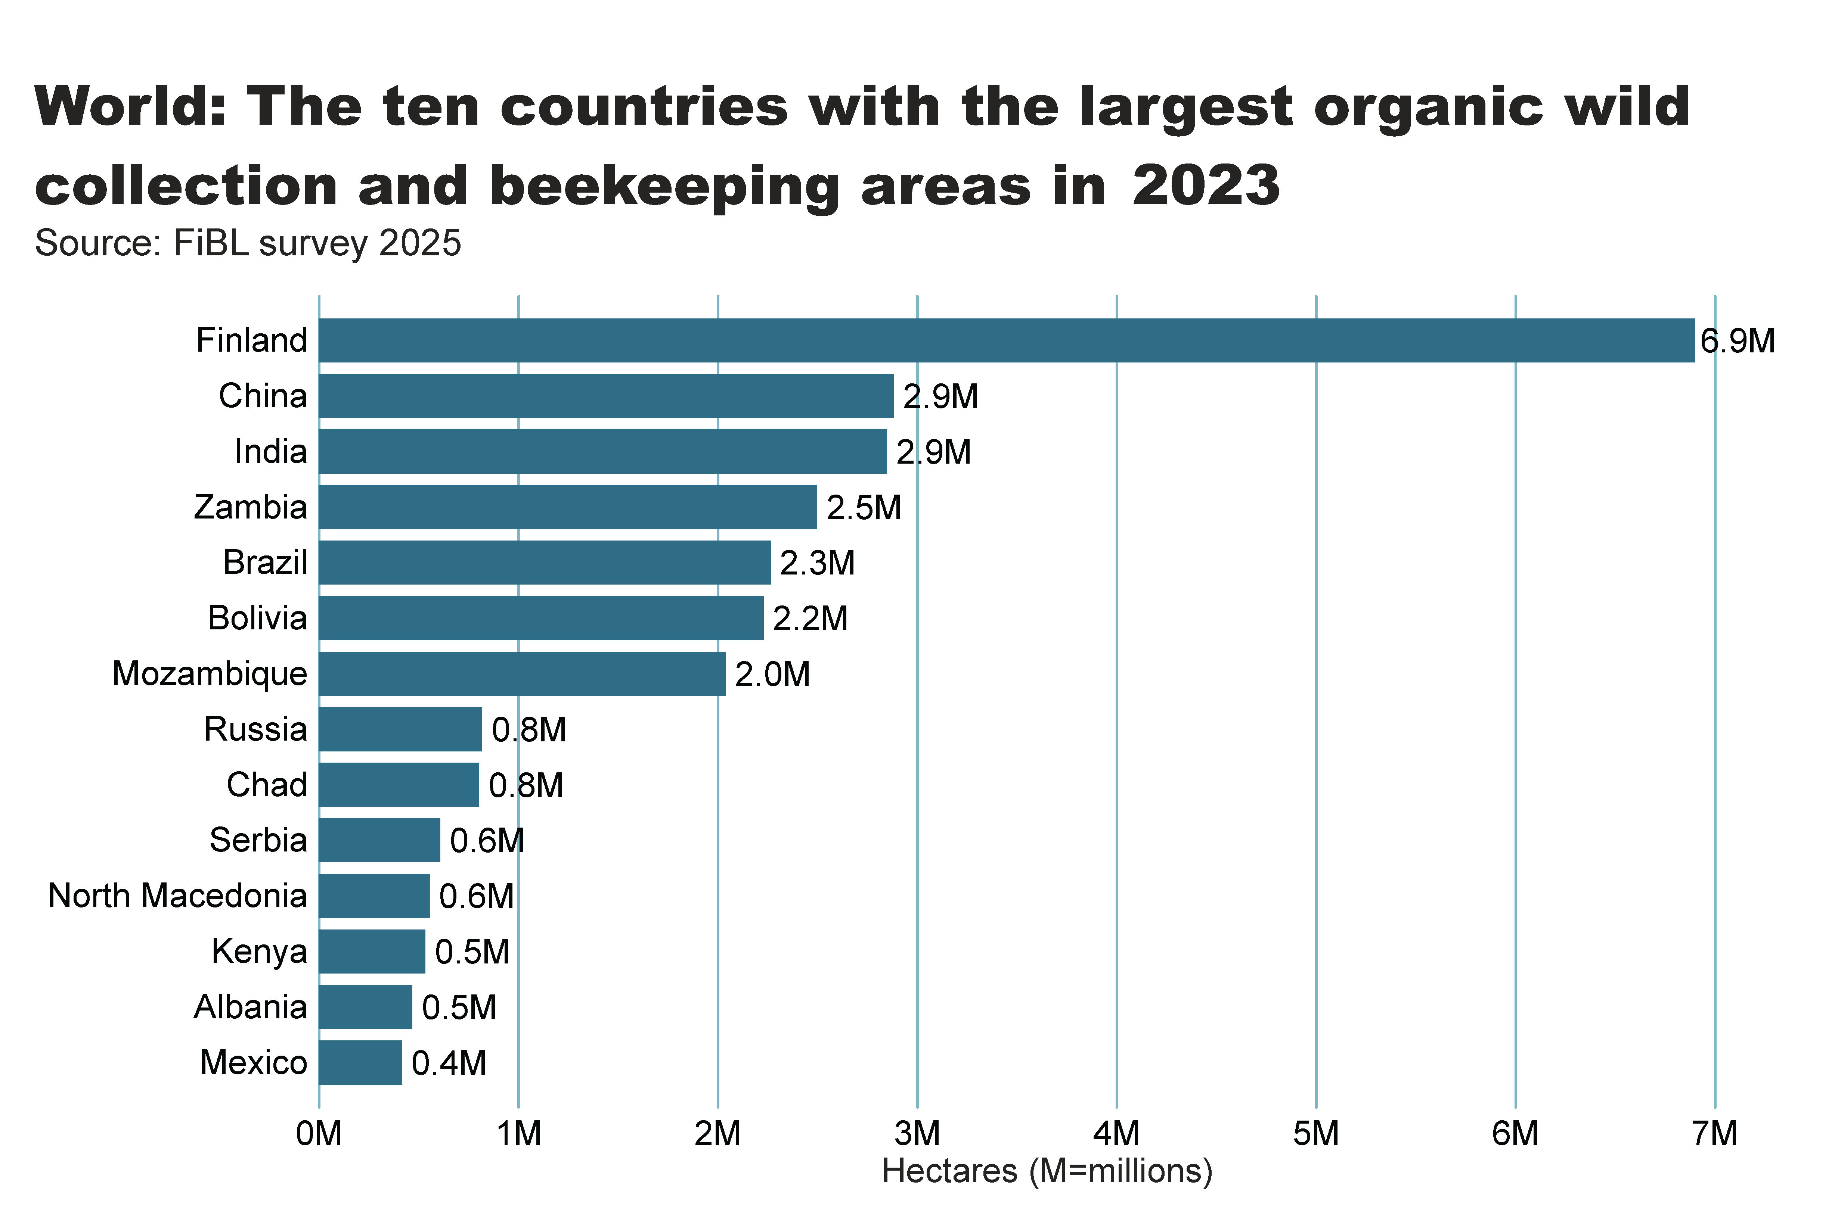
wild_ collection_by_country
Notes:
textbox
No alt text provided
clusteredBarChart
No alt text provided
card
No alt text provided

Slide 28
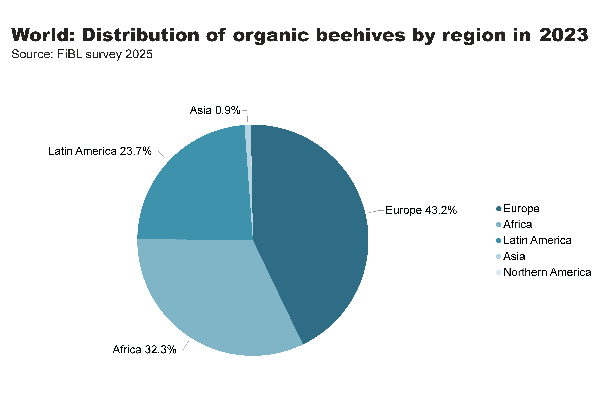
beehives_by_region
Notes:
textbox
No alt text provided
pieChart
No alt text provided
card
No alt text provided

Slide 29
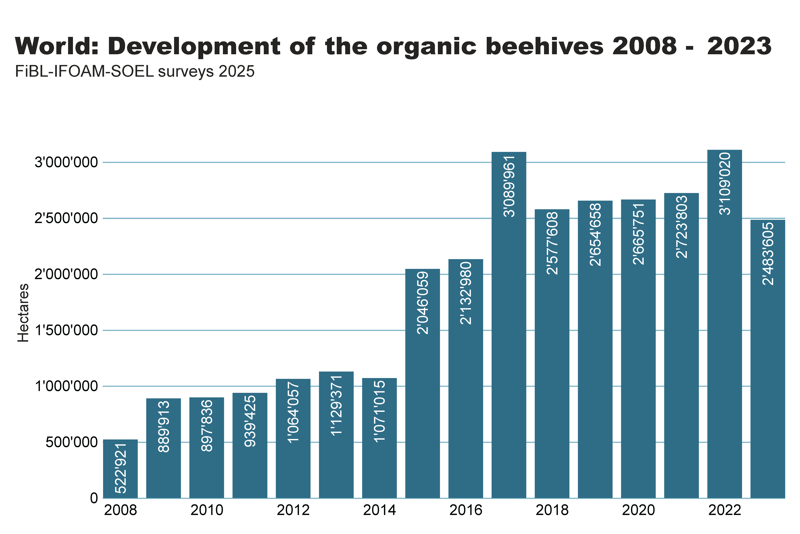
beehives_by country
Notes:
textbox
No alt text provided
clusteredColumnChart
No alt text provided
card
No alt text provided

Slide 30
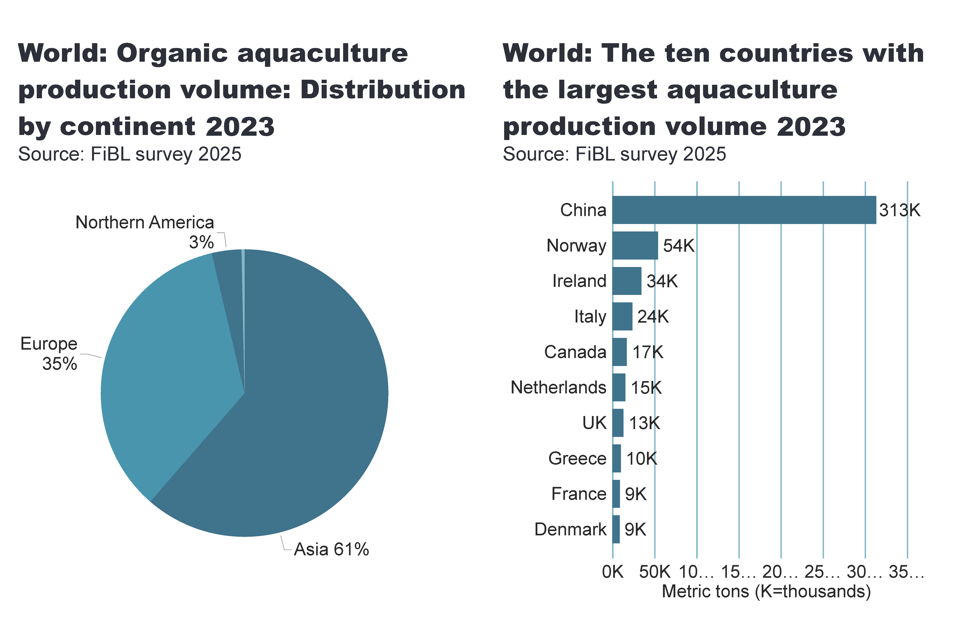
aquaculture_country
Notes:
pieChart
No alt text provided
card
No alt text provided
textbox
No alt text provided
clusteredBarChart
No alt text provided
card
No alt text provided
textbox
No alt text provided

Slide 31
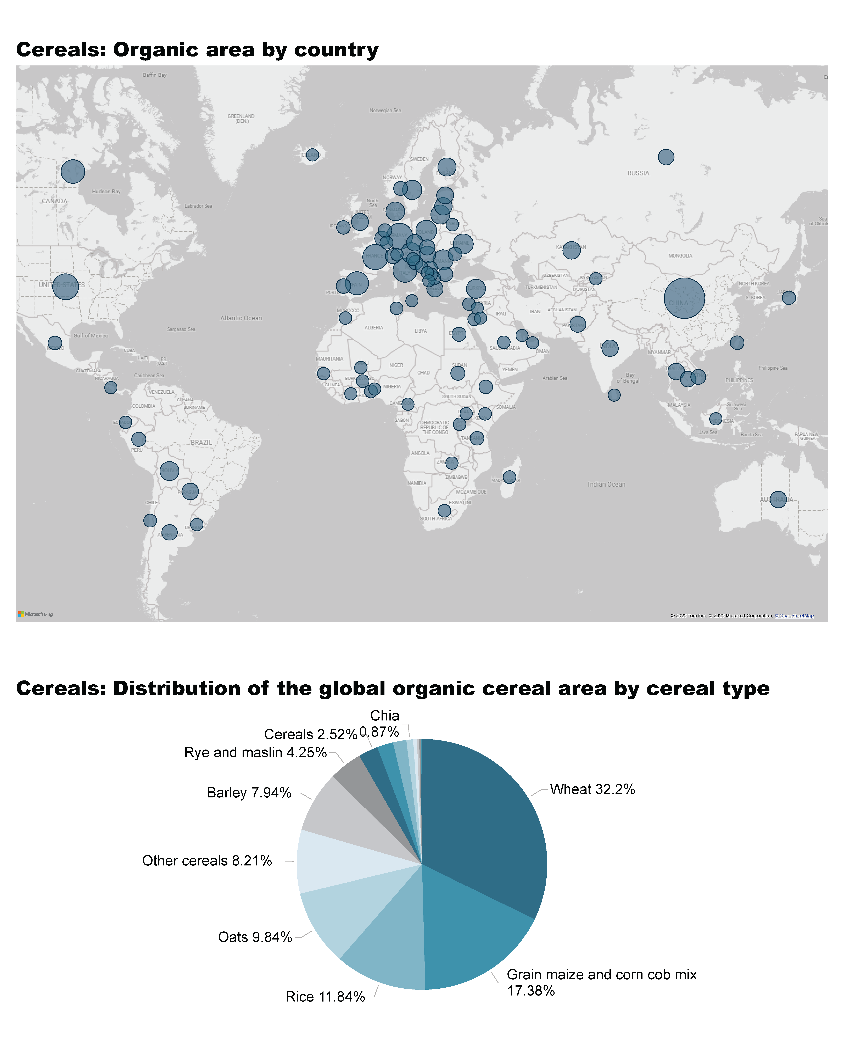
Cereals_1a
Notes:
Cereals: Organic area by country
No alt text provided

Slide 32
Cereals_1b
Notes:
Cereals: Distribution of the global organic cereal area by cereal type
No alt text provided
textbox
No alt text provided

Slide 33
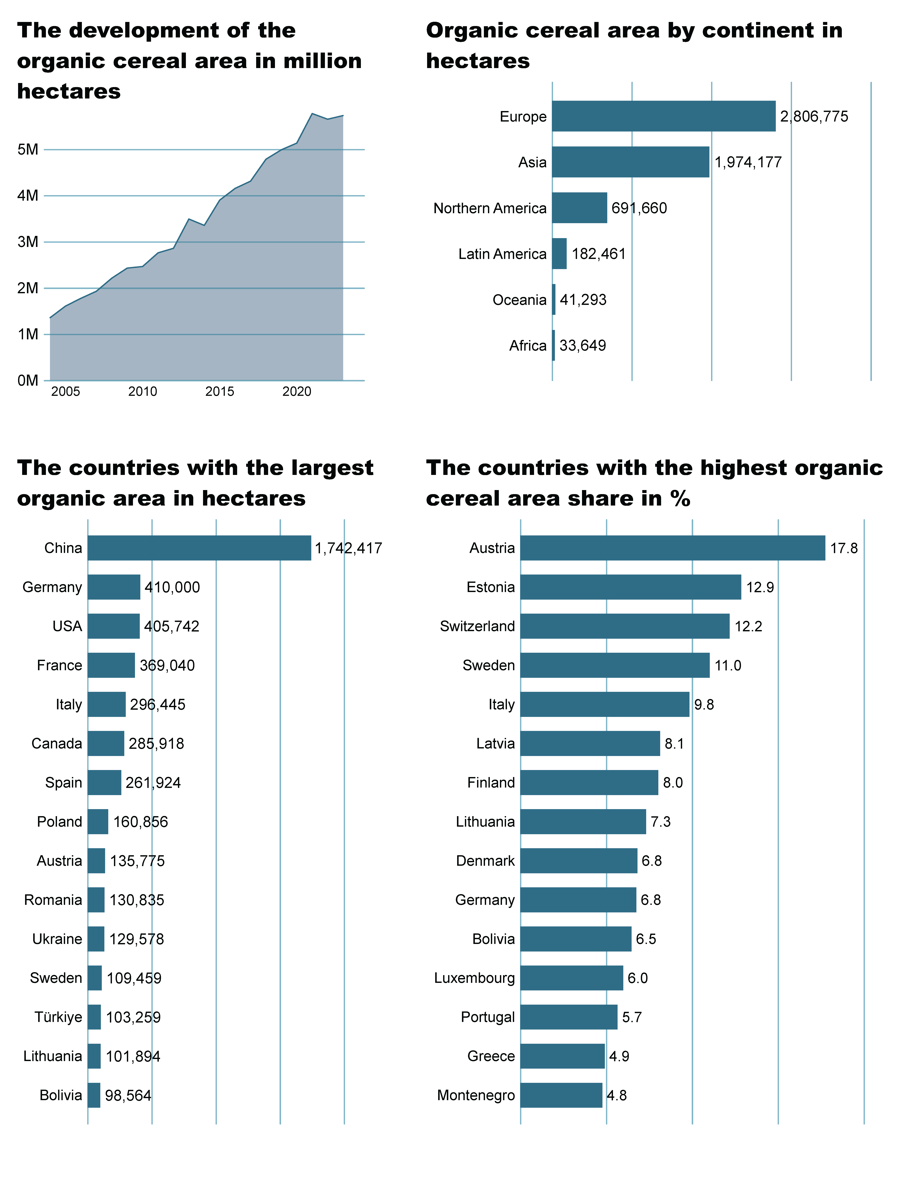
Cereals_2a
Notes:
The development of the organic cereal area in million hectares
No alt text provided
Organic cereal area by continent in hectares
No alt text provided

Slide 34
Cereals_2b
Notes:
The countries with the highest organic cereal area share in %
No alt text provided
The countries wih the largest organic area in hectares
No alt text provided

Slide 35
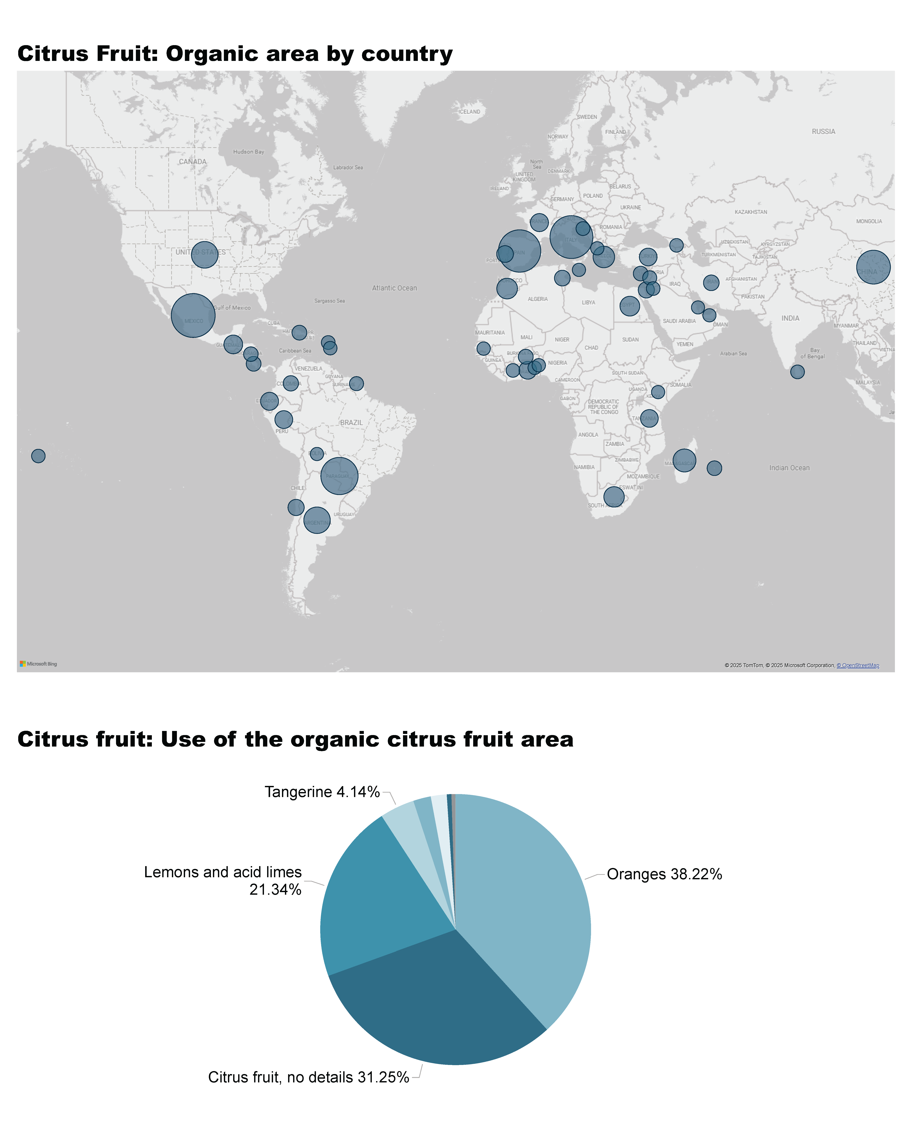
Citrus Fruit_1a
Notes:
Citrus Fruit: Organic area by country
No alt text provided
textbox
No alt text provided

Slide 36
Citrus Fruit_1b
Notes:
Citrus fruit: Use of the organic citrus fruit area
No alt text provided
textbox
No alt text provided

Slide 37
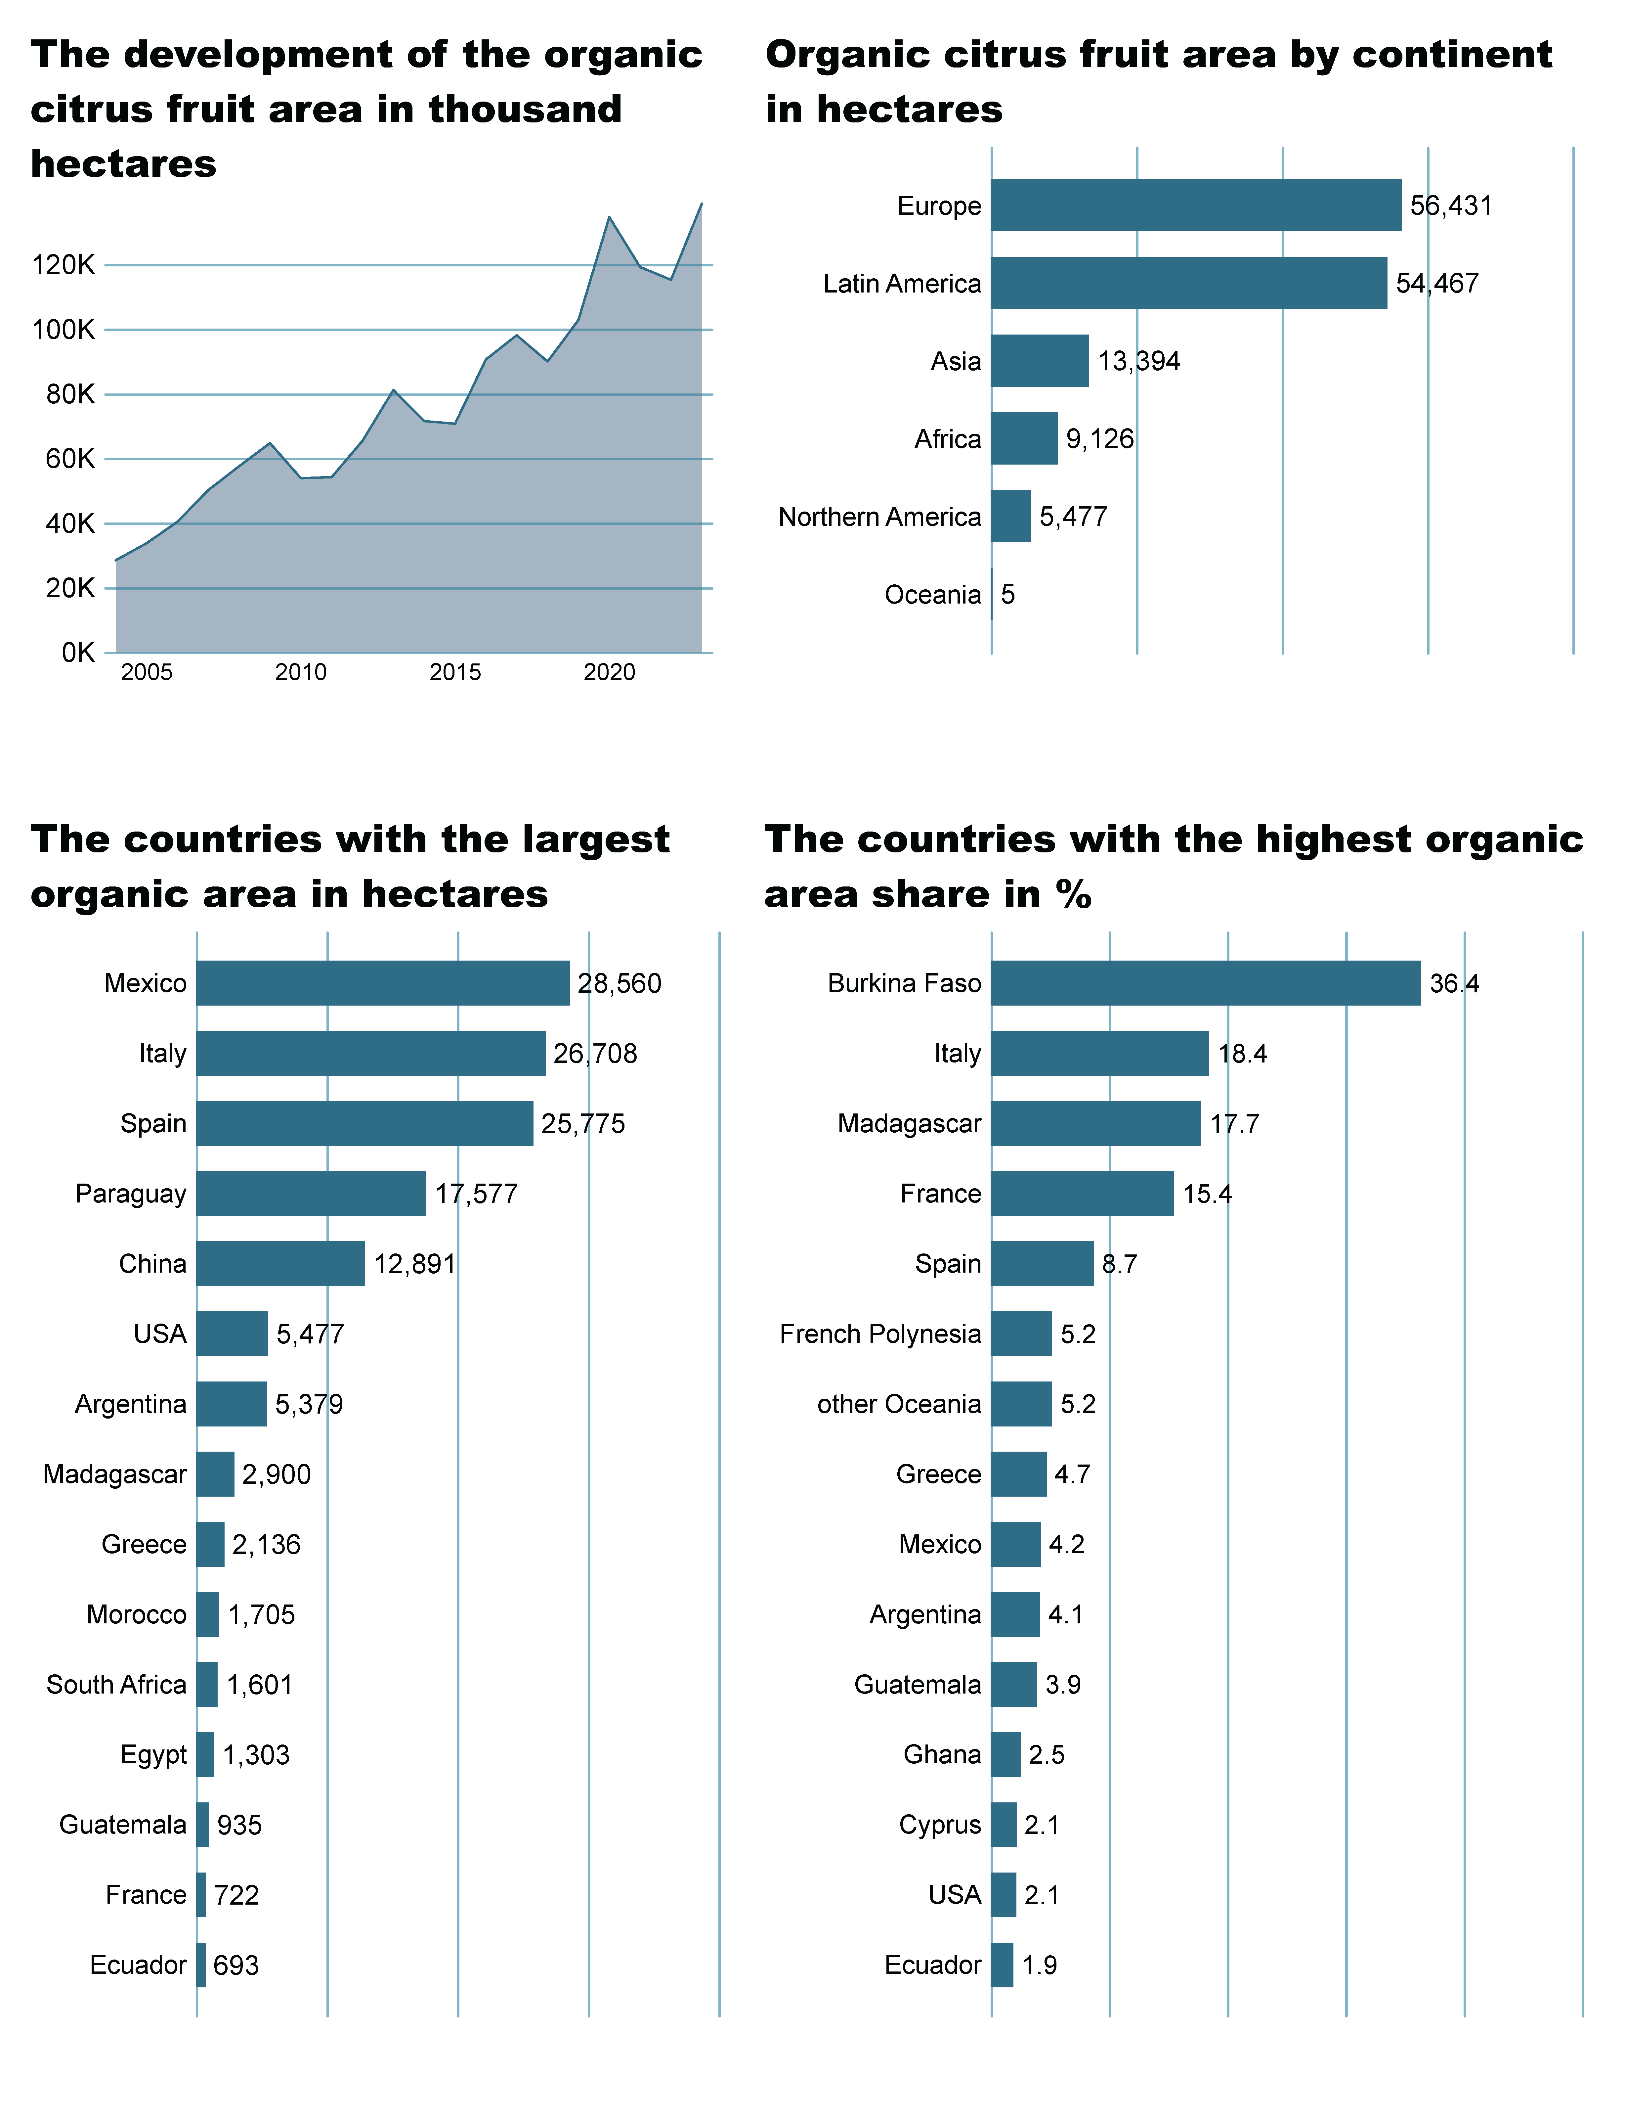
Citrus Fruit_2a
Notes:
The development of the organic citrus fruit area in thousand hectares
No alt text provided
Organic citrus fruit area by continent in hectares
No alt text provided

Slide 38
Citrus Fruit_2b
Notes:
The countries with the highest organic area share in %
No alt text provided
The countries wih the largest organic area in hectares
No alt text provided

Slide 39
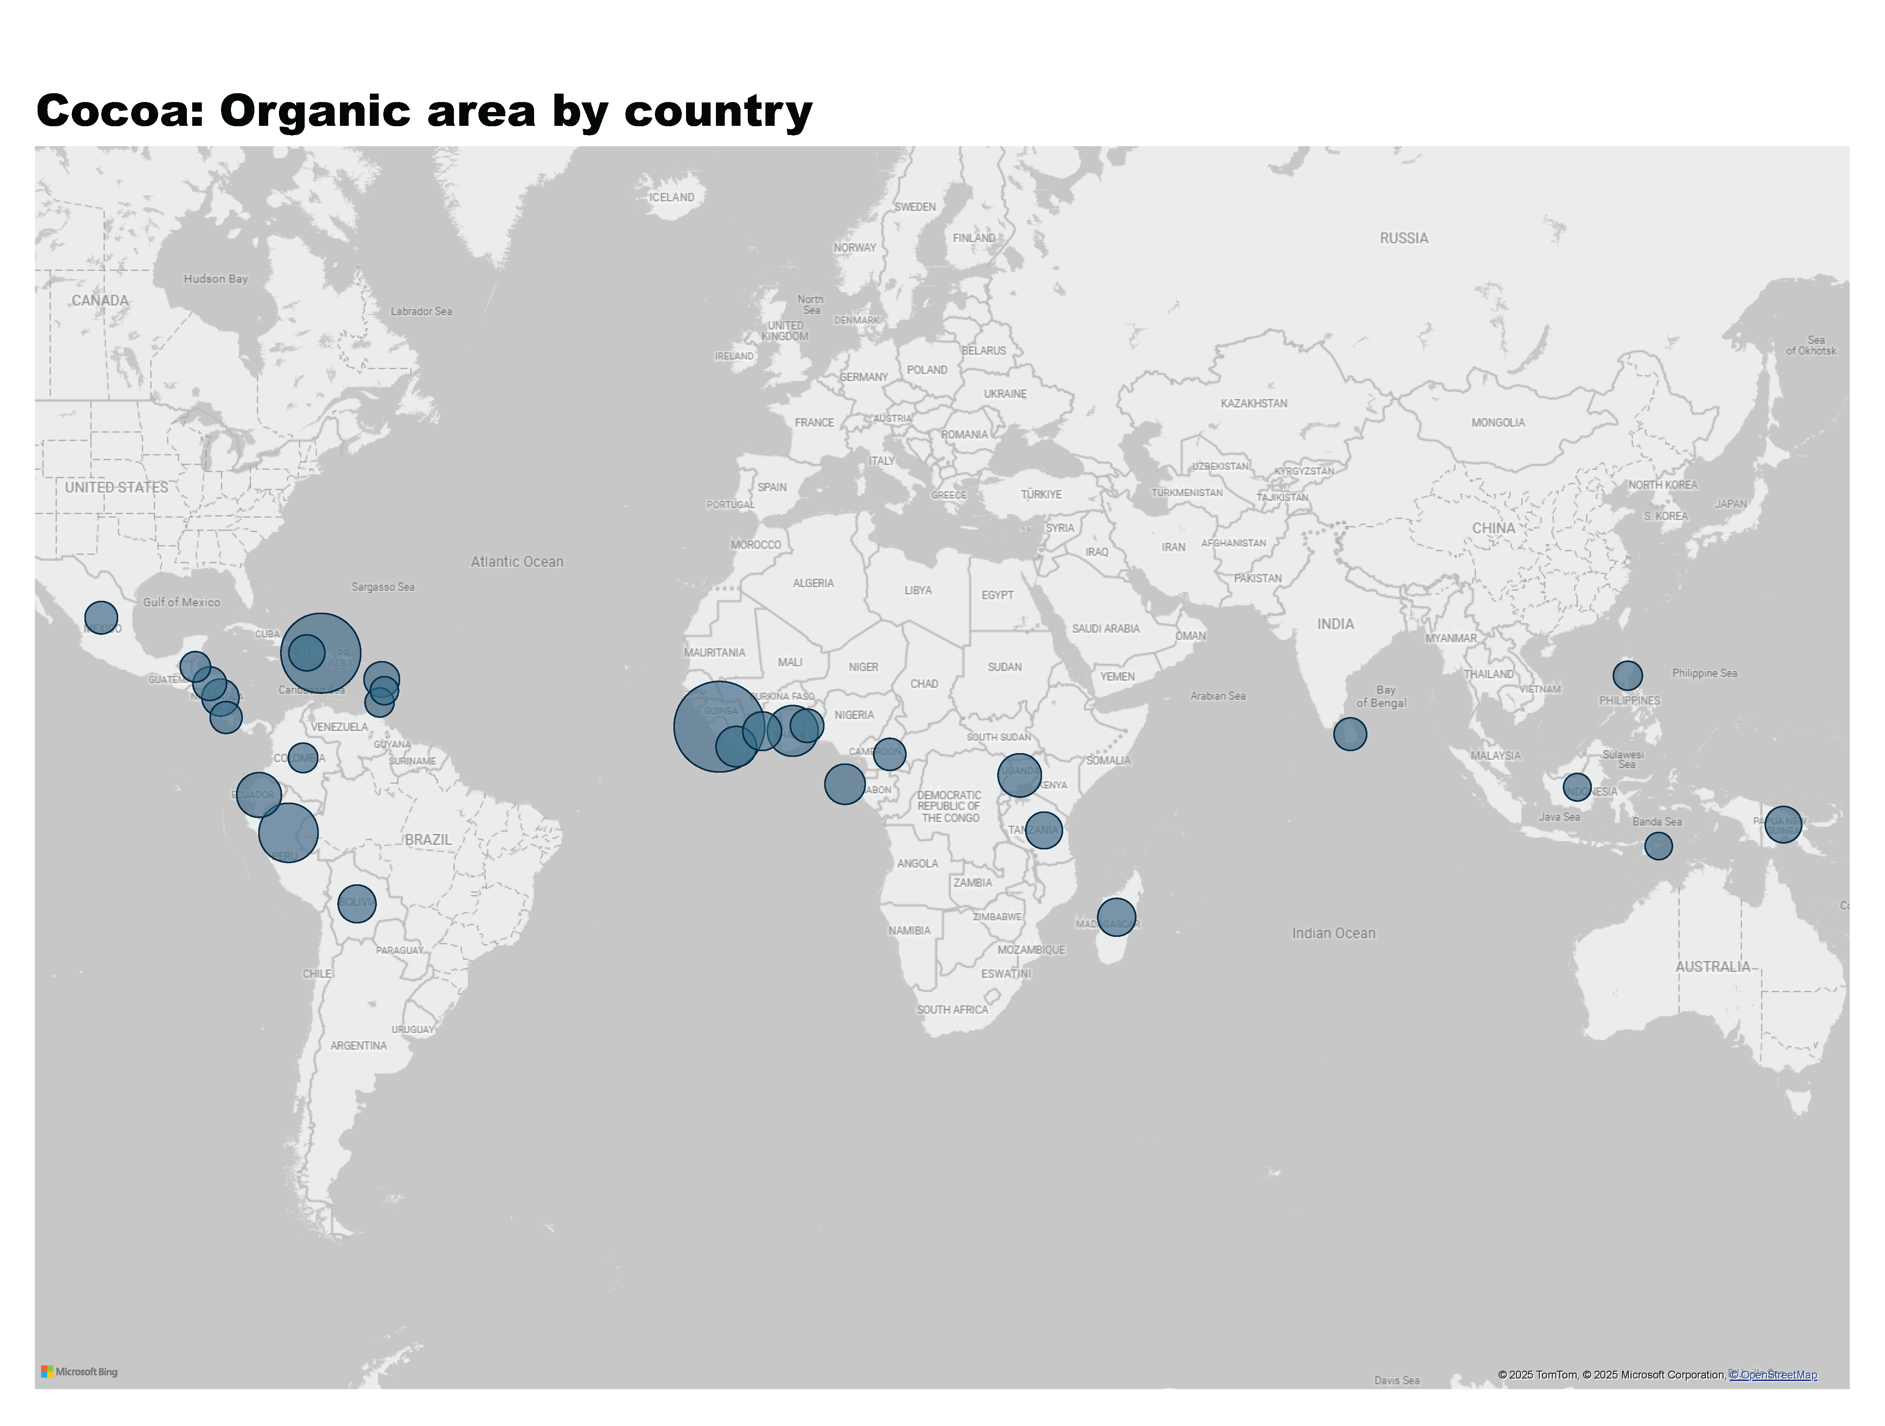
Cocoa_1a
Notes:
Cocoa: Organic area by country
No alt text provided
textbox
No alt text provided

Slide 40
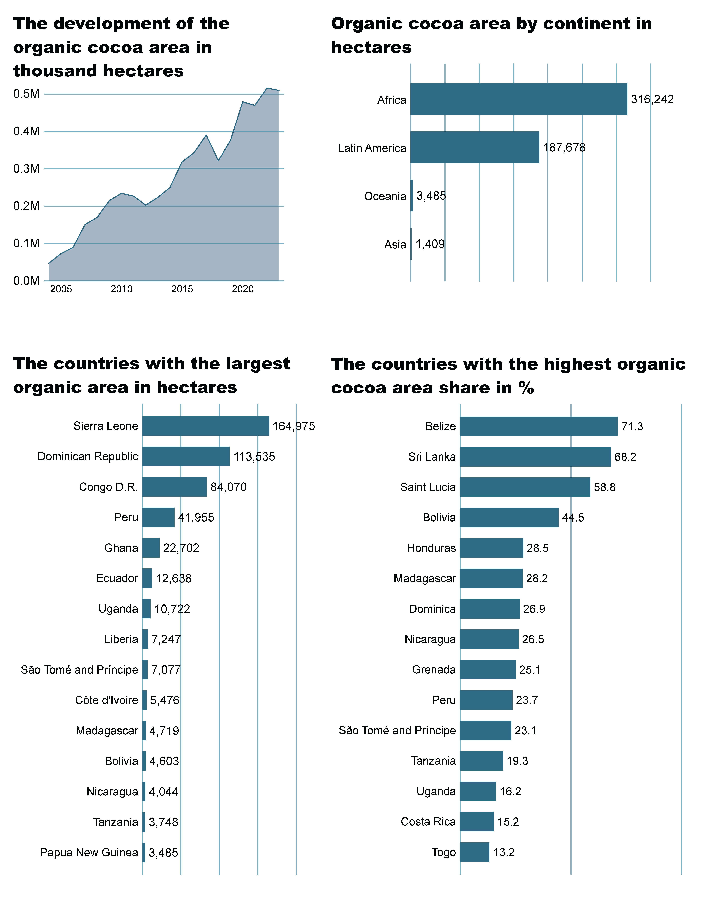
Cocoa_2a
Notes:
The development of the organic cocoa area in thousand hectares
No alt text provided
Organic cocoa area by continent in hectares
No alt text provided

Slide 41
Cocoa_2b
Notes:
The countries with the highest organic cocoa area share in %
No alt text provided
The countries wih the largest organic area in hectares
No alt text provided

Slide 42
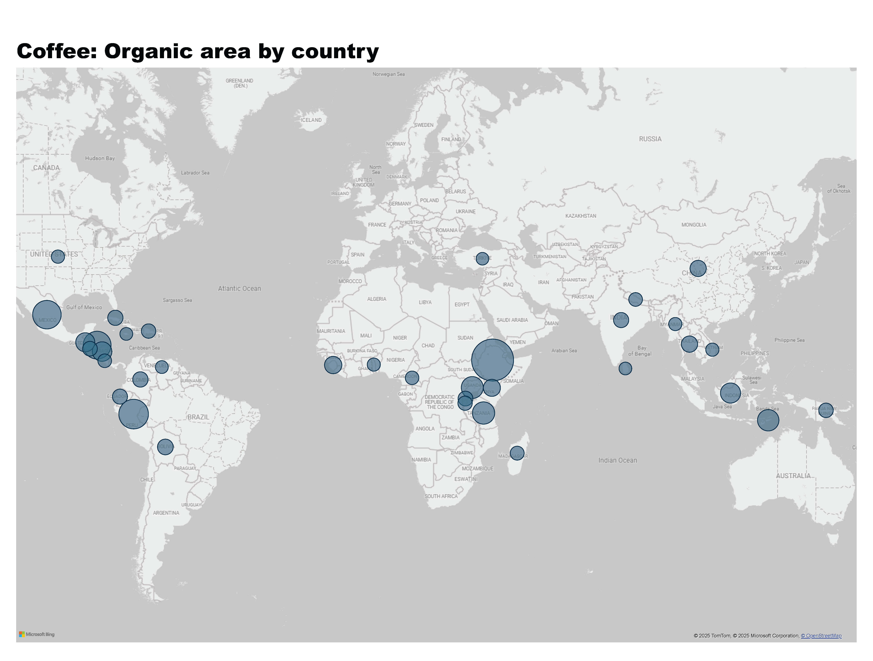
Coffee_1a
Notes:
Coffee: Organic area by country
No alt text provided
textbox
No alt text provided

Slide 43
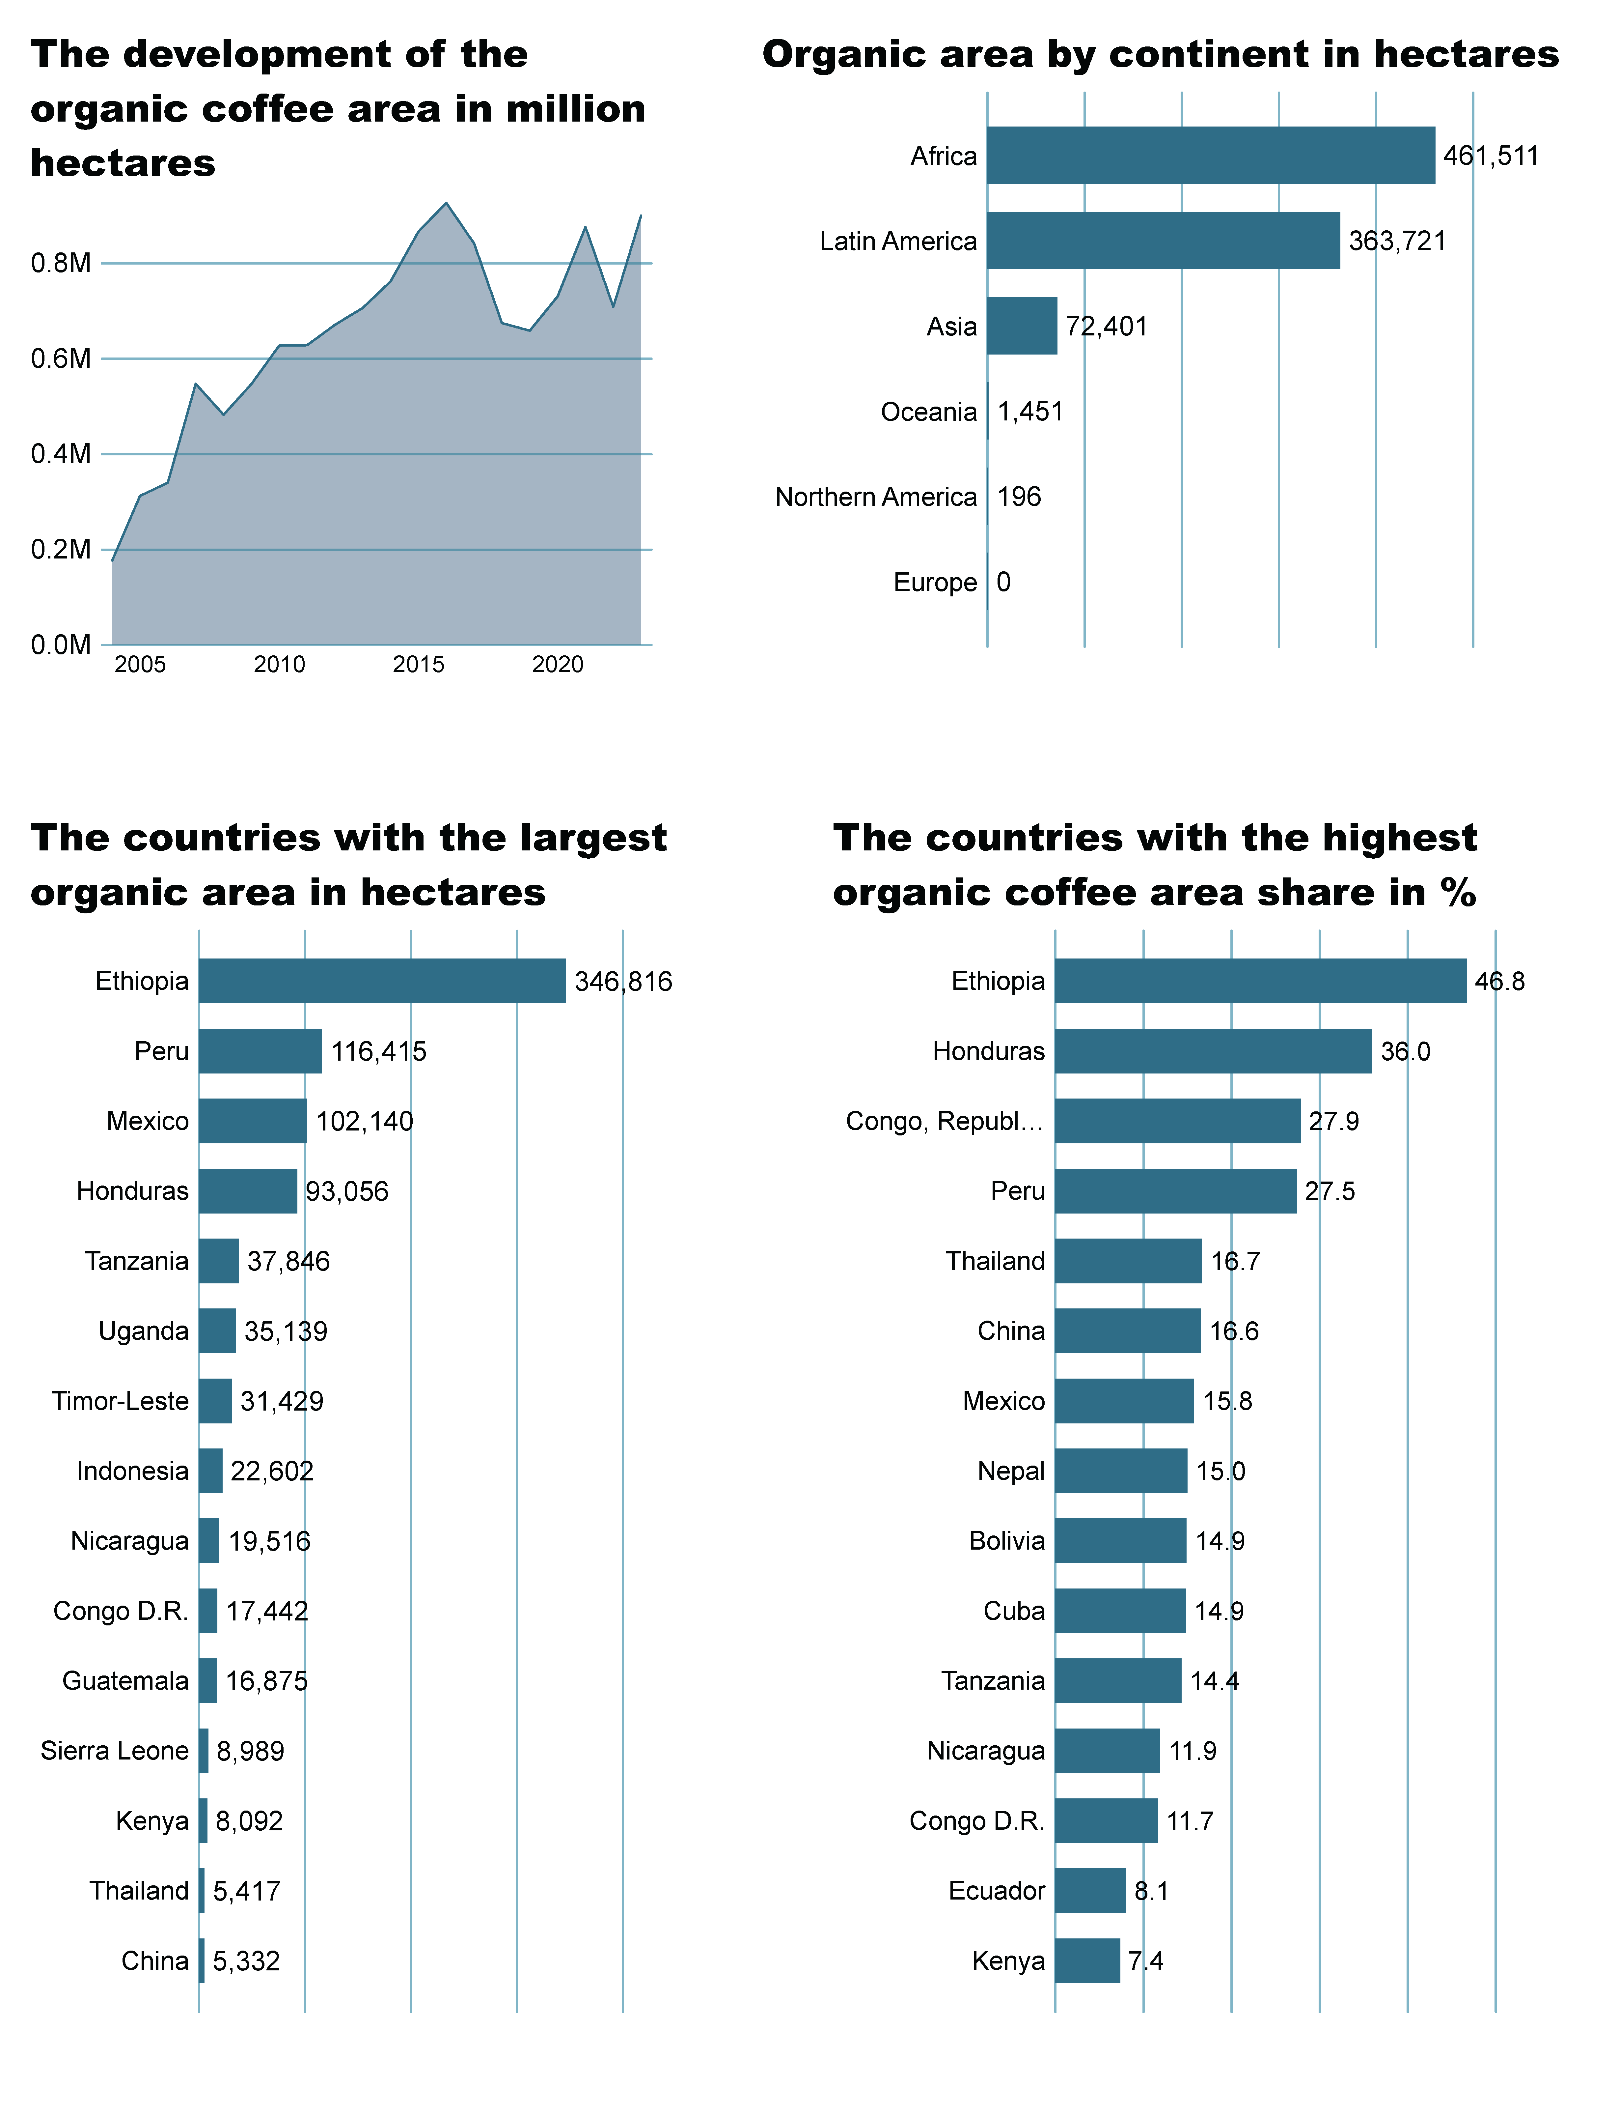
Coffee_2a
Notes:
The development of the organic coffee area in million hectares
No alt text provided
Organic area by continent in hectares
No alt text provided

Slide 44
Coffee_2b
Notes:
The countries with the highest organic coffee area share in %
No alt text provided
The countries wih the largest organic area in hectares
No alt text provided

Slide 45
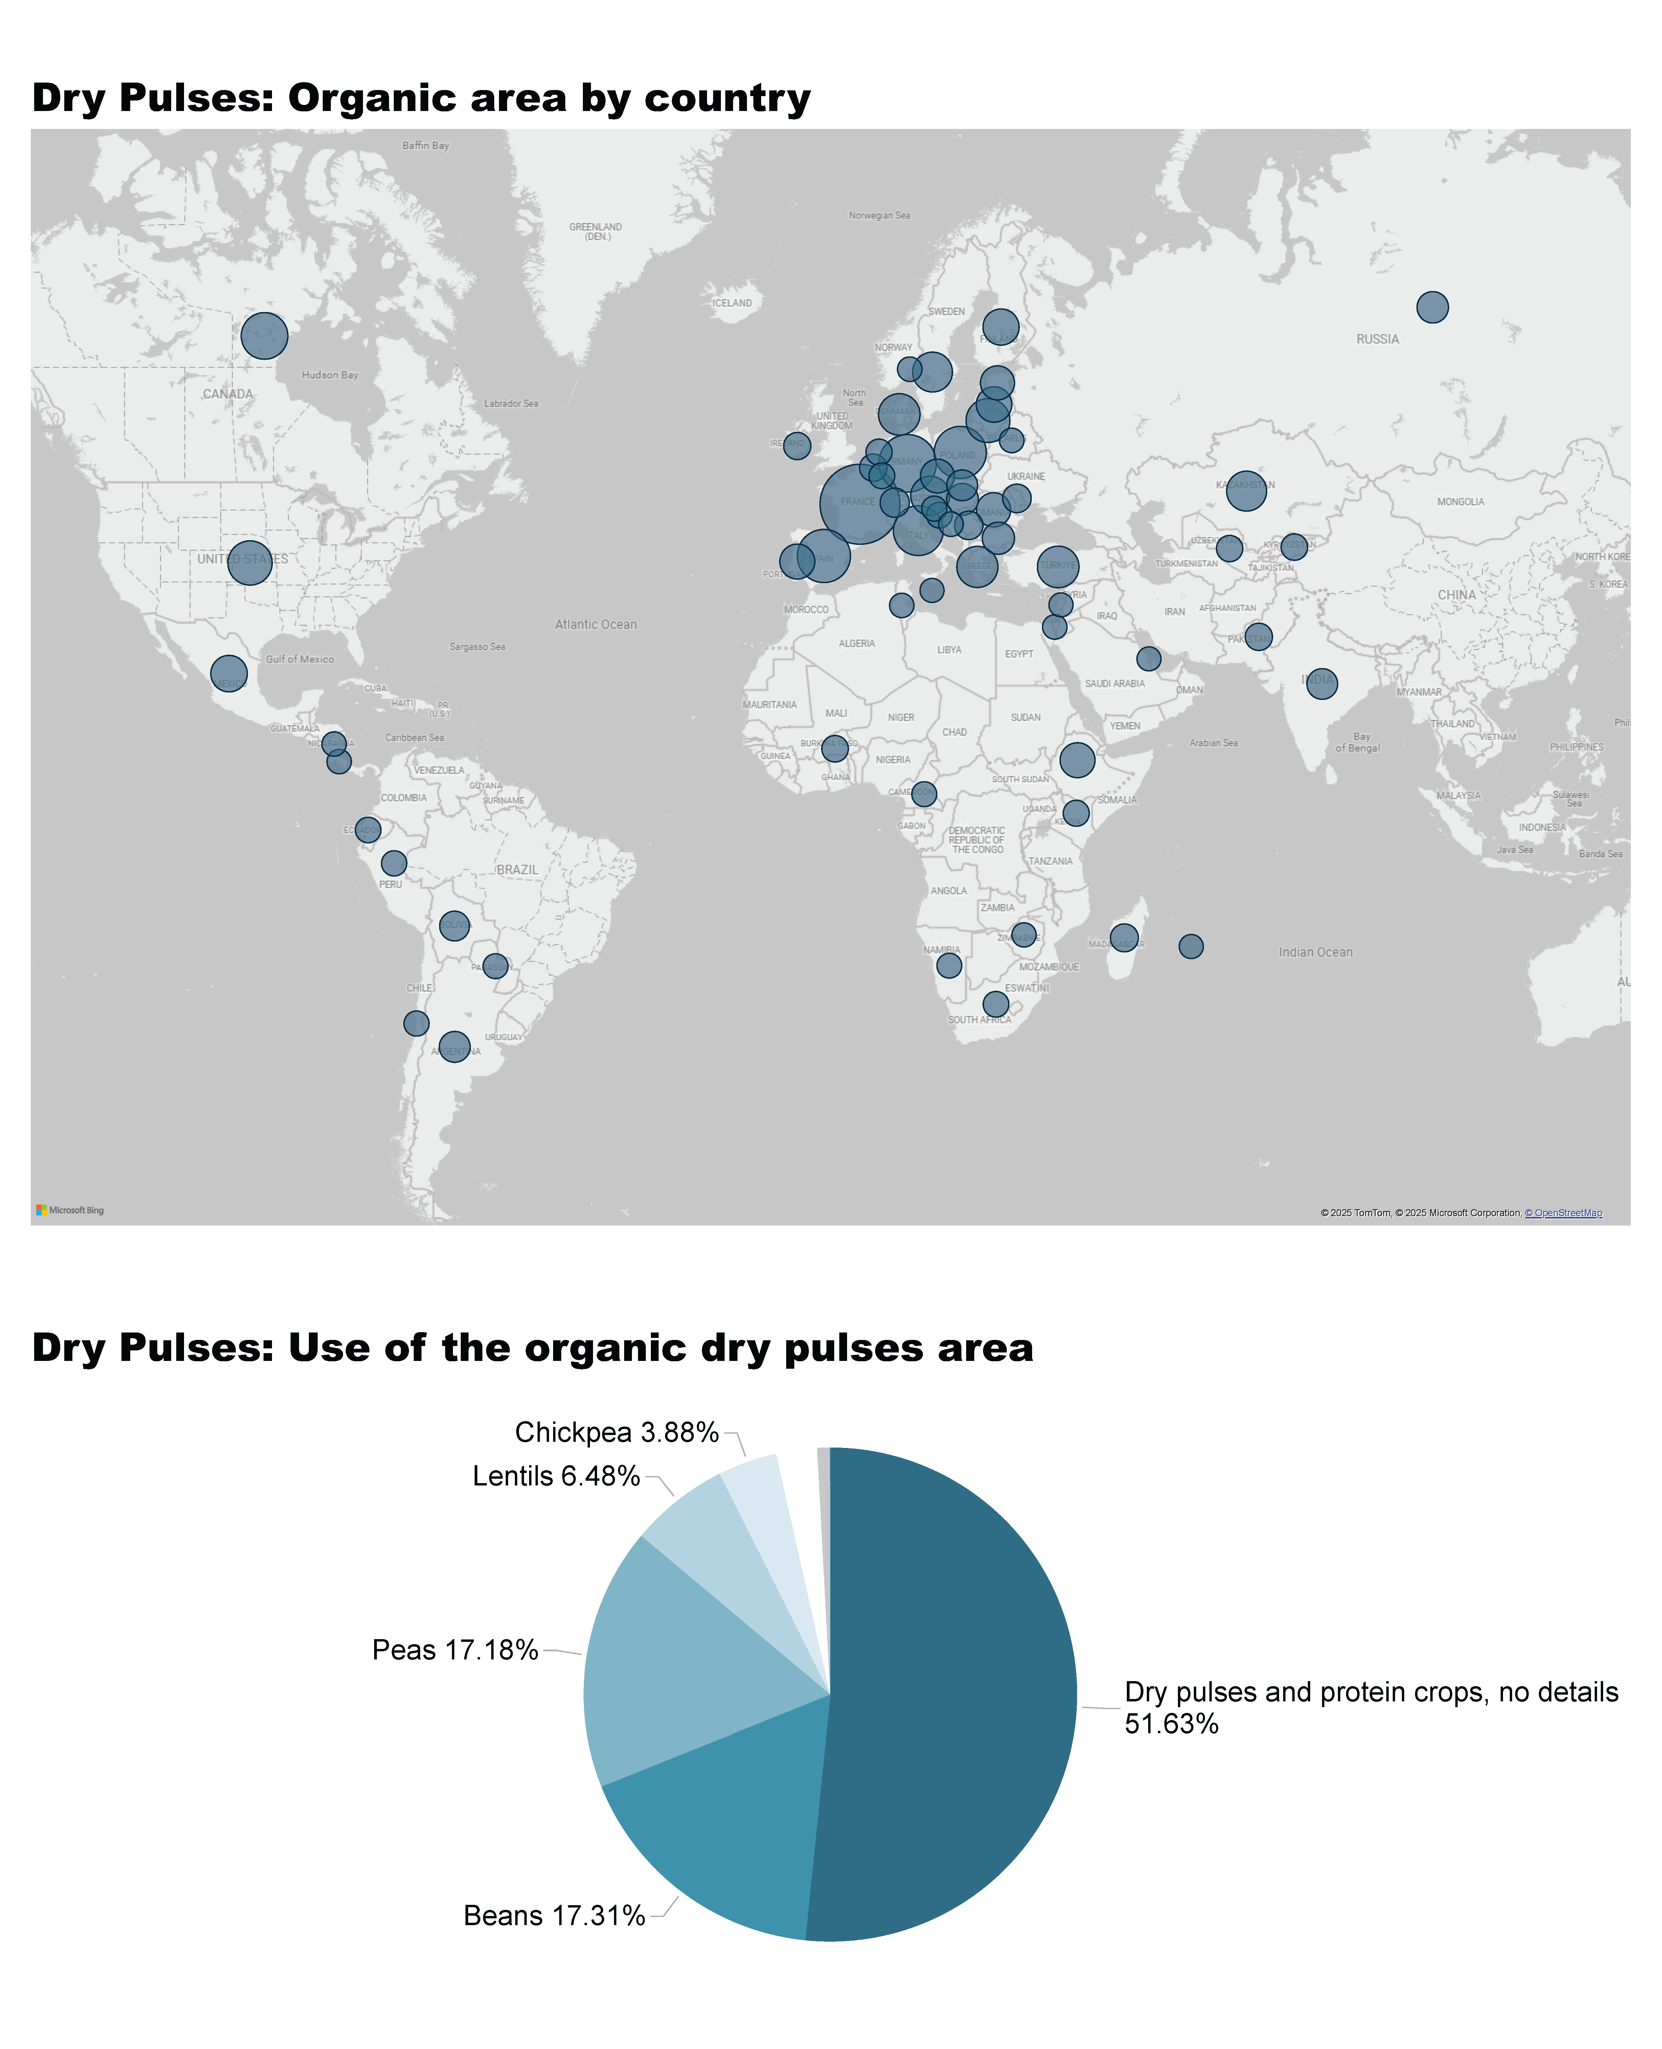
Dry Pulses_1a
Notes:
Dry Pulses: Organic area by country
No alt text provided

Slide 46
Dry Pulses_1b
Notes:
Dry Pulses: Use of the organic dry pulses area
No alt text provided
textbox
No alt text provided

Slide 47
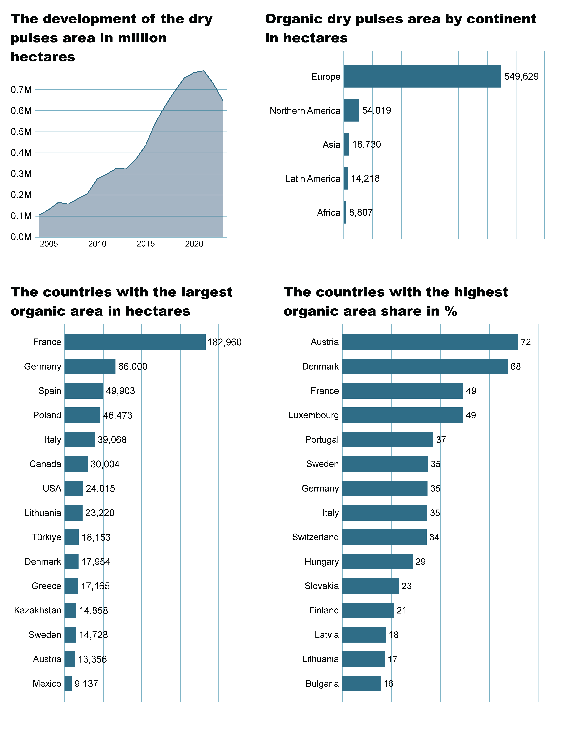
Dry Pulses_2a
Notes:
The development of the dry pulses area in million hectares
No alt text provided
Organic dry pulses area by continent in hectares
No alt text provided

Slide 48
Dry Pulses_2b
Notes:
The countries with the highest organic area share in %
No alt text provided
The countries wih the largest organic area in hectares
No alt text provided

Slide 49
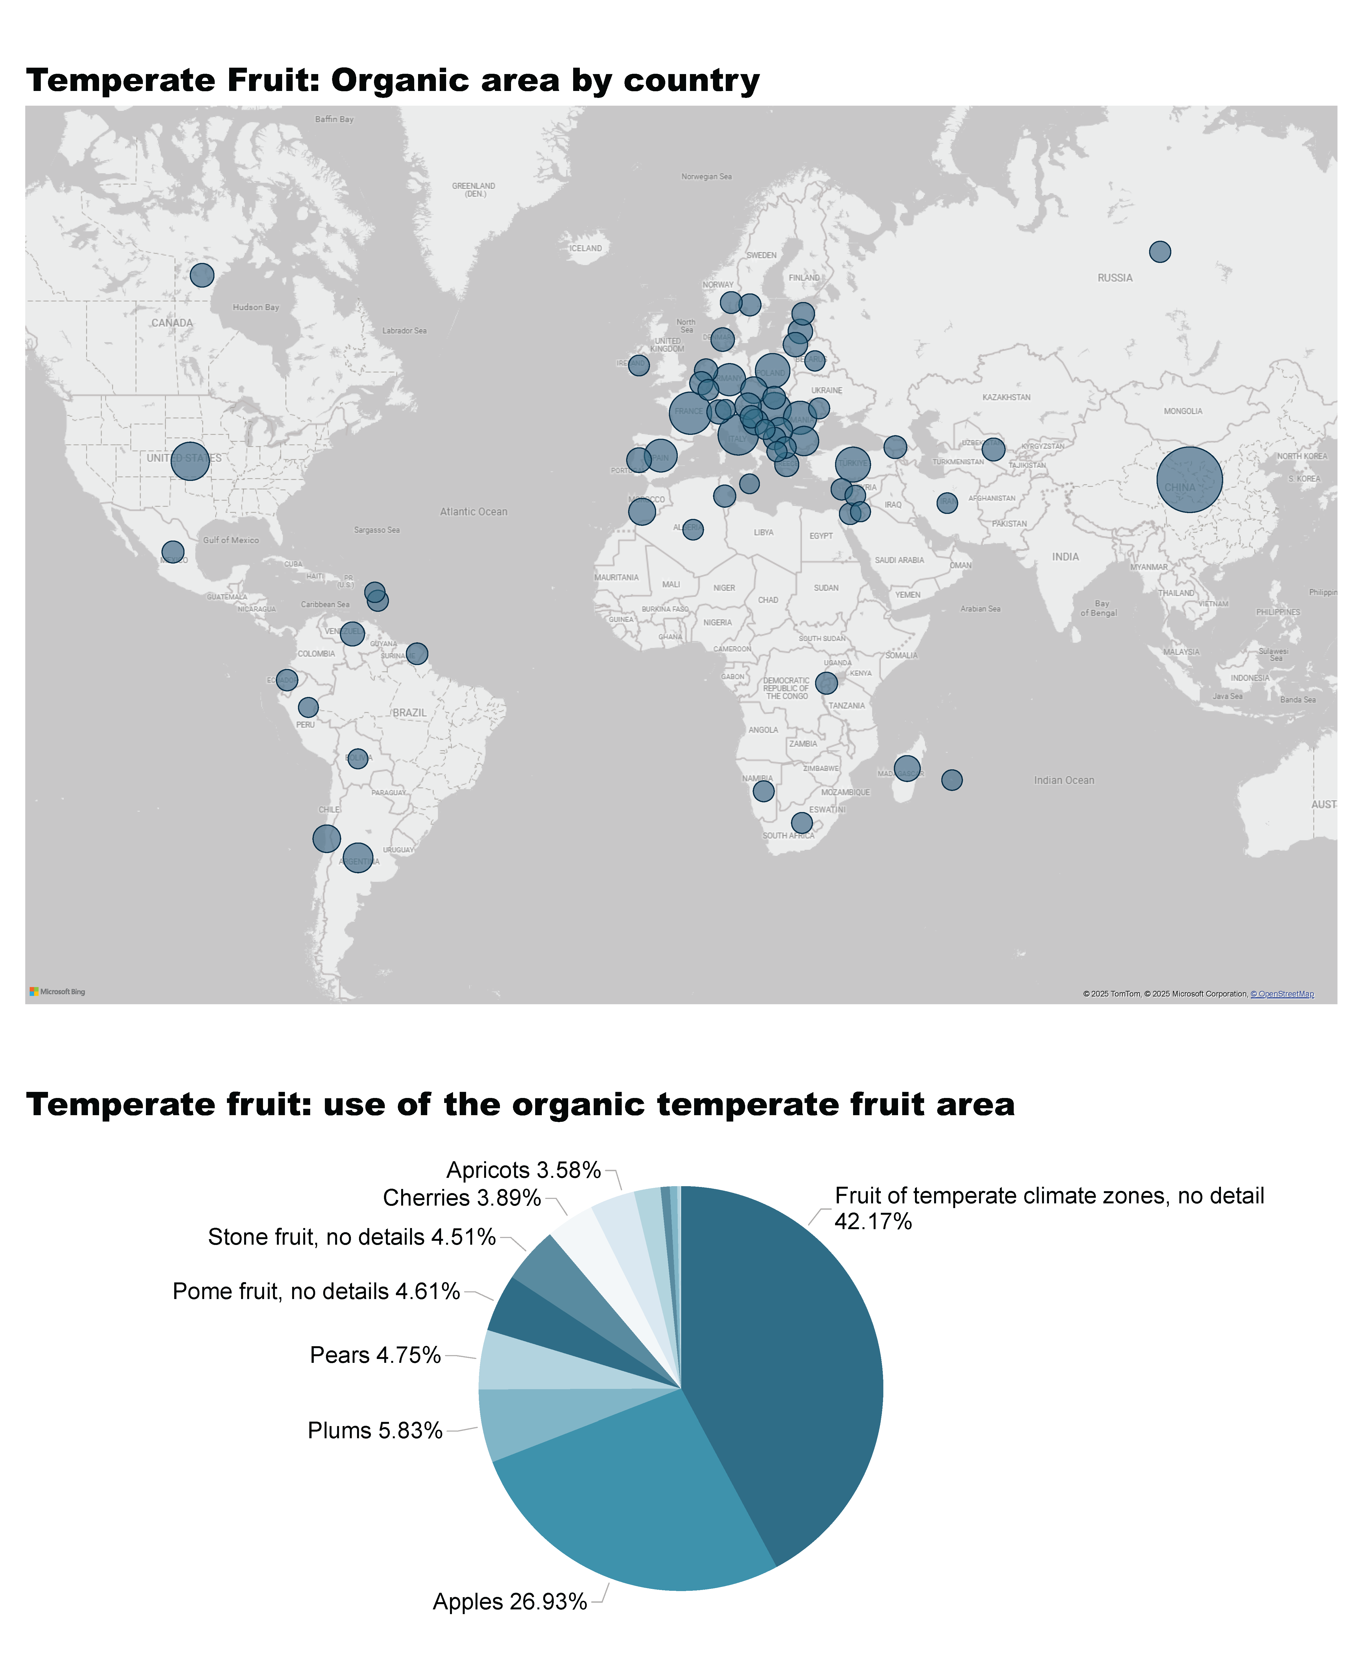
Temperate Fruit_1a
Notes:
Temperate Fruit: Organic area by country
No alt text provided

Slide 50
Temperate Fruit_1b
Notes:
Temperate fruit: use of the organic temperate fruit area
No alt text provided
textbox
No alt text provided

Slide 51
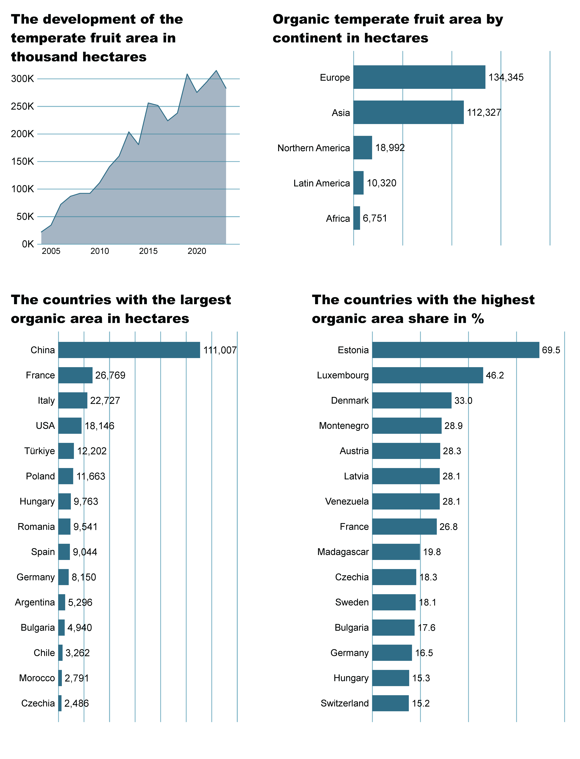
Temperate Fruit_2a
Notes:
The development of the temperate fruit area in thousand hectares
No alt text provided
Organic temperate fruit area by continent in hectares
No alt text provided

Slide 52
Temperate Fruit_2b
Notes:
The countries with the highest organic area share in %
No alt text provided
The countries wih the largest organic area in hectares
No alt text provided

Slide 53
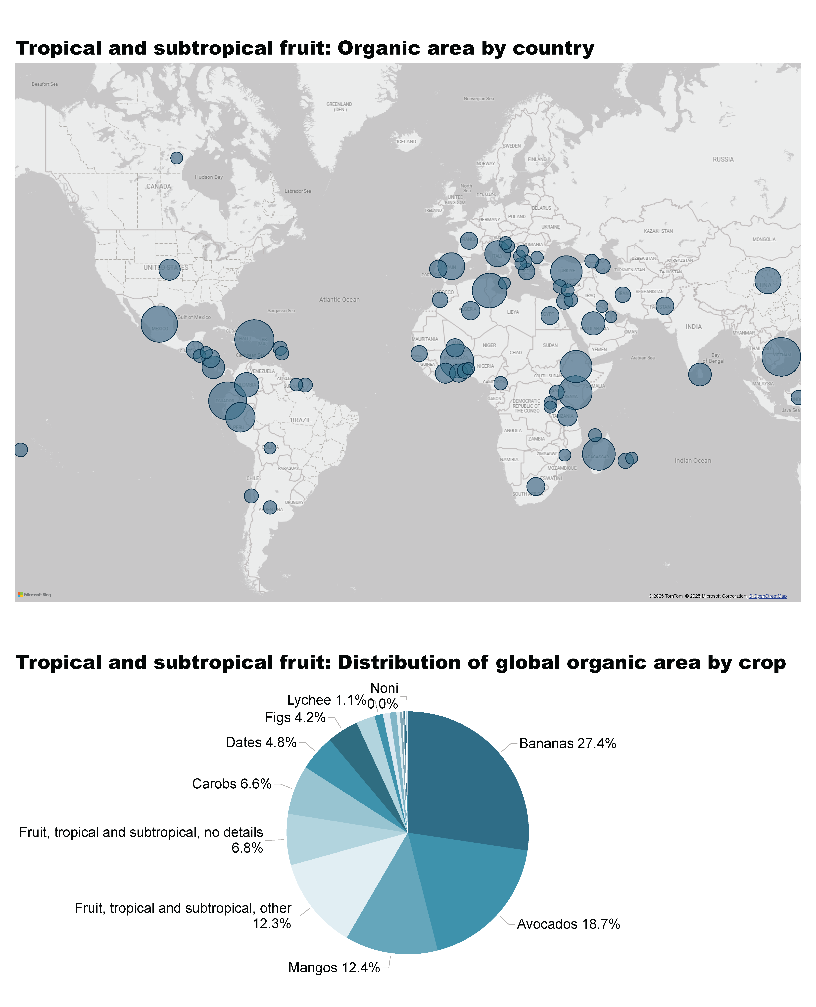
Tropical and Subtropical fruit_1a
Notes:
Tropical and subtropical fruit: Organic area by country
No alt text provided

Slide 54
Tropical and Subtropical fruit_1b
Notes:
Tropical and subtropical fruit: Distribution of global organic area by crop
No alt text provided
textbox
No alt text provided

Slide 55
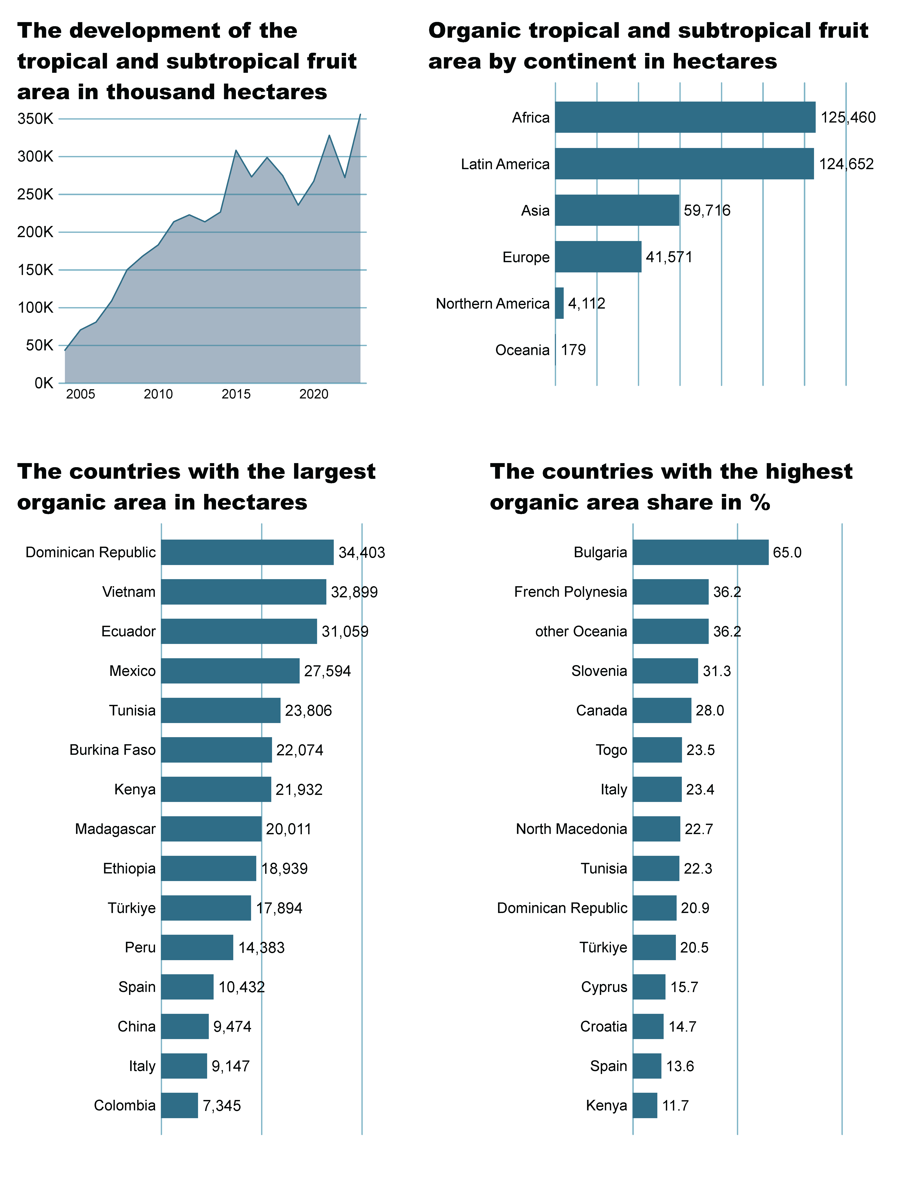
Tropical and Subtropical fruit_2a
Notes:
The development of the tropical and subtropical fruit area in thousand hectares
No alt text provided
Organic tropical and subtropical fruit area by continent in hectares
No alt text provided

Slide 56
Tropical and Subtropical fruit_2b
Notes:
The countries with the highest organic area share in %
No alt text provided
The countries wih the largest organic area in hectares
No alt text provided

Slide 57
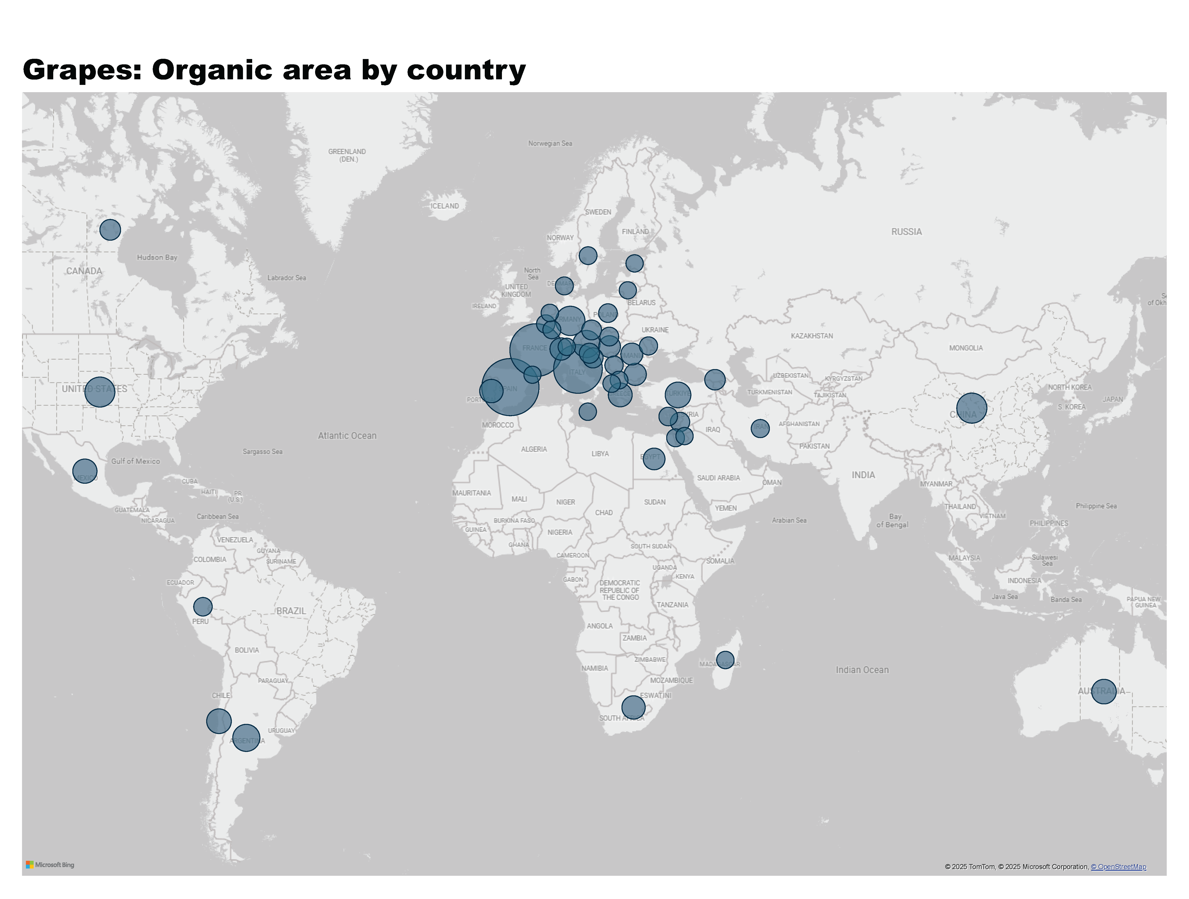
Grapes_1
Notes:
Grapes: Organic area by country
No alt text provided
textbox
No alt text provided

Slide 58
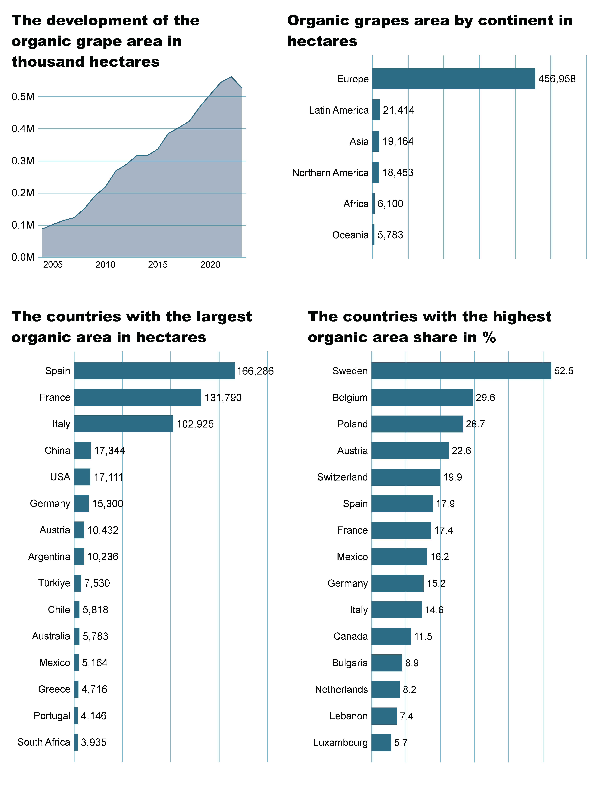
Grapes_2a
Notes:
The development of the organic grapes area in thousand hectares
No alt text provided
Organic grapes area by continent in hectares
No alt text provided

Slide 59
Grapes_2b
Notes:
The countries with the highest organic area share in %
No alt text provided
The countries wih the largest organic area in hectares
No alt text provided

Slide 60
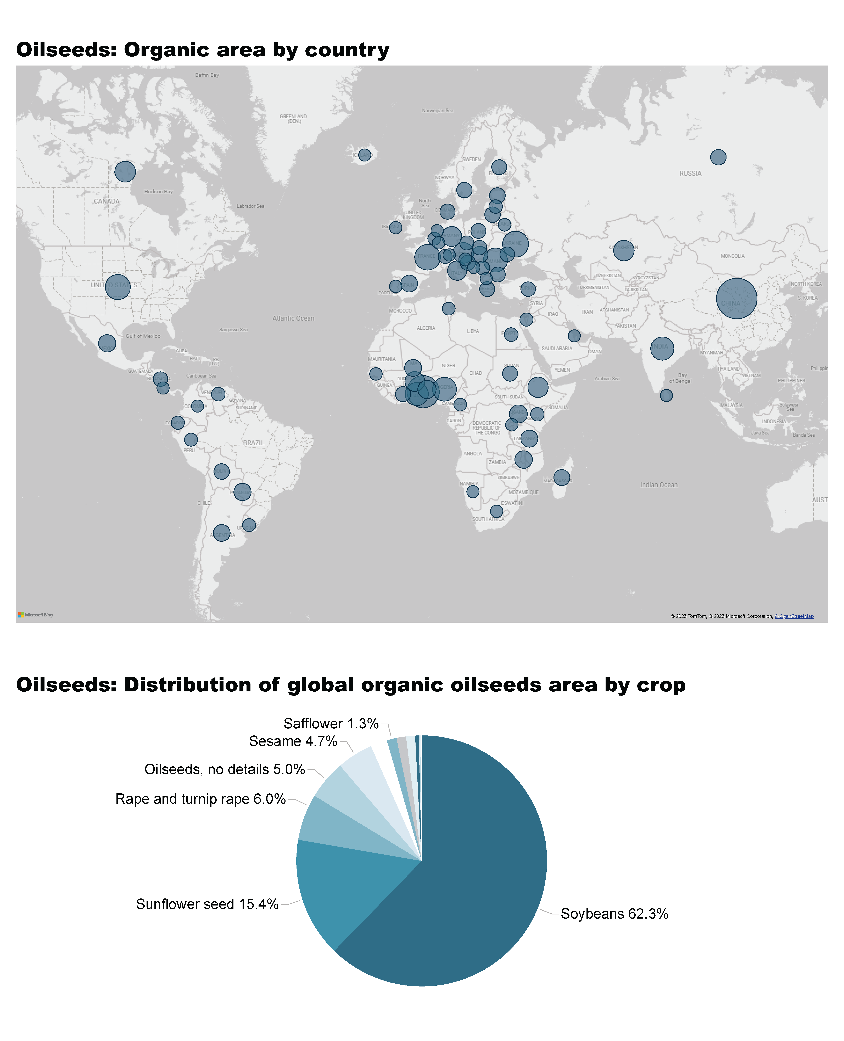
Oilseeds_1a
Notes:
Oilseeds: Organic area by country
No alt text provided

Slide 61
Oilseeds_1b
Notes:
Oilseeds: Distribution of global organic oilseeds area by crop
No alt text provided
textbox
No alt text provided

Slide 62
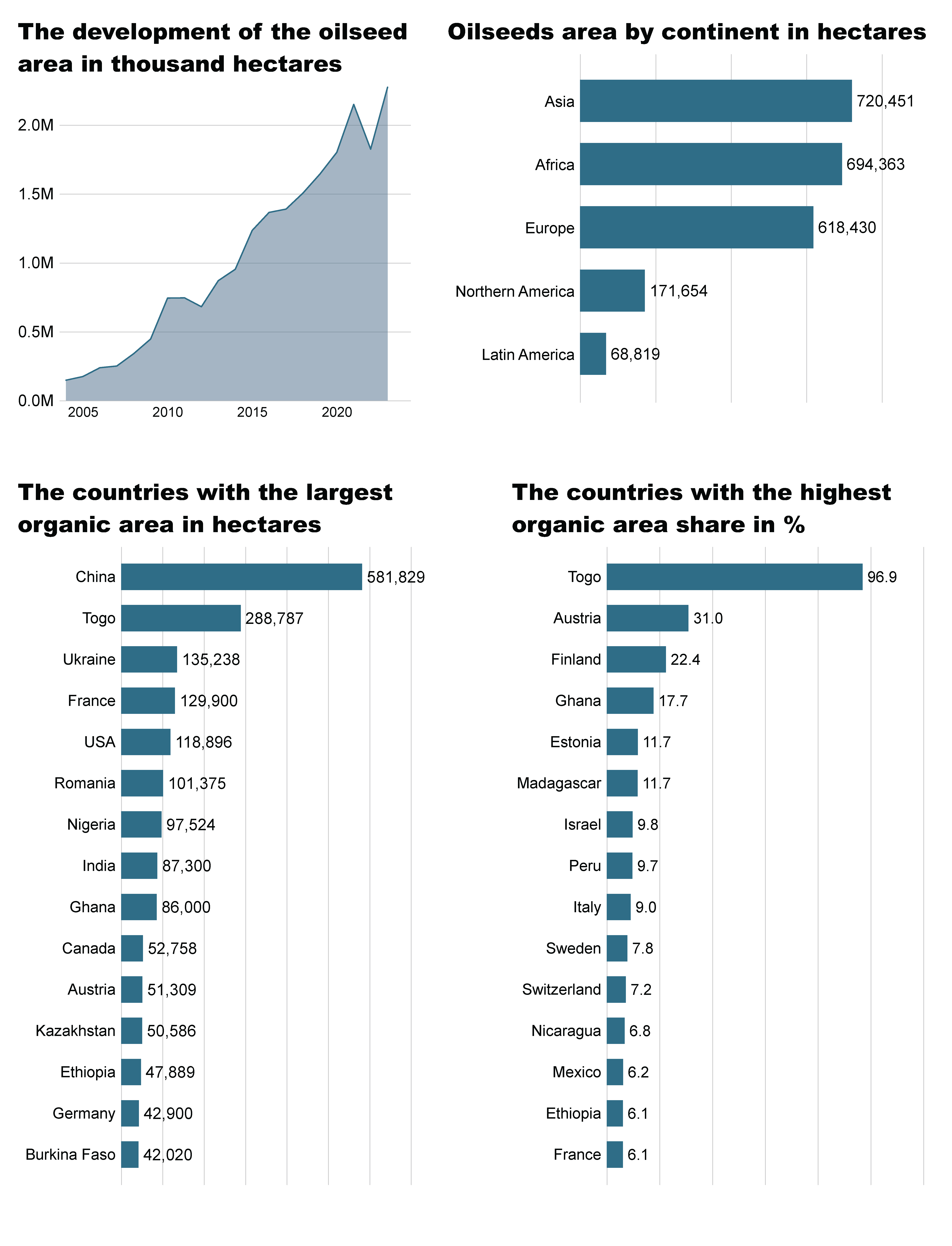
Oilseeds_2a
Notes:
The development of the oilseed area in thousand hectares
No alt text provided
Oilseeds area by continent in hectares
No alt text provided

Slide 63
Oilseeds_2b
Notes:
The countries with the highest organic area share in %
No alt text provided
The countries wih the largest organic area in hectares
No alt text provided

Slide 64

Olives_1
Notes:
Olives: Organic area by country
No alt text provided
textbox
No alt text provided

Slide 65

Olives_2a
Notes:
The development of the organic olive area in million hectares
No alt text provided
Organic area by continent in hectares
No alt text provided

Slide 66
Olives_2b
Notes:
The countries with the highest organic area share in %
No alt text provided
The countries wih the largest organic area in hectares
No alt text provided

Slide 67

Vegetables_1a
Notes:
Vegetables: Organic area by country
No alt text provided
textbox
No alt text provided

Slide 68
Vegetables_1b
Notes:
Vegetables: Distribution of the global organic vegetable area by crop group
No alt text provided
textbox
No alt text provided

Slide 69

Vegetables_2a
Notes:
Development of the organic vegetable area in thousand hectares
No alt text provided
Vegetable area by continent in hectares
No alt text provided

Slide 70
Vegetables_2b
Notes:
The countries with the highest organic area share in %
No alt text provided
The countries wih the largest organic area in hectares
No alt text provided

Slide 71
More information
More information (PDF, data sources, graphs) at:
http://www.organic-world.net/yearbook/yearbook-2025.html
Contact
Helga Willer
Research Institute of Organic Agriculture FiBL
5070 Frick
Switzerland
helga.willer@fibl.org

Slide 72
Disclaimer
All of the results contained in this slide show have been compiled by the Research Institute of Organic Agriculture FiBL. However, the possibility of mistakes cannot be ruled out entirely. Therefore, FiBL is not subject to any obligation and makes no guarantees whatsoever regarding any of the statements or results in this work; neither does FiBL accept responsibility or liability for any possible mistakes, nor for any consequences of actions taken by readers based on statements or advice contained therein.
This document has been produced with the support of the Swiss State Secretariat for Economic Affairs (SECO), the Sustainability Fund of Coop Switzerland, Bio Suisse, NürnbergMesse, IFOAM – Organics International. The views expressed herein can in no way be taken to reflect the official opinions of SECO, Coop, Bio Suisse, NürnbergMesse or IFOAM – Organics International.

Slide 73

Presentations on www.organic-world.net

Slide 74

Statistics.FiBL.org

Slide 75


www.twitter.com/fiblstatistics

Slide 76
Contact
Helga Willer
Research Institute of Organic Agriculture FiBL
Ackerstrasse 113, Box 219
5070 Frick
Switzerland
Phone +41 62 865 72 72
Phone +41 62 865 72 07 (direct)
info.suisse@fibl.org, helga.willer@fibl.org
www.fibl.org, www.organic-world.net, https://statistics.fibl.org

