Slide 1
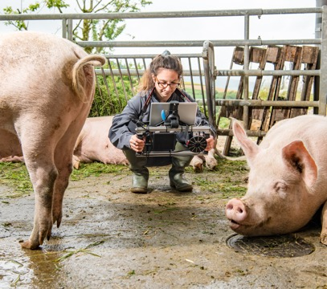
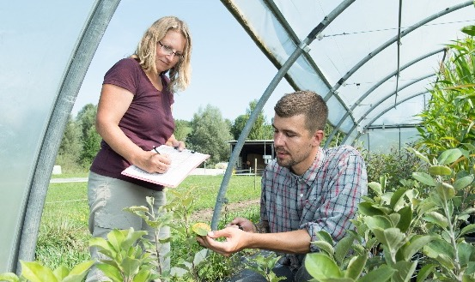
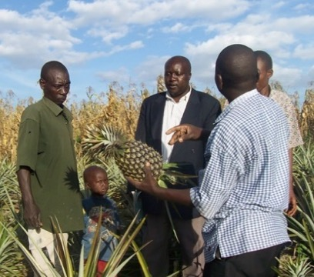
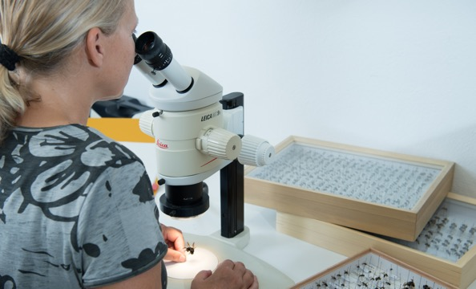
Organic Agriculture Worldwide 2023:
Key results from the FiBL survey on organic agriculture worldwide 2025
Part 3: Organic agriculture in the regions
Jan Trávníček, Bernhard Schlatter and Helga Willer
© FiBL, April 2025

Slide 2
Organic Agriculture Worldwide: Key results from the FiBL survey on organic agriculture worldwide 2025
Part 1: Global data and survey background
Data compiled by the Research Institute of Organic Agriculture FiBL, Frick, Switzerland, based on national data sources and data from certifiers.
Data as published February 2025 in The World of Organic Agriculture. Statistics and Emerging Trends 2025.* Frick and Bonn, www.organic-world.net
For updates, check www.organic-world.net
This presentation is available online at: https://www.organic-world.net/yearbook/yearbook-2025/presentations.html
Texts and graphs: Helga Willer, Bernhard Schlatter and Jan Trávníček, Research Institute of Organic Agriculture FiBL, Frick, Switzerland
Contact: Helga Willer, helga.willer@fibl.org, Research Institute of Organic Agriculture FiBL, Frick, Switzerland
© Research Institute of Organic Agriculture FiBL, Frick, Switzerland, February 2025
*Citation: Willer, Helga, Bernhard Schlatter and Jan Trávníček (Eds.) (2025): The World of Organic Agriculture. Statistics and Emerging Trends 2025. Research Institute of Organic Agriculture FiBL, Frick, and IFOAM – Organics International, Bonn.
Notes:
FiBL
19.07.2025
www.fibl.org
2

Slide 3
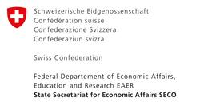

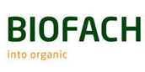
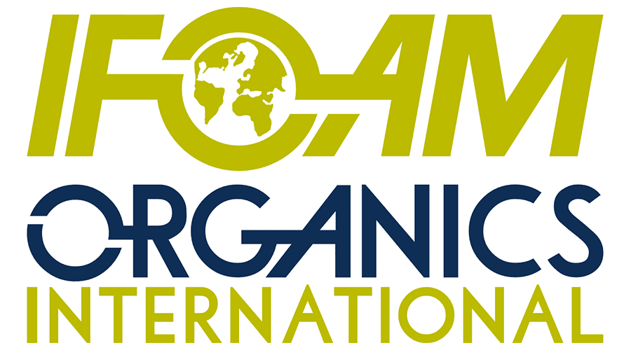

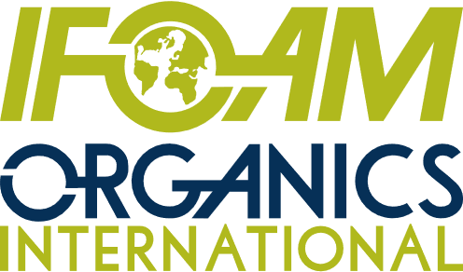
Acknowledgements
The Swiss State Secretariat of
Economic Affairs (SECO)
Coop Sustainability Fund
NürnbergMesse, the organizers of BIOFACH
IFOAM – Organics International
Bio Suisse
More than 200 experts from all parts of the world contributed to the FiBL survey 2025.

Slide 4
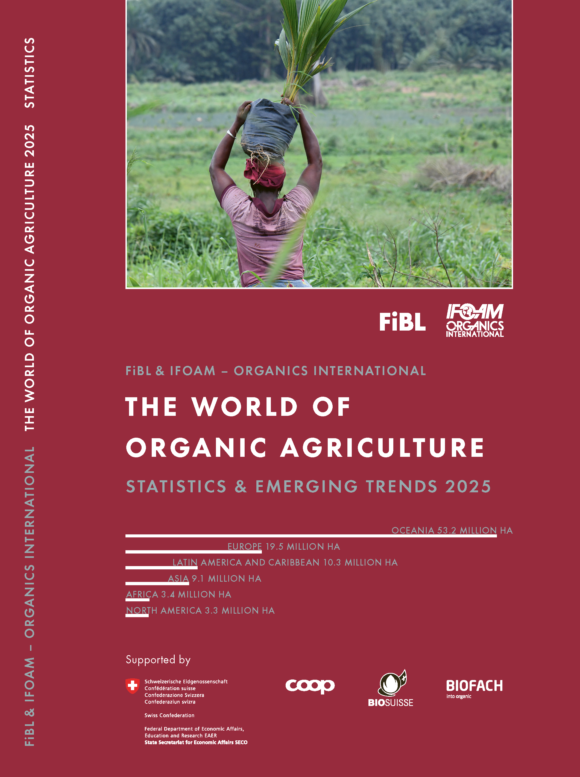

The World of Organic Agriculture 2025
The 26th edition of «The World of Organic Agriculture», was published by FiBL and IFOAM – Organics International in February 2025.
Data tables
Country and continent reports
Markets, standards, policy support
The book can be ordered or downloaded at: https://www.fibl.org/en/shop-en
www.organic-world.net
https://statistics.fibl.org

Slide 5
About this presentation
In three presentations, the key results of the FiBL survey on organic agriculture worldwide 2025 are summarized (data 2023). Apart from the global data, key results on crop and on regional data are presented.
More information is available at www.organic-world.net
The following three presentations are available at https://www.organic-world.net/yearbook/yearbook-2025/presentations.html:
  Part 1: Global data 2023 and survey background
  Part 2: Land use and key crops in organic agriculture 2023
  Part 3: Organic agriculture in the regions 2023

Slide 6
The 26th survey on organic agriculture world-wide
The 26th survey on organic agriculture worldwide was carried out by the Research Institute of Organic Agriculture FiBL in cooperation with partners from all around the world. The results were published jointly by FiBL and IFOAM – Organics International.
The survey was carried out between July 2024 and February 2025.
Data were received from 188 countries.
Data was provided by over 200 country experts (representatives from NGOs, certification bodies, governments, researchers).
The following data was collected: area data (including land use and crop details); producers, other operator types; domestic market values; export and import data; livestock data (animal heads and production in metric tons).
The results are published in the yearbook “The World of Organic Agriculture 2025” and on www.organic-world.net.

Slide 7
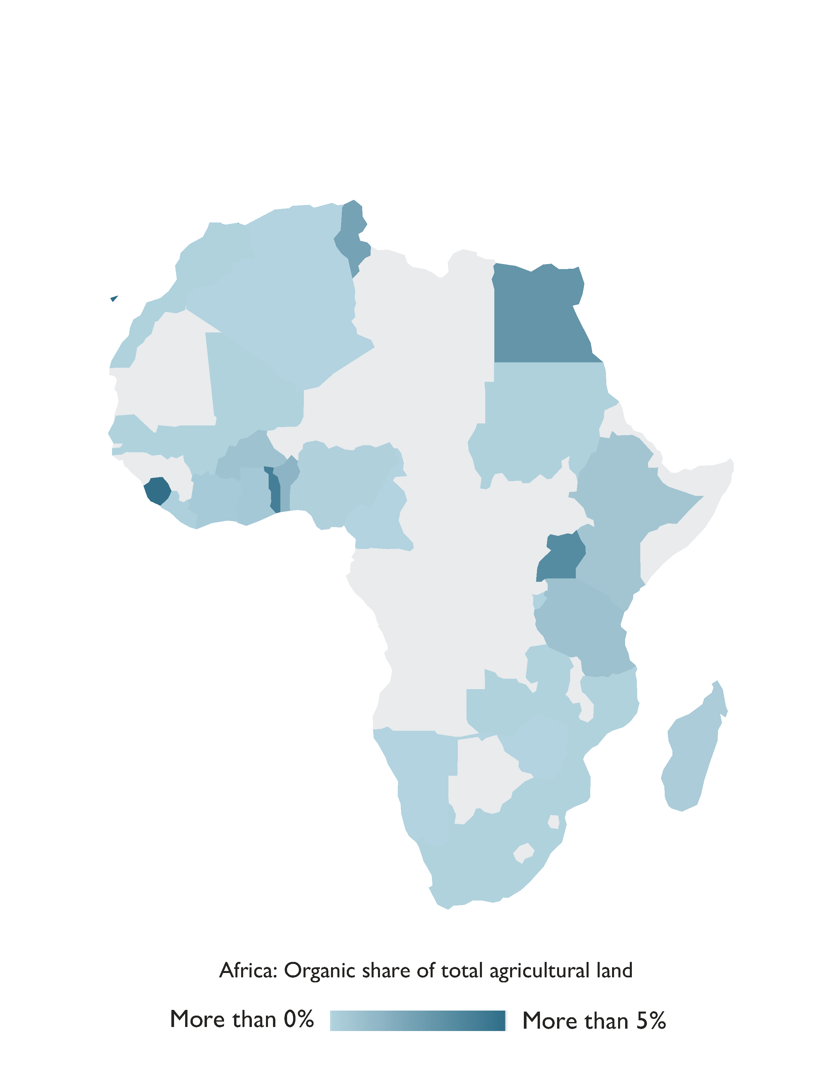
Africa

Slide 8
Organic agriculture in Africa 2023
In 2023, Africa achieved remarkable growth in organic farming, with certified organic agricultural land expanding by an impressive 24.4 percent—the highest increase among all regions.
This growth added over 668’000 hectares, bringing the total to 3’403’319 hectares.
The region also had almost one million producers actively engaged in organic farming, with Uganda leading in both organic land area (505’308 hectares) and the number of producers (404’246).
In São Tomé and Príncipe, 22.1 percent of the country’s total agricultural land is devoted to organic farming, highlighting its significant role in the sector.
Africa’s key organic products include oilseeds (over 92 percent were soybeans), coffee, nuts, textile crops, cocoa, and olives, most of which are targeted for export markets
Source: FiBL survey 2025

Slide 9
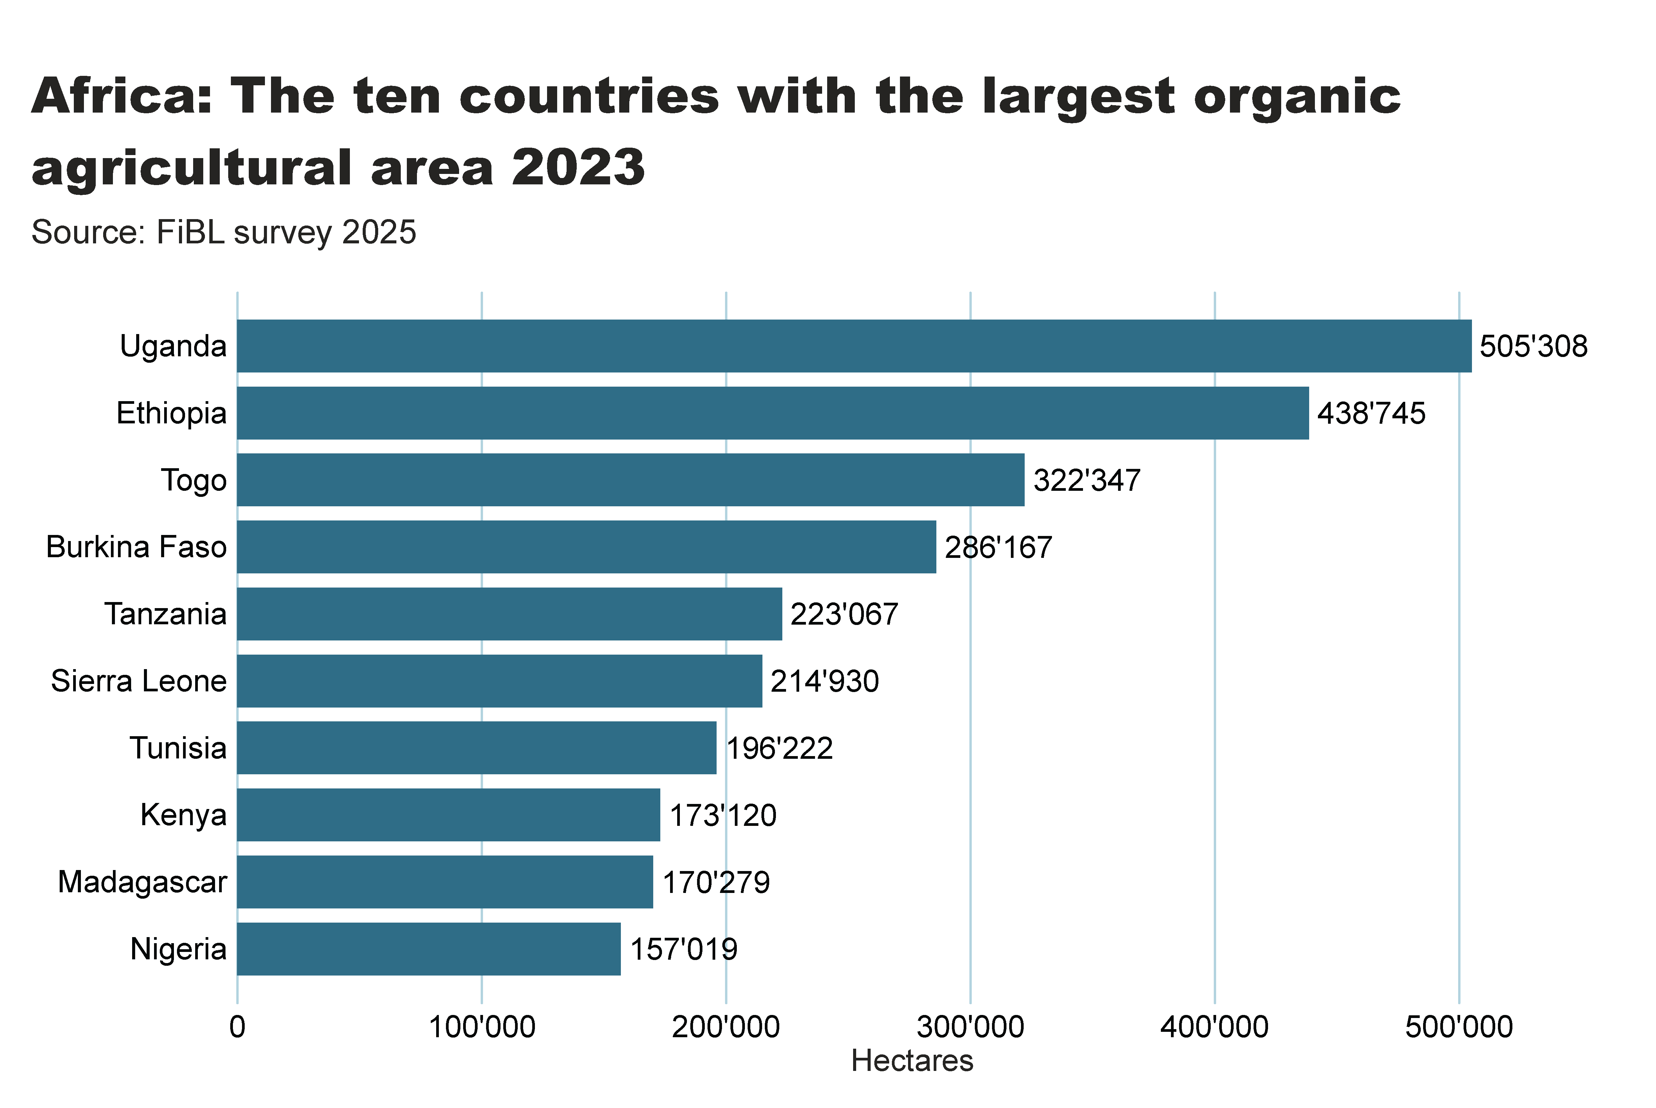

Slide 10
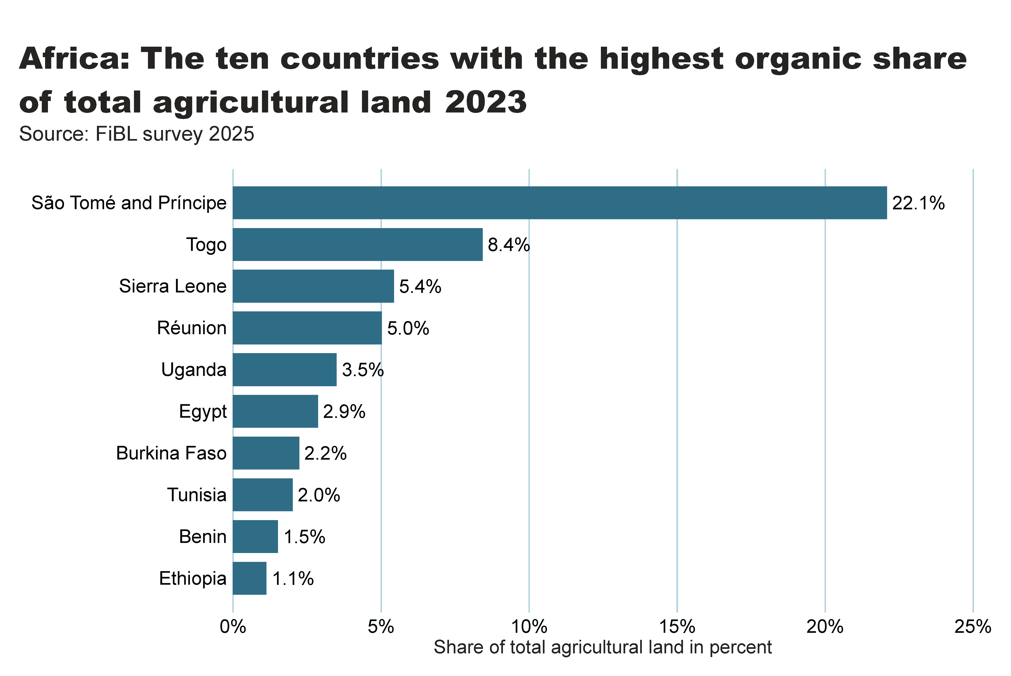

Slide 11
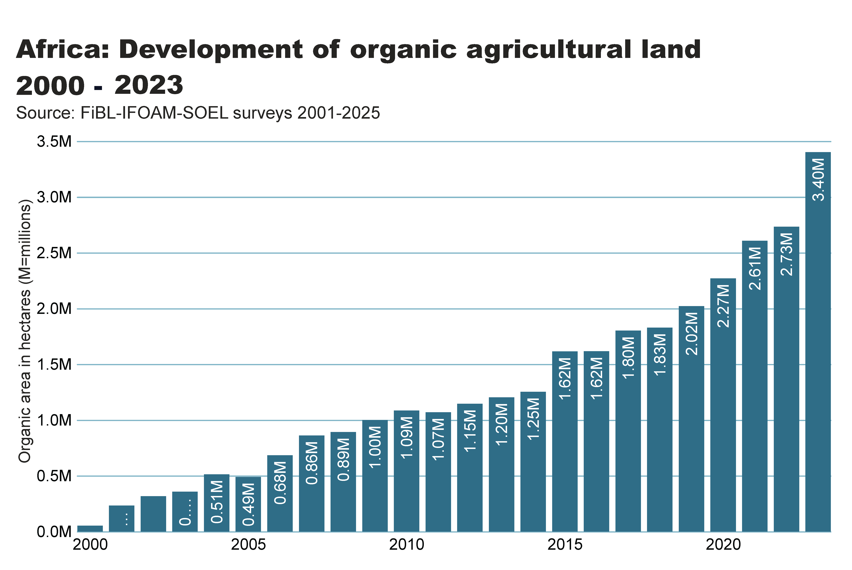

Slide 12
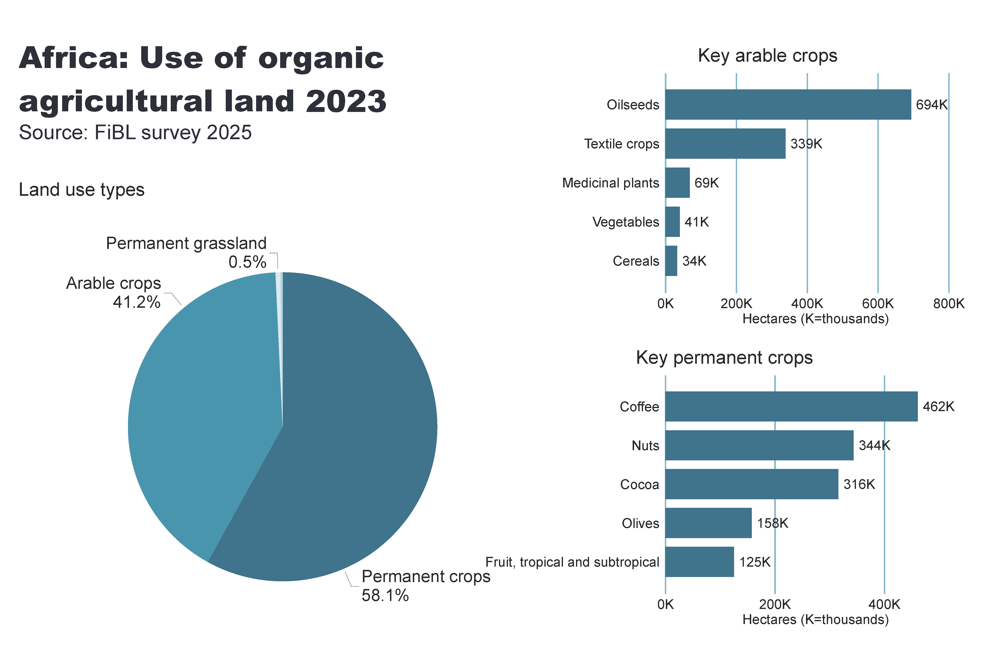
Africa_land_use
Notes:
Land use types
No alt text provided
card
No alt text provided
Key arable crops
No alt text provided
Key permanent crops
No alt text provided
textbox
No alt text provided

Slide 13
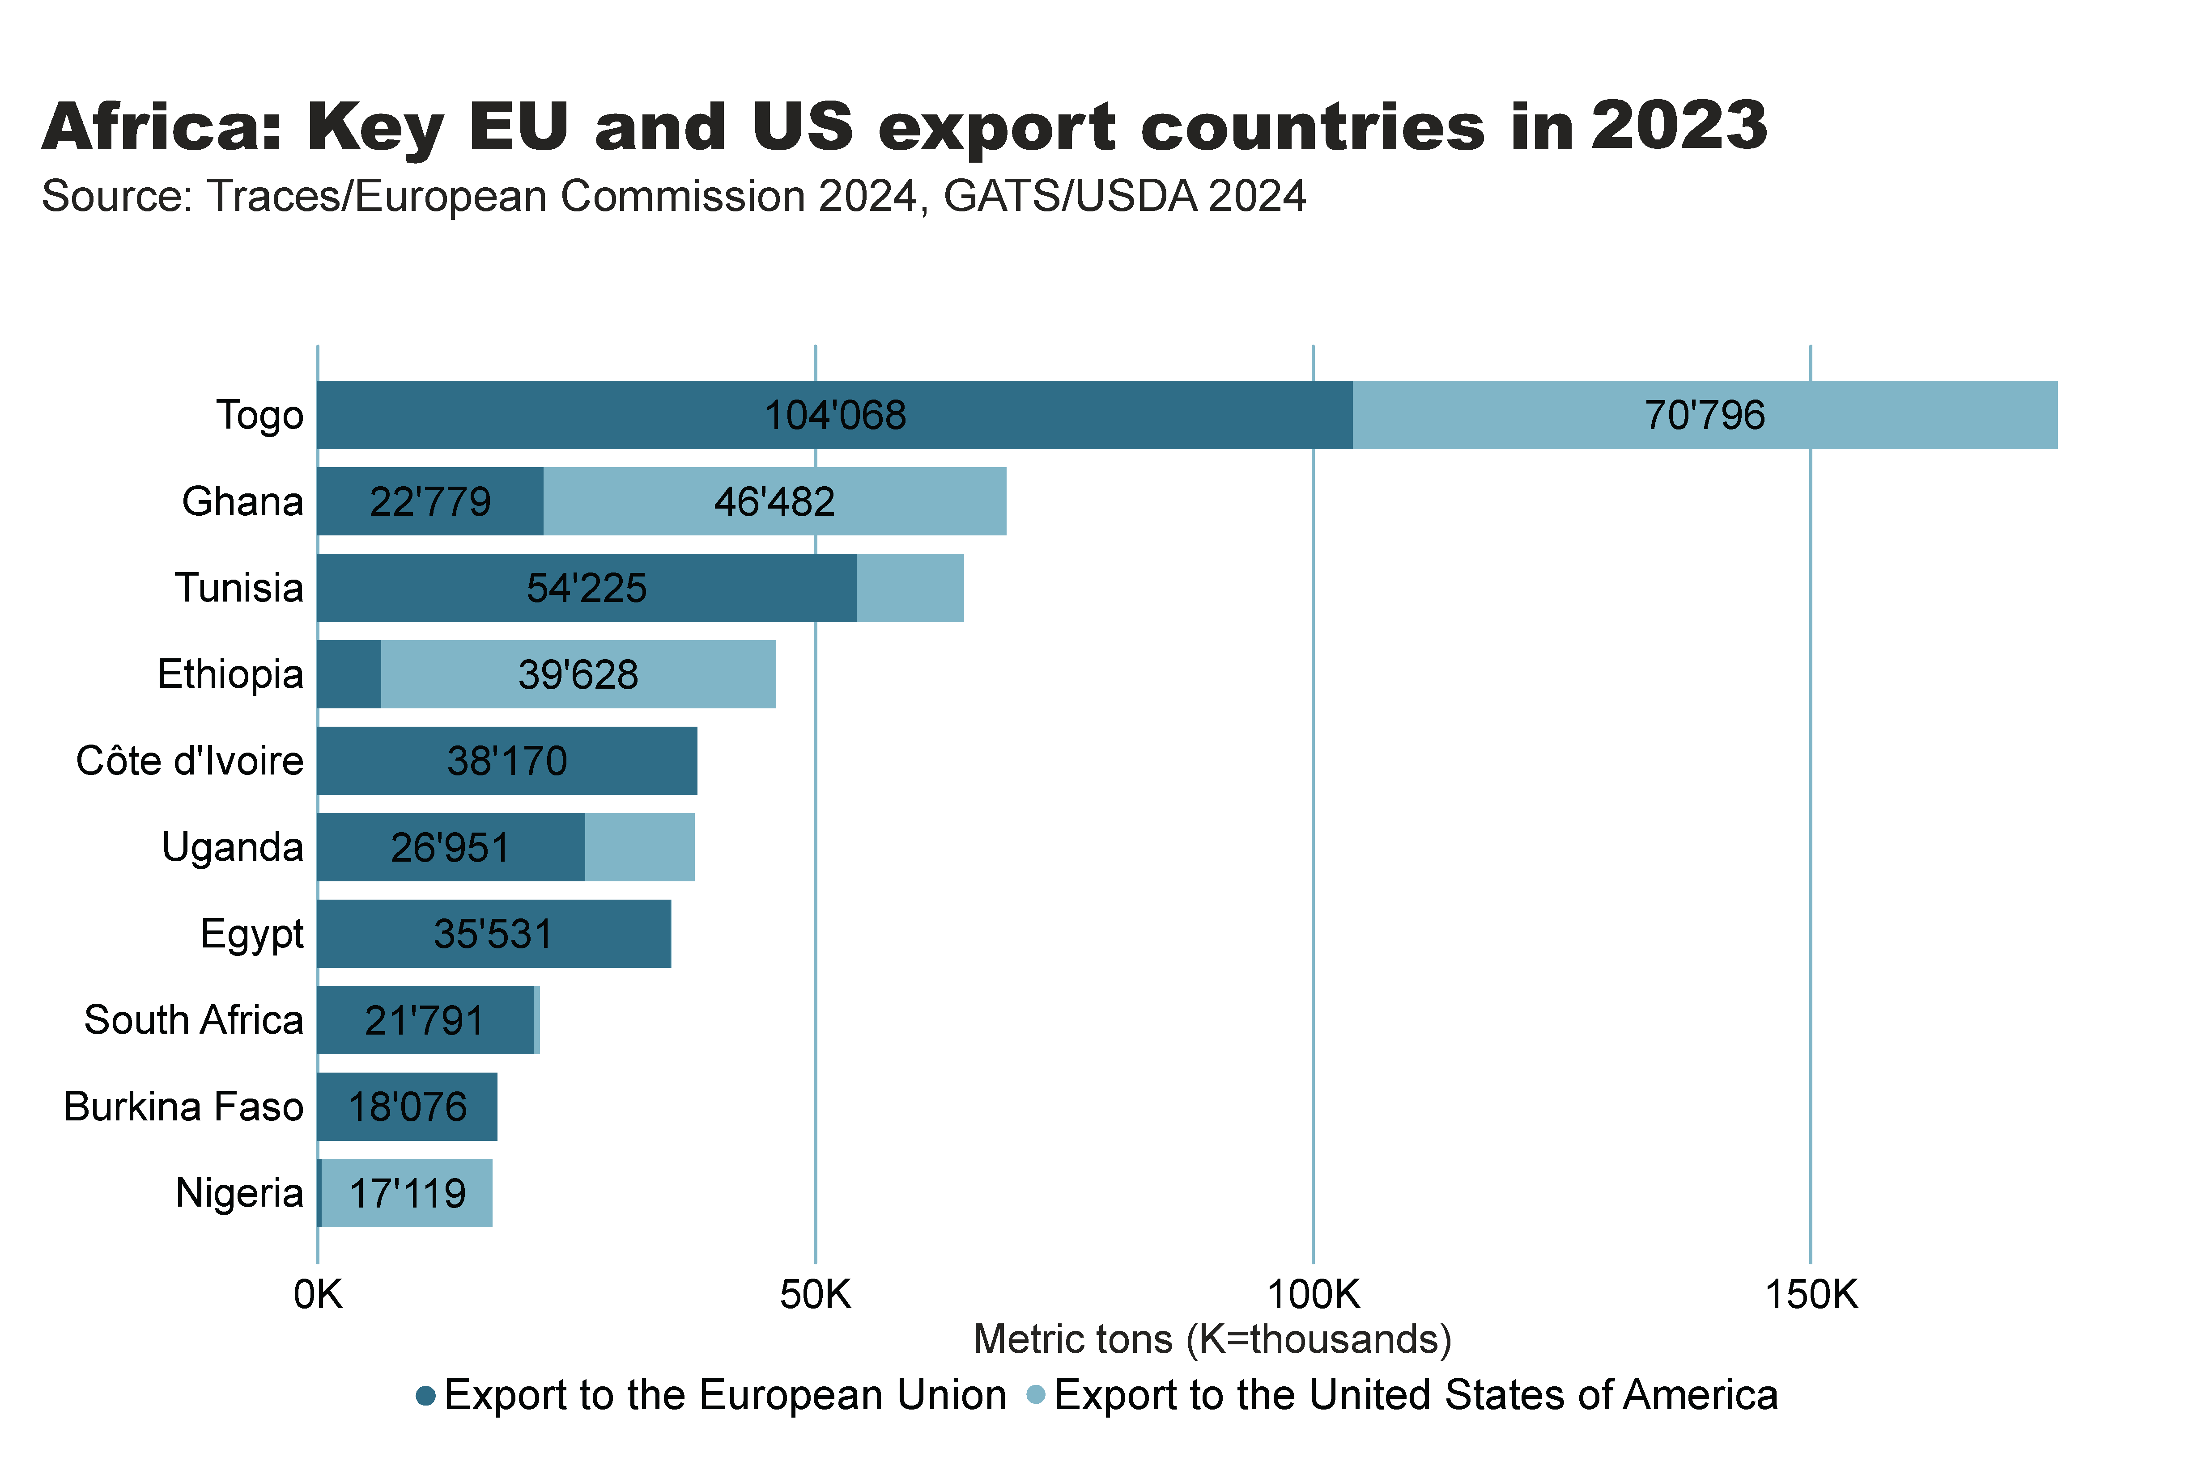

Slide 14
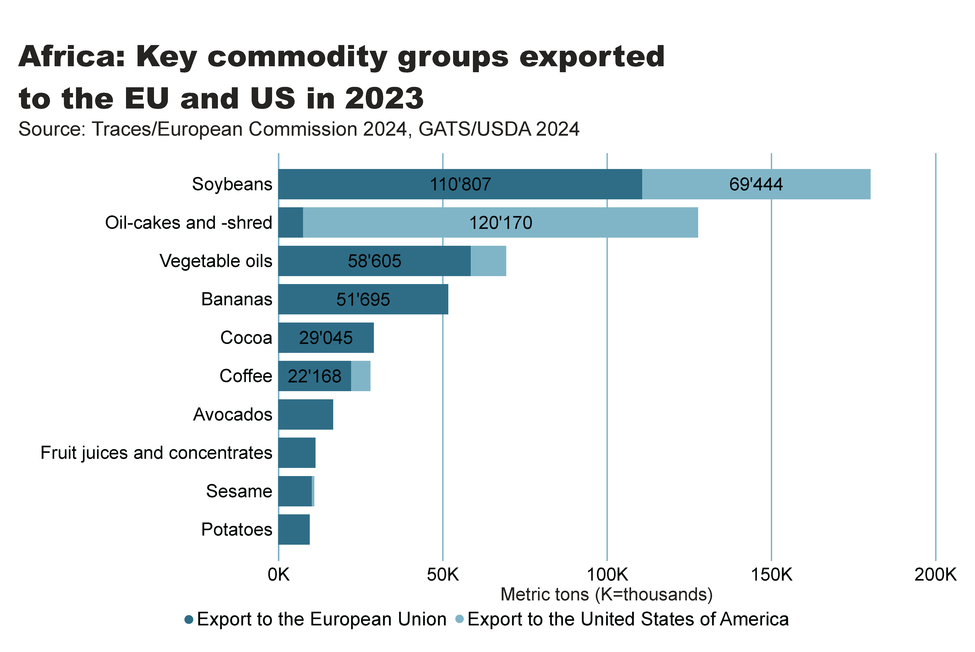

Slide 15
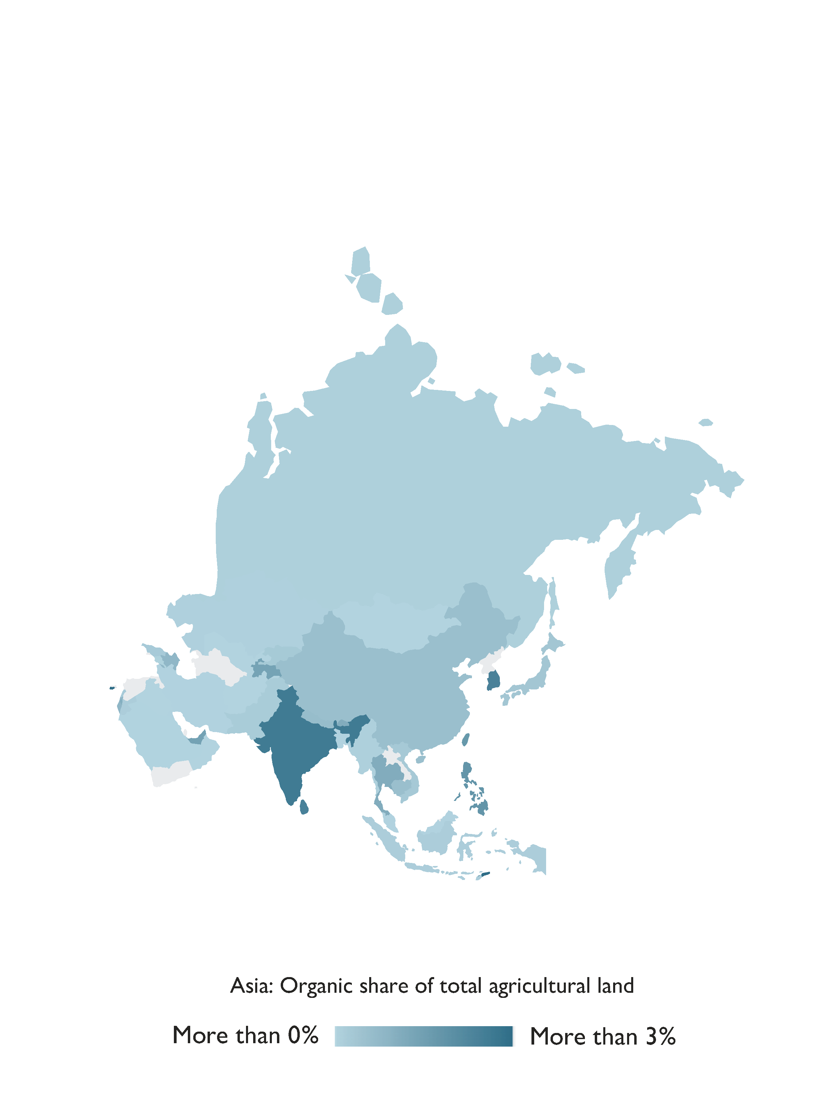
Asia

Slide 16
Organic Agriculture in Asia 2023
In 2023, Asia had over 9.1 million hectares of organic agricultural land, managed by approximately 2.6 million producers, representing 59 percent of the total organic producers.
India led in both organic area and the number of producers, with 4.5 million hectares and 2.4 million producers.
China followed with 3.4 million hectares, while Kazakhstan ranked third with 0.2 million hectares. Timor-Leste had the highest organic area share at 9.2 percent, followed by India and Sri Lanka, both with 2.5 percent.
Source: FiBL survey 2025

Slide 17
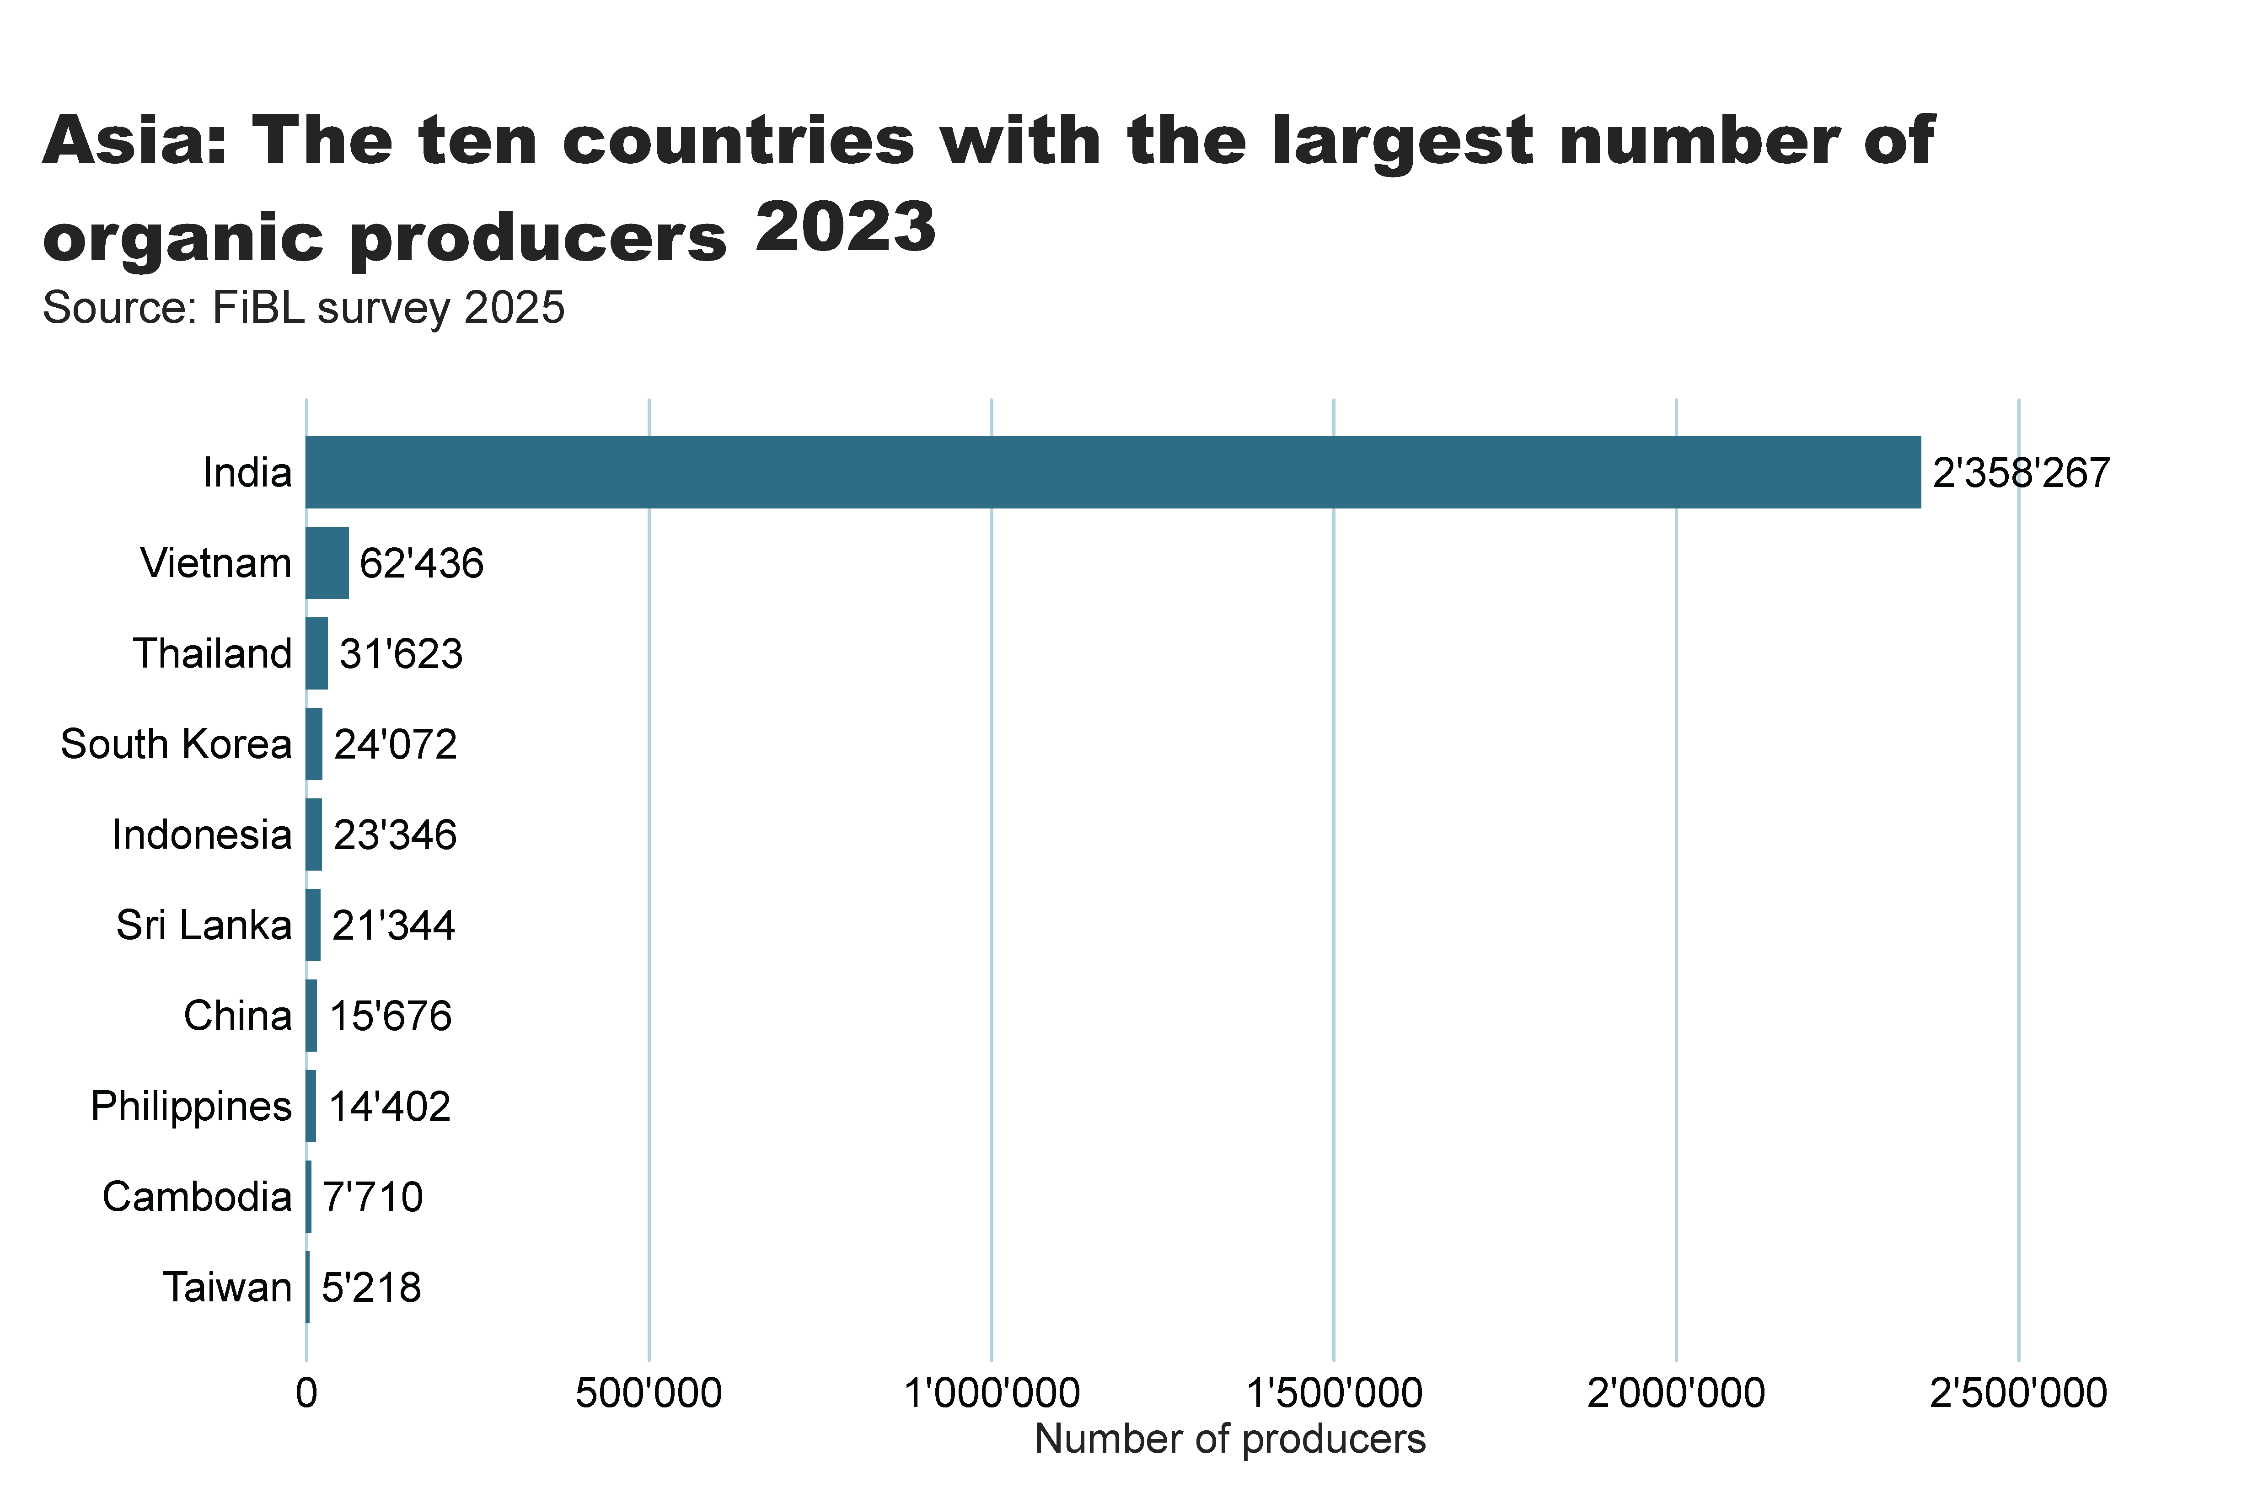
Asia_land_country
Notes:
clusteredBarChart
No alt text provided
textbox
No alt text provided
card
No alt text provided

Slide 18
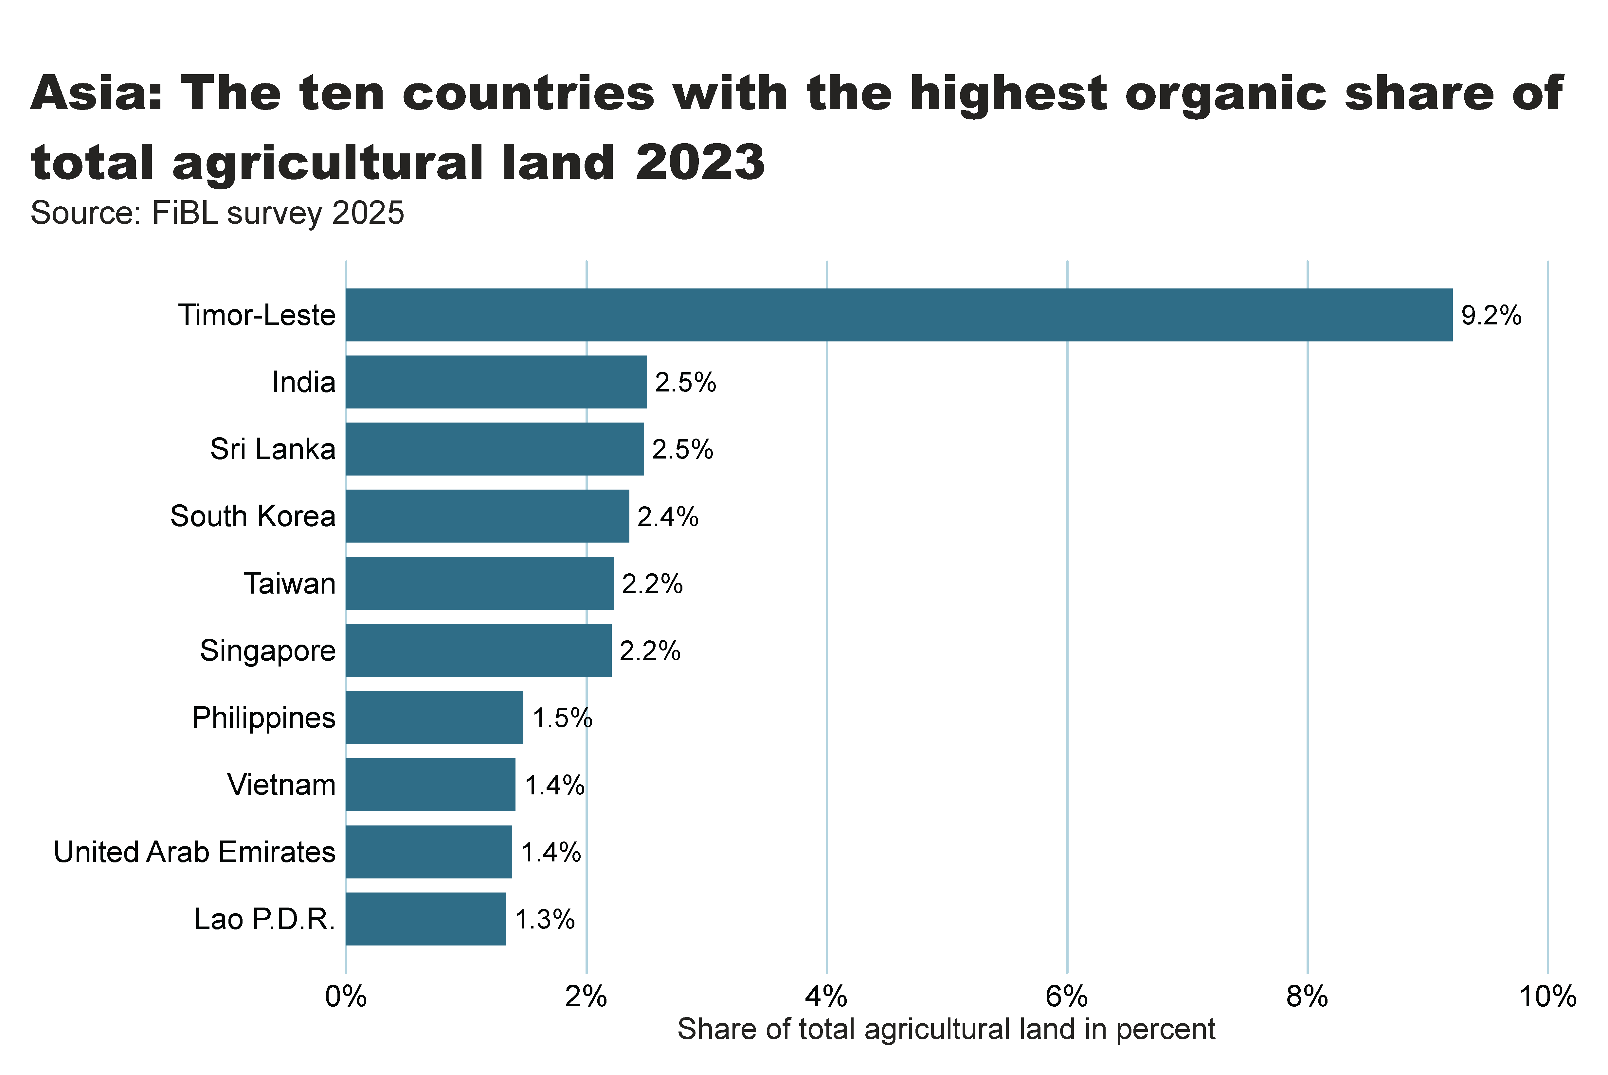
Asia_land_share_country
Notes:
textbox
No alt text provided
Source: FiBL survey 2025
No alt text provided
card
No alt text provided

Slide 19
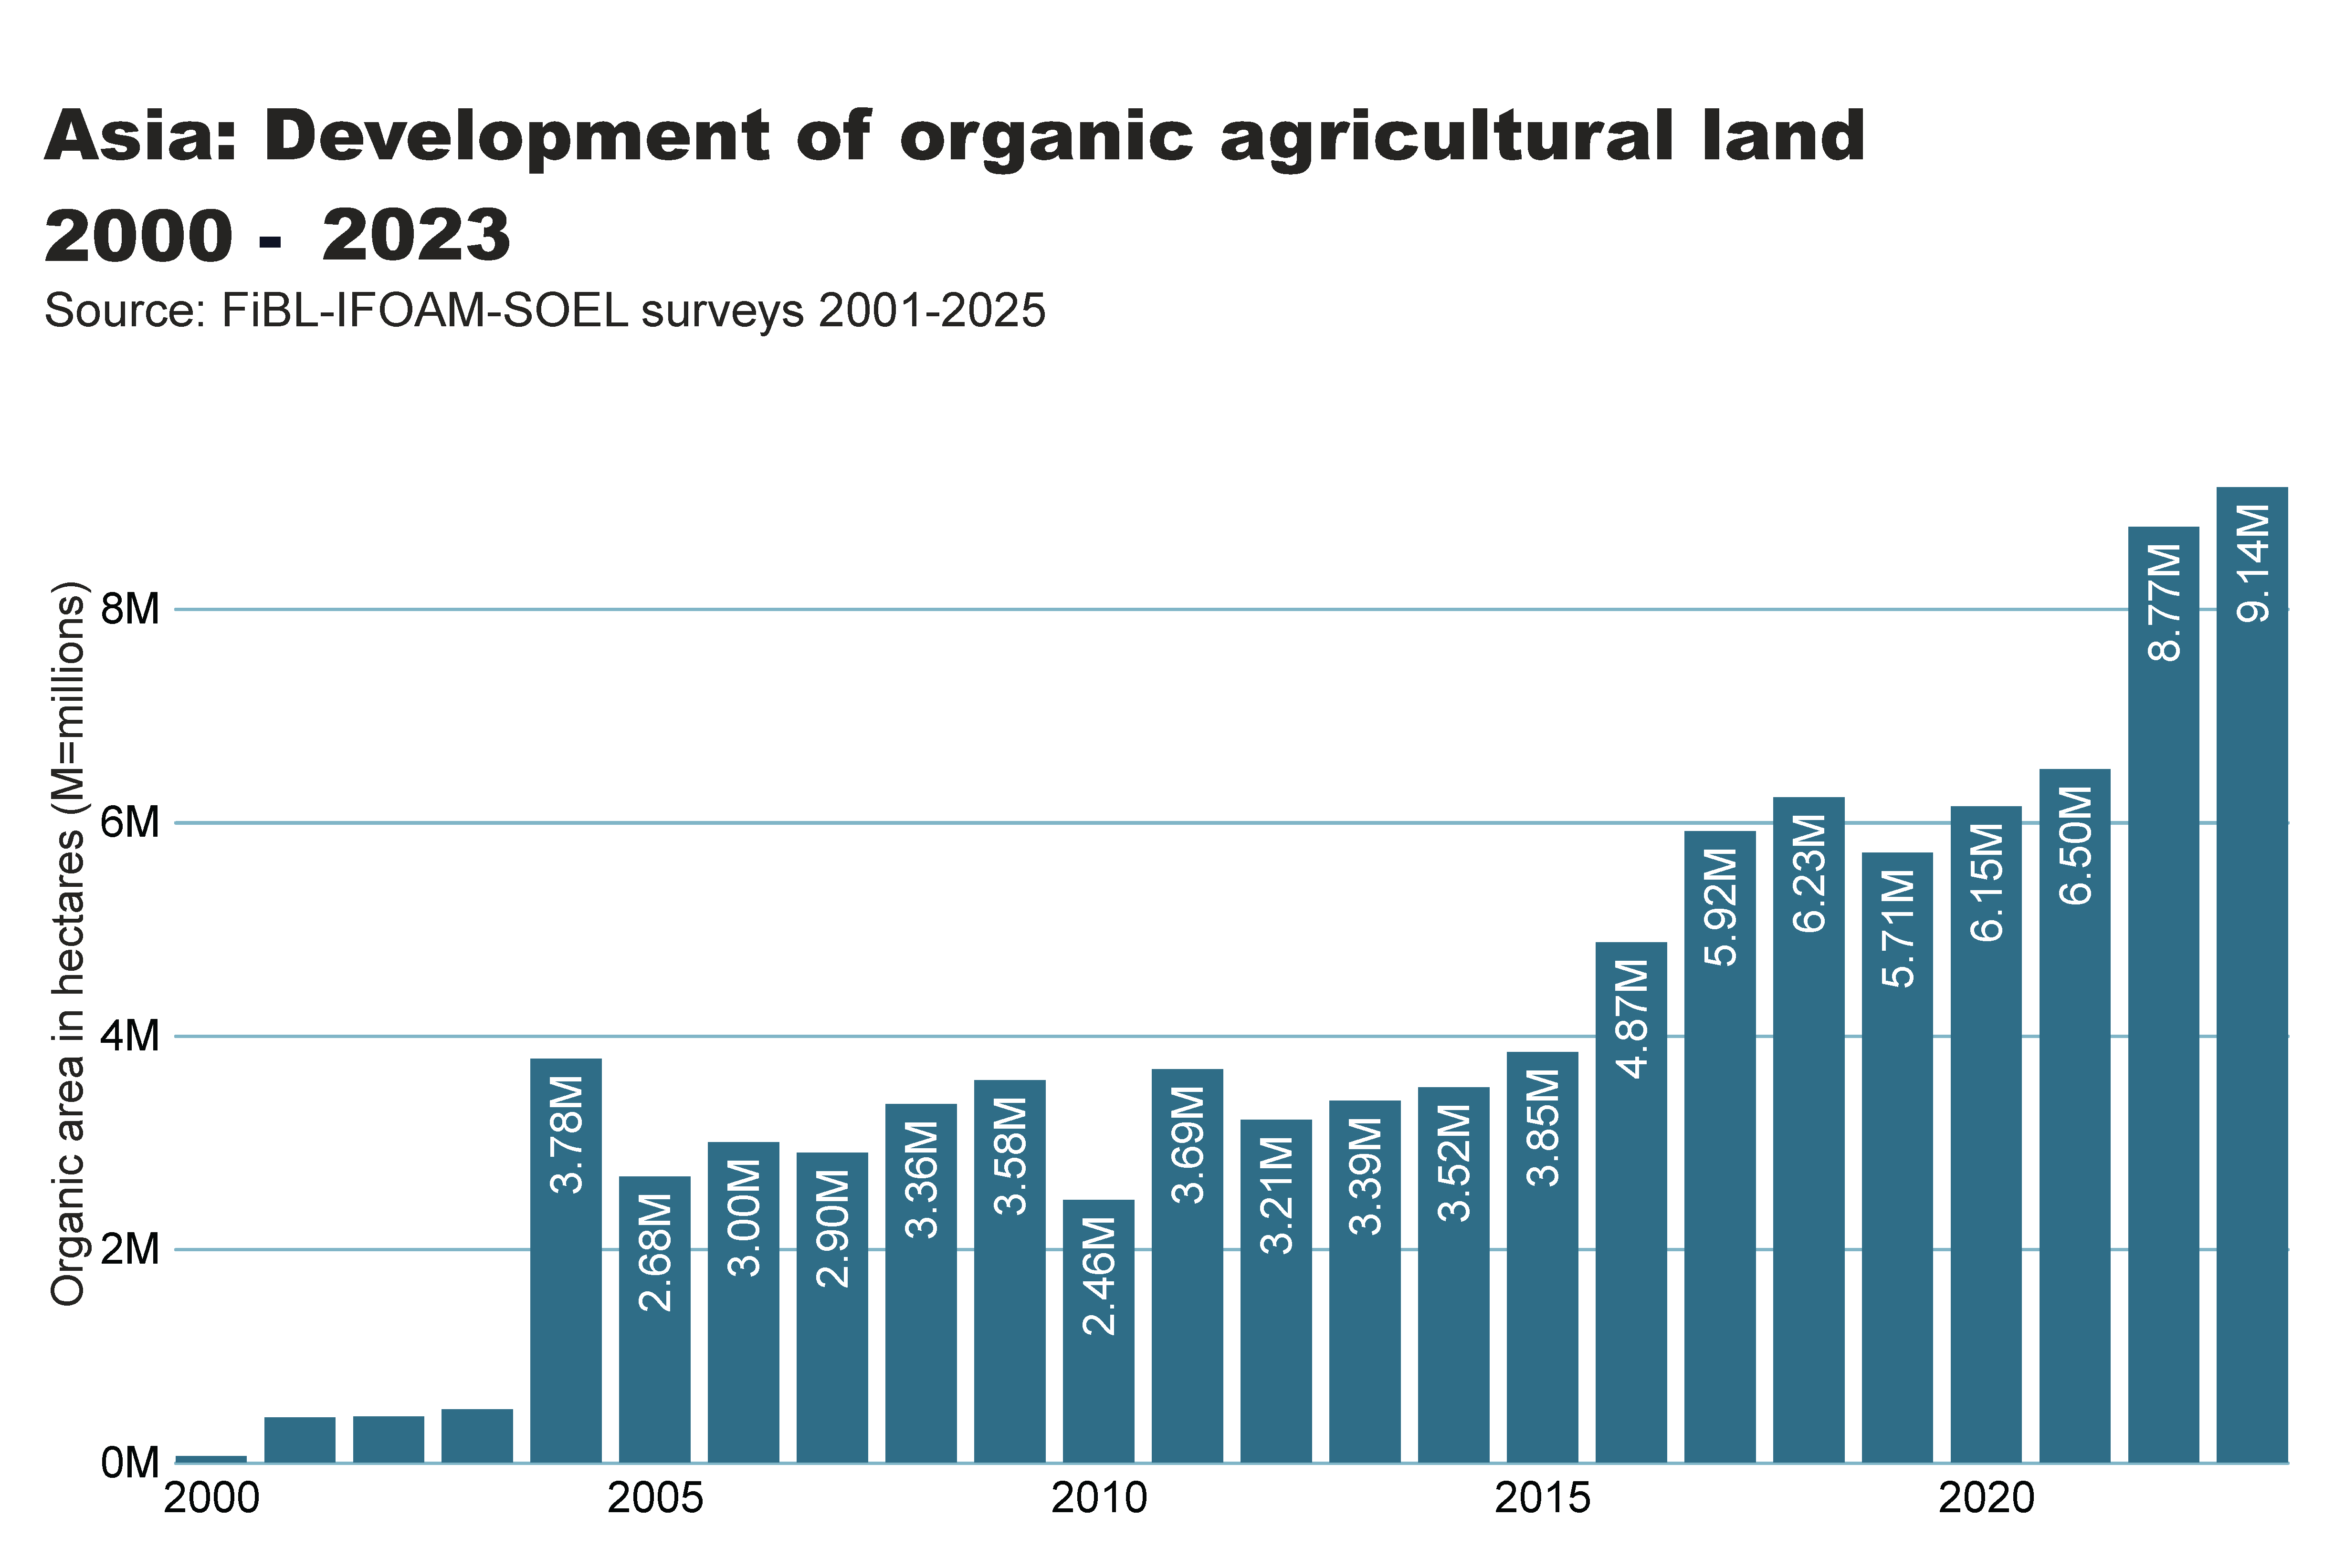
asia_land_growth
Notes:
textbox
No alt text provided
card
No alt text provided
Source: FiBL-IFOAM-SOEL surveys 2001-2025
No alt text provided

Slide 20

Asia_producers_country
Notes:
textbox
No alt text provided
card
No alt text provided
barChart
No alt text provided

Slide 21
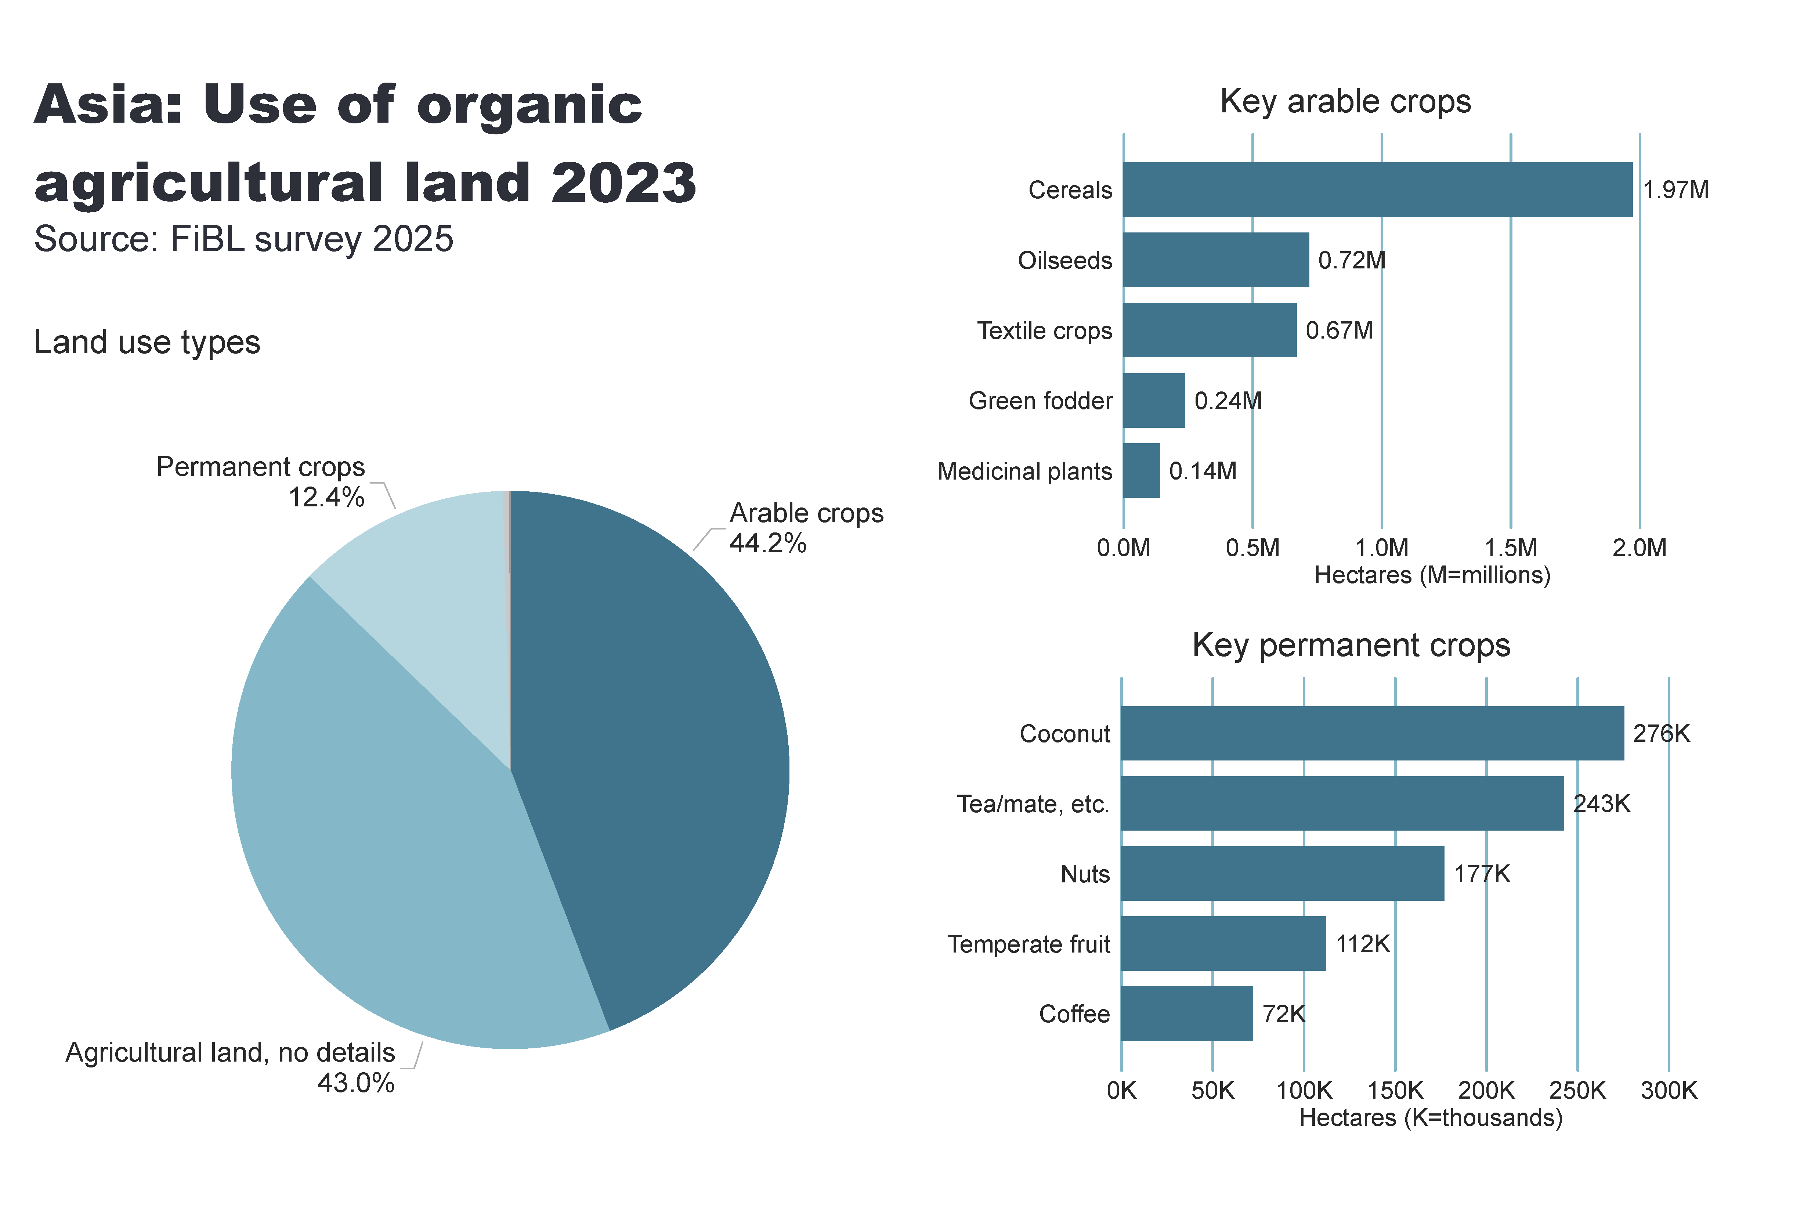
Asia_land_use
Notes:
Land use types
No alt text provided
card
No alt text provided
Key arable crops
No alt text provided
Key permanent crops
No alt text provided
textbox
No alt text provided

Slide 22
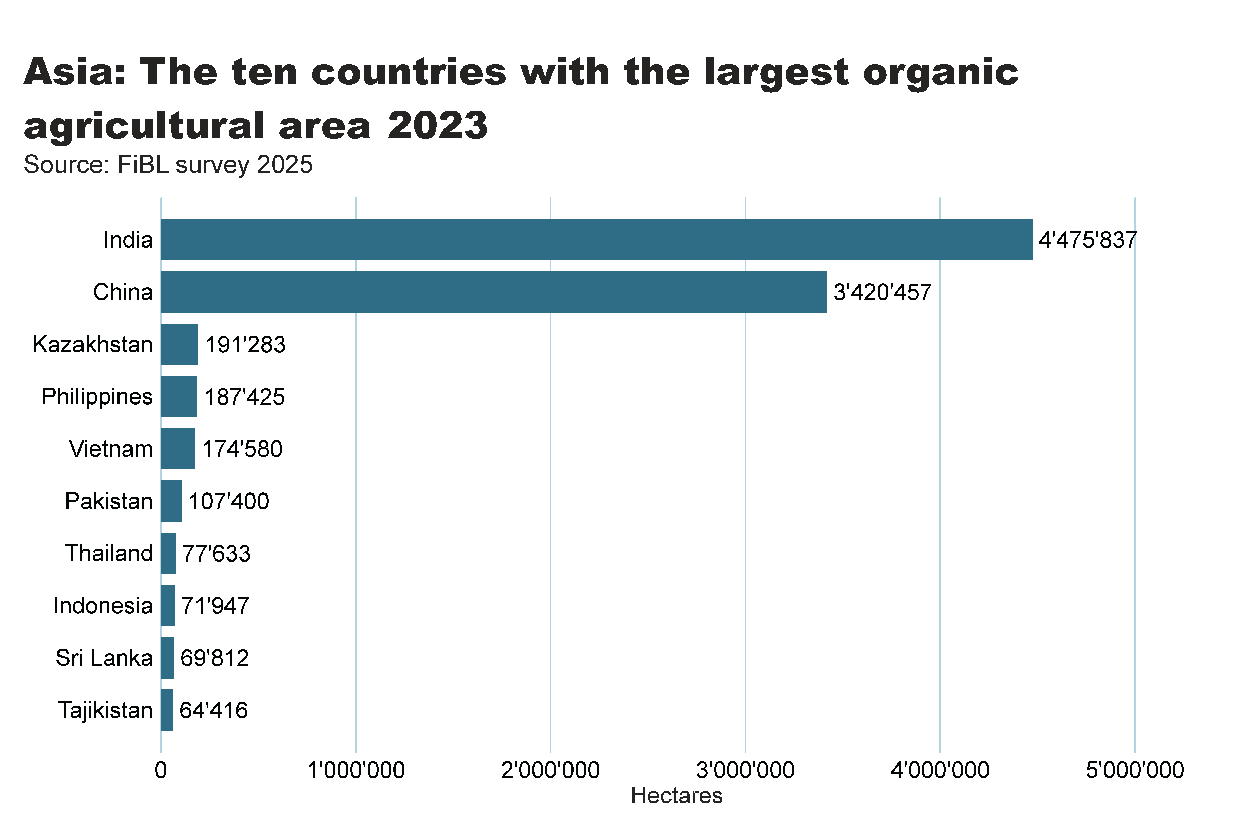
Asia_producers_country
Notes:
textbox
No alt text provided
card
No alt text provided
barChart
No alt text provided

Slide 23
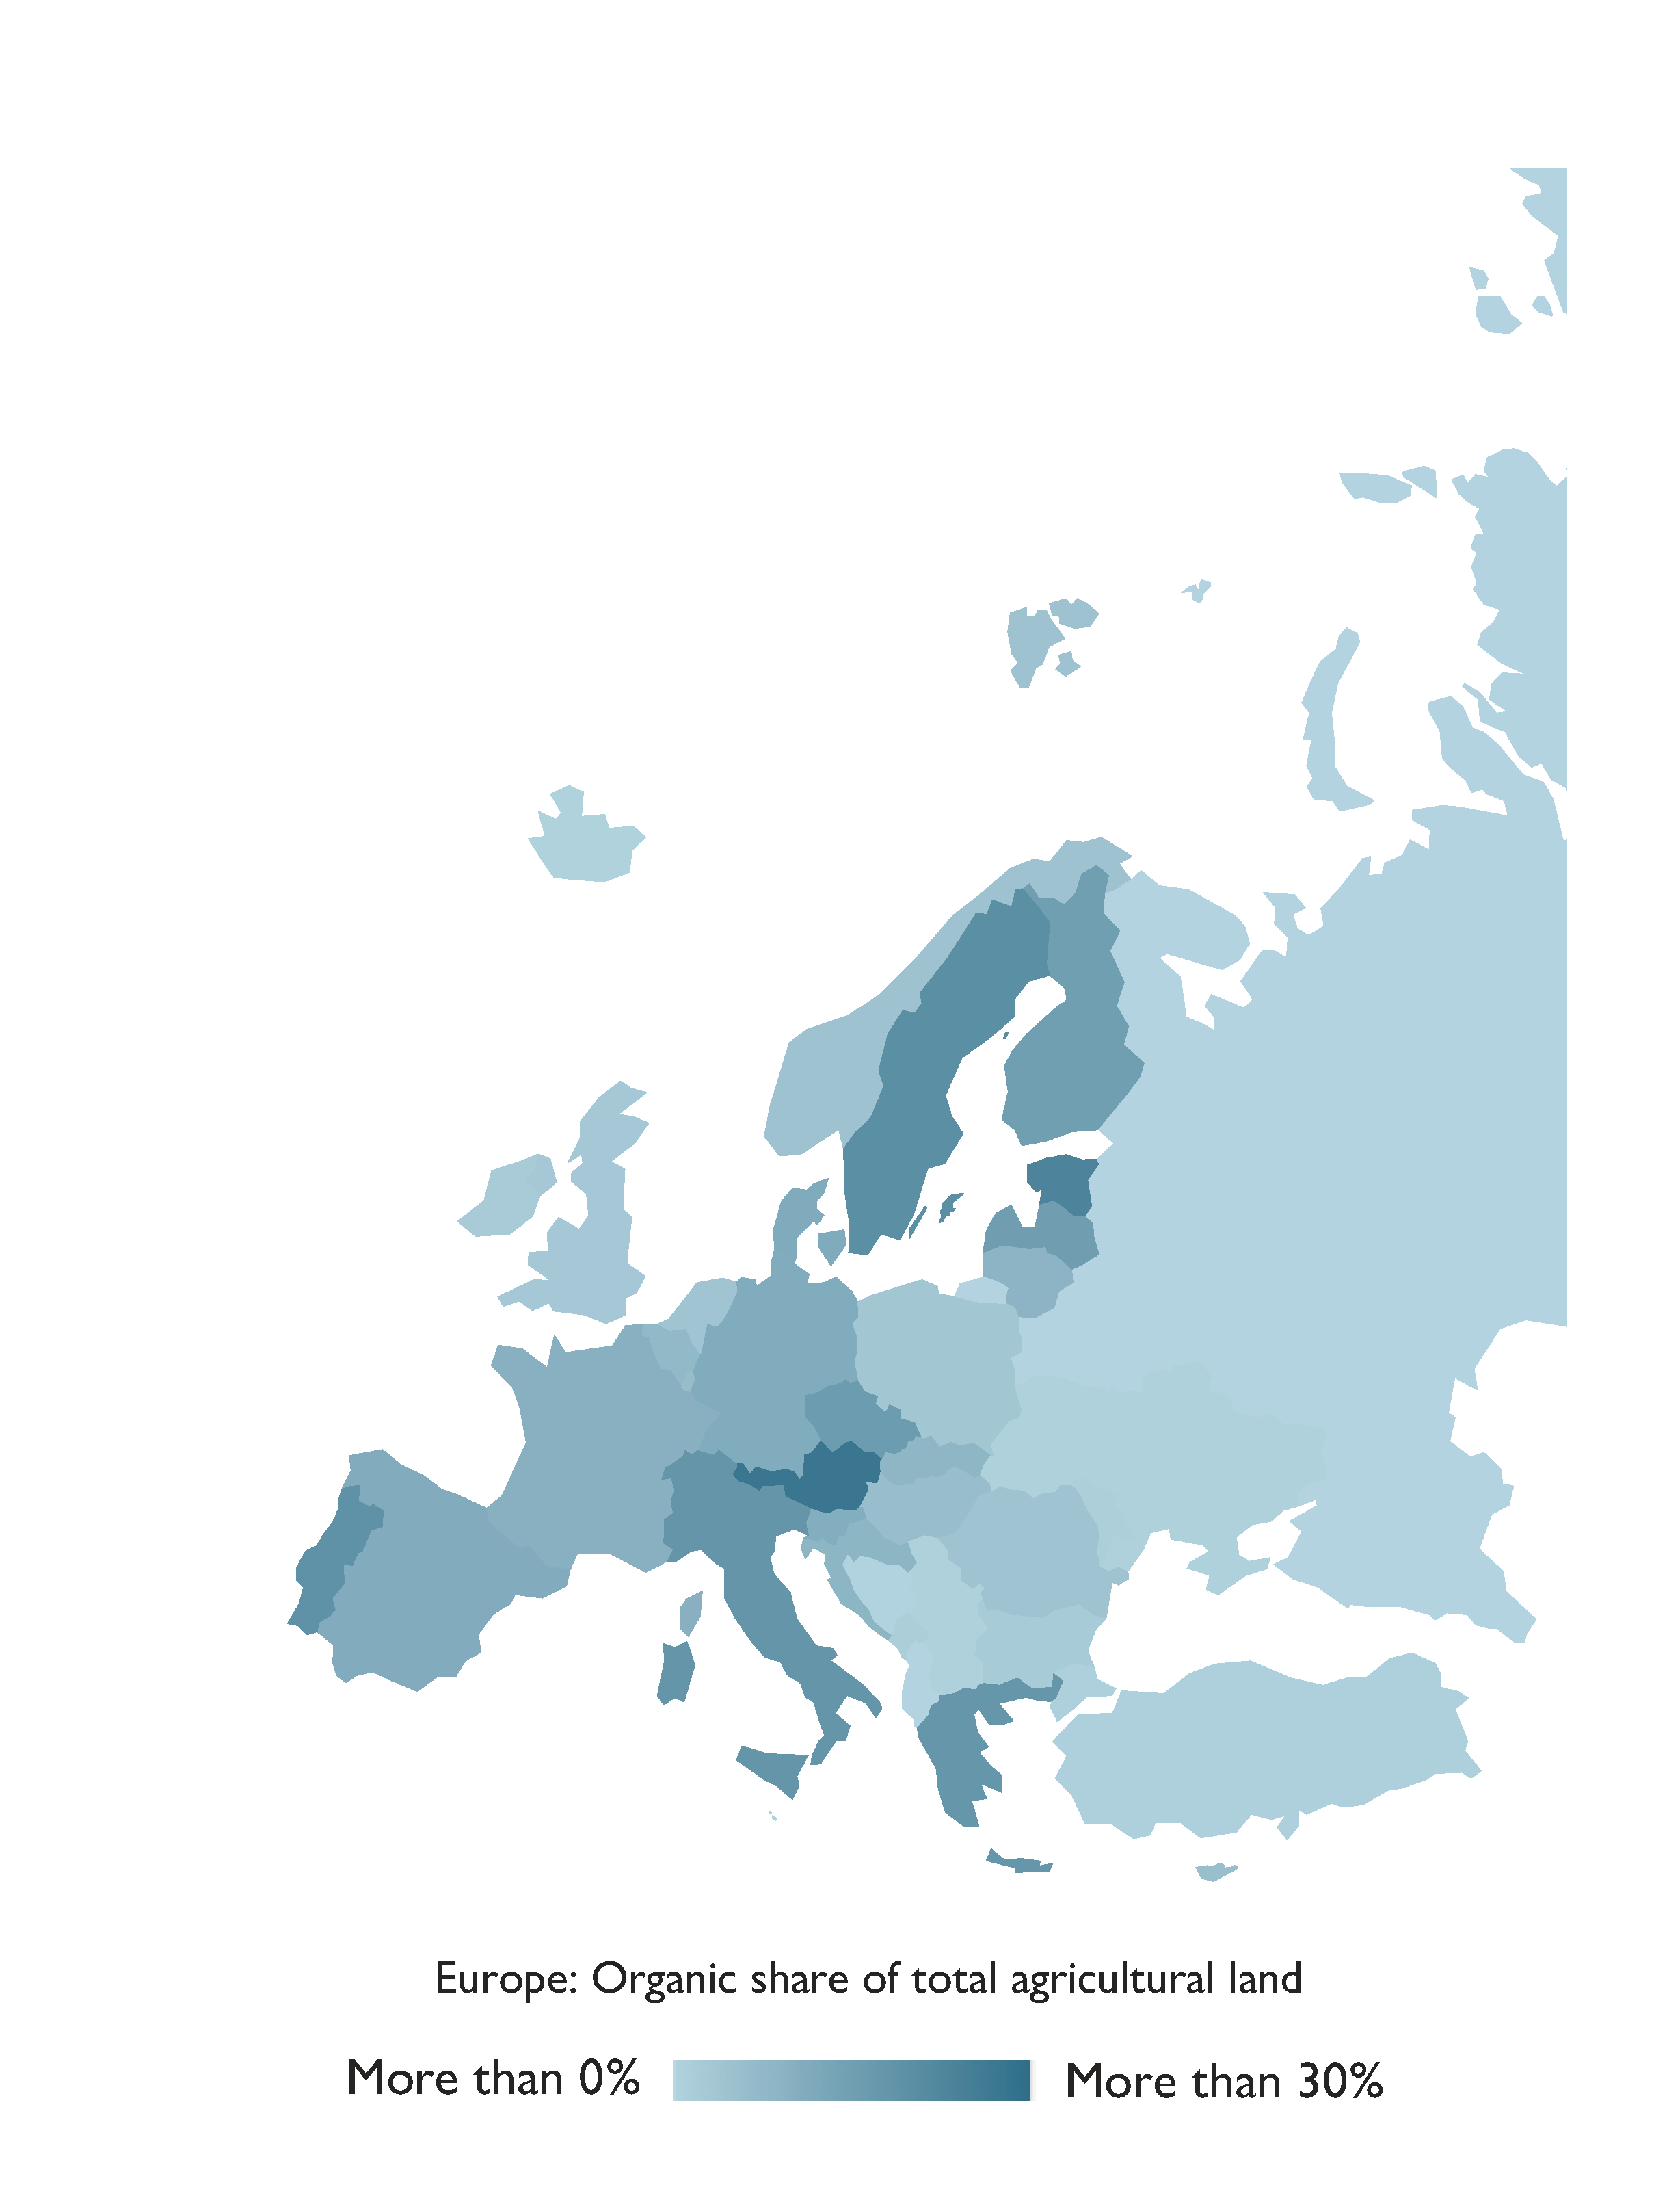
Europe:
Organic agricultural land 2023
Source: FiBL survey 2025, based on national sources and Eurostat.

Slide 24
Organic agriculture in Europe: Key data 2023
By the end of 2023, Europe had 19.5 million hectares of organic agricultural land (EU: 17.7 million hectares) managed by 494’624 producers (EU: 434’577).
Organic farmland increased by 0.77 million hectares (+4.1 percent) across Europe and by 0.62 million hectares (+3.6 percent) in the EU. Europe’s organic area accounted for 3.9 percent of total farmland, with the EU’s share reaching 10.9 percent.
Spain (2.99 million hectares), France (2.77 million hectares), and Italy (2.46 million hectares) were the top three countries by organic area.
Sixteen countries had more than 10 percent of their farmland under organic management, with Liechtenstein leading at 44.6 percent, followed by Austria (27.3 percent) and Estonia (22.9 percent).
Retail sales of organic products in Europe amounted to 54’736 million euros (+3 percent), while the EU recorded sales of 46’487 million euros (+2.9 percent). Germany, France, and Switzerland remained the largest organic markets, with retail sales of 16’080 million euros, 12’081 million euros, and 4’193 million euros, respectively.
Source: FiBL survey 2025, based on national sources and Eurostat.

Slide 25
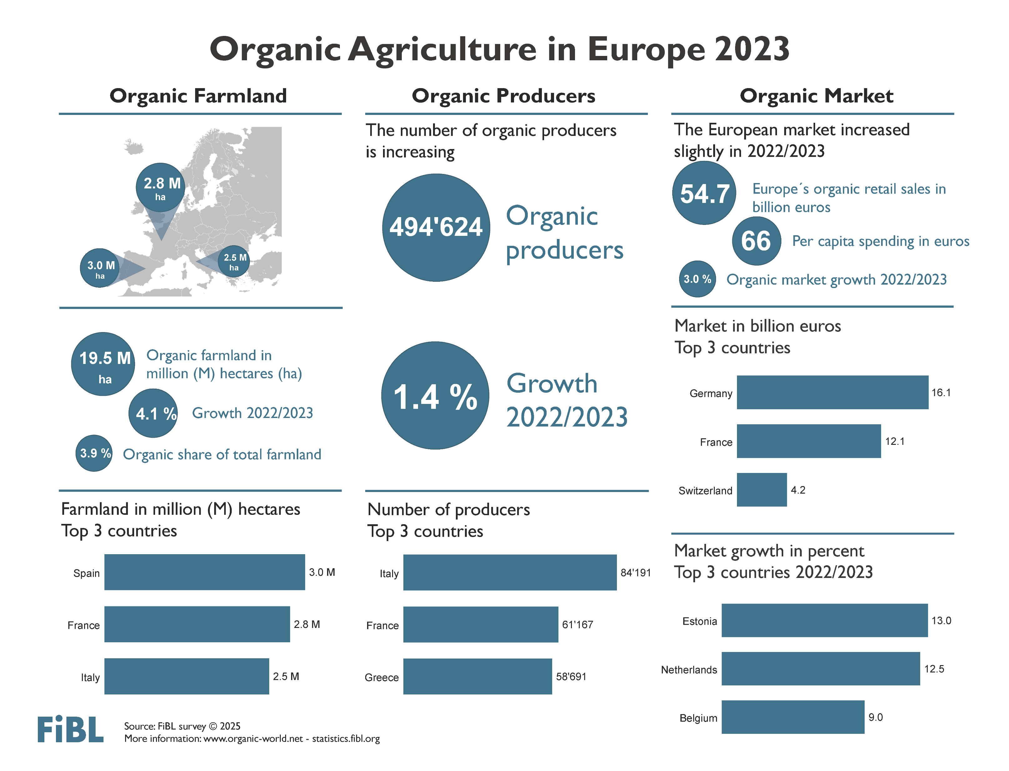

Slide 26
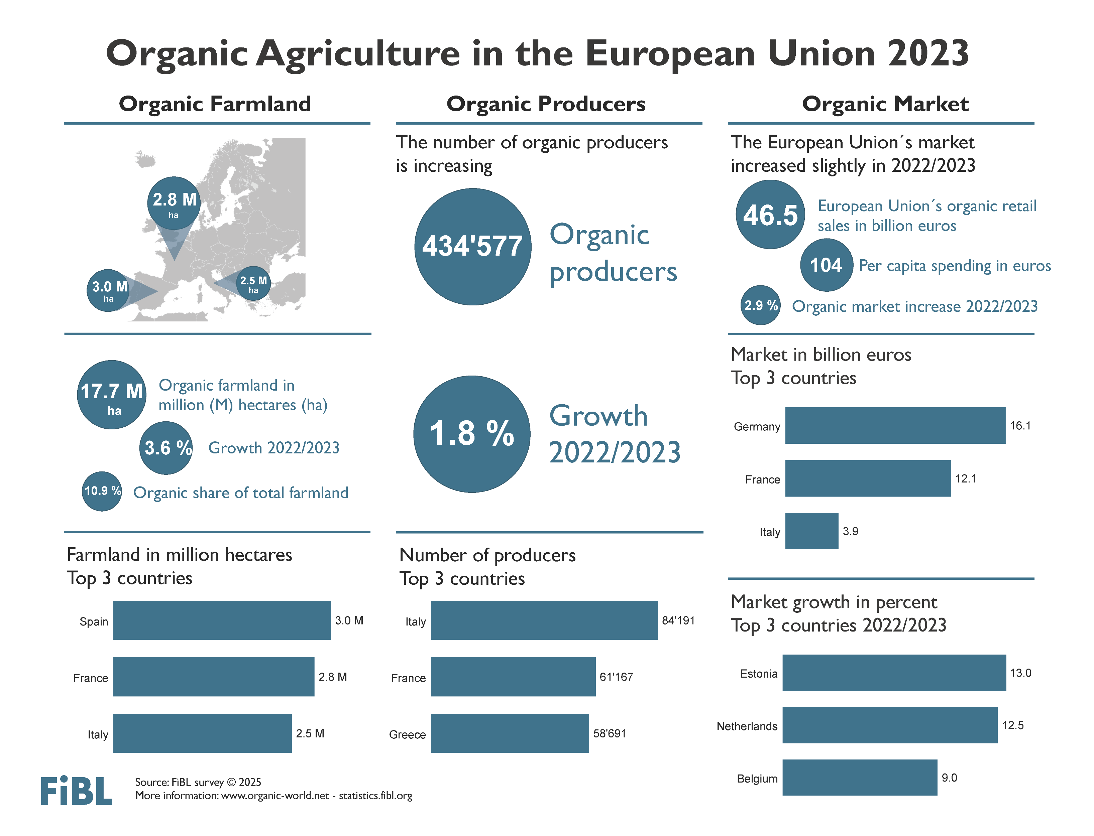

Slide 27
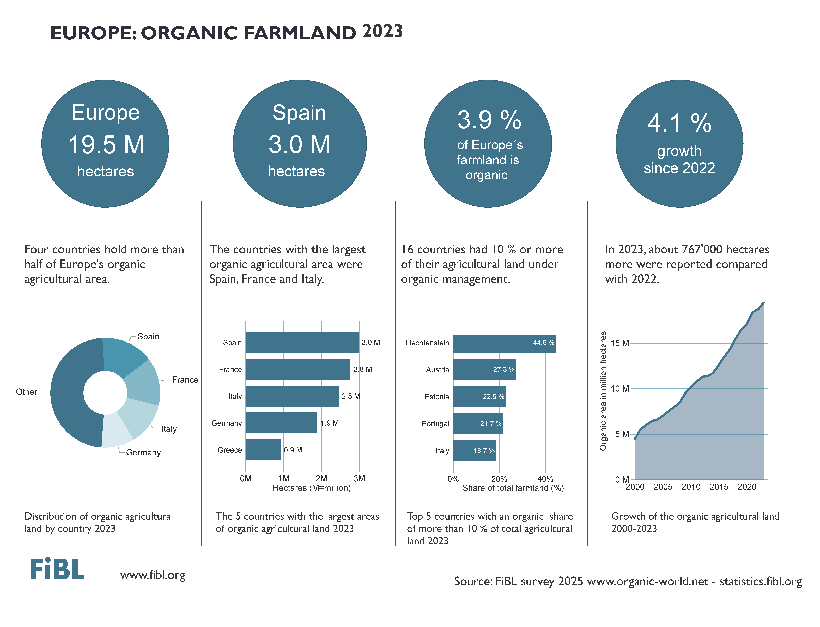

Slide 28
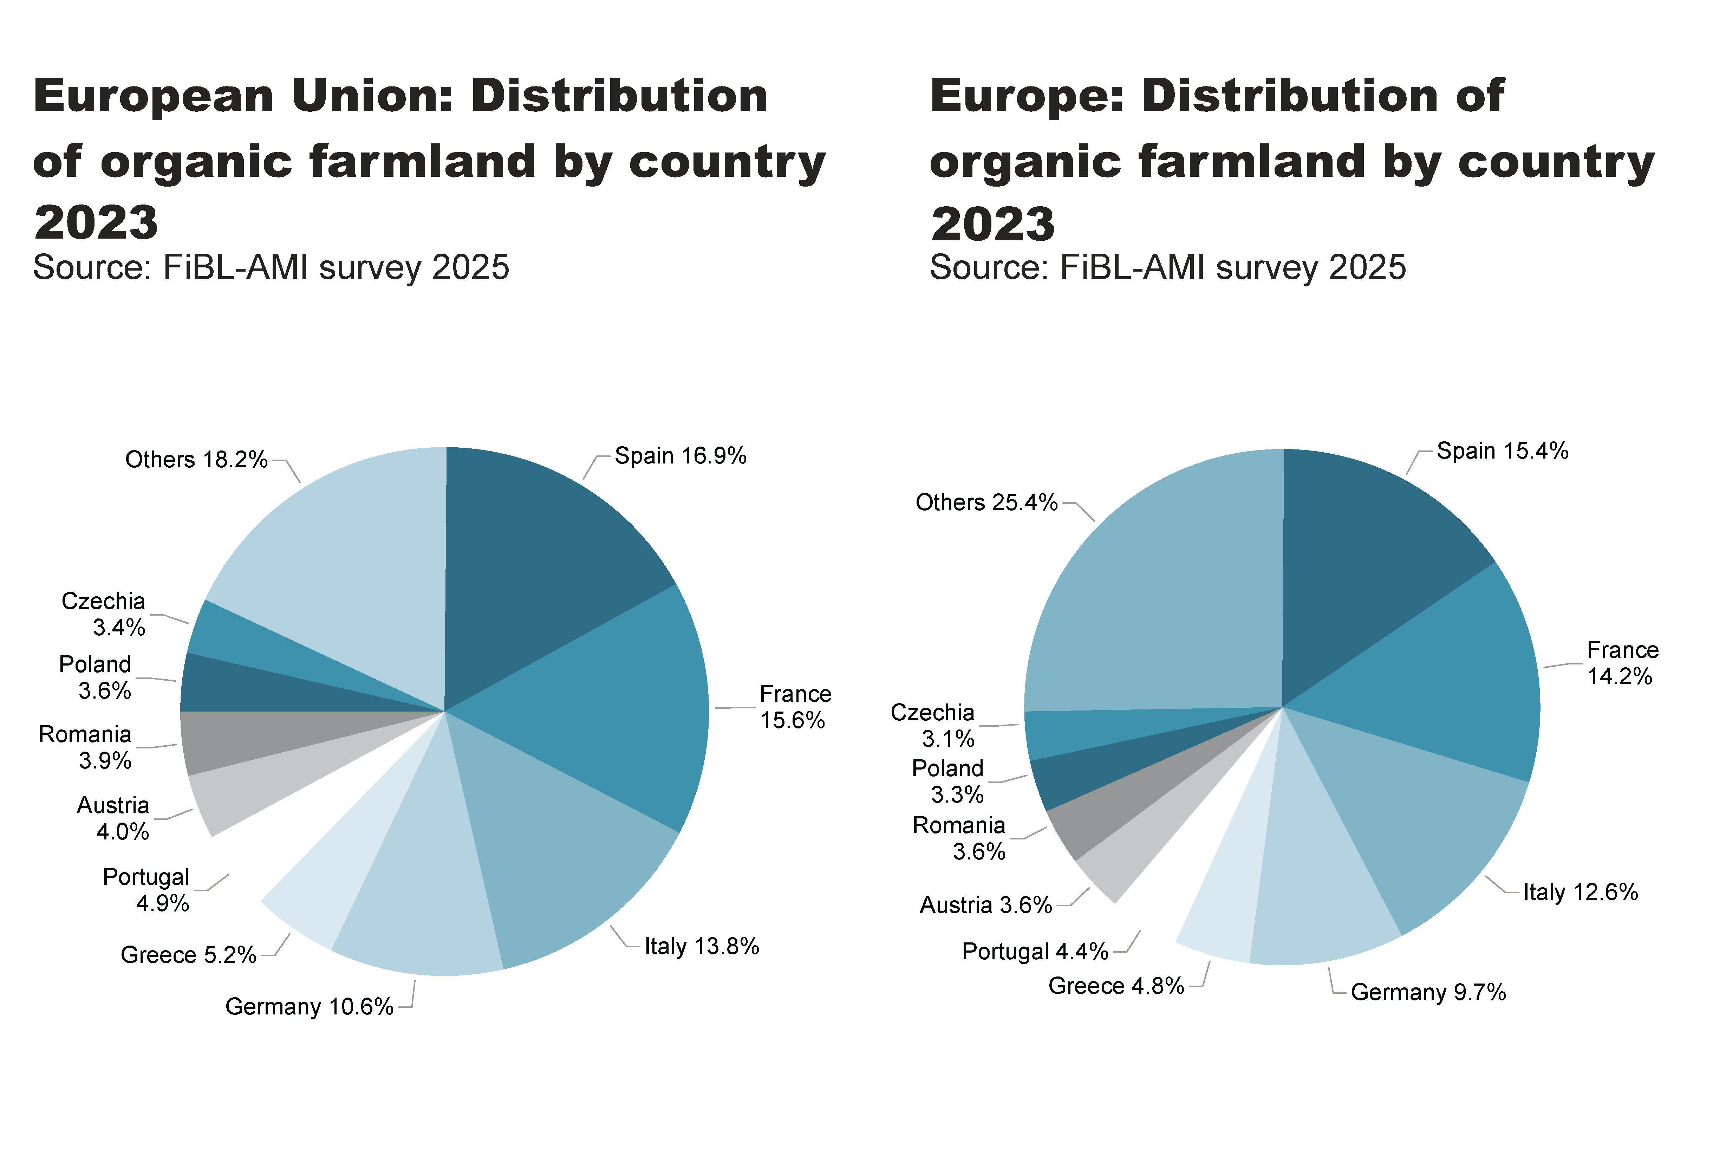
EU_Europe_land_distribution_country
Notes:
pieChart
No alt text provided
textbox
No alt text provided
card
No alt text provided
pieChart
No alt text provided
textbox
No alt text provided
card
No alt text provided

Slide 29
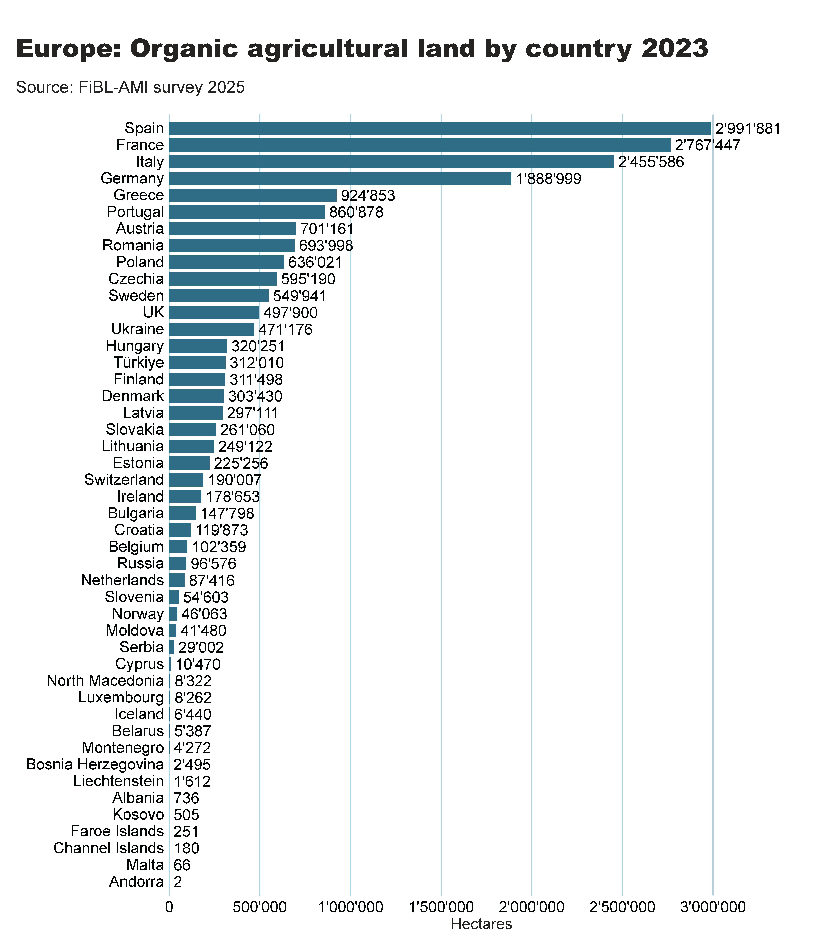
Europe_land_by_country
Notes:
clusteredBarChart
No alt text provided
textbox
No alt text provided
card
No alt text provided

Slide 30
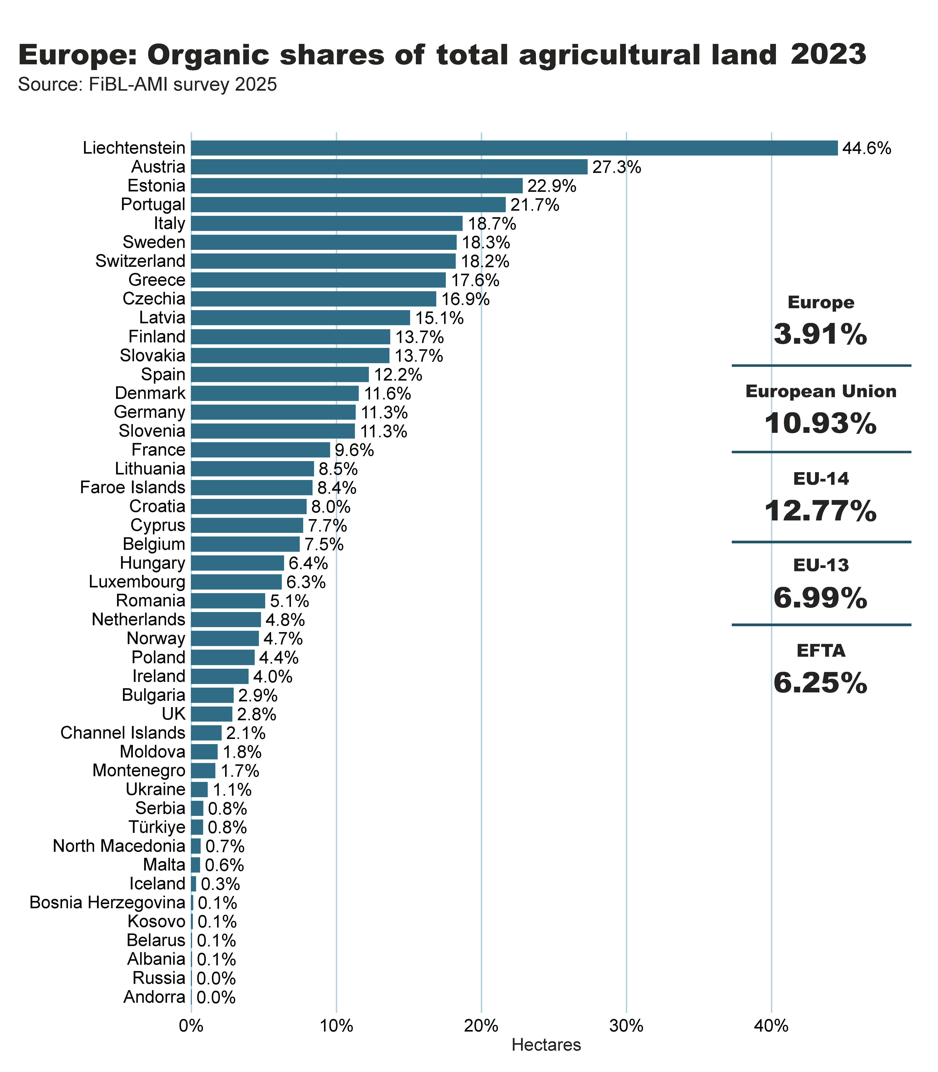
Europe_land_share_country
Notes:
clusteredBarChart
No alt text provided
textbox
No alt text provided
card
No alt text provided
European Union
No alt text provided
Europe
No alt text provided
EFTA
No alt text provided
EU-14
No alt text provided
EU-13
No alt text provided
shape
No alt text provided
shape
No alt text provided
shape
No alt text provided
shape
No alt text provided

Slide 31
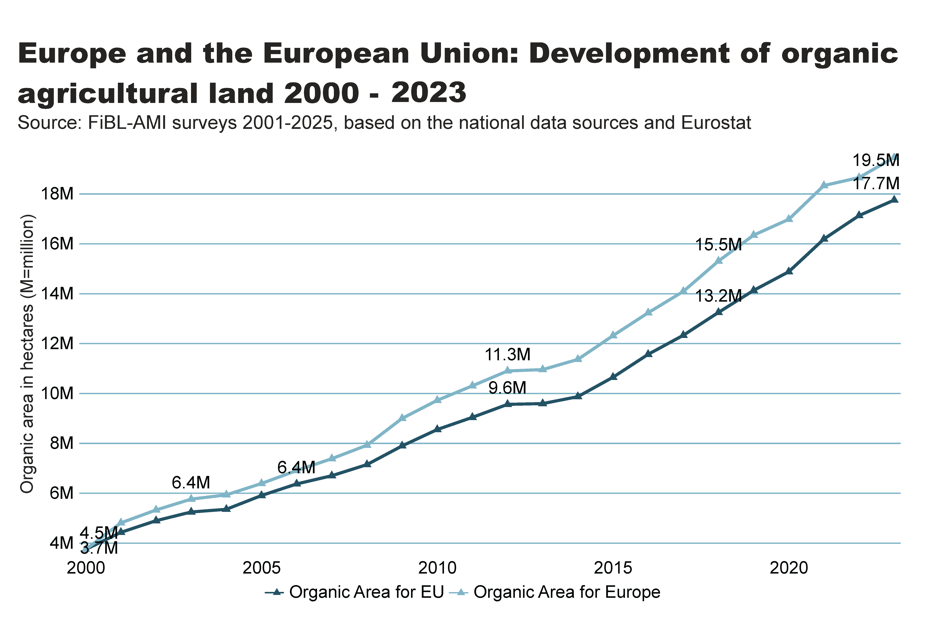
Europe_EU_growth_land
Notes:
textbox
No alt text provided
lineChart
No alt text provided
card
No alt text provided

Slide 32
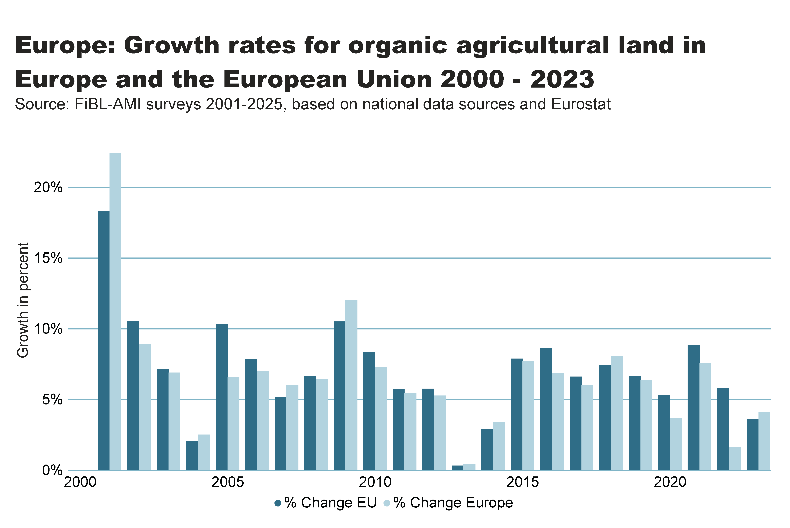
Europe_growth_percent
Notes:
textbox
No alt text provided
clusteredColumnChart
No alt text provided
card
No alt text provided

Slide 33
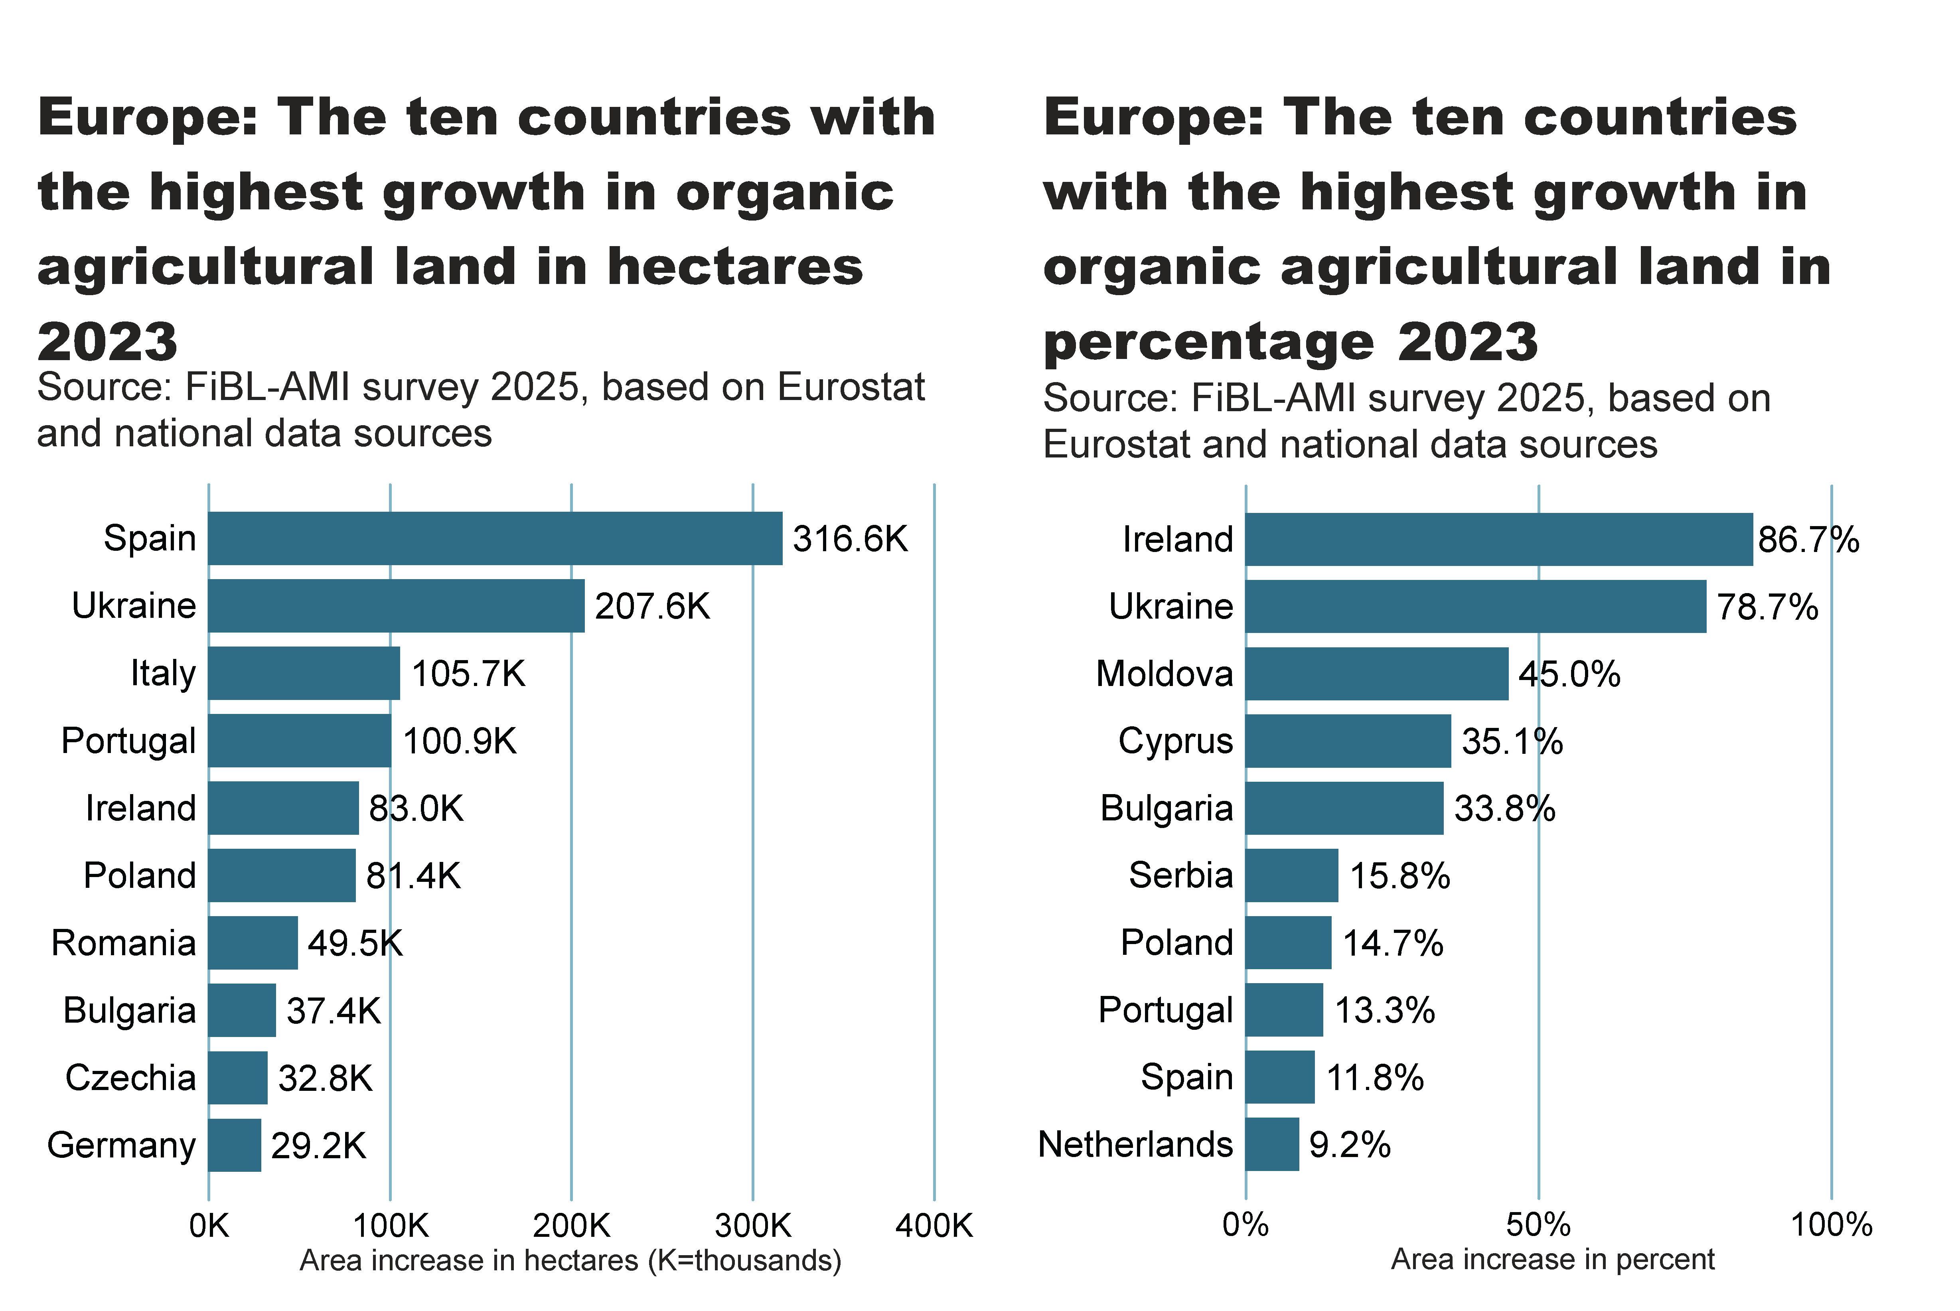
Europe_top10_land_growth_area+share
Notes:
textbox
No alt text provided
card
No alt text provided
barChart
No alt text provided
textbox
No alt text provided
card
No alt text provided
barChart
No alt text provided

Slide 34
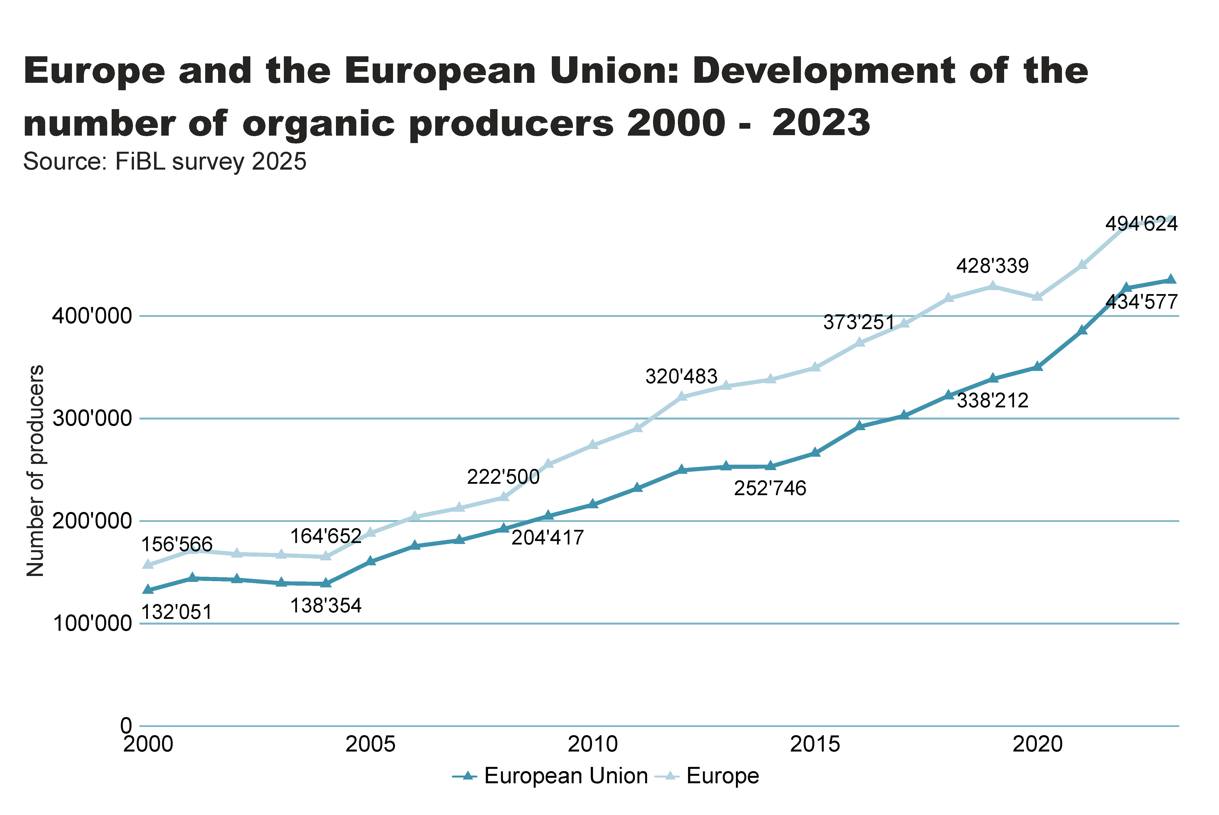
Europe_EU_growth_producers
Notes:
textbox
No alt text provided
lineChart
No alt text provided
card
No alt text provided

Slide 35
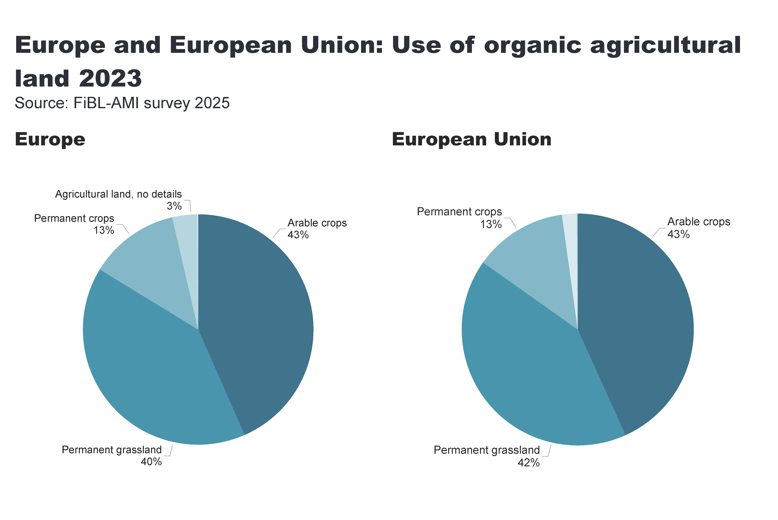
Europe_land_use
Notes:
European Union
No alt text provided
card
No alt text provided
Europe
No alt text provided
textbox
No alt text provided

Slide 36
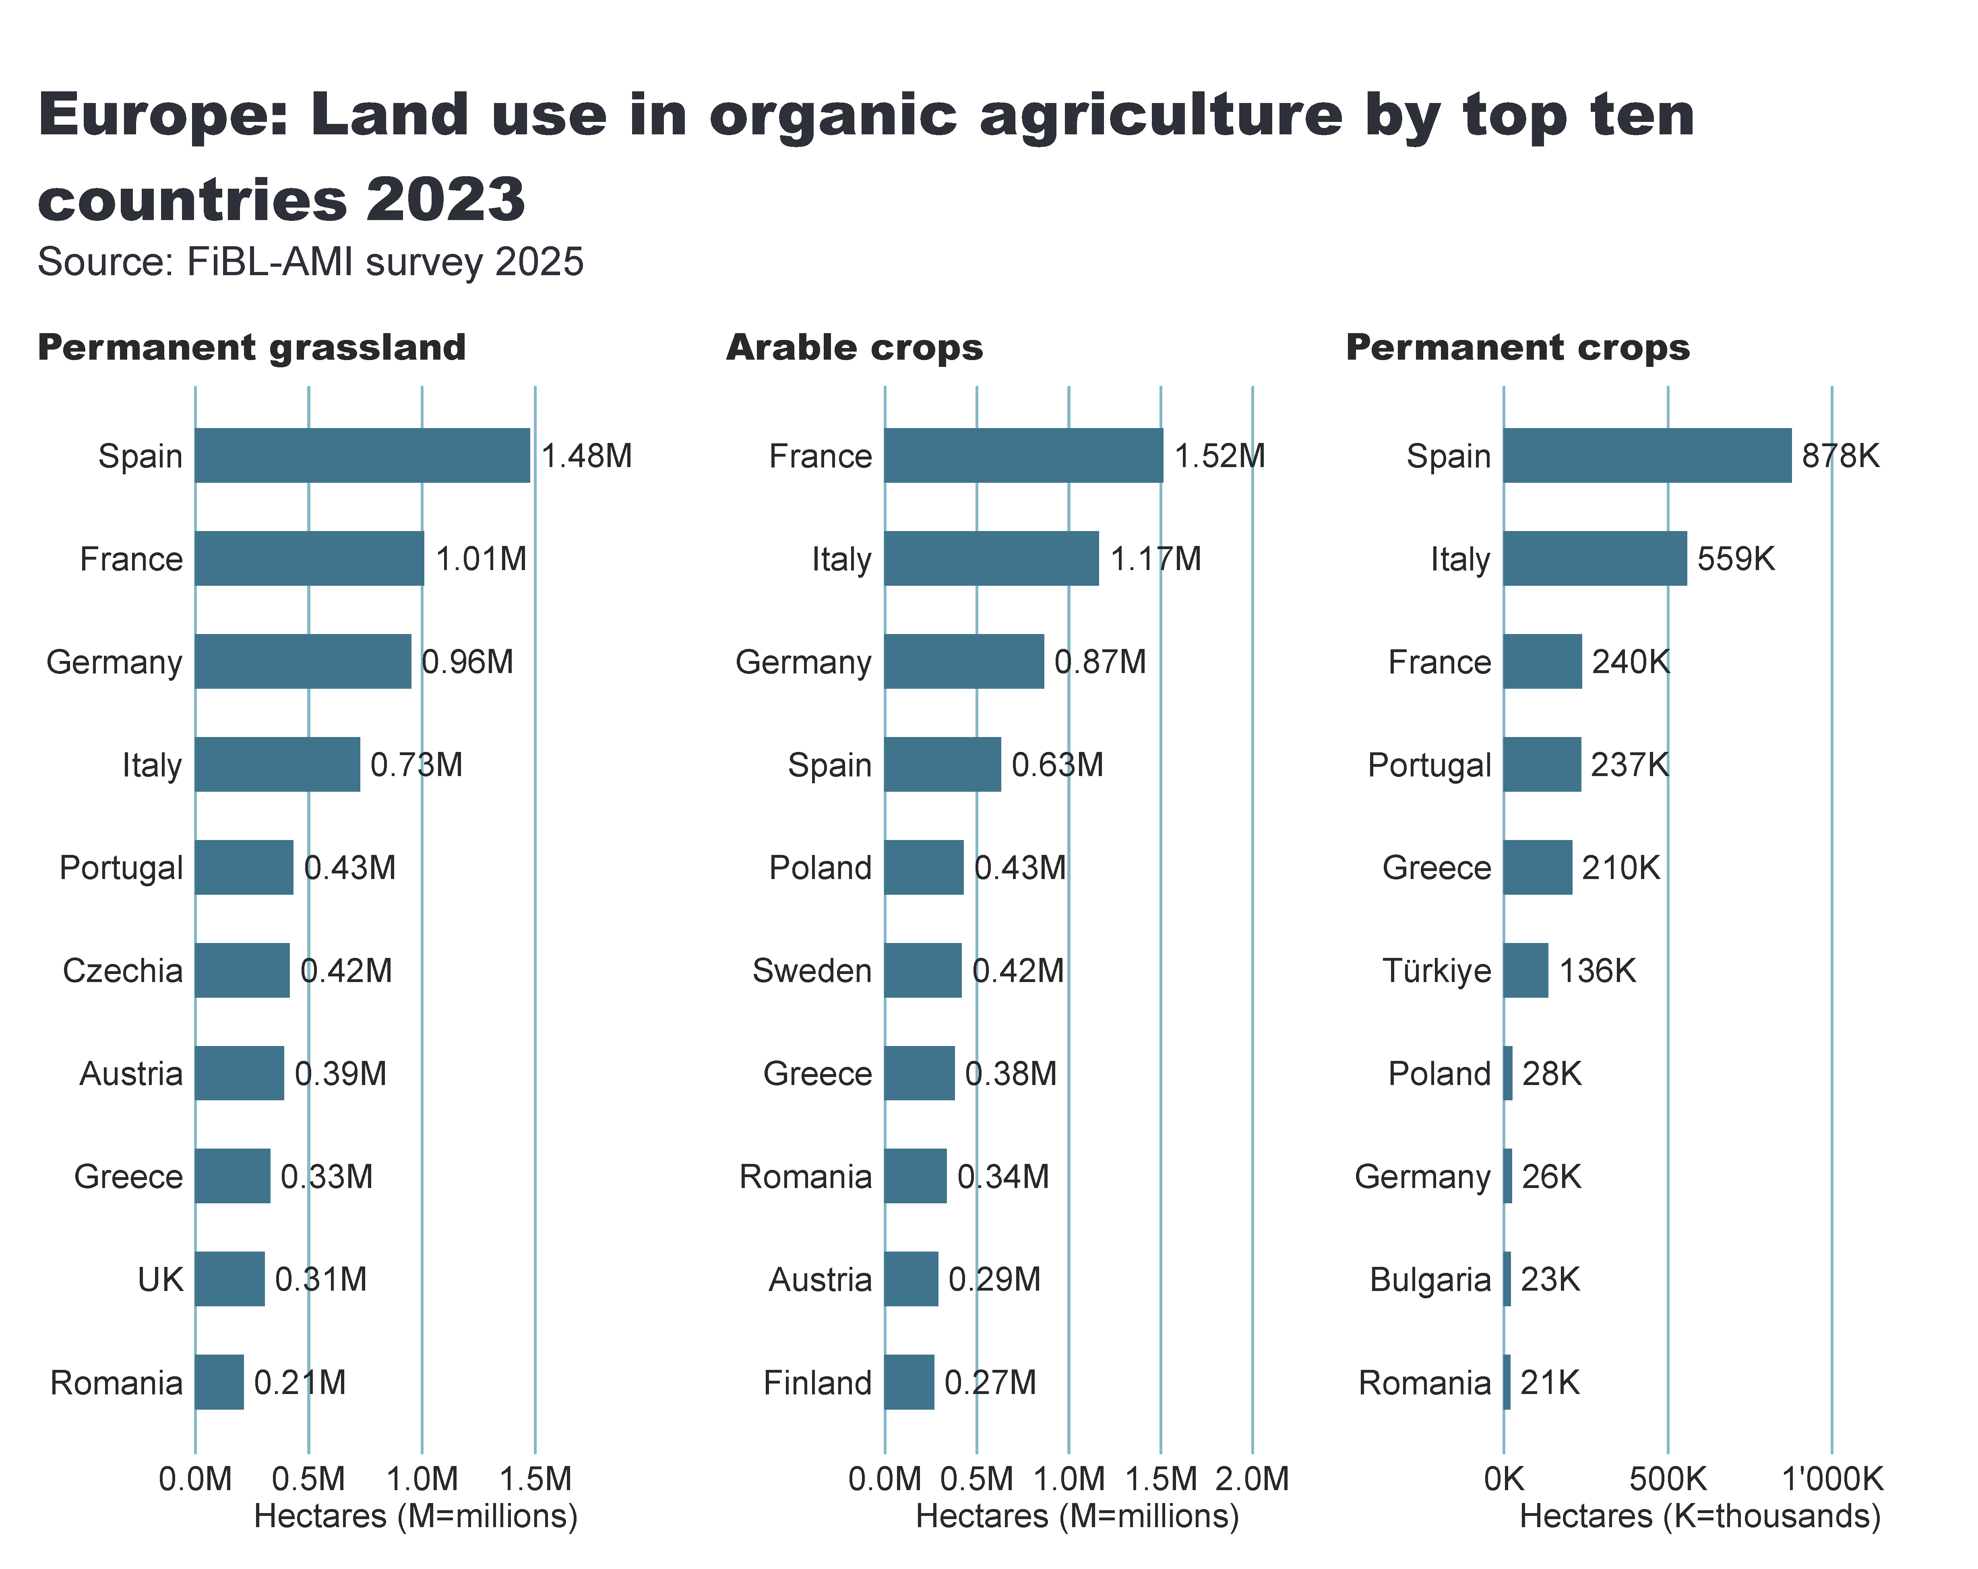
Europe_land_use_by_culture
Notes:
Arable crops
No alt text provided
textbox
No alt text provided
card
No alt text provided
Permanent crops
No alt text provided
Permanent grassland
No alt text provided

Slide 37
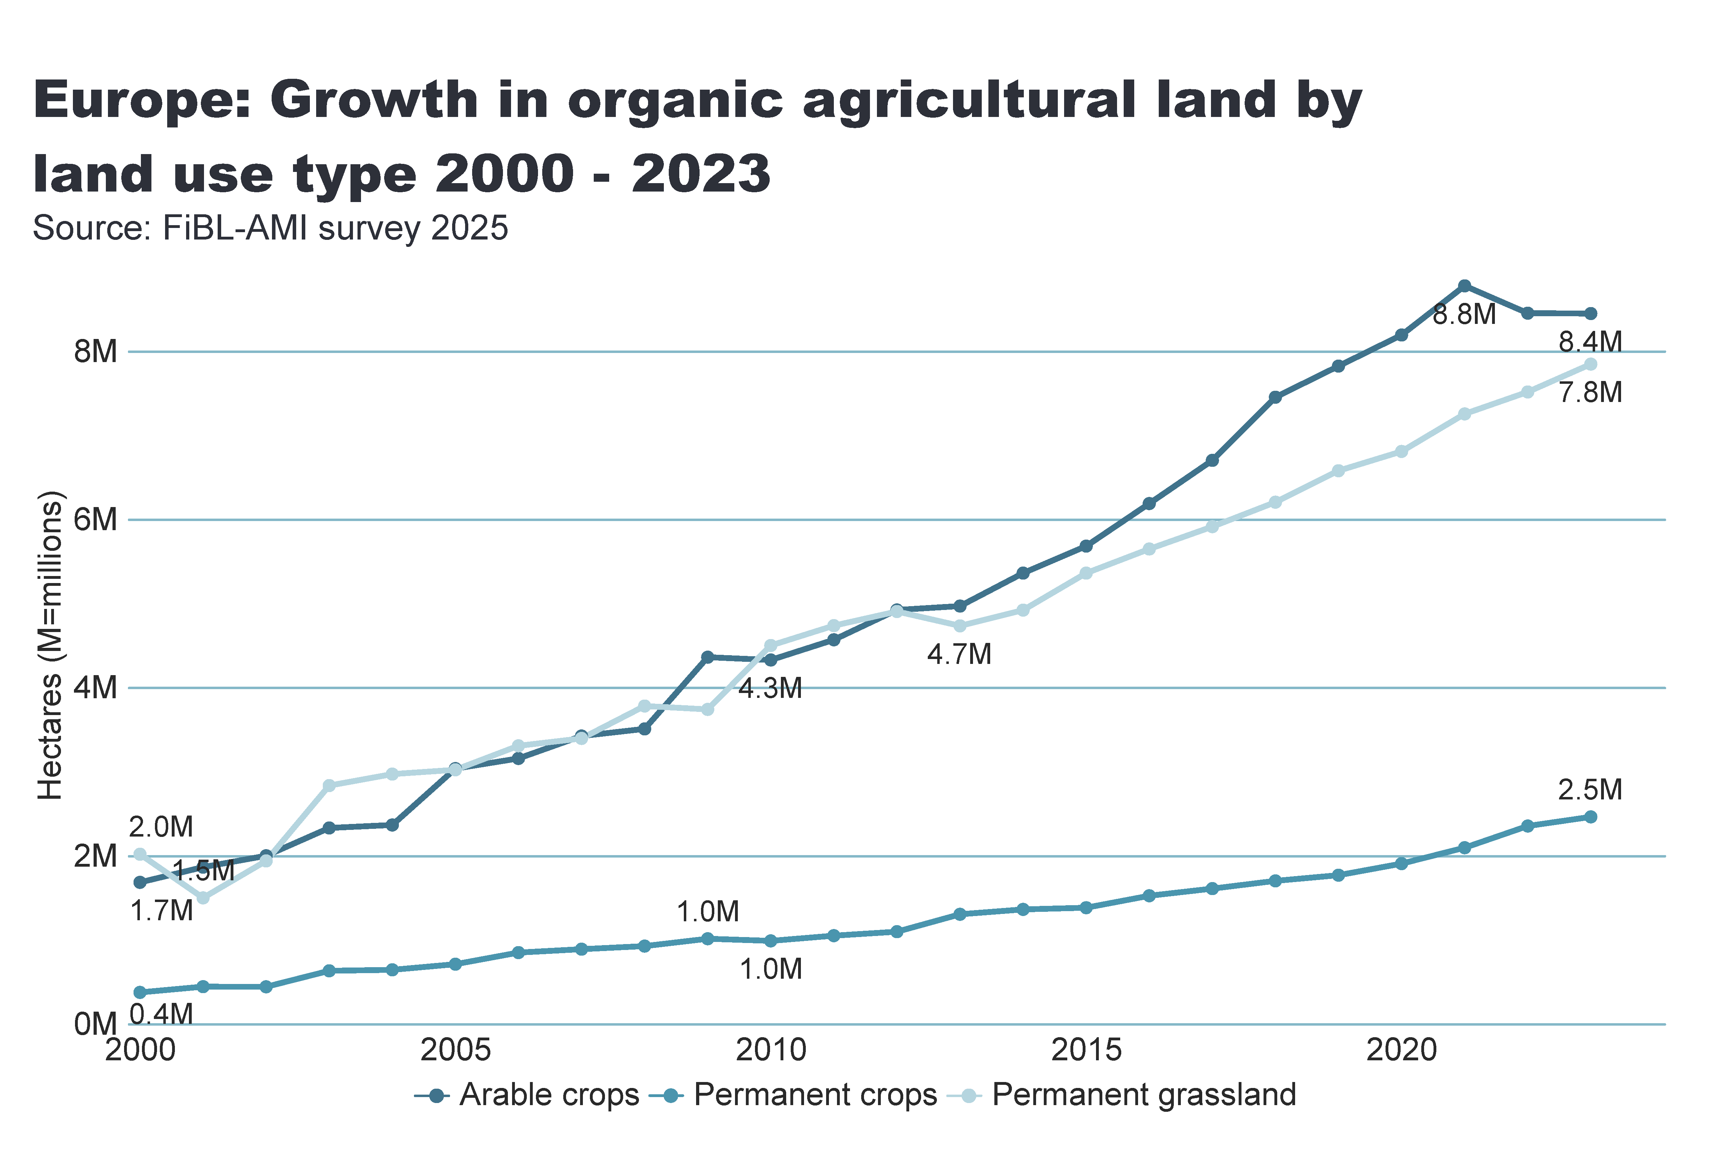
Europe_land_use_development
Notes:
Arable land
No alt text provided
textbox
No alt text provided
card
No alt text provided

Slide 38
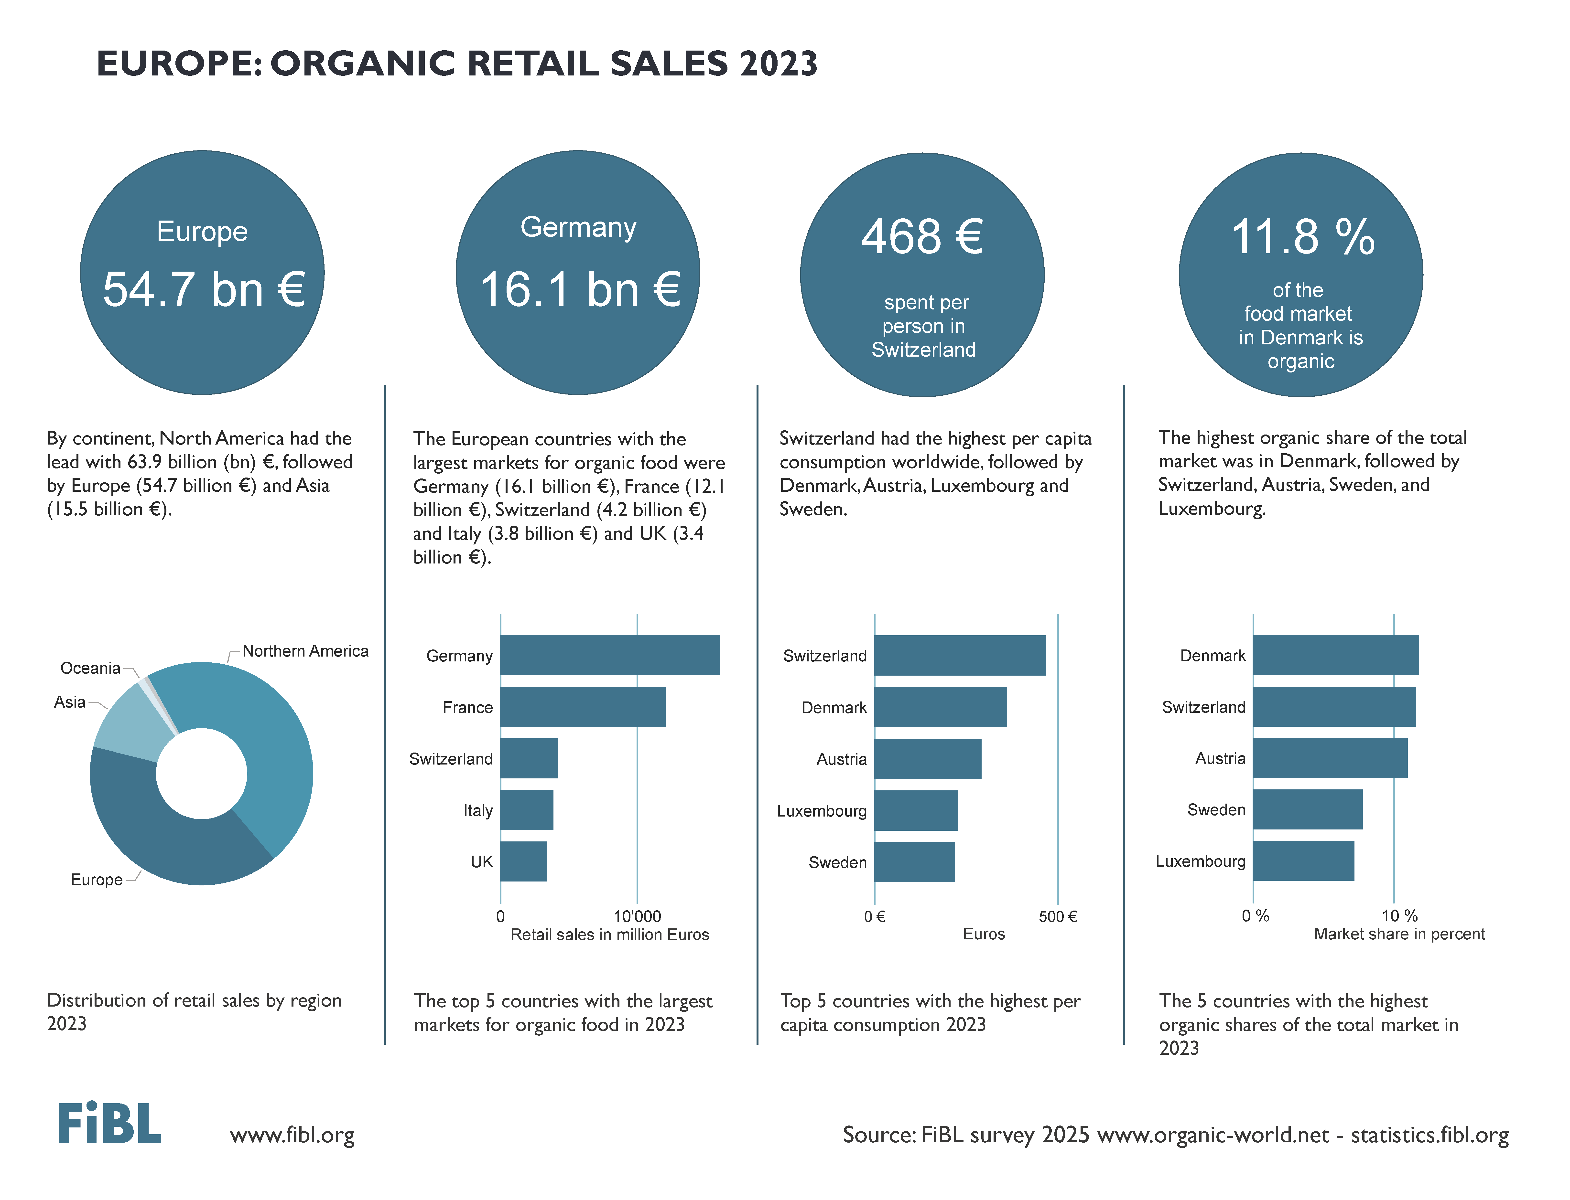

Slide 39
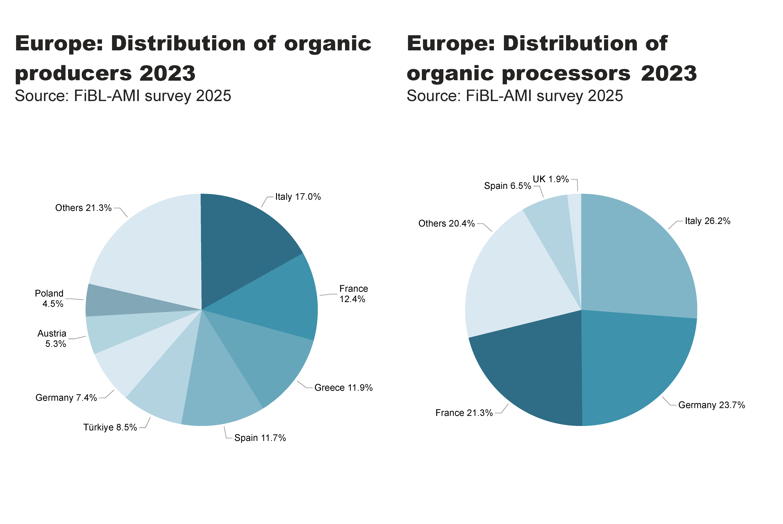
EU_producers, processors_distribution
Notes:
pieChart
No alt text provided
textbox
No alt text provided
card
No alt text provided
pieChart
No alt text provided
textbox
No alt text provided
card
No alt text provided

Slide 40
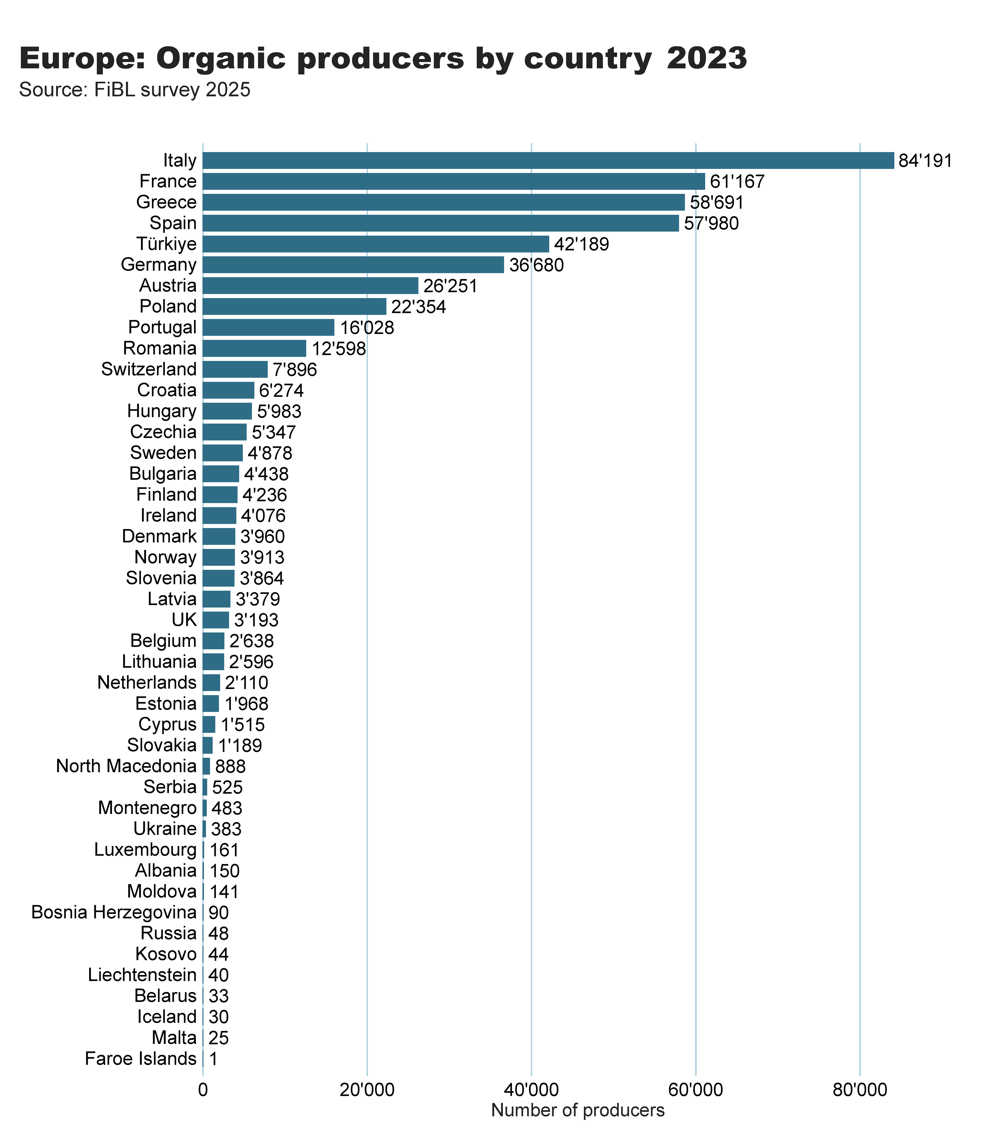
Europe_producers_by_country
Notes:
clusteredBarChart
No alt text provided
textbox
No alt text provided
card
No alt text provided

Slide 41
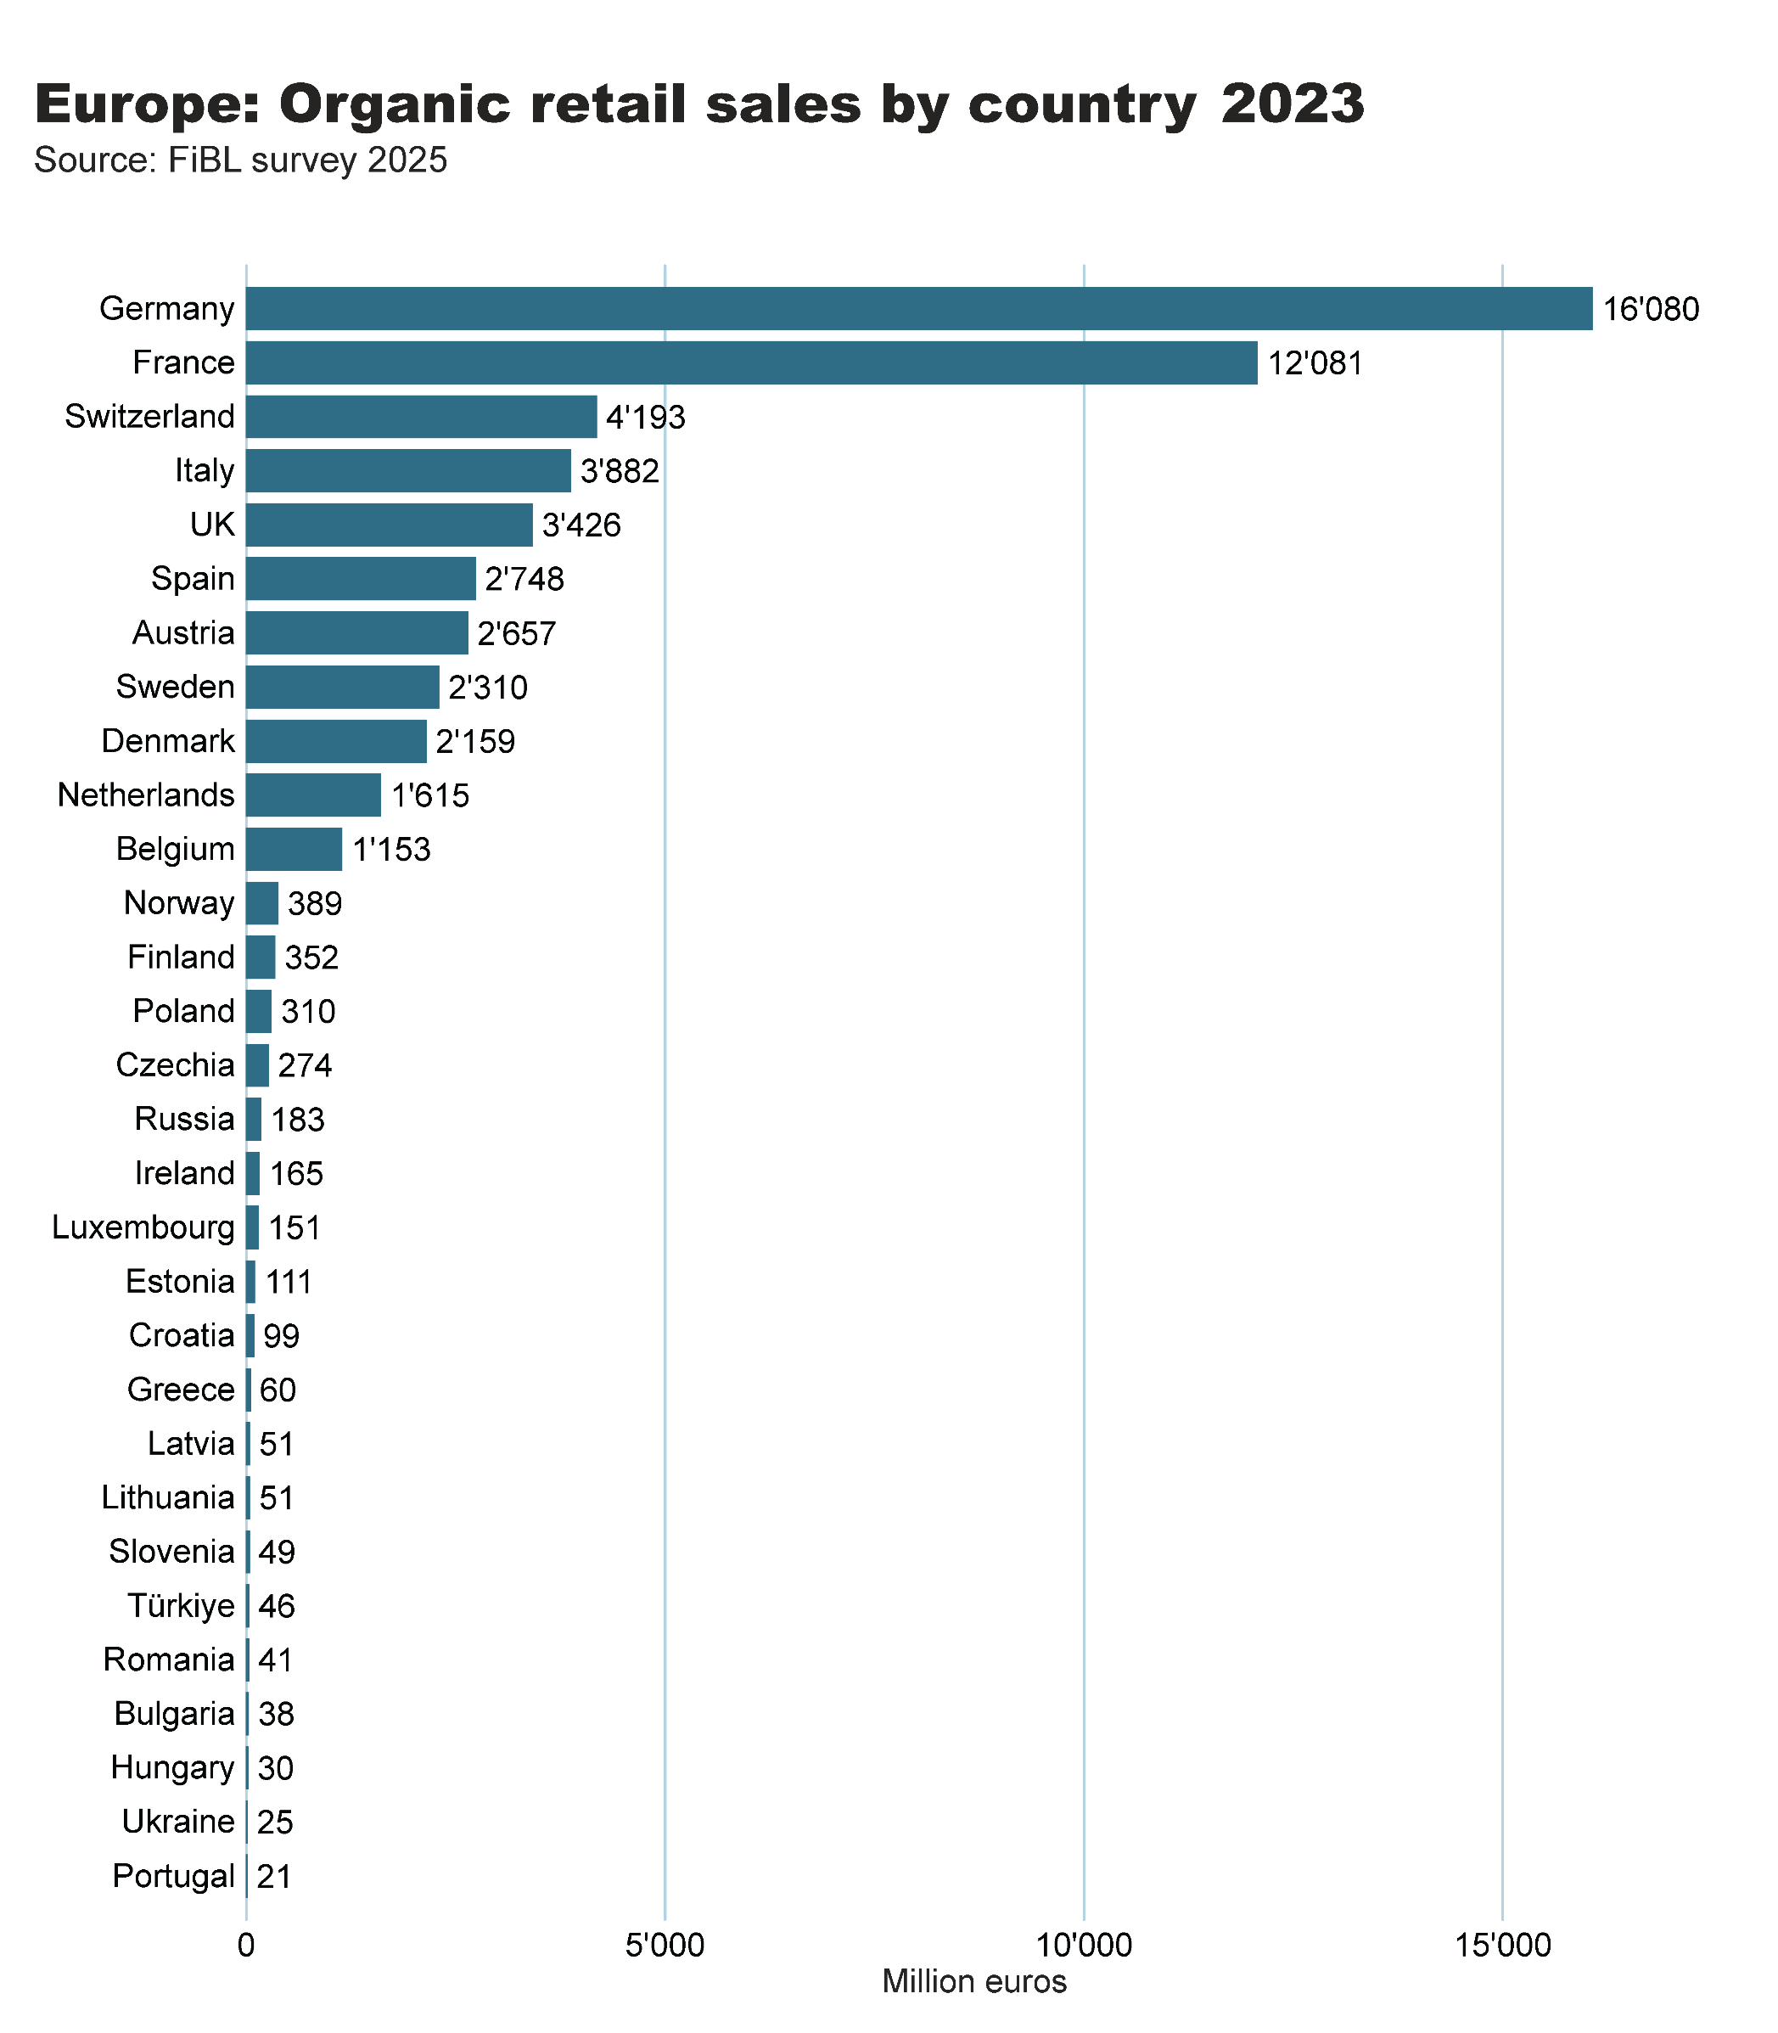
Europe_retail_sales_by_country
Notes:
clusteredBarChart
No alt text provided
textbox
No alt text provided
card
No alt text provided

Slide 42
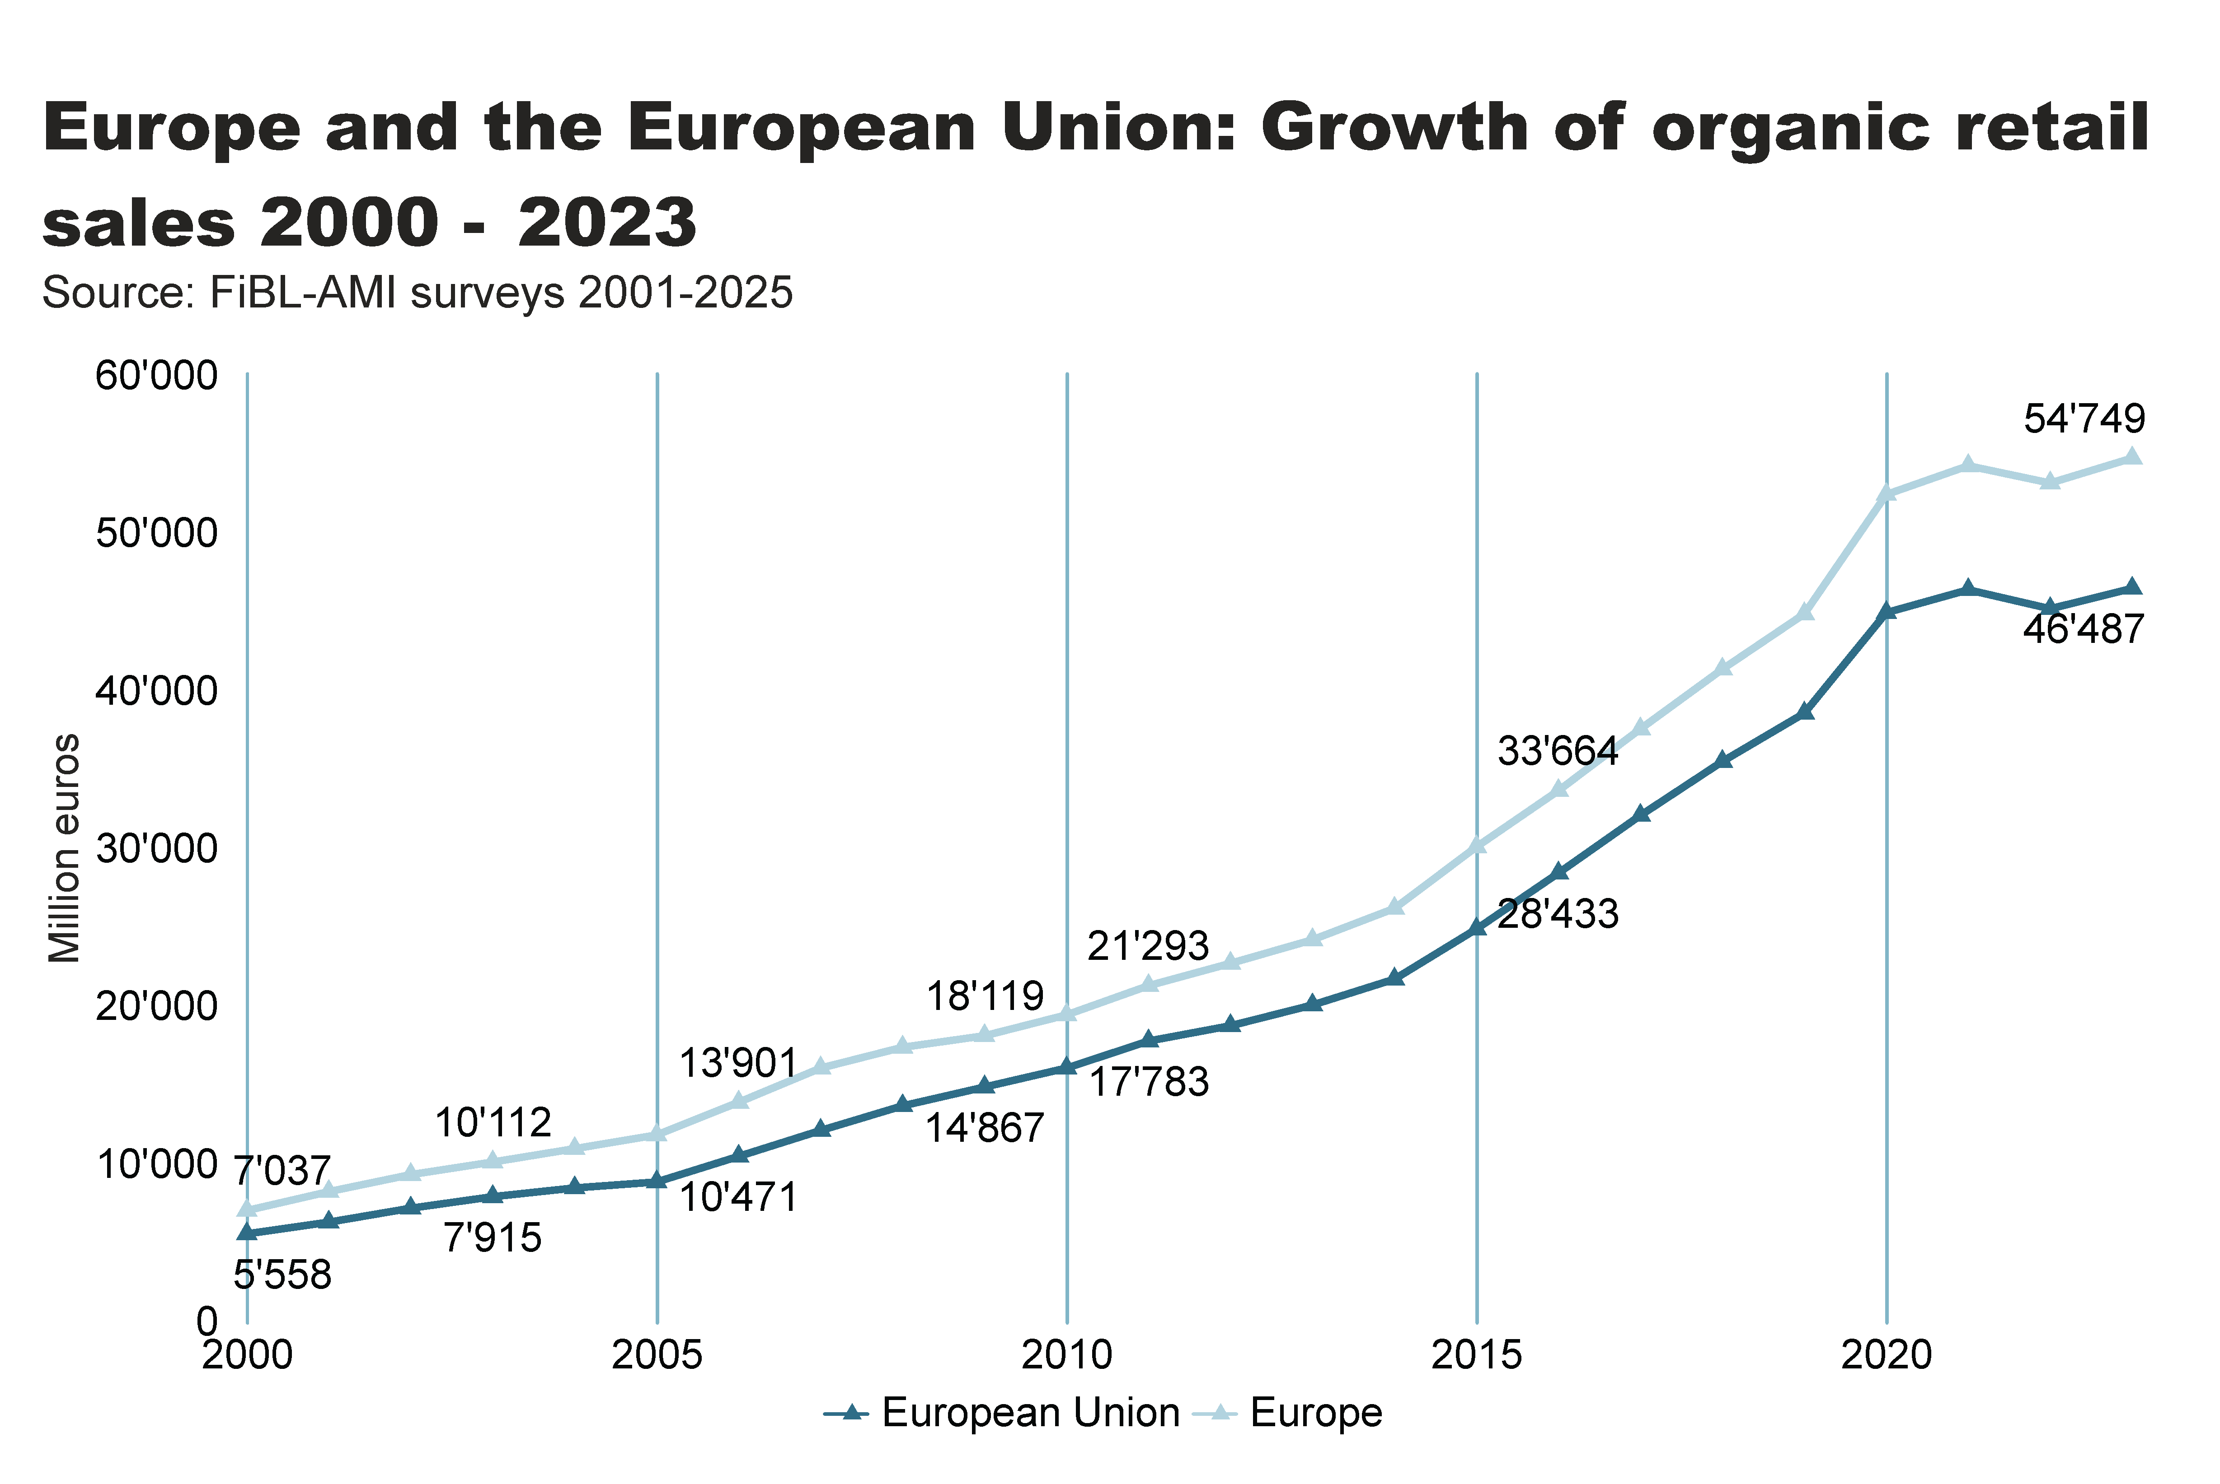
Europe_EU_growth_retail
Notes:
textbox
No alt text provided
lineChart
No alt text provided
card
No alt text provided

Slide 43
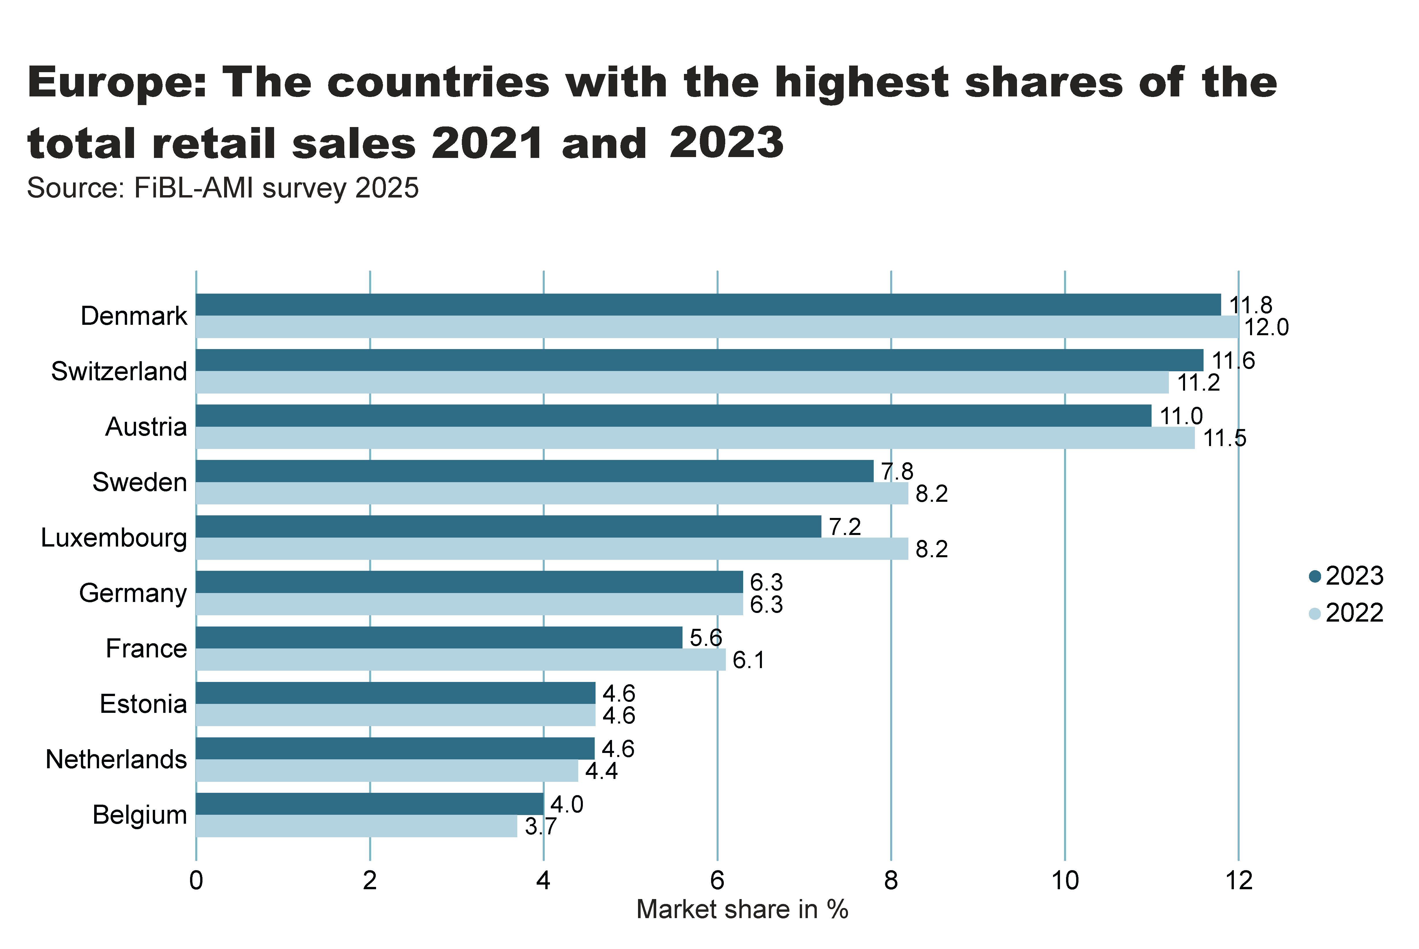
Europe_retail_growth
Notes:
textbox
No alt text provided
card
No alt text provided
clusteredBarChart
No alt text provided

Slide 44
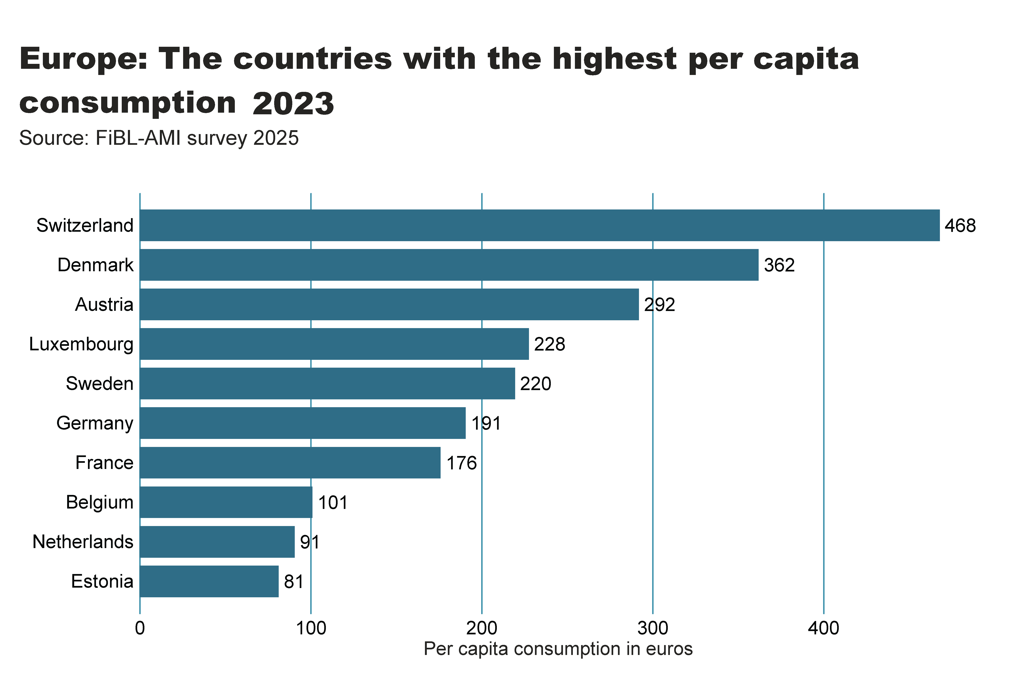
Europe_retail_per_capita
Notes:
textbox
No alt text provided
card
No alt text provided
clusteredBarChart
No alt text provided

Slide 45
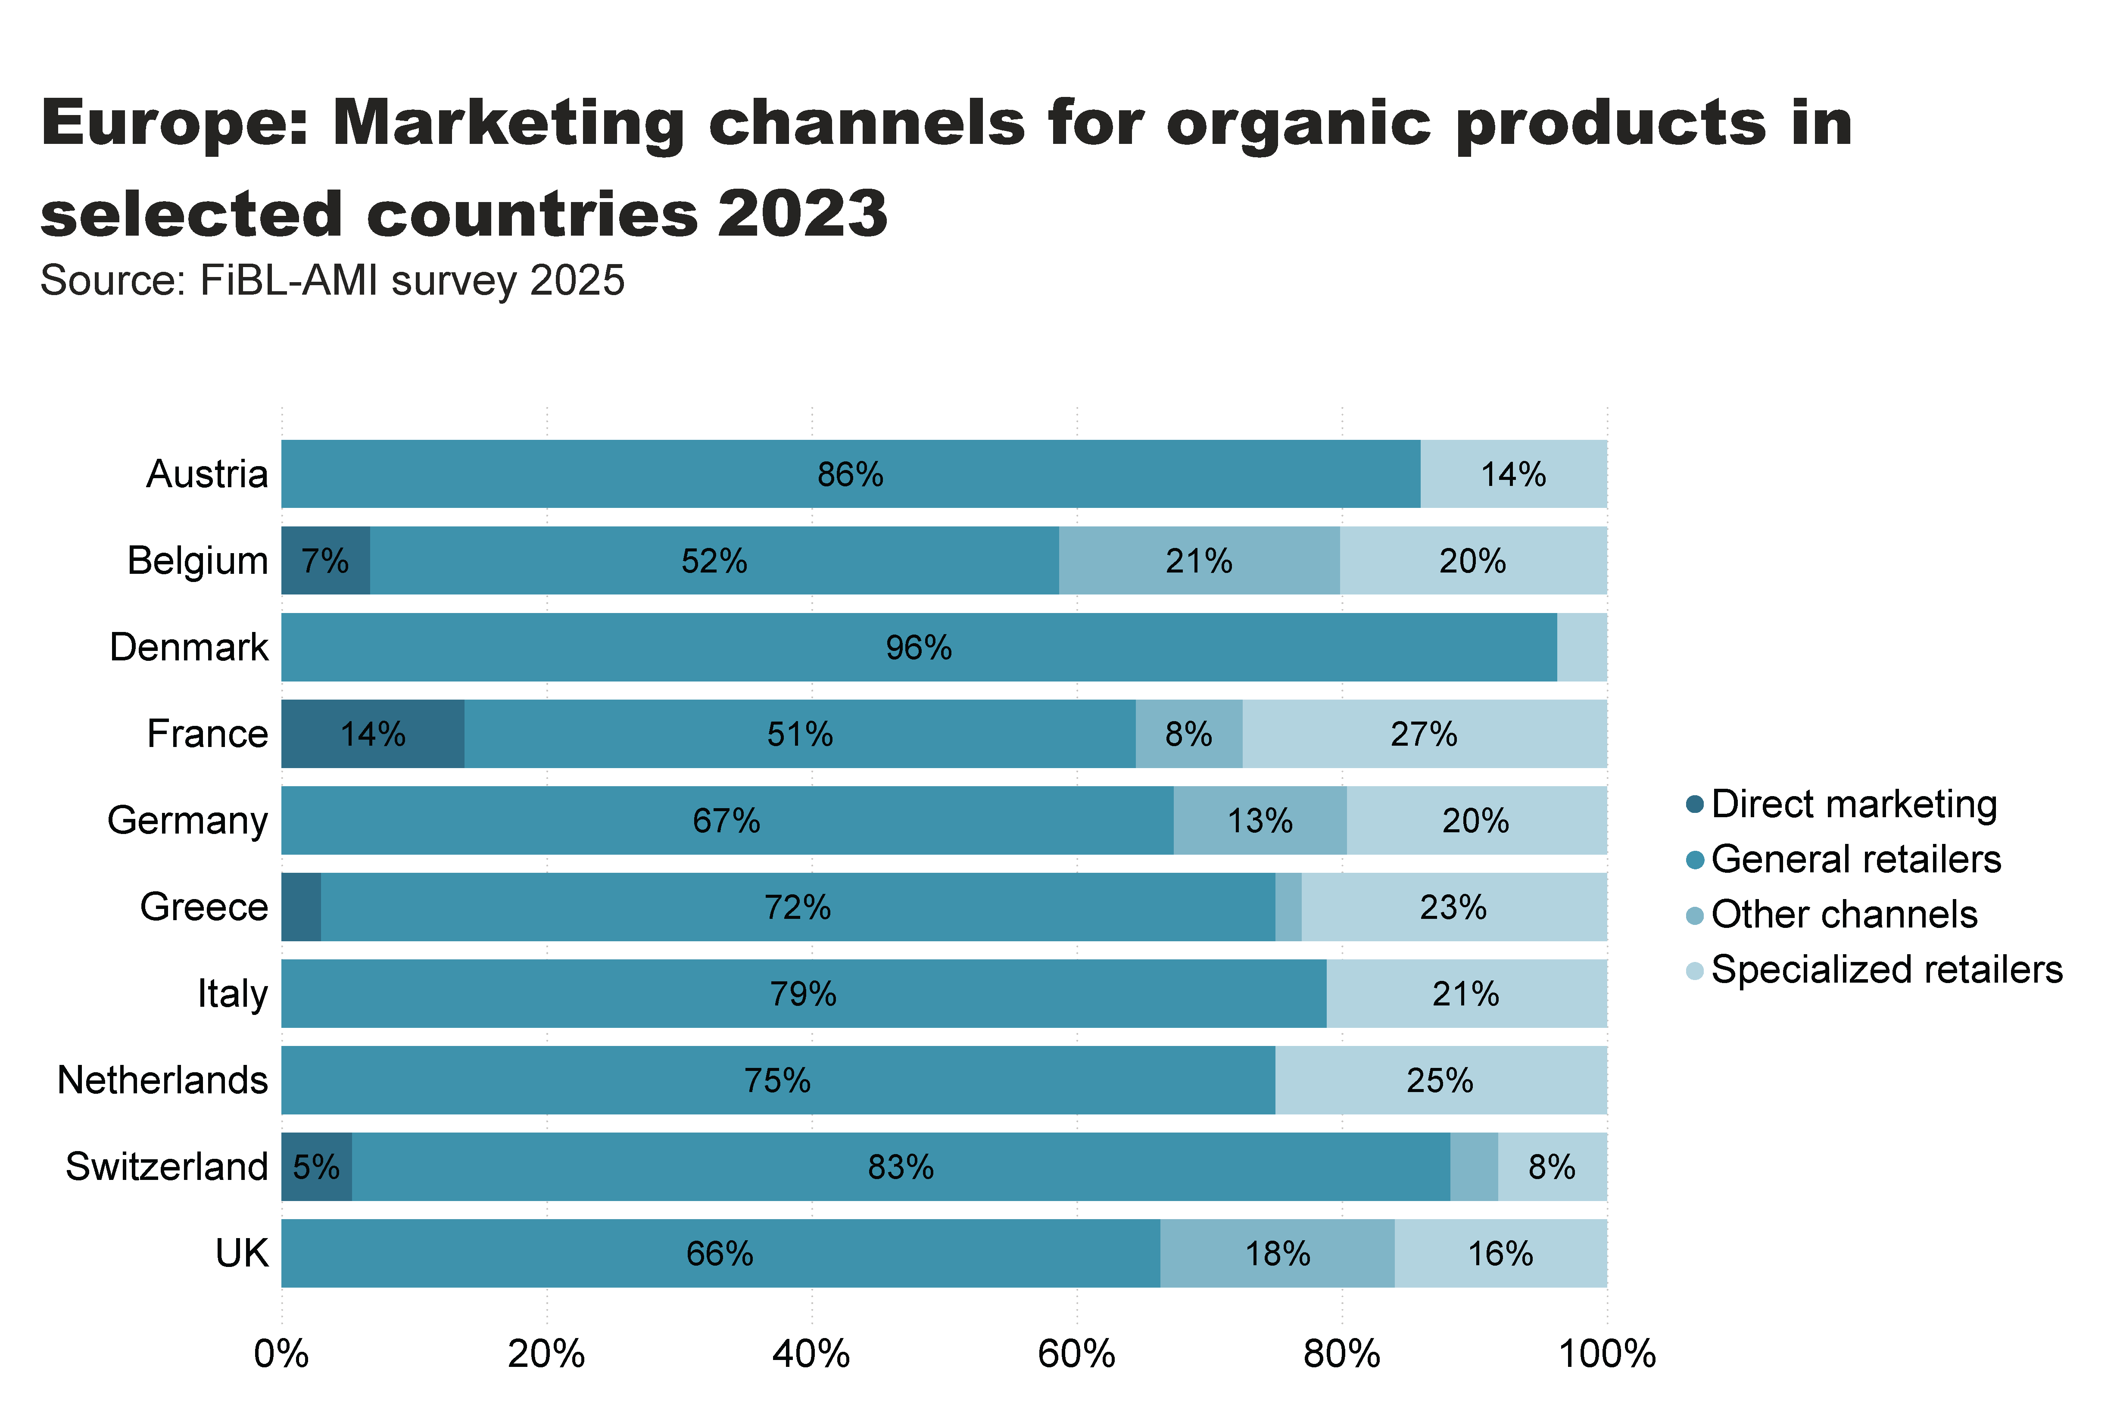
Europe_retail_by_channel
Notes:
textbox
No alt text provided
card
No alt text provided
hundredPercentStackedBarChart
No alt text provided

Slide 46
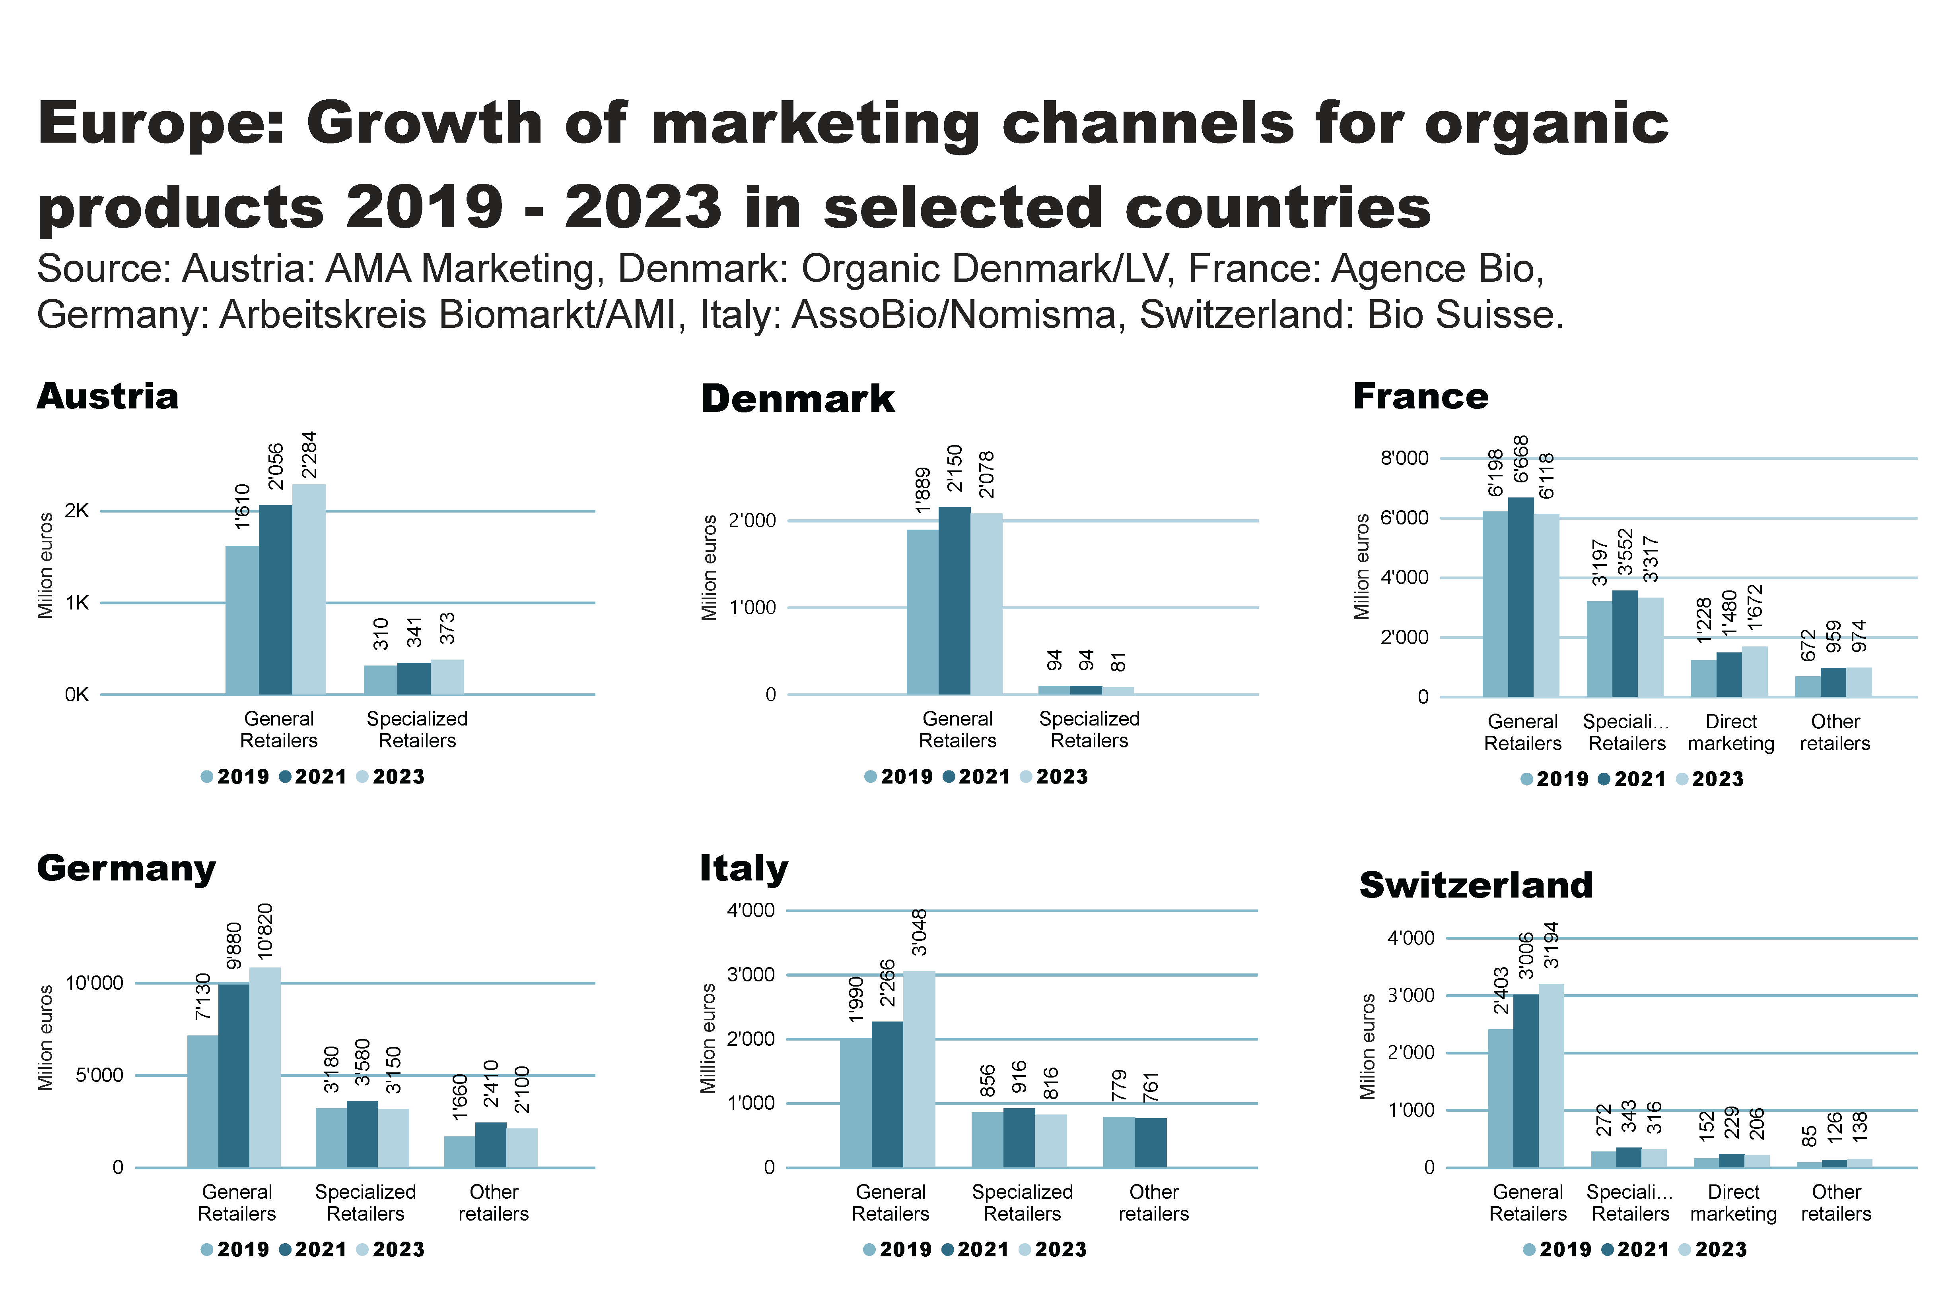
Europe_retail_by_channel_by_country
Notes:
textbox
No alt text provided
Austria
No alt text provided
Denmark
No alt text provided
France
No alt text provided
Germany
No alt text provided
Italy
No alt text provided
Switzerland
No alt text provided

Slide 47
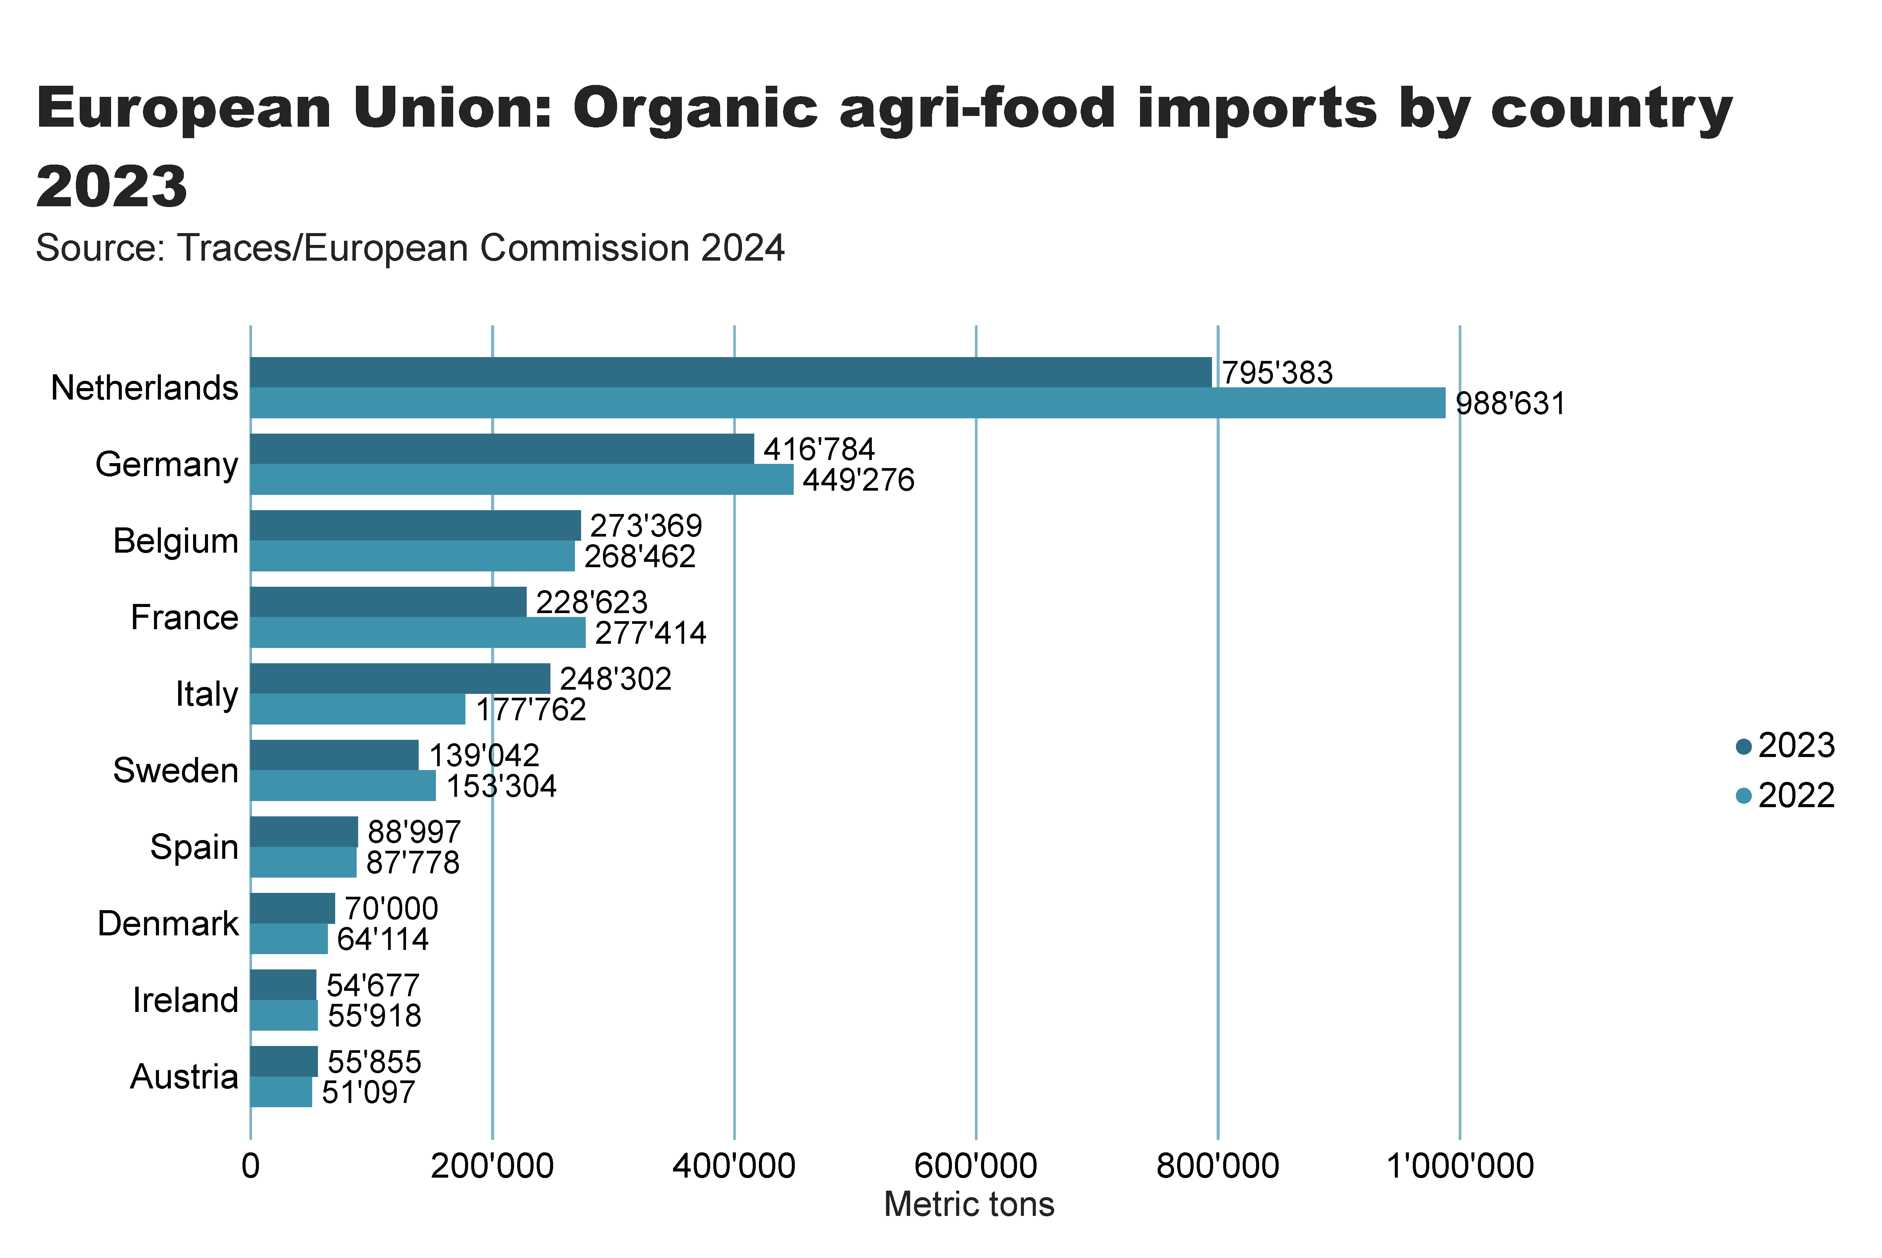
Europe_import_country
Notes:
textbox
No alt text provided
card
No alt text provided
clusteredBarChart
No alt text provided

Slide 48
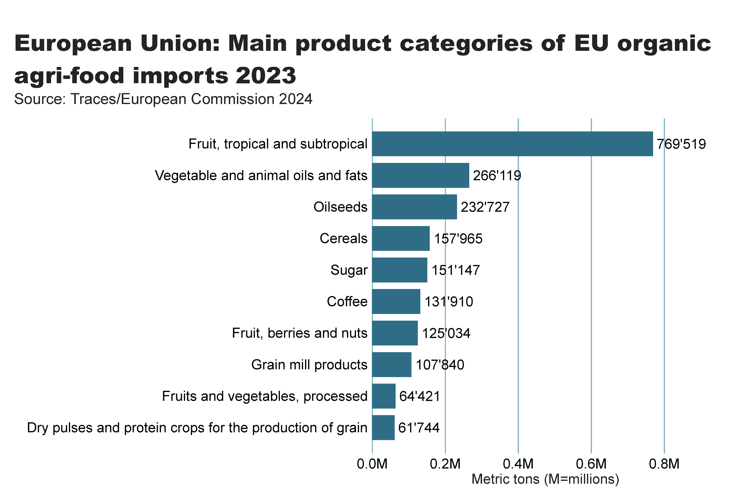
EU_import_by_food_product
Notes:
clusteredBarChart
No alt text provided
textbox
No alt text provided
card
No alt text provided

Slide 49
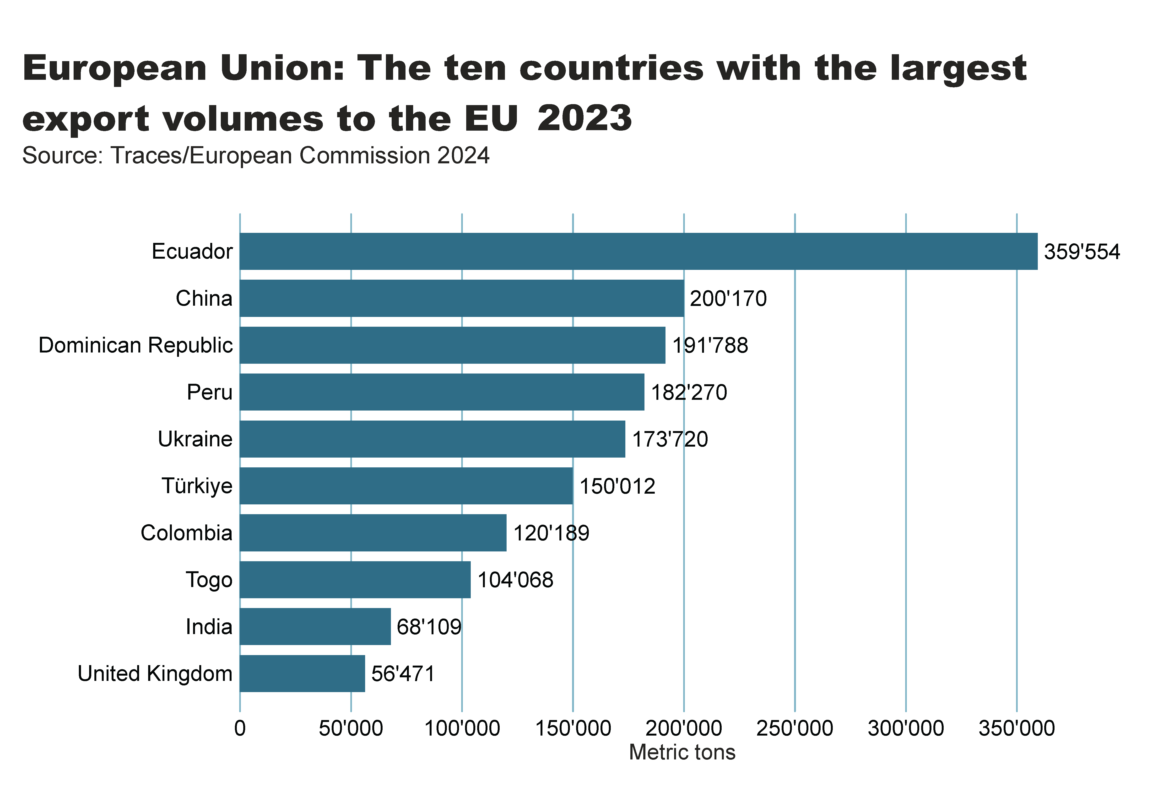
EU_import_by_exporter
Notes:
clusteredBarChart
No alt text provided
textbox
No alt text provided
card
No alt text provided

Slide 50
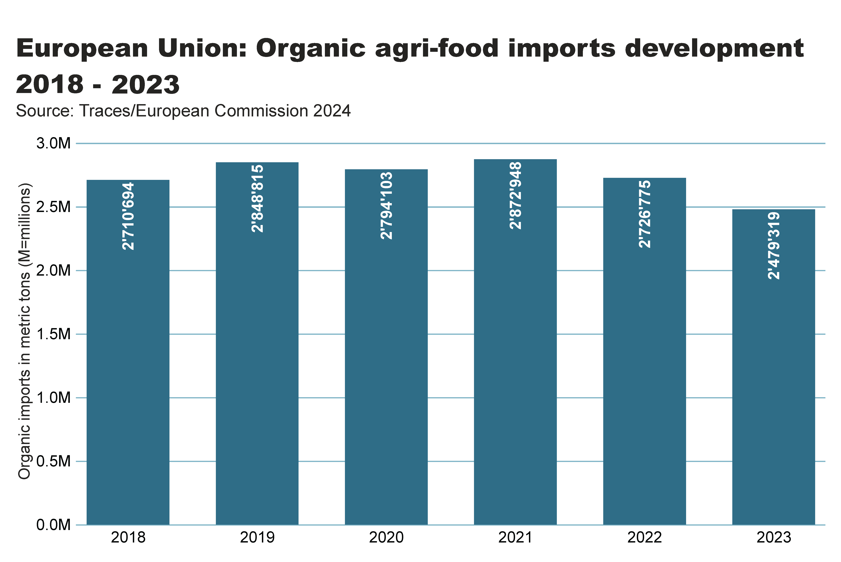
Europe_imports development
Notes:
textbox
No alt text provided
columnChart
No alt text provided
card
No alt text provided

Slide 51
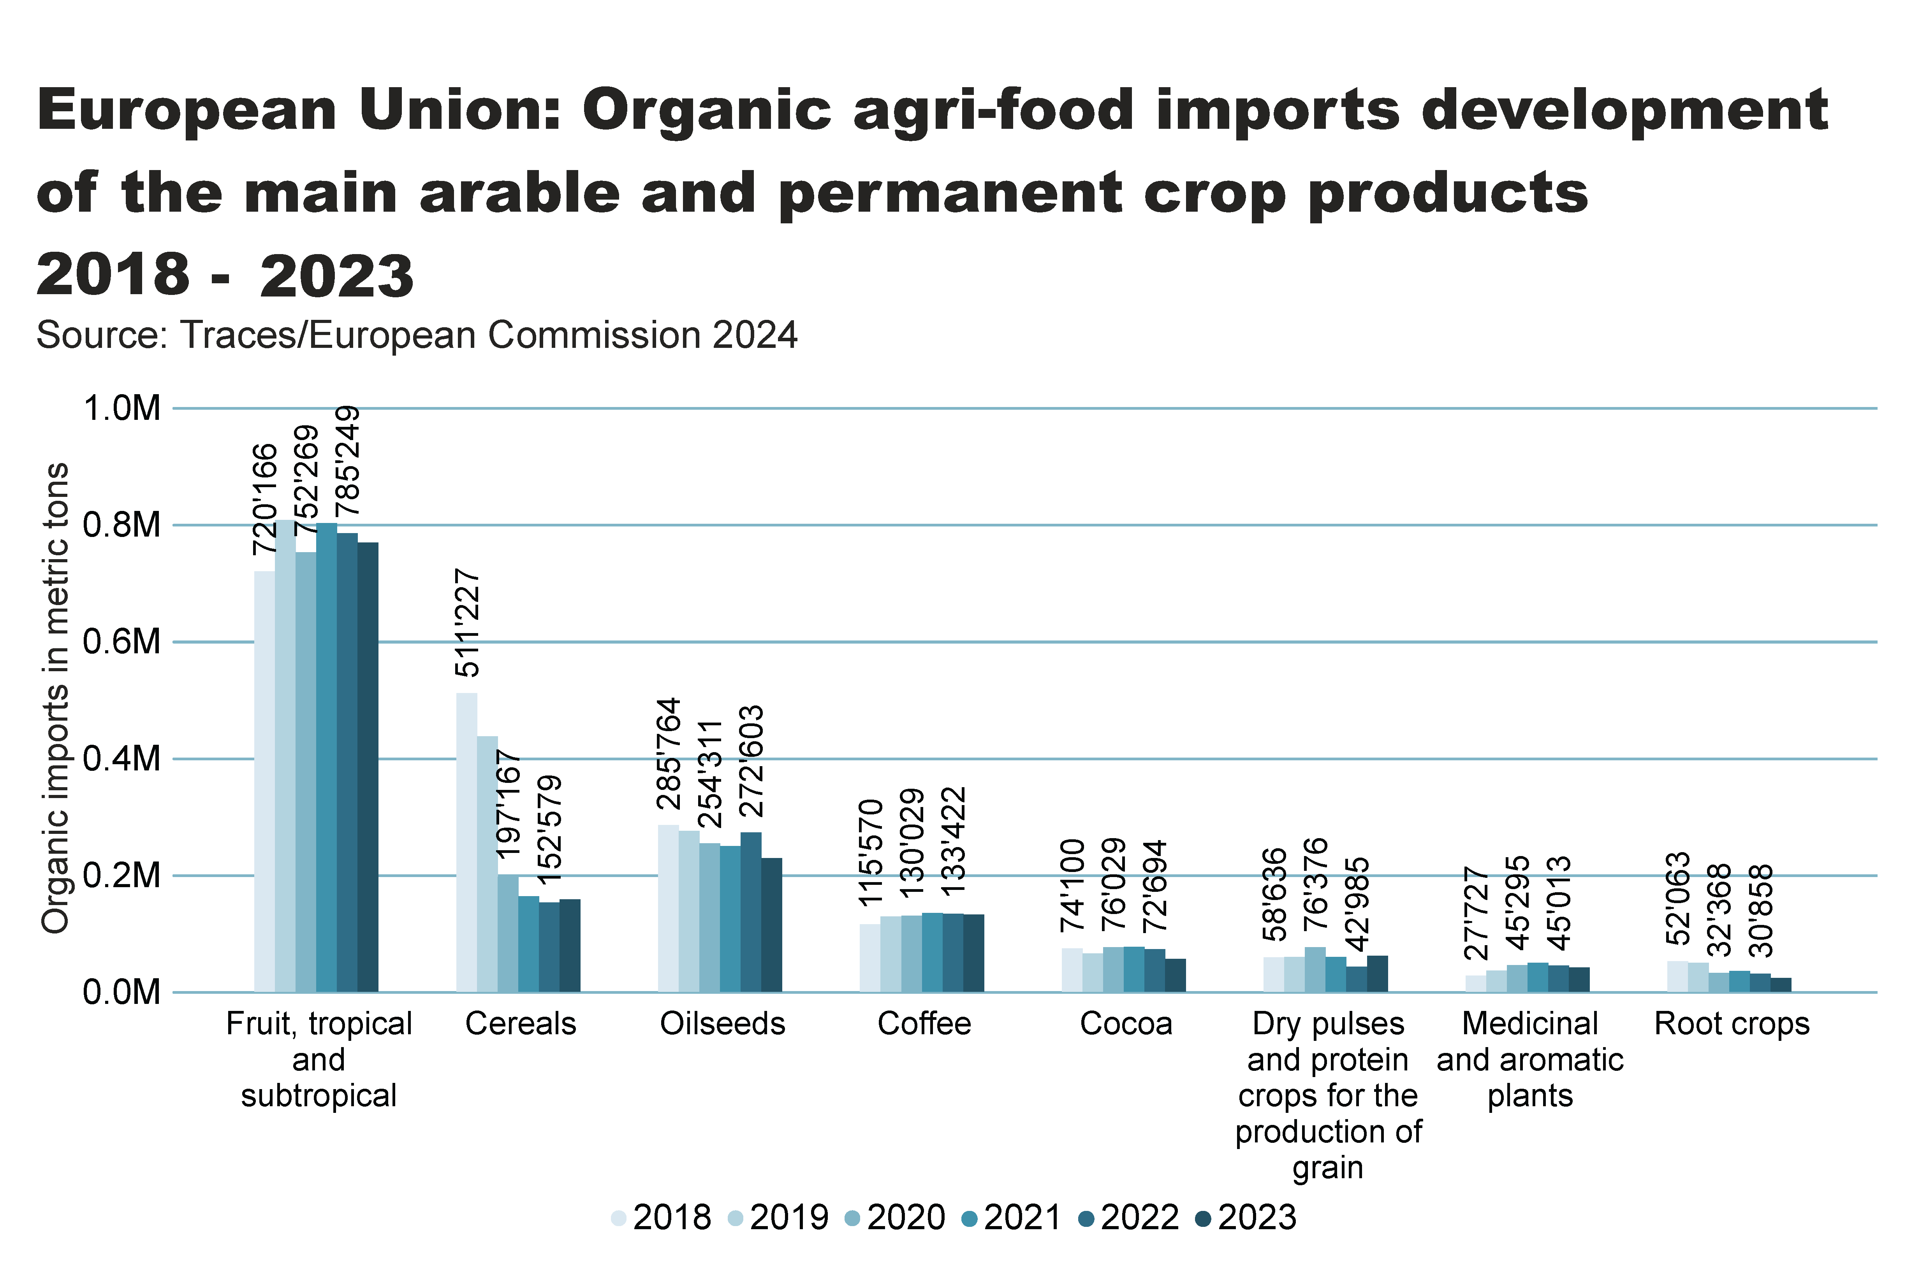
Europe_imports development_Arable_products
Notes:
textbox
No alt text provided
clusteredColumnChart
No alt text provided
card
No alt text provided

Slide 52


Slide 53

Latin America and the Caribbean

Slide 54
Latin America and Caribbean: Key figures 2023
In 2023, Latin America and the Caribbean reported 10.3 million hectares of organic agricultural land managed by 249’095 producers, representing 10.5 percent of the global organic area and 1.6 percent of the region’s total agricultural land.
Argentina led the region with 4.0 million hectares, followed by Uruguay with 3.6 million hectares and Brazil with 1.0 million hectares.
Uruguay had the highest organic share of total agricultural land at 25.4 percent, followed by French Guiana with 13.0 percent and Dominica with 11.6 percent.
Key organic exports from the region included bananas, coffee, tomatoes, and soybeans.
The region remains a significant player in the global organic market due to its large-scale organic production and export-oriented agriculture
Source: FiBL survey 2025

Slide 55

LA_land_country
Notes:
clusteredBarChart
No alt text provided
textbox
No alt text provided
card
No alt text provided

Slide 56

LA_land_share_country
Notes:
textbox
No alt text provided
barChart
No alt text provided
card
No alt text provided

Slide 57

LA_land_growth
Notes:
textbox
No alt text provided
lineClusteredColumnComboChart
No alt text provided
card
No alt text provided

Slide 58

LA_producers_country
Notes:
textbox
No alt text provided
card
No alt text provided
barChart
No alt text provided

Slide 59

LA_land_use
Notes:
Land use types
No alt text provided
card
No alt text provided
Key arable crops
No alt text provided
Key permanent crops
No alt text provided
textbox
No alt text provided

Slide 60

North America

Slide 61
Organic Agriculture in North America: Key figures 2023
In 2023, North America had 3.3 million hectares of organic agricultural land, representing 0.7 percent of the total agricultural area in the region.
The United States accounted for 2.06 million hectares, while Canada had 1.29 million hectares.
The organic market in North America recorded retail sales of 63’920 million euros.
Source: USDA and COTA 2023

Slide 62

NA_land_country
Notes:
clusteredBarChart
No alt text provided
textbox
No alt text provided
card
No alt text provided

Slide 63
NA_land_share_country
Notes:
textbox
No alt text provided
Source: COTA and USDA, 2025
No alt text provided
card
No alt text provided

Slide 64

NA_land_growth
Notes:
textbox
No alt text provided
lineClusteredColumnComboChart
No alt text provided
card
No alt text provided

Slide 65

NA_producers_country
Notes:
textbox
No alt text provided
card
No alt text provided
barChart
No alt text provided

Slide 66

NA_land_use
Notes:
Land use types
No alt text provided
card
No alt text provided
Key arable crops
No alt text provided
Key permanent crops
No alt text provided
textbox
No alt text provided

Slide 67

Oceania

Slide 68
Organic agriculture in Oceania: Key figures 2023
In 2023, Oceania had 53.2 million hectares of organic agricultural land managed by 15’575 producers, representing 14.1 percent of the region’s total agricultural land and accounting for 53.8 percent of the world’s organic area.
More than 99.7 percent of the organic land in the region was in Australia (53.0 million hectares), followed by New Zealand (79’347 hectares) and Samoa (41’307 hectares).
The highest organic share of total agricultural land was recorded in Samoa (14.6 percent), followed by Australia (14.6 percent), French Polynesia (9.3 percent), Solomon Islands (6.3 percent), and Fiji (4.1 percent).
FiBL survey 2025

Slide 69

Oceania_land_country
Notes:
clusteredBarChart
No alt text provided
textbox
No alt text provided
card
No alt text provided

Slide 70

Oceania_land_share_country
Notes:
textbox
No alt text provided
barChart
No alt text provided
card
No alt text provided

Slide 71

Oceania_land_growth
Notes:
textbox
No alt text provided
lineClusteredColumnComboChart
No alt text provided
card
No alt text provided

Slide 72

Oceania_producers_country
Notes:
textbox
No alt text provided
card
No alt text provided
barChart
No alt text provided

Slide 73

Oceania_land_use
Notes:
Land use types
No alt text provided
card
No alt text provided
Key arable crops
No alt text provided
Key permanent crops
No alt text provided
textbox
No alt text provided

Slide 74
More information
More information (PDF, data sources, graphs) at:
http://www.organic-world.net/yearbook/yearbook-2025.html
Contact
Helga Willer
Research Institute of Organic Agriculture FiBL
5070 Frick
Switzerland
helga.willer@fibl.org

Slide 75
Disclaimer
All of the results contained in this slide show have been compiled by the Research Institute of Organic Agriculture FiBL. However, the possibility of mistakes cannot be ruled out entirely. Therefore, FiBL is not subject to any obligation and makes no guarantees whatsoever regarding any of the statements or results in this work; neither does FiBL accept responsibility or liability for any possible mistakes, nor for any consequences of actions taken by readers based on statements or advice contained therein.
This document has been produced with the support of the Swiss State Secretariat for Economic Affairs (SECO), the Sustainability Fund of Coop Switzerland, NürnbergMesse, IFOAM – Organics International. The views expressed herein can in no way be taken to reflect the official opinions of SECO, Coop, NürnbergMesse or IFOAM – Organics International.

Slide 76

Presentations on www.organic-world.net

Slide 77

Statistics.FiBL.org

Slide 78


www.twitter.com/fiblstatistics

Slide 79
Contact
Helga Willer
Research Institute of Organic Agriculture FiBL
Ackerstrasse 113, Box 219
5070 Frick
Switzerland
Phone +41 62 865 72 72
Phone +41 62 865 72 07 (direct)
info.suisse@fibl.org, helga.willer@fibl.org
www.fibl.org, www.organic-world.net, https://statistics.fibl.org

