Slide 1
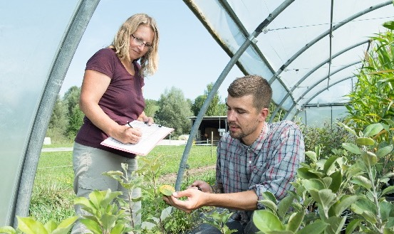
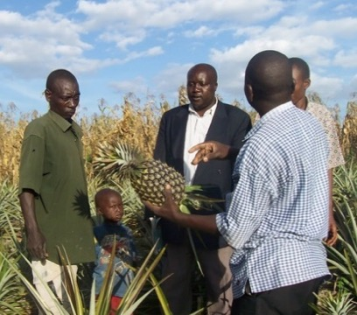
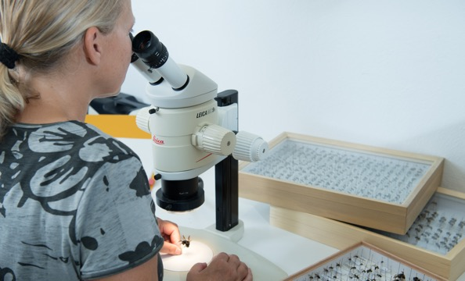
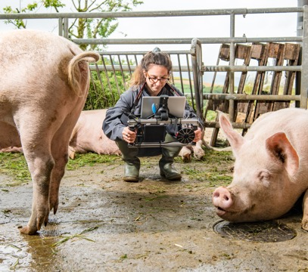
Organic Agriculture Worldwide 2023:
Key results from the FiBL survey on organic agriculture worldwide 2025
Part 1: Global data and survey background
Jan Trávníček, Bernhard Schlatter and Helga Willer
© FiBL, April 2025

Slide 2
Organic Agriculture Worldwide: Key results from the FiBL survey on organic agriculture worldwide 2025
Part 1: Global data and survey background
Data compiled by the Research Institute of Organic Agriculture FiBL, Frick, Switzerland, based on national data sources and data from certifiers.
Data as published February 2025 in The World of Organic Agriculture. Statistics and Emerging Trends 2025.* Frick and Bonn, www.organic-world.net
For updates, check www.organic-world.net
This presentation is available online at: https://www.organic-world.net/yearbook/yearbook-2025/presentations.html
Texts and graphs: Helga Willer, Bernhard Schlatter and Jan Trávníček, Research Institute of Organic Agriculture FiBL, Frick, Switzerland
Contact: Helga Willer, helga.willer@fibl.org, Research Institute of Organic Agriculture FiBL, Frick, Switzerland
© Research Institute of Organic Agriculture FiBL, Frick, Switzerland, February 2025
*Citation: Willer, Helga, Bernhard Schlatter and Jan Trávníček (Eds.) (2025): The World of Organic Agriculture. Statistics and Emerging Trends 2025. Research Institute of Organic Agriculture FiBL, Frick, and IFOAM – Organics International, Bonn.
Notes:
FiBL
19.07.2025
www.fibl.org
2

Slide 3
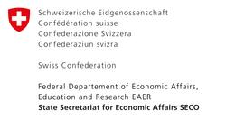
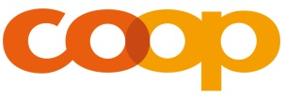
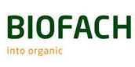
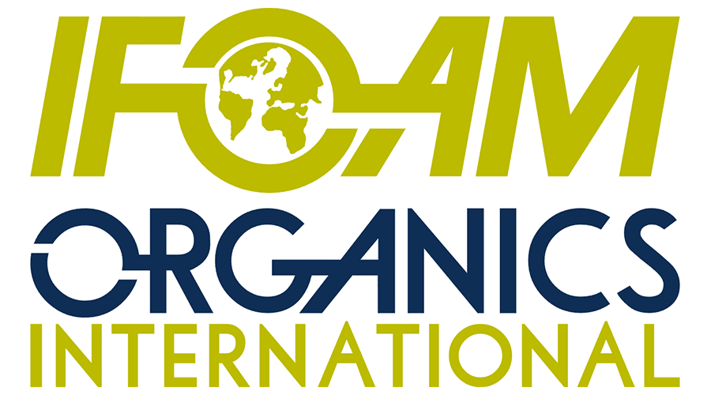
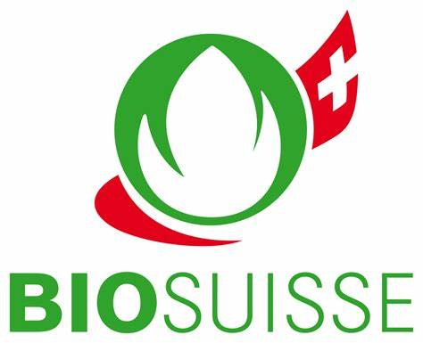
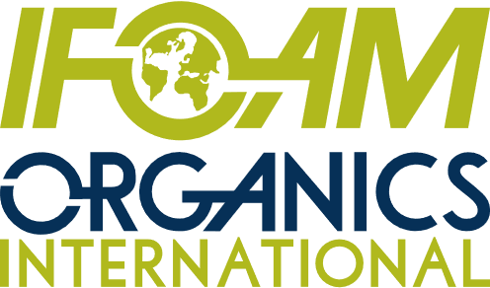
Acknowledgements
The Swiss State Secretariat of
Economic Affairs (SECO)
Coop Sustainability Fund
NürnbergMesse, the organizers of BIOFACH
IFOAM – Organics International
Bio Suisse
More than 200 experts from all parts of the world contributed to the FiBL survey 2025.

Slide 4
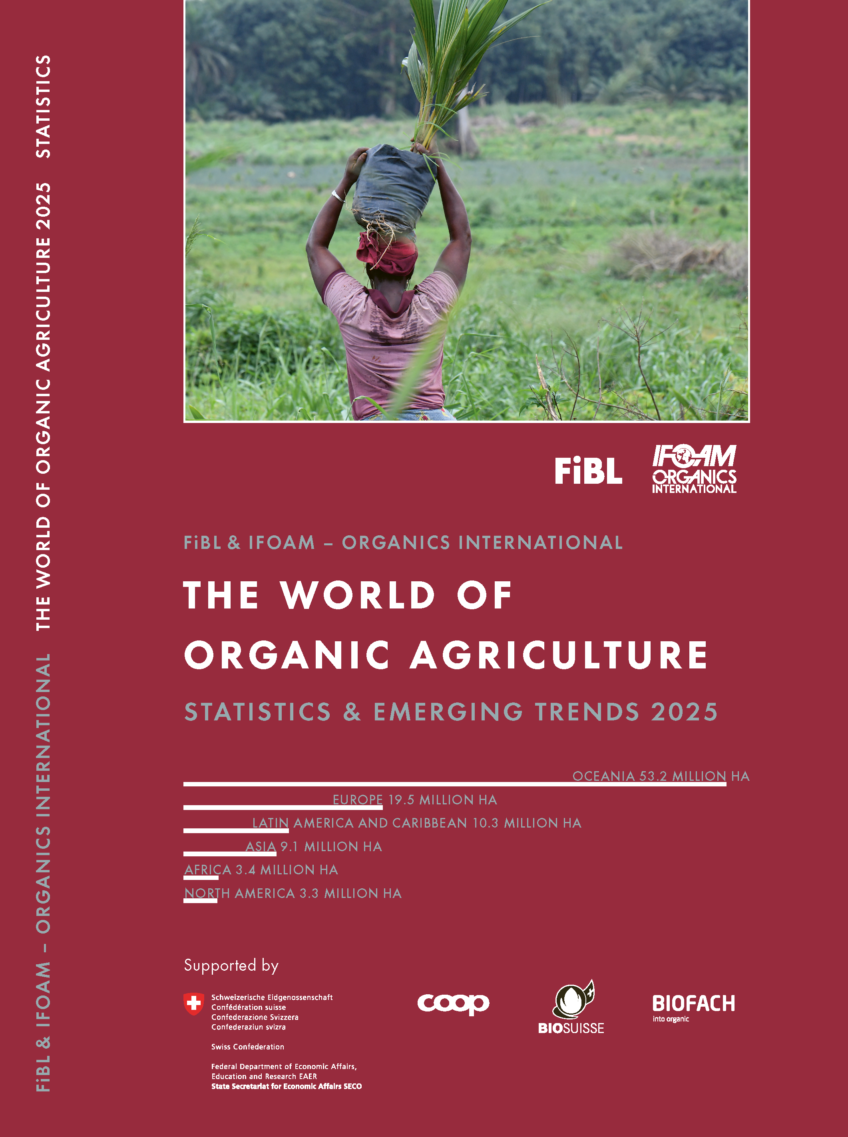

The World of Organic Agriculture 2025
The 26th edition of «The World of Organic Agriculture», was published by FiBL and IFOAM – Organics International in February 2025.
Data tables
Country and continent reports
Markets, standards, policy support
The book can be ordered or downloaded at: https://www.fibl.org/en/shop-en
www.organic-world.net
https://statistics.fibl.org

Slide 5
About this presentation
In three presentations, the key results of the FiBL survey on organic agriculture worldwide 2025 are summarized (data 2023). Apart from the global data, key results on crop and on regional data are presented.
More information is available at www.organic-world.net
The following three presentations are available at https://www.organic-world.net/yearbook/yearbook-2025/presentations.html:
  Part 1: Global data 2023 and survey background
  Part 2: Land use and key crops in organic agriculture 2023
  Part 3: Organic agriculture in the regions 2023

Slide 6
The 26th survey on organic agriculture world-wide
The 26th survey on organic agriculture worldwide was carried out by the Research Institute of Organic Agriculture FiBL in cooperation with partners from all around the world. The results were published jointly by FiBL and IFOAM – Organics International.
The survey was carried out between July 2024 and February 2025.
Data were received from 188 countries.
Data was provided by over 200 country experts (representatives from NGOs, certification bodies, governments, researchers).
The following data was collected: area data (including land use and crop details); producers, other operator types; domestic market values; export and import data; livestock data (animal heads and production in metric tons).
The results are published in the yearbook “The World of Organic Agriculture 2025” and on www.organic-world.net.

Slide 7
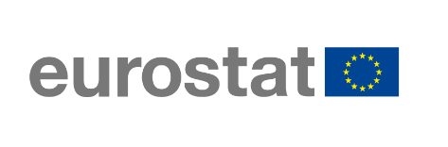
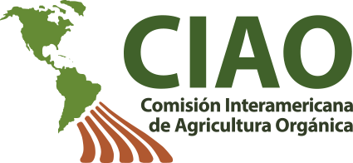
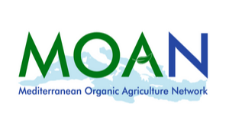

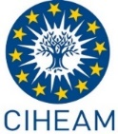
Transnational data collection efforts

Slide 8
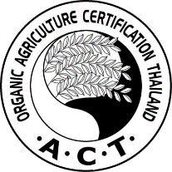


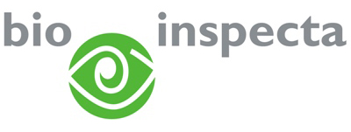




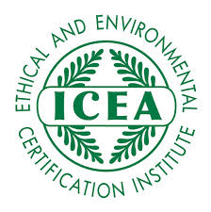

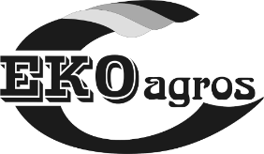
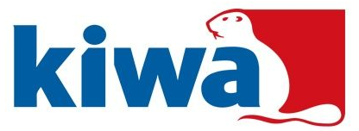

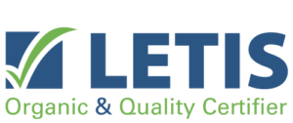

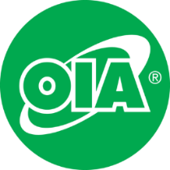
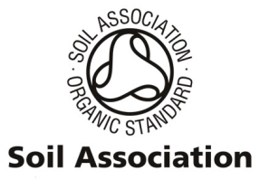


International certifiers that provided data for several countries

Slide 9
General notes on the data
Data sources: For data sources, see annex of The World of Organic Agriculture 2025 or www.organic-world.net/statistics-data-sources.html
Countries: For countries and territories, the FAO country list is used. Where the designation "country" appears in this report, it covers countries or territories. For the countries’ grouping by region, the Standard Country and Area Classifications as defined by the United Nations Statistics Division, is used in most cases.
Term organic: In the tables, the term organic refers to the fully converted and in-conversion areas.
Organic share: In some cases, the calculation of the organic share of the total agricultural land or that of individual crops, based on FAOSTAT and in some cases the Eurostat data, might differ from the organic shares obtained from ministries or local experts.
Producers: Some countries report the number of smallholders while others only report the number of companies, projects, or grower groups, which may each comprise a number of producers. This applies in particular to many African countries. The number of producers is, therefore, probably higher than the number communicated in this report.
Data revisions: Should data revisions and corrections become necessary these are communicated on Organic-World.net: https://www.organic-world.net/yearbook/yearbook-2025/yearbook-2025-corrigenda.html. Revised/corected data are included in the database.

Slide 10
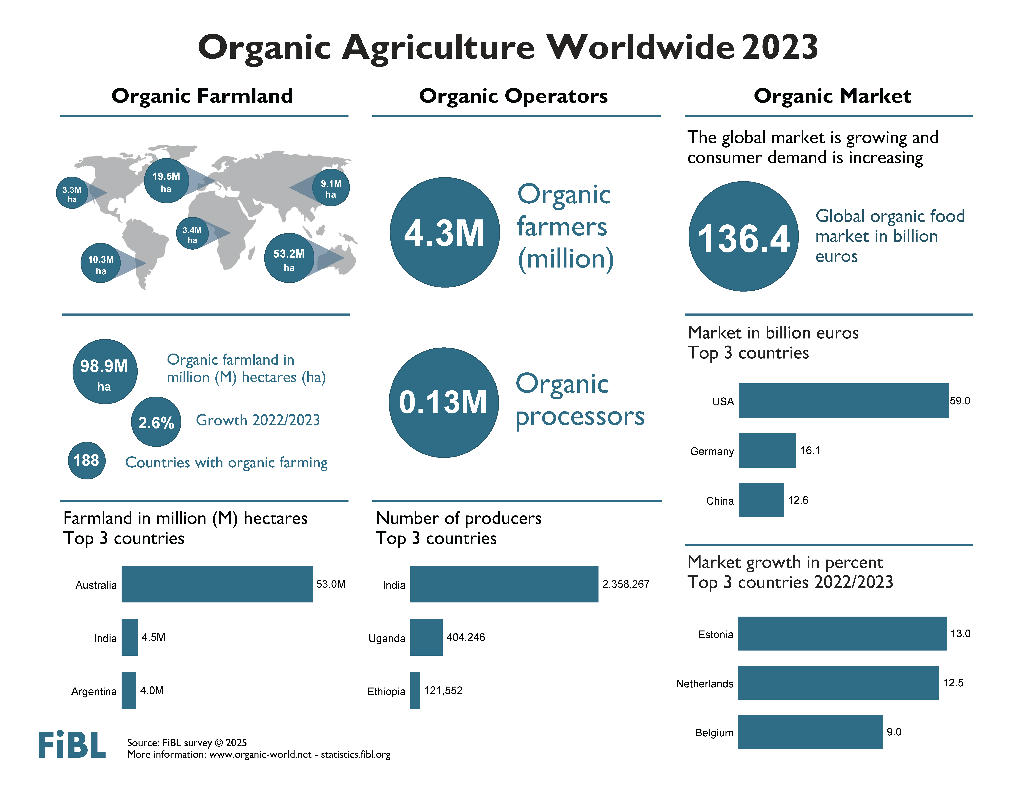

Slide 11
Key data 2023
Total Organic Area: In 2023, almost 98.9 million hectares of agricultural land were organic.
Top Countries: Australia led with 53.0 million hectares, followed by India (4.5M ha) and Argentina (4.0M ha).
Organic Share of Global Farmland: 2.1% of the world’s agricultural land was organic.
Highest Organic Shares by Country: Liechtenstein had the highest share (44.6%), followed by Austria (27.3%) and Uruguay (25.4%).
Growth in Organic Farmland: Increased by 2.5 million hectares (2.6%) in 2023.
Regional Growth Trends: Africa had the highest relative growth (+24.4%, +0.7M ha), Latin America led absolute growth (+1.0M ha, +10.8%).
Additional Organic Areas: Wild collection, beekeeping, aquaculture, and non-agricultural grazing areas totaled 32.0 million hectares.
Decline in Organic Producers: Dropped by 4% (-181,950 producers), mainly due to decreases in India (-122,592) and Thailand (-89,917).
Organic Trade Trends: EU organic imports fell by 9.1%, while U.S. organic imports surged by 27.4%, reaching 2.76M metric tons.
Leading Organic Exporters: Mexico (728,632 MT), Ecuador (665,483 MT), and Peru (302,826 MT).
Key imported products included bananas, sugar, oilcakes, and soybeans.
Global Organic Market: Reached 136B euros, led by the U.S. (59B euros), Germany (16B euros), and China (12.6B euros).
Global Organic Market: Organic food and drink sales reached 136 billion euros in 2023.Largest Markets: The United States was the biggest market (59.0 billion euros), followed by Germany (16.1B euros) and China (12.6B euros).
Market Shares: The U.S. accounted for 43.2% of global sales, the EU for 34.1% (46.5B euros), and China for 9.3%.
Switzerland had the highest per capita spending (468 euros). Highest Market Shares: Denmark (11.8%), Switzerland (11.6%), and Austria (11.0%) had the highest shares of organic in total food sales.

Slide 12
Organic farmland 2023
Organic farmland increases by 2.5 million hectares
By the end of 2023, 98.9 million hectares were managed organically, marking a 2.6 percent or +2.5 million hectare increase from 2022.
Latin America experienced the largest increase, adding 1 million hectares (10.8 percent growth), while Africa recorded the highest relative growth, expanding by 24 percent to reach 3.4 million hectares.
Oceania remains the leading region for organic farming, with 53.2 million hectares, accounting for more than half of the global organic area. It is followed by Europe, which has 19.5 million hectares, and Latin America, with 10.3 million hectares.
By country, Australia leads with 53 million hectares, followed by India (4.5 million hectares) and Argentina (4 million hectares).
Liechtenstein is the country with the highest organic area share
Globally, 2.1 percent of agricultural land was managed organically in 2023.
Liechtenstein leads with 44.6 percent of its agricultural land under organic management, followed by Austria (27.3 percent ) and Uruguay (25.4 percent ).
A total of 22 countries reported that 10 percent or more of their agricultural land is organic.

Slide 13
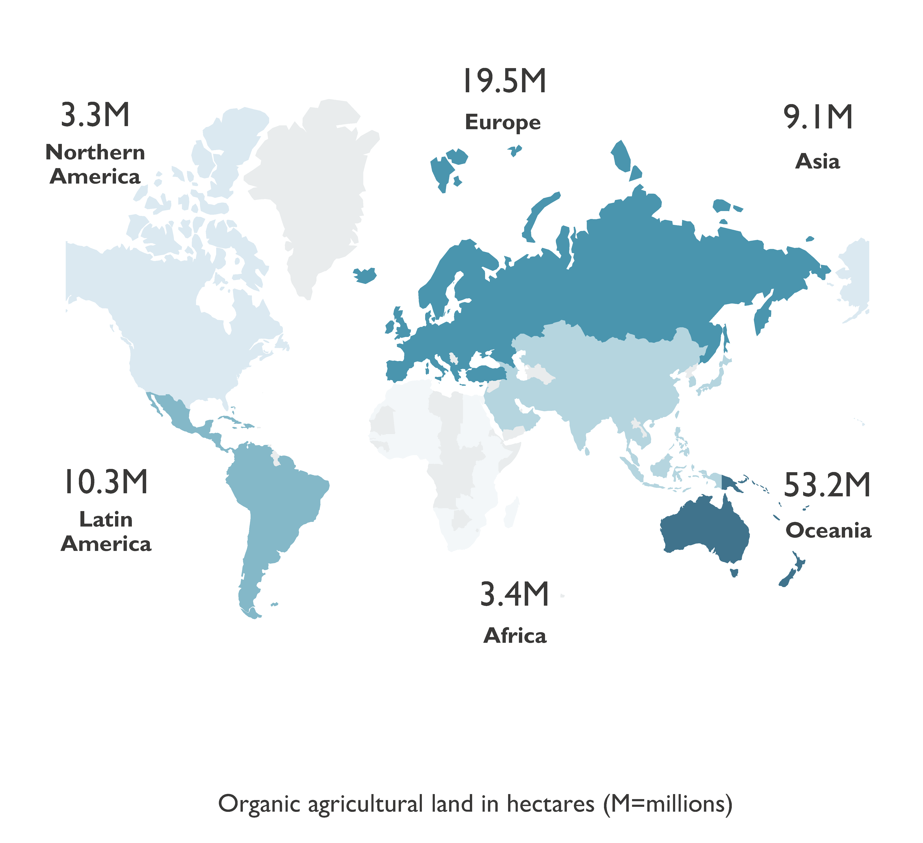
World: Organic agricultural land and other organic areas 2023
Source: FiBL survey 2025

Slide 14
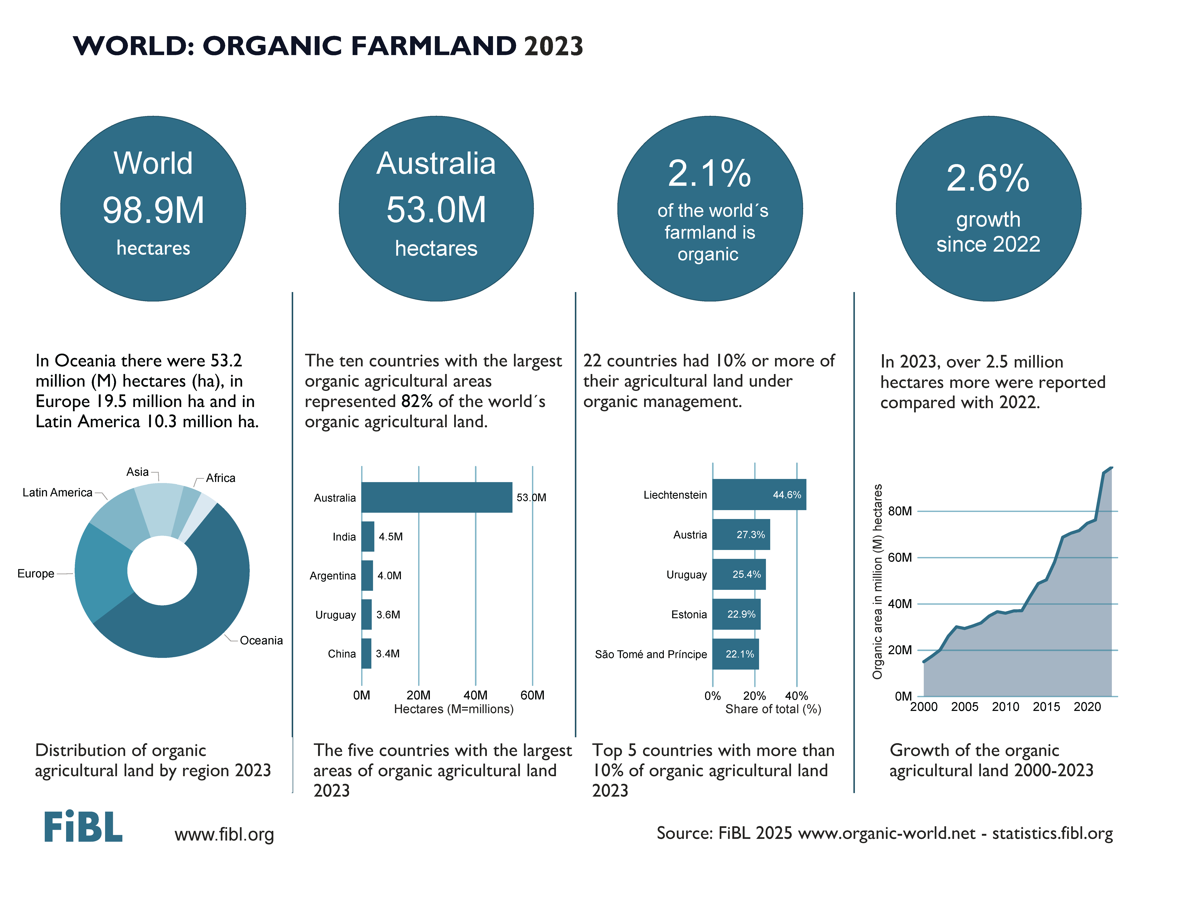

Slide 15
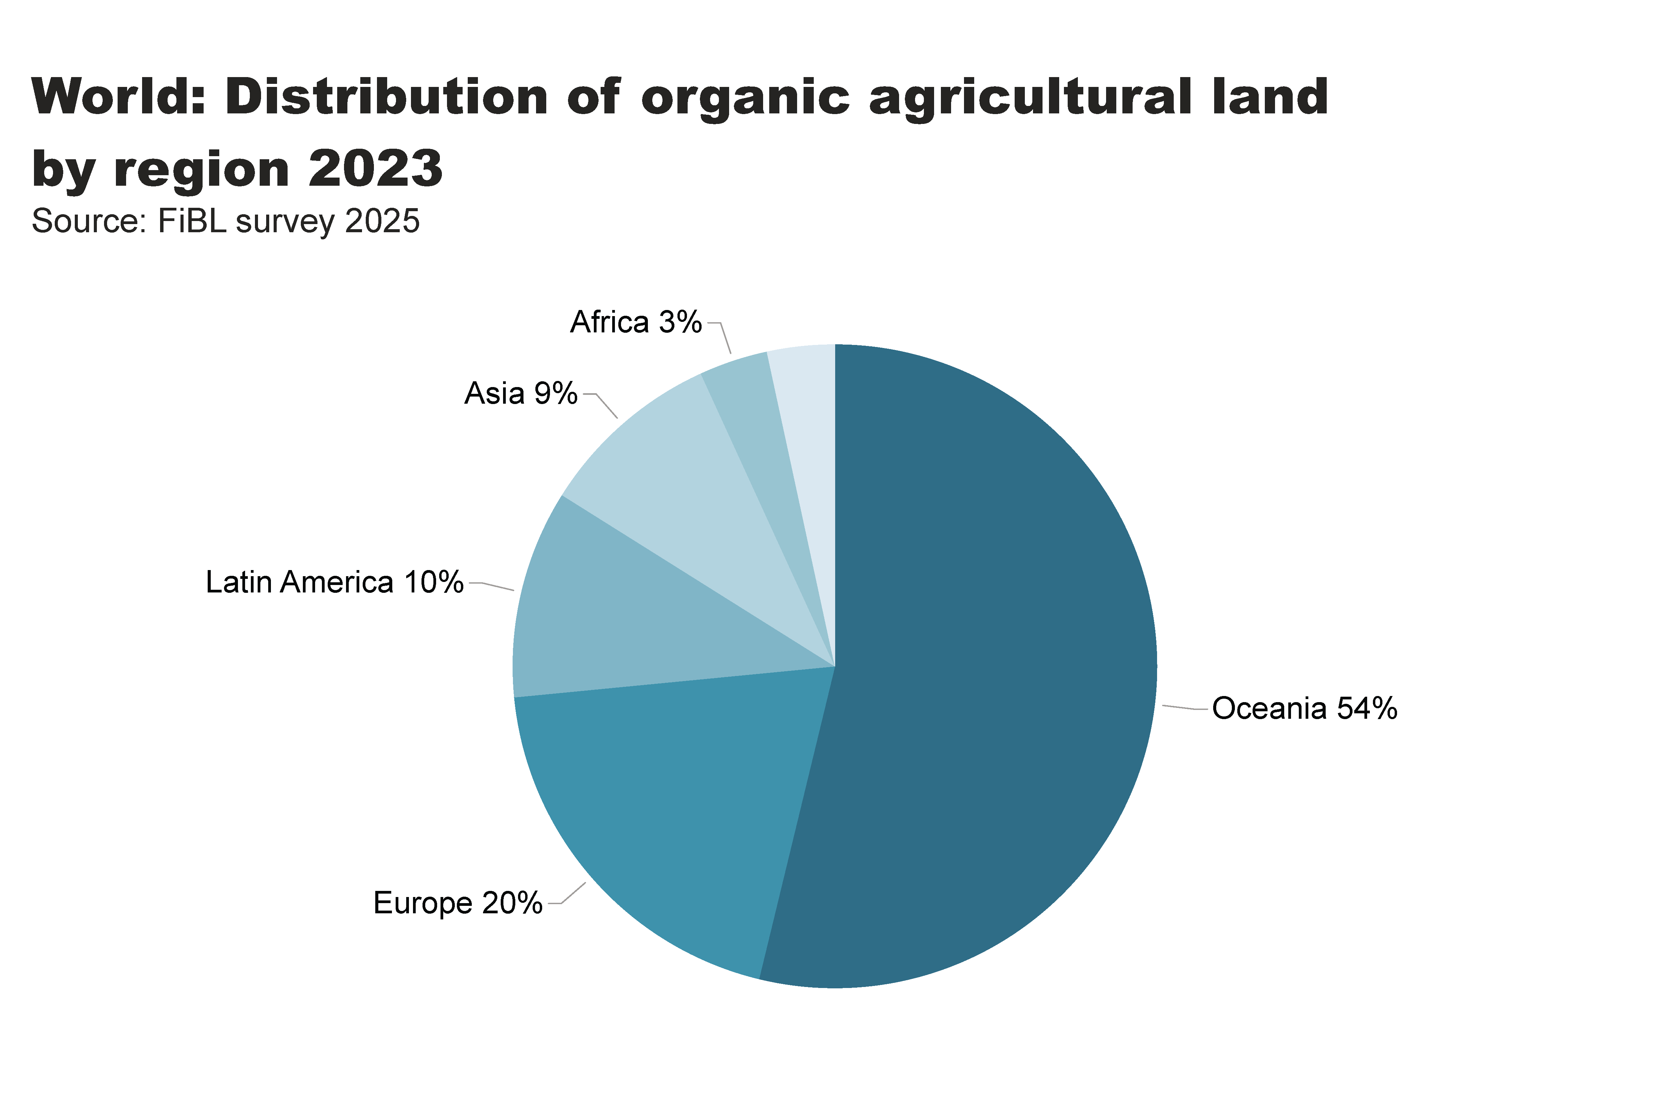
world_land_by_region
Distribution of organic farmland by region 2023
Notes:
textbox
No alt text provided
pieChart
No alt text provided
card
No alt text provided

Slide 16
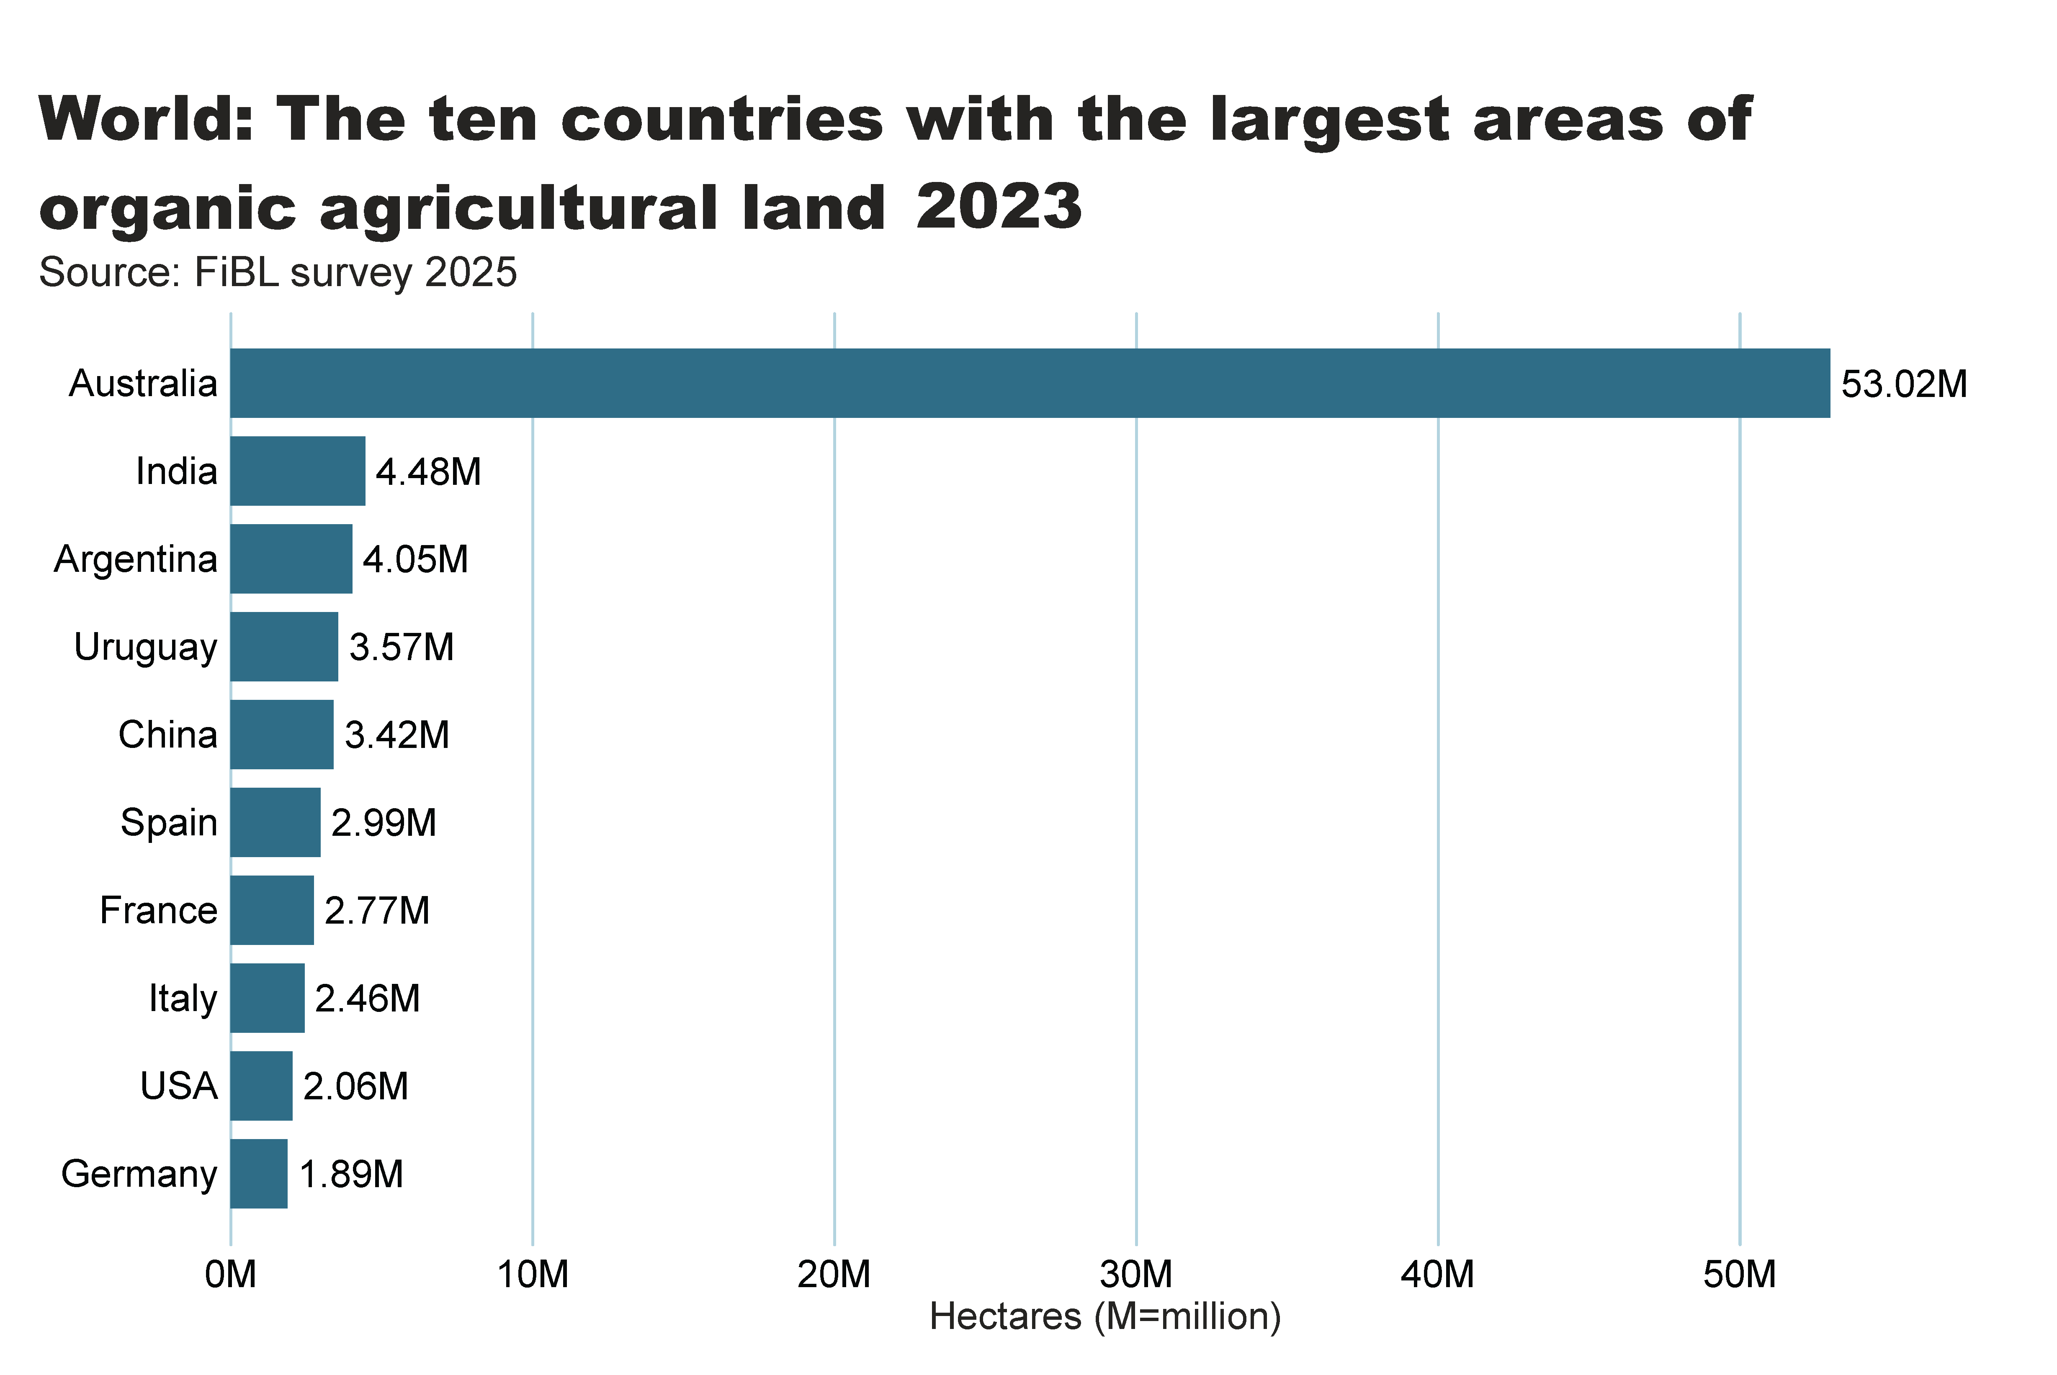
world_land_by_country
Notes:
clusteredBarChart
No alt text provided
textbox
No alt text provided
card
No alt text provided

Slide 17
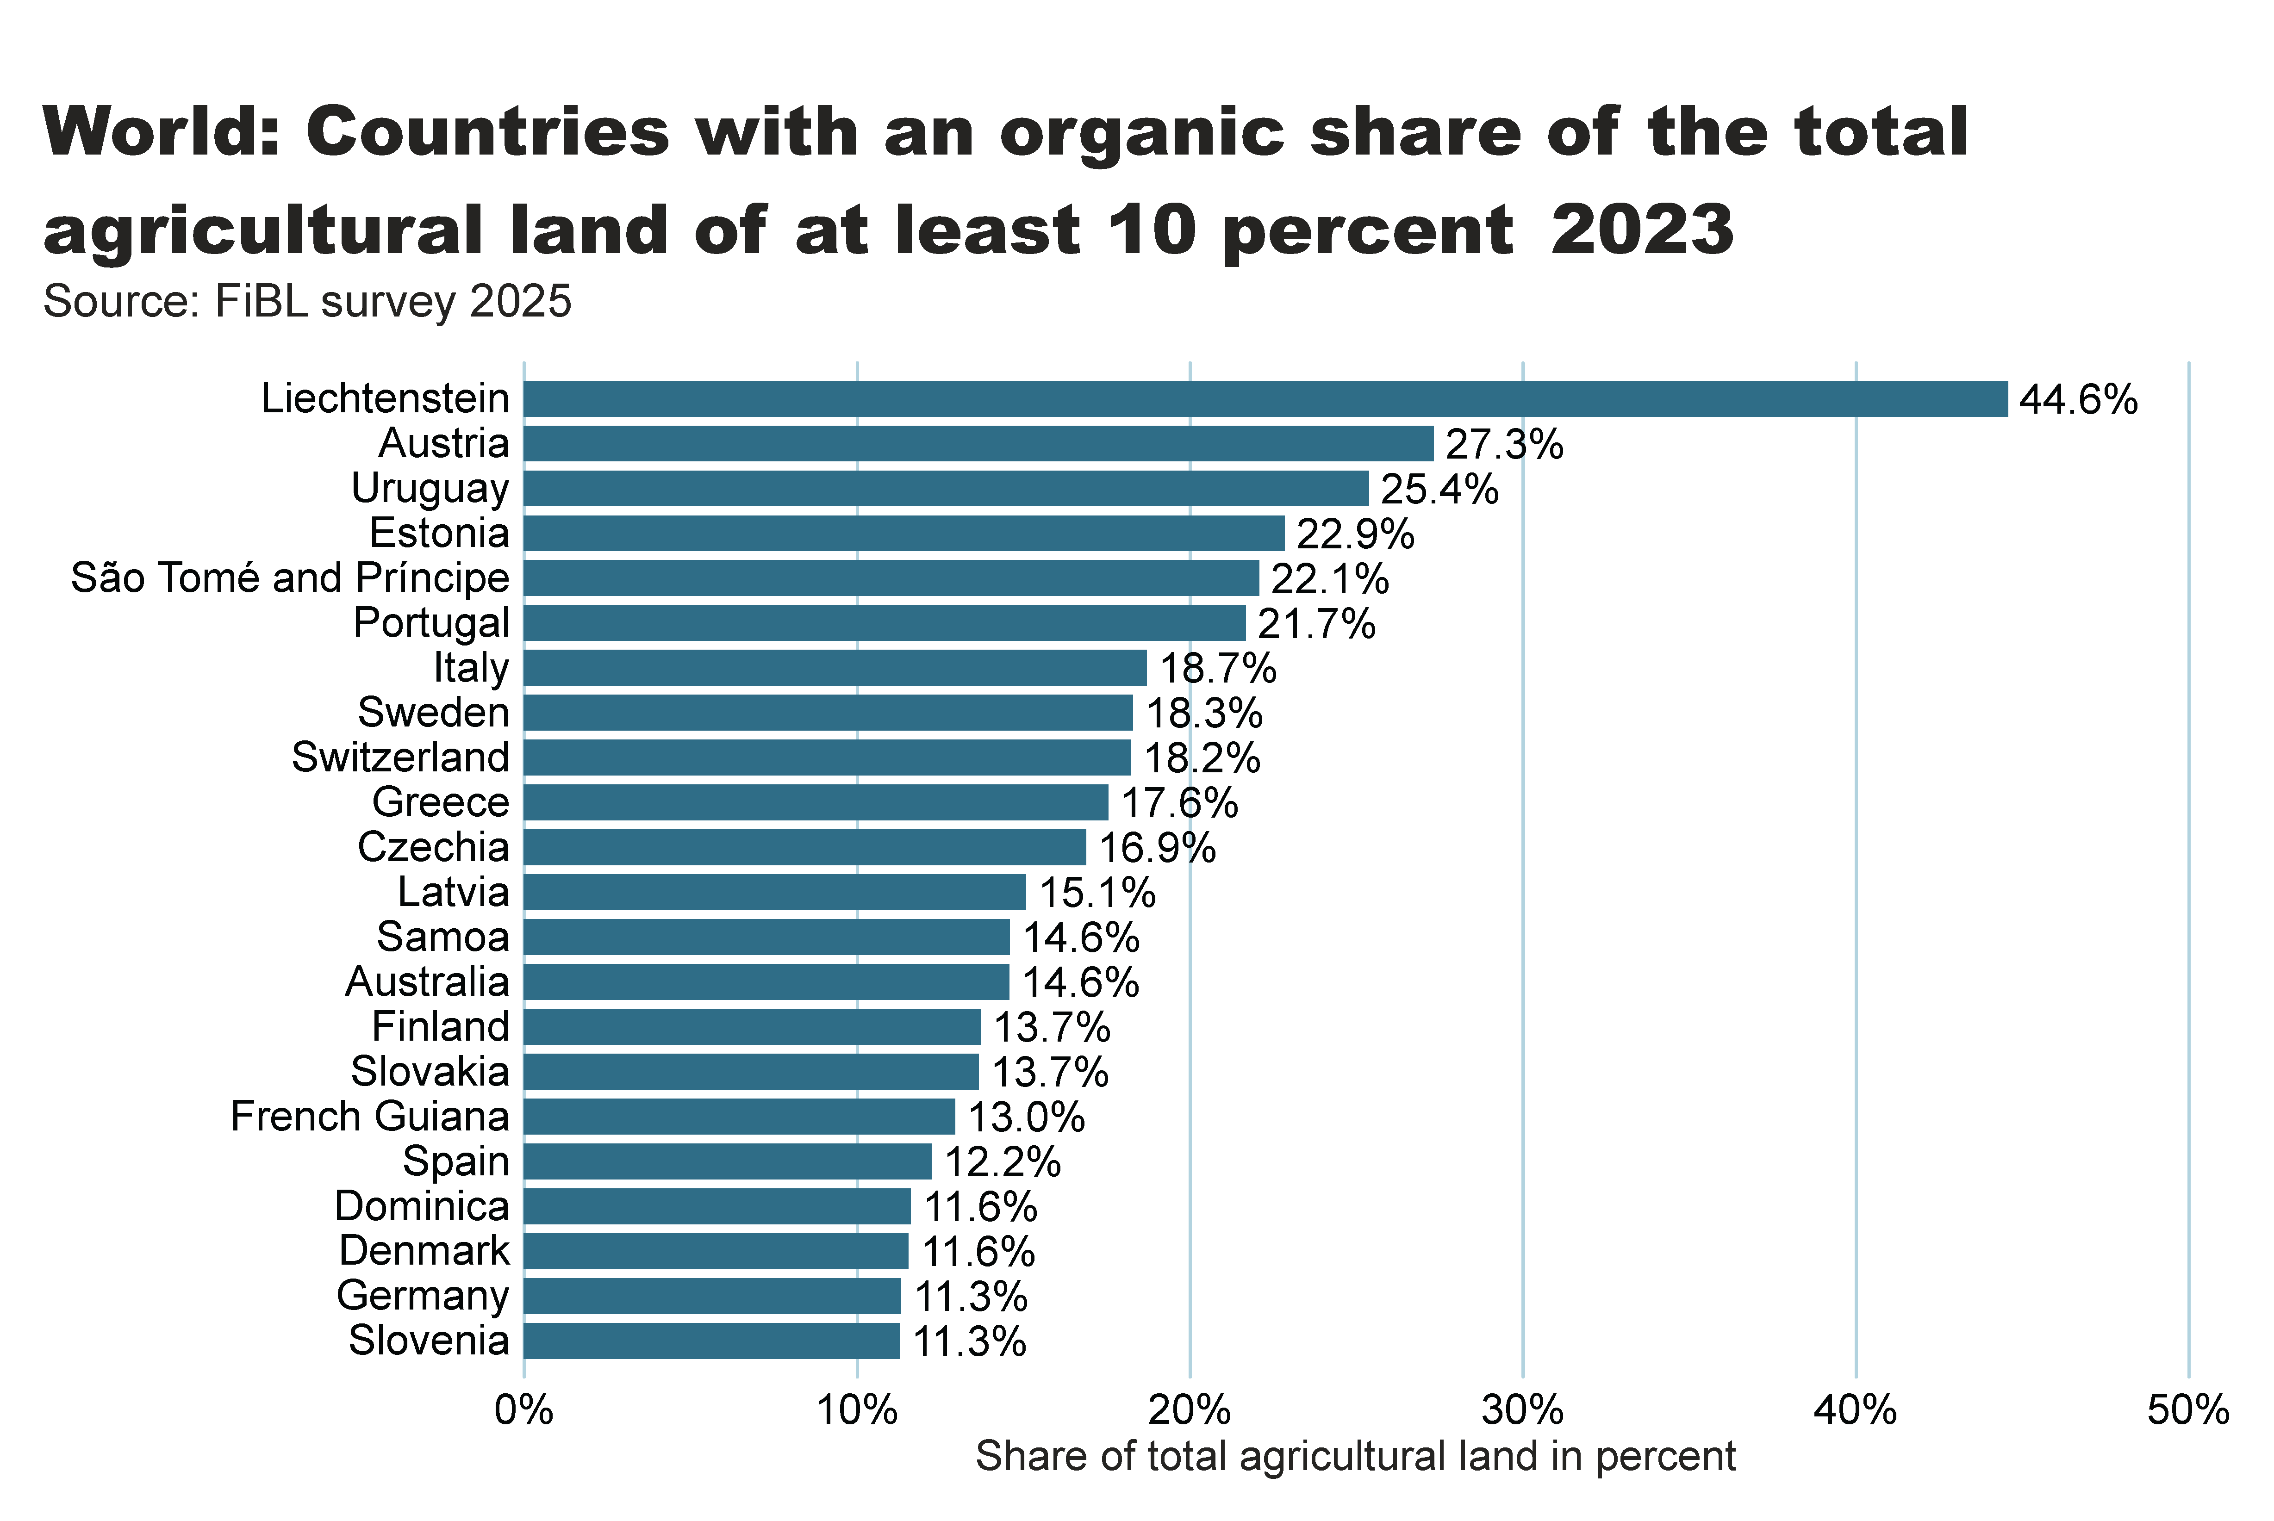
world_land_share
Notes:
textbox
No alt text provided
barChart
No alt text provided
card
No alt text provided

Slide 18
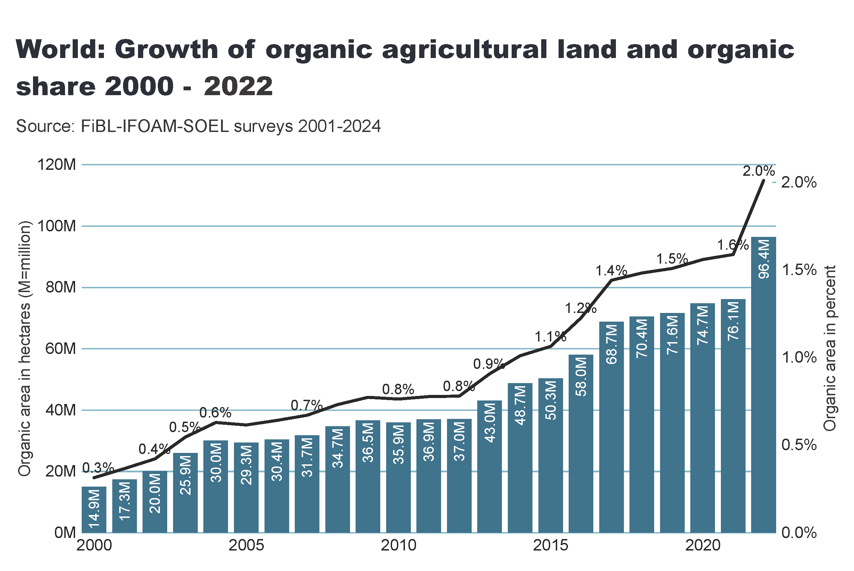
world_land_growth
Notes:
textbox
No alt text provided
lineClusteredColumnComboChart
No alt text provided
card
No alt text provided

Slide 19
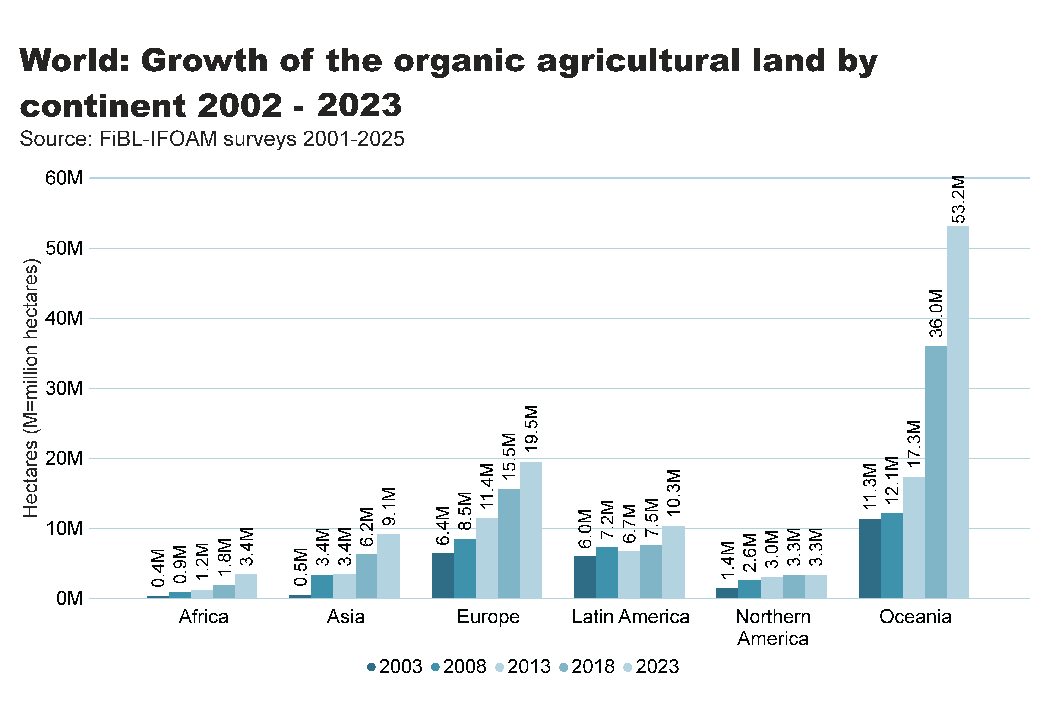
world_land_growth_region
Notes:
textbox
No alt text provided
clusteredColumnChart
No alt text provided
card
No alt text provided

Slide 20
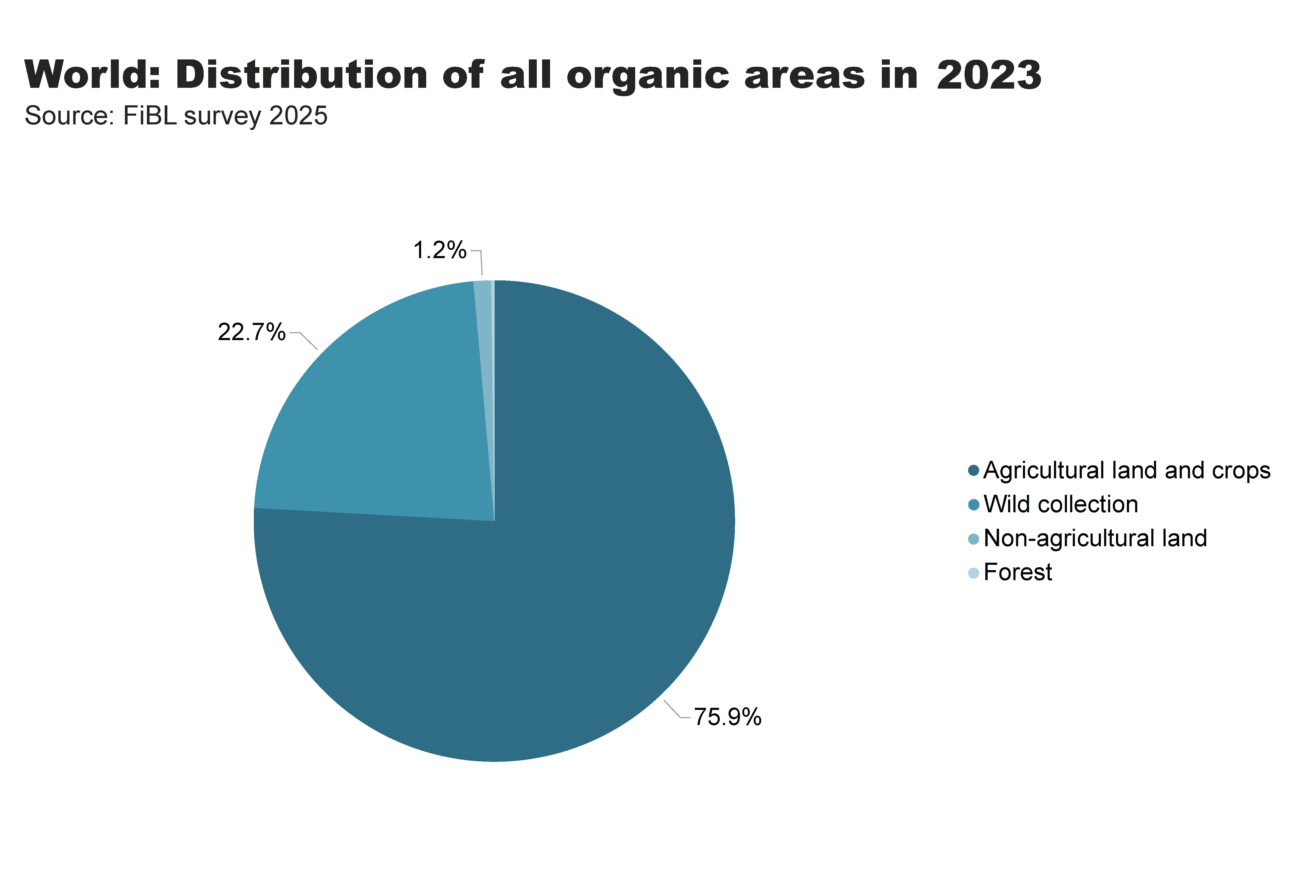
world_land_all_areas
Notes:
textbox
No alt text provided
card
No alt text provided
pieChart
No alt text provided

Slide 21
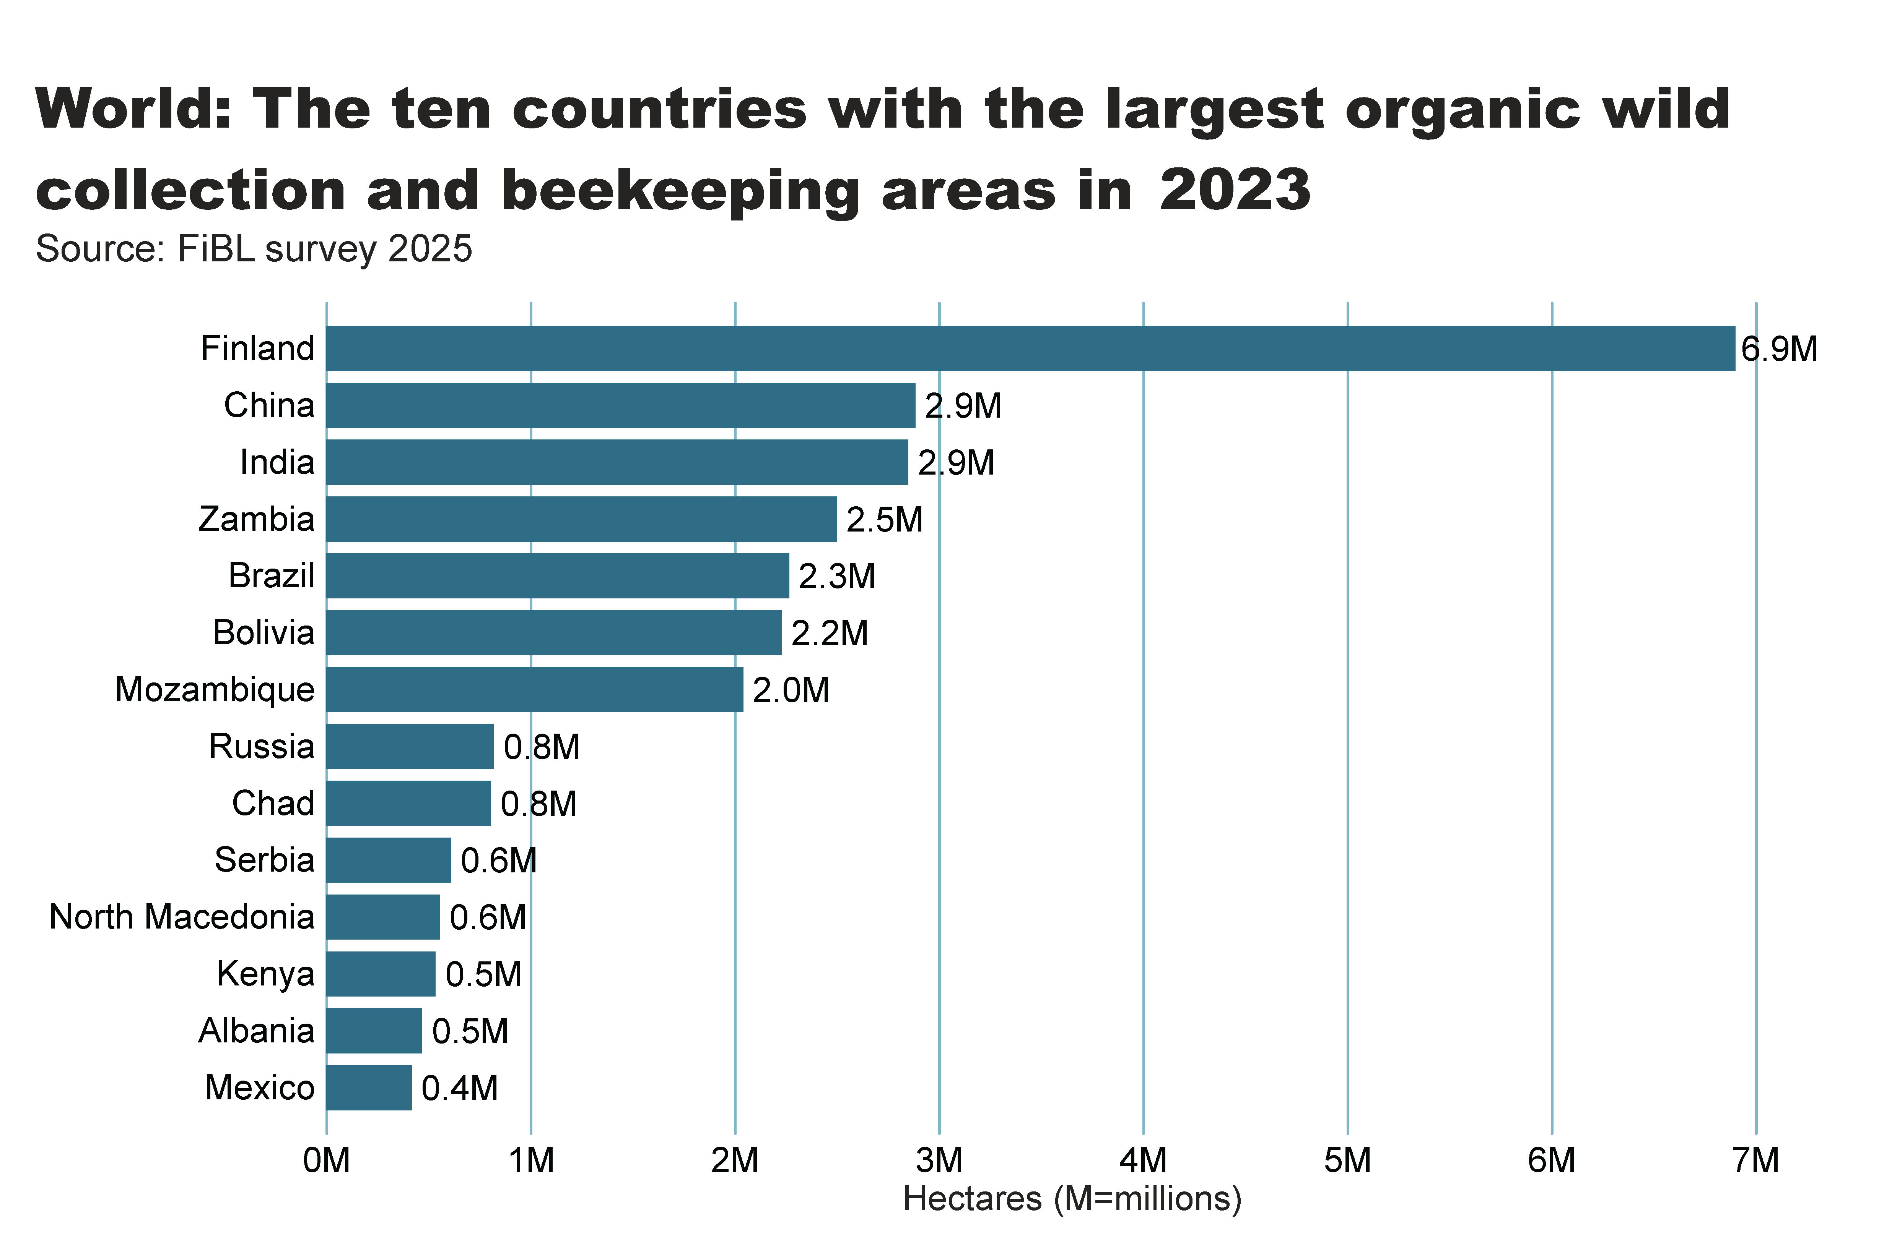
wild_ collection_by_country
Notes:
textbox
No alt text provided
clusteredBarChart
No alt text provided
card
No alt text provided

Slide 22
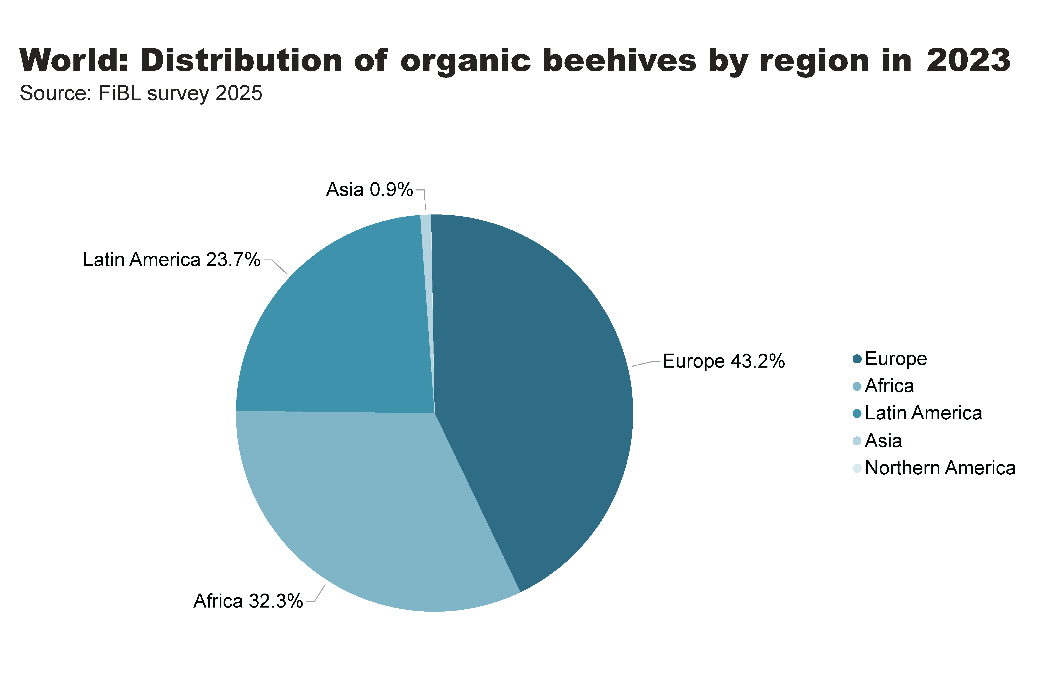
beehives_by_region
Notes:
textbox
No alt text provided
pieChart
No alt text provided
card
No alt text provided

Slide 23
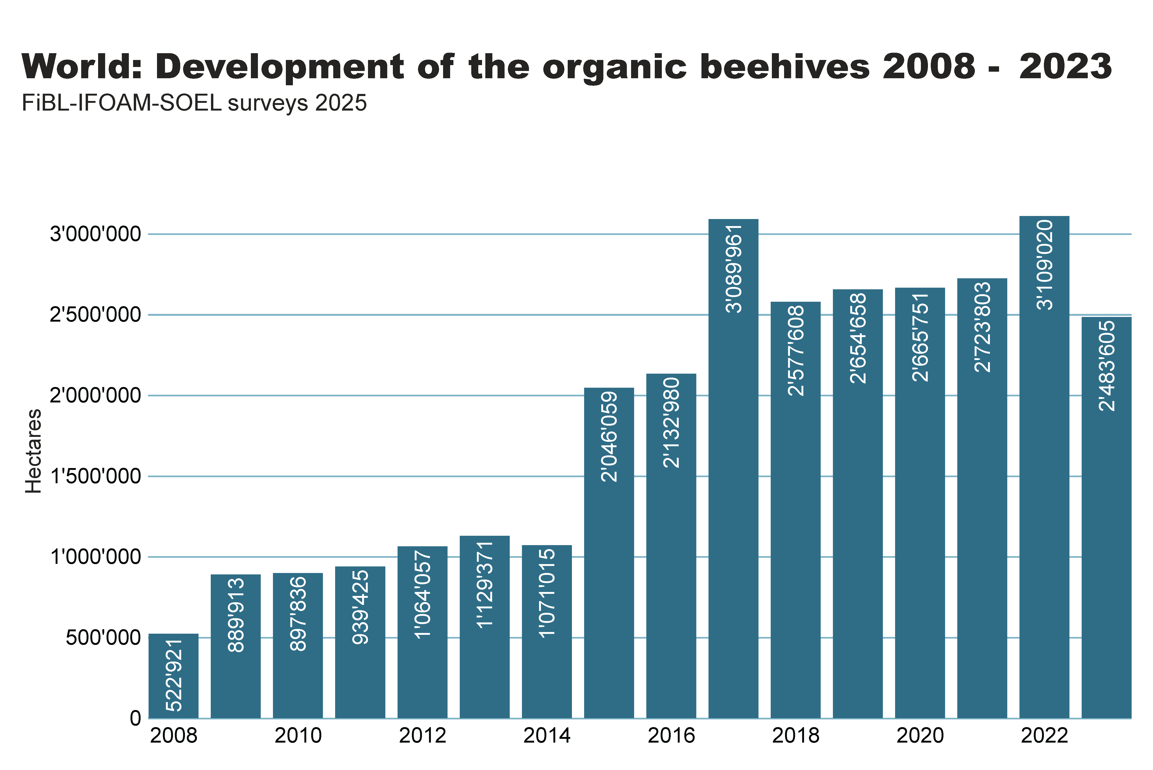
beehives_by country
Notes:
textbox
No alt text provided
clusteredColumnChart
No alt text provided
card
No alt text provided

Slide 24
Organic producers 2023
More than 2 million organic producers in India
In 2023, there were 4.3 million organic producers worldwide.
India remains the country with the most organic producers (2.36 million). Notable increases were observed in Vietnam, Sri Lanka, and Burkina Faso.

Slide 25
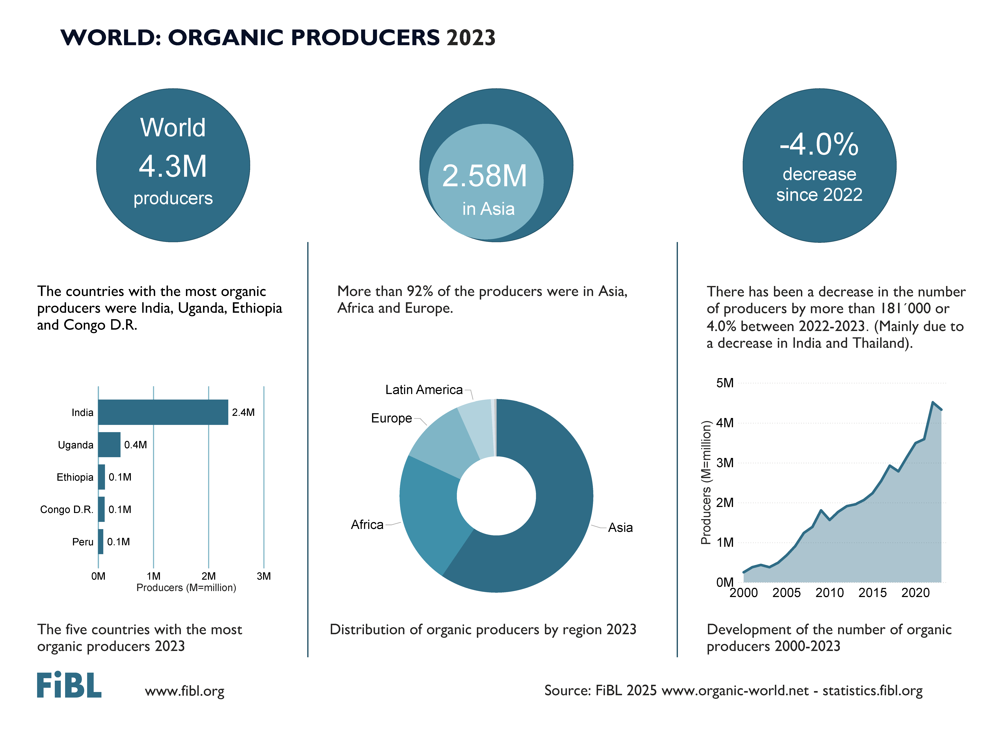

Slide 26
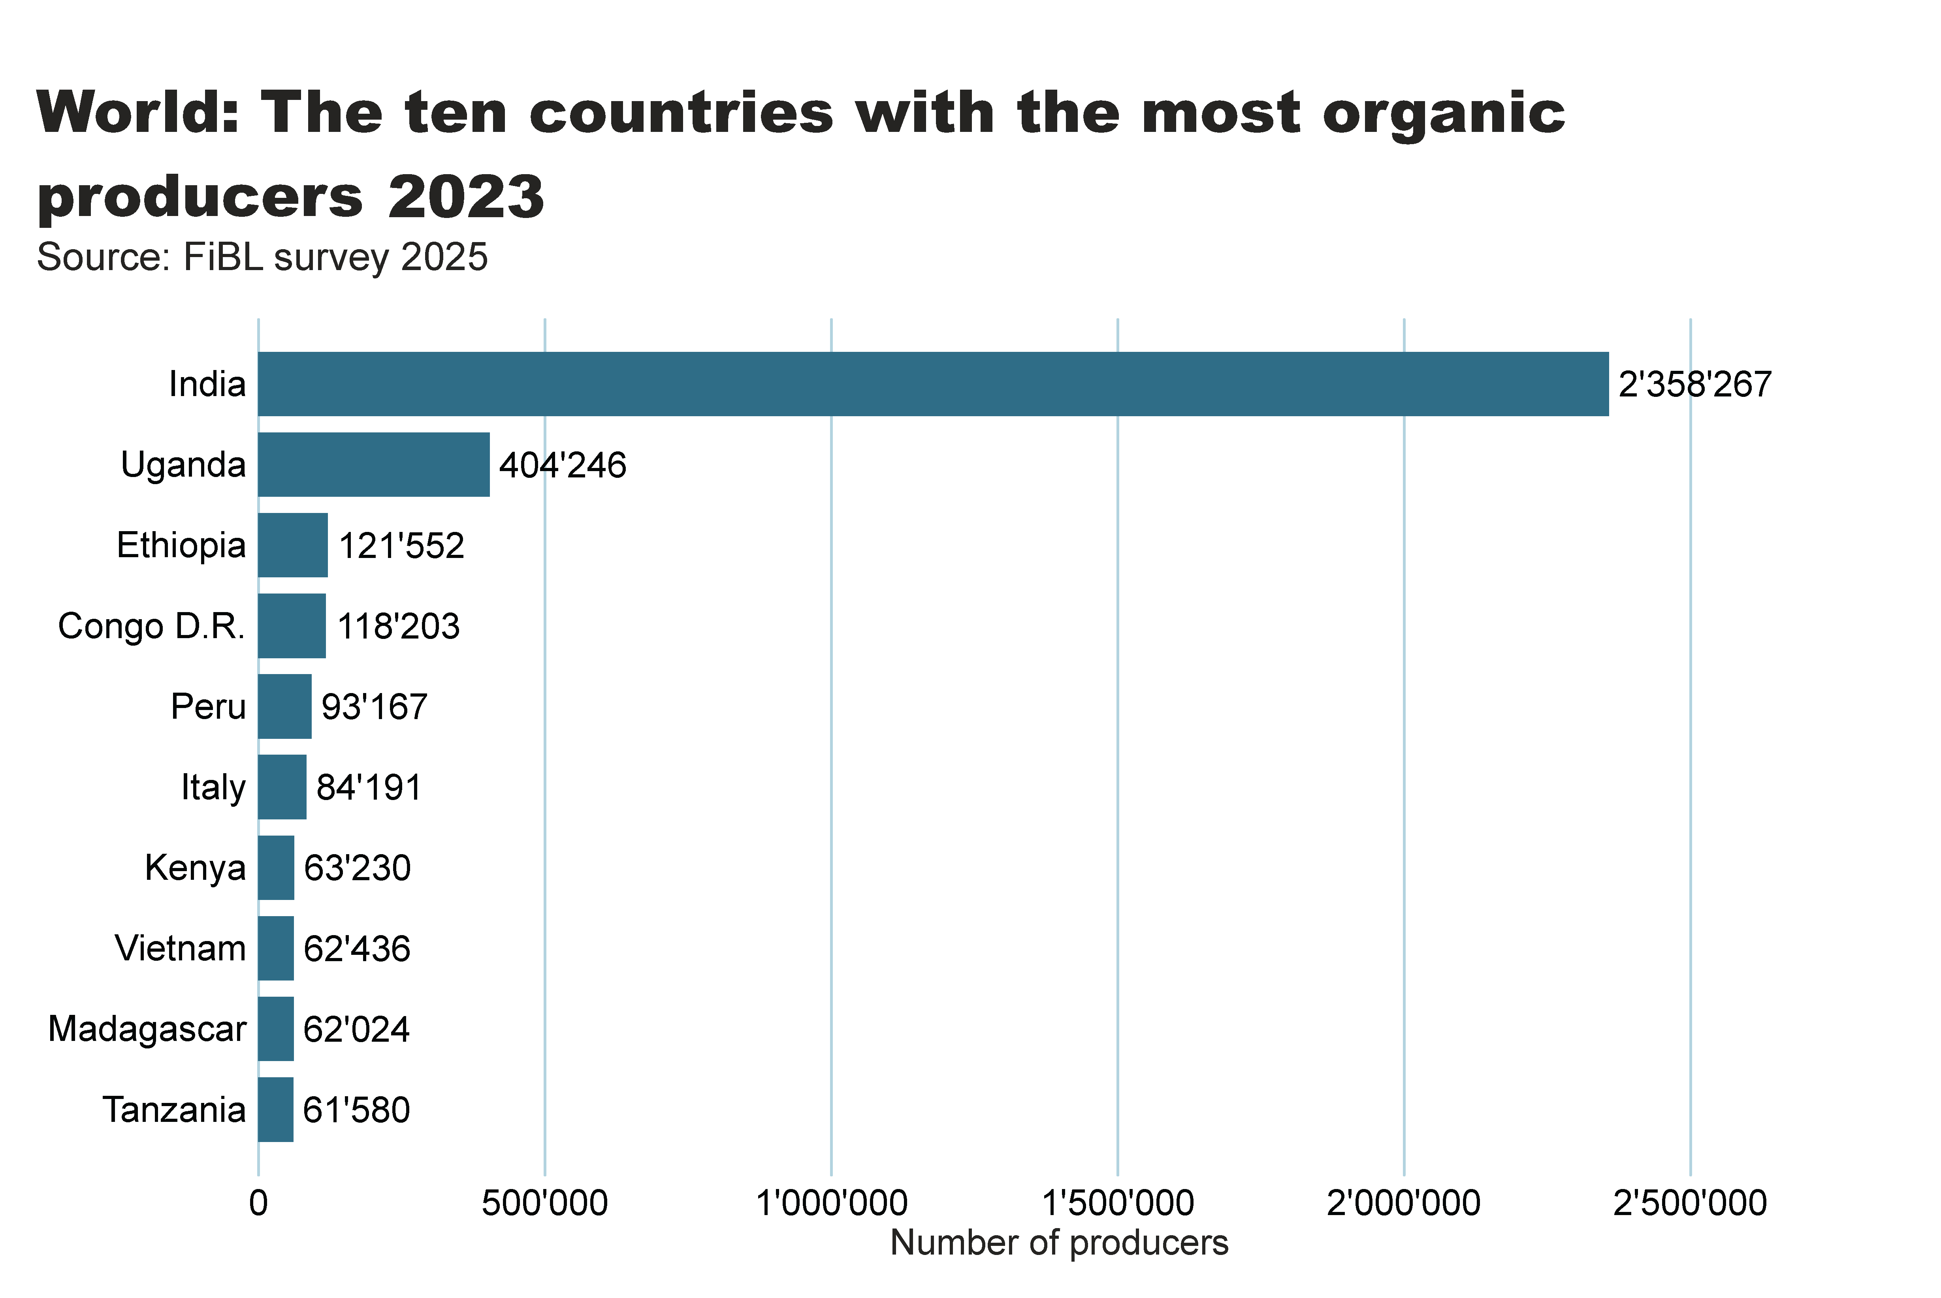
world_producers_country
Notes:
textbox
No alt text provided
card
No alt text provided
barChart
No alt text provided

Slide 27
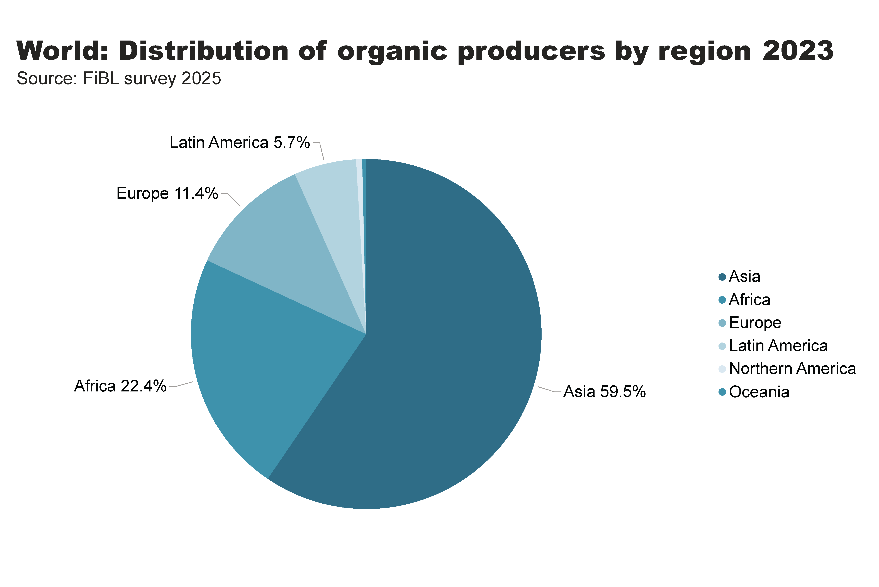
world_producers_region
Notes:
textbox
No alt text provided
pieChart
No alt text provided
card
No alt text provided

Slide 28
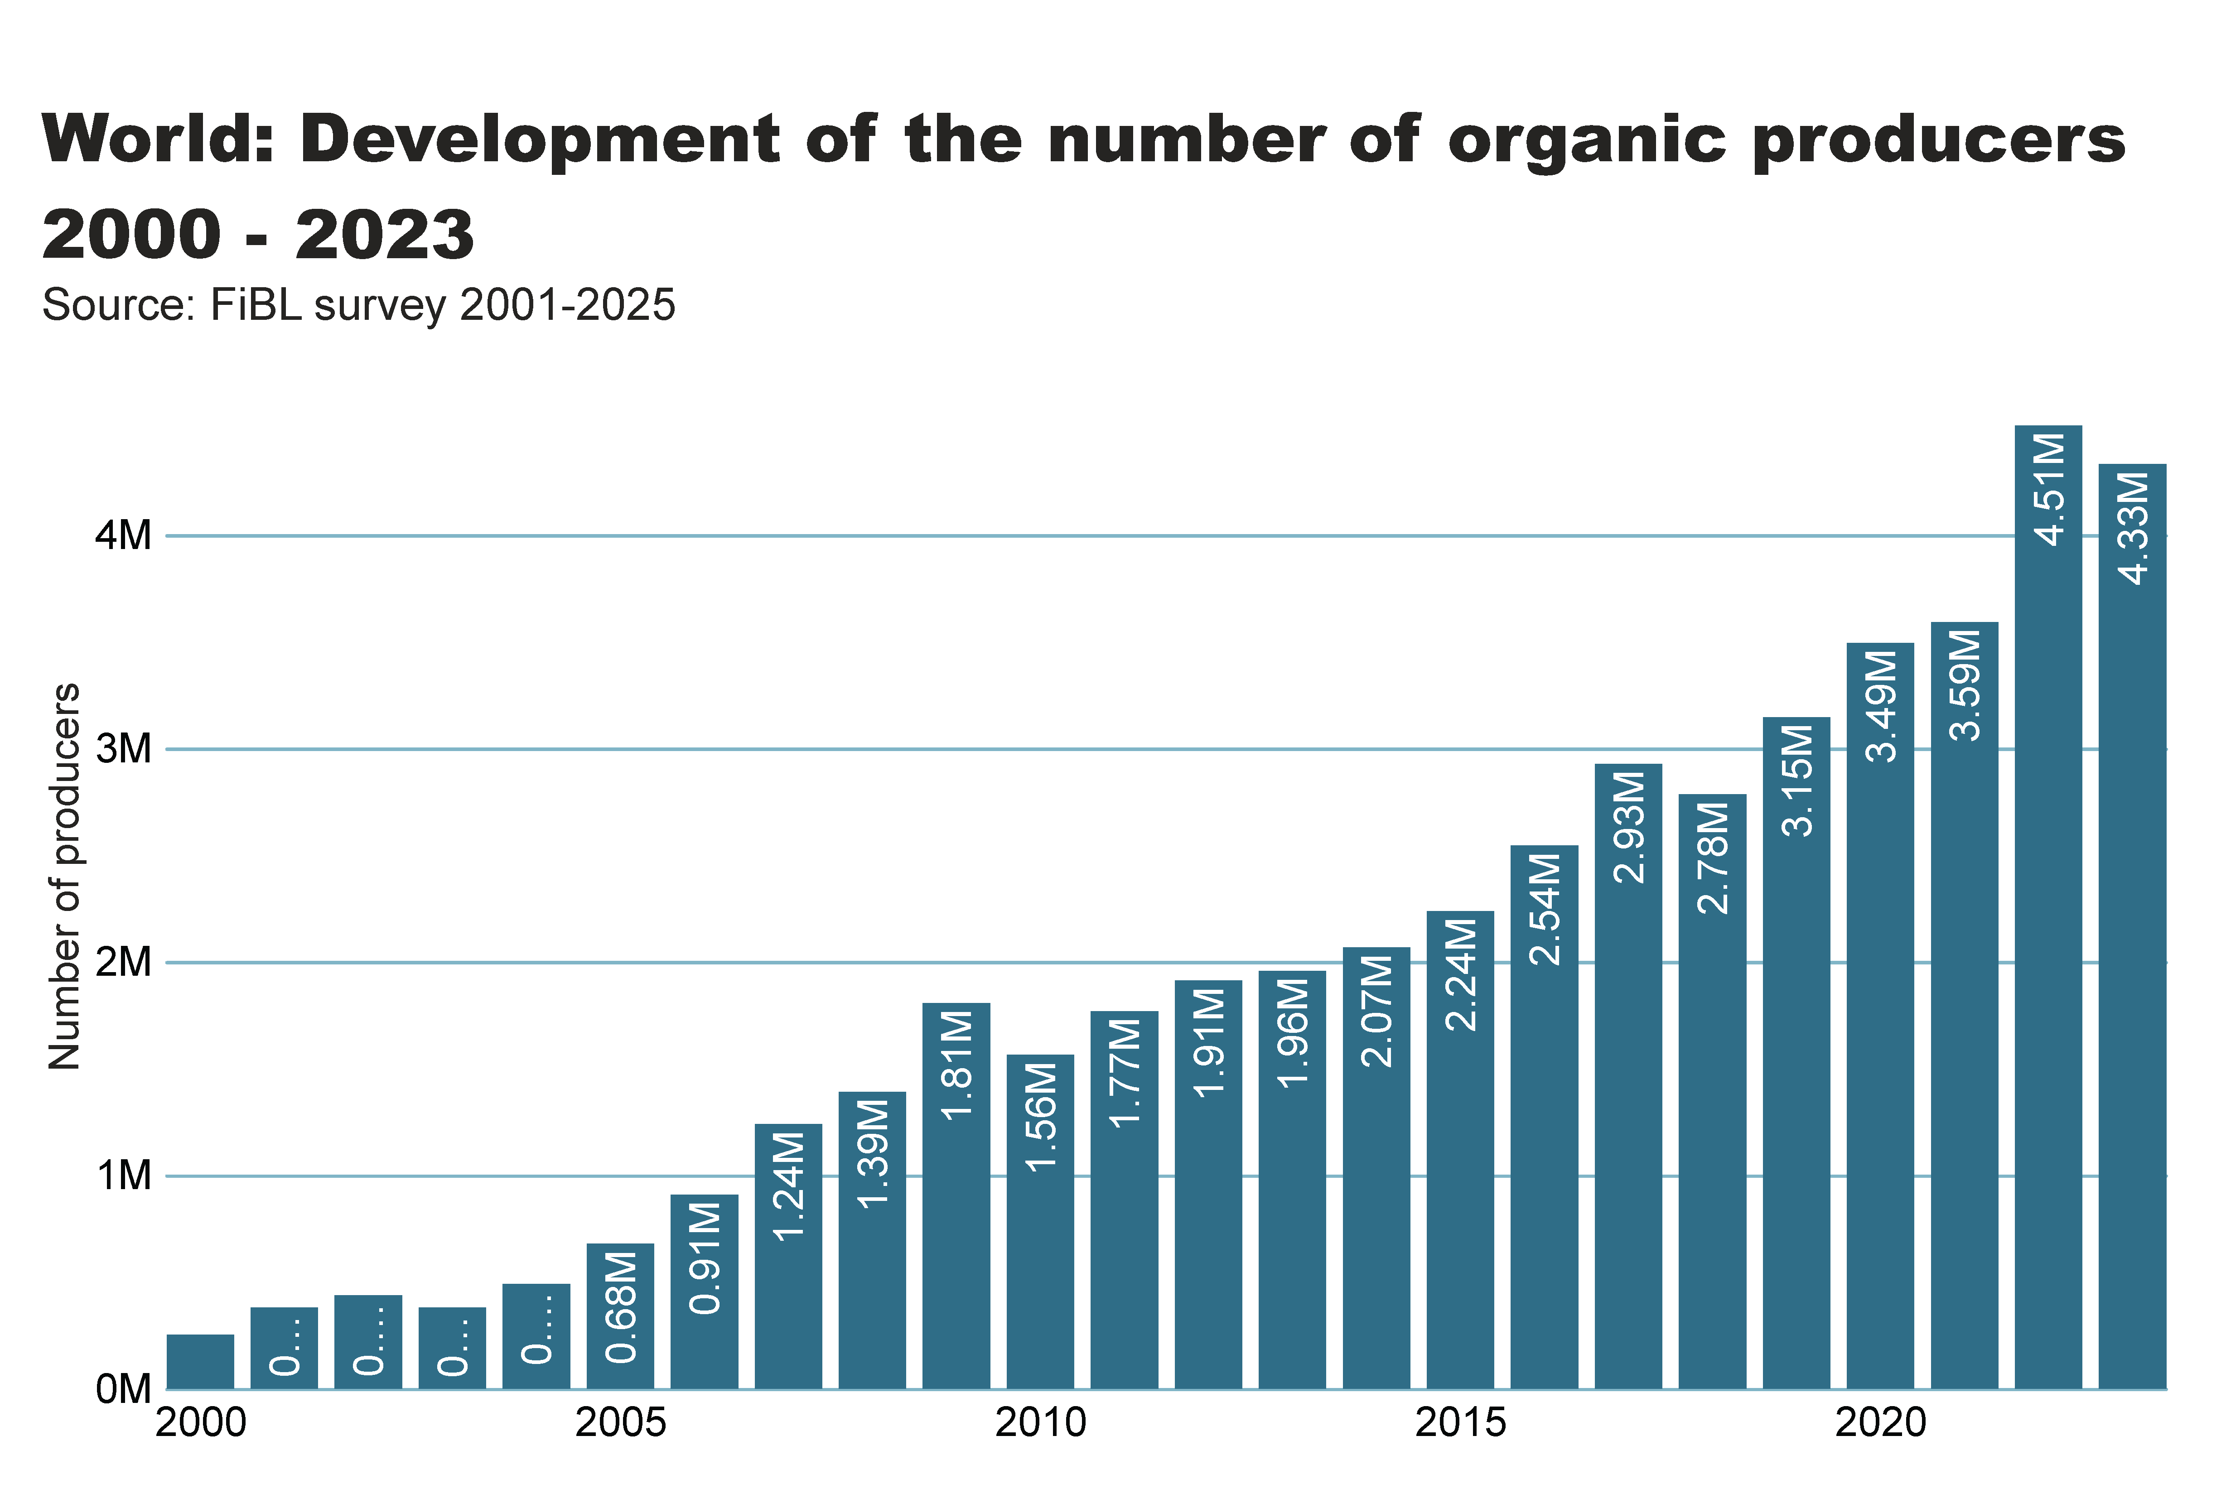
Notes:
Numbers doesn´t match with the database

Slide 29
The global market for organic food 2023
Global market continued to grow; Switzerland tops per capita consumption
The global market for organic products reached 136.4 billion euros in 2023. The European market recorded the strongest growth, with many countries recovering from the negative trend in 2022.
The United States retained its position as the largest market (59.0 billion euros), followed by Germany (16.1 billion euros) and China (12.6 billion euros).
Switzerland recorded the highest per capita spending on organic food (468 euros), while Denmark led with the largest organic market share (11.8 percent of its total food market).
Retail sales increased significantly in Estonia (+13.0 percent) and the Netherlands (+12.5 percent). The two largest markets – the United States and Germany experienced growth rates of 3.4 and 5.0 pecent, respectively.

Slide 30
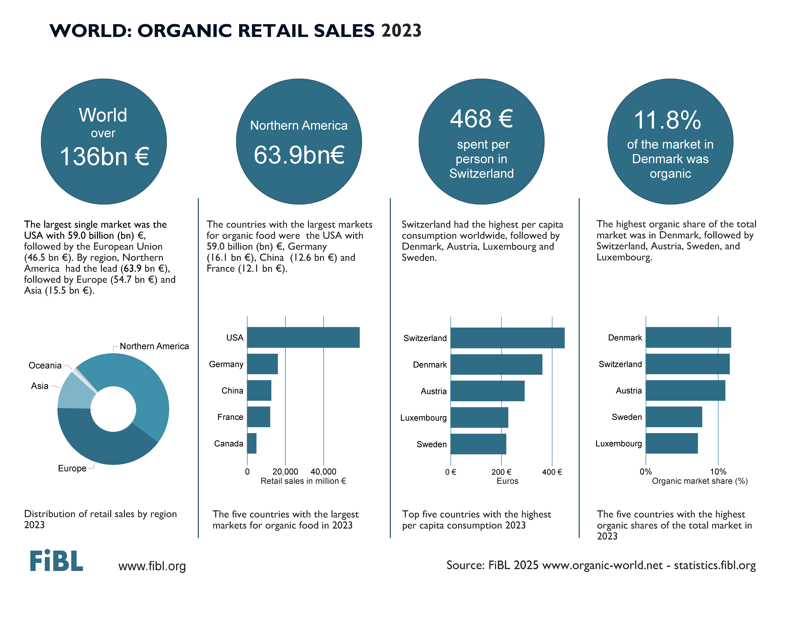

Slide 31
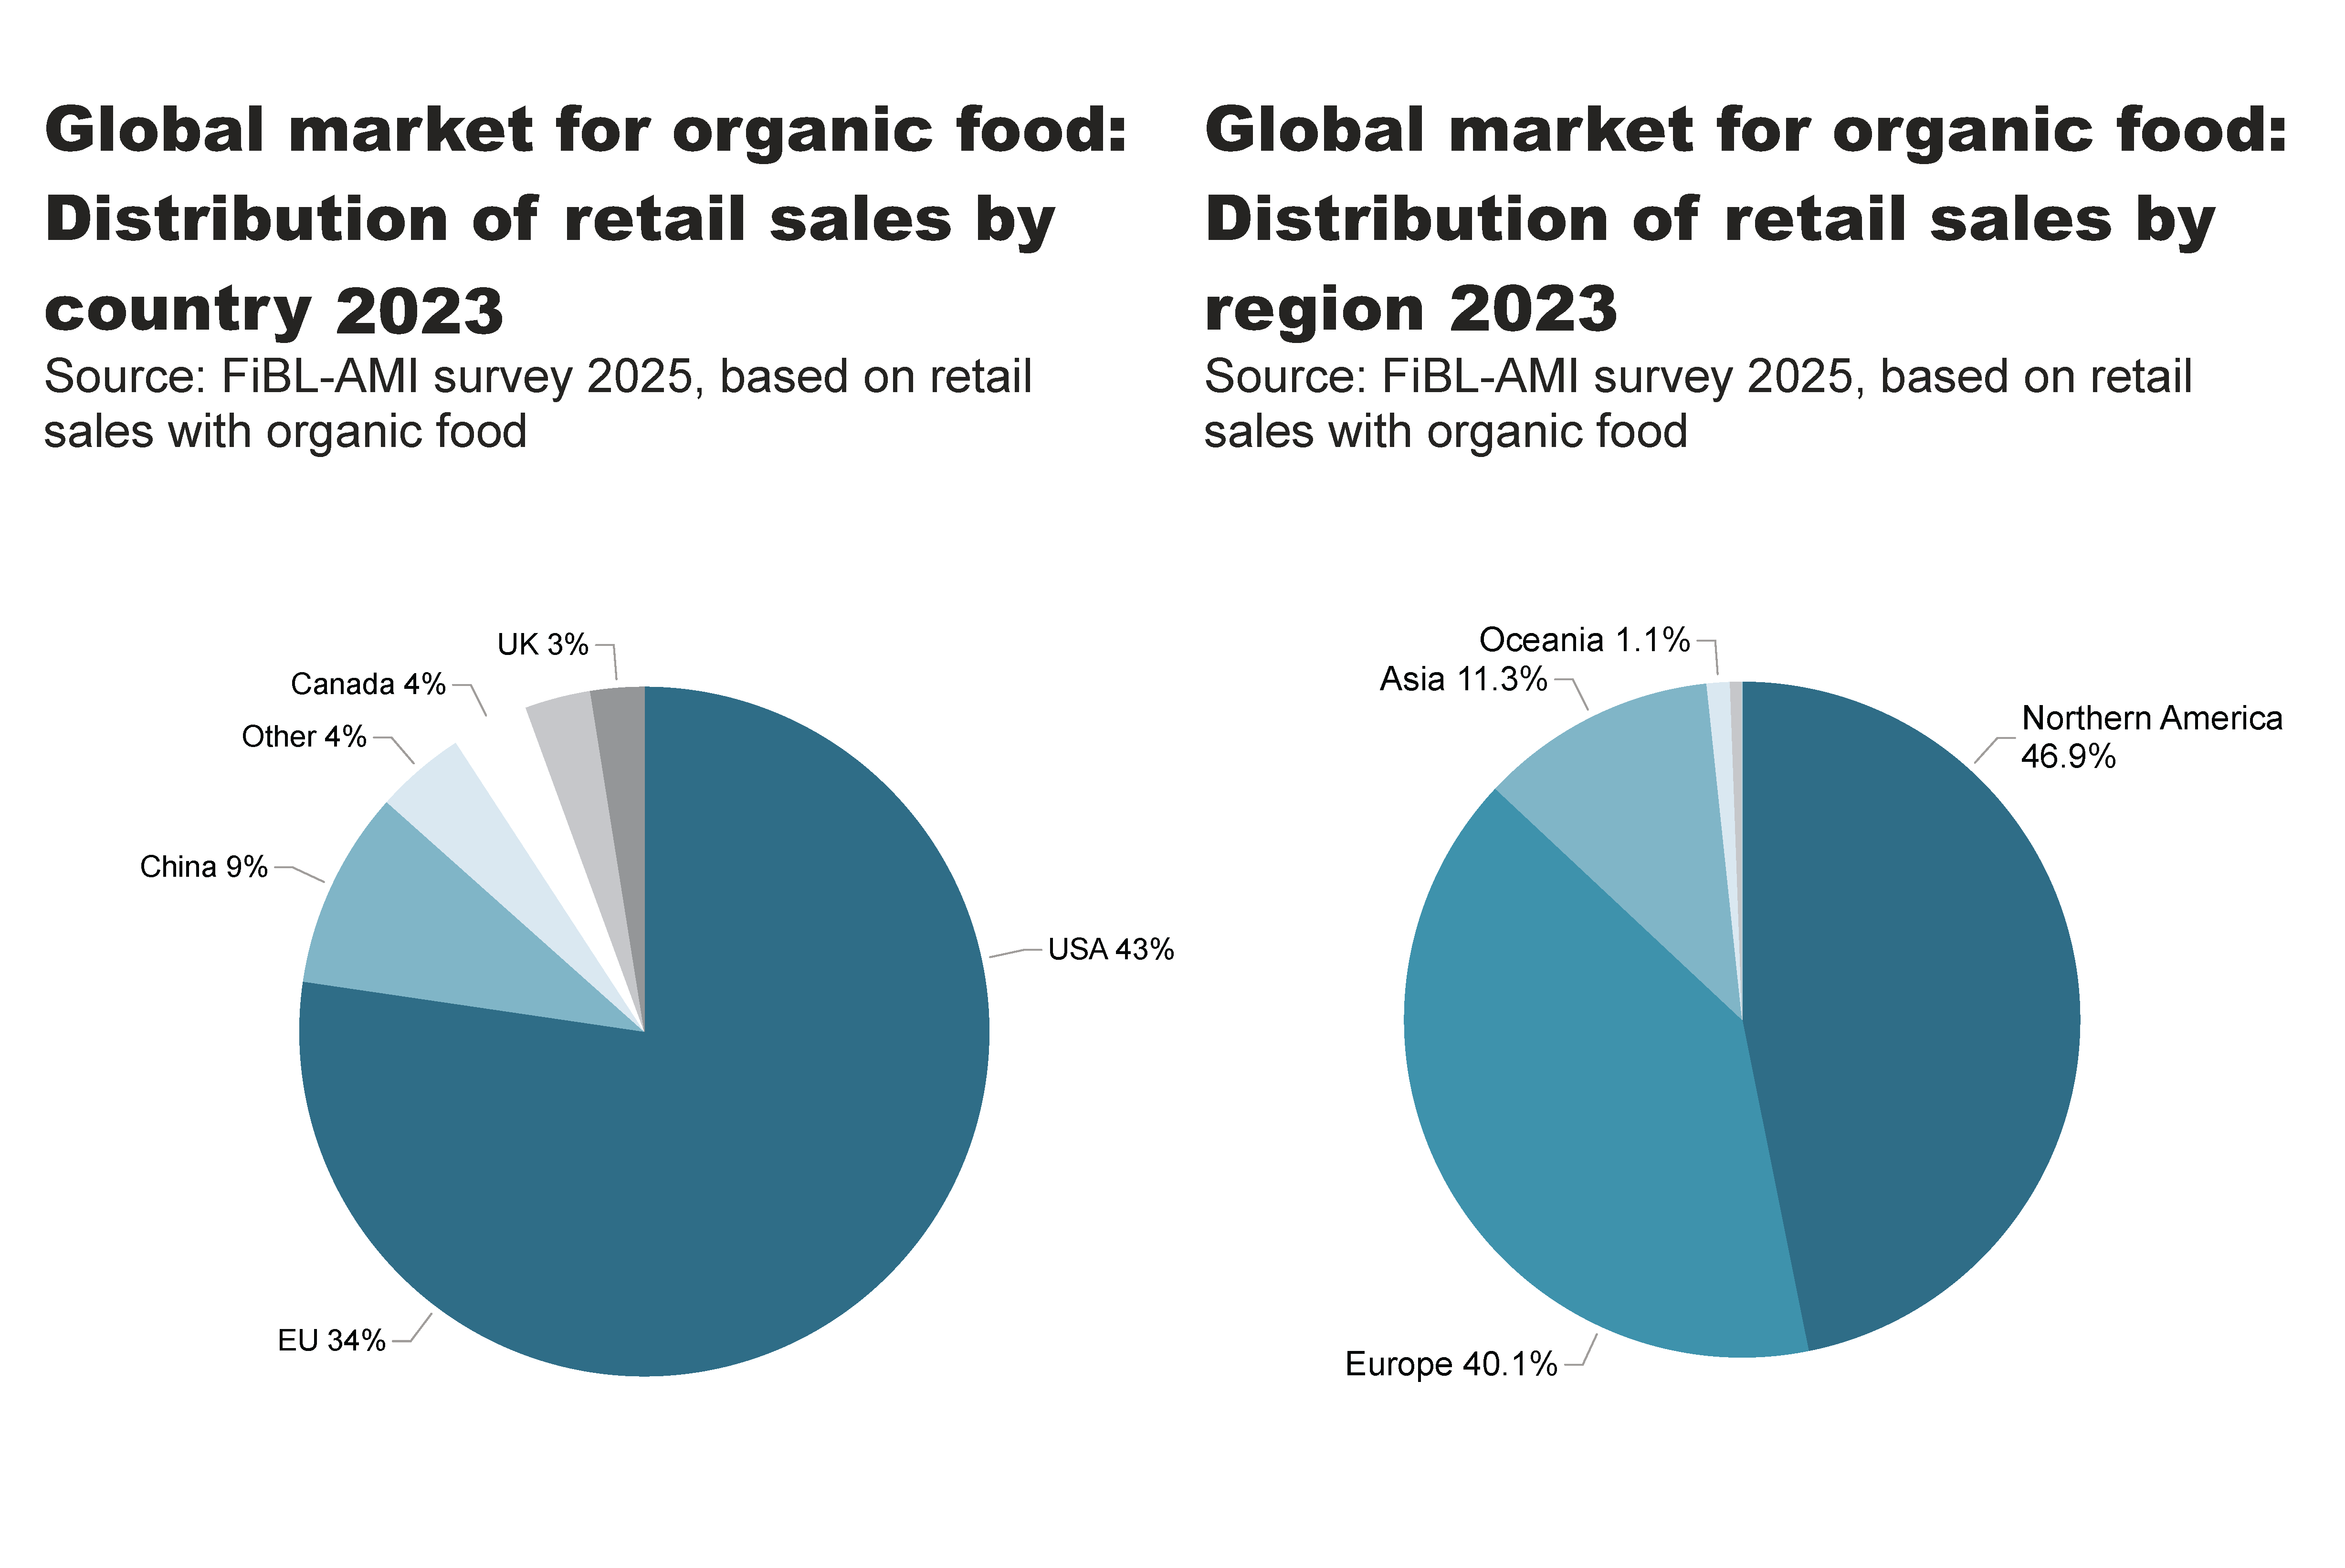
world_retail_sales_region_country
Notes:
pieChart
No alt text provided
textbox
No alt text provided
pieChart
No alt text provided
textbox
No alt text provided
card
No alt text provided
card
No alt text provided

Slide 32
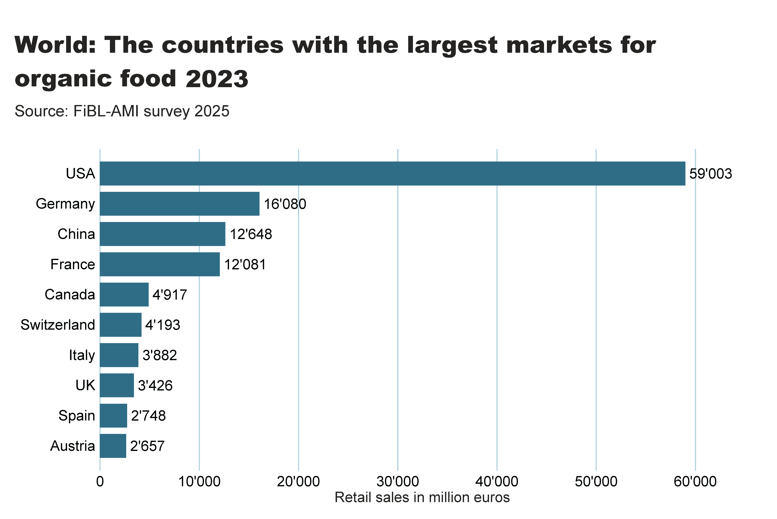
world_retail_sales_country
Notes:
textbox
No alt text provided
card
No alt text provided
barChart
No alt text provided

Slide 33
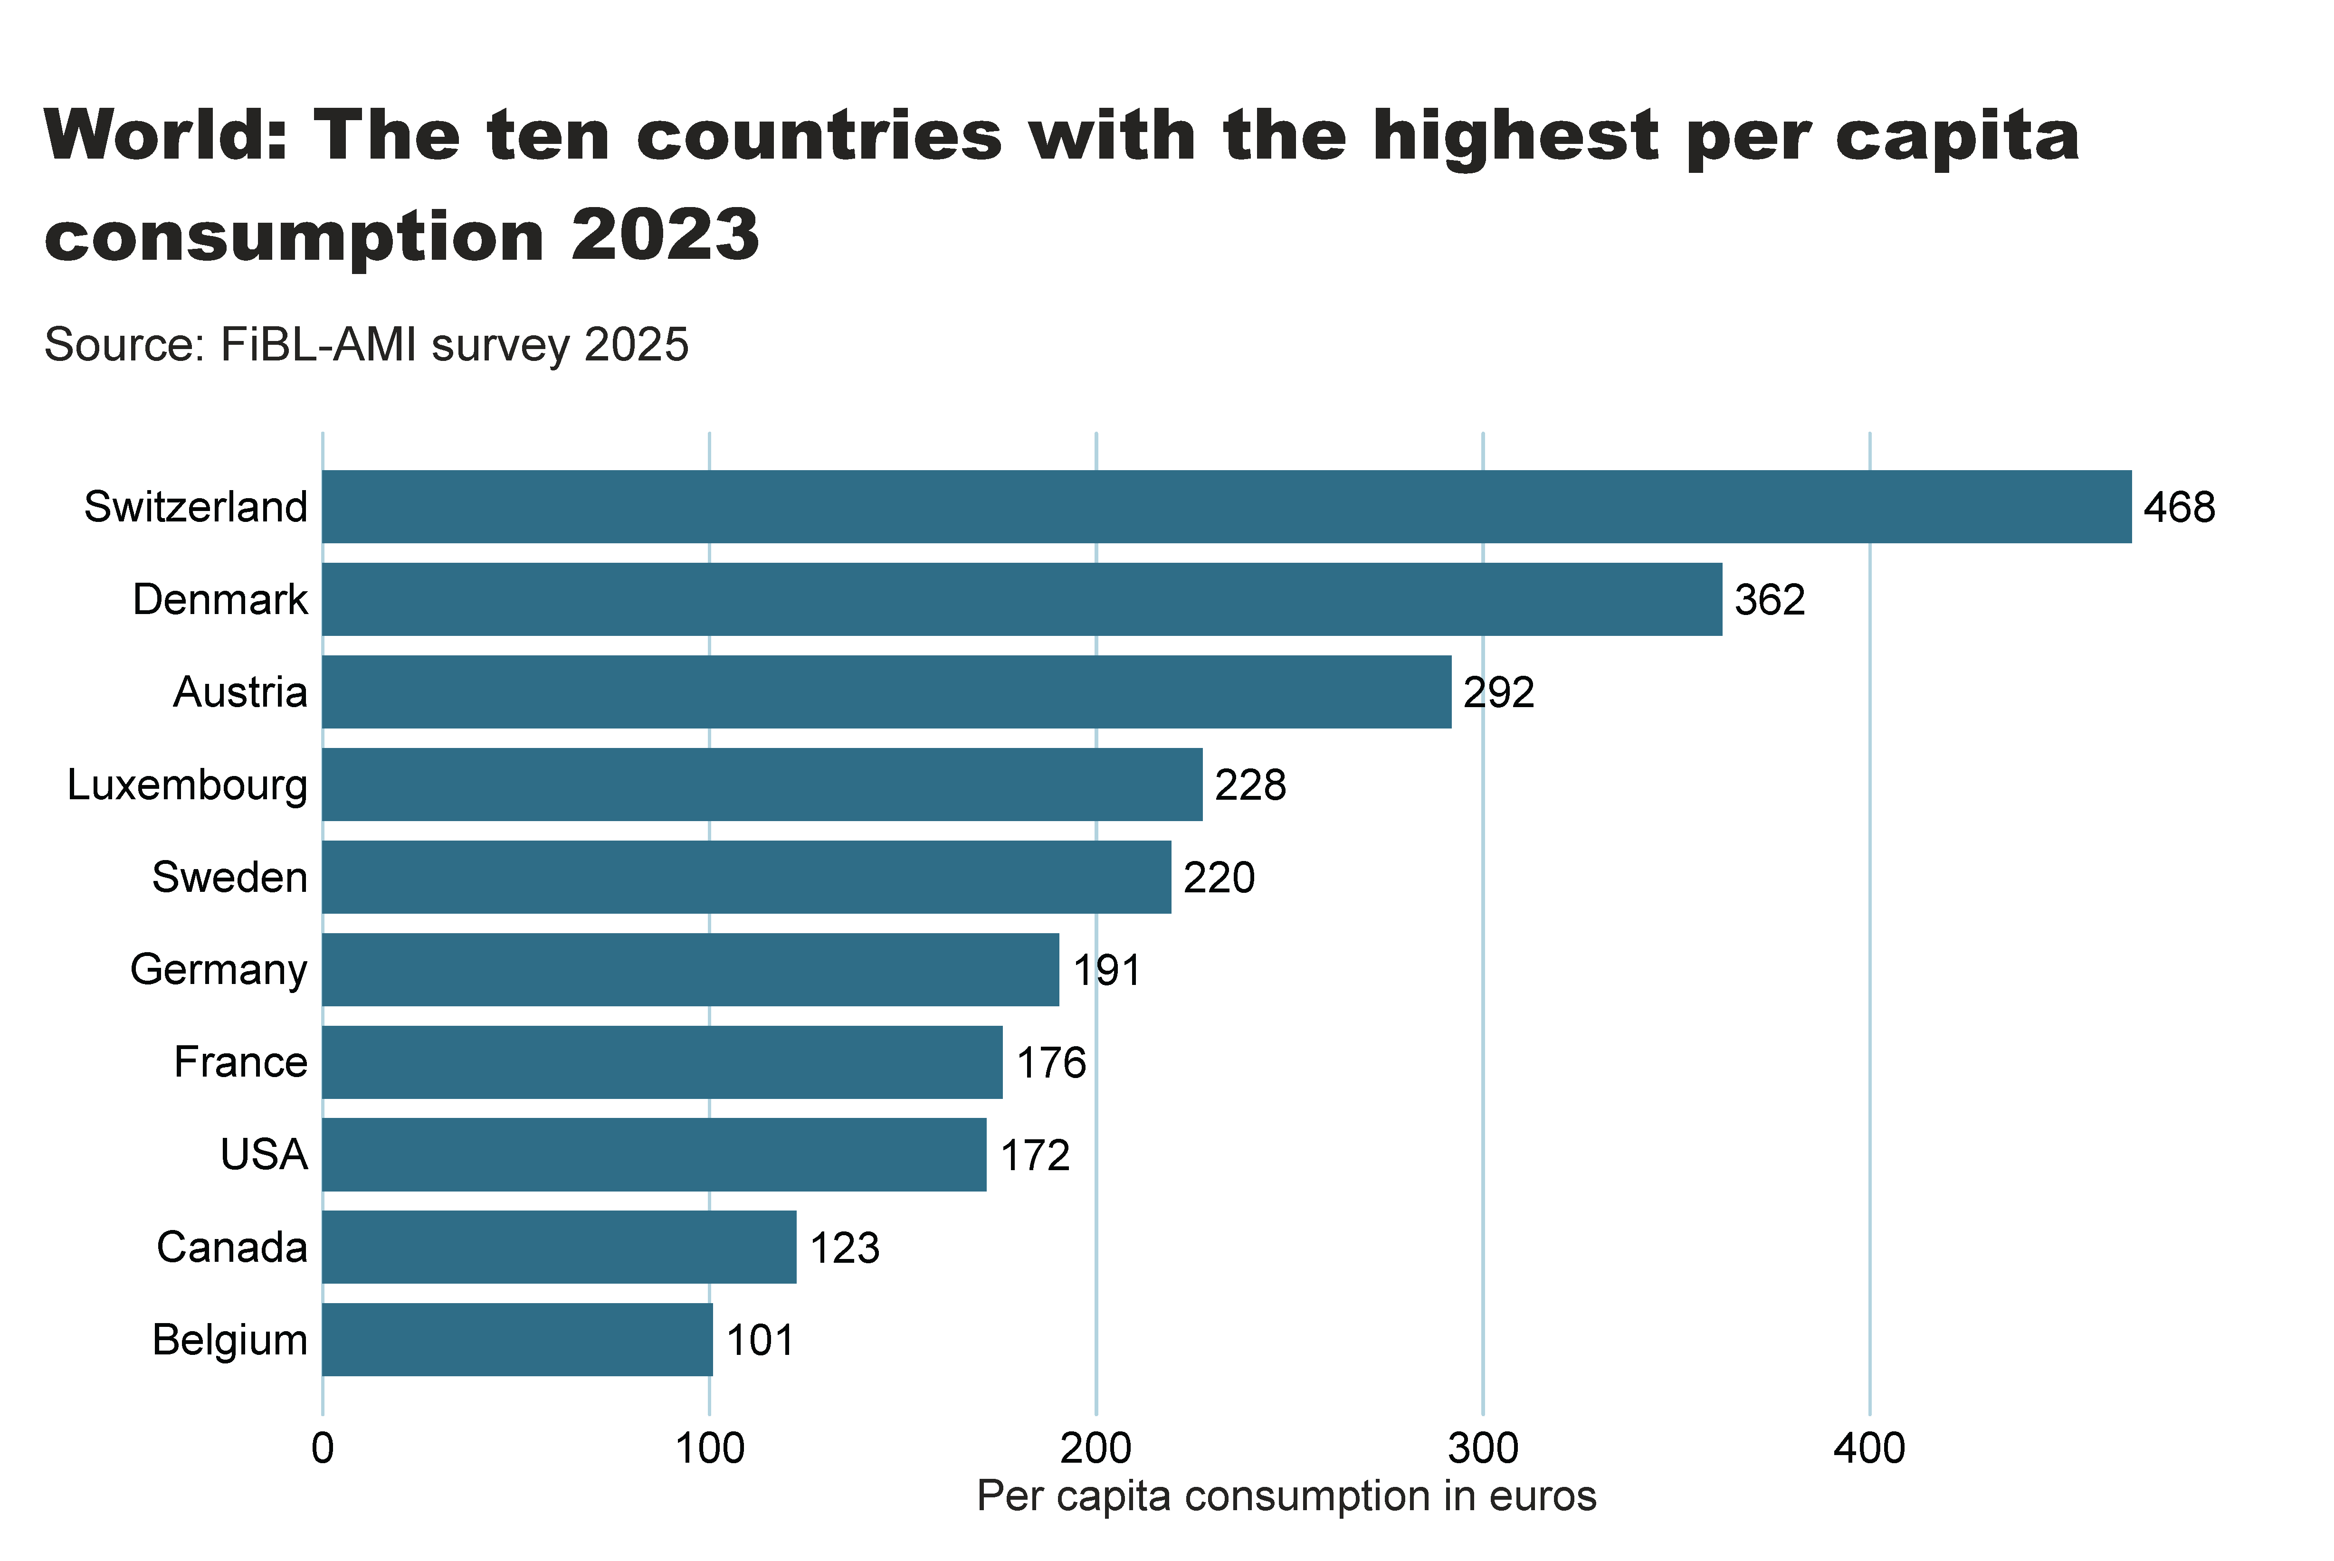
world_retail_sales_per_capita
Notes:
textbox
No alt text provided
card
No alt text provided
barChart
No alt text provided

Slide 34
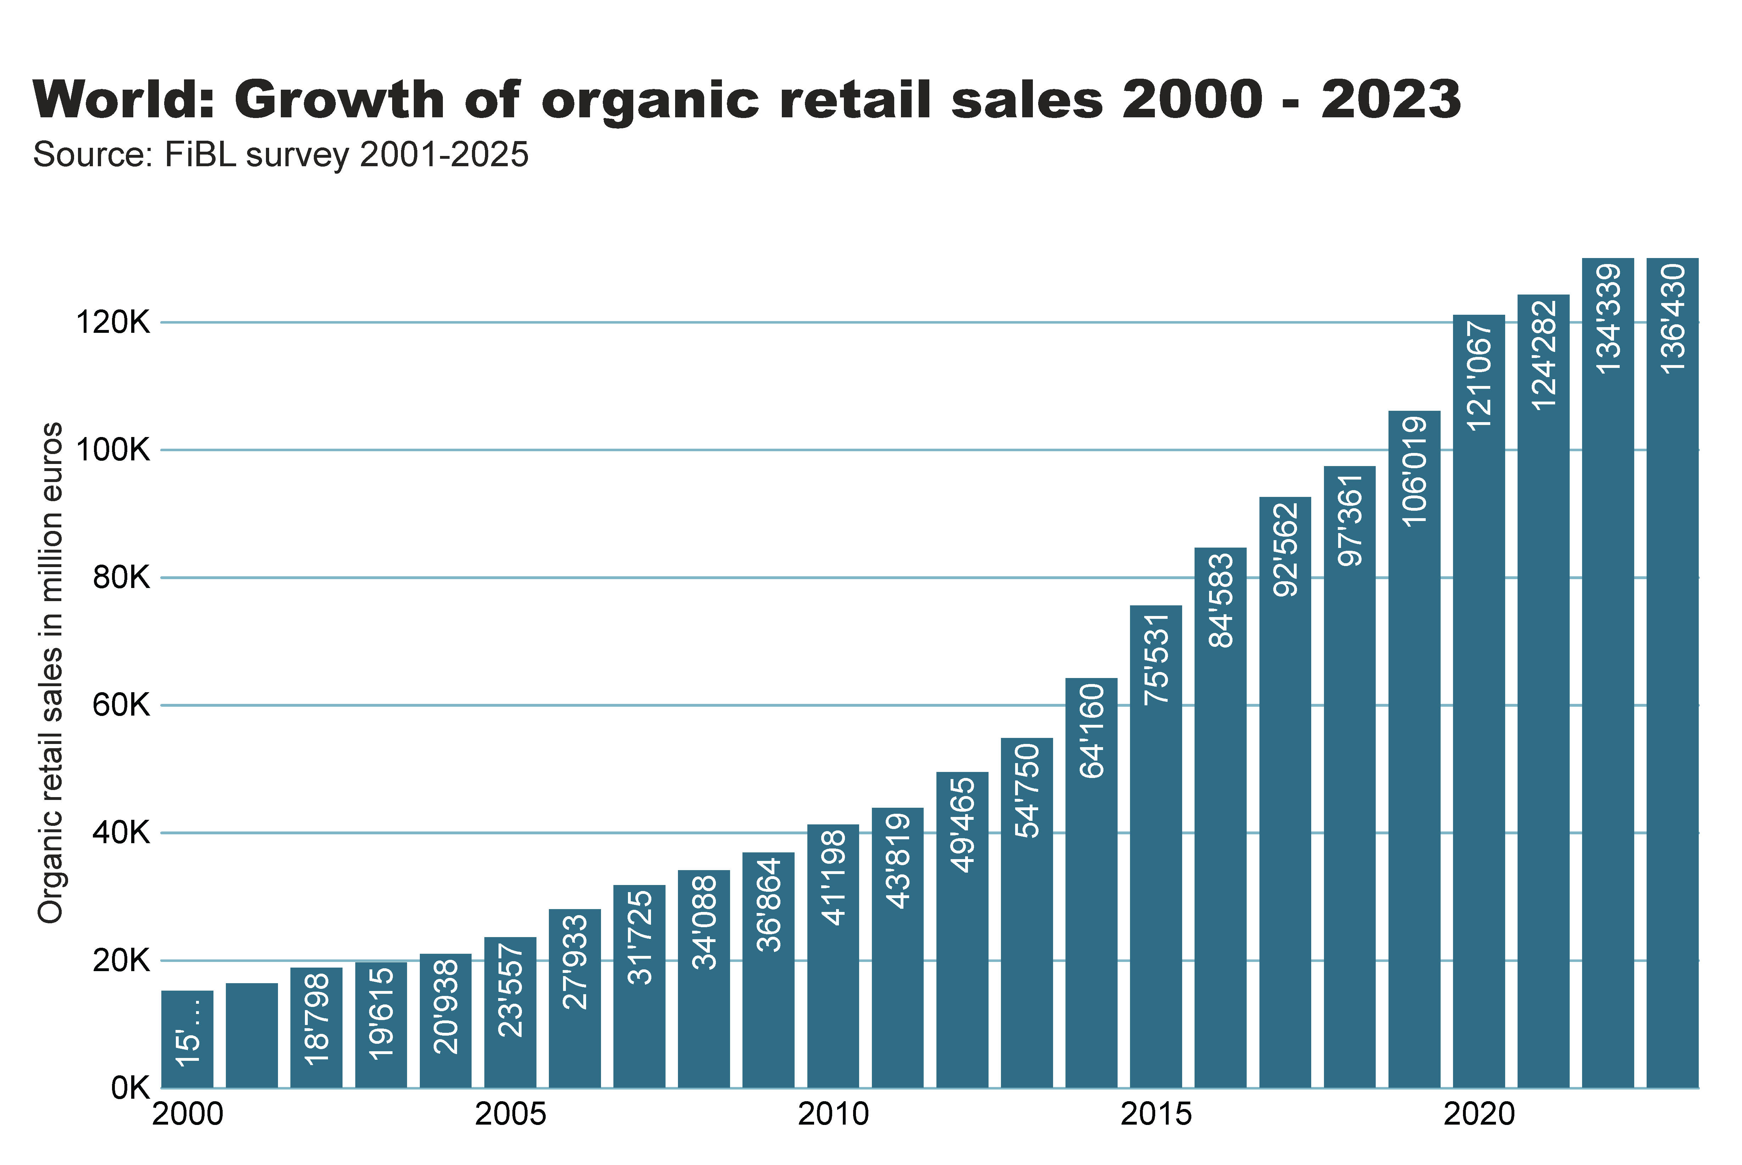
World_retail_growth
Notes:
textbox
No alt text provided
card
No alt text provided
columnChart
No alt text provided

Slide 35
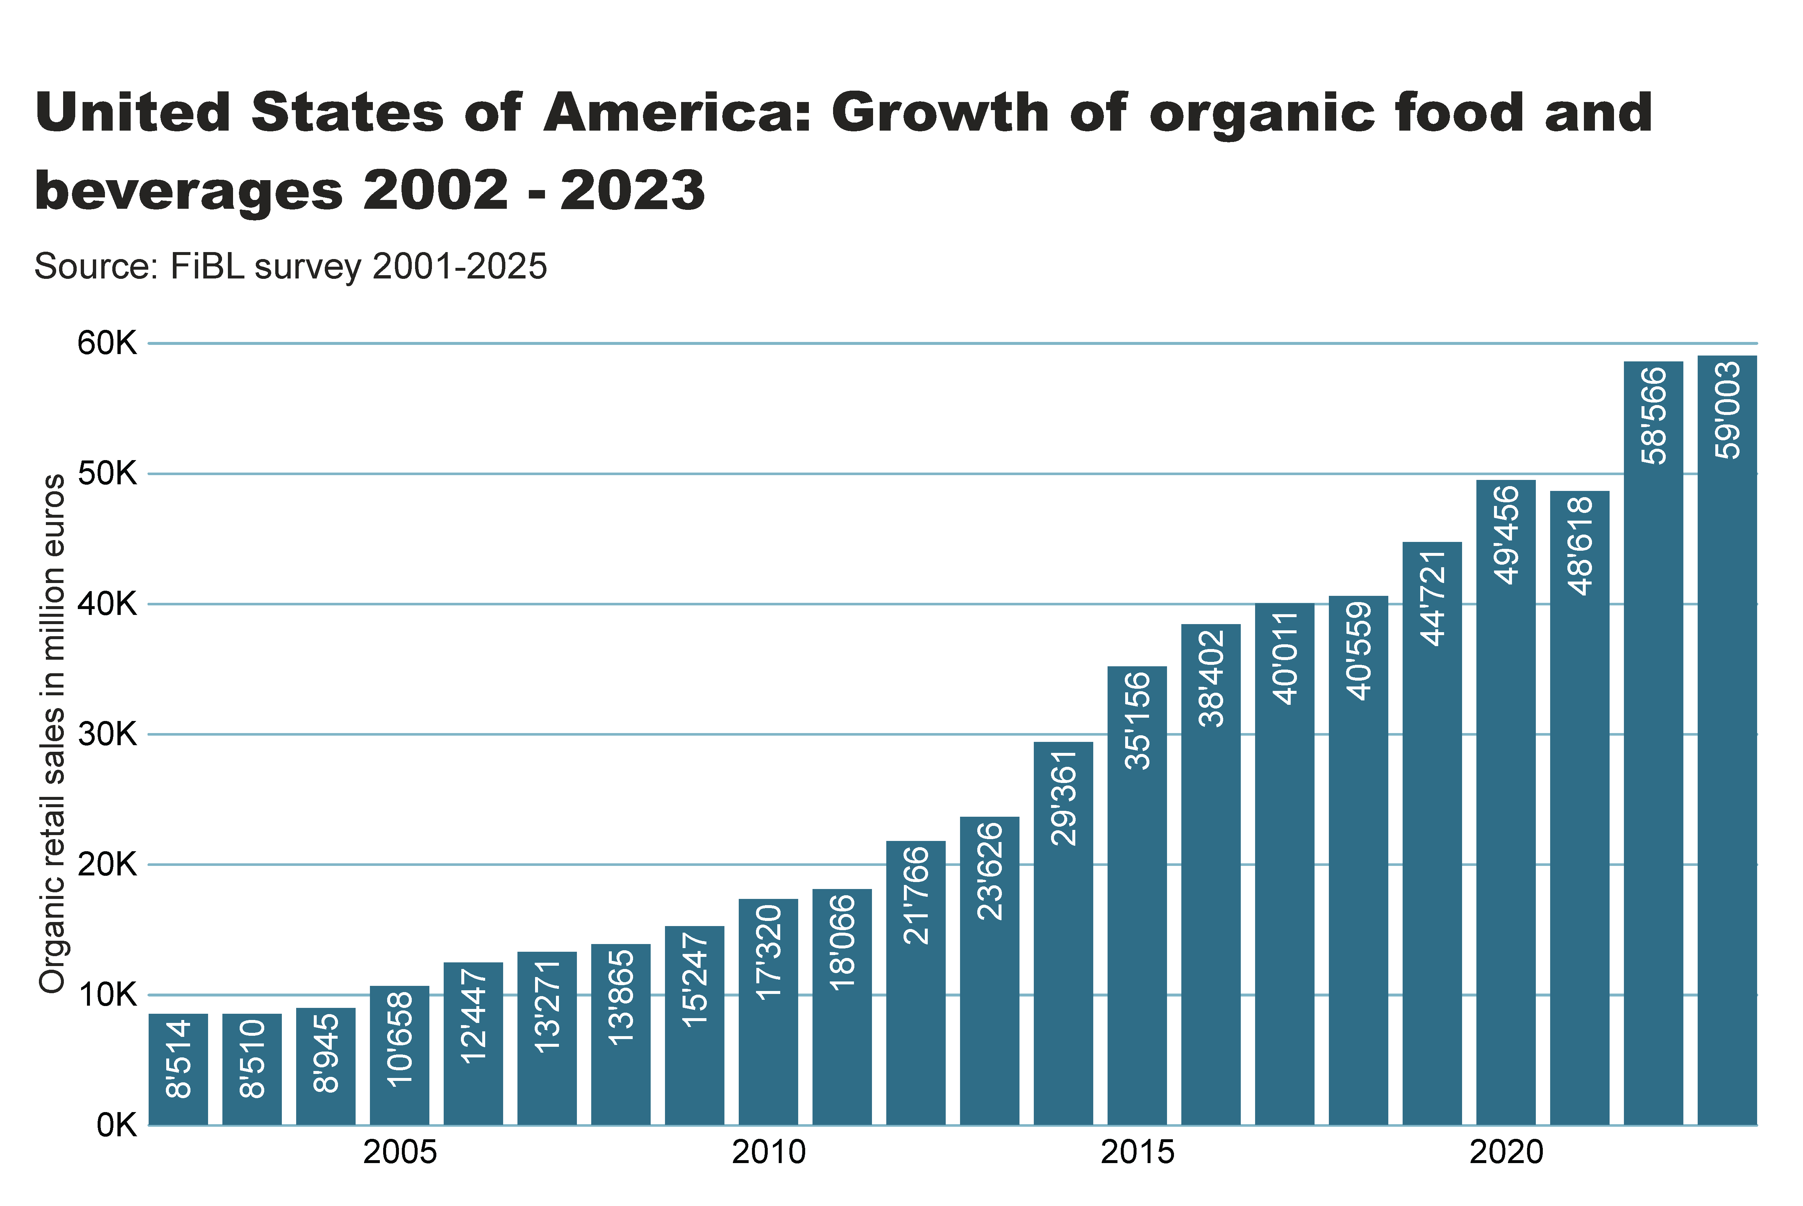

Slide 36
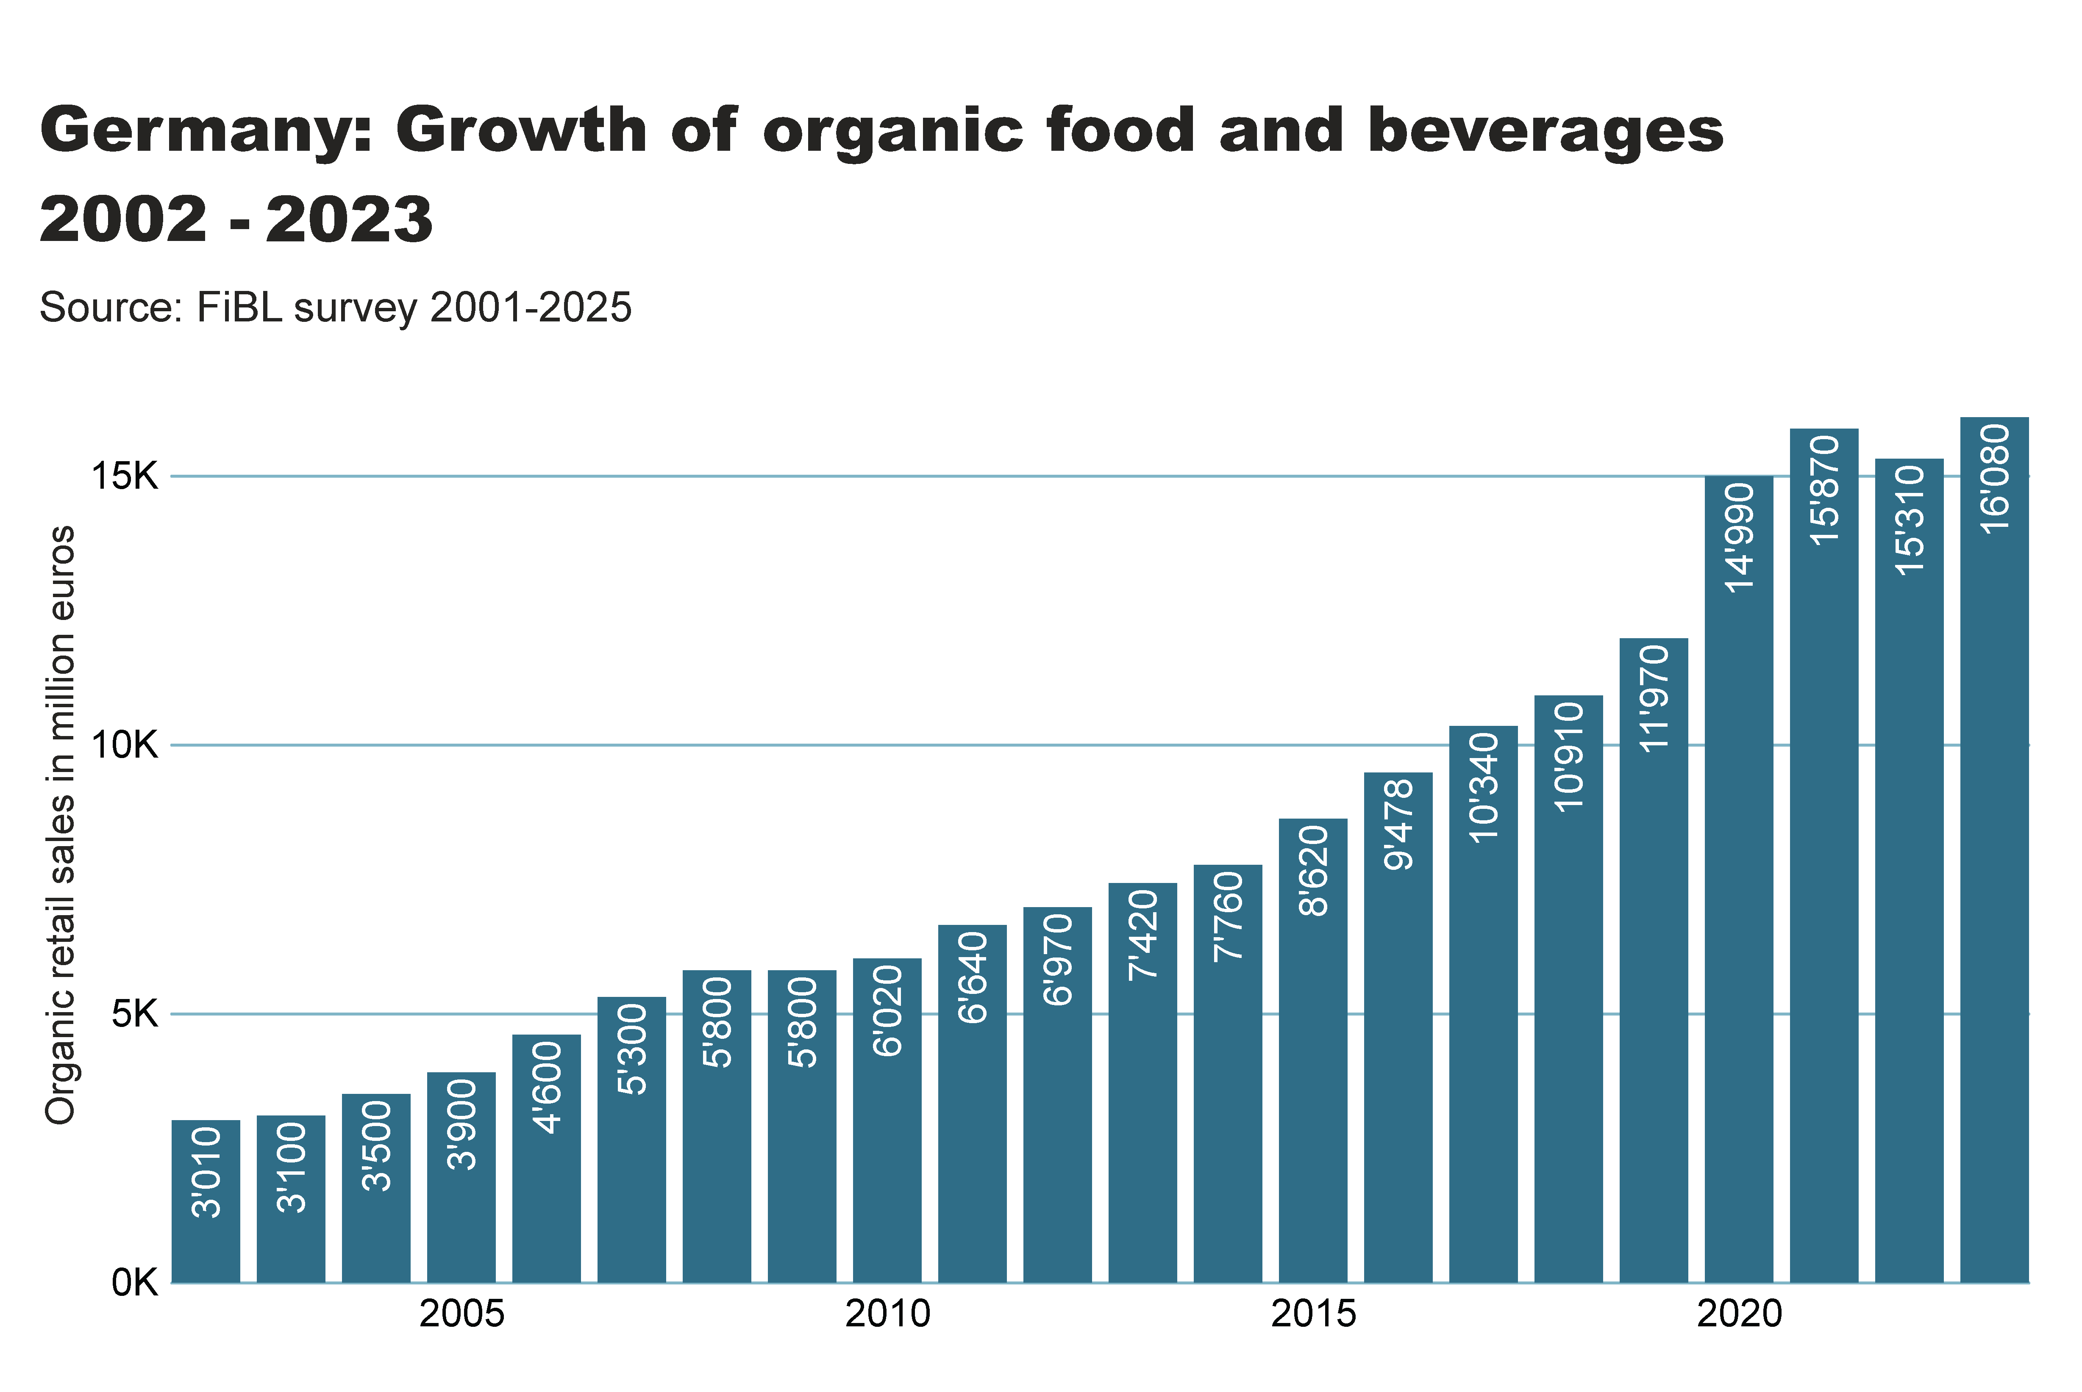

Slide 37
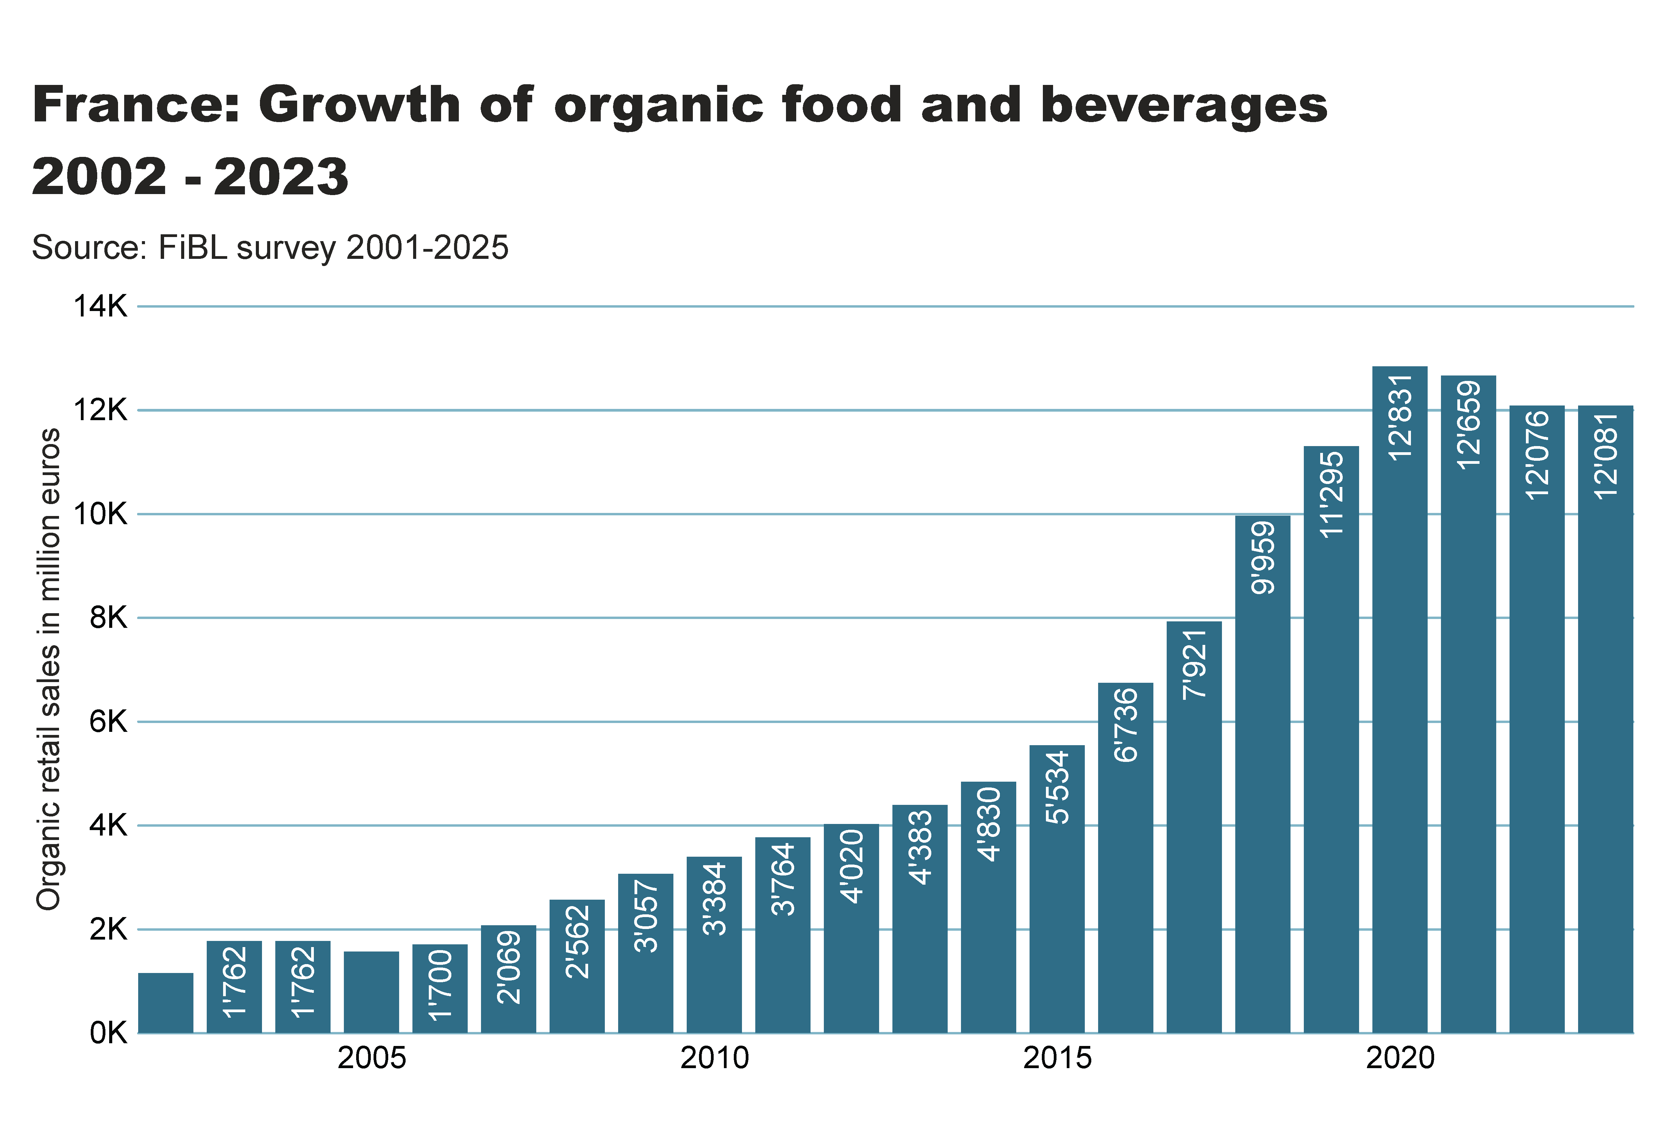

Slide 38
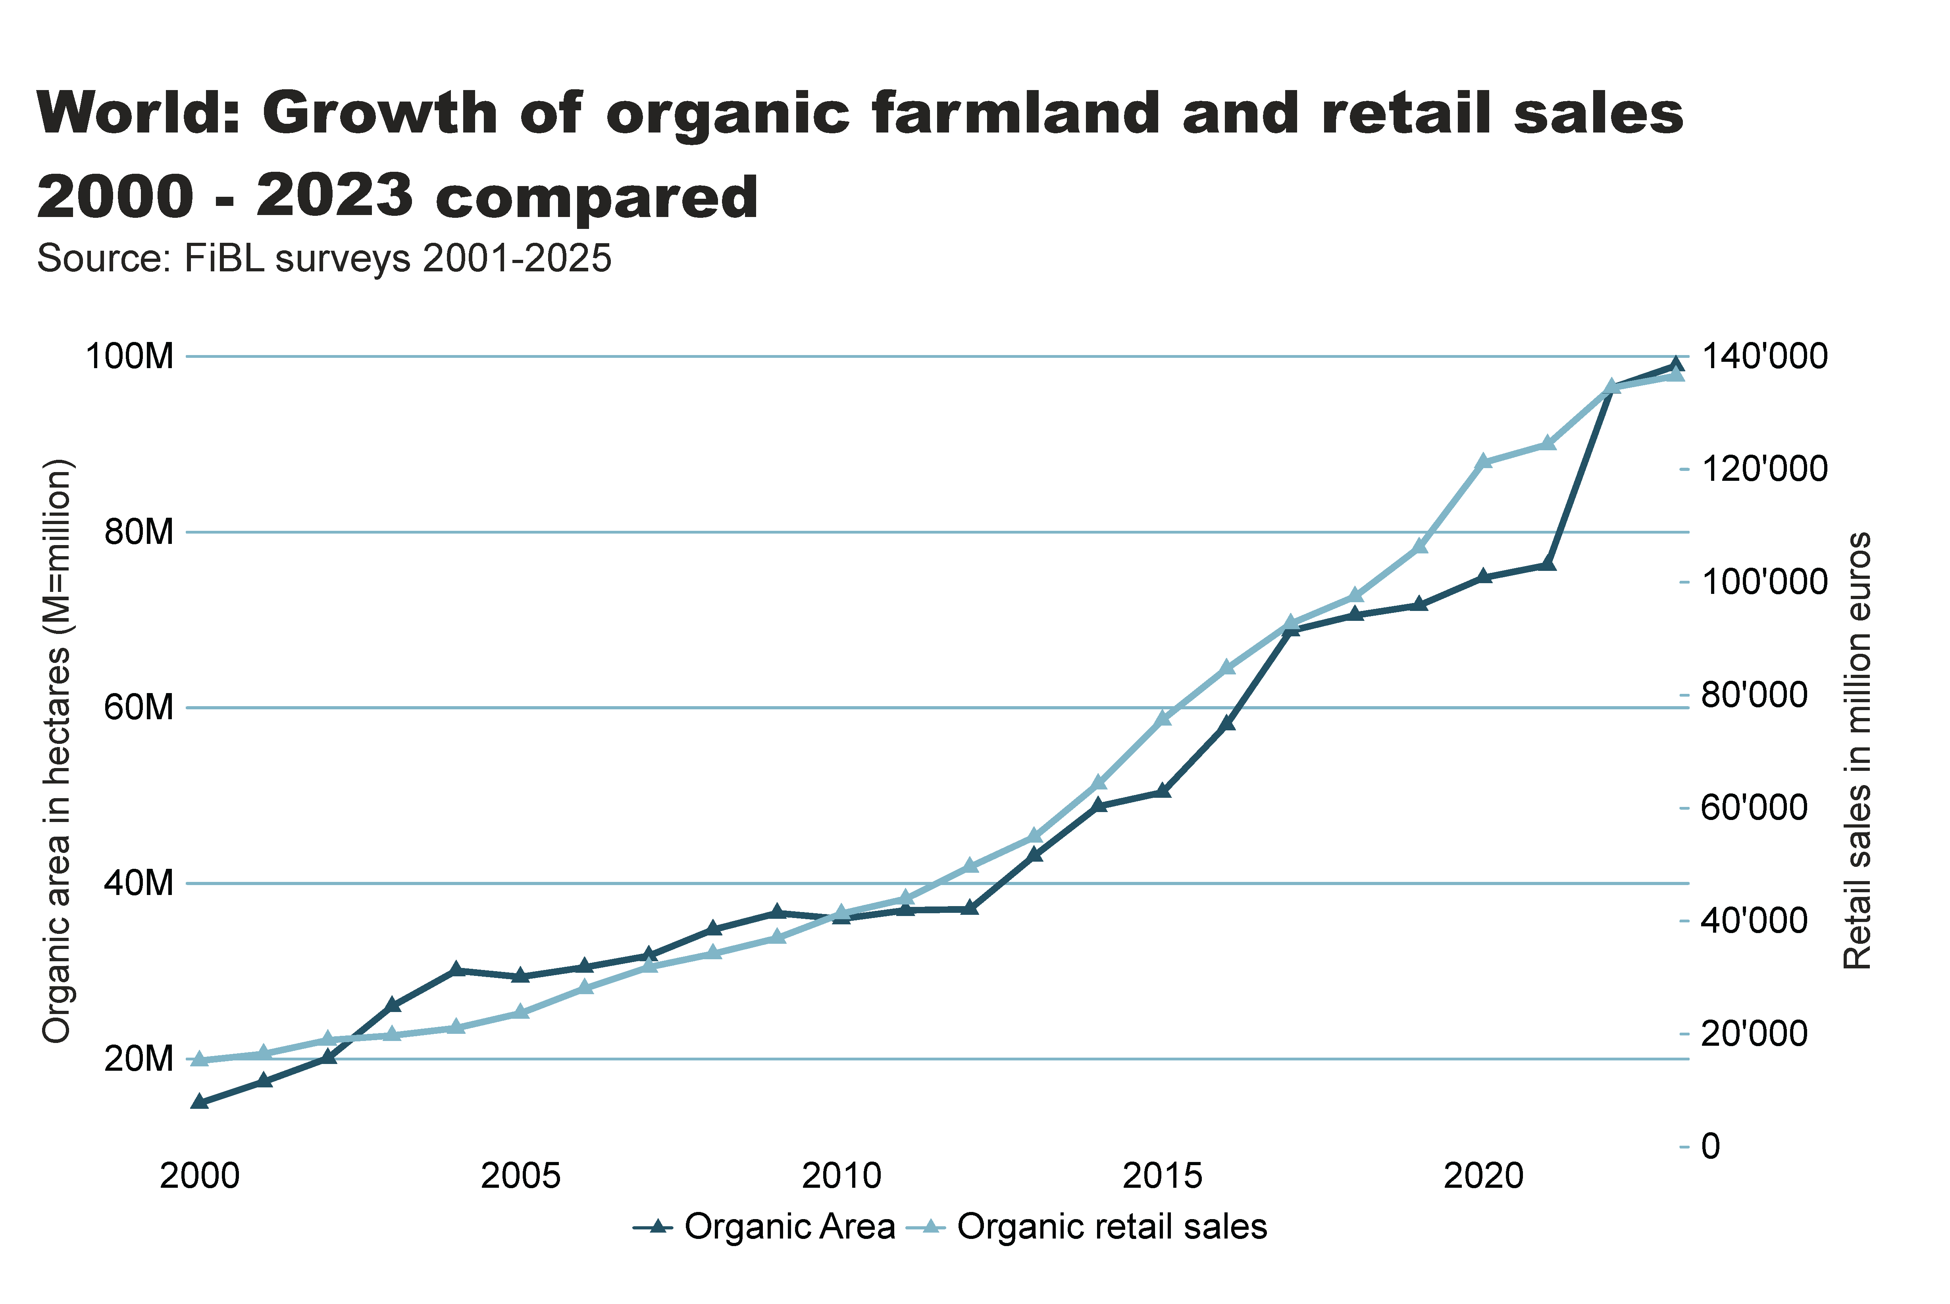
World_land_retail_growth
Notes:
textbox
No alt text provided
lineChart
No alt text provided
card
No alt text provided

Slide 39
Organic farming in developing countries and emerging markets
The Development Assistance Committee (DAC) of the Organisation for Economic Co-operation and Development (OECD) is a forum to discuss issues surrounding aid, development and poverty reduction in developing countries. The recipients of Official Development Assistance (ODA) according to the DAC list are studied in this section.
More than 3.8 million organic producers from the countries on this list were counted (88 percent of all organic producers).
About a fifth of the world’s organic agricultural land, 19.8 million hectares, is located in countries on this list.
Almost half, 46 percent of the agricultural land of the countries on the DAC list is located in Asia (9.0 million hectares), with Latin America (6.4 million) and Africa (3.4 million) in second and third place.
The countries with the largest areas of organic agricultural land are India, Argentina, China and Brazil, in that order. Not surprisingly, all of them are large countries.
The country list of the Development Assistance Committee DAC is available on the OECD website at http://www.oecd.org/dac/stats/daclist.htm

Slide 40
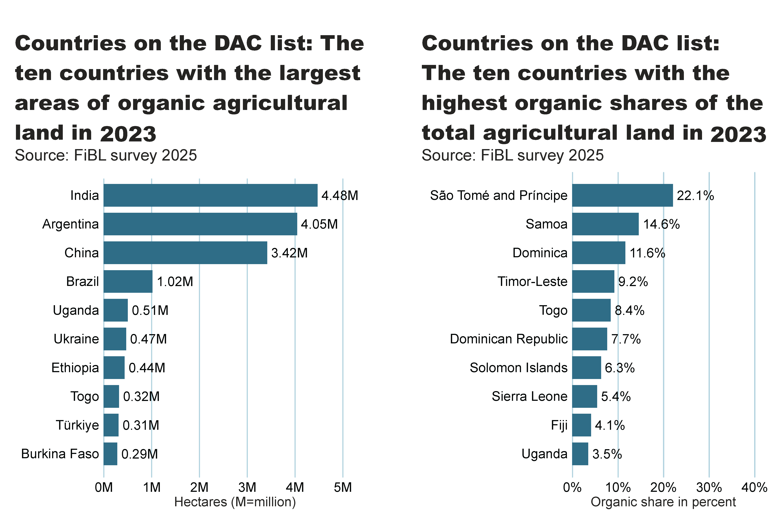
DAC_land_area_share_country
Notes:
textbox
No alt text provided
card
No alt text provided
clusteredBarChart
No alt text provided
textbox
No alt text provided
card
No alt text provided
clusteredBarChart
No alt text provided

Slide 41
More information
More information (PDF, data sources, graphs) at:
http://www.organic-world.net/yearbook/yearbook-2025.html
Contact
Helga Willer
Research Institute of Organic Agriculture FiBL
5070 Frick
Switzerland
helga.willer@fibl.org

Slide 42
Disclaimer
All of the results contained in this slide show have been compiled by the Research Institute of Organic Agriculture FiBL. However, the possibility of mistakes cannot be ruled out entirely. Therefore, FiBL is not subject to any obligation and makes no guarantees whatsoever regarding any of the statements or results in this work; neither does FiBL accept responsibility or liability for any possible mistakes, nor for any consequences of actions taken by readers based on statements or advice contained therein.
This document has been produced with the support of the Swiss State Secretariat for Economic Affairs (SECO), the Sustainability Fund of Coop Switzerland, Bio Suisse, NürnbergMesse, IFOAM – Organics International. The views expressed herein can in no way be taken to reflect the official opinions of SECO, Coop, Bio Suisse, NürnbergMesse or IFOAM – Organics International.

Slide 43
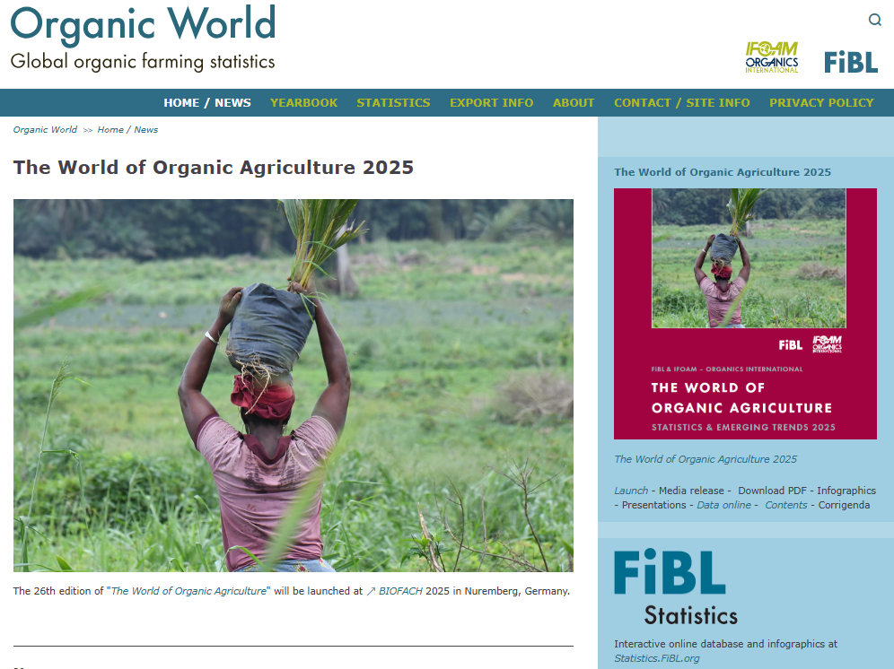
Presentations on www.organic-world.net

Slide 44

Statistics.FiBL.org

Slide 45


www.twitter.com/fiblstatistics

Slide 46
Contact
Helga Willer
Research Institute of Organic Agriculture FiBL
Ackerstrasse 113, Box 219
5070 Frick
Switzerland
Phone +41 62 865 72 72
Phone +41 62 865 72 07 (direct)
info.suisse@fibl.org, helga.willer@fibl.org
www.fibl.org, www.organic-world.net, https://statistics.fibl.org

