Slide 1
Organic Climate Farming: an overview
Name of presenter, Institution

Slide 2
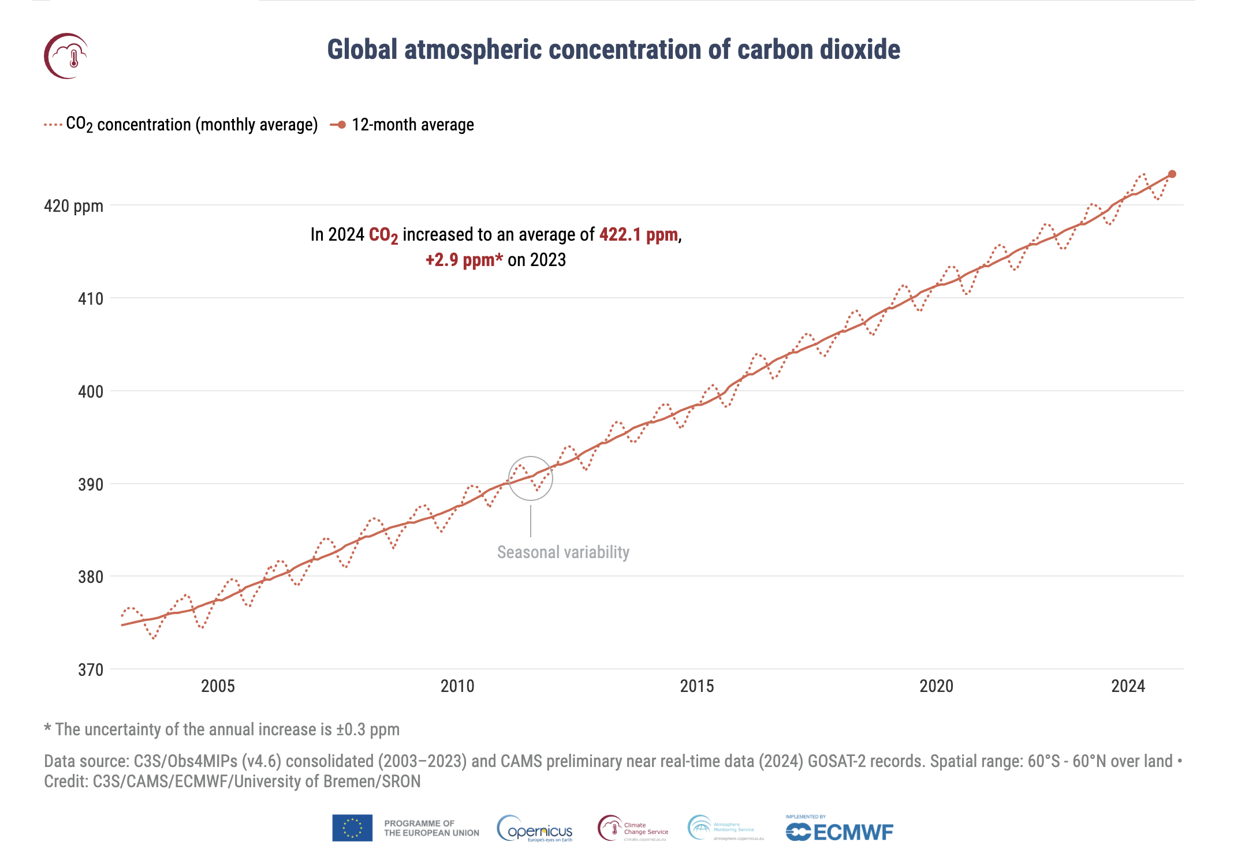
Understanding Climate Change
Definition: Long-term shifts in weather patterns, like temperature, precipitation, and other climatic factors, are driven by anthropogenic greenhouse gas (GHG) emissions
Primary causes: Extensive use of fossil fuels, industrial processes, deforestation, intensive agricultural activities, etc.
Link: https://climate.copernicus.eu/esotc/2024/trends-climate-indicators

Slide 3
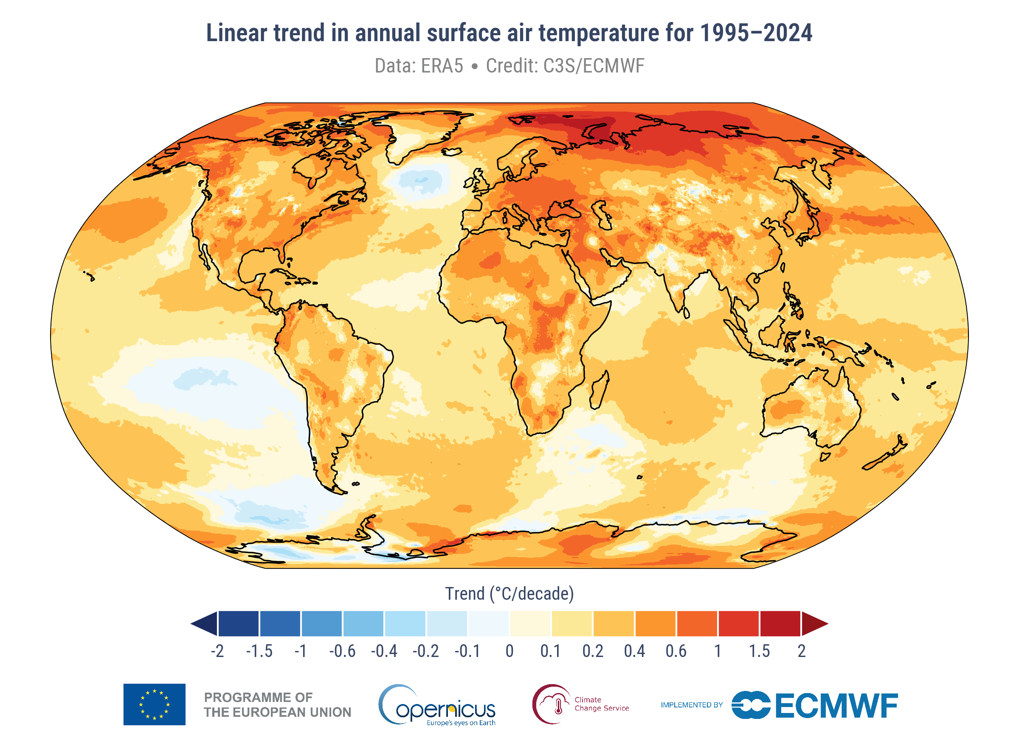
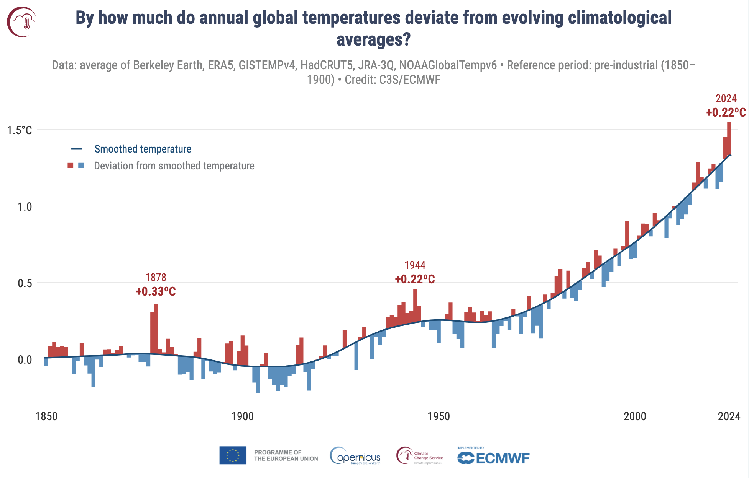
Understanding Climate Change
Alternative graph
Climate stressors
Rising global temperature
Global temperatures are ~ +1.3 °C warmer than pre-industrial average
Link: https://climate.copernicus.eu/global-climate-highlights-2024

Slide 4
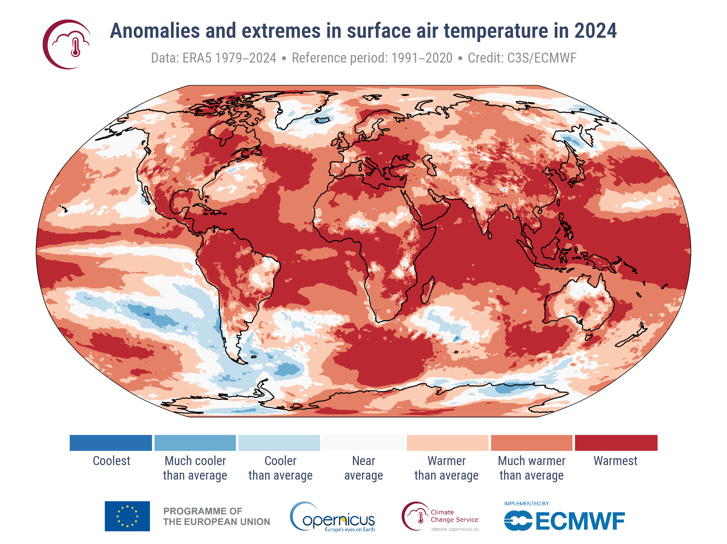
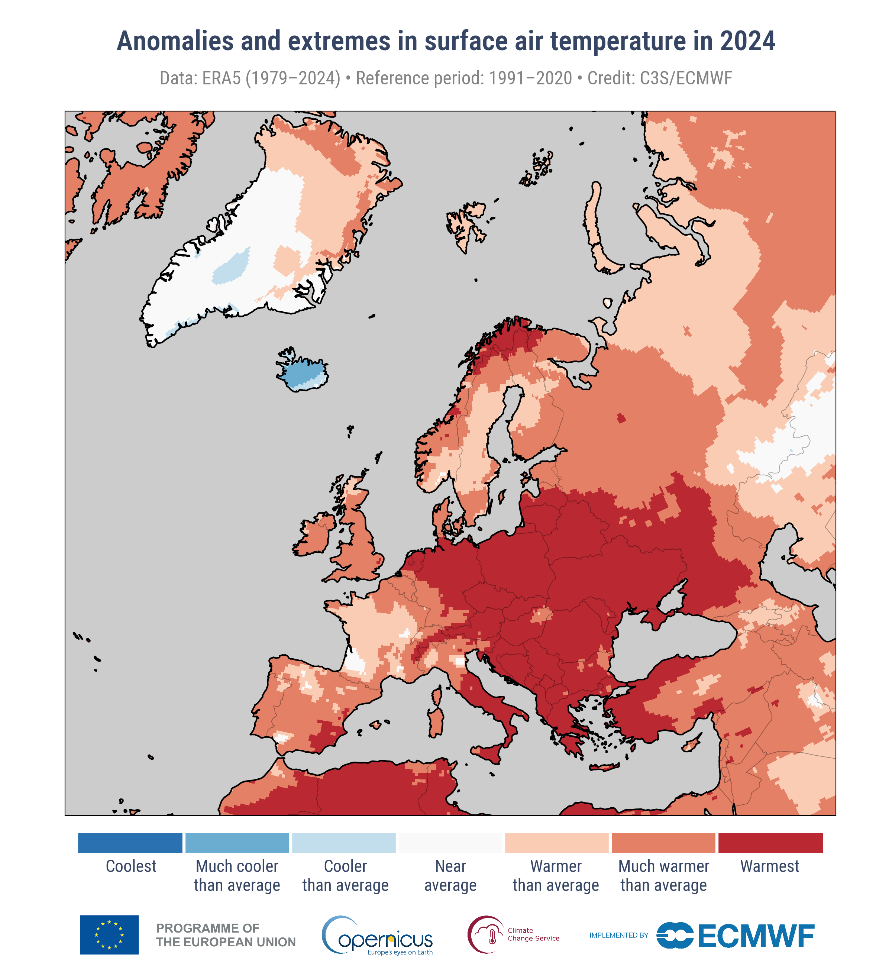
Understanding Climate Change
Alternative graph
Climate stressors
Rising global temperature
Global temperatures are ~ +1.3 °C warmer than pre-industrial average
2024 was the warmest year on record
+1.60°C warmer than pre-industrial level
Link: https://climate.copernicus.eu/global-climate-highlights-2024

Slide 5
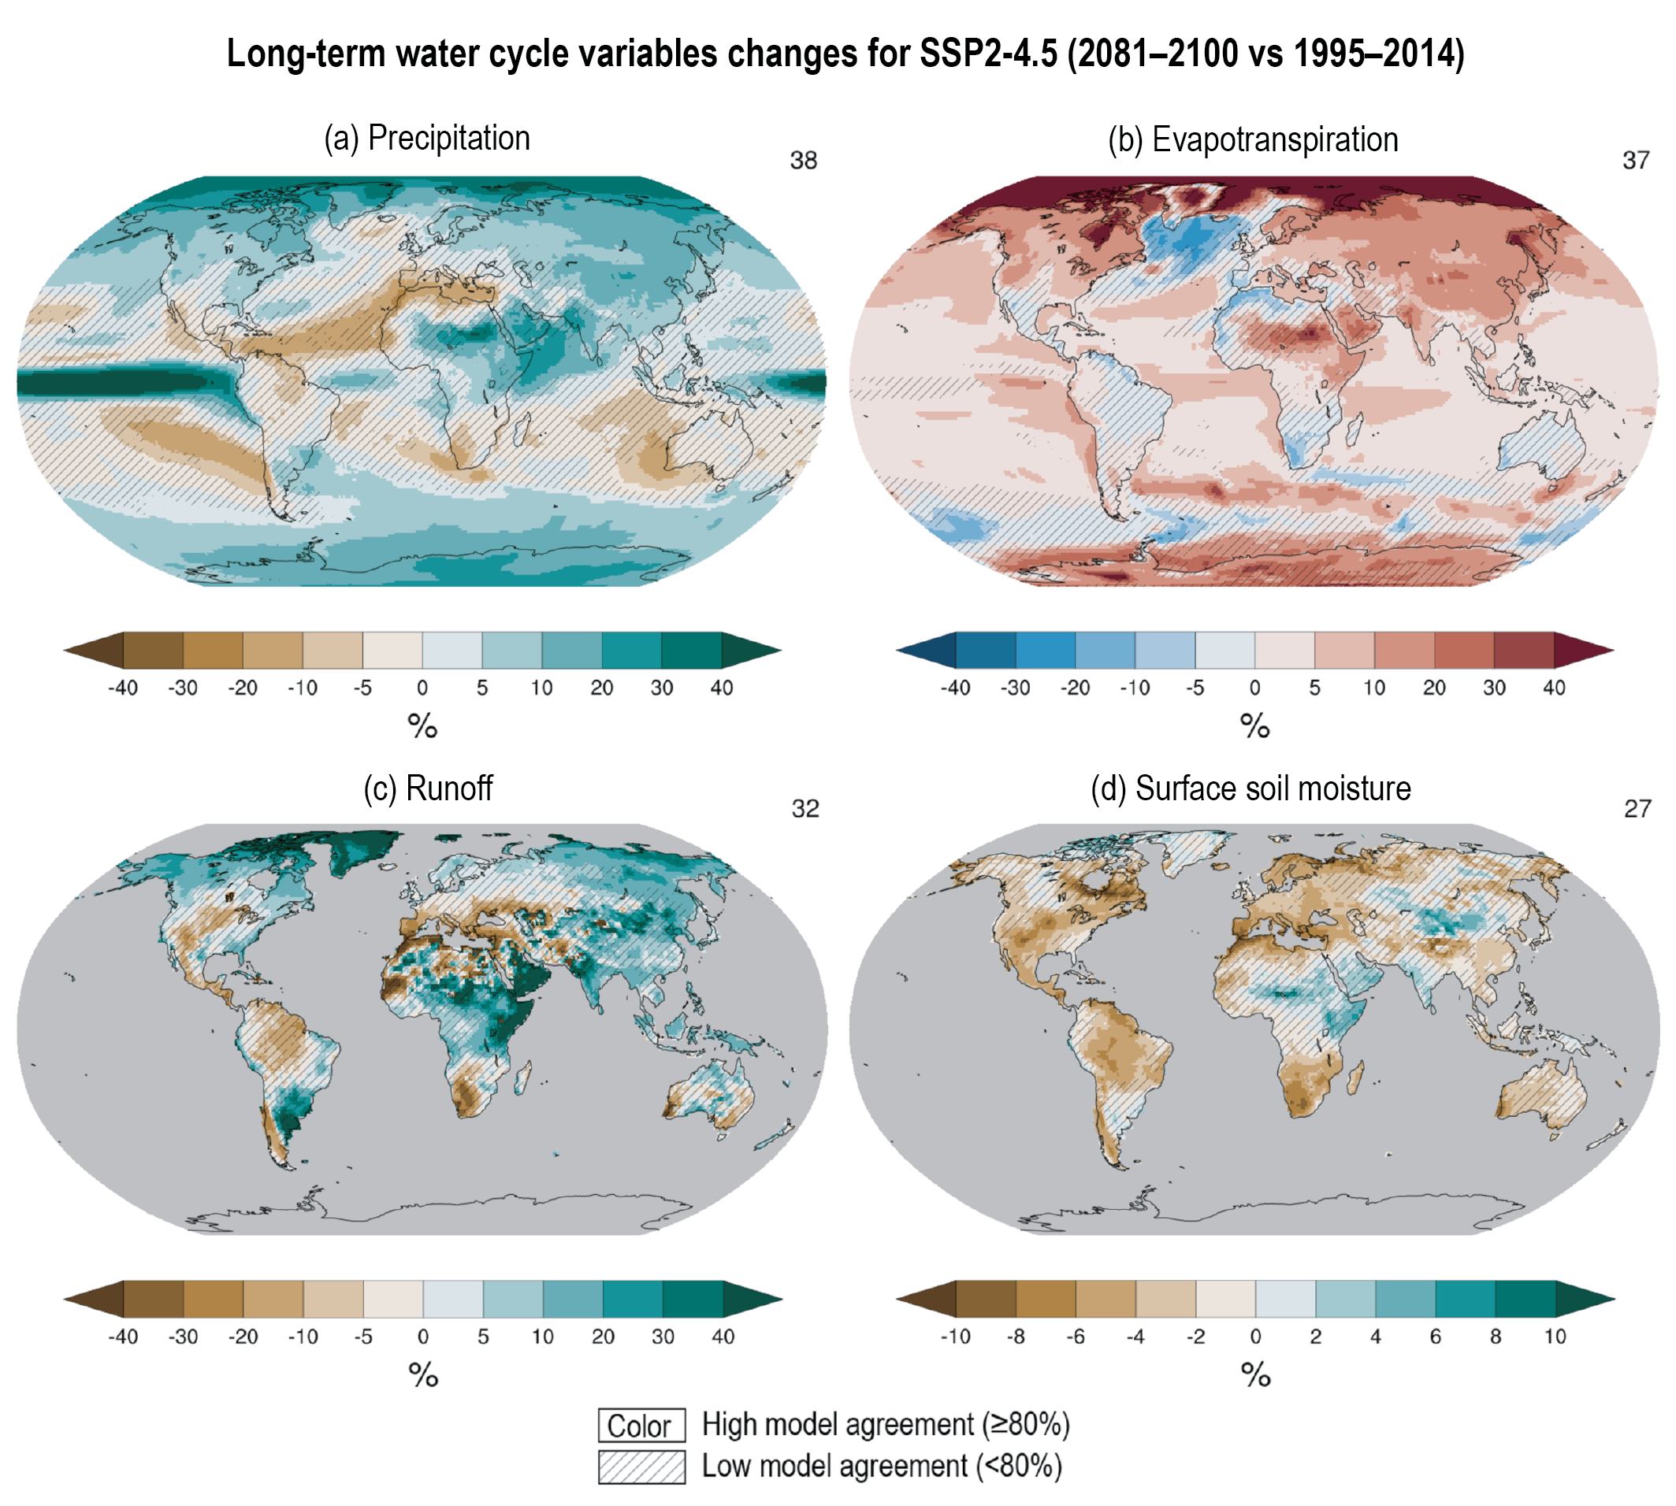
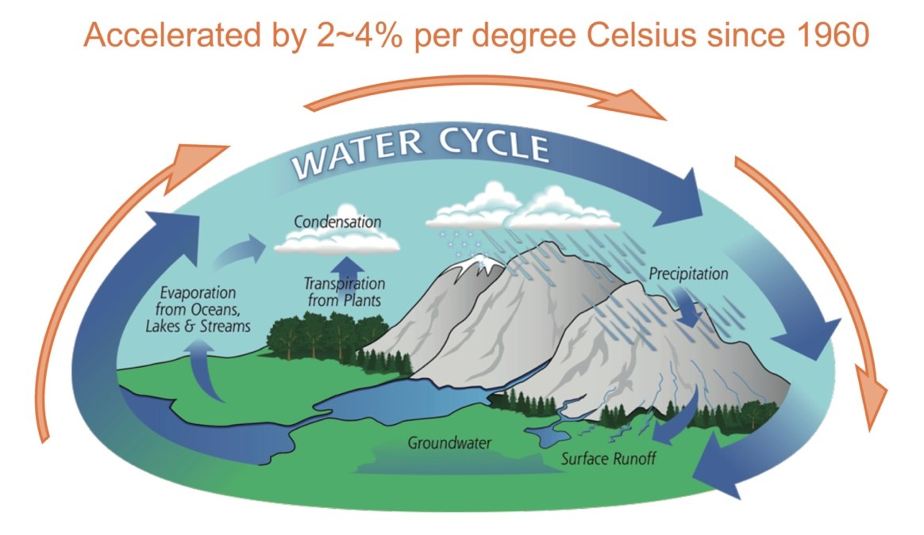
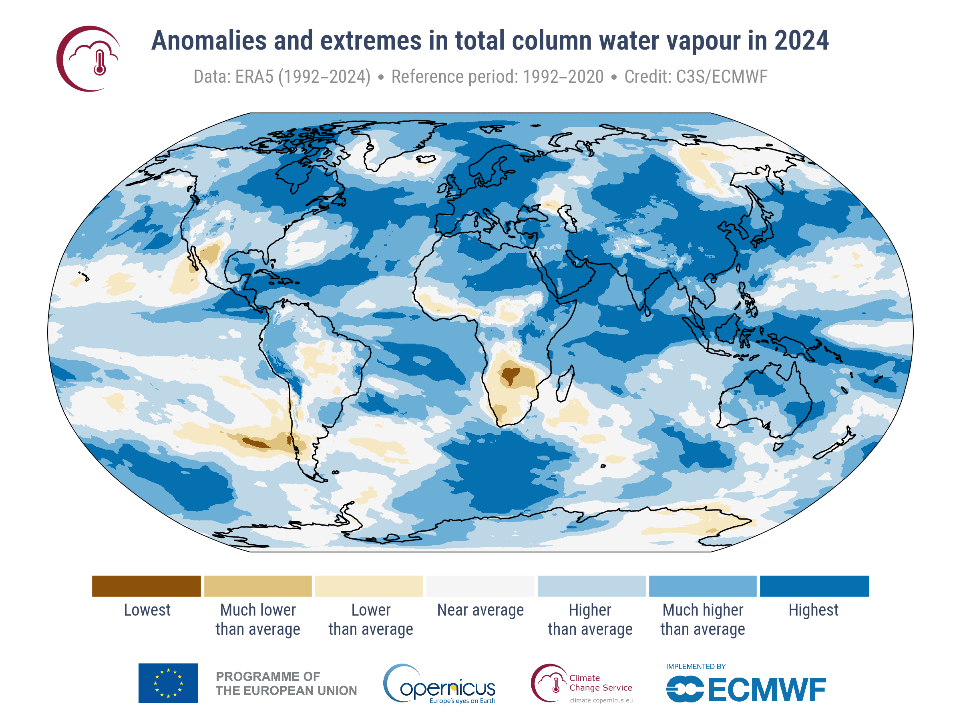
Understanding Climate Change
Alternative graphs for detailed understanding:
Climate stressors
Changes in hydrologic patterns
Higher global temperatures increase evaporation rates → greater atmospheric moisture & precipitation
Impacts vary widely across regions
Link: https://usys.ethz.ch/en/news-events/news/archive/2020/09/new-study-of-ocean-salinity-finds-substantial-amplification-of-the-global-water-cycle.html
Link: https://www.ipcc.ch/report/ar6/wg1/figures/technical-summary/
Link: https://climate.copernicus.eu/global-climate-highlights-2024
Notes:
The total amount of water in the atmosphere reached a record value in 2024, at 4.9% above the 1991–2020 average, markedly higher than in 2016 (3.4%) and 2023 (3.3%), the years with the second and third highest values.

Slide 6
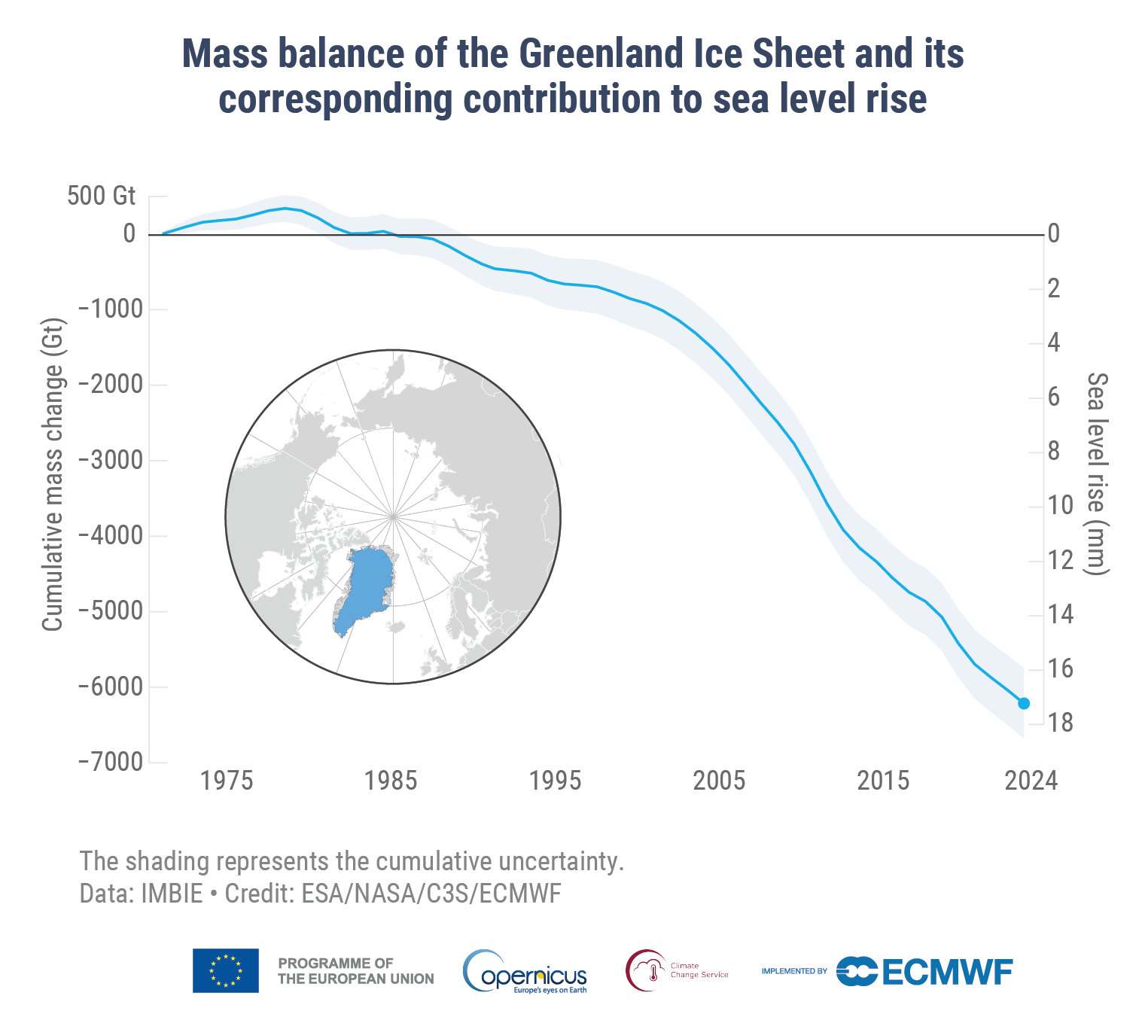
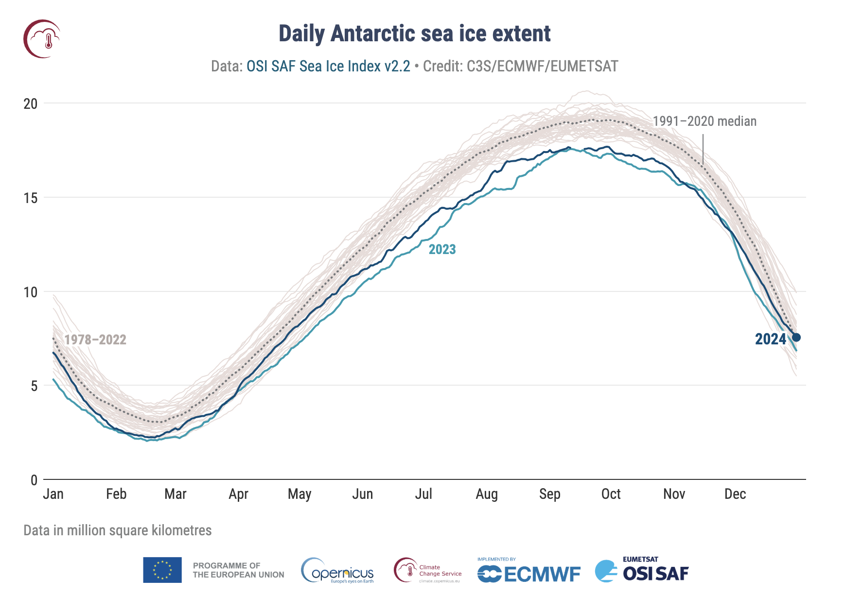
Understanding Climate Change
Alternative graph:
Climate stressors
Rising sea level and ocean acidification
Thermal expansion of seawater and melting glaciers → sea level rise
Increased absorption of CO₂ by oceans → acidification
Link: https://climate.copernicus.eu/esotc/2024/trends-climate-indicators
Link: https://climate.copernicus.eu/global-climate-highlights-2024

Slide 7
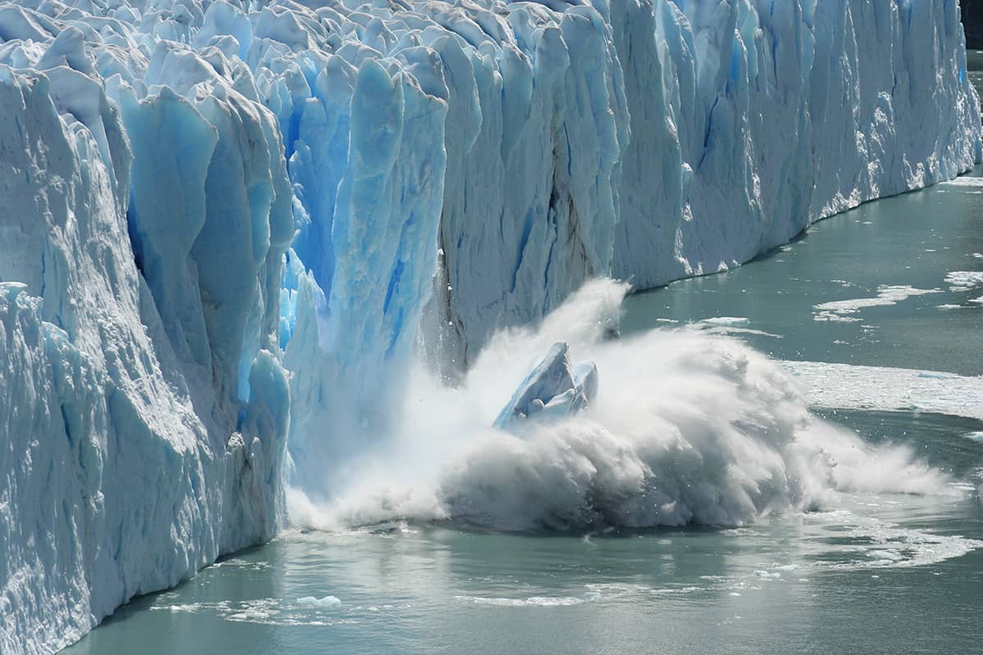
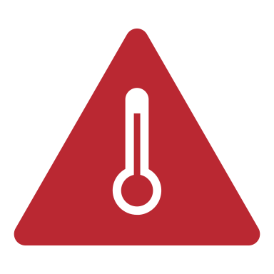
Cascading impacts of Climate Change
Climate stressors
Changes in hydrologic patterns
Rising sea level and ocean acidification
Rising global temperature
Risks
Heat waves/stress
Droughts Wildfires Floods Erosion
Major impacts
Damage to infrastructure
Public health risks
Impaired natural resources
Loss of biodiversity
Glacier: https://physicsworld.com/a/melting-glaciers-have-been-shifting-the-earths-poles-since-1995-new-study-suggests/
Notes:
Glacier: https://physicsworld.com/a/melting-glaciers-have-been-shifting-the-earths-poles-since-1995-new-study-suggests/

Slide 8
3-dimensional role of agriculture in climate change
Agriculture contributes around 10% to GHG-Emissions in EU
Mitigation
Agriculture as a solution provider to climate change
Adaptation
Food production at risk through climate change
Notes:
Agriculture has a three dimensional role in climate change..
It contributes to climate change by having natural and artificial created, additional GHG Emissions
Climate change affects agriculture directly and puts it at risk
And it is seen a solution provider to the two challenges, able to mitigate and has the possibility to adapt to climate change.
Mitigation is mainly related to the contribution of climate change, being an effort to reduce the long-term increase of climate change
Adaptation is focusing on ensuring food production in a changing long-term reality.

Slide 9
Mitigation
Reducing climate change impacts
Goal: Reduce greenhouse gas emissions & enhance carbon sequestration
Mitigation = Preventing future climate change by reducing emissions
Notes:
One of the challenge is, that this calculation also includes the avoided emissions from indirect emissions, such as the production of agrochemicals.
Currently, many emissions are not accounted for in the agriculture sector, even when they are essential.
1. Mitigation Measures (Reducing Climate Impact)
Mitigation in agriculture refers to actions that reduce greenhouse gas (GHG) emissions or enhance carbon sequestration to slow down climate change. These measures focus on reducing agriculture’s contribution to climate change.
Examples of mitigation measures:
Improved manure management (e.g., biogas production to reduce methane emissions)
Efficient fertilizer use (e.g., precision application, nitrification inhibitors to cut nitrous oxide emissions)
Agroforestry (integrating trees into farming systems to store carbon)
Conservation tillage (reducing soil disturbance to enhance carbon storage)
Cover cropping and crop rotation (improving soil carbon sequestration)
Optimized livestock feeding (reducing methane emissions from enteric fermentation)

Slide 10
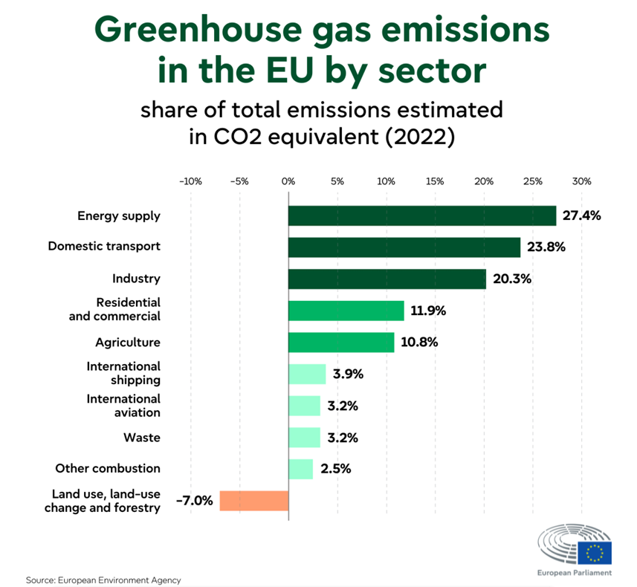
EU’s agricultural emissions → mitigation potential
When extending the system boundary to the whole & global ”agri-food system”, including pre- and post-production and land-use change, increase to 31% *
Source: EU National Inventory Document 2024
*EPRS, 2020, Data source: FAOSTAT, Emissions Totals, agrifood systems.

Slide 11
Agrifood Systems GHG Emissions in 2020 and Emission Trends (2000-2020):
Farm-gate emissions: 7.4 Gt CO2eq (nearly half of total emissions) (+13%)
Pre- and post-production emissions: 5.6 Gt CO2eq (+45%)
Land-use change emissions: 3.1 Gt CO2eq (-29%)
due to long-term decrease in deforestation rates
Source: *EPRS, 2020, Data source: FAOSTAT, Emissions Totals, agrifood systems.

Slide 12
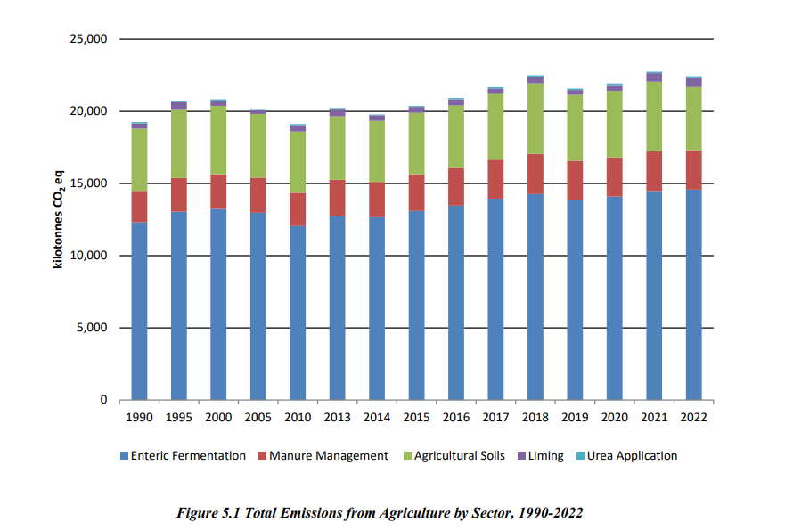
Ireland’s agricultural emissions → mitigation potential
In Ireland, the Agriculture sector was responsible for 37.8% of national Greenhouse Gases (GHGs) emissions in 2023 (EPA, 2025).
Notes:
https://www.umweltbundesamt.de/themen/klima-energie/treibhausgas-emissionen/emissionsquellen#energie-stationar
https://www.bmuv.de/jugend/wissen/details/mein-essen-die-umwelt-und-das-klima
1. Relative Emission der LaWi – wichtig, sich zu beteiligen
2. Hier nur Binnenland, aber eben Global u mit Ernährungswirtschaft eben 1/3!
LW Sektor unvermeidbare Grundemissionen – Anteil wird relativ wachsen in Zukunft
Aber: Was rechnet man mit rein?

Slide 13
3-dimensional role of agriculture in climate change
Agriculture contributes around 10% to GHG-Emissions in EU
Mitigation
Agriculture as a solution provider to climate change
Adaptation
Food production at risk through climate change
Notes:
Agriculture has a three dimensional role in climate change..
It contributes to climate change by having natural and artificial created, additional GHG Emissions
Climate change affects agriculture directly and puts it at risk
And it is seen a solution provider to the two challenges, able to mitigate and has the possibility to adapt to climate change.
Mitigation is mainly related to the contribution of climate change, being an effort to reduce the long-term increase of climate change
Adaptation is focusing on ensuring food production in a changing long-term reality.

Slide 14
Adaptation
Coping with Climate Change
Goal: making agricultural systems more resilient to climate change risks and impacts, e.g. drought, increased precipitation
Adaptation = Managing current and future impacts to maintain agricultural productivity.
Notes:
2. Adaptation Measures (Coping with Climate Change)
Adaptation focuses on making agricultural systems more resilient to climate change effects like extreme weather, shifting precipitation patterns, and rising temperatures.
Examples of adaptation measures:
Drought-resistant crop varieties (ensuring yields under changing conditions)
Improved water management (e.g., rainwater harvesting, drip irrigation)
Soil conservation practices (e.g., mulching, reduced tillage to retain moisture)
Diversification of crops and livestock (reducing risks from climate variability)
Shifting planting and harvesting dates (adapting to changing growing seasons)
Early warning systems (weather forecasting for better planning)
Key Difference:
Mitigation = Preventing future climate change by reducing emissions.
Adaptation = Managing current and future impacts to maintain agricultural productivity.
Both strategies are crucial for sustainable agriculture, and many practices (e.g., agroforestry, soil conservation) contribute to both mitigation and adaptation at the same time.

Slide 15
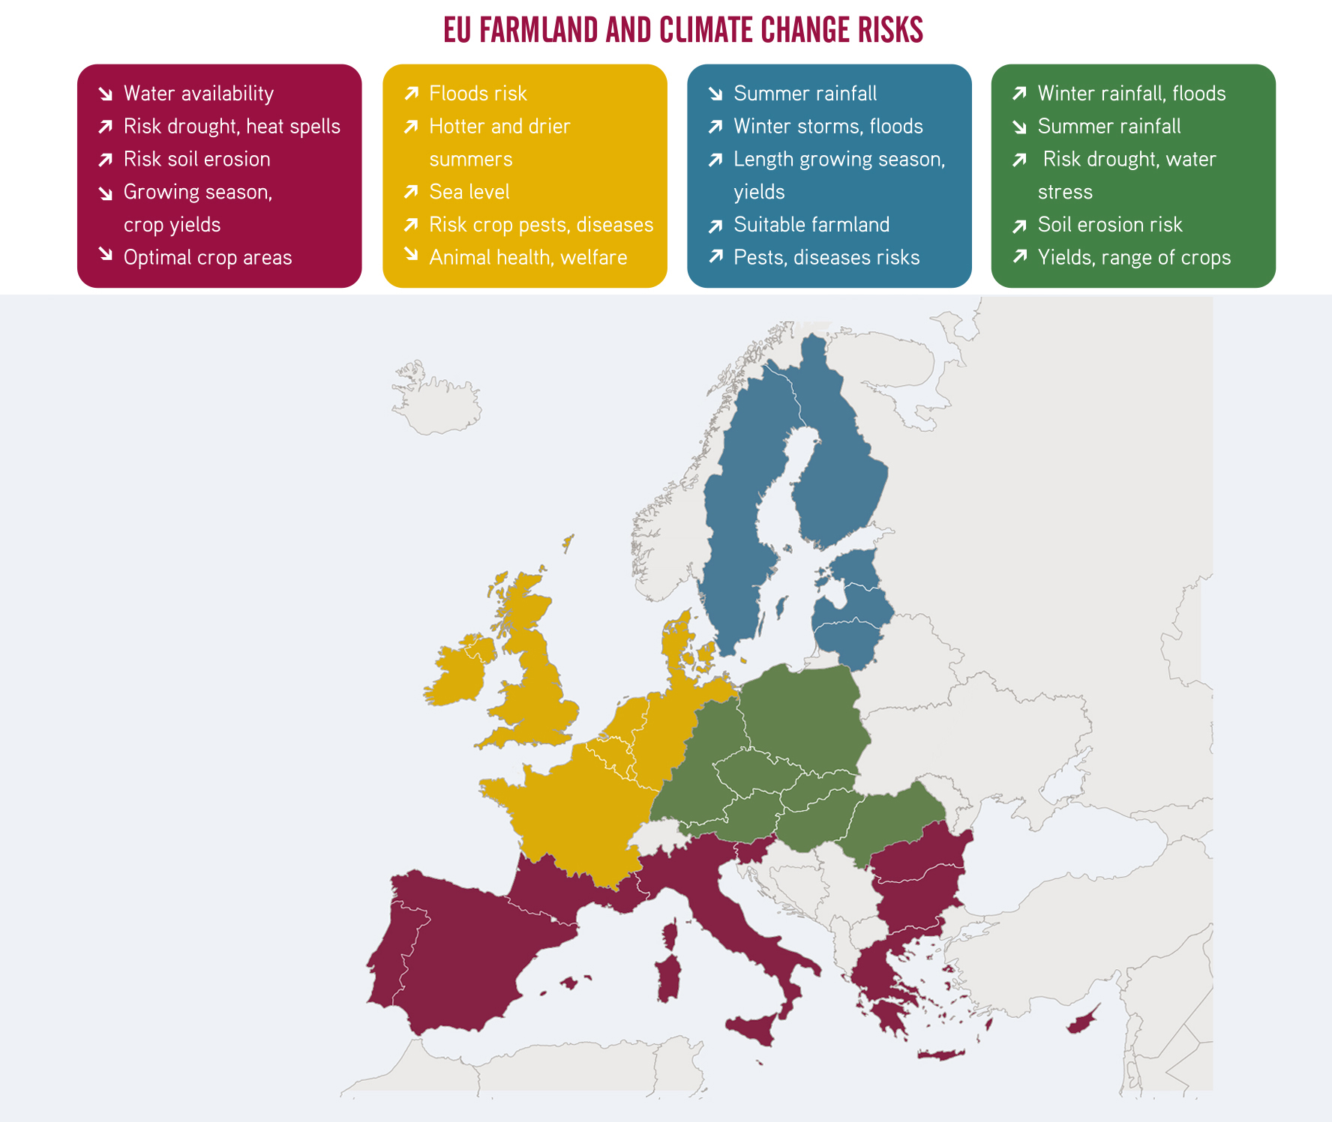
Climate change risks for EU agriculture
Crop failures
Global supply crises
Resource conflicts (water, agricultural raw materials ...)
Link: awa.agriadapt.eu

Slide 16
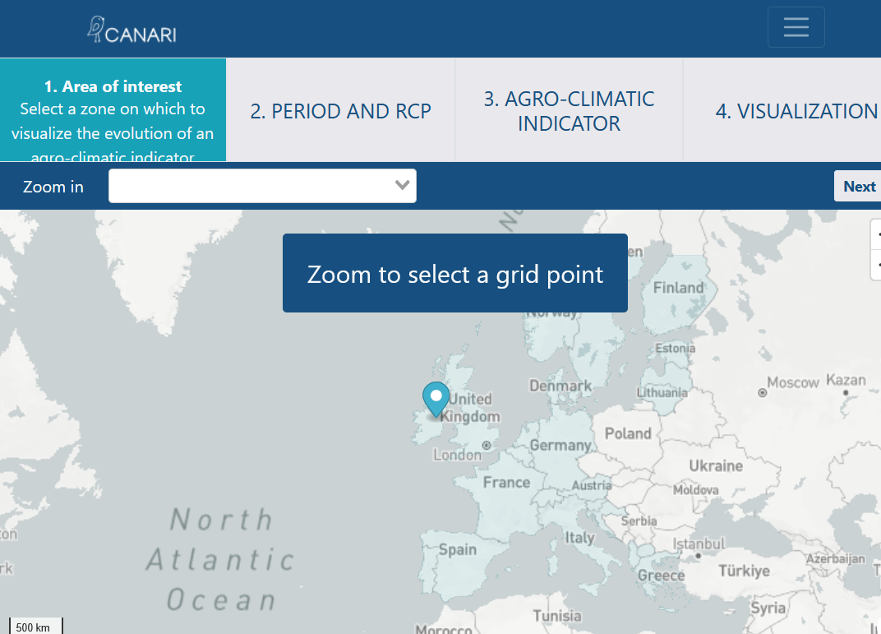
Climate change risks in Ireland
Link: awa.agriadapt.eu
Link: https://canari-europe.com/app

Slide 17
Climate change risks in Ireland
Future scenario for selected climate change indicators
Future scenario | Winter rainfall (1 Oct-28 Feb) | Summer water deficit (1 Jun-30 Sept) | Annual water deficit | Number of hot days (above 20 °C) | Average annual temperature
RCP4.5: intermediate | +8.6 mm | -4.17 mm | - 5.1 mm | + 9 days | +.63 °C
Figures shown are the projected changes in median values between recent past (1985-2020) and near future (2021-2050) under the RCP4.5 (Representative Concentration Pathway) scenario.
Link: https://canari-europe.com/app

Slide 18
Organic shows better climate impact
Systematic review of the scientific comparison studies over the last 30 years in temperate climate zones
Organic farms were on average:
1,082 kilogram less CO₂ equivalents per hectare and year
due to a higher carbon sequestration rate and reduced nitrous oxide emissions
Humus content 26% higher
Aggregate stability 15% higher
Water infiltration rate 137% higher
reducing surface runoff and soil erosion
Nitrogen use efficiency was 12% higher
Energy use efficiency 19% higher
…in comparison to conventional farming
Reference: Sanders et al, 2025
link: https://link.springer.com/article/10.1007/s13165-025-00493-w
Notes:
Sanders J., Brinkmann J., Chmelikova L., Ebertseder F., Freibauer A., Gottwald F., Haub A., Hauschild M., Hoppe J., Hülsbergen K., Jung R., Kusche D., Levin K., March S., Schmidtke K., Stein‑Bachinger K., Treu H., Weckenbrock P., Wiesinger K., Gattinger A., Hess J. (2025): Benefits of organic agriculture for environment and animal welfare in temperate climates. Organic Agriculture, published March 2025, open access.
https:// doi.org/ 10. 1007/ s13165- 025- 00493-w

Slide 19
Organic climate farming “best” practices: Experiences from Ireland

Slide 20
Selection of Organic Climate Farming practices
Alternative sectors
Input management
Soil management
Water management
Livestock
Crop & field
Infrastructure
Compost production and application
Manure storage
Slurry application
Precision agriculture
Tillage: reduce depth, frequency, no-till, min-till
Adding SOM to soil
Reduce peat use
Rewetting peatlands
Water catchment
Efficient use of water
Good irrigation practices
Monitoring water consumption
Optimising grazing management
Protein autonomy
Reduction in the use of concentrated feed
Adaptation of manure management
Dual-purpose breeds
Reduction of livestock and conversion to more plant-based production
Reduced tillage
Direct sowing instead of ploughing
Intercropping
Cover crops
Flower strips
Perennial plants
Agroforestry
Diversifying productions
Choosing varieties adapted to water or heat stress
Conversion to green electricity
Heat recovery from milk cooling or poultry houses
On-farm energy use and production, e.g. agri-photovoltaic
Reducing on-farm plastics
Electric vehicles
…many more

Slide 21
Three examples from Ireland
Mitigation + adaptation:
Multi species swards
Agroforestry
Intercropping

Slide 22
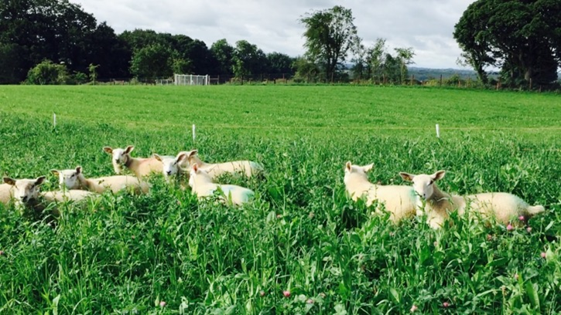
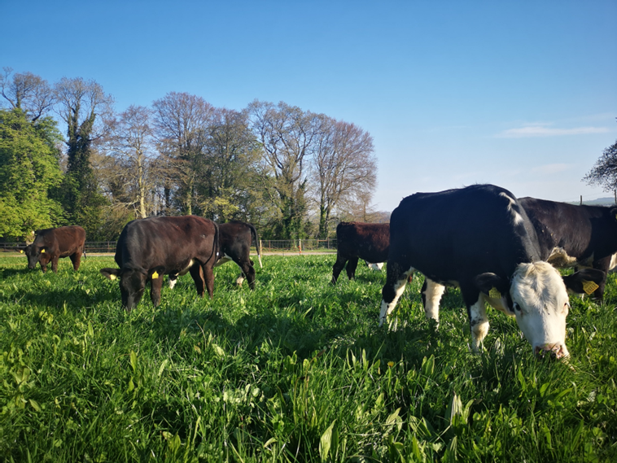
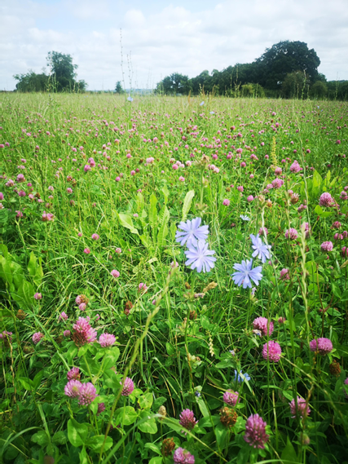
Mitigation & Adaptation
Multispecies swards

Slide 23
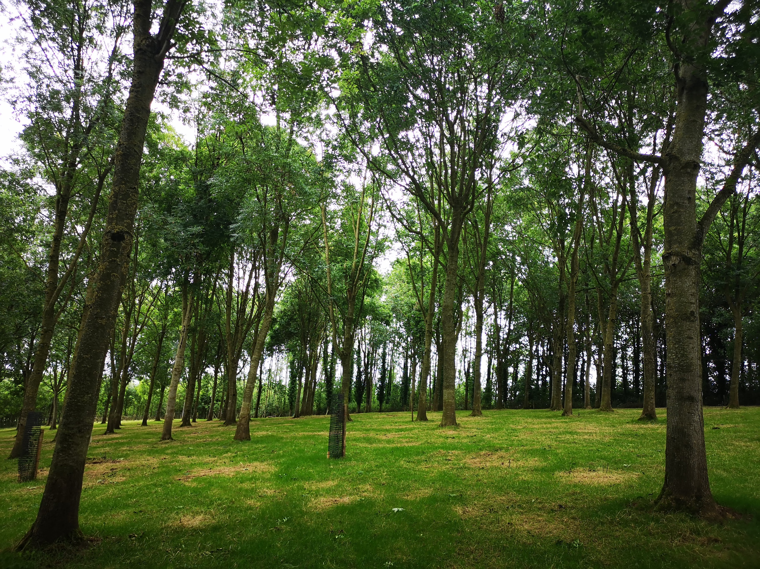
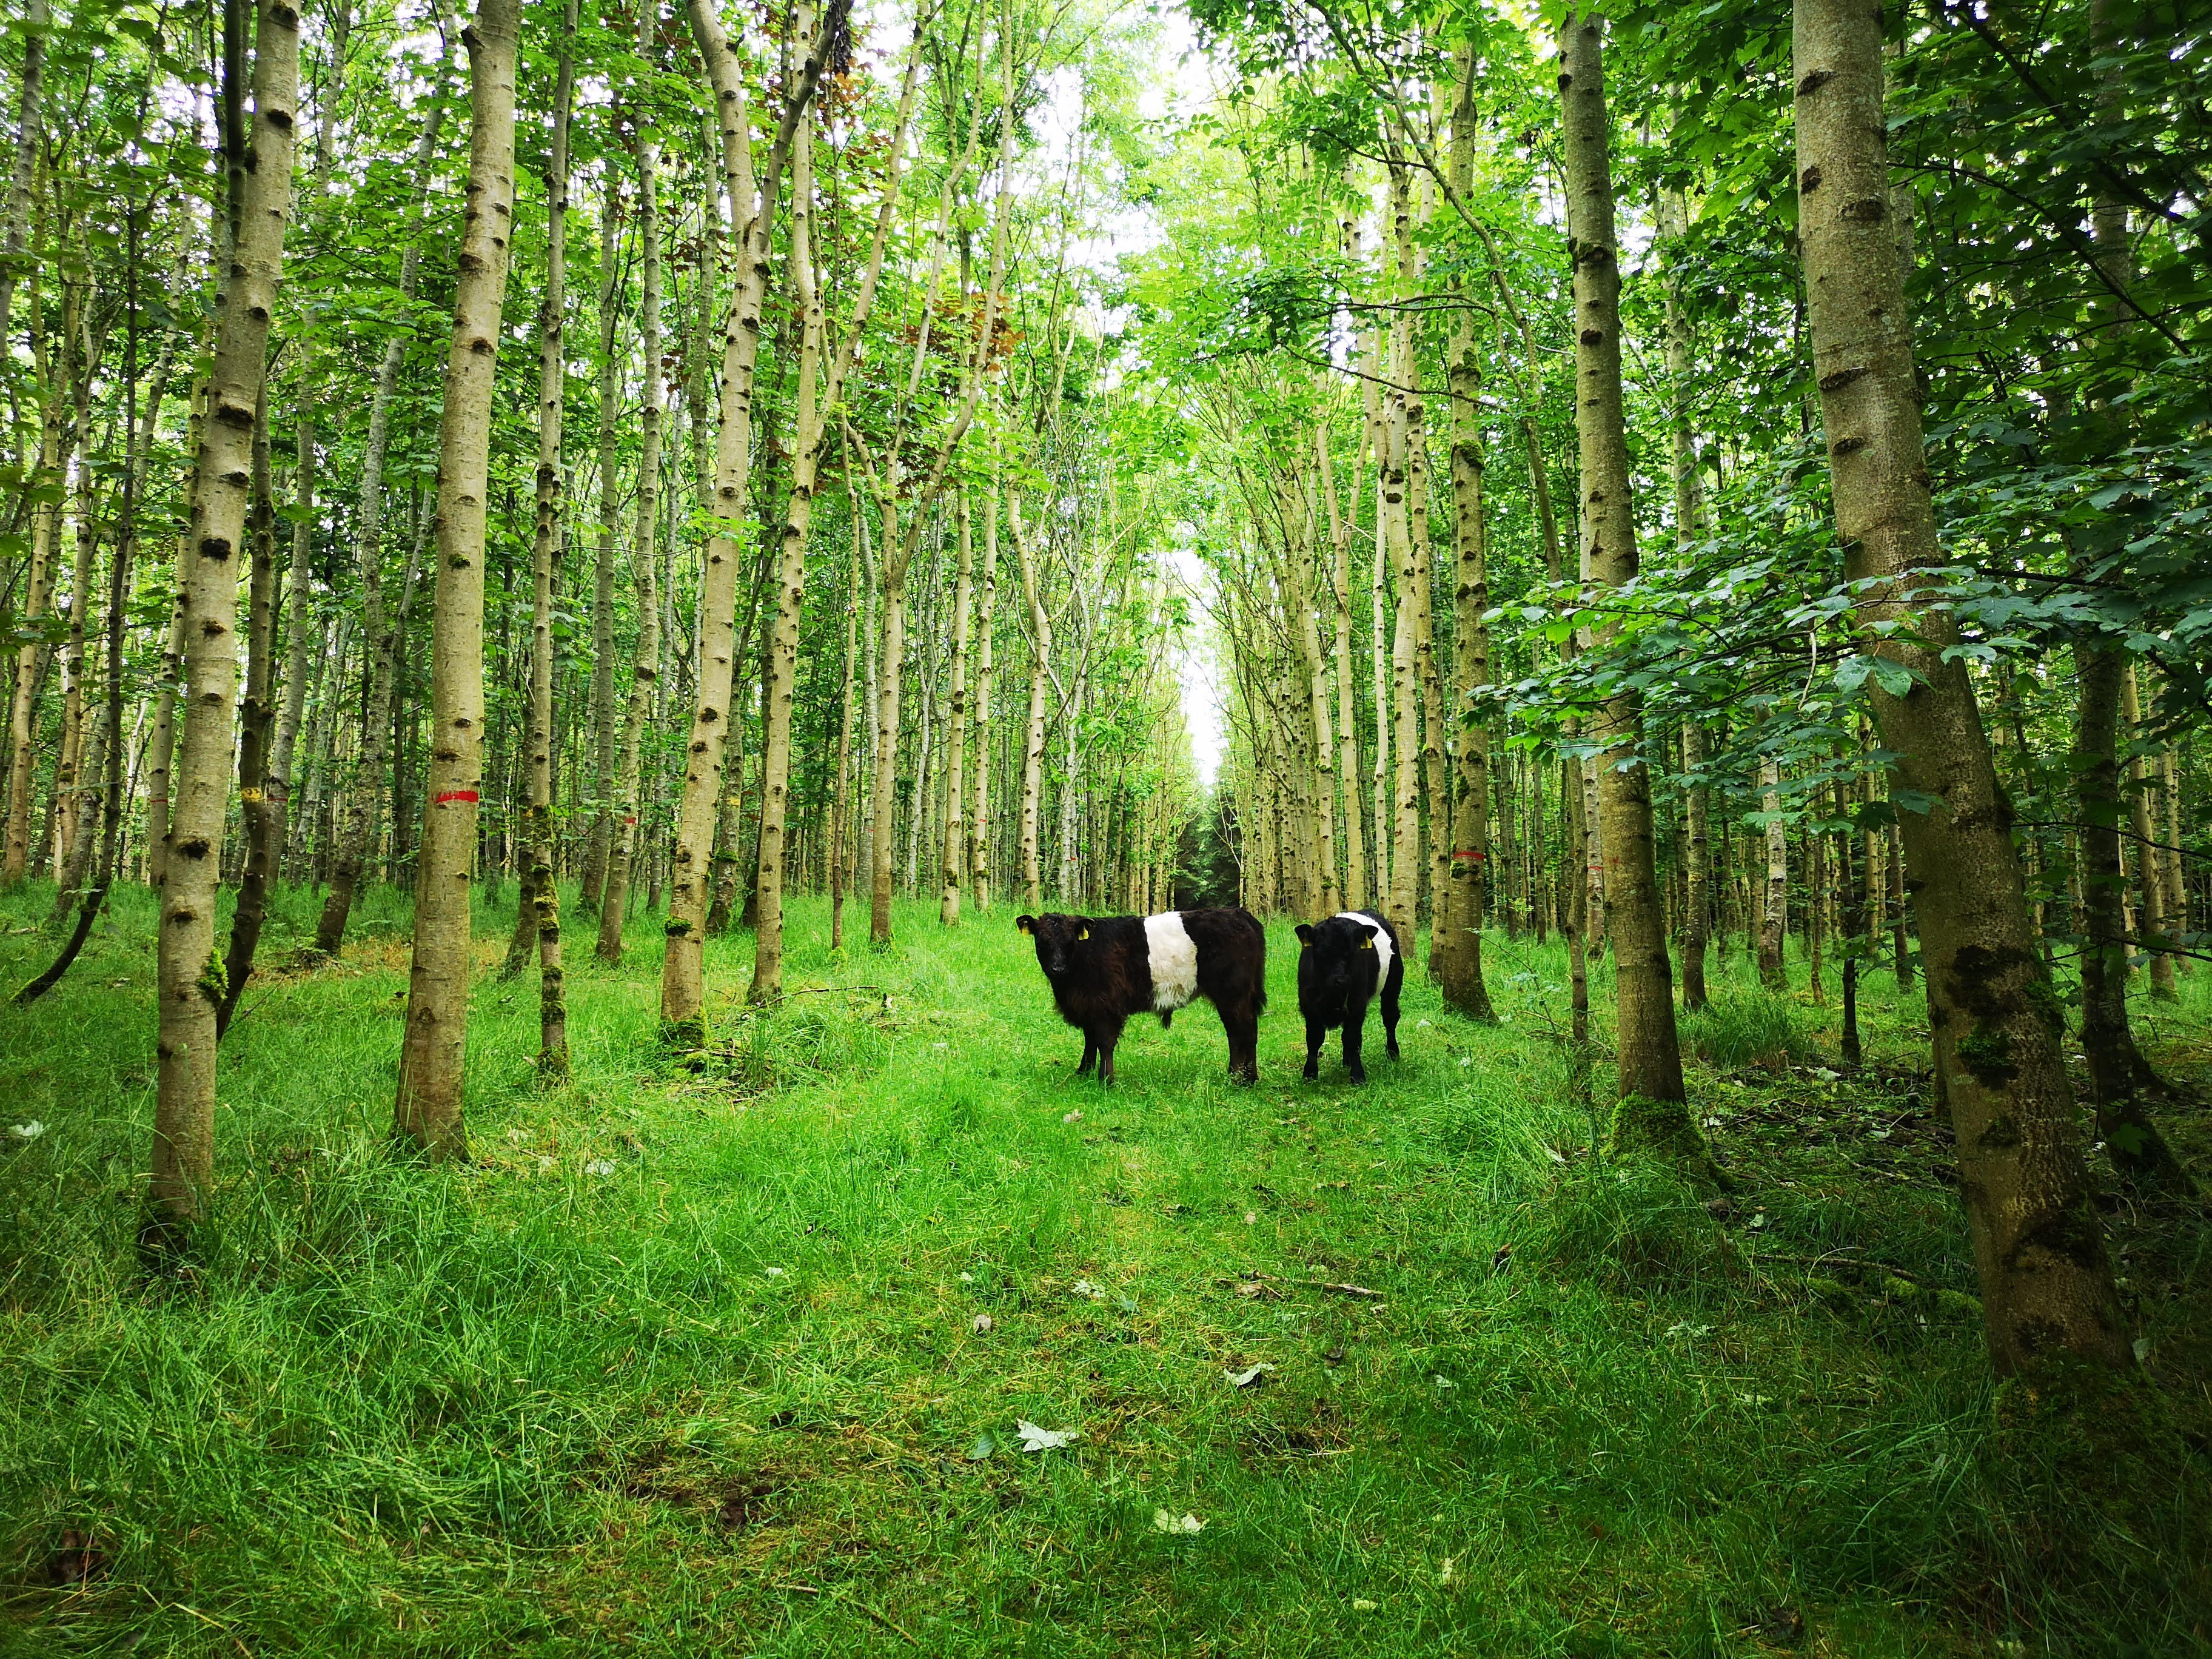
Mitigation & adaptation
Agroforestry

Slide 24
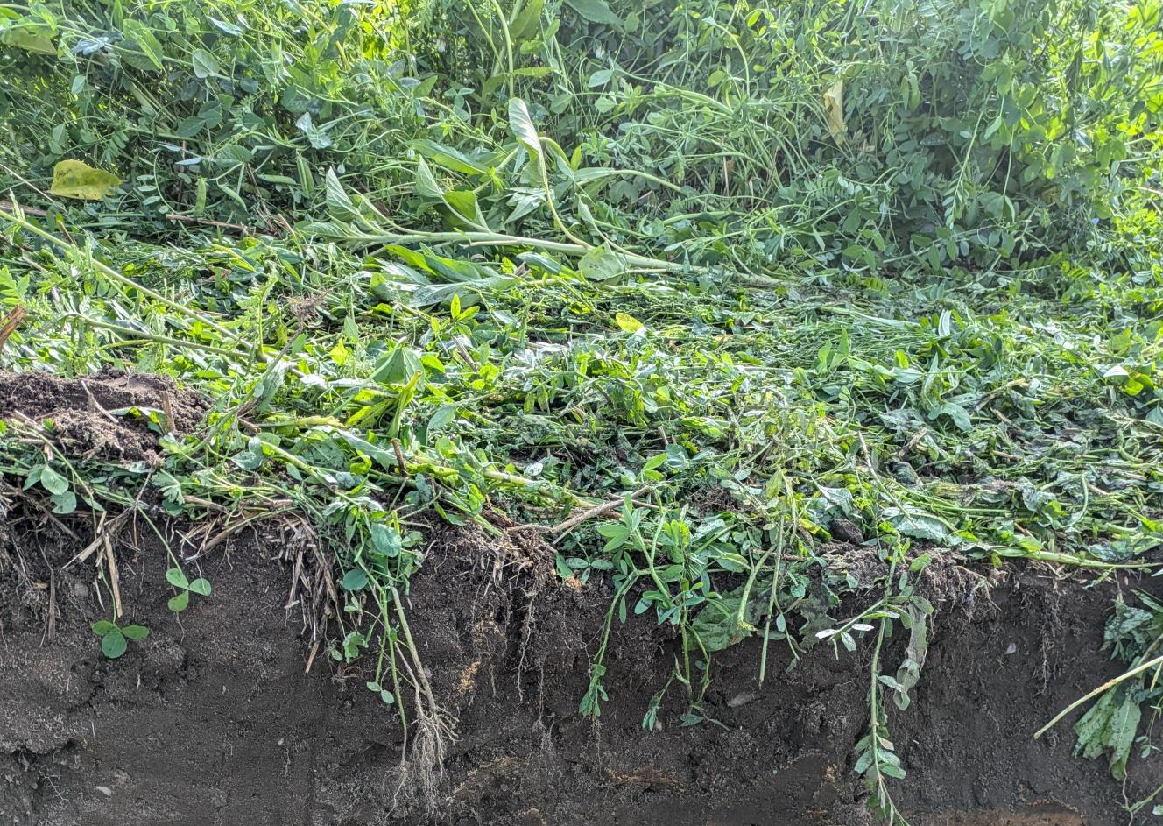
Mitigation & adaptation
Intercropping

Slide 25
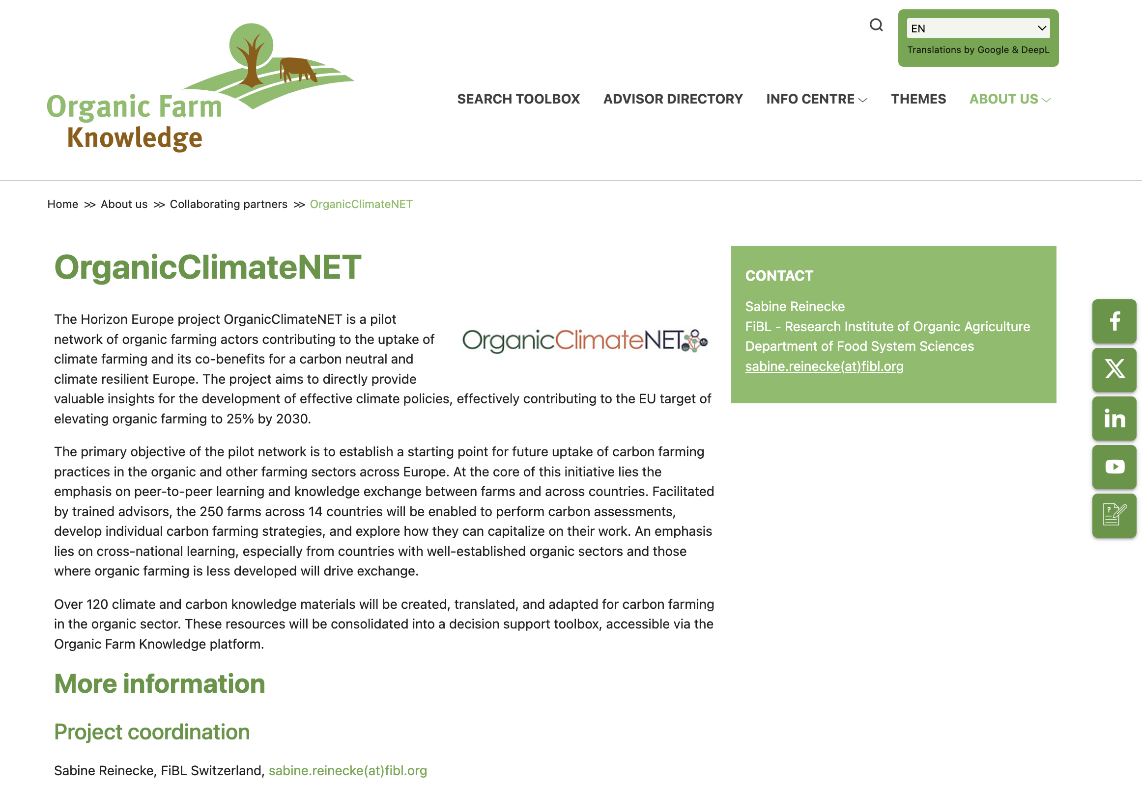
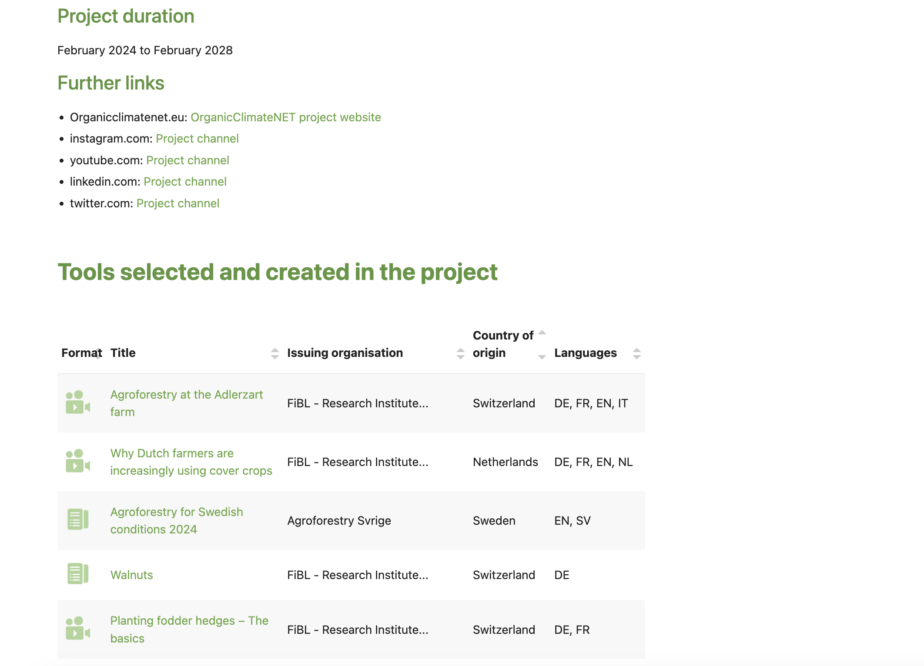
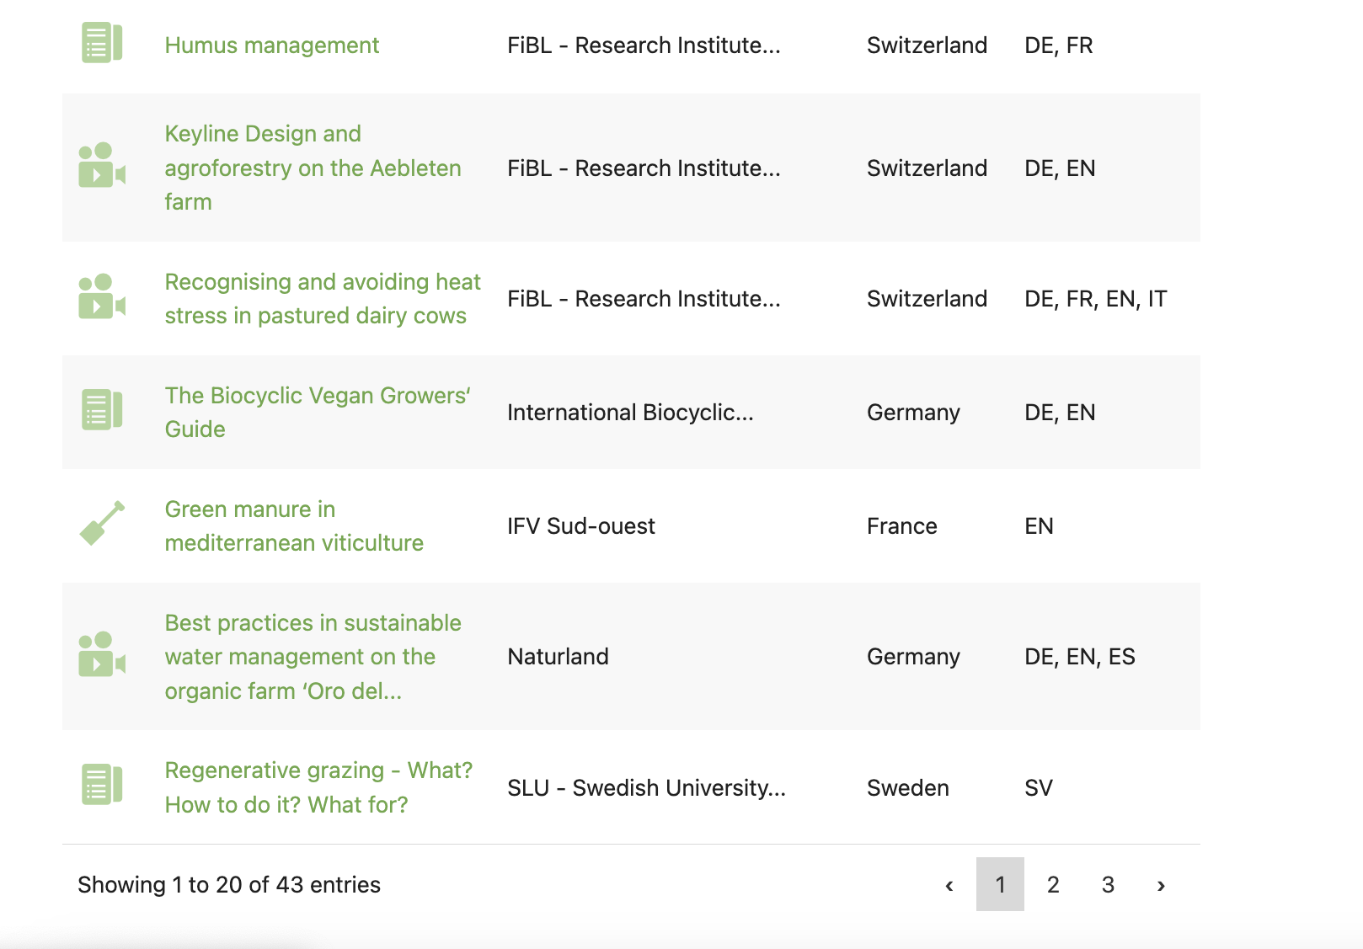
How to find further information on best practices
https://organic-farmknowledge.org/about/collaborating-partners/organicclimatenet

Slide 26
How to find further information on best practices
https://organic-farmknowledge.org/about/collaborating-partners/organicclimatenet
~60 knowledge materials about Organic Climate Farming practices available in various European languages

Slide 27
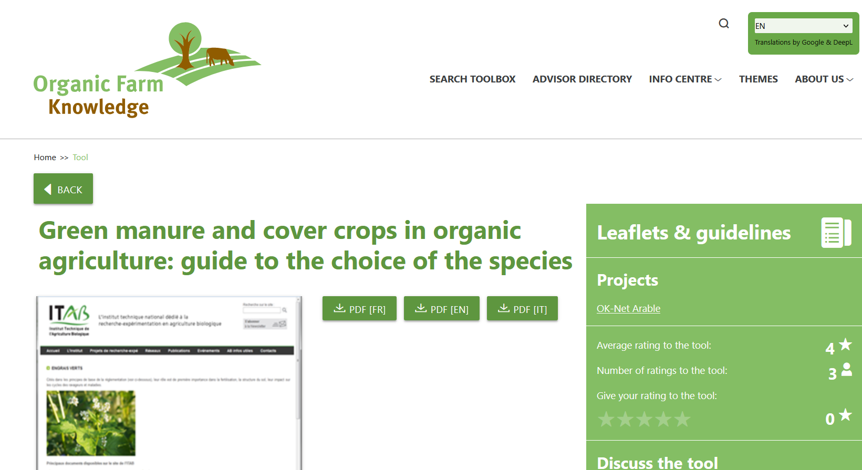

Slide 28
Conclusions
Organic agriculture’s role in climate change mitigation & adaptation
From an ecological perspective, organic has a high potential to contribute to climate solutions
There is mitigation potential… but relatively limited
It has advantages in adaptation
Practices can be optimised to support farmers adapt to challenges caused by climate change in mid and long-term
Consider trade-offs between yield level and yield stability
Notes:
One of the challenge is, that this calculation also includes the avoided emissions from indirect emissions, such as the production of agrochemicals.
Currently, many emissions are not accounted for in the agriculture sector, even when they are essential.

Slide 29
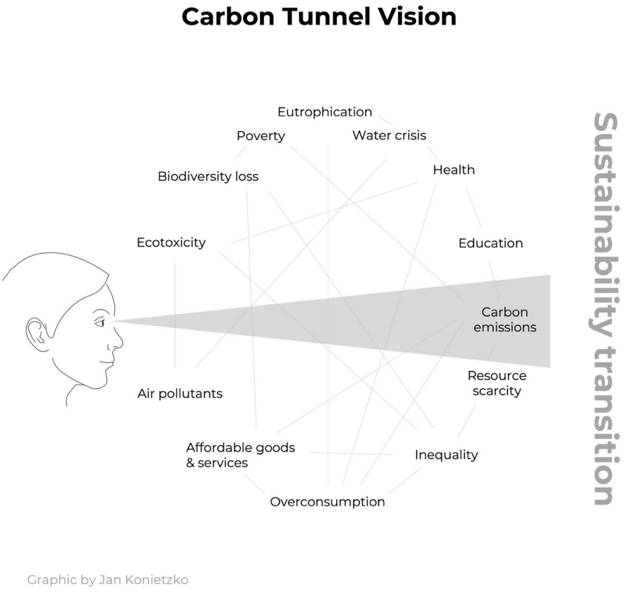
The challenges are numerous
To avoid tunnel vision, consider the whole system to guide the choice of farm-appropriate practices
Link: https://www.sei.org/perspectives/move-beyond-carbon-tunnel-vision/
Notes:
https://www.sei.org/perspectives/move-beyond-carbon-tunnel-vision/
Organic Agriculture Systemic Approach – co-benefits – Wholistic farming

Slide 30
Thank you!
Event name

