Slide 1
Organic Cattle Manual
Presentation for Training Sessions

Slide 2
Chapter 1 - Introduction

Slide 3
Benefits of cattle husbandry in Africa
Livelihoods: source of income through the sale of live animals, milk, meat, and other products such as manure or leather
Food security: source of protein for household consumption
Manure: valuable organic fertiliser that will improve soil health and increase crop yields
Risk management: a form of insurance against crop failure or other economic shocks
Adapted breeds: robust breeds that in general require fewer medicines and nutritional supplements compared to high-grade dairy or beef breeds
Draught power and transport: easier, more accurate and less labour-intensive soil preparation compared to cultivation without animal power
Climate friendly: can contribute to the reduction of climate change, if coupled with regenerative farming and grassland management.
Marketing: growing domestic markets for organic produce in many African countries, increasing awareness about human health-related issues (e.g. overuse of antibiotics or their residues in milk), animal welfare and climate-friendly agriculture, growing international market for certified organic beef
Cultural significance: highly valued cattle in Sub-Saharan African cultures and possible social and religious significance

Slide 4
Challenges of cattle husbandry in Africa
High investment costs: comparably expensive cattle compared goats or sheep
Limited access to inputs and services: possibly lacking access to essential inputs such as quality breeding stock, vaccines, and organic animal feed, as well as services such as veterinary care and market information, when needed
Land scarcity: Land scarcity can limit the number of cattle and the amount of feed that can be produced
Conflicts with predators
Climate change: Climate change can lead to reduced availability of water and pasture, risk of droughts, floods and storms is increasing.
Inadequate policy and regulatory frameworks: In some countries, inadequate policies and regulations may limit access to markets, restrict movement of animals, and limit the ability of smallholder farmers to participate in the formal economy.
Security and conflicts: Cattle can be stolen or harmed. Herders can be attacked by thieves. Disputes over land resources can lead to serious conflicts between herders and farmers
Loss of traditional knowledge: rural exodus of the youth, lack of herders, and traditional knowledge are no longer passed on to the next generation.
Access to knowledge on livestock management: lack of access to knowledge about livestock management

Slide 5
Chapter 2 – Dairy and Cattle Production Systems in Sub-Saharan Africa

Slide 6
Cattle and small ruminant production systems in Sub-Saharan Africa
Cattle production systems
Grassland-based system
Mixed crop-livestock system
Tropical lowland system
Tropical highland system
Pastoral
system
Agropastoral system
Nomadic pastoral system
Transhumant pastoral system
Mixed semi-arid system
Mixed sub-humid system
Mixed highland system
Smallholder dairy (milk)
Ranching system
Mixed humid system
Source: Otte and Chilonda, 2003

Slide 7
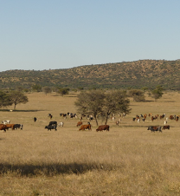
Grassland-based systems (examples)
Organic cattle farm Krumhuk in Namibia
Grass-fed Nguni cattle
Own slaughtering and processing facility
Heard size: 450 cattle (before drought 700 cattle)
Land area: 8’000 ha
Certified organic
Products: fresh and processed beef
Buyers: end consumers and supermarkets
Photo: Mareike Voigts

Slide 8
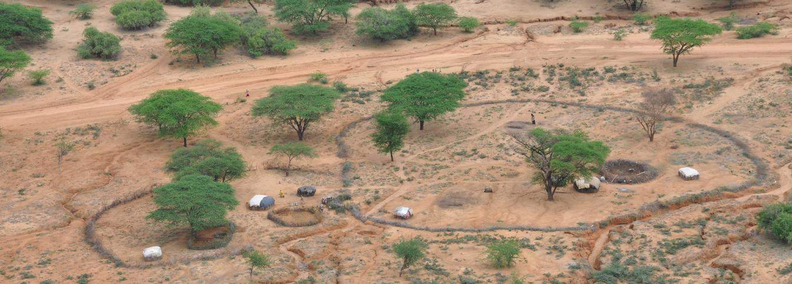
Grassland-based systems (examples)
Manyatta in Ngurunti, Kenya
Communal pastoral area
Large enclosure fenced around the farmstead
Small enclosure for the cattle at night
Photo: Mareike Voigts

Slide 9
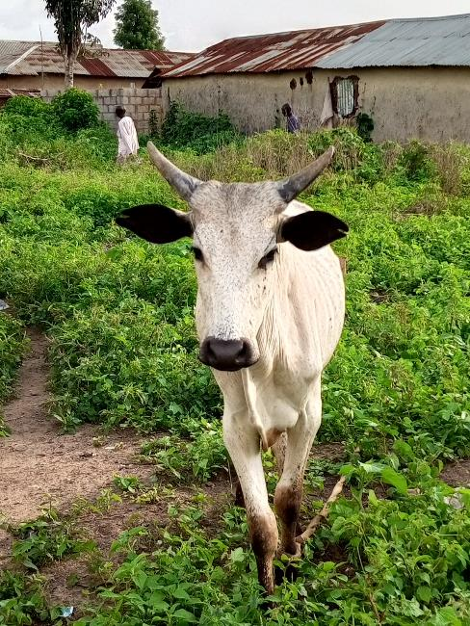
Mixed crop-livestock systems (examples)
Smallholder cattle farming in Abuja, Nigeria
White Fulani cattle breed
Crops: groundnuts, maize and beans
Manure is collected and used as organic fertiliser.
The manure that is not utilised, is sold to other farms nearby.
The cattle are taken to the grazing and watering areas and returned to the farm daily.
Additional feed is provided (partly own-grown and purchased), depending on the season.
Mainly for own consumption.
Photo: Umar Abdullahi

Slide 10
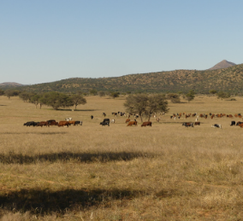
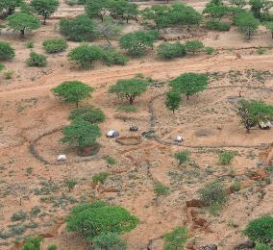
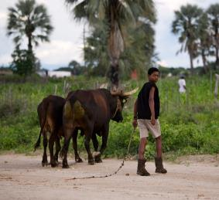
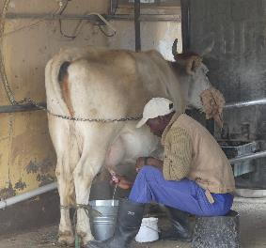
What is an “organic cattle system”?
There is not one organic livestock system.
Many different livestock systems can be organic as long their production is in line with organic principles.
Photos: Jana von Hase, Mareike Voigts

Slide 11
Principles of organic farming
Health
Ecology
No livestock feed additives
No chemical pesticides andfertilisers
Disease prevention with good husbandry
Improving soil fertility
Local recycling of nutrients
Compost
4 Principles
Care
Fairness
Traditional and new scientific knowledge
Fair share to all market partners
Excludes genetically modified organisms

Slide 12
Chapter 3 – General approach to organic cattle farming

Slide 13
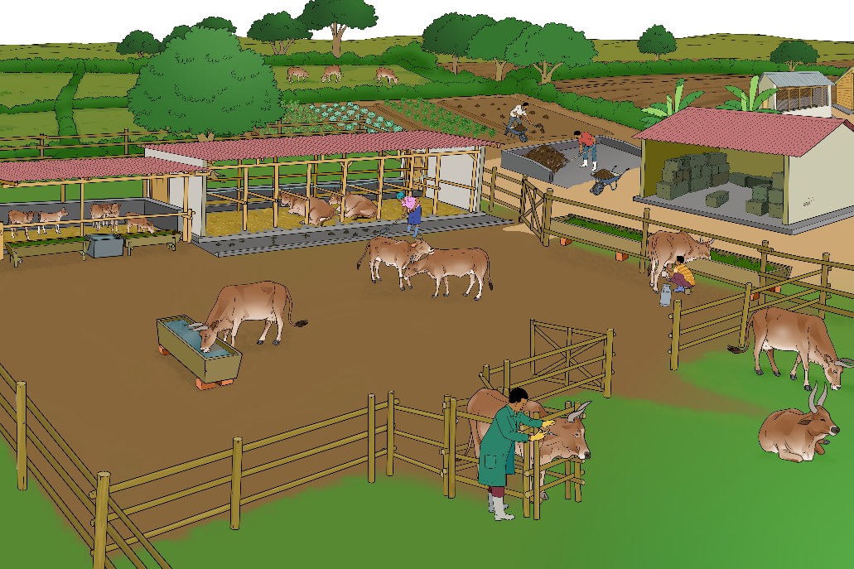
Approaches of organic dairy and cattle farming (1/2)
Appropriate herd size
Crop-livestock integration
Number of cattle adapted to the size and resources of the farm and workforce
Using manure as fertiliser for the crops
Feeding grass and crop residues to cattle
Adapted breeds
Use of breeds adapted to local conditions, and orientation of the production

Slide 14
Approaches of organic dairy and cattle farming (2/2)
Sustainable land management
Animal-human relationship
Avoiding over- or underuse of the grazable land
Respectful and friendly attitude
Proper and low-stress handling
Manure application in accordance with crop needs
Acclimating calves to touch and handling by humans
Avoiding nutrient losses in manure storage and application
Natural behaviour
Treatment of cattle with care and respect
Health management
No preventive use of antibiotics and dewormers
Offering enough space for moving and social interactions and appropriate feeding and lying places
Consistent application of preventive health measures
Need-based feeding

Slide 15
Chapter 4 – Natural behaviour and needs of cattle

Slide 16
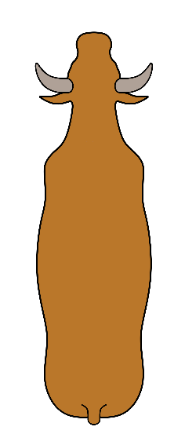
How much do cattle see?
Three-dimensional view
170°
Poor view
330°
Two-dimensional view
Cows see much more than we do.
Blind spot (no view)

Slide 17
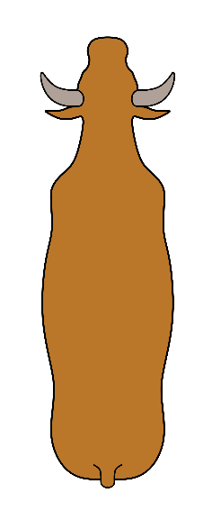
How do cattle experience the world?
Vision
330 degrees
Good detection of movements
Poor detection of details
Taste
Sensitive to the change of tastes of feed
New feeds should be introduced gradually
Smell
Very good sense of smell
Early detection of predators
Sensitive for urine from stressed animals
Temperature sensitivity
Depending on the breed
Better handling of low than high temperatures
Decreasing feed uptake above 25 °C
High humidity intensifies the negative effects of high temperatures
Increasing water needs with increasing temperature
Hearing
Hears high audio frequencies that humans do not hear
Loud and sudden noises are stressful

Slide 18
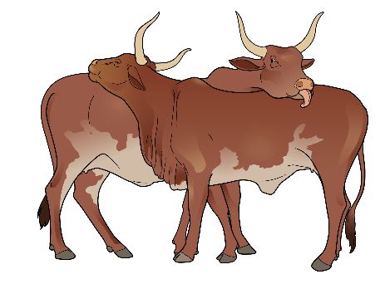
Social behaviours of cattle
Cows, bulls, calves and beef are social animals and don’t like to be alone.
Cattle are sensitive animals and suffer from pain, fear, isolation or hunger.
Cattle herds have a hierarchy and build strong relationships among each other.
Grooming is done for body care and to maintain bonds and hierarchy.
Conclusions:
Cattle should be kept in stable herds.
Tethering of single animals should be done only for short periods.
Cattle should not be inflicted with pain, e.g. by beating, as they suffer just like humans.

Slide 19
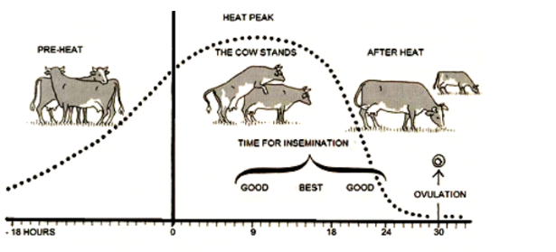
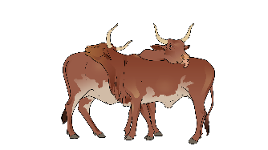
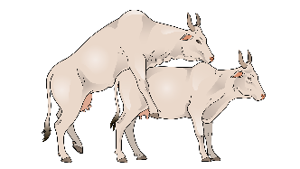
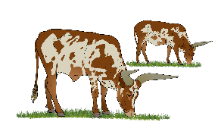
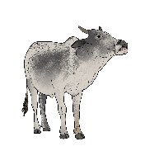
Reproductive cycle of a cow
Coming into heat
(Day 21)
Standing heat
Day 1
Going out of heat
Day 2
Cows grooming
Cows graze individually
Cow in heat standing still while being mounted by another cow
A cow makes the flehmen response by curling back of the upper lip
Ovulation
-18 hours
0 h
9 h
18 h
24 h
30 h
Good
Best
Good
Time for artificial insemination
Time for insemination by a bull

Slide 20
Chapter 5 - Housing

Slide 21
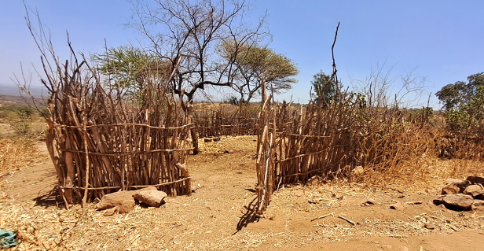
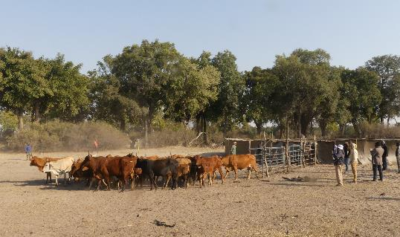
Diversity of housing systems for cattle
Enclosure for cattle, sheep and goats (Kenya)
Mobile kraal (Botswana)
Photo: Oscar Silali
Photo: Mareike Voigts
Fixed enclosure made of wood
Nomadic pastoralists
The herd grazes for several hours during the day and stays in the enclosure at night.
Some farmers move from one location to another (seasonal nomadic movement).
Mobile kraal/boma of the Herding for Hope, CLAWS* project in Botswana
Movable fence
Protection of cattle from wildlife
As predators cannot see through, they will not enter the enclosure.
*www.clawsconservancy.org

Slide 22
Cattle sheds checklist
Is there a roof to protect animals from the sun?
Is there enough fresh air and light?
Is the floor not slippery?
Is there enough space for every cow to lie down?
Is the ground of the resting area soft and not wet?
Is there a place where sick animals or calving cows can be separated from the herd?
Is there enough space at the feeding area for every cow?
Is clean water available?
Do the animals have direct contact with other animals?
Can the animals move freely and are they not tethered for long periods?

Slide 23
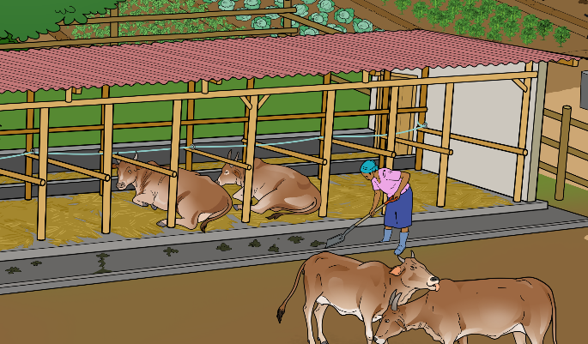
Optimising cattle sheds
The lying surfaces are not too long so that the manure falls onto the area behind them and does not soil the lying surface.
The cows have enough space at the front so that they can swing their heads forward enough when standing up.
The lying area should be quiet so that the animals can lie down and chew their cud in peace.
A barrier helps to ensure that the cows lie straight on the lying area and not cross-wise. This way they deposit the manure at the back. If the lying areas are large enough, or if deep litter is used, there is no need for side barriers.
The lying surface should be comfortable and dry so that the animals enjoy lying on it.
The lying and walking surface is cleaned regularly.
The animals can decide for themselves whether they want to lie down, eat or groom themselves with other animals.

Slide 24
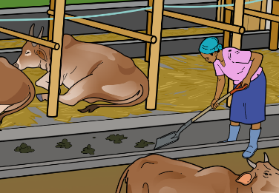
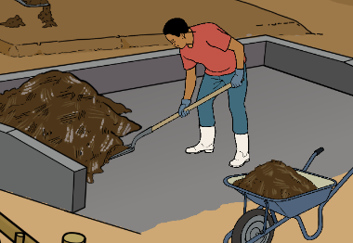
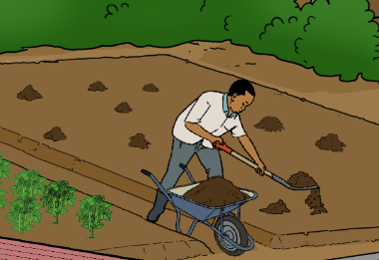
Manure management
Collection
Collect dung, urine and bedding material
Only few bedding material: collect on a daily basis
Deep litter system: add new material on a daily basis, remove periodically
Storage and transport
Dung heap or compost
Balance the mixture of manure (rich in nitrogen) and straw or wood shavings (rich in carbon).
Application
Apply to soils or crop fields.
Adjust the amount of composted organic fertiliser added to the needs of the plants and the soil conditions.

Slide 25
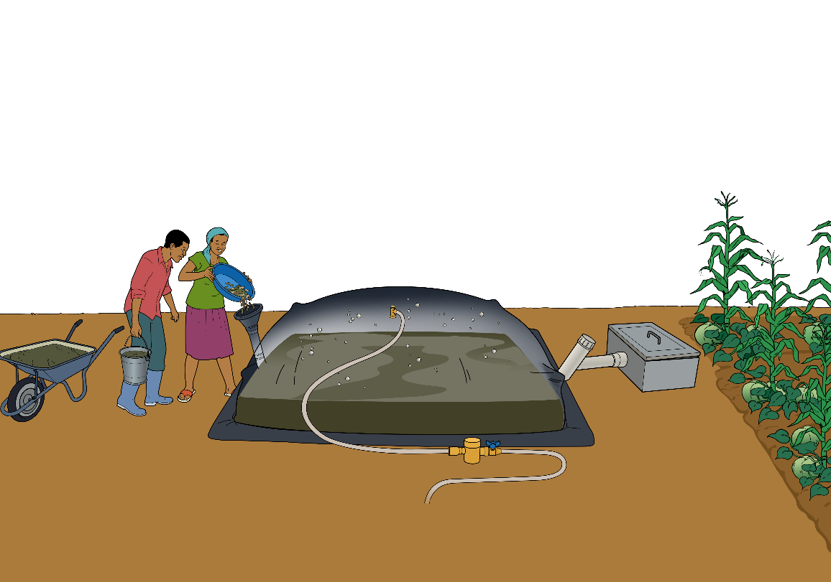
Biodigester
2. Microbes convert the organic material into gas and bioslurry.
Fertiliser
Organic
materials
Biogas
4. Bioslurry is a valuable organic fertiliser and can contribute to increased farm yields.
Bioslurry
Biogas
1. Manure and other organic materials and waste are filled into the biodigester.
3. The gas can be used as an energy source for various applications.
Note: Setting up a functioning biodigester requires instruction from an expert.
Power
Light
Heat

Slide 26
Chapter 6 – Animal Management

Slide 27
Pre-calving and birth
Timeframe | Signs | What to do
2-3 weeks before calving | Signs that a cow will calve in the near future Udder begins to enlarge, elaxation and swelling of the vulva (springing), a thick line of mucus may be seen coming out of the vulva | Observation and depending on housing system separation of cow
24 hours before calving | (Possible) Signs that a cow is about to calve Relaxation of pelvic ligaments, strutting of the teats, animal may isolate itself or prefer not to eat and is restless, softening of the tail tip | Observation
Calving (stage 1) (duration: some hours) | Dilation of cervix This stage may last for several days and may not be visible, but some signs may be present: thick clear mucus string hanging from the vagina, red vulva, decreased appetite, isolation from the herd, cow shows discomfort and restlessness, pelvic edges soften and collapse (sunken appearance on both sides of the tail head), cow pads back and forth, the tip of the cow's tail is quite soft and can be folded over | Observation
Calving (stage 2) (duration: 30 minutes to several hours) | Delivery of the calf Starts with the appearance of the water bag at the vulva, active labour of the cow. heifers calving for the first time may take 1 to several hours to give birth, cows that have already given birth generally calve within 30 minutes to 1 hour, the calf should be slowly pushed out, and its front feet and nose should arrive first | Close observation (intervention only if necessary): If there is no progress in the birth 30 to 60 minutes after the amniotic sac is first seen
Calving (stage 3) (duration: 30 minutes to 24 hours after the birth of the calf) | Delivery of placenta/ afterbirth Shedding of the placenta and fetal membranes, if the membranes have not been shed after 12 to 24 hours, they are considered retained

Slide 28
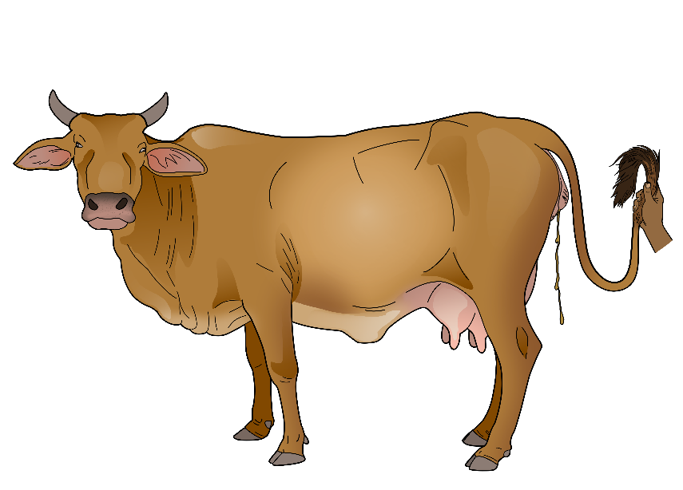
First signs of birth
How does a cow show that she is about to give birth?
The tip of the cow's tail is quite soft and can be folded over.
The ligaments around the cow's pelvic area may loosen, allowing the birth canal to expand. This can sometimes be felt by gently palpating the area around the tailhead.
A clear, mucus-like discharge from the cow's vulva may occur as the cervix begins to dilate.
Enlarged and tight udder
Cow pads back and forth, separates from the herd or is lying down and getting up frequently.

Slide 29
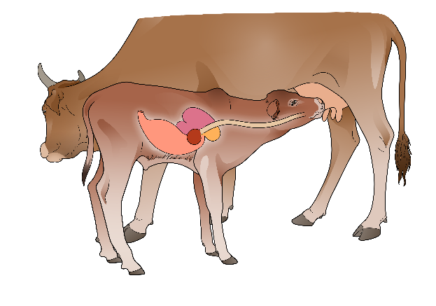
Keeping calves healthy after birth
Colostrum: make sure the calves drank enough colostrum (first milk): within the first two hours at least two liters.
Minimise stress.
Ensure very good hygiene.
Ensure proper rumen development allowing access to roughage/hay. Ensure necessary vaccinations.
Provide necessary vitamins and minerals.
Provide access to clean water at all times.
Ensure timely castration.

Slide 30
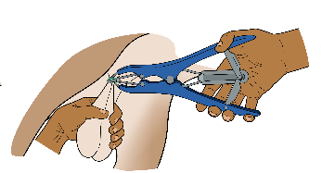
Castration
Why are calves castrated?
Oxen are less dangerous and easier to handle than bulls.
Prevention of inbreeding and unwanted mating of cows
Increased tenderness in the meat
Higher carcass yields
Changed fat composition in the meat (can be favourable or not, depending on consumers preferences)
Castration methods
Castration with the Burdizzo pliers
Banding castration
Surgical castration
Note: ALL castrations require anaesthesia!

Slide 31
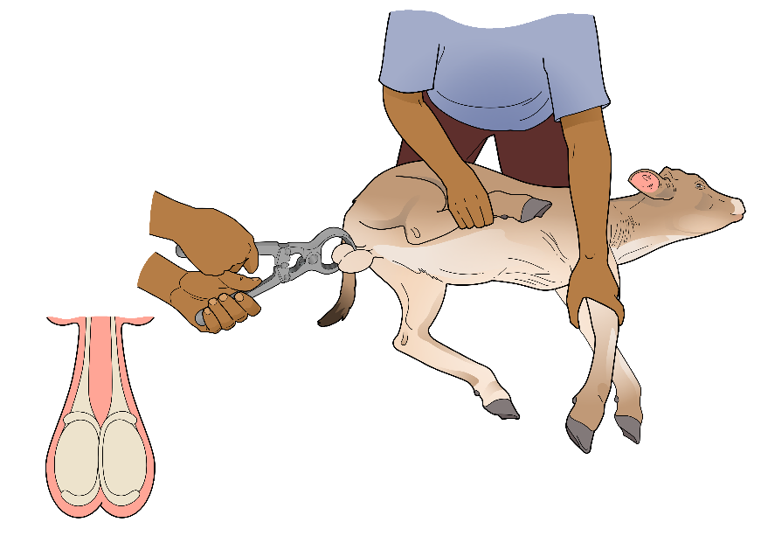
Castration
Method 1: Castration with the Burdizzo pliers
When the arms of the Burdizzo pliers are closed, they compress the spermatic cords, which supply blood to the testicles, and effectively cut off the blood flow. The lack of blood supply causes the testicles to atrophy and die, resulting in sterility.
The Burdizzo pliers are applied here. The blood vessels on each side must be compressed separately at different points for 2 minutes each.
Note: Ideally, castration is carried out by a veterinarian or a trained person.

Slide 32
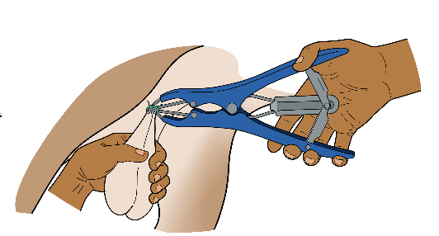
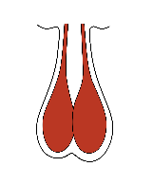
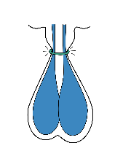
Castration
Method 2: Banding castration
Method 3:
Surgical castration
The procedure involves making an incision in the scrotum and removing the testicles.
Surgical castration requires sterile equipment, proper technique, and anesthesia to minimise pain and stress for the animal.
The procedure should be carried out by a trained veterinarian or a trained farmer only.
Blood supply to testicles stops.
Banding involves placing a tight rubber ring around the scrotum, which cuts off the blood supply to the testicles. The testicles then shrivel and fall off after several weeks.

Slide 33
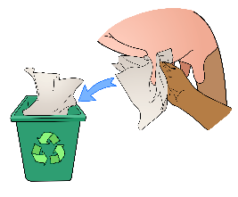
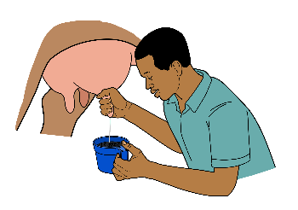
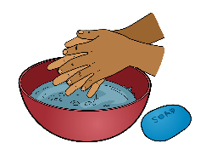
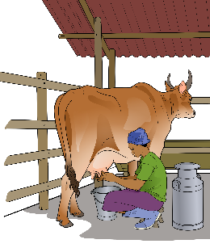
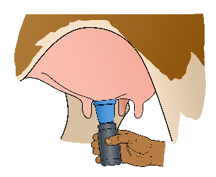
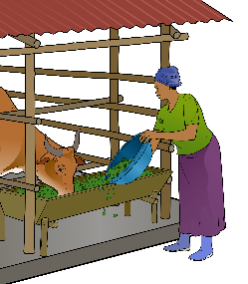
The 8 steps of hand milking
1
Wash and dry the hands with soap.
2
Clean the teats with a clean towel.
3
Wash hands again.
4
Inspect the milk for signs of deficiencies.
Feed the cow after milking so that she does not lie down immediately after milking.
Let the cow drink after milking.
5
6
Disinfect the teats.
8
Keep records of milk yield and anomalies per cow.
Milk the cow.
7

Slide 34
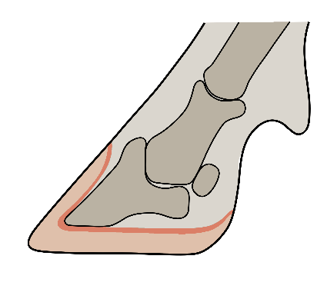
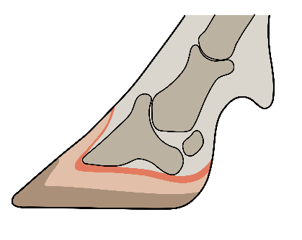
Why ensure good claw care?
Prevents claw diseases & lameness.
Regular occasion to check the animals (weight, medicine, inspection for parasites, etc.).
How does disease occur in case of insufficient claw care?
Bone
Living tissue
Horn
Bone compresses living tissue
Horn grows forwards
Normal claw
The pressure is distributed evenly.
Claw grows too long
The claw has grown too much forward and the pressure increases in the rear area of the claw. The persistent irritation can lead to disease of the claw in this area.

Slide 35
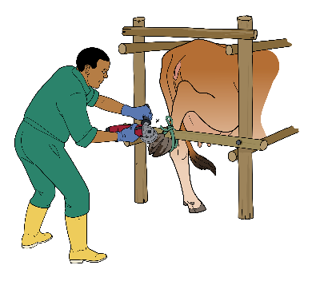
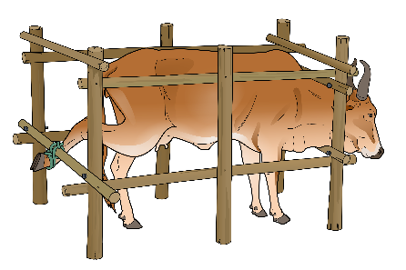
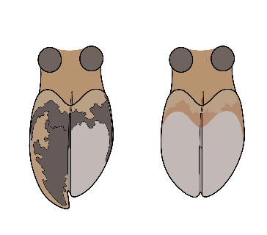
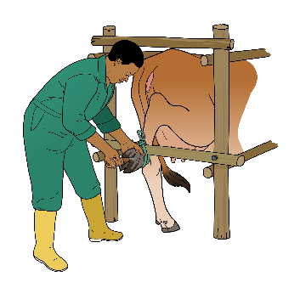
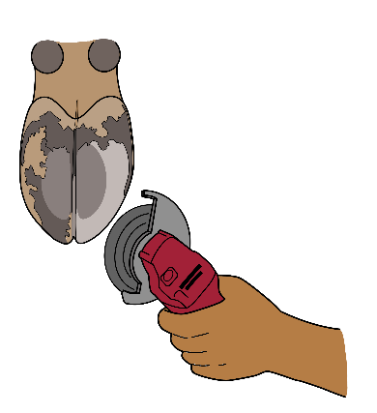
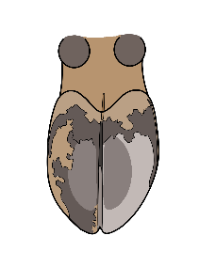
Claw care
1
Restrain the cow so that you can lift and fix all legs individually. Lift one claw and fix the leg.
2
Shorten the claw so that the length and thickness at the tip of both claws is the same.
3
Make a notch at the inner side of the claws. The weight of the animal should be on the edge and not in the middle of the claw.
4
Remove the edges (max. 1 mm).

Slide 36
Chapter 7 – Feeding and Drinking

Slide 37
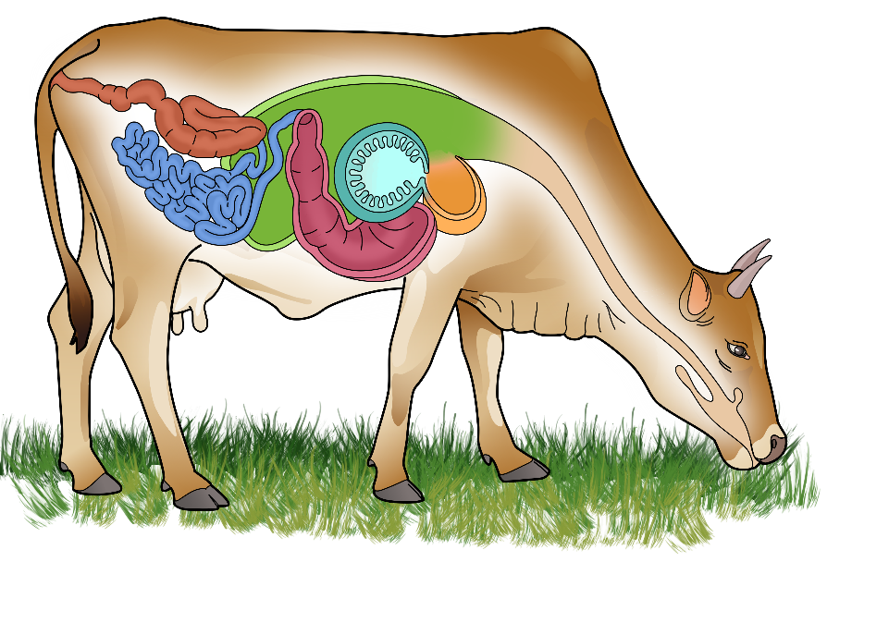
Digestive system of cattle
Mouth & Esophagus
Rumen
Reticulum
Omasum
Abomasum
Small intestine
Large intestine
Anus
8
7
2
4
6
3
5
1

Slide 38
Digestive system of calves: the esophageal groove reflex
Rumen
Reticulum
Omasum
Abomasum
The digestive system of cattle develops over time.
For their development, calves need to eat the same feed as mature cattle (access to roughage in addition to milk).
Unlike in adult cattle, in calves the milk flows not into the rumen but directly into the abomasum.
If calves drink too rapidly, the milk can flow into the rumen and cause weakness and bloating.
Rumen
Abomasum
Reticulum
Omasum
The groove prevents milk from flowing into the rumen. Instead it directly flows into the abomasum.

Slide 39
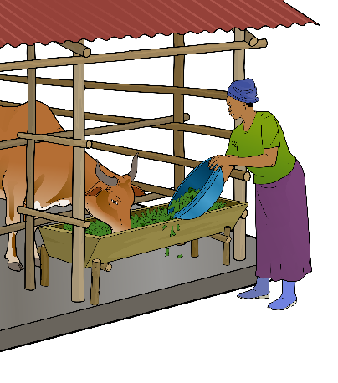
Feeding principles in organic animal husbandry
Utilisation of the farm's own feed as far as possible
No use of growth promoters, hormones as feed supplements
Feeding of ruminants based on roughage (grass, leaves and/or hay), as this corresponds to their digestive system
No feeding of (or only small amounts of) concentrates, such as grains
Preservation and storage of fodder such as hay, silage, straw or dried leaves from feed bushes to avoid or minimise costs for external feed and ensure appropriate feeding of the animals also during dry seasons
Purchase of feed originating from (certified) organic production
Selection of breeds that cope well with the local feeding conditions. In most cases, high-performance breeds are not suitable as they require a high-energy and high-protein diet.

Slide 40
Feeding strategies
Green = fits well with organic principles Yellow = can fit with organic production Red = does not fit with organic
Cattle are fed by grazing. | for farms with low to middle production level
Combination of grazing and hay/silage produced on the farm. | for farms with low to middle production level
Cattle fed mainly on pasture/high-quality grass-lands during vegetation periods and with own-produced preserved forage during the dry season. | for farms with middle to high production level
Combination of low-quality grasslands and little purchased or own-produced forages. | for farms with low production level
Combination of own-produced forages and little purchased energy/protein concentrates. | for farms with middle to high production level
Feeding is based mainly on energy/protein rich roughage and a high part of concentrates (>40 %) | for farms with high production level (as done in feedlots)

Slide 41
Factors influencing nutrient requirements
Source
How much is needed?
Influencing factors
Nutrient category
Young grass, leaves
(Potatoes, molasses, sugar cane, oil seeds etc.*)
Breed
Body weight
Lactation phase
Expected milk yield
Stage of pregnancy
Age
Climate
….
Energy
* Rich in energy but not optimal for ruminants.
Young grass, leaves
Legume forages e.g. Alfalfa, clover, Desmodium, Sunhemp, groundnut haulm
(Soybean meal, groundnut cake etc.*)
Protein
* Rich in protein, but not optimal for ruminants.
Older grass, hay, straw, roughage
Fibre
Outcome
Salt, leaves from shrubs and trees, grass, mineral feed, injections, etc.
Vitamins and minerals
Body functions
Growth and weight gain
Growth of calf
Milk production
Field work
Trough, river pond, lake, etc.
Water
Note: Most feeds consist of a mixture of all nutrients. The classification corresponds to the nutrient that this feed contains in particularly high quantities.

Slide 42
Energy requirements of a cow
 | Requirements for maintenance | + | Requirements for production | + | Requirements for pregnancy | = | Requirements in metabolisable Energy in MJ
 |  |  |  |  |  |  | (MJ = Megajoule)
What does it mean? | Sustaining body functions such as digestion, breathing, movement, body temperature, etc.) |  | Milk production (body mass growth in beef cattle) |  | Growth of fetus Preparation of lactation
When do these requirements increase? | Stress Activity |  | Milk production level |  | Size of fetus

Slide 43
Many different amino acids
Together they form a protein

Slide 44
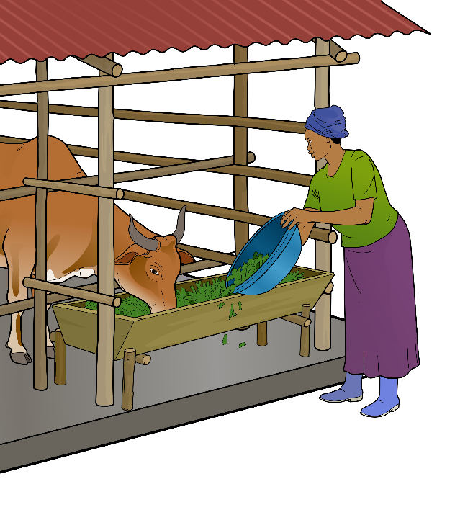
Ration control
Milk yield
Life weight estimation
App
Weight measuring tape
Body Condition Score (BCS)
Rumen fill score
Rumen contractions
Counting rumination
Examination of cow dung
Content of fat and protein in milk
Growth rate

Slide 45
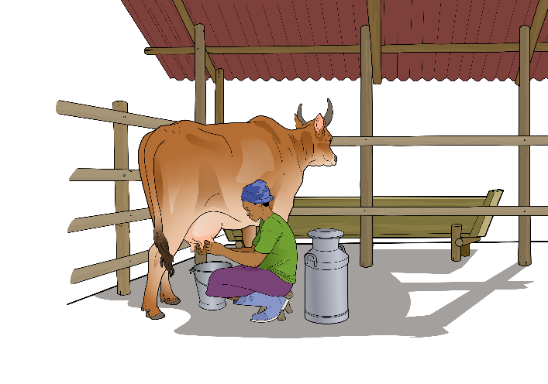
Ration control
Daily recording of the milk quantity
The amount of milk from each cow should be noted at each milking to detect abnormalities quickly.
If the milk quantity suddenly drops or stays low over a long time, this may indicate a feeding error (too little energy, protein, minerals or water) or a health problem.

Slide 46
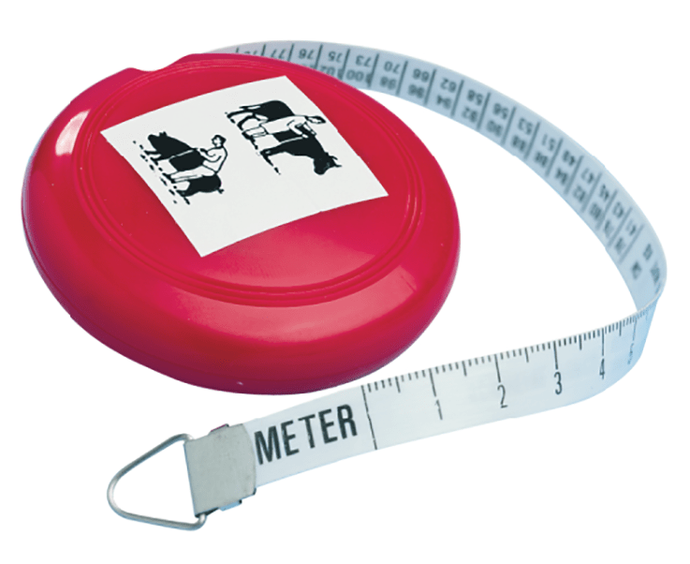
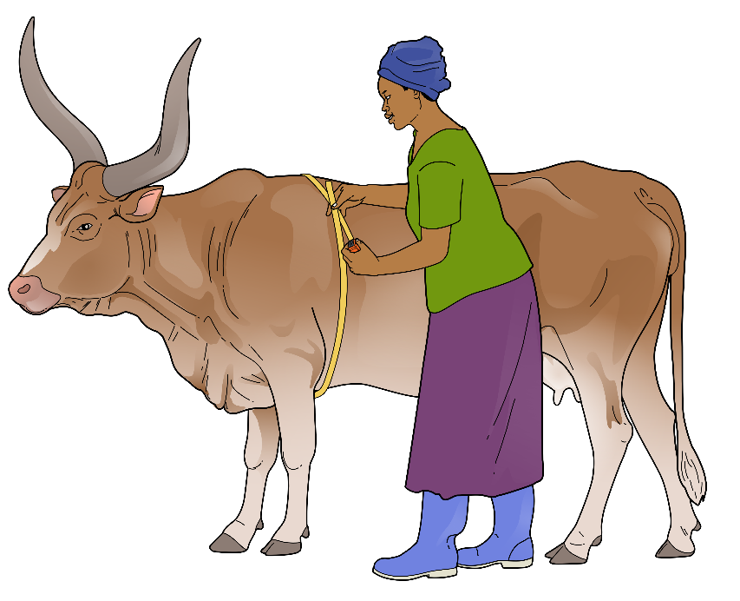
Ration control
Life weight estimation with the weight measuring tape
The photo shows the product “Rondo Combi Weight Measuring Tape” which is for pics and cattle.
Source: www.emaratshop.com
Special tapes allow to measure the chest circumference and directly give an estimate of the weight.

Slide 47
Ration control
Life weight estimation using a mobile application
The calculation of the body weight can be done with an app. There are several apps available online.
The apps usually calculate the body weight based on the entered heart girth (cm).

Slide 48
Ration control
Ration control
Monitoring with the Body Condition Score

Slide 49
Ration control
Rumen fill score
Empty hunger groove
Full hunger groove
If the hunger groove forms a one hand deep triangle (see illustration on the left), the animal has not eaten much in the last 6 hours. If this is the case for several animals in the herd over a long period, the ration must be checked.

Slide 50
Ration control
Rumen contractions
The rumen contractions can be monitored either by placing a stethoscope or a hand in the area of the hunger groove on the left side of the cow.
In a healthy cow, the contractions occur at least 3 times per 2 minutes.

Slide 51
Ration control
Observing rumination and counting chews
Cows should chew the cud about 55 times before swallowing.
Animals usually grase, ruminate and rest together.

Slide 52
Ration control
Examination of the cow dung
Too dry
Normal condition
Too fluid
Potential sign of a surplus of crude fiber, a lack of protein or a lack of water in the ration
Potential sign of too little fiber, high water content of the feed or too much protein (or a disease)

Slide 53
Ration control
Fat and protein content and its possible causes
High fat content in the milk
High fiber content of the ration
Mobilization of body fat (too low energy content)
Breed
Low fat content in the milk
Low fiber content of the ration
High energy content of the ration and/or
High percentage of concentrated feed in the ration (risk of acidosis)
Low protein content in the milk
Low protein content of the ration
Unbalanced energy-protein content in ration
The analysis of the fat and protein content of the milk can give insights into the feed ration a cow gets. This is usually done in a laboratory.

Slide 54
Ration control
Measuring of the growth rate

Slide 55
Energy balance and lactation phases
Energy balance of a cow during different stages of the lactation
Body condition
Body reserves used for milk production
Live weight constant
Body reserves regained for next lactation
Dry period & rehabilitation
Milk production (energy demand)
Body weight
Energy intake
Early lactation
Mid-lactation
Late lactation
Dry period
Day 0
Day 100
Day 200
End of lactation
Day 0
Birth of calf
Birth of calf
Energy demand higher than energy intake → negative energy balance → Body reserves are mobilized → Cow loses weight

Slide 56
Chapter 8 – Forage and Pasture Management

Slide 57
Feeding budget
1. Calculation of feed availability
2. Calculation of nutrient demand
3. Feeding budget
4. Strategic farm management decisions
Quality and quantity of forages on the farm (1 year)
Storage
Forages are preserved (hay, silage)
Forage surplus
Adapt composition of the herd
Feeding budget
E.g. less dairy cows, more calves
Nutritional needs of the cattle (1 year)
Feeding shortage
Increase number of animals
Quantity:
Expected yields
Grassland/pasture
Stock of preserved fodder
Crop residues
Times of feed shortage (dry season)
Expected quantity of feed purchased
Quality:
Visual inspection
Lists with nutrient contents per fodder
More offspring
Sale of fodder
Shortage in energy or protein?
Buy new animals
Expected feed quantity for one year
-
Needed feed quantity for one year
=
Balance
Reduce number of animals
Expected dry matter intake (DMI): a cow needs 1-3 % of its body weight in dry matter per day
Sale of living animals
Ration calculation programme
Buy feed
Increase or optimise fodder production
Slaughter of animals
Ration calculation programme
Ration control measures

Slide 58
Cultivation specifications of selected common forage grasses in Sub-Saharan Africa (1/2)
 | Brachiaria hyb. Mulato II | Brachiaria hyb. Cayman | Brachiaria hyb. Cobra | Brachiaria hyb. Camello | Brachiaria cv. Basilisk | Brachiaria cv. Xaraes (Toledo)
Palatability | high | high | high | high | good | good
Digestibility (%) | high | high | high (>69 %) | high (>62 %) | good (50 ̶ 60 %) | good (55 ̶ 70 %)
Crude Protein potential (%) | up to 18 | up to 17 | up to 17 | 14 ̶ 16 | 7 ̶ 10 | 7 ̶ 14
Tolerance to water logging | Poor | high | poor | poor | moderate | poor to moderate
Tolerance to drought | Good | good | good | good | moderate | medium
Minimum water requirem. (mm) | 700-800 | 700-800 | 700-800 | 450 (>300) | 1000 | 900
Seed rate (kg/ha) | 8 ̶ 10 | 8 ̶ 10 | 8 ̶ 10 | 8 ̶ 10 | 8 | 8
Spacing (in line and betw. lines) | for all Brachiaria and Panicum: 30 cm distance in the line and 45-50 cm between the lines
Germination days | 7 ̶ 21 | 7 ̶ 21 | 7 ̶ 21 | 7 ̶ 21 | 7 ̶ 21 | 7 ̶ 21
Days to first cut | 70 ̶ 80 | 90 ̶ 100 | 80 ̶ 90 | 80 ̶ 100 | ̴ 90 | ̴ 90
Wet season | 25 ̶ 45 days | 25 ̶ 30 days | 30 ̶ 45 days | 25 ̶ 45 days | 25 ̶ 45 days | 25 ̶ 45 days
Dry season | 60 ̶ 70 days | 60 ̶ 70 days | 70 ̶ 80 days | 60 ̶ 70 days | 60 ̶ 70 days | 60 ̶ 70 days
Plant height (cm) | 80 ̶ 100 cm | 80 ̶ 110 cm | 80 ̶ 110 cm | 110 ̶ 130 cm | 60 ̶ 100 cm | 150 mm
Prod. potential on medium to fertile soils (pH 6.3) t DM/ha/yr | up to 35 t | up to 35 | up to 35 | 27 ̶ 30 | >12 | 20 ̶ 30
Prod. potential on low fertile soils (pH 4.7) t/DM/ha/yr | 14 ̶ 17 | up to 25 | >25 |  | ̴8 | 10 ̶ 18
Soil fertility requirements | medium to high | medium to high | medium to high | intermediate | high | medium
Soil pH | No data | No data | No data | 4.5 ̶ 8 | 3.9 ̶ 7.5 | 4 ̶ 8

Slide 59
Cultivation specifications of selected common forage grasses in Sub-Saharan Africa (2/2)
 | Brachiaria cv. Piata | Brachiaria cv. MG4 | Panicum max. cv. Mombasa | Panicum max. cv. Masai | Brachiaria Nigropedata | Brachiaria Nigropedata | Crotolaria j. Sunn Hemp | Cenchrus Ciliaris (Buffelgrass)
Palatability | good | good | good | good | no data | no data | excellent | medium to high
Digestibility (%) | good (55-70 %) | good (55-70 %) | good | good (55-60 %) | no data | no data | no data | no data
Crude Protein potential (%) | 7-14 | 7-14 | 8-14 (14-16 on good soils) | 7 ̶ 11 | 12̶ 16 % (leaves) | 12-16 % (leaves) | high | up to 10-15
Tolerance to water logging | poor | poor | low | moderate | no data | no data | poor | moderate
Tolerance to drought | high | high | good | good | Good | good | high | good
Min. water requirem. (mm) | 800 | 800 | 800 | 800 (or lower) | 700̶ 1000 | 700-1000 | very low! | 700-1000
Seed rate (kg/ha) | 8 | 8 | 4 | 3-4 |  |  | 50 | varies
Spacing (in lines and between lines) | 30 cm distance in the line and 45-50 cm between the lines |  |  |  |  |  | 10-12.5 cm hills; 40-50 cm between rows | no data
Germination days | 7-21 | 7-21 | 10-28 | 10-28 | no data |  |  | 7-10
Days to first cut | ̴ 90 | ̴ 90 | 75-100 | 75-100 | no data |  | 42-56 | 90
Wet season | 25-45 days | 25-45 days | 25-30 days | no data | no data |  | no data | no data
Dry season | 60-70 days | 60-70 days | 40-45 days | no data | no data |  | no data | no data
Plant height (cm) | 85-110 cm | 150 cm | 200 cm (cut at 110 cm) | 65 cm | <100 cm |  | 100-150 cm | 30-60 cm
Prod. pot. on med. to fertile soils (pH 6.3) t DM/ha/yr | >18 | >18 | >35 | >15 | no data |  |  | 5-10
Prod. pot. on low fertile soils (pH 4.7) t/DM/ha/yr | >10 t | >10 | >25 | >10 | no data |  | 5-7 | no data
Soil fertility requirements | medium | medium | high, well drained soils! | low | no data |  | well drained soils! | Not on sand
Soil pH | 4-8 | 4-8 | no data | no data | no data |  | 7-5.5 | 5.5-7.5

Slide 60
Feed value of selected forage grasses
Plant | Dry matter¹ (%) = DM | Energy MJ ME/kg DM | Crude protein (%) | Description
 | For fresh harvested grasses in a pre-flowering stage
Napier grass (Pennisetum purpureum) | 25-30 | 8-10 | 6 -12 | High yields, perennial grass
Rhodes Grass (Chloris gayana) | 20-30 | 7-9 | 7-14 | High yields, good palatability, drought-tolerant, for grazing and hay production
Brachiaria Grass (Brachiaria spp.) | 25-35 | 8-11 | 7-16 | Good nutritional value, high dry matter content, for grazing and hay production
Panicum Grass (Panicum maximum) | 20-30 | 7-10 | 6-14 | Good productivity, good adaptability to different soil types
Setaria Grass (Setaria sphacelata) | 20-30 | 7-9 | 8-12 | Good forage yields, well-adapted to different soil types
Digitaria Grass (Digitaria eriantha) / Rhodesian Grass | 20-30 | 7-10 | 7-12 | Good nutritional value, good palatability, drought-tolerant
Blue Buffalo Grass (Cenchrus ciliaris) | 2-24 t/ha DM ² | No data | 9-12 | Adapted to warm, low rainfall areas in Southern Africa, good drought resistance
Source: information taken from various sources
¹ The dry matter is the part of the plant material that remains after deducting the total water content (completely dried). Since water contains no energy and no protein, the total energy and protein content is part of the dry matter.
² https://mel.cgiar.org/reporting/download/hash/LMFO85WW

Slide 61
Feed value of selected fodder trees
Plant | Dry matter¹ (%) = DM | Energy MJ ME/kg DM | Crude protein (%) | Description
Leucaena (Leucaena leucocephala) | 25-30 | 8-10 | 15-25 | Protein-rich, can be pruned and fed as protein supplements or incorporated into silage or hay, drought-tolerant
Gliricidia (Gliricidia sepium) | 25-30 | 8-10 | 20-30 | Protein-rich, can be pruned and fed as protein supplements or incorporated into silage or hay, grows fast, nitrogen-fixation in the soil
Calliandra (Calliandra calothyrsus) | 20-30 | 8-10 | 15-25 | Protein-rich, can be pruned and fed as protein supplements or incorporated into silage or hay, medium to high rainfall (700-2000 mm)
Sesbania (Sesbania sesban) | 25-30 | 8-10 | 20-30 | Protein-rich, high rainfall (700-200 mm), grows well in its early stage but does not regrow well after harvesting
Acacia species | 25-35 | 7-10 | 10-25 | Protein-rich foliage, pods, or gum
Moringa (Moringa oleifera) | 20-30 | 8-12 | 10-20 | Arid and semi-arid regions, rich in protein, vitamins and minerals
Faidherbia/ Winterhorn (Faidherbia albida) | 20-30 | 8-12 | 10-20 | Drylands, leaves, pods and soft young twigs highly palatable and rich in nutrients
Source: information taken from various sources
¹ The dry matter is the part of the plant material that remains after deducting the total water content (completely dried). Since water contains no energy and no protein, the total energy and protein content is part of the dry matter.

Slide 62
Chapter 9 – Cattle Health

Slide 63
Organic approach to animal health management
The animal health strategy in organic farming is based on long and medium-term prevention of diseases. In case of necessary treatment, complementary medical methods are to be used preferentially, if justifiable.
very short term
Conventional medicine
in an emergency
short term
Complementary medicine methods
curative
medium-term
Optimisation of environmental conditions and animal management
preventive
long-term
Species- and location-appropriate animal breeding
preventive

Slide 64
Pillars of herd health and disease prevention
Choose breeds known for good health and productivity; healthy cattle
Proper nutrition, clean water, little stress
Biosecurity measures that minimise the entry and spread of diseases
Clean and dry environment free of mould and manure
Vaccination program for the farm
Housing with good ventilation, sufficient space, and/or outdoor areas allowing natural behaviour
Parasite and pest prevention strategy
Quick and appropriate action in case of problems

Slide 65
Characteristics of healthy cattle
General attitude: alert, strong, eager to eat, normal growth for age (calves), normal milk production for age, normal weight for age, has no visible wounds or injuries.
Mental state and ease of movement: alert, coordinated, can walk and stand with ease
Horns: intact, growing normally, surrounded by healthy skin (no open injuries, no insect damage around horns)
Breathing: normal rate with no apparent effort, closed mouth, silent breathing without sneezing or coughing
Eyes and nose: clean with no discharge (like watery or runny nose), no unpleasant smell at nostril
Rumen: cycling normally (2-3 times per 2 minutes), appear full after eating but not overfull (no bloating, excessive movement, or no movement)
Skin and coat: Hair coat is shiny, skin is healthy, no signs of hair loss, itching or rubbing, or other obvious injuries, no external parasites seen
Udder: soft, supple, each teat similar in size and able to produce milk (no redness, swelling, hardness, or lack of milk production)
Legs and joints: legs are straight, well formed, able to carry weight evenly, and joints are uniform in size and move freely (no swelling or stiffness)
Milk (if producing): normal colour, consistency, amount (no colour change, thickening, bad smell, or sudden decrease in volume)
Feet: Claws are the proper length (not overgrown), appear strong (no cracks), soles of the feet are healthy (no bruising), and no redness, ulceration, or bad smell from between the claws or under the feet
Nomal body temperature: 38.3 to 38.8 °C (for adults)
Droppings: should not be completely liquid (diarrhea) or contain blood; should not contain worms

Slide 66
Characteristics of sick cattle
These are only examples of symptoms, the list is not exhaustive. There may also be only nuances, individual symptoms or many together. In particular, it is important to know your (healthy) animals well and to recognise when their condition or behaviour changes.
Mental state and ease of movement: appear to not know where they are, gazing at the sky or with a twisted neck, walking with a limp or difficulty, or not able to stand
Horns: broken, bleeding, surround-ing skin damaged (e.g. by insects)
Breathing: faster than normal rate, with effort, noisy, open mouth, sneezing or coughing
Rumen: not cycling normally (2 to 3 times per 2 minutes) – either too fast, or too slow, or rumen appears overfull and painful (e.g. bloat)
Eyes and nose: watery or runny nose (maybe clear or yellowish discharge), maybe unpleasant smell at the nostril
Udder: swollen, red, hard, painful in one or more quarters +/- abnormal or reduced milk production
Skin and coat: dull hair coat, rough and with signs of hair loss, itching or rubbing, has other obvious injuries, and/or external parasites (e.g. lice, mites) visible
Milk (if producing): abnormal colour, consistency, amount (e.g. colour change, thickening, bad smell, or sudden decrease in volume)
Legs and joints: legs are crooked, malformed, unable to carry weight evenly, and joints are not uniform in size and do not move freely (e.g. swelling or stiffness is present )
General attitude: depressed, weak, reluctant to eat, standing alone with head down, slow growth for age (young animals), reduced milk production for age and stage of lactation (mature animals), weight loss, and/or visible wounds or injuries
Feet: claws are overgrown, may be cracked, soles of the feet may have bruising, and redness, ulceration, or bad smell is present between the claws and/or under the feet
Droppings: maybe completely liquid (diarrhea), foamy or bloody or worms

Slide 67
Viruses
What it is and how disease is caused | Importance in cattle | Examples | Vaccine available | Repor-table | Zoonotic
Submicroscopic infectious agents Enter the body through eyes, nose, breaks in the skin (cuts), or with an insect sting Reproduce in the cells of the infected animal | Cause some of the most important diseases. Are easily introduced to a herd (e.g. on clothes). Can spread quickly and cause high death rates in a herd. Must be prevented by vaccines and biosecurity, as most available treatments are supportive but do not cure the disease. | Bluetongue |  | ---- | ----
 |  | Foot & Mouth disease | ---- |  | ----
 |  | Lumpy skin disease |  |  | ----
 |  | Rabies
 |  | Rift Valley Fever

Slide 68
Bacteria
What it is and how disease is caused | Importance in cattle | Examples | Vaccine available | Repor-table | Zoonotic
Microscopic organisms Enter the body through nose, mouth, eyes, breaks in the skin (cuts). Inside the body, they reproduce quickly. Produce toxins that damage the cells of the infected animal. | Can spread quickly and cause high death rates in herds. Some bacterial diseases can be prevented with vaccines. Most bacteria must be prevented with proper husbandry and biosecurity. Most are curable with antibiotics. | Anthrax (V)
 |  | Blackleg (V) |  | ---- | ----
 |  | Bovine tuberculosis | ----
 |  | Brucellosis (contagious abortion, Bang’s disease) (V)
 |  | Contagious bovine pleuropneumonia (+/- V) | +/- |  | ----
 |  | Pasturellosis (+/- V) | +/- | ----
 |  | Tetanus (V) |  | ----

Slide 69
Fungi and protozoa
What it is and how the disease is caused | Importance in cattle | Examples | Vaccine available | Repor-table | Zoonotic
Fungi Decomposing organisms thriving in wet and dirty environments Produce microscopic spores that enter the body through mouth and nose and then go into the airways. Damage airway cells, causing symptoms. | Can cause high death rates in herds, especially among young animals. Must be prevented by husbandry and biosecurity. | Aspergillosis | ---- | ---- | ----
Protozoa Microscopic organisms Enter the body through nose, mouth, eyes, breaks in the skin (cuts). Inside the body, they reproduce quickly. Produce toxins that damage the cells of the infected animal. | Can spread easily and cause severe diseases. Often spread by insect bites and hard to control. | East Coast Fever (ECF) |  |  | ----
 |  | Trypana-somiasis | ---- | ----

Slide 70
Chapter 10 – Breeding

Slide 71
The Nguni (Example of a well-adapted breed from Southern Africa)
Strengths of the breed:
Very hardy
Well adapted to the environment (Southern Africa)
Good fertility
Good mothering abilities
Disadvantage of the breed:
Small carcass resulting in lower prices on the market than larger framed animals
Commercial Nguni beef herd with continuous breeding in the herd.
Practices at Farm Krumhuk in Namibia:
The cattle are slaughtered and processed on the farm and not sold as live animals to overcome the challenge of lower carcass prices.
Herders are continuously with the herd to monitor the herd closely.
Cattle and calves are protected by a guarding dog against predators.
Photos: Clemens Voigts
Young Nguni breeding bull “Usil”.

Slide 72
Chapter 11 – Milk and Meat Quality

Slide 73
Composition of milk
3.2-3.5 % Protein
3.5-4.4 % Fat
4.8 % Lactose
87.5 % Water
0.7 % Vitamins, minerals and trace elements

Slide 74
Potential sources of hygiene deficiencies in milk
Improper milk transport
Improper milk storage
Mouldy feed
Poor stable hygiene
Insufficient hygiene during consumption
Poor milking hygiene
Medicine residues

Slide 75
Beef cuts
Sirloin
Tenderloin
Neck
Chuck
Short loin
Top Sirloin
Rib
Ox tail
Head
Bottom Sirloin
Round
Tongue
Cheek
Shank
Flank
Brisket
Plate
Shank
The various cuts differ in their tenderness, flavour, juiciness, texture and colour. This can be reflected in price differences. Depending on the cooking culture, certain cuts are better suited to different cooking methods.

Slide 76
Chapter 12 – Economics and Certification

Slide 77
Pricing of cattle at the market
Photo: Oscar Silali
Young, blocky and castrated bulls are preferred and achieve a good price at the livestock market in Kenya.

Slide 78
Selling livestock
Cattle lined up in a pastoral market in Kajiado County, Kenya.
Photo: Oscar Silali

Slide 79
Calculation of profit
The balance between what I earn and what I spend is my profit.
Revenues
Sales of live animals
Sales of milk
Sales of meat
Expenses
Fixed costs: shed for feed storage, milking equipment, etc.
Variable costs: medication, vaccines, feedstuff, etc.
Profit = Revenue - Expenses

