Slide 1
Making Compost with Marine Residues
23.10.2020 – Joshua Cabell

Slide 2

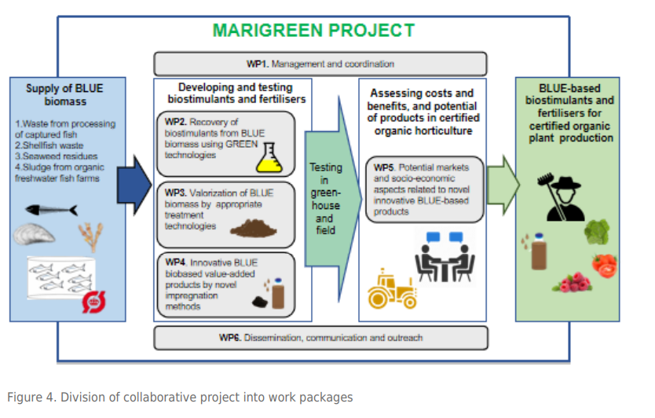



MARIGREEN
Sustainable utilization of MARIne resources to foster GREEN plant production in Europe
The MARIGREEN project will valorize residual materials from the BLUE sector, many of which are currently poorly utilized, by treating them with appropriate technology and applying them in agriculture (GREEN sector).
Significant amounts of fertilizers, applicable in organic growing, are required to achieve 25% organic farmland in EU by 2030, as proposed in the F2F strategy. The project will study available residual materials from fish capture, brown algae industry, mussel industry, and organic aquaculture.

Slide 3
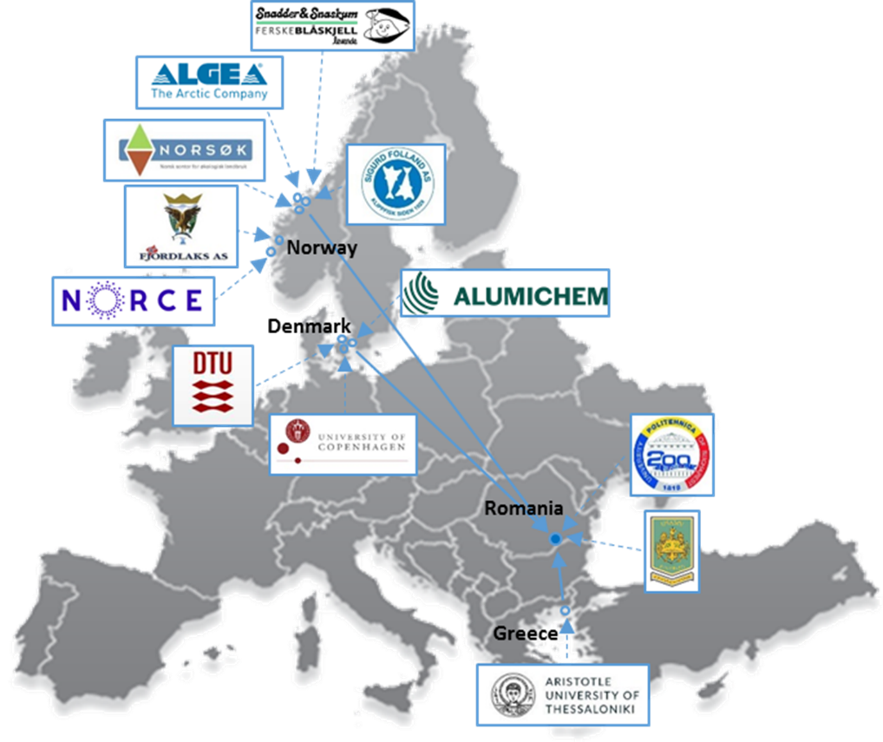
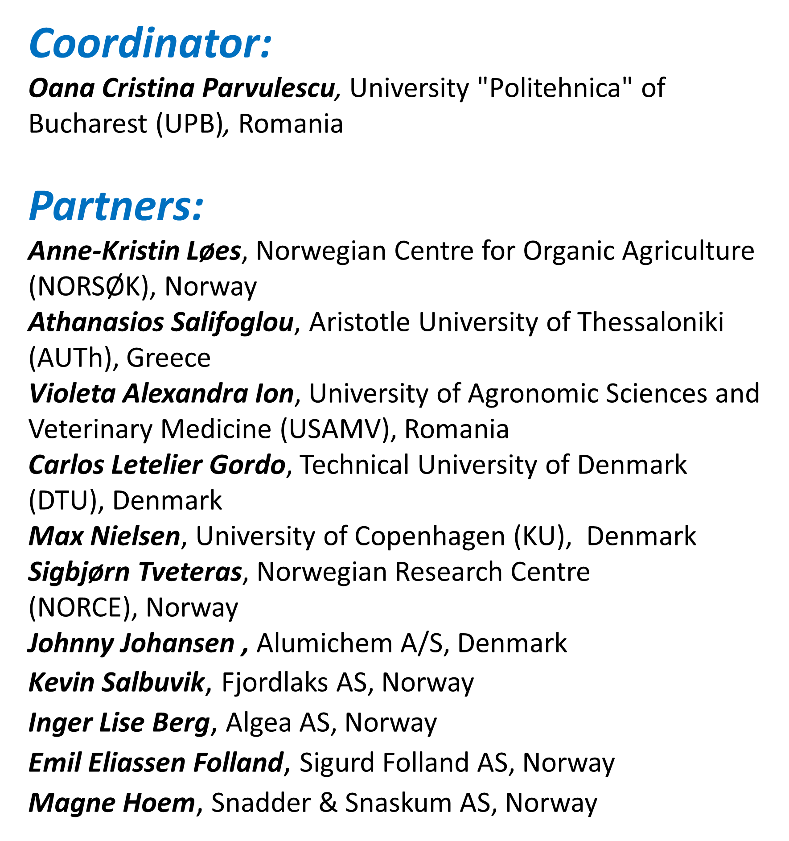
Consortium partners

Slide 4
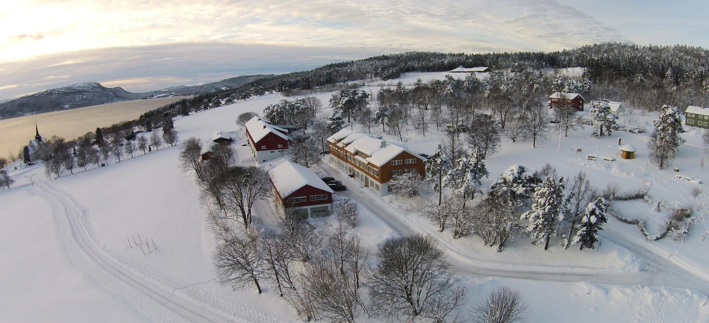
NORSØK
Notes:
Private research foundation established in 1986
The private, independent foundation NORSØK is a national centre for the development of organic agriculture through interdisciplinary research and outreach. NORSØK also manages an organic farm. Our work is based on the four principles of organic agriculture: health, ecology, fairness and care. NORSØK and the farm are located in Tingvoll in Møre og Romsdal county.
27 employees

Slide 5
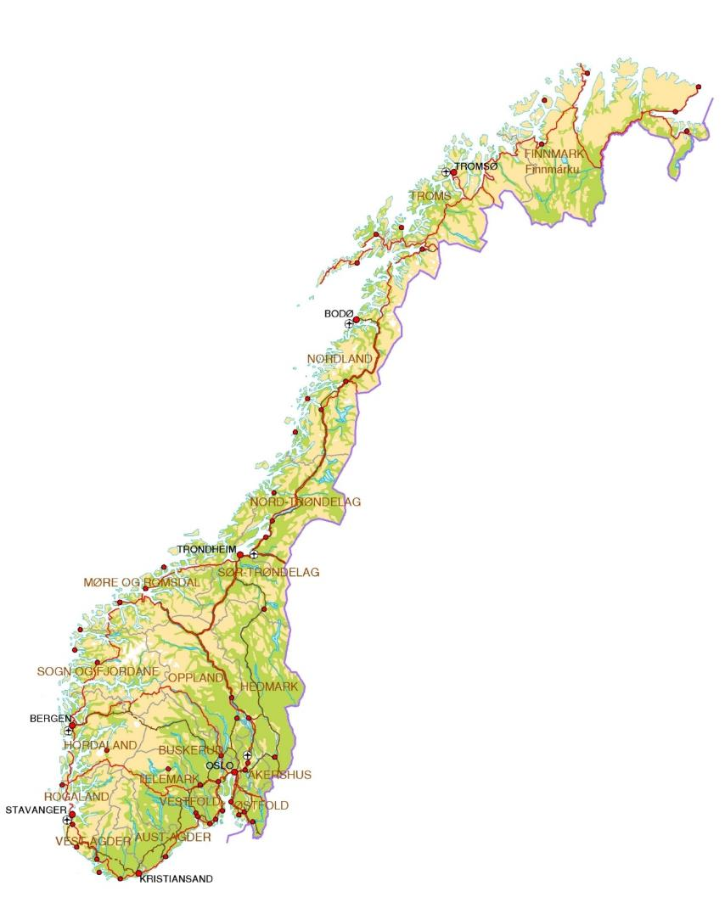
Agricultural research
Stations in Norway
NORSØK
Tingvoll

Slide 6
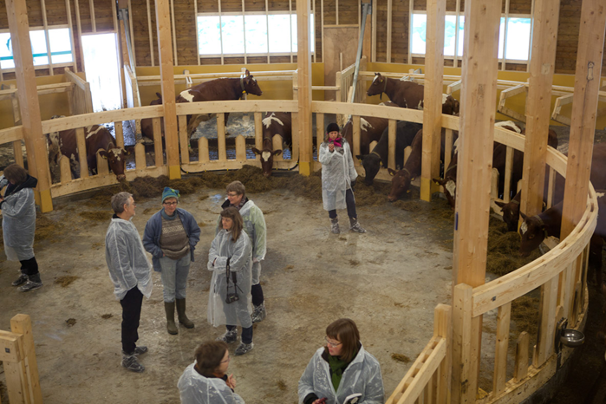
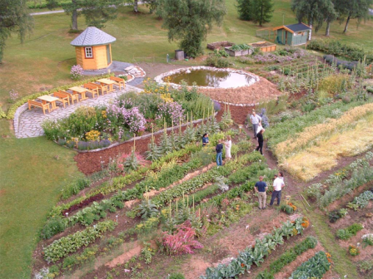
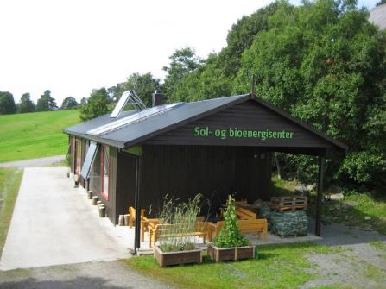
- Dairy farm, 36 ha
Demonstration garden
Center for renewable energy, biogas plant, solar arrays
Field trials
Tingvoll Økopark
Offices for NORSØK, NIBIO, and others…
Notes:
Stiftet i 1986 som privat, selvstendig stiftelse og er et nasjonalt senter for tverrfaglig forskning og kunnskapsformidling for å utvikle økologisk landbruk. Ligger i Tingvoll kommune på Nordmøre.
Har både grunnleggende og avansert forskningskompetanse og arbeider med rådgiving og formidling av kunnskap.
Fagområder er økologisk landbruk og matproduksjon, miljø og bærekraft og fornybar energi.
Forvalter Tingvoll gard, som drives som et økologisk gårdsbruk (melk). Arealet er til sammen 955 dekar (175 fulldyrket, 65 daa beite).
24 ansatte (27 fra sommer/høst 2023): 9 forskere (6 med PhD), 8 rådgivere, 3 PhD-kandidater, 4 drift/admin.

Slide 7
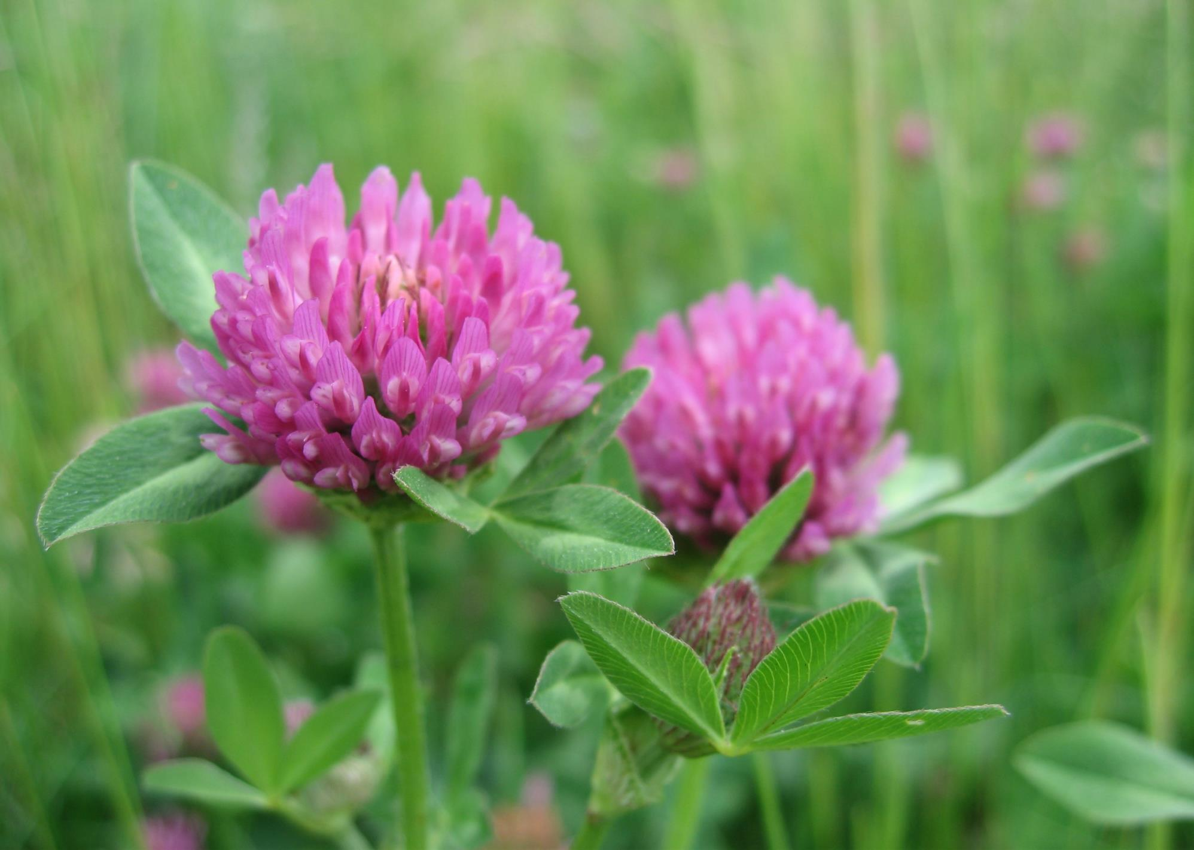
Main thematic areas in NORSØK
Soil fertility, soil biota and soil organic matter
Plant nutrition, recycling of resources
Plant health and alternative crop protection
GHG emissions from agriculture
Animal welfare
Organic food
Organic gardening
Farm-based renewable energy (biogas, solar)

Slide 8
What are composting and compost?

Slide 9
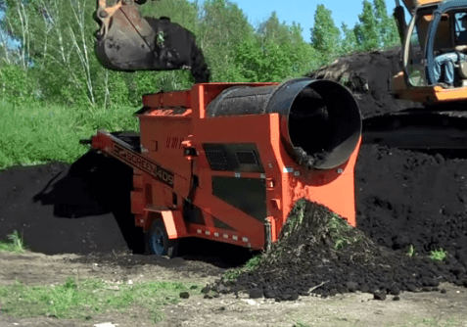
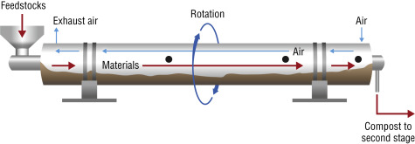
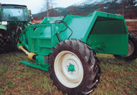
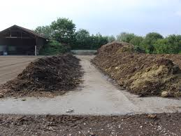
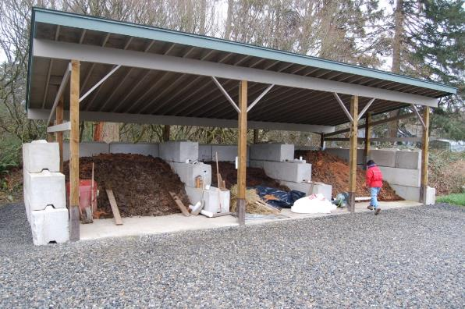
Aerobic composting

Slide 10
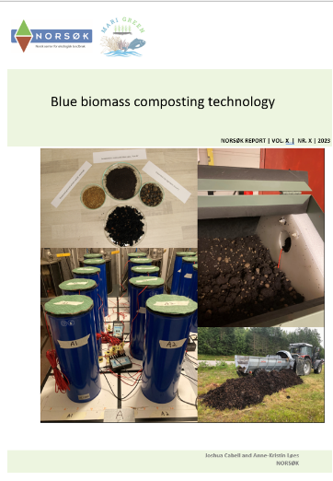
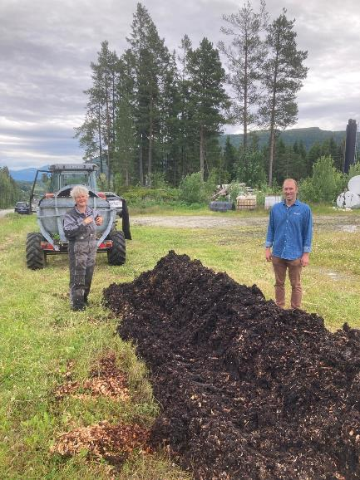
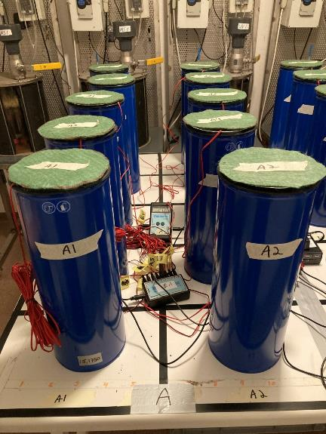
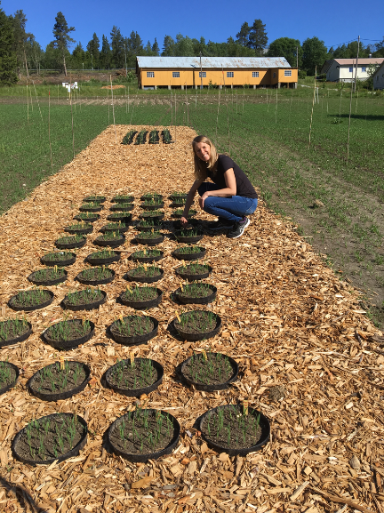
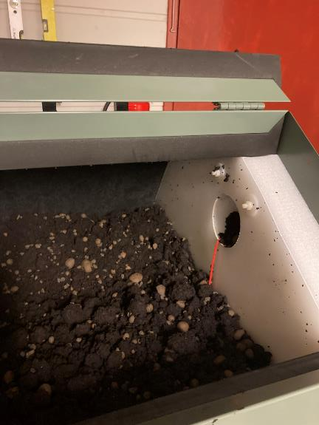
Composting and field trials at NORSØK

Slide 11
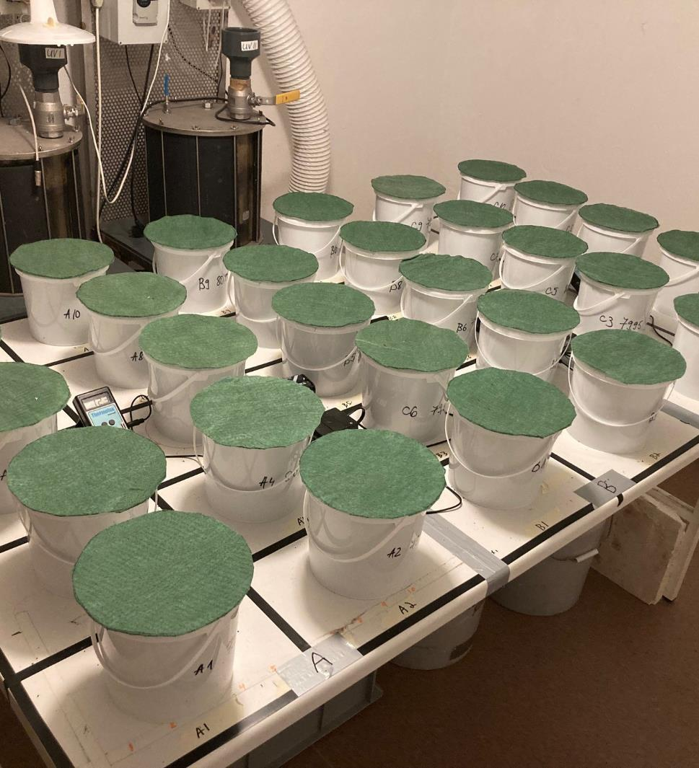
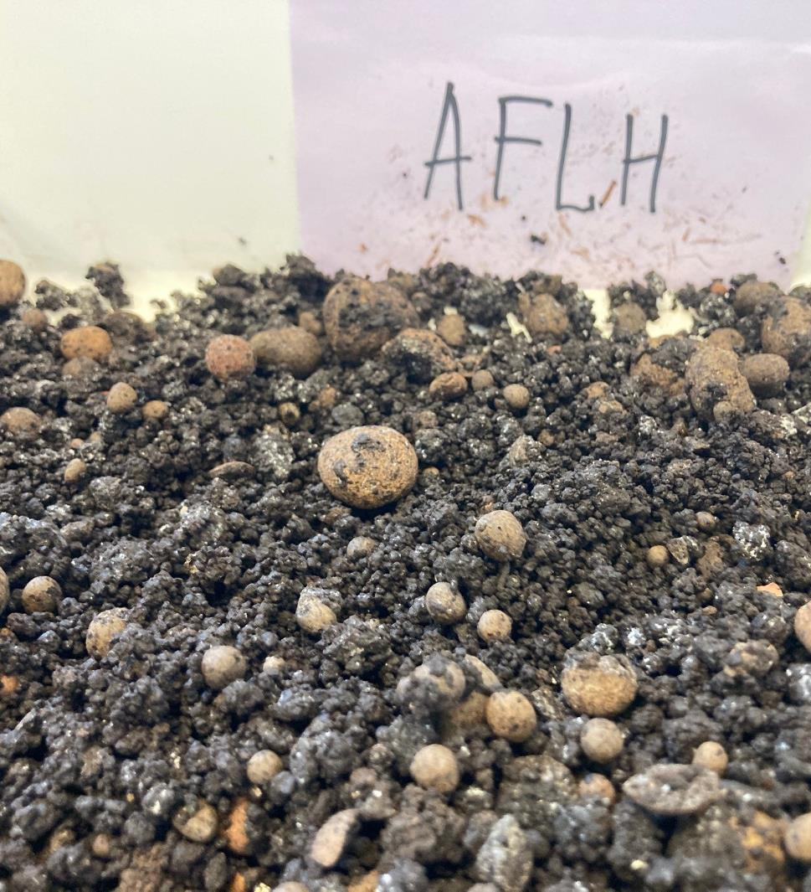
Dewar flask experiment
The objectives of this research were to determine if it is possible to achieve thermophilic aerobic composting with exclusively marine residues and to identify which combination of marine residues performed best based on the temperature profile, degree of humification (increased concentration of humic acid), and other relevant process parameters.

Slide 12
Materials and method
Algae fiber «low nitrogen» (AFLN)
Algae fiber «high nitrogen» (AFHN)
Mix of algae fibers (AFLH)
Ground ascophyllum (GSW)
Fish meal (FM)
Hydrolyzed fish bone (FB)
Mussels (MU)
Leca (lighweight clay aggregates)
Dewar «self-heating test»

Slide 13
Dewar «Self-heating Test»
Maturity index for Dewar Self-Heating Test (updated by Woods End Laboratory in 2009)
°C over ambient (approx. 20 °C) | Actual temp in Dewar flask - °C | Class of stability | Interpretation
0-5 | 20-25 | A | Mature, curing compost
5-25 | 25-45 | B | Mesophilic, active
25-50 | 45-70 | C | Thermophilic, very active
Standard BS EN 16087-2:2011

Slide 14
Chemical and physical analyses of feedstocks
Characteristic | Unit | GSW | AFL | AFH | FM | FB | MU
Physical characteristics
Dry matter | % | 89 | 90 | 94 | 90 | 95 | 98
LOI | % of DM | 67 | 57 | 62 | 65 | 34 | 16
pH | H₂O | 5.6 | 9.5 | 8.7 | 6.3 | 7.0 | 7.2
Conductivity | mS m⁻¹ | 2100 | 2700 | 4600 | 1900 | 280 | 1100
Macronutrients and Carbon
Tot-C | % of DM | 38 | 36 | 37 | 35 | 15 | 15
TOC | % of DM | 32 | 28 | 30 | 30 | 14 | 8
% TOC of Tot-C | % | 84 | 78 | 81 | 86 | 93 | 53
Tot-N | % of DM | 0.94 | 0.52 | 1.34 | 9.97 | 4.83 | 1.44
C:N | Ratio | 40 | 69 | 27 | 4 | 3 | 11
P | % of DM | 0.08 | 0.37 | 0.23 | 5.60 | 11.00 | 0.10
K | % of DM | 1.90 | 5.40 | 8.60 | 0.75 | 0.12 | 0.31
S | % of DM | 2.80 | 0.75 | 1.10 | 0.65 | 0.19 | 0.26
Ca | % of DM | 1.6 | 10.0 | 5.4 | 10.0 | 26.0 | >30
Mg | % of DM | 0.83 | 1.50 | 2.40 | 0.28 | 0.35 | 0.17
Micronutrients
B | Mg kg⁻¹ DM | 118 | 38 | 72 | - | 3 | 77
Cu | mg kg⁻¹ DM | 2.2 | 1.5 | 2.4 | 1.4 | 1.3 | 0.9
Fe | mg kg⁻¹ DM | 110 | 210 | 170 | 55 | 1600 | 650
Mn | mg kg⁻¹ DM | 17 | 29 | 54 | 7.4 | 120 | 16
Mo | mg kg⁻¹ DM | 0.78 | 0.38 | 0.89 | <0.17 | <0.17 | 0.20
Ni | mg kg⁻¹ DM | 1.4 | 3.7 | 2.3 | 0.37 | 0.17 | 0.38
Zn | mg kg⁻¹ DM | 52 | 44 | 88 | 62 | 130 | 52
Other
As | mg kg⁻¹ DM | >30 | 17 | >30 | 16 | 0.83 | 1.4
Cd | mg kg⁻¹ DM | 0.45 | 2.0 | 1.4 | 0.03 | 0.02 | 0.11

Slide 15
Treatments
Algae fiber «low-N» + fish meal
Algae fiber «low-N» + fish bone
Algae fiber «low-N» + mussel
Algae fiber «low-N» + algae fiber «high-N»
Algae fiber «low-N» + algae fiber «high-N» + fish meal
Algae fiber «low-N» + algae fiber «high-N» + fish bone
Algae fiber «low-N» + algae fiber «high-N» + mussel
Ground seaweed + fish meal
Ground seaweed + fish bone
Ground seaweed + mussel

Slide 16
Compost «recipe» and preparation of materials
Feedstock | Water content | %C | %N | Vekt | BD | C:N | cm3 | Per m3 main substrate
AFL | 13 | 33,2 | 0,45 | 2 000 | 805 | 74 | 2,48 | 1,00
FM | 11 | 36,1 | 10,2 | 195 | 805 | 4 | 0,24 | 0,10
Leca | 10 | 0,0 | 0,0 | 554 | 280 | 0 | 1,98 | 0,80
Water | 100 | 0 | 0 | 3 268 | 1000 | 0 | 3,27 | 1,32
C:N | 25,03 | 25-40
Water content | 60 | 50-60 |  | 6 017 |  |  | 7,97
BD | 755 | 400-600
All materials dried
Algae fiber, hydrolyzed fish bone, and mussels ground in a hammer mill
Fish meal sieved to <2 mm
Leca sieved to >4 mm
Mixed dried materials first, then added water, then finally Leca
Goal was the same C:N-ratio (25), water content (60%), and bulk density for all treatments (in theory…)

Slide 17
Compost recipes
Treatment code | Carbon source | Nitrogen Source | Water | Leca® | Total¹ |  | C:N¹ | MC² | BD¹
 | g | g | g | L | g | L |  | % | kg L⁻¹
AFLN+FM | 2000 | 195 | 3268 | 2,0 | 6017 | 7,97 | 25 | 64 | 755
AFLN+FB | 1900 | 365 | 3430 | 2,0 | 6270 | 8,27 | 25 | 65 | 758
AFLN+MU | 1400 | 880 | 3655 | 2,0 | 6505 | 8,21 | 25 | 64 | 792
GSW+FM | 2100 | 53 | 3304 | 2,0 | 6027 | 8,21 | 25 | 65 | 735
GSW+FB | 2000 | 100 | 3236 | 2,0 | 5892 | 8,01 | 25 | 65 | 736
GSW+MU | 1900 | 310 | 3471 | 2,0 | 6261 | 8,35 | 25 | 65 | 750
AF+FM³ | 1400 | 700+44 | 3558 | 2,0 | 6277 | 8,27 | 25 | 64 | 759
AF+FB³ | 1400 | 700+86 | 3634 | 2,0 | 6406 | 8,44 | 25 | 64 | 759
AF+MU³ | 1300 | 650+260 | 3707 | 2,0 | 6505 | 8,46 | 25 | 64 | 769
AF | 330 | 1850 | 3729 | 2,0 | 6504 | 8,56 | 25 | 64 | 760
¹ These are approximations based on the compost recipe calculator.
² MC was measured immediately after mixing.
³ In addition to fish/mussels, these treatments were mixed with algae fiber “high-N” as a second source of nitrogen. The first and larger value under “Nitrogen Source” represents the algae fiber.

Slide 18
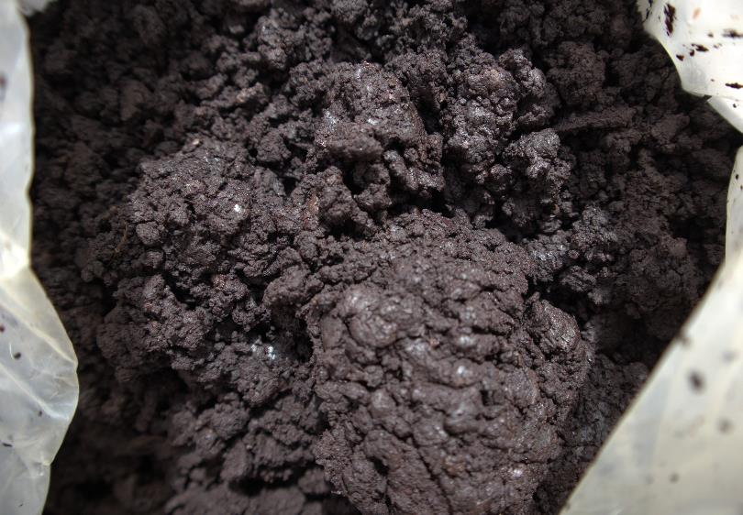
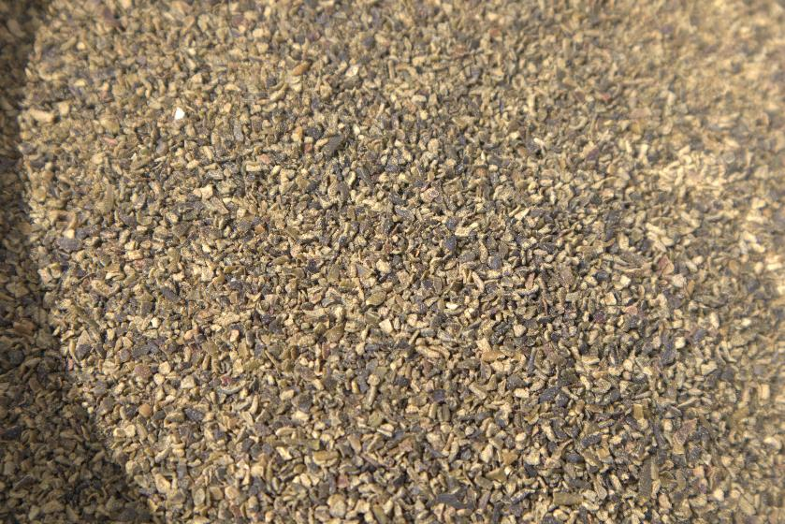
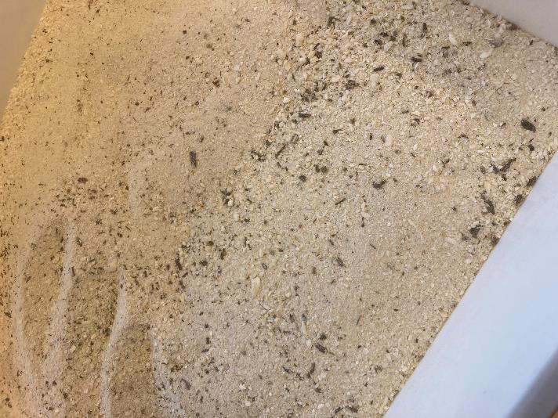
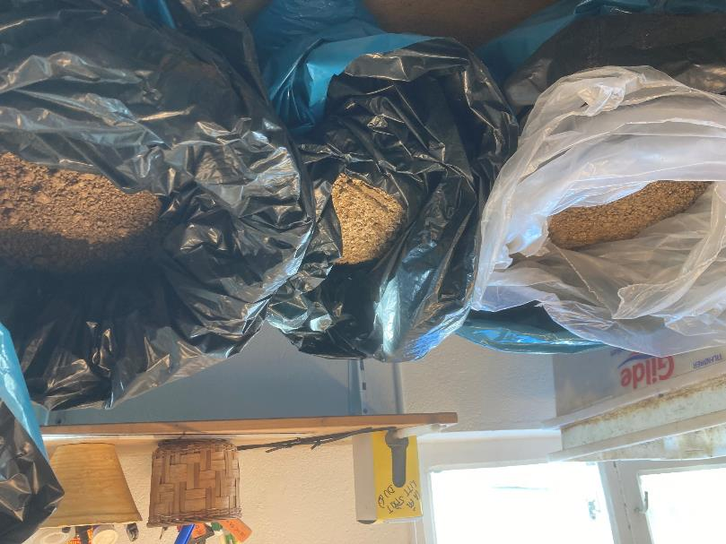
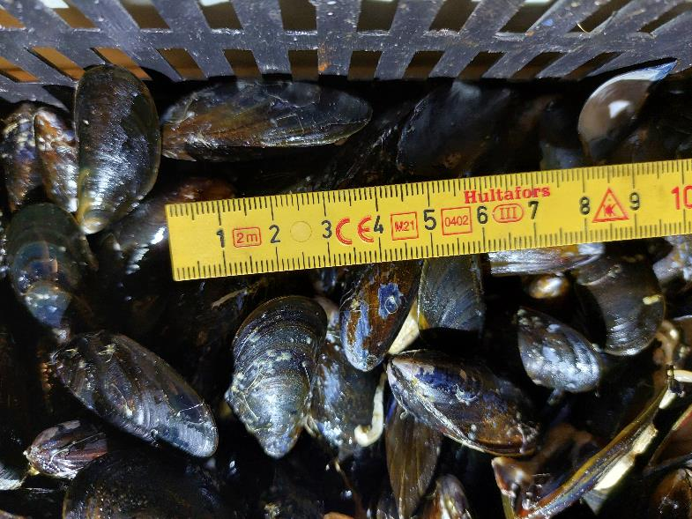
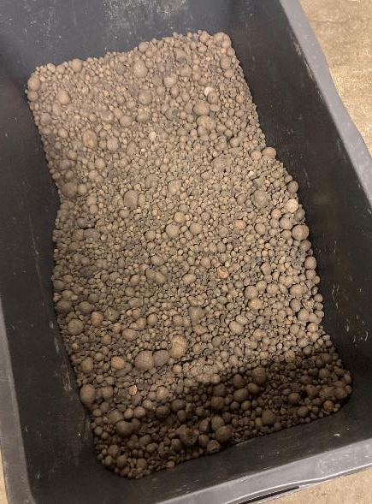

Slide 19
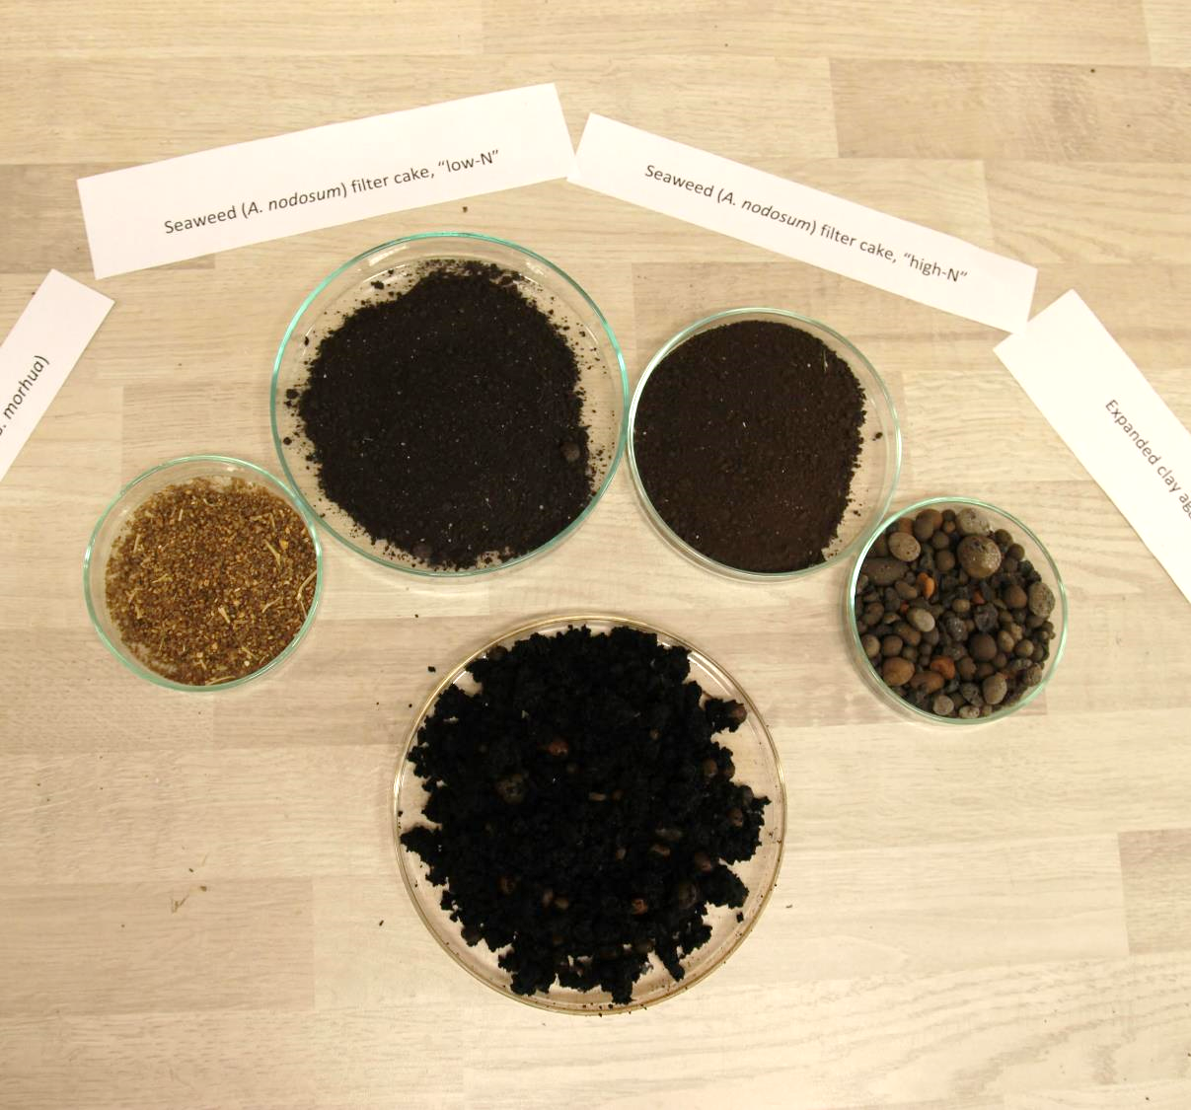
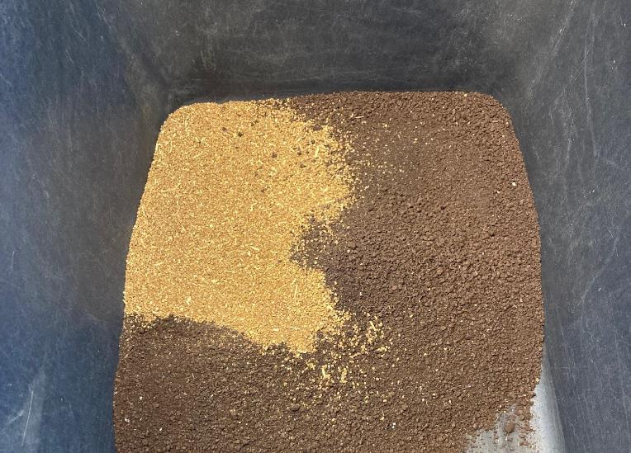
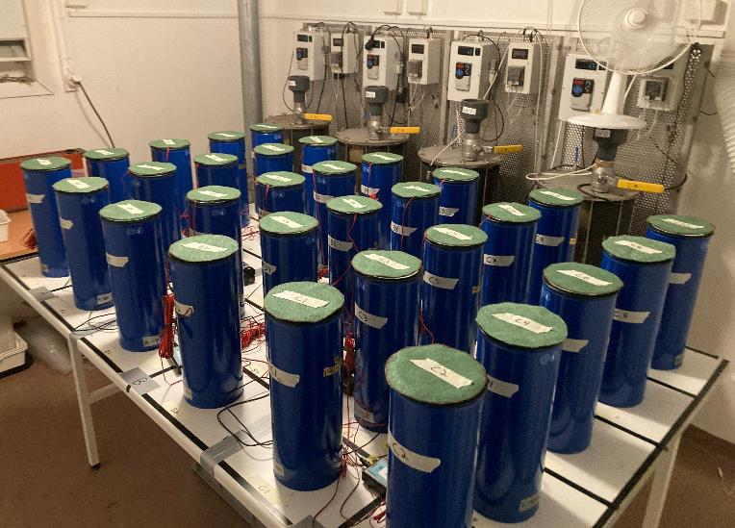

Slide 20
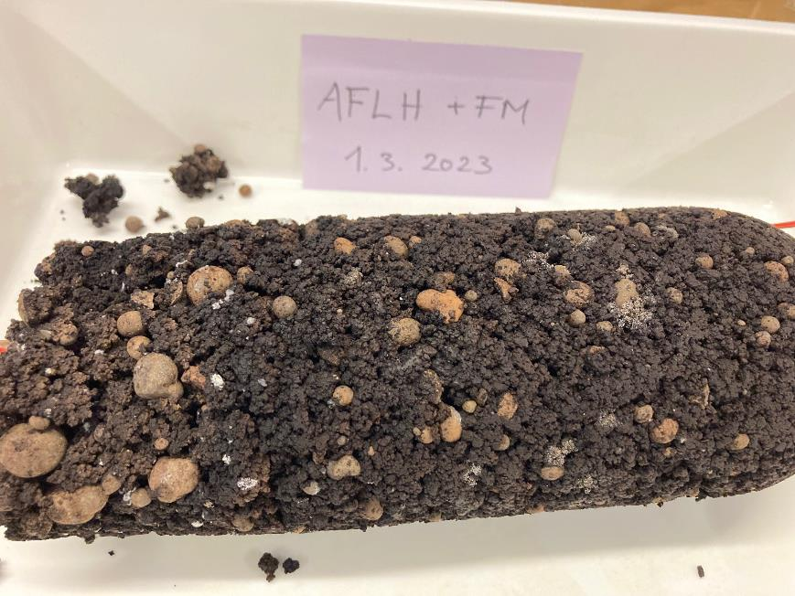
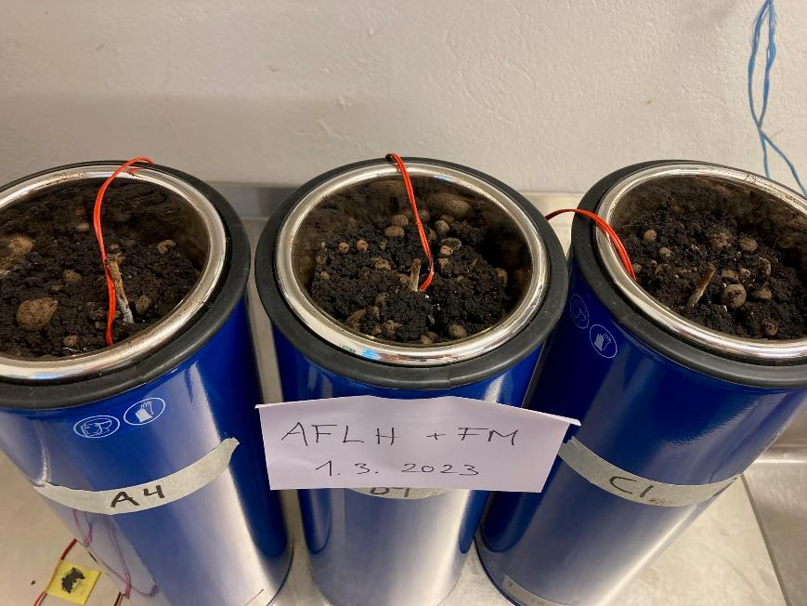

Slide 22
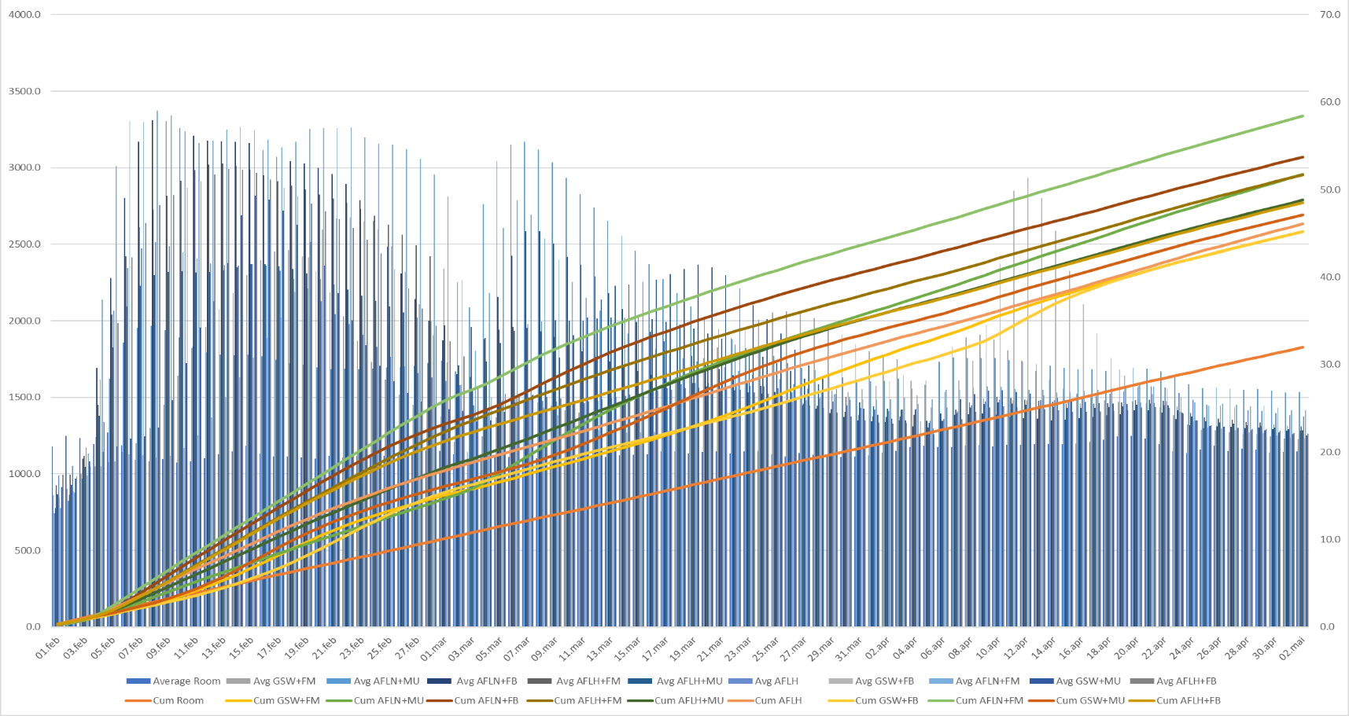
Mean and cumulative temperatures
AFLN+FM
GSW+FB
Room

Slide 23
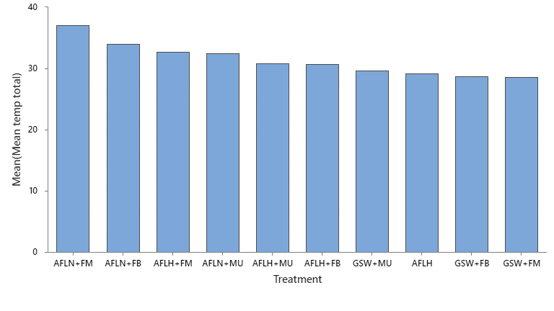
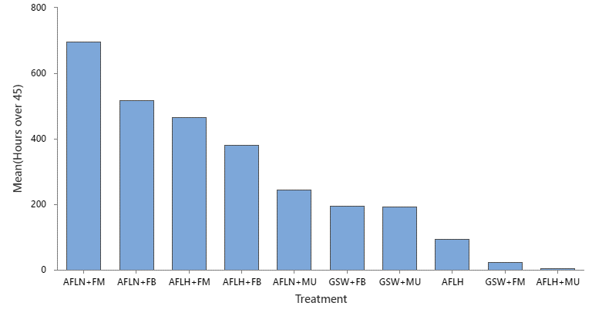
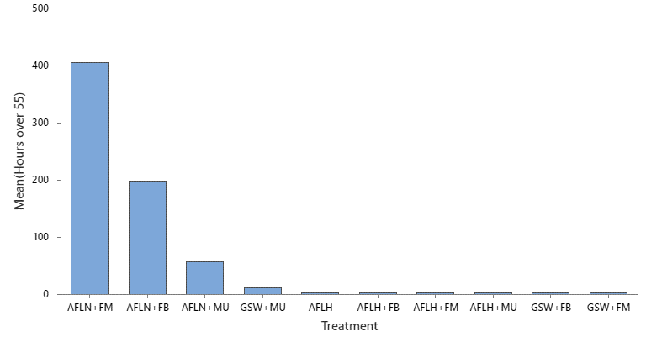
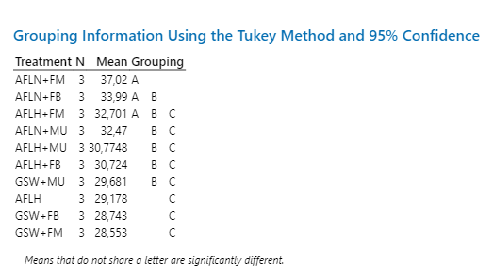
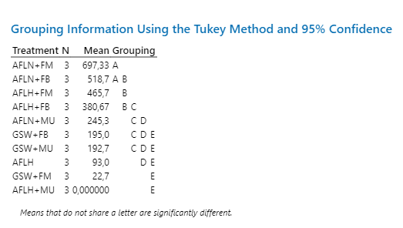
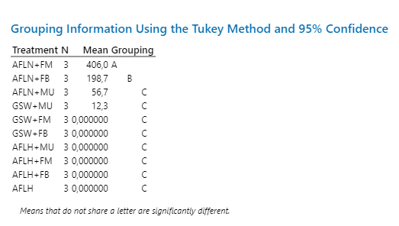
Temperature data per treatment
Mean temperature
Hours over 45 °C
Hours over 55 °C

Slide 24
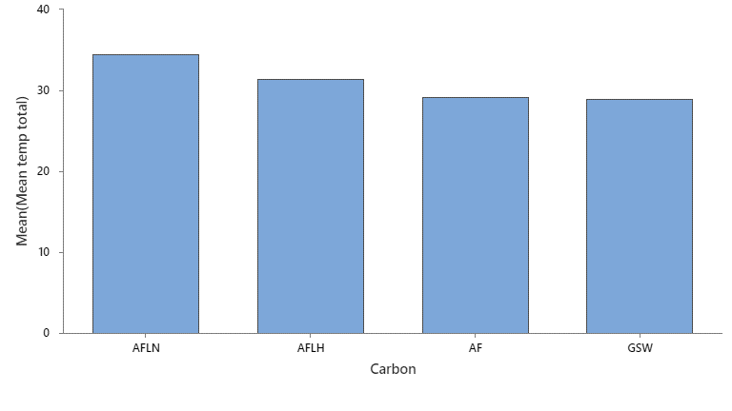
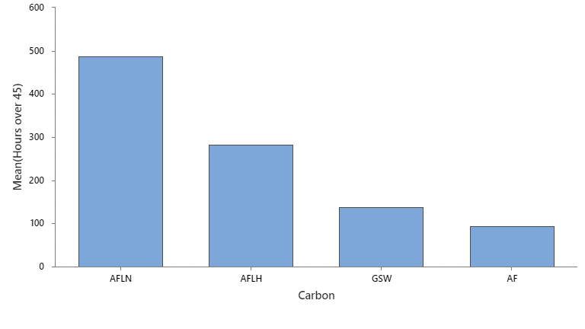
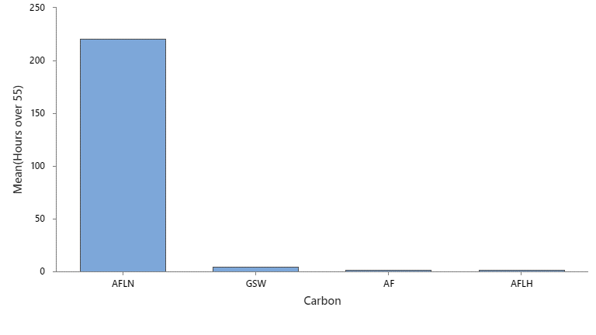
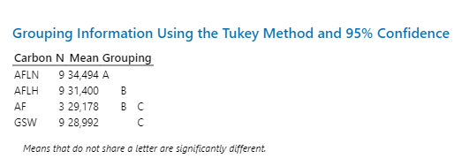
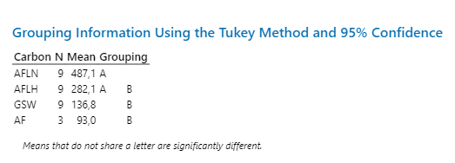
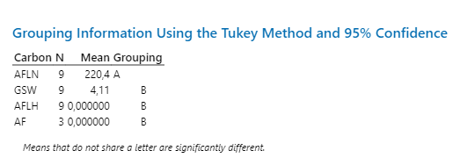
Temperature data per carbon source
Mean temperature
Hours over 45 °C
Hours over 55 °C

Slide 25
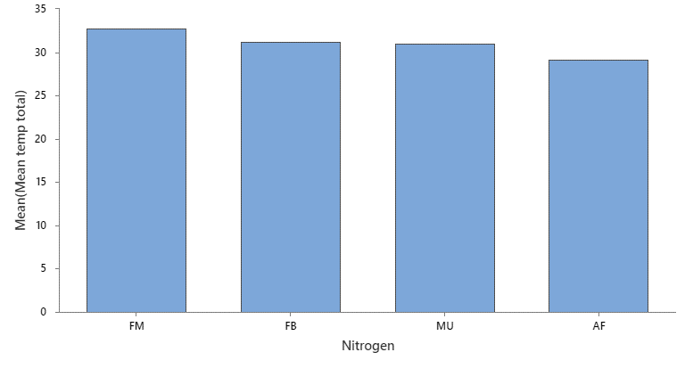
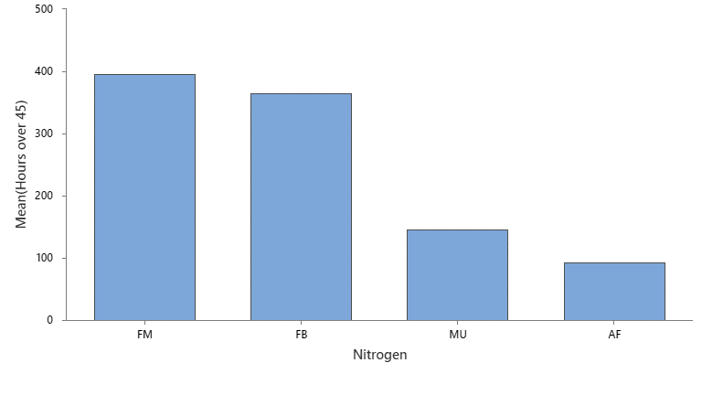
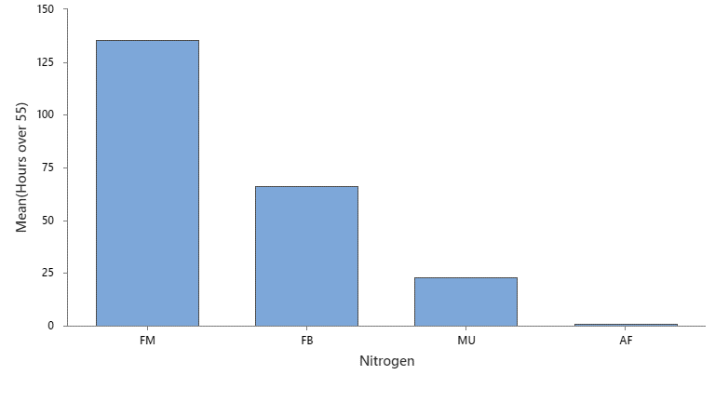
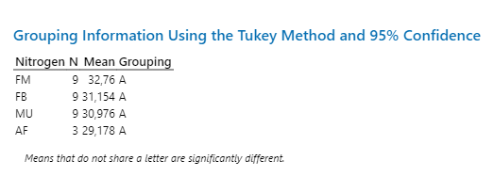
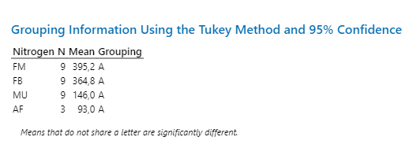

Temperature data per nitrogen source
Mean temperature
Hours over 45 °C
Hours over 55 °C

Slide 26

C:N start and finish
AFLH | -27 %
AFLH+FB | -29 %
AFLH+FM | -33 %
AFLH+MU | -32 %
AFLN+FB | -38 %
AFLN+FM | -35 %
AFLN+MU | -25 %
GSW+FB | -29 %
GSW+FM | -21 %
GSW+MU | -31 %
What happened here?
25-35:1 is optimal start C:N (25 was target in this experiment)
-21%
,
-38%
10-15:1 is optimal C:N for mature compost

Slide 27






Reduction in volume (cm³)
Per treatment
Per carbon source
Per nitrogen source

Slide 28






Loss on ignition (LOI) (% reduction)
Per treatment
Per carbon source
Per nitrogen source

Slide 29
Key finds
Significant differences in mean and cumulative temperatures by treatment and carbon source, but not nitrogen source
Little correlation between C:N-ratio and mean temperature. However, only treatments with a C:N-ratio below 30 at start (i.e., treatments with AFLN as carbon source) reached 55 °C
Tot-N concentration (and to a slightly lesser extent C:N) at the start of composting strongly correlated with reduction in volume
Change in concentration of Tot-C strongly correlated with temperature (more than change in Tot-N)
AFLN undoubtedly performed best as carbon source, but this could be a result of the optimal C:N-ratio for these treatments
Less distinction between nitrogen sources (large spread in results)
High pH in algae fiber and high conductivity (EC) in all treatments not an obvious hindrance
Awaiting results from analysis of humic acids

Slide 30
Thank you!
Joshua Cabell – joshua.cabell@norsok.no

