Slide 1
Recycling Nitrogen from urban wastes to organic farming – a scenario analysis
Marie Reimer^{1,2}, Kurt Möller^{2,3}, Jakob Magid⁴, Sander Bruun⁴
¹ Department of Agroecology, Aarhus University, Denmark, ² Department of Fertilization and Soil Matter Dynamics, University of Hohenheim, Germany, ³Center for Agricultural Technology Augustenberg (LTZ), Institute of Applied Crop Science, Germay, ⁴ Department of Plant and Environmental Sciences, University of Copenhagen, Denmark

Slide 2
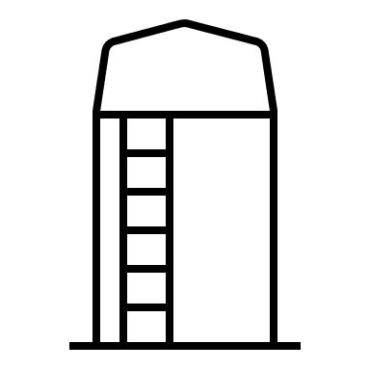
Need for suitable nutrient sources in organic farming
Political motivated goal of 25% organic farming
Phasing out of conventional manures
Need for new nutrient sources
Principal of recycling vs.
Principal of health
N
Objective: Evaluate recycled fertilizers in terms of N efficiency and contamination with potentially toxic elements (PTE) in the long and short term

Slide 3
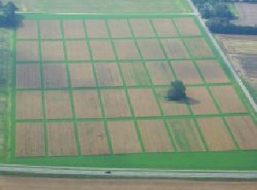
long-term field trial as solution?
CH | Compost Household waste
S | Sewage sludge
HU | stored Human Urine
DL | Deep Litter (cattle)
CM | Cattle Manure
CS | Cattle Slurry
NPK | Mineral
U | Unfertilized
CRUCIAL long-term field trial University of Copenhagen
Urban wastes
Crop rotation: mainly spring cereals without legumes
Application rates: 114 – 388 kg total N ha⁻¹ year⁻¹
Scenario simulation to account for organic crop rotation and application rates
Daisy calibration with CRUCIAL
Simulating 4 crop rotations with different N application rates
Simulation of PTE soil levels
Picture: https://plen.ku.dk/english/research/plant_soil/sf/crucial/

Slide 4
Crop rotations run for 100 years
Standard rotation |  |  | Extensive rotation |  |  | Intensive rotation
(25% legumes) |  |  | (50% legumes) |  |  | (17% legumes / 33% legumes)
Clover grass |  |  | Clover grass |  |  | Clover grass
Winter wheat |  |  | Clover grass |  |  | Winter wheat
Spring wheat (50/100/160) |  |  | Winter wheat |  |  | Spring wheat (60/120/180) |  | Spring wheat (75/150/220)
Oats* (50/100/160) |  |  | Spring wheat (20/40/80) |  |  | Oats* (60/120/180) |  | Peas* (15/30/60)
 |  |  |  |  |  | Winter wheat (60/120/180) |  | Winter wheat (75/150/220)
 |  |  |  |  |  | Spring wheat* (60/120/180) |  | Oats* (75/150/220)
Fertilizer doses (kg N ha⁻¹ year⁻¹)
Low N | Medium N | High N | Low N | Medium N | High N | Low N | Medium N |  | High N
25 | 50 | 80 | 5 | 10 | 20 | 40 | 80 |  | 120
* Cover crops

Slide 5
N yield rate dependent on N dose
Land productivity:
60 kg N ha⁻¹ ~ 3 t of winter wheat
~ 60% conventional average
CH | Compost Household waste
S | Sewage sludge
HU | stored Human Urine
DL | Deep Litter (cattle)
CM | Cattle Manure
CS | Cattle Slurry
NPK | Mineral
U | Unfertilized

Slide 6
N recovery rate
CH | Compost Household waste
S | Sewage sludge
HU | stored Human Urine
DL | Deep Litter (cattle)
CM | Cattle Manure
CS | Cattle Slurry
NPK | Mineral
U | Unfertilized
Figure 1: N recovery rate as determined by scenario simulations done in DIASY for organic crop rotations and N application rates ranging between 0 and 120 kg N ha-1 year-1 for a duration of 12 year (short-term) or 100 years (long-term).

Slide 7
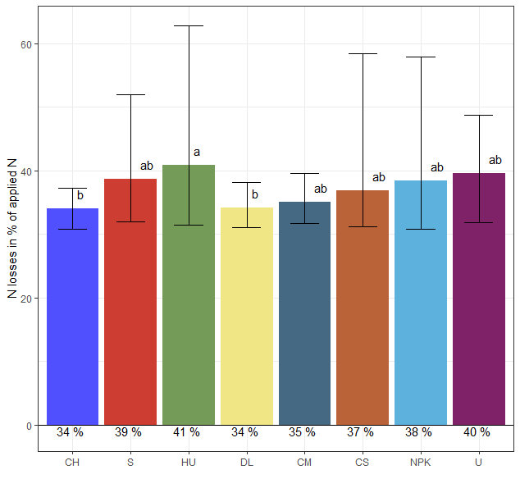
N LOSSES IN % OF TOTAL n APPLIED
CH | Compost Household waste
S | Sewage sludge
HU | stored Human Urine
DL | Deep Litter (cattle)
CM | Cattle Manure
CS | Cattle Slurry
NPK | Mineral
U | Unfertilized
70-80% leaching
Human Urine
→ High surface losses (NH₃ volatilization)
→ Lower leaching

Slide 8
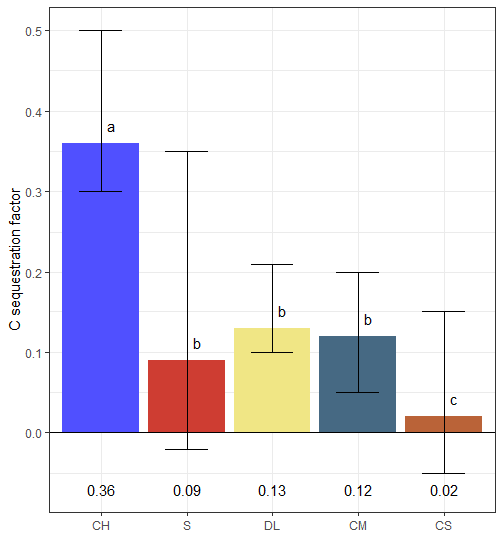
C Sequestration factor
CH | Compost Household waste
S | Sewage sludge
DL | Deep Litter (cattle)
CM | Cattle Manure
CS | Cattle Slurry
C sequestration dependent on C application rate: higher C input resulted in higher C sequestration

Slide 9
PTE in the soil -Model approach
Model approach based on Smolders and Six 2014 and Weissengruber et al. 2018
Soil PTE_{year x} = Soil PTE_{year x-1} +Input -Output
Input = deposition + fertilizer input
Output = leaching + crop offtake
Leaching dependent on soil PTE level, sorption to soil (Kd), and leaching water
Crop offtake dependent on soil PTE level, transfer factor and yields
Measured values / Model output / Literature values

Slide 10
PTE contamination
U | Unfertilized
CH | Compost Household waste
S | Sewage sludge
HU | stored Human Urine
CS | Cattle Slurry
CM | Cattle Manure
DL | Deep Litter (cattle)
NPK | Mineral
Cu:
Compost, sewage sludge surplusses up to 800 g Cu ha⁻¹ Soil levels < 30 mg kg⁻¹ soil
Threshold: 50-140 mg kg⁻¹ soil
Zn:
Compost, sewage sludge and animal manures surplusses up to 1700 g Zn ha⁻¹
Soil levels < 100 mg kg⁻¹ soil
Threshold: 150-300 mg kg⁻¹ soil
Cd:
Compost, and sewage sludge surplusses up to 7.5 g Cd ha⁻¹
Soil levels < 0.4 mg kg⁻¹ soil
Threshold: 1-3 mg kg⁻¹ soil
N dose
High
Low
Medium
Unfertilized
Crop rotation
Extensive
Intensive
Intensive (pea)
Standard

Slide 11
Cd content in soil after 100 years
U | Unfertilized
CH | Compost Household waste
S | Sewage sludge
HU | stored Human Urine
CS | Cattle Slurry
CM | Cattle Manure
DL | Deep Litter (cattle)
NPK | Mineral
Threshold: 1-3
*
* Soil content in year 0
N₀ N_{low} N_{middel} N_{high}
N₀ N_{low} N_{middel} N_{high}
N₀ N_{low} N_{middel} N_{high}
0 5 10 20 0 25 50 80 0 40 80 120
Extensive rotation
(50% legumes)
Standard rotation
(25% legumes)
Intensive rotation
(17%/33% legumes)

Slide 12
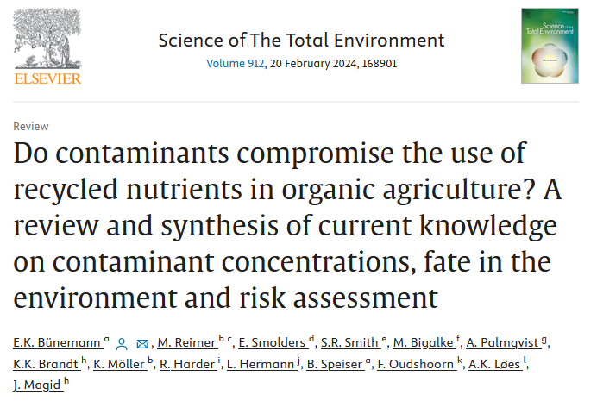
Conclusion
Are recycled fertilizers a good nutrient source for organic farming?
What are the alternatives?
Yes, but
No “One fits all”-solution
→ Compost similar to cattle manure, sewage sludge to slurry, human urine to mineral fertilization
→ Trade-off between between nitrogen fertilizer value and carbon storage
Low risk
PTE contamination
→ Compost and sewage sludge resulted in surplus Cd and Cu, while Zn levels also increased for the animal manures
→ levels remained below EU thresholds after 100 years of continuous application
→ Other contaminants
vs.
vs.

Slide 14
References
Bünemann, E. K., Reimer, M., Smolders, E., Smith, S. R., Bigalke, M., Palmqvist, A., Brandt, K. K., Möller, K., Harder, R., Hermann, L., Speiser, B., Oudshoorn, F., Løes, A. K., Magid, J. (2024): Do contaminants compromise the use of recycled nutrients in organic agriculture? A review and synthesis of current knowledge on contaminant concentrations, fate in the environment and risk assessment. Science of The Total Environment 912, 168901.
Reimer, M. (2022): Towards a sustainable nutrient management in organic farming – Closing the nutrient gap with recycled fertilizers from urban waste. University of Hohenheim, Stuttgart, Germany.
Six, L., Smolders, E. (2014): Future trends in soil cadmium concentration under current cadmium fluxes to European agricultural soils. Science of The Total Environment 485–486, 319–328.
Weissengruber, L., Möller, K., Puschenreiter, M., Friedel, J. K. (2018): Long-term soil accumulation of potentially toxic elements and selected organic pollutants through application of recycled phosphorus fertilizers for organic farming conditions. Nutr Cycl Agroecosyst 110, 427–449.

Slide 15
N losses pathway
CH | Compost Household waste
S | Sewage sludge
HU | stored Human Urine
DL | Deep Litter (cattle)
CM | Cattle Manure
CS | Cattle Slurry
NPK | Mineral
U | Unfertilized
Percentage of total N losses (%)

Slide 16
PTE budgets

Slide 17
Cu content in soil after 100 years
U | Unfertilized
CH | Compost Household waste
S | Sewage sludge
HU | stored Human Urine
CS | Cattle Slurry
CM | Cattle Manure
DL | Deep Litter (cattle)
NPK | Mineral
Threshold: 50-140
*
* Soil content in year 0
N₀ N_{low} N_{middel} N_{high}
N₀ N_{low} N_{middel} N_{high}
N₀ N_{low} N_{middel} N_{high}
Extensive rotation
(50% legumes)
Standard rotation
(25% legumes)
Intensive rotation
(17%/33% legumes)

Slide 18
ZN content in soil after 100 years
U | Unfertilized
CH | Compost Household waste
S | Sewage sludge
HU | stored Human Urine
CS | Cattle Slurry
CM | Cattle Manure
DL | Deep Litter (cattle)
NPK | Mineral
Threshold: 150-300
*
* Soil content in year 0
N₀ N_{low} N_{middel} N_{high}
N₀ N_{low} N_{middel} N_{high}
N₀ N_{low} N_{middel} N_{high}
Extensive rotation
(50% legumes)
Standard rotation
(25% legumes)
Intensive rotation
(17%/33% legumes)

Slide 19
Soil PTE thresholds
Table 9: Threshold values for PTE content in the soil (in mg kg-1 soil) in different countries in Europe.

