Slide 1


Organic live feed cultures for marine fish hatcheries
Per M. Jepsen
Session:
Exploring the untapped
potential of aquaculture

Slide 2

Why worry about organic
EU regulation states that all organic fish must be fed with feed approved for organic farming from hatch to harvest.
Hence, we need to be able to feed fish with organic food from the start.
Currently, we do not have an organic food solution for most marine fish larvae.

Slide 3
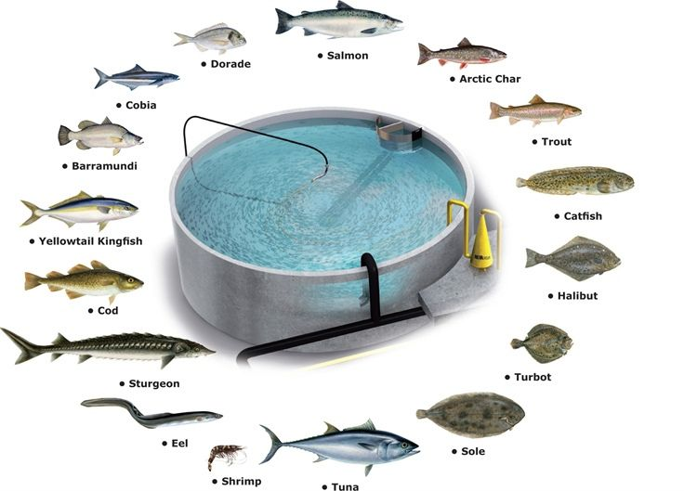
Why worry about live feed
Picture: AKVA group

Slide 4
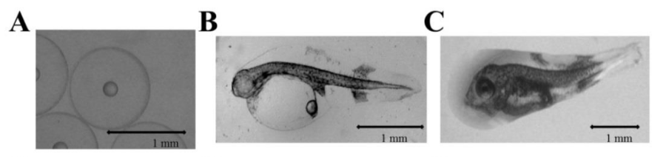
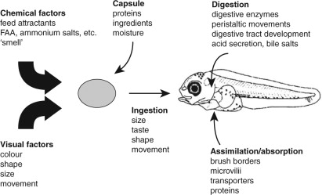
Sierra-Flores 2014
Kolkovski 2013

Slide 5
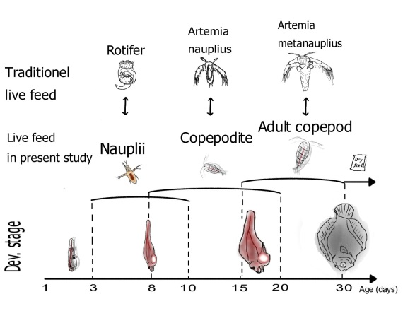
How to feed with live feed
Alternative
Abate et al., 2015

Slide 6
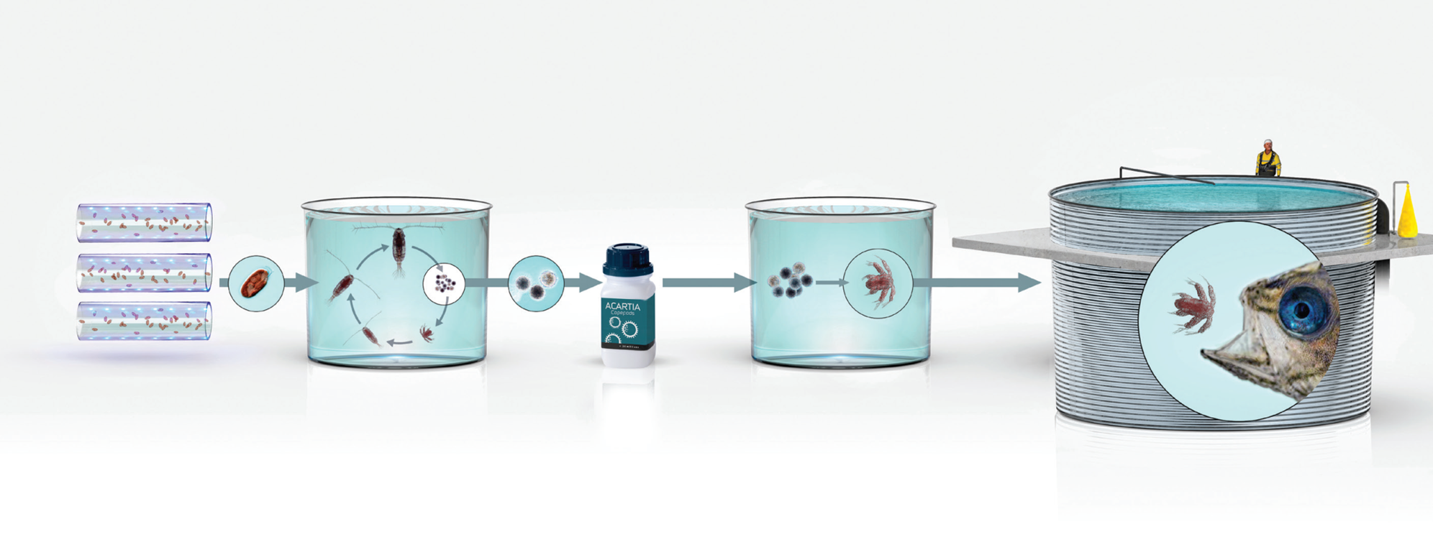
Picture: AKVA group

Slide 7
 | Copepod Diet |  |  | Copepod
Fatty acid | D. tertiolecta | R. salina | S.cerevisiae | D. ter. | R.sal. | S.cer.
C20:4 n-6 (ARA) | 0.04 ± 0.04 | 0.67 ± 0.01 | 0.01 ± 0.01 | 0.92 ± 0.30 | 0.98 ± 0.22 | 0.44 ± 0.08
18:3 n-3 (ALA) | 60.20 ± 2.51 | 21.14 ± 0.76 | 0.06 ± 0.07 | 30.17 ± 3.05 | 13.40 ± 0.32 | 3.54 ± 3.16
C18:4 n-3 | 1.29 ± 0.22 | 25.80 ± 0.93 | 0.07 ± 0.09 | 0.94 ± 0.11 | 17.06 ± 0.83 | 0.09 ± 0.15
C20:3 n-3 | n.d. | n.d. | 0.01 ± 0.03 | 2.49 ± 0.65 | 0.49 ± 0.11 | 0.09 ± 0.02
C20:5 n-3 (EPA) | n.d. | 15.22 ± 0.92 | n.d. | 1.81 ± 0.44 | 13.41 ± 2.71 | 1.16 ± 0.34
C22:6 n-3 (DHA) | n.d. | 9.42 ± 0.23 | n.d. | 28.34 ± 9.67 | 30.48 ± 9.54 | 35.30 ± 3.97
Notes:
Fig. 5. Biosynthetic pathway proposed by Sprecher (2000) within the capabilities of A. royi. Solid
arrows indicate pathways where corresponding genes were found. Dashed arrows indicate alternative
pathways not presently found in A. royi. Horizontal arrows indicate desaturation, vertical arrows
pointing downwards indicate elongation, vertical arrows pointing upwards indicate β-oxidation.

Slide 8
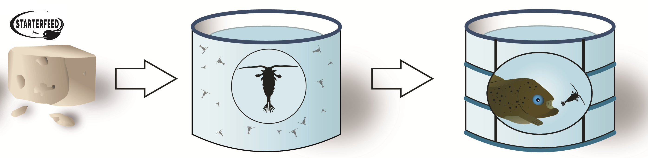
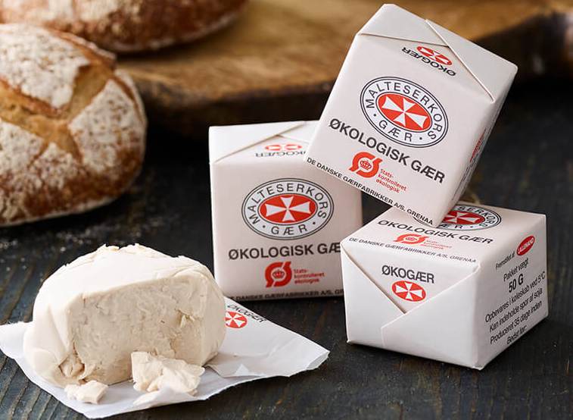

Slide 9
5000
2500
Population density (ind. L-1)
Yeast
Y. + Microalgae
1000
0
10
20
30
40
Time (Days)

Slide 10

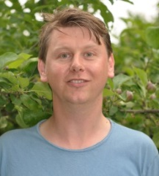
Contact: Per M. Jepsen (pmjepsen@ruc.dk)

