Slide 1
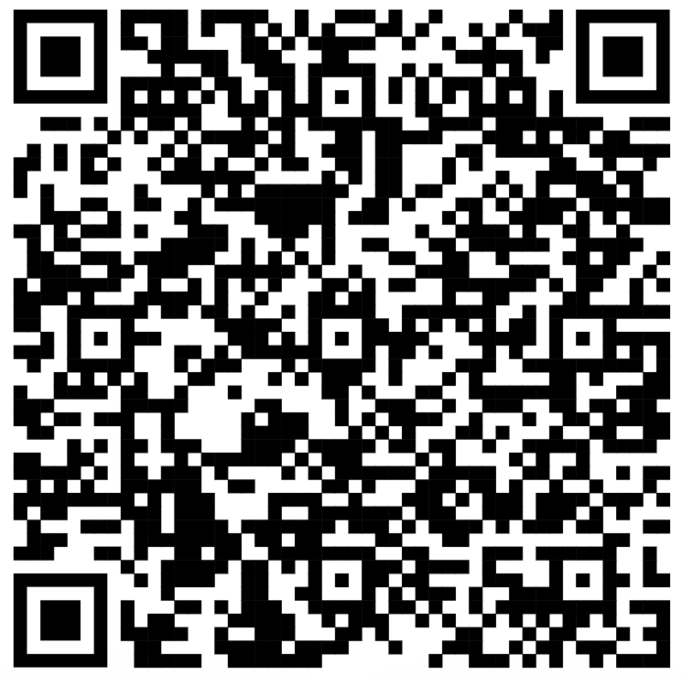
UNIVERSITY OF COPENHAGEN
Department of Plant and Environmental Sciences
Scan to view the project website

