Slide 1
AN EXTENSIVE INVESTIGATION OF A GENE BANK POPULATION OF PEA
Ph.d. Candidate Jens Axel Knuhtsen
Department of Plant and Environmental Science
PEAS & LOVE

Slide 2
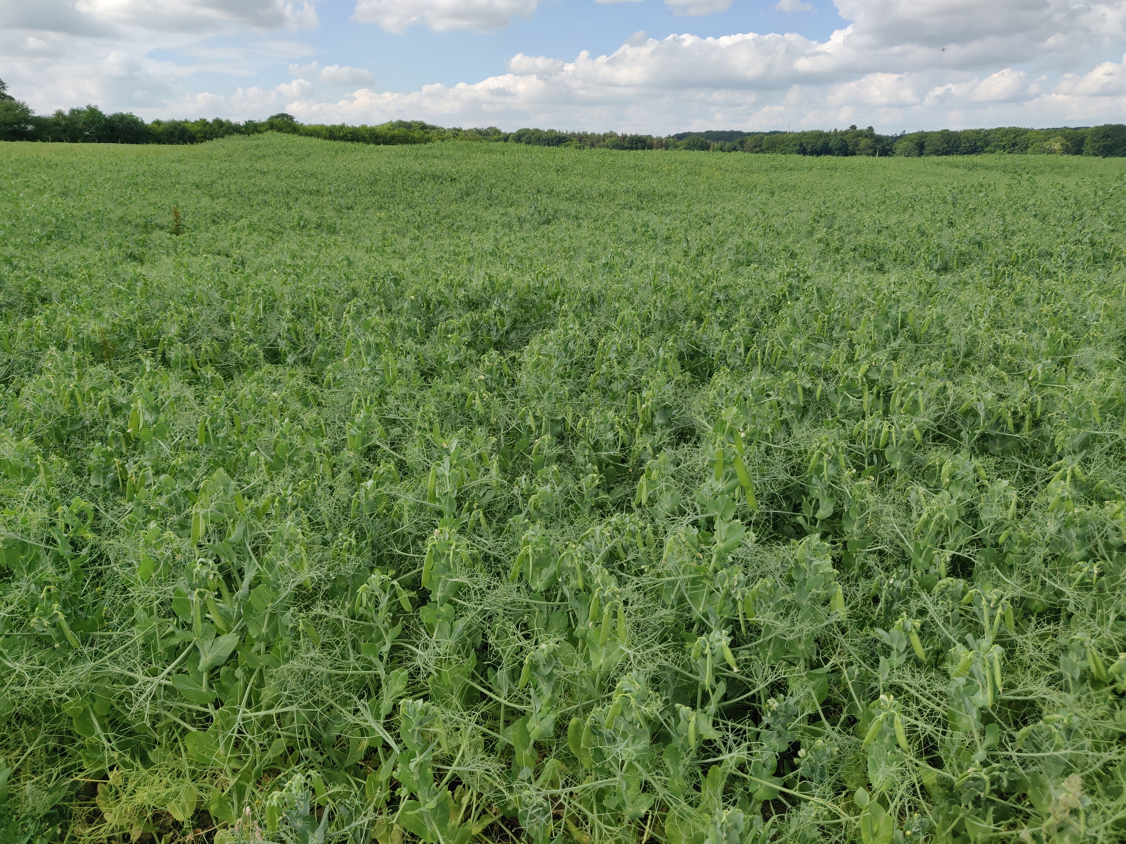
Background
Modern pea varieties – Feed
developed for agronomic traits and yield

Slide 3
Background
Modern pea varieties – Feed
developed for agronomic traits and yield
The project PEAS & LOVE

Slide 4
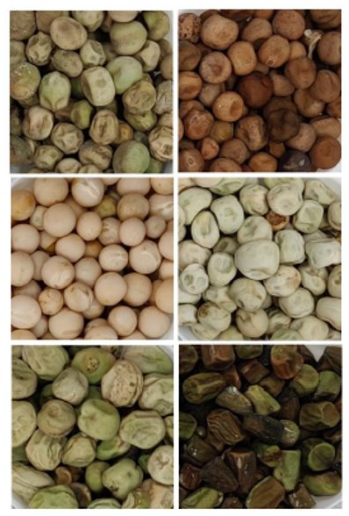
Background
Modern pea varieties – Feed
developed for agronomic traits and yield
The project PEAS & LOVE
For human consumption?
Taste
Nutritional quality (protein AA, composition)
Visually pleasing (colour, shape, size, etc.)
“Kitchen behaviour”
…
Agronomic performance

Slide 5
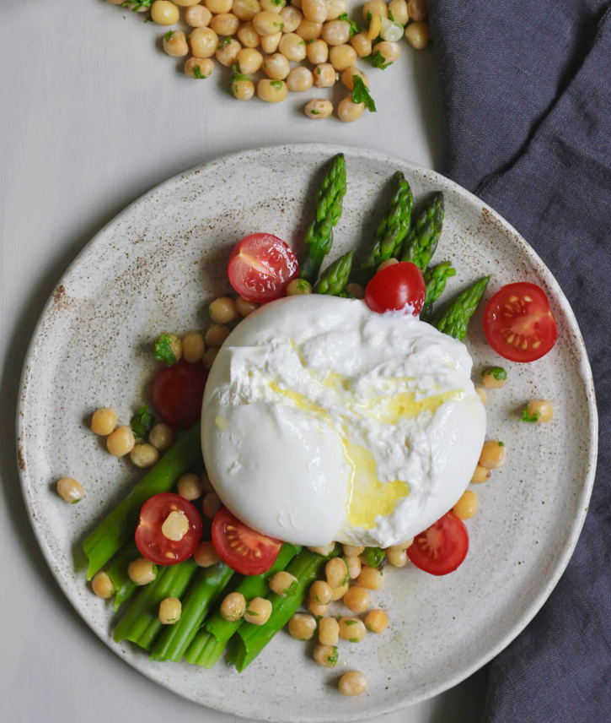
Background
Modern pea varieties – Feed
developed for agronomic traits and yield
The project PEAS & LOVE
For human consumption?
Taste
Nutritional quality (protein AA, composition)
Visually pleasing (colour, shape, size, etc.)
“Kitchen behaviour”
…
Agronomic performance
https://Puredansk.dk

Slide 6
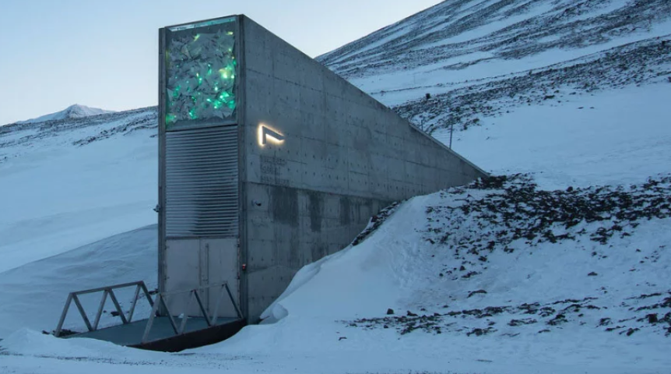
Methodology
NordGen gene bank
Croptrust.org

Slide 7
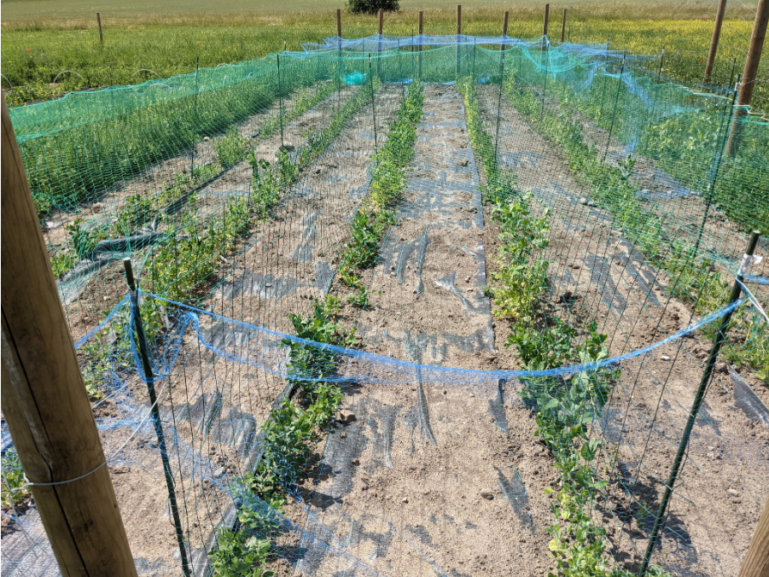
Methodology
NordGen gene bank
Mostly “old”
Scandinavian accessions
Pheno+Genotype for
useful traits
Croptrust.org

Slide 8
Goals
Identify “old” pea accessions relevant for human consumption

Slide 9
Goals
Identify “old” pea accessions relevant for human consumption
- Good taste
- Doesn’t boil out
- Optimal amino acid profile
- High protein
And ...

Slide 10
Goals
Identify “old” pea accessions relevant for human consumption
- Good taste
- Doesn’t boil out
- Optimal amino acid profile
- High protein
- Good agronomic performance

Slide 11
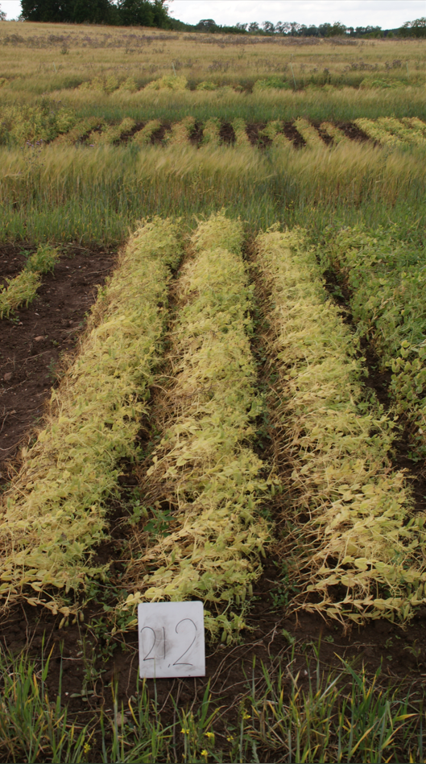
Goals
Identify “old” pea accessions relevant for human consumption
- Good taste
- Doesn’t boil out
- Optimal amino acid profile
- High protein
- Good agronomic performance

Slide 12
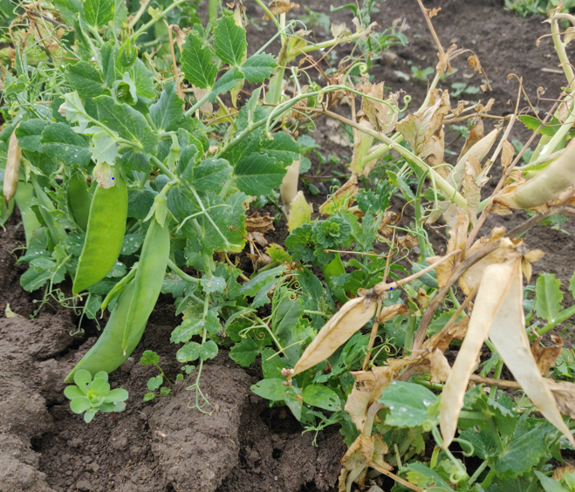
Goals
Identify “old” pea accessions relevant for human consumption
- Good taste
- Doesn’t boil out
- Optimal amino acid profile
- High protein
- Good agronomic performance

Slide 13
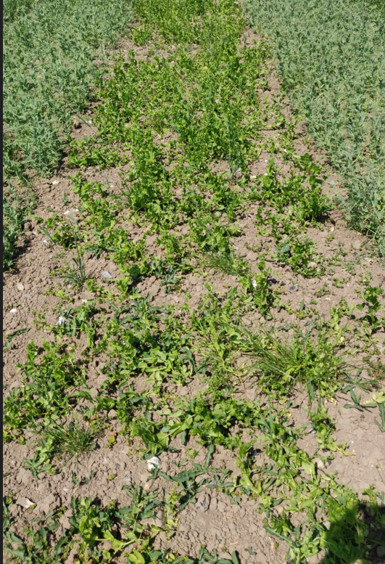
Goals
Identify “old” pea accessions relevant for human consumption
- Good taste
- Doesn’t boil out
- Optimal amino acid profile
- High protein
- Good agronomic performance

Slide 14
Goals
Identify “old” pea accessions relevant for human consumption
- Good taste
- Doesn’t boil out
- Optimal amino acid profile
- High protein
- Good agronomic performance
Identify useful genes/traits
Optimize the production of landrace type peas

Slide 15
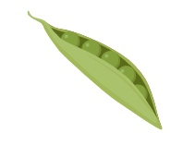
Conclusions
PEAS & LOVE set out to utilize Scandinavian genetic resources
A combination of genotyping and phenotyping of the population
Optimization of production of Scandinavian pea landraces
Thank you for your attention
Jens Axel Knuhtsen
Pea.h.d candidate
University of Copenhagen

