Slide 1
Organic Agriculture Worldwide 2022: Key results from the FiBL survey on organic agriculture worldwide 2024
Part 2: Organic land use and crops
Jan Trávníček, Bernhard Schlatter and Helga Willer
© FiBL, February 2024

Slide 2
Organic Agriculture Worldwide: Key results from the FiBL survey on organic agriculture worldwide 2024 Part 2: Organic land use and crops
Data compiled by the Research Institute of Organic Agriculture FiBL, Frick, Switzerland, based on national data sources and data from certifiers.
Data as published February 2024 in The World of Organic Agriculture. Statistics and Emerging Trends 2024.* Frick and Bonn, www.organic-world.net
For updates, check www.organic-world.net
This presentation is available online at: https://www.organic-world.net/yearbook/yearbook-2024/presentations.html
Texts and graphs: Helga Willer, Bernhard Schlatter and Jan Trávníček, Research Institute of Organic Agriculture FiBL, Frick, Switzerland
Contact: Helga Willer, helga.willer@fibl.org, Research Institute of Organic Agriculture FiBL, Frick, Switzerland
© Research Institute of Organic Agriculture FiBL, Frick, Switzerland, April 2024
*Citation: Willer, Helga, Bernhard Schlatter and Jan Trávníček (Eds.) (2024): The World of Organic Agriculture. Statistics and Emerging Trends 2024. Research Institute of Organic Agriculture FiBL, Frick, and IFOAM – Organics International, Bonn.
Notes:
FiBL
05.02.2024
www.fibl.org
2

Slide 3
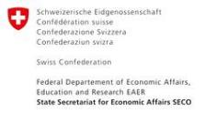
Acknowledgements
The Swiss State Secretariat of Economic Affairs (SECO)
Coop Sustainability Fund
NürnbergMesse, the organizers of BIOFACH
IFOAM – Organics International
More than 200 experts from all parts of the world contributed to the FiBL survey 2024.

Slide 4
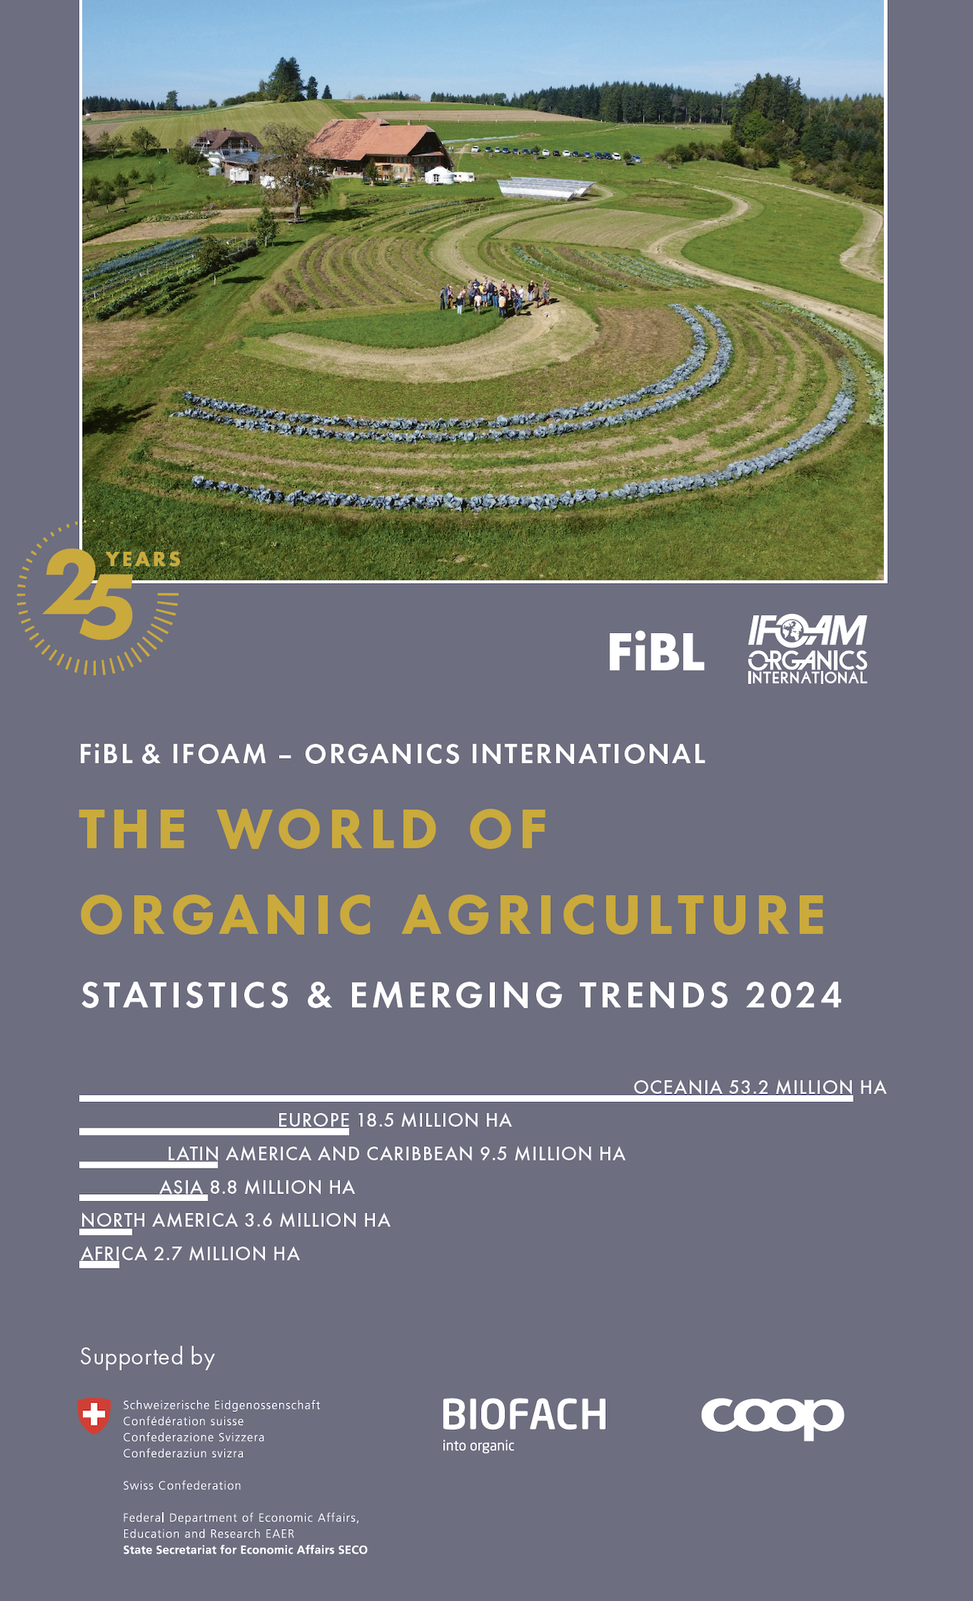
The World of Organic Agriculture 2024
The 25th edition of «The World of Organic Agriculture», was published by FiBL and IFOAM – Organics International in February 2024.
Data tables
Country and continent reports
Markets, standards, policy support
The book can be ordered or downloaded at (item number 1747): https://www.fibl.org/en/shop-en
www.organic-world.net
https://statistics.fibl.org

Slide 5
About this presentation
In three presentations, the key results of the FiBL survey on organic agriculture worldwide 2024 are summarized (data 2022). Apart from the global data, key results on crop and on regional data are presented.
More information is available at www.organic-world.net
The following three presentations are available at https://www.organic-world.net/yearbook/yearbook-2024/presentations.html:
Part 1: Global data 2022 and survey background
Part 2: Land use and key crops in organic agriculture 2022
Part 3: Organic agriculture in the regions 2022

Slide 6
The 25th survey on organic agriculture world-wide
The 25th survey on organic agriculture worldwide was carried out by the Research Institute of Organic Agriculture FiBL in cooperation with partners from all around the world. The results were published jointly by FiBL and IFOAM – Organics International.
The survey was carried out between July 2023 and February 2024.
Data were received from 188 countries.
Data was provided by over 200 country experts (representatives from NGOs, certification bodies, governments, researchers).
The following data was collected: area data (including land use and crop details); producers, other operator types; domestic market values; export and import data; livestock data (animal heads and production in metric tons).
The results are published in the yearbook “The World of Organic Agriculture 2024” and on www.organic-world.net.

Slide 7
Land use in organic agriculture
Land use information was available for 92 percent of the organic agricultural land; however, this does not mean detailed crop information is available for all areas as not all countries (e.g. Brazil and India) provided detailed crop data.
More than two-thirds of the 96.4 million hectares of organic agricultural land in 2022 were grassland/grazing areas (over 67.6 million hectares).
The cropland area (arable land with 15.1 million hectares and permanent crops with 6.4 million hectares) constituted 21.5 million hectares, which was less than a quarter of the organic agricultural land.
The key arable crops were cereals, green fodder from arable land and oilseeds.
For permanent crops, nuts, olives and coffee were the most relevant.
While the arable crops decreased only by 0.7 percent and permanent crop area increased only by 0.8 percent, organic grassland/grazing areas increased significantly, by 25.5 percent.

Slide 8
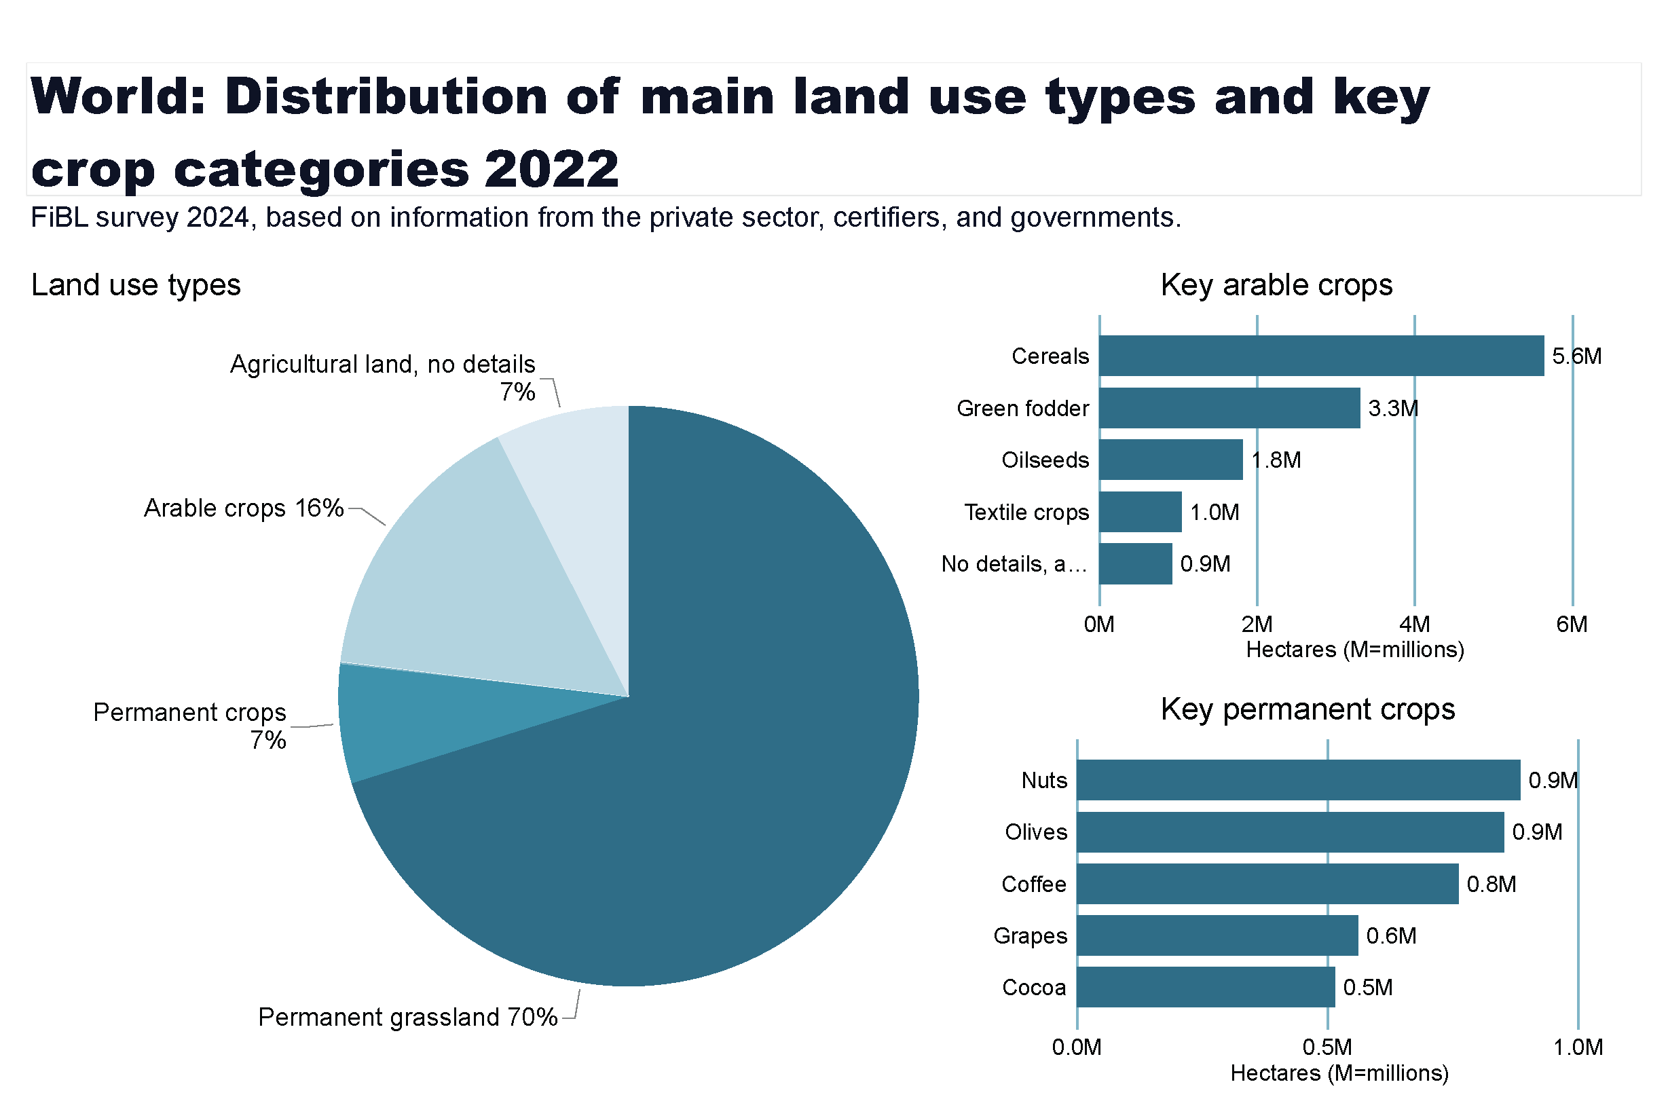
Land_use_world_arable_land1
Notes:
Land use types
No alt text provided
card
No alt text provided
Key arable crops
No alt text provided
Key permanent crops
No alt text provided
textbox
No alt text provided

Slide 9
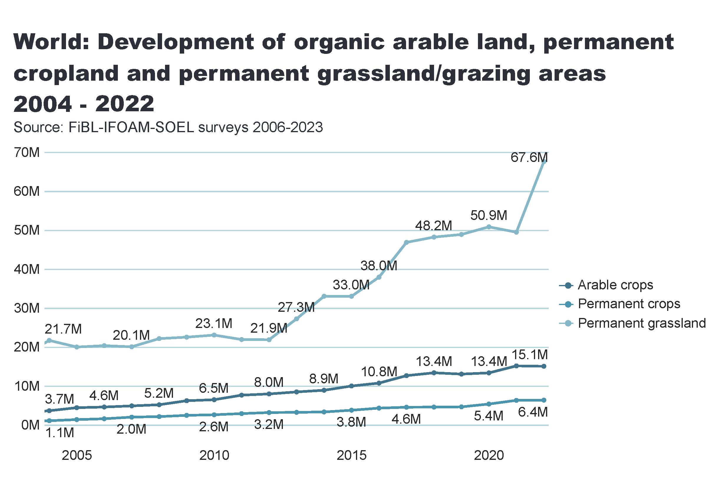
Land_use_world_development
Notes:
card
No alt text provided
lineChart
No alt text provided
textbox
No alt text provided

Slide 10
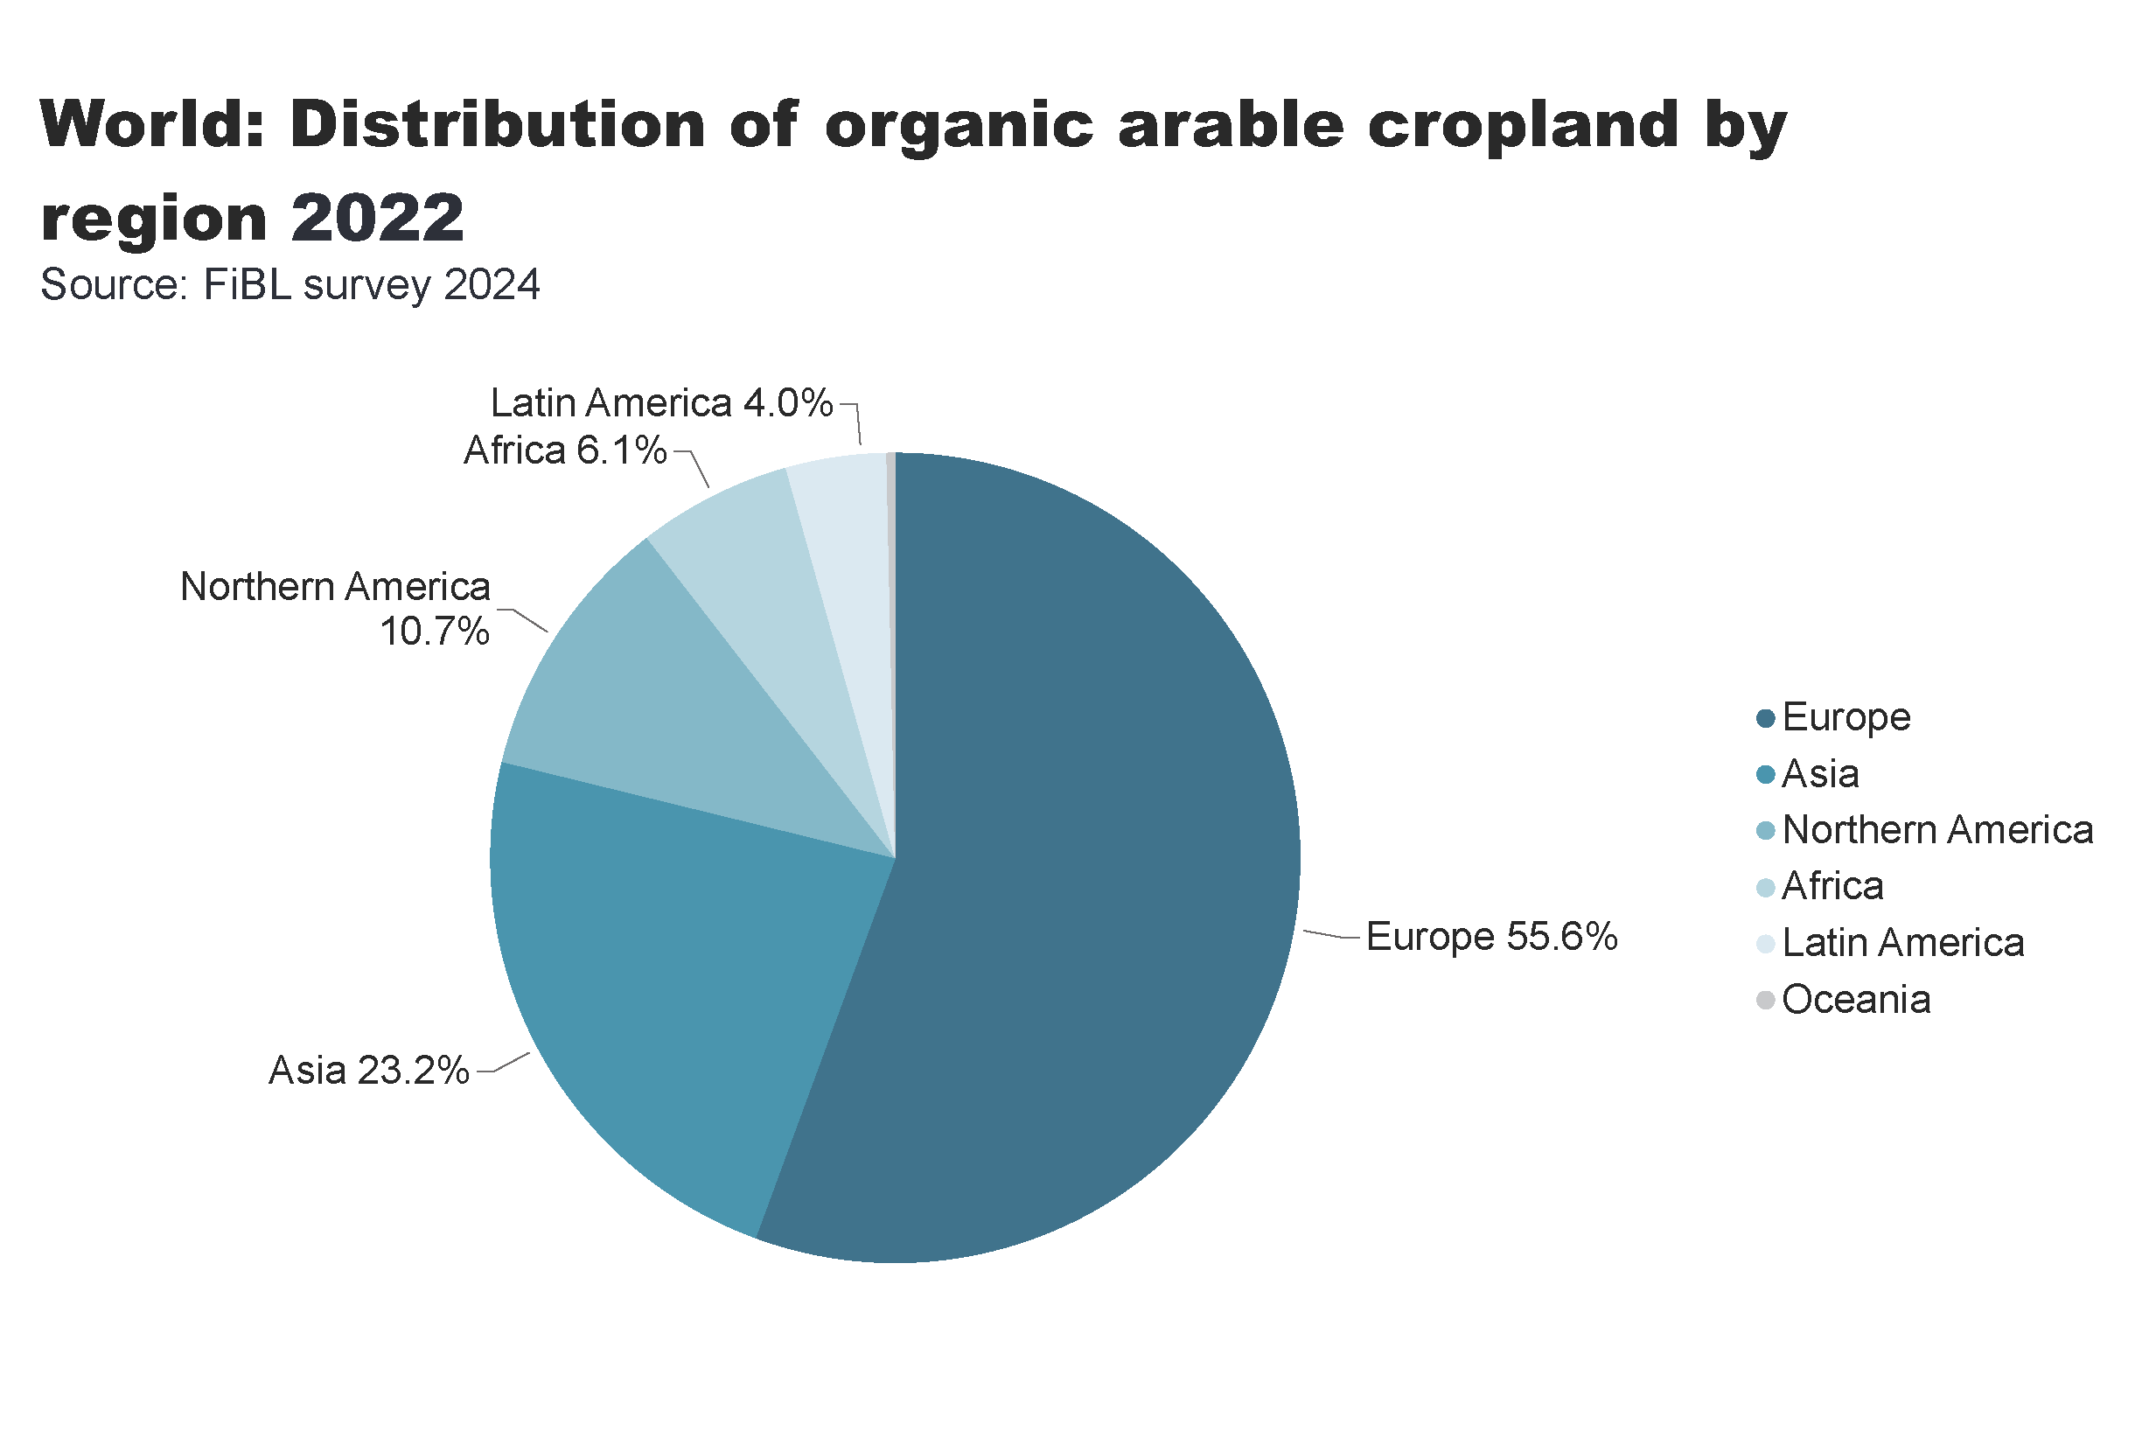
world_arable_land_distribution_by_country
Notes:
pieChart
No alt text provided
card
No alt text provided
textbox
No alt text provided

Slide 11
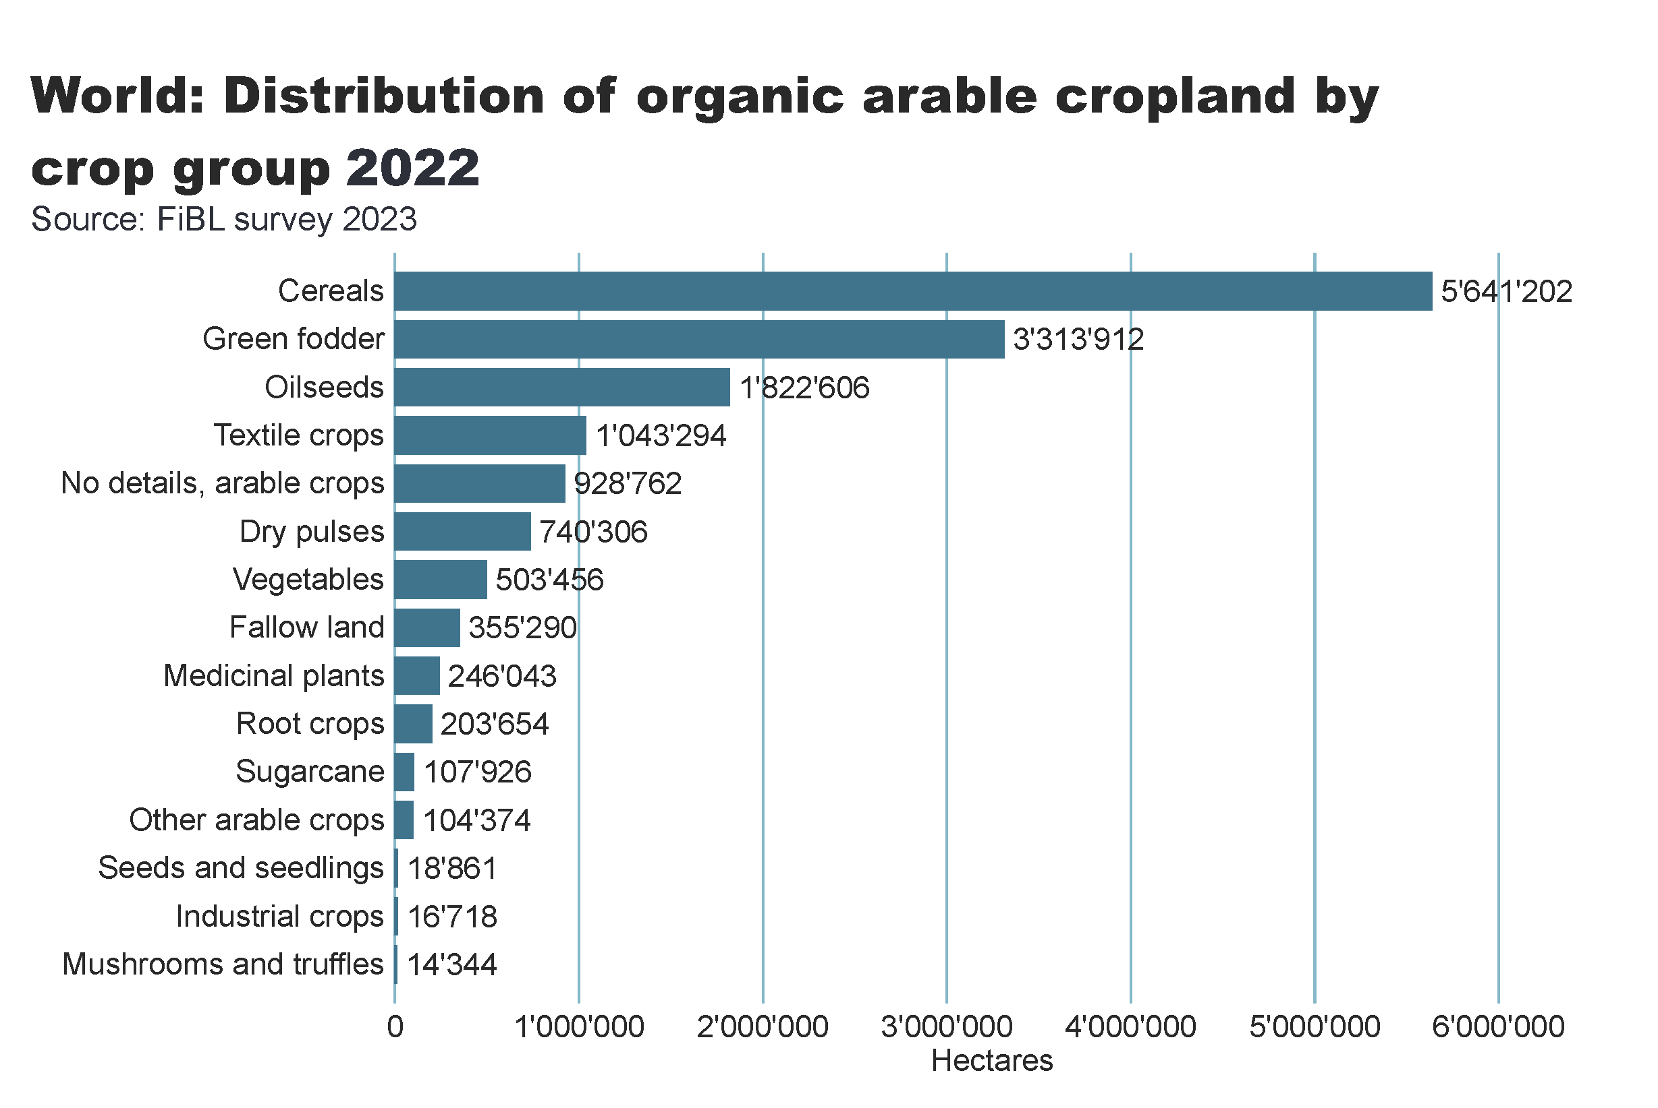
world_arable_land_distribution_by_group
Notes:
clusteredBarChart
No alt text provided
card
No alt text provided
textbox
No alt text provided

Slide 12
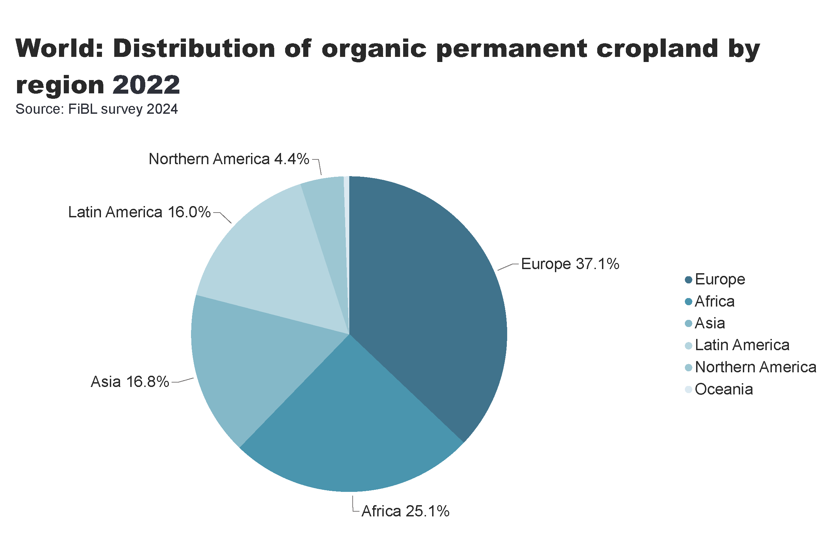
world_perm_land_distribution_by_country
Notes:
pieChart
No alt text provided
card
No alt text provided
textbox
No alt text provided

Slide 13
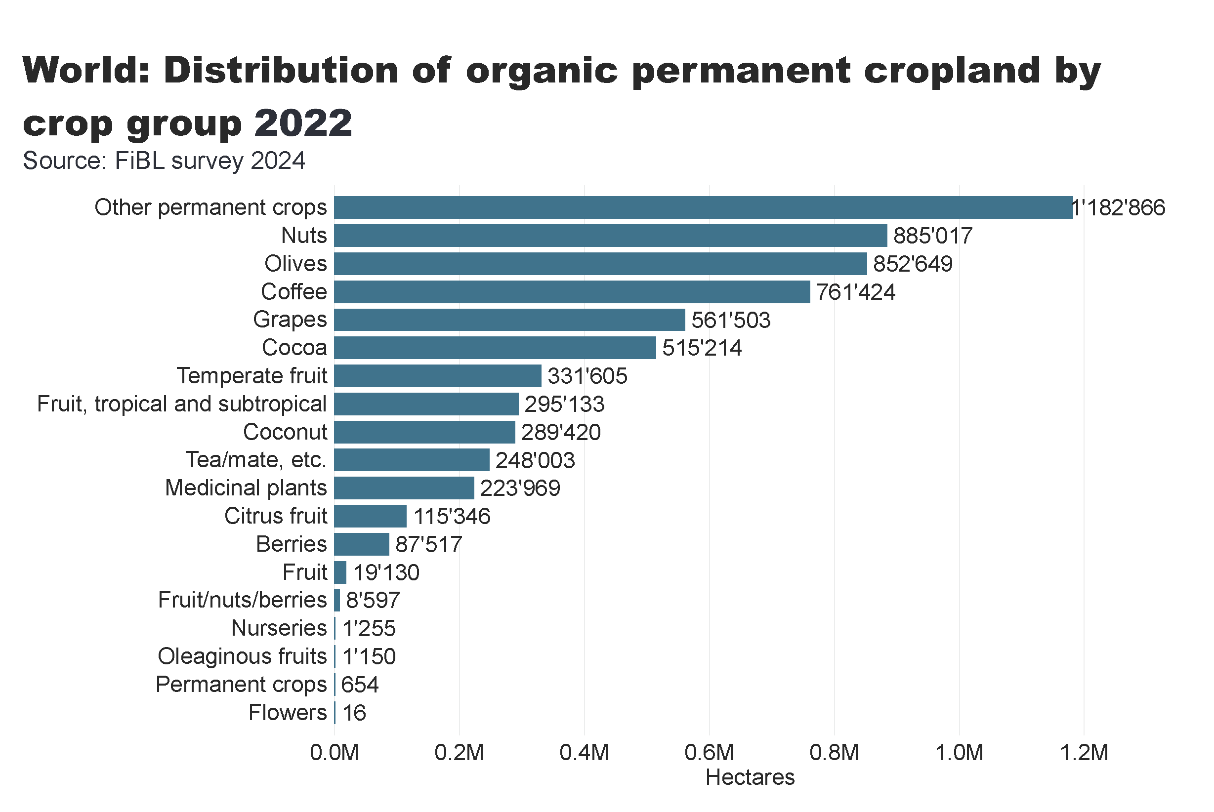
world_perm_land_distribution_by_group
Notes:
clusteredBarChart
No alt text provided
card
No alt text provided
textbox
No alt text provided

Slide 14
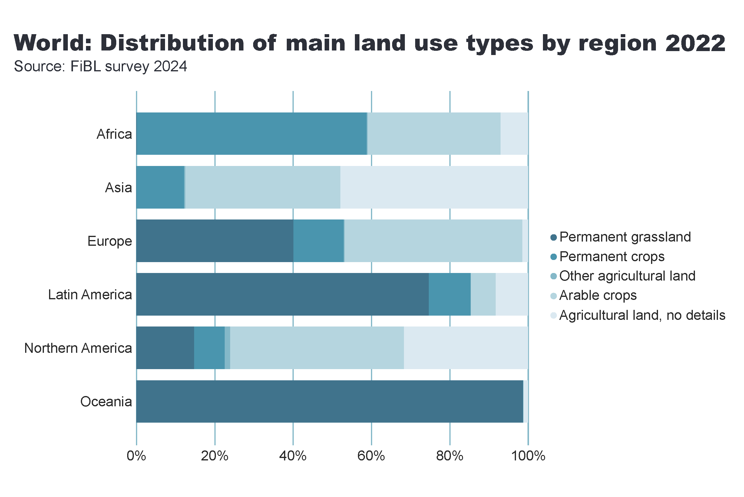
world_land_use_distribution_region
Notes:
hundredPercentStackedBarChart
No alt text provided
card
No alt text provided
textbox
No alt text provided

Slide 15
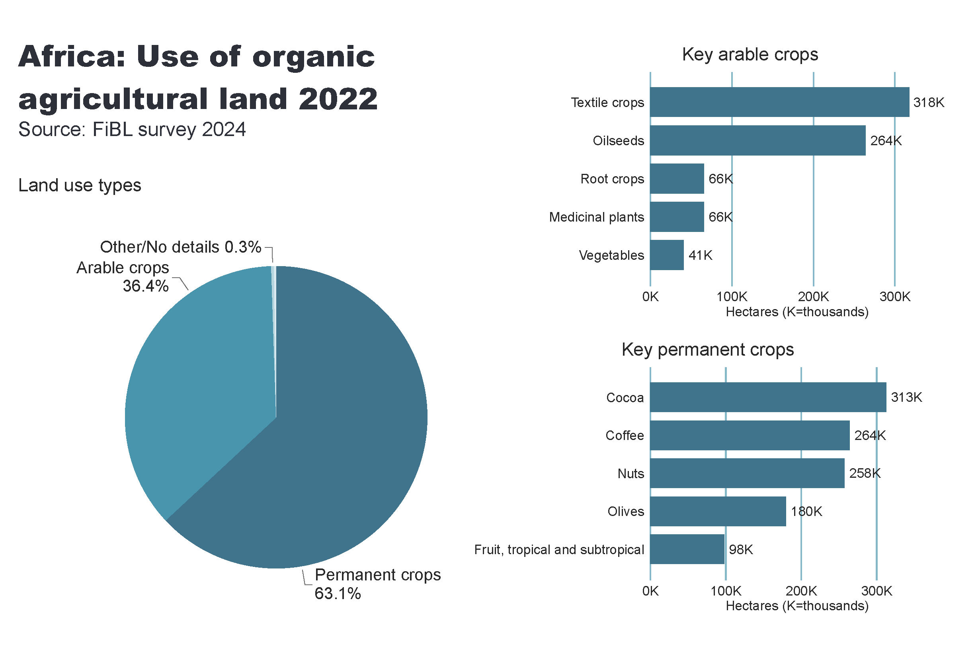
Africa_land_use
Notes:
Land use types
No alt text provided
card
No alt text provided
Key arable crops
No alt text provided
Key permanent crops
No alt text provided
textbox
No alt text provided

Slide 16
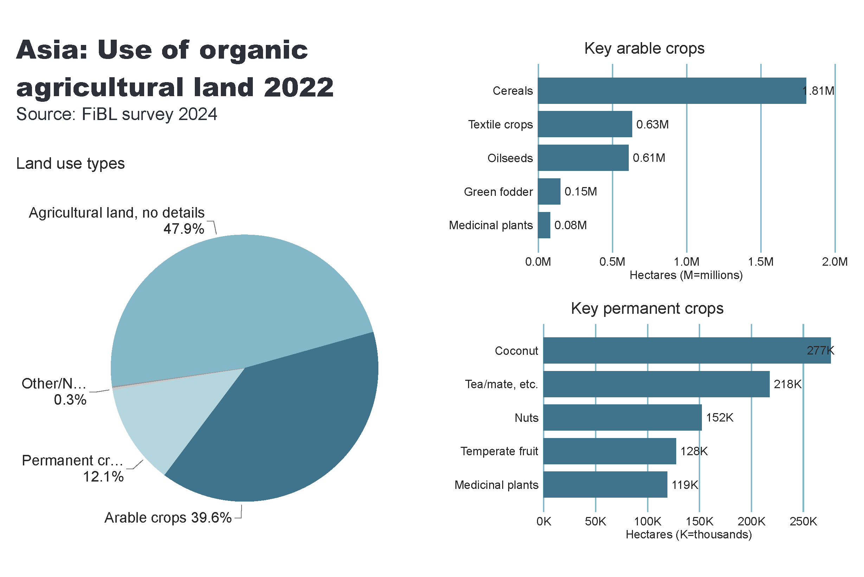
Asia_land_use
Notes:
Land use types
No alt text provided
card
No alt text provided
Key arable crops
No alt text provided
Key permanent crops
No alt text provided
textbox
No alt text provided

Slide 17
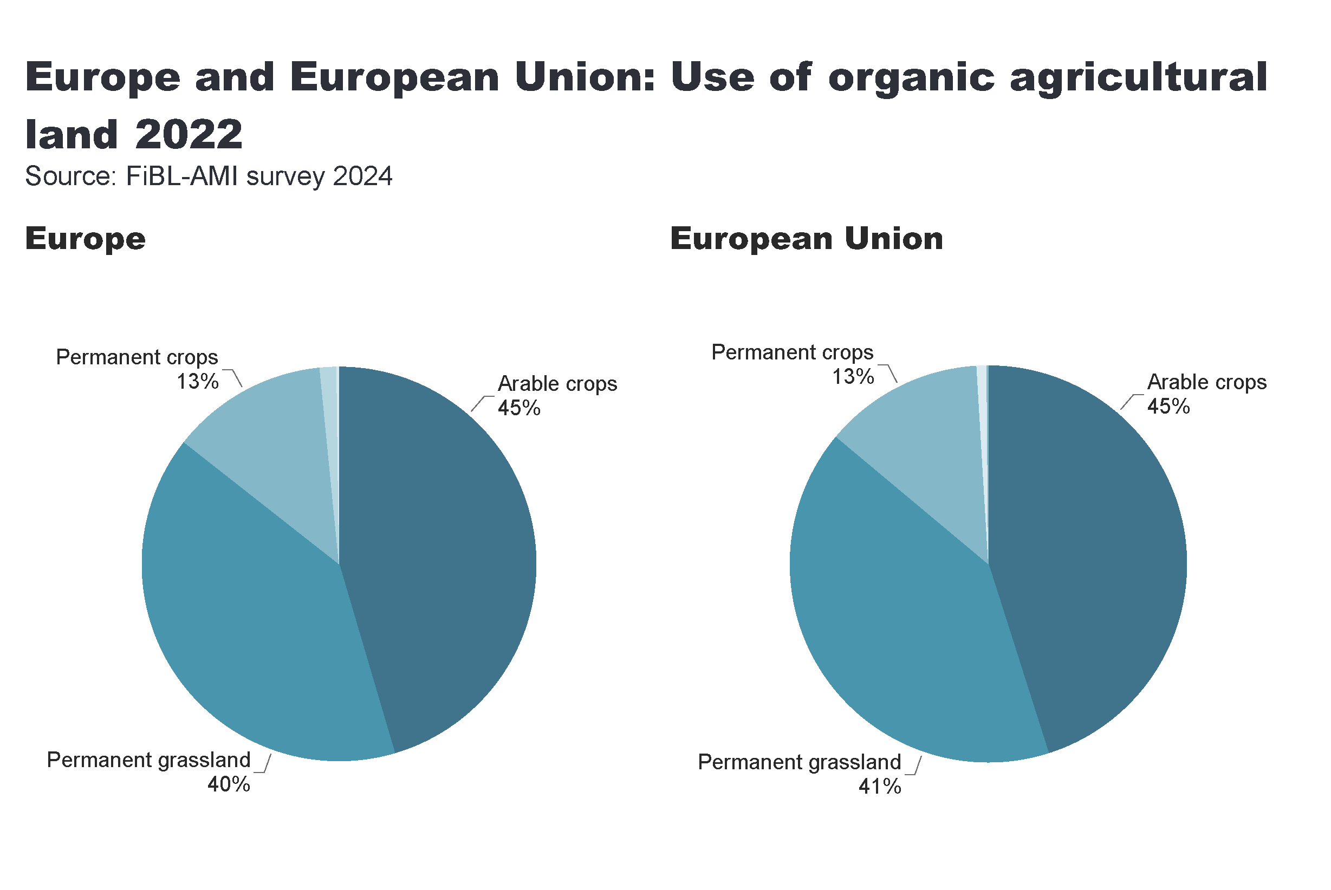
Europe_land_use
Notes:
European Union
No alt text provided
card
No alt text provided
Europe
No alt text provided
textbox
No alt text provided

Slide 18
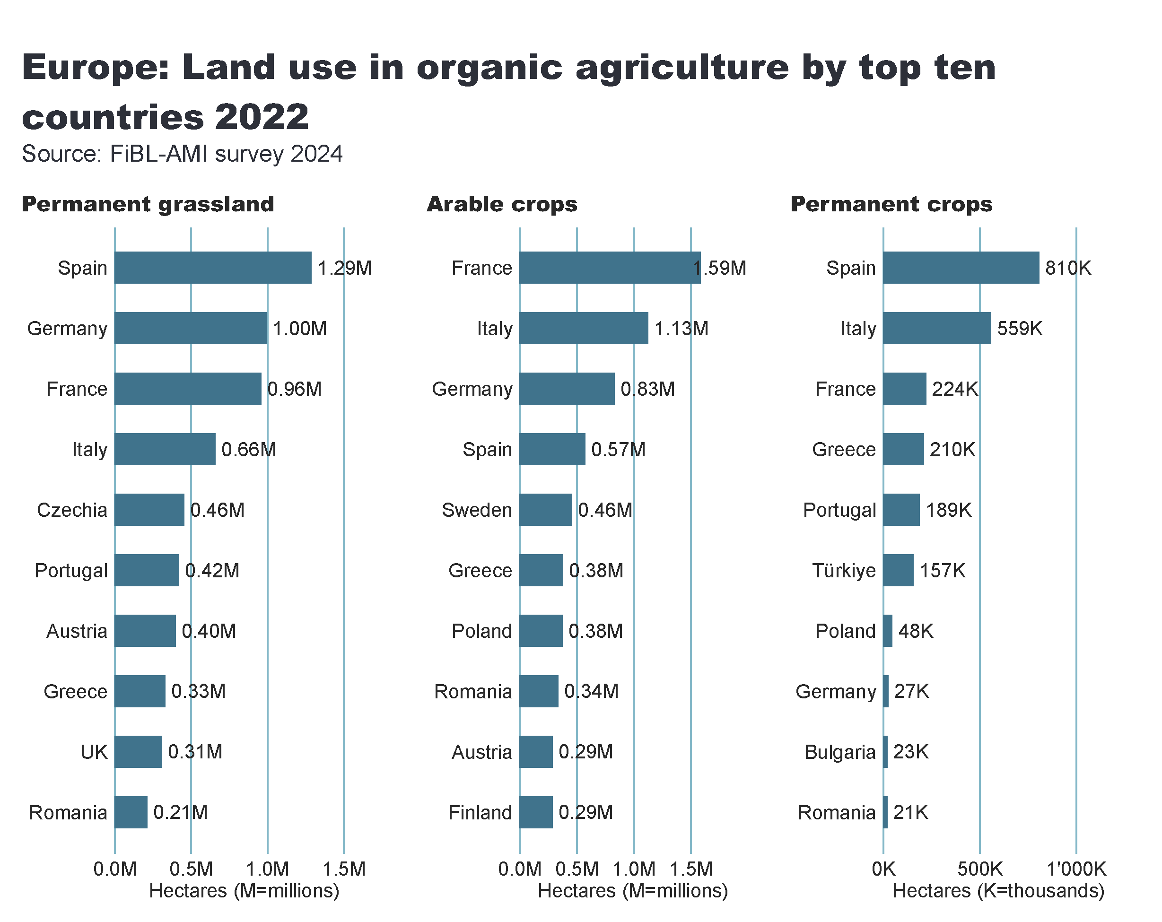
Europe_land_use_by_culture
Notes:
Arable crops
No alt text provided
textbox
No alt text provided
card
No alt text provided
Permanent crops
No alt text provided
Permanent grassland
No alt text provided

Slide 19
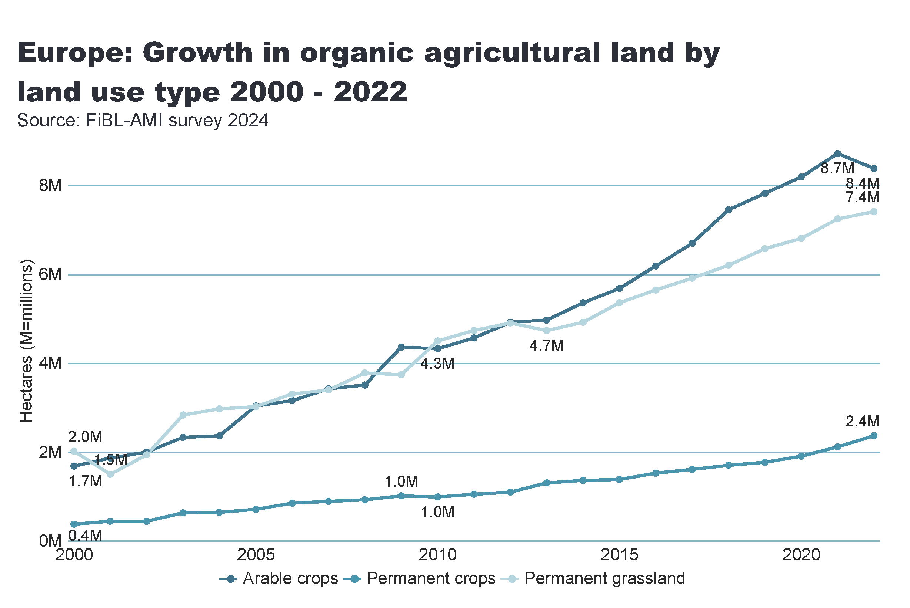
Europe_land_use_development
Notes:
Arable land
No alt text provided
textbox
No alt text provided
card
No alt text provided

Slide 20
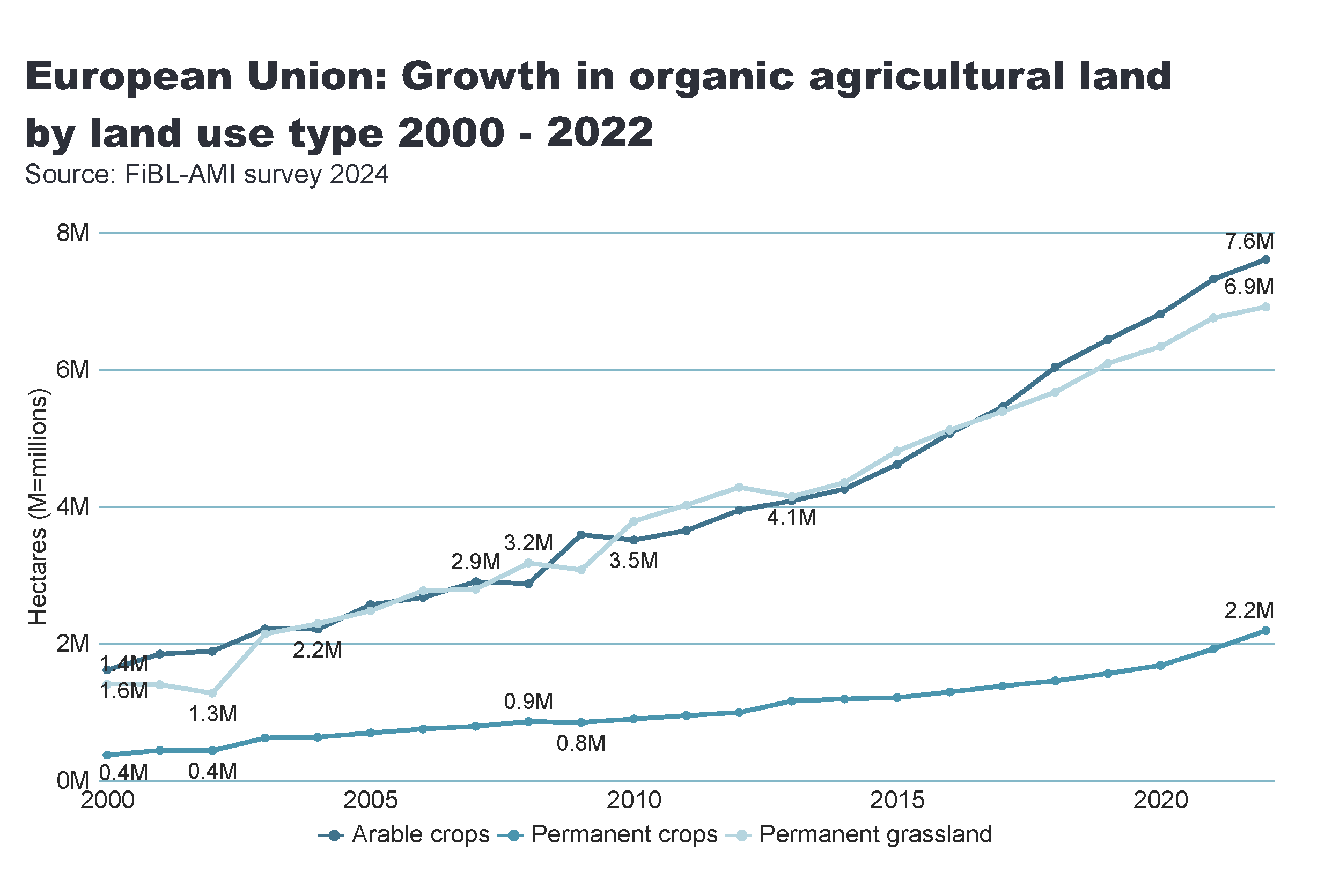
European_Union_land_use_by_culture
Notes:
Arable land
No alt text provided
textbox
No alt text provided
card
No alt text provided

Slide 21
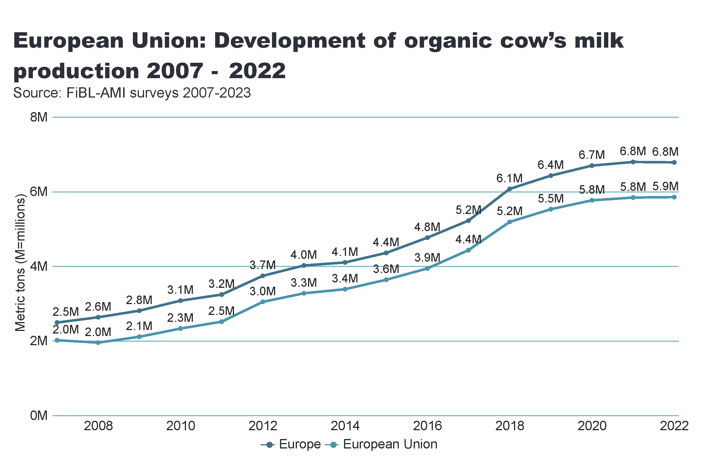
milk
Notes:
Arable land
No alt text provided
textbox
No alt text provided
card
No alt text provided

Slide 22
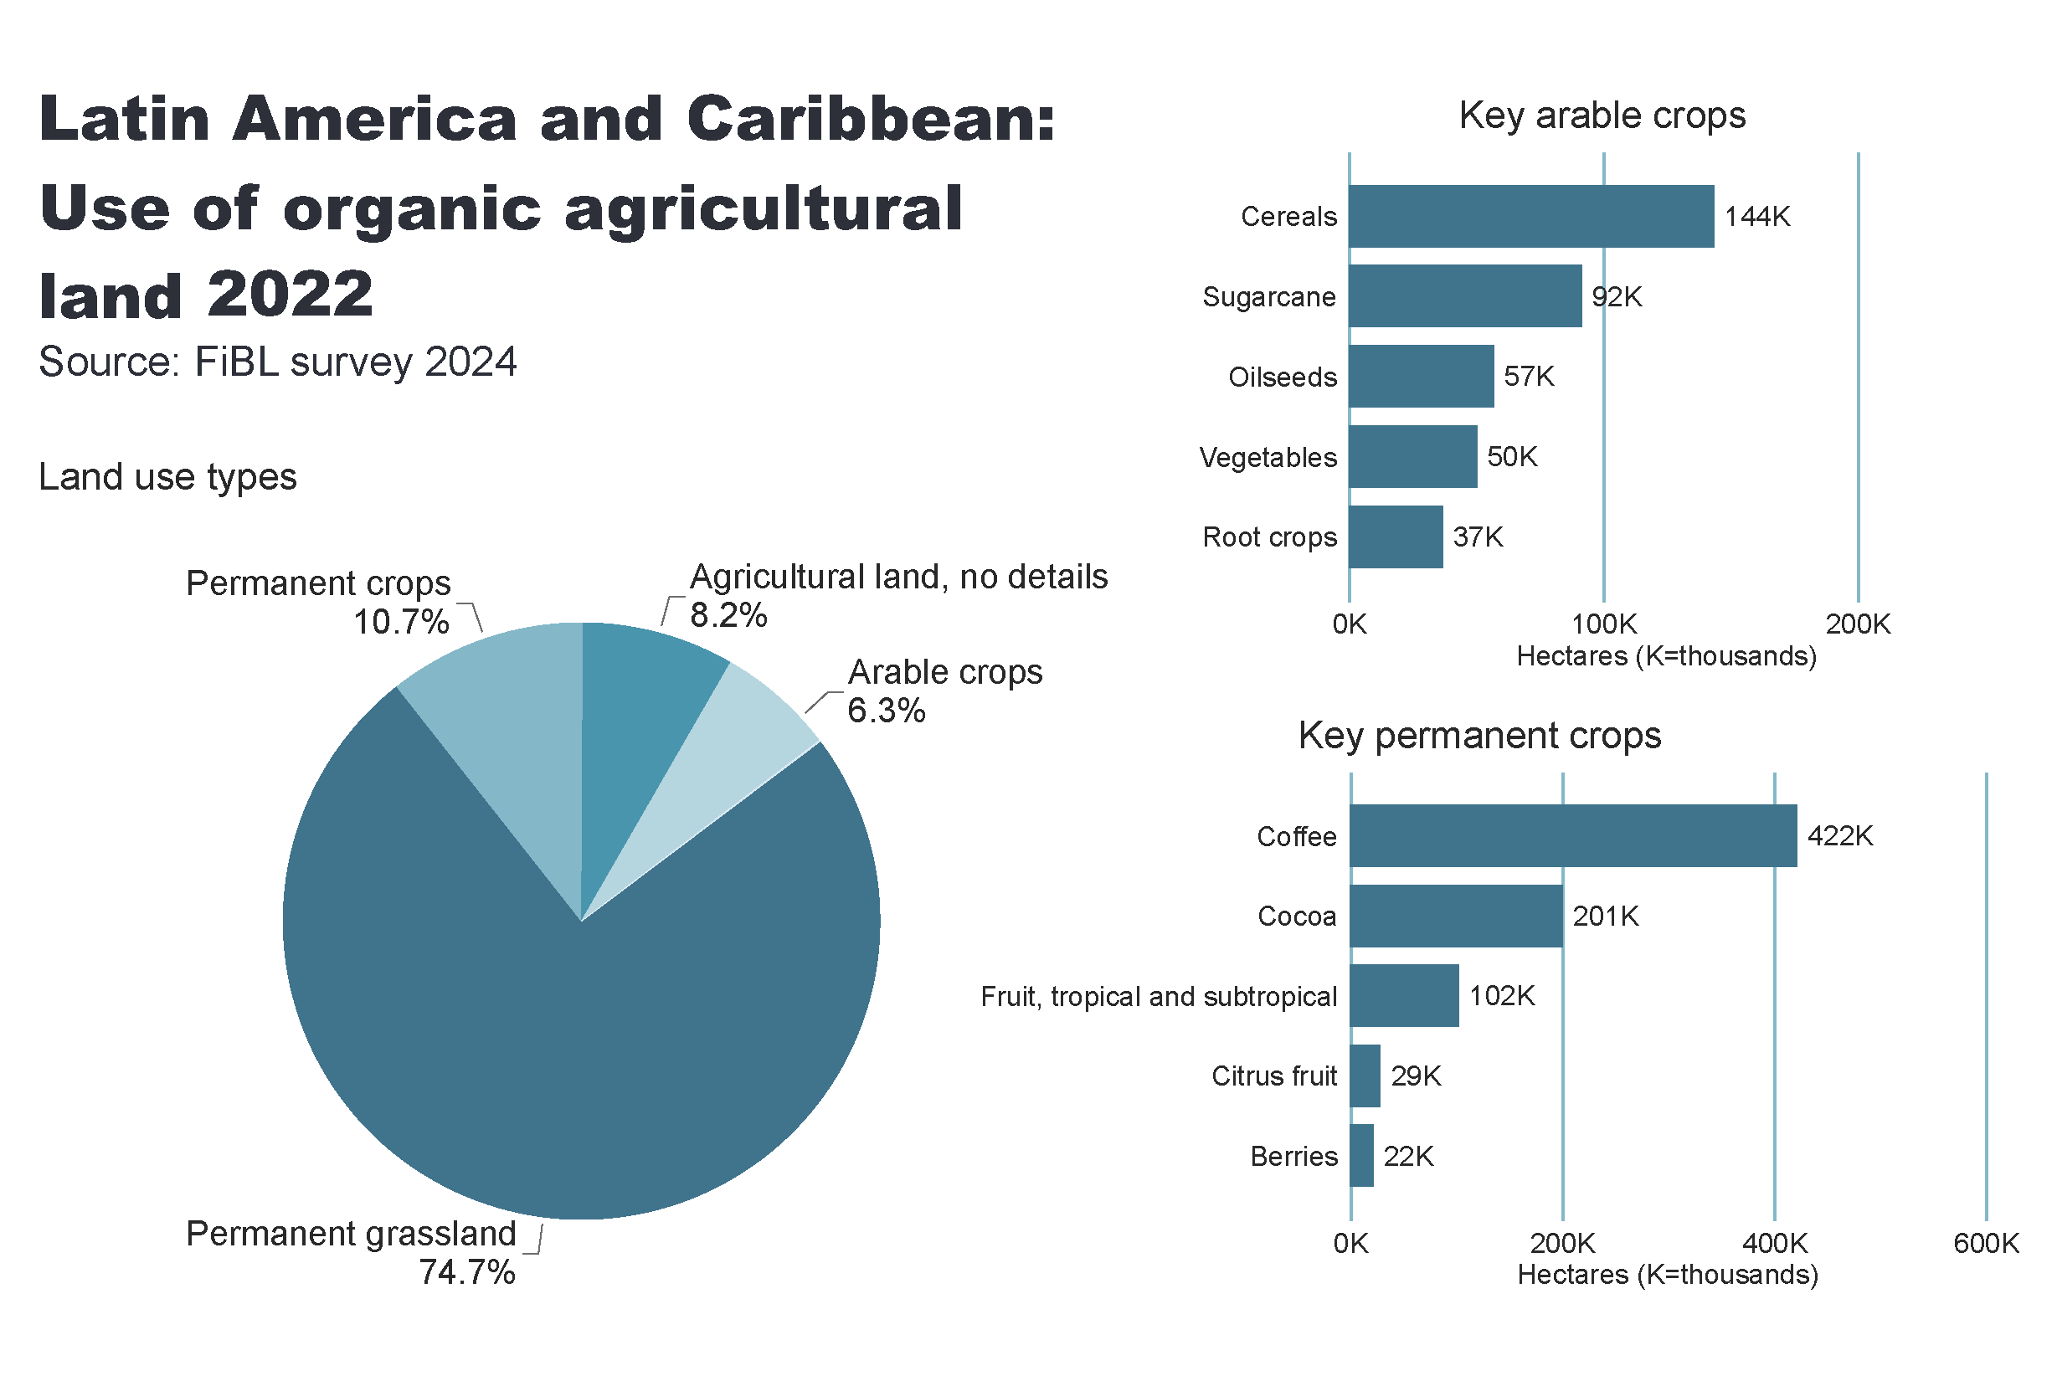
LA_land_use
Notes:
Land use types
No alt text provided
card
No alt text provided
Key arable crops
No alt text provided
Key permanent crops
No alt text provided
textbox
No alt text provided

Slide 23
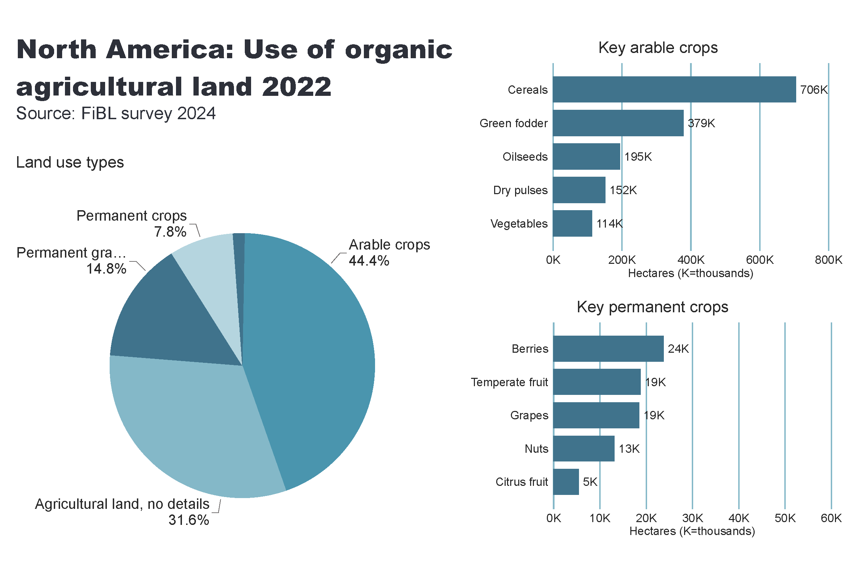
NA_land_use
Notes:
Land use types
No alt text provided
card
No alt text provided
Key arable crops
No alt text provided
Key permanent crops
No alt text provided
textbox
No alt text provided

Slide 24
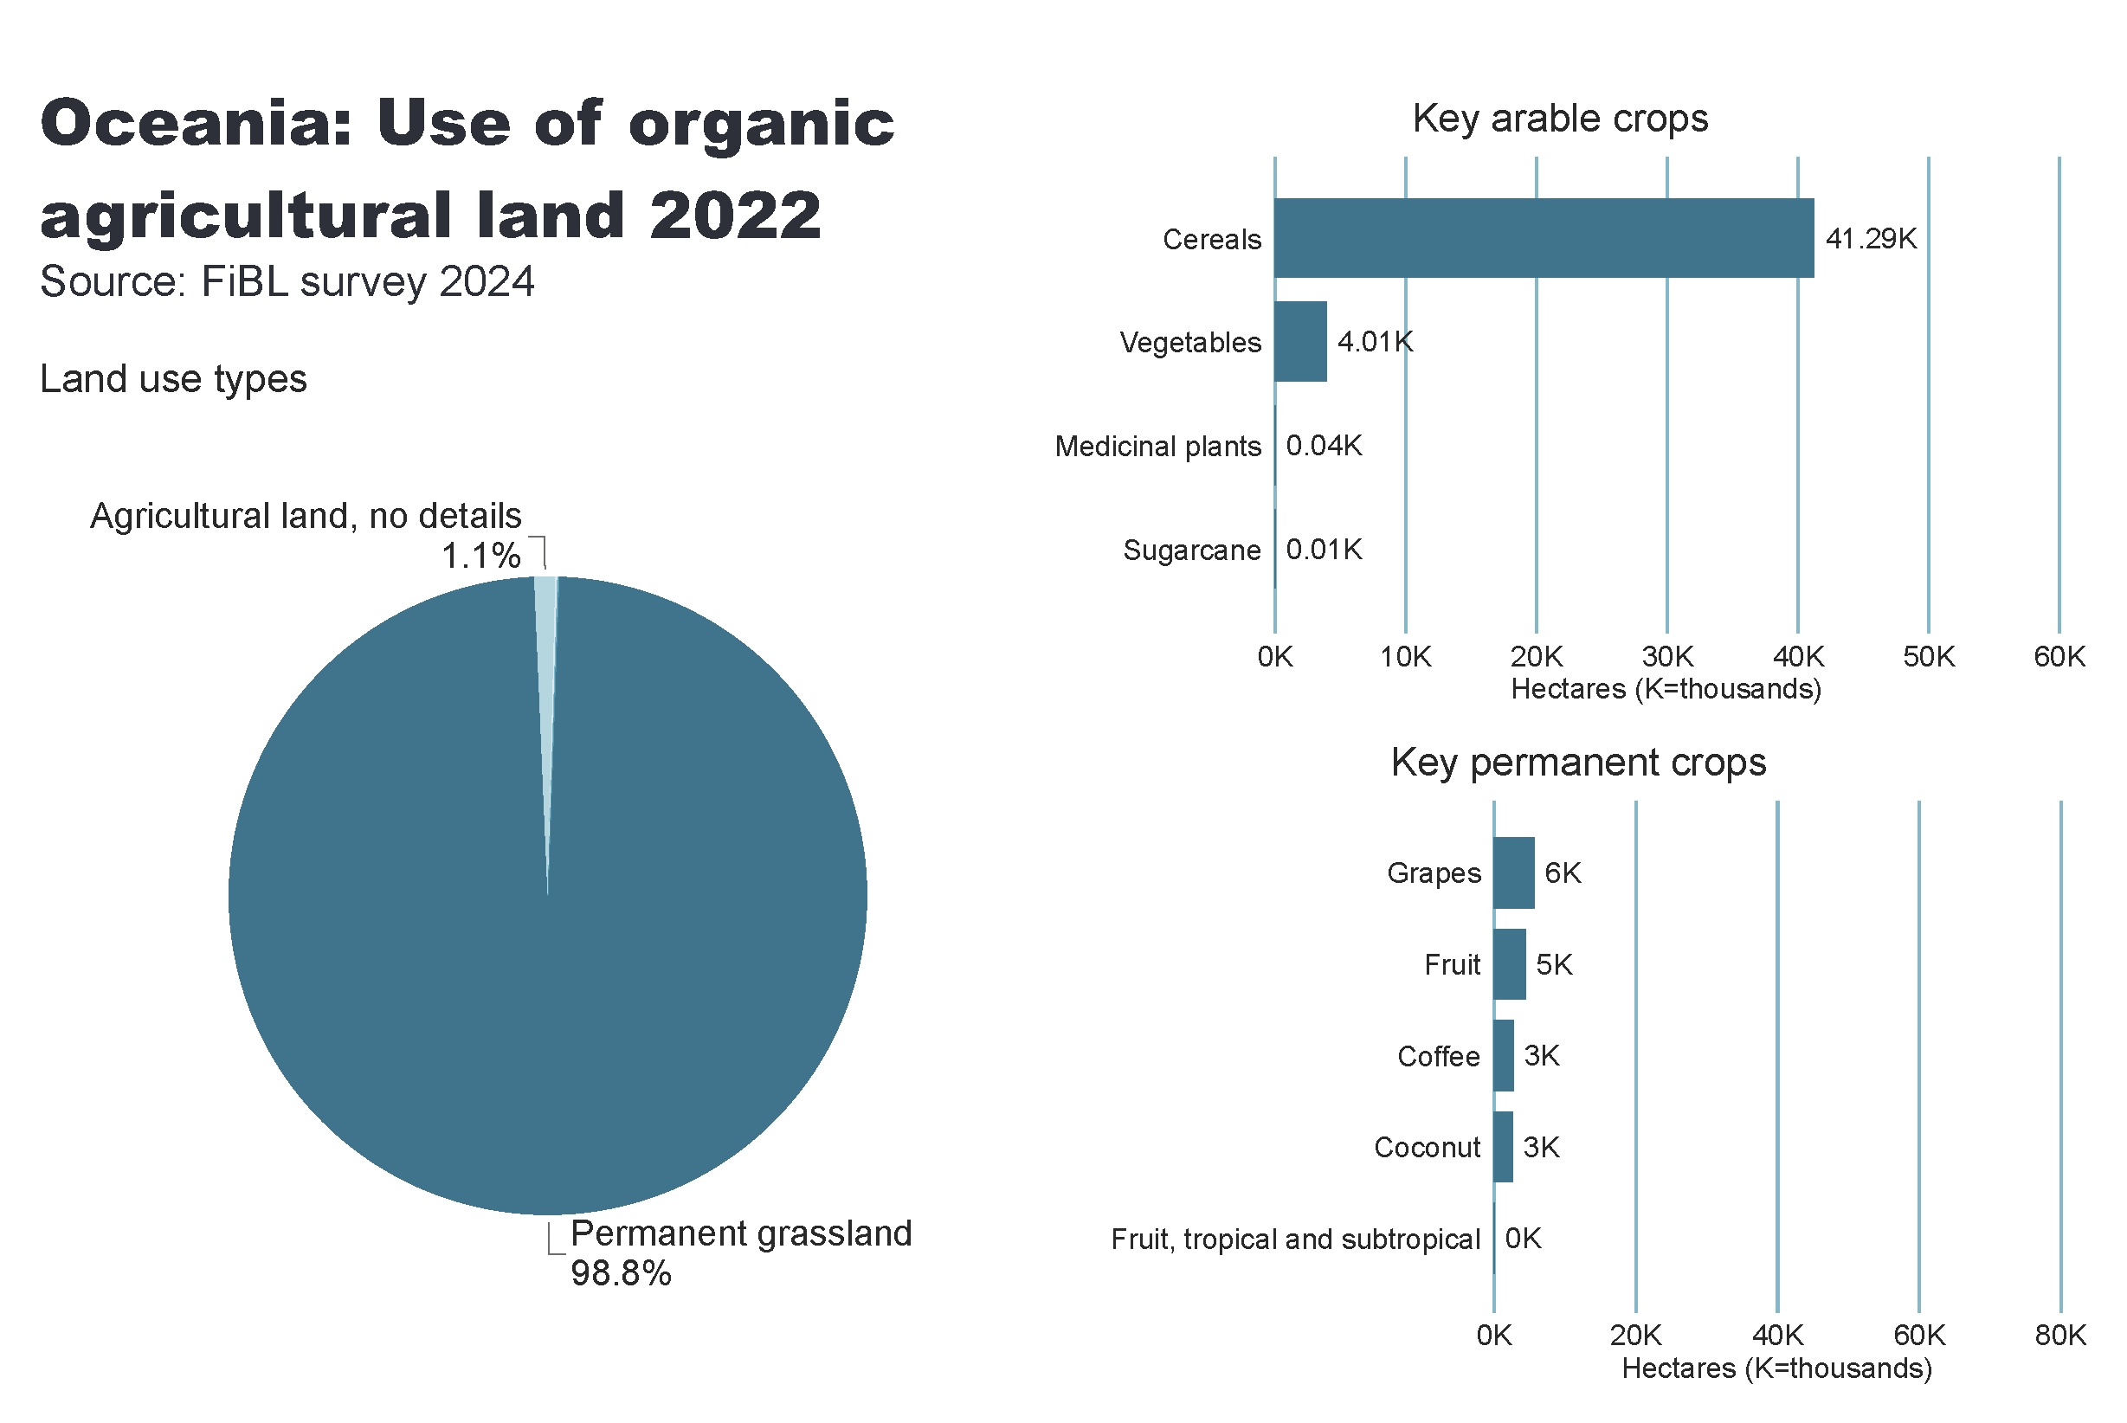
Oceania_land_use
Notes:
Land use types
No alt text provided
card
No alt text provided
Key arable crops
No alt text provided
Key permanent crops
No alt text provided
textbox
No alt text provided

Slide 25
Further organic areas: Wild collection and aquaculture
Apart from land dedicated to organic agriculture, there are further areas of organic land dedicated to other activities.
The largest parts of these are wild collection areas and beekeeping areas.
Further non-agricultural areas include aquaculture, forests, and grazing areas on non-agricultural land.
These areas totalled 36.4 million hectares, and all the organic areas together summed up to 132.4 million hectares.

Slide 26
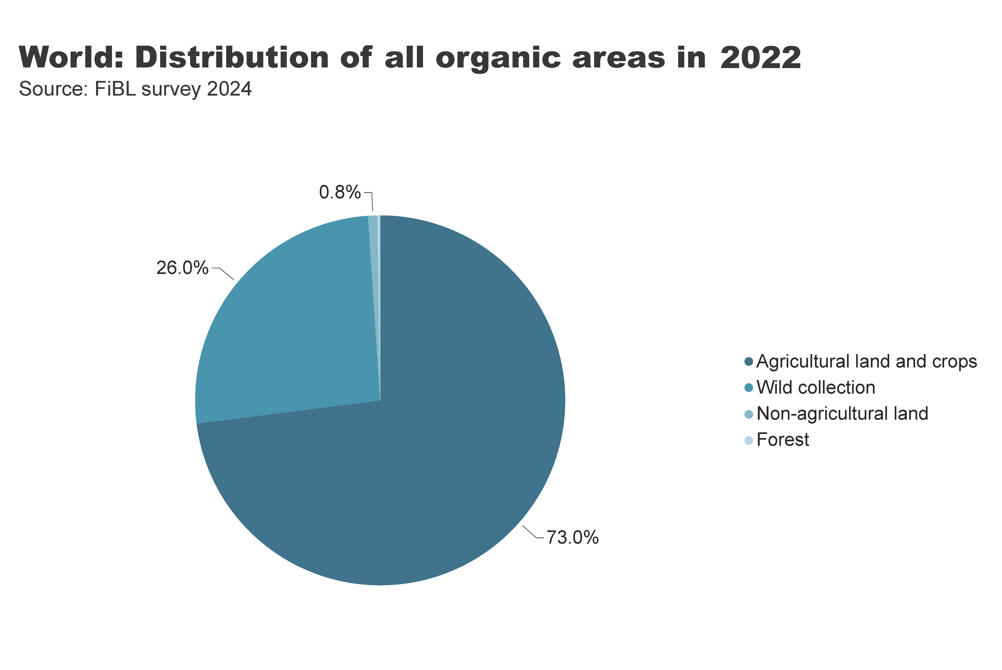
world_land_all_areas
Notes:
textbox
No alt text provided
card
No alt text provided
pieChart
No alt text provided

Slide 27
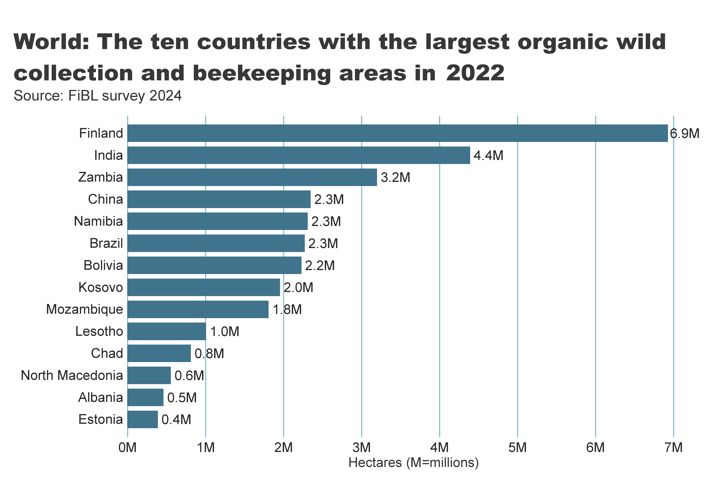
wild_ collection_by_country
Notes:
textbox
No alt text provided
clusteredBarChart
No alt text provided
card
No alt text provided

Slide 28
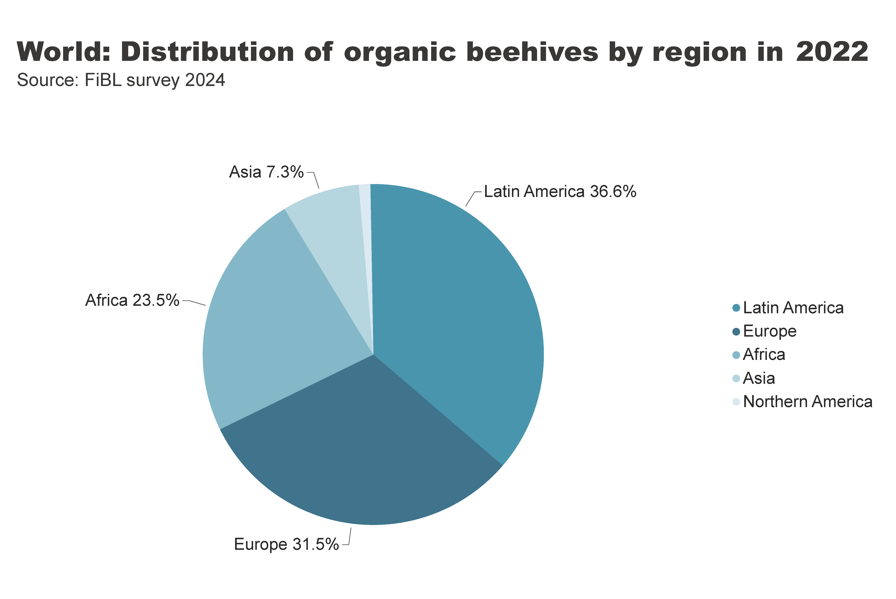
beehives_by_region
Notes:
textbox
No alt text provided
pieChart
No alt text provided
card
No alt text provided

Slide 29
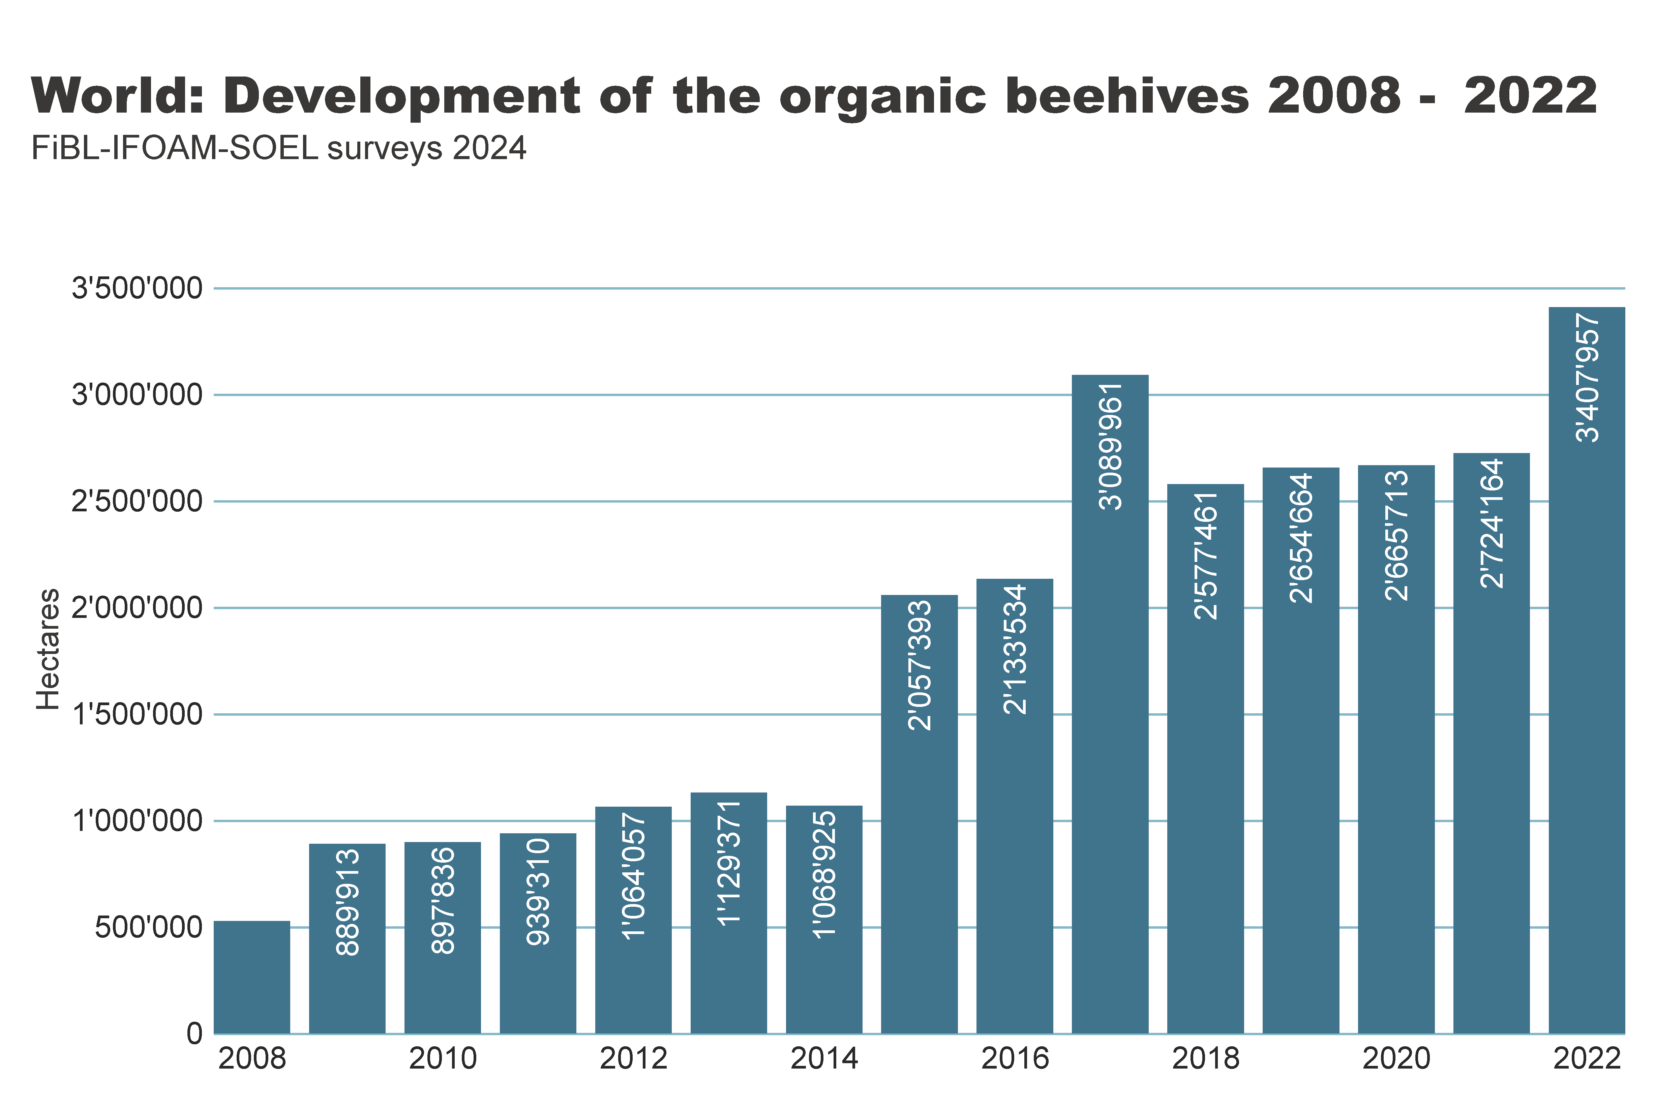
beehives_by country
Notes:
textbox
No alt text provided
clusteredColumnChart
No alt text provided
card
No alt text provided

Slide 30
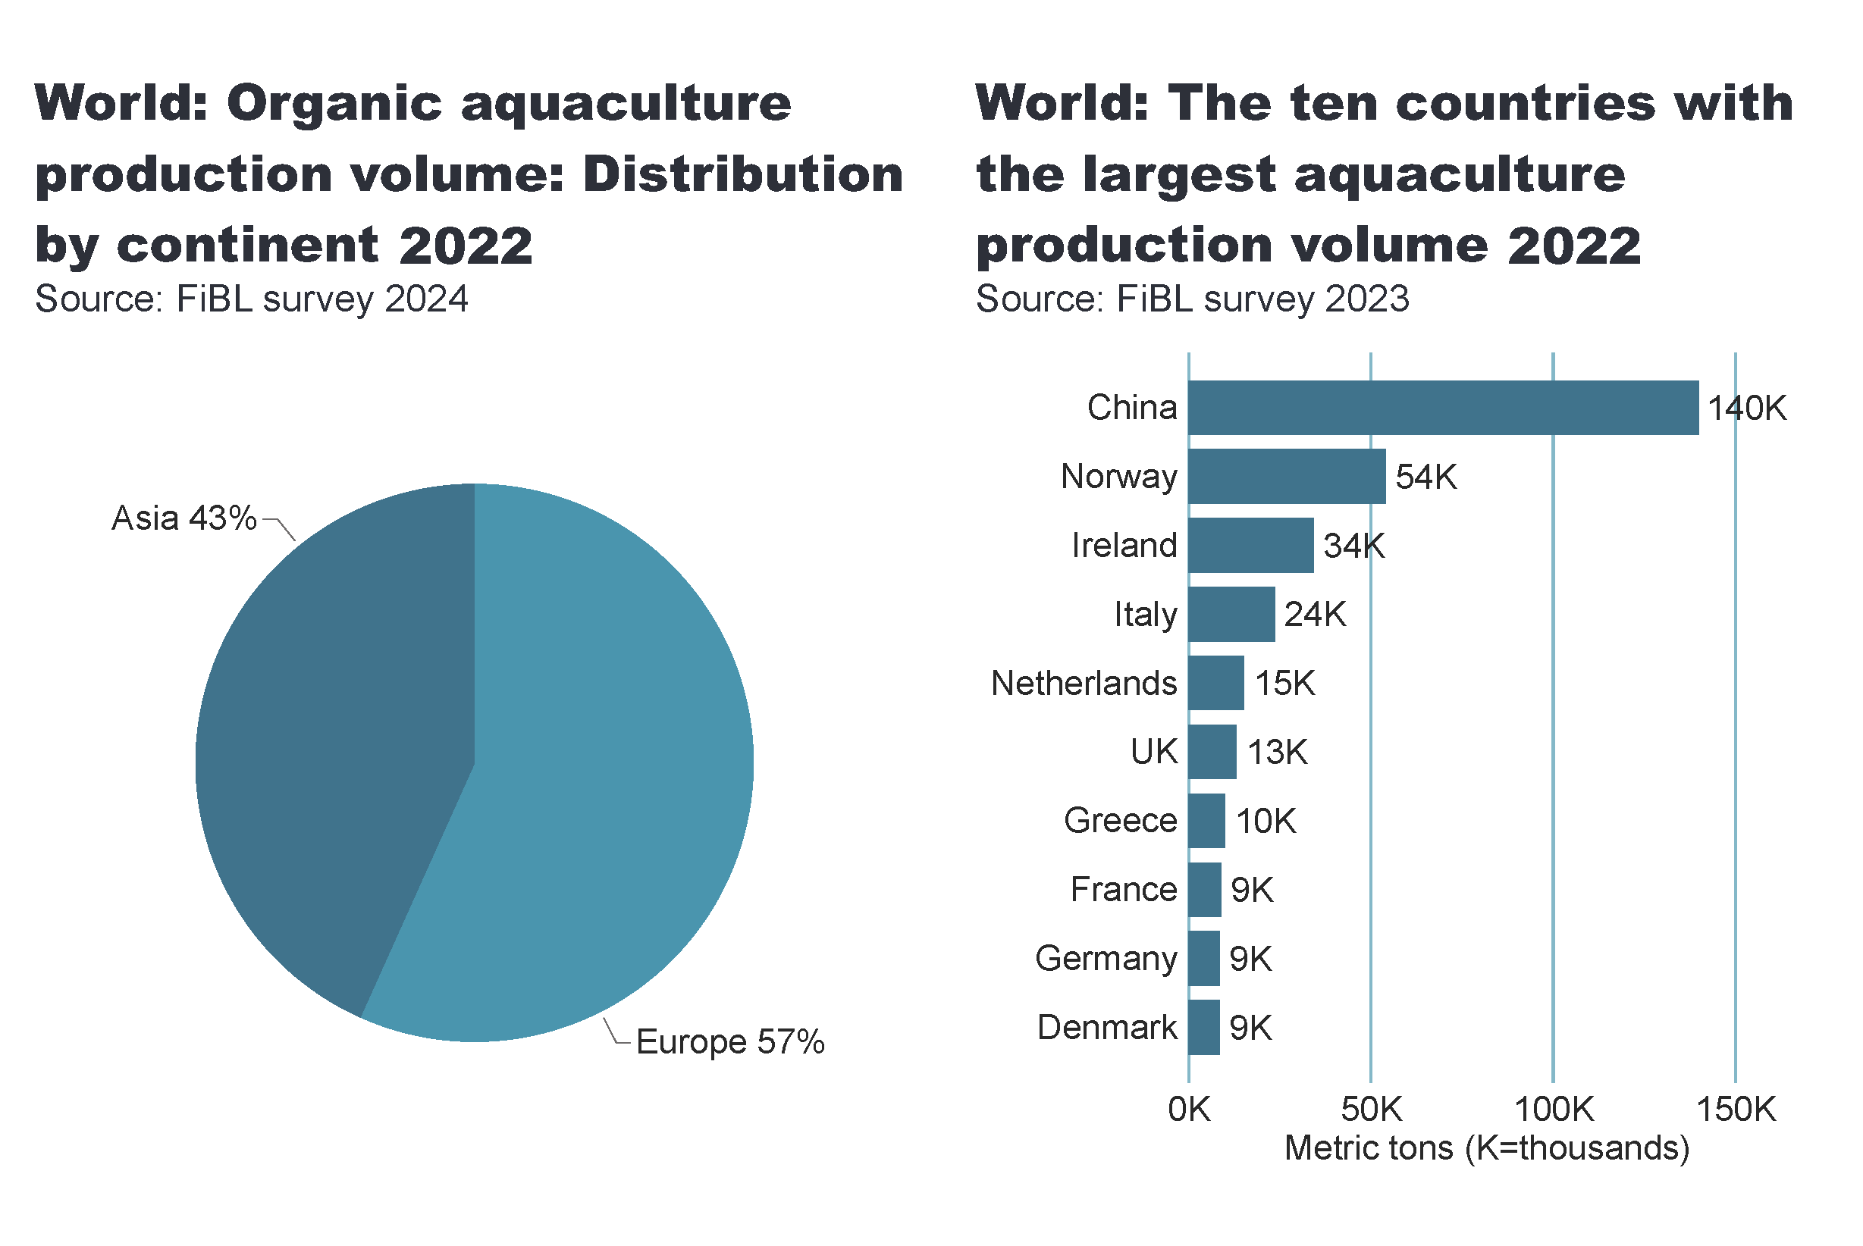
aquaculture_country
Notes:
pieChart
No alt text provided
card
No alt text provided
textbox
No alt text provided
clusteredBarChart
No alt text provided
card
No alt text provided
textbox
No alt text provided

Slide 31
Crops grown in organic agriculture

Slide 32
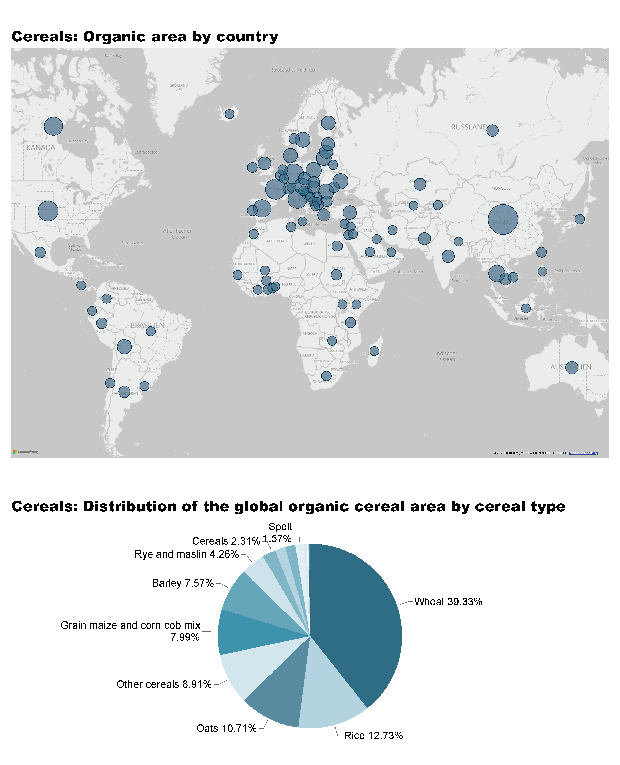
Cereals_1a
Notes:
Cereals: Organic area by country
No alt text provided

Slide 33
Cereals_1b
Notes:
Cereals: Distribution of the global organic cereal area by cereal type
No alt text provided
textbox
No alt text provided

Slide 34
Cereals_2a
Notes:
The development of the organic cereal area in million hectares
No alt text provided
Organic cereal area by continent in hectares
No alt text provided

Slide 35
Cereals_2b
Notes:
The countries with the highest organic cereal area share in %
No alt text provided
The countries wih the largest organic area in hectares
No alt text provided

Slide 36
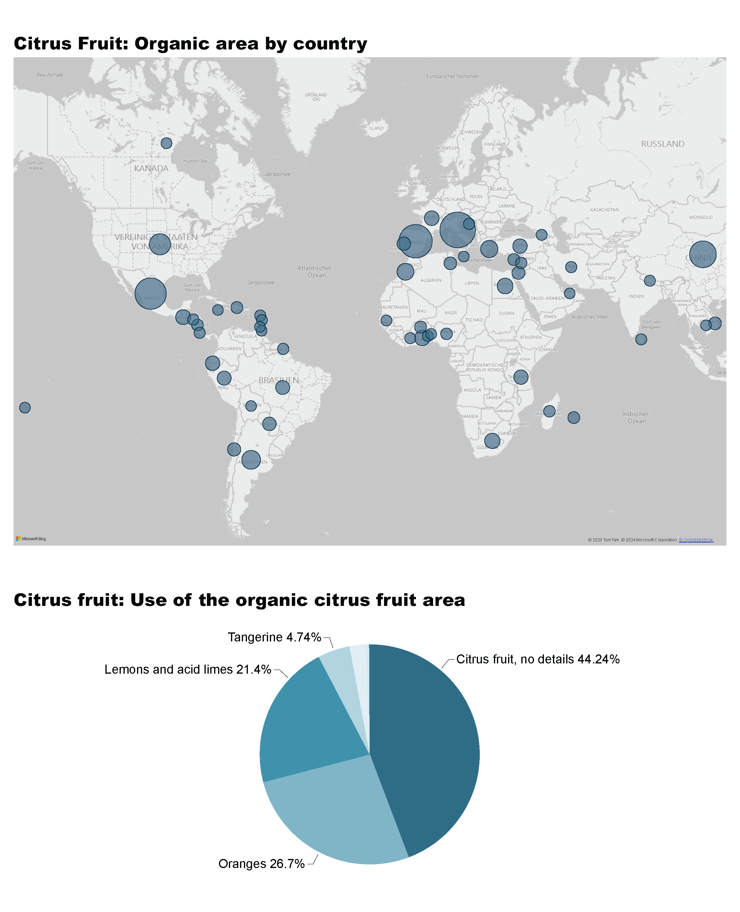
Citrus Fruit_1a
Notes:
Citrus Fruit: Organic area by country
No alt text provided
textbox
No alt text provided

Slide 37
Citrus Fruit_1b
Notes:
Citrus fruit: Use of the organic citrus fruit area
No alt text provided
textbox
No alt text provided

Slide 38
Citrus Fruit_2a
Notes:
The development of the organic citrus fruit area in thousand hectares
No alt text provided
Organic citrus fruit area by continent in hectares
No alt text provided

Slide 39
Citrus Fruit_2b
Notes:
The countries with the highest organic area share in %
No alt text provided
The countries wih the largest organic area in hectares
No alt text provided

Slide 40
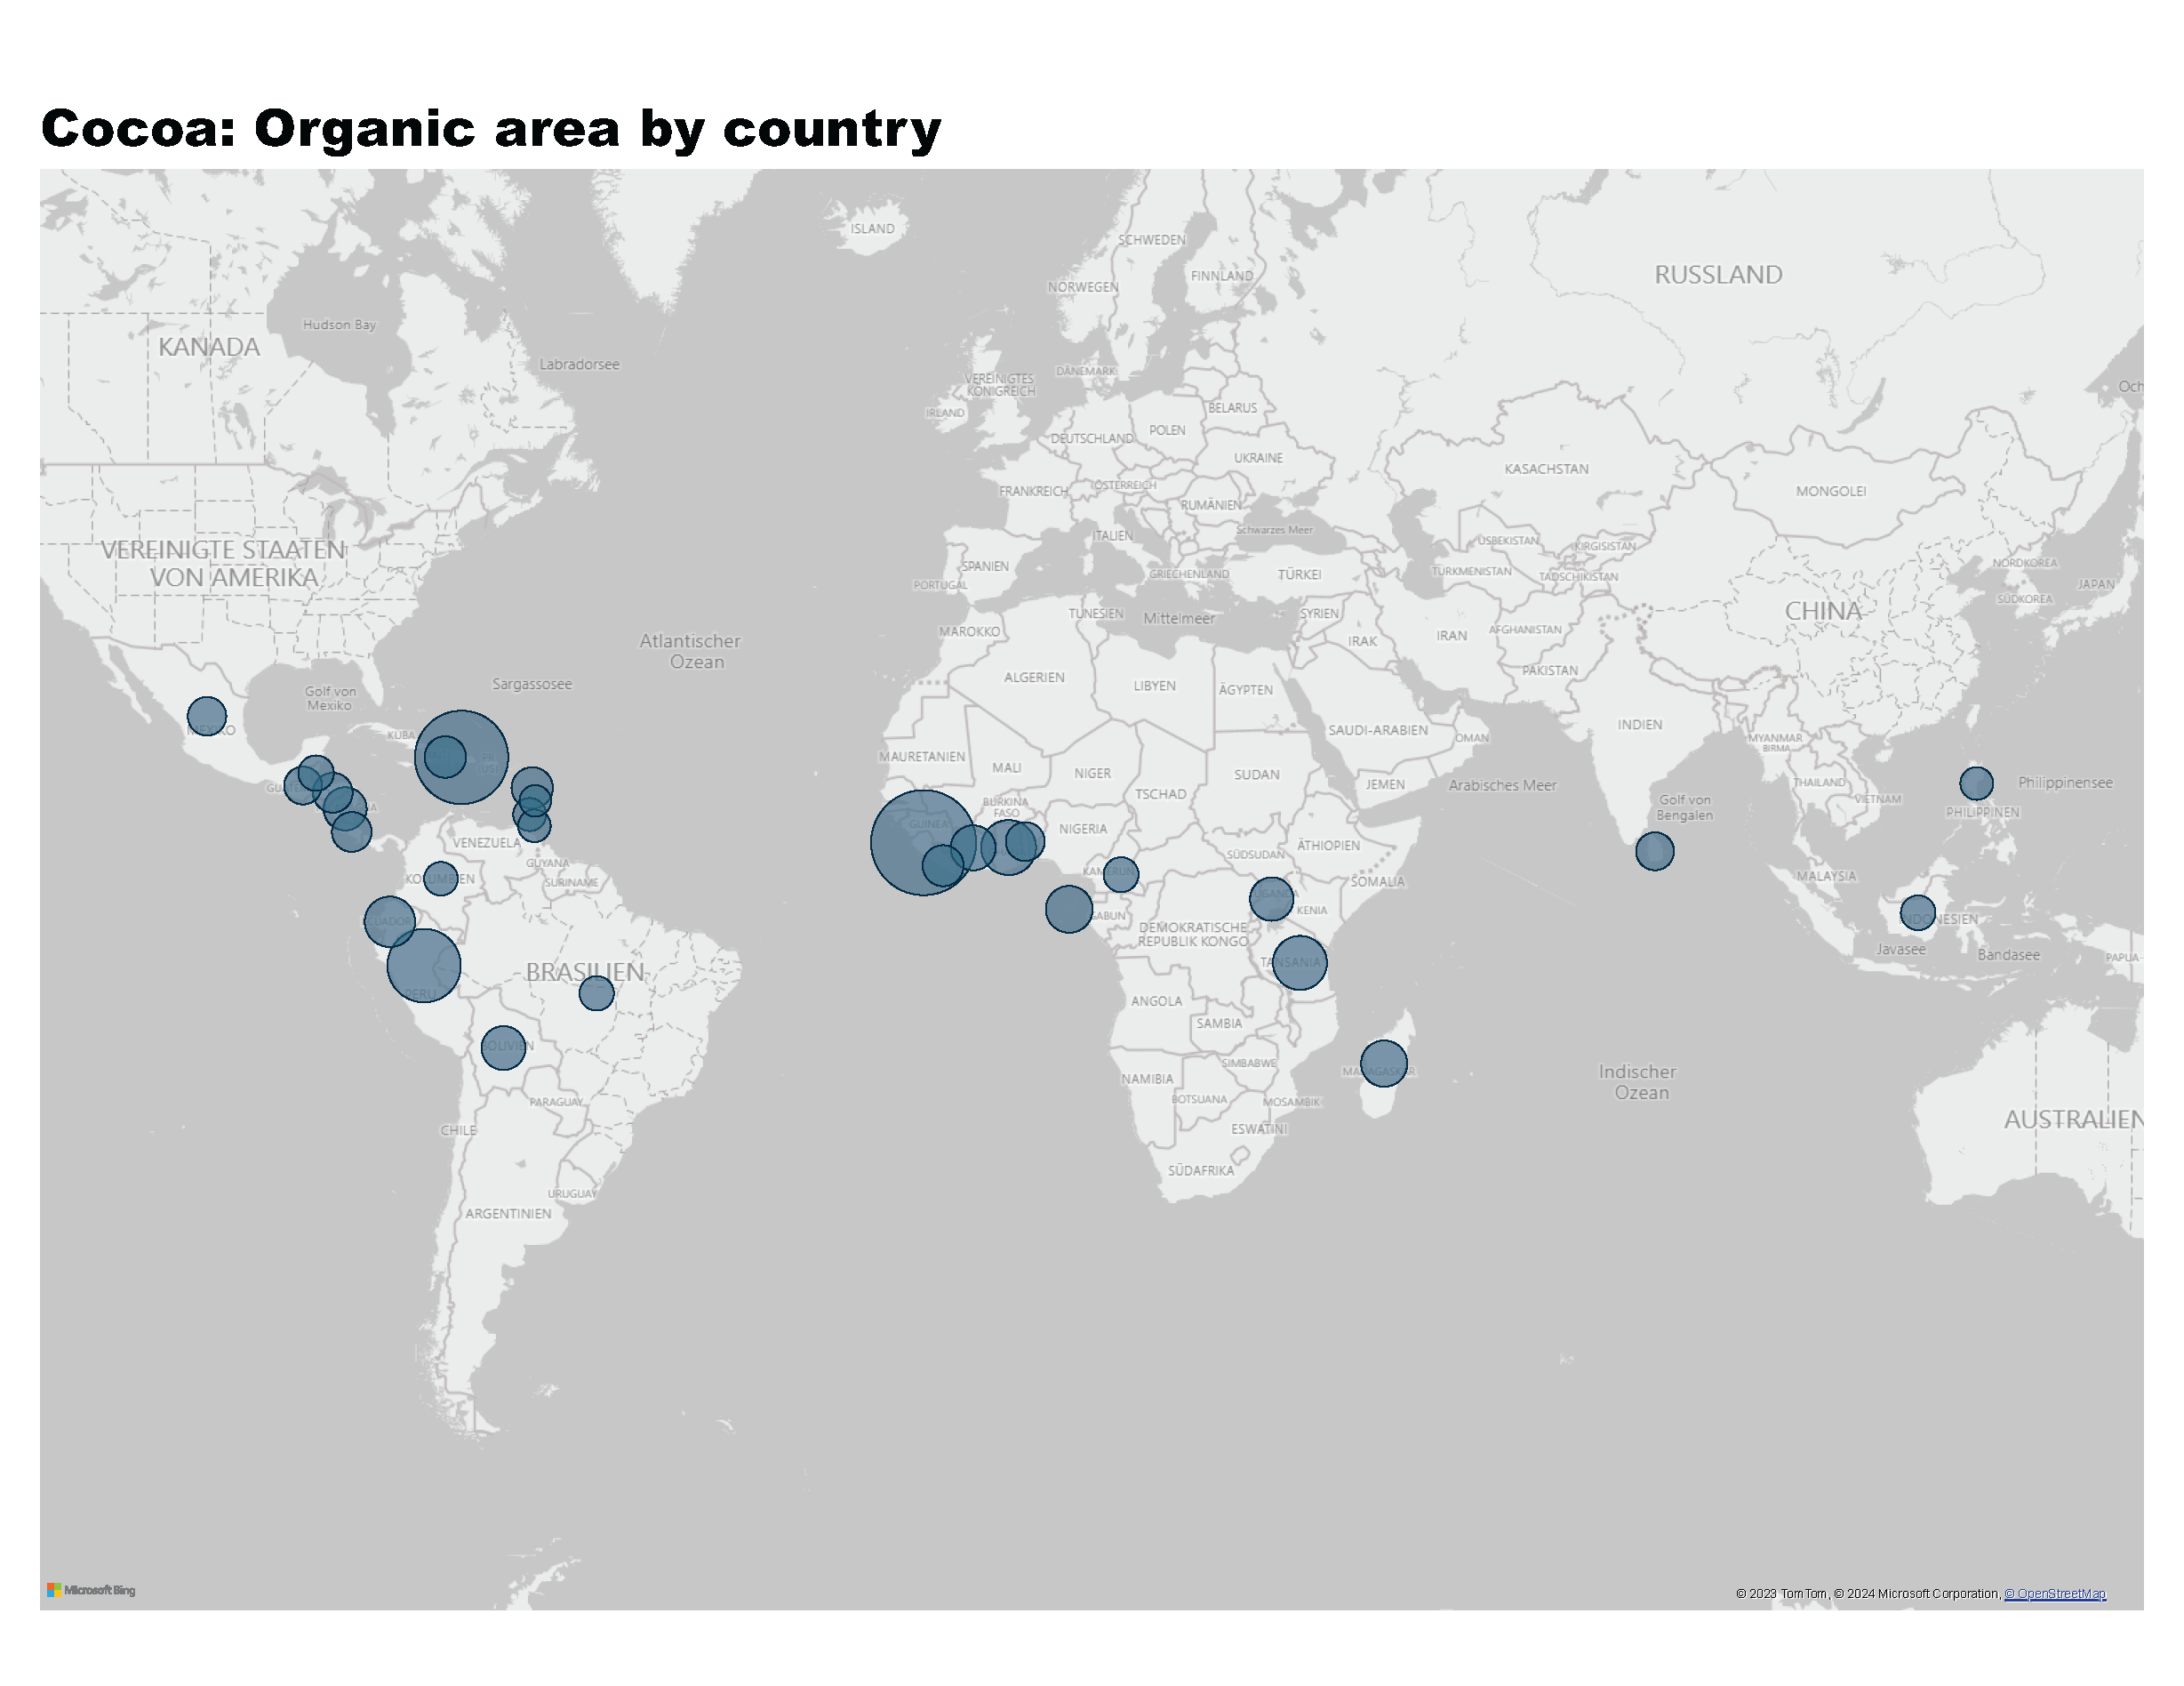
Cocoa_1a
Notes:
Cocoa: Organic area by country
No alt text provided
textbox
No alt text provided

Slide 41
Cocoa_2a
Notes:
The development of the organic cocoa area in thousand hectares
No alt text provided
Organic cocoa area by continent in hectares
No alt text provided

Slide 42
Cocoa_2b
Notes:
The countries with the highest organic cocoa area share in %
No alt text provided
The countries wih the largest organic area in hectares
No alt text provided

Slide 43
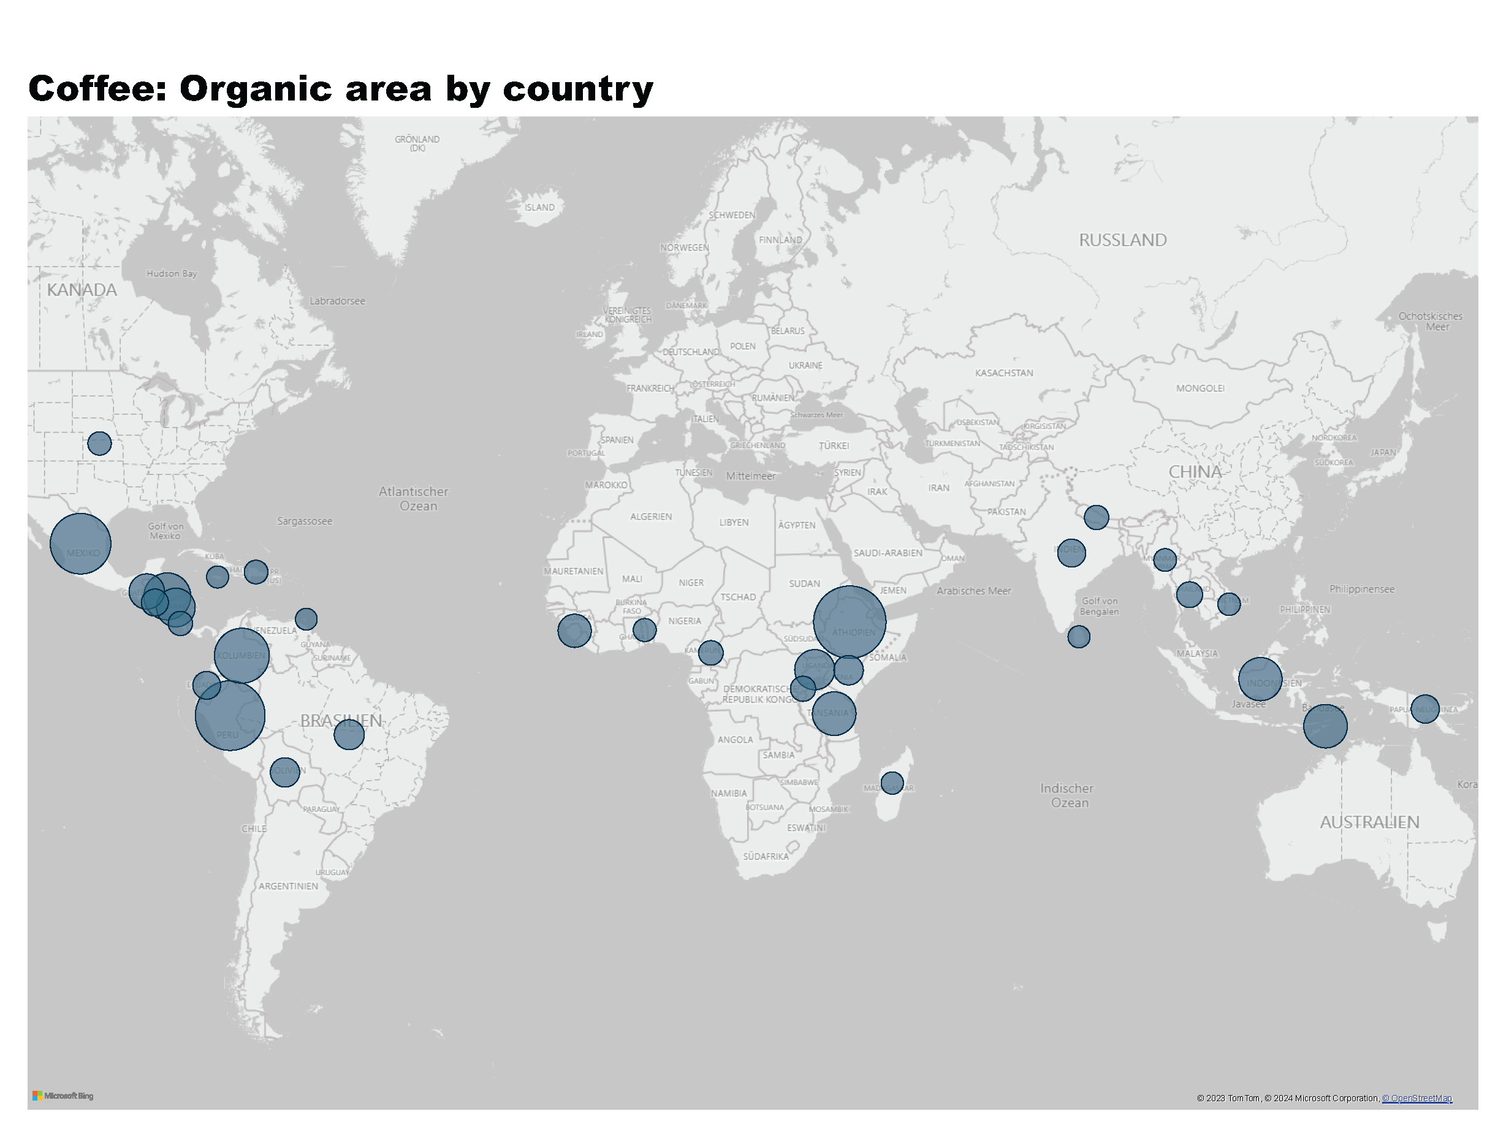
Coffee_1a
Notes:
Coffee: Organic area by country
No alt text provided
textbox
No alt text provided

Slide 44
Coffee_2a
Notes:
The development of the organic coffee area in million hectares
No alt text provided
Organic area by continent in hectares
No alt text provided

Slide 45
Coffee_2b
Notes:
The countries with the highest organic coffee area share in %
No alt text provided
The countries wih the largest organic area in hectares
No alt text provided

Slide 46
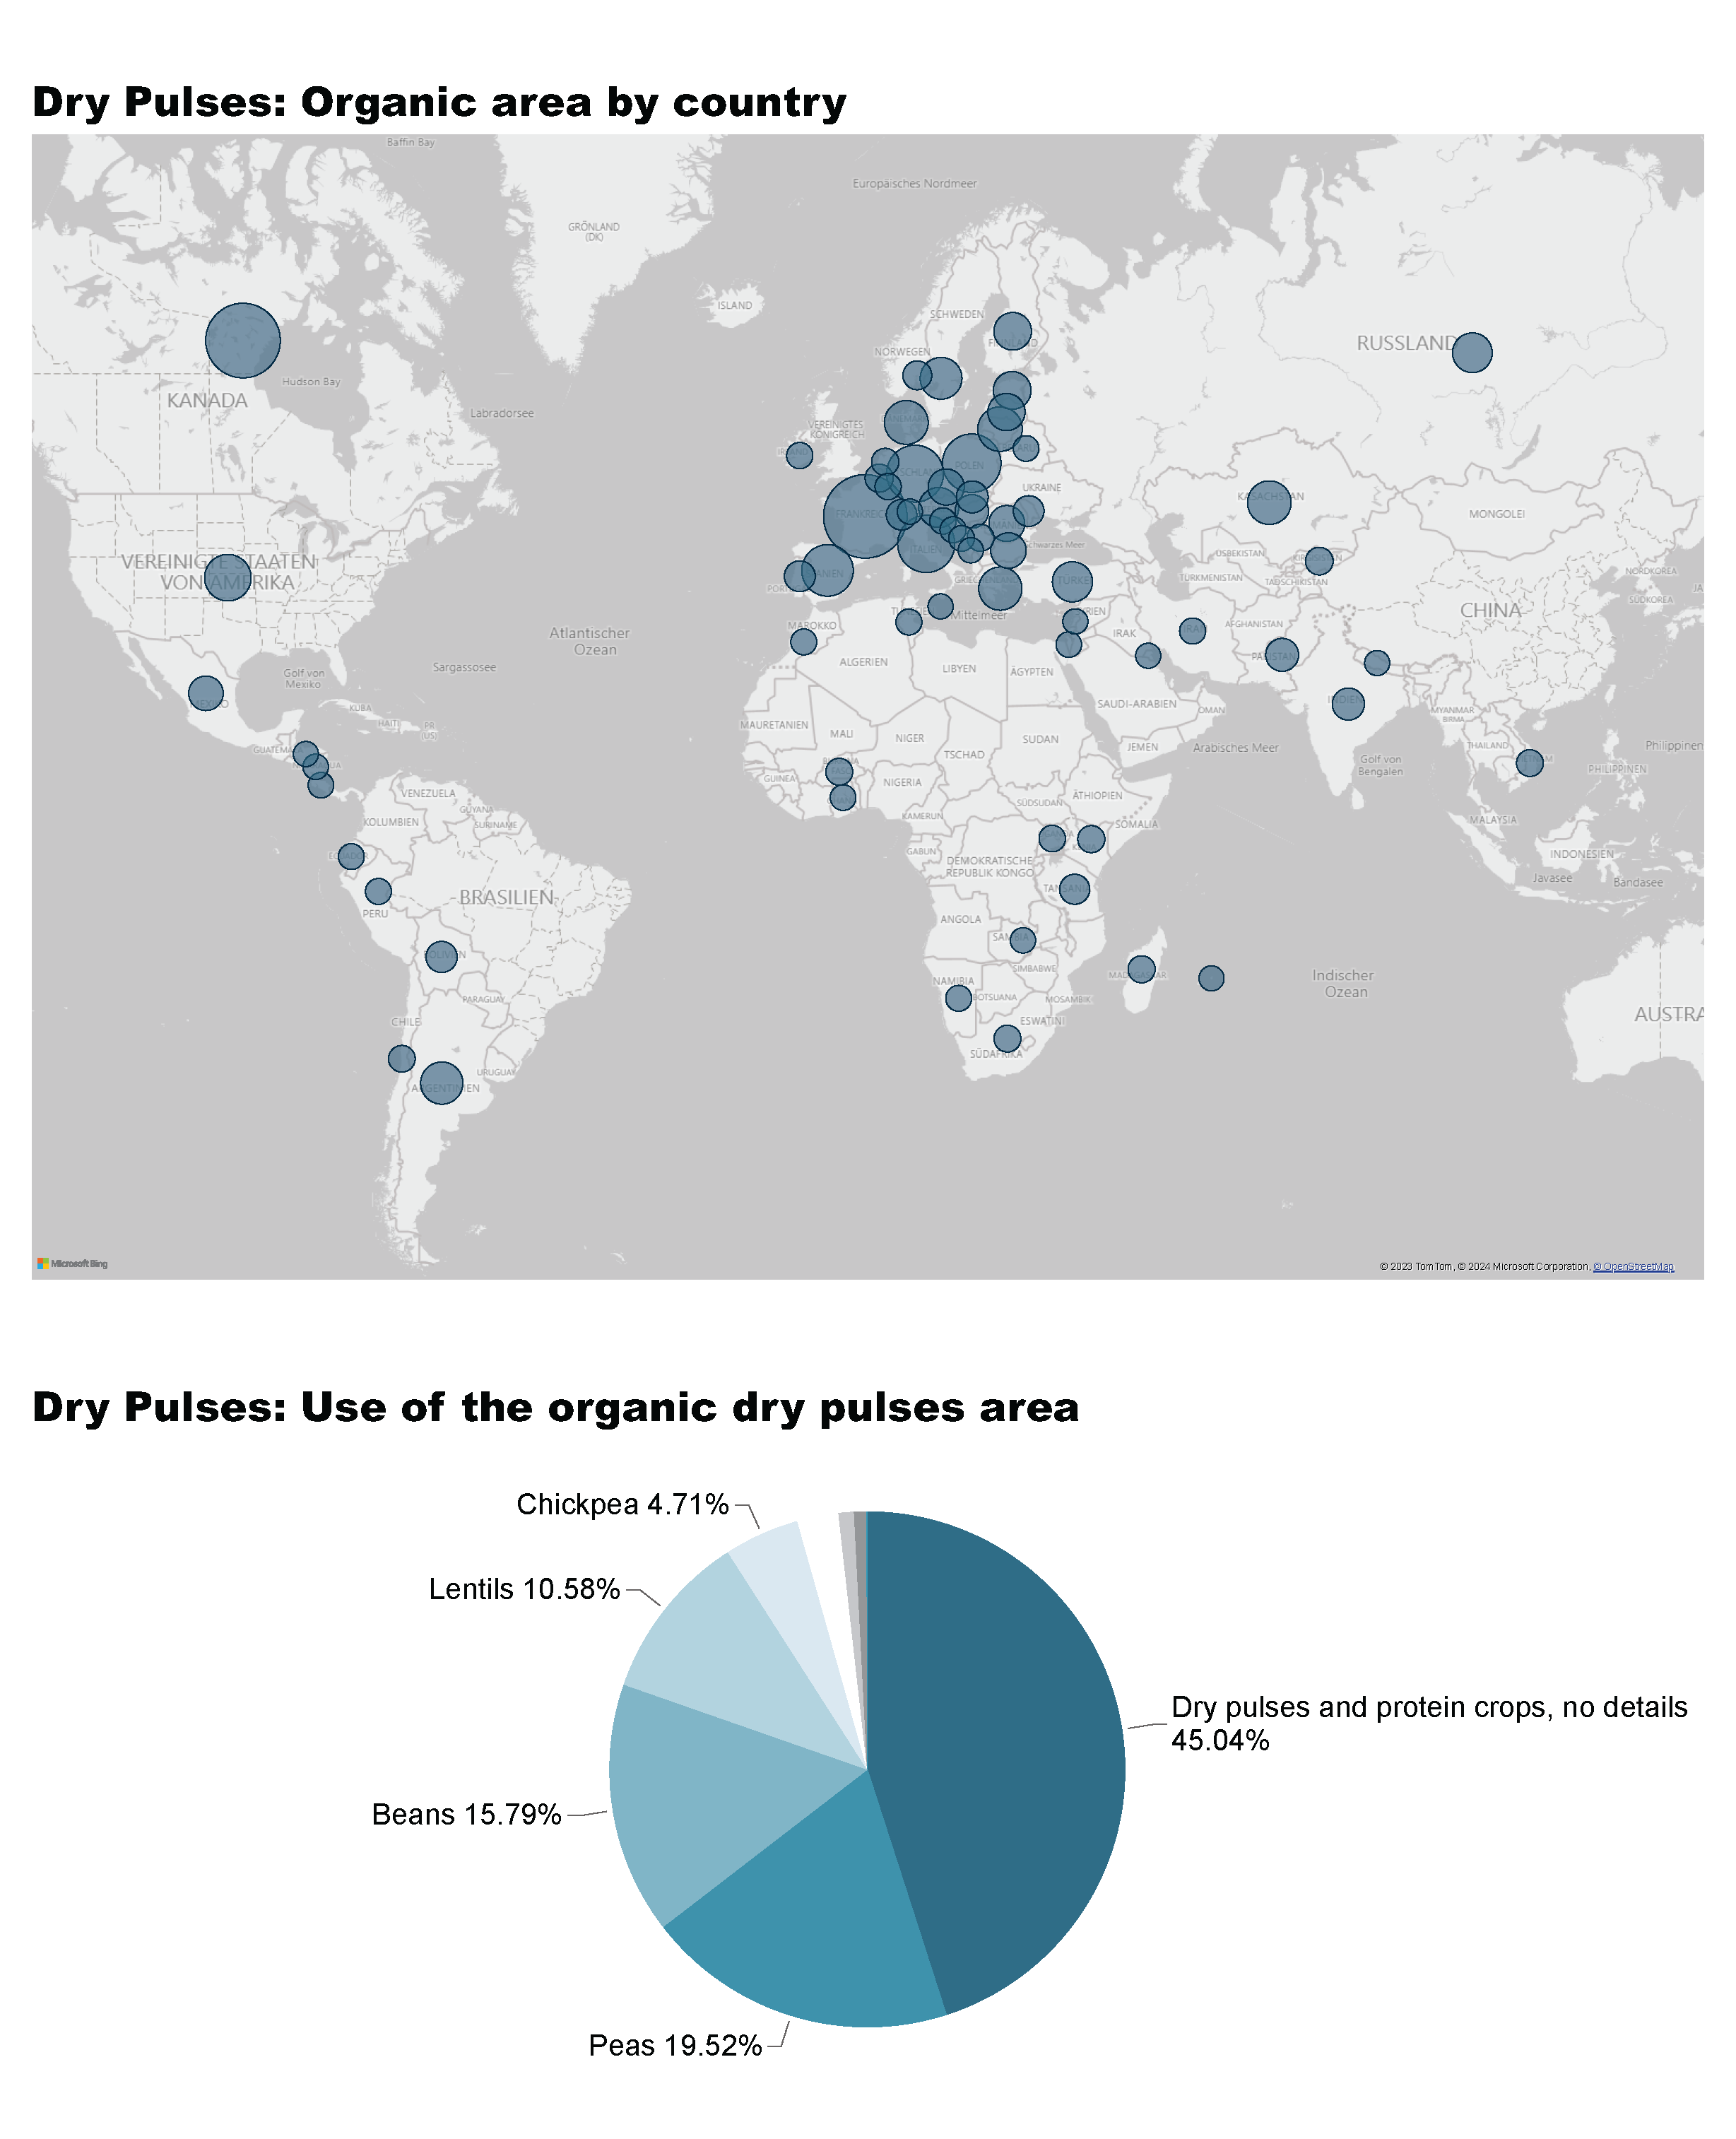
Dry Pulses_1a
Notes:
Dry Pulses: Organic area by country
No alt text provided

Slide 47
Dry Pulses_1b
Notes:
Dry Pulses: Use of the organic dry pulses area
No alt text provided
textbox
No alt text provided

Slide 48
Dry Pulses_2a
Notes:
The development of the dry pulses area in million hectares
No alt text provided
Organic dry pulses area by continent in hectares
No alt text provided

Slide 49
Dry Pulses_2b
Notes:
The countries with the highest organic area share in %
No alt text provided
The countries wih the largest organic area in hectares
No alt text provided

Slide 50
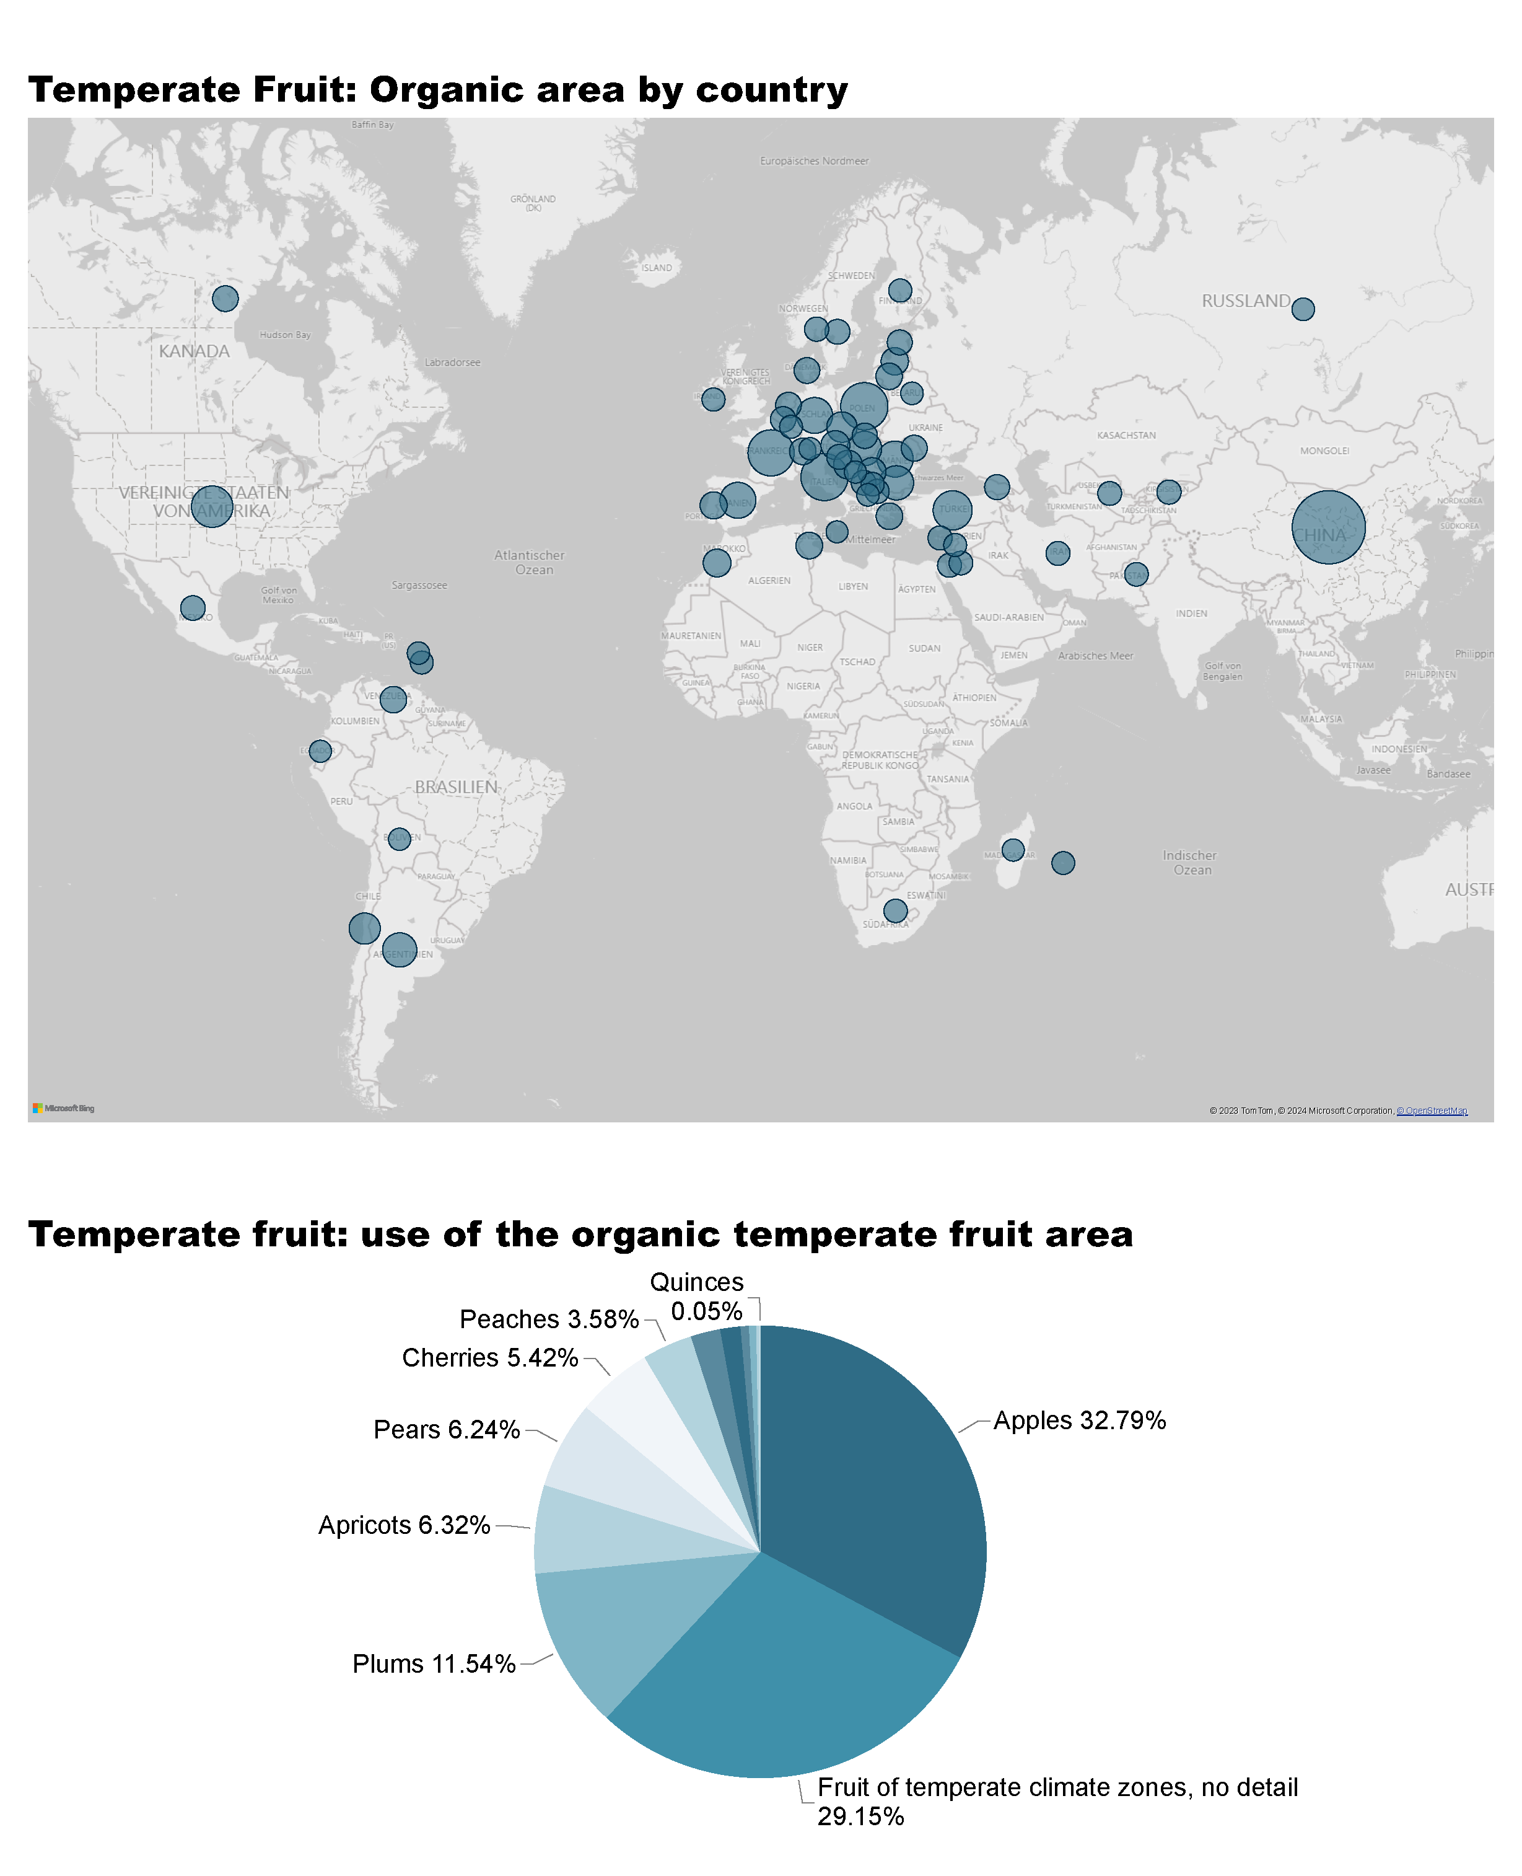
Temperate Fruit_1a
Notes:
Temperate Fruit: Organic area by country
No alt text provided

Slide 51
Temperate Fruit_1b
Notes:
Temperate fruit: use of the organic temperate fruit area
No alt text provided
textbox
No alt text provided

Slide 52
Temperate Fruit_2a
Notes:
The development of the temperate fruit area in thousand hectares
No alt text provided
Organic temperate fruit area by continent in hectares
No alt text provided

Slide 53
Temperate Fruit_2b
Notes:
The countries with the highest organic area share in %
No alt text provided
The countries wih the largest organic area in hectares
No alt text provided

Slide 54
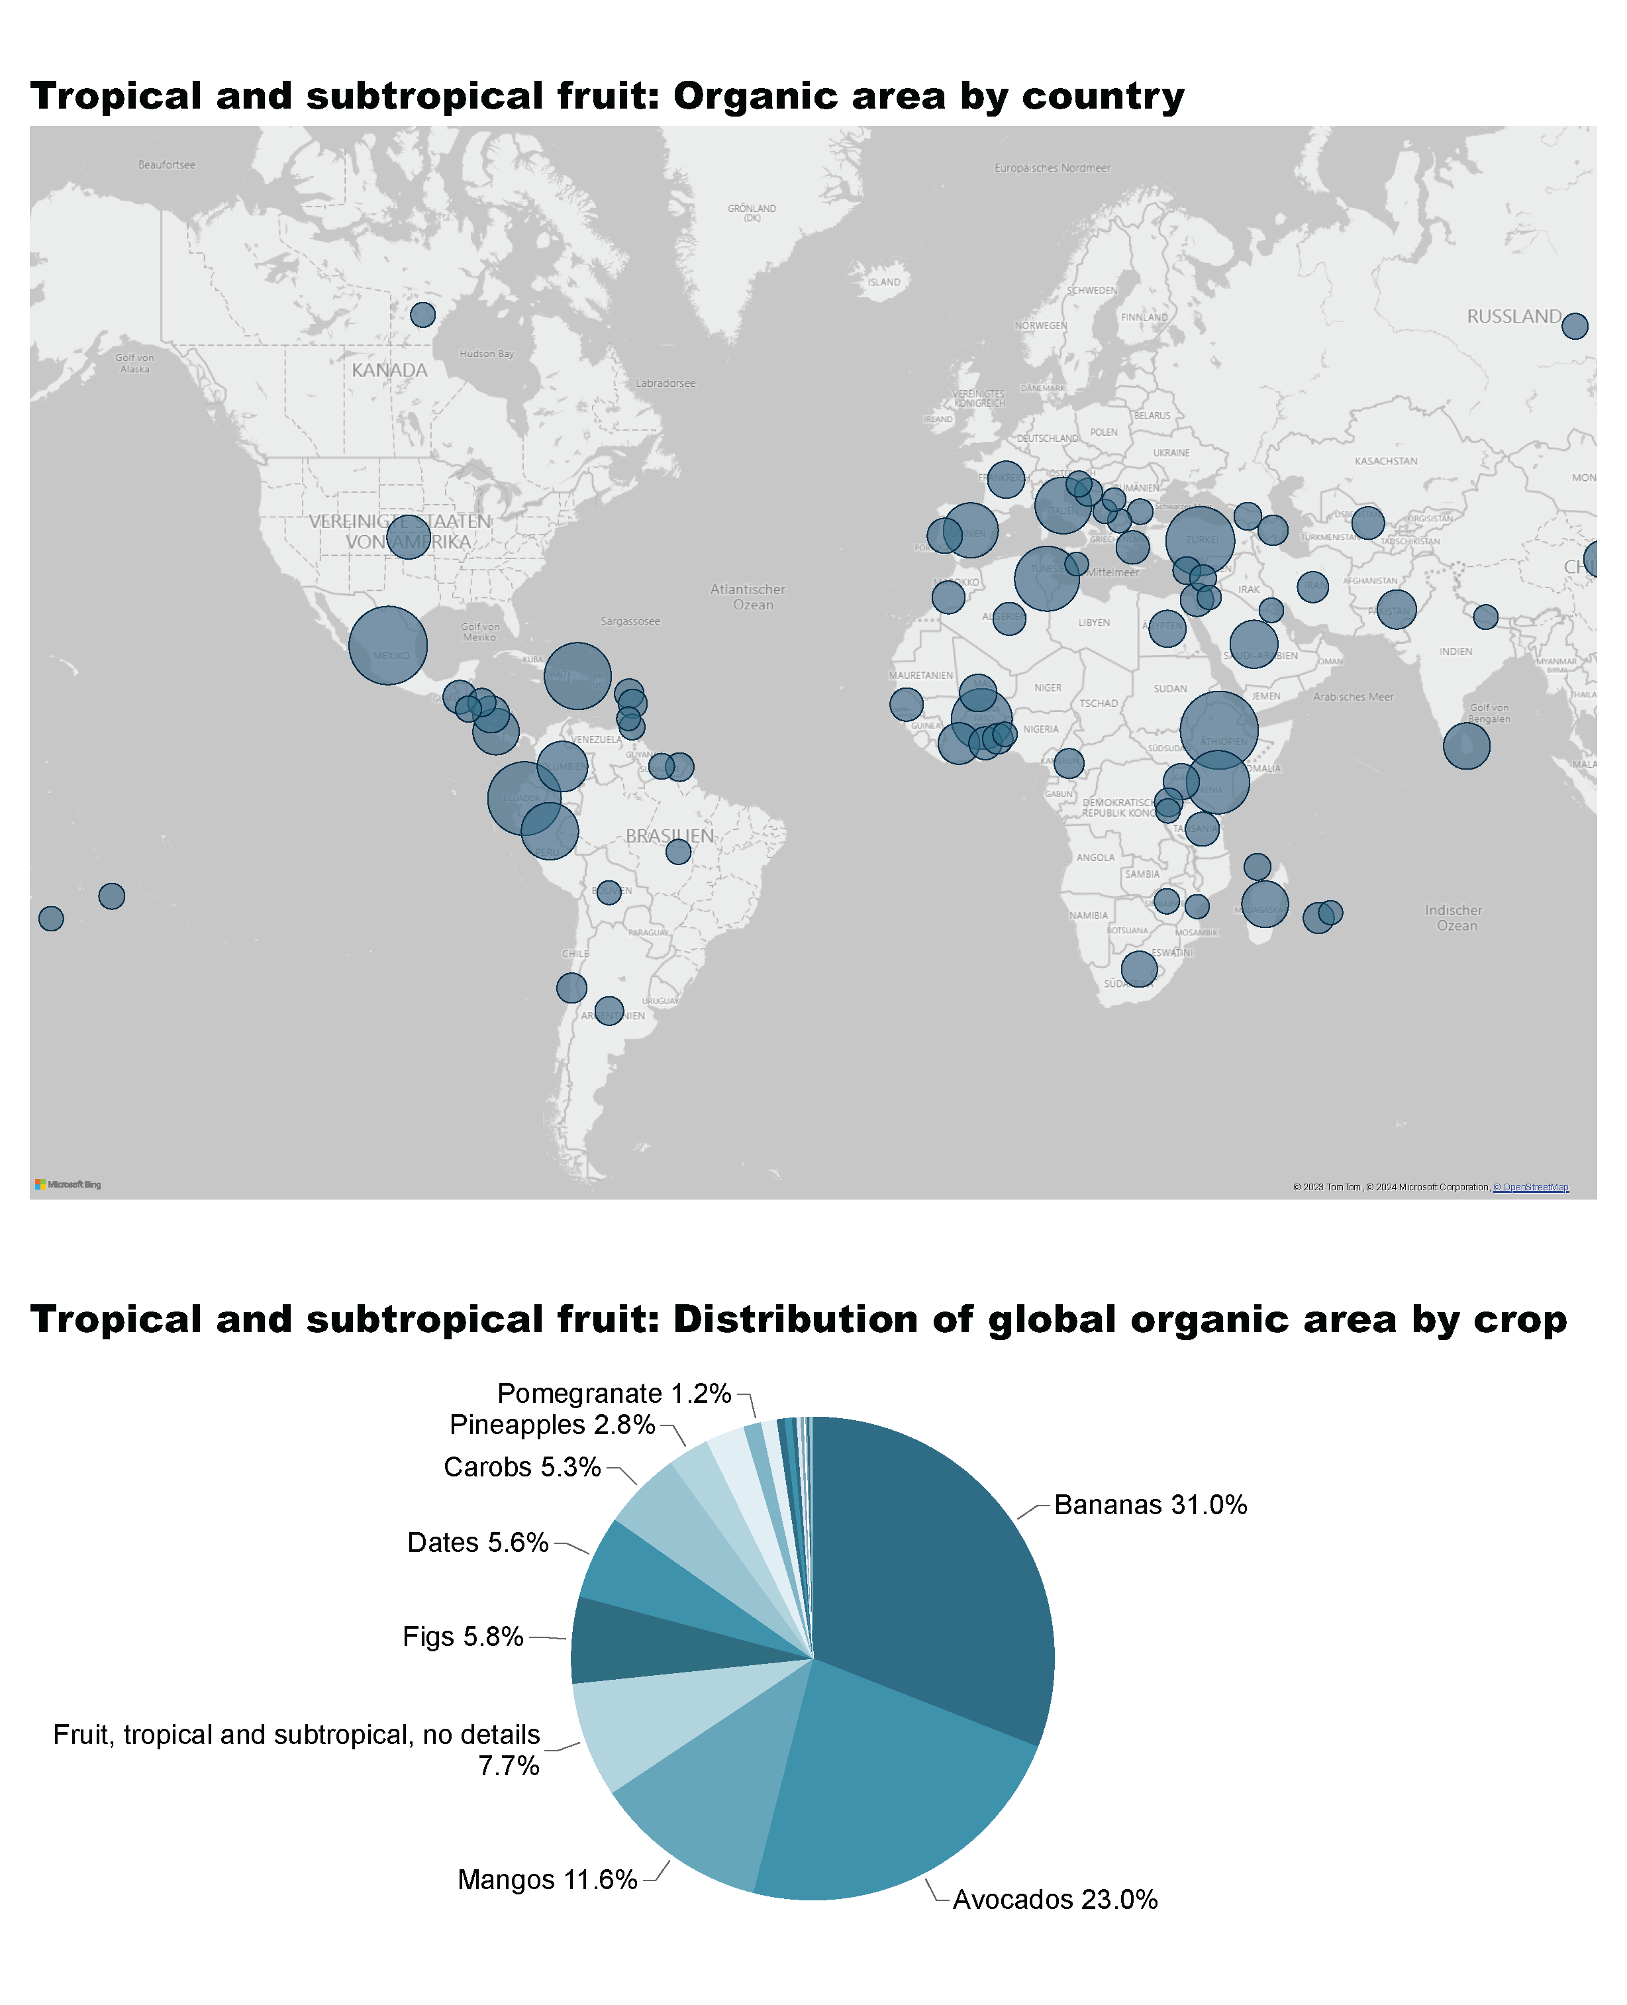
Tropical and Subtropical fruit_1a
Notes:
Tropical and subtropical fruit: Organic area by country
No alt text provided

Slide 55
Tropical and Subtropical fruit_1b
Notes:
Tropical and subtropical fruit: Distribution of global organic area by crop
No alt text provided
textbox
No alt text provided

Slide 56
Tropical and Subtropical fruit_2a
Notes:
The development of the tropical and subtropical fruit area in thousand hectares
No alt text provided
Organic tropical and subtropical fruit area by continent in hectares
No alt text provided

Slide 57
Tropical and Subtropical fruit_2b
Notes:
The countries with the highest organic area share in %
No alt text provided
The countries wih the largest organic area in hectares
No alt text provided

Slide 58
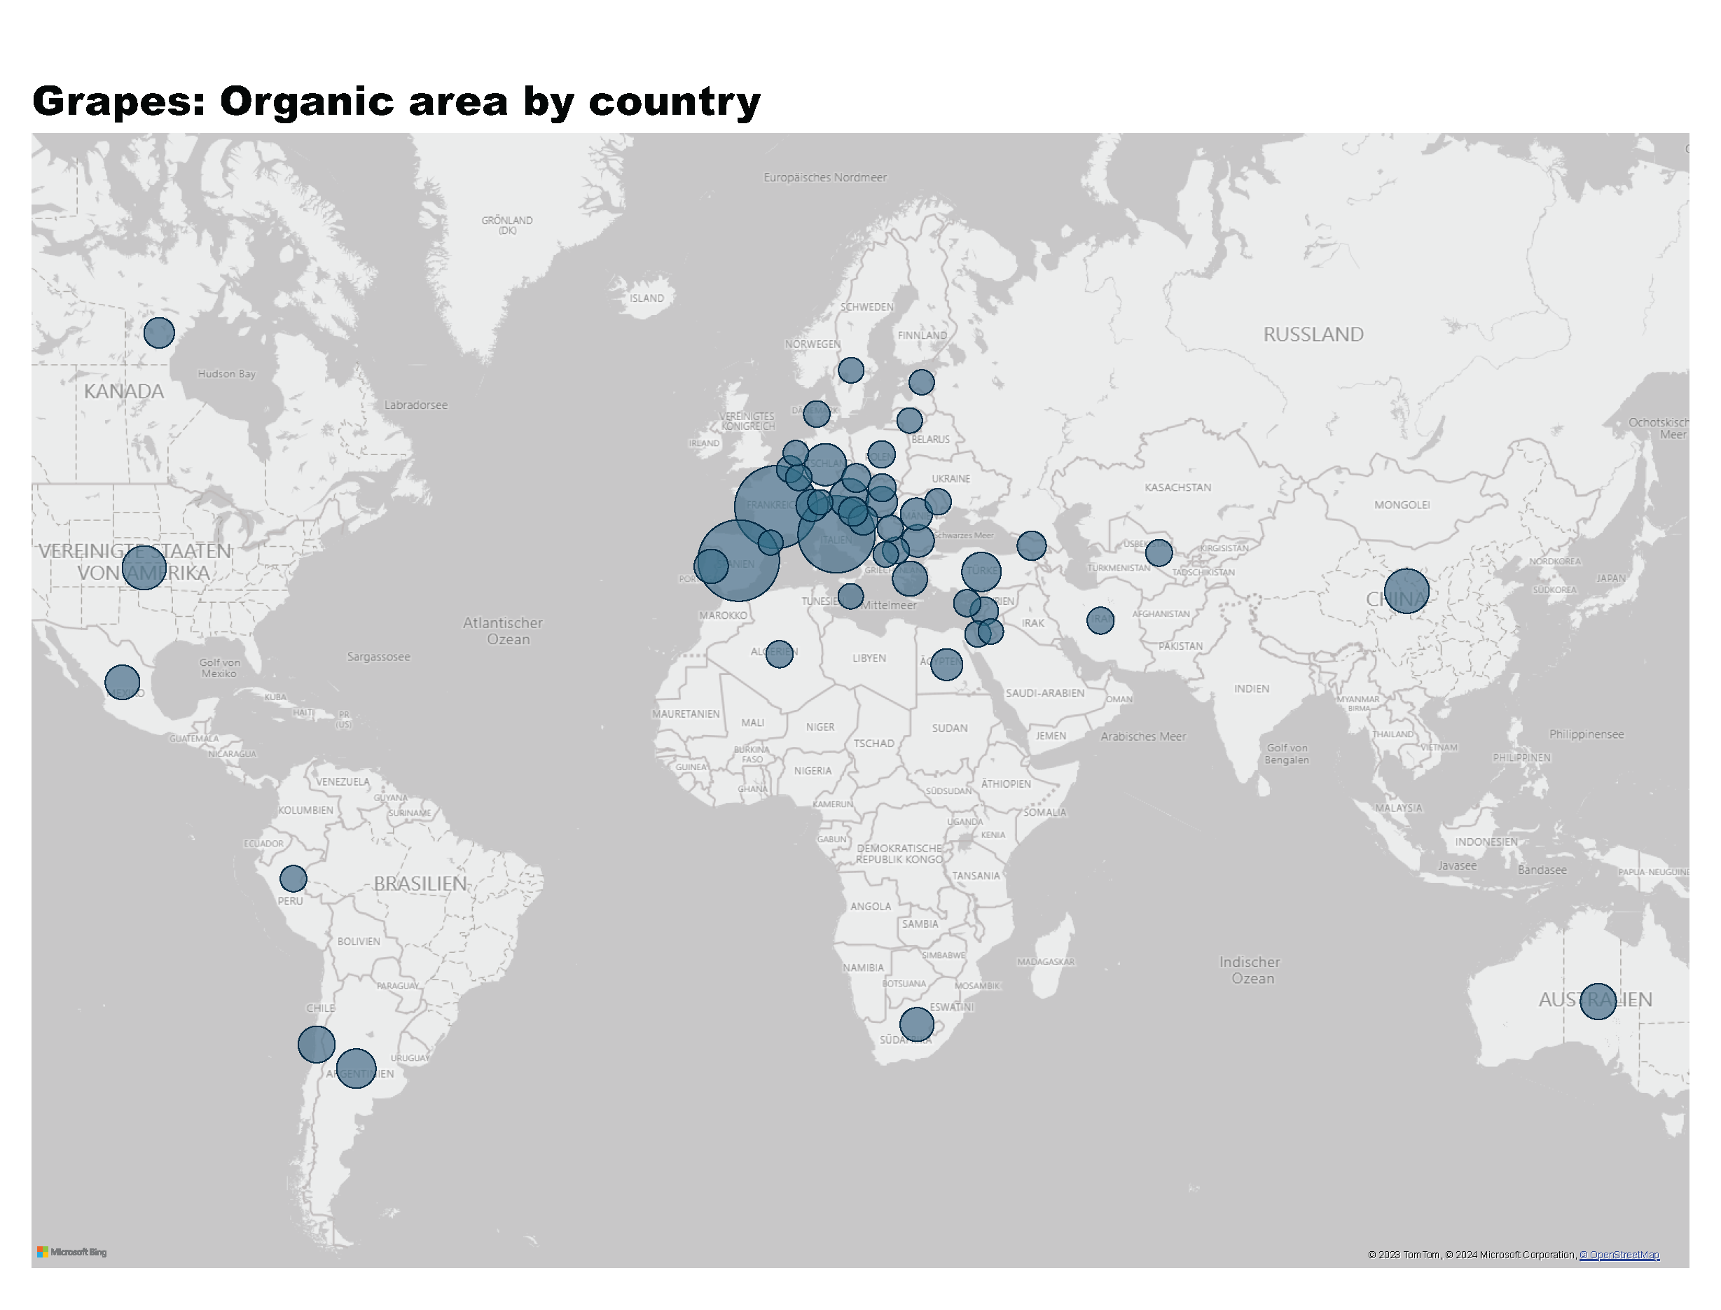
Grapes_1
Notes:
Grapes: Organic area by country
No alt text provided
textbox
No alt text provided

Slide 59
Grapes_2a
Notes:
The development of the organic grapes area in thousand hectares
No alt text provided
Organic grapes area by continent in hectares
No alt text provided

Slide 60
Grapes_2b
Notes:
The countries with the highest organic area share in %
No alt text provided
The countries wih the largest organic area in hectares
No alt text provided

Slide 61
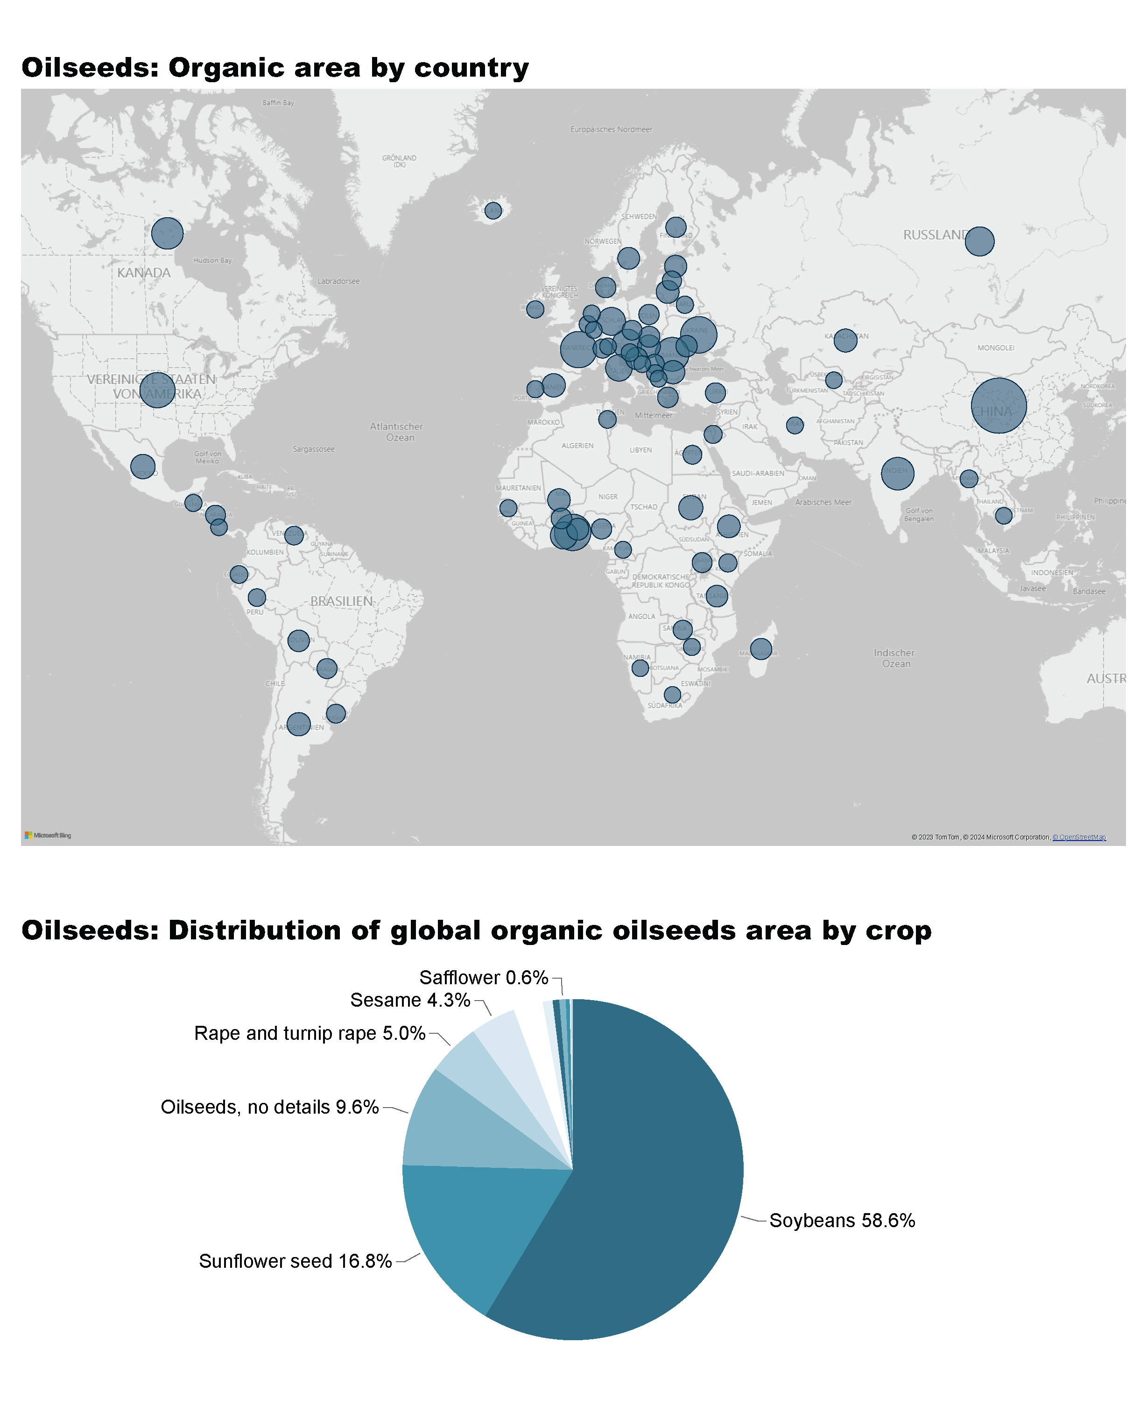
Oilseeds_1a
Notes:
Oilseeds: Organic area by country
No alt text provided

Slide 62
Oilseeds_1b
Notes:
Oilseeds: Distribution of global organic oilseeds area by crop
No alt text provided
textbox
No alt text provided

Slide 63
Oilseeds_2a
Notes:
The development of the oilseed area in thousand hectares
No alt text provided
Oilseeds area by continent in hectares
No alt text provided

Slide 64
Oilseeds_2b
Notes:
The countries with the highest organic area share in %
No alt text provided
The countries wih the largest organic area in hectares
No alt text provided

Slide 65
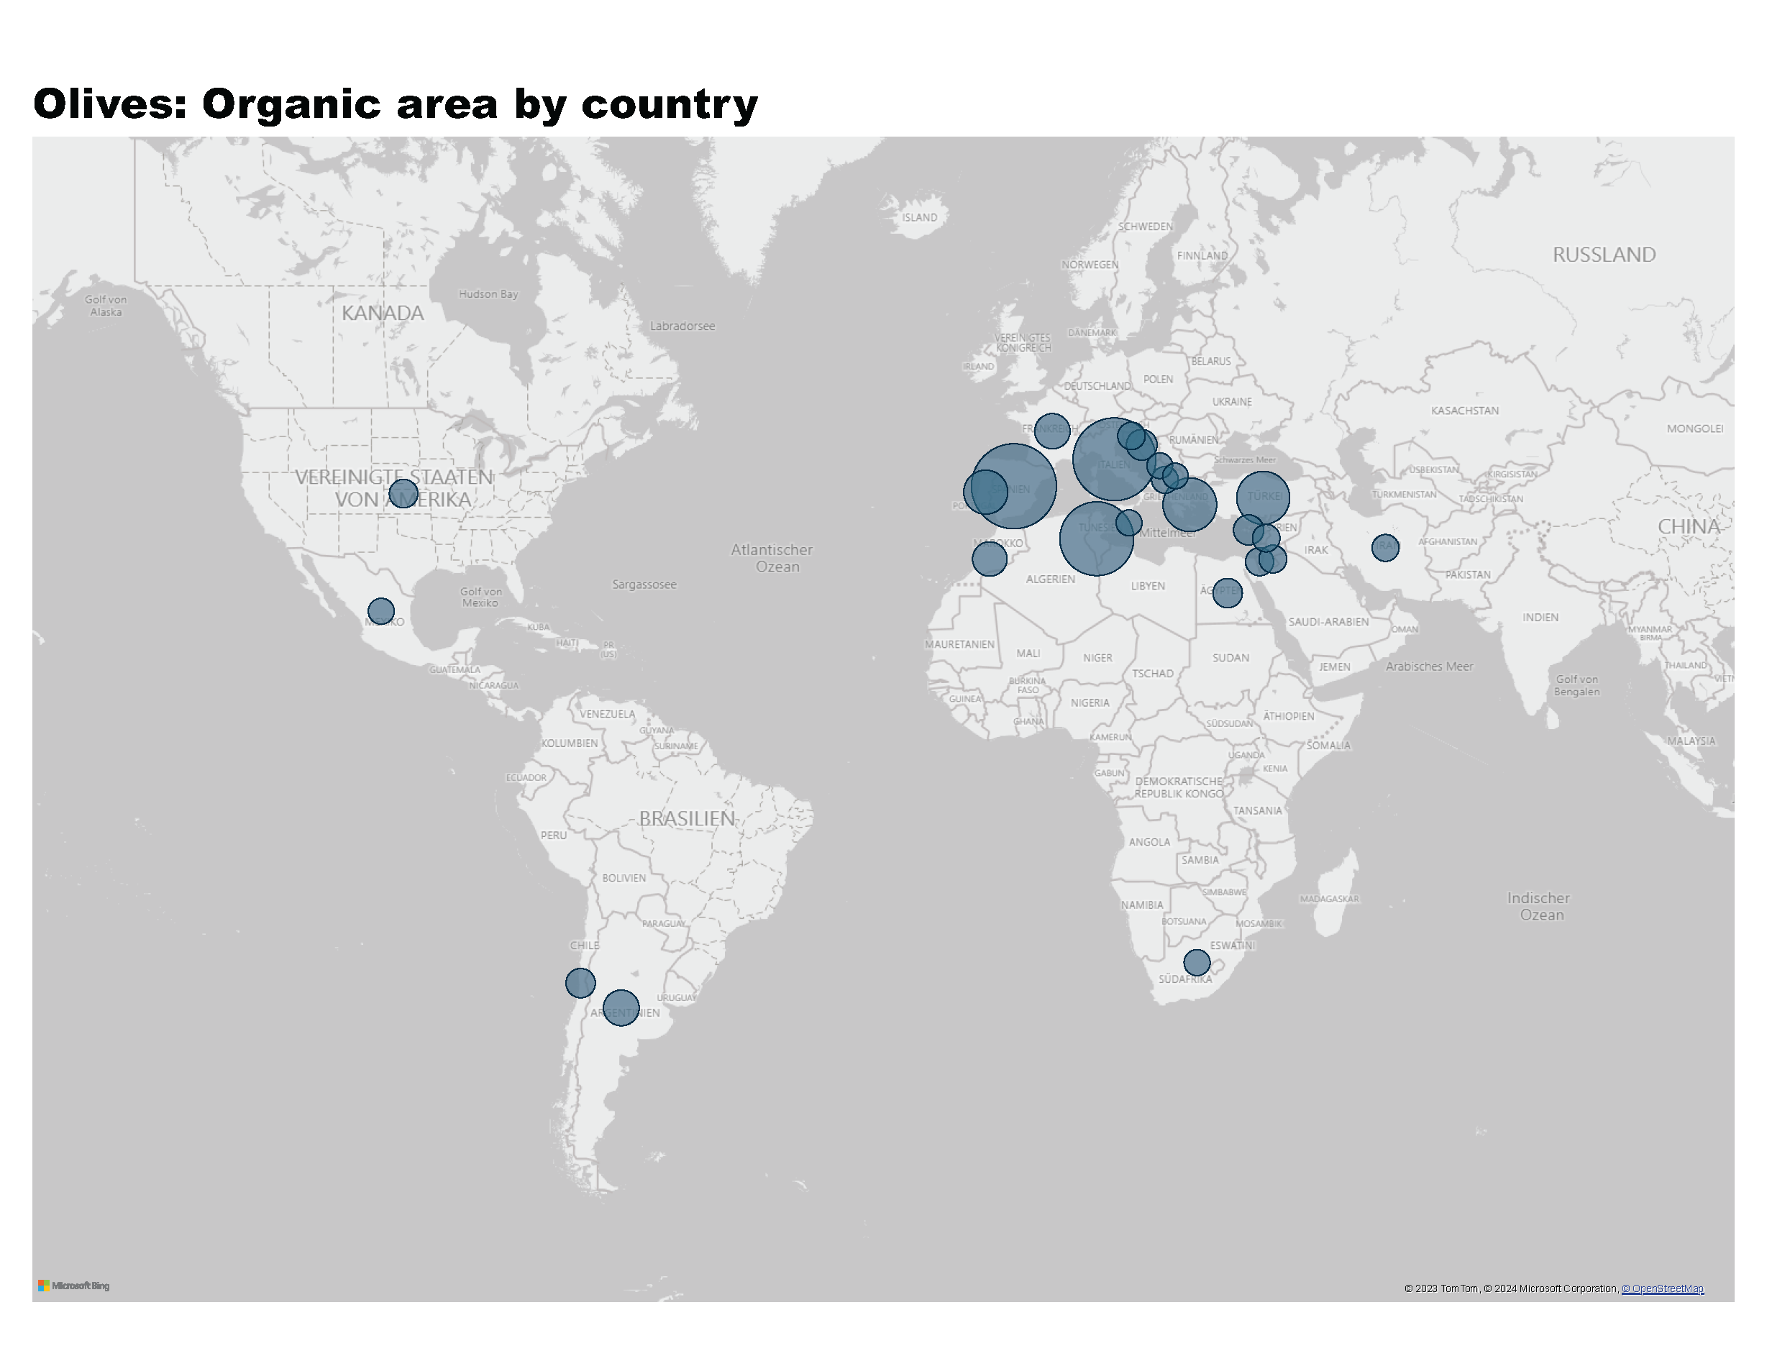
Olives_1
Notes:
Olives: Organic area by country
No alt text provided
textbox
No alt text provided

Slide 66
Olives_2a
Notes:
The development of the organic olive area in million hectares
No alt text provided
Organic area by continent in hectares
No alt text provided

Slide 67
Olives_2b
Notes:
The countries with the highest organic area share in %
No alt text provided
The countries wih the largest organic area in hectares
No alt text provided

Slide 68
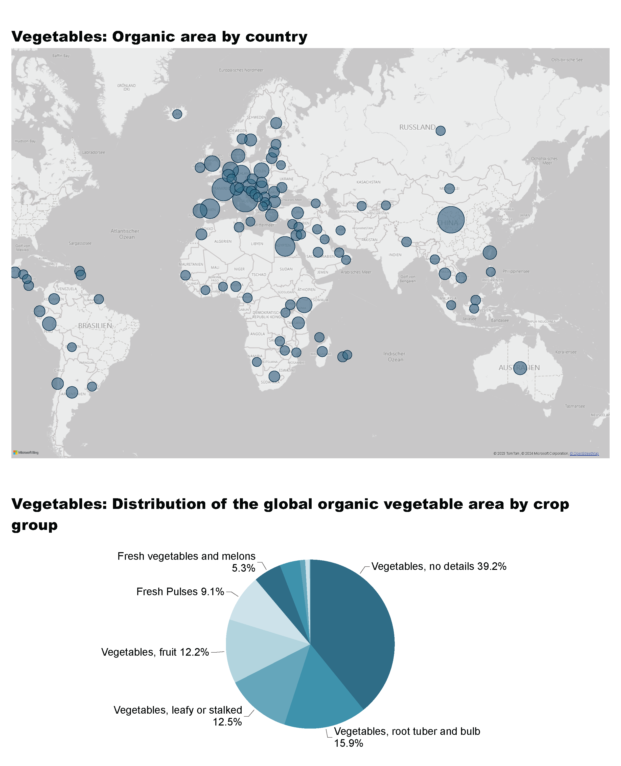
Vegetables_1a
Notes:
Vegetables: Organic area by country
No alt text provided
textbox
No alt text provided

Slide 69
Vegetables_1b
Notes:
Vegetables: Distribution of the global organic vegetable area by crop group
No alt text provided
textbox
No alt text provided

Slide 70
Vegetables_2a
Notes:
Development of the organic vegetable area in thousand hectares
No alt text provided
Vegetable area by continent in hectares
No alt text provided

Slide 71
Vegetables_2b
Notes:
The countries with the highest organic area share in %
No alt text provided
The countries wih the largest organic area in hectares
No alt text provided

Slide 72
More information
More information (PDF, data sources, graphs) at: http://www.organic-world.net/yearbook/yearbook-2024.html
Contact Helga Willer Research Institute of Organic Agriculture FiBL 5070 Frick Switzerland helga.willer@fibl.org

Slide 73
Disclaimer
All of the results contained in this slide show have been compiled by the Research Institute of Organic Agriculture FiBL. However, the possibility of mistakes cannot be ruled out entirely. Therefore, FiBL is not subject to any obligation and makes no guarantees whatsoever regarding any of the statements or results in this work; neither does FiBL accept responsibility or liability for any possible mistakes, nor for any consequences of actions taken by readers based on statements or advice contained therein.
This document has been produced with the support of the Swiss State Secretariat for Economic Affairs (SECO), the Sustainability Fund of Coop Switzerland, NürnbergMesse, IFOAM – Organics International. The views expressed herein can in no way be taken to reflect the official opinions of SECO, Coop, NürnbergMesse or IFOAM – Organics International.

Slide 74
Presentations on www.organic-world.net

Slide 75
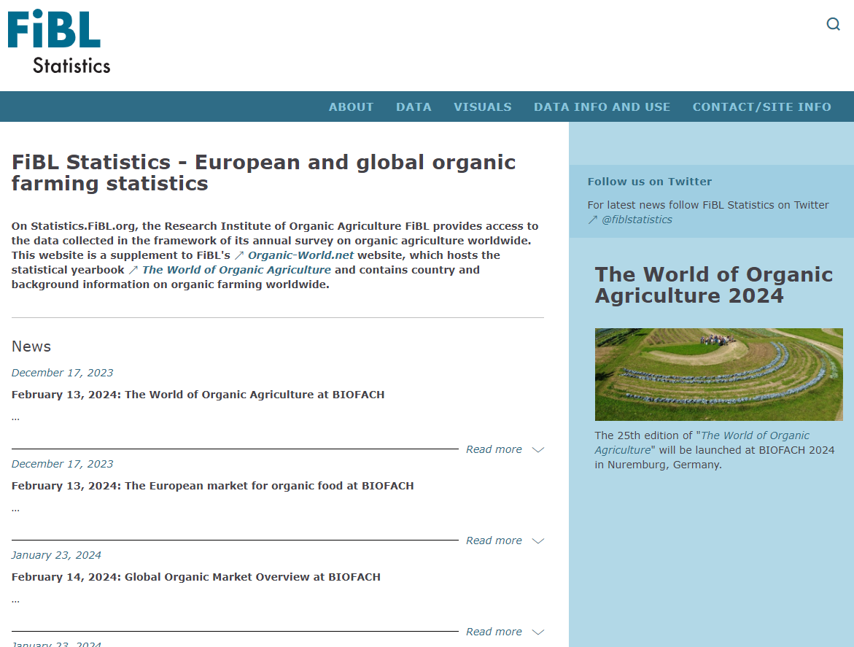
Statistics.FiBL.org

Slide 76
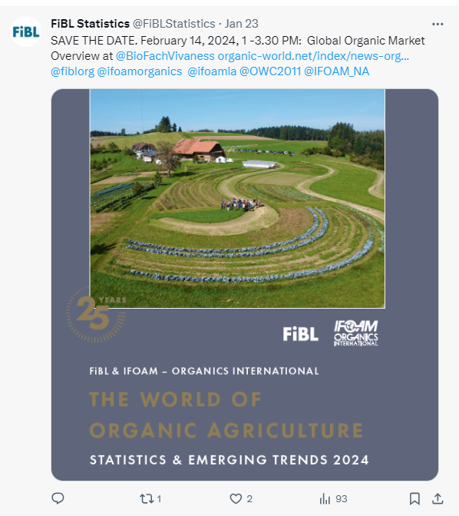
www.twitter.com/fiblstatistics

Slide 77
Contact
Helga Willer Research Institute of Organic Agriculture FiBL Ackerstrasse 113, Box 219 5070 Frick Switzerland
Phone +41 62 865 72 72 Phone +41 62 865 72 07 (direct)
info.suisse@fibl.org, helga.willer@fibl.org www.fibl.org, www.organic-world.net, https://statistics.fibl.org

Slide 78
FiBL online
www.fibl.org
www.bioaktuell.ch
fiblfilm
@fiblorg
@FiBLaktuell
linkedin.com/company/fibl

