Slide 1
Organic Agriculture Worldwide 2022: Key results from the FiBL survey on organic agriculture worldwide 2024
Part 3: Organic agriculture in the regions
Jan Trávníček, Bernhard Schlatter and Helga Willer
© FiBL, April 2024

Slide 2
Organic Agriculture Worldwide: Key results from the FiBL survey on organic agriculture worldwide 2024 Part 3: Organic agriculture in the regions
Data compiled by the Research Institute of Organic Agriculture FiBL, Frick, Switzerland, based on national data sources and data from certifiers.
Data as published February 2024 in The World of Organic Agriculture. Statistics and Emerging Trends 2024.* Frick and Bonn, www.organic-world.net
For updates, check www.organic-world.net
This presentation is available online at: https://www.organic-world.net/yearbook/yearbook-2024/presentations.html
Texts and graphs: Helga Willer, Bernhard Schlatter, Jan Trávníček and Claudia Meier, Research Institute of Organic Agriculture FiBL, Frick, Switzerland
Contact: Helga Willer, helga.willer@fibl.org, Research Institute of Organic Agriculture FiBL, Frick, Switzerland
© Research Institute of Organic Agriculture FiBL, Frick, Switzerland, February 2024
*Citation: Willer, Helga, Jan Trávníček, Claudia Meier and Bernhard Schlatter (Eds.) (2024): The World of Organic Agriculture. Statistics and Emerging Trends 2024. Research Institute of Organic Agriculture FiBL, Frick, and IFOAM – Organics International, Bonn.
Notes:
FiBL
07.02.2024
www.fibl.org
2

Slide 3
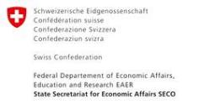
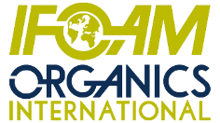
Acknowledgements
The Swiss State Secretariat of Economic Affairs (SECO)
Coop Sustainability Fund
NürnbergMesse, the organizers of BIOFACH
IFOAM – Organics International
More than 200 experts from all parts of the world contributed to the FiBL survey 2024.

Slide 4
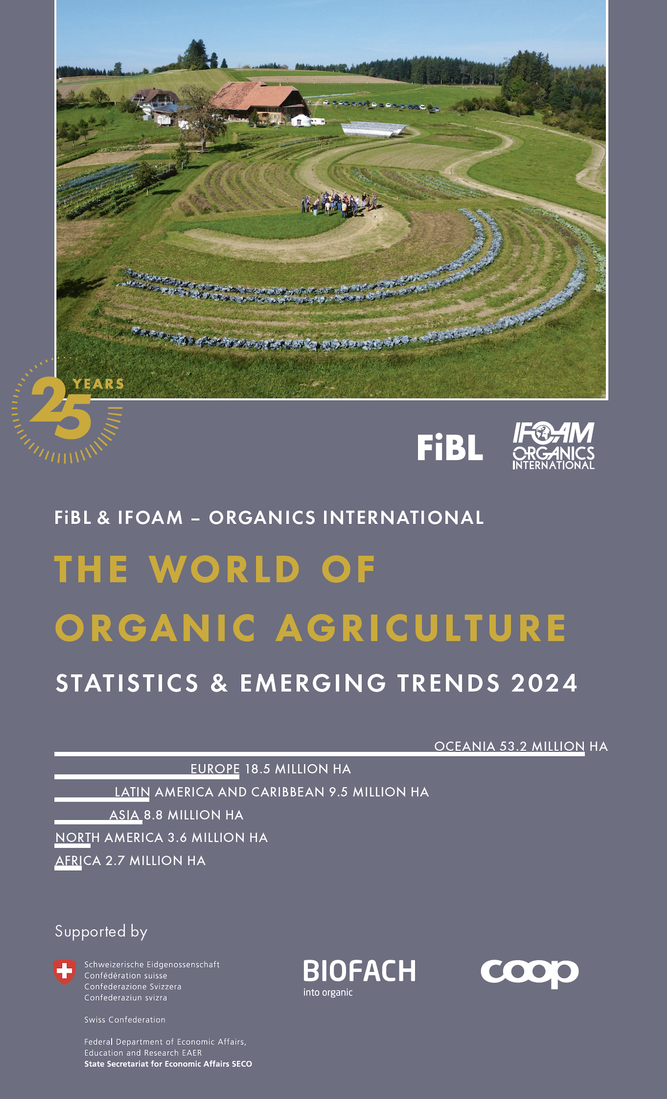
The World of Organic Agriculture 2024
The 24th edition of «The World of Organic Agriculture», was published by FiBL and IFOAM – Organics International in February 2024.
Data tables
Country and continent reports
Markets, standards and policy support
The book can be ordered or downloaded at (item number 1747): https://www.fibl.org/en/shop-en
www.organic-world.net
https://statistics.fibl.org

Slide 5
About this presentation
In three presentations, the key results of the FiBL survey on organic agriculture worldwide 2024 are summarized (data 2022). Apart from the global data, key results on crop and on regional data are presented.
More information is available at www.organic-world.net
The following three presentations are available at https://www.organic-world.net/yearbook/yearbook-2024/presentations.html:
Part 1: Global data 2022 and survey background
Part 2: Land use and key crops in organic agriculture 2022
Part 3: Organic agriculture in the regions 2022

Slide 6
The 25th survey on organic agriculture world-wide
The 25th survey on organic agriculture worldwide was carried out by the Research Institute of Organic Agriculture FiBL in cooperation with partners from all around the world. The results were published jointly by FiBL and IFOAM – Organics International.
The survey was carried out between July 2023 and February 2024.
Data were received from 188 countries.
Data was provided by over 200 country experts (representatives from NGOs, certification bodies, governments, researchers).
The following data was collected: area data (including land use and crop details); producers, other operator types; domestic market values; export and import data; livestock data (animal heads and production in metric tons).
The results are published in the yearbook “The World of Organic Agriculture 2024” and on www.organic-world.net.

Slide 7
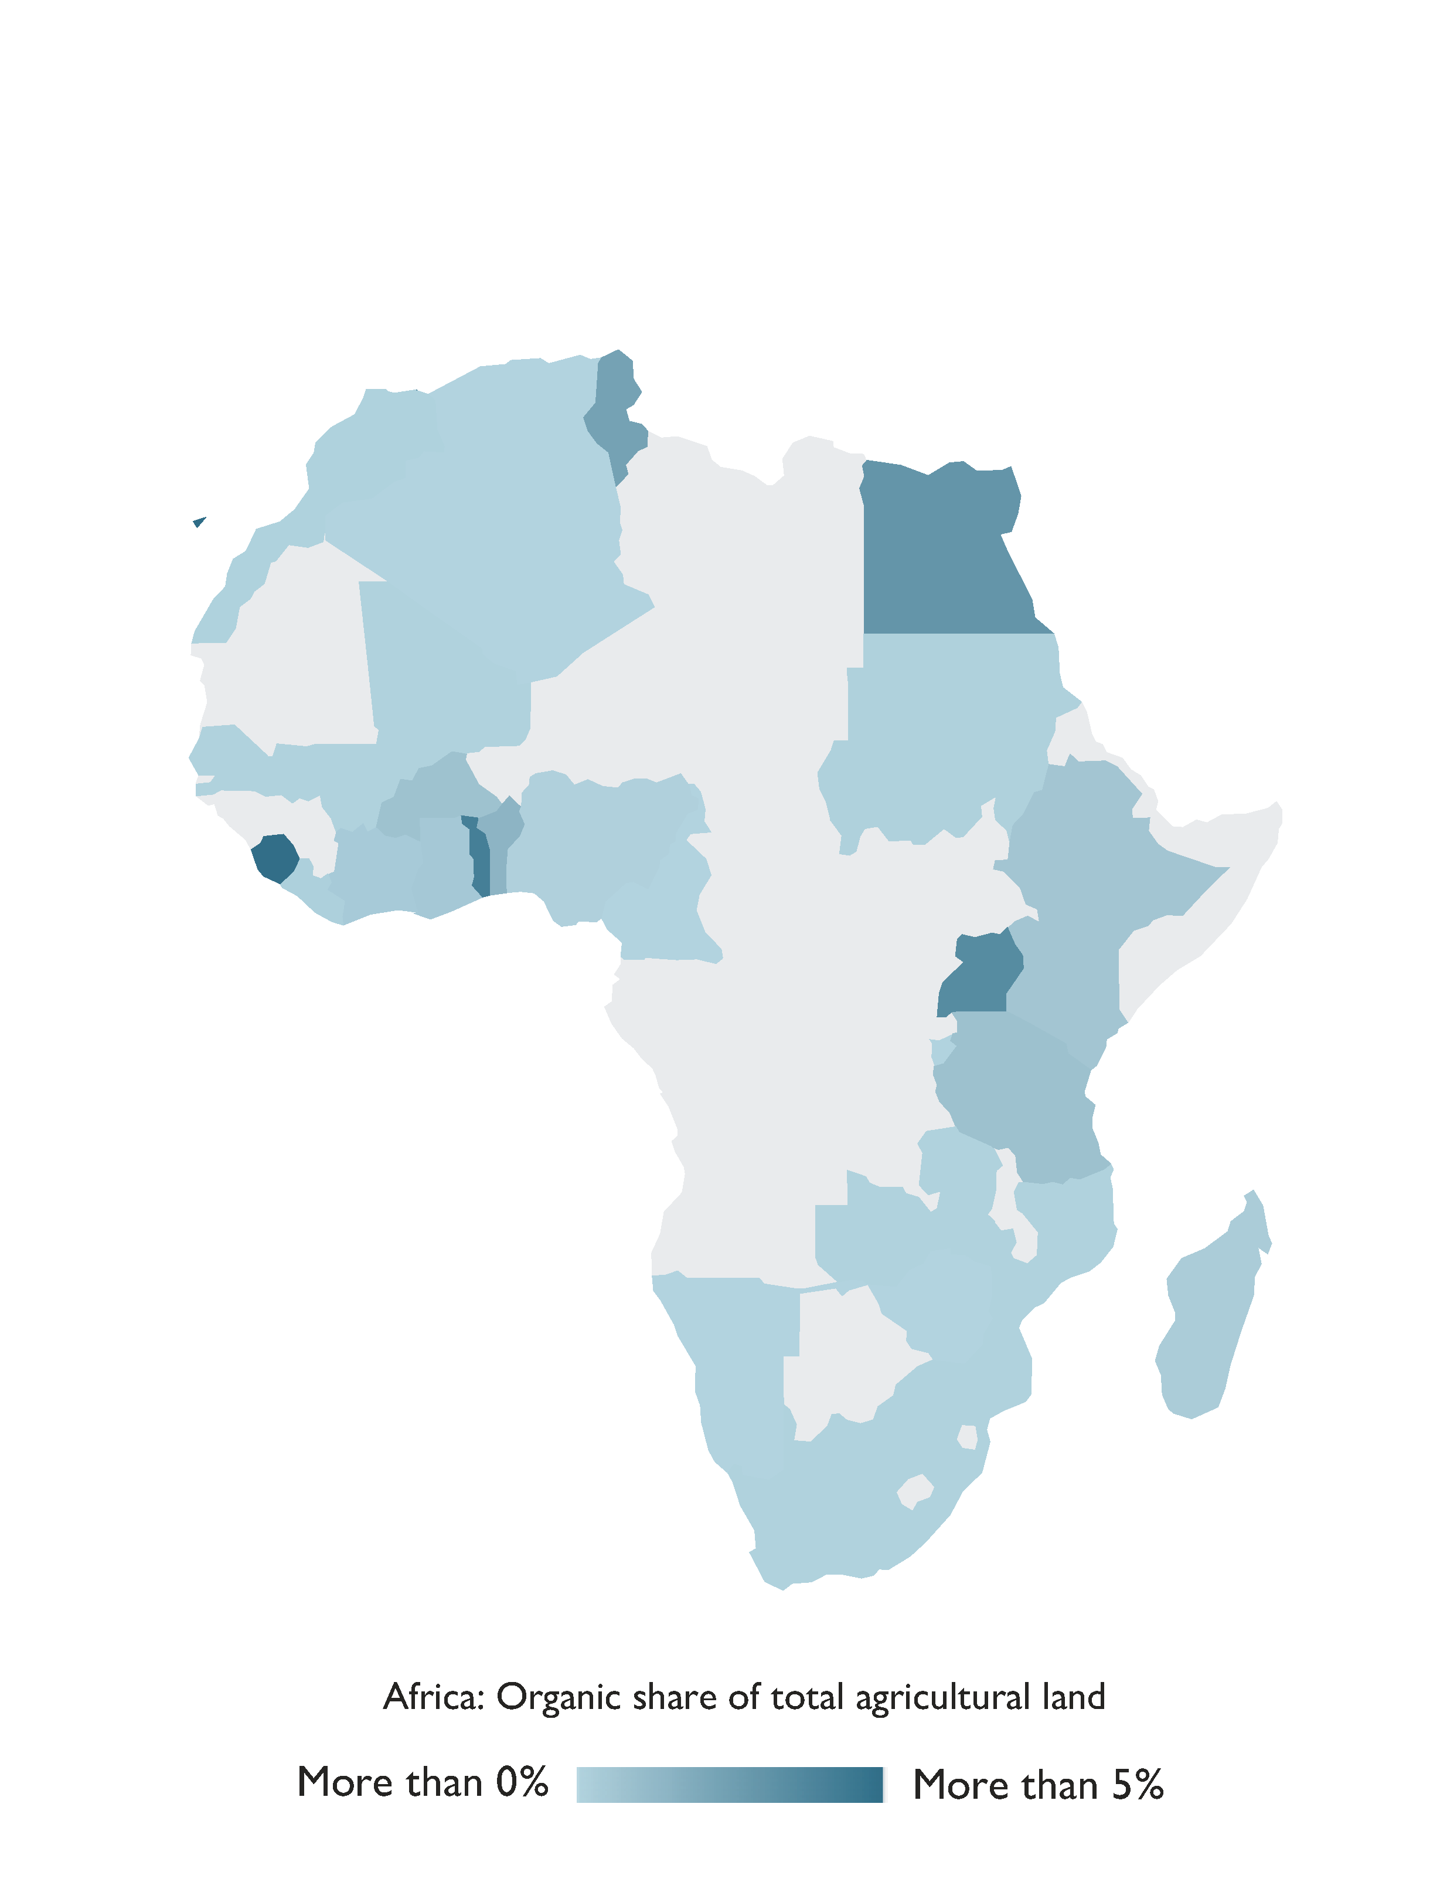
Africa

Slide 8
Organic agriculture in Africa 2022
Africa boasted more than 2.7 million hectares of certified organic agricultural land, representing a remarkable 4.9 percent increase of nearly 128´000 hectares compared to 2021.
The continent also reported over 975´000 producers involved in organic farming.
Uganda stood out as the country with the largest organic area, exceeding 505´000 hectares in 2022, and also claiming the highest number of organic producers, with over 404´000.
Notably, the island state of São Tomé and Príncipe dedicated 21.1 percent of its agricultural land to organic crops, showcasing the region's commitment to organic farming.
Most certified organic products from Africa are destined for export markets, with key crops including cocoa, cotton, coffee, oilseeds, nuts, and olives.
5 African countries have existing legislation on organic agriculture, while an additional five are
Source: FiBL survey 2023

Slide 9
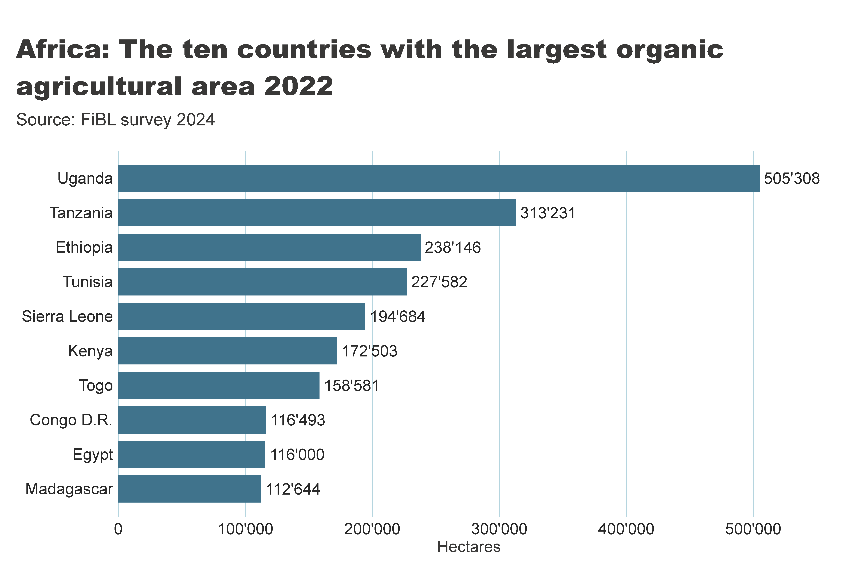
africa_land_country
Notes:
textbox
No alt text provided
Source: FiBL survey 2022
No alt text provided
card
No alt text provided

Slide 10
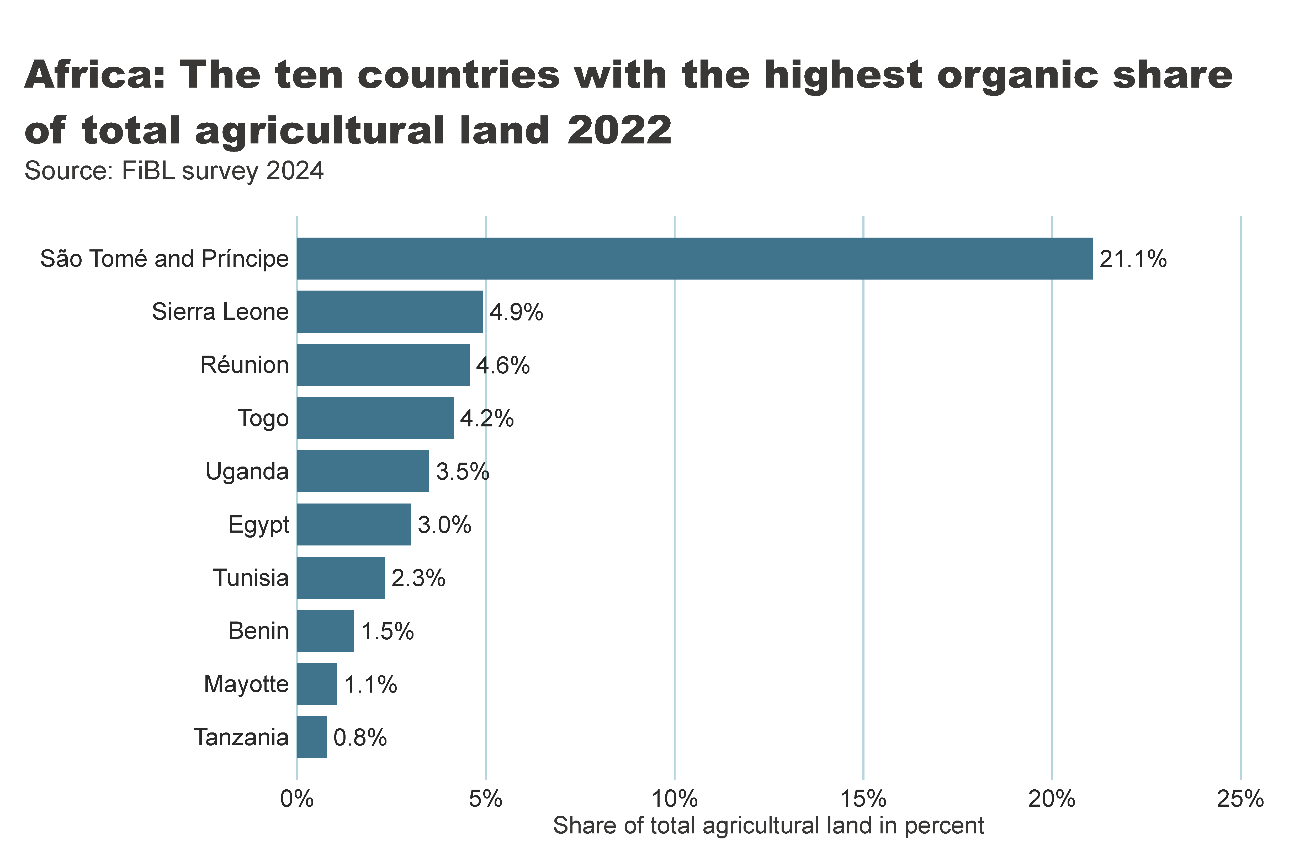
Africa_land_share
Notes:
textbox
No alt text provided
card
No alt text provided
barChart
No alt text provided

Slide 11
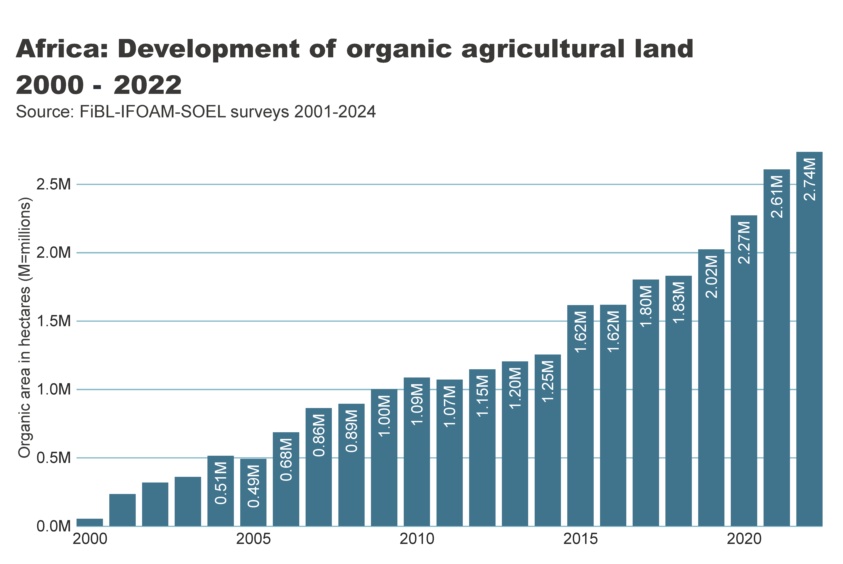
africa_land_growth
Notes:
textbox
No alt text provided
card
No alt text provided
lineClusteredColumnComboChart
No alt text provided

Slide 12
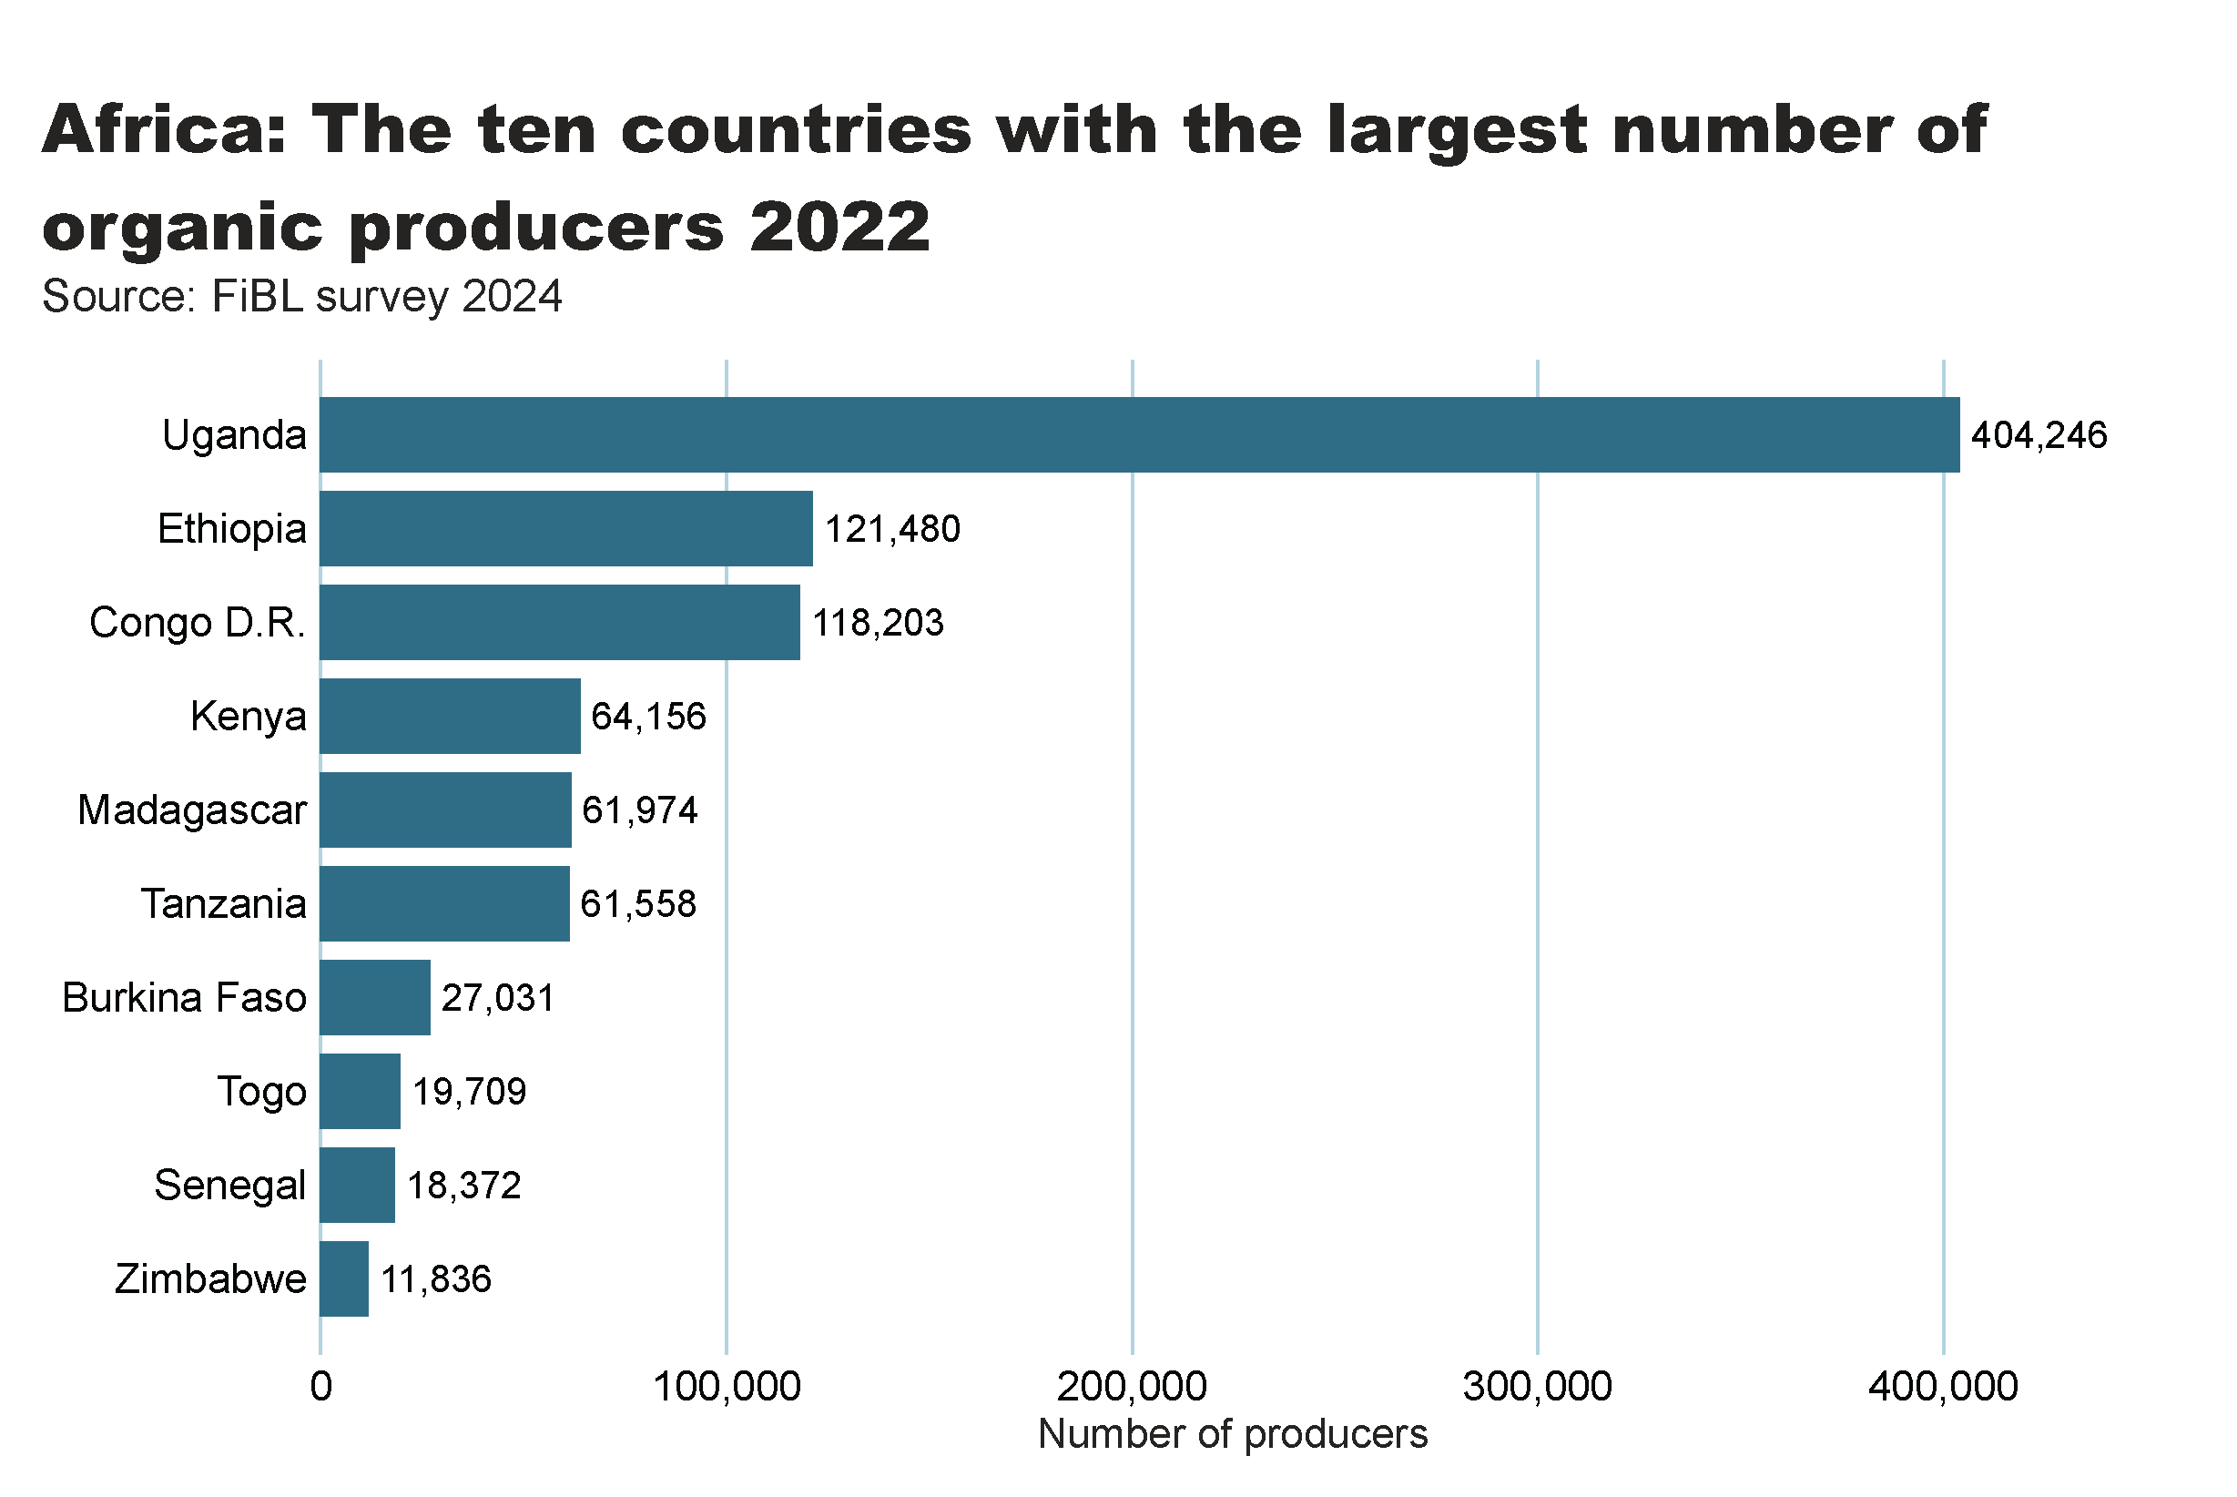
africa_producers_country
Notes:
textbox
No alt text provided
card
No alt text provided
barChart
No alt text provided

Slide 13
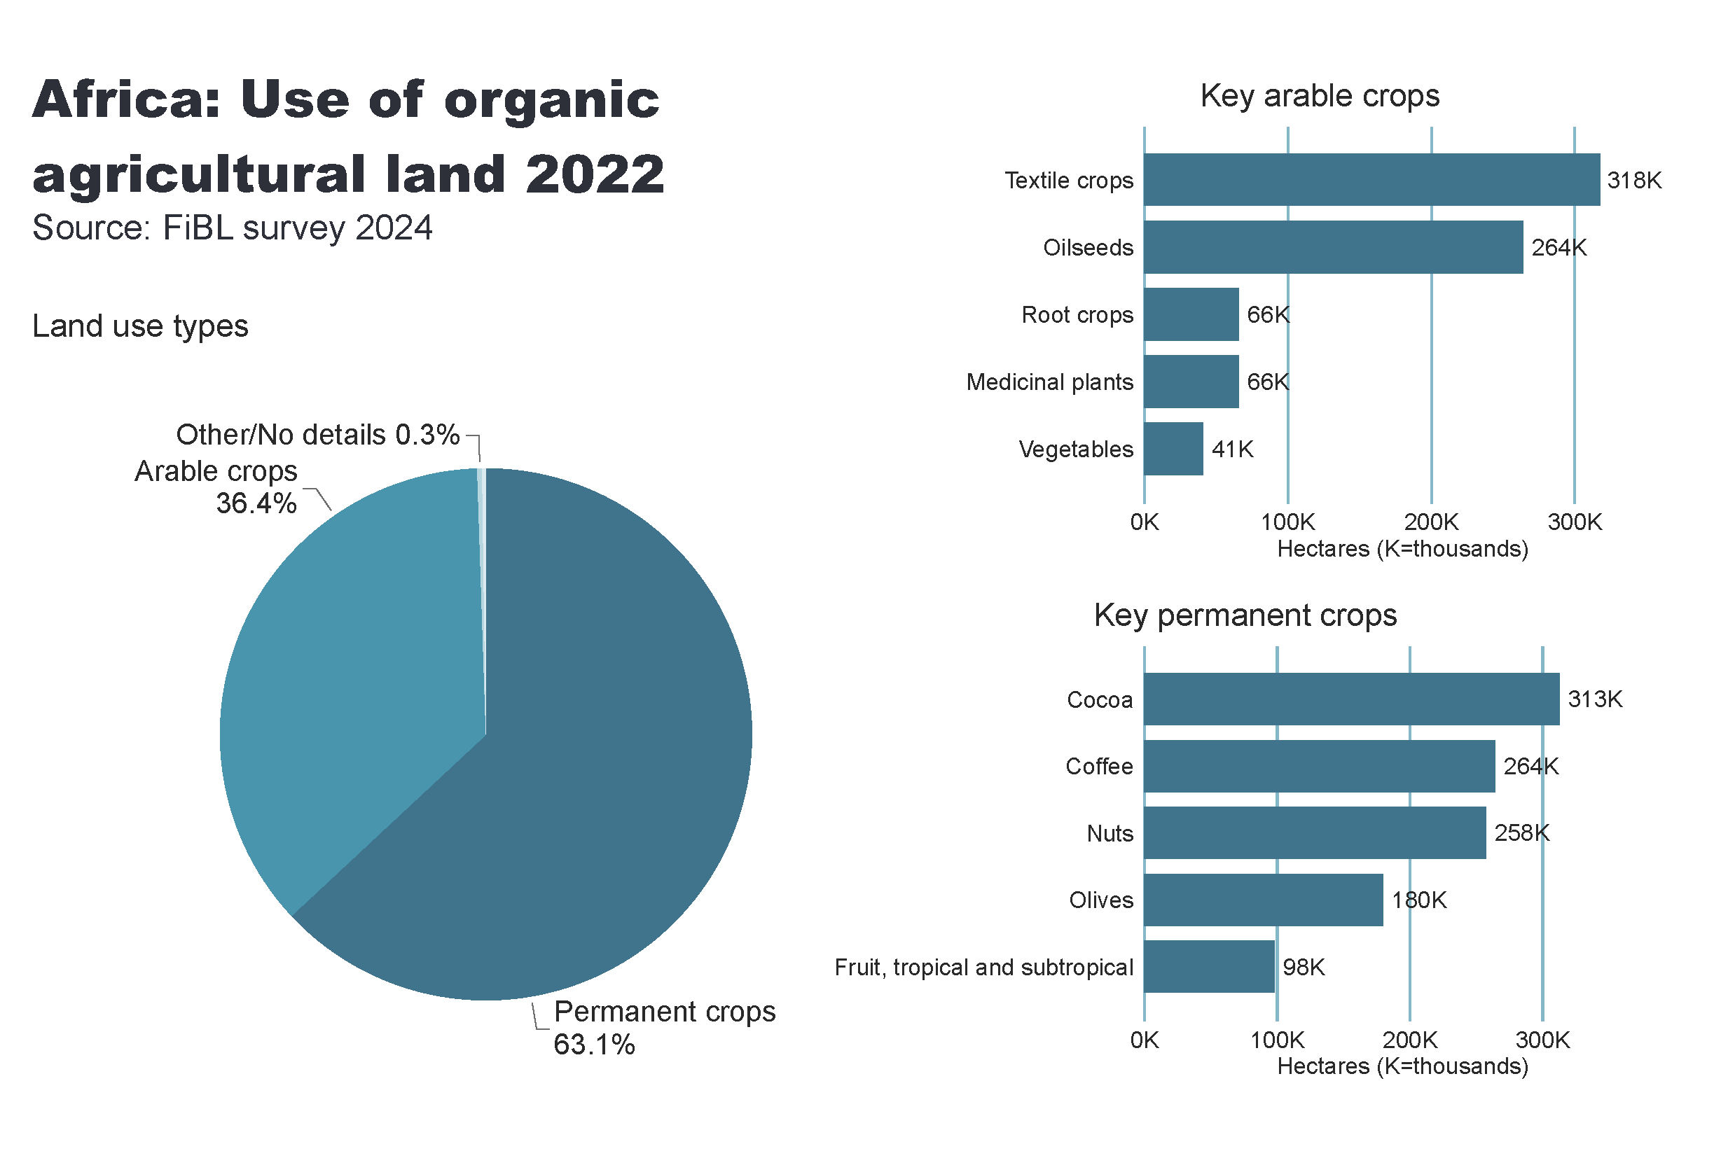
Africa_land_use
Notes:
Land use types
No alt text provided
card
No alt text provided
Key arable crops
No alt text provided
Key permanent crops
No alt text provided
textbox
No alt text provided

Slide 14
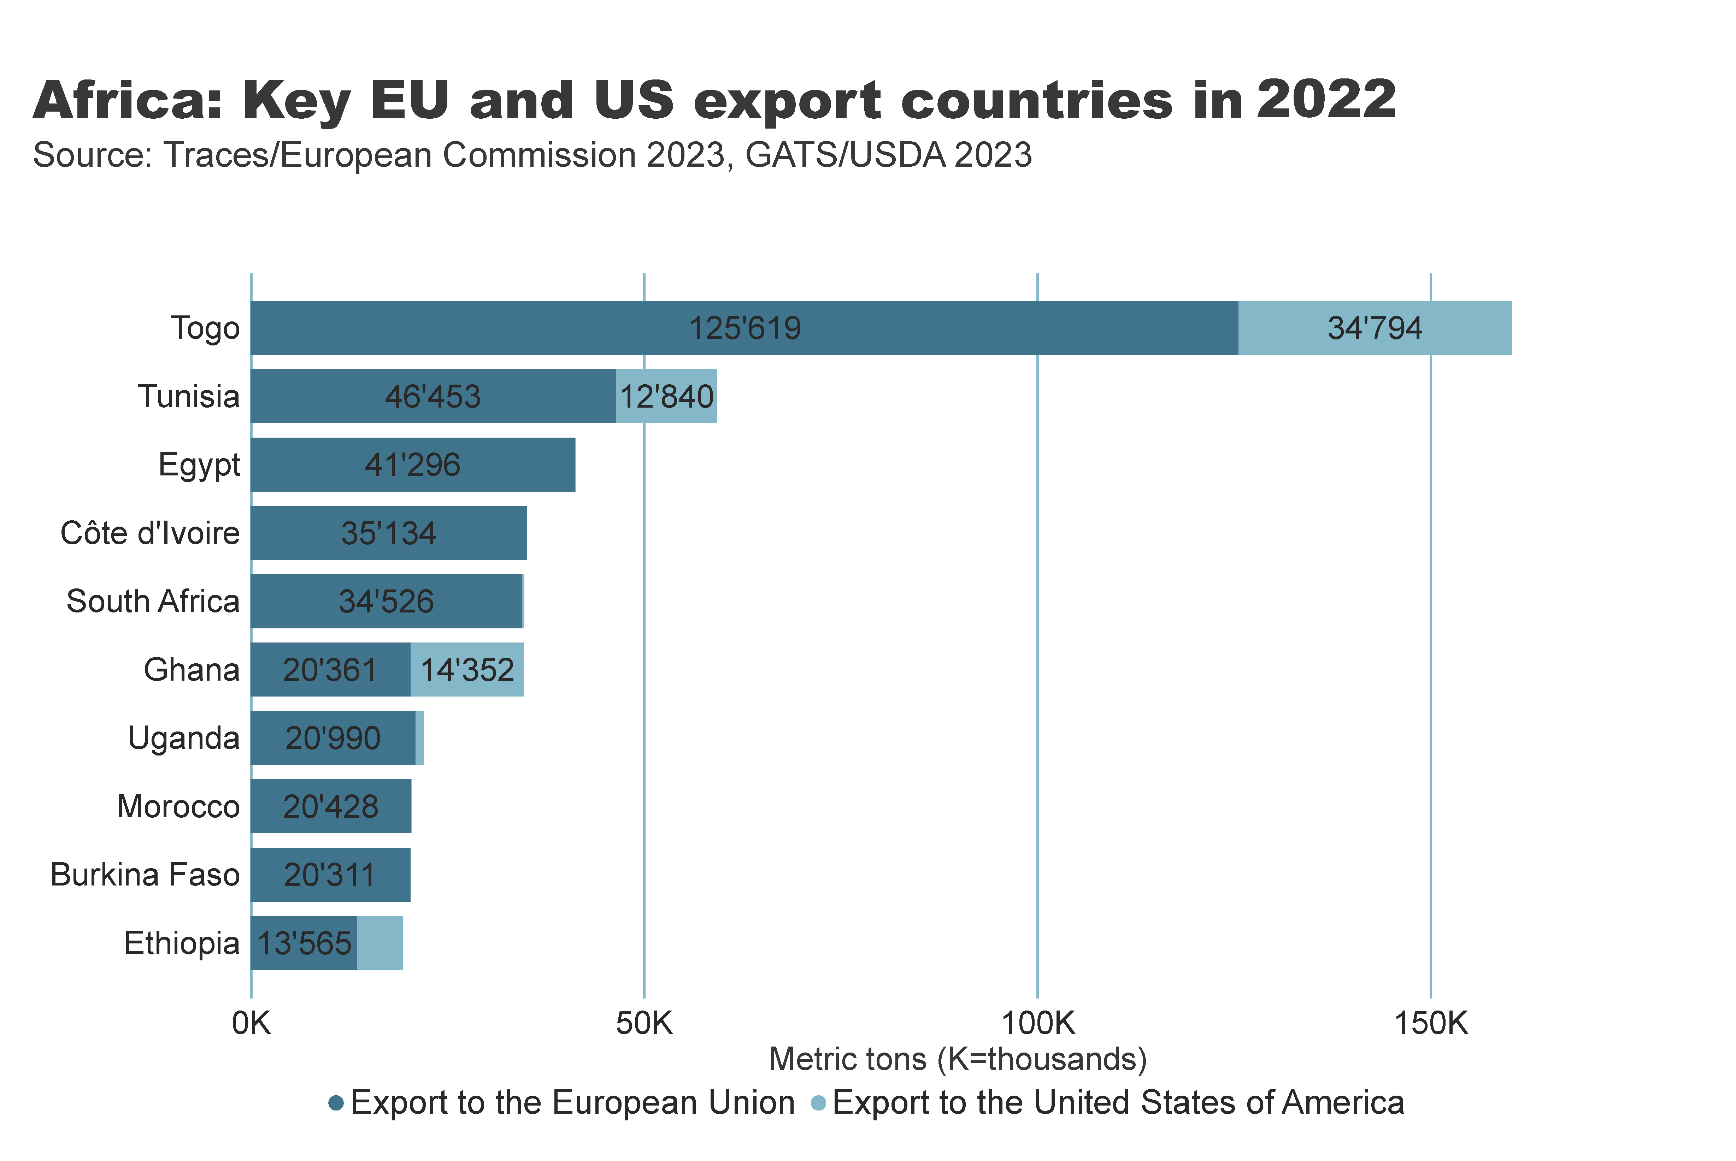

Slide 15
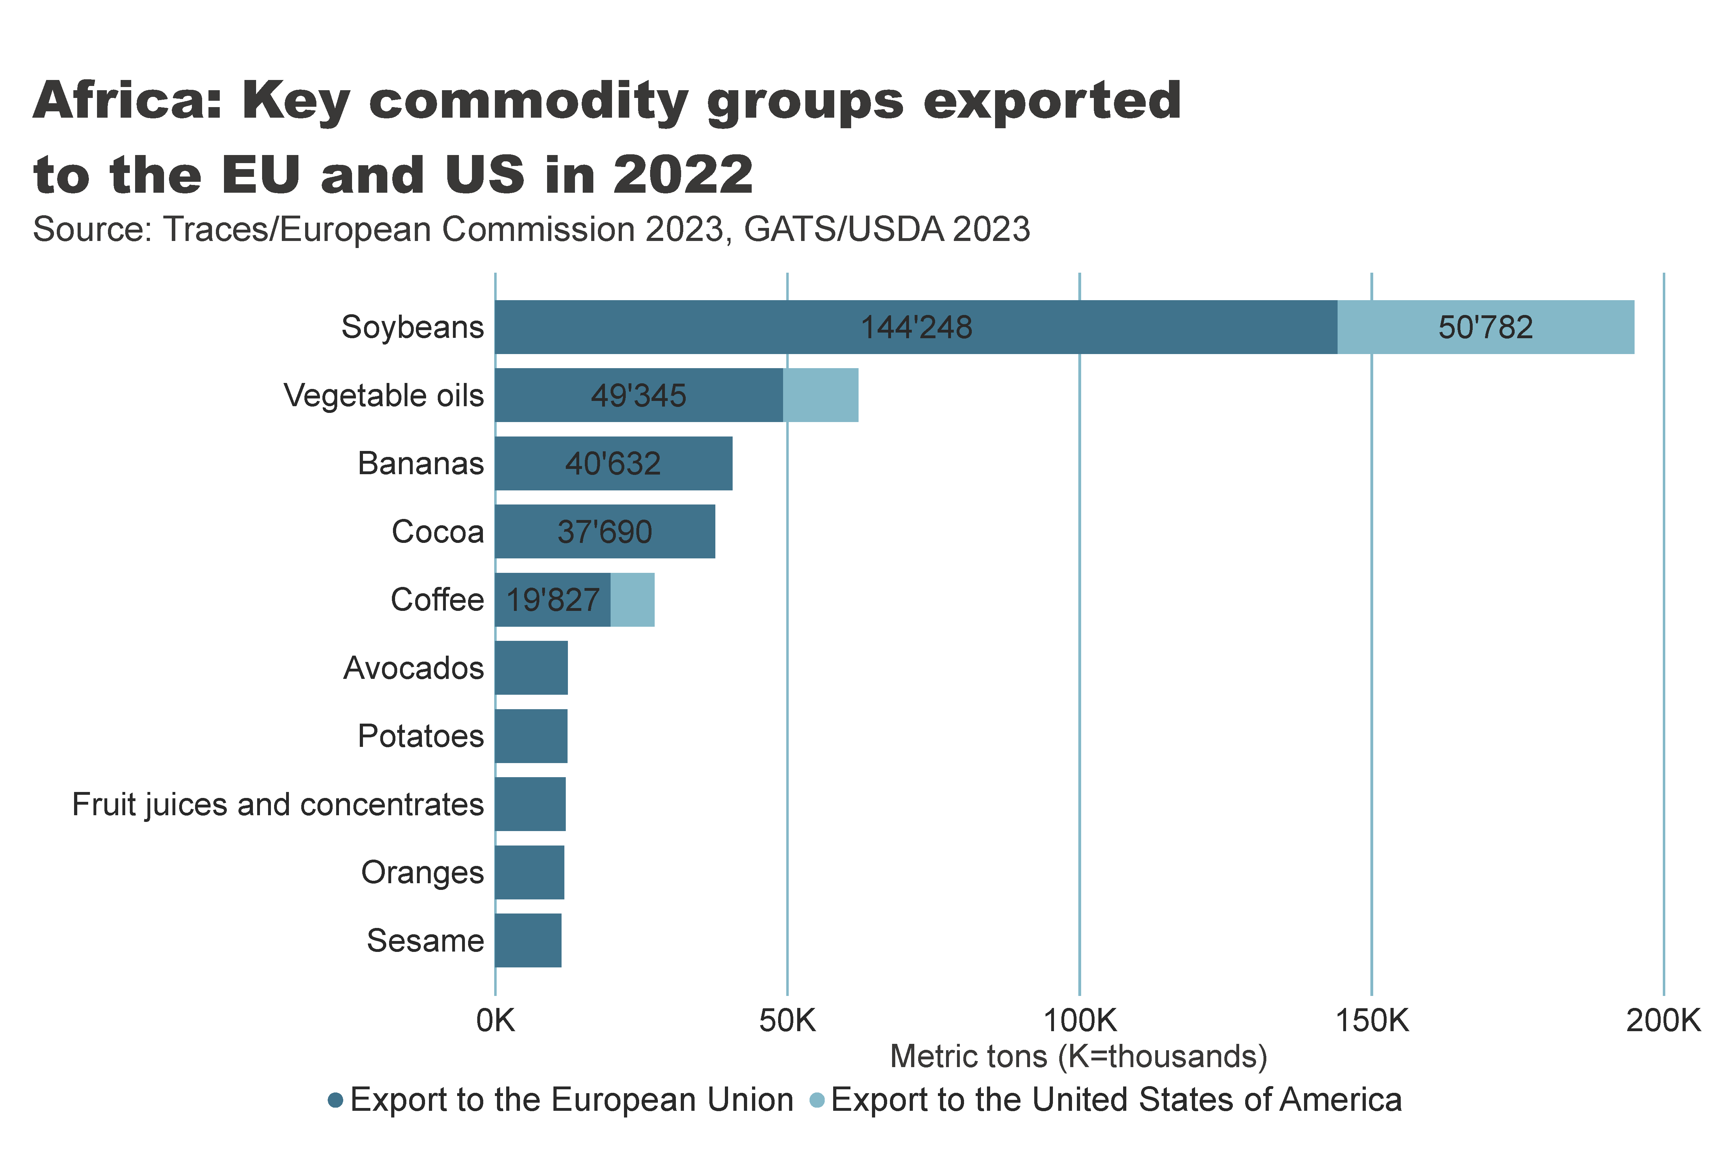

Slide 16
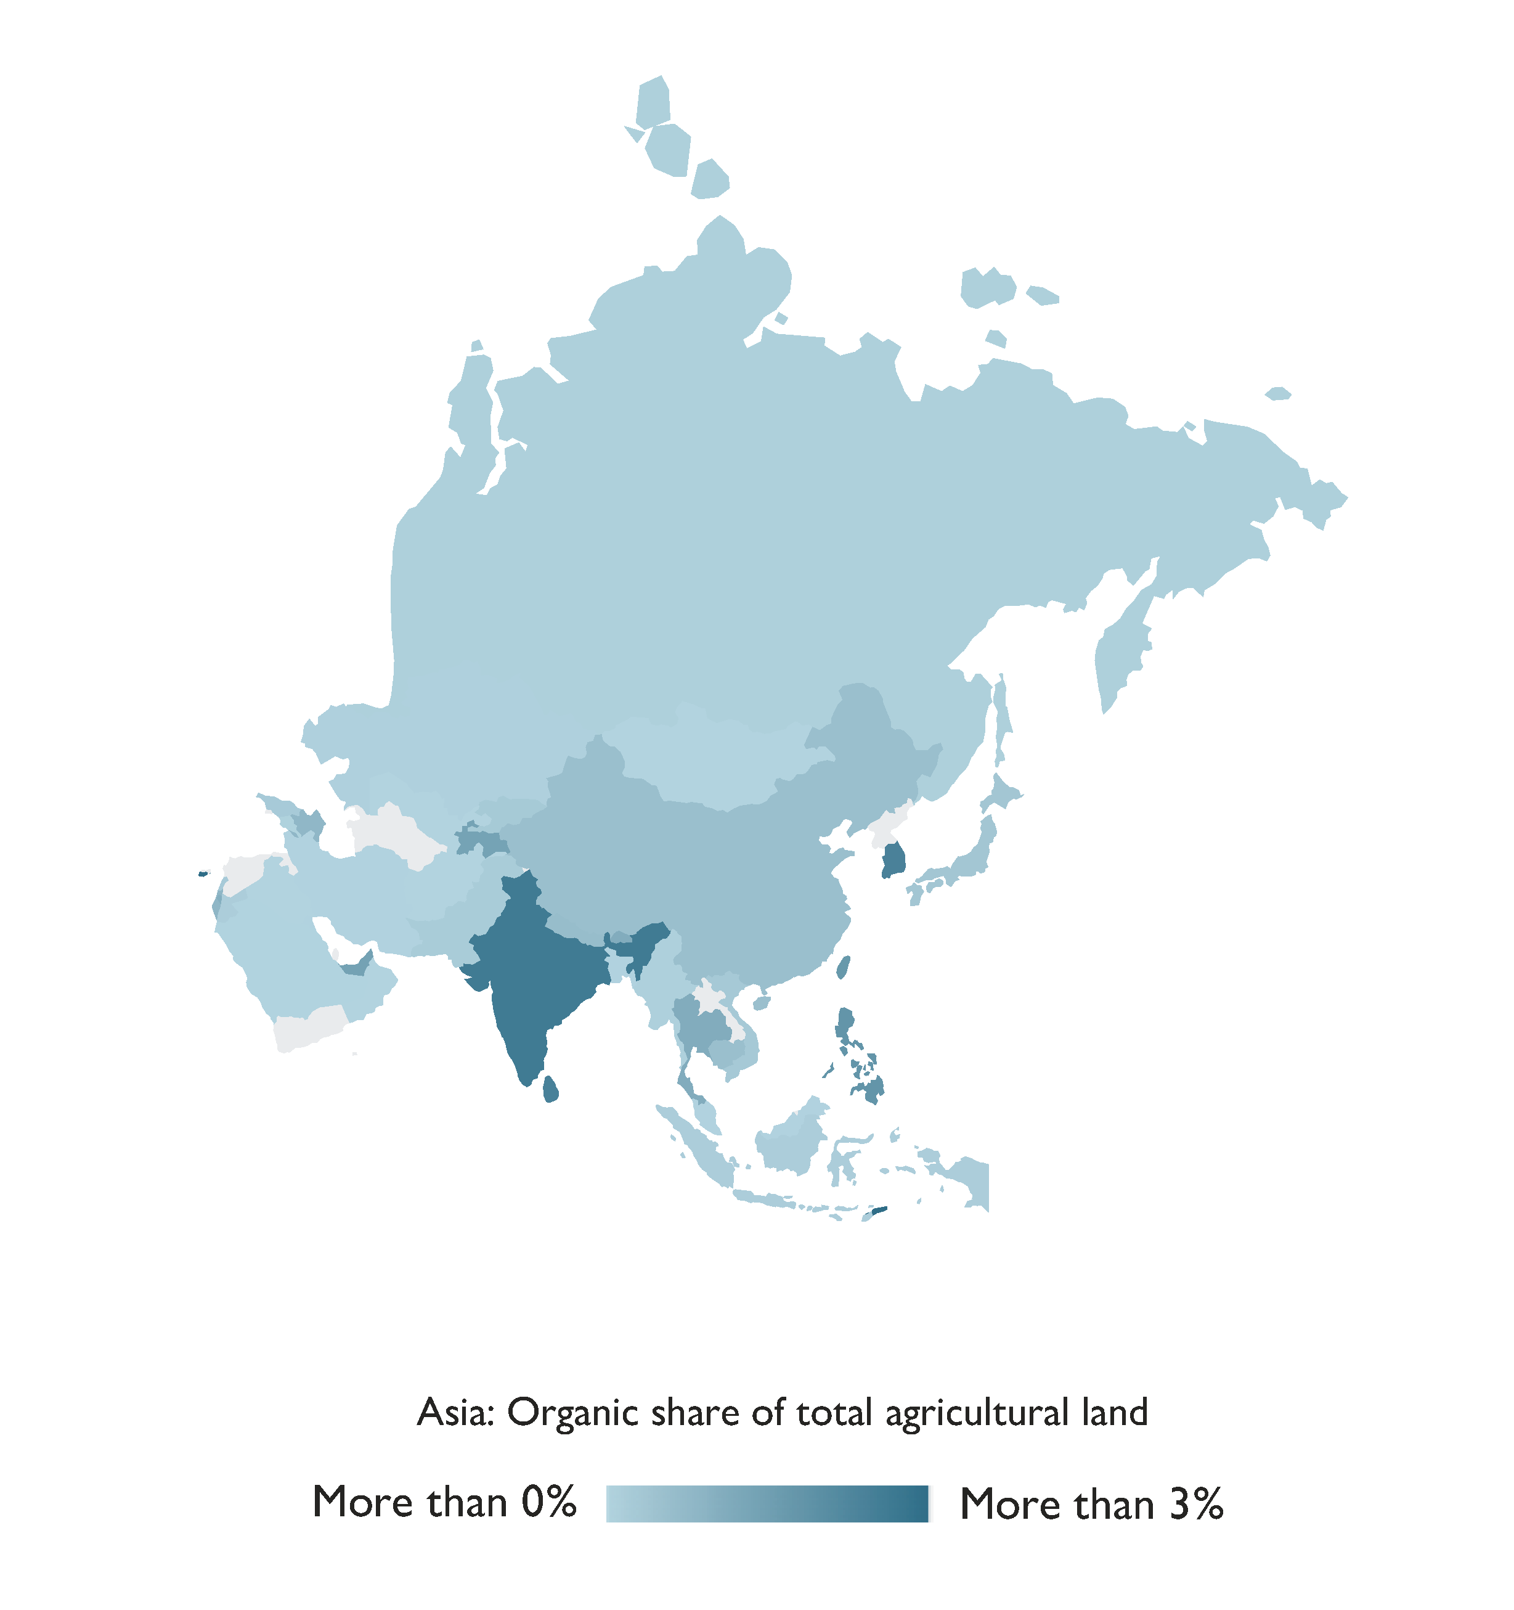
Asia

Slide 17
Organic Agriculture in Asia 2022
In 2022, Asia had over 8.8 million hectares of agricultural land
Managed by 2.7 million producers. The majority of these producers were in India, where their numbers increased by one million from 2021 to 2022, significantly contributing to the global growth of organic farmers.
India, with 4.73 million hectares, and China, with over 2.90 million hectares, emerged as the leading countries in terms of organic agricultural land.
Notably, Timor-Leste stood out with the highest proportion of organic agricultural land at 8.5 percent.
The region demonstrated a strong commitment to organic practices, with twenty-two countries having legislation in place for organic agriculture, while seven countries were in the process of drafting relevant legislation
Source: FiBL survey 2024

Slide 18
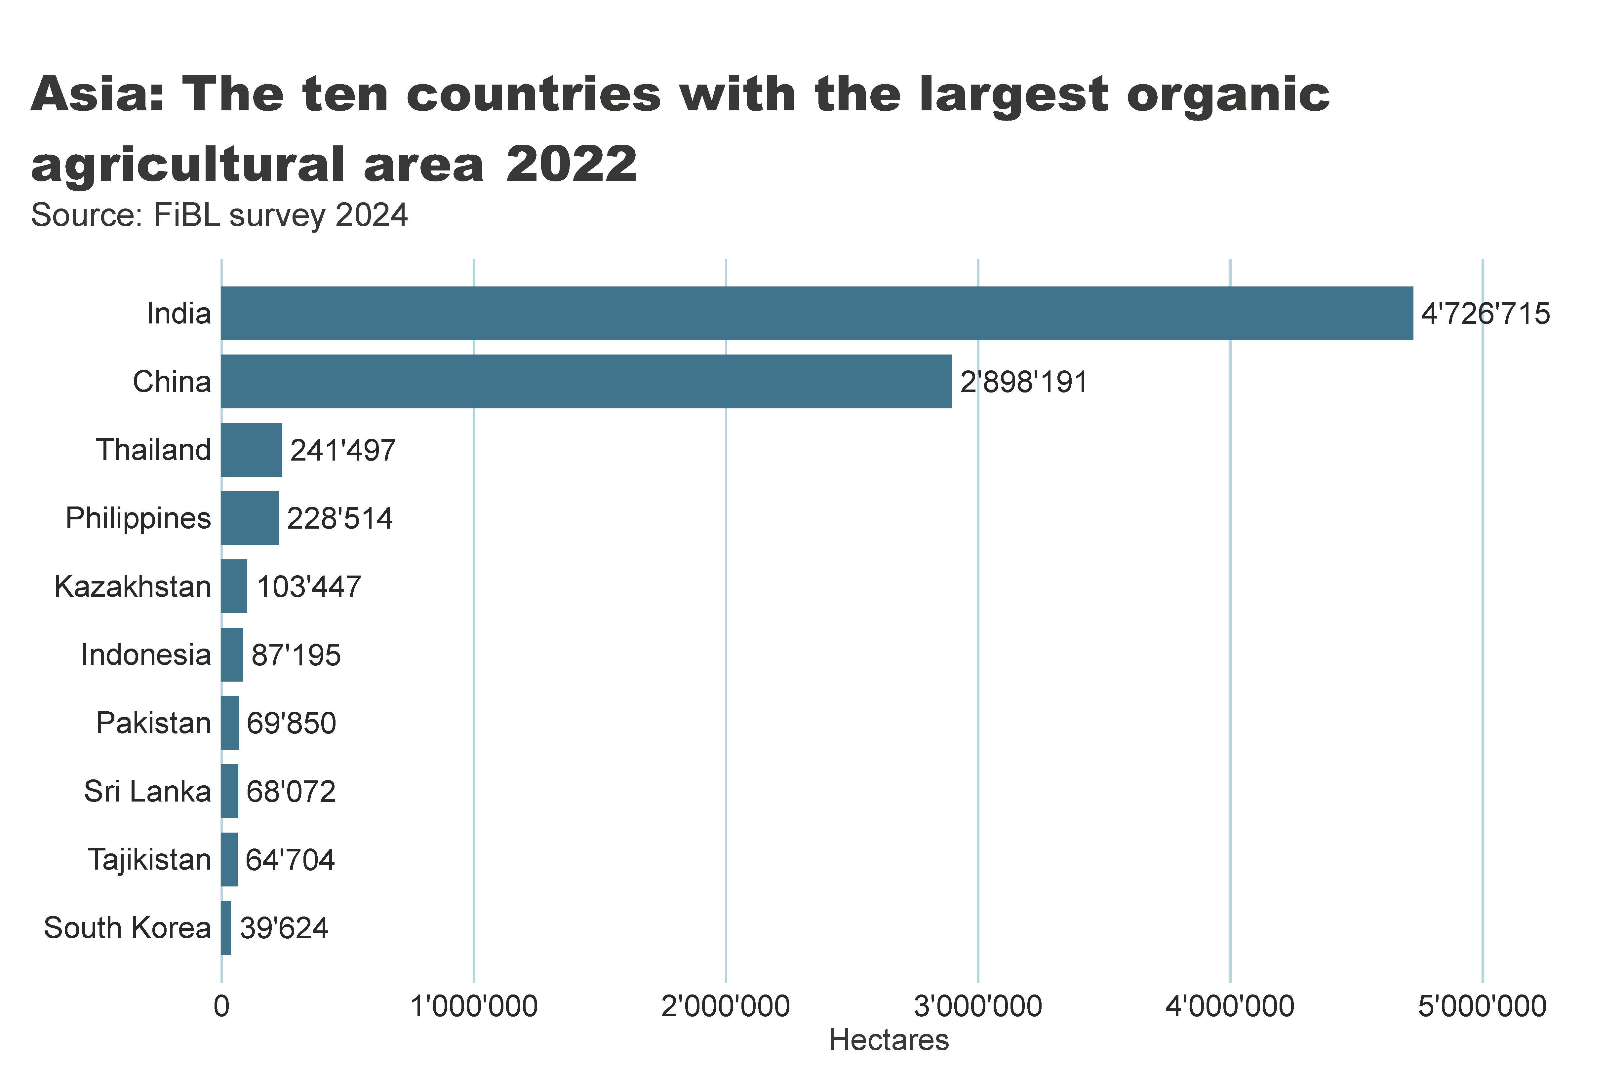
Asia_land_country
Notes:
clusteredBarChart
No alt text provided
textbox
No alt text provided
card
No alt text provided

Slide 19
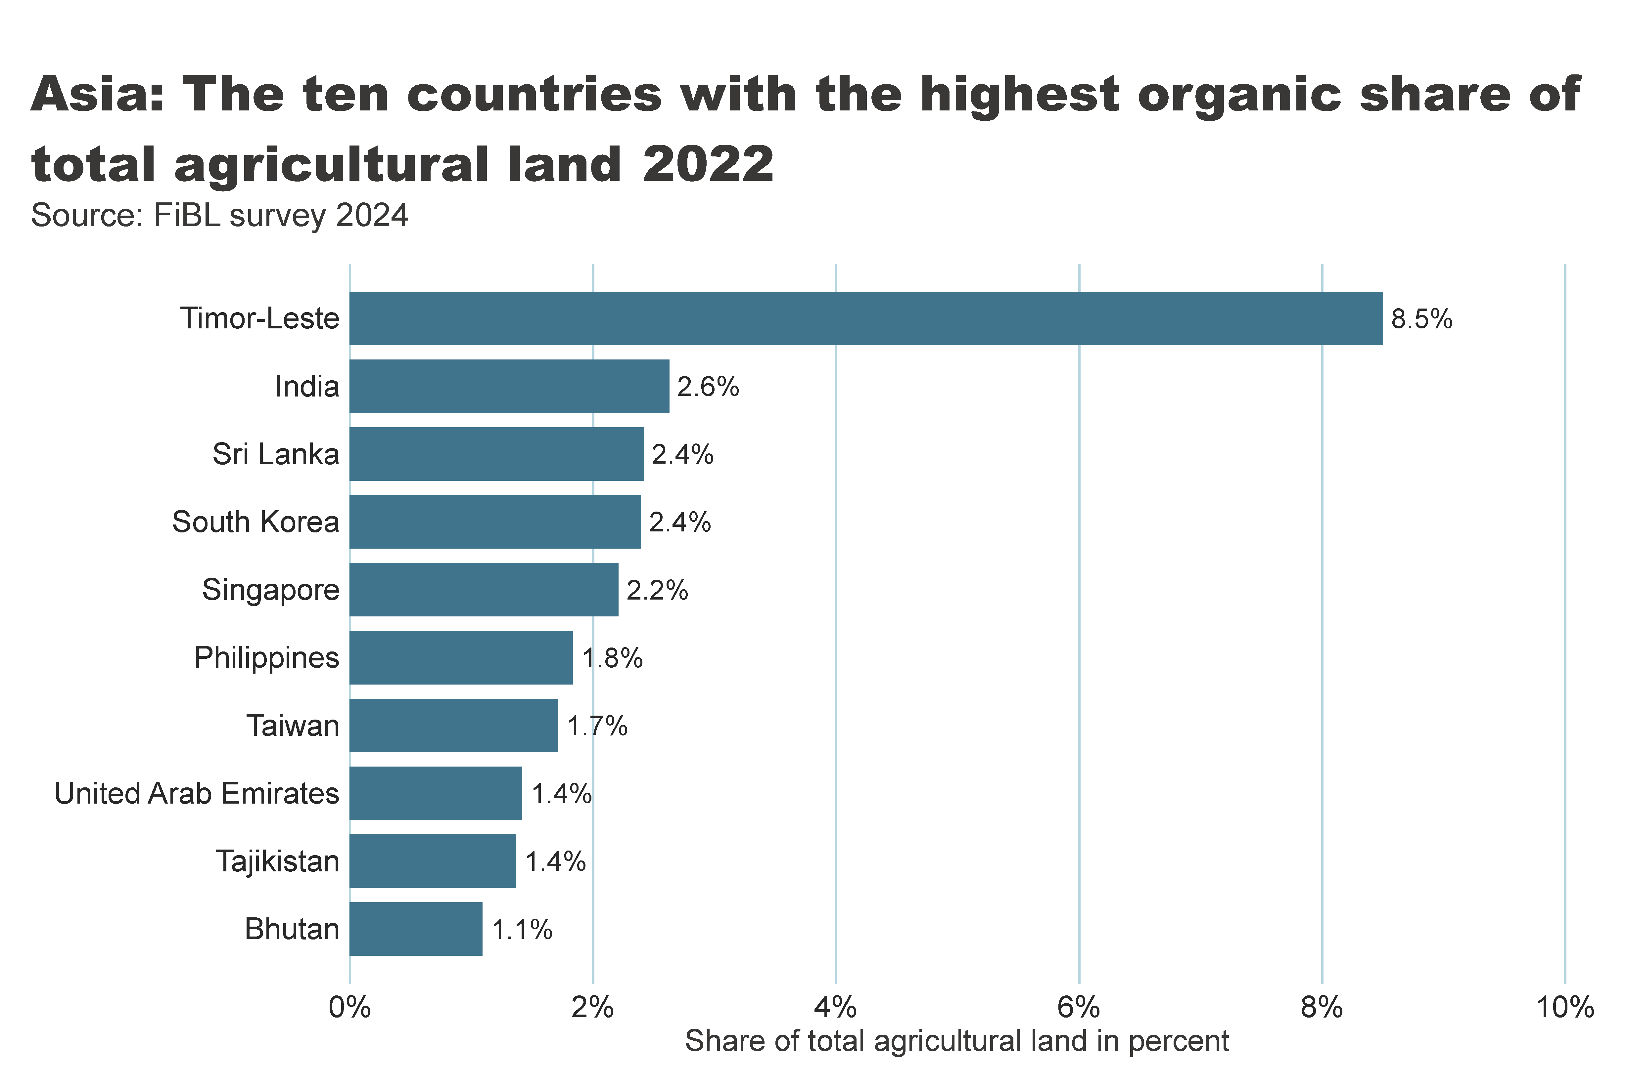
Asia_land_share_country
Notes:
textbox
No alt text provided
Source: FiBL survey 2022
No alt text provided
card
No alt text provided

Slide 20
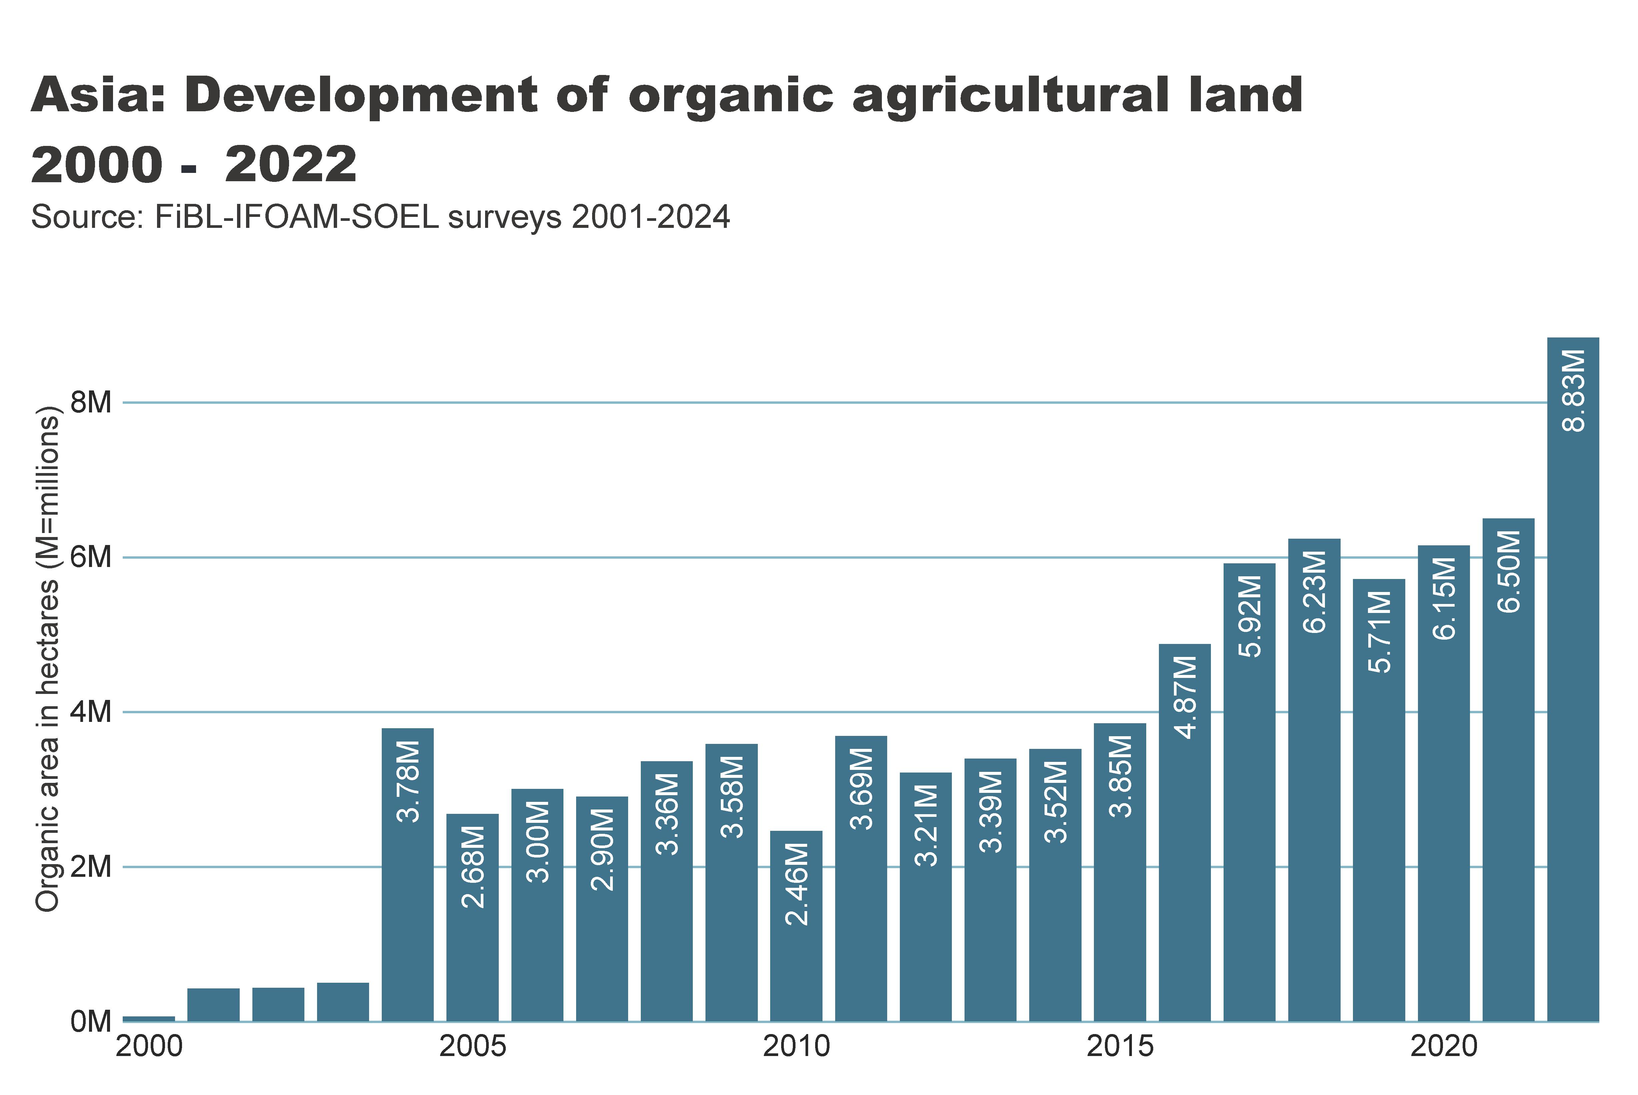
asia_land_growth
Notes:
textbox
No alt text provided
card
No alt text provided
Source: FiBL-IFOAM-SOEL surveys 2001-2022
No alt text provided

Slide 21
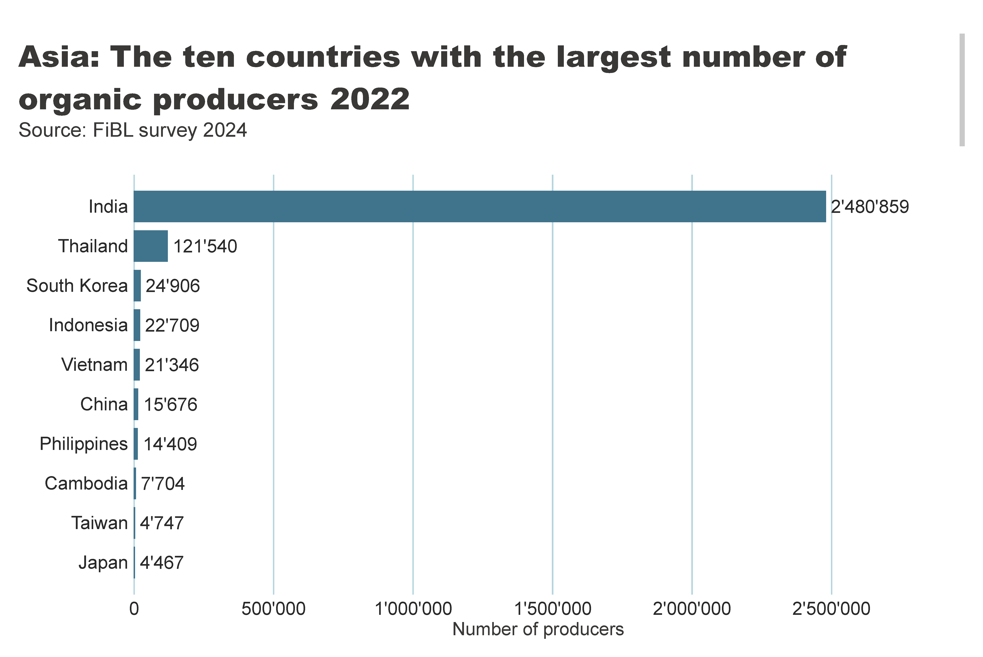
Asia_producers_country
Notes:
textbox
No alt text provided
card
No alt text provided
barChart
No alt text provided

Slide 22
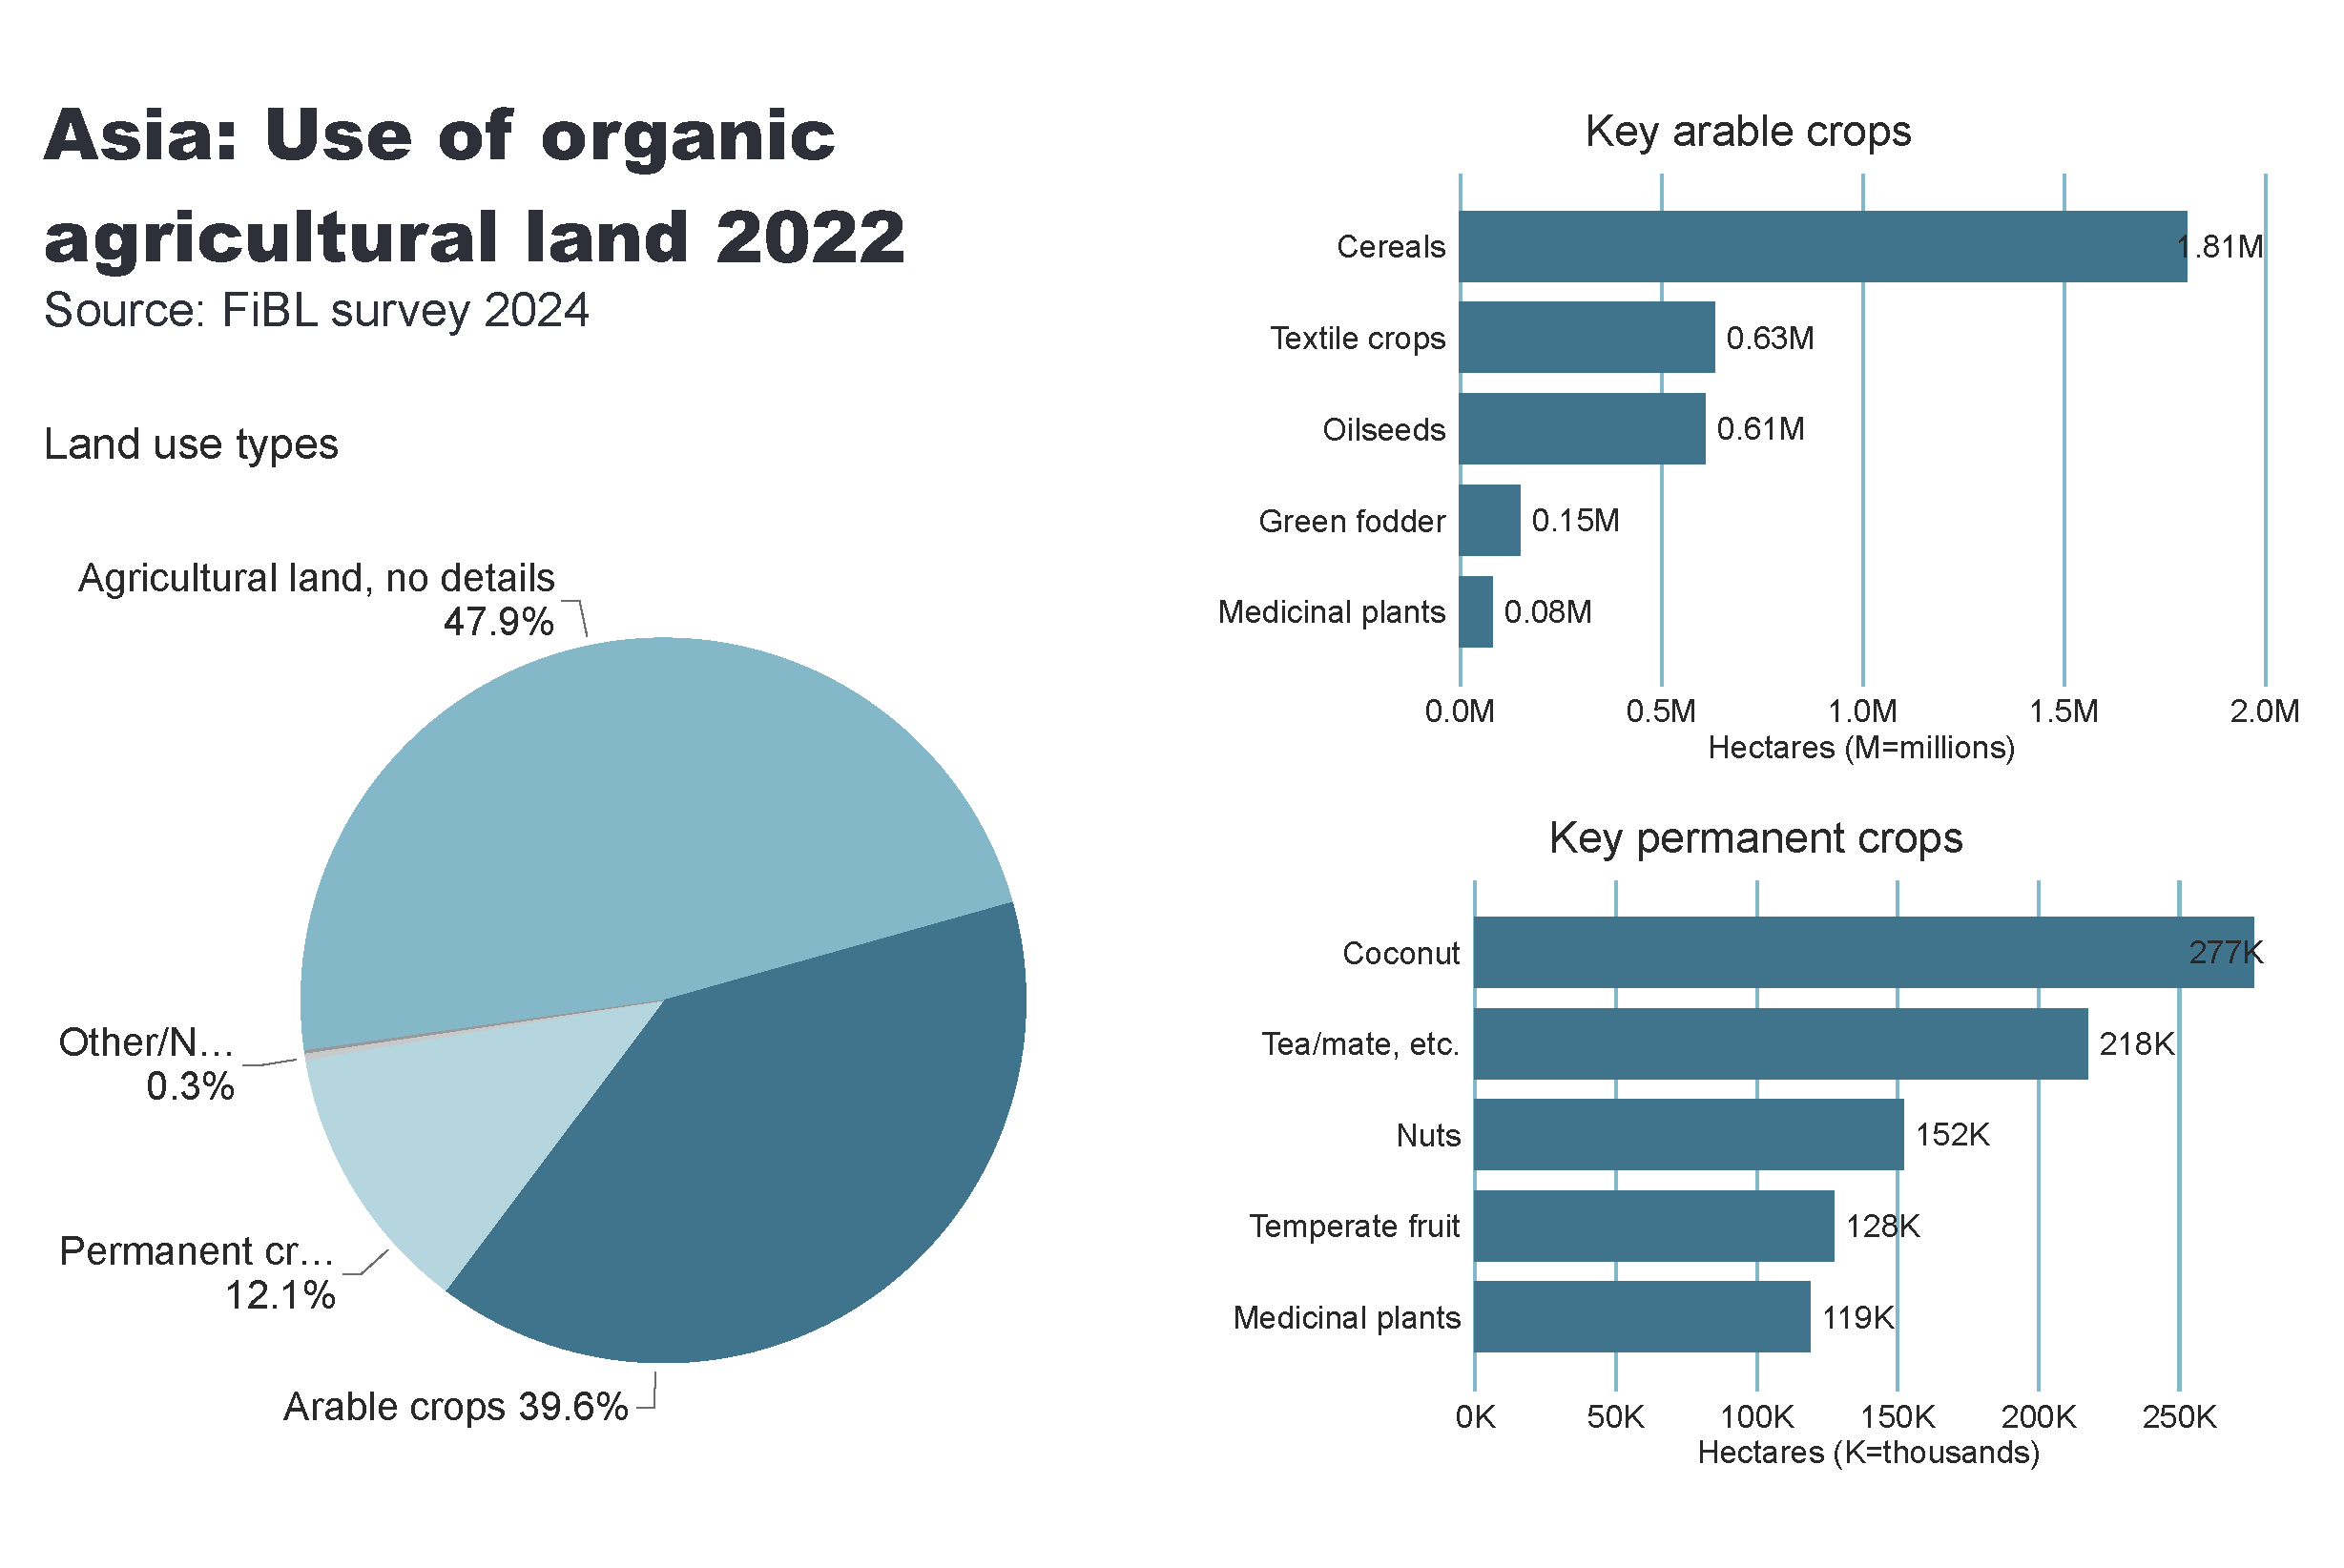
Asia_land_use
Notes:
Land use types
No alt text provided
card
No alt text provided
Key arable crops
No alt text provided
Key permanent crops
No alt text provided
textbox
No alt text provided

Slide 23
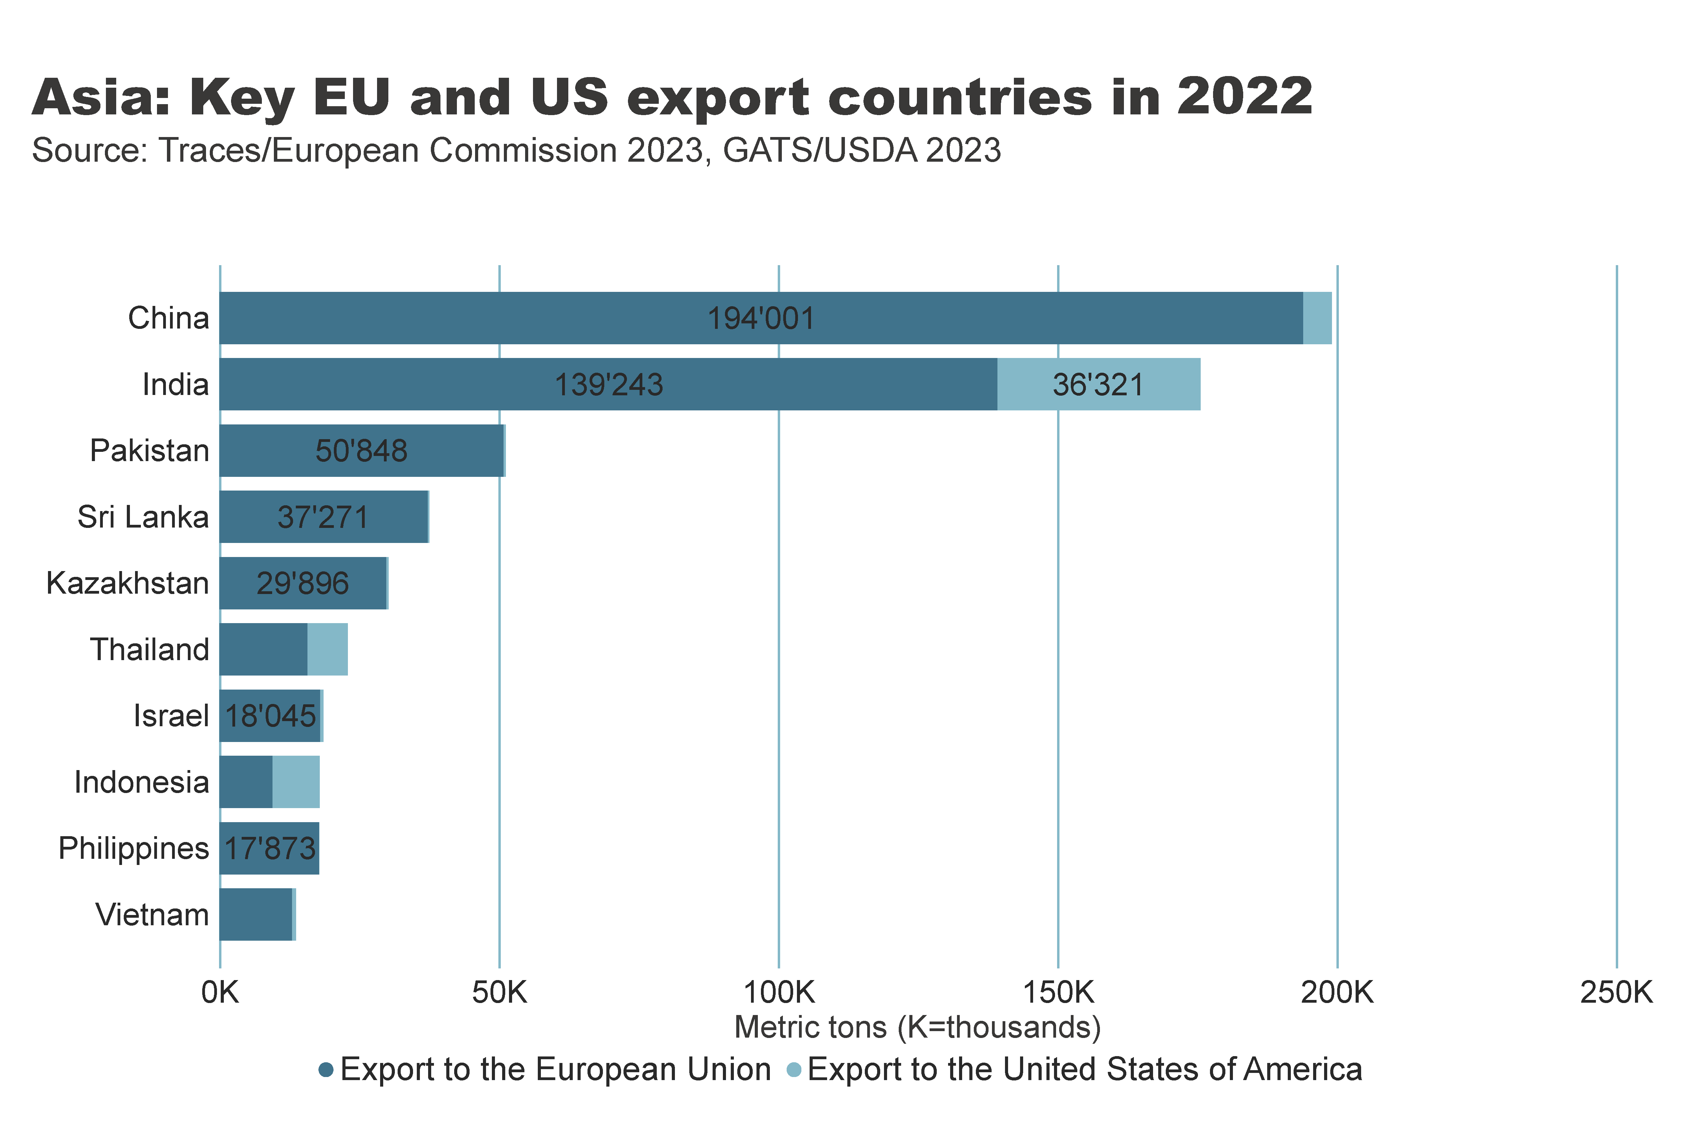
Asia_producers_country
Notes:
textbox
No alt text provided
card
No alt text provided
barChart
No alt text provided

Slide 24
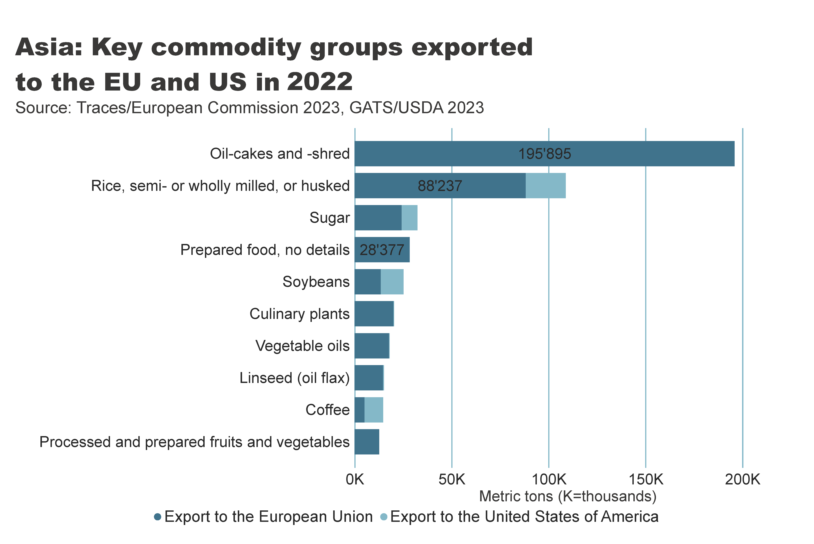
Asia_producers_country
Notes:
textbox
No alt text provided
card
No alt text provided
barChart
No alt text provided

Slide 25
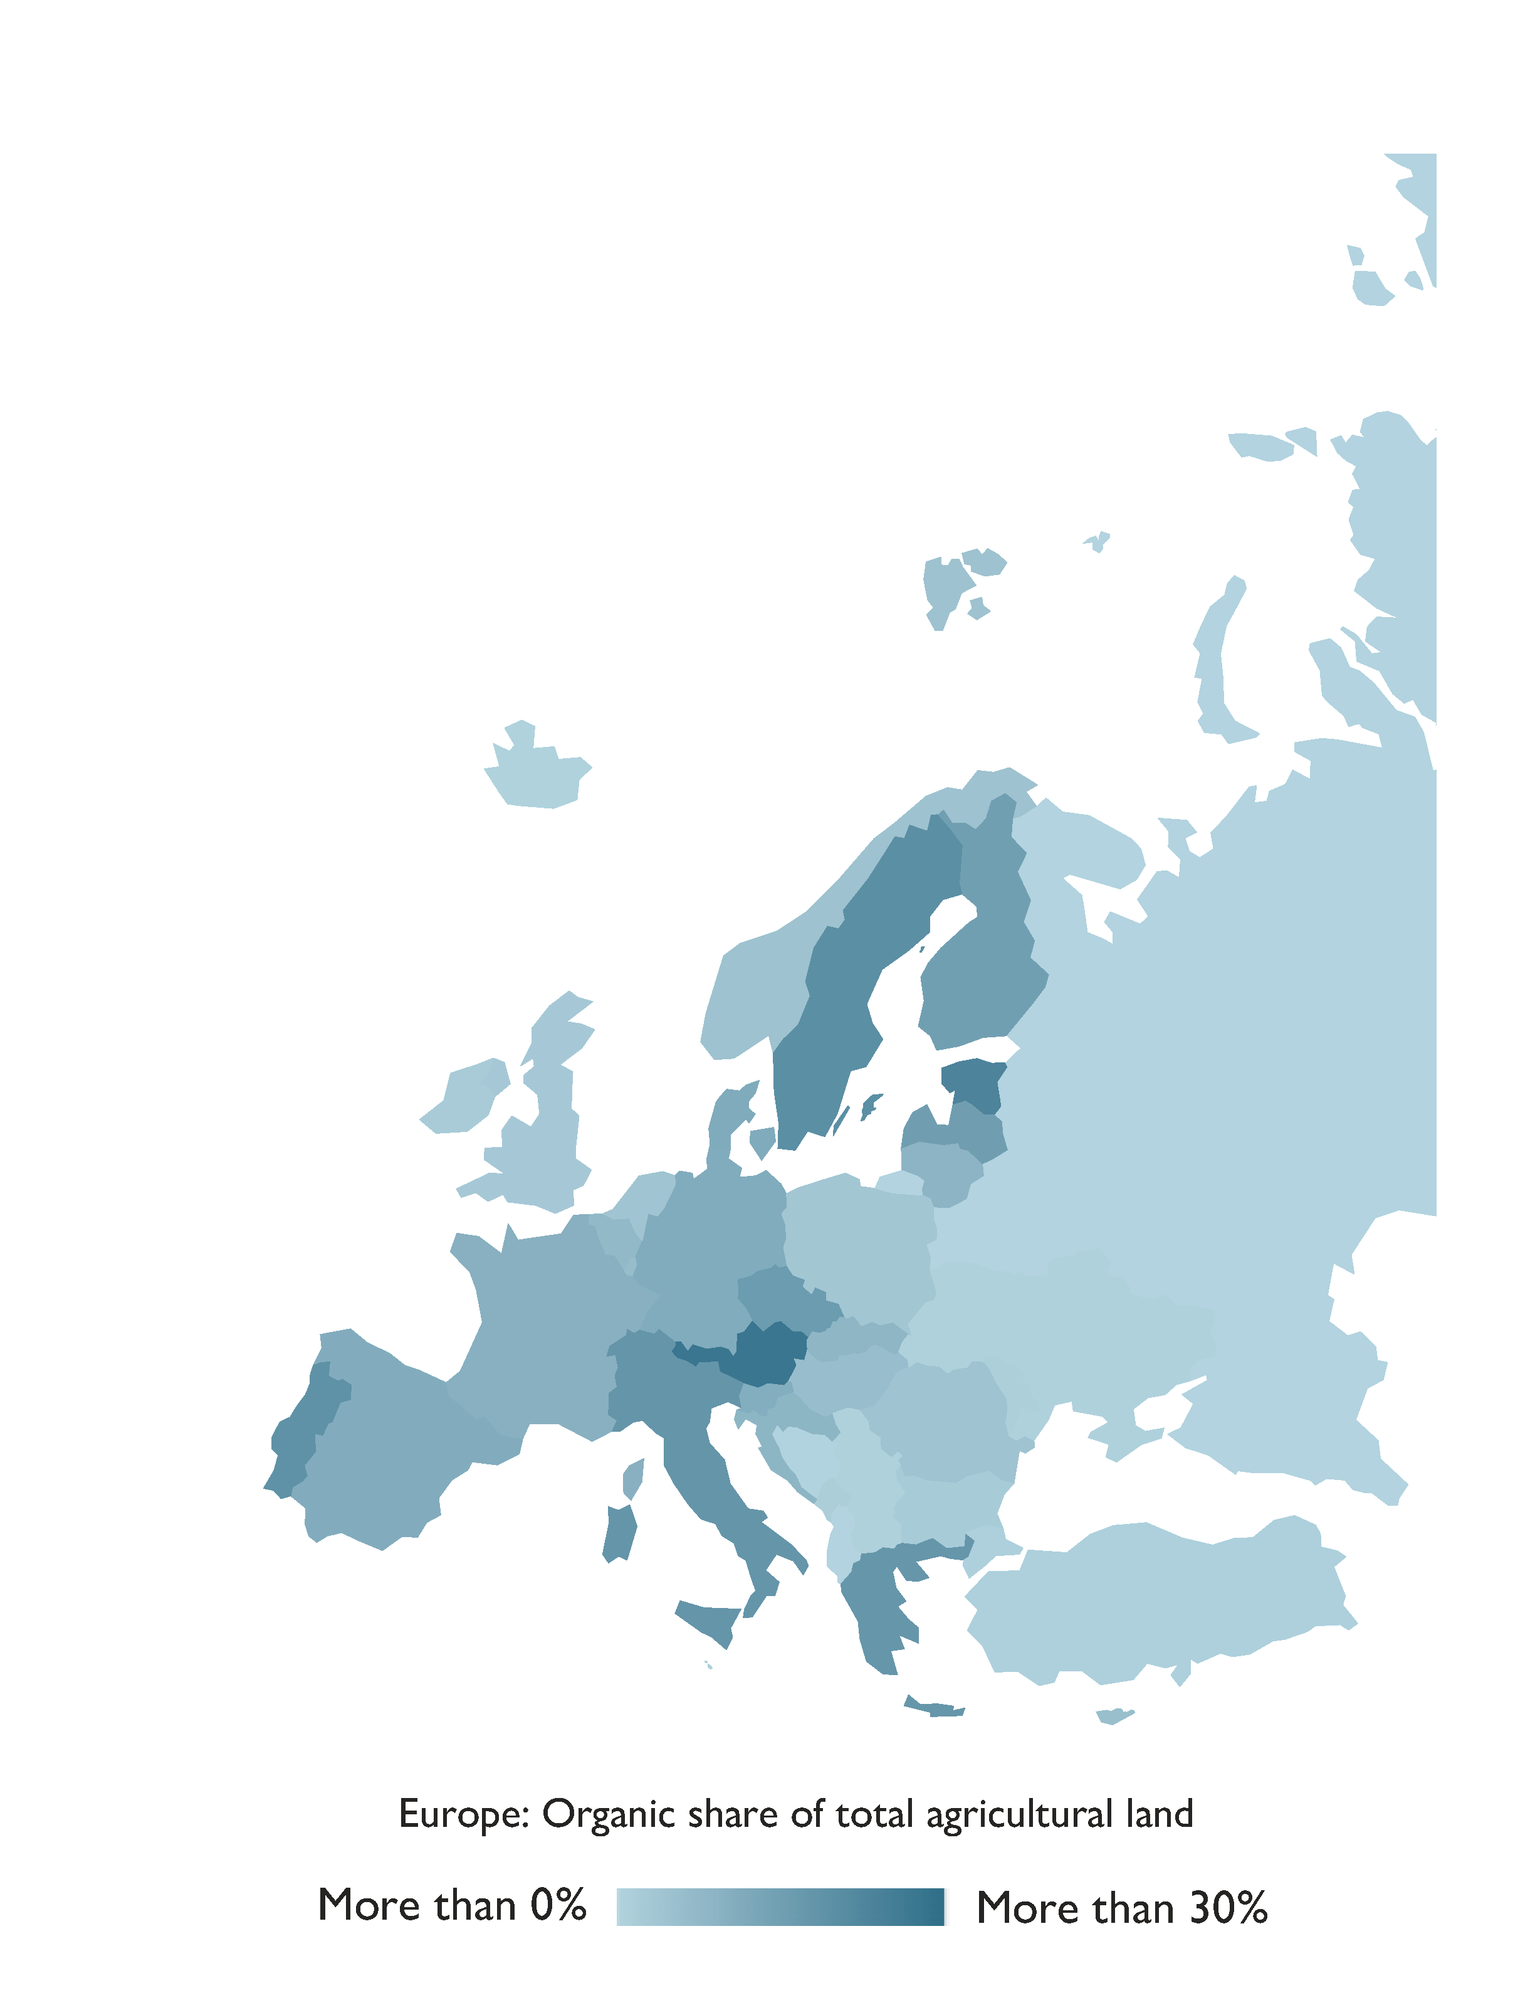
Europe: Organic agricultural land 2022
Source: FiBL survey 2024, based on national sources and Eurostat.

Slide 26
Organic agriculture in Europe: Key data 2022
By the end of 2022, in Europe more than 18.5 million hectares of organic agricultural land (European Union: 16.9 million hectares) were managed organically.
Overseen by over 480´000 producers (European Union: over 419´000).
Within Europe, organic agriculture covered 3.7 percent of the agricultural area (European Union: 10.4 percent).
Organic farmland witnessed an increase of over 0.2 million hectares in Europe and 0.8 million hectares in the European Union compared to 2021.
The leading countries in terms of organic agricultural areas were France (2.9 million hectares), Spain (2.7 million hectares), and Italy (2.3 million hectares).
Notably, 16 countries had at least 10 percent of their farmland dedicated to organic practices, with Liechtenstein leading at 43.0 percent, followed by Austria (27.5 percent) and Estonia (23.4 percent).
In 2022, retail sales of organic products amounted to 53.1 billion euros (European Union: 45.1 billion euros), representing a 2.2 percent decrease (-2.8% in the EU) since 2021.
Germany ranked as the largest market for organic products with retail sales of 15.3 billion euros, followed by France (12.1 billion euros) and Switzerland (3.9 billion euros)
Across Europe, 43 countries have legislation governing organic agriculture.
While organic farmland grew by 5 percent, consolidated data for 2022 indicate stagnation or even decline in retail sales in several countries.
Source: FiBL survey 2024, based on national sources and Eurostat.

Slide 27
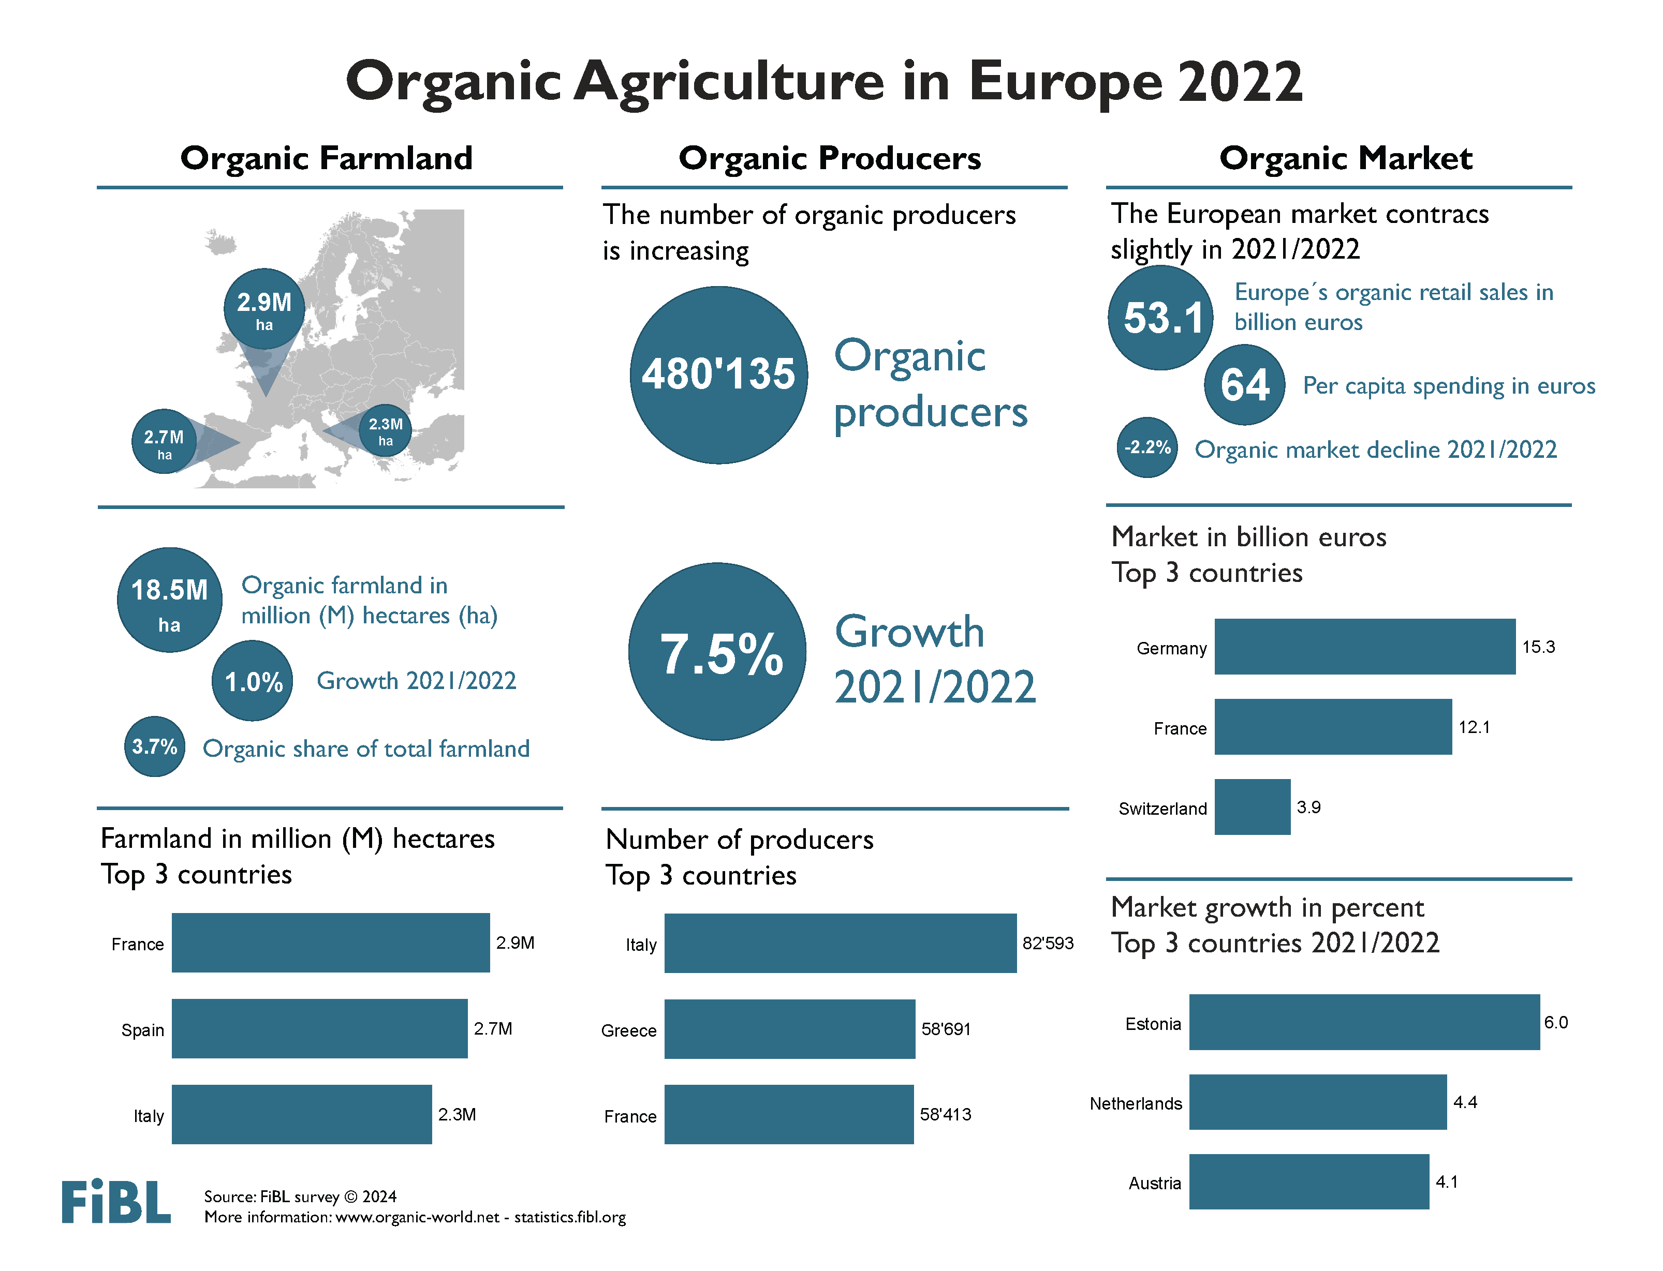

Slide 28
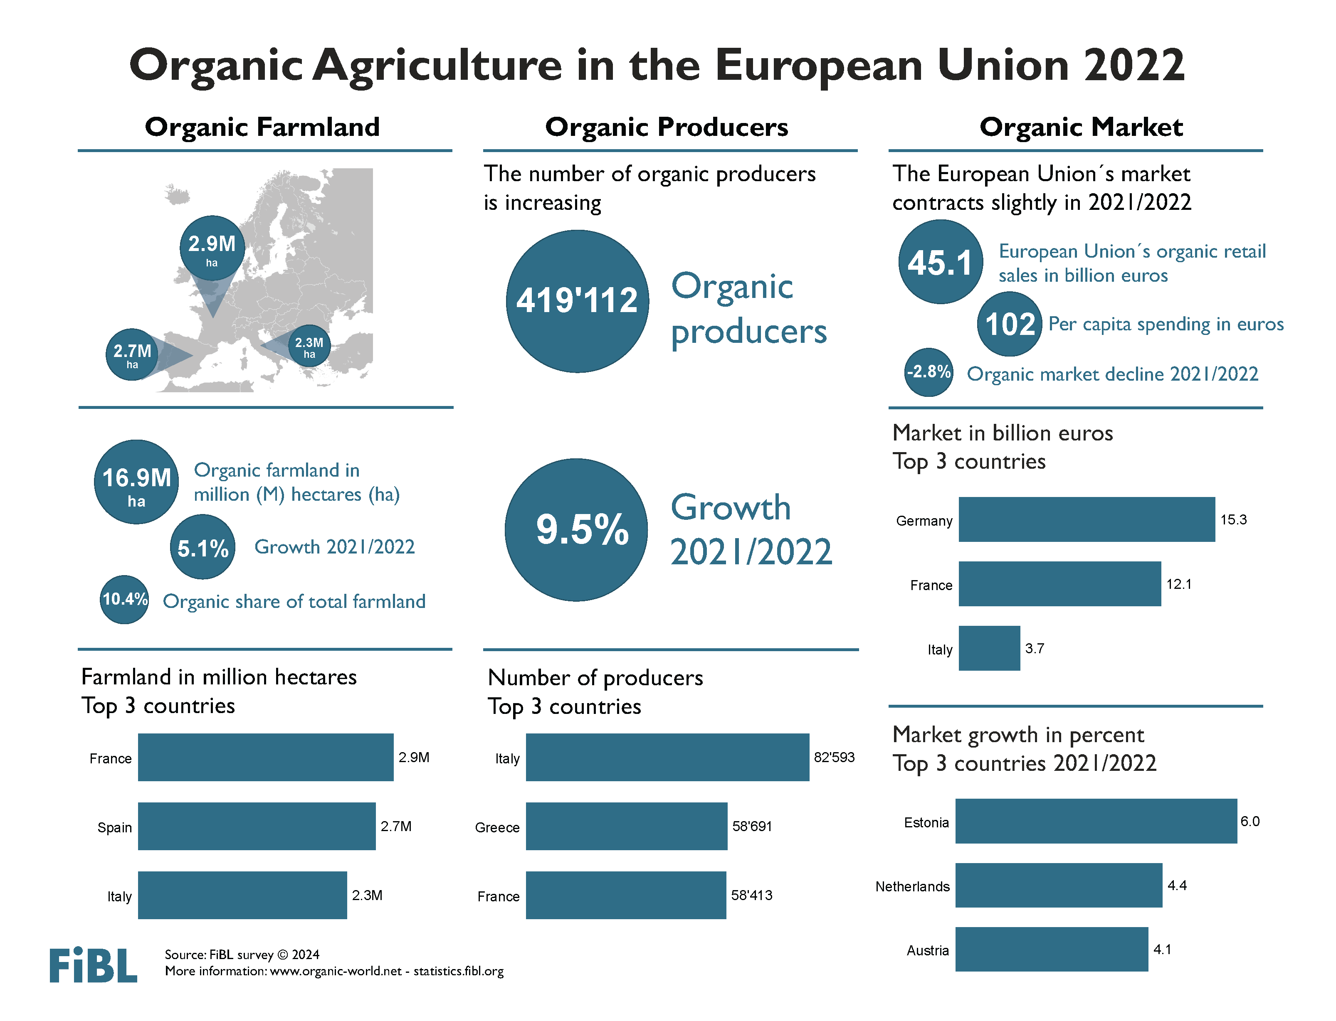

Slide 29
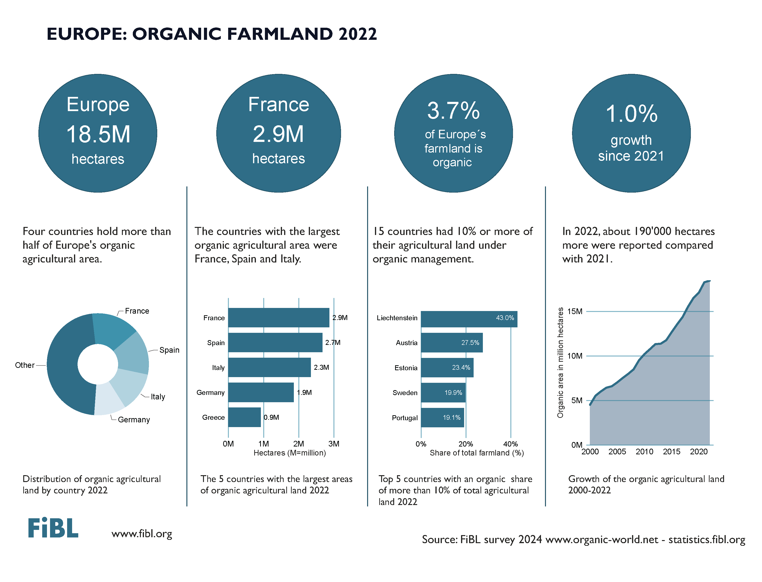

Slide 30
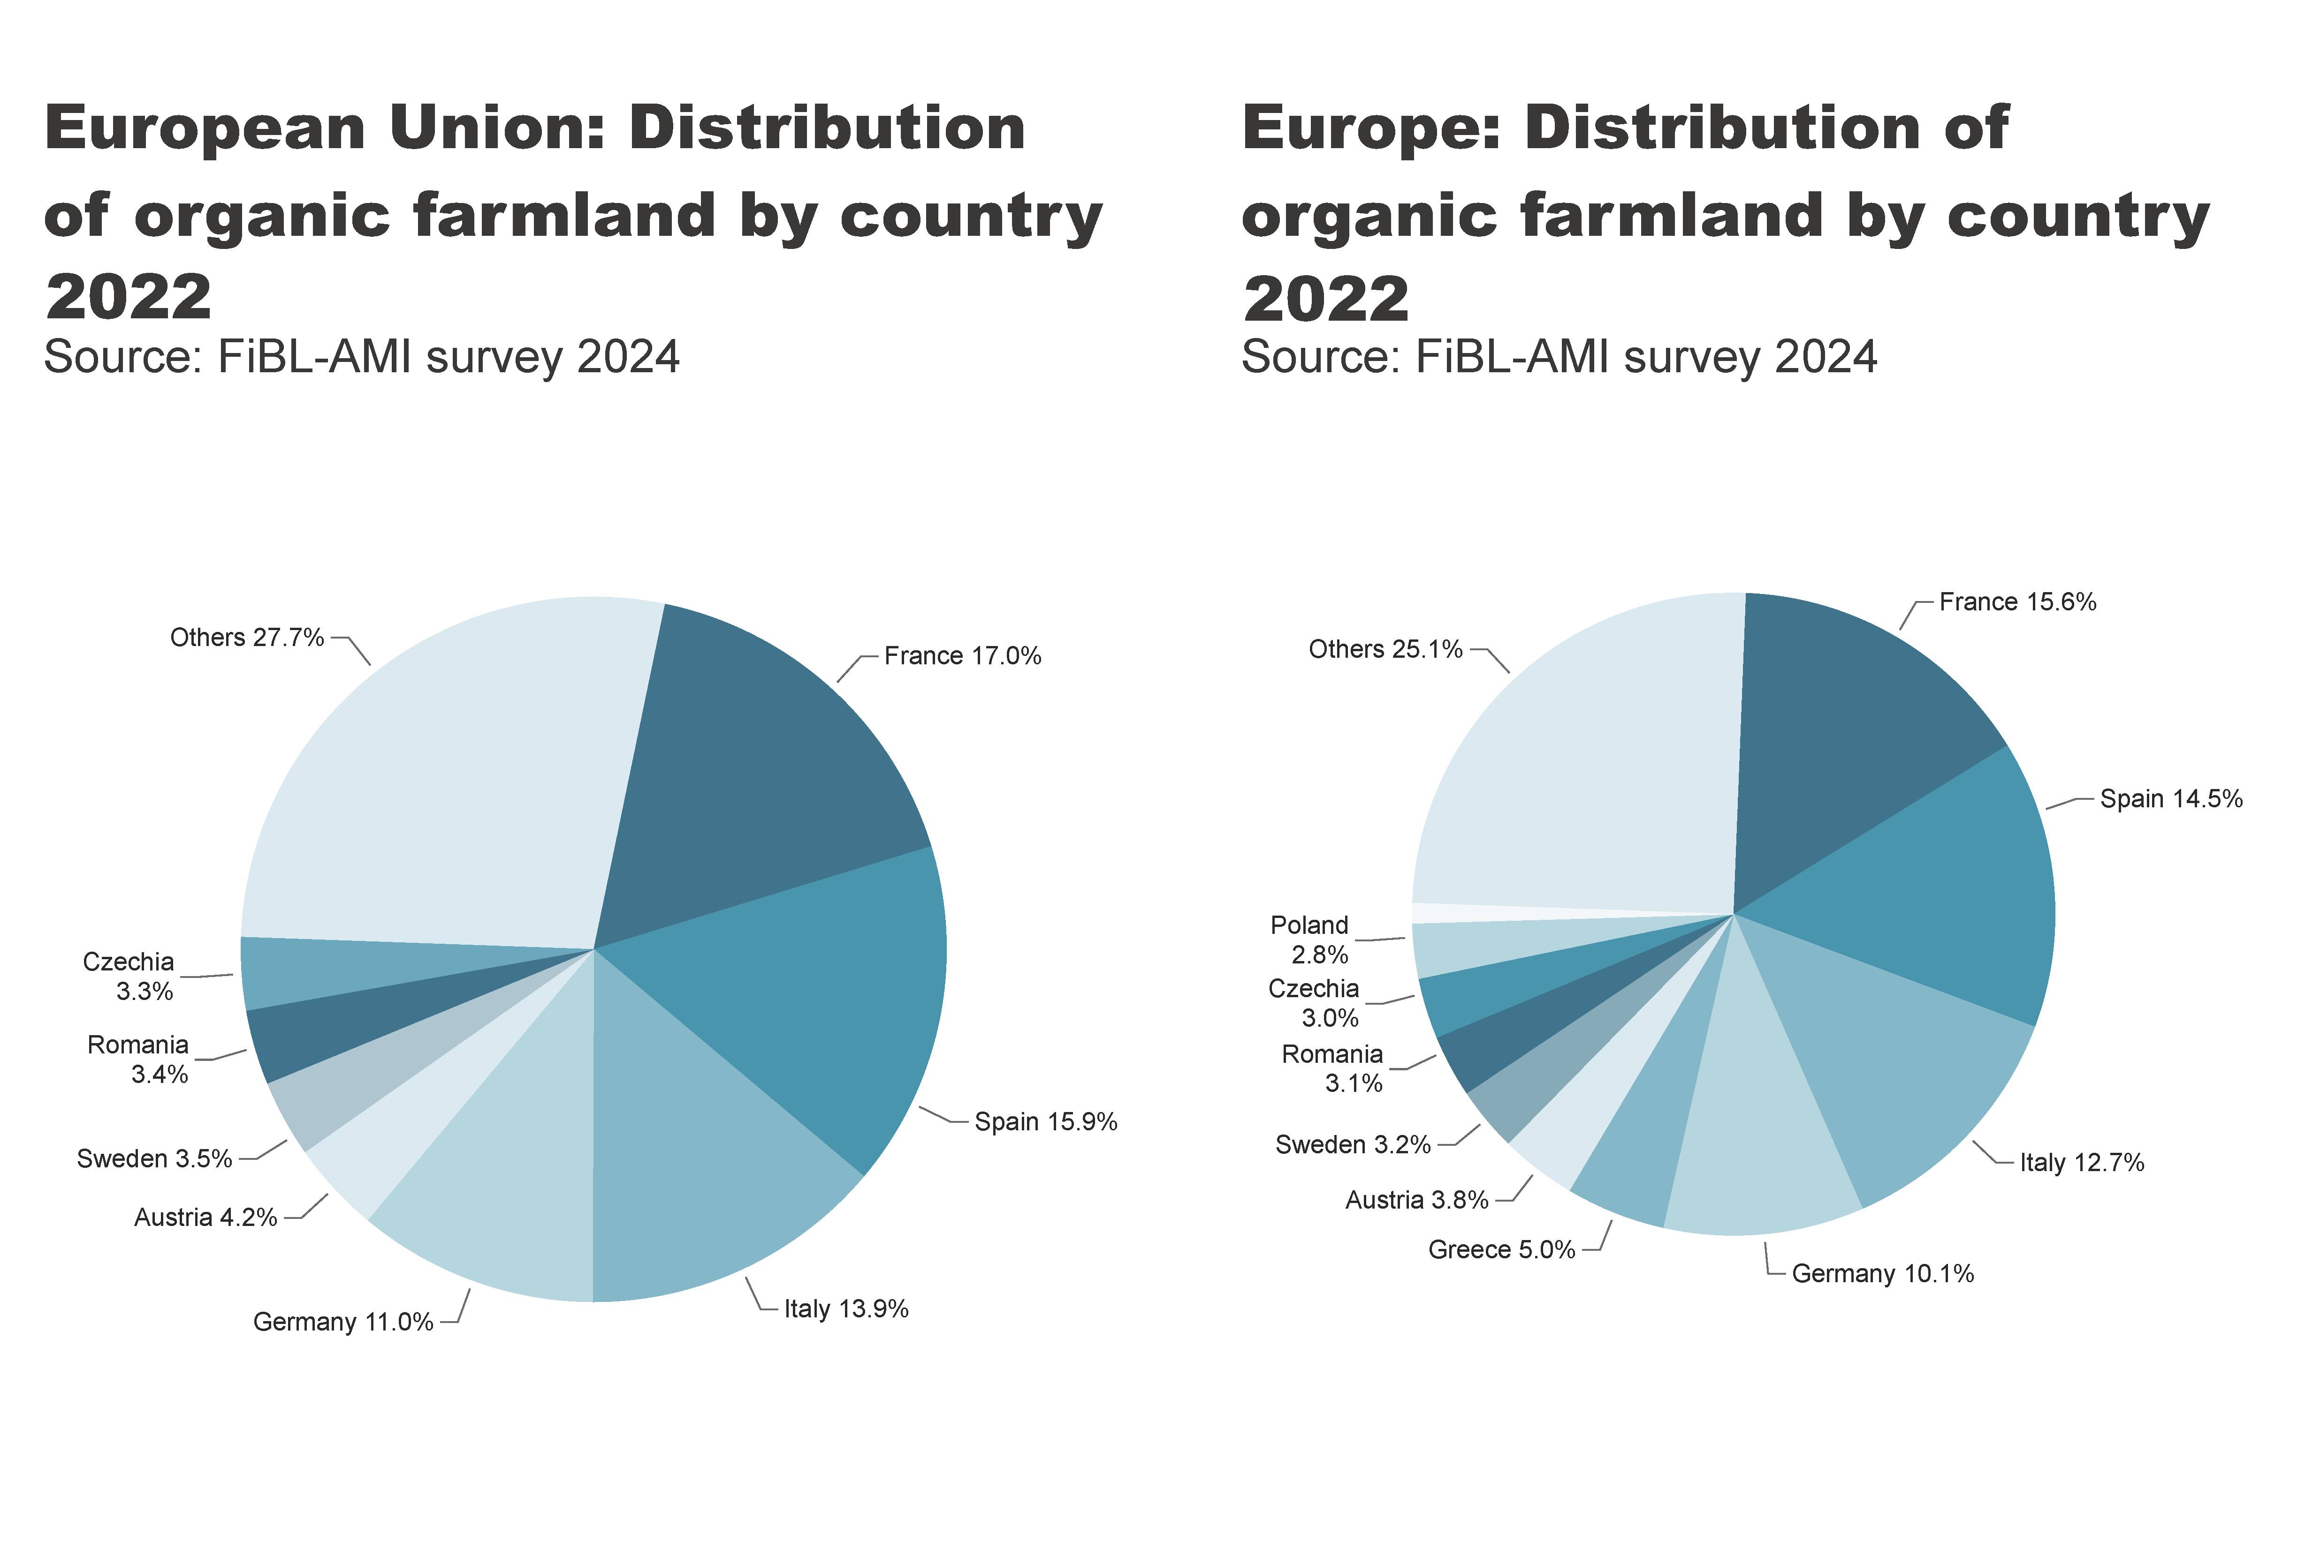
EU_Europe_land_distribution_country
Notes:
pieChart
No alt text provided
textbox
No alt text provided
card
No alt text provided
pieChart
No alt text provided
textbox
No alt text provided
card
No alt text provided

Slide 31
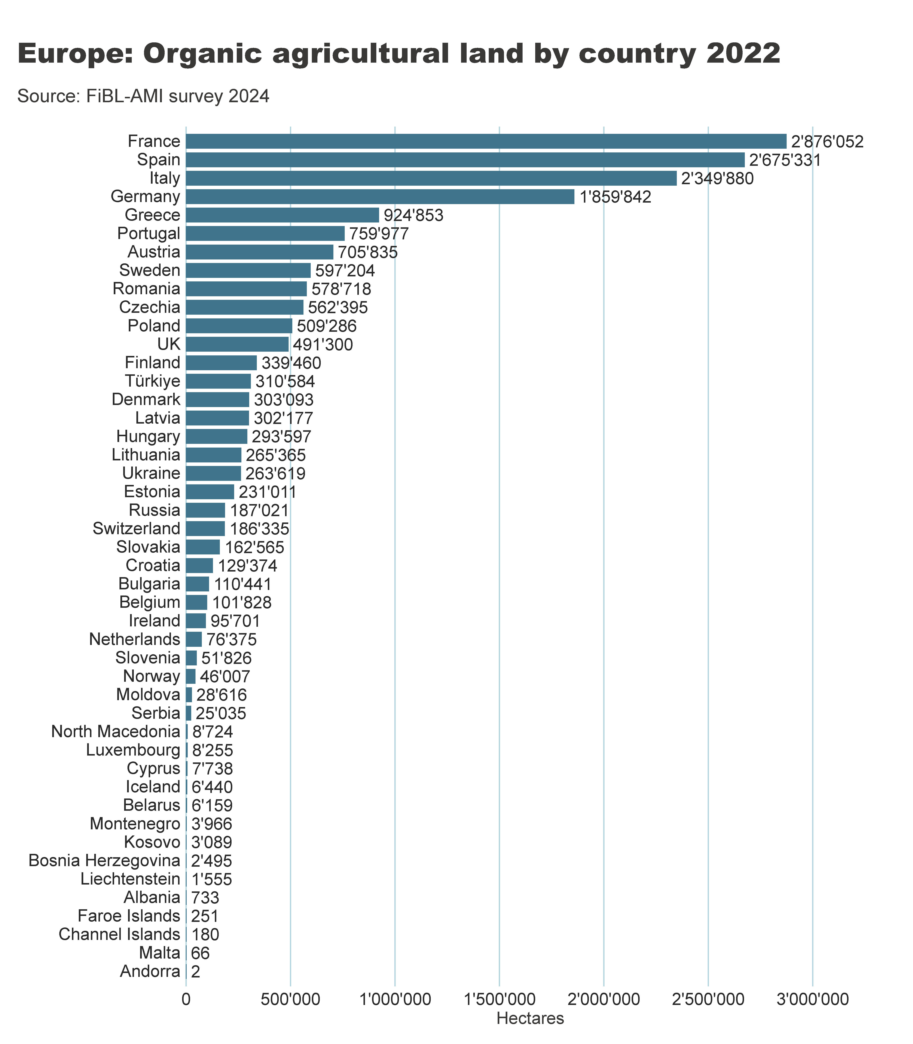
Europe_land_by_country
Notes:
clusteredBarChart
No alt text provided
textbox
No alt text provided
card
No alt text provided

Slide 32
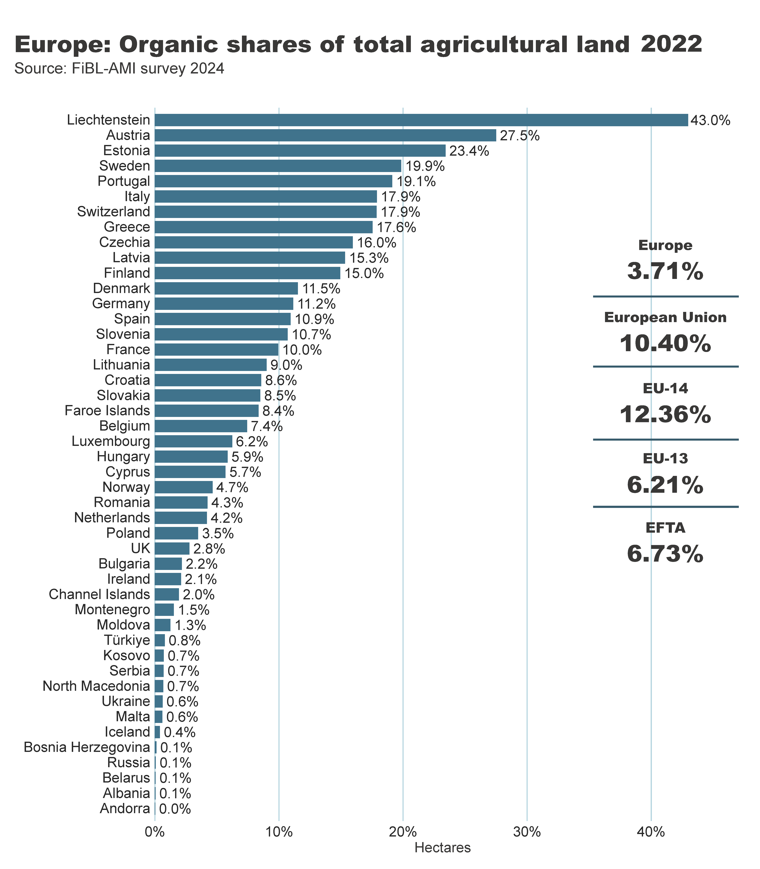
Europe_land_share_country
Notes:
clusteredBarChart
No alt text provided
textbox
No alt text provided
card
No alt text provided
European Union
No alt text provided
Europe
No alt text provided
EFTA
No alt text provided
EU-14
No alt text provided
EU-13
No alt text provided
shape
No alt text provided
shape
No alt text provided
shape
No alt text provided
shape
No alt text provided

Slide 33
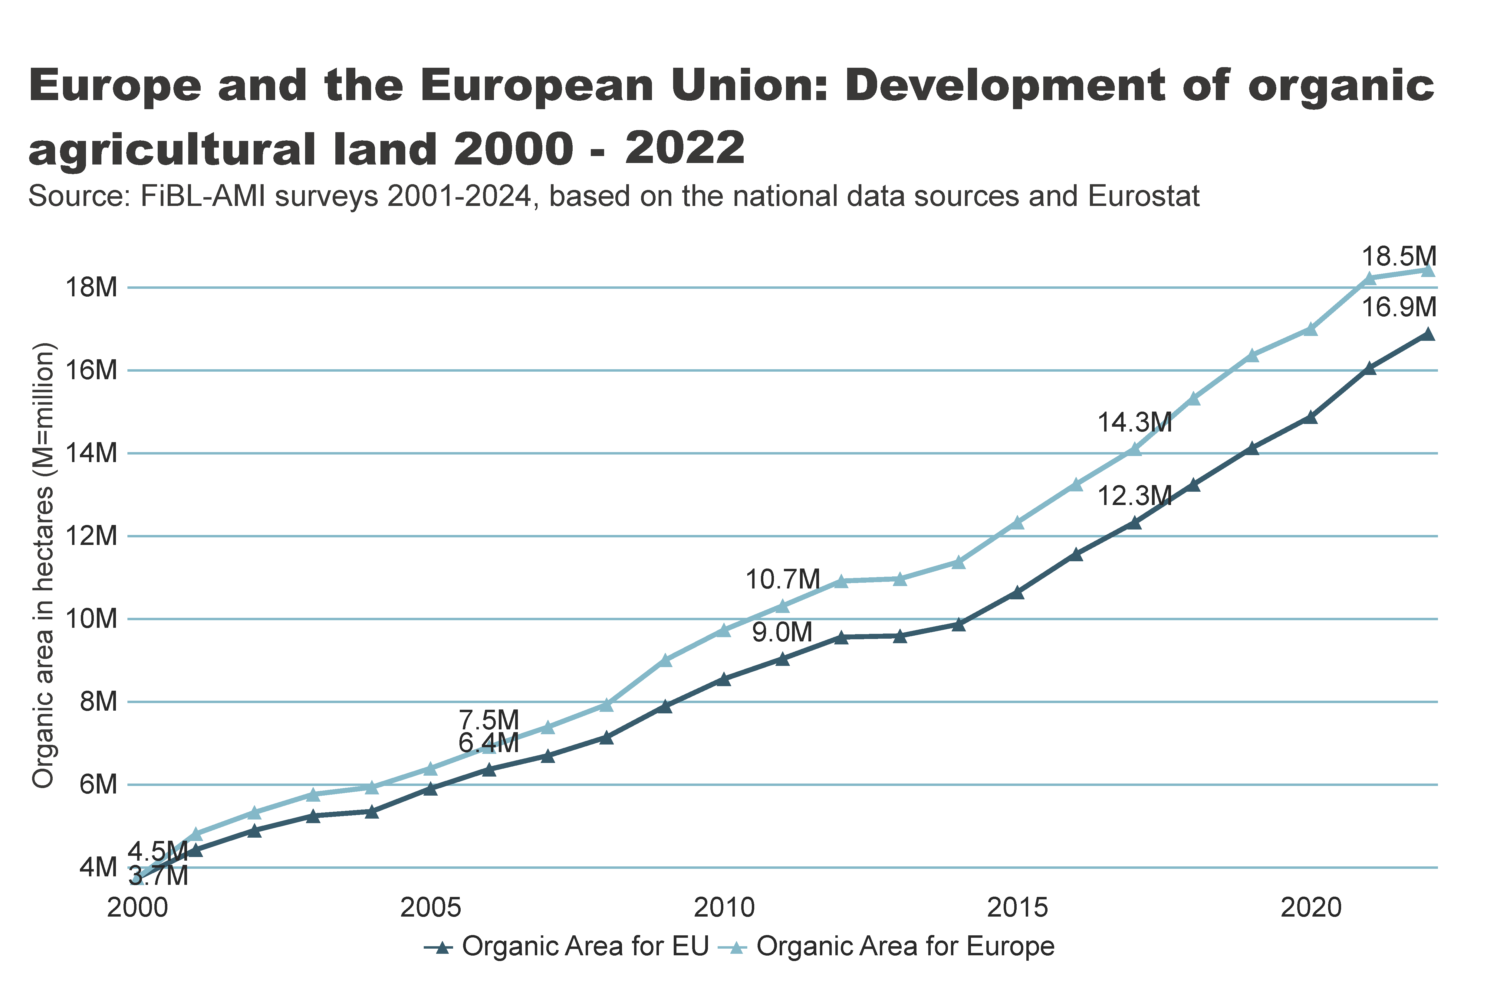
Europe_EU_growth_land
Notes:
textbox
No alt text provided
lineChart
No alt text provided
card
No alt text provided

Slide 34
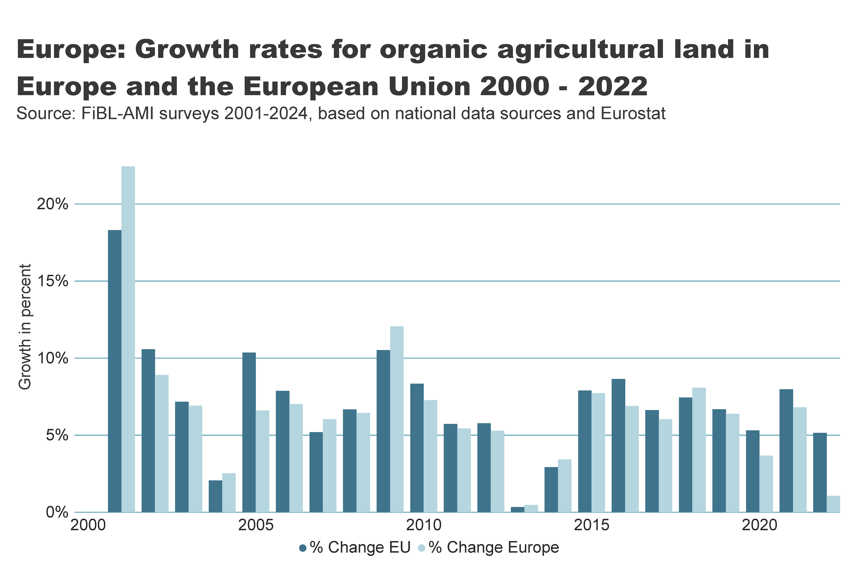
Europe_growth_percent
Notes:
textbox
No alt text provided
clusteredColumnChart
No alt text provided
card
No alt text provided

Slide 35
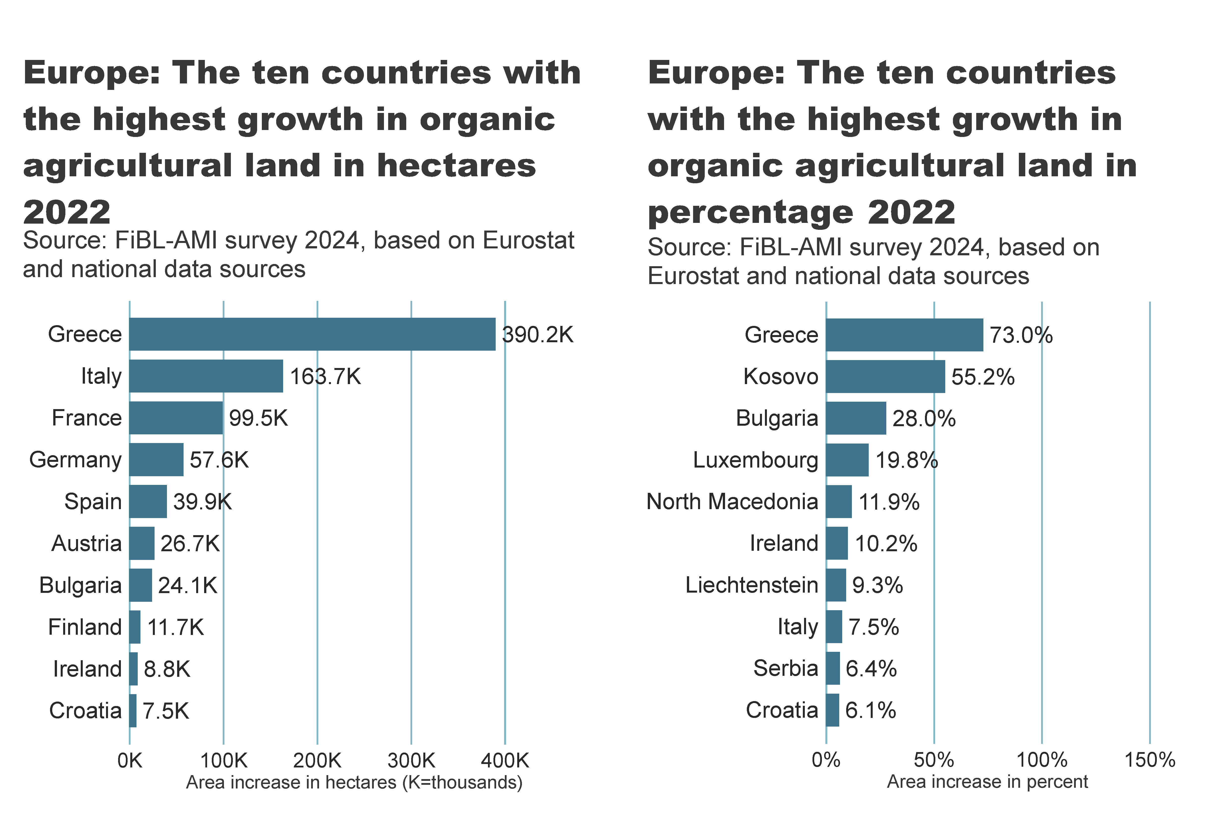
Europe_top10_land_growth_area+share
Notes:
textbox
No alt text provided
card
No alt text provided
barChart
No alt text provided
textbox
No alt text provided
card
No alt text provided
barChart
No alt text provided

Slide 36
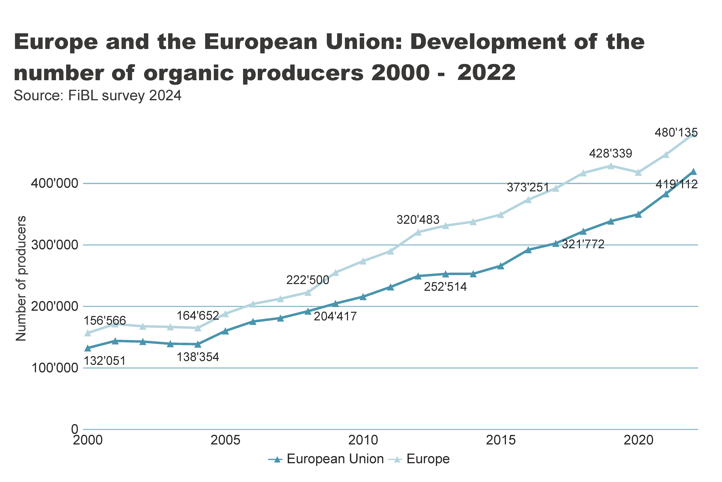
Europe_EU_growth_producers
Notes:
textbox
No alt text provided
lineChart
No alt text provided
card
No alt text provided

Slide 37
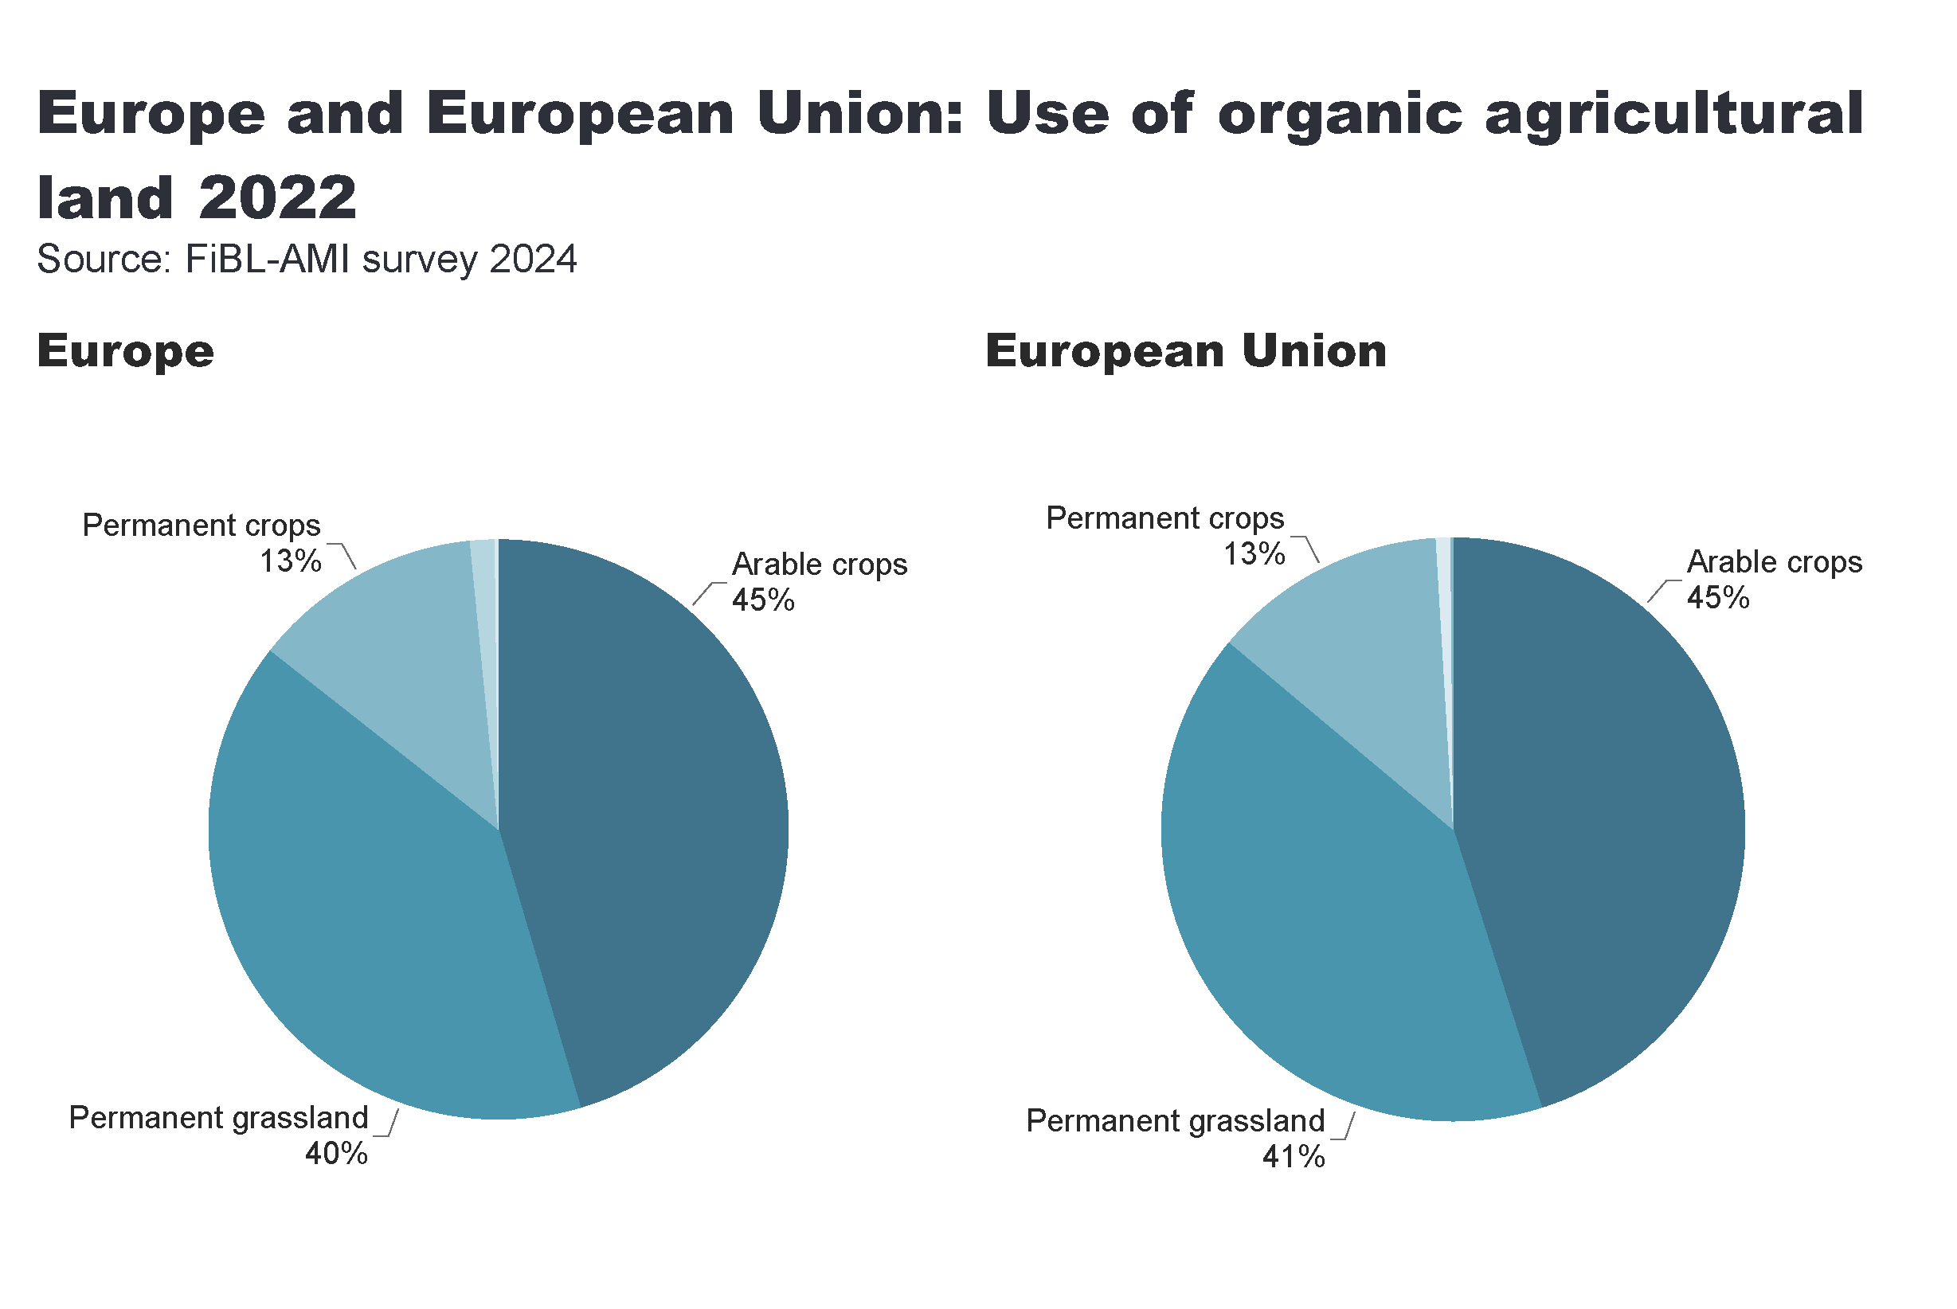
Europe_land_use
Notes:
European Union
No alt text provided
card
No alt text provided
Europe
No alt text provided
textbox
No alt text provided

Slide 38
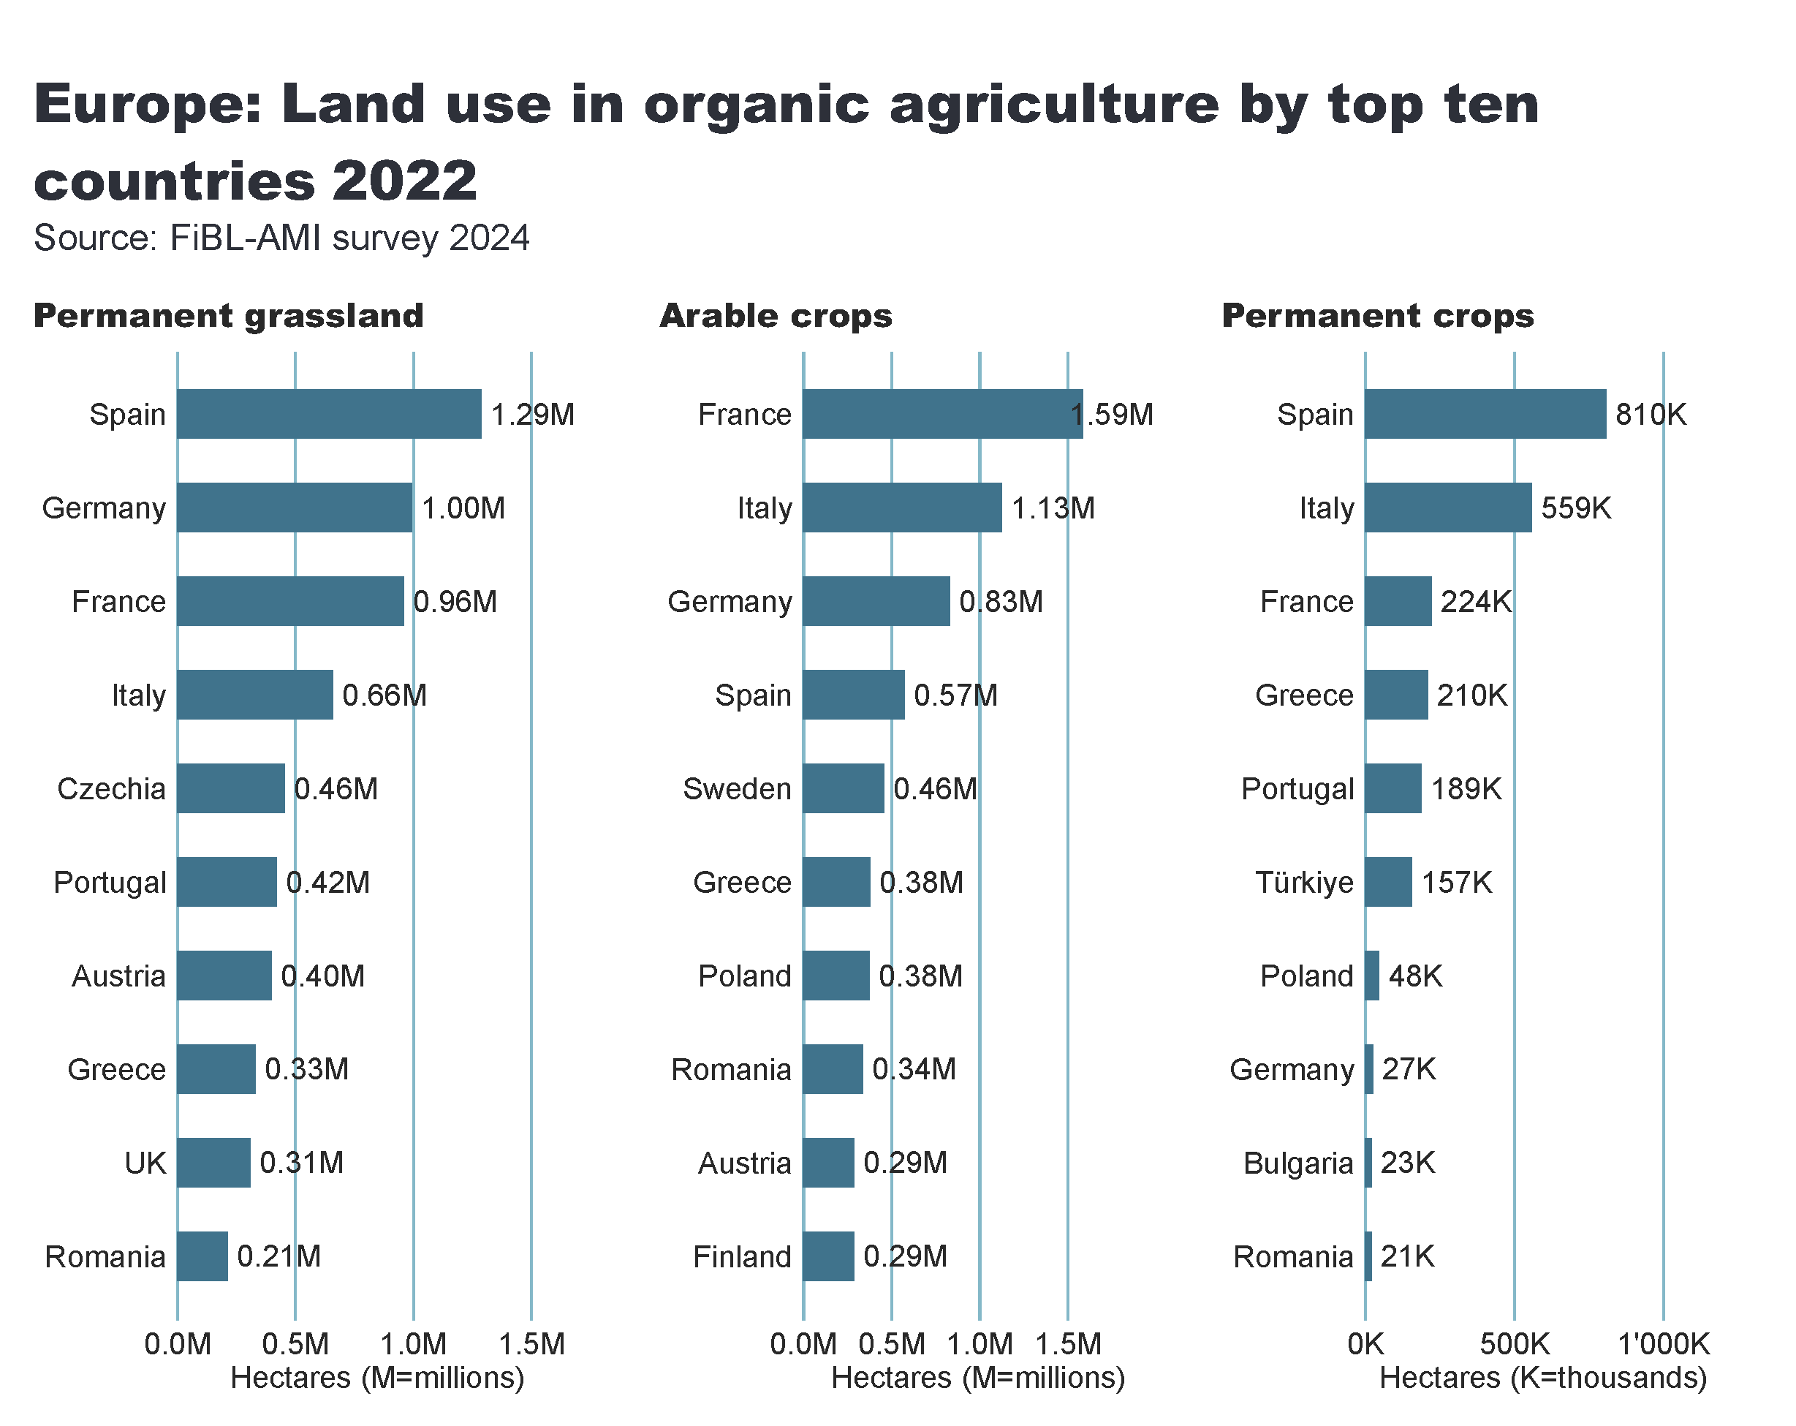
Europe_land_use_by_culture
Notes:
Arable crops
No alt text provided
textbox
No alt text provided
card
No alt text provided
Permanent crops
No alt text provided
Permanent grassland
No alt text provided

Slide 39
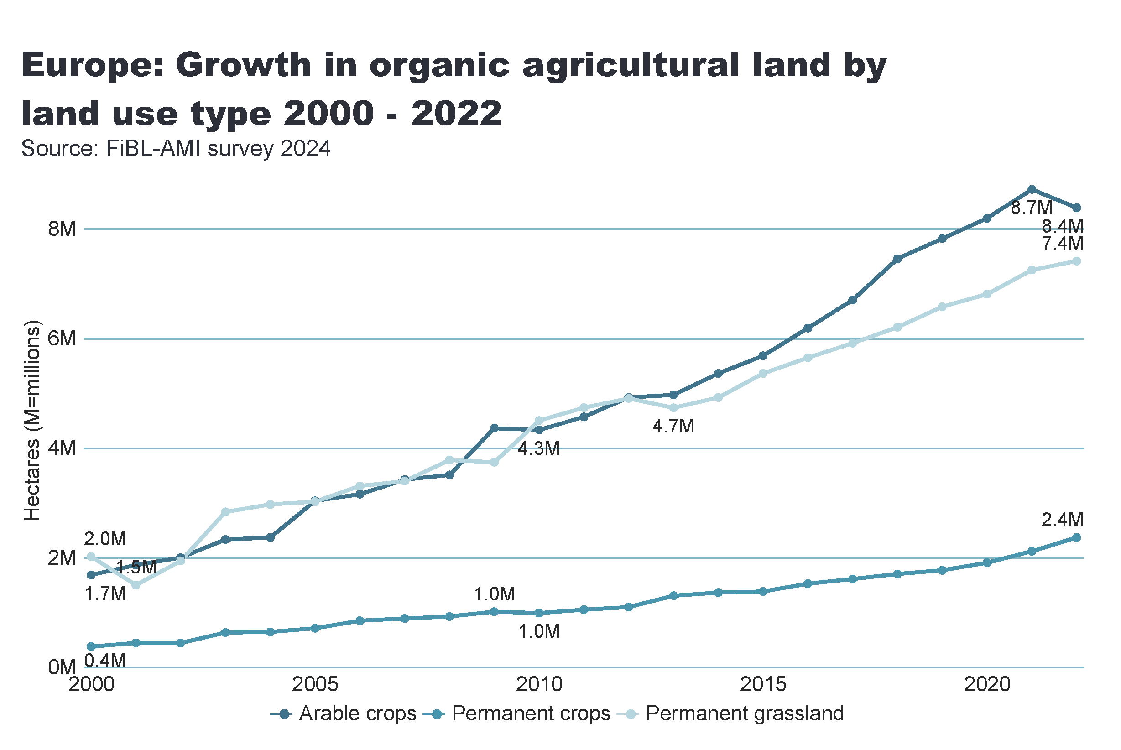
Europe_land_use_development
Notes:
Arable land
No alt text provided
textbox
No alt text provided
card
No alt text provided

Slide 40
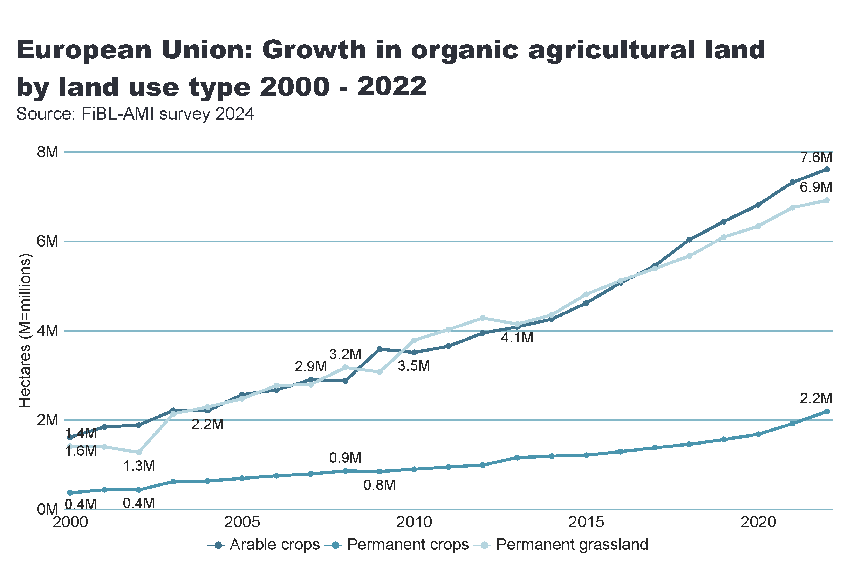
European_Union_land_use_by_culture
Notes:
Arable land
No alt text provided
textbox
No alt text provided
card
No alt text provided

Slide 41
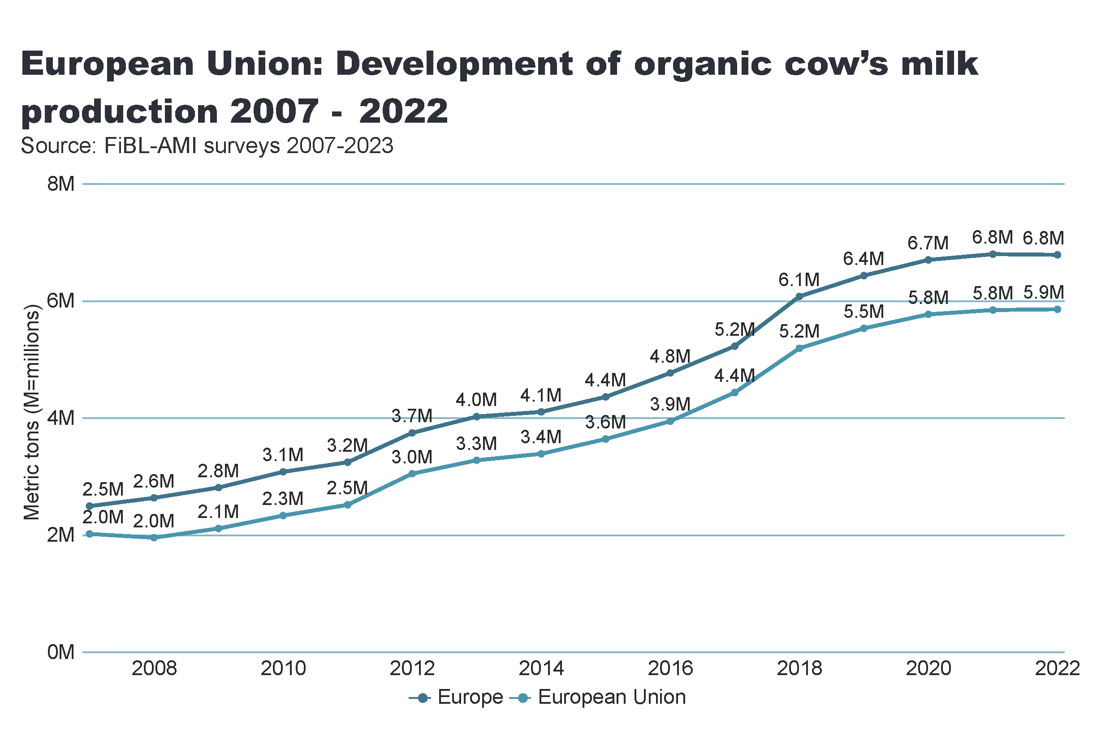
milk
Notes:
Arable land
No alt text provided
textbox
No alt text provided
card
No alt text provided

Slide 42
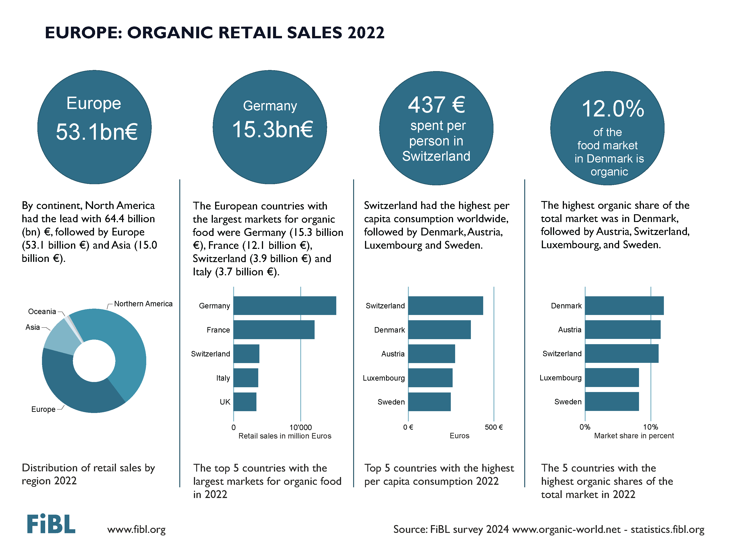

Slide 43
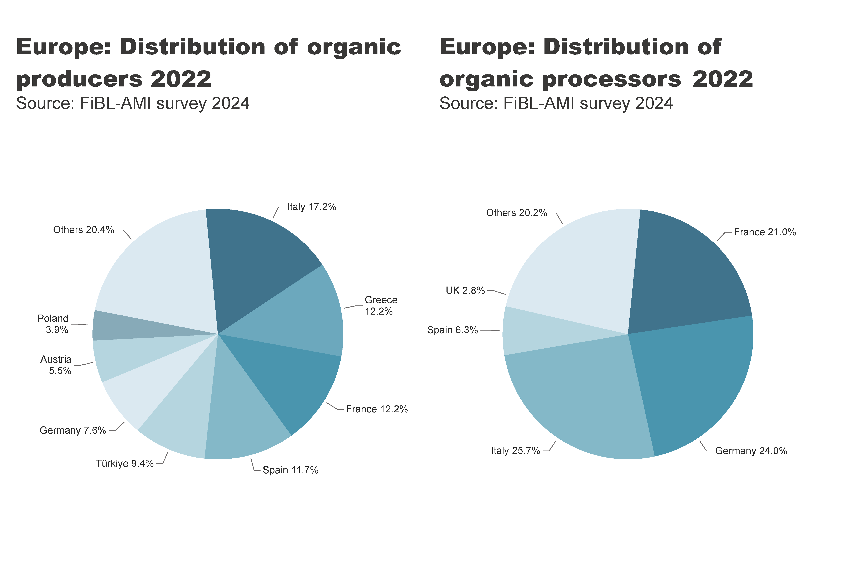
EU_producers, processors_distribution
Notes:
pieChart
No alt text provided
textbox
No alt text provided
card
No alt text provided
pieChart
No alt text provided
textbox
No alt text provided
card
No alt text provided

Slide 44
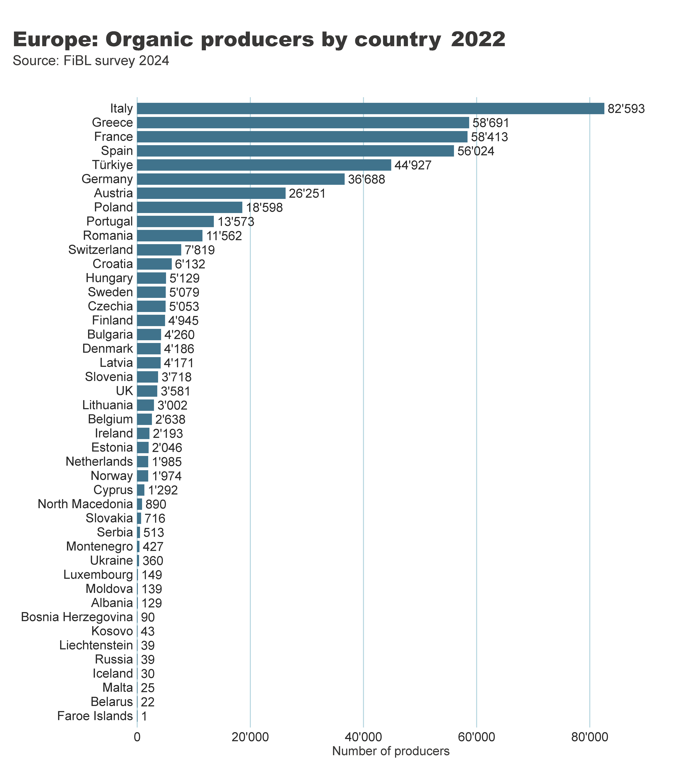
Europe_producers_by_country
Notes:
clusteredBarChart
No alt text provided
textbox
No alt text provided
card
No alt text provided

Slide 45
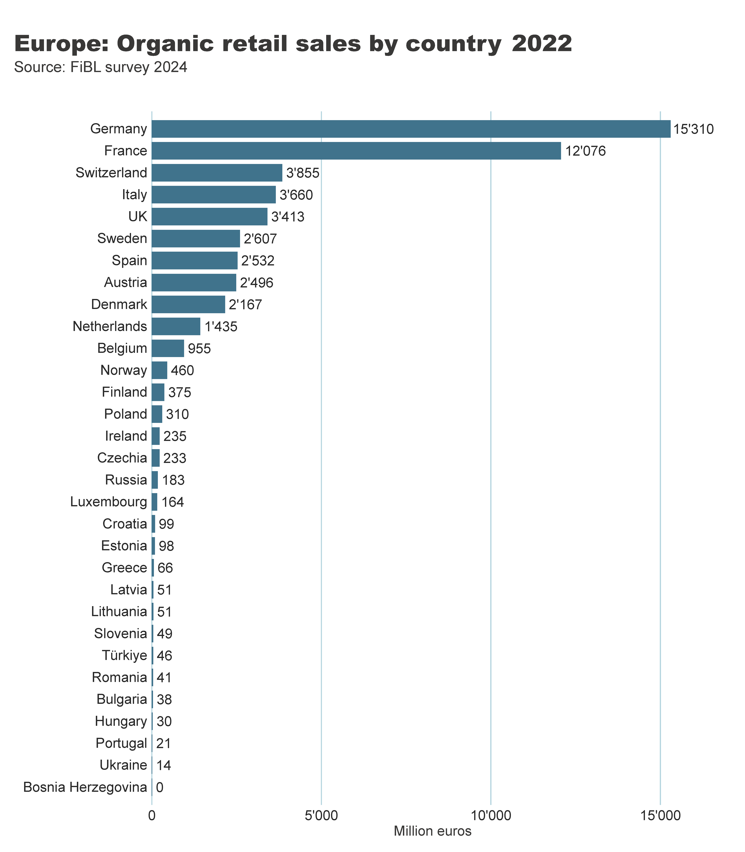
Europe_retail_sales_by_country
Notes:
clusteredBarChart
No alt text provided
textbox
No alt text provided
card
No alt text provided

Slide 46
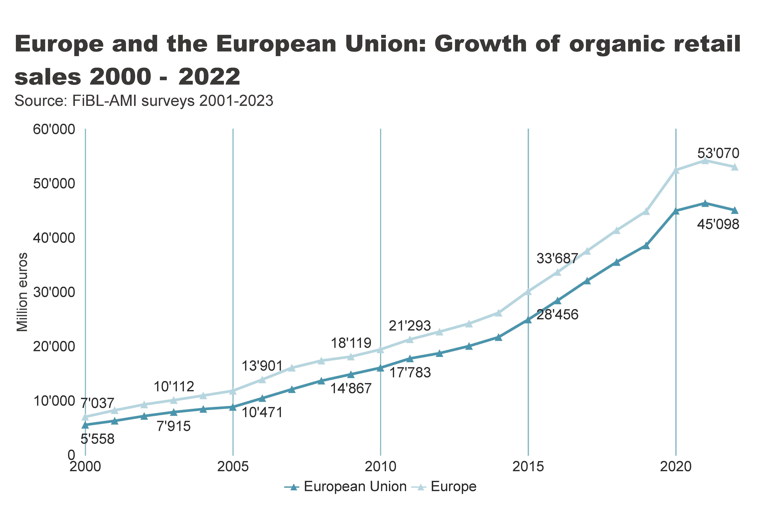
Europe_EU_growth_retail
Notes:
textbox
No alt text provided
lineChart
No alt text provided
card
No alt text provided

Slide 47
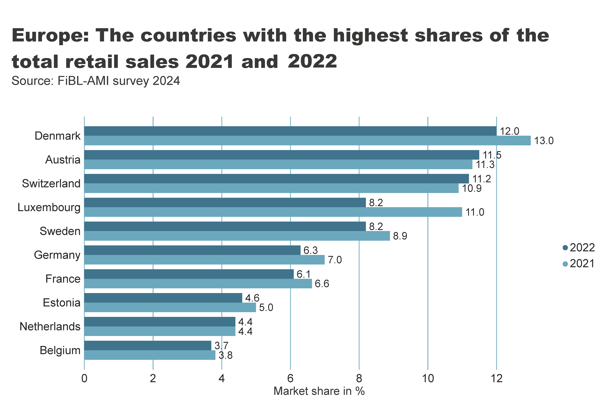
Europe_retail_growth
Notes:
textbox
No alt text provided
card
No alt text provided
clusteredBarChart
No alt text provided

Slide 48
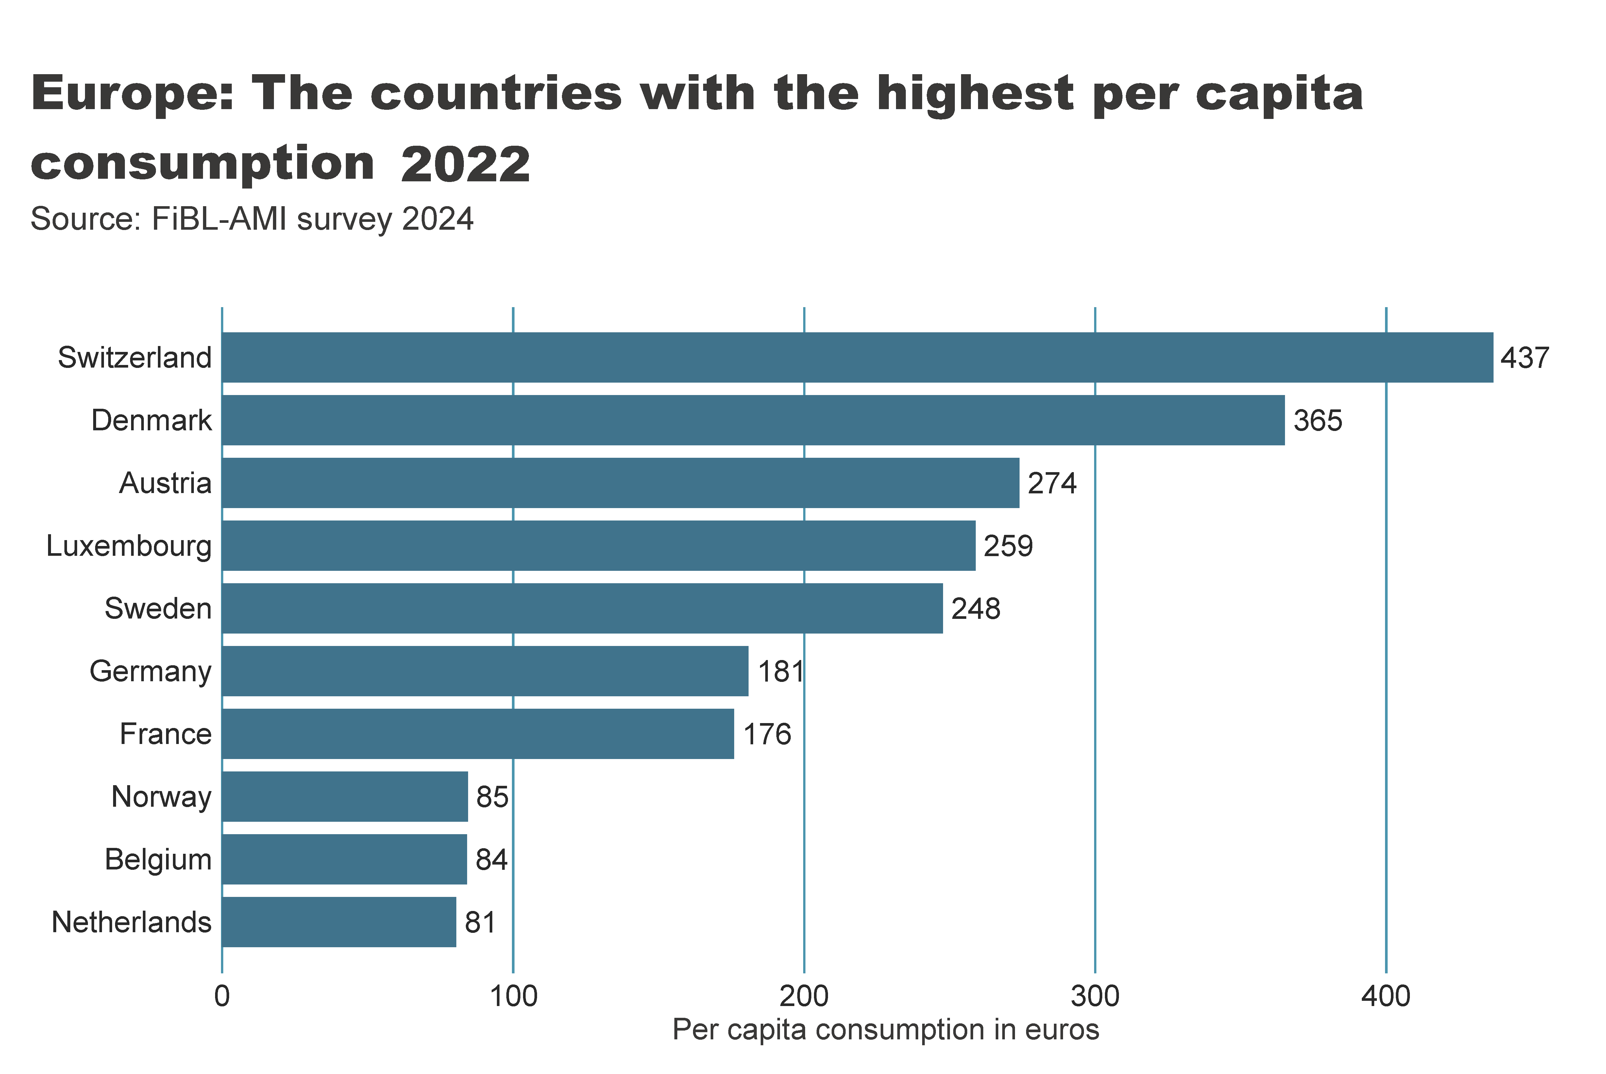
Europe_retail_per_capita
Notes:
textbox
No alt text provided
card
No alt text provided
clusteredBarChart
No alt text provided

Slide 49
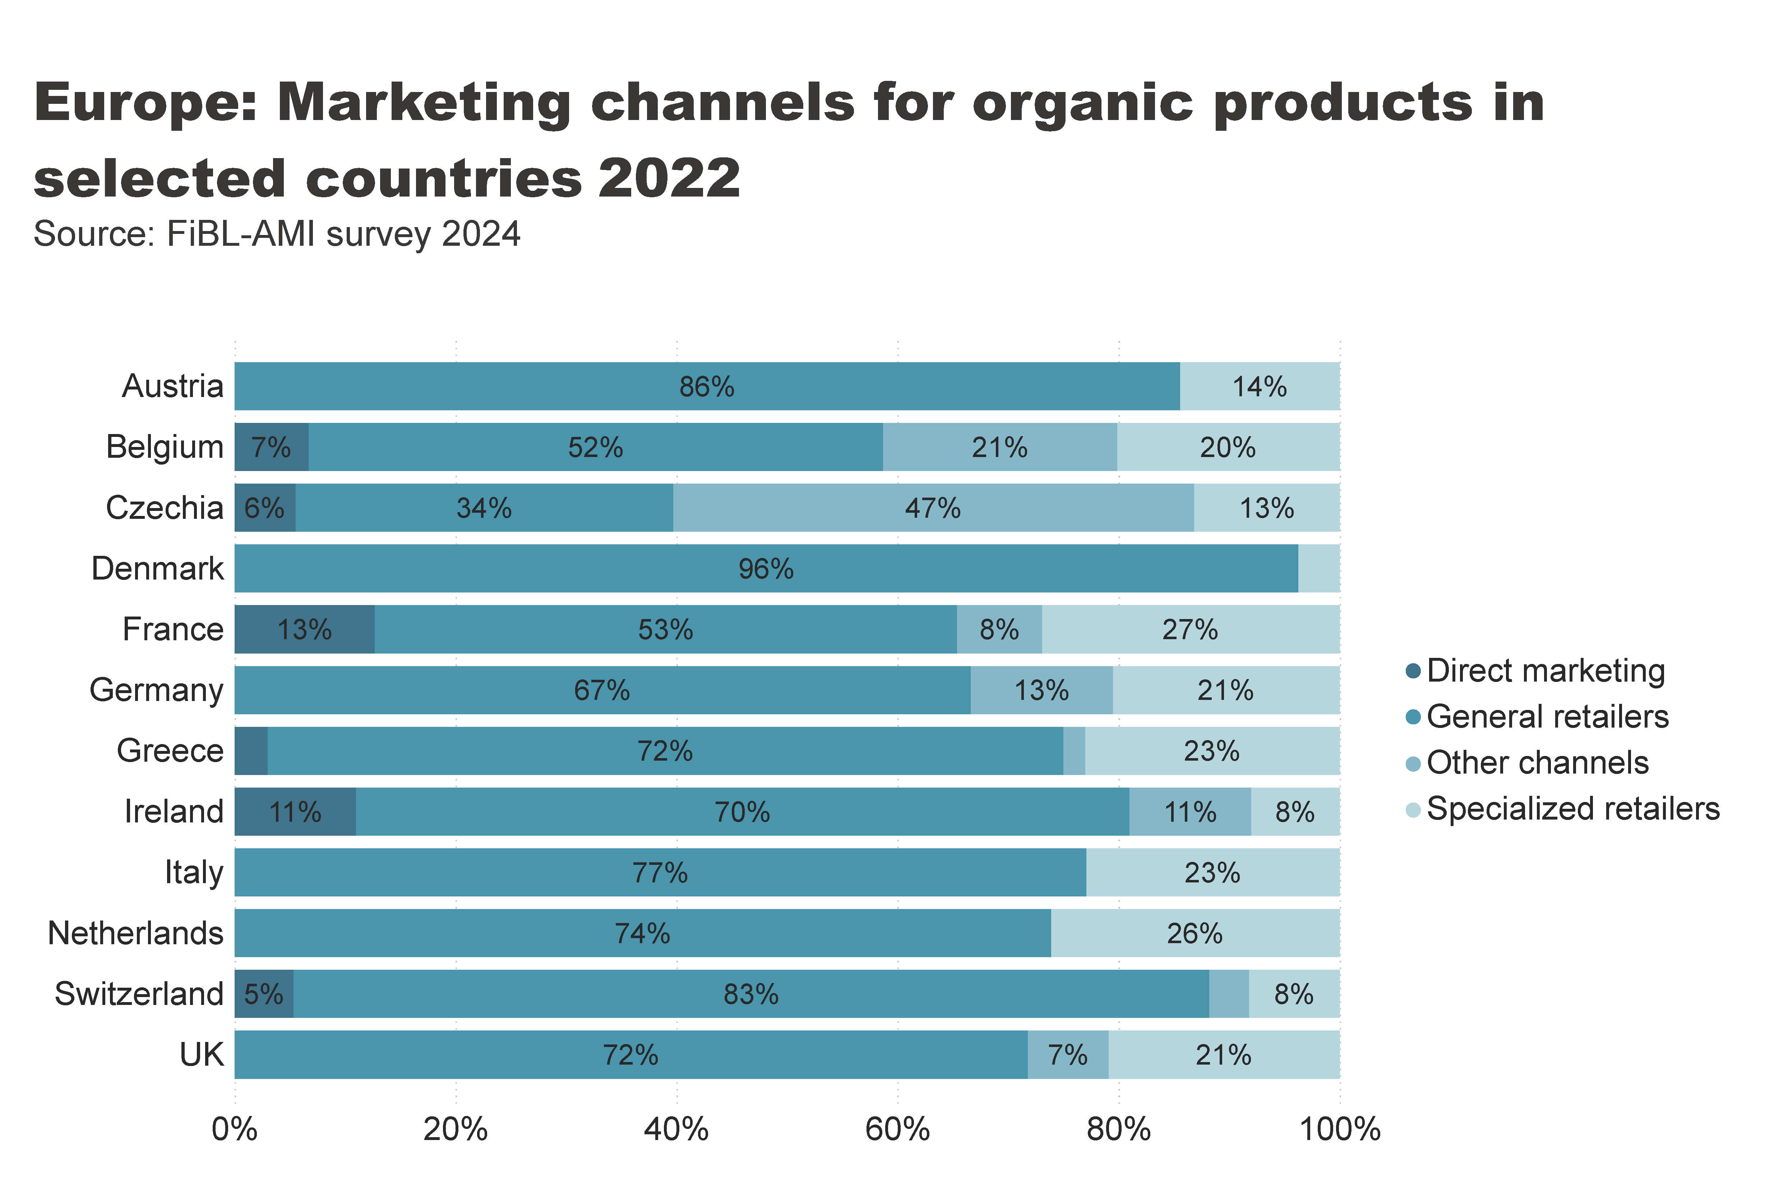
Europe_retail_by_channel
Notes:
textbox
No alt text provided
card
No alt text provided
hundredPercentStackedBarChart
No alt text provided

Slide 50
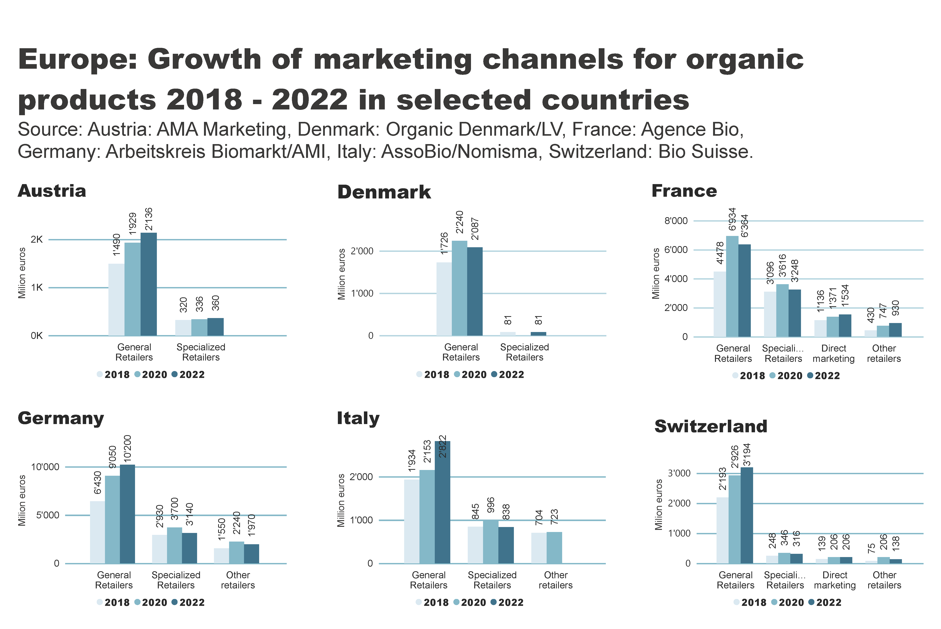
Europe_retail_by_channel_by_country
Notes:
textbox
No alt text provided
Austria
No alt text provided
Denmark
No alt text provided
France
No alt text provided
Germany
No alt text provided
Italy
No alt text provided
Switzerland
No alt text provided

Slide 51
Organic imports volumes down by 5.1 percent in 2022
Imports of organic agri-food products in the EU declined from 2.87 million metric tons in 2021 to 2.73 million metric tons in 2022, marking a 5.1% decrease.
This decline may be linked to reduced demand, likely stemming from a significant rise in food prices during the year.
The decrease was mainly driven by reduced imports of fruit and vegetables, sugar, olive and palm oils, sunflower seed, and pet food, with increased imports of organic soybeans, oilcakes, citrus fruit, rice, and honey failing to offset these losses.

Slide 52
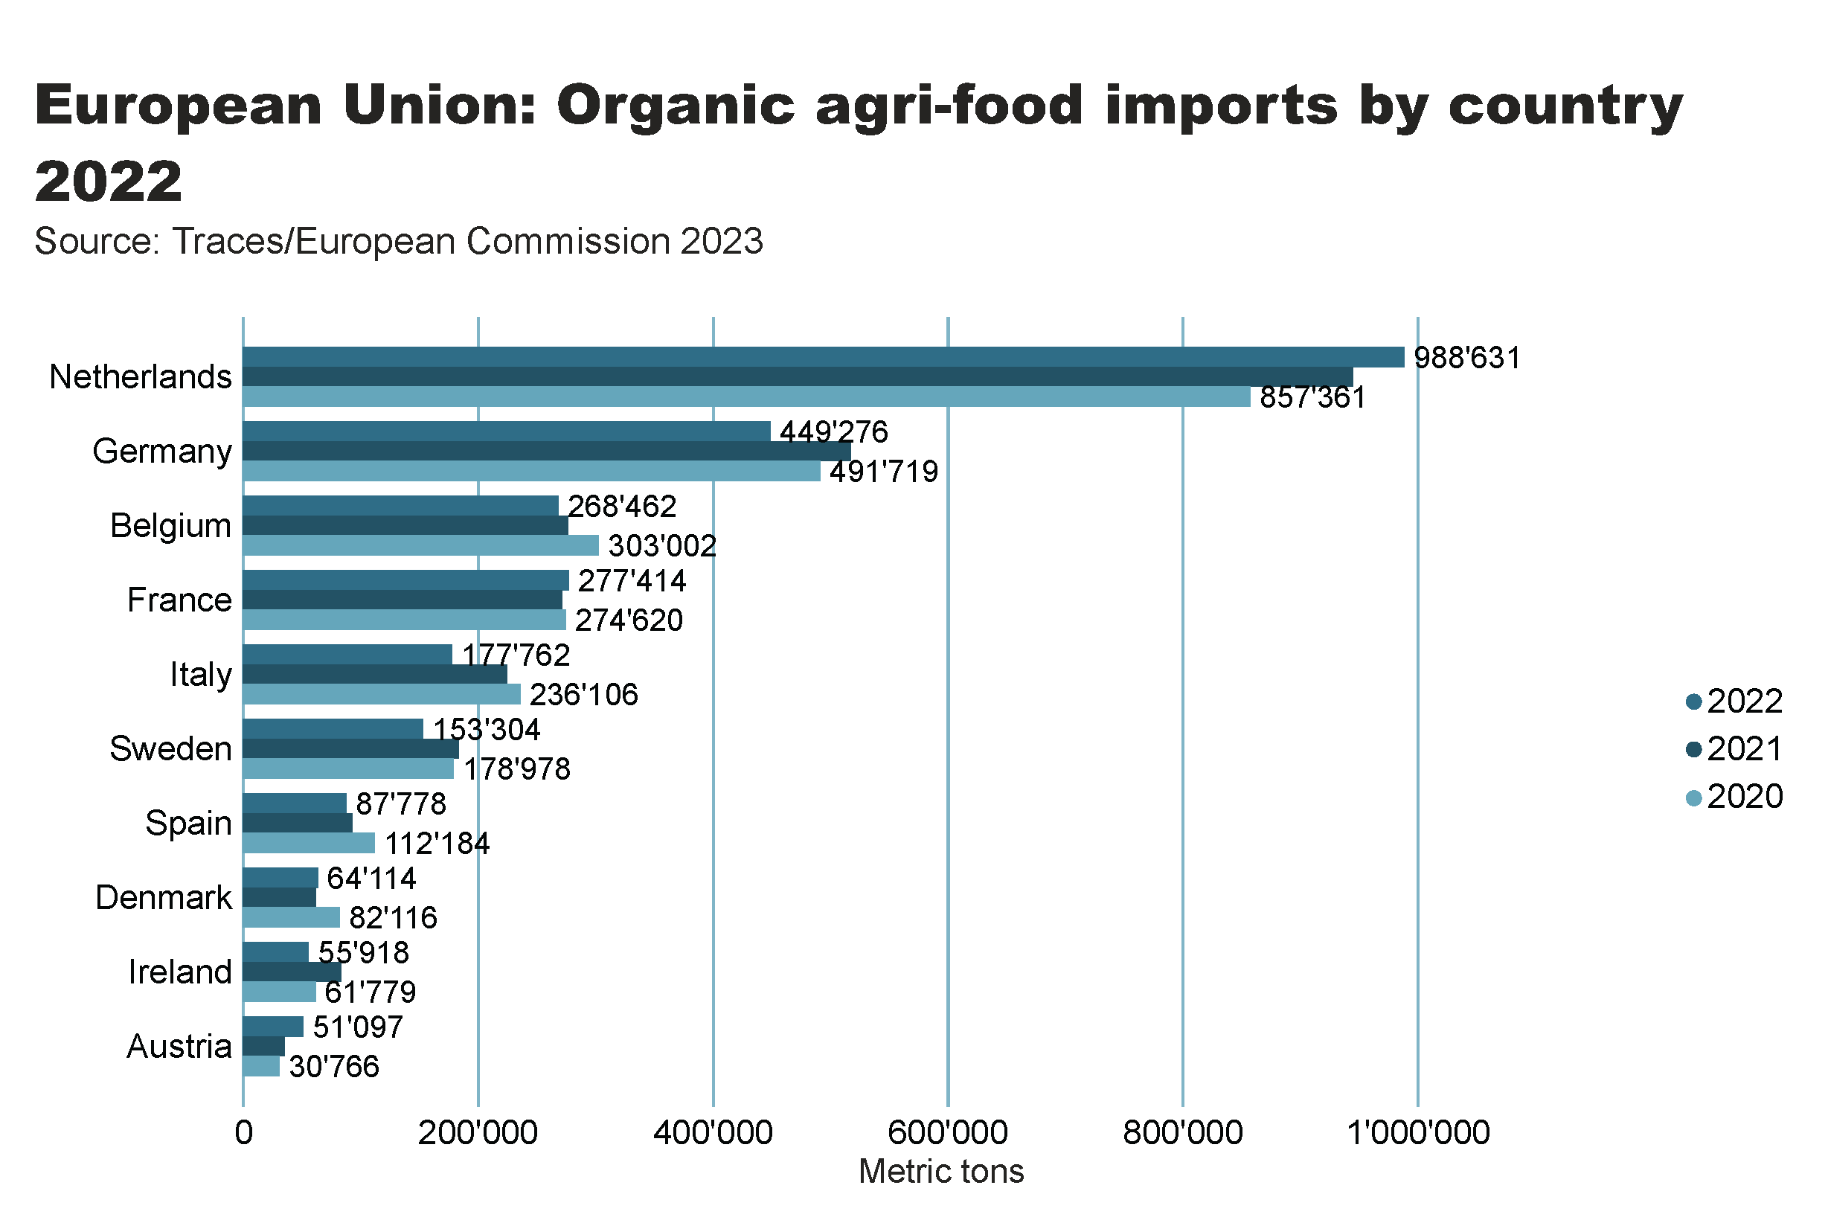
Europe_import_country
Notes:
textbox
No alt text provided
card
No alt text provided
clusteredBarChart
No alt text provided

Slide 53
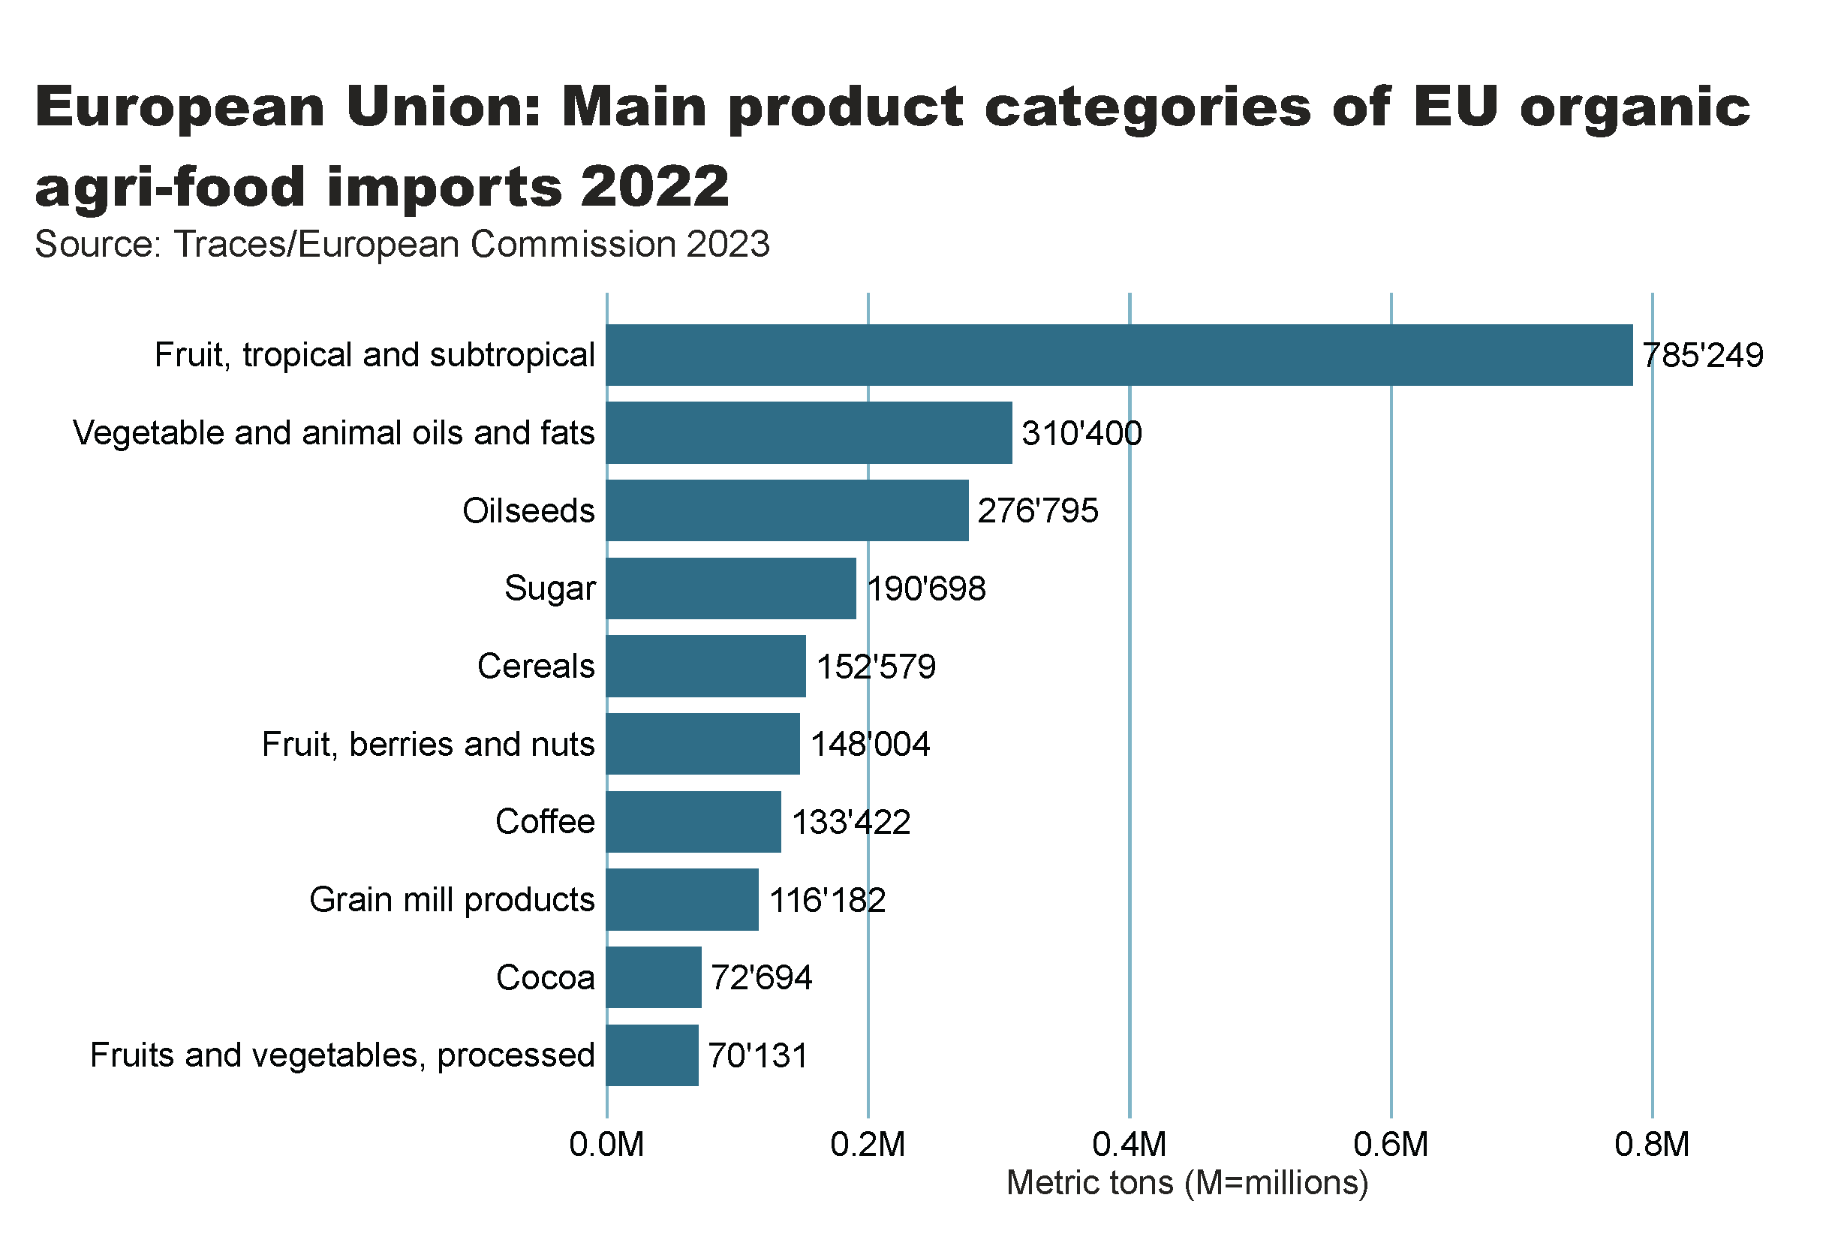
EU_import_by_food_product
Notes:
clusteredBarChart
No alt text provided
textbox
No alt text provided
card
No alt text provided

Slide 54
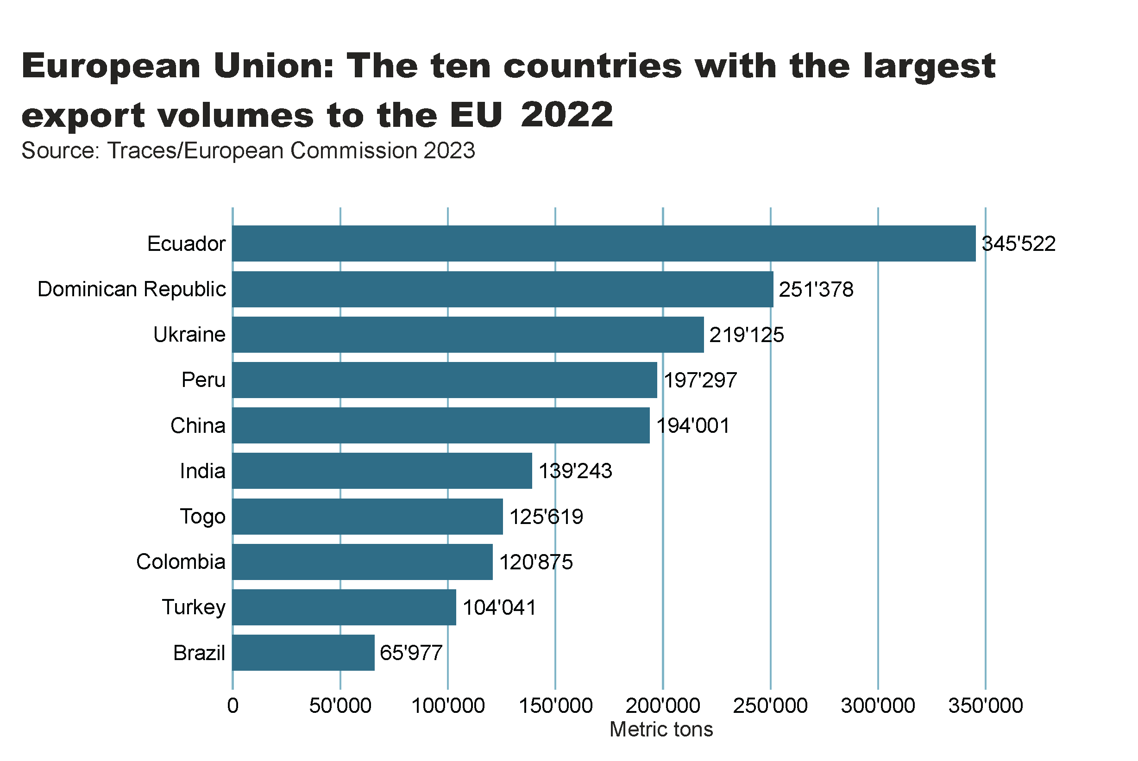
EU_import_by_exporter
Notes:
clusteredBarChart
No alt text provided
textbox
No alt text provided
card
No alt text provided

Slide 55
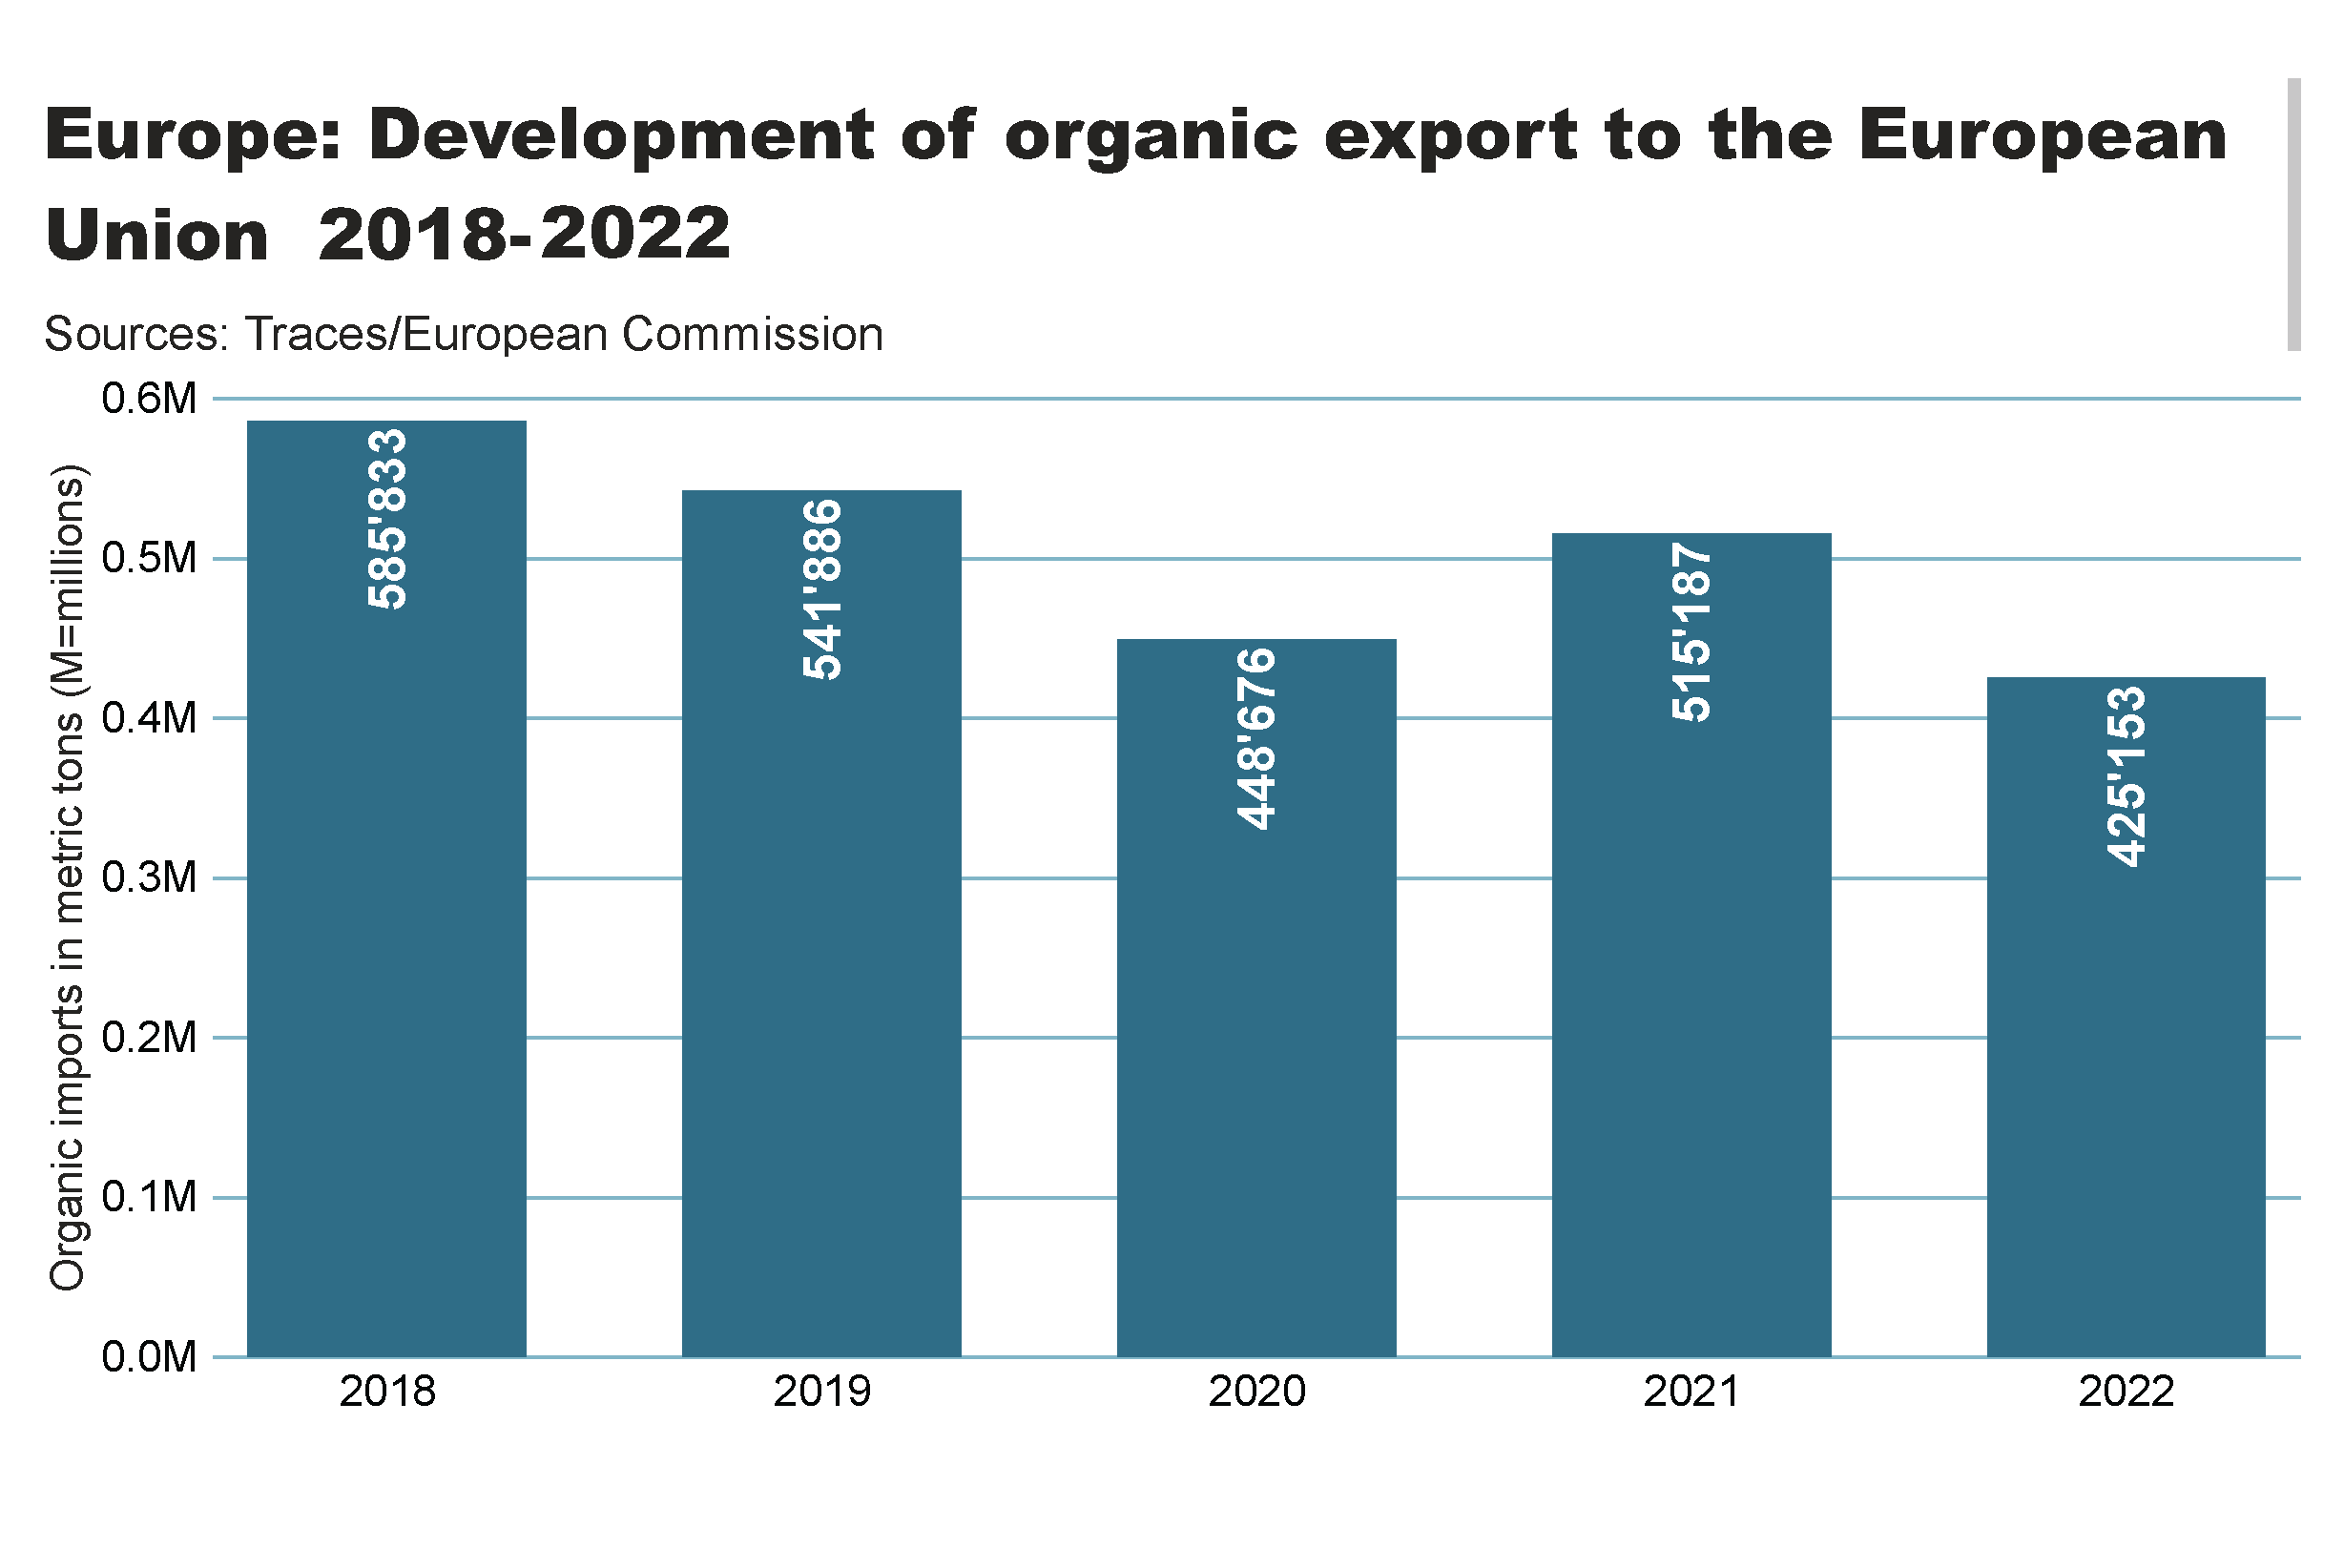
Europe_imports development
Notes:
textbox
No alt text provided
columnChart
No alt text provided
card
No alt text provided

Slide 56
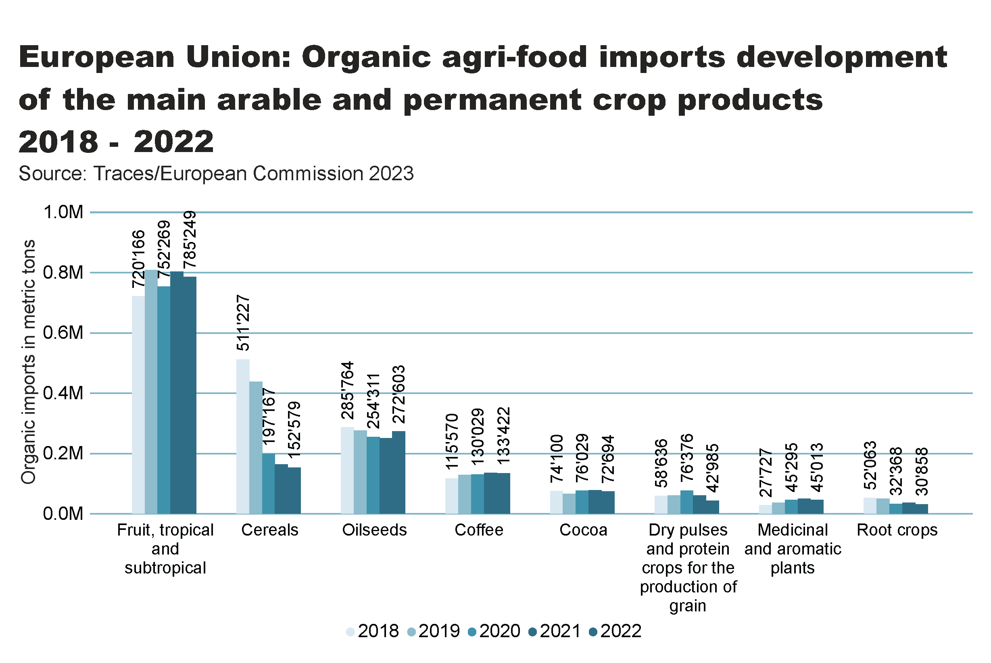
Europe_imports development_Arable_products
Notes:
textbox
No alt text provided
clusteredColumnChart
No alt text provided
card
No alt text provided

Slide 58
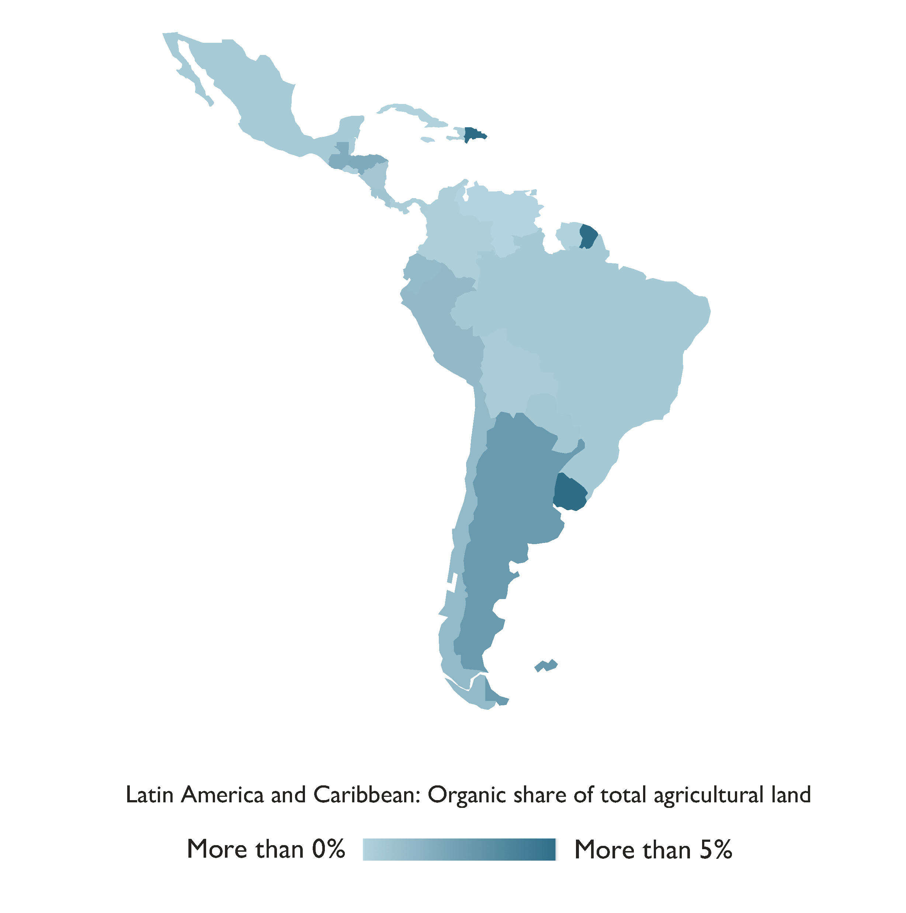
Latin America and the Caribbean

Slide 59
Latin America and Caribbean: Key figures 2022
In Latin America, a workforce of over 270´000 producers managed more than 9.5 million hectares of agricultural land organically in 2022.
This area represented 9.9 percent of the world's organic land and 1.3 percent of the region's agricultural land.
Leading countries in the region were Argentina (4.1 million hectares), Uruguay (2.7 million hectares), and Brazil (1.0 million hectares).
Uruguay boasted the highest organic share of total agricultural land at 19.6 percent, followed by Dominica (11.6 percent) and French Guiana (11.1 percent).
Several Latin American countries maintained their status as significant exporters of organic products, including coffee, cocoa, and bananas.
Nineteen countries in the region had legislation governing organic agriculture, with two more in the process of drafting such legislation.
Brazil stood out as the largest market for organic products in Latin America.
Source: FiBL survey 2024

Slide 60
LA_land_country
Notes:
clusteredBarChart
No alt text provided
textbox
No alt text provided
card
No alt text provided

Slide 61
LA_land_share_country
Notes:
textbox
No alt text provided
barChart
No alt text provided
card
No alt text provided

Slide 62
LA_land_growth
Notes:
textbox
No alt text provided
lineClusteredColumnComboChart
No alt text provided
card
No alt text provided

Slide 63
LA_producers_country
Notes:
textbox
No alt text provided
card
No alt text provided
barChart
No alt text provided

Slide 64
LA_land_use
Notes:
Land use types
No alt text provided
card
No alt text provided
Key arable crops
No alt text provided
Key permanent crops
No alt text provided
textbox
No alt text provided

Slide 65
North America

Slide 66
Organic Agriculture in North America: Key figures 2022
In North America, organic farming covered more than 3.6 million hectares in 2023, with 2.06 million hectares in the United States and 1.56 million hectares in Canada.
This constituted 0.8 percent of the total agricultural area in the region.
Key crops grown are cereals, oilseeds and dry pulses.
There were more than 23’948 organic producers in North America. A total of 17’445 producers were counted in the US and 6’503 in Canada.
With almost 142’000 metric tons and almost 64 percent of the North American organic exports, cereals (mainly maize, oats and wheat) were the most important product group, followed by oilseeds (29’752 metric tons, mainly soybeans) and fresh vegetables (17’031 metric tons, mainly cucumbers, tomatoes and peppers).
The organic market in North America achieved sales of 64.4 billion euros.
Source: USDA and COTA 2022

Slide 67
NA_land_country
Notes:
clusteredBarChart
No alt text provided
textbox
No alt text provided
card
No alt text provided

Slide 68
NA_land_share_country
Notes:
textbox
No alt text provided
Source: COTA and USDA, 2022
No alt text provided
card
No alt text provided

Slide 69
NA_land_growth
Notes:
textbox
No alt text provided
lineClusteredColumnComboChart
No alt text provided
card
No alt text provided

Slide 70
NA_producers_country
Notes:
textbox
No alt text provided
card
No alt text provided
barChart
No alt text provided

Slide 71
NA_land_use
Notes:
Land use types
No alt text provided
card
No alt text provided
Key arable crops
No alt text provided
Key permanent crops
No alt text provided
textbox
No alt text provided

Slide 72
Oceania

Slide 73
Organic agriculture in Oceania: Key figures 2022
Altogether, there were over 24’000 producers on 53 million hectares, constituting 14.3 percent of the region’s agricultural land and more than half the world’s organic land.
More than 99 percent of the organic land in the region is in Australia (53.0 million hectares, mostly extensive grazing land), followed by New Zealand (over 79’000 hectares) and Samoa over 47’000 hectares).
The highest organic shares of all national agricultural land were in Samoa (16.7 percent), followed by Australia (14.8 percent), Solomon Islands 6.5 percent), French Polynesia (4.8 percent) and Fiji (4.5 percent).
Four countries in Oceania have legislation on organic agriculture.
FiBL survey 2024

Slide 74
Oceania_land_country
Notes:
clusteredBarChart
No alt text provided
textbox
No alt text provided
card
No alt text provided

Slide 75
Oceania_land_share_country
Notes:
textbox
No alt text provided
barChart
No alt text provided
card
No alt text provided

Slide 76
Oceania_land_growth
Notes:
textbox
No alt text provided
lineClusteredColumnComboChart
No alt text provided
card
No alt text provided

Slide 77
Oceania_producers_country
Notes:
textbox
No alt text provided
card
No alt text provided
barChart
No alt text provided

Slide 78
Oceania_land_use
Notes:
Land use types
No alt text provided
card
No alt text provided
Key arable crops
No alt text provided
Key permanent crops
No alt text provided
textbox
No alt text provided

Slide 79
More information
More information (PDF, data sources, graphs) at: http://www.organic-world.net/yearbook/yearbook-2024.html
Contact Helga Willer Research Institute of Organic Agriculture FiBL 5070 Frick Switzerland helga.willer@fibl.org

Slide 80
Disclaimer
All of the results contained in this slide show have been compiled by the Research Institute of Organic Agriculture FiBL. However, the possibility of mistakes cannot be ruled out entirely. Therefore, FiBL is not subject to any obligation and makes no guarantees whatsoever regarding any of the statements or results in this work; neither does FiBL accept responsibility or liability for any possible mistakes, nor for any consequences of actions taken by readers based on statements or advice contained therein.
This document has been produced with the support of the Swiss State Secretariat for Economic Affairs (SECO), the Sustainability Fund of Coop Switzerland, NürnbergMesse, IFOAM – Organics International. The views expressed herein can in no way be taken to reflect the official opinions of SECO, Coop, NürnbergMesse or IFOAM – Organics International.

Slide 81
Presentations on www.organic-world.net

Slide 82
Statistics.FiBL.org

Slide 83
www.twitter.com/fiblstatistics

Slide 84
Contact
Helga Willer Research Institute of Organic Agriculture FiBL Ackerstrasse 113, Box 219 5070 Frick Switzerland
Phone +41 62 865 72 72 Phone +41 62 865 72 07 (direct)
info.suisse@fibl.org, helga.willer@fibl.org www.fibl.org, www.organic-world.net, https://statistics.fibl.org

Slide 85
FiBL online
www.fibl.org
www.bioaktuell.ch
fiblfilm
@fiblorg
@FiBLaktuell
linkedin.com/company/fibl

