Slide 1
Organic Agriculture Worldwide 2022: Key results from the FiBL survey on organic agriculture worldwide 2024
Part 1: Global data and survey background
Jan Trávníček, Bernhard Schlatter and Helga Willer
© FiBL, April 2024

Slide 2
Organic Agriculture Worldwide: Key results from the FiBL survey on organic agriculture worldwide 2024 Part 1: Global data and survey background
Data compiled by the Research Institute of Organic Agriculture FiBL, Frick, Switzerland, based on national data sources and data from certifiers.
Data as published February 2024 in The World of Organic Agriculture. Statistics and Emerging Trends 2024.* Frick and Bonn, www.organic-world.net
For updates, check www.organic-world.net
This presentation is available online at: https://www.organic-world.net/yearbook/yearbook-2024/presentations.html
Texts and graphs: Helga Willer, Bernhard Schlatter and Jan Trávníček, Research Institute of Organic Agriculture FiBL, Frick, Switzerland
Contact: Helga Willer, helga.willer@fibl.org, Research Institute of Organic Agriculture FiBL, Frick, Switzerland
© Research Institute of Organic Agriculture FiBL, Frick, Switzerland, February 2024
*Citation: Willer, Helga, Bernhard Schlatter and Jan Trávníček (Eds.) (2024): The World of Organic Agriculture. Statistics and Emerging Trends 2024. Research Institute of Organic Agriculture FiBL, Frick, and IFOAM – Organics International, Bonn.
Notes:
FiBL
05.02.2024
www.fibl.org
2

Slide 3
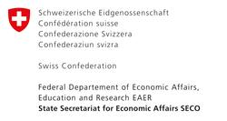
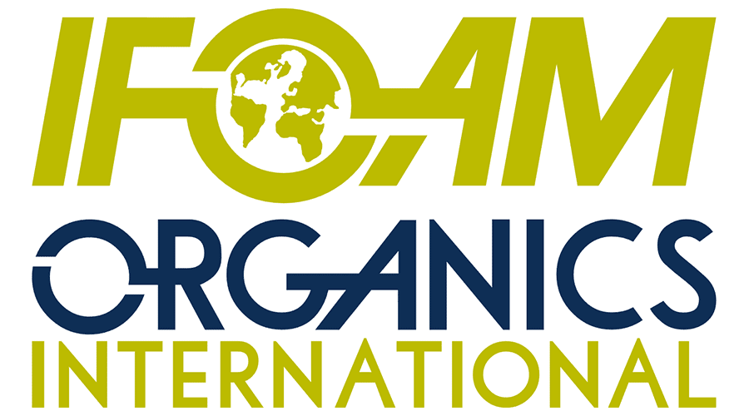
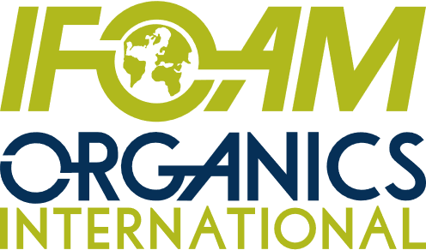
Acknowledgements
The Swiss State Secretariat of Economic Affairs (SECO)
Coop Sustainability Fund
NürnbergMesse, the organizers of BIOFACH
IFOAM – Organics International
More than 200 experts from all parts of the world contributed to the FiBL survey 2024.

Slide 4
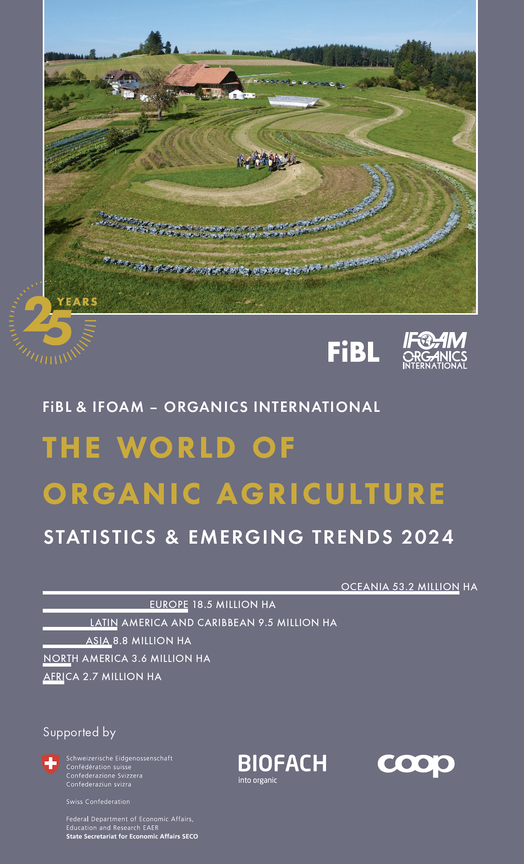
The World of Organic Agriculture 2024
The 25th edition of «The World of Organic Agriculture», was published by FiBL and IFOAM – Organics International in February 2024.
Data tables
Country and continent reports
Markets, standards, policy support
The book can be ordered or downloaded at: https://www.fibl.org/en/shop-en
www.organic-world.net
https://statistics.fibl.org

Slide 5
About this presentation
In three presentations, the key results of the FiBL survey on organic agriculture worldwide 2024 are summarized (data 2022). Apart from the global data, key results on crop and on regional data are presented.
More information is available at www.organic-world.net
The following three presentations are available at https://www.organic-world.net/yearbook/yearbook-2024/presentations.html:
Part 1: Global data 2022 and survey background
Part 2: Land use and key crops in organic agriculture 2022
Part 3: Organic agriculture in the regions 2022

Slide 6
The 25th survey on organic agriculture world-wide
The 25th survey on organic agriculture worldwide was carried out by the Research Institute of Organic Agriculture FiBL in cooperation with partners from all around the world. The results were published jointly by FiBL and IFOAM – Organics International.
The survey was carried out between July 2023 and February 2024.
Data were received from 188 countries.
Data was provided by over 200 country experts (representatives from NGOs, certification bodies, governments, researchers).
The following data was collected: area data (including land use and crop details); producers, other operator types; domestic market values; export and import data; livestock data (animal heads and production in metric tons).
The results are published in the yearbook “The World of Organic Agriculture 2024” and on www.organic-world.net.

Slide 7
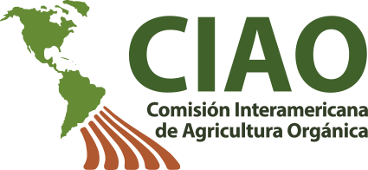
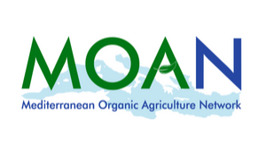
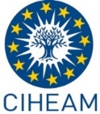
Transnational data collection efforts

Slide 8
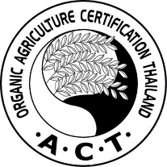
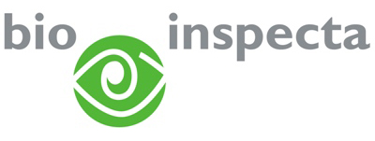
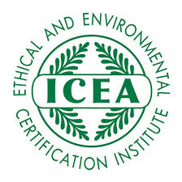
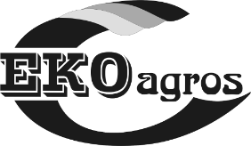
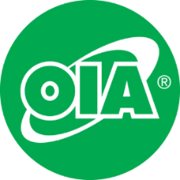
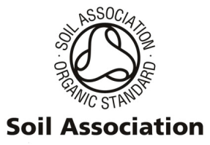
International certifiers that provided data for several countries

Slide 9
General notes on the data
Data sources: For data sources, see annex of The World of Organic Agriculture 2024 or www.organic-world.net/statistics-data-sources.html
Countries: For countries and territories, the FAO country list is used. Where the designation "country" appears in this report, it covers countries or territories. For the countries’ grouping by region, the Standard Country and Area Classifications as defined by the United Nations Statistics Division, is used in most cases.
Term organic: In the tables, the term organic refers to the fully converted and in-conversion areas.
Organic share: In some cases, the calculation of the organic share of the total agricultural land or that of individual crops, based on FAOSTAT and in some cases the Eurostat data, might differ from the organic shares obtained from ministries or local experts.
Producers: Some countries report the number of smallholders while others only report the number of companies, projects, or grower groups, which may each comprise a number of producers. This applies in particular to many African countries. The number of producers is, therefore, probably higher than the number communicated in this report.
Data revisions: Should data revisions and corrections become necessary these are communicated on Organic-World.net: https://www.organic-world.net/yearbook/yearbook-2024/yearbook-2024-corrigenda.html. Revised/corected data are included in the database.

Slide 10
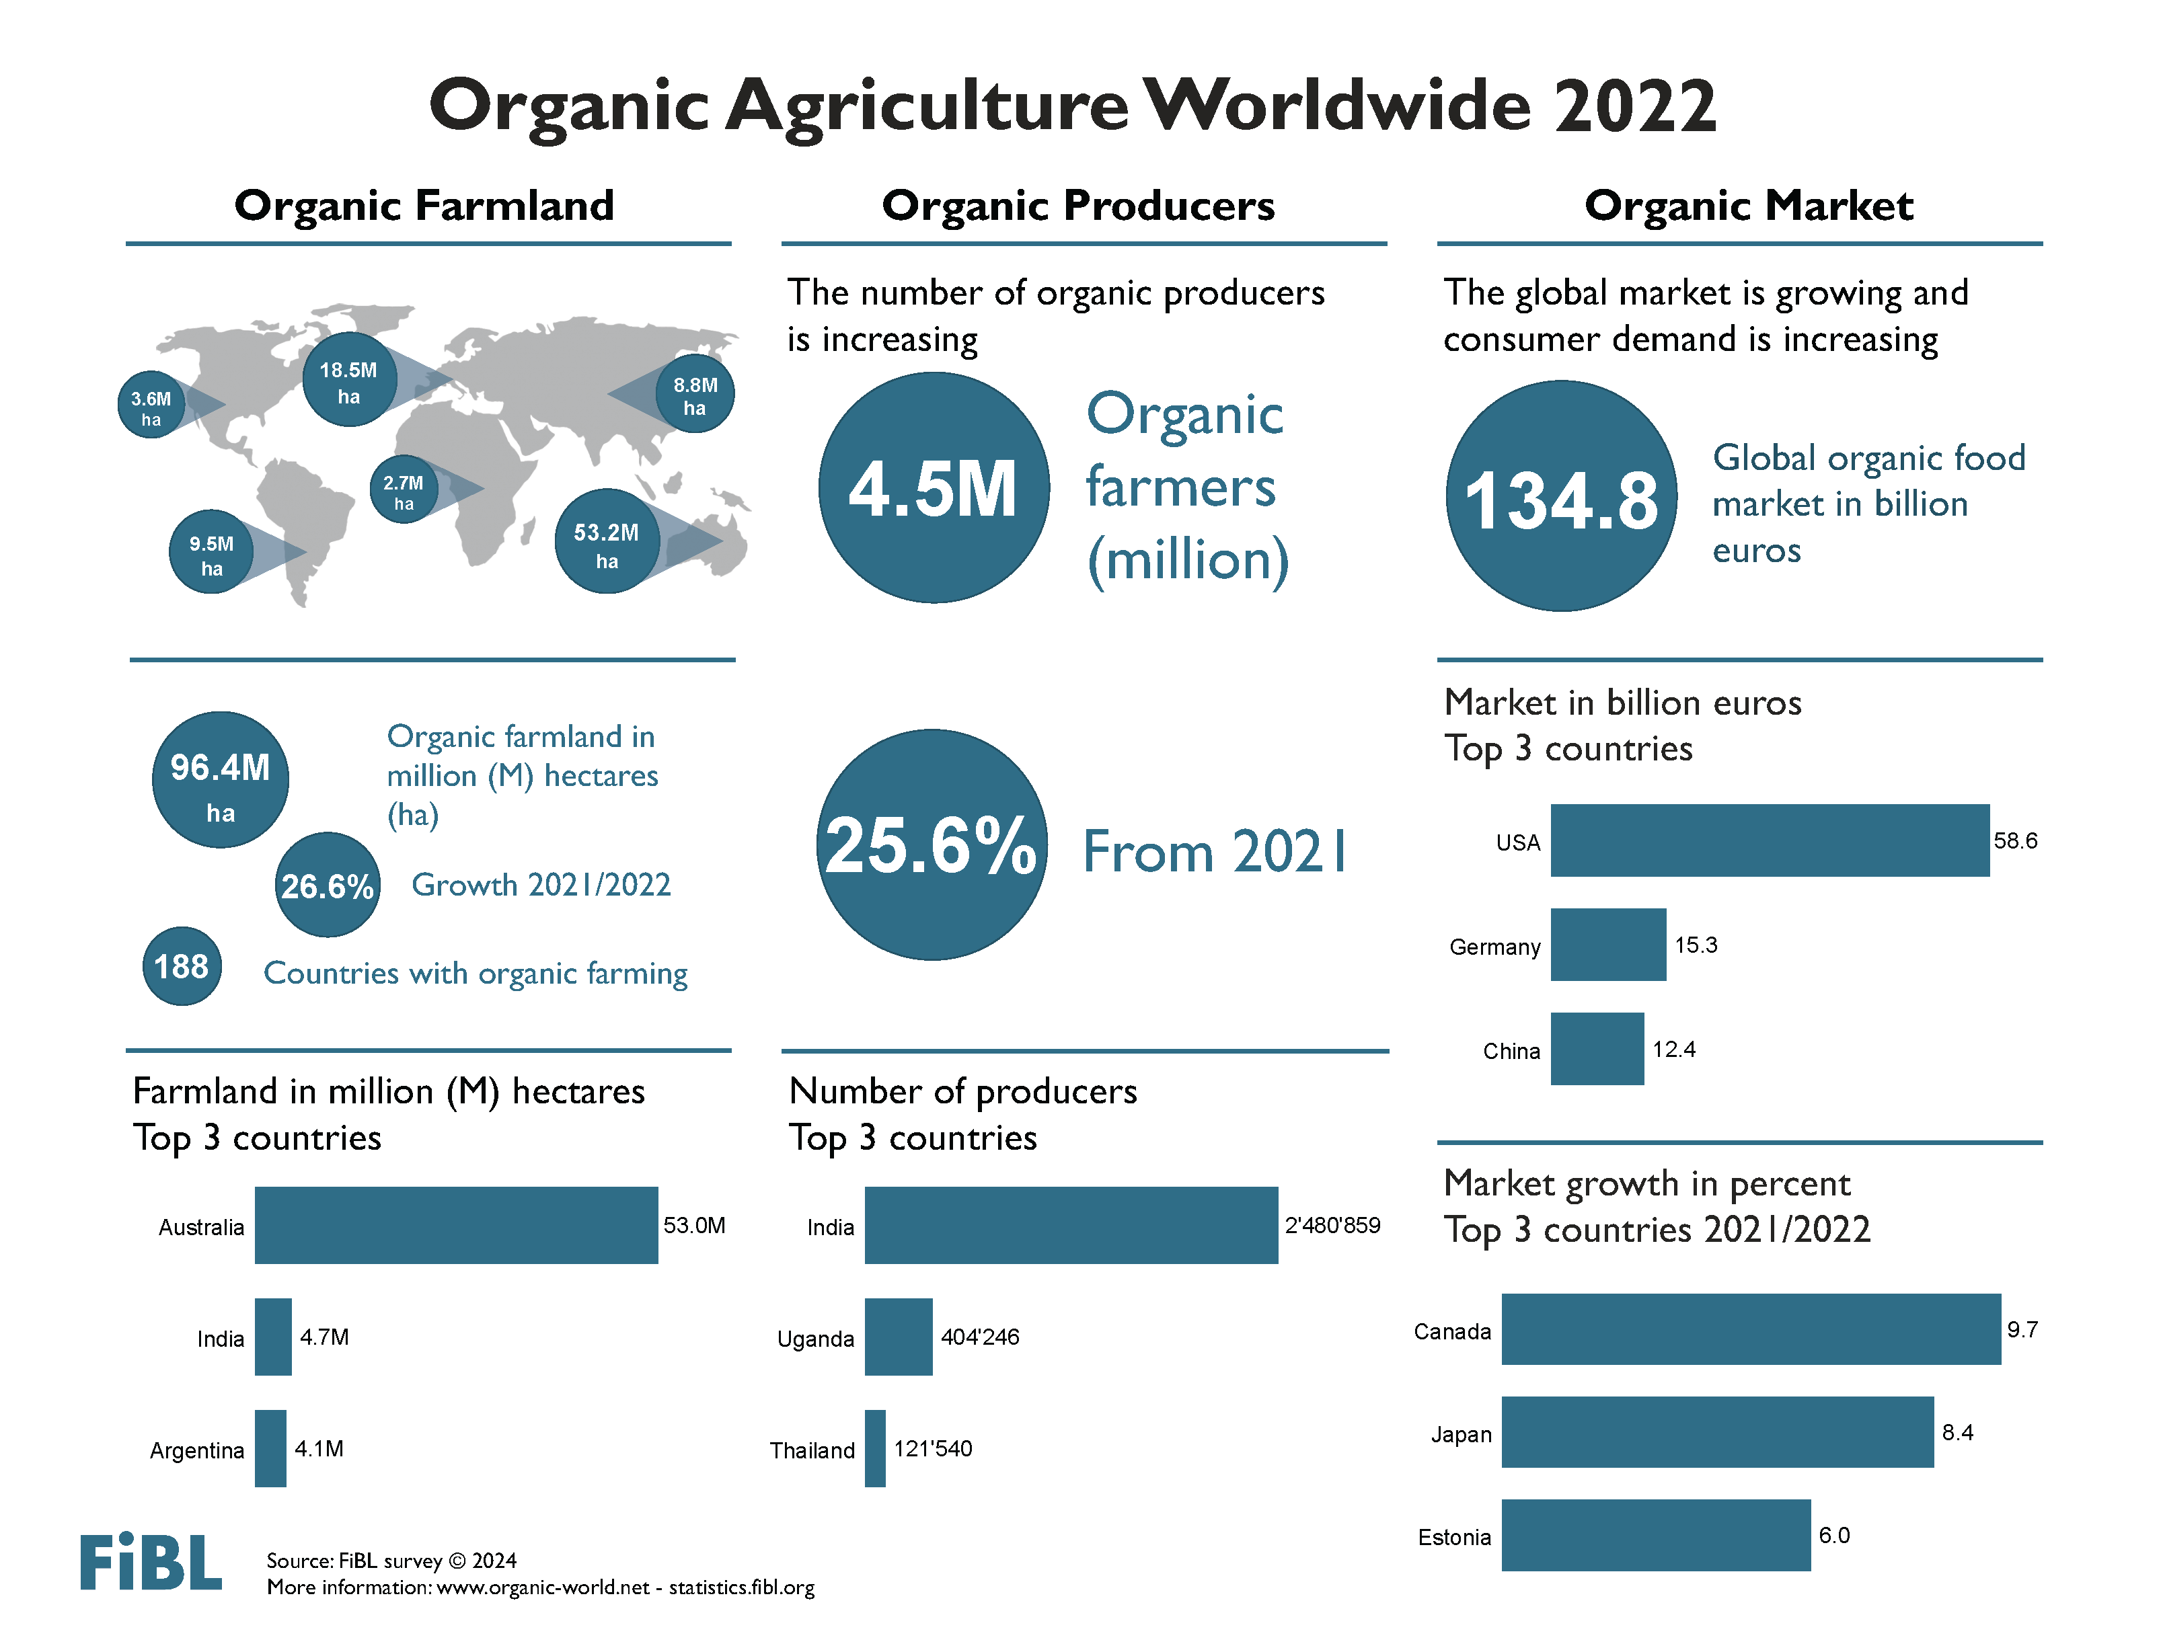

Slide 11
Key data 2022
Organic agricultural land reached more than 96.4 million hectares
Area growth: 20.3 million hectares more than in 2021, 26.6 percent increase
Area increase mainly due to additional 17.3 million hectares in Australia and 2.1 million hectares in India.
2.0 percent of the agricultural land is organic
In 22 countries 10 percent or more of the farmland is organic
4.5 million producers were reported
188 countries with organic activities
34.6 million hectares of non-agricultural areas

Slide 12
Organic farmland 2022
In 2022, nearly 96.4 million hectares of agricultural land were organic (including in-conversion areas). The regions with the largest organic agricultural land areas were Oceania (53.2 million hectares – comprising more than half of the world's organic agricultural land, at 55 percent) and Europe (18.5 million hectares, accounting for 19 percent). Latin America followed with 9.5 million hectares (10 percent), succeeded by Asia with 8.8 million hectares (9.2 percent), Northern America with 3.6 million hectares (3.8 percent), and Africa with 2.7 million hectares (2.8 percent). For details on organic areas, see chapters from page 42).
The countries with the most organic agricultural land were Australia (53.0 million hectares), India (4.7 million hectares) and Argentina (4.1 million hectares).
In 2022, 2.0 percent of the world’s agricultural land was organic. The highest organic shares of the total agricultural land, by region, were in Oceania (14.3 percent) and in Europe (3.7 percent; European Union: 10.4 percent).
Some countries achieve significantly higher organic shares compared to the global average. Liechtenstein (43.0 percent), Austria (27.5 percent), and Estonia (23.4 percent) had the highest organic shares. Remarkably, in 22 countries, 10 percent or more of their agricultural land was organic, setting a new record.
Organic farmland witnessed a substantial expansion of 20.3 million hectares (26.6 percent) in 2022, with numerous countries reporting significant growth. The largest increases in absolute terms were observed in Australia, India, and Greece. Australia's organic farmland surged by more than 17´328´259 hectares (+49 percent), while India experienced a growth of nearly 2´068´825 hectares (+78 percent), and Greece saw an increase of almost 390´223 hectares (+73 percent). Nevertheless, some countries experienced a decrease in organic farmland, with the most significant decline occurring in the Russian Federation, where data showed a reduction of nearly 0.5 million hectares.
In 2022, organic agricultural land increased on all continents. The highest absolute growth was in Oceania (+47.8 percent, +17.2 million hectares), followed by Asia (+35.9 percent, +0.39 million hectares), North America (+10.7 percent, +0.35 million hectares), Africa (+4.9 percent, +0.1 million hectares), Europe (+1 percent, +0.2 million hectares), and Latin America (+0.6 percent, +52´996 hectares).

Slide 13
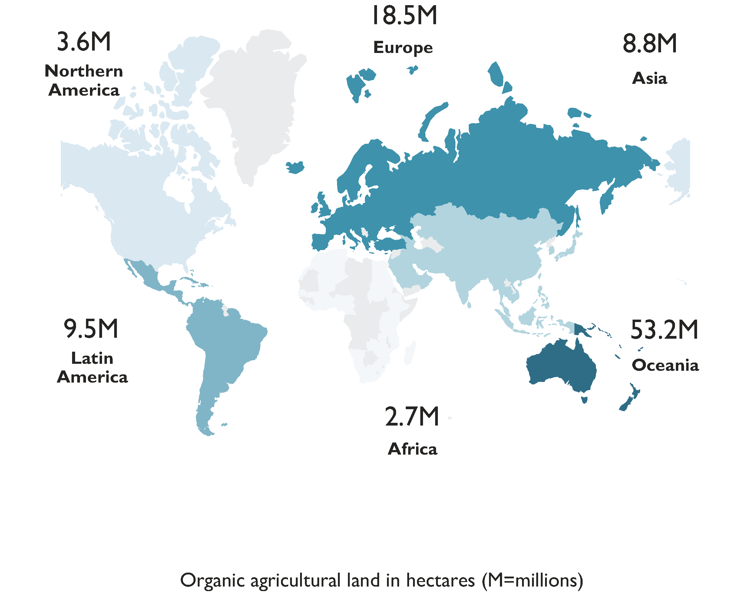
World: Organic agricultural land and other organic areas 2022
Source: FiBL survey 2024

Slide 14
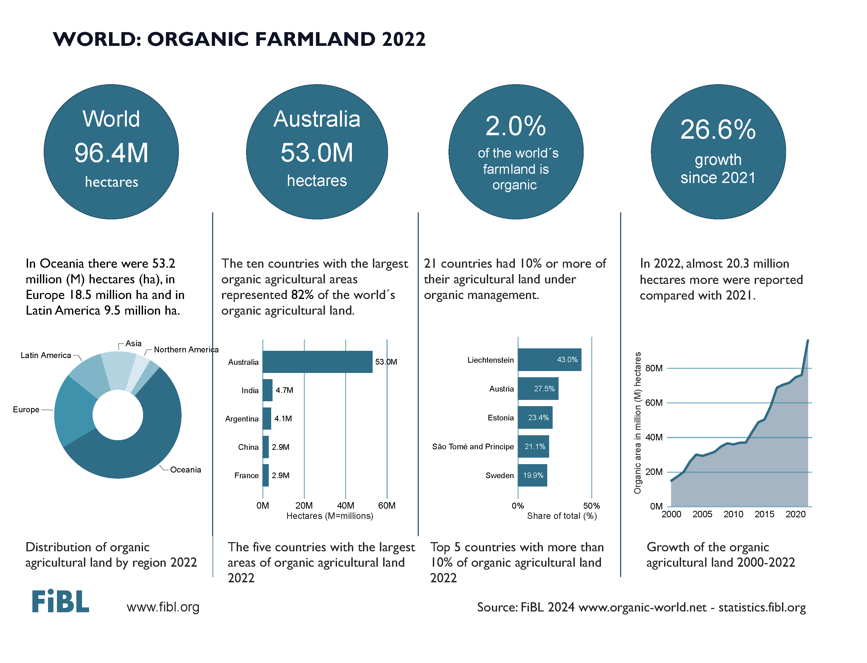

Slide 15
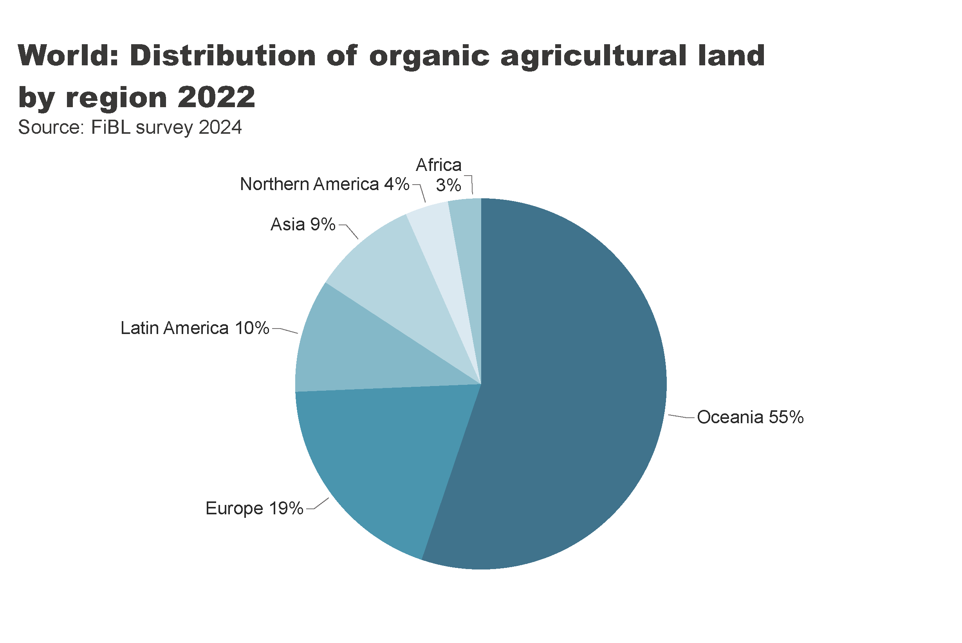
world_land_by_region
Distribution of organic farmland by region 2022
Notes:
textbox
No alt text provided
pieChart
No alt text provided
card
No alt text provided

Slide 16
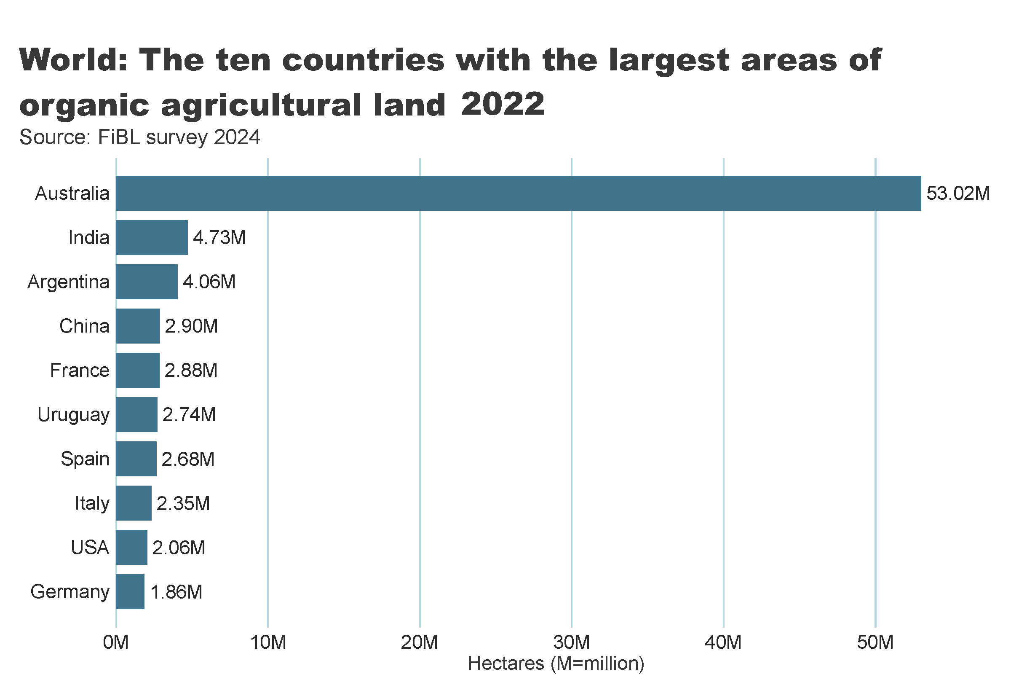
world_land_by_country
Notes:
clusteredBarChart
No alt text provided
textbox
No alt text provided
card
No alt text provided

Slide 17
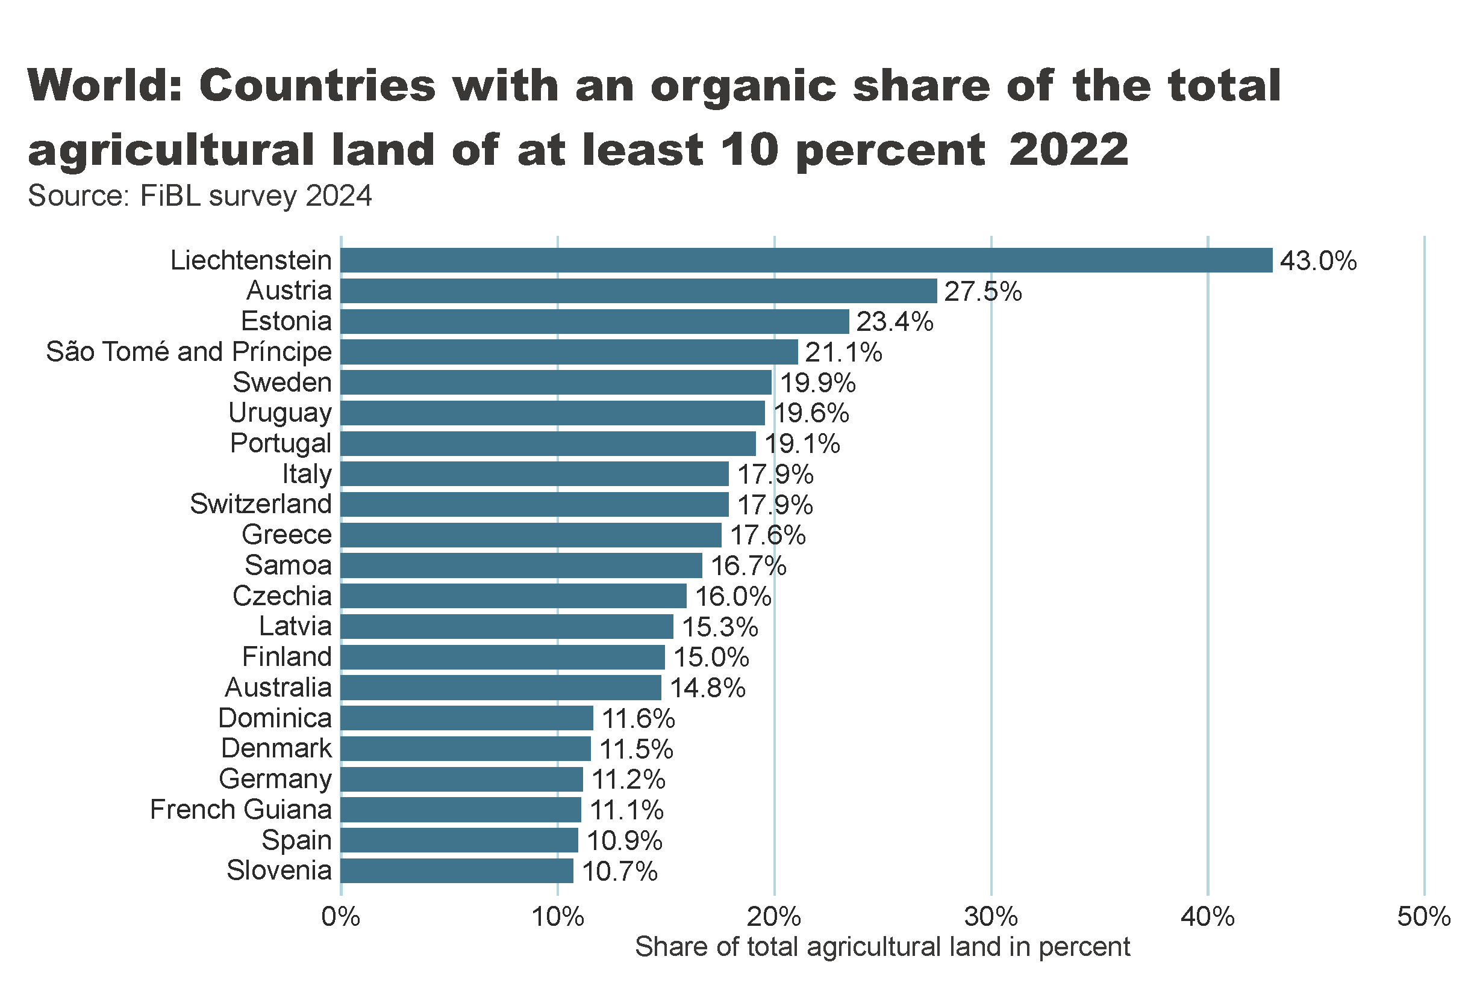
world_land_share
Notes:
textbox
No alt text provided
barChart
No alt text provided
card
No alt text provided

Slide 18
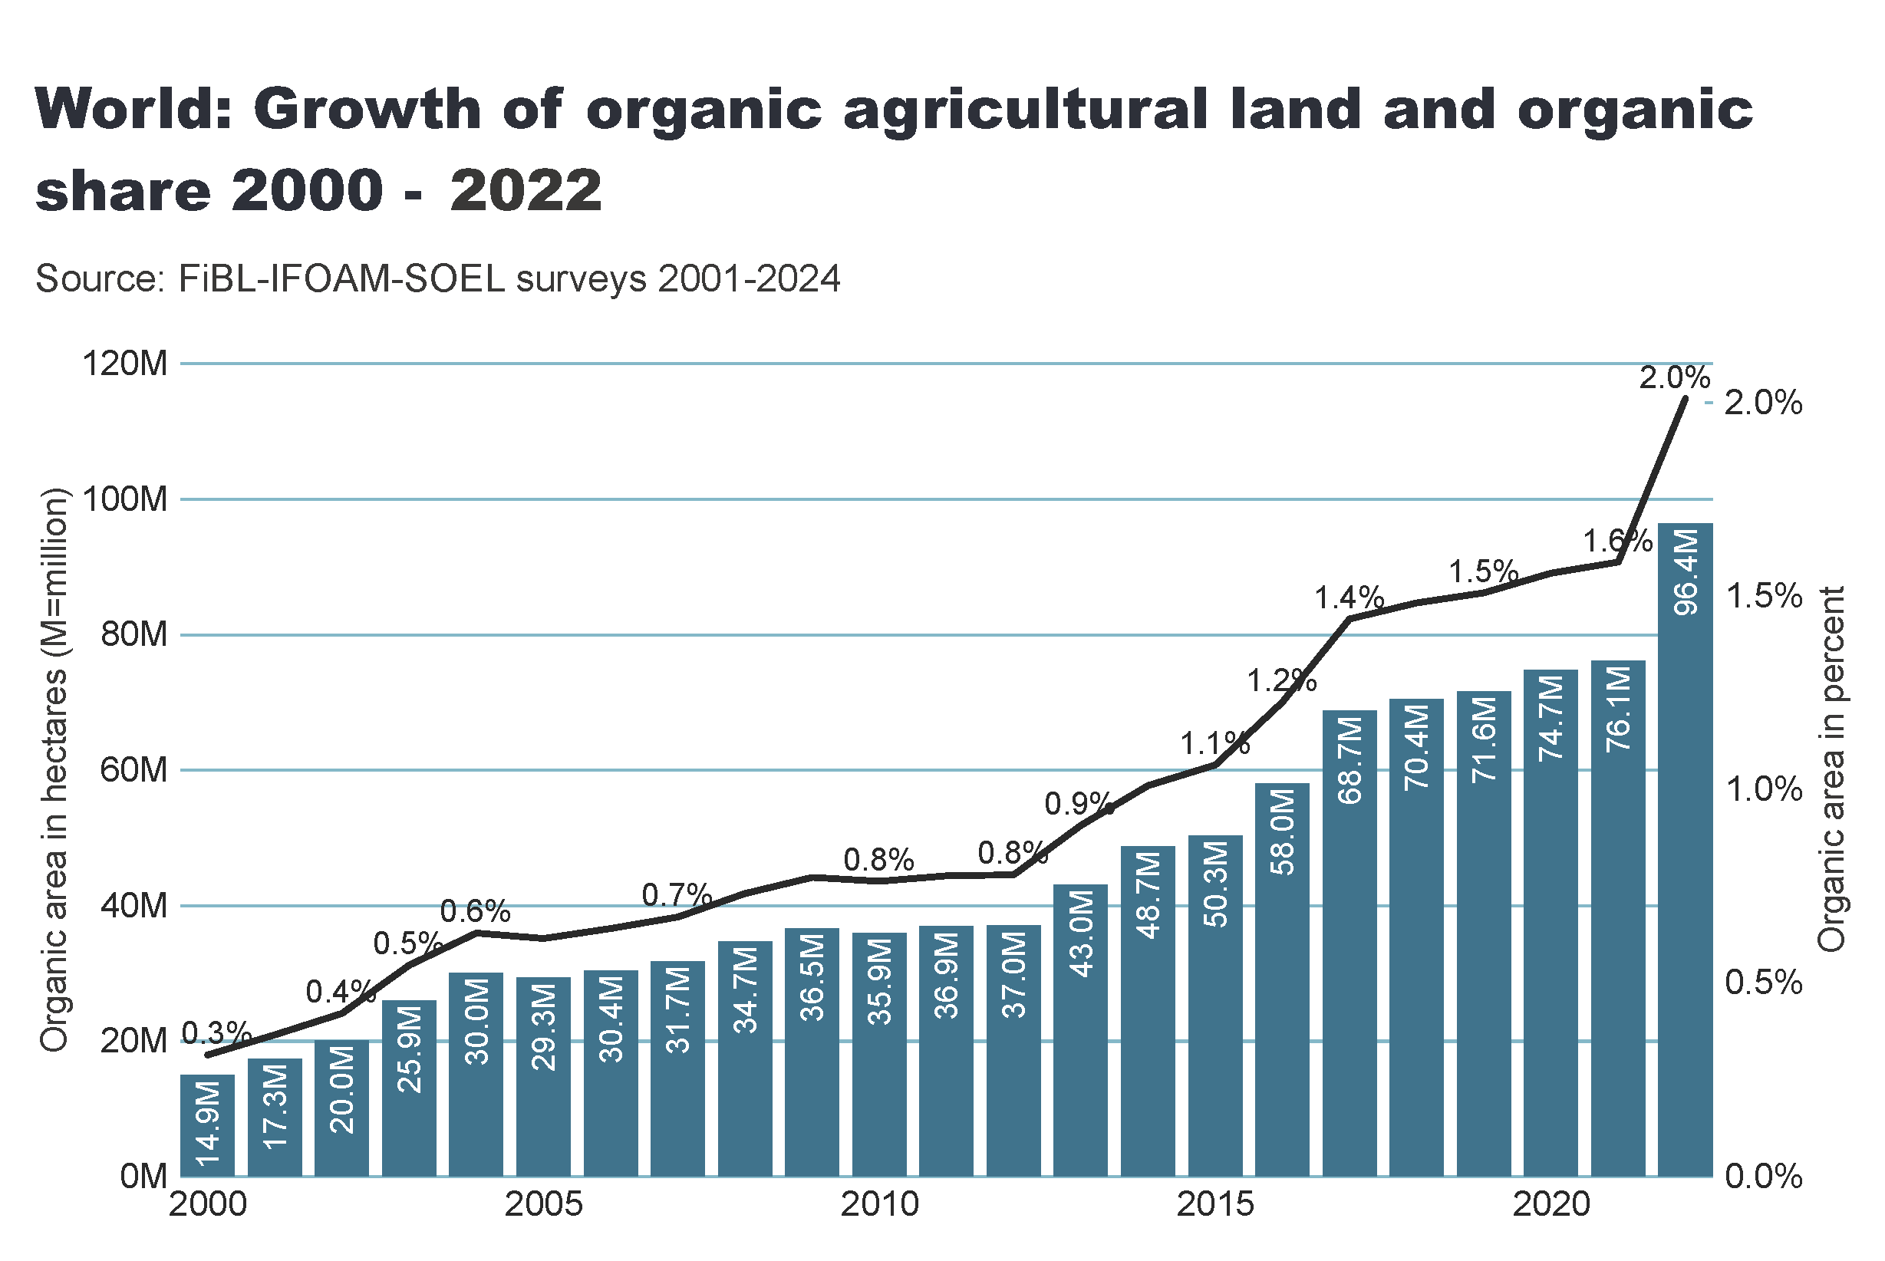
world_land_growth
Notes:
textbox
No alt text provided
lineClusteredColumnComboChart
No alt text provided
card
No alt text provided

Slide 19
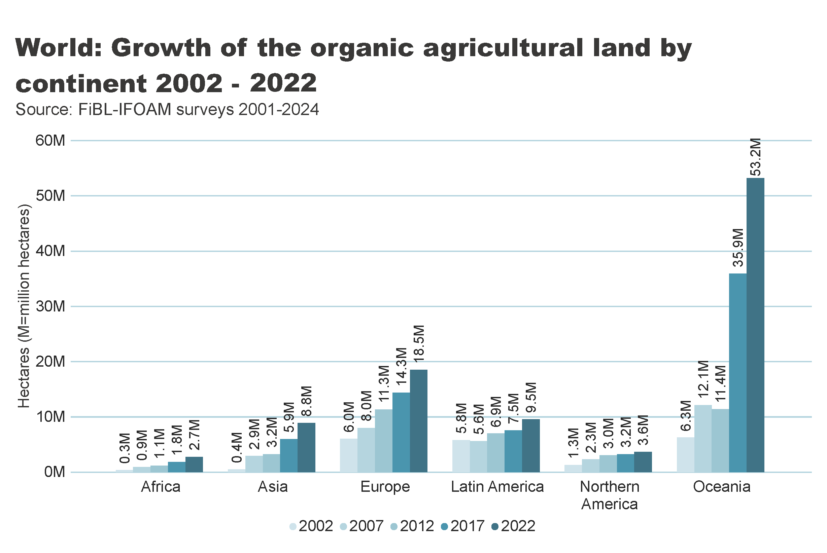
world_land_growth_region
Notes:
textbox
No alt text provided
clusteredColumnChart
No alt text provided
card
No alt text provided

Slide 20
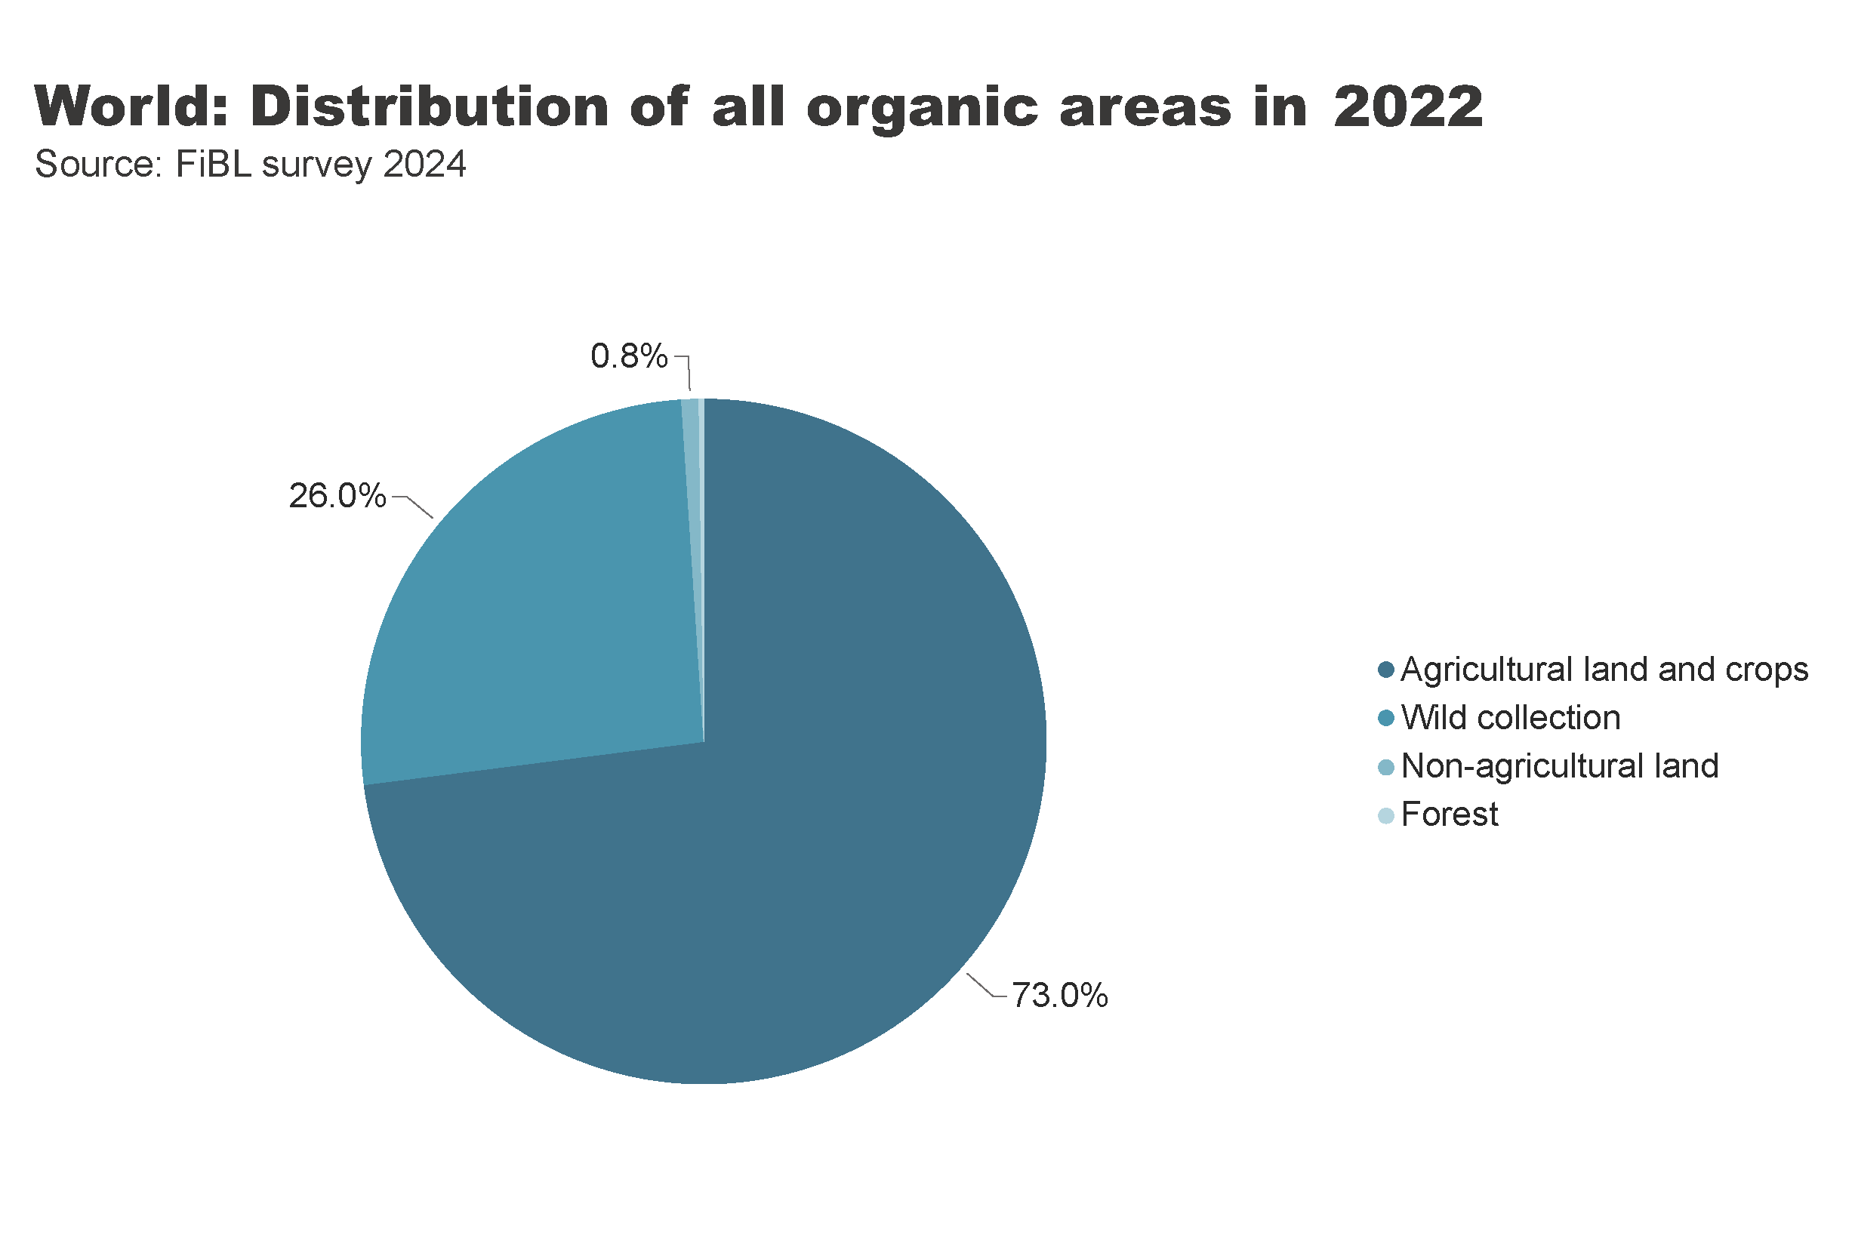
world_land_all_areas
Notes:
textbox
No alt text provided
card
No alt text provided
pieChart
No alt text provided

Slide 21
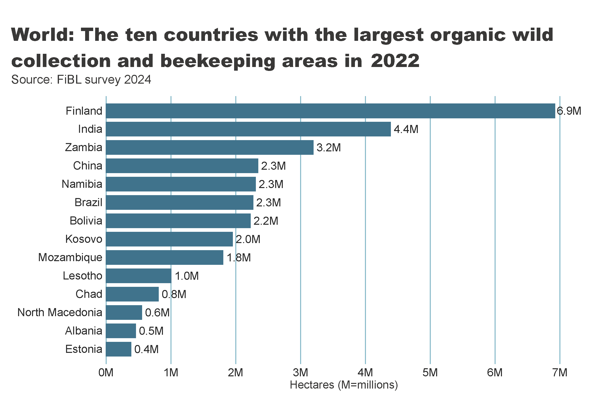
wild_ collection_by_country
Notes:
textbox
No alt text provided
clusteredBarChart
No alt text provided
card
No alt text provided

Slide 22
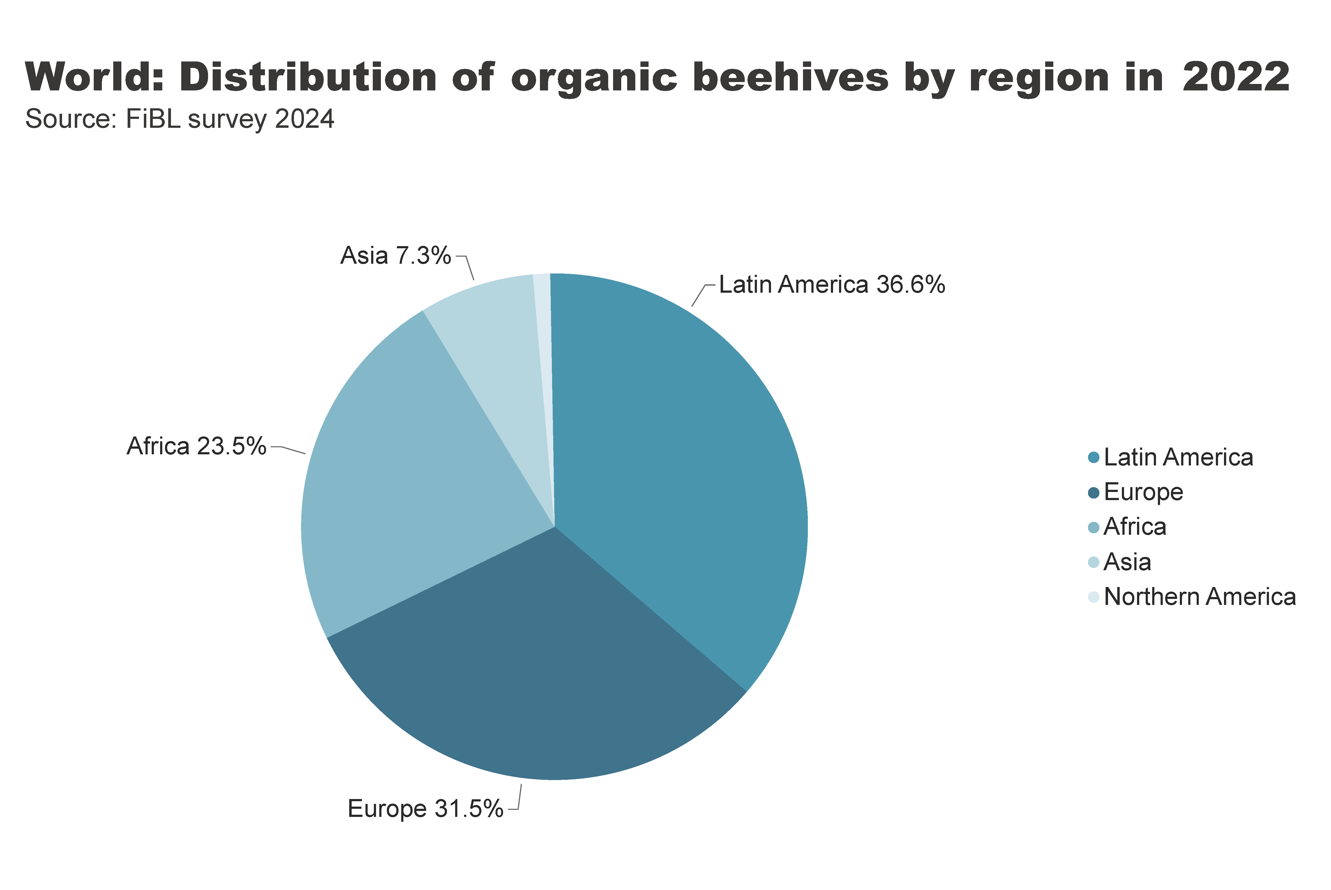
beehives_by_region
Notes:
textbox
No alt text provided
pieChart
No alt text provided
card
No alt text provided

Slide 23
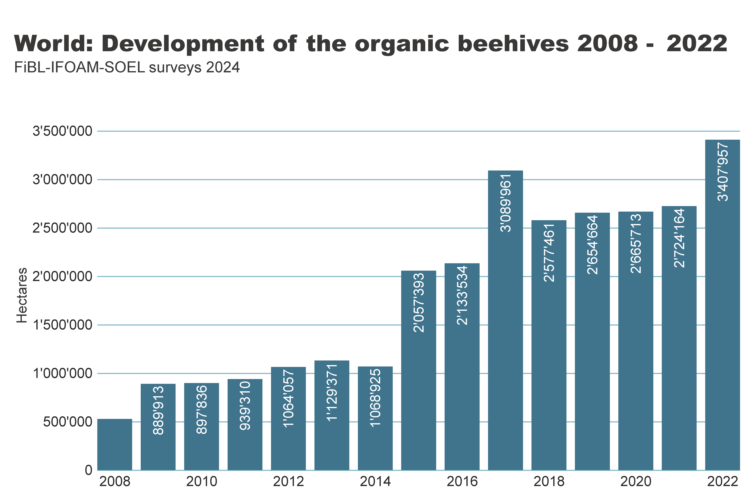
beehives_by country
Notes:
textbox
No alt text provided
clusteredColumnChart
No alt text provided
card
No alt text provided

Slide 24
Organic producers 2022
In 2022, the global count of organic producers surged to a staggering 4.5 million.
Asia led the way with a commanding 61 percent of the world's organic producers, closely trailed by Africa at 22 percent, Europe at 11 percent, and Latin America at 6 percent.
The top three countries with the highest number of organic producers were India (2´480´859), Uganda (404´246), and Thailand (121´540).
Notably, there was a remarkable increase in the number of producers, with a dramatic rise of nearly 919´000 or an astonishing 25.6 percent growth compared to 2021.

Slide 25
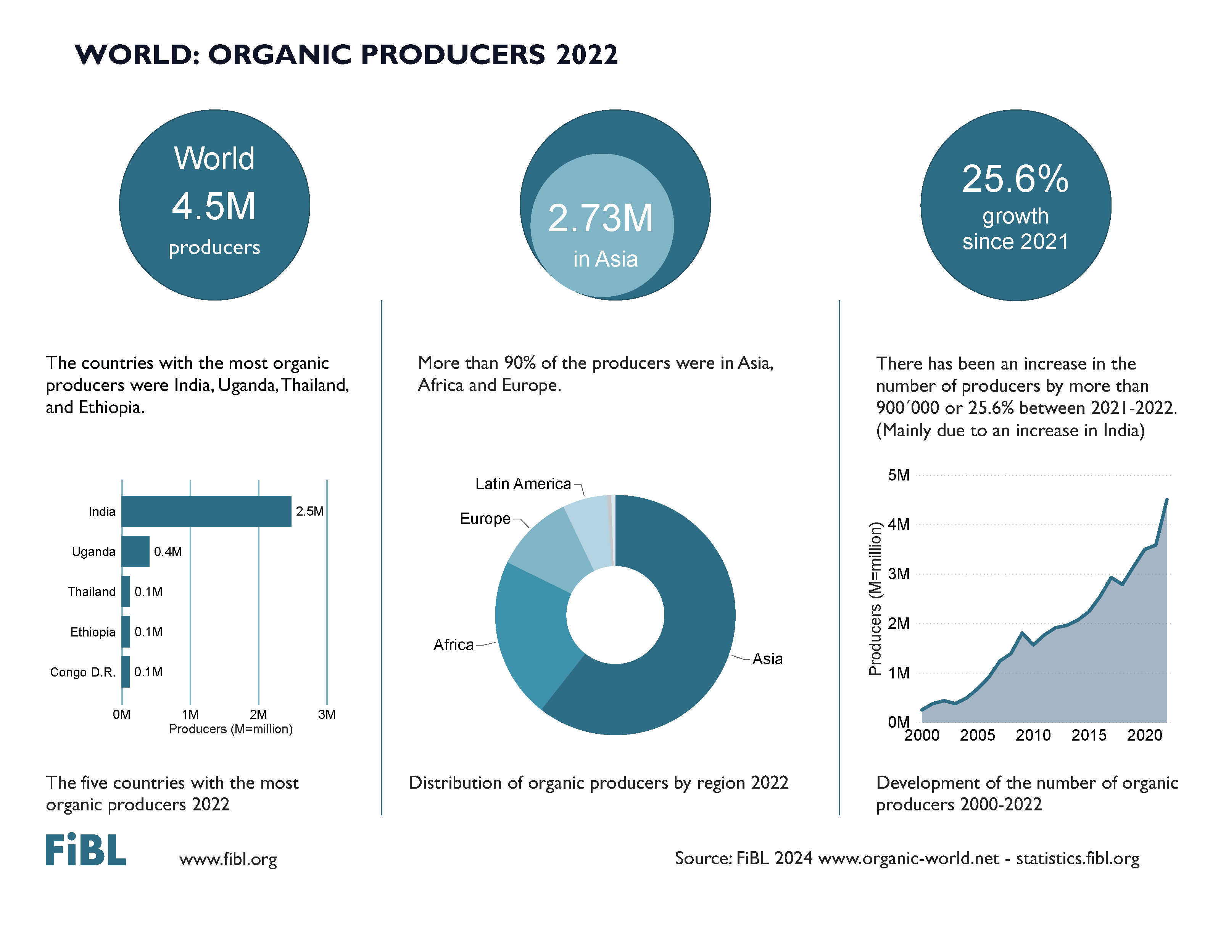

Slide 26
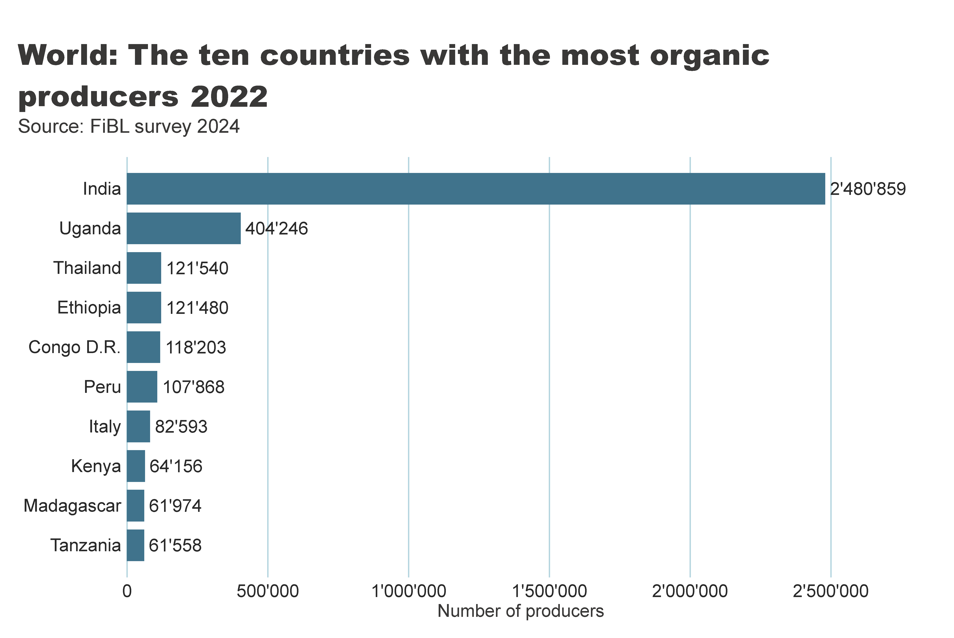
world_producers_country
Notes:
textbox
No alt text provided
card
No alt text provided
barChart
No alt text provided

Slide 27
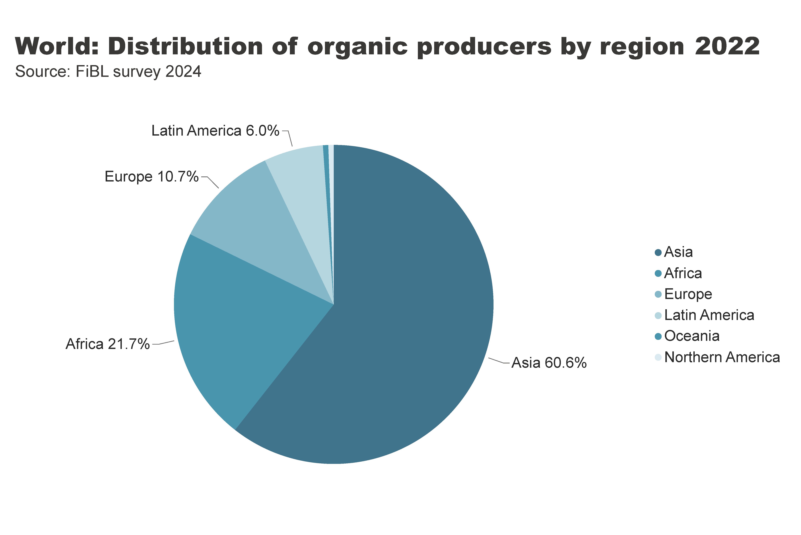
world_producers_region
Notes:
textbox
No alt text provided
pieChart
No alt text provided
card
No alt text provided

Slide 28
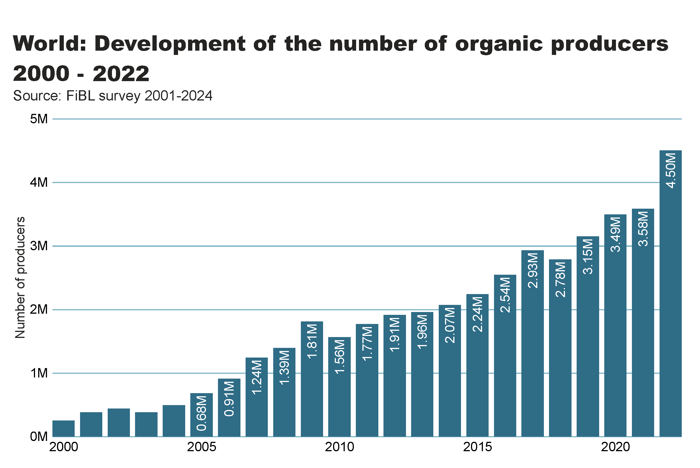
Notes:
Numbers doesn´t match with the database

Slide 29
The global market for organic food 2022
Organic food and drink sales reached nearly 135 billion euros.
In 2022, the countries with the largest organic markets were the United States (58.6 billion euros), Germany (15.3 billion euros) and China (12.4 billion euros). The largest single market was the United States (43 percent of the global market), followed by the European Union (45.1 billion euros, 34 percent) and China (12.4 billion euros, 9.2 percent).
Switzerland had the highest per-capita consumption in 2022, with 437 euros.
The highest organic market shares were reached in Denmark (12.0 percent), Austria (11. percent) and Switzerland (11.2 percent).
Several markets experienced a decline, and in Europe, organic retails sales decreased by more than two percent. In North America, however, the market increased.
According to Sahota (2024), the major challenges facing the global organic food market include rising food prices due to inflation, geopolitical factors disrupting supply chains, the impact of the Ukrainian conflict on the economy, and concerns about oversupply in the wake of increased demand during the pandemic. Consumer demand for organic products varies, driven by health reasons, ethical considerations, and environmental concerns.
In conclusion, while global organic food sales stabilized after a surge in 2020, challenges such as inflation and supply disruptions have affected consumer demand. Growth is expected to resume as economic conditions improve.

Slide 30
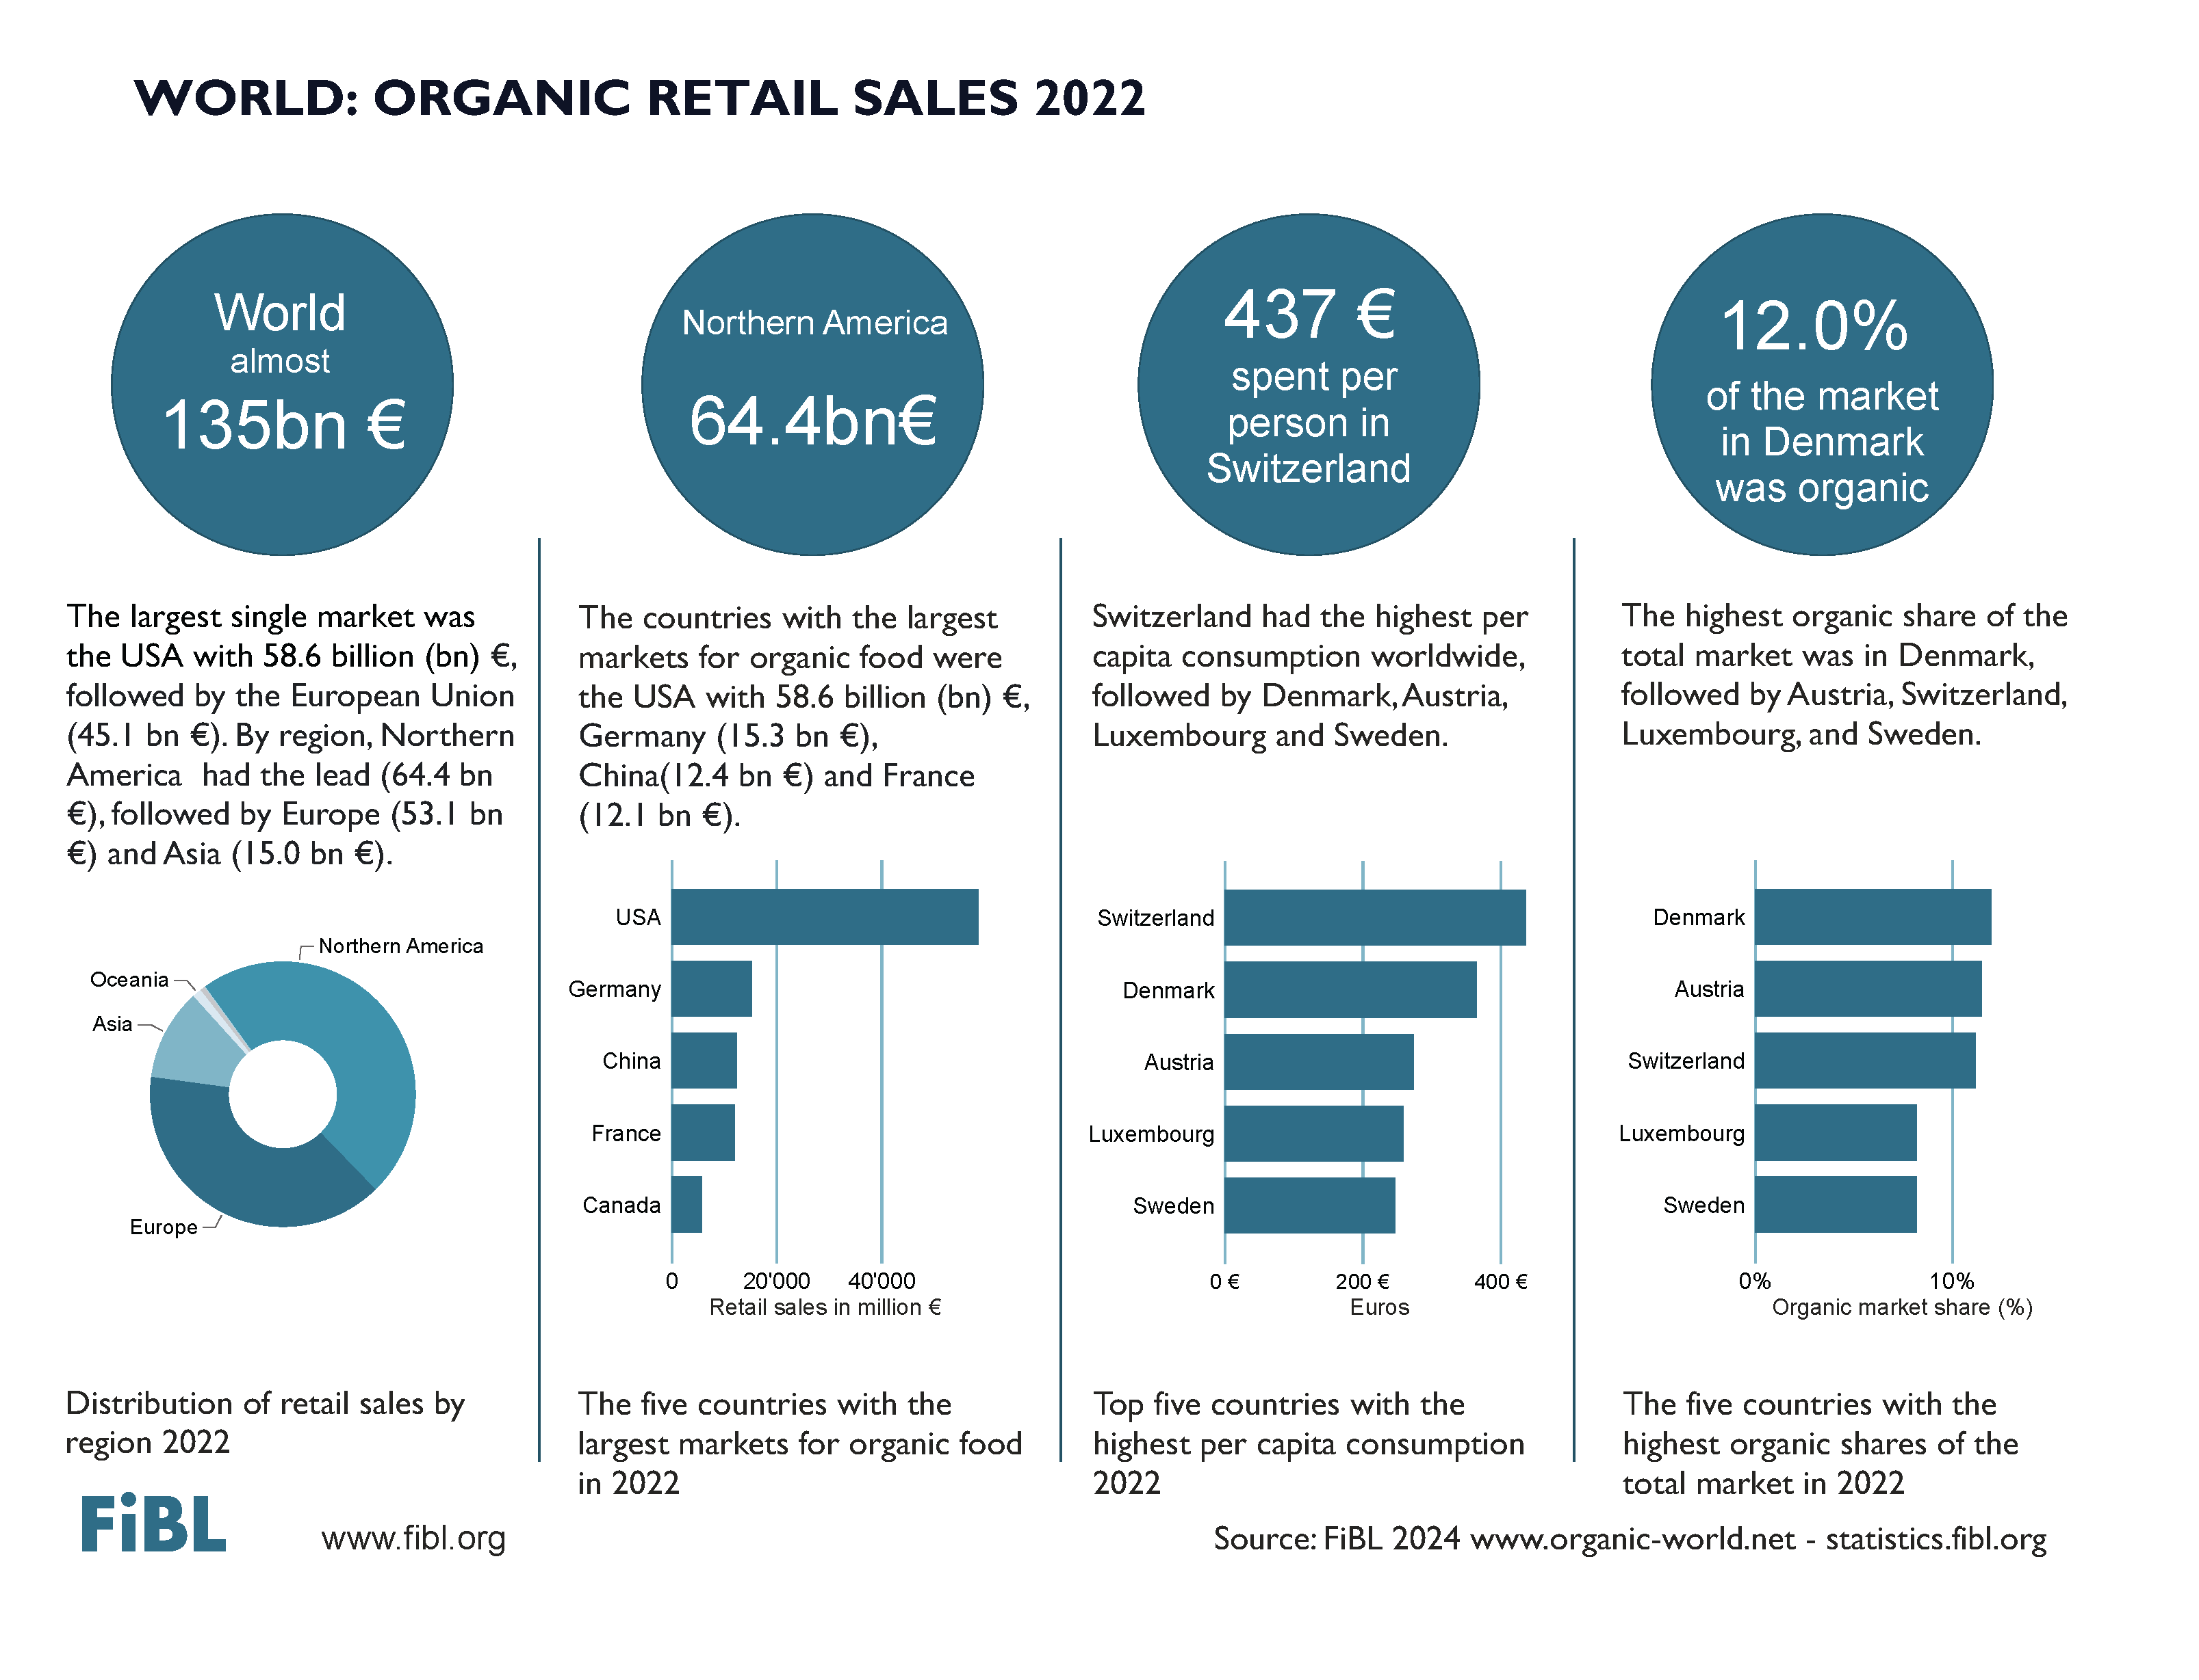

Slide 31
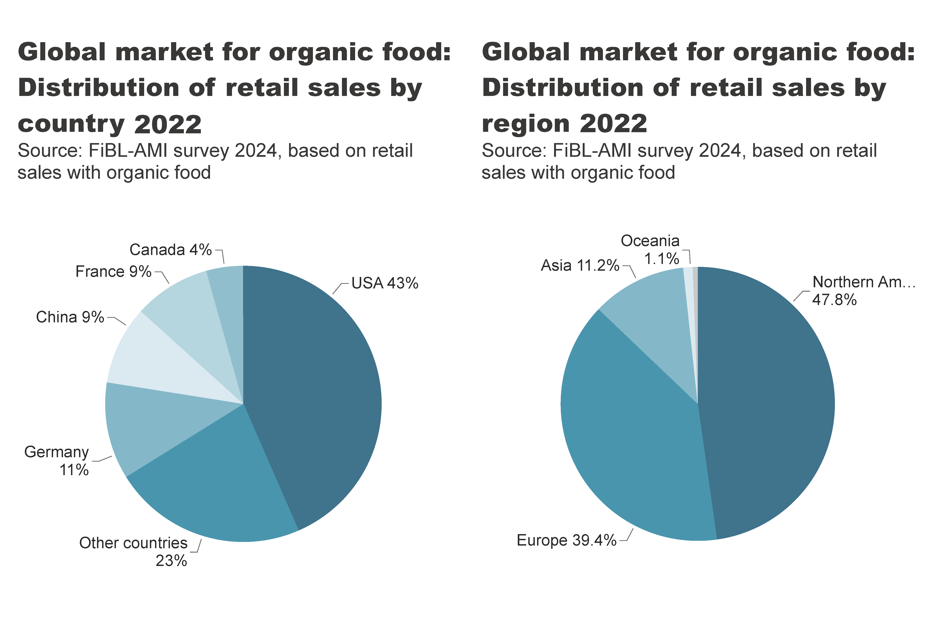
world_retail_sales_region_country
Notes:
pieChart
No alt text provided
textbox
No alt text provided
pieChart
No alt text provided
textbox
No alt text provided
card
No alt text provided
card
No alt text provided

Slide 32
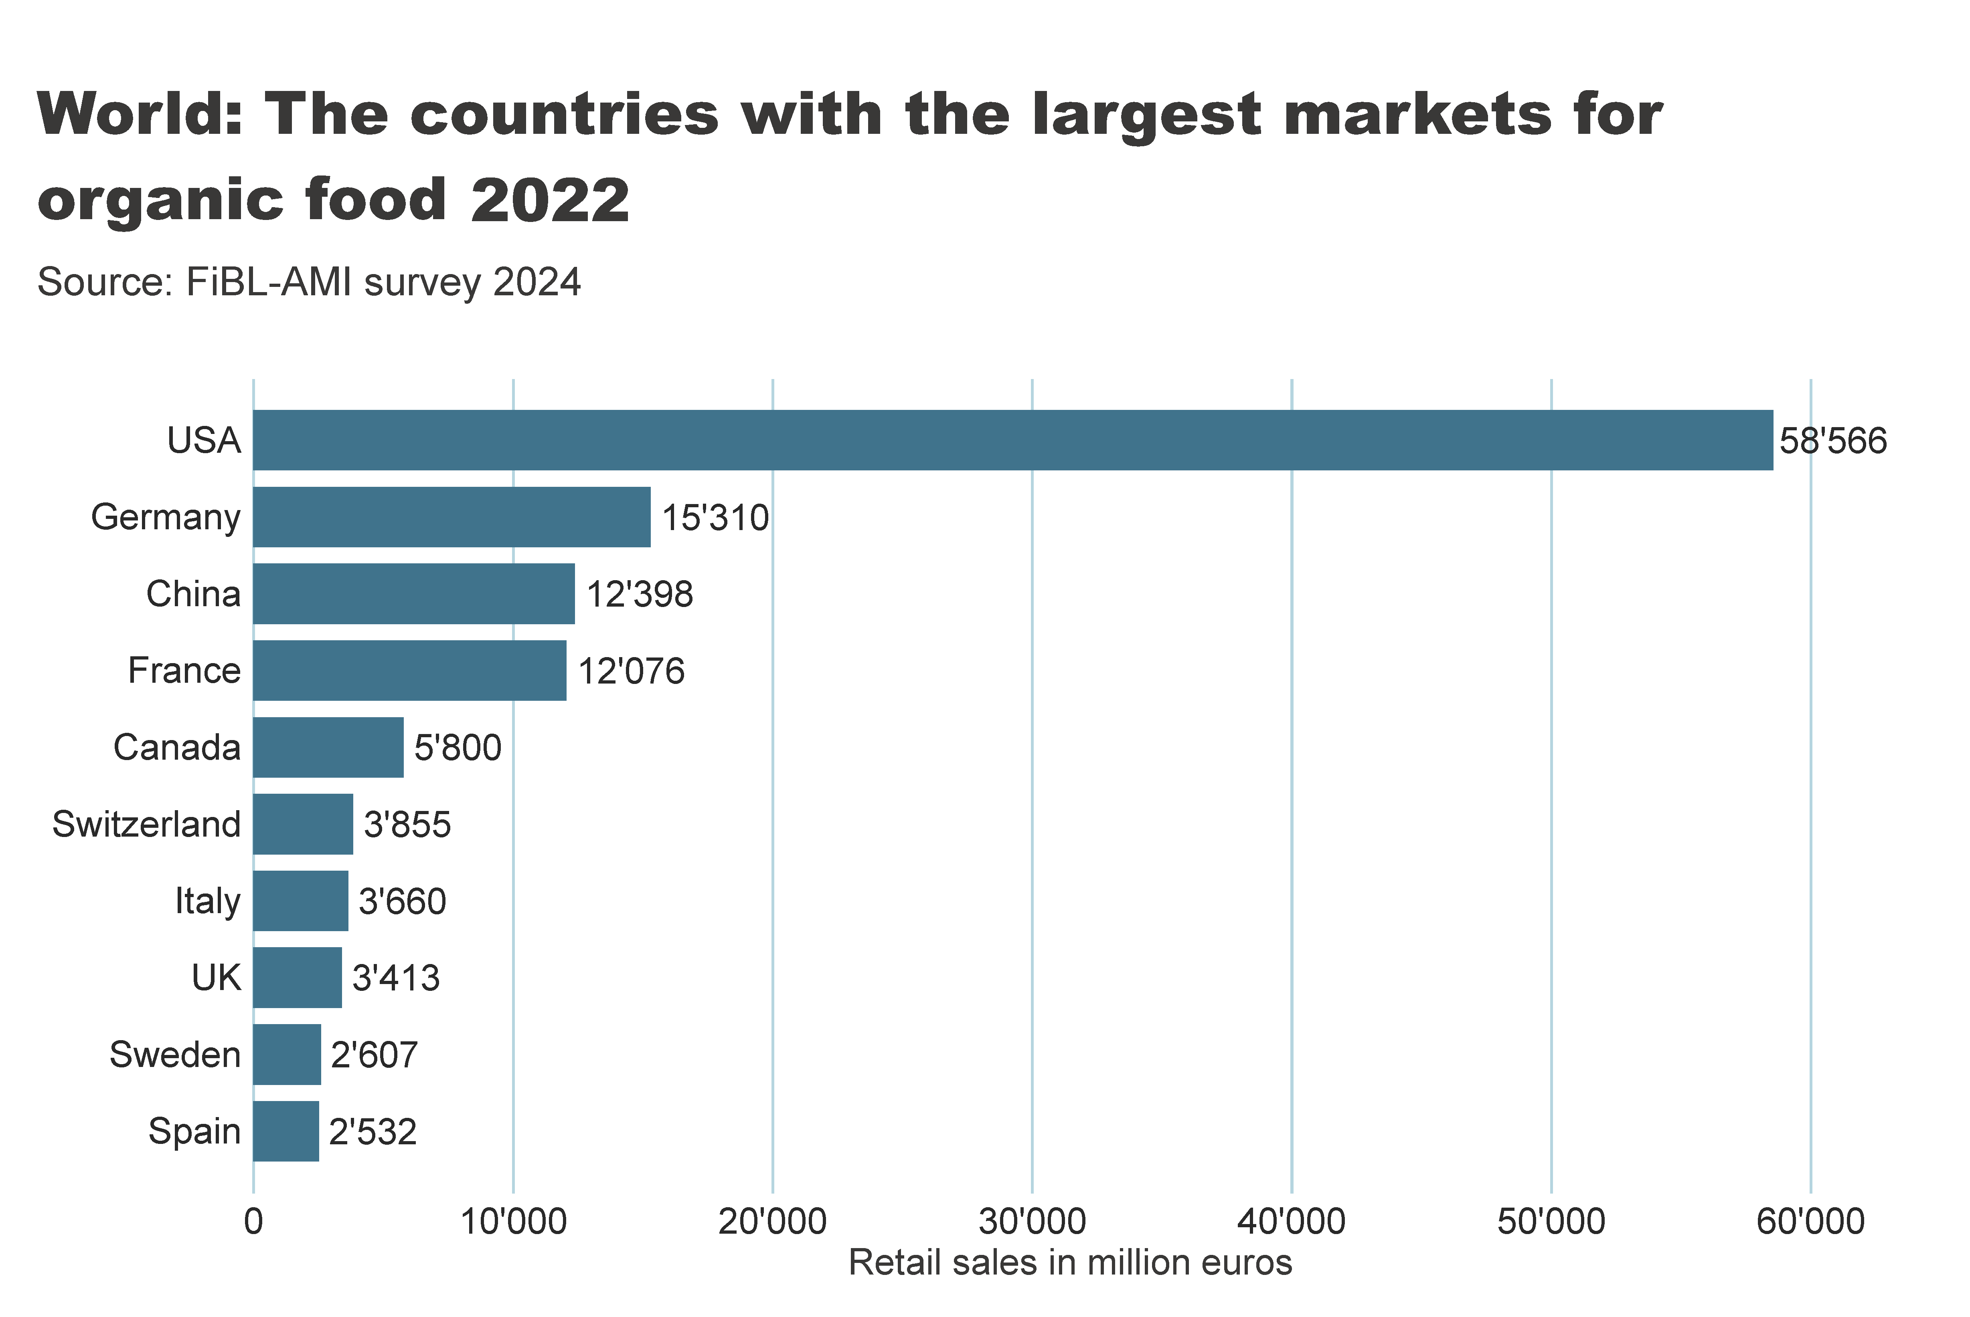
world_retail_sales_country
Notes:
textbox
No alt text provided
card
No alt text provided
barChart
No alt text provided

Slide 33
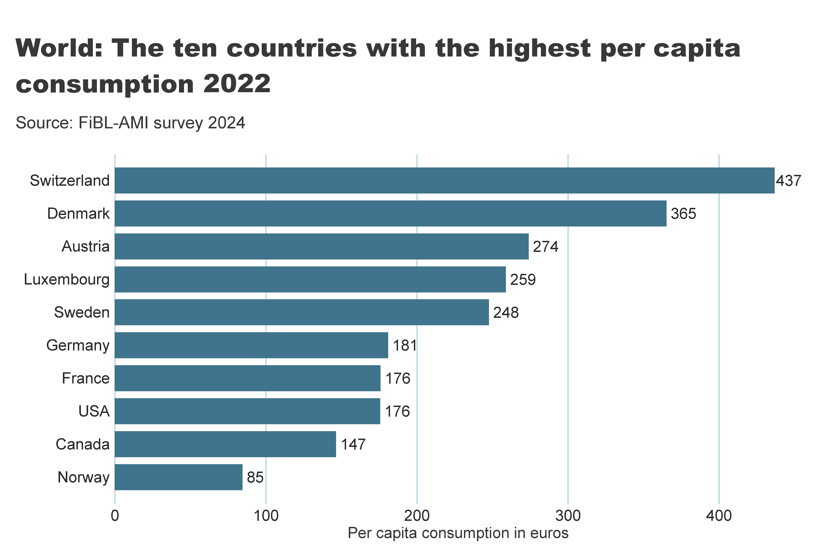
world_retail_sales_per_capita
Notes:
textbox
No alt text provided
card
No alt text provided
barChart
No alt text provided

Slide 34
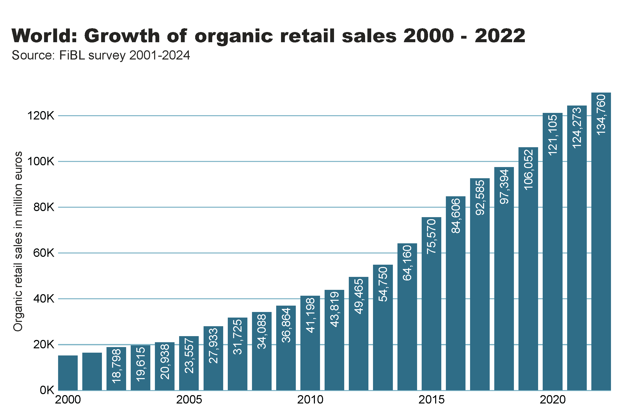
World_retail_growth
Notes:
textbox
No alt text provided
card
No alt text provided
columnChart
No alt text provided

Slide 35
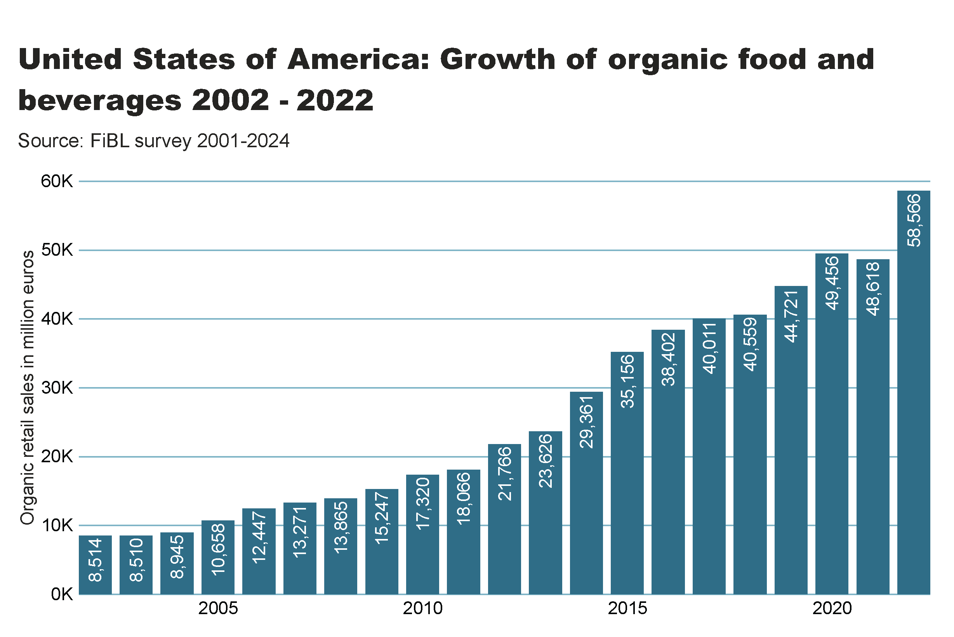

Slide 36
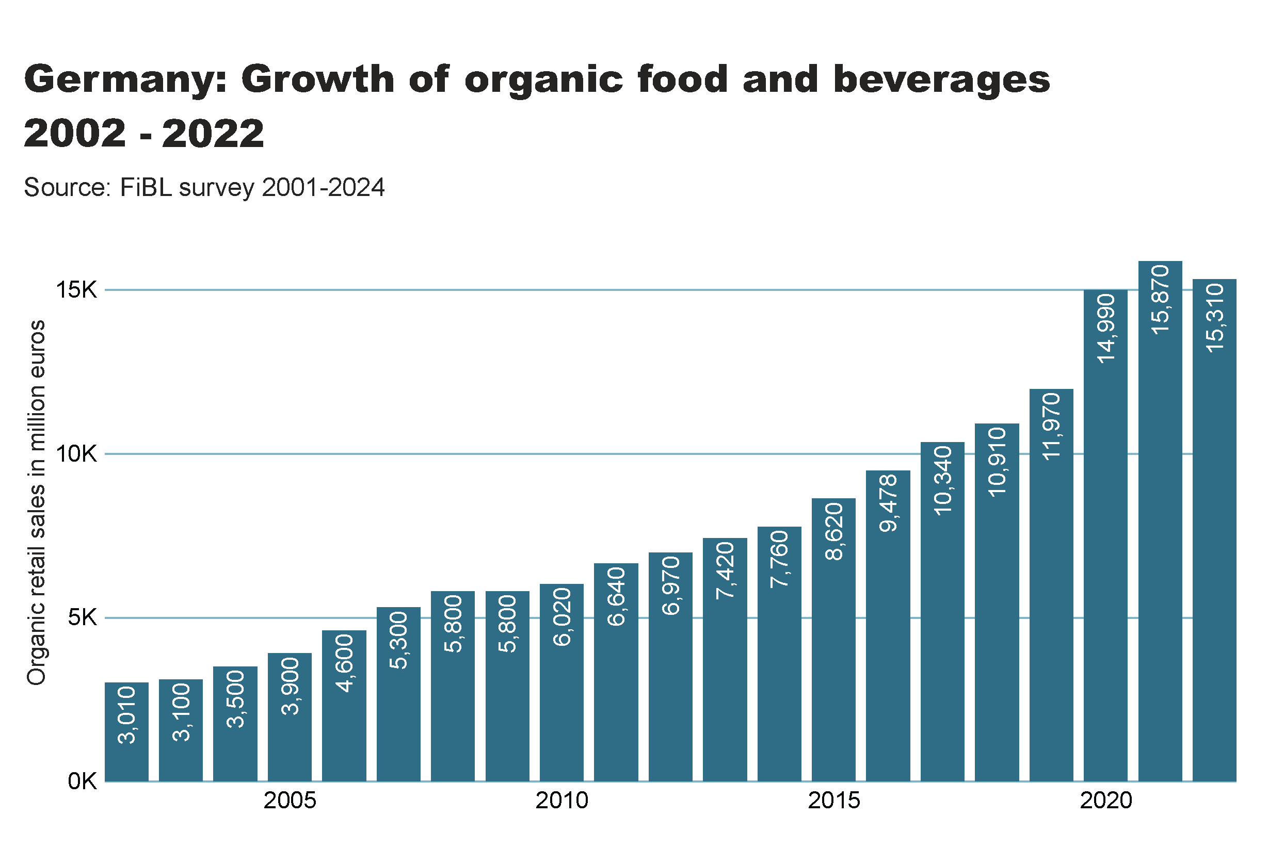

Slide 37
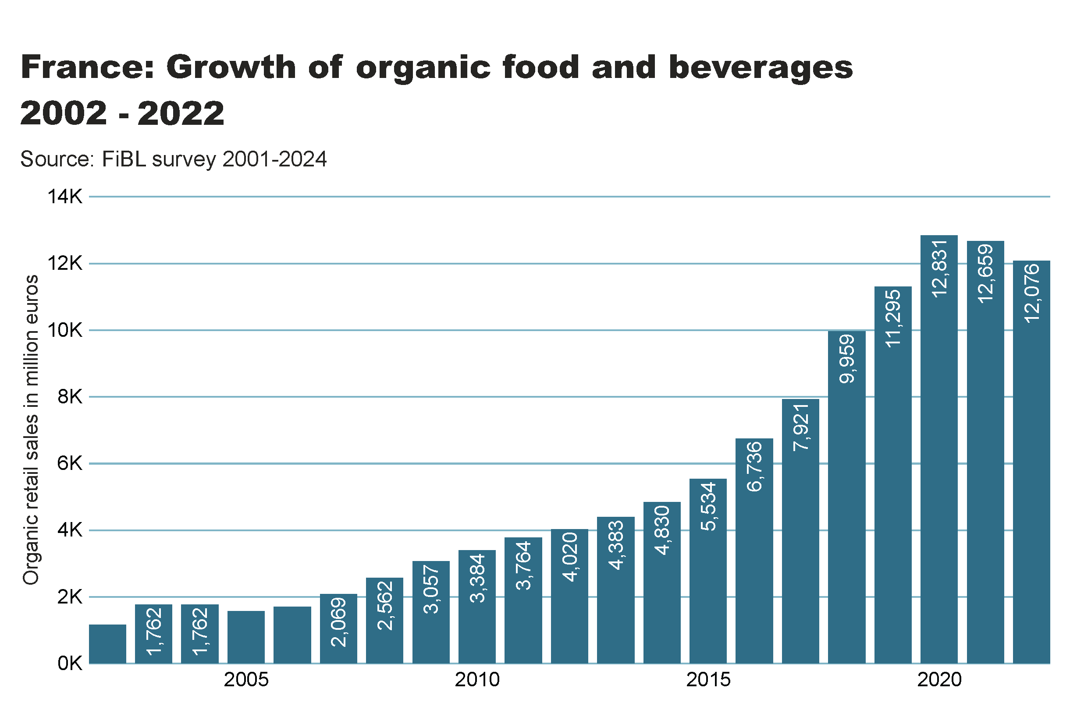

Slide 38
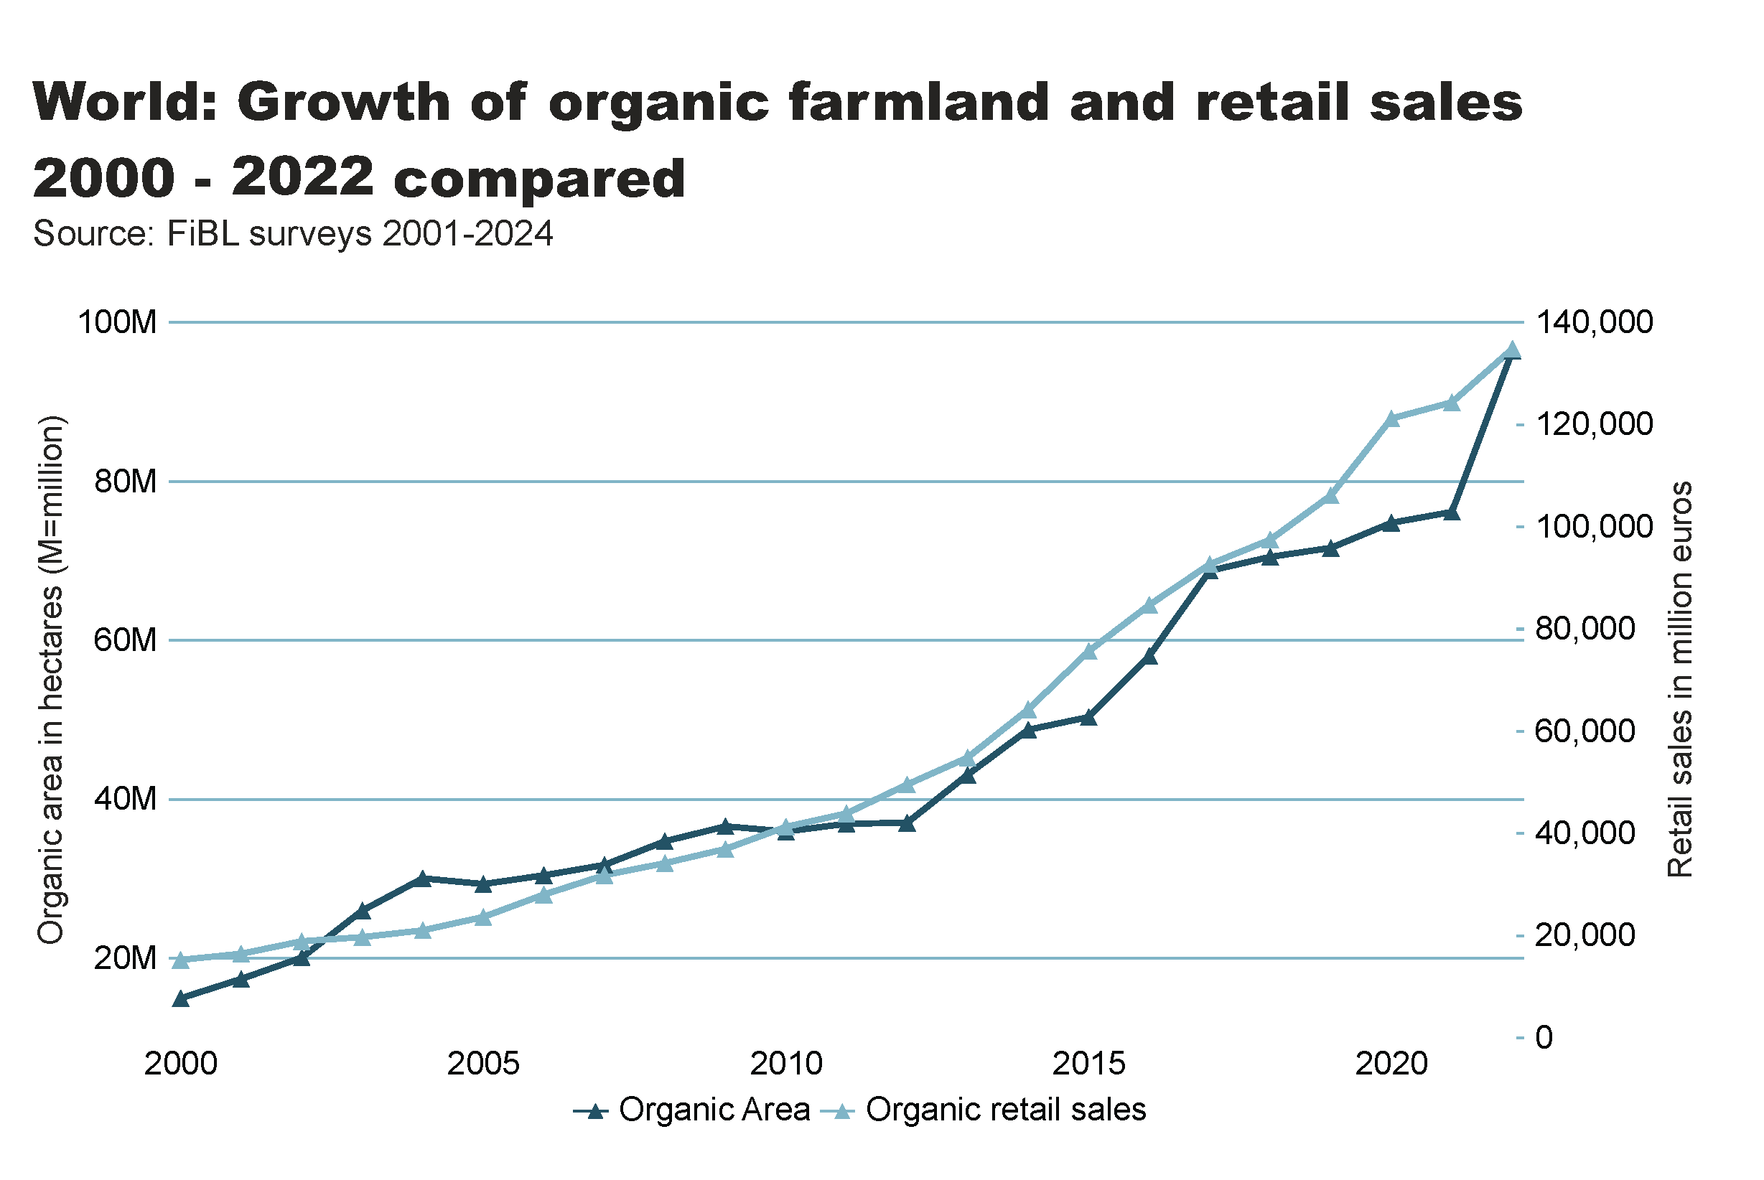
World_land_retail_growth
Notes:
textbox
No alt text provided
lineChart
No alt text provided
card
No alt text provided

Slide 39
Organic farming in developing countries and emerging markets
The Development Assistance Committee (DAC) of the Organisation for Economic Co-operation and Development (OECD) is a forum to discuss issues surrounding aid, development and poverty reduction in developing countries. The recipients of Official Development Assistance (ODA) according to the DAC list are studied in this section.
More than 4.0 million organic producers from the countries on this list were counted (89 percent of all organic producers
About a fifth of the world’s organic agricultural land, 18.8 million hectares, is located in countries on this list.
Almost half, 47 percent of the agricultural land of the countries on the DAC list is located in Asia (8.7 million hectares), with Latin America (6.6 million) and Africa (2.7 million) in second and third place.
The countries with the largest areas of organic agricultural land are India, Argentina, China and Brazil, in that order. Not surprisingly, all of them are large countries.
The country list of the Development Assistance Committee DAC is available on the OECD website at http://www.oecd.org/dac/stats/daclist.htm

Slide 40
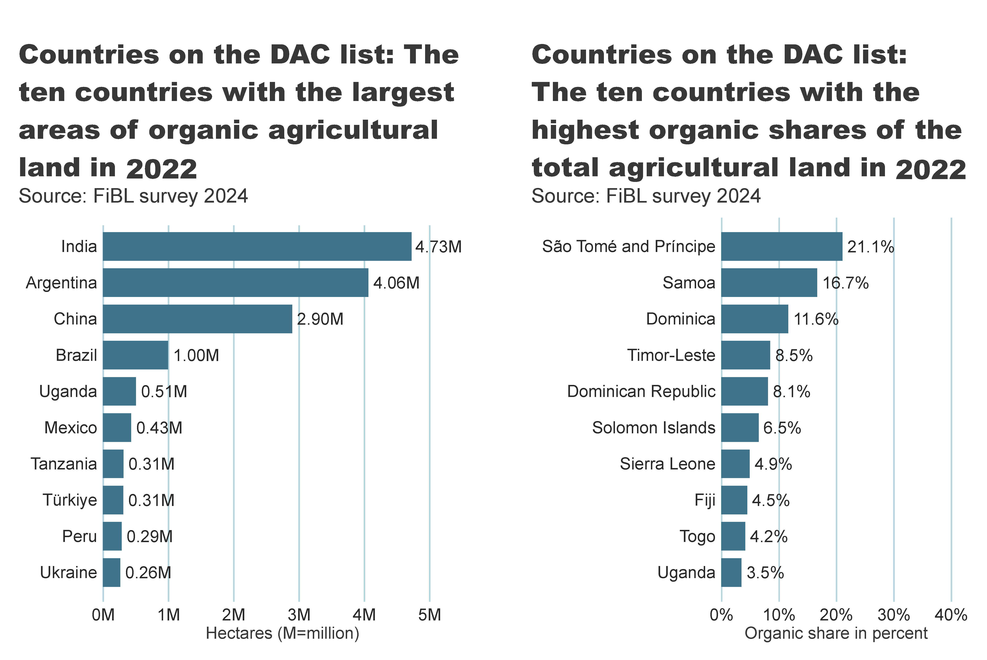
DAC_land_area_share_country
Notes:
textbox
No alt text provided
card
No alt text provided
clusteredBarChart
No alt text provided
textbox
No alt text provided
card
No alt text provided
clusteredBarChart
No alt text provided

Slide 41
More information
More information (PDF, data sources, graphs) at: http://www.organic-world.net/yearbook/yearbook-2024.html
Contact Helga Willer Research Institute of Organic Agriculture FiBL 5070 Frick Switzerland helga.willer@fibl.org

Slide 42
Disclaimer
All of the results contained in this slide show have been compiled by the Research Institute of Organic Agriculture FiBL. However, the possibility of mistakes cannot be ruled out entirely. Therefore, FiBL is not subject to any obligation and makes no guarantees whatsoever regarding any of the statements or results in this work; neither does FiBL accept responsibility or liability for any possible mistakes, nor for any consequences of actions taken by readers based on statements or advice contained therein.
This document has been produced with the support of the Swiss State Secretariat for Economic Affairs (SECO), the Sustainability Fund of Coop Switzerland, NürnbergMesse, IFOAM – Organics International. The views expressed herein can in no way be taken to reflect the official opinions of SECO, Coop, NürnbergMesse or IFOAM – Organics International.

Slide 43
Presentations on www.organic-world.net

Slide 44
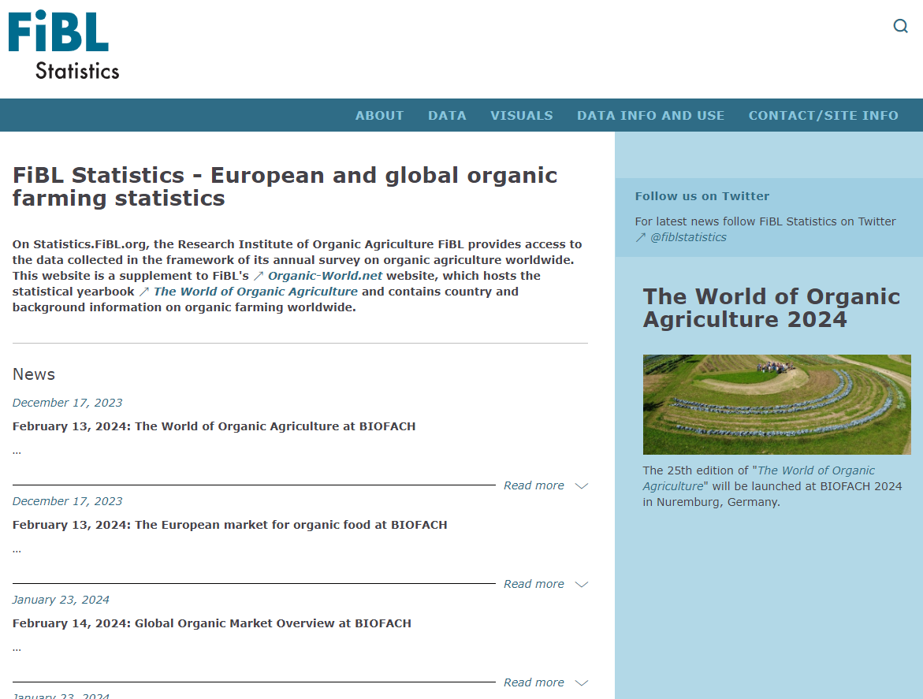
Statistics.FiBL.org

Slide 45
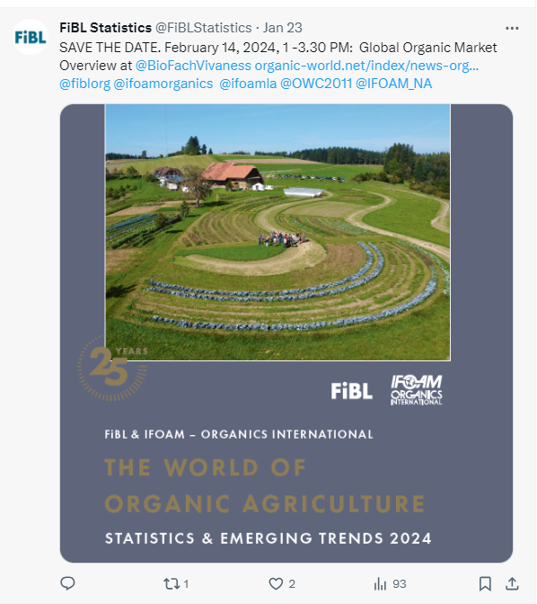
www.twitter.com/fiblstatistics

Slide 46
Contact
Helga Willer Research Institute of Organic Agriculture FiBL Ackerstrasse 113, Box 219 5070 Frick Switzerland
Phone +41 62 865 72 72 Phone +41 62 865 72 07 (direct)
info.suisse@fibl.org, helga.willer@fibl.org www.fibl.org, www.organic-world.net, https://statistics.fibl.org

Slide 47
FiBL online
www.fibl.org
www.bioaktuell.ch
fiblfilm
@fiblorg
@FiBLaktuell
linkedin.com/company/fibl

