Slide 1


Establishing and Managing Organic Farming Demonstrations
A User’s Guide developed for the Organic Agriculture Working Group of the GIZ-GIAE Programme
2020, Version 1

Slide 2
Imprint
Published by:
Research Institute of Organic Agriculture FiBL
Ackerstrasse 113 / Postfach 219, CH-5070 Frick, Switzerland
info.suisse@fibl.org, www.fibl.org
Deutsche Gesellschaft für Internationale Zusammenarbeit (GIZ) GmbH
Friedrich-Ebert-Allee 32 + 36, D-53113 Bonn, Germany
info@giz.de, www.giz.de
Authors: Irene Kadzere, Noah Adamtey, David Bautze, Mirjam Holinger, Veronika Maurer, Felix Heckendorn, Toralf Richter, Brian Ssebunya, Gilles Weidmann, Gian Nicolay, Andreas Fliessbach (all FiBL), Stefanie Zeiss, Wendy Escobar Zavala (GIZ), Andrew Thadzi, Shaibu Kananji, and Mike Ching'amba (LUANAR – NRC, Malawi)
Elaborated in collaboration with the Natural Resources College of the Lilongwe University of Agriculture and Natural Resources (LUANAR-NRC) in Malawi
DOI 10.5281/zenodo.10598332
This work is licensed under a Creative Commons Attribution-Non Commercial-ShareAlike 4.0 International
2020, Version 1
Disclaimer: All the information contained in this manual has been compiled by the authors to the best of their knowledge. Reasonable efforts have been made by the Research Institute of Organic Agriculture FiBL and their partners to publish reliable data and information. The authors, the editors and the publishers cannot assume responsibility for the validity of the materials. Neither the authors, nor the publishers, nor anyone else associated with this publication, shall be liable for any loss, damage or liability directly or indirectly caused or alleged to be caused by the training manual and its tools. The manual’s findings, conclusions and recommendations are those of the authors, and do not necessarily reflect positions or policies of the funding organisation.

Slide 3

Table of contents
Imprint Page 2
Preface Page 5
Acronyms Page 6
Explanation on sets of guiding questions used in this User's Guide Page 7
Chapter 1: Introduction, definitions and rationale Page 8
1.1: Introduction and definitions Page 8
1.2: Rationale and importance of demonstrations in organic agriculture Page 10
1.3: Key considerations before starting demonstrations Page 11
Chapter 2: Types of demonstrations and objectives Page 12
2.1: Demonstration types Page 13
2. 2: Problem definition Page 15
2.3: Goal and specific objectives definition Page 21
2.4: Expected outputs Page 25
2.5: Target groups Page 28
2.6: Schematic example - problem, goal, specific objectives, outputs, target groups Page 32
Chapter 3: Demonstration components - pre-establishment planning and preparations Page 33
3.1: Key components of a demonstration Page 34
3.2: Timeframe, budget considerations, and labour resources Page 39
3.3: Site selection Page 42
3.4: Demonstration design and choosing planting patterns Page 44
3.5: Inputs, tools and facilities for crop demo plots Page 49
3.6: Land preparation and application of manure/compost Page 58
3.7: Demonstration reference document / handbook Page 62
Organic Demonstration User Guide, 2020

Slide 4
Chapter 4: Establishment and management – demonstrations involving crops only Page 64
  4.1 Planting / Sowing Page 66
  4.2: Weeding, training and pruning Page 72
  4.3: Plant nutrition Page 75
  4.4: Plant protection Page 82
  4.5: Labelling of the demonstrations Page 95
Chapter 5: Livestock husbandry in organic demos Page 98
5.1: Introduction and basic requirements for livestock Page 99
5.2: Organic pigs - housing, feeding and health Page 102
5.3: Organic poultry feeding, housing, breeding and health Page 105
5.4: Small ruminants feeding and behaviour Page 108
5.5: Small ruminants: breeding and health management Page 109
Chapter 6: Harvesting Page 114
Chapter 7: Postharvest management Page 116
Chapter 8: Data collection and management Page 131
Chapter 9: Dissemination and learning Page 143
9.1: Regular reflections and learnings by the demonstration team Page 144
9.2: Technological dissemination from the demonstrations Page 147
Further reading and sources of icons Page 152
Annex 1: Examples of structures that can help to stabilise soils on sloppy land Page 155
Annex 2: Additional considerations for site – weather station Page 161
Annex 3: Procedures for soil sampling, if required Page 157
Annex 4: Germination tests and correction for seeding rates Page 163
Annex: 5: Additional considerations for scientific demonstrations / trials Page 165
Annex 6: Nursery establishment to raise seedlings Page 181
Organic Demonstration User Guide, 2020

Slide 5
Preface
This User’s Guide on Organic Demonstration (‘Demos’) was developed by the Research Institute of Organic Agriculture FiBL together with NRC and GIZ to assist the Organic Agriculture Working Group (OA WG) of GIZ’s Green Innovation Centres (GIC) Programme with establishing and managing unbiased demonstration plots on organic agriculture. The User’s Guide, developed within the framework of the German BMZ’s ‘One World No Hunger programme’, is not meant for highly scientific experimental plots or settings, but could be adapted for such as may be found necessary.
The guide is generic and practically applicable to various countries and contexts. It highlights, in a step by step manner, the process of defining the purpose of the demo plots and what they aim to resolve and achieve, and how to manage them. Examples from the experiences of FiBL and its collaborative partners in some countries such as Bolivia, India, and Kenya, are used. Pictures and/or diagrams are provided where necessary to enable the users to visualise the content and context. Some experiences were drawn from the Malawi process of establishing and managing demo plots on organic crop production at the Natural Resources College (NRC) through the GIC programme.
The User’s Guide has been prepared using a combination of statements and questions which are meant to stimulate the users to think through their plans and actions, and ensure that key considerations are made at all critical stages and steps of the demonstrations. By posing the questions rather than providing descriptive content only, the User’s Guide becomes more applicable for different farming contexts. In a number of sections, users are referred to existing materials and literature where they can find more detailed explanations about a certain topic or theme. The PowerPoint format used for the guide enables new content to be added easily as required. The users are encouraged to contribute their own experiences and successes as well as lessons to enrich the guide. Before focusing on certain sections of the guide, the authors encourage potential users to read through the whole guide first in order to obtain a good overview of the content and potential pitfalls.
Demonstrations have a number of possible purposes. These can be categorised into three broad types: to illustrate a phenomenon, concept, law, theory or process; to motivate; and to stimulate or arouse the curiosity of surrounding communities such as farmers, students, extension staff, private businesses, policy makers, and others.
Organic Demonstration User Guide, 2020

Slide 6
Acronyms / Terminology
Used acronyms and terms
Demonstration | A demarcated plot, field, or farm that can be used to test or experiment various agricultural practices and used to train, teach, showcase or create awareness on these practices or on new technologies, crops, livestock, or methods. The plot, field or farm should be located in a strategic site for ease of access to the target group.
FiBL | Research Institute of Organic Agriculture
GIC | Green Innovation Centres Programme of the GIZ
GIZ | Deutsche Gesellschaft für Internationale Zusammenarbeit (GIZ) GmbH. The German Corporation for International Cooperation GmbH. www.giz.de
IFOAM - Organics International | The worldwide umbrella organisation for the organic agriculture movement. It is a membership-based organisation working to bring true sustainability to agriculture across the globe. www.ifoam.bio
OA | Organic agriculture https://www.ifoam.bio/why-organic/organic-landmarks/definition-organic
Organic inputs | Inputs that are permitted for use in organic management and practices
OA WG | Organic Agriculture Working Group (OA WG) of GIZ’s Green Innovation Centres (GIC) Programme within the framework of the German BMZ’s ‘One World No Hunger’ programme
NRC | Natural Resources College which is a constituent college of the Lilongwe University of Agriculture and Natural Resources (LUANAR) in Malawi
SysCom | Long-term Farming Systems Comparison Trials in the Tropics
Organic Demonstration User Guide, 2020

Slide 7
Sets of guiding questions used in the User’s Guide
For contextual setting, a set of guiding questions have been included under each main topic. This allows the demonstration team to brainstorm and reflect on the key points that need to be taken into consideration at each stage, and may influence their decisions. Note that the sets of questions are not exhaustive. The team can feel free to add more questions, or disregard some of the questions that might not be applicable to their context.
Notes: on some sections, additional information is provided to help explain some of the content on the slides.
For a contextual setting to the GIZ/GIC Organic Agriculture Working Group, the organic agriculture demonstration at Natural Resources College (NRC) of the Lilongwe University of Agriculture and Natural Resources (Malawi) (LUANAR-NRC) will be used as the key example in this User’s Guide, together with examples from FiBL’s programmes and others sources.

Slide 8
Chapter 1: Background, definitions and rationale
1.1: Introduction and definitions
In the search for possible solutions to sustainable agriculture and resilient food systems, organic agriculture is one of the promising options owing to the important roles that it plays. The Green Innovation Centres Programme of the GIZ in Africa and Asia is supporting several countries to implement organic agriculture as one of the initiatives contributing towards ending hunger, achieving food security and improving human nutrition. Demonstrations at local level addressing producers are key tools to promote organic agriculture.
What is organic agriculture?
According to IFOAM-Organic Internationals (2008), organic agriculture (OA) is a production system that sustains the health of soils, ecosystems, and people. It relies on ecological processes, biodiversity and cycles adapted to local conditions, rather than the use of inputs with adverse effects. Organic Agriculture combines tradition, innovation, and science to benefit the shared environment and promote fair relationships and good quality of life for all involved.
Organic agriculture is premised around four principles:
  Health (soil, plant, animal, human and planet),
  Ecology (ecological systems and cycles)

Slide 9
  Fairness (relationships that ensure fairness regarding common environment and life opportunities)
  Care (protecting the health and well-being of current and future generations and the environment).
  The four principles express the contribution that organic agriculture can make to the world, and a vision to improve all agriculture in a global context.
What is an agricultural demonstration?
An agricultural demonstration plot, field, or farm refers to a ‘site’ / place that can be used to test or experiment various agricultural practices and used to train, teach, showcase or create awareness on these practices or on new technologies, crops, livestock, or methods. The plot, field or farm should be located in a strategic and easily accessible site. Demonstrations on organic can involve comparisons to existing agricultural methods or practices (e.g. conventional farming) by the beneficiaries to elucidate the added benefits of converting to organic, or practicing organic agriculture.
Organic agriculture requires a systems perspective. Any organic demonstration (plot, field, or farm) and field trial needs a proper baseline and a control in order to benchmark and track the performance of organic in a sound manner.

Slide 10
1.2: Rationale and importance of demonstrations in organic agriculture
Demonstrations are one of the many tools for effective agricultural extension and farmer learning in organic agriculture (OA). The key advantages of demonstrations include:
OA Demonstrations
Platform for practical learning
of farmers by seeing, feeling, building skills, exchanging, and
self-evaluation on OA
Contextualise the principles of OA to reduce complexity and misunderstandings that can arise from theoretical teaching
Observation of the (potential) benefits of OA by farmers encouraging the adoption of promising OA technologies
Tool for extension agents or trainers to provide contextual evidence and encourage interactive communication with the aim to effect desirable changes in farming practices
Tool for education and training centres, and research stations to provide educators, researchers, and students with the opportunity to try out and innovate on new methods or concepts on
sustainable agriculture.
Tool to test concepts and techniques of OA in a controlled setting and adapt or further develop them for local conditions

Slide 11
1.3: Key points to consider before starting a demonstration plot/field/farm
Consider availability of resources
Even for a small demonstration, resources will be required at different stages of the implementation. Therefore, ensure the availability of resources to facilitate the activities. The actual resource needs, and extent, will be determined later by the type, size and complexity of the demonstration, guided by the objectives.
  Think about the possible duration. Will the demonstration run for one, two, or many seasons? The allocated land / structures will be fixed for this duration. The duration influences resource requirements, too. The possible duration will become clearer during the design and initial implementation stages.
Inform relevant people / stakeholders
If the demonstration will be established on-station or at a training center, inform the relevant management / authorties about the intention to set up a demonstration.
During implementation, these people will need to be updated regularly on the progress and emerging lessons or bottlenecks from the demonstration, particularly if the bottlenecks require modifications that may have a bearing on resource requirements.
Setting up a team
Set up a demonstration coordination and implementation team with clear leadership from the very beginning.
Agree on roles and responsibilities among the team members (for both internal and external partners) and ensure that these are well documented for future reference.

Slide 12
Chapter 2: Types of demonstrations, objectives and target groups
This chapter outlines some of the key differences among organic agriculture demonstrations.
After describing the different types of demonstrations, the chapter provides a guide on how to:
Define the problem to be solved by the demonstration – the problem is linked to the target group. The demonstration will help to address this problem / challenge;
Set the goals to be achieved through the demonstration;
Define the specific objectives of the demonstration;
Identify the target group(s), and
Identify the outputs from the demonstrations – these are linked to the target group
For a contextual setting to the GIZ/GIC Organic Agriculture Working Group, the organic agriculture demonstration at NRC of the Lilongwe University of Agriculture and Natural Resources (Malawi) (LUANAR-NRC) will be used as the key example in this User’s Guide, together with examples from FiBL’s programmes and others sources.

Slide 13
2.1: Demonstration types
Organic demonstrations can vary from simple observations to various levels of complexity depending on the problem to be solved, the specific objectives and other factors. The demonstrations can differ in attributes such as:
Unit size
e.g. a plot / field versus a farm; individual animals versus herds / flocks of animals; etc.
Number and types of features showcased
e.g. one variety or one crop versus multiple varieties or multiple crops with and without rotations; one type of livestock only versus several types of livestock; either crop or livestock demonstrations only versus a combination of crops and livestock, etc; one season or more than one season.
Number of topics covered
e.g. one topic such as ‘how to make good compost’ versus a package/multiple topics such as ‘how to make good compost and use it in different crops to influence soil fertility and crop growth’; or one botanical for pest control versus a combination of different strategies for pest control; etc
Arrangement in time & space
e.g. period / duration of observation (length of the demonstration period, e.g. a single season, two seasons, or more); layout of the demonstration components in the specific plot / field / or in multi-locations.
Increasing complexity levels of demonstrations on organic agriculture

Slide 14
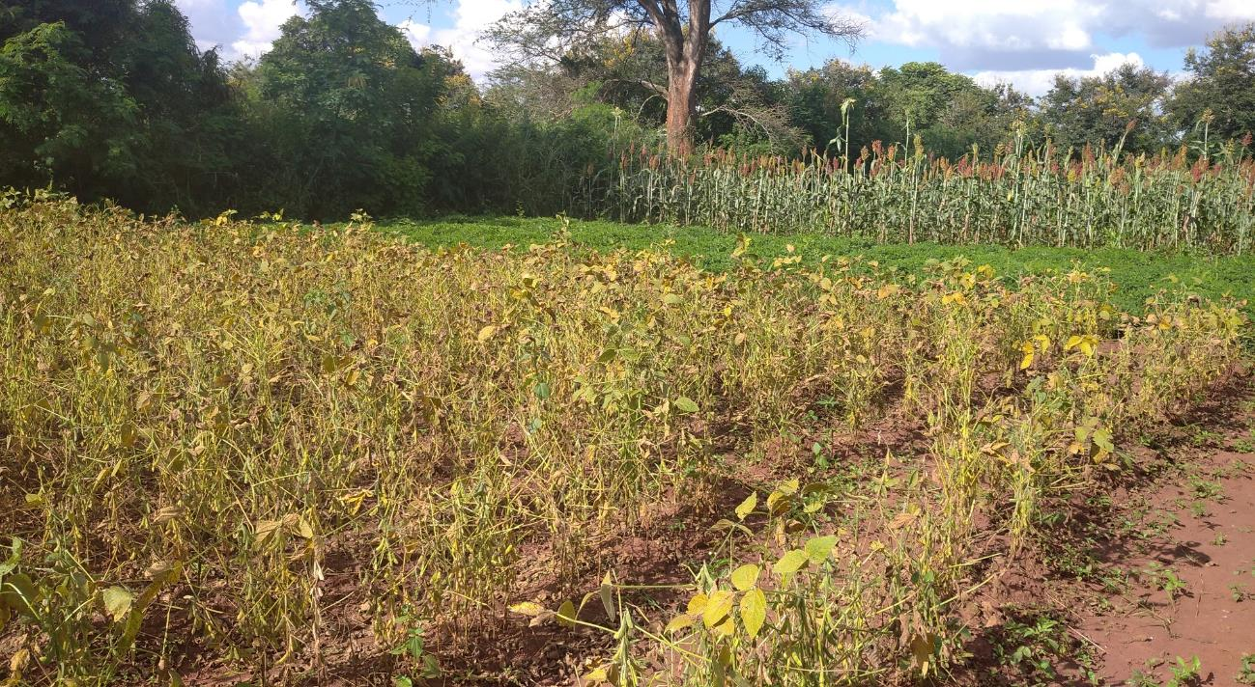
The Malawi NRC demonstration, extract below, is of medium complexity involving different crops that are managed under organic and conventional methods in a rotational pattern. Scientific data are also being collected and the demonstration will run for several seasons.
Picture: Andrew Thadzi – NRC – showing soybean, groundnut and sorghum components in a 5-year cereal-legume rotation

Slide 15
2.2: Problem statement
Identify and define the problem that the demonstration is trying to solve. Narrow down on key specific aspects and avoid spending resources (money, labour, etc.) on unnecessary activities.
An assessment of the needs of the target group should be carried out to help define the problem and identify possible opportunities or solutions to this problem.
Possible problems that may be addressed:
Low productivity of certain crops or livestock, land degradation/poor soil fertility, lack of appropriate technologies, low knowledge on organic techniques, poor market access, unavailability of empirical data for decision making and/or advocacy and policy development.
Guiding questions to defining the problem
What are the main problems to be addressed by the organic demonstration?
What are the current problems which farmers face in the area?
What do other stakeholders (consumers/researchers) report as current problems or bottlenecks related to sustainable agriculture, food and nutrition security?

Slide 16
Examples of problem statements
The main problem in our area is the low productivity of maize crop due to low rainfall and low soil fertility.
General findings from research studies showed severe agricultural land degradation leading to low productivity despite increasing use of agrochemical inputs.
The negative impacts of climate change and weather variability
(e.g. flooding, drought, pest and disease incidences, etc.) are affecting food and nutrition security in our area.
Write down your problem statement, e.g.:
Problem statement for the NRC demonstration: Low productivity of maize crop due to low soil fertility, and limited knowledge on organic farming by students, extension, and farmers.

Slide 17
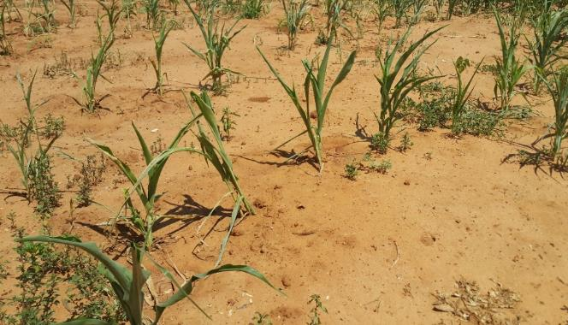
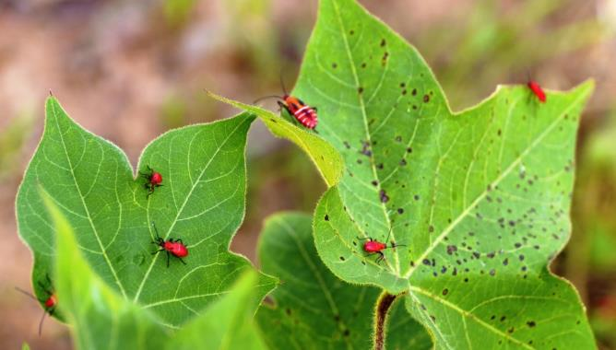
In defining the problem, be sure to characterise all the challenges adequately.
Visual examples of the problem can help to contextualise it.
Is the problem to be solved related to low soil fertility, degraded soils, climatic factors such as reccurrent dry spells or droughts, lack of knowledge, etc.?
Picture: Irene Kadzere (FiBL)
Are the problems of a biological nature (e.g. pest infestations leading to yield reduction)?
Picture: Gian Nicolay (FiBL)
17

Slide 18
Background to NRC demonstration plot
In 2018/19 season, NRC in partnership with GIZ-Malawi and FiBL established the demonstration trial to integrate field crops, vegetables and livestock production under organic management.
The main aim was to enable students and farmers to appreciate OA management and the role of OA in preserving the genetic resources which have the potential to pest and disease control.
The demo-plot is also meant to act as a research trial for several interventions in OA.
The Coordination Team was set up to manage the OA demo plots and the members are as follows: Mike Ching’amba, Andrew Thadzi, Shaibu Kananji, Aida Kamoto, Marion Sanuka, Davis Sibale, Timothy Pasani and Flackson Likupe.

Slide 19
Problem statement for the NRC demonstration
Problem statement for the NRC demonstration: Low productivity of maize crop due to low soil fertility, and limited knowledge on organic farming by students, extension, and farmers.

Slide 20
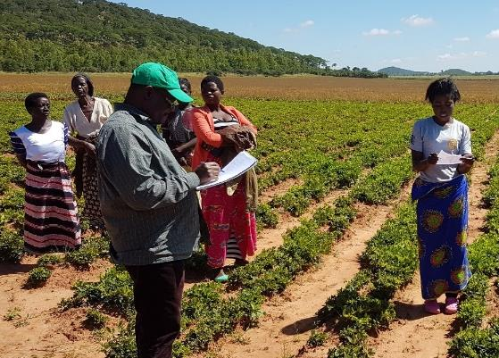
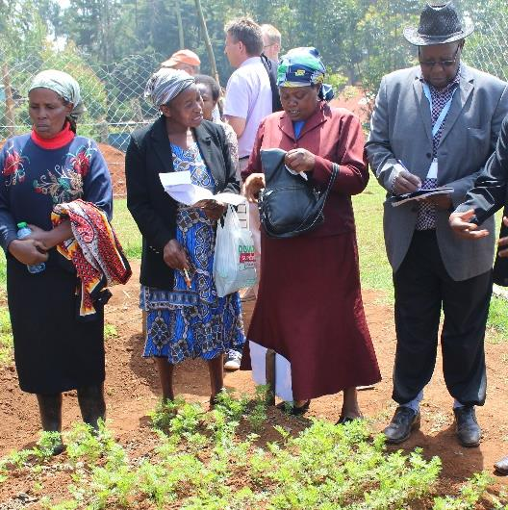
Defining the problem with key stakeholders / potential target groups
Participatory process - in defining the problem, involve key stakeholders and potential target groups for mutual clarity so as to tailor the demonstration design components to their key needs.
Picture: Malawi, by Mareike Brandt
Picture: Kenya, by Noah Adamtey
Above (left), visits were made by NRC, FiBL, Naturland and GIZ to some smallholder farmers to discuss some of key challenges in crop cereal-legume production in 2018 in Malawi as part of the process to define and design the demonstration objectives and components.
Above (right), a similar approach implemented in Kenya for the SysCom Longterm Trial.

Slide 21
2.3: Goal and specific objectives of the demonstration
After having identified and characterised the main problems related to agriculture in the area, reflect on what the most effective approach to addressing the problem is.
Is an organic demonstration the most appropriate way of resolving the problem, or are other approaches/activities necessary, separately or in addition to the demonstration?
If a demonstration is an option to resolving the problem, then you need to define the goal with the demonstration in mind. Think of the end outcome that you expect to see as a result of implementing the demonstration. At this point, it is also important to think about (or define) the system elements that you want to change and those that you want to keep constant.
«A goal is the desired result or achievement of an action and efforts.»
Guiding questions to defining a goal
What is the goal of implementing the demonstration?
What should have happened or changed at the end of demonstration implementation?
Can the demonstration solve (or contribute to solve) one or several of the problems that are stated in the problem statement? If yes, reflect as a team how to state this as a goal.

Slide 22
Examples of goal statements
Write down the goal(s), e.g.:
To improve soil fertility and maize productivity using locally adapted farming practices under organic management.
To provide the surrounding communities with a platform where they can learn about and observe organic farming in practice locally.
Note: In the process of goal definition, if you realise that an organic demonstration will not help to achieve your goal and help to solve the defined problem, then think about alternative approaches that can help you to achieve the goal in the most effective and efficient manner. For example, the problems of lack of market access for organic products can often not be solved by establishing demonstration in the field, but you can work with farmers and set up some participatory market linkage initiatives or contact local organic organisations to request for technical or other forms of support.
Goal statement for the NRC demonstration: Based on the problem statement, the goal of the NRC demo plots is to contribute to the improved food and nutrition security and resilient livelihoods in Malawi through soil fertility, maize productivity improvement, and diversification.

Slide 23
Specific objectives
After having defined the goal, you need to define key specific objectives which can help you to achieve the goal. What do you want to know or do?
«A specific objective is a breakdown of the goal into smaller smart objectives which you want to achieve with the demonstration.»
The objective(s) must be specific and not general, and you should be able to measure (and quantify) the achievements. Within the timeframe given, you should be able to attain the expected results in order to assess the effects/impact of your intervention (in this case the demonstration).
Note: You can use the S.M.A.R.T. concept (S = Specific, M = Measurable,
A = Achievable/Attainable, R = Relevant/Realistic, T = Time-oriented)
For more information refer to: https://doi.org/10.1016/j.evalprogplan.2016.12.009.
The specific objectives could be developed from one or more of the following areas (and others): knowledge co-creation, innovation adoption, problem solving, product quality, building/strengthening capacity, raising/creating/building awareness, strengthening networking, generation of sound data/evidence, etc. The specific objectives will lead to the specific outputs.

Slide 24
Guiding questions to defining the specific objectives
What are the specific objectives of the organic demonstration?
Do you want to showcase the performance of organic-based single techniques such as pest control, or a whole farming system (involving both plants and animals)?
Do you also want to perform practical training or field days using the demonstration, and for who?
Do you want to collect data on the demonstration (farm or plots)?
Examples of objectives from the NRC demonstration are:
To assess and showcase the effects of different organic management practices on soil fertility (ability to retain and supply soil nutrients for good plant growth in the short and long-term).
To increase maize yield (by at least 25 % from the current level) within the next 3 years
(or seasons).
To train students and local farmers on different organic management practices in soil fertility for maize production.
To increase awareness on the benefits of organic agriculture among stakeholders.

Slide 25
2.4: Target groups
A target groups is a specific group of people you want to reach, in this case with your organic demo plots activities and outputs or outcomes and mostly related to farmers or producers. Depending on what the demonstration aims to achieve, it is beneficial to invite different actors to learn from the plots and/or contribute to the impact of the demos. Generally, you need to decide between direct and indirect target groups (see examples on next slide).
Guiding questions to defining the target groups?
Who are the target groups of the organic demonstration?
Which stakeholders could directly benefit through training at the demonstration site or from visits to the demonstration site?
Are women and /or youth especially targeted?
Which stakeholders can act as multipliers for knowledge from the demonstration?
Who can help to amplify the outcomes of the demonstration to reach even more people?
Note: You might have realised that the definition of target groups might also affect your goal or specific objectives. In that case, you have to go back and adapt your goal or specific objectives with the target groups in mind. Additionally, you may also need to define the roles of the target groups, e.g. participate in on-station demonstration activities, organize and host field days for on-farm demonstrations, etc.

Slide 26
  Examples of direct target groups:
  Smallholder farmers: They can incorporate the know-how in their daily work on their own farms, and can share their experiences with fellow farmers and family members.
  Women / female farmers: farming women can be a special target group of an organic demonstration. Gender and age are some of the factors that can be considered for targetting.
  Students/Researchers/Extension Agents/Trainers: They gain practical know-how, but can also bring in other innovations or help to carry out monitoring and evaluation. They can also help to share the outcomes of the demonstration widely, beyond the direct targets.
  Consumers/Retailers/Traders from the agri-food chain: They can gain awareness about farming related problems and possible solutions and their presence can strengthen the links between producers and markets.
  Leader/policy makers: They are confronted with practical problems and policy barriers for farmers as well as potential incentives to improve policy and regulation. Observing alternative practices within their local context can help to convince them of the need to support such alternative agricultural practices.
  Agricultural press/media: They can communicate the know-how to a wider audience.
Students, academics, farmers, extension staff, policy makers, development actors, etc.

Slide 27
NRC Demonstration target groups
Students
Academics
Farmers
Extension staff
Policy makers
Development actors
etc.

Slide 28
2.5: Expected outcomes and outputs of the demonstration
Expected outcomes:
These are the direct quantitative and / or qualitative results or changes attainable from or due to the implementation of the demonstration. These could relate, for example to quantitative measures such as an increase in yields, production or soil chemical and physical properties; behavioural changes in order to address the targeted problem; or certain levels of capacity and skills achieved by the target groups, etc. Along the way, some unintended outcomes may arise. These can be negative, positive, or both.
Guiding questions to defining the expected outcomes?
At the end of the demonstration, what do you expect to see as a result of implementing the demonstration?
Do you expect to observe quantitative changes, or qualitative changes, or both?
Do you know how to measure and verify that the intended results have been achieved? What particular indicators can help you to determine that the expected outcomes have been achieved?
Are you aware that it is possible to generate some unintended positive and negative changes as a result of the demonstration(s)? This is important to keep in mind when you design the demonstration(s) so that the unintended negatives or tradeoffs are avoided, or at least minimized.

Slide 29
Expected outputs of the demonstration are the envisaged measureable achievements at the end of the implementation. They are directly derived from the specific objectives. It is important to decide on how accurate the measurements will be done – are qualitative measurements adequate or are quantitative measurements necessary, or both? When defining the expected outputs, keep in mind the target groups.
Guiding questions to defining the expected outputs?
What are the expected outputs of the demonstration?
If you want to perform trainings at the demos, to whom and how many people do you intend to train?
Will field days and/or guided tours be held and if so, how many of such events and during which stages?
Are physical data envisaged to be generated from the demo plots and if so, what kind of data need to be captured, from how many seasons, etc.?
Is/are website(s), newsletter(s), manual(s), photos, scientific publication(s), technical briefs/flyers/guides, policy briefs, press release, database, etc. foreseen as possible outputs from the demo plots and if so, how many of such?

Slide 30
Overview on activities
Write down your expected outputs, e.g.:
The demonstration reaches 500 stakeholders related to maize production directly through trainings and field visits.
Additional 1,000 stakeholders will be reached indirectly through
30 regional extension agents to be trained from the demonstration.
A technical brief and a policy brief are produced and shared widely.
A total media coverage of 5 radio programmes and 5 newspaper articles will be disseminated.
After defining the problem, goal, specific objectives, expected outputs and target groups, it is a good idea to also think about the potential broad activities which could be implemented. At this stage, these activities will be preliminary and can be refined after Chapter 3. During the implementation phase, the activities can also be refined annually based on lessons learned from the previous seasons or years.

Slide 31
Expected Outcomes and Outputs from NRC demonstration
Expected Outcomes
Improved livelihood for small scale farmers and other stakeholders through increased crop yields under organic management practices
Increased staff interest on organic agriculture practices
Enhanced teaching and learning on organic agriculture through curriculum mainstreaming
Increased collaboration and support from other stake holders
Expected Outputs
200 students and 100 local farmers trained on organic management practices for increased soil fertility
Many farmers exposed to organic agriculture are now practicing the system
Increased awareness on the organic agriculture through field days, newsletter articles and publications
Maize yields increased by at least 25% from the current small scale production levels within the next 5 seasons

Slide 32
2.6: Schematic example with defined problem, goal, objectives and outputs
At the end of Chapter 2, the team can prepare a summarised schematic like the one below:
Problem: «The main problem in our area is the low productivity of maize crop due to low rainfall and low soil fertility. »
Goal: «To improve soil fertility and maize productivity using locally adapted farming practices under organic management. »
Objective 1: «To increase maize yield by at least 25 % from the current level within the next 3 years (or seasons). »
Objective 2: « To train local farmers on different organic management practice in soil fertility for maize production. »
…
Output 1: « 500 direct stakeholders trained on or aware of organic maize production. »
Output 2: « 1000 indirect beneficiries reached through 30 regional extension agents trained on the demo plots. »
Output 3: « A total media coverage of 5 radio programmes and 5 newspaper articles disseminated. »
…
Broad activities
Broad activities
Broad activities
Broad Activities

Slide 33
Chapter 3: Demonstration components,
and pre-establishment planning and preparations
In this chapter, the features of a demonstration are discussed, together with planning and
pre-establishment preparatory requirements.
After defining the problem, goal, specific objectives, outputs and target groups, it is now time to make some preparations towards establishing the demonstration. Among other considerations, you have to think about the major components of the demonstration, a suitable location for the demonstration farm/plots, and your available resources.
The more time you invest into this phase, the better and more predictable will be your outputs and outcomes from the demonstration. The following points should be discussed during the planning phase:
Key components of the demonstration and design features
Timeframe and budget
Staff and labour resources
Site selection and characteristics
Tools, inputs, material and facilities
Requirements for land preparation and application of pre-planting inputs for soil fertility
Demonstration reference document/ handbook development

Slide 34









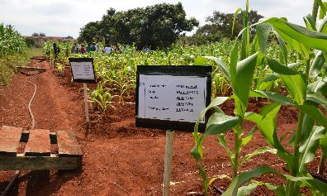
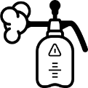





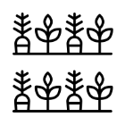

3.1: Key components of a demonstration - issues to consider in preparing for the demonstration
?
Site selection
Site characterisitics
Timeframe and budget
Human resources
Organic demo plot
?
Tools and inputs
Material and facilities
Demonstration components and design
For sources of icons, please see slides 153 -154

Slide 35
Guiding questions on the potential components of a demonstration
Before selecting a site/location for establishing the demonstration farm or unit, it must be clear what components need to be showcased. The size and complexity of demonstration depend on the objectives and available resources and costs (land, labour, inputs, etc) among other considerations.
Does the demo involve crops only, livestock only, or both? Does it also involve comparisons to existing practices / models?
Include livestock
Only crops
Which animals are to be included? Poultry, non-ruminants, small ruminants, large ruminants? All?
Are they annuals, perrenials, or both?
Both crops and livestock
Will all crops be rain-fed, or do they need irrigation? If irrigation is required, are there sources of good quality of water, what type of irrigation, are the necessary irrigation facilities, budget and expertise available?
Does the space available allow for organic management practices to be implemented?
Do you intend to sell crops / animals and/or their products?
If marketing is an objective, are the markets already known and are relevant/ appropriate infrastructure including transport available? What are the quality expectations of the target market, and can the demonstration farm/unit setting feasibly achieve these market expectations? Is there expertise within the team to support market linkages / market development?

Slide 36
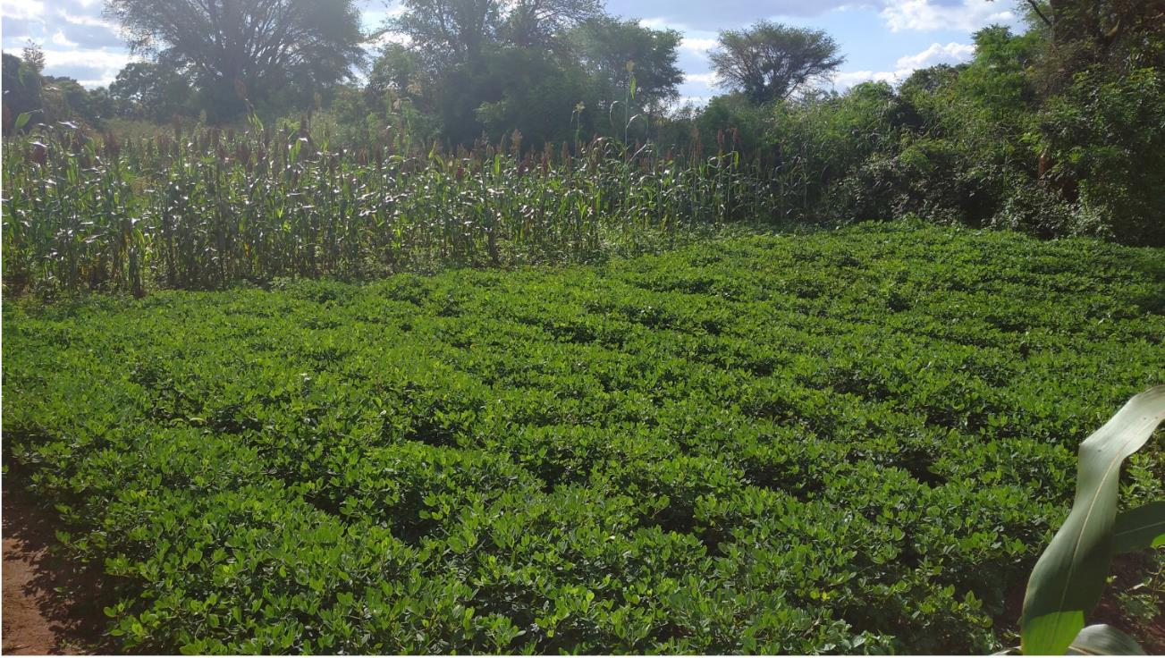
Example of key components in a demonstration at NRC Malawi:
sorghum and groundnuts in an organically managed cereal - legume rotation
Photo: Andrew Thadzi, NRC Malawi

Slide 37
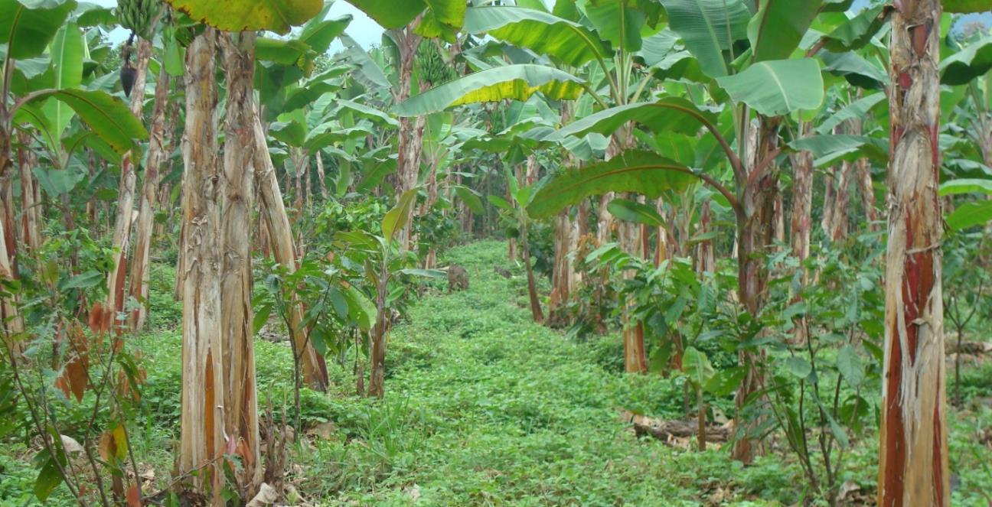
Example of key components in a demonstration:
Young cocoa plantation showing young cocoa trees intercropped with bananas/ plantains in Bolivia’s SysCom Longterm Experiment
Photo: FiBL
Organic Demonstration User Guide, 2020

Slide 38

Example of key components in a demonstration at NRC Malawi:
sorghum and groundnuts in an organically managed cereal - legume rotation
Photo: Andrew Thadzi, NRC Malawi

Slide 39
3.2: Timeframe, budget, and labour resources considerations
The time and financial resources available to organise and manage a demonstration are important to consider because they limit your ability to execute activities and achieve the desired outputs.
Duration
and costs
What is the envisaged timeframe of the demonstration?
How much time is needed to set up and run the demonstration, e.g. at the beginning, and every season?
Do you need time for dissemination and networking at various levels of implementing the demonstration? At which stages?
What is the budget for the demo plots?
Is the necessary budget available for the foreseen timeframe? What procedures and processes are required to access funds and what lead time is required to get the funds on time for timely establishment? Here, it is also important to know who is responsible for disbursing the money and to have the lead team member of the demo plots aware of the expected channels and potential bottlenecks so that he/she can plan accordingly.
For how long is the demonstration going to run? Is it just for one season, two seasons or for many seasons and years?
Will there be additional costs to consider, e.g. for trainings events, dissemination materials?
What are the costs of setting up and managing various components of the demonstration? Think of the types of materials, quantities per unit, unit cost, transport costs, etc.

Slide 40
Staff and labour resources requirements
Competence of staff and skills
Setting up and managing organic demonstrations requires certain competence and expertise related to the topic on organic and also on key technical topics. Check if such skills are available among the existing staff. If not currently available, then decide whether to send some of the staff for training or whether to hire additional staff with the necessary skills and knowledge.
Note that the staff training route can be lengthy, depending on the current level of knowledge and skills, hence collaborating with expert partners who can work with the demo plots team could also be an option to consider. Such experts can train the existing demonstration farm/unit staff in a step-by-step manner through practice for several seasons until the team can run the demonstration on their own.
Support staff / field workers
Timely availability of adequate semi-skilled labour is also important to undertake various tasks such as land clearing, land preparation, planting, weeding, crop protection, harvesting, etc. Ensure that the workers are well trained on the procedures for the demonstration and can implement activities and follow the instructions well. They will require good supervision on a regular basis. Good communication skills and interpersonal skills are therefore of utmost importance among the team in order to convey instructions to and obtain feedback from the field workers.
Organic Demonstration User Guide, 2020

Slide 41
Guiding questions on staffing
Are staff with competence available to set up and manage the demonstration?
What is the level of complexity expected for the demonstration?
What competence is necessary to set up and manage such a demonstration?
Do you need additional competence to execute activities like designing the demonstration, training, data collection/analysis, conducting field days, preparing technical leaflets, etc.?
Is there a competent person or team which has the needed skills and knowledge?
Is staff training necessary to acquire the skills and knowledge?
If yes, what kind of training, who can provides such training and how much does it cost? Also, what lead time is required to ensure that the competence is available at the onset of the demonstration?
Do you have a backstopping plan if additional expertise are required during the process?

Slide 42
3.3: Site selection and site characteristics
  Site selection can happen in two scenarios. The first scenario is where the site is fixed, and the components to be selected for the demonstration must suit the site, or where there is flexibility in selecting a suitable site for the intended demonstration components. The demonstrations can be estiablished on-station, on-farm(s), or both. What ever the case is, the site must be easily accessible to the target groups, e.g. road network, proximity to target markets, etc. All demonstrations will require water in one way or another, hence proximity to a good water source is important.
Guiding questions for further consideration on site selection
    Does the land compy with organic requirements? Consider, e.g. potential contamination.
    What is the terrain of land where the demonstration will be established? Are permanent conservation structures (e.g. terraces and contours) required on the target land before preparation and demarcation? If land is slopy, see ANNEX 1 for conservation methods.
    What are the key geographical parameters of the site (altitude, latitude, longitude, climatic/weather (see ANNEX 2).
    What is the landuse history of the selected site? Is land clearing necessary, and if so, is the labour and appropriate tools available?
    Is the land uniform enough to generate objective (unbiased) results or outcomes?
    If unknown, is a soil analysis or a test crop (planted to check uniformity) necessary before setting up the demo plots? If needed, see ANNEX 3 for soil sampling procedure.
Organic Demonstration User Guide, 2020

Slide 43
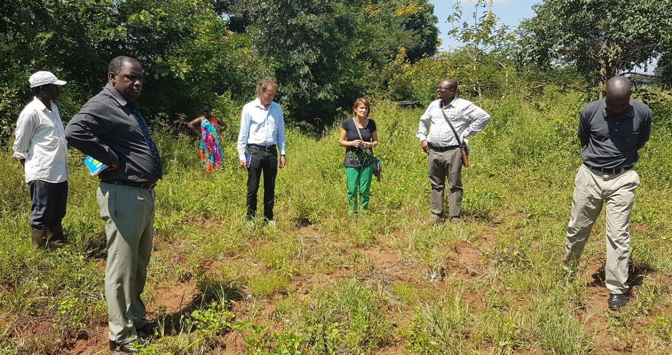
In the picture above, a team is inspecting a prospective demo plot site at the Natural Resources College (NRC), Lilongwe, Malawi in 2018
Physical visits to a prospective site is an important part of the decision making process.
Organic Demonstration User Guide, 2020
43

Slide 44
3.4: Demonstration farm/plots design and choosing cropping patterns
Another key part of the planning and pre-establishment phase is the design of the actual demonstration. Depending on the goal, specific objectives and key components selected for the demonstration, you need to think of how the various components will be laid out in the field. Some specific factors to consider include:
The farming system/cropping system/management practice which will be demonstrated and
Allocation of the components to the plots/fields/ farm sections - the layout of specific features, e.g. cropping patterns and rotations/mixtures, etc. - how the physical plot(s) looks like and how it has to be established on the ground.
Guiding questions
What kind of crop/plant/animal will be used on which part of the demonstration?
In case of crops and plants, which variety do you want to use?
What is their spacing and requirements on nutrition and water?
What are proceeding/following crops? How does the whole crop rotation look like?
What kind of weed and pest and disease management is required?
In the case of crops, do you have access to good quality seed? Do you know how to determine the quality of the seeds? see ANNEX 4 for germination tests.
Is it possible to include comparisons in order to observe the demo effect?
For scientific data collection one needs to also consider other questions in the design –
see ANNEX 5 for further details regarding scientific demonstrations.
Organic Demonstration User Guide, 2020

Slide 45
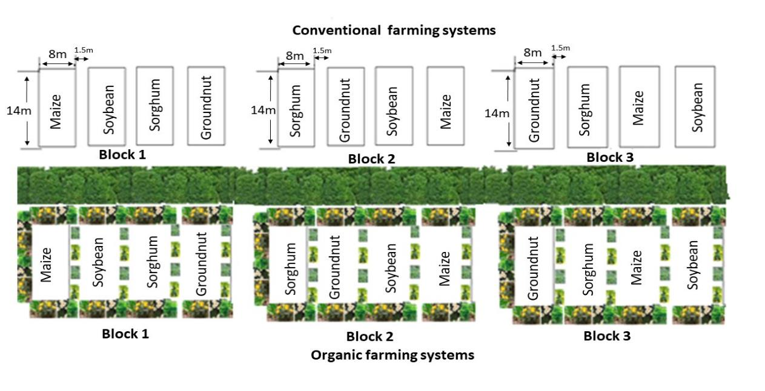
Example of a demo plot design used at NRC:
Showcasing organic production in a cereal - legume cropping systems (5 year rotations) at the NRC of Lilongwe University of Agriculture and Natural Resources, Malawi. This design was a result of the processes explained in this User’s Guide. The tree buffer zone helps to prevent contamination between conventional and organic plots.

Slide 46
Replication in demonstration design - repetition
Note: Ensure that the comparisons are fair by fairly allocating the treatments to the available land and its variability (e.g. slope, fertility gradient, hydrological characteristics, etc.). Good knowledge of the history of the land is required to avoid biased allocation of the treatments.
In order to collect meaningful measurements of differences between organic and other practices or treatments, replication is necessary. Instead of establishing only one plot or field, for the practice or treatment in questions, replication involves repeating the same ‘treatment’ several times so as to increase the precision in identifying differences that are caused by the practice or ‘treatment’ being demonstrated. Treatments within each replication must be allocated in a random manner (randomized). Replication allows for a sound analysis of the data or observations generated from the demonstration(s). This analysis will help determine whether detected or observed differences in treatments are real or are due to random chance and helps observers or beneficiaries to have increased confidence in the outcomes of the demonstration(s) or trial(s).
Note: When choosing crops to mix or rotate in the demonstration, give consideration to the compatibility information on the next two slides.

Slide 47
Guiding questions on choosing crops, planting patterns and rotations to use
What crops should you plant in various seasons? That depends on many factors and knowing the family where your crop belongs is important.
Most used crop families and their common names
Family | Common names
Allium | Chive, garlic, leek, onion, shallot
Cucurbit (Gourd family) | Bitter gourd, bottle gourd, chayote, cucumber, ivy gourd, luffa gourd, melons, pumpkins, snake gourd, squash, wax gourd
Crucifer (Brassica) | Broccoli, Brussels sprout, cabbage, Chinese cabbage, cauliflower, collard, kale, mustard, radish, turnip, watercress
Legume | Common beans, broad beans, clover, cowpea, Lima beans, lintel, mungbean, peanut, pigeon pea, soybean, etc.
Aster | Lettuce, artichoke
Solanaceous (Nightshades) | Potato, tomato, pepper, egg plants
Grains and cereals | Corn, rice, sorghum, wheat, oats, barley, millet
Carrot family | Carrot, celery, dill, parsnip, parsley
Root crops | Cassava, sweet potato, taro, yam, water chestnut
Mallow family | Cotton, okra
Source: Kuepper et al. (2001)
Organic Demonstration User Guide, 2020

Slide 48
Can some crops be grown together, what are the benefits and risks?
Guiding questions
Which crops grow well together and what does not? Are the target demo plots crops compatible?
Does growing certain crops simultaneously or in sequence enhance or antagonise them?
Family | Good companions | Bad companions (antagonists)
Asparagaus (Asparagaceae) | Tomato, parsley, basil
Legume | Most vegetables and herbs | Onion, garlic, gladiolus
Beets | Cabbage and onion families, lettuce | Pole beans
Carrot (Apiaceae or Umbelliferae) | Peas, lettuce, rosemary, onion family, tomato, leeks | Dill
Corn (Poaceae - Grass) | Potatoes, beans, peas, cucumber, Pumpkin, squash | Tomato
Cucumber (Cucurbitaceae) | Beans, corn, peas, sunflower, radish | Potatoes and aromatic herbs
Lettuce (Asteraceae) | Carrots, radish, strawberry, cucumber, onions
Sunflower (Asteraceae) | Cucumber | Potato
Source: Kuepper et al. (2001)
Organic Demonstration User Guide, 2020

Slide 49
3.5: Inputs, tools and facilities for crop demo plots
Demonstrations involve different tyes of inputs, tools and facilities. Some of these may already be available, but in many cases new types may need to be procured. The questions below can help the team to develop a list of what the demonstrations will require.
Guiding questions
Which inputs, tools/equipment and facilities are necessary for the demo plot?
What kind of organic inputs and/or raw materials do you need? Fertiliser (both organic and conventional depending on the demonstration comparisons), seeds, plant protection inputs, etc.?
What kind of tools do you need?
How much of these inputs/tools do you already have? If you currently do not have them,
is there a supplier nearby to purchase them or you have to purchase them from distant places/markets? If they are to be purchased from distant markets, do you have the necessary transport (own or hired) to bring the materials to the demonstration site?
What other facilities do you need for the demo plot?
  Is there an existing workshop/shed or does one need to be established for keeping/storing tools, materials and equipment?
  Do you need to raise a nursery for seedling production?
  Are storage and processing facilities for the produce available, or do they need to be constructed?
Organic Demonstration User Guide, 2020

Slide 50
Varieties, seed pre-treatments and seedling production requirements
Guided by the components selected for the demonstration, and the design proposed including the planting patterns, it is important to think ahead about the planting materials which will be needed. Adequate quantities of the planting materials will need to be procured, taking into consideration potential seed/seedling losses during sowing / planting, or germination and transplanting. Some crops can be direct seeded, e.g. maize and groundnuts, but others require transplanting, e.g. sweetpotatoes and some vegetables. These characteristics have an influence on the length of the preparatory period before field establishment. For example if seedlings should be raised for the demonstration, it can take weeks or several months to raise these seedlings before field planting can take place.
Guiding questions
  Which crop varieties must you purchase? Take into consideration the pest and disease tolerance and adaptation to the target demo plot site.
  What quantities of each variety are required? Consider the seeding rate for each type and the total area to be covered by each.
  It is advisable to conduct a seed germination test and then use the germination test results to adjust the seeding rate at sowing or planting. See ANNEX 4.
  Do the crops require transplanting, or is direct seeding feasible?
  If transplanting is required, will you purchase seedlings ready for transplanting, or will you raise the seedlings yourself? If you intend to raise the seedling, refer to ANNEX 6 for further details regarding nursery.
Organic Demonstration User Guide, 2020

Slide 51
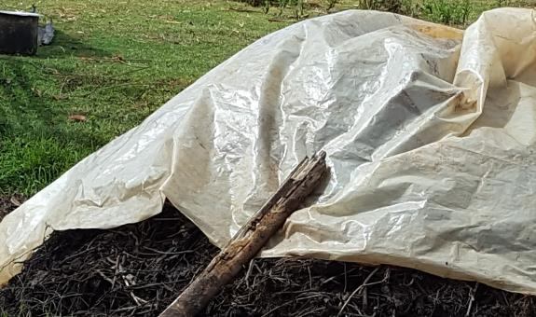
Organic inputs for soil fertility management and plant nutrition
  What type of organic inputs are available within your location?
  Are the available inputs adequate? Do they contain the primary nutrients to meet crop nutrient requirement?
  Is there the need to apply the inputs separately or in combinations?
  Can the inputs be applied directly or need to be processed first, e.g. through composting?
  Do you know potentially how much nutrients are contained in the raw materials used for compost? This information is important for the team to have an idea on potential nutrient deficiencies which may need to be corrected by augmenting from other sources.
Picture: Pile of cattle manure covered by a plastic in Kenya – photo by Irene Kadzere
Organic Demonstration User Guide, 2020

Slide 52
Examples of organic inputs that can be used directly as mulch or as raw materials in compost making
Nutrient content (dry weight) of some composting materials (%)
 | N | P | K | B | Zn | Cu | C/N
Cattle manure | 1.5-2.5 | 0.3-0.5 | 1.9-2.2 | 6.5 | 23.6 | 4.5 | 15
Maize stover | 0.7-0.8 | 0.9-1.3 | 1-1.3 |  |  |  | 60
Ash | 0.4-0.5 | 1.2-1.3 | 8.8-9.0
Mucuna pruriens | 2-2.3 | 2.6-3.6 | 1.3-1.5 | 1.8 | 2.9 |  | 13
Tithonia diversifolia | 2.6-3.3 | 3.6-4.9 | 3.5-3.7 | 5.9 | 7.3
Lantana camara | 1.6-2.0 | 2.1-3.1 | 1.8-2.0 | 2.3 | 4.1 | 4.0
Leucaena trichandra | 4.15 | 0.23 | 1.7
Source: Noah Adamtey (forthcoming publication)
Organic Demonstration User Guide, 2020

Slide 53
Compost making and requirements
Good quality compost is a fundamental part of organic agriculture in many respects. Compost provides nutrients to the crops, improves soil chemical and physical characteristics, and also promotes soil biodiversity. Making compost is quite a lengthy and involving process, and timing is of utmost importance in order to have it ready at the time when it is required.
Guiding questions for compost making
  Do you have enough practical skills and experience in compost making? If not, can you associate with someone who has this experience?
  According to the demonstration design, how much compost is required to provide the necessary nutrients to the crops?
  Are there enough raw materials and suitable space for composting and how far in advance must you start preparing compost before planting
  Is there a reliable water source available near the compost site?
  Is there enough labour for the compost making activities?
  Do you plan to test the compost for quality paramaters such as nutrient contents, chemical contamination, etc.? If so, do you have the appropriate laboratory facilities for such analyses?
Organic Demonstration User Guide, 2020

Slide 54
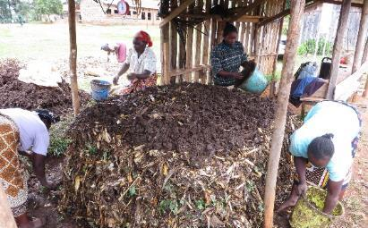
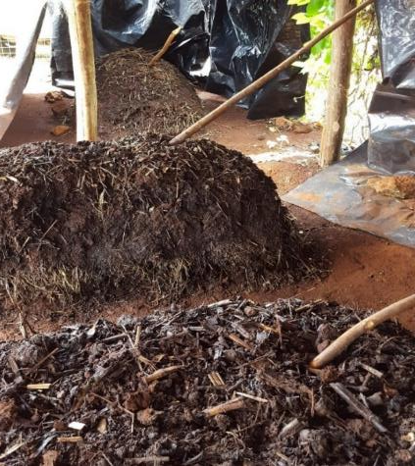
Methods of making composting:
a) the heap composting method under shade (in a shed or under a tree)
Pictures: SysCom Trial, Kenya
Note: The stick inserted in the compost heap helps to monitor the performance of the compost. When the stick is removed and feels cold, it means that the decomposition process is not going well due to exessive moisture,,extreme dryness or lack of green materials. When the stick feels very hot, it means that compost needs to be turned. If the stick feels warm, then the process is progressing well.
Refer to the video on : https://www.youtube.com/watch?v=au5mTPC68UM
Refer also to Module 2 of the African Training Manual (https://www.organic-africa.net/training-manual/english-training-materials/module-2-soil-fertility-management.html) and the Poster on ‘Making Good Quality Compost’
Organic Demonstration User Guide, 2020

Slide 55
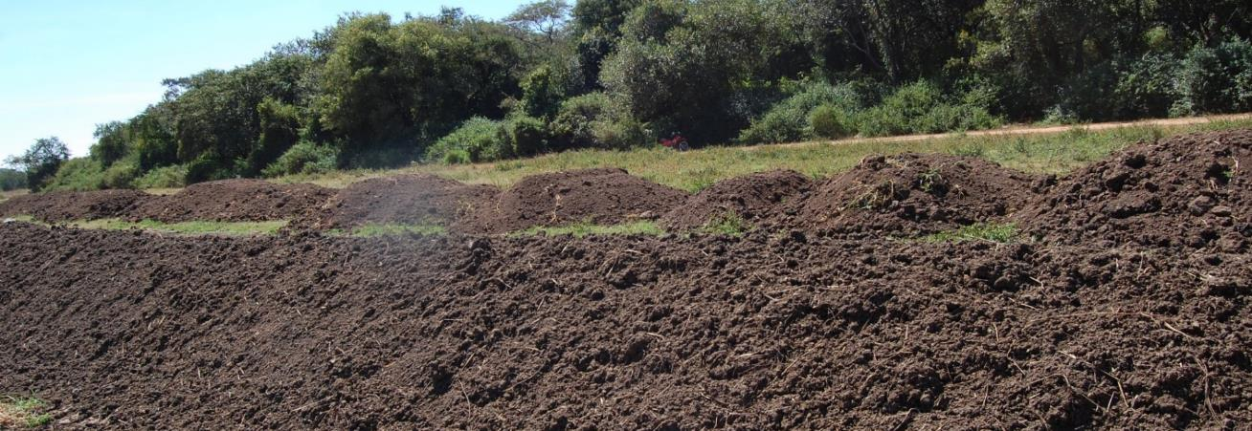
b) Windrow composting method
Picture: Irene Kadzere, FiBL – captured at Kasisi Agricultural Training Center in Zambia
Considerations for windrow composting
The piles can range from 90 cm (dense raw materials such as manures) to 360 cm height (light raw materials such as leaves). The piles can vary from 3 to 6m width. Pile dimensions are determined to a large extent by the equipment/machinery available for turning. Examples of the machinery include front-end loader or a bucket loader on a tractor.
The piles of raw materials need to be turned regularly to mix the materials and enhance aeration for good decomposition.
Organic Demonstration User Guide, 2020

Slide 56
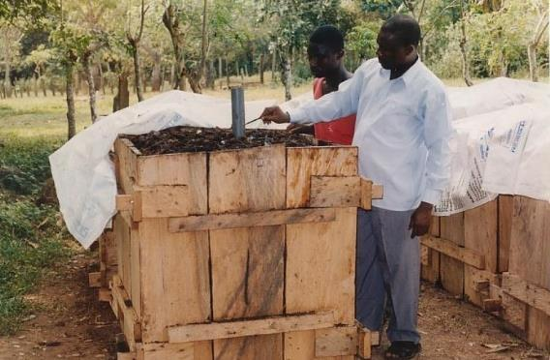
c) Box composting method - example
Picture: Noah Adamtey, FiBL – captured at the University of Ghana, Agriculture Research Station, Kade
Organic Demonstration User Guide, 2020

Slide 57
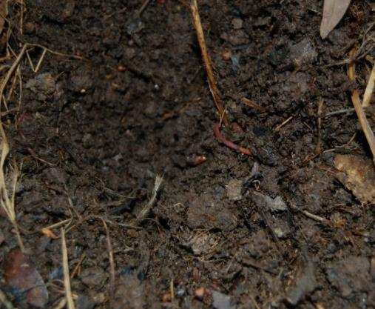
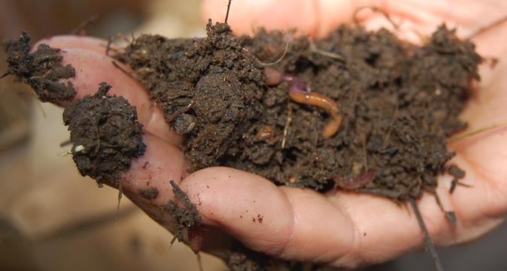
The quality of the compost is an important aspect. While the chemical quality characteristics can only be determined in a laboratory, some other characteristics can be determined in a qualitative manner. For example, the moisture content can be assessed through a hand feel method.
Pictures: At Kasisi Agricultural Training Centre in Zambia
To check the moisture of the material, a sample is collected and pressed in the hand. If it falls apart, it is too dry. If it smears, it is too wet. If the material keeps its form without dripping, it has the ideal moisture.
Organic Demonstration User Guide, 2020

Slide 58
3.6: Land preparation and application of pre-planting inputs for soil fertility
Several questions can help the team to develop and execute a good land preparation operation for the demonstration plot / field / farm.
Guiding questions
  When must you plant? Does the land need to be cleared of bushes, trees, etc. before tillage and planting?
  Is the site well protected from wild animals, livestock (if crop demonstration), thieves, etc.?
  Is ploughing (animal or tractor powered)/digging/ripping necessary (decide of which method of land preparation suits your needs best)?
  Do you have the necessary equipment and labour for land preparation?
  How do you plan to delineate and demarcate the plots for the various ‘treatments’ involved in your demonstration?
  Have you planned enough time between land clearing and planting to ensure a good?
  Do you have the water source and connections ready, if irrigated production or supplimentary irrigation is envisaged?
  What and how much soil nutrients are required at the pre-planting or planting stages?
Organic Demonstration User Guide, 2020

Slide 59
Soil fertility and health are important considerations
It is important to remember that soil fertility and general soil health is central for crop / plant growth and development, and ultimately yields. Land preparation time is a good time for soil sampling to achieve a assess the baseline status of the soil before the demonstration begins.
Guiding questions about soil sampling
What kind of soil sample do you need? Think ahead and try to imagine what kind of a soil sample you need - consider sampling depth, number of soils cores to combine, number of analyses you can pay for or run yourself if you have direct access to a laboratory.
How much soil can go to an archive after drying, or can be kept moist at 2-4°C, or frozen at -20°C or even -80°C for molecular analyses depending your aims?
Do you need any field measures for soil, e.g. bulk density, soil profile, a spade test, or setting up decomposition in litterbags in the field?
If you want soil quality to be checked later to assess the impacts of organic farming, remember that the quality should be measured it the same way as done at the baseline time.
Refer to ANNEX 2 for further details about soil sampling

Slide 60
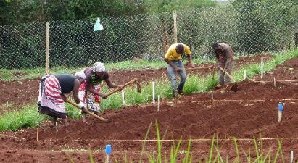
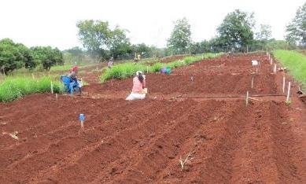
Depending on the site and objectives, land preparation can be done by hand
Pictures: Edward Karanja, SysCom Kenya
Organic Demonstration User Guide, 2020

Slide 61
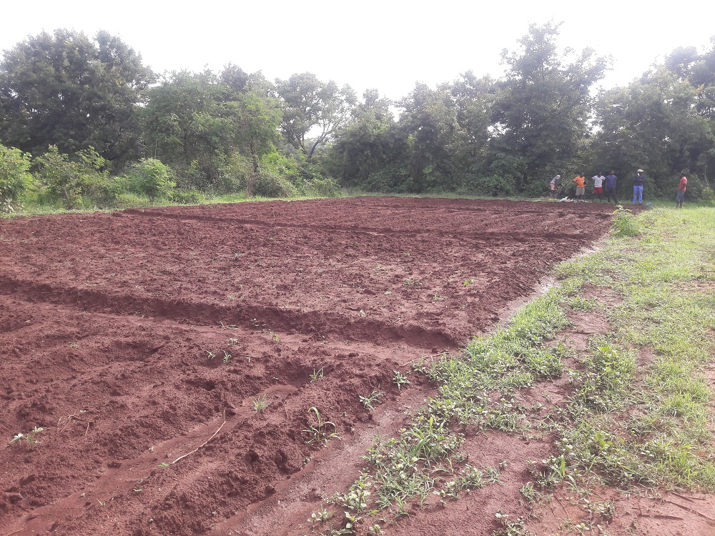
Plots ready for planting at NRC

Slide 62
3.7: Demonstration reference document / handbook development
At the end of Chapter 3, the team will be in a position to develop a concept note. The concept note will outline the the key issues that have been addressed in Chapters 1, 2 and 3. At this stage, an estimated budget should be prepared, and incorporated into the concept.
Activity and cropping / livestock management calendar as an important part
One of the important sections to this reference document is an operational calendar of activities for effective management. This calendar lays out the major steps of the demonstration, the stages and key activities which need to be undertaken, and the timing of such activities. Expert advice might be required for developing the various components of the calendar. If well prepared, the calendar can be a very useful tool to the demonstration team in planning their work throughout the cycles of the demonstrations. Labour demand peaks can be identified and appropriate measures put in place to ensure that adequate labour is available at the critical moments. of the key stages when certian management practices are to be implemented. Allow enough lead time for key activities on the calendar. It is common that startup activities can take more time than planned, hence allow for contingency.
Presenting the Concept to relevant stakeholders
Depending on the set up, the team then presents the full concept to the relevant people or authorities to ensure insitutional support and timely availability of the resources and inputs.

Slide 63
The Reference Document should be a living tool for managing the demonstration
The different sections of the concept can be updated, elaborated and / or modified during the demonstration implementation. This allows the team to sharpen the concept, based on their own experiences lessons learned from the process of implementing. The reasons for any changes in existing procedures should be explained. Changes that are made to the structual and operational design of the demonstration can affect the data collection (procedure and/or data collection sheets), hence all affected documents should also be appended. All members of the team must be aware of the key modifications that are made to Demonstration Reference Document. The chnages must be clearing documented, together with key dates when changes were made. If the changes are major, then it is advisable to prepare an Annex that can be appended to the document. A revised version should be shared with all relevant stakeholders.
Note: Ensure proper and systematic documentation of all key processes and procedures of the demonstration setup and that all members are fully aware of these.
Guiding questions
  Do I have a calendar of the key activities expected for each type of crop, and or livestock?
  Does the calendar clearly show, in sequence (critical path), when critical management activites are to be undertaken (including how long they last)?
  Does everyone in the demonstration team understand the calendar and what roles they must play at each stage?

Slide 64
Chapter 4: Field establishment and management practices for crop demonstrations
Once the preparation phase is completed, the next steps involve field establishment and the subsequent day to day management of the demonstration farm or plots. The length of establishment and field management phases can vary depending on the objectives of the demonstration.
This chapter provides some guidance on:
Planting / Sowing
Weeding
Plant nutrition
Plant protection
Training and pruning
Labelling
Data collection and documentation
Organic Demonstration User Guide, 2020

Slide 65


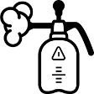










Overview on considerations for field establishment and management
Soil cultivation
Seeding
Nutrient management
Pest &
Disease control
Weed
management
Harvest
For sources of icons, please see slides 153 -154
Organic Demonstration User Guide, 2020

Slide 66
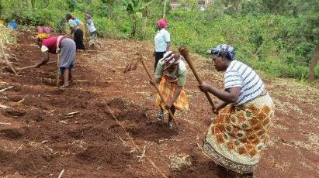
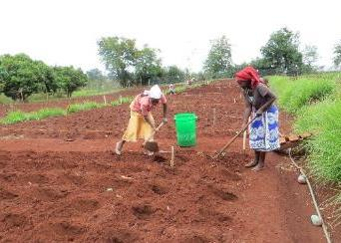
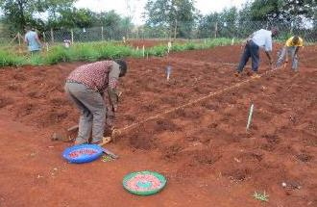
4.1: Planting / Sowing
  Use appropriate tools for the appropriate crop at the appropriate time.
  Ensure that there is enough labour when needed. Labour shortages can lead to late planting and poor performance of the demo plots.
  Which crop must you plant first? How do you check for germination and/or emergence in the field (the outcomes here can help to determine if gap-filling or rather replanting in necessary)?
Pictures: Edward Karanja, SysCom Kenya
Organic Demonstration User Guide, 2020

Slide 67
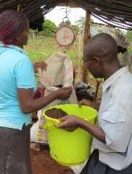
Applying the right amounts of compost to crops is important to ensure good outcomes from the organic demonstration. If you have comparison plots (organic vs conventional or farmer’s practice), ensure that the amounts of nutrients applied to both are similar to meet crop needs and avoid bias from unfair nutrient dosages.
Applicaton of organic inputs for soil fertility and plant nutrition at planting
Note:
  Different crops require different quantities of compost/manure/or other organic inpus to supply enough nutrients such as nitrogen, phosphorus and potassium.
  Before applying such inputs, ensure that a lab analysis of the compost has been made to determine its nutrient contents.
  Use the nutrient concentrations to calculate compost/ manure/inputs application rates depending on the requirements for each crop.
  Weigh the compost with a field scale to ensure that the correct rates are applied to the demonstration plots.
  Since the quality of compost varies depending on raw materials used and other factors, ensure that supplementary sources of nutrients (like rock phophate for phosphorus) are available to augment the nutrients supplied by the compost.
Picture: Edward Karanja, SysCom Kenya
Organic Demonstration User Guide, 2020

Slide 68
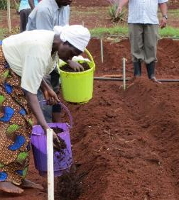
Organic input application at planting
Note:
Composts, manure, and other soil nutrient sources vary in their quality, e.g. the amounts of nutrients contained and other characteristics can differ. The nutrient status of the soil also determines how much additional nutrients, and types, will be required.
Applying the correct amounts of compost/manure or other organic inputs for soil fertility management requires expert advice, e.g. from the extensions agents / researchers in the Ministry of Agriculture, university, research /academic institutes or NGOs to train the field workers. Alternatively, you can determine the amount to apply from published materials in your locality or country.
Picture: Edward Karanja, SysCom Kenya
Organic Demonstration User Guide, 2020

Slide 69
How much compost did NRC apply?
Calculations based on plot size (8m x 14m each), crop type and initial soil nutrients (lab test)
Crop | Compost applied per plot at planting (kg)
Maize | 79
Sorghum | 60
Soybeans | 37
Groundnts | 33

Slide 70
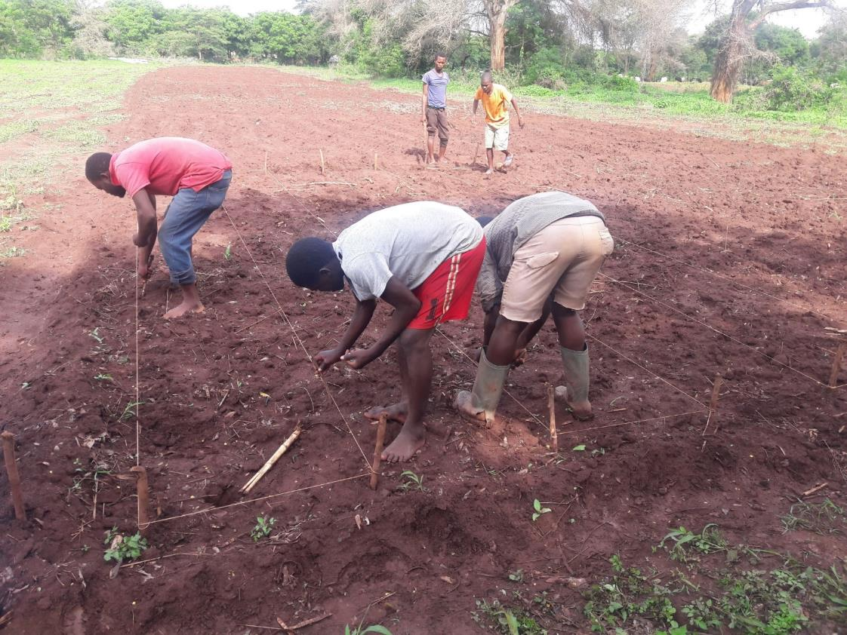
Planting at NRC

Slide 71
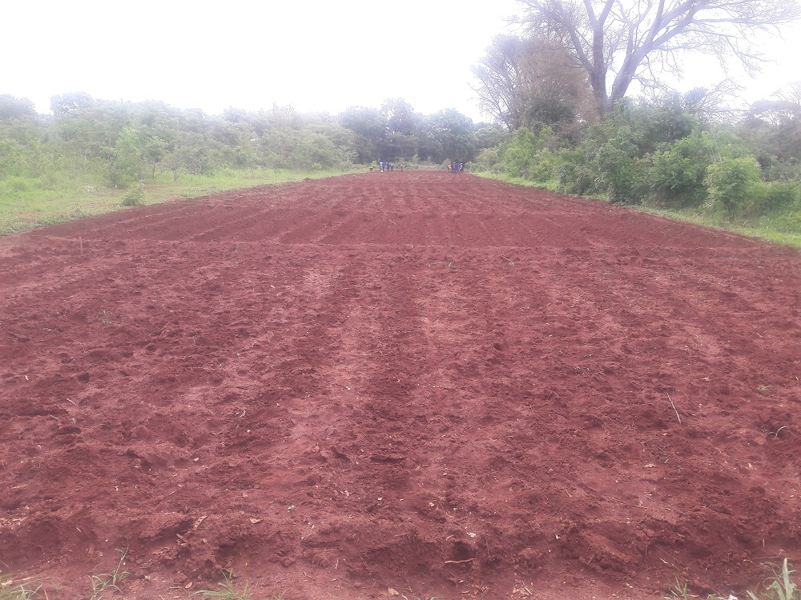
Planted plots at NRC

Slide 72
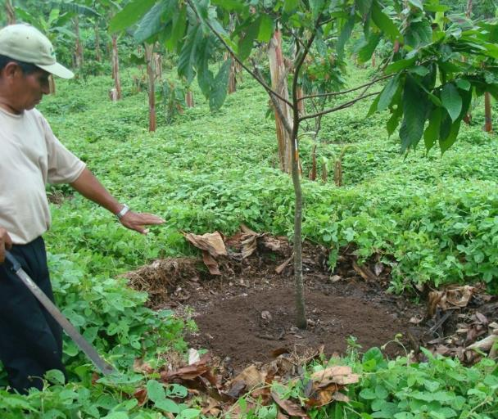
4.2: Weeding, plant training and pruning
Timely weeding is important to avoid competition between the crops and weeds for production resources such as light, water and nutrients. In organic agriculture, the use of herbicides is prohibited and weeds must be controlled through other strategies. Some of the common strategies, depending on the site and cropping systems include: i) hand weeding, ii) mechanical weeding with handheld, or animal/machine drawn implements, iii) smothering weeds using mulches and cover crops, iv) hand pulling, v) flaming, vi) grazing by animals (but for some crops such as moringa, animals may not be allowed in the plantations due to potential hygiene/contamination problems). Preventing weed seed accumulation and dispersal are also important measures to manage weeds in organic.
Example on smoothering weeds with a suitable legume cover crop in agroforestry cocoa. The legumes help to fix nitrogen, in addition to controlling the weeds. The heavy leaf litter from the trees also helps to suppress weeds while recycling nutrients.
For each crop, do you know the most effective time for weeding? At which stages is the crop most sensitive to competition from weeds?
Picture: Monika Schneider, FiBL
Organic Demonstration User Guide, 2020

Slide 73
For the selected demonstration crops, ensure that you know the special management requirements associated with each one. Crop husbandry practices such as roguing of weak and/or disease/insect infested plants, thinning to reduce plant populations and increase spacing among individual plants in a plot are important for plant growth and development. Some crops require topping to stimulate branching while others require some shade to grow and produce well, e.g. cocoa. Potatoes require mounting to promote tuber formation and growth.
If your demonstration involves crops such tomatoes, and tree crops like grapes, mango, cocoa, apples, and others, there are certain plant training activities such as trellising (tomatoes and grapes), pruning off dead parts or old wood to stimulate new growth. A good balance between stimulating new growth in trees and leaving enough bearing branches for the current season is important. You will need to refer to the recommended specific training and pruning procedures for the respective crops in order to avoid potential yield reductions due to excessing pruning.
Guiding questions
Does the particular crop require special management practices such as training, What agronomic practices are required for the different crops (consider thinning, roguing, topping, shade provision, training such as trellising for tomatoes, mounting in tubers, etc.)

Slide 74
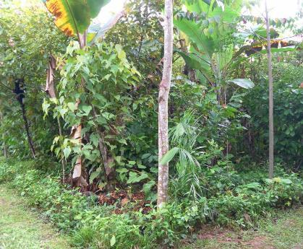
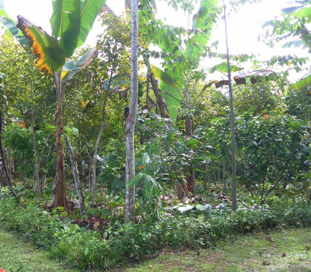
Example on pruning of trees: example of successional agroforesty systems
If you have trees in the demonstration, they will require pruning and/or training, see the following example of successional agroforesty systems
Before weeding/pruning
After weeding/pruning
Pictures: SysCom project, Bolivia
Organic Demonstration User Guide, 2020

Slide 75
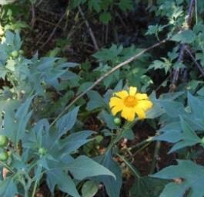
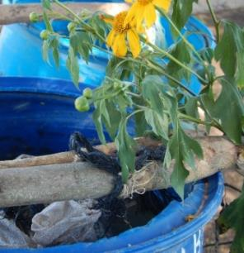
4.3: Plant nutrition during growth
Compost, manures and other organic sources of nutrients can be applied at planting. During growth, crop nutrition can be augmented through application of leaf / manure tea extracts, tree prunings and other sources. Some guidance notes are provided in the next sections.
Steps in preparing Tithonia leaf tea:
The quantity of leaves to use for tea preparation depends on the amount of nitrogen to be supplied as a top up.
For example, to use Tithonian tea as a top dressing fertilizer for maize cultivation and supply about 12 to 25 kg nitrogen per hectare, you can use 2,780 to about 5,670 kg of fresh tender Tithonian leaves per hectare.
Divide the Tithonia leave amounts per hectare by the area of the plots and this will give you the amount to use per plot.
Chop the Tithonian leaves into small pieces and soak them in plastic drums at a ratio of 1:5 leaf to water.
Keep the drum containing the mixture under a shade and also cover the top open-end to avoid ammonia volatilisation.
Stir once every 3 days for 10 to 14 days to allow for mineralisation. The water turns dark brownish green - an indication that most of the nutrients have dissolved into the water.
On day 14, sieve the dark brownish green mixture and spread the sieved residues between the maize rows.
Dilute the liquid water at the ratio of 1:2 (leaf tea to water) to reduce the tea concentration.
Apply the plant tea equally to all the plants in the plot.
Pictures: Irene Kadzere, FiBL,
at Zambia Kasisi Agricultural Training Center
Organic Demonstration User Guide, 2020

Slide 76
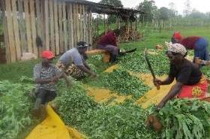
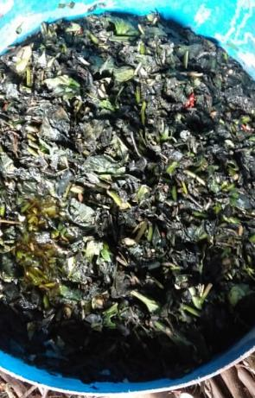
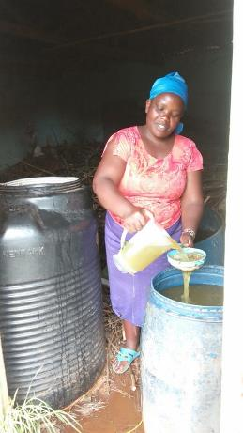
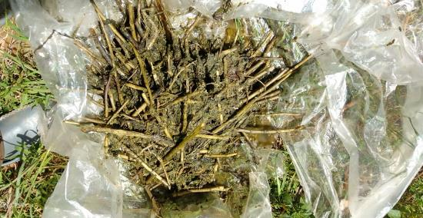
Preparation of Tithonian tea
Chopping the fresh Tithonia plants after collection
Mixture, and sieving the mixture
Pictures: Edward Karanja, ICIPE, Kenya
Residues after seiving
Organic Demonstration User Guide, 2020

Slide 77
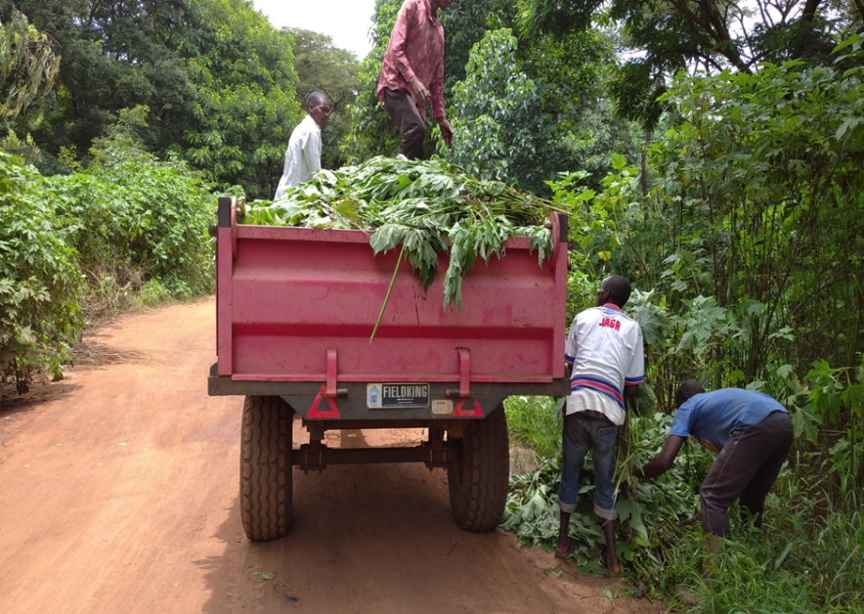
NRC Malawi - Tithonia plant collection for mulch application in maize before crop tasseling
Picture: NRC, Malawi

Slide 78
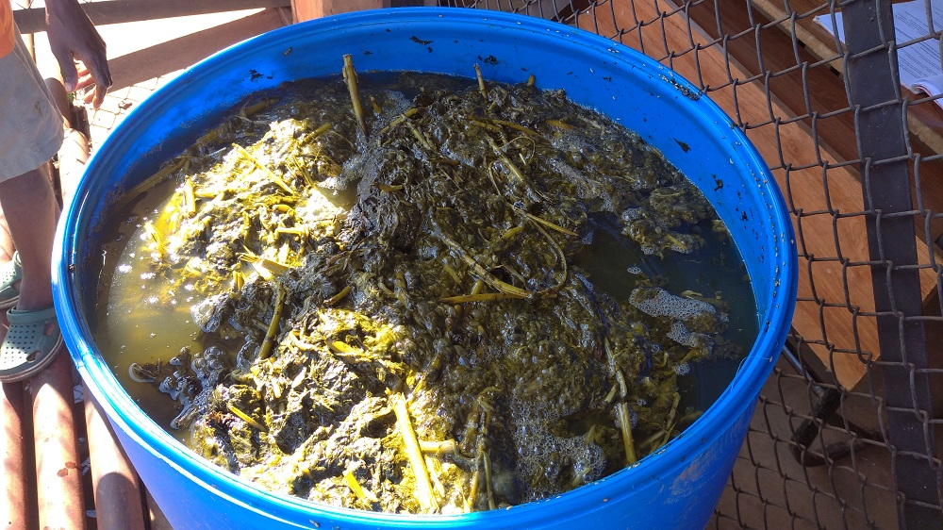
Tithonia tea preparation at NRC
125 Kgs of Tithonia diversifolia fresh leaves collected and chopped for plant tea.
Soaking chopped Tithonia in plastic drums at 1:5 (leaf to water).
Picture: NRC, Malawi

Slide 79
Tithonia tea preparation procedure used by NRC for maize in organic plots
Drums were closed tight (avoid ammonia volatilization), placed under shade.
Mixture stirred once every 3 days to allow for mineralization for 10 to 14 days.
At day 14, the dark brownish green mixture was sieved to remove the trash.
Trash was applied by spreading in between the maize rows in the field.
The generated liquid was then diluted with water at the ratio of 1:2 (mixture to water) to reduce the tea concentration.

Slide 80
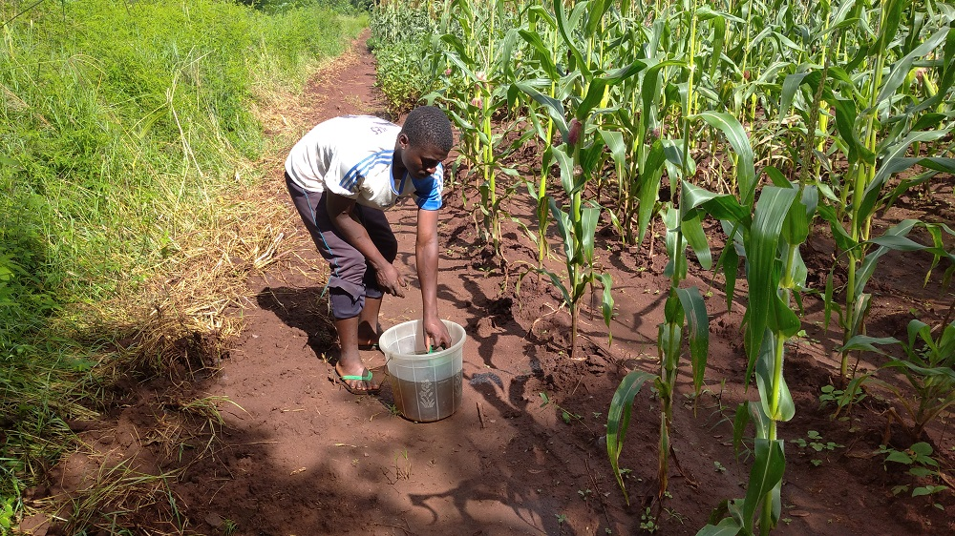
Tithonia tea application at NRC
Diluted liquid was applied to each plant station at the rate of 0.5 litre per station
Picture: NRC, Malawi

Slide 81
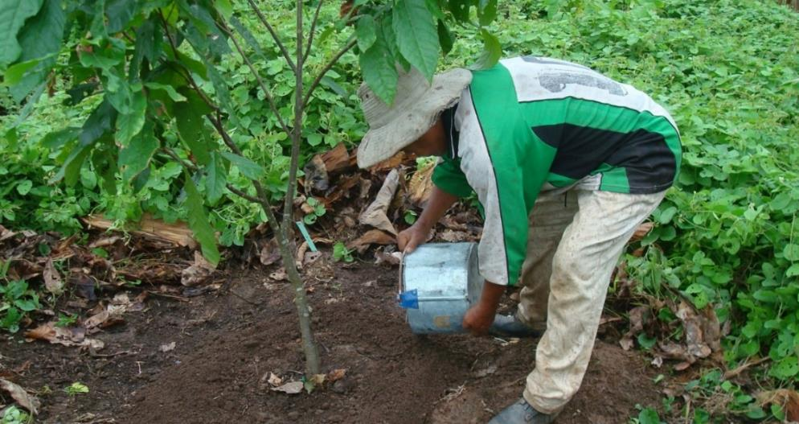
Adding compost to tree crops
See also the dense legume cover crop that helps to provide nitrogen
Picture:
Monika Schneider, FiBL
Guiding questions
  When do you need to apply top dressing nutrients to the crops?
  Do you know the local sources of materials that can be used to augment nutrients to plants?
  Do you know how to prepare, how to apply, and how much to apply?
Organic Demonstration User Guide, 2020

Slide 82
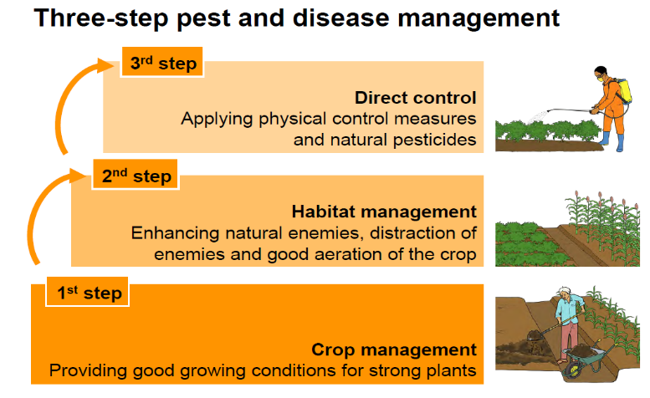
Pest and disease management and control in organic agriculture assumes a three-step approach as depicted on the illustration, below. There is great emphasis on preventive measures, i.e. Steps 1 and 2, in order build a resilient system and help reduce the need for direct control measures.
4.4: Plant protection – pest and disease management
Guiding questions
  What are the major pests and diseases for the target crops (varieties)? Are there tolerant / resistant varieties available for your use?
  Are these key pests and diseases known in the area and could potentially affect the crops and/or livestock that will be produced in the demonstrations?
  Do you know other pest and disease preventive methods apart from suitable varieties?
  Do you know how to carry out pest/disease scouting and determine if the populations are high enough to warrant spraying?
  Do you have sources of information to develop control strategies for the diseases and/or pests?
Organic Demonstration User Guide, 2020

Slide 83
Steps of pests management
Apply good crop management and field hygiene practices such as:
Use of resistant varieties
Nutrition: Apply the right and adequate amount of nutrition
Removal from field highly of heavily infested plants
Crop rotation to ensure that crops of the same family do not follow each other in subsequent seasons.
Plant crops on a spot that provides adequate conditions (sun/shade; soil type; water supply, etc.).
Habitat management
Timely and effectively weed management
Companion cropping-use plants that can deter the insects. Care must be taking not to intercrop with companion plants that are host (e.g. chilli is not a good companion of French bean).
Direct control
Biological control where organisms like fungi are used to kill insects.
Predation/parasitism where natural enemies are used to feed on the insects.
Botanicals – use of plant extracts to kill the pests
Traps which attract insects by an attractive colour, food smell or a pheromone - attracted insects either stick to the trap (glue) or drown in the liquid.
Organic Demonstration User Guide, 2020

Slide 84
Reading of the input label
Not every pesticide is effective against the same kind of pests. Biological control products often act only under very specific conditions, or against certain life stages of the pests. It is essential to read the label carefully before applying any products. Screening of the available botanicals and biocontrols for their effectiveness within your context is recommended. Alternatively you can seek for expert support.
Note: For various reasons, some products may not be as effective as they are expected to be. It might be necessary to make some observations within your own context about the effectiveness of the available plant protection products.?
Organic Demonstration User Guide, 2020

Slide 85
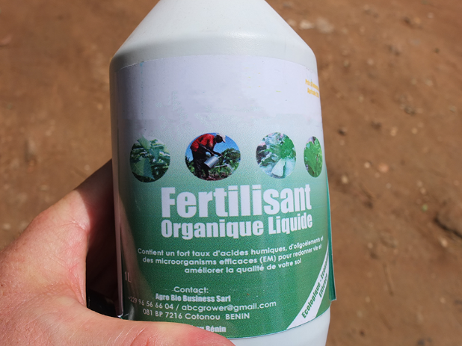
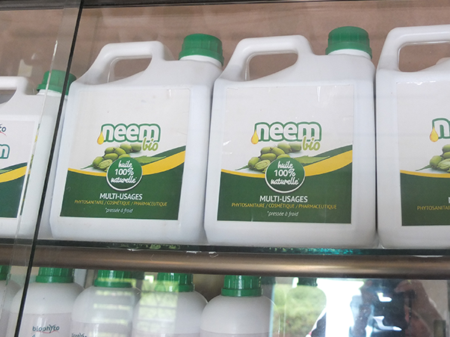
Examples of botanicals and biopesticides available in Africa (note that these may change with time)
Botanicals
Biocontrol products
Note: These pictures are provided as examples only. FiBL does not recommend the use of any specific commercial product, and accepts no liability for any damage caused by the use of commercial products.
Organic Demonstration User Guide, 2020

Slide 86
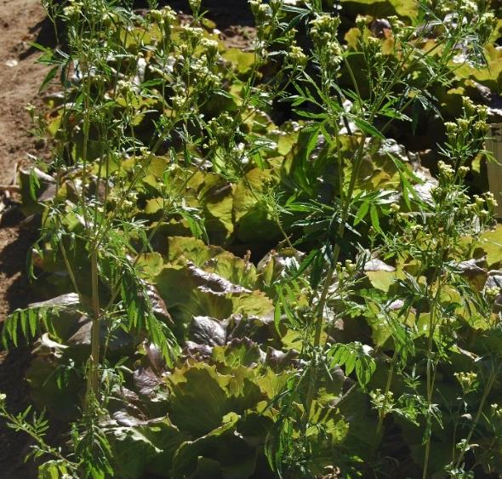
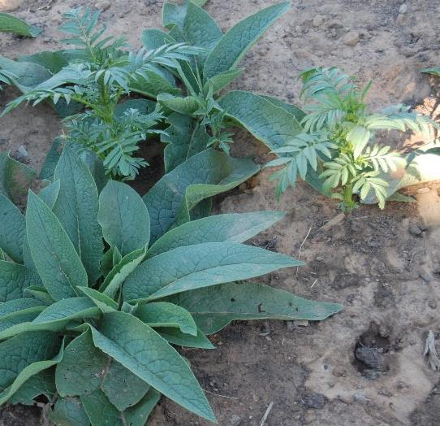
Tagetes minuta plants mixed with salad and broccoli to help repel insect pests.
Examples of some plants that help to repel pests
Marigold
Comfrey
Pictures: Irene Kadzere
Organic Demonstration User Guide, 2020

Slide 87
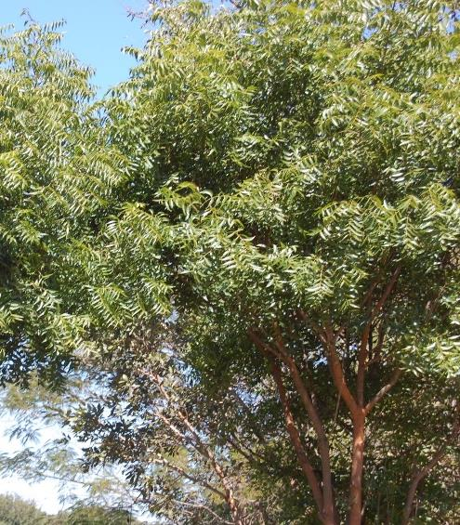
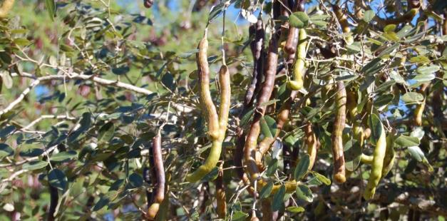

Find out if any of the key plants used for biopesticides are available locally, and if not can you plant / produce them? Before using these, it is advisable to seek for advice from organic experts in your country / area, e.g. certification bodies if relevant, to ensure that they are permissible in your context.
Snake bean tree
Neem tree
Marigold
Pictures: Irene Kadzere, FiBL
Organic Demonstration User Guide, 2020

Slide 88


Promoting diversification and biodiversity
Example: farmers in Kenya and Zambia mix vegetables for crop protection purposes.
Pictures: Irene Kadzere, FiBL
Refer to the crop rotation and compatibility tables to ensure complementarity between or among the crops.
Organic Demonstration User Guide, 2020

Slide 89




Inspecting crops for pest/disease attack at different stages
Pictures: FiBL and ICIPE
Organic Demonstration User Guide, 2020

Slide 90




Strategies in managing virus infections in plants
Infection
Prevention
Virus-free seed tubers
Resistant varieties
No overlapping of potato crops
Controlling nightshades and volunteer potatoes on own and neighbouring fields
Control
Early rogueing of diseased plants
Control of sucking insects
Sucking insects carrying viruses
Infected plant
Healthy plant
Aphids
Virus
Virus
Virus
Infected planting material
After rogueing the diseased plants, they need to be buried or burnt to prevent disease spread.
Organic Demonstration User Guide, 2020

Slide 91

Example on how to scout for pests and diseases in large fields
A lower threshold of less than 30 % is necessary for organic crop production.
Organic Demonstration User Guide, 2020

Slide 92
Decision making process regarding compliance of inputs for use in organic
Step 1: Is the substance formally registered for use in agriculture in the intended country?
NO  Input cannot be used, need to submit a request to owner of the standard or label for inclusion.
YES  Go to Step 2
Step 2: Is the substance and/or product compliant to national organic regulations?
NO  Input cannot be used.
YES  Input can be used in national context, but if subject to approval then check with a competent national authority.
Go to Step 3
Step 3: For organic exports, is the substance and/or product permitted for the target export countries?
NO  Input cannot be used for organic products earmarked for export
YES  Input can be used for export products. Go to Step 4
Step 4: Is the substance and/or product permitted for branding with private label/standard in target export countries?
NO  Input cannot be used on agricultural products branded with a private label
YES  Input can be used on agricultural products branded with a private label. (All key needs have been satisfied)
Source: van den Berg et. al. 2020, Assessing Compliance of Inputs in Organic Agriculture: A User’s Guide

Slide 93
Guiding questions related to the prevention or reduction of contamination
  Managing treatment cross-contamination in above and below ground levels
  Do you know that treatments, e.g. pesticide and fertiliser application from conventional plots can contaminate adjacent or nearby organic plots/fields if there is insufficient barrier separating the two?
  Are you aware of the need to install some barriers to prevent or reduce such contamination?
  Do you know how to check for the effectiveness of such barriers in preventing the contamination?
Note when using trees as barrier plants:
  The distance between the conventional and organic field should not be less than 20 meters in width.
  The trees should be thick enough to prevent pesticides drifts from reaching the organic plots.
  Organic plots at the lower end of the field can be contaminated through run-off water from the conventional plots.
Organic Demonstration User Guide, 2020

Slide 94
Prevention or reduction of contamination below and above ground
  Treatments, e.g. pesticide and fertiliser application from conventional plots can contaminate adjacent or nearby organic plots/fields
  Need for sufficient separation barriers?
    Distance (at least 150m from a conventional crop – but feasibility in smallholder landholdings is questionable)
    Structures such as hedges / trees
    Covers – depending on crops
Organic Demonstration User Guide, 2020

Slide 95

4.5: Labelling of the demonstrations
A good demonstration clearly shows key information about the demonstration itself. Anyone who visits the demonstration should be able to tell the key features of the demonstration, including its objectives just by reading the lables. A large board listing the key components and information about the demonstration can also be instered at the strategic point of the demonstration, e.g. entrance,
Example from the Long-term Farming System Comparison Experiment (SysCom) in Kenya, on-station and on-farm
Conv-Low and Org-Low, 45 kg N/ha, 60kg P₂O₅/ha , Rain fed
Treatments:
Conv-High and Org-High, 45 kg N/ha, 60kg P₂O₅/ha, Supt. irrigation
Crop type: e.g. Green pea
Crop variety: e.g. Kelplus Vuna
Date of planting: e.g. 19 Nov 2020
Picture: Noah Adamtey, FiBL
Organic Demonstration User Guide, 2020

Slide 96

Knowing the layout of the demonstration is important for each member of the team.
Picture: Monika Schneider, SysCom Bolivia
Organic Demonstration User Guide, 2020

Slide 97




Examples of demonstration plots/trials labels - SysCom Kenya
Pictures: Noah Adamtey and David Bautze, FiBL
Organic Demonstration User Guide, 2020

Slide 98




Chapter 5: Livestock husbandry in organic demos
Organic Demonstration User Guide, 2020

Slide 99
5.1: Introduction and basic requirements for livestock
Organic livestock are reared and managed differently from the conventional ones. In organic livestock management, farmers aim to use natural breeding methods and strive to minimise stress to the animals. Farmers also strive to maintain animal health and welfare while avoiding the use of chemical allopathic veterinary drugs, especially antibiotics. Animals to be used for organic production should be adapted to the natural production conditions, in particular the locally available feed resources and quality. Hence, high yielding animals may not always be suitable to organic, locally based, management. Selecting breeds that are adapted to the production environment will help to assure success and reduce costs while safeguarding the health and welfare of the animals.
Key basic requirements for organic livestock production
Managing the animals in a way that conserves biodiversity and natural resources.
Raising the animals on organic certified land.
Using only organic certified feed.
Minimize nutrient imports into the systems.
Having year-round outdoor access for the animals.
Special care for animal welfare
No use of growth hormones.
Minimize the use of antibiotics.
Organic Demonstration User Guide, 2020

Slide 100
Before bringing in animals into the demo site, you need to ensure that the construction of relevant facilities has been completed, and that all the grazing lands/or fodder and feed for zero grazing are ready to support production in an organic manner. A grazing plan or fodder production and feeding plan also needs to be in place for non-grazing livestock types.
Guiding questions about livestock
  Does the team have animal experts with good theoretical and practical knowledge skills?
  What animals and breeds are the most suitable? Which ones are adapted to the type of environment? Are sources of starter animals available, i.e. can you easily get the starter animals, e.g. a dairy cow, chicks for egg and meat poultry production, fingerlings for fish?
  Does the selected land comply with organic expectations?
  Are adequate quantities of grazing land/pastures available? Do the meadows contain a variety of grazing plants – grass, herbaceous plants, shrubs, etc.?
  Are there enough sources and/or stocks of fodder/supplementary feed?
  Do you have good housing facilities for the respective types of animals? Are the free-range areas for poultry/pigs well prepared and containing suitable structures (including shade and water) for good animal welfare?
  Are there enough water drinking points for the respective types of livestock?
  Do you have enough land to bring out the manure without causing nitrogen leakage?
  Do you have enough labour to handle animals in the expected organic management?
Organic Demonstration User Guide, 2020

Slide 101
Further guiding questions on basic requirements
Do you have the necessary materials/inputs for animal health (ethnobotanical sources, commercial sources, etc.)?
Will the animals be well protected from predators such as leopards, snakes, hyenas, etc.?
What kind of animal handling tools and facilities do you need and do you have, e.g. stalls for fodder storage, dairy/milking facilities and containers, egg trays, etc.?
Are storage and processing facilities for the livestock inputs, tools, fodder, products
(e.g. milk) produce available, or do they need to be constructed, purchased?
Guiding questions relating to housing in organic livestock production:
  Do you have appropriate housing for the animals – does the housing allow sufficient movement of the animals within it (small herds or flocks are recommended per structure to avoid overcrowding, stress, and potential disease outbreaks)?
  Do you have access to adequate dry litter for animal bedding?
  Are you aware that animals under organic management should not be tethered in buildings or caged?
  Will you have enough grazing area for the animals as appropriate?
  Will you be able to provide the animals with the maximum amount of fresh air and daylight?
Organic Demonstration User Guide, 2020

Slide 102


5.2: Organic pigs - housing, feeding and health
  Pigs are omnivorous animals.
  Feed may include farm-grown crops, roughages such as grass or hay,
  by-products from food processing or well-cooked kitchen waste.
  Access to sufficient water is crucial.
Picture: Mirjam Holinger, FiBL
  Housing of organic pigs should enable them to express their species-specific behaviours such as rooting in the soil, foraging, social behaviour, and lying.
  Pigs are very sensitive to heat and need shade and a wallow, if kept on pasture.
Picture: Gwendolyn Rudolph , FiBL
Link: Animal-friendly pig husbandry. An advisory toolf for Swaziland, FiBL, 2016
Organic Demonstration User Guide, 2020

Slide 103

Example of an indoor pen for weaner pigs with an outdoor area
Organic Demonstration User Guide, 2020

Slide 104

Organic pigs: breeding and health management
Disease prevention should include:
  Vaccination
  Rotation of pig pastures to reduce parasite infestation
  Daily monitoring of the health status
  Prevention of contact to other pigs
  Good nutrition
  Use of adapted and robust breeds
Picture: Davide Bochicchio
An ideal organic pig breed has the following characteristics:
  It is adapted to local climatic conditions
  It can efficiently use locally grown feed
  It is resistant to common diseases
  Sows do not have too many piglets
  It is locally available, also for exchange of breeding animals
Link: Improving health and welfare of pigs. A handbook for organic pig farmers. FiBL, 2015
Organic Demonstration User Guide, 2020

Slide 105

5.3: Organic poultry feeding, housing, breeding and health
Poultry are omnivorous animals and scavengers. They don’t need a lot of inputs in form of purchased compound feed, and still provide the humans with important protein in form of meat and eggs. Feed may include farm-grown crops, by-products from food processing or well-cooked kitchen waste and even roughage.
Organic poultry can be kept in extensive or semi-intensive free-range systems, but never indoors only.
Housing should enable the poultry to express their species-specific behaviours:
  Elevated resting places (perches)
  A dropping board below the perches to collect valuable droppings and to improve hygiene
  Litter area for scratching and foraging
  Sufficient feeding and drinking places
  Protection from predators
  An outdoor area with shelters to protect them from sun and rain and, for water fowl, access to ponds.
Picture: Thomas Alföldi, FiBL
Organic Demonstration User Guide, 2020

Slide 106

Example of semi-intensive house for laying hens
Source of picture/illustration: Aviforum, Zollikofen, Switzerland
Organic Demonstration User Guide, 2020

Slide 107
Organic poultry breeding and health management
High performing hybrid animals need very good management and high quality compound feed. Where this cannot be guaranteed, indigenous breeds (village chicken) are the better choice. Poultry have a short reproduction cycle, it is therefore easy to start a breeding programme in order to improve productivity of the animals without changing to the more demanding hybrids.
An ideal organic and free-range poultry breed has the following characteristics:
  It is adapted to local climatic conditions
  It can efficiently use locally grown feed
  It is resistant to common diseases
Disease prevention should include:
  Vaccination, in particular against Marek‘s and Newcastle disease helps to keep mortality low
  Daily monitoring of the health status
  Monitoring for and treatment of blood sucking mites in the poultry house
  Minimise contact to other poultry and wild birds as far as possible
  Good nutrition
  Use of adapted and robust breeds
Organic Demonstration User Guide, 2020

Slide 108
5.4: Small ruminants feeding and behaviour
Goats, sheep and new world camelids are referred to as small ruminants. All species are herbivores consuming various degress of herbage and foliage. Sheep and new world camelids predominately show grazing behaviour, whereas the feed of goats comprises both, browse and pasture.
  Small ruminants (especially traditional breeds) are able to cope with scarce nutritive resources and are well suited for extensive farming systems. Highly productive sheep and goat breeds require more attention as regarding appropriate rations (e.g. proteine).
  Access to sufficient water is important, especially in hot climates.
  Small ruminants do not require sophisticated housing but shade (i.e. shelter or tree) is important.
  Wool (sheep, new world camelids) helps to regulate cold and heat whereas hairy animals (goats, hair sheep) are more susceptible to heat stress.
  Sheep and new world camelids exhibit a pronounced flocking behaviour and are not to be kept on their own. A minimum number of 4 animals is needed in order to meet their behavioural needs.
Organic Demonstration User Guide, 2020

Slide 109
5.5: Small ruminants: breeding and health management
Disregarding the existence of some highly productive sheep and goat breeds, breeding in small ruminants did not focus as much on production as in other farm animals. The focus of breeding was much more directed towards adaptation to specific – often harsh -environments and conditions. The resulting worldwide number of small ruminant breeds is impressive.
The choice of a breed which is well adapted to a given environment is therefore easily possible and should be of major importance.
Breeding for production and disease resistance traits (e.g. parasites) is of interest only for the main production breeds.
Proper health management includes:
Particular attention on neonatal care of kids and lambs (umbilical desinfection, colostrum)
Adapted feeding (progressive weaning, no abrupt changes between fresh and conserved feed, sufficient roughage)
An appropriate pasture management strategy to prevent parasite infection
Regular inspection of claws, especially in humid areas
Regular visual checks of animals
Organic Demonstration User Guide, 2020

Slide 110
Guiding questions relating to feeds/feeding in organic livestock production:
  How many animals do you plan to raise in the demo plots? Is the number consistent or will increase over the years?
  Do you know the feed requirements of these animals based on their different physiological stages of growth?
  Do you have sufficient green fodder for the intended livestock?
  Can you access more than half of the feeds from farms or other sources within the region?
  Do you have sufficient clean and potable drinking water for the livestock?
  Are you aware that the following are prohibited for organic livestock production: preservatives and synthetics (growth promoters, appetizers coloring agents, amino acids), emulsifiers, urea, and others (to be checked with local organic experts)?
Organic Demonstration User Guide, 2020

Slide 111
Guiding questions relating to disease prevention in organic livestock production:
  Are you aware that indigenous breeds are generally resistant to most local diseases compared to exotic breeds? Hence, do you know the key diseases in your local area, and do you have access to local breeds for the type of livestock to be included in the demo plots?
  Besides selecting for the correct breed, are you aware that the animals should be raised in a way that stimulates good resistance against diseases and infections?
  Are you also aware that good value feed in outdoor areas helps to strengthen the animals’ natural immune systems?
  Do you have enough space for the animals to avoid animal overcrowding (remember that overcrowding can promote development of certain diseases)?
  Are you also aware that vaccines are very useful in situations where diseases cannot be controlled by other management related techniques?
Organic Demonstration User Guide, 2020

Slide 112
Guiding questions relating to animal treatment in organic livestock production:
  The emphasis in organic livestock production in relation to animal treatment lies on Non-allopathic medicines, herbal medicines and methods, including homoeopathy, ayurvedic medicine and acupuncture while avoiding the reliance upon routine or prophylactic or conventional veterinary medicines.
  Do you know that conventional veterinary medicines are allowed in case of an emergency, and that if the conventional medicines are used, the with-holding period for livestock products should be twice the legal essential period?
For the best outcome, always consult with your local organic experts or Certification Bodies.
Organic Demonstration User Guide, 2020

Slide 113
If you intend to sell the animals as organic, they will require to be certified. The certification is based on the regulatory standards stipulated by the Certification Body and takes into consideration various aspects. Some of the components which are considered in a standard for livestock certification include:
  Length of the conversion period to organic
  Presence of brought-in animals
  Integration of livestock into the farm landscape
  Fertilisation policy; stocking density (animals per hectare)
  Animal husbandry management
  Animal nutrition and feeding management
  Veterinary medicine
  Mutilations, such as dehorning
  Animal transport and slaughter
Always consult your local organic experts and/or Certification Bodies for the correct and applicable organic standards for your situation.
Organic Demonstration User Guide, 2020

Slide 114




Chapter 6: Agroforestry integration in arable systems
Possible entry points for agroforesty in arable crop production include use in soil fertility improvement, shade provision, biodiversity enhancement, and livestock feeding
Gliricidia and Leucaena species
Pictures: Zambia – Kasisi Agricultural Training Center 2016, by Irene Kadzere
Organic Demonstration User Guide, 2020

Slide 115

Pigeon pea
Picture: Showing pigeon pea plot at Kasisi Agricultural Training Center (taken by Irene Kadzere, FiBL)
Organic Demonstration User Guide, 2020

Slide 116

Do you know when to harvest different components of the demo plots? The example in this picture shows bean harvesting before the maize crop is mature in a maize/bean intercrop below.
Chapter 7: Harvesting and postharvest management
Picture: Edward Karanja – SysCom Kenya Trial
Organic Demonstration User Guide, 2020

Slide 117
Crop harvesting
Harvesting is one of the most important and rewarding operations in farming. Timely and proper harvesting helps to assure good quality of the harvested produtcs, and also to reduce losses from the field if crops are left to over-grow or become over-mature. Each crop and animal type has ist own characteristics that portray maturity and readiness for harvest. For some crops, e.g. tomatoes, harvesting before ripening can facilitate better storage and transportation to markets. The maturity of harvested perishable commodities has an important bearing on their storage life and quality and may affect the way that they are handled, transported, and marketed.
Guiding questions
  Do you know the maturity indices for the specific type of crops growing in the demo plots (is it based on, e.g. days from planting, days from flowering, physical and visual changes occuring such as changes in shape or colour of the edible plant parts, etc.)? Are special tools required to measure maturity? For example, to measure the soluble solids content of the juice in mango or grape fruits to determine if they are within the correct range for harvest.
  What equipment and tools are necessary for harvesting a particular crop or livestock type/livestock product?
  Is the harvesting team well trained and aware of these maturity indices and expectations?
  Do you have enough containers for harvesting? Are the containers suitable for the type of product in such a way that they cushion or protect the produce from damage?
Organic Demonstration User Guide, 2020

Slide 118
Development stages for crops
Development
Growth
Maturation
For horticultural crops, knowing the physiological maturity is important as the economic importance of a crop, and its usefulness are higher before the crop reaches full maturation.
Physiological maturity
Ripening
Senescence
Adapted from Watada et al., 1984.
Organic Demonstration User Guide, 2020

Slide 119




How do you determine when to harvest? What maturity indices are associated with the various crops?
Pictures: Johanna Rüegg, FiBL
Pictures: Laura Armengot, FiBL
Organic Demonstration User Guide, 2020

Slide 120

Which coffee berries are ready for harvest?
Picture: Johanna Rüegg, FiBL
Organic Demonstration User Guide, 2020

Slide 121
Handling harvested crops
Guiding questions (continued)
  Do you know how to handle the produce after harvest? Are there any special procedures which must be undertaken immediately after harvest, e.g. removing latex from freshly harvested mangoes?
  Soon after harvest, what should you do to protect the produce from postharvest losses – e.g. does the produce require immediate temperature control (through protecting from direct sunlight and hot environments, or providing a cool environment)?
  Is transport available to move the harvested products from the field to the sheds/homestead/processing facilities/markets?
  Is there a clean source of water for cleaning the produce (as relevent) or to clean the tools/equipment and facilities?
  Do you have proper facilities for preservation, e.g. drying facilities, cooling, atmosphere controlled facilities such as hermetic sealed bags, etc.?
  Do you have enough labour to see your harvest through to storage, or to the markets? Does the crop require several harvests and is labour available for each harvest?
Organic Demonstration User Guide, 2020

Slide 122
Sorting and grading
Some descriptions:
Sorting is the process by which products/produce are separated into several quality group based on attributes such as size, shape, weight/density, colour, texture (firmness), freedom from damage (physical, phsysiological, pest, disease) and freedom from contamination, etc.
Grading of products - is the process of classifying products based on some standards that relate to the commercial value and usefulness of the product. Usually, these grades or standards are set by trading agencies or institutions.
Guiding questions (continued)
  Is sorting and grading of the harvested produce necessary (why is sorting and grading important)?
  What sorting and grading criteria are important for the type of produce that you harvest from the demonstration farm or plots? Is size, shape, etc. important?
  What sorting and grading techniques will you use?
  Do you have the neceeary tools/equipment for the expected sorting and grading?
Organic Demonstration User Guide, 2020

Slide 123

Cooling fresh produce at the farm or local level
For fresh produce, you can consider building a charcoal cooler in the absence of electric/solar power driven cold rooms or cooling facilities. However, charcoal use raises environemental concerns, e.g. related to deforestation and land degradation. Do you know of other locally adapted techniques of cooling/preserving different types of produce?
Picture: courtesy OACK and KOAN – Kangari, Muranga, Kenya
Organic Demonstration User Guide, 2020

Slide 124

Fermenting cocoa beans, Bolivia
Assuring availability of appropriate processing facilities for each crop
Picture: Laura Armengot, FiBL
Organic Demonstration User Guide, 2020

Slide 125

Drying cocoa beans after fermentation in Bolivia
Picture: Laura Armengot, FiBL
Organic Demonstration User Guide, 2020

Slide 126

Drying crops after harvest
Picture: Laura Armengot, FiBL
Organic Demonstration User Guide, 2020

Slide 127

Shelling of maize
Picture: Monika Schneider, FiBL
Organic Demonstration User Guide, 2020

Slide 128
Some quality attributes in organic products and factors contributing
  Organic fertilisers only used for crops
    Slow growth,
    Less water content
    Different composition because N is limited (proteins, flavours)
  Prohibition of synthetic chemical pesticides
    Hardly any pesticide residues (plants rely more on own protective mechanisms)
  Animals
    Fed on mainly organic feed
    High proportion of roughage, limited use of feed concentrates
    Slow growth
    Different quality
  Use of site-adapted plant varieties and animal breeds
    Heterogeneity of the crop and the final product

Slide 129




Sorting and grading – size, shape, color,
Small round tomatoes (cherry and grape)
Large round tomatoes (Campari and beefsteak)
Plum tomatoes (multiple colors)
Marmande or hierloom tomatoes (multiple colours)
Pictures - FiBL

Slide 130
Further guiding questions for the postharvest stage
  If the demo plots are for scientific purposes, do you know the type of information/data that must be collected at harvest and do you have to collect any samples and send them to a laboratory for analysis? See further guiding information in Chapter 8.
  Is the storage place/containers clean and well protected fom the elements as well as pests and dirt?
  What diseases and pests can affect the harvested produce? Do you know how to prevent or control them and do you have the necessary materials for pest/disease control?
  For how long do the harvested products stay before either processing, marketing, or consumption?
  Do you have enough packages for storage or transportation to markets?
  What happens to the crop residues after harvest, do they require to be cut (e.g. cotton stems), and can they be composted?
Organic Demonstration User Guide, 2020

Slide 131
Chapter 8: Data collection and management - overview
Why data collection is important:
Data collection, and its timing, is an important step in the demonstration cycle. Depending on the objectives of the demonstrations, and the intended target group, you should know what data are important to collect at different times of the year/season. Good data, rather than anecdotal, can help you to tell a sound story about the performance of your demonstration. Authentic data and evidence increase the confidence in your story by viewers, listeners and readers. Besides, it also help others to develop an idea on what could be expected from implementing certain practices although this also depends on some context specific situations.
Data collection: example of SysCom research trial in Kenya
What do you need to do?
What data: As a team, you need to decide on what data can help you to tell your story to the target beneficiaries or audience in a convincing way. What types of data to collect depend on the stage of growth or development or plants and/or animals, and should be informed by the objectives of the demonstration and target outputs.
When to collect: It helps to design a calendar showing all key data that need to be collected at different times. Ensure that the team is fully aware of their roles and responsibilities and that the necessary tools are available.
Organic Demonstration User Guide, 2020

Slide 132
Skills: Assess the skills and capacities of the team in making records or observations, if need be, undertake some training or orientation on key procedures to ensure that correct and accurate information is recorded. Before each data collection session, it is advisable to orient the team and go through the procedures and clarify any unclear aspects. The data collection sheets should be well labelled and enough copies must be available for each data collector. Teamwork is important, so is accountability in data collection and record keeping.
Tools: A field management notebook or other proper recording materials are required to record activities and data from the demonstration(s). If a paper notebook is used, it is advisable to use hard and plastic covered types for good protection from possible rain/water damage. In the field, the data can be collected onto a notebook, or sheets of paper, or directly onto suitable electronic gadgets such as laptops, tablets or others. When using paper based recording media, it is better to use a lead pencil that a pen. Unless specialized, text written in pencil can withstand the elements better than a pen.
Organic Demonstration User Guide, 2020

Slide 133
Guiding questions and tips
Samples: In addition to recording quantitative data, it may be necessary to collect some samples from the plants and/or animals in the demonstration. When samples are collected, ensure that the same procedures for collecting, processing, storing, and analyzing the samples is similar for the baseline samples and subsequent ones. For soil samples, it is often a good practice to keep some baseline samples that will be analyzed together with subsequent samples from the same plot / filed / farm.
  Do you know what data are important for the demo plots at different times of the year/season? Have you designed a calendar showing all key data that need to be collected at the different times? Does the demonstration team know what is expected of them – are they fully aware of their roles and responsibilities? What tools and / gadgets do you require for recording / capturing the data and storing it?
  Assess the skills and capacities of the team in taking records or observations, if need be, before embarking on data collection, undertake some training or orientation on key procedures to ensure that correct and accurate information is recorded.
  Teamwork is important, so is accountability in data collection and record keeping.
Organic Demonstration User Guide, 2020

Slide 134




Examples of types of data to be recorded
The types of records depend on many factors
Pictures: ICIPE
Pictures: Monika Schneider, FiBL
Organic Demonstration User Guide, 2020

Slide 135

Taking records in cocoa plantations
Picture: Laura Armengot, FiBL
Organic Demonstration User Guide, 2020

Slide 136


Assessing cocoa pulp yield
Weighing samples in a laboratory
Pictures: Laura Armengot, FiBL
Organic Demonstration User Guide, 2020

Slide 137

Taking good records requires good labelling of the harvested products.
Picture: Monika Schneider, FiBL
Organic Demonstration User Guide, 2020

Slide 138
Examples of tools and their uses in sample and data collection
1. Plant growth data collection
  Meter rule for measuring, e.g. height, breadth, or length
  Measuring tape for measuring, e.g. height and canopy breadth or length
  Leaf area meter for measuring the area of leaves
  A caliper for measuring stem / trunk girth or fruit width, a refractometer to measure sugar content, etc.
  Weighing scale for recording the weight of samples or produce
  Packets for samples
  Labels for unique identification of samples
  Markers for labelling
2. Yield data collection
  Weighing scale
  Digital scale with 3 decimal points is more appropriate for smaller products.
  Large and non-digital scales (field scales) are useful for large products.
3. Soil sample
  Auger and cylinder core for soil sample collection
  Containers e.g. trays, buckets for carrying and / or drying the soil
  Packaging materials for samples
  4. Soil moisture
  Time Domain Refractometer
  Gravimetric method using the soil cylinder core
Organic Demonstration User Guide, 2020

Slide 139
Examples of data which can be collected from a maize demonstration
At establishment phase | Growth up to harvest phase | Postharvest phase
Record all weather data during the season (once every month) | Plant growth – height, Leaf Area Index (LAI) at different stages, plant girth. For tree crops – measure the canopy size as well. For animals, examples of data include live weight, body conformations, etc. | Costs incurred on inputs, transport, labor, pesticides, energy, etc.
Seed quality at sowing/planting (weight of 100 seeds of grains / cereals). | Flowering – days to flowering (including days to bud-break in tree crops), (tasseling for grains), silking in maize. | Record prevailing market prices for the harvested products per time.
For tubers or other planting materials, grading and selection should be done. | Record pest and disease incidence and damage (scouting as per crop stages)
Germination - days to initial germination, 50 % germination and 100% germination | Date to physiological maturity attainment, date of harvest, quality attributes of harvested products.
Soil moisture content throughout the season depending on crop | Size (including fresh and/or dry weight) of harvested products (cobs, threshed grain, leaves, fruits, wood, egg counts and weights, carcase, wool, etc:) – both marketable and unmarketable products
 | Moisture content of various plant parts
Organic Demonstration User Guide, 2020

Slide 140

Data collection in maize plots in NRC demo plots
Measuring the height of maize
Picture: Andrew Thadzi, NRC, Malawi
Organic Demonstration User Guide, 2020

Slide 141

Data collection in sorghum plots in NRC demo plots
Measuring the height of sorghum
Picture: Andrew Thadzi, NRC, Malawi

Slide 142

Data collection in groundnuts plots in NRC demo plots
Picture: Andrew Thadzi, NRC, Malawi

Slide 143
Chapter 9: Learning and dissemination
9.1: Regular reflections and learnings by the demonstration team
There are many lessons to be drawn from a demonstration, varying from process learnings to visual benefits portrayed from the demonstration outcomes.
If a demonstration is running for more than one seasons or year, there are likely to be certain modifications or adjustments in subsequent seasons / years based on the outcomes of preceeding seasons / years. For example, an irrigated crop can be added to the rotations in a rain-fed demonstration, or the type and quantities of organic sources of nutrients can be modified, or livestock can be added into a crop-based demonstration. While the changes help to refine the objectives and expected outcomes of the demonstrations, they may bring some complexity to the demonstration set up. Along the way, the team can also learn of new methods or techniques for certain practices, hence the demonstrations can lead to enhancement among the implementing team, but also for the main target groups.
Organic Demonstration User Guide, 2020

Slide 144
9.1: Regular reflections and learnings by the demonstration team
The team should conduct regular reviews and evaluate progress towards attainment of the objectives while also identifying gaps and areas for improvement. It is important to discuss technical, logistical and resource requirements, and make any necessary adjusments in a timely manner. Ensure that any changes to processes, procedures, and staffing are well documented and shared among the team. In addition to the internal review among the team members, the progress and any bottlenecks encountered together with proposed major changes (especially those with implications on resource requirements), should be communicated to the relevant stakeholders, including the host institution’s management / authorities.
Organic Demonstration User Guide, 2020

Slide 145
Regular reflections at the demonstration sites – some pathways for the demonstration team members
Demonstration Site
Data collection sessions
Field days or tours
Training sessions
Orientation of new staff
Regular team meetings by
Advocacy sessions
Publications

Slide 146




Team visits to demo site – example from the SysCom Kenya and India
Make frequent visits as a team to the demo plots to jointly discuss progress, performance and emerging challenges. Evaluate if your objectives are being met, or what changes / improvements are necessary in order to address any emerging bottlenecks.
Pictures: SysCom Program, FiBL
Organic Demonstration User Guide, 2020

Slide 147
9.2: Technological dissemination from the demonstrations
In line with the objectives of the demonstration, regular learning and dissemination sessions should be organized for the target beneficiaries, including key stakeholders who could benefit from the demonstrations, or can have interests in supporting such initiatives. It is important to prepare some information materials to share with the public, and with those who visit the demonstrations. This will help to increase the number of people reached by the messages. In the growing era of social media, one of the rapid ways to get information out to the potential beneficiaries is to use appropriate social media platforms – website, facebook, whatspp, linkedin, and others. For many smallholder farmers, the word of mouth from other farmers, radio, TV, group meetings, etc. continue to be effective cgannels to share information. Newspapers are also common sources of information, e.g. for policy makers. Be sure to include school children as another dissemination pathway!
Guiding questions
Who are the key users/beneficires of the demonstration outcomes
How can the demo plots and the emanating information/results be promoted for the users’ benefit?
What information will be important to share?
How best can the information/experiences/lessons from the demo plots be best shared, or how can it best reach the users?
For example, is it necessary to set up a website for the demo plots to facilitate online sharing? Which other social media platforms are relevant for the target groups?
Organic Demonstration User Guide, 2020

Slide 148
Awareness creation / strengthening and advocacy through the demos
What other platforms and/or channels (including social media) are best suited for the target group?
Can farmer/user-field days or learning tours/exposure visits and exchanges at different stages of the demo plots provide a good opportunity to share progress and results/outcomes?
What knowledge products are suitable for the target group?
Consider, e.g.:
Newsletter or technical bulletins about the demo plots
Videos about the demo plots
Flyers
Manuals
Radio programmes
Policy briefs
Press releases,
Scientific papers (if research design is applied – refer to Chapter 7) etc.
Organic Demonstration User Guide, 2020

Slide 149
Awareness and advocacy from demonstrations – pathways for target beneficiaries and other key stakeholders
Demonstration Site
Various social media
Field days or tours
Training sessions
Pass through
Regular group meetings
Advocacy sessions
News - papers
Radio
TV
School children
Farmer to farmer
Journals, flyers, briefs
Press releases

Slide 150

Hosting / holding beneficiary training, field days/tours and other sessions
Picture: Monika Schneider, FiBL – Bolivia Longterm Farming Systems Experiment (SysCom
Organic Demonstration User Guide, 2020

Slide 151

Stakeholder assessments of the demonstration performance
Picture: Lohse Evento, Bolivia SysCom, Sara Ana
Organic Demonstration User Guide, 2020

Slide 152
Further reading
African Organic Agriculture Training Manual (www.organic-africa.net)
Animal-friendly pig husbandry. An advisory tool for Swaziland (fibl.org)
Bjerke, M.B. and Renger, R. (2017). Being smart about writing SMART objectives, Evaluation and Program Planning, Volume 61, Pages 125-127, ISSN 0149-7189, https://doi.org/10.1016/j.evalprogplan.2016.12.009.
https://www.agromisa.org/product-category/series-agrodok/animal-production/
Icons for infographics: https://thenounproject.com/
John L. Havlin, James P. Shroyer and Daniel L. Devlin, 1990. Establishing on-farm Demonstration and Research Plots (ksu.edu)
On-farm composting methods (fao.org)
Organic Livestock Farming Benefits; Principles; Challenges | Agri Farming
SysCom website: https://systems-comparison.fibl.org/
Organic Demonstration User Guide, 2020

Slide 153



Sources of icons used in this document
Surya Cannavale, ID https://thenounproject.com/search/?q=landscape&i=3450993
Jeevan Kumar https://thenounproject.com/search/?q=selection&i=1221689
Vectors Point, PK
https://thenounproject.com/search/?q=shrub&i=3243562
Ben Davis, RO https://thenounproject.com/search/?q=soil&i=1025570
Juraj Sedlák, SK https://thenounproject.com/search/?creator=336152&q=earth&i=908091
ArmOkay, TH
https://thenounproject.com/search/?creator=4175734&q=management&i=3121147
Phạm Thanh Lộc, VN https://thenounproject.com/search/?q=shed&i=2540262
nareerat jaikaew, TH https://thenounproject.com/search/?q=soil&i=3522755
Gan Khoon Lay
https://thenounproject.com/term/oil-palm/1925730/
Made, AU https://thenounproject.com/elki/collection/agriculture/?i=1187387
Juraj Sedlák, SK https://thenounproject.com/term/insecticide/919109/
Gan Khoon Lay
https://thenounproject.com/term/fruit-industry-worker/1925717/
Creative Stall, PK https://thenounproject.com/search/?q=timeframe&i=981415
Denis Devyatov, RU
https://thenounproject.com/search/?q=fertilizer&i=1590167
Gan Khoon Lay
https://thenounproject.com/term/cow-butcher/1925714/
Creative Mania, IN
https://thenounproject.com/search/?creator=2251916&q=cow&i=1147034
Vectors Market
https://thenounproject.com/search/?q=budget&i=1326902
Organic Demonstration User Guide, 2020

Slide 154

Sources of icons used in this document, continued
Ben Davis, RO https://thenounproject.com/search/?q=seeds&i=1848204
Handicon, ID
https://thenounproject.com/search/?q=time&i=3109445
Juraj Sedlák, SK https://thenounproject.com/term/insecticide/919109/
Max Hancock, US
https://thenounproject.com/search/?q=money&i=1886177
faisalovers, ID https://thenounproject.com/search/?q=weeding&i=1217816
Denis Devyatov, RU
https://thenounproject.com/search/?q=fertilizer&i=1590167
coer, RU https://thenounproject.com/search/?q=soil&i=1132958
Jeevan Kumar https://thenounproject.com/search/?q=selection&i=1221689
Becris
https://thenounproject.com/search/?q=harvest&i=1176638
Vectors Point, PK
https://thenounproject.com/search/?q=fertilizer&i=3216467
Llisole
https://thenounproject.com/search/?creator=2095749&q=insect&i=3184772
Gan Khoon Lay
https://thenounproject.com/term/oil-palm/1925730/
Yu luck, KR
https://thenounproject.com/search/?q=pesticide&i=415297
Gan Khoon Lay
https://thenounproject.com/term/fruit-industry-worker/1925717/
Symbolon, IT
https://thenounproject.com/search/?q=sowing&i=1046355
Gan Khoon Lay
https://thenounproject.com/term/cow-butcher/1925714/
Organic Demonstration User Guide, 2020

Slide 155

ANNEX1: Examples of structures to help stabilize soils on sloppy land
If the available or selected site is slopy, the team needs to check if in-field water harvesting/erosion control structures (contours, terraces, ridges, etc.) are in place. If not, they need to think of how to protect and stabilize the soil appropriately when they implement the demonstration. Examples of soil conservation measures / stabilizing structures are shown below.
Plant tree and shrub buffers
Establish terraces along contours
Avoid overgrazing
Minimise soil disturbance
Promote natural and planted soil covers
Organic Demonstration User Guide, 2020

Slide 156


The A- Frame can help in marking the land to prepare contours for soil conservation
Tools for marking contours in the field
The A-Frame
For more details on the A-frame, refer to Page 28 of the Module of the African Organic Agriculture Training Manual – Soil Fertility Management: https://www.organic-africa.net/fileadmin/organic-africa/documents/training-manual/chapter-02/Africa_Manual_M02.pdf
Organic Demonstration User Guide, 2020

Slide 157
Before sampling the soil for analysing nutrients, pH, organic matter content, etc., you need to decide if this information is required for your demonstration.
ANNEX 2: Procedures for soil sampling, if soil analysis is required
Steps in sampling the soil:
Make two perpendicalar lines across the field using a rope and pegs.
Sample the soil from each of the points marked with blue dots on the perpendicular line using an auger or cutlass. The sampling should be done at different depths,
e.g. 0-20 cm, 20-40 cm, etc., depending on the objectives of the sampling.
Mix the samples and follow the recommended procedures for the expected type of analysis.
Send the sample to a nearby laboratory for analysis to be done.
Note: The costs for the lab analyses should be considered in the initial budget.
Organic Demonstration User Guide, 2020

Slide 158

Marking points for soil smapling
Simplified procedure for sampling soil from
a field ( = definite sampling point
= points to be considered for further sampling if the field is larger than one acre (0.41 ha) or if the plot / field is very heterogenous)
Source of picture: Edward Karanja, SysCom project, Kenya
For more information, see https://www.organic-africa.net/fileadmin/organic-africa/documents/training-manual/chapter-02/Africa_Manual_M02.pdf
Organic Demonstration User Guide, 2020

Slide 159






Spade examination of the soil
Spade examination of the soil to determine some qualitative characteristics of the demo plots’ soils. After collecting the soil samples, carry out an examination of the soil as shown below.
1. How is the soil’s moisture?
2. How does the soil smell?
3. Does it have rust-coloured and blue-grey stains on the cut?
4. When breaking the clod, does it fall into small, crumbly bits or into bigger, egged parts?
5. Do the roots show any signs of disturbance?
6. Are there any signs of biological activity?
For more information, see
https://www.organic-africa.net/fileadmin/organic-africa/documents/training-manual/chapter-02/Africa_Manual_M02.pdf
Organic Demonstration User Guide, 2020

Slide 160

Knowing the profile of the soil in the demonstration farm/plot can also be important in knowing the soil type and for decision making
Soil profile
Depending on the type of crop, the soil depth to be considered varies, e.g. suitable soil depths for:
Vegetables = 40 to 100 cm
Maize = 100 to 150 cm
Trees like cocoa = 122 cm and more
For a demonstration that is also focusing on soil fertility or soil health, the soil profile can also provide information on soil texture and its classification.
Picture: Monika Schneider, FiBL
Organic Demonstration User Guide, 2020

Slide 161


ANNEX 3: Additional considerations for site – weather station
  Weather station:
  Are weather data necessary for the demonstration’s objectives?
  If yes, can they be obtained easily, e.g. from the local or national meteorological offices?
  If weather data are not available for the area, are they important enough to warrant setting up a micro-weather station?
Picture: Edward Karanja, SysCom Kenya
Picture: Laura Armengot, SysCom Bolivia
Organic Demonstration User Guide, 2020

Slide 162
More about a weather station
  Things to consider when installing a mini weather station (if one is required)
  Maintain a good distance between the weather station and any tall objects:
    Never install a weather station under a tree or overhang, as this can lead to incorrect rainfall data.
    Do not place the weather station at the alley or between two buildings as this can affect the anemometer resulting in wrong wind data.
  The rain gauge should be placed at least 5 ft (about 1.50 m) high from any horizontal obstruction so that the rain is not blocked by the object.
  To keep away birds from pooping or nesting in the rain gauge, plastic spikes can be mounted on the gauge.
  The World Meteorological Organisation (WMO) agreed standard for the height of the Stevenson screen is between 1.25 m (4 ft 1 in) and 2 m (6 ft 7 in) above the ground.
  The Stevenson screen is always painted white, to reflect direct solar radiation.
Organic Demonstration User Guide, 2020

Slide 163




ANNEX 4: Conducting a seed germination test to determine seed quality and its implications on seeding rate
1
2
Wash the hands. Mix the seeds thoroughly. Count 100 seeds randomly for the germination test. Divide the seeds into batches of 25 seeds for each of the 4 sections of the bed.
Make a raised fine seedbed in a secure place where birds, poultry or other livestock cannot access. Divide the bed into four sections.
3
4
Place the seeds on top of the moist soil. Cover the seeds with a moist gunny sisal bag. Peg the covering material. Keep the bed moist by sprinkling water. Routinely check on the germinating seeds.
At the end of the germination period, count and record the number of germinated seeds with a healthy radical and shoot in each of the sections of the bed.
Organic Demonstration User Guide, 2020

Slide 164
Adaptation of sowing density based on the seed germination test
How to calculate the germination rate:
(B / A) x 100
B = number of successfully germinated seeds (after 7 days)
A = number of seeds sown for the test
Germination rate | Adjustments to seeding rate
0-50 % | Discard the seed batch and obtain good quality seeds
51-60 % | Discard the seed batch and obtain good quality seeds or plant 3 seeds per hole/planting station (tripple the amount of seed)
61-70 % | Discard the seed batch and obtain good quality seeds or plant 2 seeds per hole/planting station (double the amount of seed)
71-90 % | Increase amount of seed by 20 % (e.g. use 6 kg instead of 5 kg)
91-100 % | Use the normal seed quantity for sowing
Adaptation of seed quantity for sowing
Note: Additional seedlings can be raised in a separate seedbed to supply excess seedlings for filling germination gaps.
Organic Demonstration User Guide, 2020

Slide 165
ANNEX 5: Further considerations for scientific demonstrations / trials
  How many treatments and comparisons do you plan to include in the demonstration?
  Can the size of the available farm or piece of land accommodate the planned comparisons?
  Is blocking necessary, e.g. if the piece of land is not uniform, or when you have to use two
  or more individual pieces of land to accommodate the full design or comparisons?
  Is there a buffer zone or barrier between the plots and the surroundings?
  Do you need control plots?
  Are your gross plots large enough for subdividing them into reasonable net plots for sampling and data collection?
  Is randomisation and repetition/replication of the plots necessary (see note)?
Note: Replication and randomisation is used to increase precision in identifying treatment differences. It allows a statistical analysis of field variation and whether differences in treatments are real or due to random chance. Replication can either be done through repeating plots in different locations or several repetitions of each plot in one location depending on the land available to conduct the experiment/trial.
Organic Demonstration User Guide, 2020

Slide 166
Blocking and replications - example
Block 1
Treatment A | Treatment B | Treatment C
Block 2
Treatment B | Treatment C | Treatment A
Block 3
Treatment C | Treatment A | Treatment B
Block 4
Treatment B | Treatment A | Treatment C
Organic Demonstration User Guide, 2020

Slide 167

Example of the layout of a field experiment on organic agriculture:
DOC Trial in Switzerland (established in 1978)
The trial involves organic, biodynamic and conventional farming treatments.
Organic Demonstration User Guide, 2020

Slide 168


Example of the layout of a field experiment on organic agriculture in Kenya
The trial involves low and high input organic and conventional farming systems.
Organic Demonstration User Guide, 2020

Slide 169


Layout of the SysCom Bolivia Agroforesty Cocoa Long term Trial under organic and conventional management
Pictures: SysCom Bolivia
Organic Demonstration User Guide, 2020

Slide 170

Layout of the SysCom India Cotton-Cereal Long term Trial
Picture: SysCom India Team
Cotton-cereal based systems under organic, biodynamic and conventional farming systems
Organic Demonstration User Guide, 2020

Slide 171

A permaculture farm in Malawi
Photo – Mike Chingamba

Slide 172
Additional considerations for scientific demo plots
If the demonstration is to be used for scientific investigation, the following key aspects need to be taken into consideration:
Collection of weather data
Sample collection - soil, crops, soil fertilization products, pest and disease control products, labour use, quantities applied, etc).
Statistical analysis
  Use appropriate Statistical Analysis and Packages.
  Need the necessary staff expertise in data handling, processing, analysis and interpretation of the analysis outcomes
    Be ready to conduct thorough verification and checks for possible errors – some measurements might require to be repeated if in doubt.
Packaging of information/knowledge/data/evidence in formats that are suitable for different users
Publications: What scientific publications are envisaged from the demo plots?
Organic Demonstration User Guide, 2020

Slide 173
Example of a demonstration plot identification and history data
Record the following information about the demonstration plots:
Name of plot
Date of of recording the information
Name of person recording the information
Specific location of plot or field number
Location address
Title of the Demonstration
Objectives of the demonstration
Land history
  Previous crops – list all crops in the last 5 years
  Fertilization history for the crops above – in last 5 years
    Include the names of fertilizers, typese.g. basal, foliar application, etc.), sources, rates applied,
Site characteristics
  Soil physical properties - type and texture, depth,
  Chemical characteristics (at known depths) – pH, Organic matter content, Nitrogen, Phosphorus, Potassium, Micronutrients (selected depending on type of crops to be grown)
Team responsible for the demonstrations
Adapted from: John L. Havlin, James P. Shroyer and Daniel L. Devlin, Establishing on-farm Demonstration and Research Plots (ksu.edu)
Organic Demonstration User Guide, 2020

Slide 174
Example of data to be collected on a demonstration plot worksheet
Climatic conditions (rainfall, temperature, irrigation water applied if applicable, growing degree days (for estimation of heat accummulation), chilling hours (for crops such as apples and peaches), et.c
Planting and cultural practices
  Residue cover at planting
  Preplanting tillage
  Soil conditions at planting time
  Variety planted
  Planting date, depth, rate, population (or specainf in-row and between rows) – depending on the crop
  Planting equipment used (and brands if available)
  Compost, manure and fertilizers application – types (specific names), rates, sources, quality (e.g. based on lab tests for manures or composts), date of application
  Weeding / weed control methods and dates. If herbcidies are used in conventional plots then record the name, formulation, rates and methods of herbicide application,
  Pest and disease management – what disease and which crop, what methods and / or what substances, when (dates and crop stage), how much, etc.
  Other management practices
Adapted from: John L. Havlin, James P. Shroyer and Daniel L. Devlin, Establishing on-farm Demonstration and Research Plots (ksu.edu)
Organic Demonstration User Guide, 2020

Slide 175

Example of a demonstration plot worksheet
Source: John L. Havlin, James P. Shroyer and Daniel L. Devlin, Establishing on-farm Demonstration and Research Plots (ksu.edu)
Organic Demonstration User Guide, 2020

Slide 176
Types of labour input data that can be collected
Labour data and timing (including number of people involved in the operation): record the number of hours taken, period and length of time taken to do the following activities:
Collecting and weighing of composting raw materials (manure, shrubs, grass, etc.)
Forming compost heap(s)
Turning of compost (1st, 2nd, 3rd, etc.)
Preparing land and planting crops
Applying soil fertility improving and plant nutrition inputs such as Rock phosphate, compost, farmyard manure, Tithonia tea, etc.)
Preparing liquid manure, e.g. Tithonia leaf extract
Gap filling in case of poor germination/emergence (1st and 2nd )
Weeding or any other weed control methods
Training (e.g. staking plants) and pruning plants where this is necessary
Scouting for and controlling pests and diseases
Carrying out supplementary irrigation
Other operations as deemed relevant

Slide 177
Types of labour input data to be collected - continued
Harvesting of crops, fodder, honey, milking, picking eggs, slaughtering animals, etc.
Grading
Postharvest handling, e.g. threshing of maize, drying, etc.
Constructing and maintenance of field terraces/contours, drying/processing structures, animal housing, etc.
Further data to be collected
Amount, and timing (period when activity was implemented) of input application and other management practices in the demonstration.
Manure, compost, DAP, liquid fertilizers, and other soil fertility/plant nutrition inputs
Irrigation
Plant protection inputs

Slide 178
What calculations can be done - some examples
Calculating Leaf Area Index
Required information:
Number of leaves per plant sampled.
Leaves width (LW)
Leaves length (LL)
Ground cover area (GCA)
To calculate Leaf Area (LA), get the average leaf length and leaf width and multiply with a correlation factor
Therefore LA = Av LA × Av LW × correlation factor
To calculate Ground Cover Area (GCA), use πr² to calculate the area covered by the plant. The radius is measured between the rows to avoid errors between crops on the same row.
Therefore LAI=LA/ πr²

Slide 179
Some examples of calculations - continued
2. Determination of % moisture content in harvested samples and grains
For grains such as maize, groundnuts, beans, soya – the harvested grain should be dried to the appropriate moisture content, e.g. 13% for maize, using a grain moisture meter. The meter provides a direct moisture content reading for the grain.
Plant samples such as maize stalks or cabbage leaves should be first cut into pieces and placed into well-labelled brown paper envelopes before oven drying at 70°C until a constant weight is recorded. Normally, the constant weight is attained after 3 days of drying for maize, and after 7 days for cabbage. The % moisture content (% MC) of the sample will be calculated as follows:
Average Dry Weight of a sample
Fresh Weight of a sample
100
% MC =
For further calculations on crops/plants, consult an expert agronomist or hoticulturist. Calculations involving animals and animal products should be inform by an animal expert.

Slide 180
Handling and managing collected data
All data should be recorded properly and checked/verified for accuracy before being stored or analysed.
Clearly record the title of the data collection exercise, date of collection, site, treatments, and the name of the person recording/ collecting the data.
Upon checking and verifying all data entries in the field notebook, submit the data for subsequent entry onto a computer database in Excel or other suitable formats (electronic/soft copies).
Soft copy data files should be verified after entry using the hard copy data files in addition to clarifications from parties involved in data collection and comments written on field research notebooks.
Hard copy data files should be marked as ‘captured’ and then signed after entry into a computer.
Hard copy data files should be kept in a safe place for future reference.
Soft copy data in the form of pictures and videos should be uploaded into the data base (from camera and other sources) and saved in well-labelled folders that clearly indicate the activities or happenings recorded and where they were recorded from, i.e., site, treatment, time/date, person recording, etc.
A copy of the soft copy database containing all the data files should be made and stored in an external database as a third back-up file of the data.
A copy of the verified data files should be availed for data analysis and processing.
Note: Any key field observations not captured in the data collection sheet shall be recorded in a different note book and should clearly indicate the date, plot/field/animal, etc. Where possible, photos or other recordings should be made to support the written observations.

Slide 181
ANNEX 6: Further guiding questions and considerations if a nursery is required
If raising a nursery is necessary as part of the demonstration, ask further questions as follows:
Is the demonstration site suitable for raising the nursery? Is there enough water, do you need soil for potting mix, and if so, is the soil and other raw materials for the potting mix available?
Is shade required for the nursery? If yes, will you use natural shade (e.g. from trees, a grass thatch), or do you need to buy shade cloth or plastic?
Do you know how to pretreat the different types of seeds for which seedlings need to be raised? For example, are you aware of the need to scarify seeds that have a hard seed coat, or to stratify seeds that require a cold treatment before sowing?
Do you need to construct raised benches for the nursery?
Is the labour available to establish and care for the nursery?
Are the necessary nursery tools and good quality seed/propagules available?
How much time is required to raise the seedlings to reach a stage where they can be transplanted into the demo plots?
Is grafting and/or budding required before transplanting? If budding/grafting are required, are there good quality sources of the scions (i.e. the mature branches where grafts and buds of the desired trees can be obtained), and are the relevant tools and materials available?
Organic Demonstration User Guide, 2020
181

Slide 182


Considerations in raising and managing a good nursery
The nursery site should be:
  sited at a place that is close to a continuous source of water (good quality water),
  accessible all year round for various operations,
  protected from strong winds and from livestock and other animal pests,
  receive good sunlight, and
  on a gentle slope to allow good drainage.
Good soils (well sterilised with hot water or solarisation) and other good quality planting materials should be used. Seek expert guidance for most common methods for treating seeds, e.g. with hot water for the control of seed-borne diseases.
There should be enough space among the seedlings, depending on whether they will be raised in pots or in beds.
Construct a shade to protect the seedlings from extreme weather elements using appropriate materials.
Pictures: Laura Armengot, FiBL
Organic Demonstration User Guide, 2020

