Slide 1
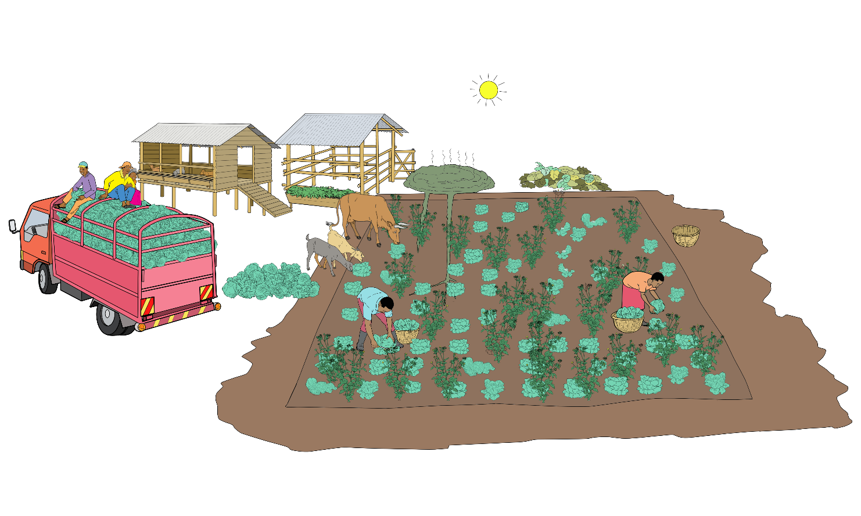
Poor cabbage production practices
Harvesting at mid-day
Contact of animal manure with vegetables
Rotting plant residues in proximity of fields
Inappropriate transportation
Poor crop hygiene
Soil exposed to sun and wind
Monocropping of cabbages
No water source in proximity

Slide 2
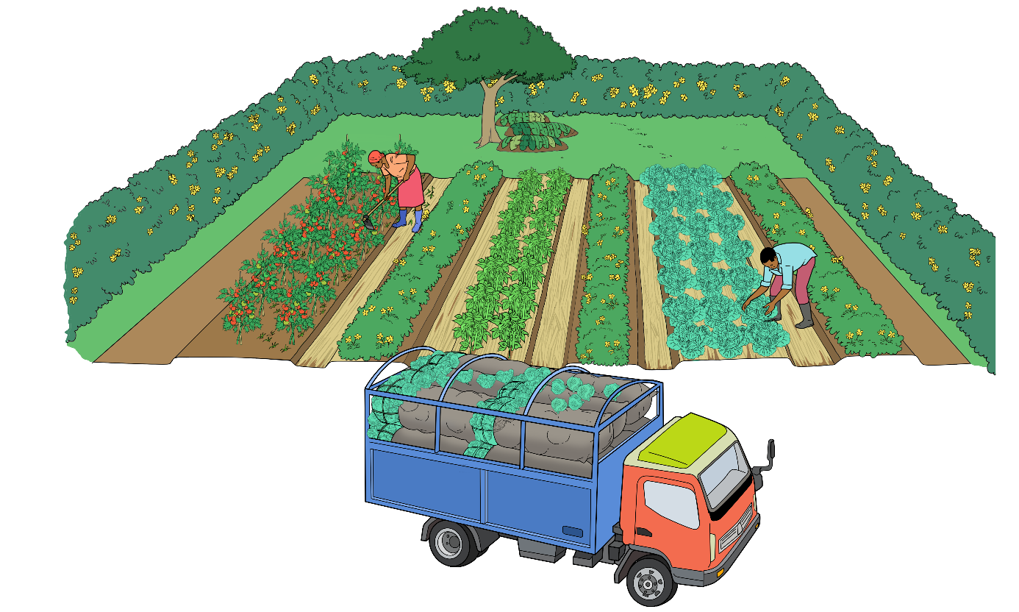
Improved cabbage production practices
Proper recycling of crop residues
Harvesting early in the morning
Boundary between animals and vegetables
Water source in proximity
Planned rotation of crops
Intercropping of cabbages with other vegetables
Protection of the soil with mulch
Hedges to protect vegetables from wind and provide some shade
Proper crop hygiene
Good transportation

Slide 3
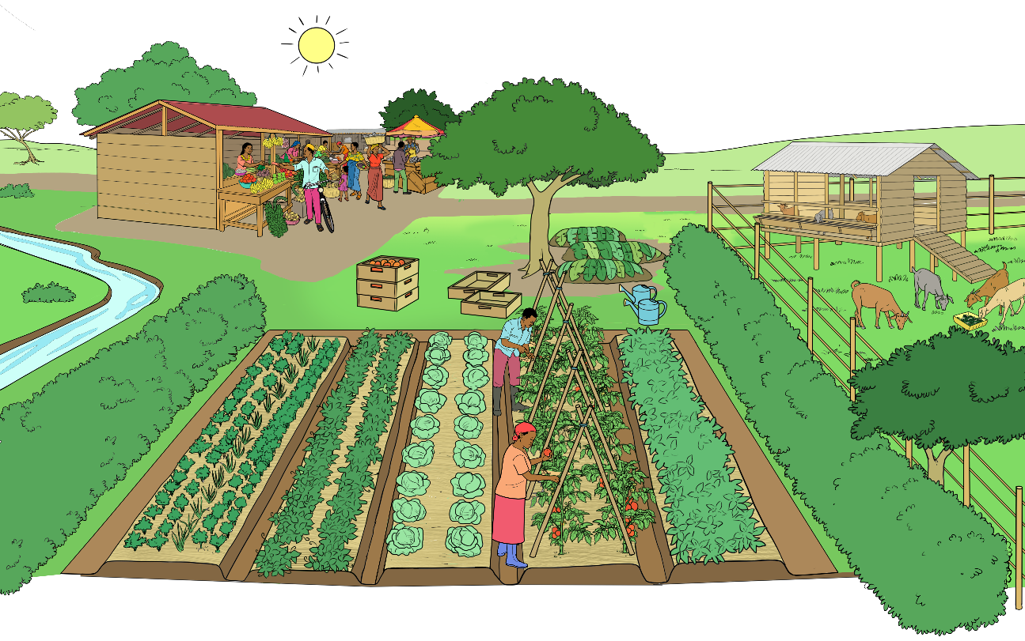
Motivations for organic farming
Conserving the natural resources soil, water, and air
Feeding the animals with farm-own feed
Increasing farm income
Reducing dependence on external inputs
Improving natural soil fertility
Increasing yields and yield stability
Avoiding the use of chemical-synthetic pesticides
Producing healthy food

Slide 4
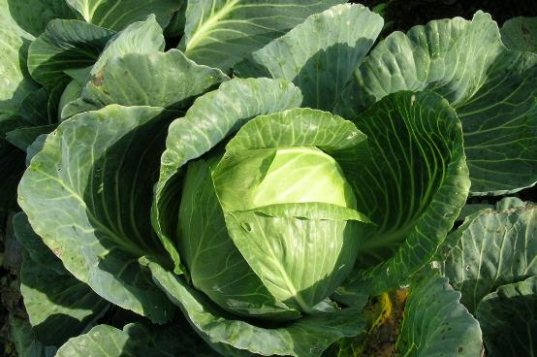
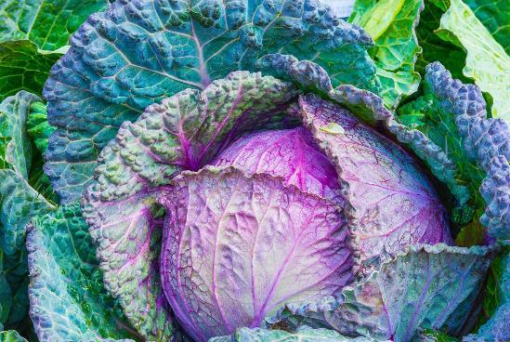
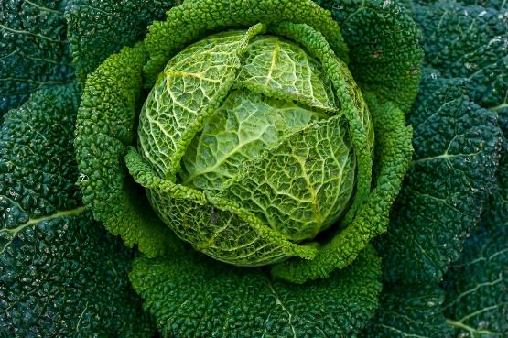
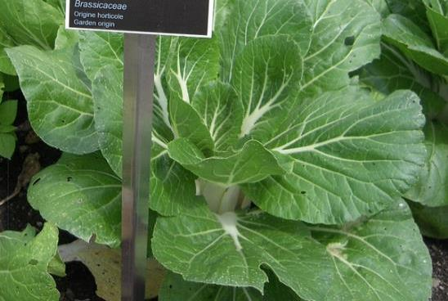
Different types of cabbage
Green (or white) cabbage
Red cabbage
Photo: Anja Vieweger, FiBL
Photo: Jose Antonio Alba on Pixabay
Savoy cabbage
Chinese (or Napa) cabbage
Photo: Franck Barske on Pixabay
Photo: lyetstan on Pixabay

Slide 5
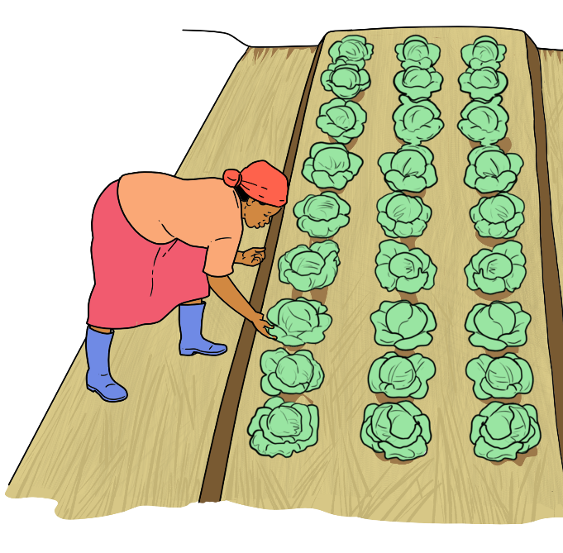
Production requirements of cabbages
Optimum temperature:
18 and 20 ºC
Day length:
neutral
Water requirements:
30 to 40 mm per week (30 to 40 litres per m²)
Soil requirements:
deep, well-drained loamy, fertile soils with a slightly acidic to neutral pH (about 6 for light soils and 7 for heavier soils)

Slide 6
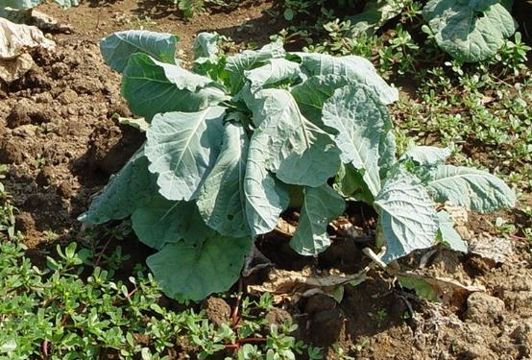
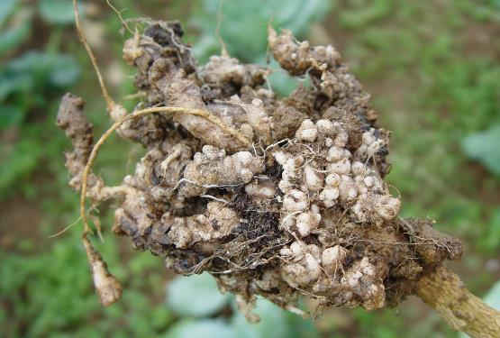
Symptoms of club root disease
Yellowing leaves
Wilting during hot days
Stunted growth
Swollen roots, into thick, irregular club shapes.
Formation of galls on the roots.
Eventually rotting of the roots and dying of the plant
Wilting
Photos: Gerald Holmes, Strawberry Center, Cal Poly San Luis Obispo, Bugwood.org
Galls on the roots

Slide 7
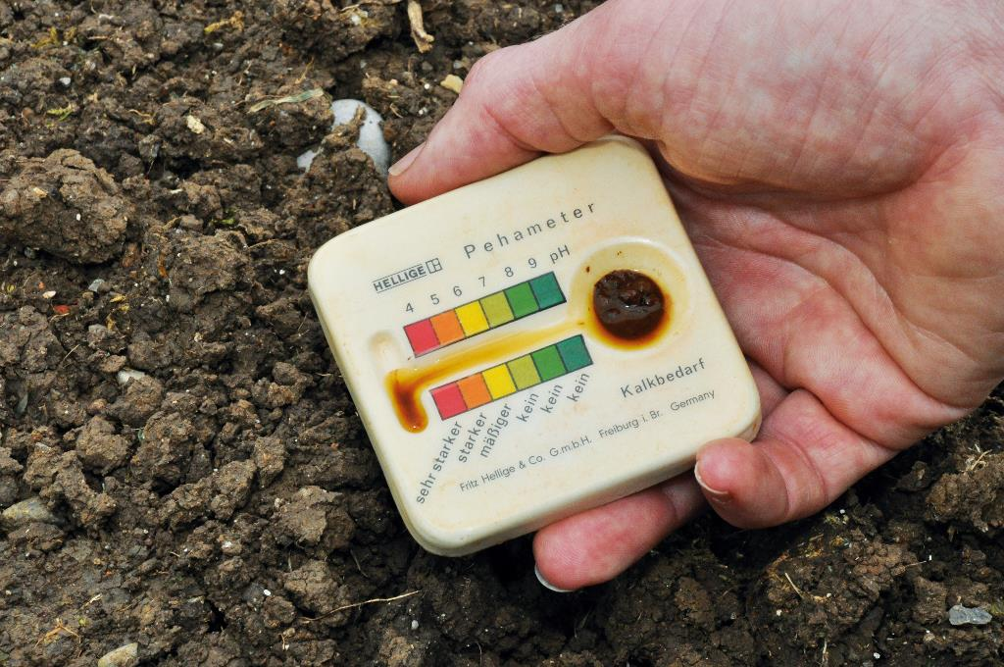
Soil pH test kit
Example of a simple set for soil pH measurement. With a small spoon, a little soil is placed on the pH measuring plate and drizzled with 1 ml indicator solution. Depending on the pH value of the soil, the soil sample changes colour to the indicator colour.
Photo: Thomas Alföldi (FiBL)

Slide 8
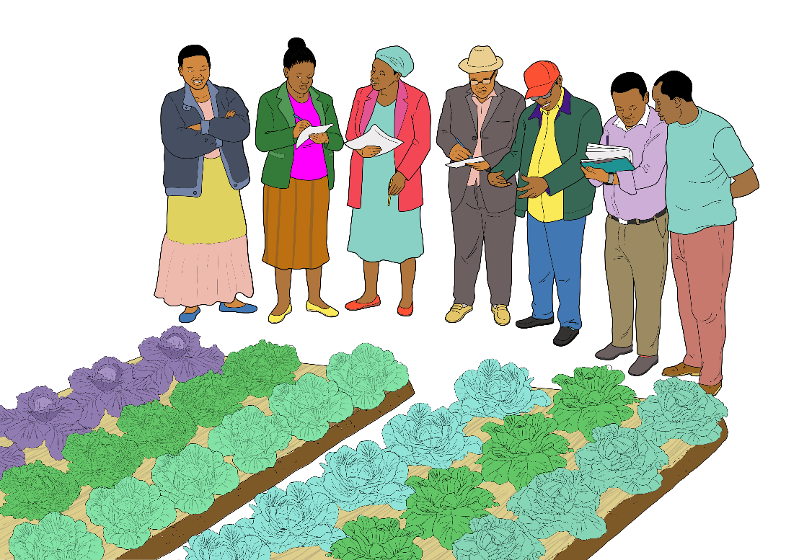
Variety selection
Length of growth (days to maturity)
Resistance or tolerance to major diseases prevailing in the area
Suitability for prevailing growing conditions, e.g. soil, temperature and others
Market availability and target market requirements
Type of head formed in relation to intended use

Slide 9
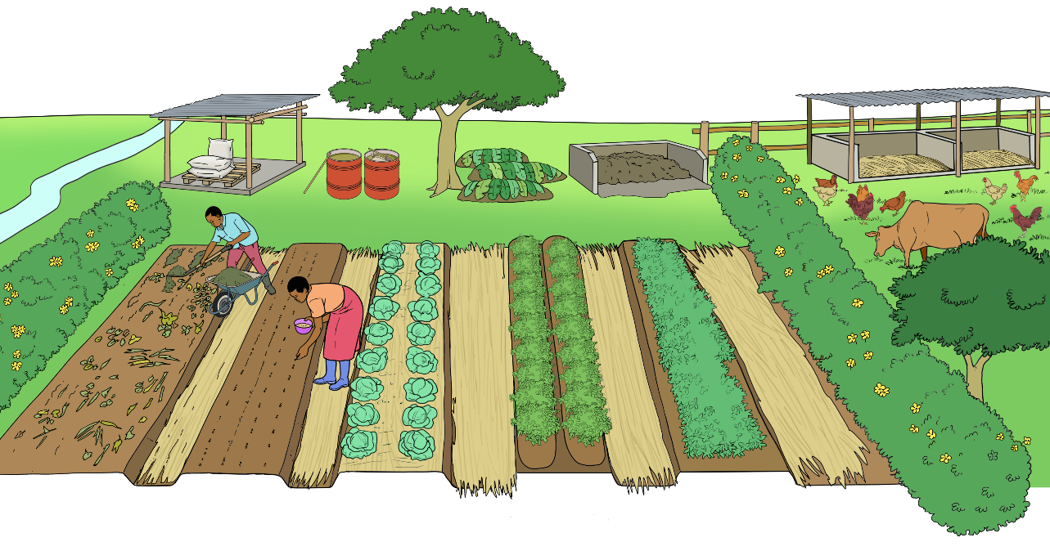
Nutrient sources for fertilisation
Rock phosphate
Tea and manure extract
Lime
Compost
Animal manure
Crop residues
Soil nutrient reserves
Nitrogen fixed by legumes

Slide 10
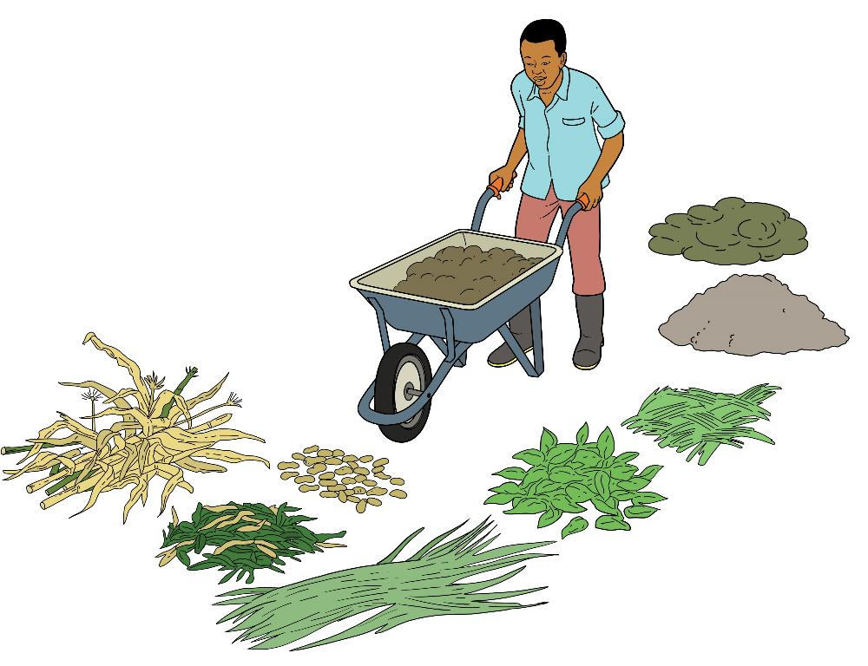
Raw materials for compost production
Animal manure
Ashes
Leaves and gras
Crop residues

Slide 11
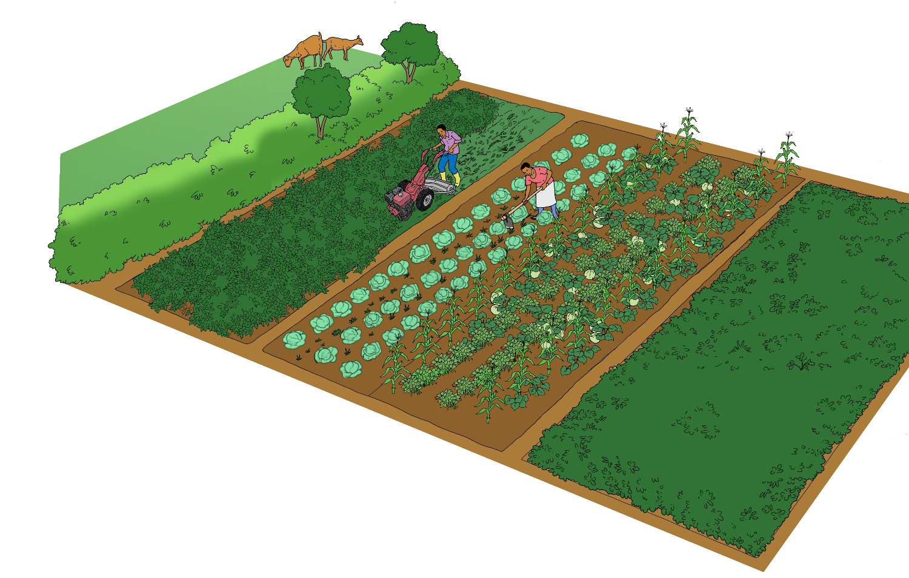
Enhancing nutrient availability
Nutrient mobilisation through hoeing

Slide 12
N, P, K contents of selected organic sources
Sources | Nitrogen (%) | Phosphorus (%) | Potash (%)
Saw-dust | 0.1 | 0.2 | 0.4
Rice husks & hulks | 0.3 – 0.5 | 0.2 – 0.3 | 0.4 – 0.5
Farmyard manure | 0.4 – 0.5 | 0.25 | 0.5
Compost manure | 0.5 – 0.6 | 1.5 | 2.3
Molasses | 0.7 | – | 5.32
Bone meal | 3 – 4 | 15 – 20 | –
Poultry manure | 3.8 | 1.5 | 1.7
Cotton cake (with rind) | 4.0 | 1.9 | 1.6
Neem cake | 5.2 | 1.1 | 1.5
Sesame cake | 6.2 | 2.0 | 1.2
Cotton cake (without rind) | 6.4 | 2.9 | 2.2
Source: https://newagriindia.com/nutrient-content-in-manures-and-fertilizers/

Slide 13
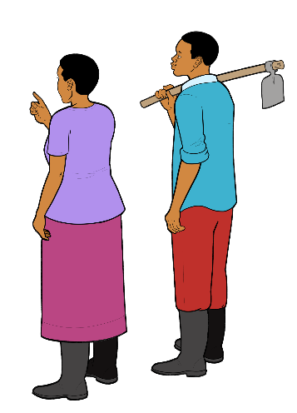
Availability of phosphorus in relation to soil pH and organic matter content
 |  | Organic matter
pH |  | <2 % | 2 – 5 % | >5 %
 | <4.5 | very low | low | moderate
 | 4.5 – 6.0 | low | moderate | high
 | 6.0 – 7.5 | moderate | high | very high
 | >7.5 | low | moderate | high

Slide 14
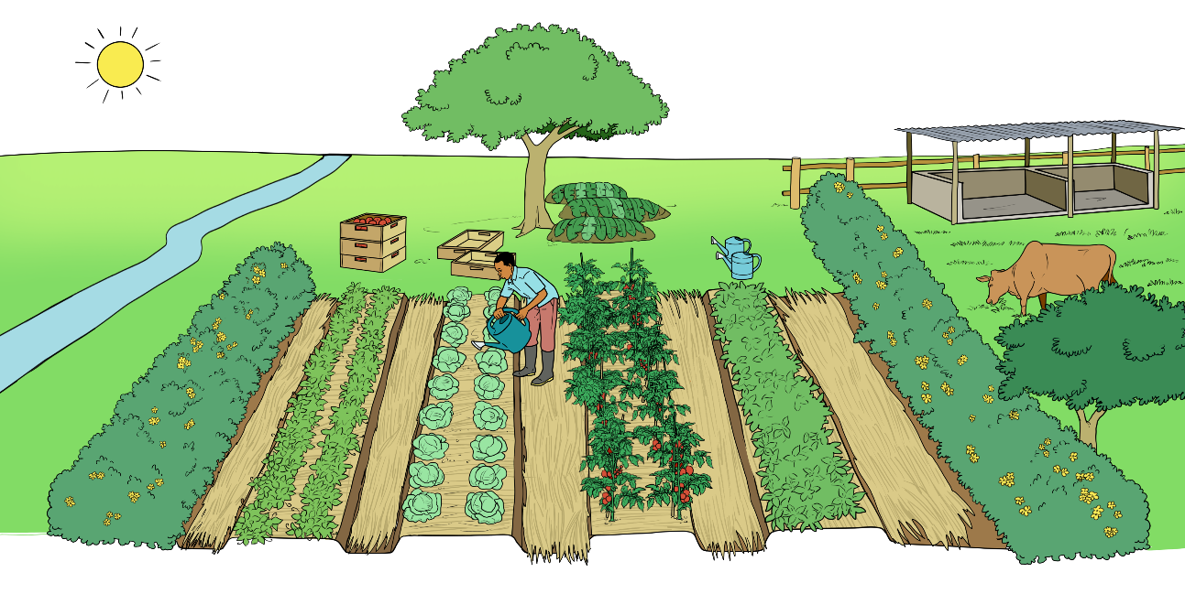
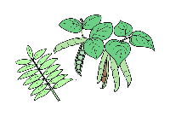
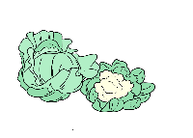
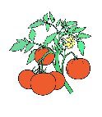
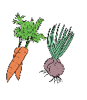
Cabbage in rotation with other vegetables
1
2
3
1
After every growing season, on a given plot, a new crop is grown according to the crop rotation plan
1
2
3
1
Green manure or legume crop
e.g. velvet bean, sunhemp, bean or pea
Heavy feeder
e.g. cabbage, broccoli, kale, spinach
Medium or light feeder e.g. tomato, pepper, potato, carrot, onion
Green manure or legume crop
e.g. velvet bean, sunhemp, bean or pea

Slide 15
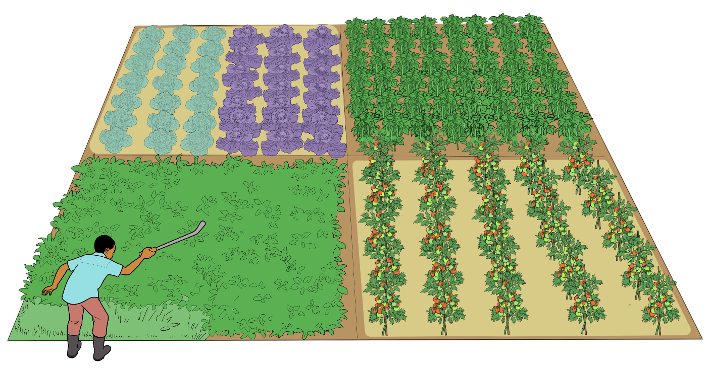
4-year rotation with cabbage
Cabbages
Beans
Heavy feeder
Legume crop
Medium feeder
Green manure
Tomato

Slide 16
Examples of intercrops with cabbage
Cabbage - coriander
Cabbage - tomato
Cabbage - field beans

Slide 17
Seed quantities, germination and planting distances
 | Chinese cabbage | Kale | White/red cabbage | Broccoli | Cauliflower
Thousand kernel weight (TKW) | 3 to 4 g | 3 g | 3 to 4 g | 2.5 to 3 g | 2.5 to 4g
Seed requirement for transplanting | 2 to 4 g/a | 1 g = 180 plants | 1 g = 100 to 150 plants | 1 g = 100 to 150 plants | 1g = 150 plants
Seed requirement for direct sowing | 4 to 7 g/a | 15 g/a | 3.5 to 6 g/a | - | -
Sowing depth | 2 cm | 1 cm | 1 to 2 cm | 1 cm | 1 cm
Germination temperature | 18 to 22 °C | 15 to 20 °C | 18 to 20 °C | 15 to 20 °C | 15 to 20 °C
Germination duration | 4 to 6 days | 5 to 10 days | 6 to 10 days | 6 to 10 days | 6 to 10 days
Planting distance (between rows / in the row) | 35 cm / 30 cm | 40 cm / 40 to 70 cm | 40 to 60 cm / 50 to 60 cm | 50 cm / 40 to 50 cm | 50 cm / 50 to 60 cm

Slide 18
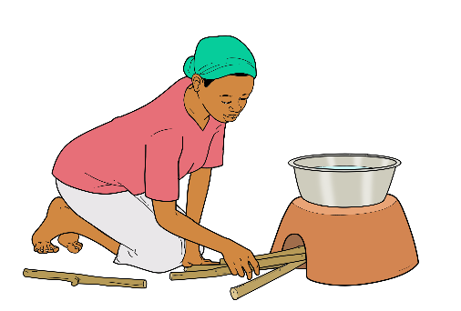
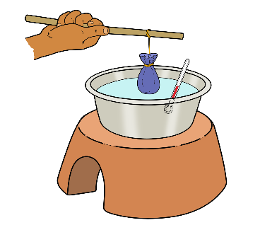
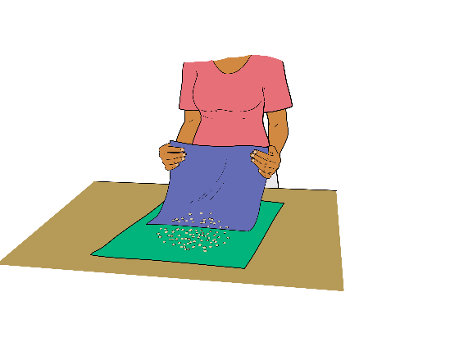
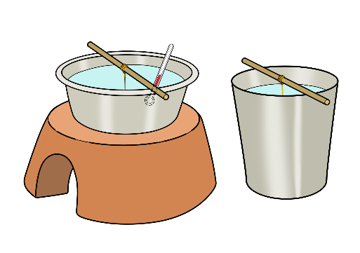
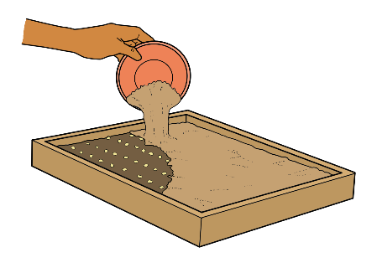
Seed hot water treatment for disease control
This treatment is useful to control seed-borne diseases like Alternaria leaf spot, bacterial leaf spot, black leg and black rot.
1
2
Heat some water in a good sized pot to 50 °C.
Wrap the seeds in a clean piece of cloth and immerse them into the water at the recommended temperature.
3
4a
4b
Warm water
Cold water
Maintain the temperature and leave the seeds in the water for 25 minutes. Then cool the seeds in cold water for 5 minutes.
Spread the seeds on a clean and dry piece of cloth or paper, and allow to dry before storage.
Or sow immediately.

Slide 19
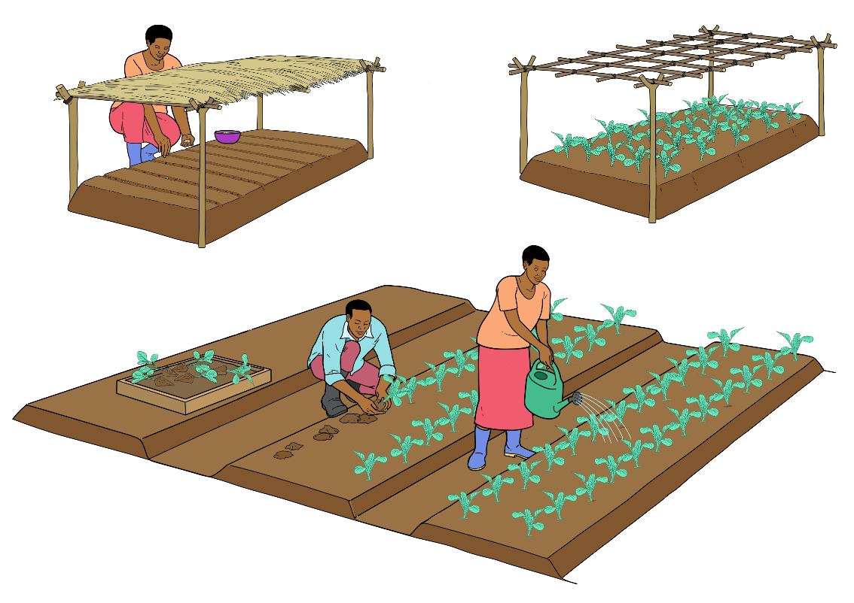
Seedling production in nursery beds
1
2
Sowing into shaded nursery beds
Hardening-off before transplanting
3
Transplanting

Slide 20
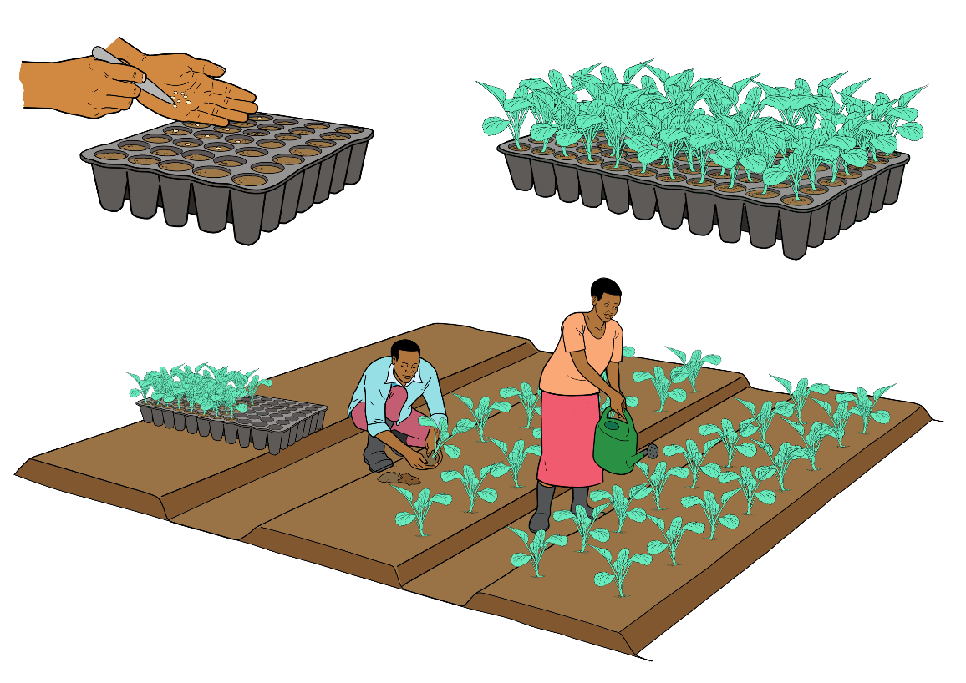
Seedling production in trays
1
2
Sowing into trays
Hardening-off before transplanting
3
Transplanting

Slide 21
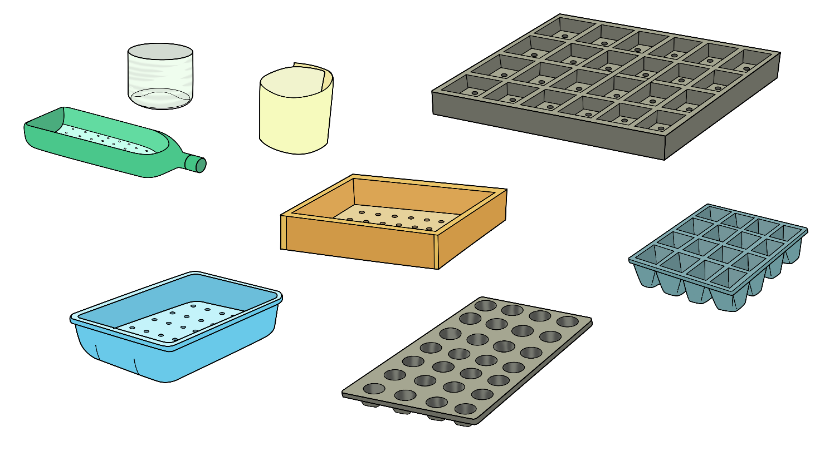
Examples of containers for seedling production
Empty tins cut to the right size
Empty buckets cut to the right size
Tray for large seedlings
Empty plastic/hard paper bottles
Wooden box with holes
Tray for medium size seedlings
Old dish with holes
Tray for small seedlings

Slide 22
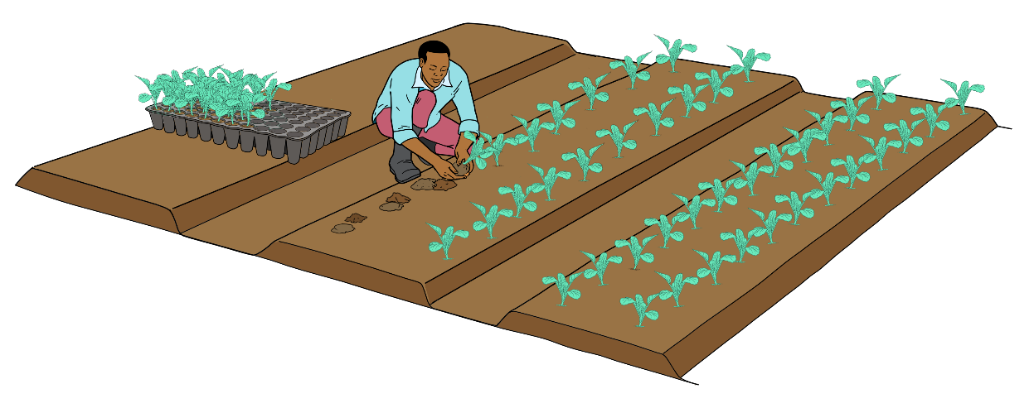
Field establishment
Within rows
Between rows
 | Chinese cabbage | Kale | White/red cabbage
Distance between the rows | 30 cm | 40 to 70 cm | 50 to 60 cm
Distance within the rows | 35 cm | 40 cm | 40 to 60 cm

Slide 23
Mechanical weed management strategy
Harvest
Weeks
Planting
Normal weed pressure
Cover crop
High weed pressure
Cover crop
1 False seedbed
2 Seedlings in pots: tine cultivator with protective disks or brush cultivator; speedies planted deeply: chain harrower or finger weeder
3 Rotary hoe or tine cultivator with ridging bodies; alternate ridging and de-ridging
Weed sensitive period
Tine weeding
Harrowing

Slide 24
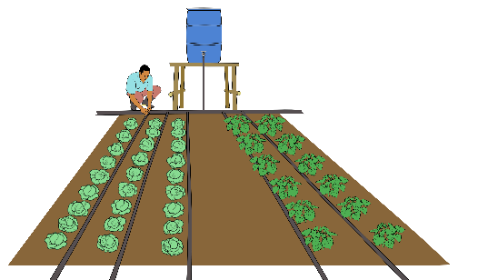
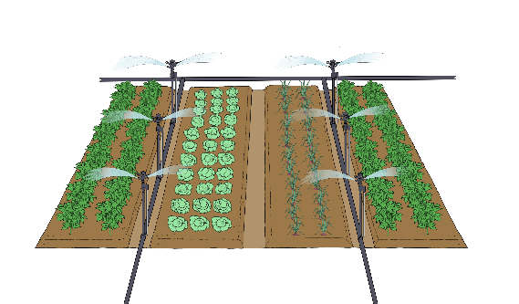
Irrigation of cabbage
 | Drip irrigation | Sprinkler irrigation
Advan-tages | Very high irrigation efficiency Lower investments than for mini-sprinklers Low labour requirement Minimal water losses through evaporation or percolation Irrigation possible at any hour during the day Low fungal disease pressure because of dry canopy | Suitable for light soils Suitable for sloping or uneven fields Can be used to reduce ET by reducing leaf temperature
Disadvan-tages | Clogging of emitters by algae, bacterial slime or sediments possible Root zone restricted to the wetted area Sub-optimal wetting pattern in light soils Needs an efficient filtering system. Salt accumulation in the border zone between dry and wet soil Drip lines hinder mechanical weeding. Subsurface drip systems: maintenance difficult and costly | Big droplets can damage the soil structure (especially from rain-guns). Requires high capacity pumps and pressure-walled piping. Risk of increased disease pressure in over-canopy irrigation Uneven water distribution pattern Water loss through drift, evaporation and irrigation of unproductive areas Use of clean water only to avoid soiling High energy requirement

Slide 25
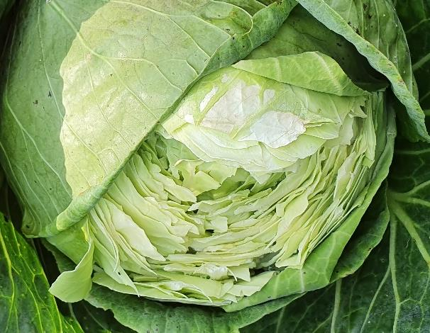
Cabbage head cracking
Cracked cabbage head due to irregular or too much water supply, or heavy rains during late growth
Photo: Irene Kadzere, FiBL

Slide 26
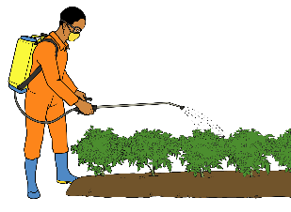
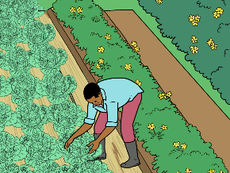
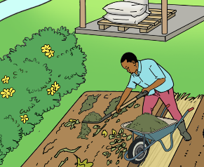
3-step approach to pest and disease management
3rd step
Direct control
Applying physical control measures and natural pesticides
2nd step
Habitat management
Enhancing natural enemies, distraction of enemies and good aeration of the crop
1st step
Crop management
Providing good growing conditions for strong plants

Slide 27
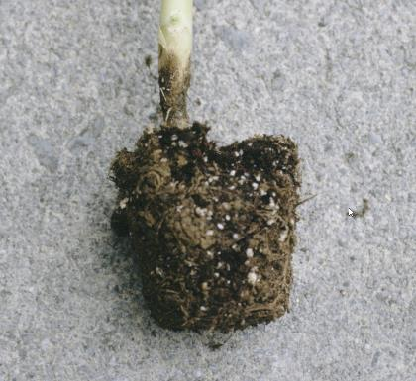
Damping-off diseases
(Pythium, Rhizoctonia and Alternaria species)
Symptoms | Wilted plants which turn purple and die. Emerging seedlings collapse. Plants often without lateral roots.
Important to know | Caused by several different fungi and fungus-like organisms. Often favoured by cool, wet conditions that slow germination and seedling growth.
Measures before planting | Soil sterilisation through solarising or other heat treatments. Use of healthy seed and seedlings. Use high-quality compost only. Clean growing containers carefully.
Measures after planting | Ensure optimum growing conditions (optimum temperature, even humidity, sufficient ventilation).
Measures in case of infestation | Rogueing off and destroying infected cabbages and volunteer crops or host weeds.
Photo: Mary Ann Hansen, Virginia Polytechnic Institute and State University, Bugwood.org

Slide 28
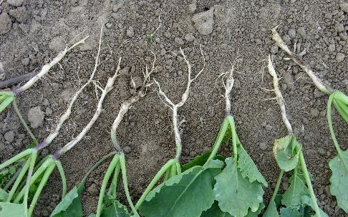
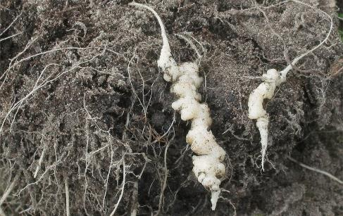
Clubroot
(Plasmodiophora brassicae)
Symptoms | Stunting and wilting Infected plants turn purplish The roots form swellings which produce a foul smell when rotting.
Important to know | The disease is aggravated by acidic soils and poor drainage. The spores can last for up to two decades in the soil.
Measures before planting | Use of well drained sites Liming of acidic soils to increase pH Soil solarisation Planned crop rotation with recommended cultivation breaks between brassicas
Measures after planting | Good irrigation management avoiding waterlogging
Measures in case of infestation | Removal and destruction of affected plants
Early symptoms on roots.
Photo: Astrid Oldenburg
Photo: Rasbak, Wikipedia

Slide 29
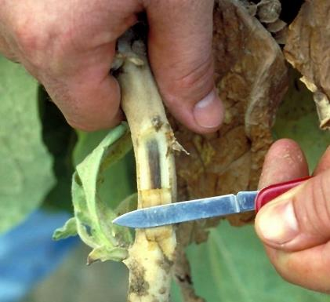
Fusarium wilt
(Fusarium oxysporum f.sp. conglutinans (cabbage fusarium wilt)
Symptoms | Yellowing of the lower leaves, often on one side of the plant only. Discoloured vascular tissue. Infested leaves turn brown and drop off.
Important to know | More common during summer periods. Once present, the fungus survives indefinitely in the soil.
Measures before planting | Avoid introducing the pathogen to clean fields. Use of resistant varieties Planned crop rotations with recommended cultivation breaks between brassicas Plant cabbage in periods with low temperatures when conditions are less favourable for the pathogen. Soil solarisation.
Measures after planting | Practicing good crop hygiene.
Photo: William C. Nesmith, University of Kentucky Research and Education Center, Bugwood.org

Slide 30
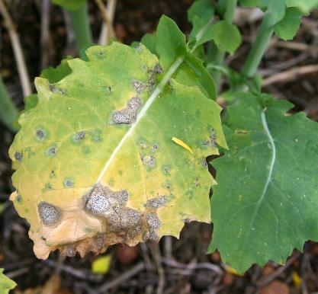
Black leg
Symptoms | Lesions on the stems and leaves with small black dots in the center. Complete plant wilting and yellowing possible. Ultimate death of seedlings possible.
Important to know | The fungus is dispersed by the wind as ascospores or by rain splashes as conidia. Seed borne disease, but can also spread from infected transplants and by insects. In nurseries, an entire seedbed can become infected from a single plant. Grows best in wet conditions at 5 to 20 °C.
Measures before planting | Use of disease-free seeds. In case of infested soil, raising of seedlings in containers in a disease-free medium. Practicing good crop rotations and field hygiene including removal and destruction of all old cabbage plants and related crops. Transplanting only healthy seedlings with no black spots on stems or leaves.
Measures in case of infestation | Spraying of recommended fungicides if disease prevalence is high.
(Leptosphaeria maculans,
Phoma lingam)
Photo: Eleanor Brock, Wikimedia Commons

Slide 31
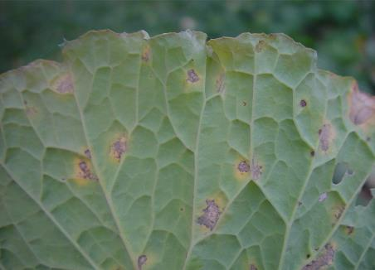
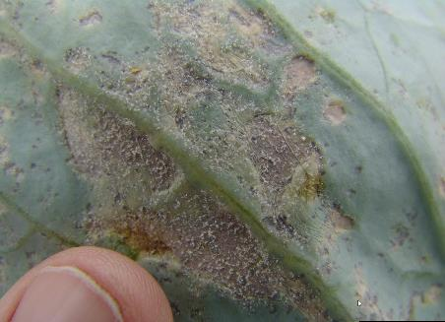
Downy mildew
(Hyaloperonospora parasitica)
Symptoms | Yellow spots on the leaves. Fluffy white mold on the underside of the leaves during humid conditions.
Important to know | Airborne disease More prevalent in humid cool weather Can survive in plant remains in the field.
Measures before planting | Destroying cabbage and other susceptible plant remnants at the end of the season to prevent pathogen carryover to the next crop Planting in a clean bed or field
Measures in case of infestation | Spraying of allowed fungicides to the seedlings (copper preparations).
Photo: Gerald Holmes, Strawberry Center, Cal Poly San Luis Obispo, Bugwood.org
Photo: Gerald Holmes, Strawberry Center, Cal Poly San Luis Obispo, Bugwood.org

Slide 32
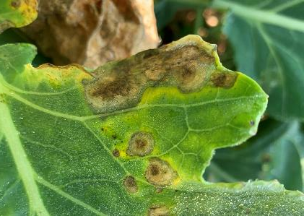
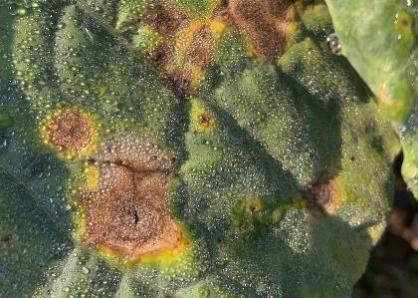
Alternaria leaf spot
(Alternaria brassicicola)
Symptoms | Initially, small, dark spots on older leaves. Later, large circular lesions with concentric rings. The lesion centers can drop off. In wet conditions, brown or black velvety mass of mold spores on lesions possible.
Important to know | Fungal disease. Common during cool, rainy weather. Transmission via seed and infested crop residues.
Measures before planting | Using disease-free seeds. Hot water treatment of seeds before sowing. Transplanting of healthy seedlings only. Practicing good rotations.
Measures after planting | Good crop hygiene. Dry crop management (ideally drip irrigation). Removal of insect nets after pest flights.
Measures in case of infestation | Spraying of allowed fungicides (copper preparations); however effect is unsufficient.
Photo: FiBL
Photo: Irene Kadzere
Photo: Anja Vieweger, FiBL

Slide 33
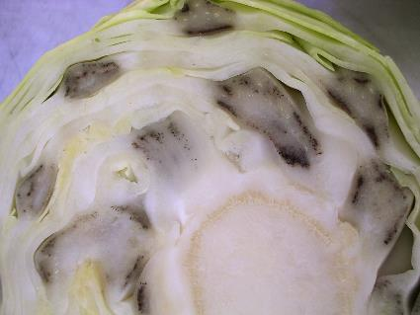
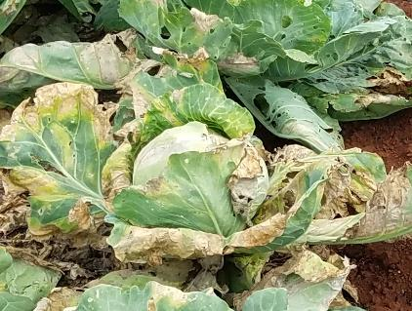
Black rot
Symptoms | Large V-shaped yellow to light brown patches starting at the leaf margins. Black leaf veins, later brown dry patches. Leaf drop and stunting of seedlings. Death of whole seedlings.
Important to know | Seed-borne bacterial disease. Can also be spread by infected plants or insects. The disease can survive for up to 5 years in stems of host plants or in the field.
Measures before planting | Selection of tolerant varieties. Using healthy seed or seedlings. Hot water treatment of the seeds before sowing. Good hygiene, destroying affected plants and cruciferous weeds before transplanting.
Measures after planting | Where possible, avoiding sprinkler irrigation. Increasing irrigation intervals, but taking care to not stress the plants.
Measures in case of infestation | Remove nets when the foliage is dry. Treatment with copper preparations is possible, but in general shows unsatisfactory effect. Chopping up crop residues well and work in superficially to promote rapid decomposition. Clean tools well after use.
(Xanthomonas campestris pv. campestris)
Black leaf veins
Photo: Martin Koller, FiBL
Photo: Nelson, Wikimedia

Slide 34
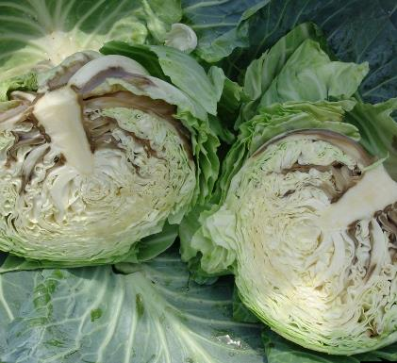
Bacterial soft rot
Symptoms | Initial infection on the outer petiole (leafstalk), then progressing to the head. Infected heads become watery and often the entire head rots, emitting a foul odour.
Important to know | The disease is most severe during storage. The bacteria is spread in the field by water splashes or contact with contaminated tools.
Measures before planting | Planting on ridges or raised beds to prevent waterlogging around the plants. Preventing other or damage that may provide opportunities for soft rot to infest and develop. Applying good crop rotation.
Measures after planting | Washing hands, field tools and harvesting knives – observing good hygiene at all times. Avoiding harvesting when conditions are warm and moist. Harvesting healthy cabbage heads first and storing them in a cool, dry, and airy place.
Measures in case of infestation | Removing and destroying diseased crop residues and volunteer brassicas.
(Erwinia carotovora var. carotovora)
Photo: Gerald Holmes, Strawberry Center, Cal Poly San Luis Obispo, Bugwood.org

Slide 35
Bacterial leaf spot
Symptoms | Initially small, faint, water-soaked areas on the underside of leaves. Brownish to purplish grey irregular necrotic spots. The spots may coalesce or join to form large irregularly shaped spots. Wrinkled leaves with teared tissue.
Important to know | More severe in cool, moist weather.
Measures before planting | Planting tolerant or resistant cultivars. Using disease-free seed or seed treated with hot water before sowing. Using disease-free seedlings. Practicing suitable crop rotation.
Measures after planting | Avoiding sprinkler irrigation. Increasing the interval between irrigation, but without detriment to plants. Controlling cruciferous volunteer crops and weeds which can harbour disease.
Measures in case of infestation | Ploughing infected plant material deep into the soil to bury them.
(Pseudomonas syringae pv. maculicola)

Slide 36
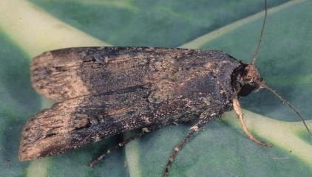
Cutworms
Symptoms | Cut or damaged stems close to the ground level, particularly in young succulent plants. The caterpillars can be found curled at the base of the young plants or inside the soil near the seedlings.
Important to know | The damage occurs during the night as cutworms are nocturnal.
Measures after planting | Practicing good pest scouting. Using pheromone traps to catch the male adult moths. Spraying with garlic concoction to deter the cutworms. Using seedling collars in small plots. Placing abrasive materials, e.g. crushed bones, around the newly planted seedling.
Measures in case of infestation | Removing the cutworm next to damaged plants to prevent further attack on remaining plants.
Photo: Merle Shepard, Gerald R.Carner, and P.A.C Ooi, Insects and their Natural Enemies Associated with Vegetables and Soybean in Southeast Asia, Bugwood.org
Photo: Clemson University - USDA Cooperative Extension Slide Series, Bugwood.org

Slide 37
Aphids
Symptoms | Malformed, distorted, curled leaves.
Important to know | Sap sucking pests. Can transmit different viral diseases which can cause serious problems in cabbage. Cool, dry weather favours aphid development. The Brevicoryne brassicae aphids overwinter as eggs on plant residues.
Measures before planting | Only plant aphid-free seedlings. Cover young plants with insect protection netting when growing outdoors.
Measures after planting | Ensuring rapid plant growth (e.g. with irrigation in dry conditions). Regular checking of crops for infestation. Cover the crop with fine-meshed nets. Promoting natural enemies such as ladybirds.
Measures in case of infestation | Removing and destroying infested plant resi-dues, host weeds and volunteer host crops. Spraying potash soaps against aphids. Spraying pyrethrin (mixed with sesame oil) or neem to prevent build-up of large populations.
(Brevicoryne brassicae, Myzus persicae, Lipaphis erysimi)
Photo: Tichaona Charova (ZOPPA Zimbabwe)
Photo: Whitney Cranshaw, Colorado State University, Bugwood.org
Photo: Martin Koller, FiBL

Slide 38
Bagrada bug
Symptoms | Wilting, deformation and dying of leaves due to sucking of sap. Infected cabbage plants may fail to form heads and affected young seedlings may die. Stunted growth and leaf deformation.
Important to know | Populations can build up quickly reaching damaging densities that require control. Some wasps can feed on the eggs while the hover fly is reported to feed on the adult bugs.
Measures before planting | Rotating host plants with non-host plants. Removing cabbage stumps and crop remains. Frequent light soil cultivation to destroy eggs laid in the soil. Soil solarisation to destroy the eggs and the hatching nymphs.
Measures after planting | Intercropping with strong smelling crops or plants such as garlic deters the bugs. Handpicking of bugs in small plots. Overhead irrigation to keep populations low.
Measures in case of infestation | Spraying with soapy solutions or a mixture of chilies, soap, garlic and paraffin.
(Bagrada cruciferarum, Bagrada hilaris)
Photo: Gevork Arakelian, LA County Dept. Agriculture, Bugwood.org
Photo: Tichaona Charova (ZOPPA Zimbabwe)
Photo: Jennifer Carr, University of Florida, Bugwood.org

Slide 39
Red spider mite
(Tetranychus urticae)
Symptoms | Red spider mites thrive in dry conditions. These tiny sucking pests weave a fine web on the underside of the leaves. They can be devastating, damaging plants permanently if left uncontrolled.
Measures before planting | Practicing good rotations with non-host plants or crops such as celery, amaranthus and others. Raising cabbage nurseries in pest free seedbeds. Applying ashes to the leaves on seedlings in the nursery, especially when they are wet.
Measures after planting | Removing and destroying known host crops and plants, like tomatoes, before planting. Regular scouting for the pest.
Measures in case of infestation | Spraying with neem oil mixed with a soap solution and warm water; or with a mixture of hot red chili mixed with permitted soaps.
Photo: Gilles San Martin on Wikimedia

Slide 40
Cabbage whitefly
(Aleyrodes proletella)
Symptoms | Discoloured patches on the leaves.
Important to know | Contamination of the harvest with sooty mould. At least 5 generations per year. The pest flies all day long.
Measures before planting | Avoid proximity to last year's cabbage fields.
Measures after planting | Cover crop with protective netting before infestation (max. mesh size 0.9 mm). Only effective if there are no other cabbage crops in the immediate vicinity. Promoting natural enemies. Scouting and monitoring the populations.
Measures in case of infestation | Treatment with pyrethrin + sesame oil + rapeseed oil, Azadirachtin, fatty acids, or Beauveria bassiana when the net is removed for hoeing.
Photo: FiBL
Photo: Martin Koller, FiBL

Slide 41
Thrips
(Thrips tabaci Frankliniella spp.)
Symptoms | Rough bronzed blisters on leaves inside the cabbage head.
Important to know | Sap sucking insect.
Measures before planting | Practicing good crop rotations. Cultivating and harrowing before transplanting to destroy pupae in the soil.
Measures after planting | Promoting natural enemies, such as predatory bugs, predatory mites and predatory thrips. Planting non-host crops like oilseed rape, and winter cereals such as oats.
Measures in case of infestation | Spraying the cabbages with neem oil mixed with a permitted soap and water can repel thrips. If available, Spinosad-based sprays can control the thrips.
Photo: Hansueli Höpli, Agroscope
Photo: Gerald Holmes, Strawberry Center, Cal Poly San Luis Obispo, Bugwood.org

Slide 42
Diamondback moth
(Plutella xylostella)
Symptoms | Small holes on the outer side of leaves or growing points of young plants
Important to know | Some fungi such as Entomophthorales can attack the larvae.
Measures before planting | Intercropping brassicas with trap plants such as Indian mustard, and repellent plants such as tomato.
Measures after planting | Covering seedlings and crops with fine nylon mesh from the beginning. Promoting natural enemies, or release the parasitoid wasp such as Diadegma semiclausum and the egg parasite Trichogramma pretiosum. Other natural enemies include spiders, lacewings larvae, syrphid fly larvae, and some beetles. Sprinkler irrigation or heavy rainfall can drown young larvae.
Measures in case of infestation | Spraying insecticidal soaps against aphids. Spraying pyrethrum or neem punctually only to prevent build-up of large populations. Spraying Bt-based products. Avoid broad use of pyrethroids.
Larva
Photo: Clemson University, Wikimedia
Moth
Photo: James Lindsey, Wikimedia

Slide 43
Cabbage webworm
(Hellula undalis)
Symptoms | Webs over leaves and growing points.
Important to know | The webworm larvae feed on leaves and growing points.
Measures before planting | Removing and destroying plant debris which might be carrying the pest. Planting repellent plants such as tomatoes, onions, garlic and herbs like thyme and sage which deter the larvae.
Measures after planting | Promoting natural predators of the pest by planting flowering plants around or near the cabbages to ensure a good habitat for them. Practicing good rotations.
Measures in case of infestation | Spraying the cabbages with neem extracts and Bt.
Photo: Ben-Sale-Wikimedia

Slide 44
Cabbage fleas
Symptoms | Small holes, some of which may not go all the way through the leaf. Hole surrounded by pale brown scar tissue.
Important to know | Newly transplanted seedlings are most susceptible, especially in dry, warm weather. The beetles hibernate in the soil near cruciferous plants such as weeds, green manures, and crops.
Measures before planting | Avoiding plots or fields where cruciferous plants were growing before. Transplanting seedlings that are strong and can withstand the pest pressure
Measures after planting | Maintaining a rough tilth during cultivation. Covering the seedlings with nets if possible. Dusting the cabbages with stone meal.
Measures in case of infestation | Spraying with permitted substances, e.g. Heliosol to delay infestation. Avoiding dry conditions which promote beetle multiplication. Regular watering can help to control the pest. Treatment with Spinosad.
(Phyllotreta spp.)
Photo: Anja Vieweger, FiBL
Photo: Martin Lichtenhahn, FiBL

Slide 45
Loopers
Symptoms | Irregular holes in the leaves. Complete defoliation in case of heavy infestations. Burrowing of the loopers into the cabbage heads.
Measures before planting | Practicing suitable crop rotations and mixtures. Promoting natural enemies like parasitic wasps and flies. Birds and bats feed on the adult moths. Planting clean seedlings (inspect the seedlings for eggs before transplanting).
Measures after planting | Removing plant residues after harvest to prevent possible carry-over of the pest. Covering the crop with nets.
Measures in case of infestation | Picking caterpillars by hand and destroying them. Sprinkling food grade diatomaceous earth onto the leaves. Spraying neem-based products or Bt in the early growth stages.
(Trichoplusia ni)
Photo: Wikimedia Commons
Photo: Lua Eva Blue, Wikimedia Commons

Slide 46
Nematodes
Symptoms | Stunted growth with signs of nutrient and/or moisture stress.
Important to know | Tiny organisms. Easily transmitted through soil movement, with runoff water from infected fields, with soil on transplanted seedlings, on farm implements and tools
Measures before planting | Selecting or planting tolerant varieties. Using clean nursery beds or sowing media (soil solarisation before sowing). Using clean seedlings and planting them into a clean field.
Measures after planting | Removing and destroying infected host plants, and other good hygiene strategies such as cleaning farm implements and tools after use. Practicing good plant rotations. Applying heavy mulch to limit runoff and reduce nematode movement.
Measures in case of infestation | Applying neem cake can suppress some harmful nematodes.
(Meloidogyne species)
Photo: Jeffrey W. Lotz, Florida Department of Agriculture and Consumer Services, Bugwood.org

Slide 47
Nets (and fleeces) for pest control
Advantages:
Effective protection against pests.
Reduced reliance on (expensive) pesticides that can impact beneficial organisms.
Reduced evaporation of water (higher water efficiency).
Higher temperatures under the net improving the growing conditions in cold weather.
Reduction of damage from hail.
Disadvantages:
Relatively high costs for large-scale use.
Additional labour for removing and reapplying the nets (e.g. for weed control).
Promotion of fungal diseases towards the end of the crop (especially under fine nets). Early removal of the nets can prevent this.
Risk of pressure damage to leaves on sensitive crops (e.g. lettuce) in strong winds and rain.
Risk of heat accumulation in hot weather.

Slide 48
How to use nets
Key considerations:
Use suitable nets for the specific pest and crop.
Cover seedbeds even before the seedlings emerge, and cover seedlings immediately after transplanting.
Transplant only pest-free seedlings.
Transplant only into pest-free fields.
Anchor the nets well in the ground at the edges and close them tightly.
Regularly inspect net-covered crops for pests. Pest populations under the net can rapidly increase.
Do operations which require removal of the net when the pest is less active (e.g. cabbage flies fly in the morning and evening, earth fleas are active in the sun).
Put back nets in place immediately after crop operations.
Pay attention needs to possible heat accumulation under the net, and to increased disease pressure in humid weather.
After harvest, cleaned the nets of any plant debris and store them in a clean and dark place.

Slide 49
Types of insect traps
Pheromone sticky trap against swede midge
Traps with attractant (e.g. pheromone) for sampling moths, hoppers and beetles mainly.
Yellow sticky trap against whiteflies, thrips, winged aphids, leaf miners, etc. (may also catch natural enemies such as parasitic wasps, midge flies and ladybirds)

Slide 50
Companion cropping for pest control
Coriander: strong scent helps to repel some pests.
Tomatoes: can reduce diamondback moth.
Chilies: repel the diamondback moth.
Indian mustard: acts as trap for the diamondback moth.
Dill, spinach or beans: can reduce aphid infestations on cabbage.
Additional good companion crops to cabbage: lettuce, cucumbers, celery
Not suitable: other brassicas and alliums like garlic and onions
x

Slide 51
Promoting beneficial insects with flower strips
1
Flower strips attract the beneficial insects with an early and rich supply of nectar.
2
A cabbage whitefly braconid wasp Cotesia glomerata parasitising cabbage whitefly larvae.
Photo: Henryk Luka, FiBL
After planting the cabbage, the flower strip continuously provides food and shelter for the beneficial insects. Cornflowers placed between the cabbage plants serve as stepping stones and promote parasitisation of the pests.

Slide 52
Using nets and/or flower strips?
 | Without net | With net
Climate | Rapid drying of the moist crop | Increased humidity and risk of leaf spot diseases such as Alternaria Heat accumulation possible
Beneficials | Access to the crop | No access to the crop Pests that are under the net can multiply unhindered.
Pests | Regulation with selective plant protection products partly possible | Effective against all pests with suitable mesh size
Cultural measures | No restriction | The net must be removed before hoeing and weeding and the crop must be covered again immediately afterwards. The weeds wither less well.

Slide 53
Browning of the midrib
Symptoms | When leaves are damaged, the midrib part often turns to a brown colour (discoloration). This is more common in cabbages that are harvested late or at an overmature stage. The damaged parts also serve as entry points for pathogens.
How to prevent | Avoiding or minimising damage to the leaves during harvest and postharvest handling.

Slide 54
Yellowing
Symptoms | Gradual loss of the green colour from the leaves resulting in yellowing of the leaves.
How to prevent | Minimising storage at room temperature. Providing adequate ventilation during storage. Avoiding storing cabbage with ethylene producing vegetables and fruits or other products that produce ethylene.

Slide 55
Pepper spot or black leaf speck
Symptoms | The specks may initially develop randomly on the leaves as small spots and may coalesce to form larger ones.
How to prevent | Using resistant varieties Avoiding growing conditions which cause lush or vigorous growth. Minimising storage at room temperature. Ensuring good management of potassium in the soil; high K levels reduce the incidence of the disorder. Avoiding exposure of the heads to warm temperatures after cold storage

Slide 56
Determining maturity for harvest
Criteria:
Number of days from transplanting
Firmness or compactness of the heads
Head size (most commonly used indicator): diameter of 10 to 15 to 25 cm
Arrangement of the wrapper leaves (well spread wrapper leaves with the head exposed)
Type/ variety of cabbage | Time from transplanting to maturity | Shelf life at 98 to 100 % RH and 0 ºC storage
Early maturing varieties | 30 to 45 days | 3 to 6 weeks
Late maturing varieties | 62 to 120 days | 5 to 6 months
Photo: Irene Kadzere
Delays in harvesting cause rotting and further cracking of the cabbages in the field.

Slide 57
Cabbage harvest
Cleaning
Grading
Attributes | Types
Head shape and form | Round Conical Flat Savoy leaves or smooth leaves
Head size | Small (0.8 kg or less) Medium (0.9 to 1.4 kg) Large (1.5 kg or more)
Head compactness | Loose Medium firmness Hard
Leaf colour | Green Red Purple
Trimming the stem end to 2 cm
Removing torn and loose wrapper leaves leaving only 3 to 6 wrappers

Slide 58
Cabbage post-harvest management
Cold storage
Packaging
Charcoal insulated storage structure
Disease and insect free
With no signs of wilting
Rigid containers such as boxes, cartons or large baskets are preferable
Careful handling
For cabbages ideally at more than 95 % relative humidity and 0 °C.

