Slide 1
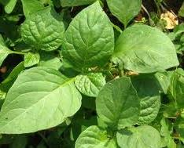
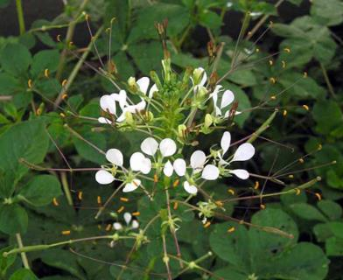
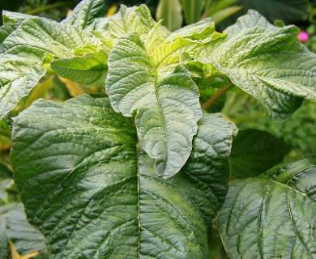
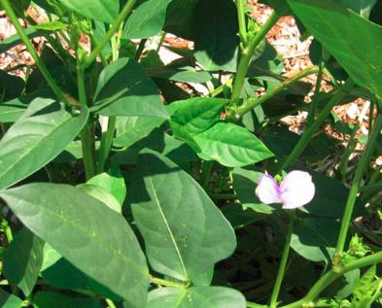
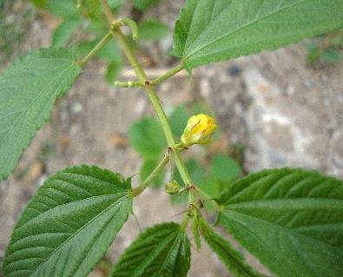
Examples of indigenous vegetables
Photo: Irene Kadzere (FiBL)
Photo: Irene Kadzere (FiBL)
Photo: Irene Kadzere (FiBL)
African nightshade
Spider plant
Amaranthus
Photo: Irene Kadzere (FiBL)
Photo: Wikimedia commons
Cowpea
Jute mallow (bush ocra)

Slide 2
Nutritious parts of indigenous vegetables
Plant | Part consumed as vegetable
African nightshade | Leaves
Spider plant | Leaves
Amaranthus | Leaves
African eggplant | Tender and ripe fruits
Cowpea | Leaves, young pods, grain
Jute mallow | Leaves
Ethiopian mustard | Leaves
Yam, sweet potatoes, cassava, pumpkin, beans | Leaves
Citrullus species | Spined and non-spined fruits like melons

Slide 3
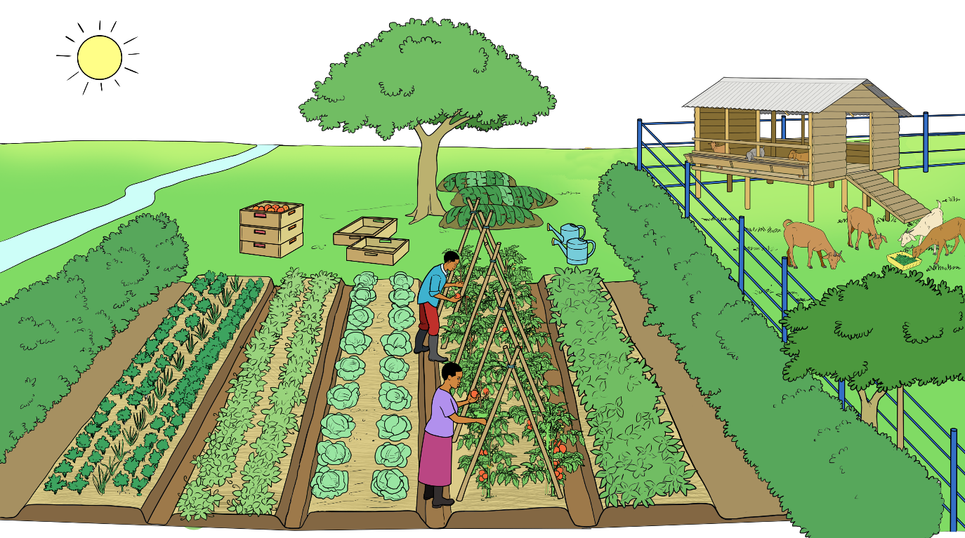
Definition of organic agriculture –
IFOAM Principles of organic agriculture
Health
Ecology
No chemical pesticides
Restoring soil fertility
No livestock feed additives
Promoting biodiversity
Creating a healthy environment
Recycling of nutrients
Care
Fairness
Efficient use of resources
Fair shares for all partners in the value chain
Including traditional knowledge
No GMOs

Slide 4
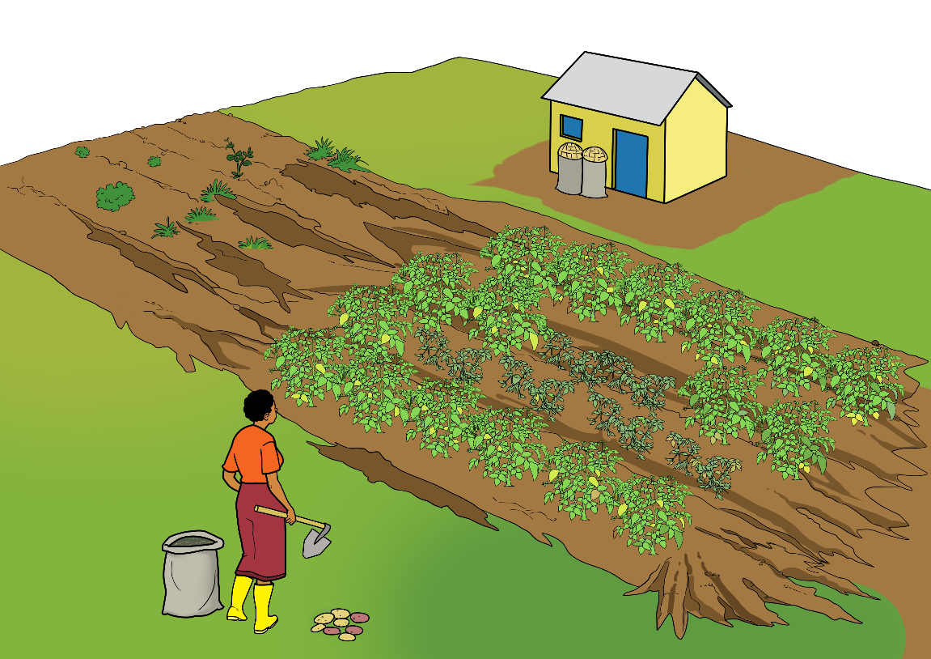

Key challenges in vegetable production
Limited availability of and access to high quality seed
Limited access to markets
Long distances to markets
Competitive markets
High susceptibility of vegetables to pests and diseases
High certification requirements
Limited knowledge and know-how
Poor soil fertility
Human disease pandemics
Limited availability of water
Lack of financial resources

Slide 5
Motivations for organic farming
Conserving the natural resources soil, water, air
Feeding the animals with farm-own feed
Improving natural soil fertility
Producing nutritious and healthy food
Increasing farm income
Increasing yields and yield stability
Renouncing the use of chemical-synthetic pesticides
Reducing dependence on farm inputs

Slide 6
Improved vegetable production situation
Harvesting early in the morning
Separation of animal husbandry and vegetable fields
Proper recycling of crop residues
Water source in proximity
Use of appropriate harvesting containers
Rotation of vegetable crops
Protection of vegetable crops from wind with hedges
Protection of the soil with mulch
Proper crop hygiene

Slide 7
Temperature requirements of vegetables species
Warm season vegetables (ideal temp. of 21 to 35 °C) | Cool season vegetables sensitive to frost (minimal day temp. of 4.5 to 10 °C) | Cool season vegetables not sensitive to frost (minimal day temp. of 4.5 °C)
Cantaloupe | Beets | Asparagus
Cucumbers | Broad beans | Brussel Sprouts
Egg plant | Broccoli | Cabbage
Green beans | Carrots | Garlic
Lima beans | Cauliflower | Kale
Peppers | Celery | Leeks
Pumpkin | Chard | Onion
Snap beans | Chinese Cabbage | Peas
Squash | Lettuce | Radish
Sweet corn | Mustard | Shallots
Sweet potato | Potato | Spinach
Tomatoes
Water melon

Slide 8
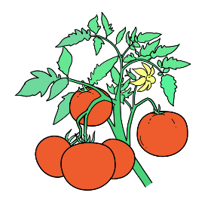
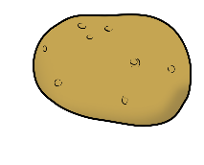
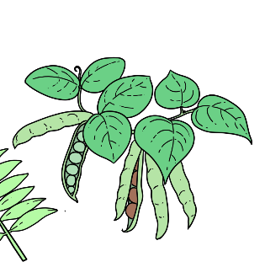
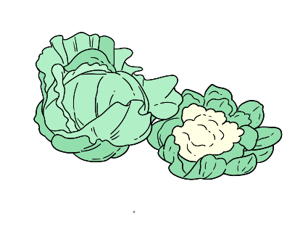
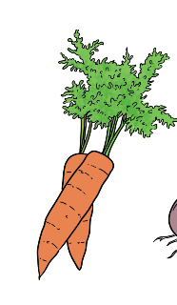

Susceptibility of vegetables to freezing injury
High frost susceptibility | Moderate frost susceptibility | Low frost susceptibility
Beans | Lettuce | Cabbage
Eggplant | Peas | Carrots
Potatoes | Spinach | Kale
Sweet potatoes
Tomatoes

Slide 9
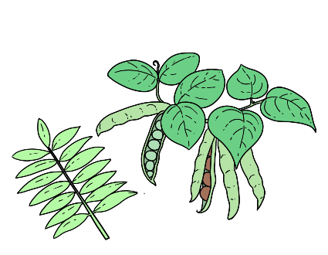
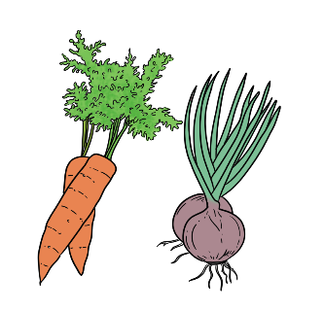
Required day length for proper vegetable growth
Vegetables requiring short day length (examples) | Vegetables requiring long day length (examples) | Day length insensitive vegetables (examples)
Carrot | Black-eyed peas | Brussels Sprouts
Lettuce | Sweet potatoes | Cabbage
Peas |  | Kale
Potato |  | Tomatoes
Onion
Spinach

Slide 10
Water demand of selected vegetables
Examples of vegetables with low water demand (drought tolerant) | Examples of vegetables with high water demand
Bell peppers | Cabbage
Eggplant | Lettuce
Sweet potatoes | Broccoli
Mustard greens | Cauliflower
Peppers | Watercress
Okra | Celery
Swiss chard | Spinach
Squash | Kohlrabi
Water melons | Kale
Chickpea | Taro (Colocasia esculenta)
Lima bean | Garden pea
Amaranthus | Turnips
Tomato (many varieties) | Brussel sprouts
Artichoke | Collards (e.g. Sukuma in Swahili)

Slide 11
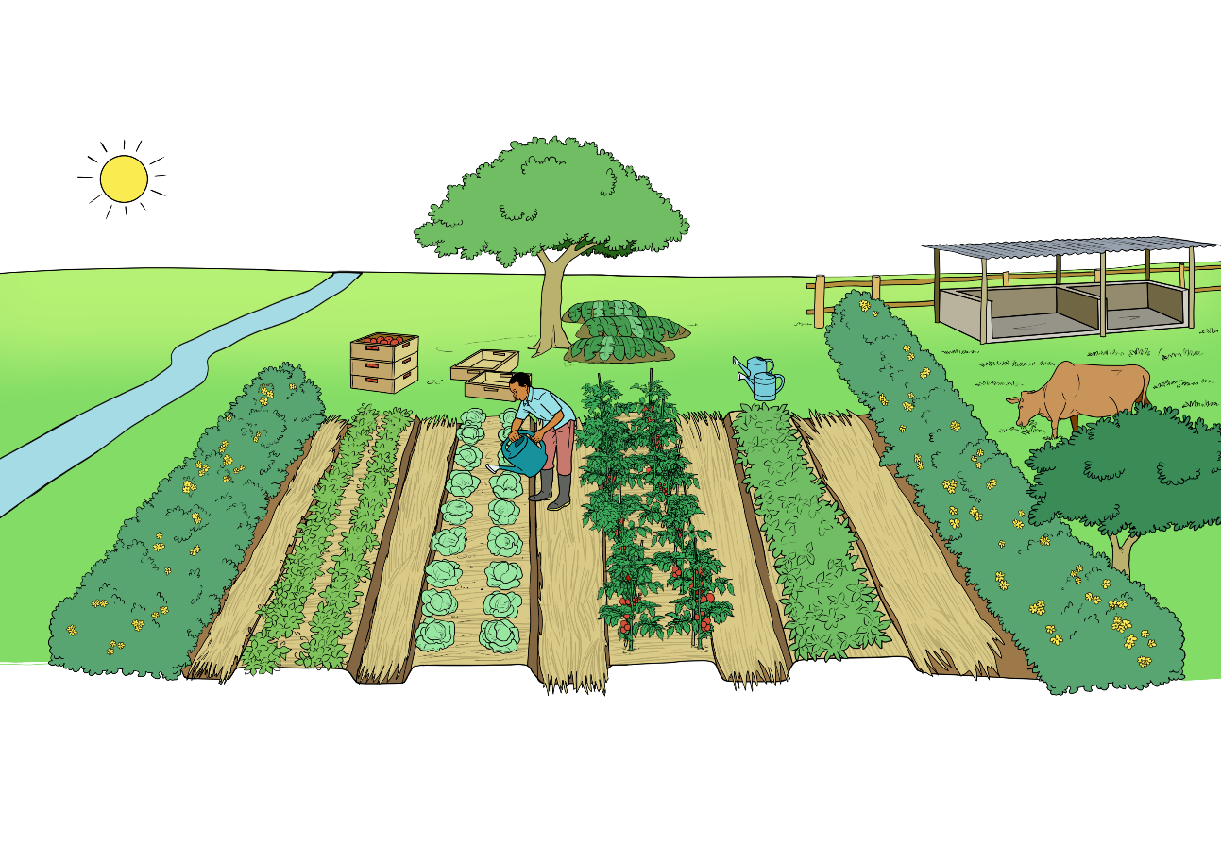
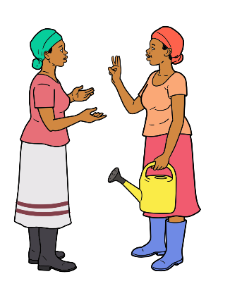
Factors to consider in vegetable species selection
Consider the following aspects:
Does my farm have suitable soils?
Do you grow the vegetable for household consumption or marketing?
Does the species best grow in low, moderate or high temperatures?
How much water does it need?
How much labour does it require?
Which management does it require?
How well does it store?
Are good quality seeds available?
What do I need to consider when I select vegetable species?

Slide 12
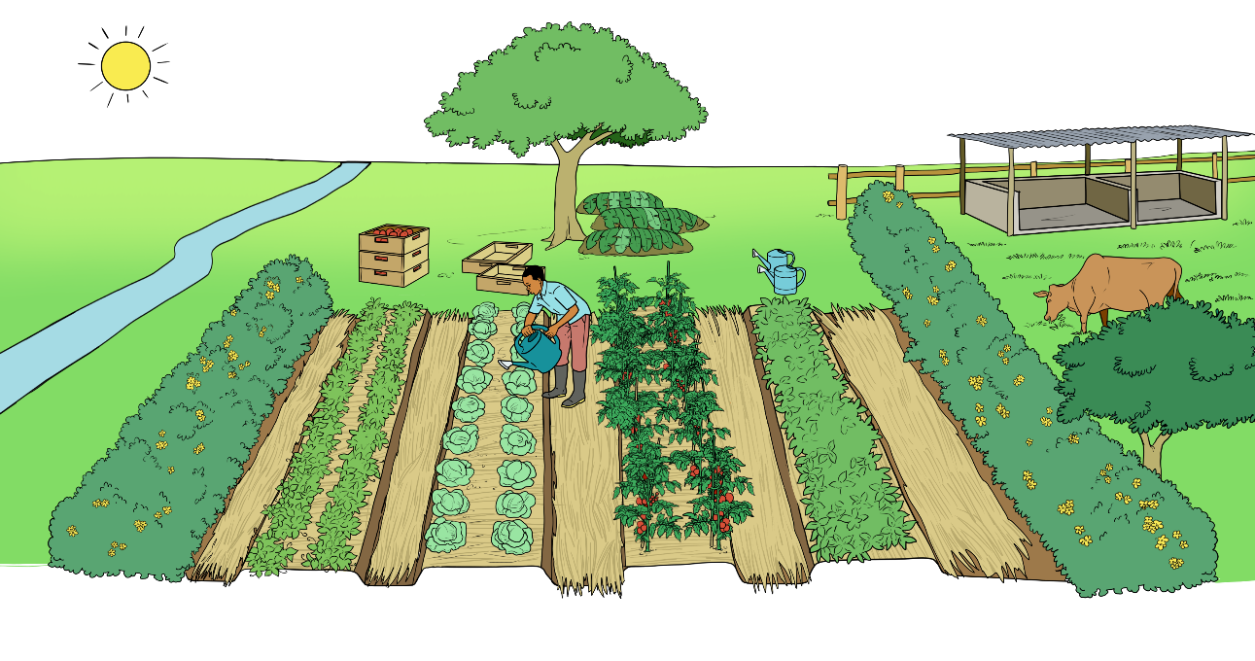
Selecting appropriate varieties
What do I need to consider when I select vegetable varieties?
Consider the following aspects:
What are the market requirements?
What growth habit does the variety have?
How much time does it need to maturity?
How much sunny days does it require?
To which pests and diseases is it resistant?
What yield potential does it have?
How well does it store?
Are good quality seeds available?

Slide 13


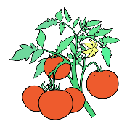
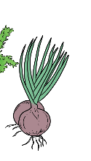



Soil pH tolerance by various vegetables
Very acid (pH 5.0 to 5.8) | Moderately acid (pH 5.5 to 6.8) | Slightly acid (pH 6.0 to 6.8) | Very alcaline (pH 7.0 to 8.0)
Celeriac Chickory Eggplant Endive Potato Shallot Spinach beet Sweet potato | Bean Brussels sprouts Carrot Collard greens Corn Garlic Lima bean Parsley Pea Peppers Pumpkin Radish Rutabaga Soybean Squash Tomato Turnip | Asparagus Beet Bok choy Broccoli Kale Kohlrabi Lettuce Mustard Okra Onion Spinach Swiss chard | Cabbage Cauliflower Celery Chinese cabbage Cucumber

Slide 14
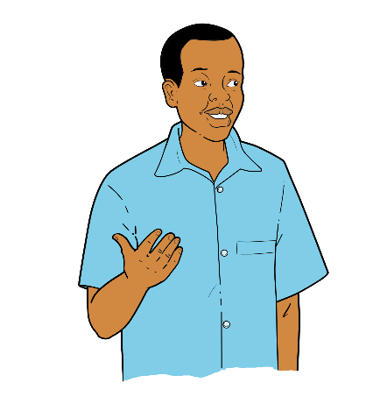

Hybrid or inbred varieties?
We know that hybrids generally have higher nutrient requirements for growth and must be purchased from seed companies. Therefore, we should carefully evaluate advantages and inconveniences for each vegetable species.
Should we grow hybrids? Hybrid varieties grow faster, are more uniform, and produce higher yields.

Slide 15
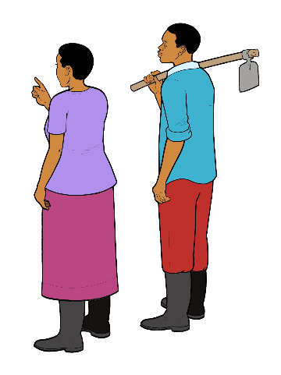
Suitable vegetable crops for own seed production
Self-pollinated vegetables | Cross-pollinated vegetables
Dwarf bean (Phaseolus vulgaris) | Amaranths species
Lentils (Lens culinaris) | Cucumber (Cucumis sativus)
Lettuce (Lactuca sativa) | Muskmelon (Cucumis melo)
Peas (Pisum sativum) | Pumpkin (Cucurbita moschata)
Peppers (Capsicum species) | Spinach (Spinacea oleracea)
Tomato (Lycopersicon escul.) | Squash (Cucurbita pepo)
 | Watermelon (Citrullus lanatus)
For these vegetable crops, we can easily produce own seeds!

Slide 16
Minimum number of plants from which to collect seed
Selected vegetable species |  | Suggested minimum number of plants
Species not susceptible to inbreeding depression
Beans, Cucumber, Lettuce, Melons, Peas, Peppers, Pumpkins, Tomatoes |  | 1 plant (but more than 1 plant gives better results)
Species susceptible to inbreeding depression
Brassicas |  | 6 to 40 plants
Corn |  | 100 plants
Onion |  | 20 to 50 plants
Sources: Ashworth, S. and Whealy, K. 2002; Deppe, C. 2000

Slide 17
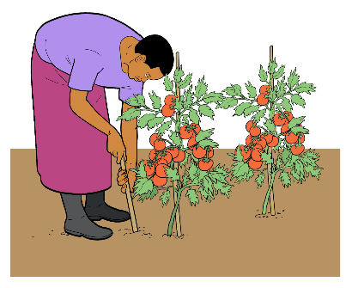
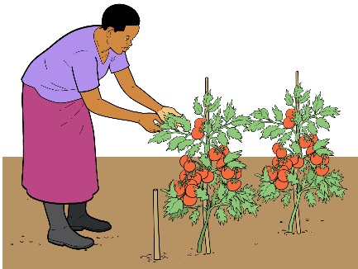
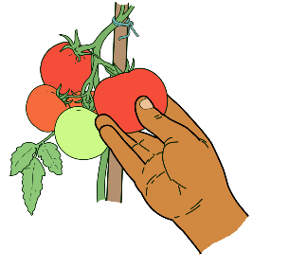
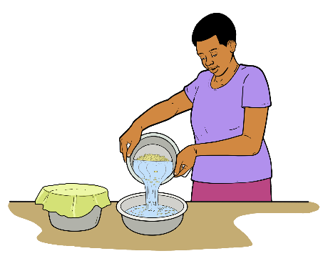
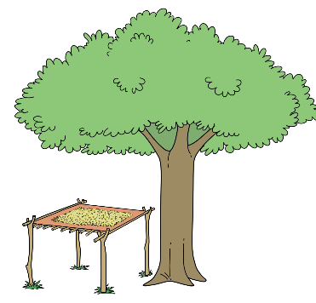
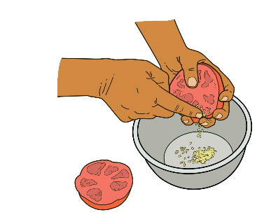
Selecting tomato seeds
1
2
3
Look for 1 to 5 healthy plants, which correspond to required criteria. Mark and stake them.
Inspect the plants regularly for tolerance to diseases. Keep them healthy.
Allow fruits to completely ripen on the plant before harvesting for seed.
4
5
6
Cut each fruit at its equator into half and gently squeeze out the jelly-like substance with the seeds.
Ferment the seeds for 1 or 2 days in a container, then rinse the seeds several times with clean water.
Dry the seeds in partial shade on newspaper.

Slide 18
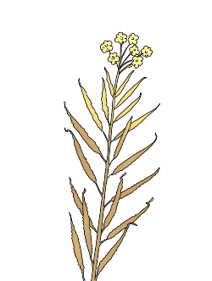
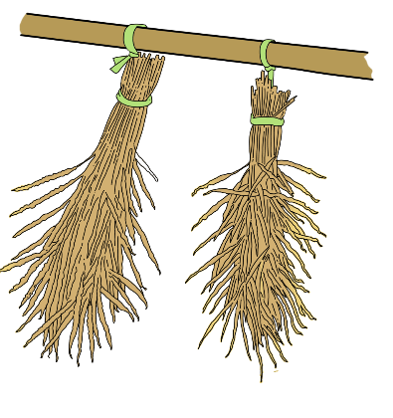
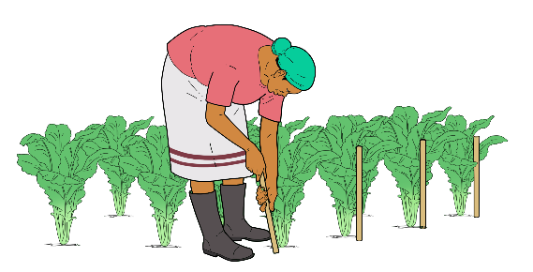
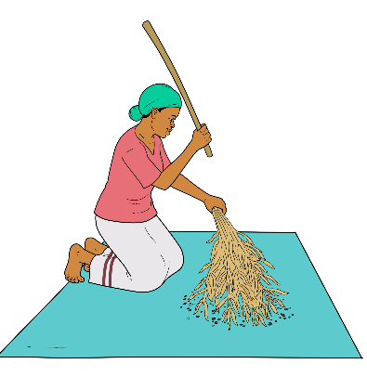
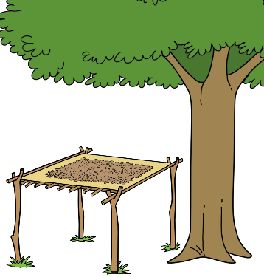
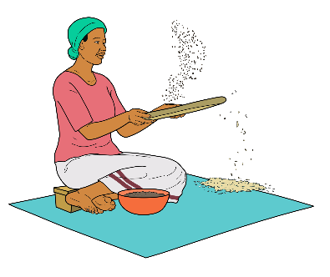
Selecting seeds of leafy vegetables (brown mustard)
1
2
3
Harvest seeds when 60 to 70 % of the pods have turned brown and most of their inner seeds are light brown and firm.
Select and mark 6 to 40 attractive and healthy plants, which correspond to required criteria.
Cure the harvested seed stalks for 1 to 2 weeks.
4
5
6
Thresh the pods with a thin stick.
Sift, winnow or sieve the seeds.
Dry the clean seeds in partial sun.

Slide 19
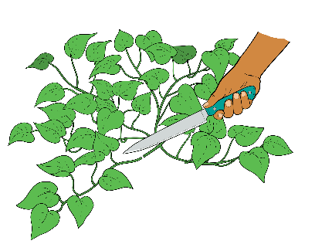
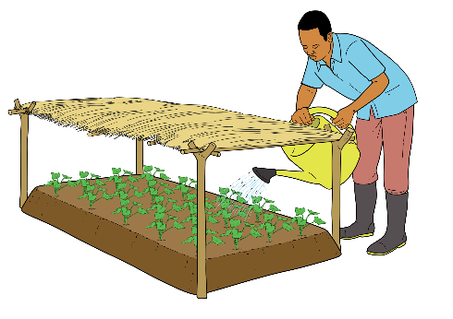
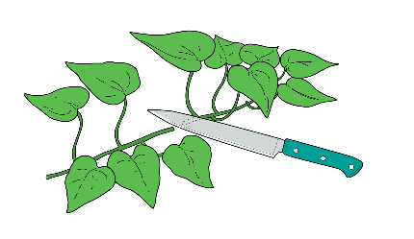
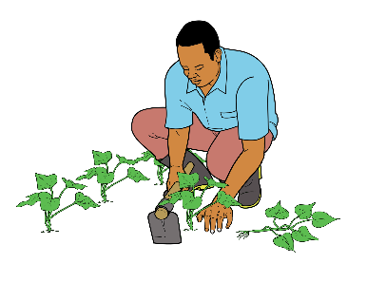
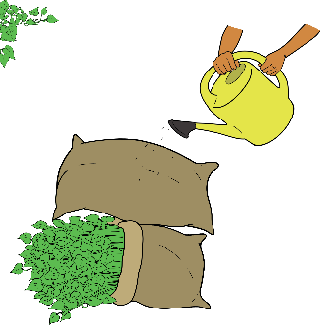
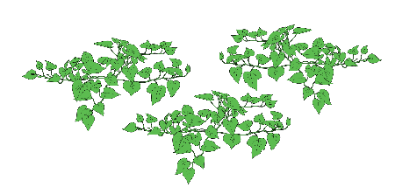
Selecting seeds of a root vegetable (sweet potato)
1
2
3
Select cuttings 25 cm long of a healthy, vigorous clone.
Cut the vine into ‘mini’ vine cuttings with one to three nodes ensuring clean cuts.
Plant the cuttings into a nursery bed 10 to 20 cm apart, with at least one node buried under the soil.
4
5
6
After 2 to 4 weeks the vines can be planted to an intermediate field for multiplication.
After another few weeks new vines can be cut for planting the main crop.
For planting remove the lower leaves and pack the vines into a damp sack around the base. Store in a cool and shady place while awaiting planting.

Slide 20
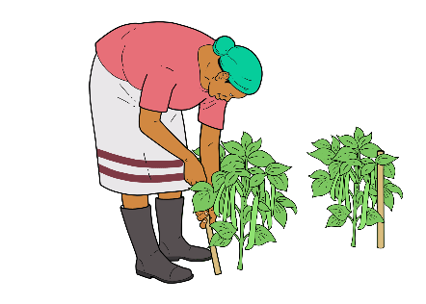
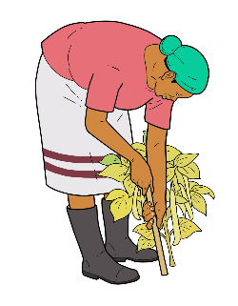
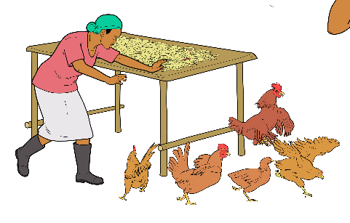
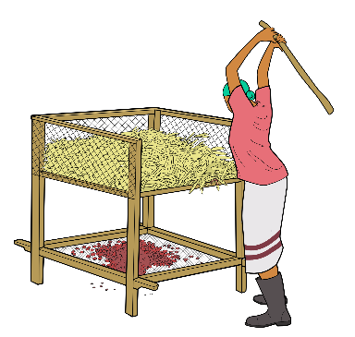
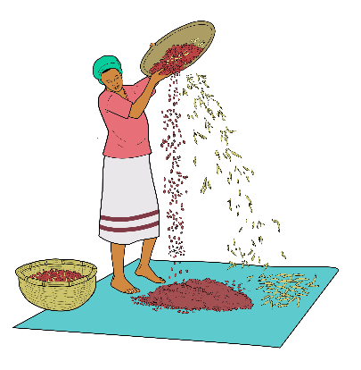
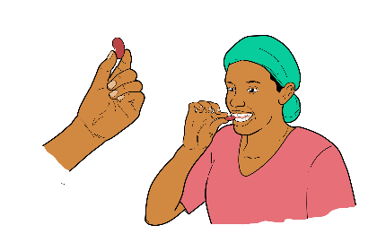
Selecting seeds of a seed vegetable (beans)
1
2
3
Select and mark healthy, vigorously growing, high yielding plants. Avoid off-type and diseased plants.
Harvest pods when they have turned yellow, but are not yet completely dry. Harvest in the morning.
Dry the pods in the sun from morning to evening for 2 sunny days on a raised platform and keep off animals.
4
5
6
Break a few pods open and bite or pinch the beans with your fingers to test whether they are dry.
Thresh the pods on a threshing rack to protect seed from damage, dirt and scattering.
Dry the threshed seeds for 1 to 3 sunny days, winnow and sort them.

Slide 21
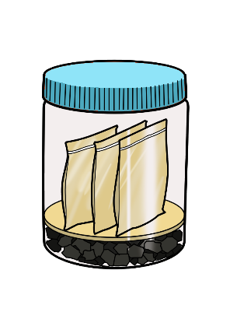
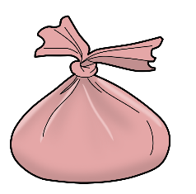
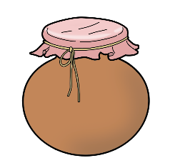

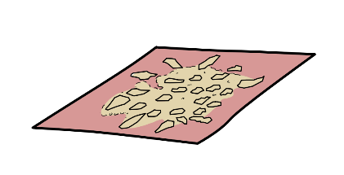
Proper storage of vegetable seeds
Storage in seleable paper pockets
Paper
Storage in an air-tight glass or tin
Storage in a cloth together with charcoal and neem seeds
Storage in a sealed or tightly closed clay pot.
Charcoal

Slide 22


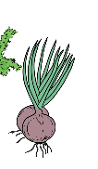


Indicative seed storage periods for selected vegetables
Short duration (1 to 2 years) | Medium duration (3 to 4 years) | Long storage duration (5 years)
Lettuce | Beans | Cabbage
Okra | Cabbage | Cucumber
Onion | Pea | Egg plant
Parsley | Pumpkin | Musk melon
Sweet corn | Tomato | Spinach
The storage periods apply to well-dried seeds stored in dry places and at optimum temperatures (with about 8 % moisture content) stored in dry places (around 15 % RH) and low temperatures of about 4.5 °C)

Slide 23

Nutrient availability related to pH level of soil
Adapted from: Roques, Kendall, Smith, Newell Price and Berry, 2013

Slide 24
Identifying common vegetable nutrient disorders (1)
The descriptions are indicative only. Proper diagnosis will be required before any corrective measures are taken.
Symptoms | General plant growth characteristics | General leaf characteristics | Nutrient likely to be deficient | Occurrence
Symptoms first appearing in old leaves | Growth upright and more spindly than normal | Leaves mottled, curling inwards with puffing and marginal scorching. Young leaves distorted. | Molybdenum | On very acidic soils
 |  | Leaves fading to yellow green, often dying back from tips or being shed. Stems slender, fibrous | Nitrogen | Excessive leaching on light soils
 |  | Leaves darker green than normal, developing reddish purple tints especially on the undersides. Stems slender and fibrous. | Phosphorus | On acidic soils, temporary deficiencies on cold wet soils
 | Growth of normal habit or droopy | Leaves an unnatural green, usually darker or blue. Leaf margins bronzing or purpling, scorching and leaves cupping upwards. Stems slender and woody. | Potassium | Excessive leaching on light soils
 |  | Leaves white or yellow mottled. Leaf margins may show marginal scorch. Leaves brittle. | Magnesium | On acid soils, on soils with very high potassium levels, or on very light soils subject to leaching.
 |  | Leaves droopy and very pale or whitened. | Copper | Most cases of copper deficiency occur on muck or peat soils

Slide 25
Identifying common vegetable nutrient disorders (2)
Symptoms | General plant growth characteristics | General leaf characteristics | Nutrient likely to be deficient | Occurrence
Symptoms first appearing in old leaves | Growth upright and more spindly than normal | Leaves mottled, curling inwards with puffing and marginal scorching. Young leaves distorted. | Molybdenum | On very acidic soils
Symptoms first appearing on young leaves | Growth deformed or collapsing | Young leaves collapse and die. | Calcium | On acid soils, following leaching rains, on soils with very high potassium levels, or on very dry soils
 |  | Young leaves deformed with spots, often brown. Petioles brilliant, often with splits. | Boron | On soils with a pH above 6.8 or on crops with a high boron requirements such as broccoli, carrot, cauliflower
 | Growth not deformed but often spindly | Young leaves mottled, becoming pale yellow but not dying. | Iron | On soils with a pH above 6.8
 |  | Young leaves mottled and developing dead areas. | Manganese | On soils with a pH above 6.7
Source:

Slide 26




Vegetable groups according to feeding habits
Leafy and fruit vegetables: Heavy feeders
Root and bulbs: Light feeders
Legumes: Soil builders

Slide 27
Examples of vegetable families and feeding habits
Feeding habits | Vegetable group | Example of crops
Light feeders | Allium | Onion, leeks, shallots, garlic
 | Legume | Beans, peas
 | Amaranthaceae | Amaranth
 | Mallow (Malvaceae) | Okra, Jute mallow
Moderate feeders | Umbellifers | Carrots, fennel, celery, parsley
Heavy feeders | Chenopods | Spinach, beets, Swiss chard
 | Composites | Lettuce, artichokes
 | Crucifers | Cabbage, cauliflower, kale, broccoli, Brussels sprouts, mustard
 | Curcubits | Pumpkins, melons, squashes, cucumbers
 | Gramineae | Maize, wheat
 | Solanaceaes | Tomato, potato, peppers, eggplant
 | Asparagaceae | Asparagus

Slide 28

Creating a favourable environment for vegetables
A multilayer and multipurpose cropping system creates a favourable micro-climate, contributes to better soil fertility and increases yield safety.
Tall fruits trees on the boundaries of the field
Small fruit trees and larger trees with a light canopy for light shade
Hedges for protection against wind and animals
Rows of leguminous shrubs for biomass and mulch production
Vegetable beds covered with dry mulch for protection
A favourable combination of crops in space and time

Slide 29

Farm-own fertilisers for soil fertility management
Tree prunings
Well-rotten animal manure
Compost
Crop residues
Additional farm-own sources of organic fertiliser are: green manures, liquid manure and plant tea.

Slide 30





How to make compost
1
3
Collect materials from
non-contaminated sources
Pile the mixed materials
2
Mix and water the materials
4
5
Check the temperature after 2 to 3 days
Turn the heap at least 3 times

Slide 31







How to make liquid fertiliser
Preparation of liquid manure
1
2
Hang a bag with manure into a drum with water. Let the manure soak for up to 14 days.
Fill a watering can with the liquid manure and dilute it with water.
Preparation of Tithonia leaf tea
1
2
3
4
Collect green plants
Chop the fresh plants
Let the Tithonia soak for about 14 days in water
Sieve the mixture and dilute with water

Slide 32
Green manures for vegetable cropping systems
Species | Elevation (m) | Soil pH | Dry matter yield estimates (t/ha) | Comments
Jack bean (Canavalia ensiformis) | Up to 1800 | 4.3 - 8.0 | 2 - 7 | Adapted to degraded soils, tolerant to drought and to shade
Sunnhemp (Crotalaria species) | Up to 1500 | 5.0 - 8.4 | Up to 20 | Tolerant to drought and mild frost
Wild Hops (Flemingia species) | Up to 2000 | 4.6 - 7.5 | 12 | Effective weed suppressant
Lablab (Purpureus species) | Up to 2100 | 4.5 - 8.0 | 3 | Tolerant to low rainfall and drought
Velvet bean (Mucuna pruriens) | Up to 1500 | 4.0 - 7.5 | 7 - 9 | Adapted to degraded soils, tolerant to drought
Fish bean (Tephrosia vogelli) | Up to 2100 | 4.5 - 7.0 | 2 | Adapted to degraded soils, tolerant to drought
Others include pigeon pea (Cajanus cajan), common vetch (Vicia sativa), cowpea
(Vigna unguiculata), Pueraria (Pueraria phaseoloides).

Slide 33

How to plan a vegetable rotation
Select the vegetables you want to grow.
Allocate the species to the crop families or to the groups based on their feeding habits.
Plan a rotation sequence with different crop families following each other with the highest feeder following legumes.
Make sure species with same sensitivity to pests and diseases do not follow each other.

Slide 34
Simple steps and examples of a rotation plan
Select the vegetables you want to grow depending on the time of year, preference and market requirements
Plan a rotation sequence which takes care of the following considerations:
  Vegetables in the same group must not follow each other in a rotation.
  Vegetables attacked by the same pests and diseases must not follow each other
  Highest feeder vegetables to be planted after legumes. These legumes can be either food legumes or green manures grown for direct and indirect use for soil fertility improvement depending on whether the farmer owns livestock or not
1
Green manure or legume crop e.g. velvet bean, sunhemp, bean or pea
2
Heavy feeder
e.g. cabbage, broccoli,
kale, spinach, tomato
3
Medium or light feeder
e.g. pepper, potato,
carrot, onion
4 Season Rotation: Onion – Beans – Cabbage – Tomato
Asparagus – Tomato – Beans/Peas – Cabbage
5 Season Rotation: Onion – Beans – Cabbage – Tomato – Carrots/Beetroot
Carrots – Tomato – Beans/Peas – Cabbage – Onion
6 Season Rotation: Onion – Beans – Cabbage – Tomato – Carrots – Peas
Peas – Cabbage – Onion – Carrots – Beans – Tomato

Slide 35
Selecting appropriate vegetable intercrops
When selecting vegetable intercrops …
Do not grow vegetables of the same family together.
Do mix heavy feeders with light or light-medium feeders.
Solanaceous plants and Alliums normally grow well together.
Carrots are good companions with beetroot, onions, lettuce, cabbage, and tomatoes.
Garlic is not good companion with legumes (such as beans and peas).
Tall-growing species generally combine well with short-growing species.
Ensure that the crops have similar growing conditions but are both not heavy feeders.
Some companion plants provide beneficial effects to the vegetable crop (e.g. marigolds suppress nematodes, lemongrass helps to repel insect pests, asparagus is reported to repel nematodes, tomatoes are known to repel the asparagus beetle).
Combination of vegetable crops with trees can be suitable (e.g. Moringa oleifera, Calliandra calothyrsus). They can contribute fruits, shade or fertiliser, but good spacing is needed.
Amaranths, basil, garlic, marigold are reported to be good companion plants which can help to repel insect pests from tomatoes.
Maize and tomatoes share a common pest, the bollworm, and should ideally be grown away from each other to minimise attack.

Slide 36

Common types of nematode damage
Root lesions
Root galls
Root enlargement

Slide 37






Crop rotation/intercrops in case of nematode damages
In case of nematode damages avoid growing susceptible crops for some years
1
2
3
4
5
Present
Season +1
Season +2
Season +3
Season +4
Susceptible crop like tomato, eggplant, cabbage
or potato
Susceptible crop like eggplant, tomato or cabbage with nematode damage
Non-host crops like cowpea (in dry land), peas (wetland) or toxic crop
like rye, timothy, rapeseed and other mustards, crotalaria, marigolds
Tolerant crop like groundnut, okra, onion, citrilus

Slide 38





Hot water treatment to enhance seed germination
1
2
Boil a good amount of water and pour it into a suitable container (large enough for the seed). Let the water cool down to 82 °C, depending on the type of seed.
Wrap the seeds in a clean piece of cloth or place them in a clean cloth bag and immerse them into the hot water
3
4a
4b
Cold water
Warm water
Leave the seeds in the water until the water cools down
Remove the seed and sow them immediately to the seedbed or to the field.

Slide 39



Seed hot water treatment for disease control
This treatment is useful to control seed-borne diseases like anthracnose; blight; bacterial leaf streak, spot; black rot; black leg; black scurf; powdery scab; septoria; and others
1
2
Heat some water in a good sized pot to the required temperature.
Wrap the seeds in a clean piece of cloth and immerse them into the water at the recommended temperature.
3
4a
4b
Warm water
Cold water
Maintain the temperature and leave the seeds in the water for the recommended time. Then cool the seeds in cold water for 5 minutes.
Spread the seeds on a clean and dry piece of cloth or paper, and allow to dry before storage.
Or sow immediately

Slide 40
Recommended temperatures and durations for seed hot water treatment for disease control
Vegetable | Water temperature (°C) | Treatment duration (minutes)
Brussels sprouts, eggplant, spinach, cabbage, tomato | 50 | 25
Broccoli, cauliflower, carrot, collard, kale, kohlrabi, rutabaga, turnip | 50 | 20
Mustard, cress, radish | 50 | 15
Pepper | 51 | 30
Lettuce, celery, celeriac | 47 | 30
Shallots | 46 | 60
Source: adapted from Ohio State University Extension

Slide 41





Indoor seed germination test without soil
1
2
Wash the hands. Then mix the seeds thoroughly to obtain a larger sample. Count 50 or 100 seeds (400 seeds minimum according to ISTA) for the germination test without selecting them. Divide the seeds into batches of 25, 50 or 100 seeds.
Place the seeds from each batch on a moist cloth, paper towel or newspaper. Make sure the seeds are spaced apart. Cover the seeds with another moist piece of the same material.
3
4
Keep the seeds moist (but not wet) by sprinkling water. Allow the seeds to germinate during 8 days.
At the end of the germination period count and record the number of germinated seeds with a healthy radical and shoot in each tray.

Slide 42




Indoor seed germination test with soil
1
2
Take 50 or 100 (or 400 in case of large quantities) seeds and divide them into batches of 25, 50 (or 100 seeds). Sow the seeds from each tray into a nursery tray with clean sand or soil. Plant one seed per hole.
Wash the hands. Then mix the seeds thoroughly to obtain a larger sample.
3
4
Keep the seeds moist during the germination period using a perforated tin or a watering can fitted with a fine rose.
Then carefully dig the seedlings up and observe their roots and shoots on a piece of cloth or paper. Count and record the number of healthy seedlings.

Slide 43
Example of a germination test calculation
 | Batch 1 | Batch 2
No. of seed used in the germination test (A) | 20 | 20
No. of germinated seeds (B) | 10 | 12
Germination proportion (C = B / A) | 10 divided by 20 = 0.5 | 12 divided by 20 = 0.6
Germination percentage (D = C * 100) | 0.5 * 100 = 50 % | 0.6 * 100 = 60 %
Average germination percentage | (50 % + 60 %) divided by 2 = 55 %
Easier calculations for each seed set
If 20 seeds are used for each germination test, the germination percentage for each set can easily be obtained by multiplying the number of germinated seeds in each set by 5.
If 50 seeds are used, multiply the number of germinated seeds by 2.
If 100 seeds are used, multiply the number of germinated seeds by 1.
Note: The above examples are true only when all the seeds used are retained until the end of the germination test. If some of the seeds in the test are lost before the end of the test through e.g. consumption by rodents or if seeds fall out of the germination medium, then the test has to be redone.

Slide 44
Minimum seed germination levels (1)
Vegetable | Minimum recommended germination rate (%) | Mean number of days to germination (under conditions)
Asparagus | 60 | 10
Bean (Snap) | 75 | 7
Beets | 65 | 4
Broccoli | 75 | 4
Brussels Sprouts | 70 | 4
Cabbage | 75 | 4
Carrot | 55 | 6
Cauliflower | 75 | 5
Celery | 55 | 7
Chinese Cabbage | 75 | 4
Cucumber | 80 | 3
Eggplant | 60 | 6
Kale | 75 | 4

Slide 45
Minimum seed germination levels (2)
Vegetable | Minimum recommended germination rate (%) | Mean number of days to germination (optimal conditions)
Leek | 60 | 7
Lettuce | 80 | 3
Muskmelon | 75 | 4
Okra | 50 | 6
Onion | 70 | 6
Pea | 80 | 6
Pepper | 55 | 8
Pumpkin and squash | 75 | 4
Spinach | 60 | 5
Sweetcorn | 75 | 3
Swiss Chard | 65 | 4
Tomato | 75 | 6
Turnip | 80 | 3
Watermelon | 80 | 4

Slide 46




Examples of vegetable nursery beds
Nursery bed with mulch
Nursery bed shaded with a raised grass structure
Nursery bed shaded with a shed cloth
Elevated nursery bed

Slide 47
Sterilising the nursery bed soil with fire
Prepare the seedbed and water thoroughly.
Place slow burning materials such as grain husks on top of the moist soil (exampes include rice husks, coconut leaves, brushwood, hay).
Burn the materials ensuring that the fire is started against the wind direction to slow down the burning and maximising the soil -heat contact.
Allow the soil to cool for about 2 days before sowing.
Ensure that the sowing tools for the seed are clean.
Instead of fire, soil solarisation can be used to ensure that the soil is free of pathogens.

Slide 48




Soil solarisation for seedbed sterilisation
1
2
When temperatures are high, dig a trench around the seedbed.
Water the soil to field capacity.
3
4
Cover the soil with a plastic sheet. Make sure that the edges are tightly secured into the soil.
Remove the sheet after 4 to 6 weeks and sow the seeds as soon as possible.

Slide 49

Preparing a medium for seedling containers
Compost
Soil
Sand
A good potting mix
contains the following components:
2 parts well rotted compost
1 part clean sand
1 part clean soil

Slide 50

Container types for seedling production
Empty tins cut
to the right size
Empty buckets cut to the right size
Tray for large seedlings
Empty plastic/hard paper bottles
Wooden box with holes
Tray for medium size seedlings
Old dish with holes
Tray for small seedlings

Slide 51






Filling seedling containers with a sowing medium
1
2
3
60 cm
10-15 cm
40 cm
Fill the container with a layer of stone pebbles followed by a layer of coarse sand.
Then fill the container with the suitable medium (mixture of sand, ripe compost and or soil).
Make a box out of wooden boards and drill small holes into the bottom for drainage.
4a
4b
5
Sow the seeds in rows.
Or broadcast the seeds evenly.
Cover the seeds with some sand and water the container carefully.

Slide 52

Raised nursery structures for seedling containers
Raised wooden benches under shade
Raised brick benches under shade

Slide 53




Seedling pricking procedure
Examples of vegetables that can be pricked: leafy brassicas such as cabbage, sprouts or broccoli, lettuce, kohlrabi, tomatoes, etc.
1
2
Grow the seedlings to a stage when the first 4th true leaf emerges (this differs with type of vegetable)
Remove the seedlings carefully without damaging the roots.
3
4
Transplant each seedling into a pot or bag filled with appropriate substrate.
Grow the pricked seedlings in half-shade until they have developed strong roots. Harden the seedlings before transplanting to the field.

Slide 54



Field establishment through raising seedlings in the seedbed
1
2
Sow the seeds in rows into a shaded seedbed ensuring sufficient spacing in the rows.
Remove the shade on a cloudy day when seedlings have reached appropriate size for transplanting to the field.
3
Examples of vegetables species whose seedlings can be raised in seedbeds:
Cabbage | Spinach
Tomato | Brocolli
Onion | Lettuce
Transplant seedlings to the field ensuring appropriate spacing. Water transplanted seedlings well and cover the soil with mulch.

Slide 55





Field establishment through pricked seedlings
1
2
3
Sow seeds into trays.
Prick the seedlings into pots or bags.
Align the pots or bags in a shaded nursery.
4
5
Remove the shade on a cloudy day for hardening the seedlings before transplanting.
Water the hardened seedlings well and transplant them to the field.

Slide 56



Field establishment through direct sowing
1
2
Sow the seeds in rows directly to the field at final row distance but slightly higher plant density as required.
Thin rows out if necessary to allow for development of the plants to full size.
3
Examples of vegetables that are or can be established through direct sowing include: carrots, radishes, onion, etc.
Let the plants grow to full size.

Slide 57
Recommended spacing of vegetables (1)
Vegetable species | In row (cm) |  | Between rows (cm)
 | Minimum | Maximum | Minimum | Maximum
Asparagus | 22.5 | 37.5 | 120 | 180
Bush bean | 5 | 10 | 45 | 90
Pole Bean | 15 | 22.5 | 90 | 120
Beet | 5 | 10 | 30 | 75
Broccoli | 30 | 60 | 45 | 90
Brussels sprouts | 45 | 60 | 60 | 100
Cabbage | 30 | 60 | 60 | 90
Carrot | 2.5 | 7.5 | 40 | 75
Cauliflower | 35 | 60 | 60 | 90
Celeriac | 10 | 15 | 60 | 90
Celery | 15 | 30 | 45 | 100
Chard (swiss) | 30 | 37.5 | 60 | 90
Chinese cabbage | 25 | 45 | 45 | 90
Corn | 20 | 30 | 75 | 105
Cucucmber | 20 | 30 | 90 | 180
Egg plant | 45 | 75 | 60 | 120
Garlic | 2.5 | 7.5 | 30 | 60
Kale | 45 | 60 | 60 | 90
Leek | 5 | 15 | 30 | 90

Slide 58
Recommended spacing of vegetables (2)
Vegetable species | In row (cm) |  | Between rows (cm)
 | Minimum | Maximum | Minimum | Maximum
Kohlrabi | 7.5 | 15 | 30 | 90
Lettuce (cos) | 25 | 35 | 40 | 60
Lettuce (leaf) | 20 | 30 | 30 | 60
Muskmelon | 30 |  | 150 | 210
Onion | 2.5 | 10 | 40 | 60
Parsnip | 5 | 10 | 45 | 90
Peas | 2.5 | 7.5 | 60 | 120
Pepper | 30 | 60 | 45 | 90
Potato | 15 | 30 | 75 | 105
Pumpkin | 90 | 150 | 180 | 240
Radish | 1.25 | 2.5 | 20 | 45
Rutabaga | 12.5 | 20 | 45 | 90
Spinach | 5 | 15 | 30 | 90
Squash (bush) | 60 | 120 | 90 | 150
Squash (vining) | 90 | 240 | 180 | 240
Tomato (flat) | 45 | 120 | 90 | 150
Tomato (staked) | 30 | 60 | 105 | 150
Turnip | 5 | 15 | 30 | 90
Water melon | 60 | 90 | 180 | 240

Slide 59

Factors to consider in vegetable spacing
Which type of vegetable is it: leafy, root, bushy, vining, etc.?
Which growth habit does it have? Does it grow upright, lateral, or does it spread?
Which natural size does the plant attain?
Which size is desired (closer spacing can result in small product)?
Management practices: Will the crop be staked or grown on the flat?
Which tools or motorised machinery will be used? What working width do they have?

Slide 60
Weed sensitive periods of vegetable crops
Lasting presence of weeds tolerated as of the: |  | Beginning |  |  | Middle |  |  |  | End
Mid growing season
 |  | Examples: cabbage, red beet, winged bean, head lettuce, carrots
1-2 weeks after mid-growing season
 |  | Examples: celery, fennel, Swiss chard
4 weeks after mid-growing season
 |  | Examples: leek, onion
Never
 |  | Examples: spinach, commom beet, mâche, chives, parsley
 | Weed sensitive period |  |  |  |  | Weed tolerant period

Slide 61
False seedbed
False seedbed for weed control
Plough or harrow
Tine weeder
Crop
Weeds
1. Prepare the seedbed early (2 to 4 weeks before seeding or planting).
2. Wait until the weeds have emerged.
3. Destroy the weeds at intervals of 7 to 10 days using a tine-weeder.

Slide 62




Sources of water for vegetables
Rain water
River, dam or fish pond
Run-off from roads and rocks
Wells

Slide 63
Estimating soil water condition using the feel method
Behaviour and/or appearance of sands and sandy loams |  | Soil moisture condition |  | Behaviour and/or appearance of loams, clay loams and clays
Free water can be squeezed out of the soil |  | Water logged conditions |  | Soil is very sticky Soil oozes water when squeezed
No free water on the soil when squeezed Wet outline left on the hand during squeezing |  | Moist soil (100 % field capacity) |  | Soil is sticky and forms a ball when squeezed, but no free water on the soil Soil can be rolled into thin rods and leaves a wetting outline on the hand when squeezed or rolled
Soil is slightly coherent when squeezed but only forms a weak ball |  | 75 % available moisture in soil (enough for plant growth) |  | Soil can still be rolled into thin but short ribbons Soil has a sleeper feeling, and is still coherent
Soil is less coherent and appears to be dry |  | 50 % available moisture in soil (just enough water for plant growth) |  | Soil is still coherent and forms a ball under pressure Soil tends not to form ribbons except when pressed between a finger and the thumb
Soil appears to be dry Soil will not form a ball under pressure |  | Critical (soil needs replenishment to resume plant growth) |  | Soil appears crumbly Soil will not form a ribbon when pressed between a finger and the thumb Soil can still form a ball under pressure
Soil is dry and loose Soil will flow through the fingers |  | Dry (too dry for plant growth) |  | Soil looks crumbly and powdery Soil will not form a ball under pressure

Slide 64
Growth periods of peak water demand of vegetables
Vegetable | Period of peak water demand
Cabbage, broccoli, cauliflower, lettuce | Head development
Carrots, turnips, radishes, sweet potatoes | Root enlargements
Tomatoes, cucumber, peppers, melons | Flowering, fruit set, fruit development/fruit enlargement
Peas | Flowering and seed development
Beans | Flowering/pollination, pod development
Spinach | Continuous
Potatoes | Tuber set and enlargement
Onions | Bulb enlargement
Sweet corn | Silking, tasseling, ear development and grain filling

Slide 65

Crop Peak Water Demands
Adapted from Allen, Pereira, Raes and Smith (1998)

Slide 66




Irrigation methods
Watering can
Furrow
Sprinkler
Drip irrigation

Slide 67


Irrigating vegetable fields through drip systems
Two types of simple drip irrigation systems

Slide 68



Types of mulch for soil moisture conservation
1
2
3
Grass, straw or crop residues
Organic mulch material
Plastic

Slide 69

Drip irrigation under mulch material
1
2
3
Lay out irrigation pipes
Cover them with mulch material
Plant in planting holes

Slide 70
Examples of agents and products for disease control (1)
Name | Derived from | Diseases controlled | Examples of crops sprayed | Application stage of plant growth | Comments
Ampelomyces quisqualis (e.g. Bio-Dewcon) | Fungal | Powdery Mildew disease caused by pathogens like Erysiphe sp., Blumeria sp., Oidium sp., Sphaerotheca sp., Microsphaera sp., Uncinula sp., and Leveillula sp. | Wide range of crops | All stages | Available both in liquid and powder formulation
Chaetomium globosum (e.g. Con-Blight) | Fungal | Late blight, Leaf blight, Head Blight, Botrytis and Root rot diseases caused by pathogens like Phytopthora sp., Fusarium sp., Erwinia sp., Xanthomonas sp., | Tomato, potato | All stages | Available in liquid and powder formulation
This is a guide only; farmers are recommended to contact their local extension services and organic farming certifying agents in their area or country to get an accurate list of the disease control products that are allowed in their area and for the particular crop in question.

Slide 71
Examples of agents and products for disease control (2)
Name | Derived from | Diseases controlled | Examples of crops sprayed | Application stage of plant growth | Comments
Pseudomonas fluorescens (e.g. Bio-Cure-B) | Bacterial | Pyniculasa oryzae, Alterneria spp., Mycosphaerella grasicola, Pythium spp., Rhizoctonia solani, Fusarium spp., Botrytis cinerea, Sclerotium rolfsii, and Sclerotinia homoeocarpa which cause root rot, root wilt, seedling rot and color rot diseases | Wide range of crops | All stages | Available both in liquid and powder formulation
Trichoderma viride (e.g. Bio-Cure-F) | Fungal | Disease-causing pathogens such as Pythium spp., Rhizoctonia solani Fusarium spp., Botrytis cinerea, Sclerotium rolfsii, and Sclerotinia homoeocarpa causing root rot, root wilt, seedling rot and color-rot diseases | Wide range of crops | All stages | Available both in liquid and powder formulation

Slide 72
Examples of agents and products for pest control (1)
Active substance | Derived from | Pests controlled | Examples of crops sprayed | Plant appli-cation stage | Comments
Azadirachtin – cold pressed (e.g. Nimbecidine) | Plant extract | Whitefly, aphids, thrips, mealy bugs, caterpillars and leafhoppers in a wide range of crops | Cabbage, broccoli, cauliflower, onion, carrot, coriander, tomato, eggplant, okra, pumpkin, cucumber, water melon, sweet corn | At all stages | Apply preferably in the early morning or late evening hours. Add water to Nimbecidine (do not add Nimbecidine to water). Safe to natural enemies like beneficial parasites and predators
Beauveria bassiana (e.g. Bio-Power) | Fungal | Borers, cutworms, root grubs, leafhoppers, whitefly, aphids, thrips and mealybug | Pulses, plantation crops, vegetables, fruit crops, cereals, flowers and nurseries, green houses | At all stages | Available in liquid and powder formulation Apply preferably in the early morning or during the late evening hours. Safe to natural enemies of pest
This is a guide only; farmers are recommended to contact their local extension services and organic farming certifying agents in their area or country to get an accurate list of the disease control products that are allowed in their area and for the particular crop in question.

Slide 73
Examples of agents and products for pest control (2)
Active substance | Derived from | Pests controlled | Examples of crops sprayed | Plant appli-cation stage | Comments
Verticillium lecanii (e.g. Bio-Catch) | Fungal | Sucking pests such as aphids, jassids, whitefly, leaf hoppers, mealy bugs and root mealy bugs | Wide range of crops | At all stages | Available in liquid and powder formulation
Metarhizium anisopliae (e.g. Bio-Magic) | Fungal | Leaf hoppers, root grubs, borers, cutworms, termites, palm weevils | Wide range of crops | At all stages | Available in and powder formulation Safe to natural enemies of pest such as beneficial parasites and beneficial predators
Paecilomyces fumosoroseus (e.g. Priority) | Fungal | Acarine pests like Brown Wheat Mite, Rust mite, Blue oat mites, Red Spider Mites, Pink Mite, Purple Mite, Pale mite, Scarlet mite | Wide range of crops | At all stages | Available in and powder formulation Safe to natural enemies of pest such as beneficial parasites and beneficial predators

Slide 74
Examples of agents and products for pest control (3)
Active substance | Derived from | Pests controlled | Examples of crops sprayed | Plant application stage | Comments
Paecilomyces lilacinus (e.g. Bio-Nematon) | Fungal | Root knot nematodes, burrowing nematodes, cyst nematodes, lesion nematodes | Wide range of crops | At all stages | Available in liquid and powder formulation.

Slide 75

Greenhouses – advantages and disadvantages
+
–
Advantages | Disadvantages
Better control of growing conditions and hence ability to supply fresh products during the ‘out of season’ period and take advantage of premium prices Allows for better timing of production and supply Allows better control on weeds, diseases and pests Produce is of more uniform quality e.g. appearance Reduced swings in production volumes therefore consistency in volumes for markets and also prices Improves food safety Allows to have a tighter control on water quality | High costs of production due to costs of materials and installation costs for the structures and facilities e.g. irrigation systems Skilled management required to conform to recommended practices Energy might be required to heat the greenhouses when there is insufficient sunlight

Slide 76

Factors to consider for greenhouse construction
    What costs can we afford?
    Is there a market for the products?
    Is the location easily accessible?
    Does the topography allow placement of a greenhouse?
    Is the required infrastructure available?
    Does the soil type allow vegetable production?
    Do the prevailing climatic conditions require a greenhouse?
    Is a good quality and reliable water source available?

Slide 77

Different types of greenhouses
Low tunnel for prevention of frost
Big tunnel with plastic or polyethylene netting
Self-made greenhouse made of wood and plastic sheet
Expensive glasshouse

Slide 78


Types of shading for greenhouses
External shading material
Shading material placed inside the greenhouse

Slide 79
Harvest indices for vegetables (examples) (1)
Vegetable type | Examples | Harvest indices
Leafy | Kale, spinach | Days from transplanting, leaf appearance (marketable size, changes in shape, changes in surface characteristics)
 | Cabbage, lettuce, Brussel sprouts | Days from transplanting, solid feel of the head
Flower | Broccoli, cauliflower | Days from transplanting, shape and compactness of the head
Fruit | Tomato | Days from flowering, external colour change (may require special equipment in order to be accurate and avoid missing the right stage of harvest) Appearance (changes in internal structure e.g. development of the jelly layer in the fruit)
 | Honeydew melons, eggplant | Appearance (development of a glossy/waxy surface on the skin)
 | Some pumpkins, okra; peas | Texture (feel) – development of a hard skin
 | Water melon | Appearance (internal colour change)
 | Musk melon | Easy to detach from main plant (abscission layer)

Slide 80
Harvest indices for vegetables (examples) (2)
Vegetable type | Examples | Harvest indices
Root/Tubers | Carrot | Days from sowing; shape (e.g. uniform root tapering)
Bulbs | Dry onions | Days from transplanting, when the tops start to collapse
 | Green onions | Anytime when the leaves are still green

Slide 81

Manual or mechanical harvest?
Manual harvest
Advantages | Disadvantages
Ability to select uniform vegetables Number of people can be increased or decreased depending on amounts to be harvested. Can be quite cheap. Delicate vegetables can be handled carefully. Can minimise damage. | Requires training of harvesters. Seasonal labor shortages can affect harvesting timing. Needs careful planning for efficient use of labour.

Slide 82

Manual or mechanical harvest?
Mechanical harvest
Advantages | Disadvantages
Can increase speed of harvesting. Requires lees people and therefore is easier to manage, e.g. less need for hiring and managing people. Facilitates large areas to be harvested easily. | High rate of harvesting may not correspond with rate of handling (e.g. cleaning, packaging), processing and marketing. Reduces the number of people benefiting from farm employment. If changes occur in the cropping programme, machines might not be suitable for other crops. High initial costs to buy the machines

Slide 83
Types of vegetable spoilage
Physical spoilage – e.g. wilting of leafy vegetables
Physiological aging – through natural senescence processes which can be accelerated by exposure to ethylene
Insect pest or rodents attack – they eat the vegetables and also transmit pathogens
Mechanical damage – cuts, cracks, compression, crushing, bruising and other forms damage
Enzyme spoilage – damage to vegetable cells causes the cells to release chemicals (enzymes) which can react and result in rapid deterioration of produce
Chemical spoilage – damage from chemical substances, also through enzyme reactions
Microbial spoilage – bacteria, moulds and yeasts cause diseases and other forms of deterioration to the vegetables

Slide 84
Don’ts for fresh produce storage
Do NOT handle crops for storage when they are wet. Do NOT overload storage rooms or stack containers too close together. Avoid lower than recommended temperatures. Do NOT stack containers beyond their stacking strength. Do NOT store onions or garlic in high humidity environments. Avoid storing ethylene sensitive vegetables with ethylene producing vegetables. Avoid storing produce known for emitting strong odors (apples, garlic, onions, turnips, cabbages, potatoes) with odour-absorbing commodities.
Source: Adapted from Kitinoja and Adel, 2015

Slide 85
Dos for fresh produce storage
Know the requirements for the vegetables you want to put into storage. Store produce of proper maturity which is free of damage and decay. Cure root, tuber and bulb crops before storage. Provide shade for storage structures with a roof overhang of at least 1 meter, or paint buildings white or silver to reflect heat. Keep the storage room dark. Keep the storage facility clean and free from rodents by keeping the immediate outdoor area clean, and free from trash and weeds. Ensure proper air circulation leaving air space between the stacks and the walls, and place produce upon pallets. Provide adequate ventilation in the storage room. Place thermometers at several locations to monitor storage room temperature. Inspect stored produce regularly for signs of injury, water loss, damage and disease. Remove damaged or diseased produce to prevent the spread of problems.
Source: Adapted from Kitinoja and Adel, 2015

Slide 86
Suitable storage conditions for selected vegetables
Vegetable | Optimal storage temperature (°C) | Optimal relative humidity (%) | Estimated storage period
Asparagus | 0 ˗ 2 | 95 ˗ 100 | 14 ˗ 21 days
Broccoli, Brussels sprouts | 0 | 95 ˗ 100
Cabbage | 0 | 98 ˗ 100 | 3 ˗ 6 weeks
Carrot (mature) | 0 ˗ 4.4 | 98 ˗ 100 | 7 ˗ 9 months
Cauliflower | 0 | 95 ˗ 100
Egg plant | 7.8 ˗ 12.2 | 90 ˗ 95 | 1 week
Kale | 0 | 95 ˗ 100 | 2 ˗ 3 weeks
Lettuce | 0 | 98 ˗ 100 | 2 ˗ 3 weeks
Okra | 7 ˗ 10 | 90 | 7 ˗ 14 days
Onion (green) | 0 | 95 ˗ 100
Onion (dry) | 0 | 65 ˗ 70 | 1 ˗ 8 months
Potato | 4.4 | 90 ˗ 95 | 4 ˗ 5 months
Spinach | 0 | 95 ˗ 100 | 10 ˗ 14 days
Sweet corn | 0 | 90 ˗ 98 | 5 ˗ 14 days
Tomato (ripe) | 7.8 ˗ 10 | 90 ˗ 95 | 4 ˗ 7 days
Sources: Hardenburg et al., 1986; Kader; 1992; Saltveit, 1993

Slide 87
Prolonging shelf life of vegetables through icing
Vegetables which can be iced (examples) | Vegetables which should not be iced (examples)
Asparagus | Cucumbers
Beets | Garlic
Broccoli | Green beans
Cauliflower | Okra
Green onions | Onion bulbs
Leafy greens | Romaine lettuce
Radishes | Squash
Spinach | Tomato

Slide 88

Ethylene producing vegetables (examples)
Very low | Low | Moderate | High
Artichoke | Eggplant | Honeydew melon | Cantaloupe
Asparagus | Pepper | Tomato
Broccoli | Pumpkin
Brussels sprout | Okra
Cabbage | Watermelon
Cauliflower
Celery
Garlic and onion
Cucumber
Leafy vegetables (e.g. kale, spinach, lettuce)
Peas
Potato
Root vegetables (e.g. carrot, sweet potato)
Sweet corn
To prevent
fast ripening of vegetables we should keep ethylene-sensitive species separate from species that emit the gas.
Vegetables sensitive to ethylene
Asparagus | Eggplant
Broccoli | Green beans
Cabbage | Lettuce
Cauliflower | Potato
Cucumber | Okra
Celery | Spinach

Slide 89
Desirable and undesirable effects of ethylene in vegetable postharvest
Desirable effects | Undesirable effects
Flower initiation in bromeliad plants such as pineapples Degreening in citrus fruits Colour development in fruits during ripening Softening of fruits during ripening in e.g. bananas and tomatoes | Hastening of vegetable deterioration after harvest Hastening of vegetable deterioration after harvest Abscission of leaves in e.g. leafy vegetables such as cabbage Sprouting of seeds or buds Spotting on some leafy vegetables Yellowing of some vegetables or vegetable parts Undesirable toughening of edible parts, e.g. in asparagus Development of off-flavours and discouloration, e.g. in sweet potatoes

Slide 90
Symptoms of ethylene injury in vegetables
Species | Symptoms | Species | Symptoms
Asparagus | Increased toughness | Garlic | Off-flavours, sprouting
Broccoli | Yellowing, florets abscise, off-flavours | Lettuce | Russet spotting
Brussel sprouts | Yellowing | Onion | Off-flavours, sprouting
Cabbage | Leaf yellowing, leaf abscission or fall | Okra | Loss of green color
Cauliflower | Leaf yellowing and/or browning, leaf abscission | Potato | Sprouting
Carrot | Bitterness | Tomato (ripe) | Tissue softening, decay
Cucumber | Yellowing, accelerated softening | Spinach | Accelerated yellowing
Egg plant | Brown spots, browning of flesh and seed, decay | Sweet corn | Can cause husk yellowing

Slide 91




Examples of local postharvest cooling structures
Underground storage
Simple grass thatch insulated storage
Charcoal insulated storage structure
Cold room

Slide 92

How to make a Janata cooler
Procedure for making a Janata cooler:
Add water to the clay bowl into which the storage pot will be placed, and dampen the piece of cloth and the sand with water.
Spread the damp sand on the floor to allow the clay bowl to sit on top.
Place the storage pot into the bowl with the water.
Cover the storage pot with the damp cloth allowing the bottom part of the cloth to sit inside the water.
Storage pot
Wet cloth
Earthenware bowl filled with water
Wet sand
Elements of a Janata cooler:
a large clay bowl
enough clean water
a storage pot large enough to contain the produce to be cooled
a piece of cloth

Slide 93
Hygiene: sources of vegetable contamination at field level
Stage | Risks | Prevention strategies
General operations | Animal faecal contamination (direct or indirect) | Avoid access to the plots by domestic (including pets) and wild animals.
 | Human faecal contamination (direct or indirect) | Practice good personal hygiene and use toilets. Wash hands properly before carrying out any field operations such as thinning, weeding, etc.
Fertilising | Pathogens in organic fertilisers | Do not use raw manure - use properly composted manure/plant residues. Manure must be aerobically composted at 60-80 °C (note that static piles and earthworm composting do not necessary guarantee inactivation of microorganisms). Do not use water contaminated by raw sewage.
Irrigation | Pathogens in water | Ensure that good quality water is sued for irrigation. Use drip irrigation - avoid water contact with the vegetable leaves/fruits.
Adapted from ‘FAO Manual for the preparation and sale of fruits and vegetables: From field to market.
FAO Agricultural Services Bulletin 151, 2004’: Chapter 4 Hygiene and Sanitation. ISBN 92-5-104991-2

Slide 94
Hygiene: sources of vegetable contamination
at harvest and during postharvest (1)
Stage | Risk | Prevention strategies
Harvest | Human faecal contamination | Personal hygiene Portable bathrooms Risk awareness
 | Animal waste contamination | Do not allow animals to graze in the vegetable plots. Do not pick vegetables from sections of the plots where animal faecal matter has been observed. Avoid picking vegetables that have been in contact with animal waste.
 | Pathogens in containers and tools | Use plastic bins. Clean and disinfect tools and containers using permitted disinfectants.
Adapted from ‘FAO Manual for the preparation and sale of fruits and vegetables: From field to market. FAO Agricultural Services Bulletin 151, 2004’: Chapter 4 Hygiene and Sanitation. ISBN 92-5-104991-2

Slide 95
Hygiene: sources of vegetable contamination
at harvest and during postharvest (2)
Stage | Risk | Prevention strategies
Packhouse | Faecal contamination | Personal hygiene Sanitary facilities Avoid animal entrance. Eliminate places may harbour rodents.
 | Contaminated water | Alternative methods for precooling Use potable water. Filtration and chlorination of recirculated water. Multiple washing
Adapted from ‘FAO Manual for the preparation and sale of fruits and vegetables: From field to market. FAO Agricultural Services Bulletin 151, 2004’: Chapter 4 Hygiene and Sanitation. ISBN 92-5-104991-2

Slide 96
Hygiene: sources of vegetable contamination
at harvest and during postharvest (3)
Stage | Risk | Prevention strategies
Storage and transportation | Development of microorganisms on produce | Keep produce at suitable temperature and relative humidity. Watch conditions inside packaging. Clean and disinfect facilities. Avoid repackaging. Practice good personal hygiene. Do not store or transport with other fresh products. Use new packing materials.
Sale | Product contamination | Practice good personal hygiene. Avoid animal access.
 |  | Sell whole units. Clean and disinfect facilities. Discard garbage daily.
Adapted from ‘FAO Manual for the preparation and sale of fruits and vegetables: From field to market. FAO Agricultural Services Bulletin 151, 2004’: Chapter 4 Hygiene and Sanitation. ISBN 92-5-104991-2

Slide 97
Economic considerations in organic vegetable production
Issue | Aspects to consider
Land availability | Minimum quantities required for the vegetable either for home consumption or for marketing
Technical know-how | Knowledge about the production and other requirements of the particular vegetable Consider also seasonality of the vegetables – when is the peak supply and peak demand, can off-season production be done to take advantage of the optimal prices?
Labour | Labour required and peak labour requirements in relation to other farm activities (will organic production increase or decrease labour requirements and can the household meet these changes in labour needs?) For land preparation Planting and field husbandry (weeding, thinning, pruning, pest and disease control), timely harvesting, marketing Soil fertility management practices, e.g. growing and incorporating green manures, making compost
Costs and initial capital outlay | Land, labour, construction materials, constructing and maintaining facilities, irrigation, packaging, transportation, etc. Available initial capital outlay for investment to meet the costs associated with successful production and marketing of vegetable crops
Markets and marketing | Availability of markets at local or distant places Reliability - consider also the possible impacts of produce gluts at the markets Accessibility and potential perishability of the vegetables in transit Transport availability (private or public), reliability and suitability Pricing of the produce in relation to costs
Impacts | Impacts that the product is likely to have on the household social relationships – e.g. need for better planning, shifts in focus, ownership, possible shifts in household power

Slide 98
Example of a simple economic analysis of vegetable enterprise
Input costs | Land (Ld)
 | Seed (S)
 | Labour (Lb) this includes wages and in kind contributions, e.g. food, protective clothing etc.
 | Water (W)
 | Fertilisers (F)
 | Chemicals (C)
 | Equipment (machines or tools) (Eq) – purchase or for maintenance
 | Energy ( E ) or Fuel
 | Packages
 | Storage
 | Transport
Production cost (Pc) | Ld + S + Lb + W + F + C + Eq + E
Organic certification (Oc) | This depends on whether annual membership fees are paid or other methods
Packaging cost (Pkc) | Number of packages x cost per package
Storage costs (Stc) | Cost of cooling, rental of storage facilities (if applicable), labour etc. for the required storage period
Transport cost (Trc) | Cost per trip x number of trips
Revenue (R) | Quantity sold x price
Profit (P) | R –Pc – Oc – Pkc – Stc - Trc

Slide 99
General requirements for organic production and certified organic vegetable production
  Use of well-prepared compost and other organic manures to maintain soil fertility
  No use of synthetic fertilisers to boost soil fertility as well as synthetic pesticides to control pests, diseases and weeds
  No use of chemical sprays in postharvest handling of vegetables to increase their shelf life
  Good hygiene management by using clean tools, clean water, clean packaging containers and facilities, personnel hygiene and proper disposal of all wastes
  Only use permitted cleaning agents for utensils, equipment, surfaces, and others
  Avoidance of possible contamination during harvest, handling, packaging, transportation and storage

Slide 100


Why organic certification?
Certification is compulsory for products to be sold as ‘organic’ and carry an organic label. Certification is needed to access the organic market.
Certification ensures that everyone adheres to defined organic standards.
Many countries have protected the term ‘organic’ by law. A product can only be sold or labelled as ‘organic’, if it is certified.
Large plantations are certified as individual farms.
Smallholder farms are mostly certified as a group with an internal Control System (ICS). The group markets the farmers’ products collectively.
ORGANIC

Slide 101




Organic certification of farms and groups
Organic certification normally requires annual organic inspection of every single organic farm.
Smallholder farmers can build a ‘Grower Group’ (e.g. a farmer producer company or a group organised by a contract production company) and apply an Internal Control System (ICS).
The ICS Group operates an Internal Control System with ‘internal inspections’ of all members to check that they comply with the certified standards.
The ICS Group markets the members’ organic products as a group.
GROWER GROUP
ICS
Inspector

Slide 102



Procedure of smallholder group certification
The Organic Certification Body inspects the farmer group every year.
  It checks whether the ICS is effective.
  It re-inspects some group member farms to evaluate the ICS.
  It checks the product flow from members to sales by the group.
It issues ONE certificate for the entire group.
ORGANIC CERTIFIER
GROUP
ICS

Slide 103
Key elements of the Participatory Guarantee System (PGS)
Shared vision | Key stakeholders (producers, consumers, NGOs, traders, religious institutions, governments, and others) collectively identify and agree to support the principles guiding the objectives and goals of the PGS.
Trust | The idea of trust assumes that the individual producer has committed to the shared vision of protecting nature and ensuring consumer health through organic production.
Horizontality | PGS initiatives are intended to be non-hierarchical. This is reflected in the overall democratic structure and through the collective responsibility taken up by those involved.
Transparency | All stakeholders, including producers and consumers, are informed on how the guarantee system works, including information on standards, norms (the organic guarantee process), and decision-making processes.
Participation | The stakeholders involve actively in PGS operations.
Learning process | Through the exchange of ideas and experiences a learning process unfolds and becomes an ongoing dynamic of PGS.

Slide 104
Features of the Participatory Guarantee System (PGS)
Grassroots Organisation | As far as possible, a PGS will be built on local initiatives with and for the people it is designed to serve.
Principles and values that enhance livelihoods | PGS are characterized by defined and documented principles and values that focus on enhancing livelihoods, and the well-being of farming families, fair relations with consumers, and the promotion of organic agriculture.
Farmers' pledges | Producers joining a PGS agree to established norms or standards via a record or document.
Norms conceived by all the stakeholders | For organic agriculture, a generally recognised set of organic production rules should be agreed upon by key stakeholders involved in a specific PGS.
Clear, pre-defined consequences for non-compliance | The approaches that a PGS initiative adopts to verify compliance are not only a tool for controlling producer adherence to defined criteria, but are also a tool for supporting producer’s improvement.
Documented management systems and procedures | For an organic guarantee system to be transparent and deliver on a consistent and equitable basis, systems and procedures need to be documented.
Mechanisms to verify compliance | Mechanisms to verify producer compliance with established norms can include description of the farm and farming activities, farm inspections, knowledge building, sharing responsibilities and reinforcing the idea of horizontality.
Suitable to smallholder agriculture | A PGS is designed to be affordable for smallholder family farmers and culturally appropriate in terms of paperwork, procedures, and applied processes.
Mechanisms to support farmers | PGS can provide support to producers in several ways, e.g. facilitation of market access, information and technical support, collective activities.
Seals or labels as evidence of organic status | A seal is used by a PGS initiative to provide a formal endorsement of key documents, such as producer certificates.

Slide 105
What are the differences between Third-party and PGS certification?
Third-party certification | PGS certification
Professional certification | Voluntary to professional certification
Independent from stakeholders | Participatory (stakeholder involvement)
In accordance with international norms | Following general international principles but locally adapted
Gives access to international markets | Access mostly to local, regional or unregulated markets
Normal guarantee system in government organic regulations | Often not recognised by governments
Deals only with certification | Combines with other functions, e.g. capacity building, marketing, etc.
Source: IFOAM

Slide 106

Market channels: Direct marketing
Channels:
Farm-gate
Road-side
Farmer markets
Institutions (e.g. schools, hospitals)
Hospitality industry (hotels, restaurants, food festivals and other food outlets)
Requirements, advantages, and disadvantages
Direct marketing is possible for individual or organised farmer/producer groups
Individual or group certification is possible, group certification has more advantages
The individual farmer or farmer group has/have to set up a stall or other market structure
Depending on location of the outlet, direct makrketing can be more costly or cheaper in view of costs associated with packaging, transport, rentals, handling, etc.
The reach to customers is narrower compared to retail, especially for localized outlets
Direct contact with customers is enhanced – this can facilitate relationship building
The returns to investments can be higher due to reduced handling and middleman fees

Slide 107

Market channels: Marketing through retailers
Channels:
Retail shops
Wholesale shops
Some requirements, advantages, and disadvantages
Selling through retailers is possible for individual or organised farmer/producer groups
Group certification is possible
The individual farmer or farmer group has to proactively approach the retail outlets and also explain to or train the retailer about their product
It can reduce some costs that are associated with direct selling
Enables wider reach to customers in a more efficient and less costly way
Can facilitate joint campaigns with marketing channel members
Direct contact with customers is limited or lacking – less relationship build-up
Prices can be lower as the retailers must include a price mark-up on the products

Slide 108

Appropriate transportation of vegetables
✓
✗
Good transportation | Poor transportation
Clean transportation facilities Optimal loading Refrigeration (if available and necessary) No exposure to direct sun Good separation of organic produce from conventionally produced products Separation of ethylene sensitive vegetables from ethylene producing species No contamination from smoke, cleaning detergents, and other chemicals Reliable transport services | Dirty transportation facilities Overloading Lack of cooling facilities especially for long distance transportation of highly perishable vegetables Exposure to direct sun Organic vegetables mixed with conventional produce Mixing of ethylene producing and sensitive produce Exposure to smoke and non-permitted chemicals Unreliable transport services

Slide 109








Types of packages for transporting vegetables
Examples for use from the field to the packhouses and/or markets
Basket with or without handles for unripe tomatoes
Flat trays for e.g. ripe tomatoes, squash, lettuce
Cardboard boxes for unripe tomatoes
Hessian bags for e.g. potatoes, unshelled beans/peas
Polyethylene bags of different sizes for e.g. onion, carrot
Punnets for tomatoes and other soft vegetables
Large wooden boxes or bins for cabbages, sweet potatoes, carrots, onions

