Slide 1
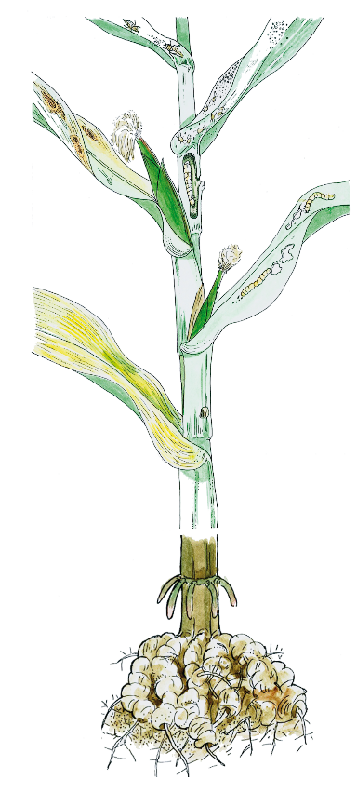
Different pest types
Aphids
Mites
Stemborer
Caterpillar
Nematodes

Slide 2
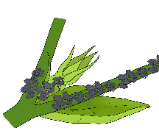
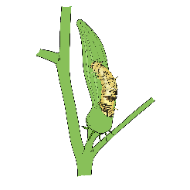
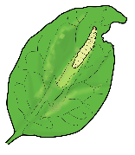
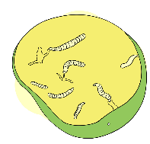
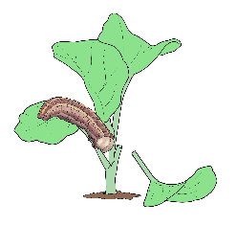
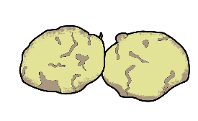
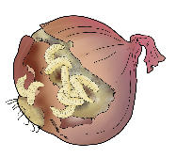
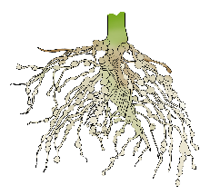
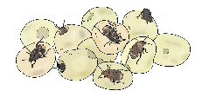
Examples of pest damage
Affected part | Typical damages | Pest types
Plants | Withering plants, damping-off young plants, eaten roots | Larvae of noctuids or stemborer
 | Missing young plants | Birds like sparrows, starlings and crows
 | Yellowish, withering and dying plants | Nematodes on plant roots
Leaves | Leaves with holes or missing parts | Caterpillars, weevils
 | Curled leaves | Aphids sucking sap
 | Woven tissue on yellowish leaves | Spider mites
Fruits | Damaged or rotten fruit | Larvae of fruit flies
Seeds | Holes in seeds | Seed beetle, grain borer

Slide 3
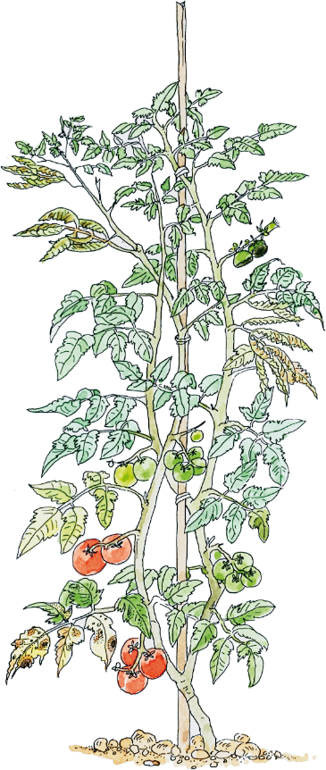
Examples of disease damage
Patched leaves due to virus attack
Rotting due to fungal infection
Withering due to fungal infection
Blight due to fungal infection
Patches due to bacterial infection

Slide 4
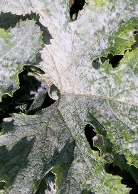
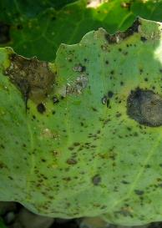
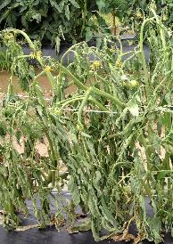
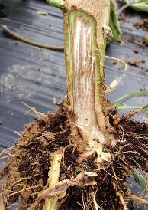
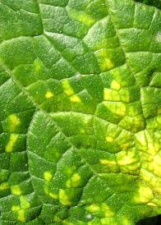
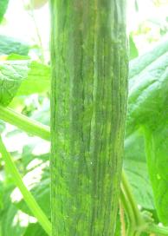
Types of disease pathogens
Fungal diseases
Bacterial diseases
Viral diseases
Symptoms
Light green/yellow patches on leaves
Stunted growth
Spreading through
Infected planting material such as seeds, seedlings and cuttings
Insect vectors
Symptoms
Spotting, canke­ring, blighting
Wilting, scabbing and rotting on different plant parts
Withering and dying of plants
Spreading through
Rain, wind, tools, humans and animals
Infected planting material such as seeds, seedlings and cuttings
Symptoms
Individual wilting and rotting plants
Discoloration of lower stem and ­internal discoloration of stem
Formation of plant tumours
Spreading through
Rain, wind, tools, humans and animals
Infected plants and / or plant parts

Slide 5
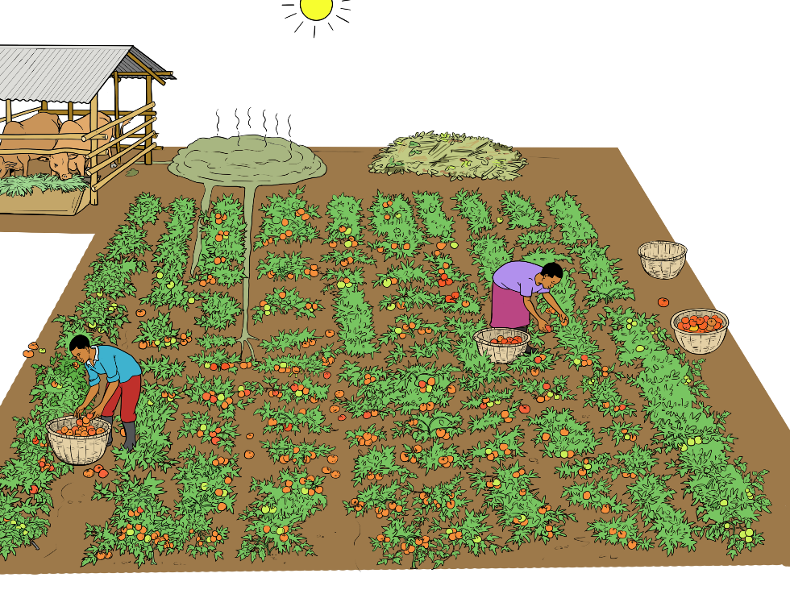
When do pests and diseases become a problem?
Conducive environment for pests and diseases
Monocropping
Sensitive cultivars
Introduction of pathogens to the field
Lack of knowledge on symptoms and life-cycles
Poor crop growth conditions
No consistent implementation of preventive cultural measures
No monitoring of pest and disease appearances
Lack of natural enemies
Poor crop hygiene
Lack of effective inputs

Slide 6
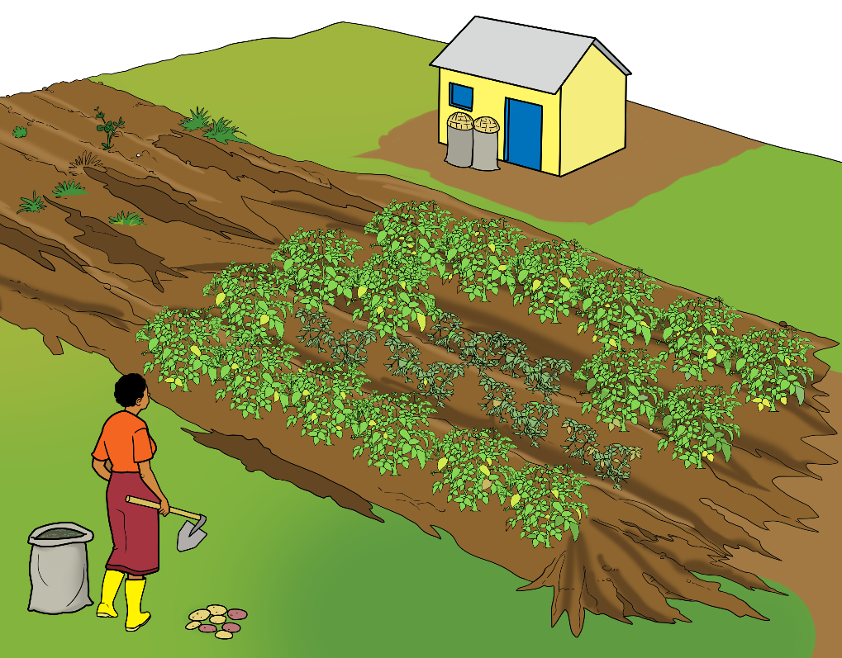
Implications of poor pest and disease management
Income losses
Low agricultural output
Poor implementation of preventive measures
No monitoring
Yield losses and poor product quality
Proliferation of pest and disease populations
Slowed crop growth and unproductive plants

Slide 7
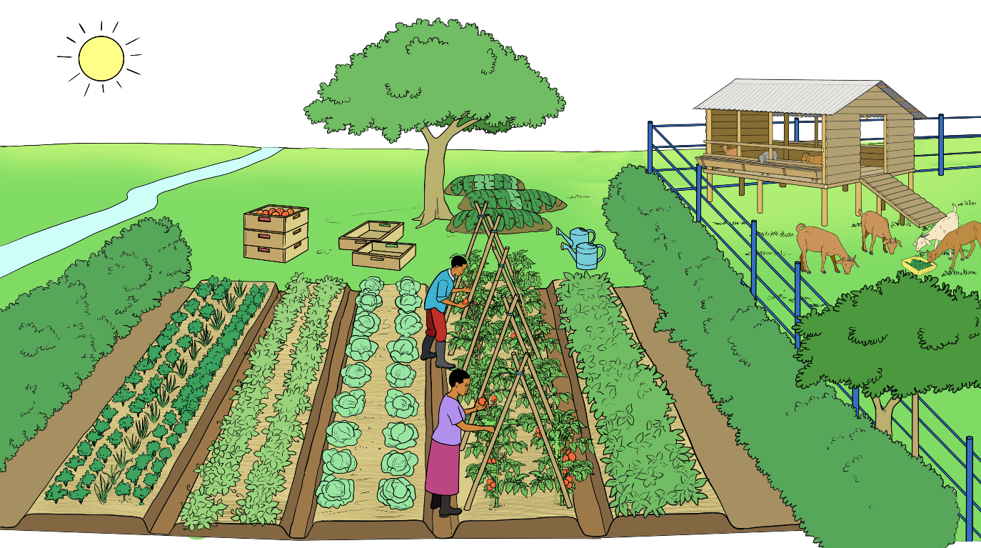
IFOAM Principles of organic agriculture
Health
Ecology
No chemical pesticides
Restoring soil fertility
No livestock feed additives
Promoting biodiversity
Creating a healthy environment
Recycling of nutrients
Care
Fairness
Efficient use of resources
Fair shares for all partners in the value chain
Including traditional knowledge
No GMOs

Slide 8
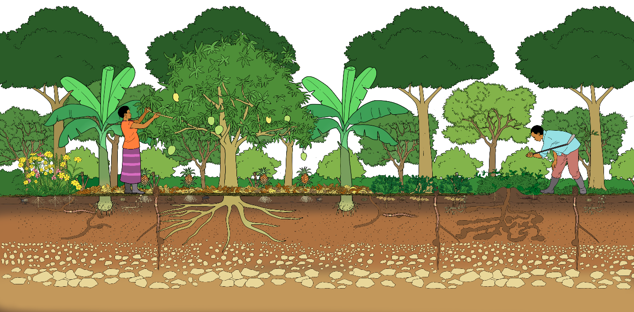
Principles of organic pest and disease management
Renouncing chemical pesticides
Preventing development of pest populations
Minimising negative impacts of pesticide use on the environment and beneficial organisms
Careful monitoring of crop health
Optimising the potentials of a diverse ecological system
Promoting natural regulation mechanisms
Prevention – Monitoring - Control
Minimising the risk of disease infections
Promoting strong and healthy plants (healthy soil – healthy plants)
Continuous improvement of the system

Slide 9
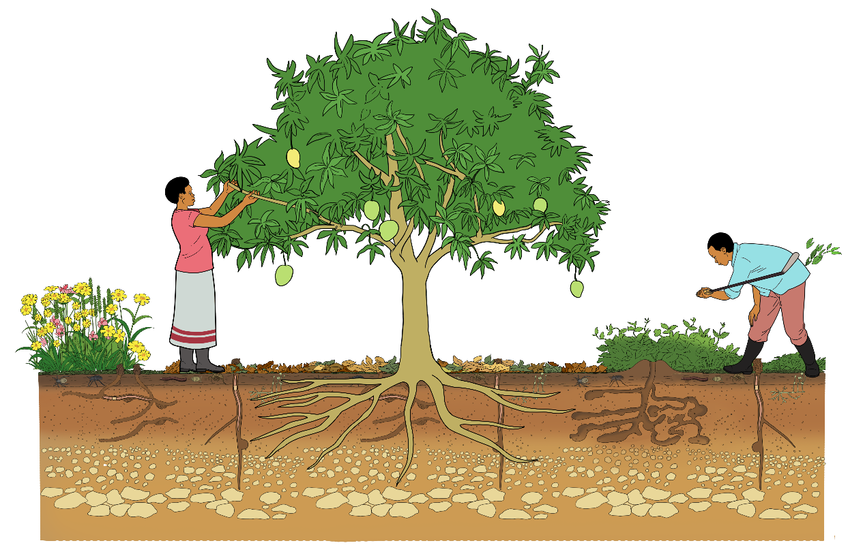
Healthy soil – healthy plants
Healthy soil:
Is rich in humus
Is rich in microorganisms, flora and fauna
Has a stable structure
Allows water penetration through micro- and macropores
Is resistant against soil erosion
Harbours no pests, diseases or weeds

Slide 10
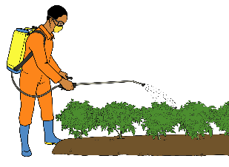
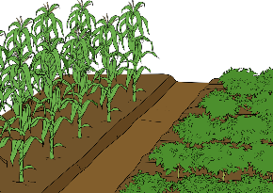
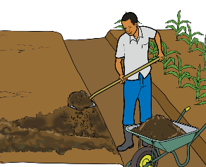
Three-step approach to manage pests and diseases
3rd step
Direct control
Applying physical control measures and natural pesticides
2nd step
Habitat management
Enhancing natural enemies, distraction of enemies and good aeration of the crop
1st step
Crop management
Providing good growing conditions for strong plants

Slide 11
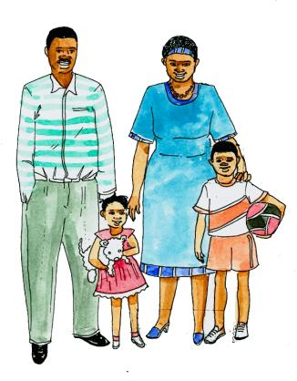
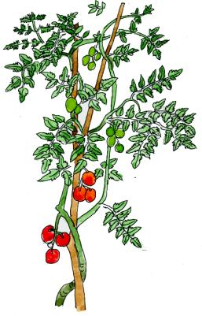
Comparing management of human and plant health
3. Direct treatment: medicines
3. Direct control: biological control, biopesticides
2. Natural remedies: homeopathy, vitamins, food supplements
2. Natural enemies: conservation biocontrol, intercropping, quarantine
1. Healthy living: good food, water, exercise, hygiene, accomodation
1. Good growing conditions: strong varieties, timely planting, soil fertility management

Slide 12
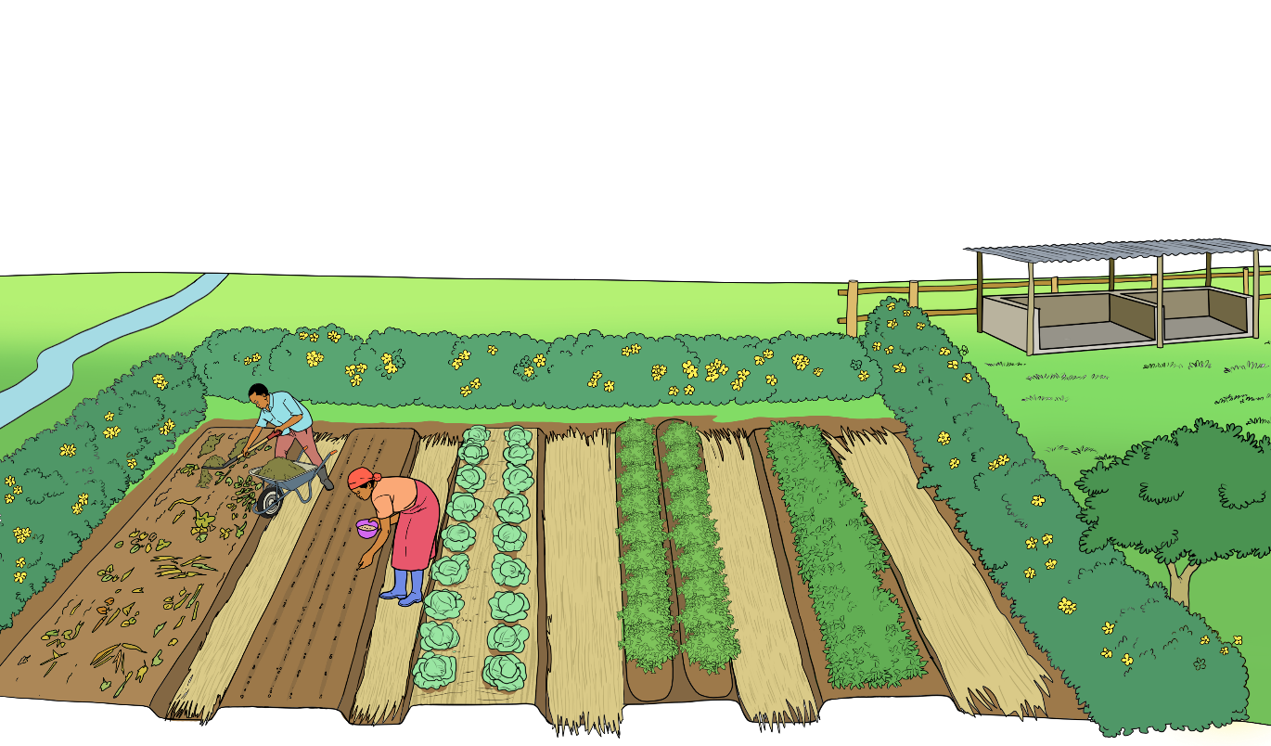
Disease management step 1 strategies and tools Managing the soil and the crops to ensure good growing conditions
Apply compost
Rotate crops
Strengthen the plants
Use appropriate spacing
Prepare the soil well
Use disease-free planting materials
A planned crop rotation is essential to control soil-borne diseases
A fertile soil provides the foundation for strong plants that can tolerate damage better
Disease resistant or tolerant varieties offer the best protection
Applying plant strengthening preparations or products can increase plant vigour or improve disease resistance

Slide 13
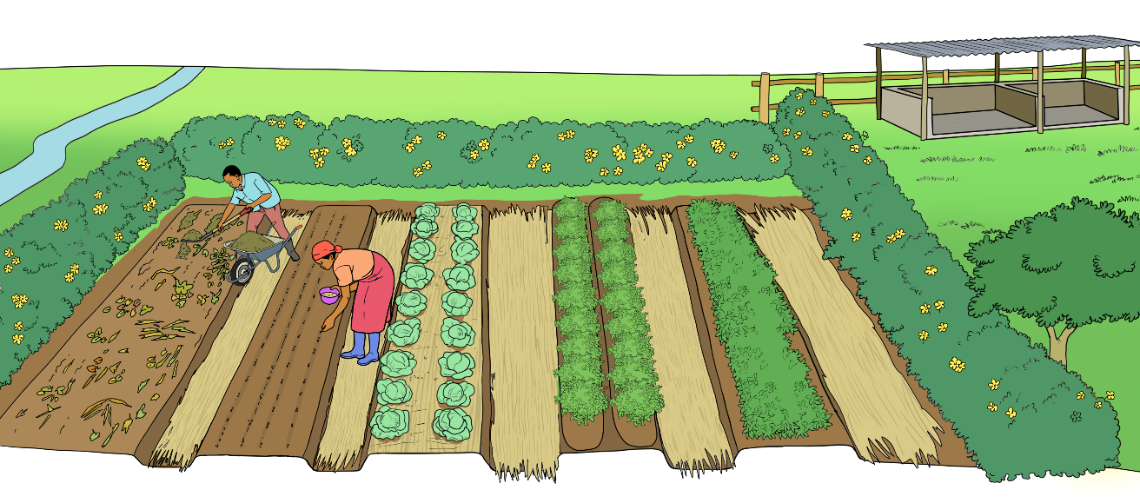
Pest management step 1 strategies and tools Ensure good growing conditions
Plant hedges around fields
Use pest-free seeds and seedlings
Ensure good fertilisation
Ensure timely planting
A well-planned crop rotation is essential to control soil-borne pests
A fertile soil provides the foundation for the development of strong plants
Local varieties and cultivars may best cope with local conditions
Use good quality seed of pest tolerant varieties from reliable sources

Slide 14
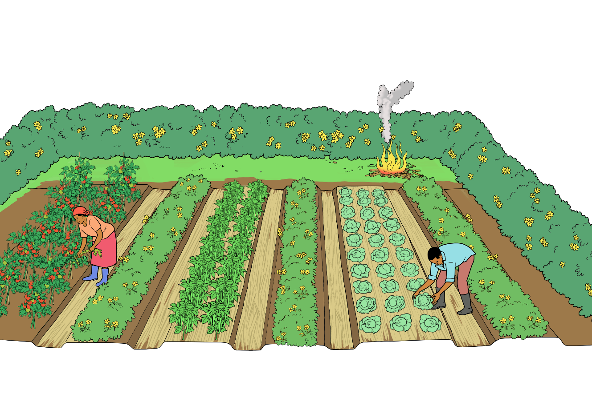
Disease management step 2 strategies and tools
Limiting disease spread through field hygiene and disease scouting
Remove and dispose properly diseased plants and plant parts
Regularly scout for disease symptoms
Maintaining a good hygiene in the field limits spreading of diseases
The identification of plant diseases requires a good knowledge of the symptoms of infection
The sooner a disease is detected, the better the healthy plant parts and plants can be protected

Slide 15
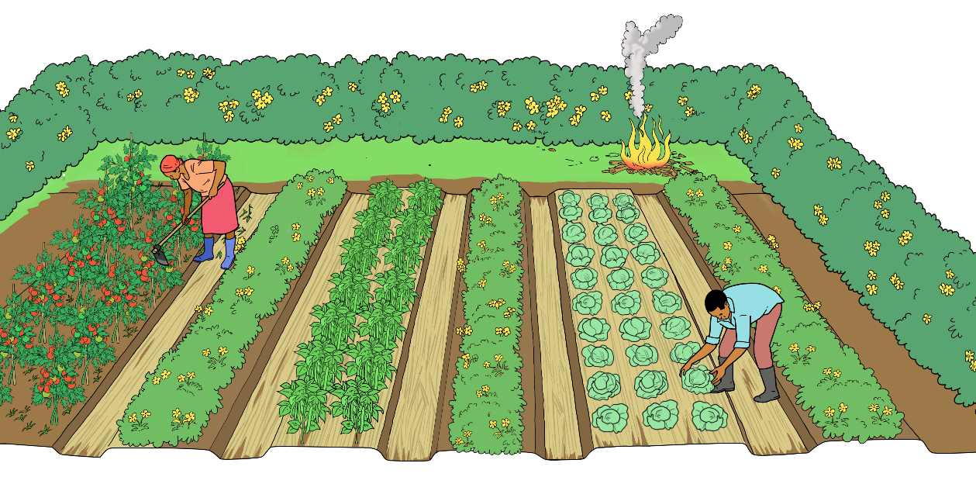
Pest management step 2 strategies and tools Promoting natural enemies, scouting for pests and maintaining good field and crop hygiene
Remove and destroy infested plants and plant parts
Remove alternative hosts of pests
Promote host plants for natural enemies
Hedges with indigenous shrubs and selected flowering plants sown in strips or planted between the crops can host natural enemies to control pests
Intercropping with non-host crops or trap crops and/or repellant plants keeps the pests away from the crops
Regular scouting ensures timely detection of the pests

Slide 16
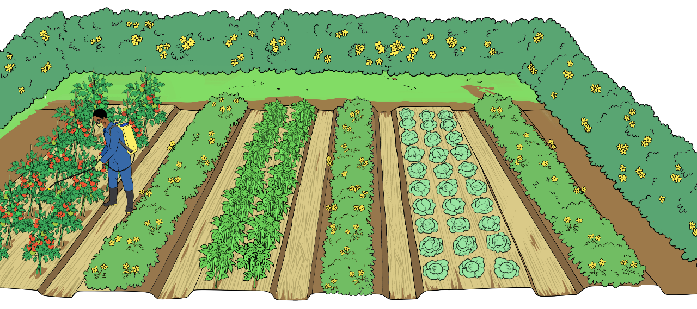
Disease management step 3 strategies and tools
Controlling the diseases and their vectors with approved products
Apply fungicides timely
Control virus vectors timely
Viruses can only be controlled through preventive measures (steps 1 and 2) and control of their vectors (e.g. aphids)
Bacterial diseases are limited through crop hygiene mainly; treatments with copper can be effective
Fungicides protect healthy plants only, they do not cure diseased plants

Slide 17
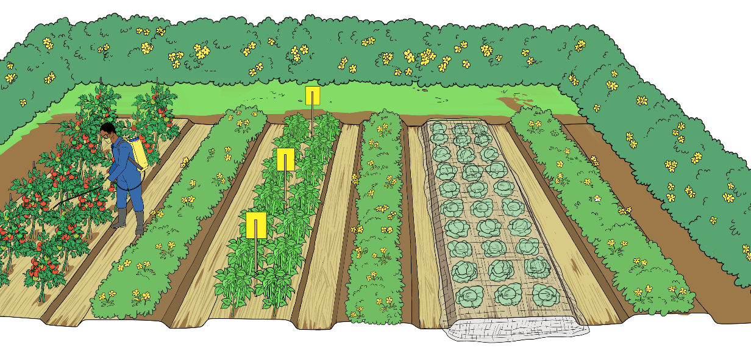
Pest management step 3 strategies and tools Controlling the pests with physical and biological methods
Use bait, light and colour traps
Apply approved pesticides timely
Use fine-meshed nets
Biopesticides with a narrow range of action spare the natural enemies
Apply approved insecticides and acaricides (including plant extracts, plant oils, and mineral oil), and biological agents (including predatory insects, mites and parasitoids, viruses, and bacteria) at risk of damage
Nematodes and other soil-borne pests can be controlled by solarisation

Slide 18
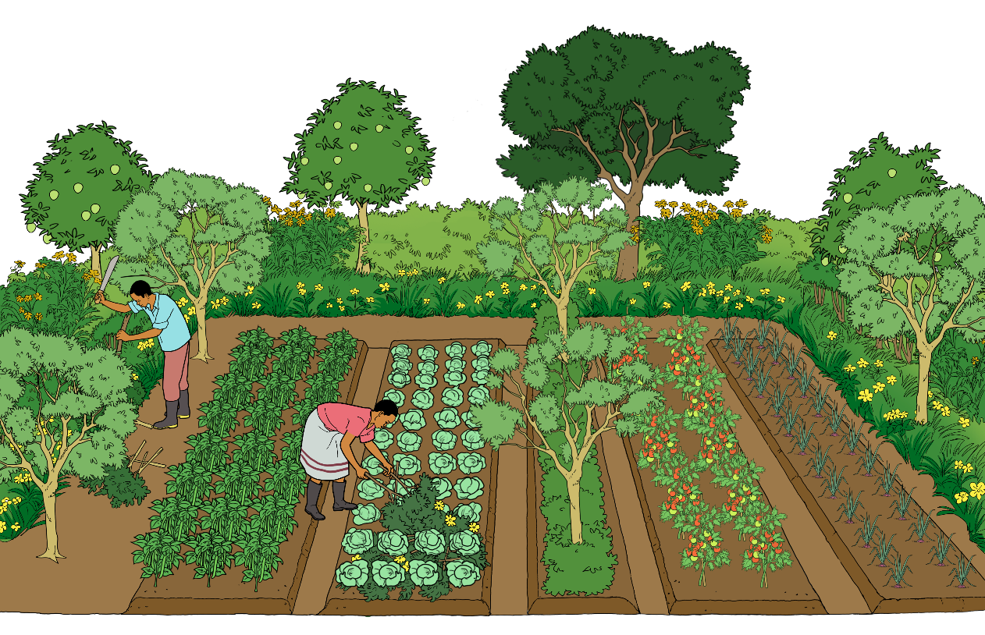
Creating a favourable environment for the crops
Diversity of crops
Natural environment
A favourable combination of crops in space and time
Soil protection
Multilayer cropping system
A diverse cropping system creates a favourable micro-climate, contributes to better soil fertility, reduces the risk of crop losses, and increases yield safety.

Slide 19
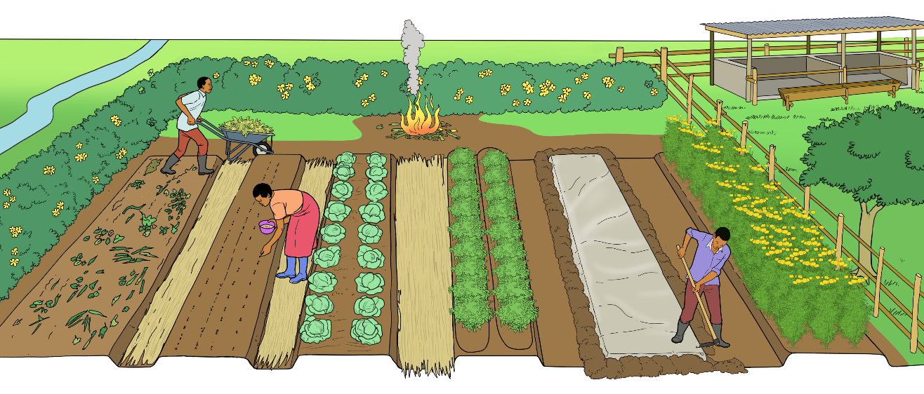
Ensuring a pest- and disease-free field
Mulching with disease- and pest-free material
Removal and proper disposal of diseased plants and plant parts
Well-planned crop rotation
Biofumigation with marigold
Promotion of biological activity in the soil
Solarisation of the soil

Slide 20
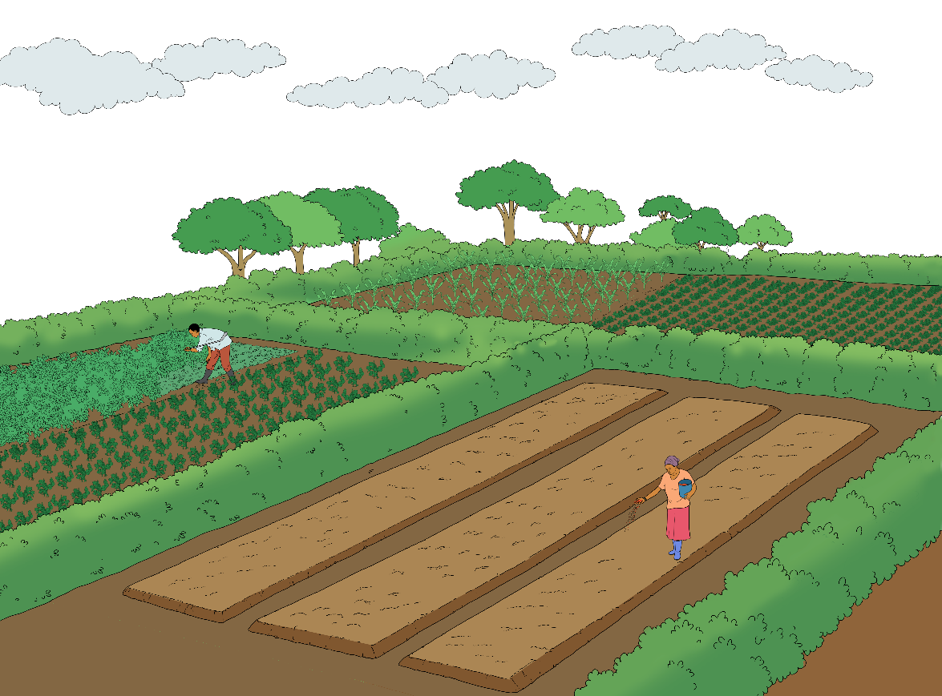
Timely planting of annual crops
Ensure enough good quality seed is available well before the rains or planting time
Ensure all necessary tools and equipment are read and in good condition
Ensure there is enough labour for land preparation and sowing / planting
Any seed pre-treat-ments, like soaking or hot water treatment are done properly
Plant when the soil has enough moisture for successful seed germination
Avoid coincidence of sensitive plant growth stages with infestation periods of pests or diseases
Planting at the beginning of the rainy season allows quick plant growth before pests and diseases develop

Slide 21
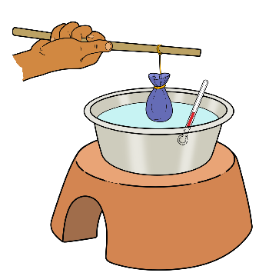
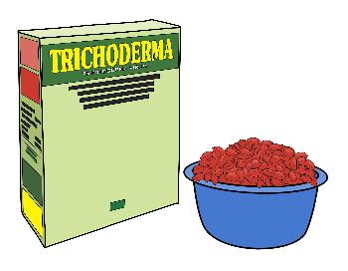
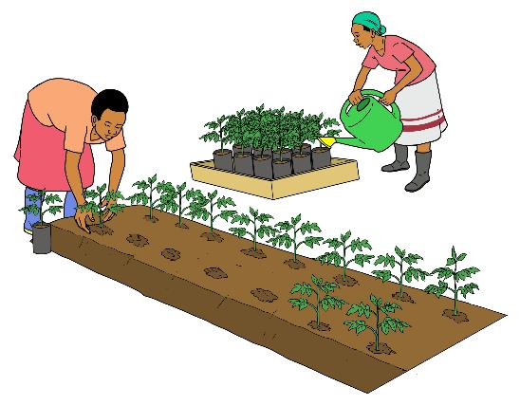
Use of healthy and robust seeds and planting materials
Treatment of the seeds with plant symbionts
Treat own seeds with hot water
Use of healthy seeds of verified origin
Use of varieties tolerant or resistant to major pests and diseases

Slide 22
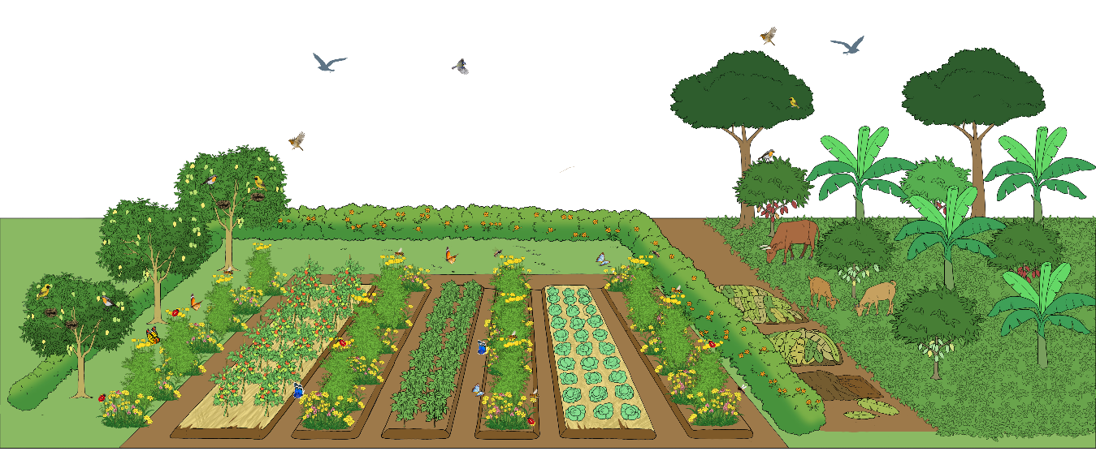
Promotion of natural enemies to control pests
Diverse cropping systems
Hedgerows
Natural habitats
Soil cover
Natural weed flora
Flower strips
Reduced soil cultivation

Slide 23
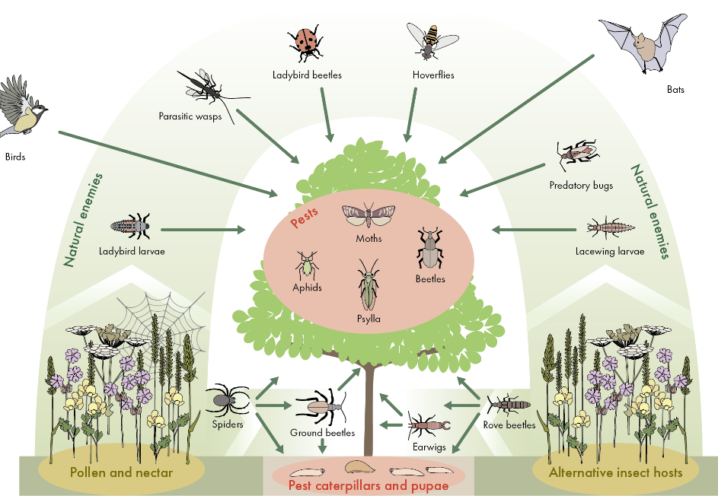
Example of promoting natural enemies with flower strips
Flower strip
Flower strip
Strips of selected flowers, sown next to fruit trees, can maintain a diverse population of natural enemies close to the trees. In this way, they manage to rapidly control pest populations in a natural way.

Slide 24
Controlling stemborer with the push-pull method
Maize
Napier grass
Desmodium
The trap crop is more attractive to the pest either as alternative food source or egg laying site than the main crop.
The repellent crop produces an odour that ‘pushes’ the pest away.
Trap plant (napier grass)
Repellent plant (Desmodium)
Trap plant

Slide 25
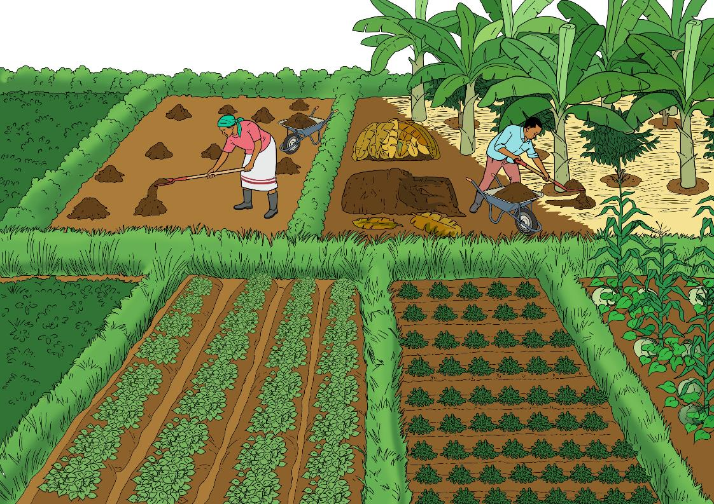
Good soil fertility management
Mulching and reduced tillage
Applying compost
Cultivating green manures
Cultivating nitrogen fixing legumes in the rotation

Slide 26
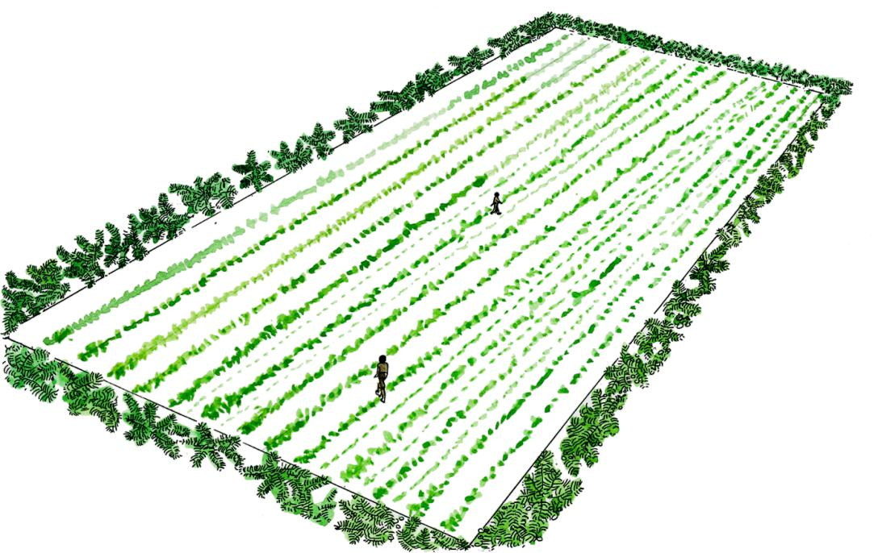
Regular scouting of the crops
The recommended scouting pattern follows a zigzag- or M-shaped route through the field
1st step: Crop management compatible with natural processes, such as farm/field location, crop rotation, soil fertility management, crop competition
Careful regular monitoring of pest and disease levels, especially during critical times of crop growth, allows timely and thus more effective control interventions.

Slide 27
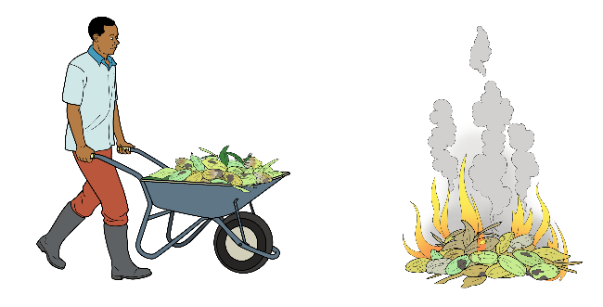
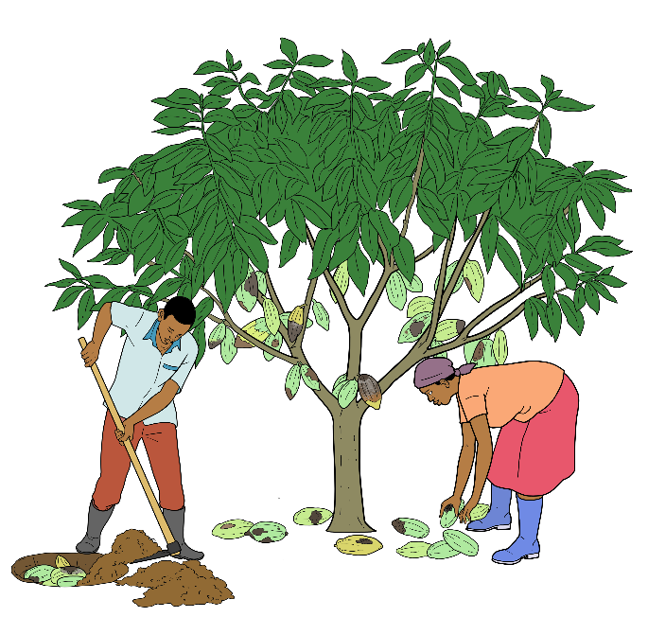
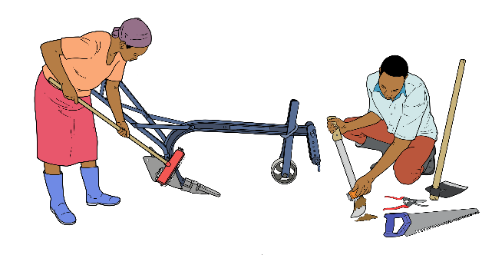
Observing good field hygiene
Burning of infested crop residues prevents transfer of pathogens to subsequent crops
Removing infected plants or plant parts minimises spreading of infections
Cleaning of tools that come into contact with infected plants with alcohol or heat reduces propagation of pathogens

Slide 28
African plants with insecticidal properties
Plants | Range of action and caution
Neem (Azadirachta indica) | many insects, nematodes (neem cake)
Pyrethrum (Chrysanthemum cinerarifolium) | most insects and mites
Fish bean (Tephrosia vogelii) | caterpillars, mites
Chili (Capsicum frutescens) | many insects
Tobacco (Nicotiana spp.) | all insects and mites (very toxic for humans)
Mexican and African marigold (Tagetes spp.) | repellent against insects, effects against nematodes
Garlic (Allium sativum) | anti-feedant for insects
Wild basil (Ocimum suave) | repellent against insects

Slide 29
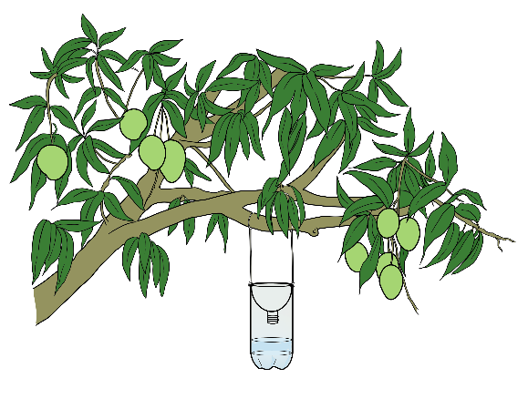
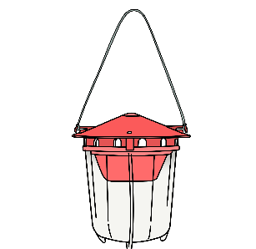
Monitoring insect pests with traps
Yellow or blue sticky traps → Insects
Homemade trap → fruit flies
Pheromone trap → pest insects
Light trap → noctuids

Slide 30
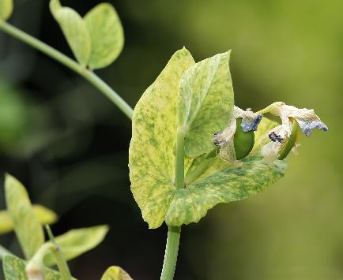
Bean common mosaic virus (BCMV)
Important to know | Disease transmitted by viruses and through infected seeds
Measures before planting | If possible, choose varieties that are resistant to BCMV. Use seeds from approved seed suppliers. Maintain a cultivation interval of at least 3 years (also of related species such as peas, soybean and peanuts).
Measures after planting | Ensure proper plant nutrition to ensure strong and healthy plants. Effectively control aphids.
Measures in case of infestation | Maintain good field hygiene by removing any plants with virus symptoms from the field and burning or burying them.
Source: iStock

Slide 31
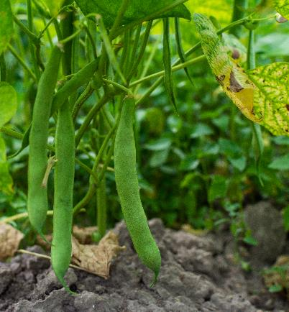
Halo blight, leaf rust, Fusarium root rot, anthracnose and angular leaf spot
Important to know | All fungal infections are favoured by high moisture and warm temperatures (above 20 °C). All soil-borne diseases
Measures before planting | Choose certified disease-free seed – angular leaf spot is seed-borne. Destroy crop residues or use them as mulch away from the bean fields. Plant on hills or ridges. Avoid furrow irrigation to allow good drainage. Do not grow beans (or related species such as peas, soybean or peanuts) on the same plot for any two consecutive seasons.
Measures after planting | Do not weed or do other operations in bean fields when the soil is wet. Weed carefully to avoid damaging roots or stems.
Measures in case of infestation | Spray Sulphur compounds (0.2 % concentration) at the first signs of rust infection.
Source: iStock

Slide 32
Bean aphids
Important to know | Black ants are very common on plants with aphid infestations – they feed on the honeydew produced by aphids. Aphids attack beans at any stage, from seedling to flowering/fruiting, and they attack any parts of the growing plant.
Measures before planting | Do not grow beans (or related species such as peas, soybean, or peanuts) on the same plot for any two consecutive seasons. Intercrop with chives or garlic to repel aphids. Plant early to avoid water stress. Grow or leave natural areas around the boundary or along strips in the field.
Measures after planting | Regularly monitor fields to detect aphids early. Remove weeds which compete with beans for nutrients.
Measures in case of infestation | Apply neem or pyrethrum-based products.
Source: Pixabay

Slide 33
Bean flies (Ophiomyia spp.)
Important to know | Attacked plants may wilt or get stunted. Resistant dry bean varieties to bean fly infestation are available in some countries. Vigorous plants can tolerate bean fly infections.
Measures before planting | Beans (or related species such as peas, soybean or peanuts) should not be grown on the same plot for any two consecutive seasons. Grow or leave natural areas around the boundary or in strips in the field. Plant early in the season (low bean fly populations).
Measures after planting | Scout regularly for early detection of the bean flies. Do not apply fresh manure to the bean plot. During weeding, slight ridging or earthing up helps damaged plants to recover.
Measures in case of infestation | Remove and destroy crop residues and all infected plant parts (by burning). Use plant extracts (such as Tephrosia, Tithonia, Marigold, Datura and Neem leaves) to spray infected plants.
Source: Merle Shepard, Gerald R.Carner, and P.A.C Ooi, Insects and their Natural Enemies Associated with Vegetables and Soybean in Southeast Asia, Bugwood.org

Slide 34
Bruchids/bean weevil (Acanthoscelides obtectus)
Important to know | They are small beetles, which attack dried beans in storage. The pest destroys the seeds and reduces germination capacity. Heavy infestation can lead to total loss of stored crop.
Measures before storage | Maintain good storage hygiene in the crop store. Ensure a moisture content of the beans of less than 15 %. Clean the beans to remove all the chaff. Store the beans in clean bags or containers. Store seed material in plastic bags, which can be hermetically sealed (made airtight).
Measures after storage | Maintain proper ventilation of the storage facility.
Measures in case of infestation | Place the stored bean seed out in the sun occasionally (once every month) in order to reduce moisture content and to kill off pests.
Source: iStock

Slide 35
Pineapple mealy bugs and scales
Important to know | Mealybugs and scales are sap-sucking pests. Mealybugs are the most serious pests of pineapples, also transmitting the pineapple wilt disease.
Measures before planting | Remove alternate hosts such as hibiscus, custard apple, guava in and around the pineapple crop field. Avoid using 5 to 6 years old suckers for planting. Remove all mealybug infested plant residues and burn them. Remove weeds present in the field. Use clean equipment in an uninfested field.
Measures after planting | Ensure good crop nutrition and water supply. Control weeds timely.
Measures in case of infestation | Remove all diseased or infected plants from the field and bury or burn them.
Source: Patrick R. Marquez, USDA APHIS PPQ, Bugwood.org

Slide 36
Pineapple root nematodes
Important to know | Root-knot nematodes (Meloidogyne javanica) and root lesion nematodes (Pratylenchus brachyurus) affect the roots and cause premature death.
Measures before planting | Use clean planting materials and clean fields. Include grasses in a 3-year crop rotation for pineapples. Maintain a weed-free and host-free fallow period of at least 6 months. Prepare the land properly allowing it to dry to kill nematodes.
Measures after planting | Maintain good soil fertility and watering practices. Remove weeds early.
Measures in case of infestation | Remove all diseased or infected plants from the field and bury or burn them.

Slide 37
Pineapple phytophthora heart (top) rot and Phytophthora root rot
Important to know | Both common fungal diseases are controlled the same way, but are caused by different pathogens. The fungi cause premature ripening of fruits. Top rot also shows dead leaves around the center of the plant. Both are caused by overwatering, poorly drained soils or too much rainfall.
Measures before planting | Use a well-drained seedbed to plant pineapples. Avoid excessively deep planting. Prevent soil entering the heart during planting. Plant on raised beds of at least 20 cm height.
Measures after planting | Maintain proper drainage of pineapple fields.
Measures in case of infestation | Remove all diseased or infected plants from the field and bury or burn them.
Source: Brantlee Spakes Richter, University of Florida, Bugwood.org
Source: Gerald Holmes, Strawberry Center, Cal Poly San Luis Obispo, Bugwood.org

Slide 38
Cocoa swollen shoot virus disease (CSSV)
Important to know | The disease is transmitted by mealybugs such as Planococcoides species. The pathogen leads to swelling of roots and stems, loss of colour on the leaves, and yellowing of the trees. In case of a severe attack, infected trees die.
Measures before planting | Use disease resistant or tolerant varieties. Ensure good soil fertility management for strong trees. Ensure that healthy planting material is collected from non-infested trees and/or plantations only. Remove all diseased or infected plants, pods and other plant parts from the plantation, and destroy them.
Measures after planting | Prune well and control the height of the trees to improve the health of the trees. Continue to improve soil fertility for healthy trees.
Measures in case of infestation | Remove all diseased or infected plants, pods and other plant parts from the plantation and destroy them.
Source: FiBL

Slide 39
Cocoa black pod disease
Important to know | Most important yield-limiting cocoa disease in Africa Infects pods at any stage of development.
Measures before planting | Use cocoa varieties with tolerance to black pod disease. Use disease-free planting materials to establish new cocoa fields.
Measures after planting | Remove some cocoa branches and shade trees to allow light and air circulation. Remove ripe pods as soon as possible to minimise attack. Harvest at regular intervals of 1.5 to 3 weeks. Remove weeds regularly to increase air circulation around the trees.
Measures in case of infestation | Regularly remove all diseased pods. Spray Sulphur compounds at 0.2 % concen-tration at the first signs of infection.
Source: FiBL

Slide 40
Cocoa mirids or capsids
Important to know | Mirids (capsids) damage young shoots and cocoa pods reducing yields. Young cocoa trees are most vulnerable to attack when grown without shade.
Measures before planting | Regularly monitor the crop – attacks are frequent during the rainy season. Do not interplant cocoa with cashew, tea, sweet potato, guava, cotton, and mango which are alternative hosts for the pest.
Measures after planting | Prune, remove weeds and plant shading plants to control the pest. Remove the ripe pods as soon as possible to minimise attack by fungal diseases or animal pests. Harvest at regular intervals of 1.5 to 3 weeks.
Measures in case of infestation | Spray with insecticidal soap, neem or pyrethrum.
Source: FiBL

Slide 41
Groundnut rosette
Important to know | The most destructive groundnut disease in Africa; can cause 100 % yield loss. A viral disease transmitted by aphids such as the groundnut aphid (Aphis craccivora). It is more serious during years with drought, and can spread rapidly through the crop.
Measures before planting | Plant varieties resistant to the rosette disease. Remove volunteer groundnut plants in the rotation, and bury or burn them. Intercrop groundnut with other crops such as maize, beans or sorghum. Plant early with the first good rains to reduce infestations by aphids.
Measures after planting | Remove noxious weeds like couch grass or spear grass to reduce competition. Apply compost – and to some extent also farmyard manure – to improve soil fertility.
Measures in case of infestation | Remove and destroy infected plants by either burning or deep burying. Apply neem or leaf extracts against aphids.

Slide 42
Groundnut late and early leaf spots
Important to know | Most widespread diseases of groundnut globally leading to yield losses of up to 50 %. The diseases are favoured at temperatures of 25 to 30 °C and 6 to 8 hours of high humidity. Both are largely soil-borne fungal diseases that survive mainly on crop residues and volunteer crops that grow from the previous season.
Measures before planting | Rotate groundnuts with other crops to create a break in time between groundnut crops in a field. Bury, burn or feed residues of groundnut crops to animals after harvest. Plant new groundnut crops upwind as far away as possible from previous groundnut crops. Use resistant or tolerant, early yielding varieties.
Measures after planting | Remove volunteer plants and weeds.
Measures in case of infestation | Remove infected plants, and bury them deep in the soil, or burn them.
Source: iStock
Early leafspots
Late leafspots

Slide 43
Groundnut aphid (Aphis craccivora)
Important to know | Aphids attack and suck sap from the tender parts of the growing groundnut plant, like leaf and flower shoots, which weakens the plants. The aphids are important vectors in the transmission of the Rosette disease virus.
Measures before planting | Ensure proper crop rotation, removal of volunteer plants and weeds, intercropping, and burying crop residues during early land preparation. Use tolerant or resistant varieties, if available.
Measures after planting | Promote natural enemies by allowing natural areas (including flowering plants) around the fields to control the aphids.
Measures in case of infestation | Spray with potassium soap, quassia extract, or with neem seed or leaf extracts.
Source: iStock

Slide 44
Termites
Important to know | Termites can damage groundnut roots and stems, and bore holes in the pods, thereby damaging nuts. When termites damage pods, they also provide an entry point for the Aspergillus fungi that produce aflatoxin.
Measures before planting | Incorporate crop residues into the soil early enough. Plant early for healthier and more vigorous plants, which can better tolerate termite attack.
Measures after planting | Harvest in time before termites damage the pods.
Measures in case of infestation | The use of synthetic termiticides is not allowed in organic production. Destroy the termite mounds and remove the queen termites.
Source: iStock

Slide 45
Groundnut leafminer moth (Aproaerema modicella)
Important to know | The leafminers tunnel into the leaves and feed between the upper and lower surface of the leaf. Mined leaves become distorted within a few days, turn brownish, rolled and dry. Severe cases of leaf miner damage look like the crop has been burnt.
Measures before planting | Use resistant varieties. Practice crop rotation with non-leguminous crops such as maize and sorghum. Plant early at the start of the rains to avoid the pest build-up. Intercrop with trap crops such as pearl millet and cowpea. Remove alternative hosts and weeds, e.g. amaranthus, hyacinth bean (lablab), mung beans, and Indigofera hirsuta.
Measures after planting | Avoid drought stressing the plants by irrigating – where possible - or early planting the crop.
Measures in case of infestation | Removing and destroy webbed leaves, in which the green larvae hide. Use light, sticky or pheromone traps to attract and catch the adult moths and to monitor the pest populations.

Slide 46
Soybean root-knot nematodes (Meloidogyne spp.)
Important to know | Nematodes are small worms residing in the soil and damaging the roots. The effects of nematode damage are yellow leaves, stunted growth, even if soil fertility is good, and wilting even when there is enough water in the soil.
Measures before planting | Plant resistant varieties, if available. Practice crop rotation with cereals for at least 3 to 4 years.
Measures after planting | Remove weeds early to reduce competition with the soybean crop. Improve soil fertility to strengthen plants and make them less susceptible.
Measures in case of infestation | Infested plants and fields cannot be effectively treated - rather the land can be put under proper rotation to get rid of the nematodes.
Source: iStock

Slide 47
Soybean rust
Important to know | Grey green to dark brown or reddish-brown lesions which cause leaf yellowing, and eventually result in premature loss of leaves and pod maturity. Most severe during long periods of leaf wetness (rainy seasons) and high humidity Soybean is susceptible at any development stage, and rust can reduce yield by as much as 90 %. The pathogen is however not seed-borne in soybean.
Measures before planting | Avoid planting soybean near or in immediate rotation with cowpea, beans, or other leguminous crops. Do not grow soybeans or other legumes on the same plots for any 2 consecutive seasons. Choose resistant varieties. Ensure proper spacing to allow good air circulation.
Measures after planting | Remove weeds to reduce on field competition and potential alternative hosts of the disease
Measures in case of infestation | Remove infested crop residues, and bury or burn them. Spray Sulphur compounds (0.2 % concentration) at the first signs of infection.
Source: iStock

Slide 48
Soybean bacterial blight (Pseudomonas savastonoi)
Important to know | Small yellow to light brown spots on leaves, but also on stems, petioles, and pods. Young leaves are most susceptible. Infected young leaves are distorted, stunted, and turn yellow. Seeds can be infected through the pods during the growing season, or they may be invaded during harvesting. The bacterium is spread during windy rainstorms and during cultivation while the foliage is wet. The disease is seed-borne.
Measures before planting | Use certified clean seeds. Plant resistant varieties, if available. Practice good sanitation throughout.
Measures after planting | Remove weeds to reduce on competition with the crop.
Measures in case of infestation | Remove and destroy infected plants.
Source: iStock

Slide 49
Soybean mosaic viruses (soybean mosaic virus or mosaic potyvirus)
Important to know | Leaves of infected plants are distorted and die, and infected plants may become stunted. The disease is transmitted by aphids, beetles, whiteflies, and infected seeds.
Measures before planting | Use certified, disease-free seeds. Select virus resistant varieties.
Measures after planting | Remove weeds to reduce on competition with the crop. Ensure that disease vectors such as aphids and whiteflies are under control.
Measures in case of infestation | Remove and destroy infected plants.
Source: iStock

Slide 50
Steps to clarify the authorisation of pesticides for organic farming (1)
Step 1: Is the substance formally registered for use in agriculture in the intended country?
No ➔ Input cannot be used, need to submit a request to owner of the standard or label for inclusion.
Yes ➔ Go to Step 2
Step 2: Is the substance and/or product compliant to national organic regulations?
No ➔ Input cannot be used.
Yes ➔ Input can be used in national context, but if subject to approval then check with a competent national authority.
Go to Step 3

Slide 51
Steps to clarify the authorisation of pesticides for organic farming (2)
Step 3: For organic exports, is the substance and/or product permitted for the target export countries?
No ➔ Input cannot be used for organic products earmarked for export.
Yes ➔ Input can be used for export ­products.
No ➔ Input cannot be used on agricultural products branded with a private label.
Step 4: Is the substance and/or product permitted for branding with private label/standard in target export countries?
Yes ➔ Input can be used on agricultural products branded with a private label
(All key needs have been satisfied).

Slide 52
Sulphur
Application against | Fungal diseases (anthracnose, leaf spot, rust, blight)
Mode of action | Under the influence of moisture, light and oxygen, sulphur dioxide is formed, which is toxic to fungi. Sulphur molecules penetrate the fungal hyphae killing them from the inside.
Impact remarks | The higher the temperature, the better the effect. Insufficient effect below 12 °C Short effect above 25 °C due to high evaporation (at 30 °C approx. 4 to 5 days). Effect of 6 to 12 days under favourable conditions
Side effects | Toxic reactions to the plant possible with increasing temperature and application rate, and depending on the sensitivity of the variety and the stage of the crop. High application rates also harm predatory mites.
Application | Not to be mixed with white oil or rapeseed oil. In hot weather, apply in the early morning or in the evening. Reduce application rate for sensitive varieties.
Source: Wikimedia Commons

Slide 53
Copper (-hydroxide, -lime broth, -oxychloride, -sulphate)
Application against | Fungal diseases (anthracnose, leaf spot, rust, blight)
Mode of action | Copper ions in solution block the enzyme system in the metabolism of the microorganisms. Copper can also stimulate the plant’s own defense mechanisms.
Impact remarks | Better than Sulphur at lower temperatures Hardly any differences between copper formulations
Side effects | Accumulates as a heavy metal in the soil and (especially at low pH) can damage earthworms and inhibit microbial nitrogen mineralisation. Very toxic to aquatic organisms
Remarks on the application | Not miscible with Sulphur lime, alumina preparations and potash soap Adding copper to Sulphur improves the effect of Sulphur at lower temperatures. Not to be used during flowering of a crop. Limited amounts per surface allowed in organic farming depending on the regulation
Source: Wikimedia Commons

Slide 54
Lime sulphur
Application against | Fungal diseases (anthracnose, leaf spot, rust, blight)
Mode of action | Due to the high pH value, the lipids of the cell membranes of the fungi are saponified, improving the absorption of the active substance. The active substance intervenes in the metabolism of the cells of the fungus.
Impact remarks | Contact fungicide with preventive, curative and non-specific effect Treatments into damp foliage during fungal germination Through contact with the atmosphere, the active ingredient degrades to Sulphur and forms a preventive protective coating.
Side effects | Can cause sunburn at more than 28 °C like net Sulphur. Can have a thinning effect in fruit crops.
Application | Not to be mixed with other products Can be used as curative treatment after the onset of infection. Rinse and wash all spray material well after treatment (corrosive effect).

Slide 55
Potassium bicarbonate
Application against | Fungal diseases (anthracnose, leaf spot, rust, blight)
Mode of action | Causes the hyphae to burst and delays the mycelium formation of the germinating spores due to hygroscopic properties and the high pH value.
Impact remarks | Best effect when treated into wet foliage during the infection phase
Side effects | Leaf burn possible with certain formulations and varieties if treated frequently without washing off When mixed with Sulphur, no fruit russeting at the recommended application rates
Application | Not miscible with lime Sulphur, alumina and yeast preparations. Mixture with copper products not advisable Improved effect in combination with Sulphur Waiting period: 8 days

Slide 56
Pyrethrin
Application against | Aphids Lice Moths
Mode of action | Obtained from chrysanthemum species Contact poison that rapidly enters the nervous system of insects and leads to paralysis and death. Often addition of sesame oil to enhance the effect
Impact remarks | Rapid disintegration on contact with sunlight and air
Side effects | Broad spectrum of action; also partially harms beneficial insects. Very toxic to aquatic organisms Hasardous to bees
Application | Not miscible with lime Sulphur, bicarbonates and bacterial, yeast and alumina preparations. Treatment of the insects before rolling of the leaves using good application technique with plenty of water and high pressure. For a long duration of effect, carry out the treatments in the evening or early morning. Better effect through addition of soap preparations Waiting period: 3 weeks
Source: Roger Culos/ Wikimedia Commons

Slide 57
Neem extracts (azadirachtin)
Application against | Aphids Leaf miner
Mode of action | Extract from the seeds of the neem tree (Azadirachta indica) with many active components Azadirachtin, the main active ingredient, can be taken up by the plant and translocated through the leaf (translaminar) but not in the sap stream.
Impact remarks | Inhibits larval development and reduces the fecundity of insects (delayed but high effect).
Side effects | Hasardous to bees Toxic to aquatic organisms
Application | Not miscible with Sulphur lime, alumina preparations and oils Effective against aphids even after the leaves have curled up, due to stomach poison and translaminar distribution of the active ingredient in the leaves Good wetting crucial for a successful treatment Application before or after flowering of fruit crops
Source: Forest & Kim Starr/ Wikimedia Commons
Source: Roger Culos/ Wikimedia Commons

Slide 58
Bacillus thuringiensis (Bt)
Application against | Spider moths
Mode of action | Consist of protein crystals from bacterial spores. After digestion by the caterpillars, the protein crystals form toxins that dissolve the cells of digestive system.
Impact remarks | The younger the caterpillars at treatment, the better the effect At <15 °C, the effect is too low due to insufficient feeding activity.
Side effects | None known Only effective against certain butterfly caterpillars, therefore selective
Application | Not miscible with alkaline agents and additives as well as potassium soap, pyrethrum and copper products Application only above 15 °C
Crystals of Bt-toxin from Bacillus thuringiensis. Source: P.R.Johnston/ Wikimedia Commons

Slide 59
Fatty acids (potassium soaps)
Application against | Spider mites Aphids
Mode of action | Reduce the surface tension of the water, which allows them to penetrate the insects’ respiratory tubes, causing them to suffocate. The lye has an additional osmotic effect and dries out thin-skinned insects.
Impact remarks | Soap products wash off quickly and have low UV stability. Fatty acids enhance the effect of pyrethrin.
Side effects | Only minor impairment of beneficial insects Harmful to aquatic organisms
Application | Only miscible with pyrethrum and quassia extracts To be applied in the evening or early morning. The time of application and optimal wetting through a suitable application technique are crucial. Waiting period: 1 week

Slide 60
Rapeseed oil, white oil (paraffin oil)
Application against | Scale insects Red spiders Frost moth Mites Aphids
Mode of action | The oil film coats and suffocates the pests and their eggs. White oil also has an insecticidal contact effect. Rapeseed oils can also be used to improve wetting and adhesion properties of other products.
Impact remarks | Better effect in warm, dry weather due to stronger respiration of the animals White oils are slightly more effective than vegetable oils, but are degraded more slowly.
Application | Miscibility with other products must be checked. Miscible with copper, but not recommended due to the different amounts of water required. Good wetting is crucial for success. If necessary, divide the treatment into two applications with the same amount of broth, but half the concentration.

Slide 61
Calcium carbonate and kaolin (clay)
Application against | Leaf suckers Tree bugs
Mode of action | Powder made from pure white limestone The white coating makes the trees less attractive for egg laying (repellent) and prevents hatched larvae from sucking on the tree.
Impact remarks | Applications of kaolin before hot days can reduce sunburn problems on fruits (check approval).
Side effects | Little harm to beneficial insects
Application | Not miscible with other products 3 to 4 applications from the beginning of the flight of the insects until before flowering in fruit crops. Spray into dry foliage. After treatment, the product should be allowed to dry. Recommended dosage: calcium carbonate 64 kg/ha, kaolin 32 kg/ha in 1000 l of water.
Source:
Marion Halft/Wikimedia Commons

Slide 62
Quassia extract
Application against | Sawflies Aphids Leaf miner
Mode of action | Extracted from the tropical shrub Quassia amara Stomach and contact poison Paralyses insects as a neurotoxin.
Impact remarks | Treatment against the newly hatched larvae immediately after flowering
Side effects | Little harm to beneficial insects
Application | Not miscible with Sulphur lime and alumina preparations Can be made from bitter-wood.
Source:
Pescov/Wikimedia Commons

