Slide 1
Organic Agriculture Worldwide 2021: Key results from the FiBL survey on organic agriculture worldwide 2023
Part 1: Global data and survey background
Jan Trávníček, Bernhard Schlatter and Helga Willer
© FiBL, April 2023

Slide 2
Organic Agriculture Worldwide: Key results from the FiBL survey on organic agriculture worldwide 2023 Part 1: Global data and survey background
Data compiled by the Research Institute of Organic Agriculture FiBL, Frick, Switzerland, based on national data sources and data from certifiers.
Data as published February 2023 in The World of Organic Agriculture. Statistics and Emerging Trends 2023.* Frick and Bonn, www.organic-world.net
For updates, check www.organic-world.net
This presentation is available online at: https://www.organic-world.net/yearbook/yearbook-2023/presentations.html
Texts and graphs: Helga Willer, Bernhard Schlatter and Jan Trávníček, Research Institute of Organic Agriculture FiBL, Frick, Switzerland
Contact: Helga Willer, helga.willer@fibl.org, Research Institute of Organic Agriculture FiBL, Frick, Switzerland
© Research Institute of Organic Agriculture FiBL, Frick, Switzerland, February 2023
*Citation: Willer, Helga, Bernhard Schlatter and Jan Trávníček (Eds.) (2023): The World of Organic Agriculture. Statistics and Emerging Trends 2023. Research Institute of Organic Agriculture FiBL, Frick, and IFOAM – Organics International, Bonn.
Notes:
FiBL
23.10.2023
www.fibl.org
2

Slide 3
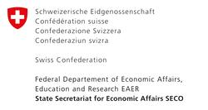
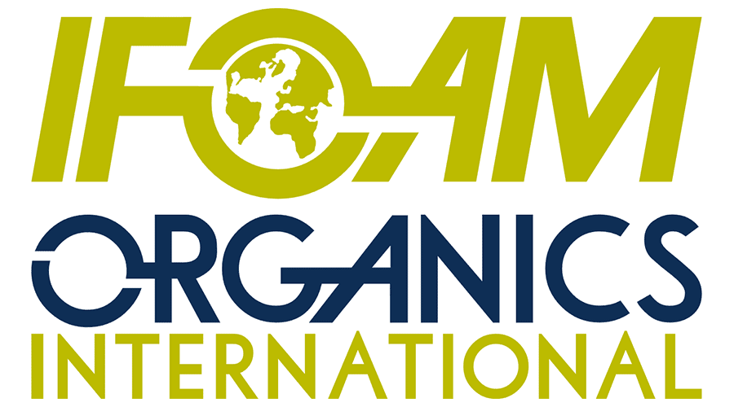
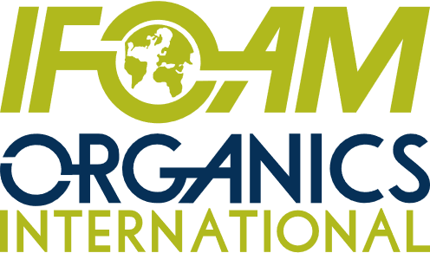
Acknowledgements
The Swiss State Secretariat of Economic Affairs (SECO)
Coop Sustainability Fund
NürnbergMesse, the organizers of BIOFACH
IFOAM – Organics International
More than 200 experts from all parts of the world contributed to the FiBL survey 2023.

Slide 4
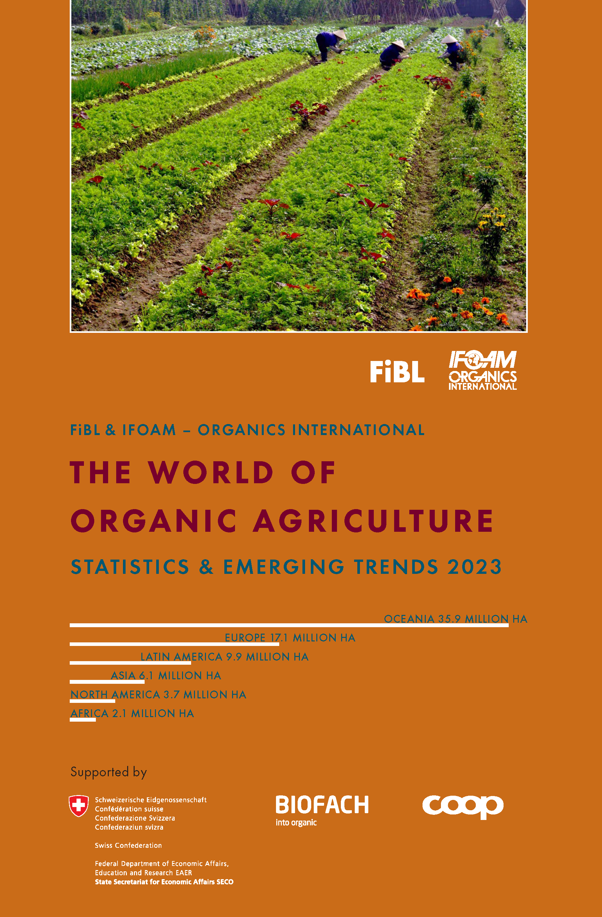
The World of Organic Agriculture 2023
The 24th edition of «The World of Organic Agriculture», was published by FiBL and IFOAM – Organics International in February 2023.
Data tables
Country and continent reports
Markets, standards, policy support
The book can be ordered or downloaded at (item number 1254): https://www.fibl.org/en/shop-en
www.organic-world.net
https://statistics.fibl.org

Slide 5
About this presentation
In three presentations, the key results of the FiBL survey on organic agriculture worldwide 2023 are summarized (data 2021). Apart from the global data, key results on crop and on regional data are presented.
More information is available at www.organic-world.net
The following three presentations are available at https://www.organic-world.net/yearbook/yearbook-2023/presentations.html:
Part 1: Global data 2021 and survey background
Part 2: Land use and key crops in organic agriculture 2021
Part 3: Organic agriculture in the regions 2021

Slide 6
The 24th survey on organic agriculture world-wide
The 24th survey on organic agriculture worldwide was carried out by the Research Institute of Organic Agriculture FiBL in cooperation with partners from all around the world. The results were published jointly by FiBL and IFOAM – Organics International.
The survey was carried out between July 2022 and February 2023.
Data were received from 191 countries.
Data was provided by over 200 country experts (representatives from NGOs, certification bodies, governments, researchers).
The following data was collected: area data (including land use and crop details); producers, other operator types; domestic market values; export and import data; livestock data (animal heads and production in metric tons).
The results are published in the yearbook “The World of Organic Agriculture 2023” and on www.organic-world.net.

Slide 7
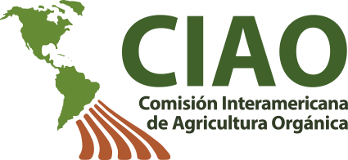
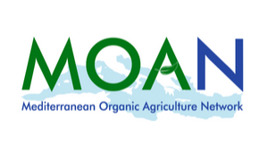
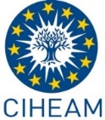
Transnational data collection efforts

Slide 8
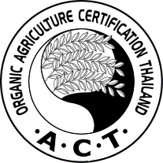
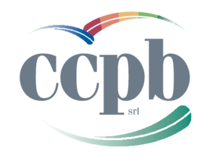
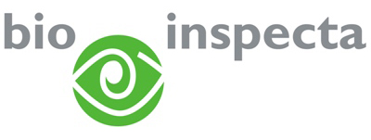
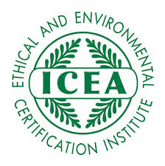
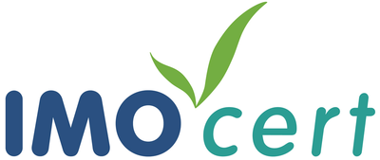
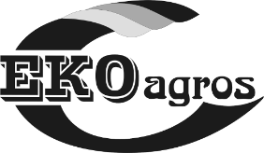
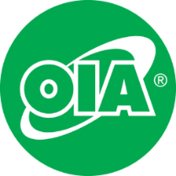
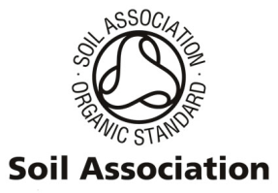
International certifiers that provided data for several countries

Slide 9
General notes on the data
Data sources: For data sources, see annex of The World of Organic Agriculture 2023 or www.organic-world.net/statistics-data-sources.html
Countries: For countries and territories, the FAO country list is used. Where the designation "country" appears in this report, it covers countries or territories. For the countries’ grouping by region, the Standard Country and Area Classifications as defined by the United Nations Statistics Division, is used in most cases.
Term organic: In the tables, the term organic refers to the fully converted and in-conversion areas.
Organic share: In some cases, the calculation of the organic share of the total agricultural land or that of individual crops, based on FAOSTAT and in some cases the Eurostat data, might differ from the organic shares obtained from ministries or local experts.
Producers: Some countries report the number of smallholders while others only report the number of companies, projects, or grower groups, which may each comprise a number of producers. This applies in particular to many African countries. The number of producers is, therefore, probably higher than the number communicated in this report.
Data revisions: Should data revisions and corrections become necessary these are communicated on Organic-World.net: https://www.organic-world.net/yearbook/yearbook-2023/yearbook-2023-corrigenda.html. Revised/corected data are included in the database.

Slide 10
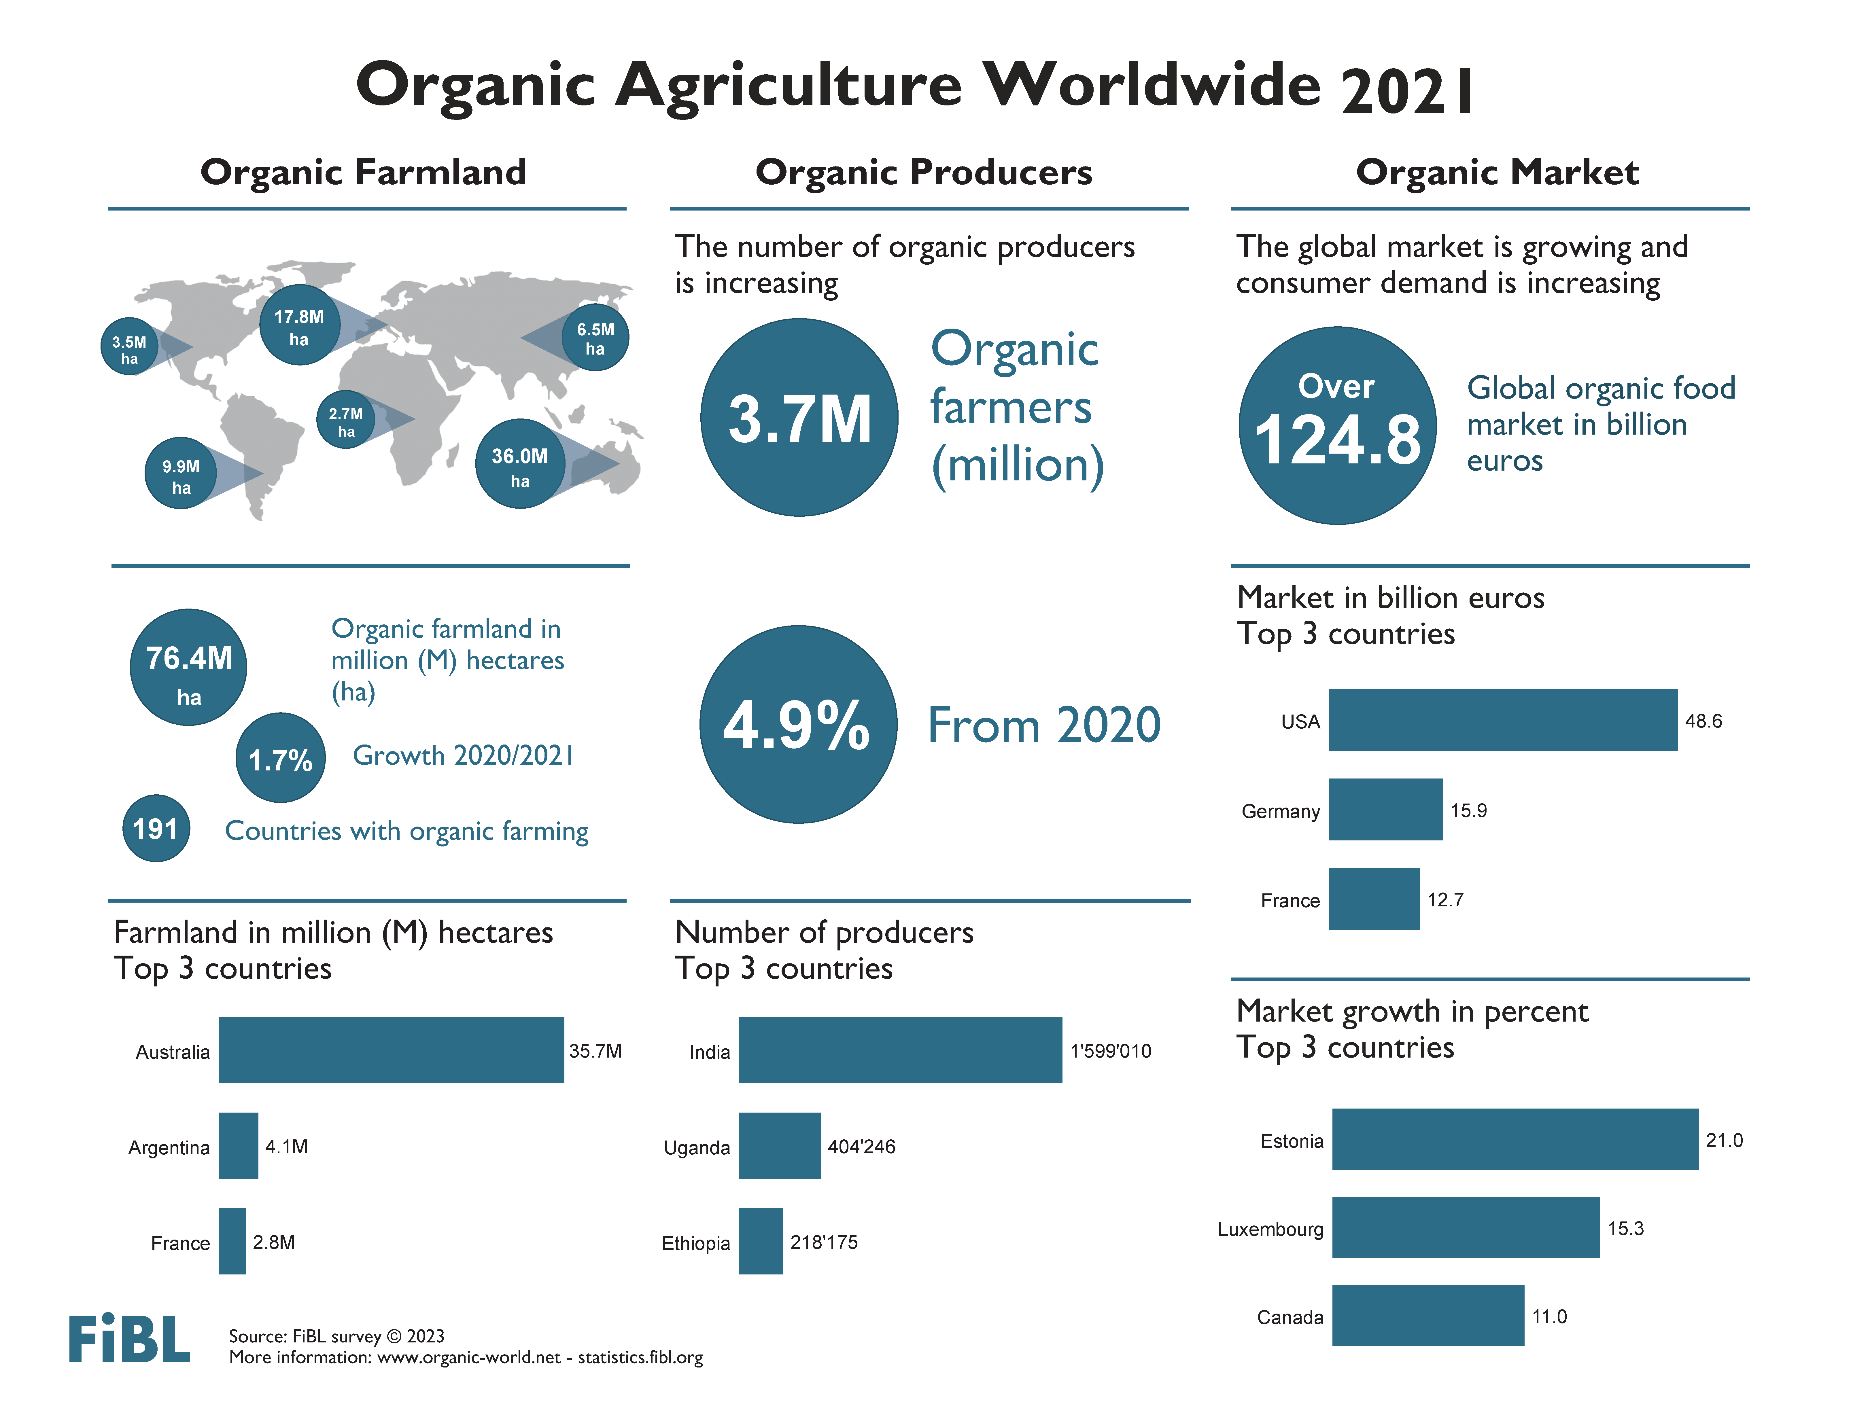

Slide 11
Key data 2021
Organic agricultural land reached more than 76.4 million hectares
Area growth: 1.3 million hectares more than in 2020, 1.7 percent increase
Area increase mainly due to additional 0.75 million hectares in China, France and Spain
1.6 percent of the agricultural land is organic
In 20 countries 10 percent or more of the farmland is organic
3.7 million producers were reported
191 countries with organic activities
31.8 million hectares of non-agricultural areas

Slide 12
Organic farmland 2021
In 2021, over 76.4 million hectares of organic agricultural land, including in-conversion areas, were recorded. The regions with the largest organic agricultural land areas are Oceania (36.0 million hectares – almost half the world’s organic agricultural land pr 47 percent) and Europe (17.8 million hectares, 23 percent). Latin America had 9.9 million hectares (13 percent), followed by Asia (6.5 million hectares, 8.5 percent), Northern America (3.5 million hectares, 4.6 percent) and Africa (2.7 million hectares, 3.5 percent).
Countries with the most organic agricultural land were Australia (35.7 million hectares), Argentina (4.1 million hectares) and France (2.8 million hectares).
In 2021, 1.6 percent of the world’s agricultural land was organic. The highest organic shares of the total agricultural land, by region, were in Oceania (9.7 percent) and in Europe (3.6 percent; European Union: 9.6 percent).
Some countries reach far higher shares than the global share: Liechtenstein (40.2 percent), Samoa (29.1 percent) and Austria (26.5 percent) had the highest organic shares. In 20 countries, 10 percent or more of the agricultural land was organic – a new record.
Organic farmland increased by 1.3 million hectares (1.7 percent) in 2021. Many countries reported a significant increase. In absolute terms, the biggest increases were in China, France and Spain: in China, organic farmland increased by almost 320'000 hectares (+13.1 percent), in France by nearly 228'000 hectares (+8.9 percent) and in Spain by almost 198'000 hectares (+8.1 percent). However, some countries also reported decreases. The most notable decrease occurred in Argentina, which reported almost 0.38 million hectares less (mainly grazing areas).
In 2021, organic agricultural land increased in Africa, Asia, Europe and Oceania (Table 5). The highest absolute growth was in Europe (+4.4 percent, +0.75 million hectares), followed by Africa (+17.3 percent, +0.39 million hectares) and Asia (+5.8 percent, +0.36 million hectares), while Latin America and North America reported a decrease of organic farmland.
Land use and crop details were available for over 92 percent of the organic agricultural land. Some countries with very large organic areas, such as Brazil and India, had little or no information on their land use (see page 72).

Slide 13
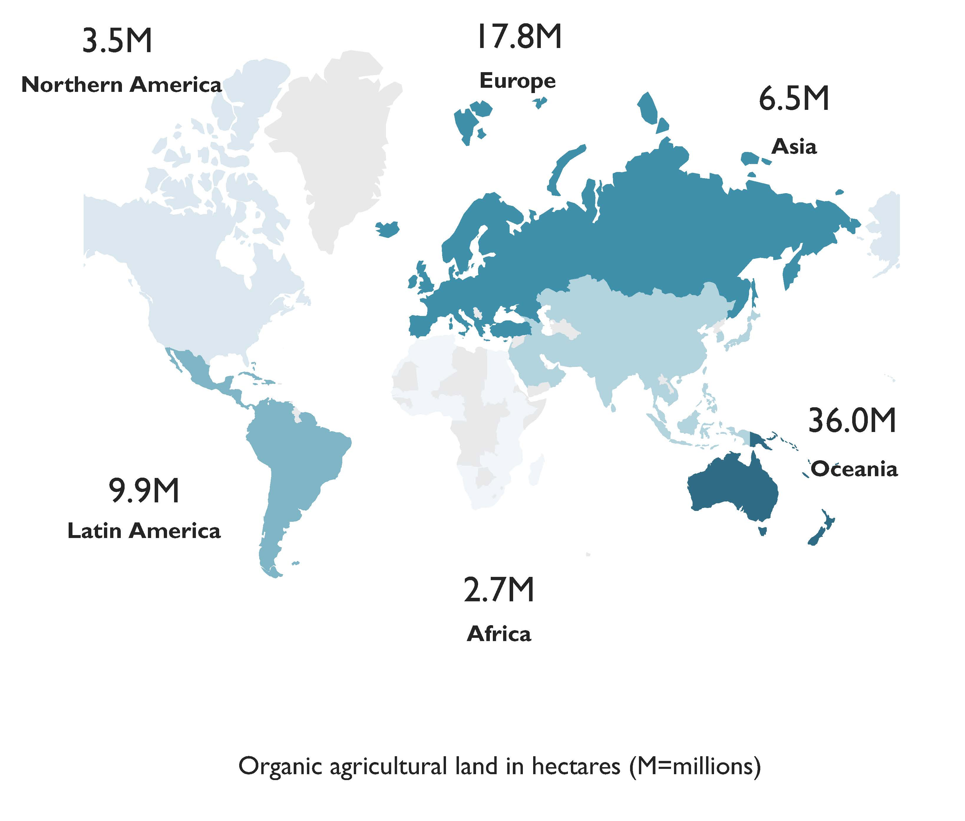
World: Organic agricultural land and other organic areas 2021
Source: FiBL survey 2023

Slide 15
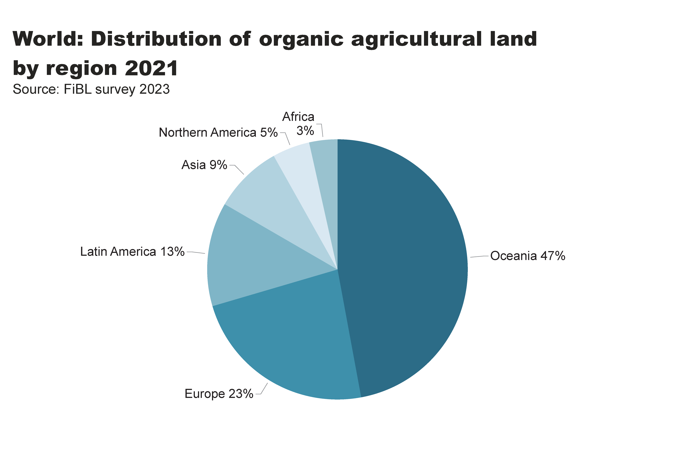
world_land_by_region
Distribution of organic farmland by region 2021
Notes:
textbox
No alt text provided
pieChart
No alt text provided
card
No alt text provided

Slide 16
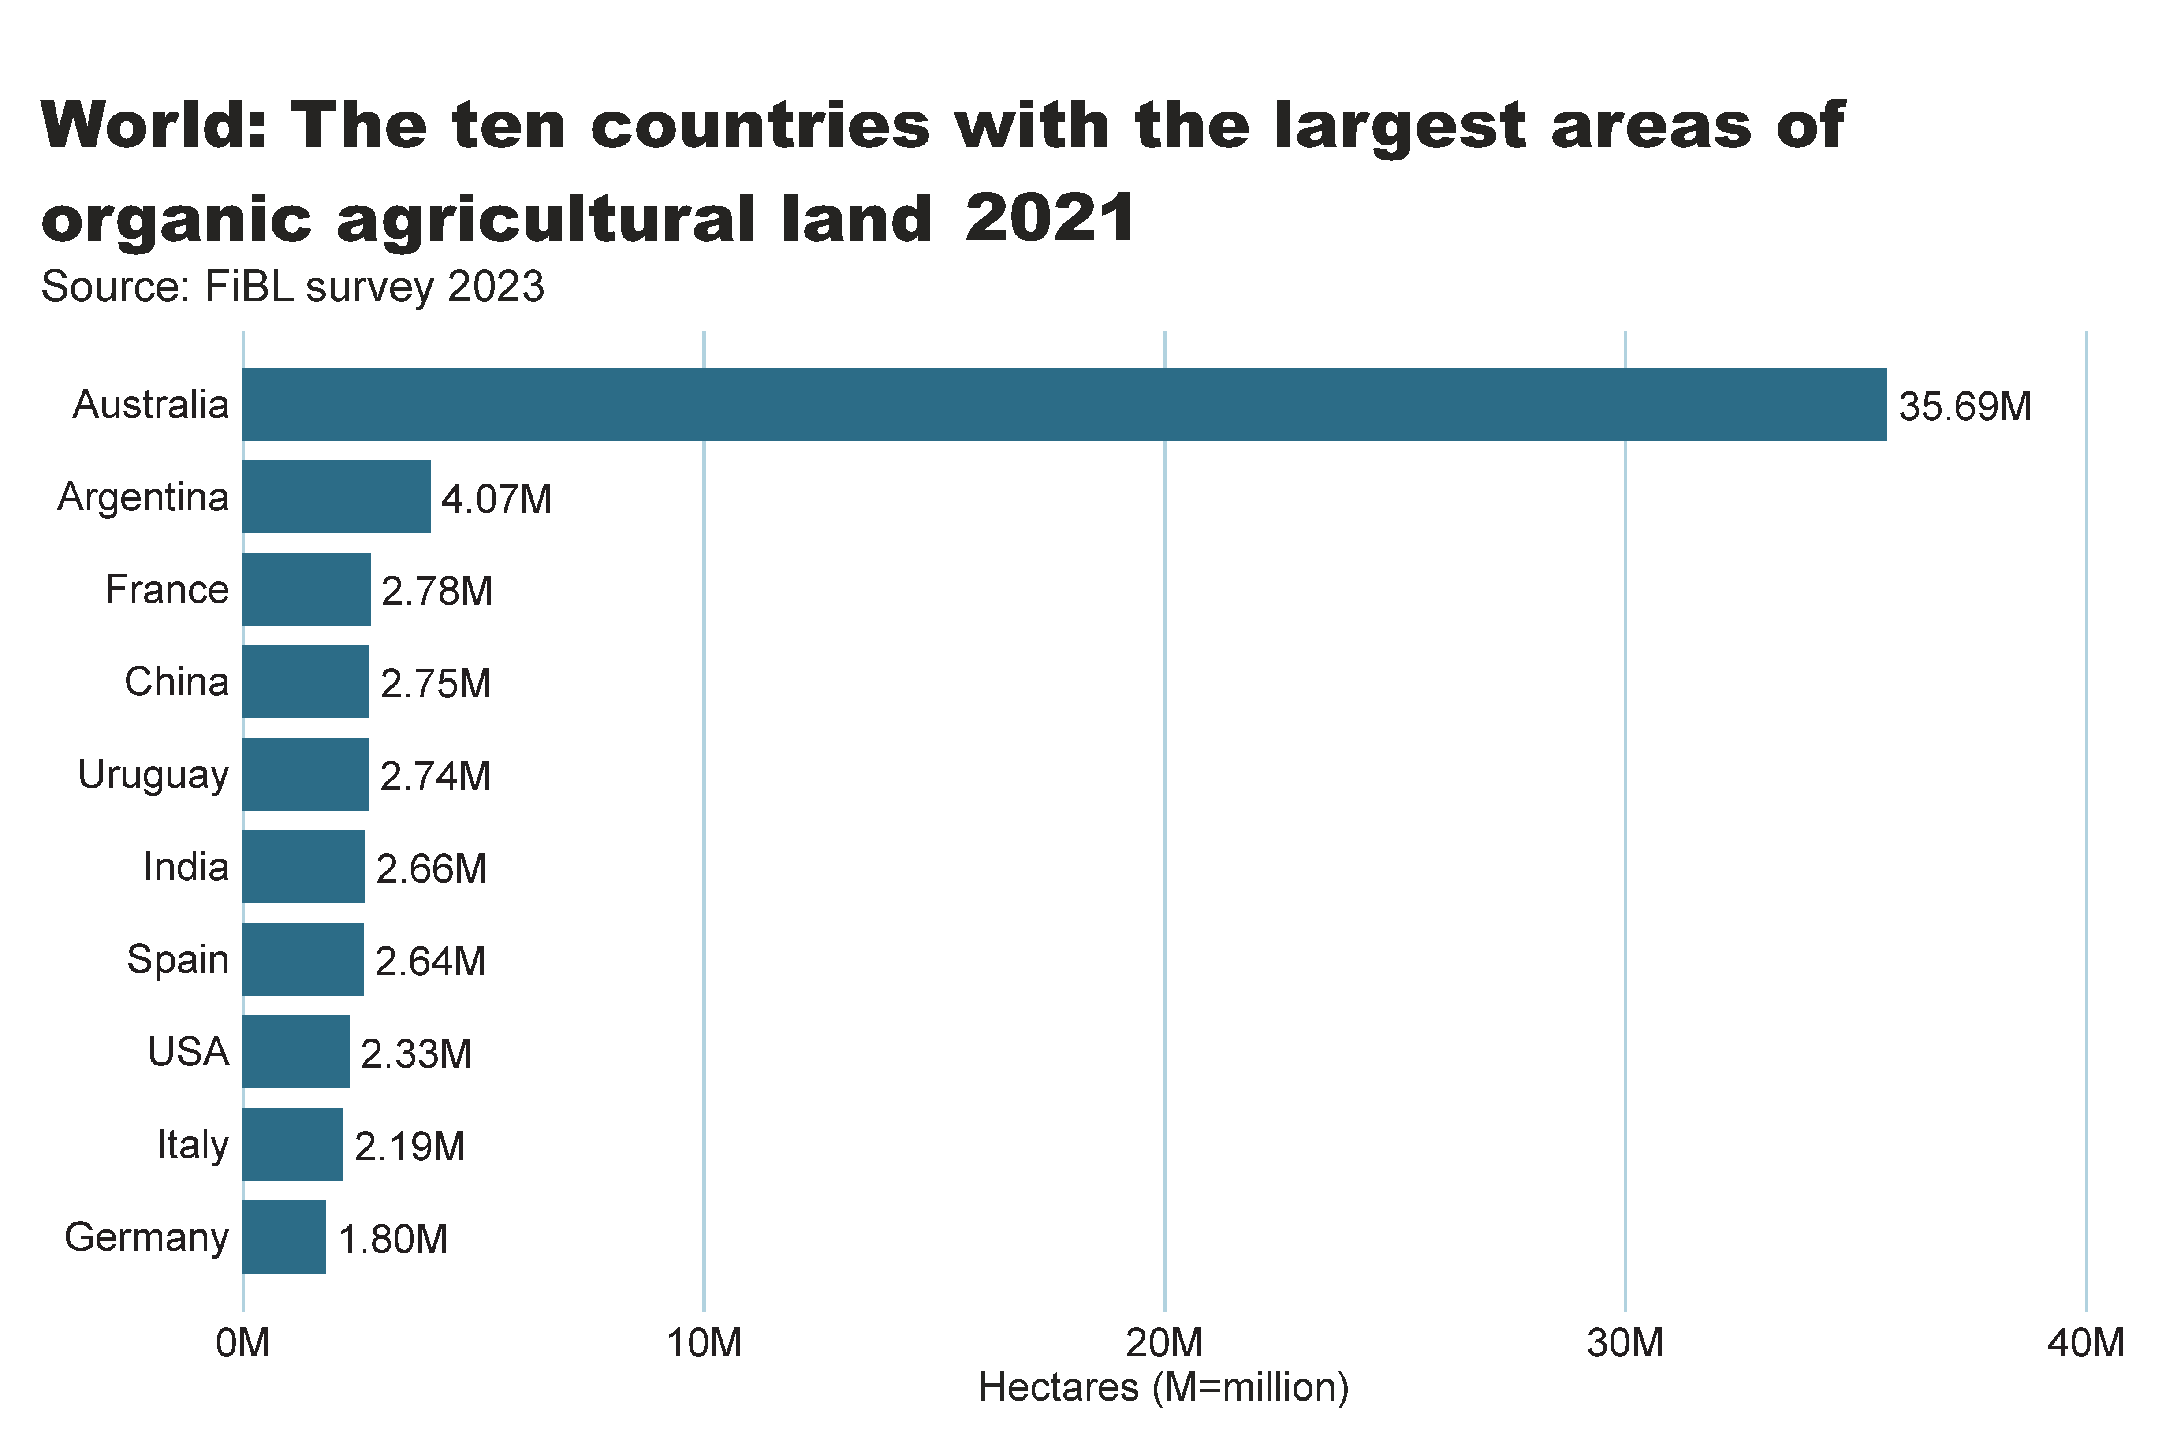
world_land_by_country
Notes:
clusteredBarChart
No alt text provided
textbox
No alt text provided
card
No alt text provided

Slide 17
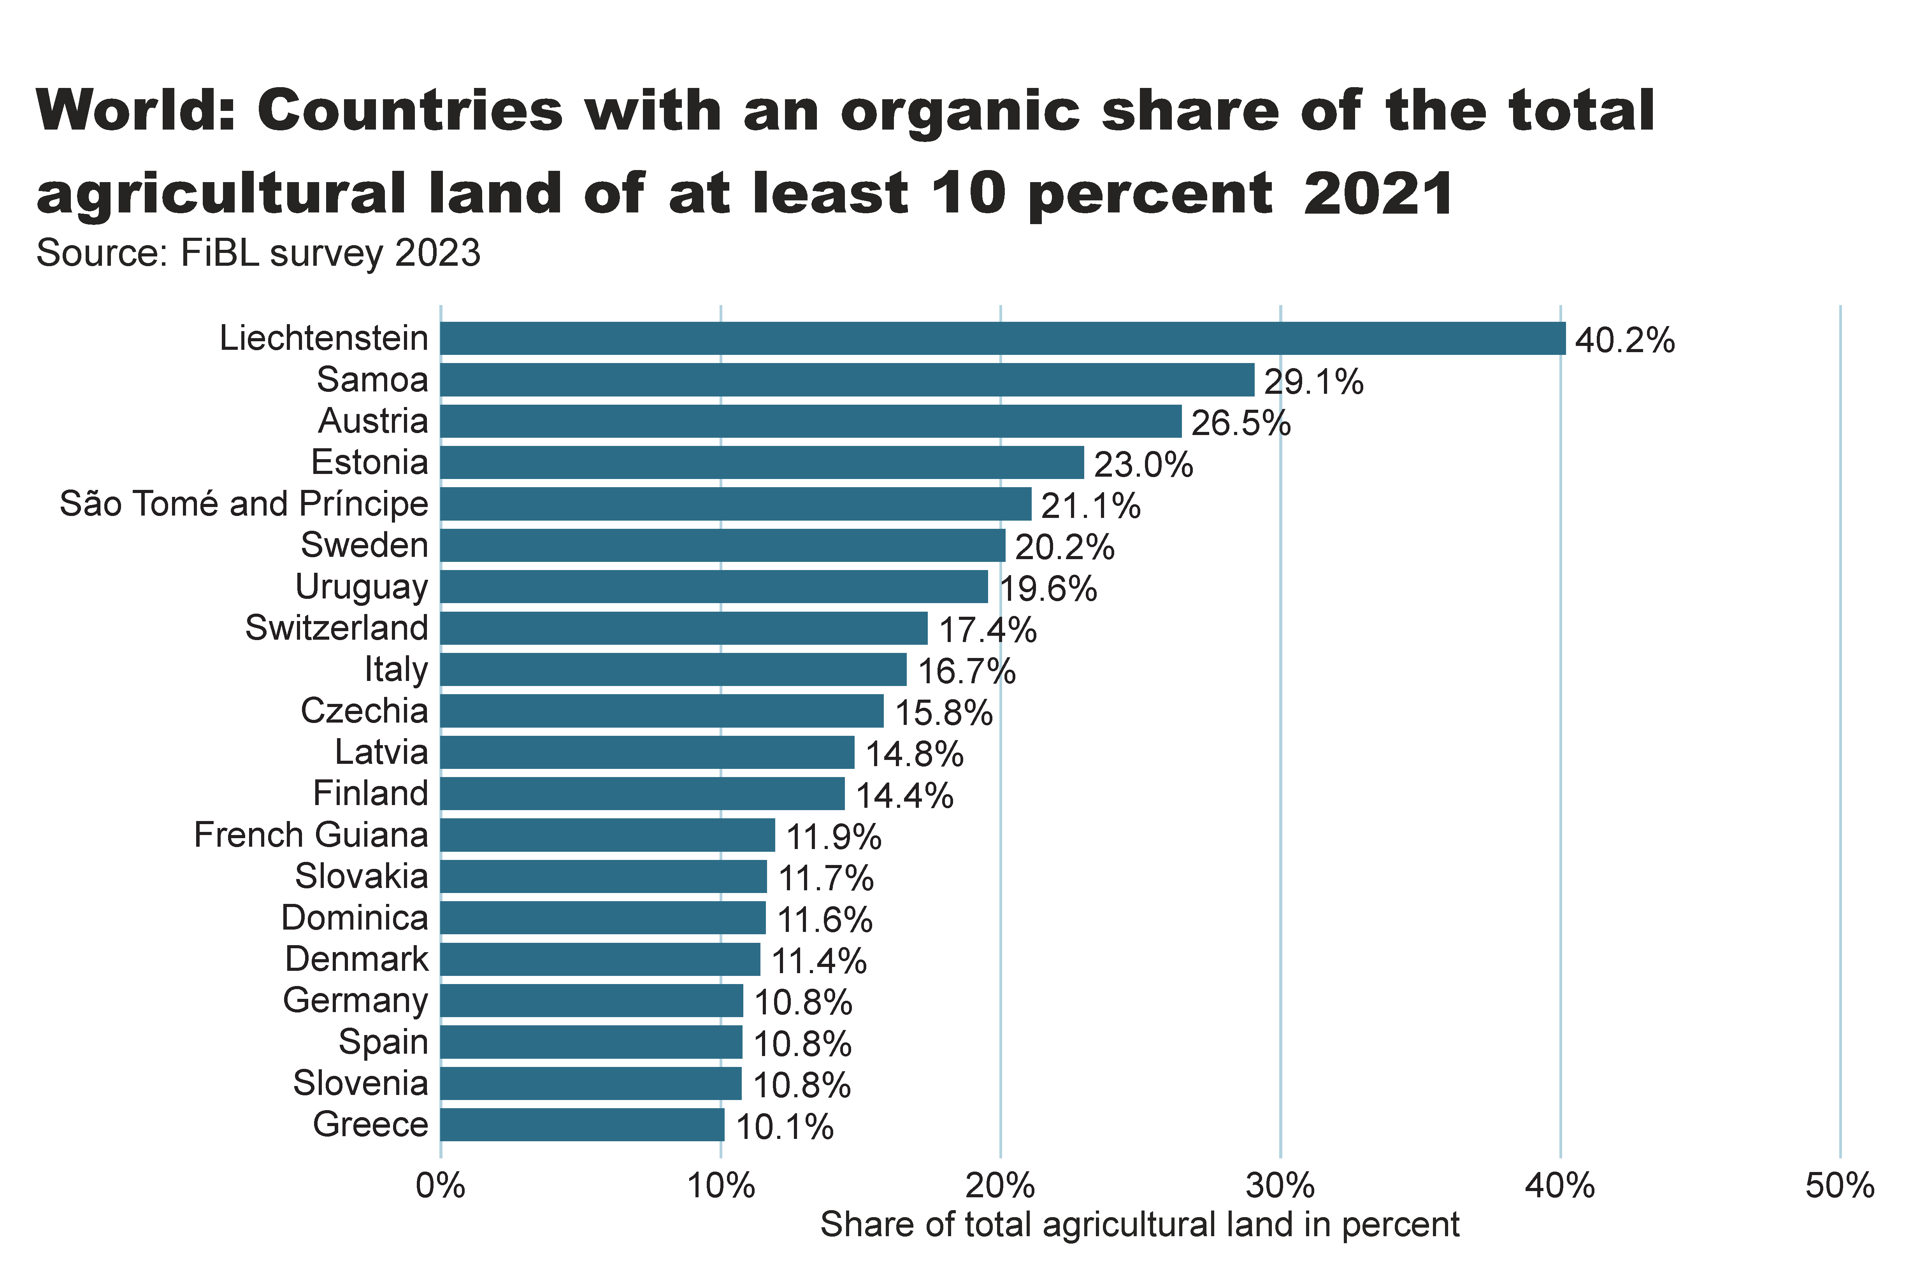
world_land_share
Notes:
textbox
No alt text provided
barChart
No alt text provided
card
No alt text provided

Slide 18
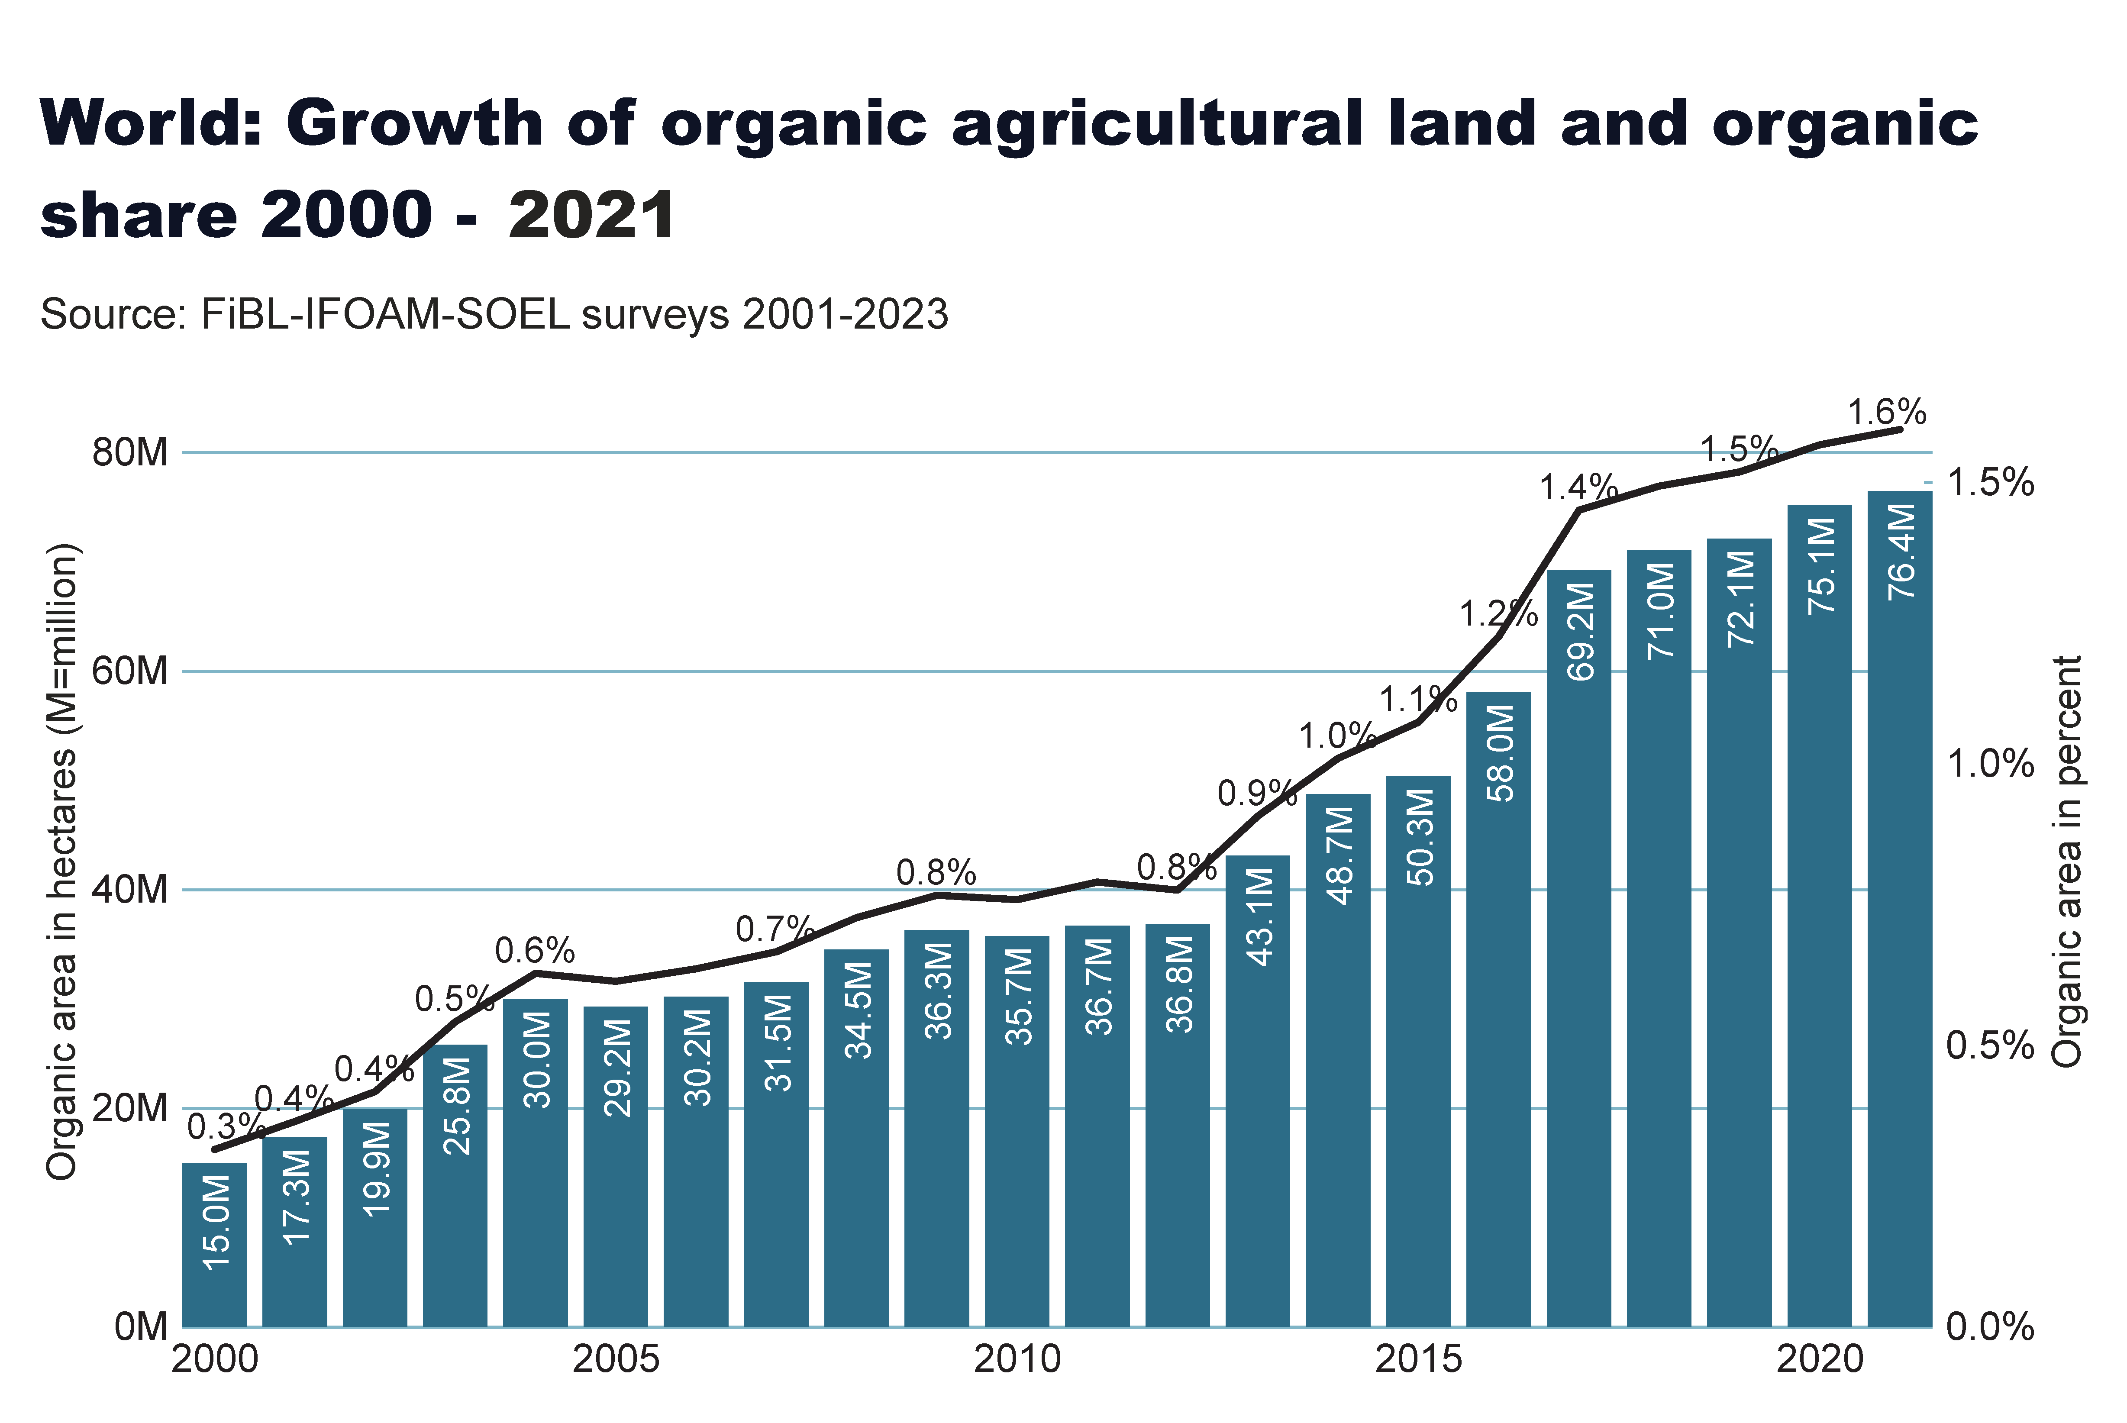
world_land_growth
Notes:
textbox
No alt text provided
lineClusteredColumnComboChart
No alt text provided
card
No alt text provided

Slide 19
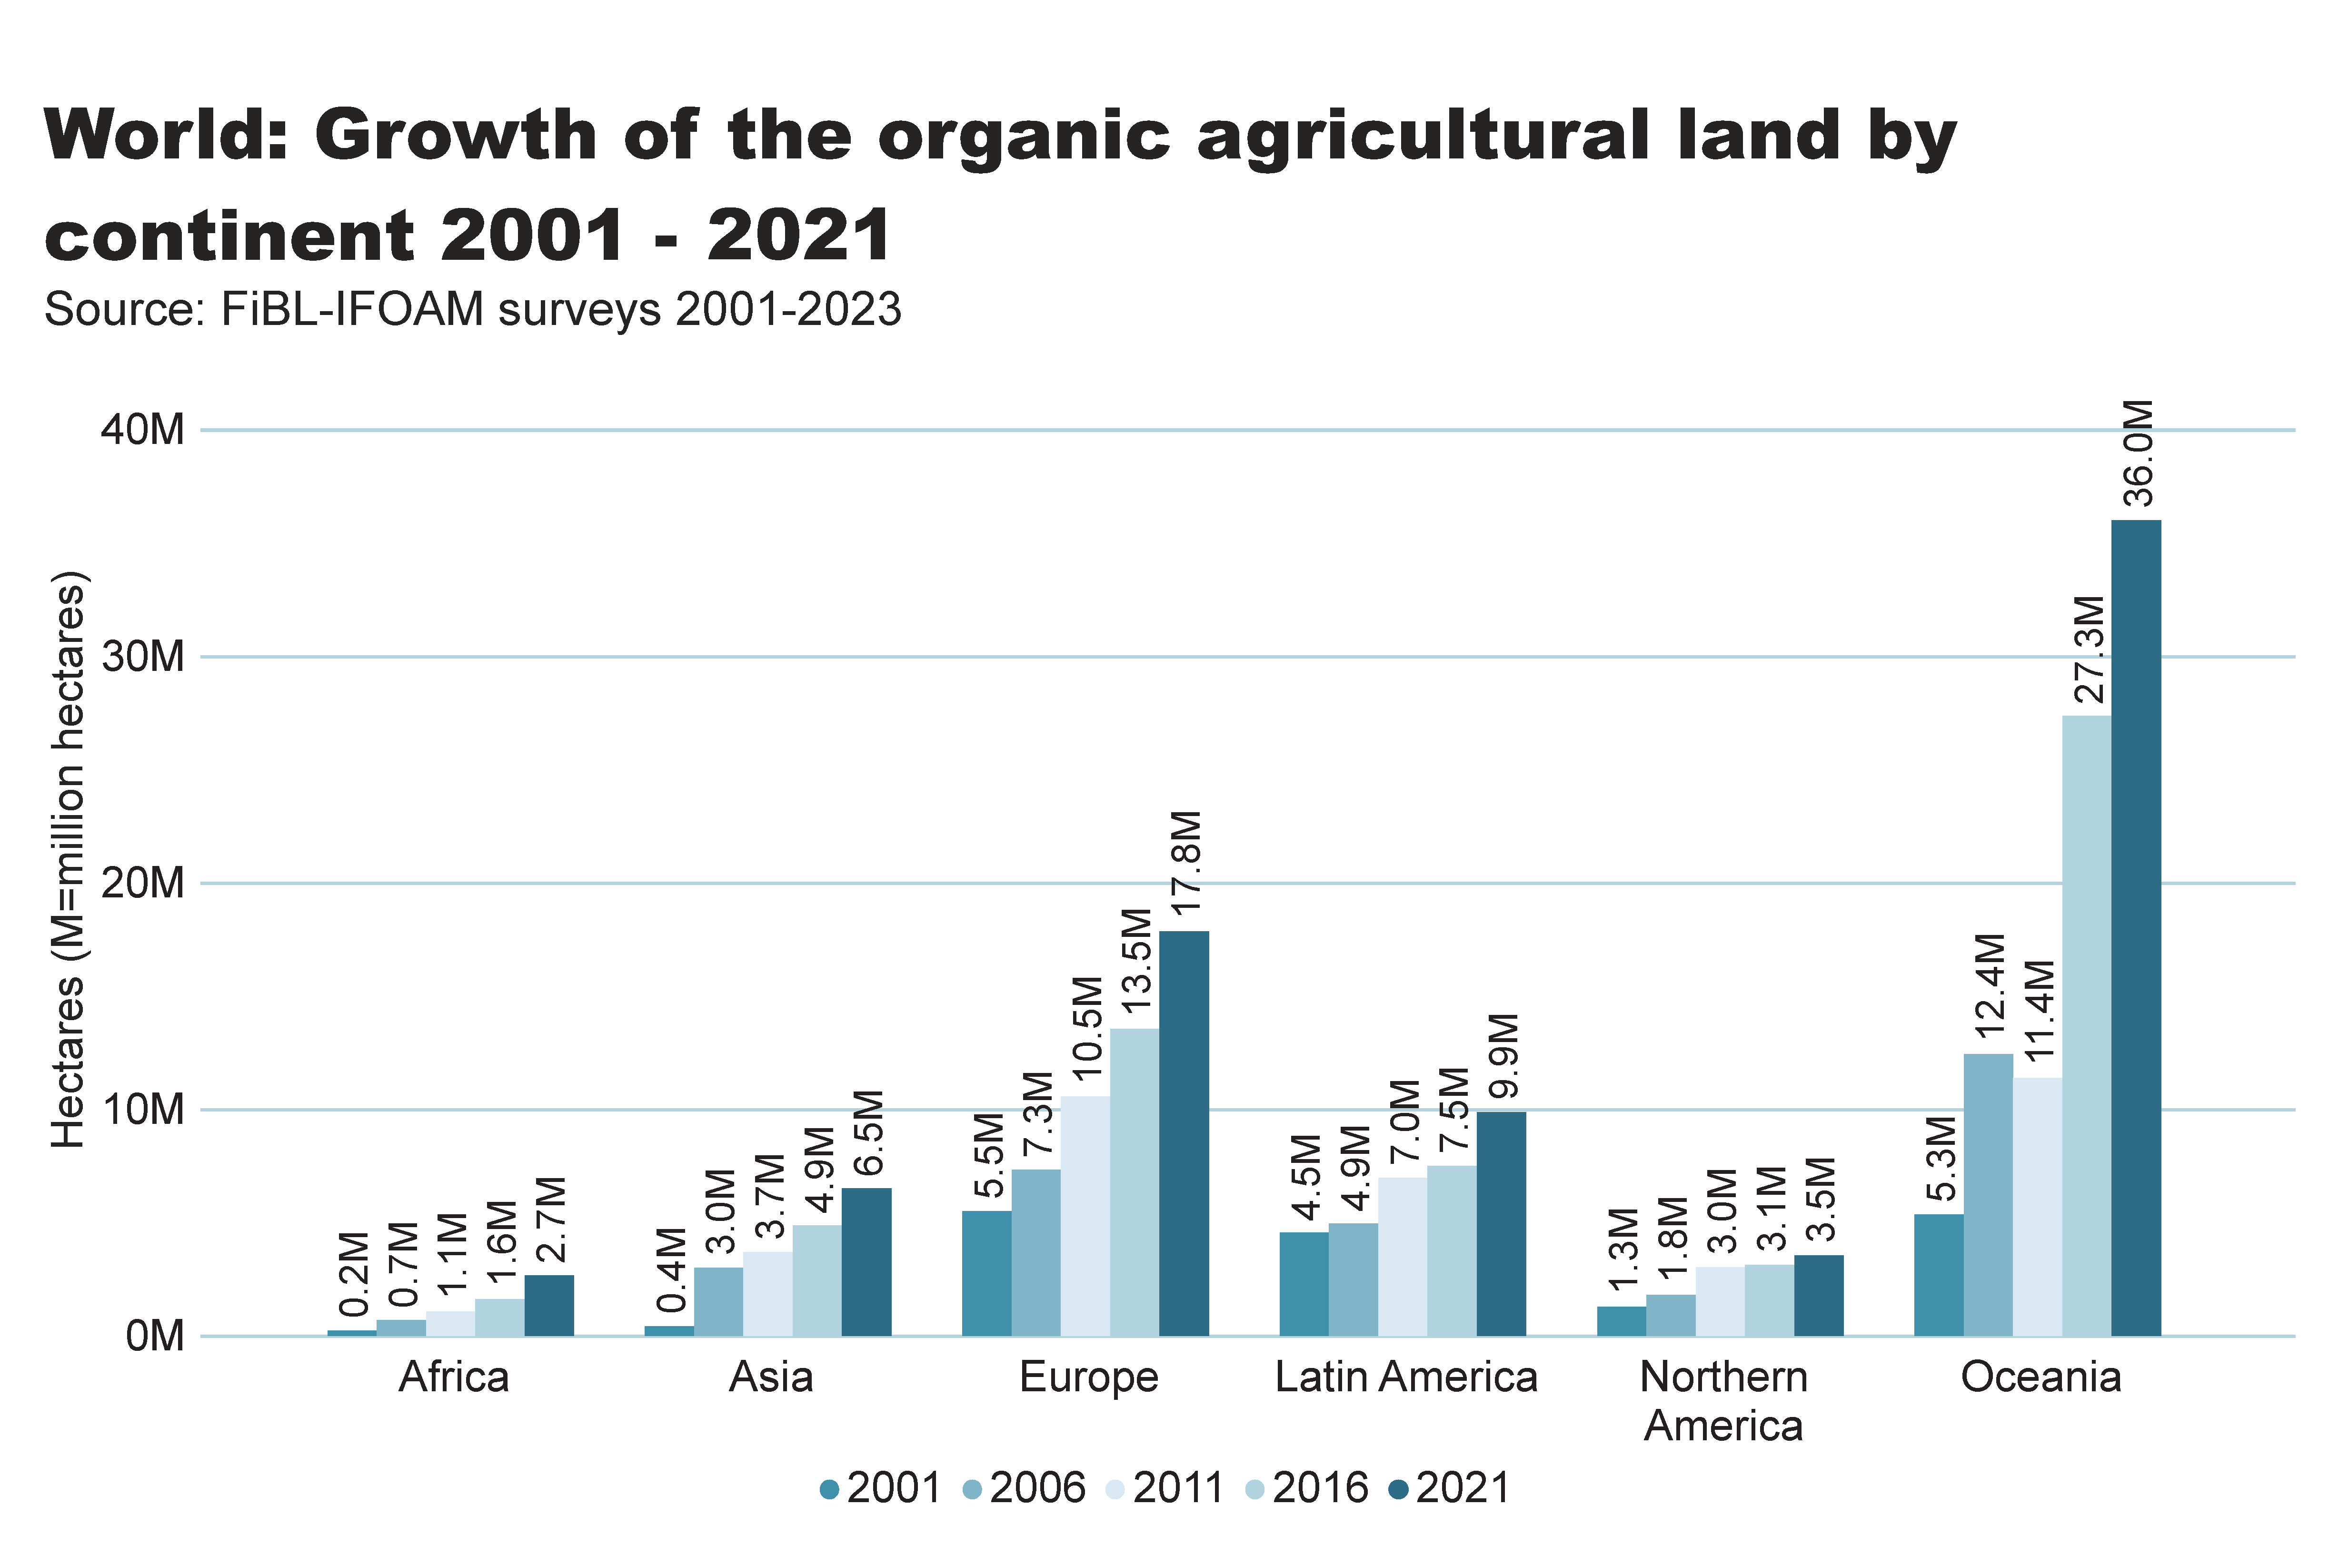
world_land_growth_region
Notes:
textbox
No alt text provided
clusteredColumnChart
No alt text provided
card
No alt text provided

Slide 20
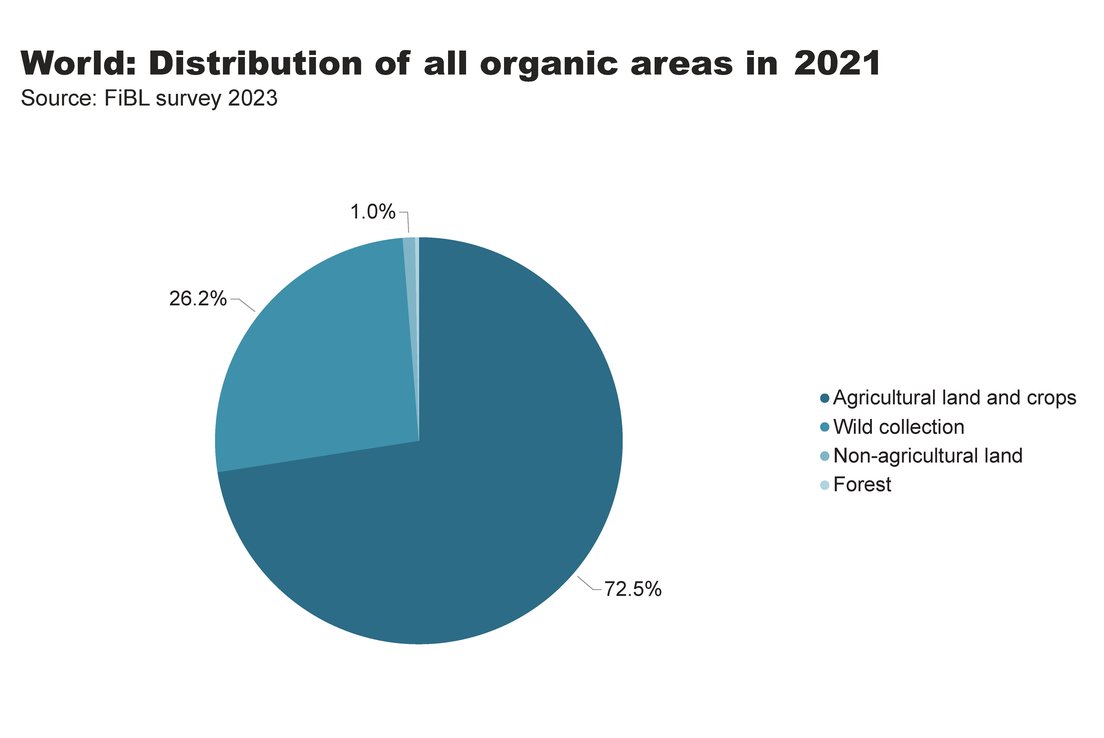
world_land_all_areas
Notes:
textbox
No alt text provided
card
No alt text provided
pieChart
No alt text provided

Slide 21
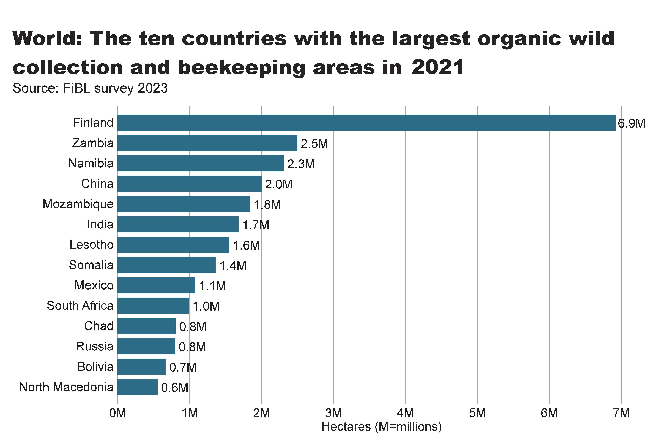
wild_ collection_by_country
Notes:
textbox
No alt text provided
clusteredBarChart
No alt text provided
card
No alt text provided

Slide 22
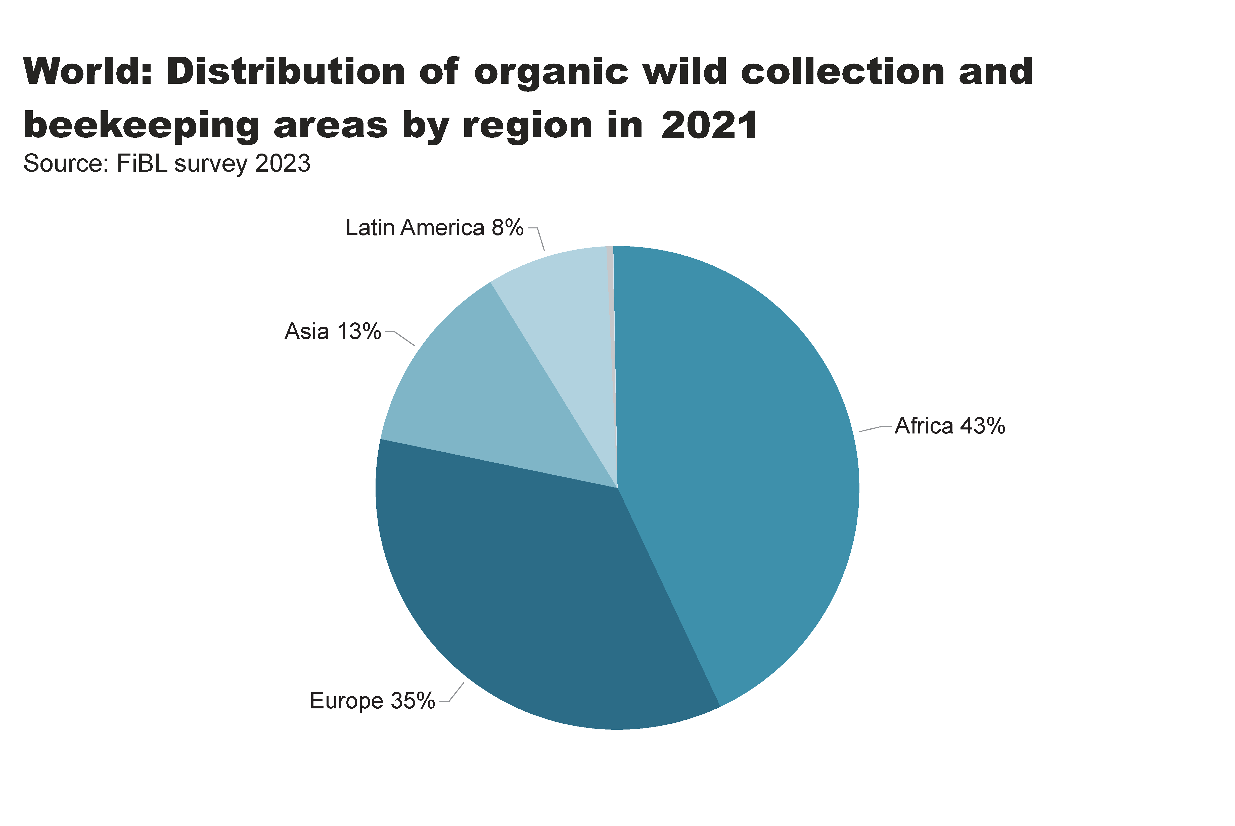
beehives_by_region
Notes:
textbox
No alt text provided
pieChart
No alt text provided
card
No alt text provided

Slide 23
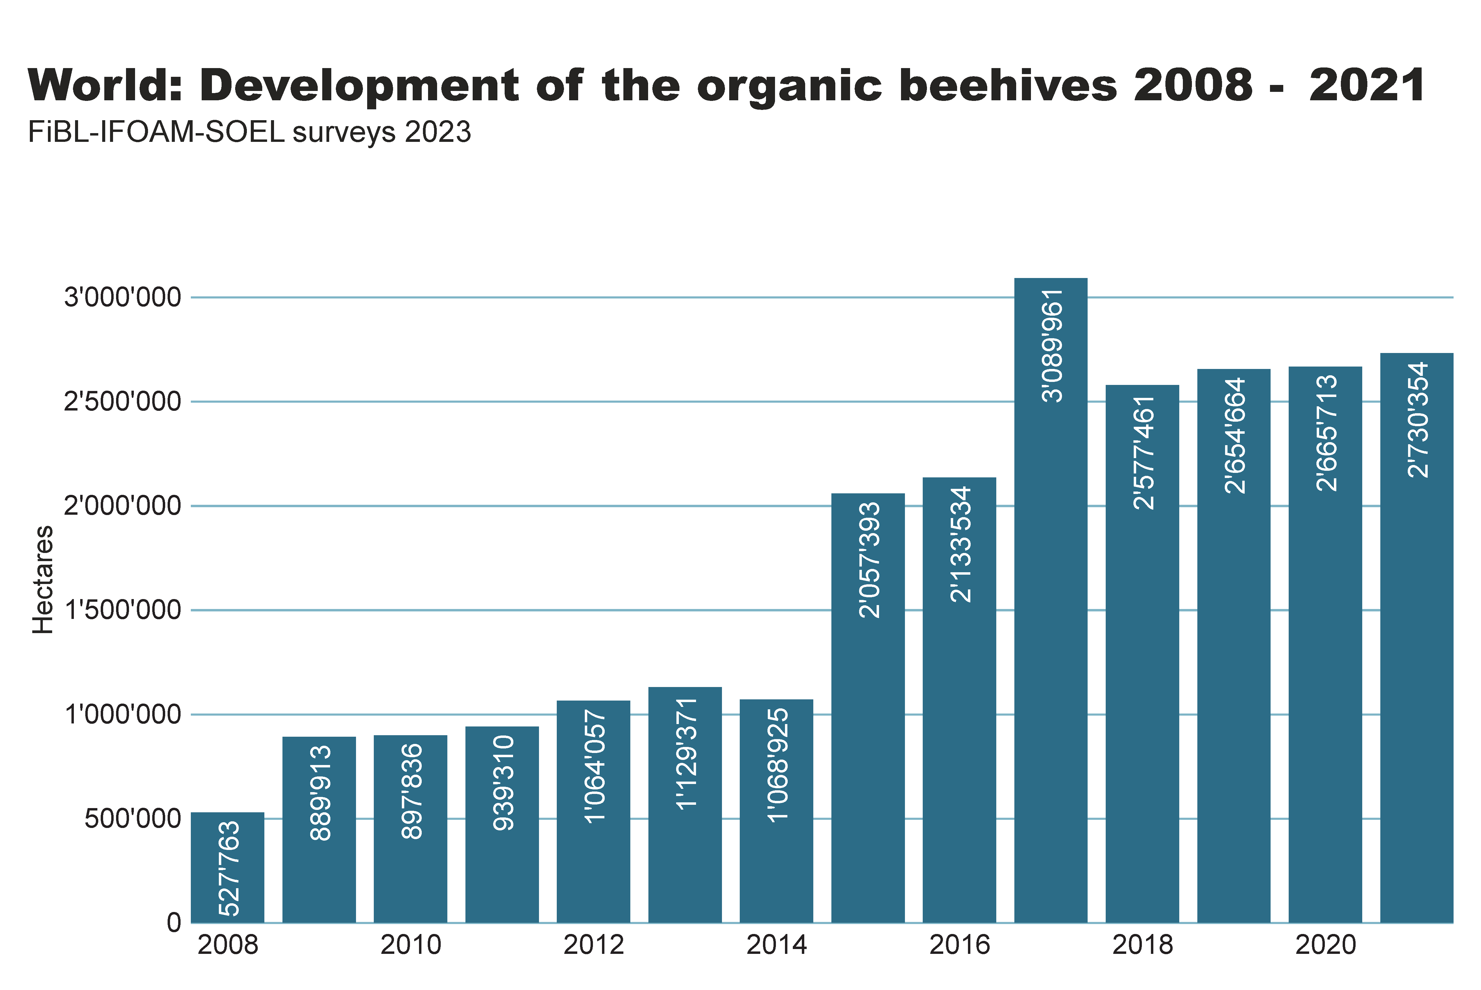
beehives_by country
Notes:
textbox
No alt text provided
clusteredColumnChart
No alt text provided
card
No alt text provided

Slide 24
Organic producers 2021
There were at least 3.7 million organic producers in 2021.
Forty-nine percent of the world’s organic producers were in Asia, followed by Africa (31 percent), Europe (12 percent) and Latin America (8 percent).
The countries with the most producers were in India (1'599'010), Uganda (404'246) and Ethiopia (218'175).
There has been an increase in the number of producers of more than 170'000, or 4.9 percent, compared to 2020.
It should be noted that not all data providers reported the number of producers; the number is probably higher than 3.7 million.

Slide 25
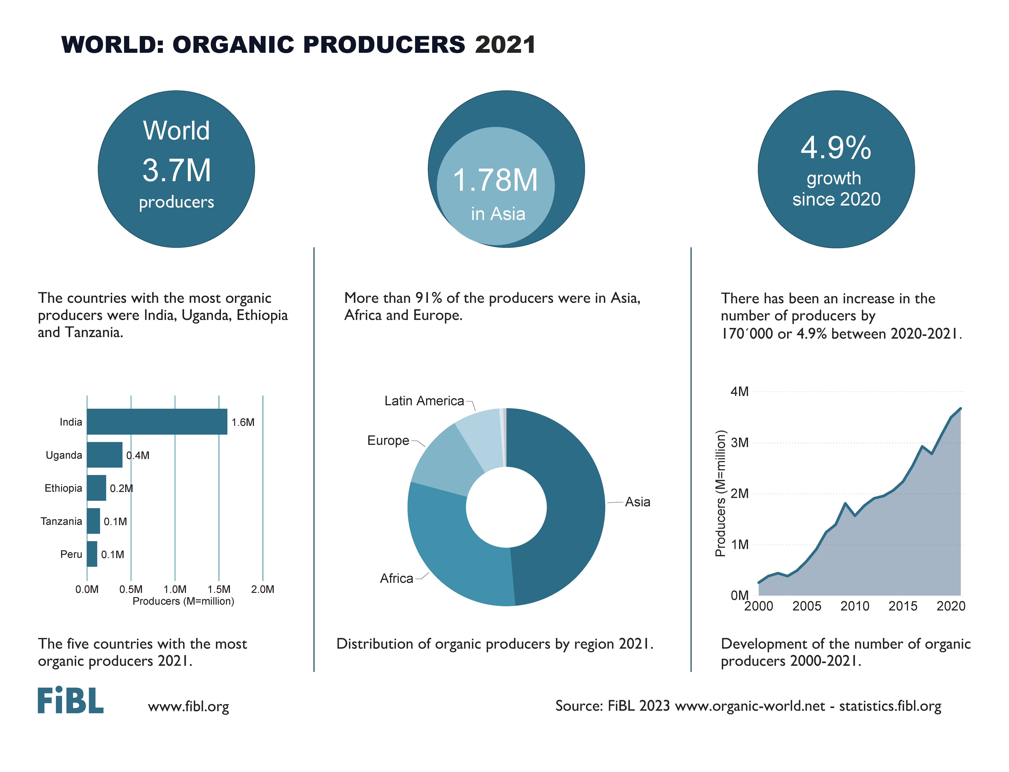

Slide 26
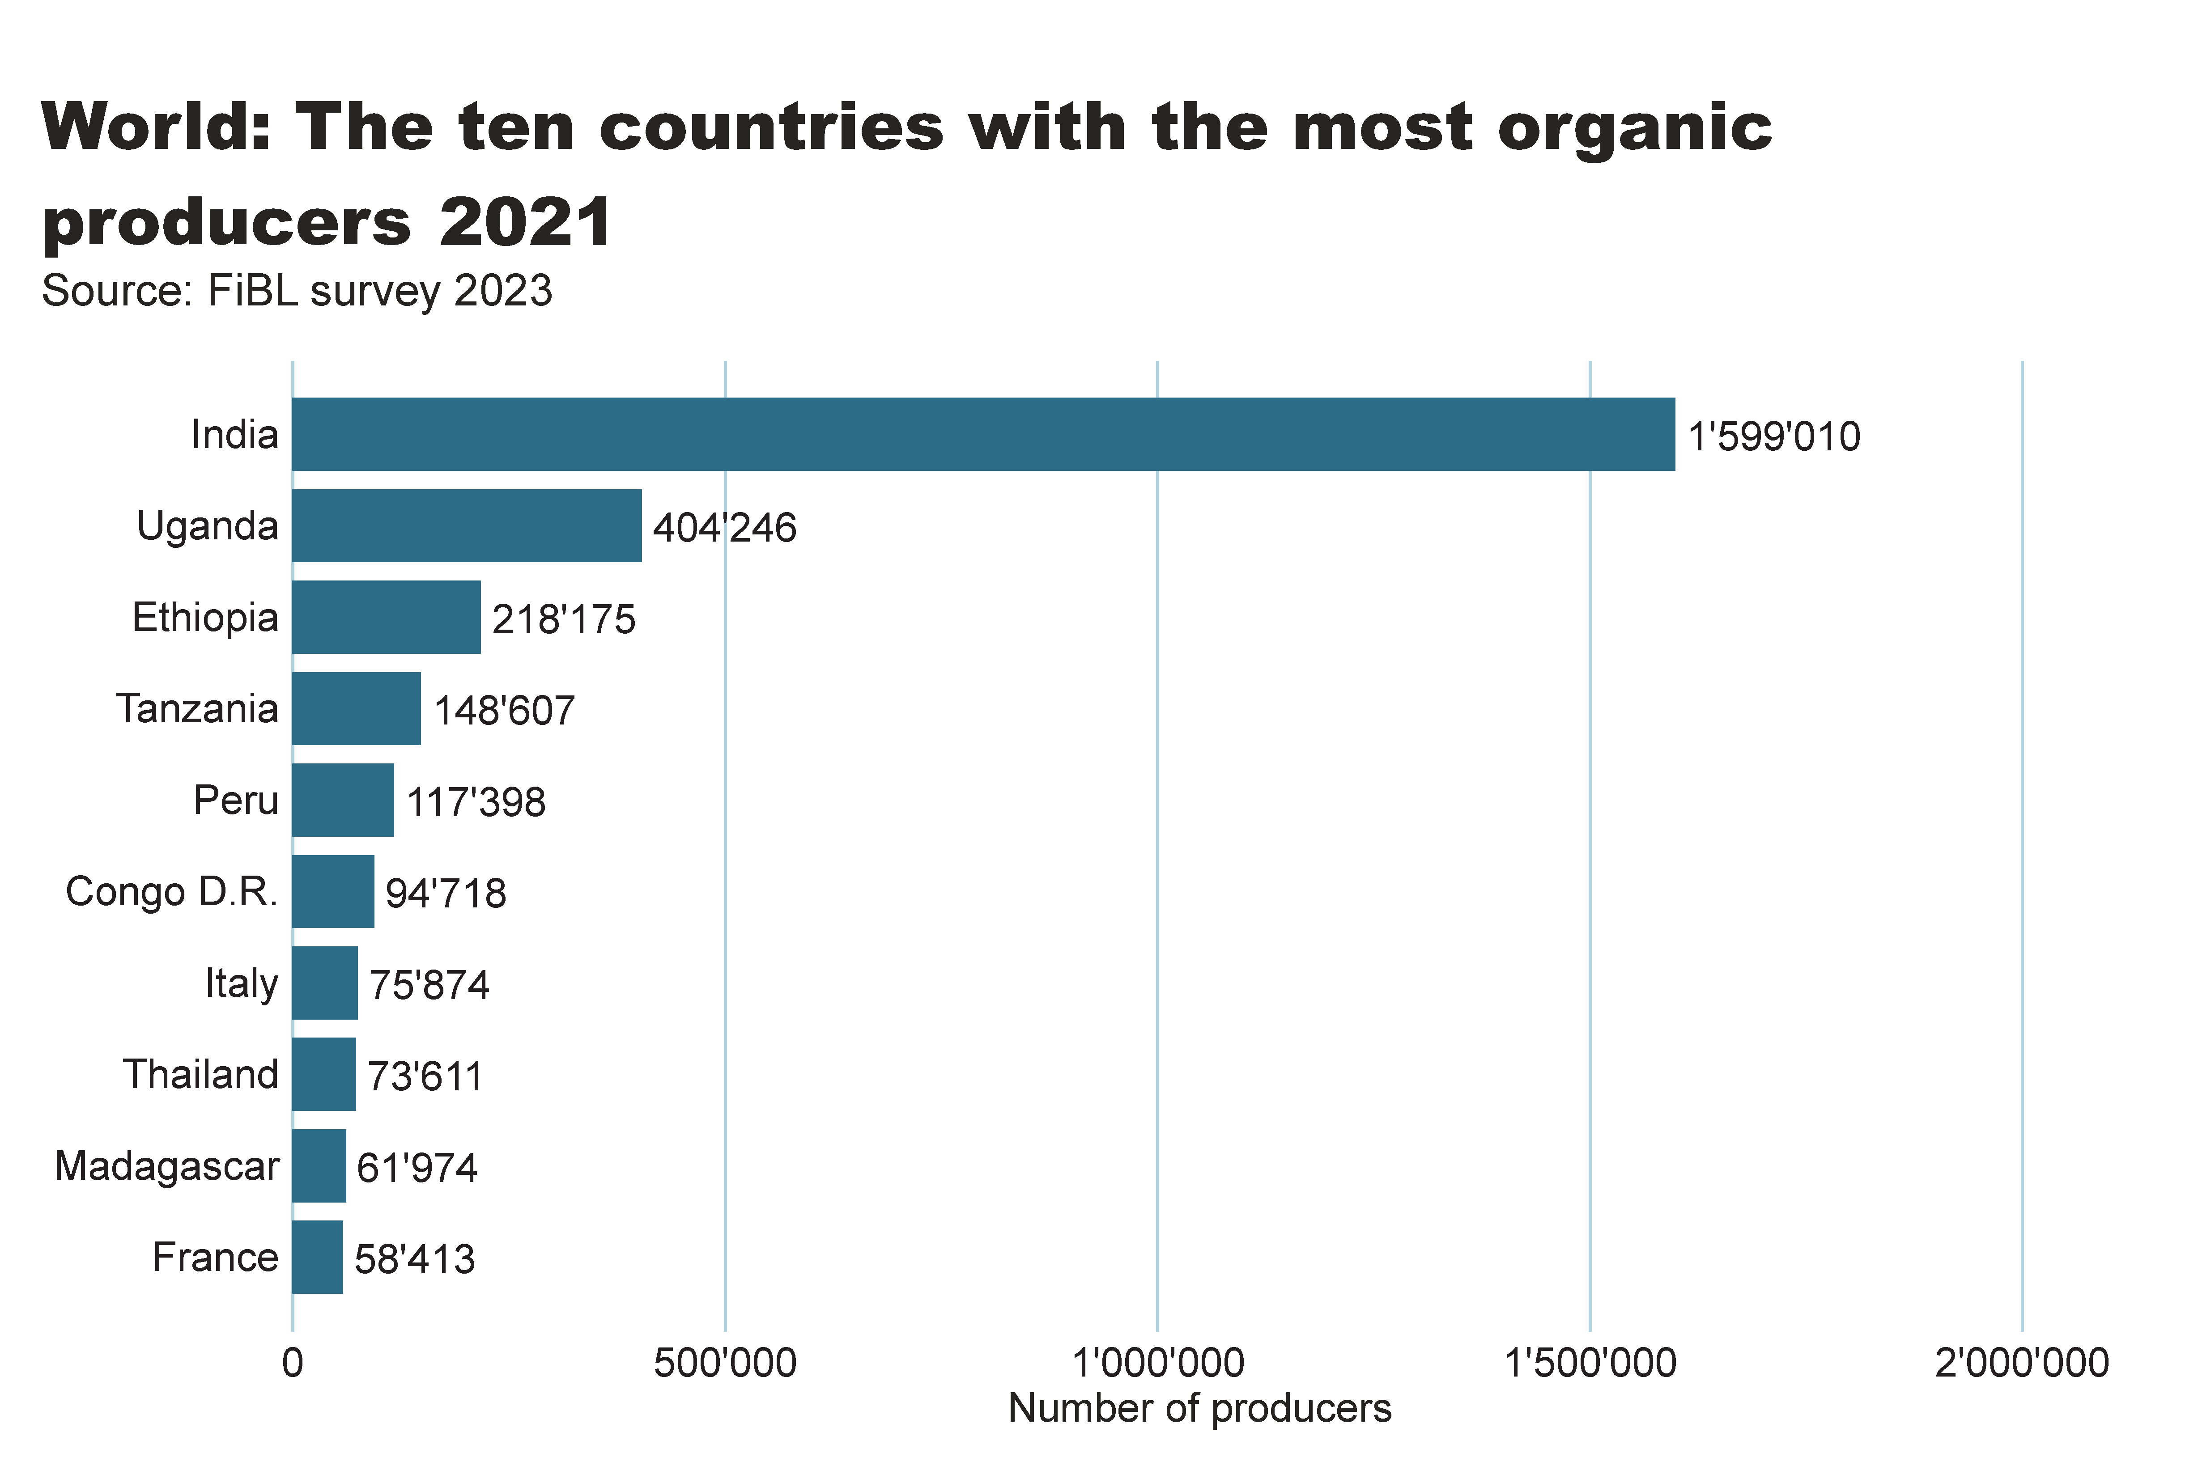
world_producers_country
Notes:
textbox
No alt text provided
card
No alt text provided
barChart
No alt text provided

Slide 27
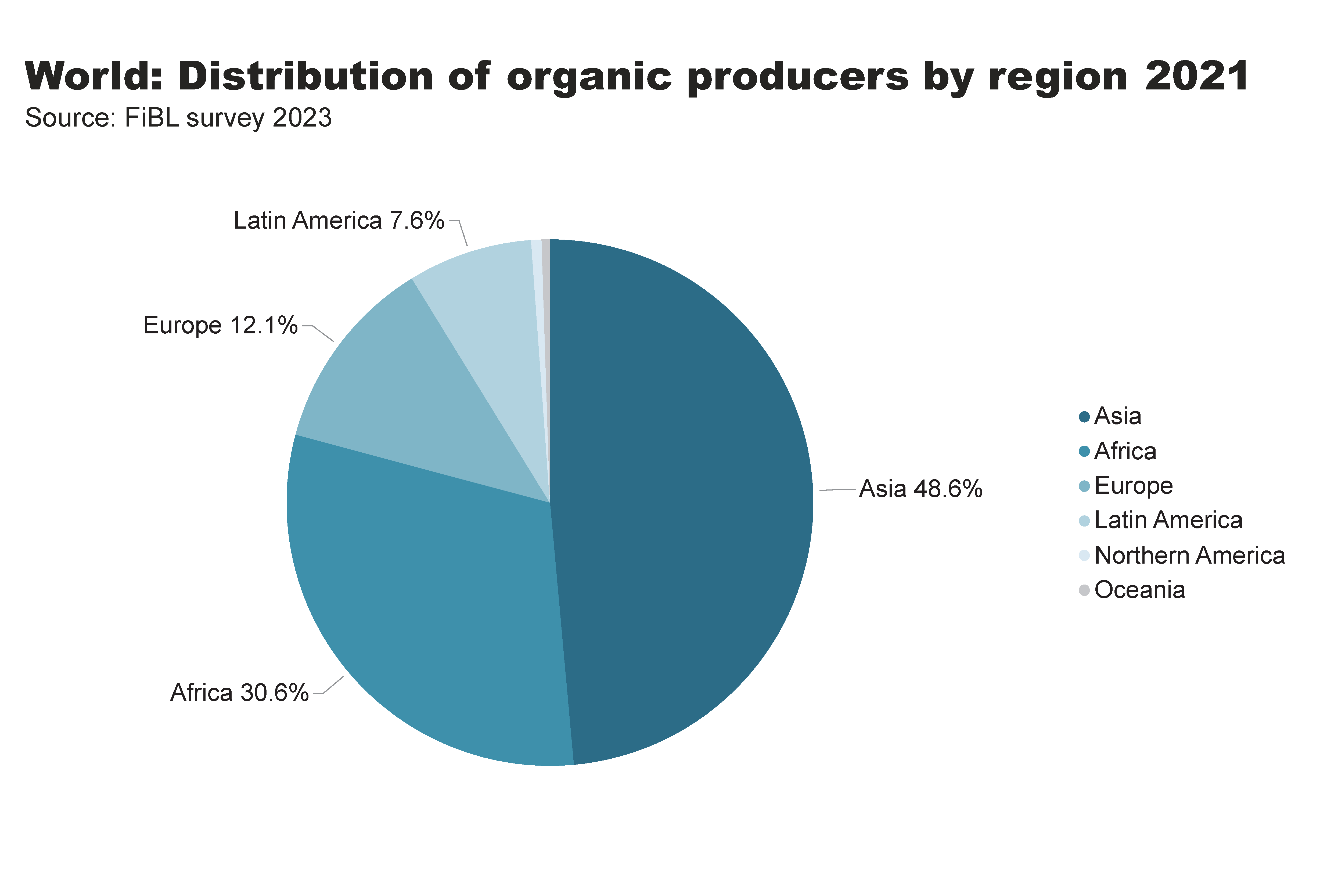
world_producers_region
Notes:
textbox
No alt text provided
pieChart
No alt text provided
card
No alt text provided

Slide 28
Notes:
Numbers doesn´t match with the database

Slide 29
The global market for organic food 2021
Organic food and drink sales reached nearly 125 billion euros in 2021.
In 2021, the countries with the largest organic markets were the United States (48.6 billion euros), Germany (15.9 billion euros) and France (12.7 billion euros).
The largest single market was the United States (39 percent of the global market), followed by the European Union (46.7 billion euros, 37 percent) and China (11.3 billion euros, 9.1 percent)
Switzerland had the highest per-capita consumption in 2021, with 425 euros.
The highest organic market shares were reached in Denmark (13.0 percent), Austria (11.6 percent) and Luxembourg (11 percent).
Source: FiBL survey 2023

Slide 30
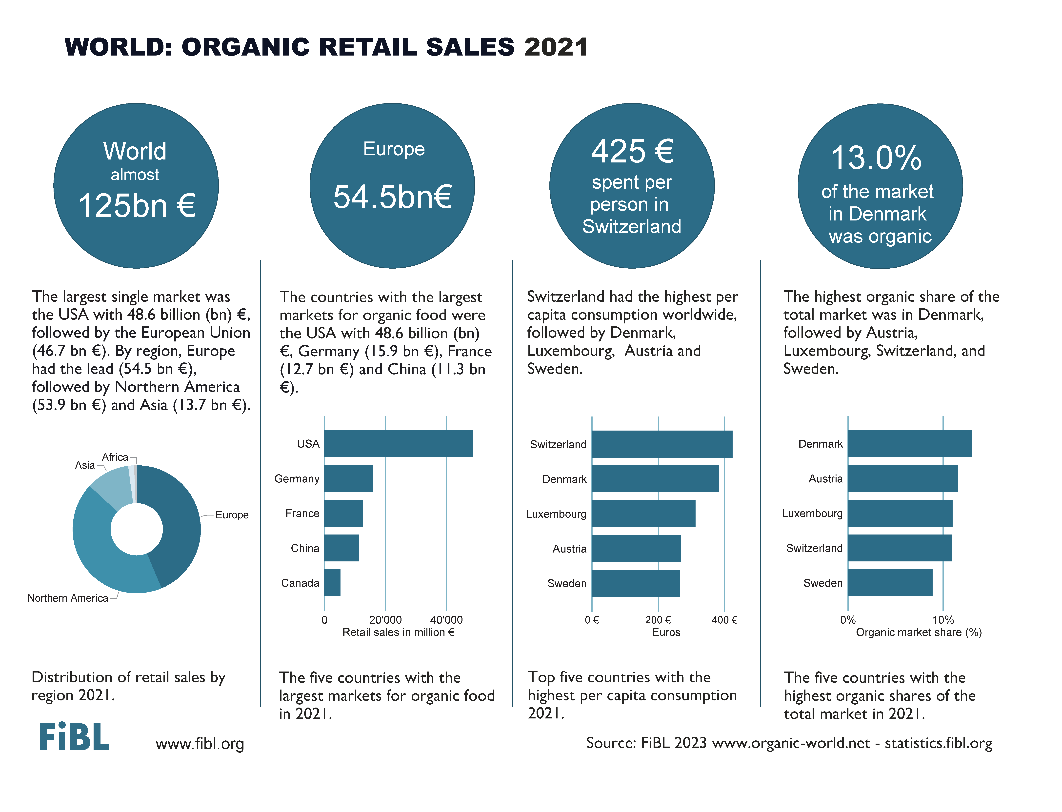

Slide 31
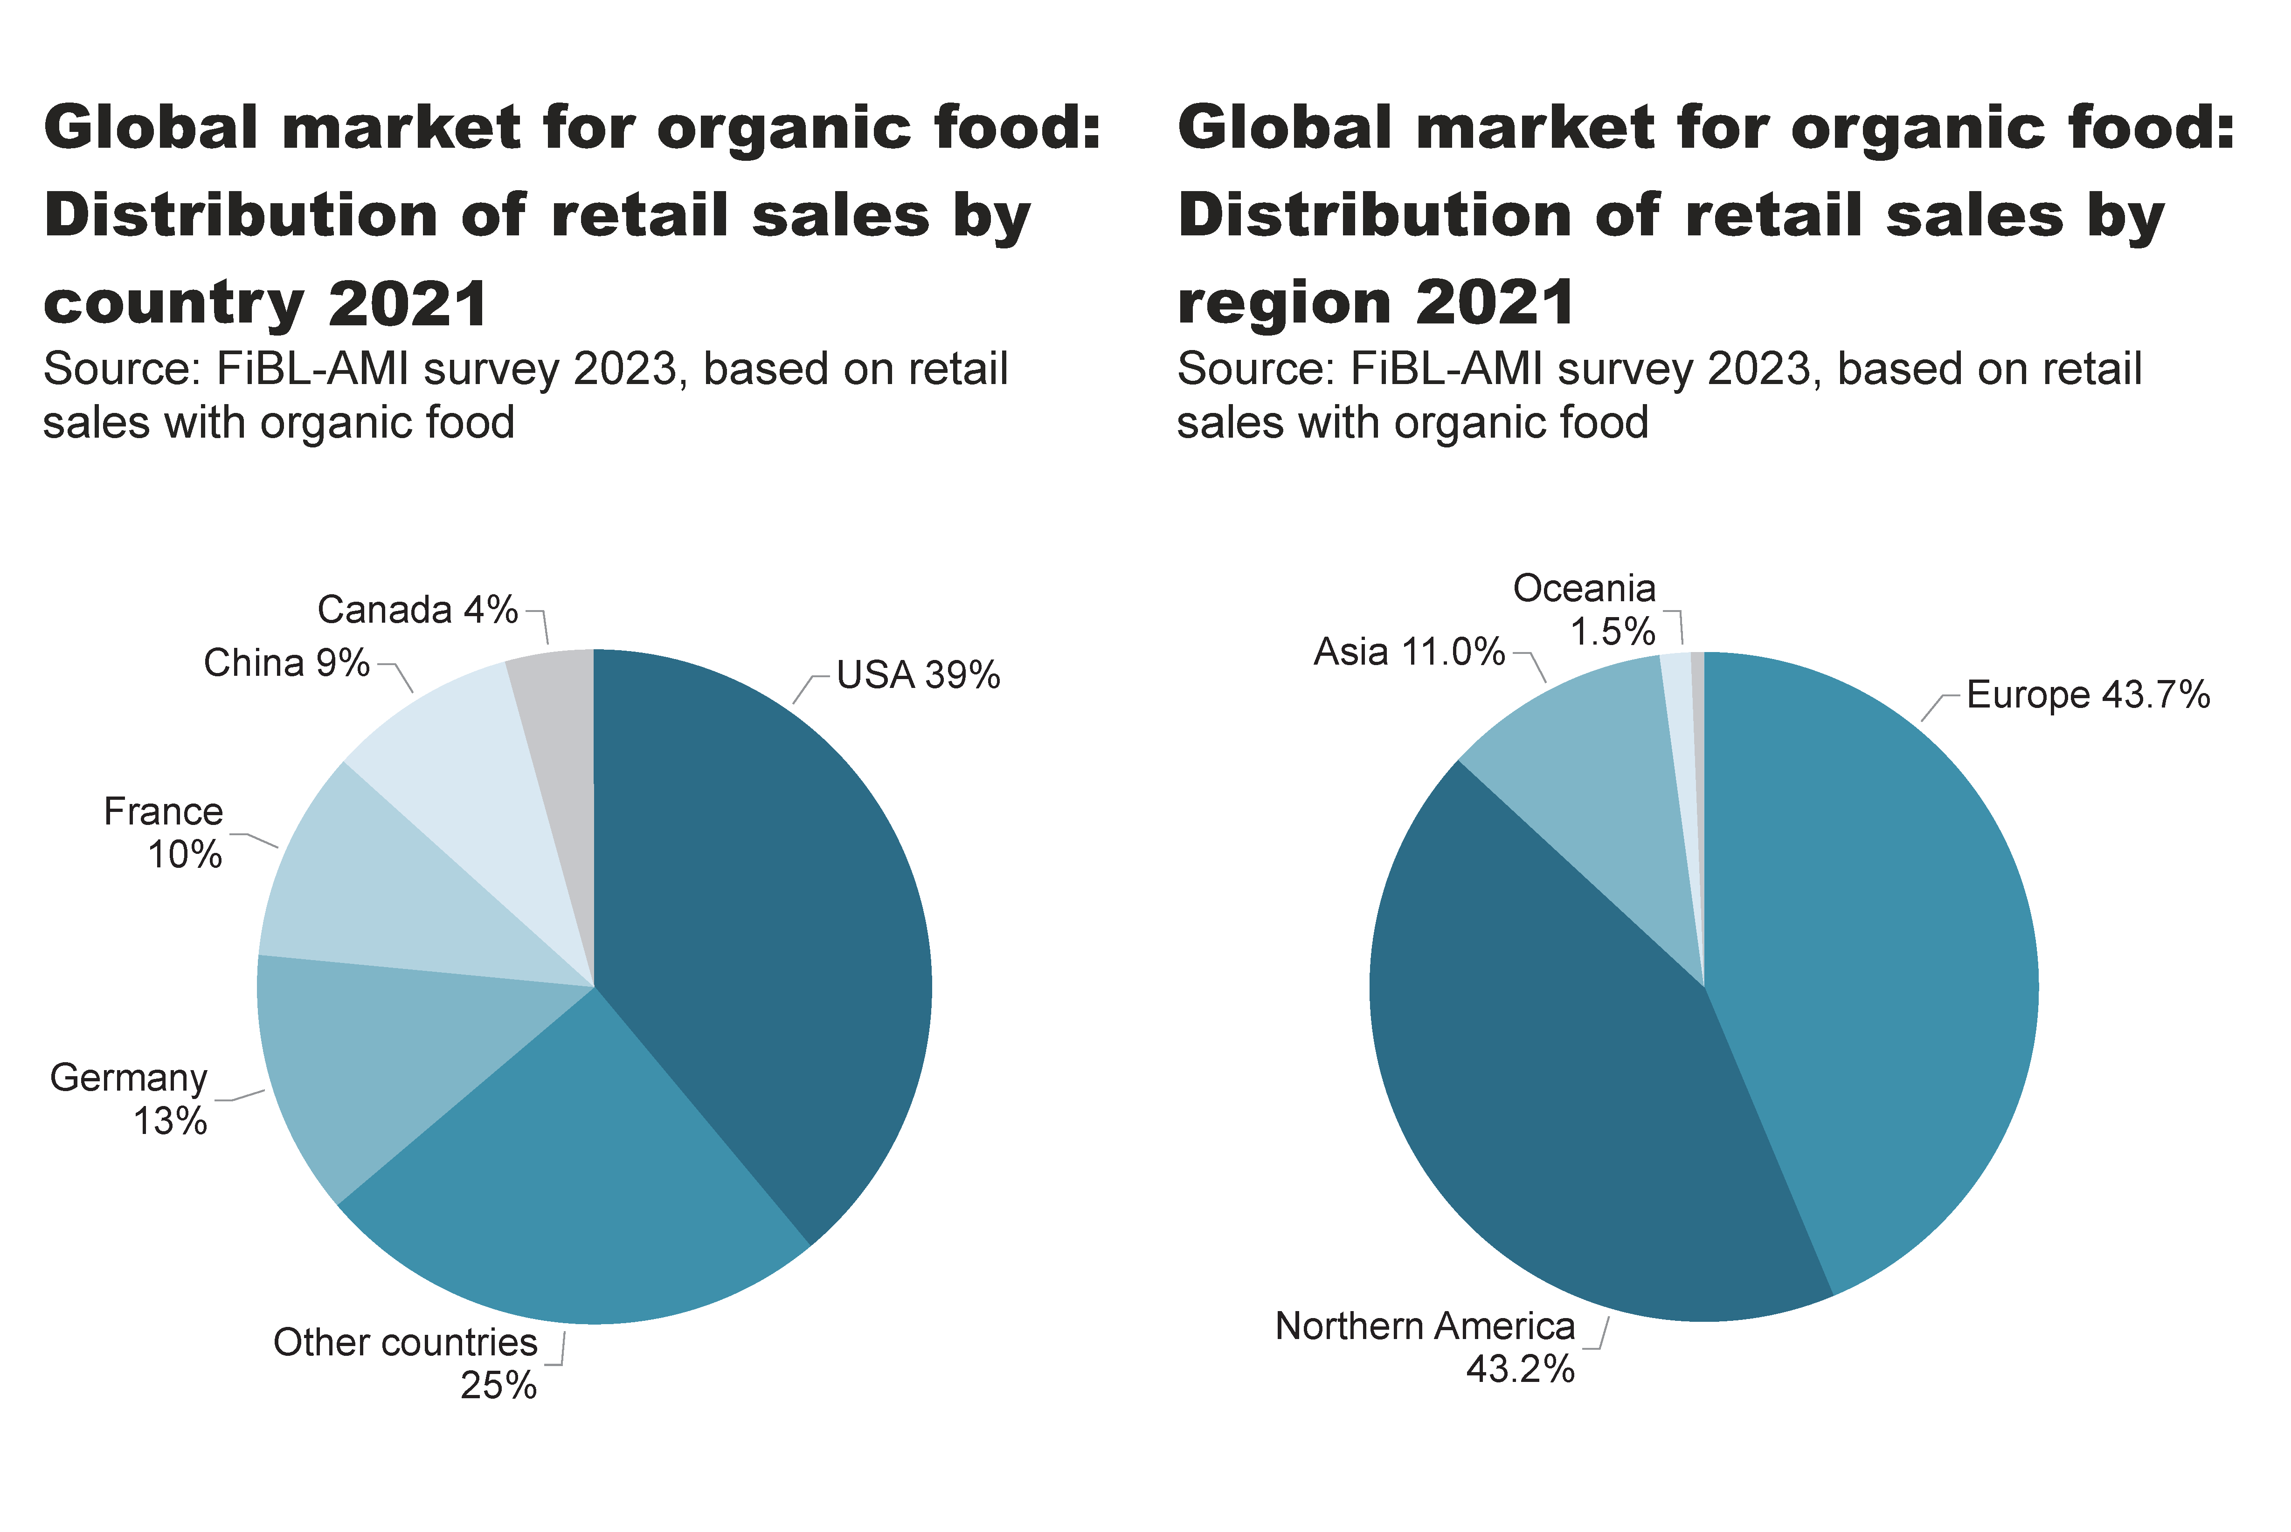
world_retail_sales_region_country
Notes:
pieChart
No alt text provided
textbox
No alt text provided
pieChart
No alt text provided
textbox
No alt text provided
card
No alt text provided
card
No alt text provided

Slide 32
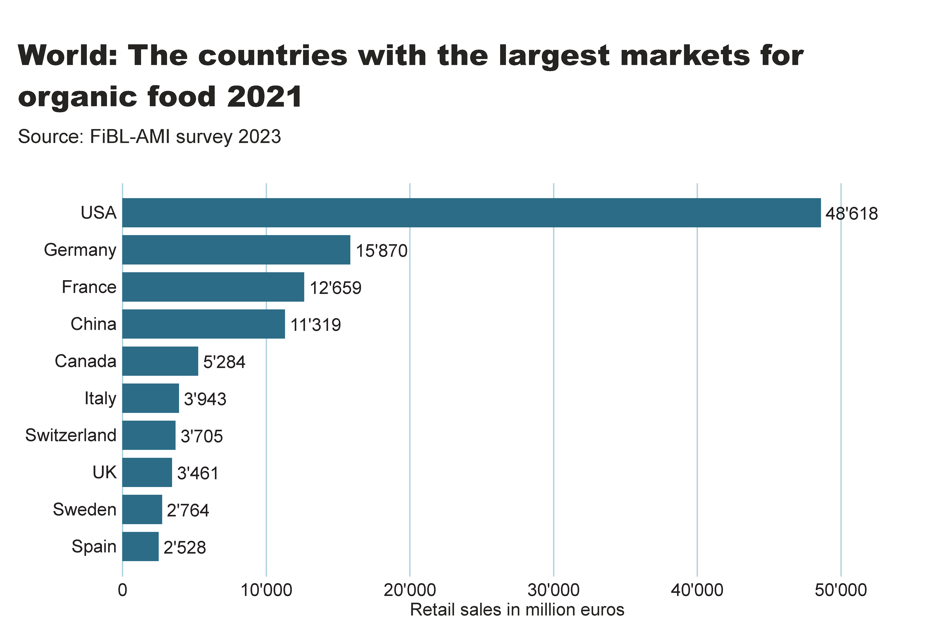
world_retail_sales_country
Notes:
textbox
No alt text provided
card
No alt text provided
barChart
No alt text provided

Slide 33
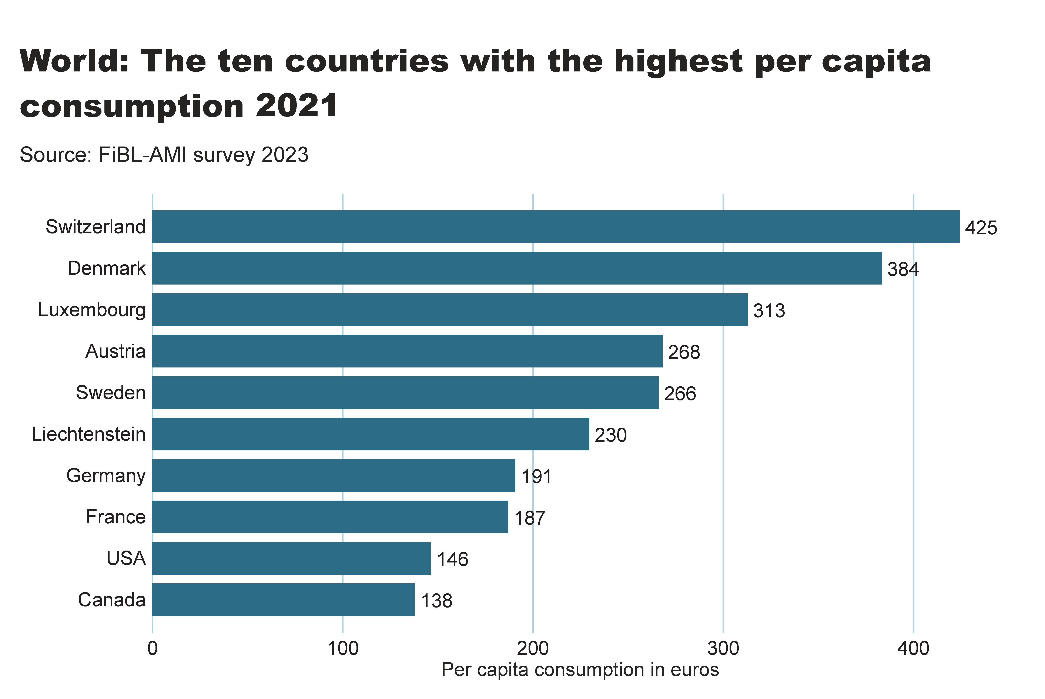
world_retail_sales_per_capita
Notes:
textbox
No alt text provided
card
No alt text provided
barChart
No alt text provided

Slide 34
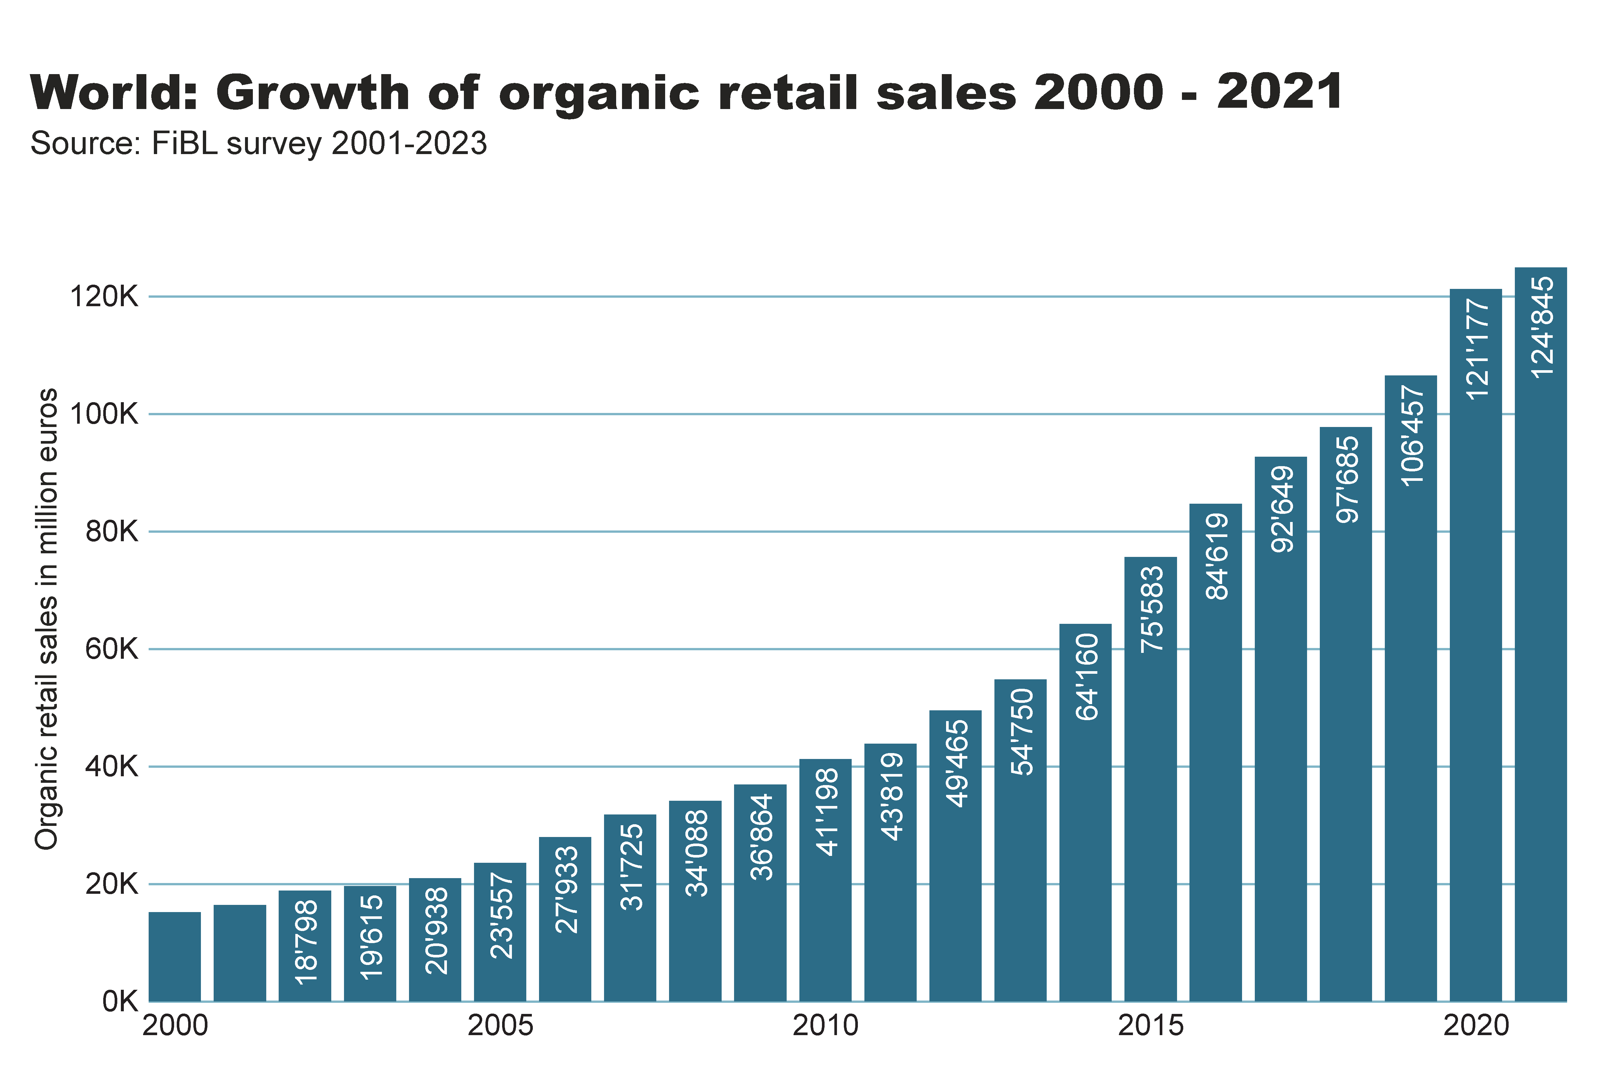
World_retail_growth
Notes:
textbox
No alt text provided
card
No alt text provided
columnChart
No alt text provided

Slide 35
United States of America: Growth of retail sales 2002-2021

Slide 36
Germany: Growth of retail sales 2000-2021

Slide 37
France: Growth of retail sales 2000-2021

Slide 38
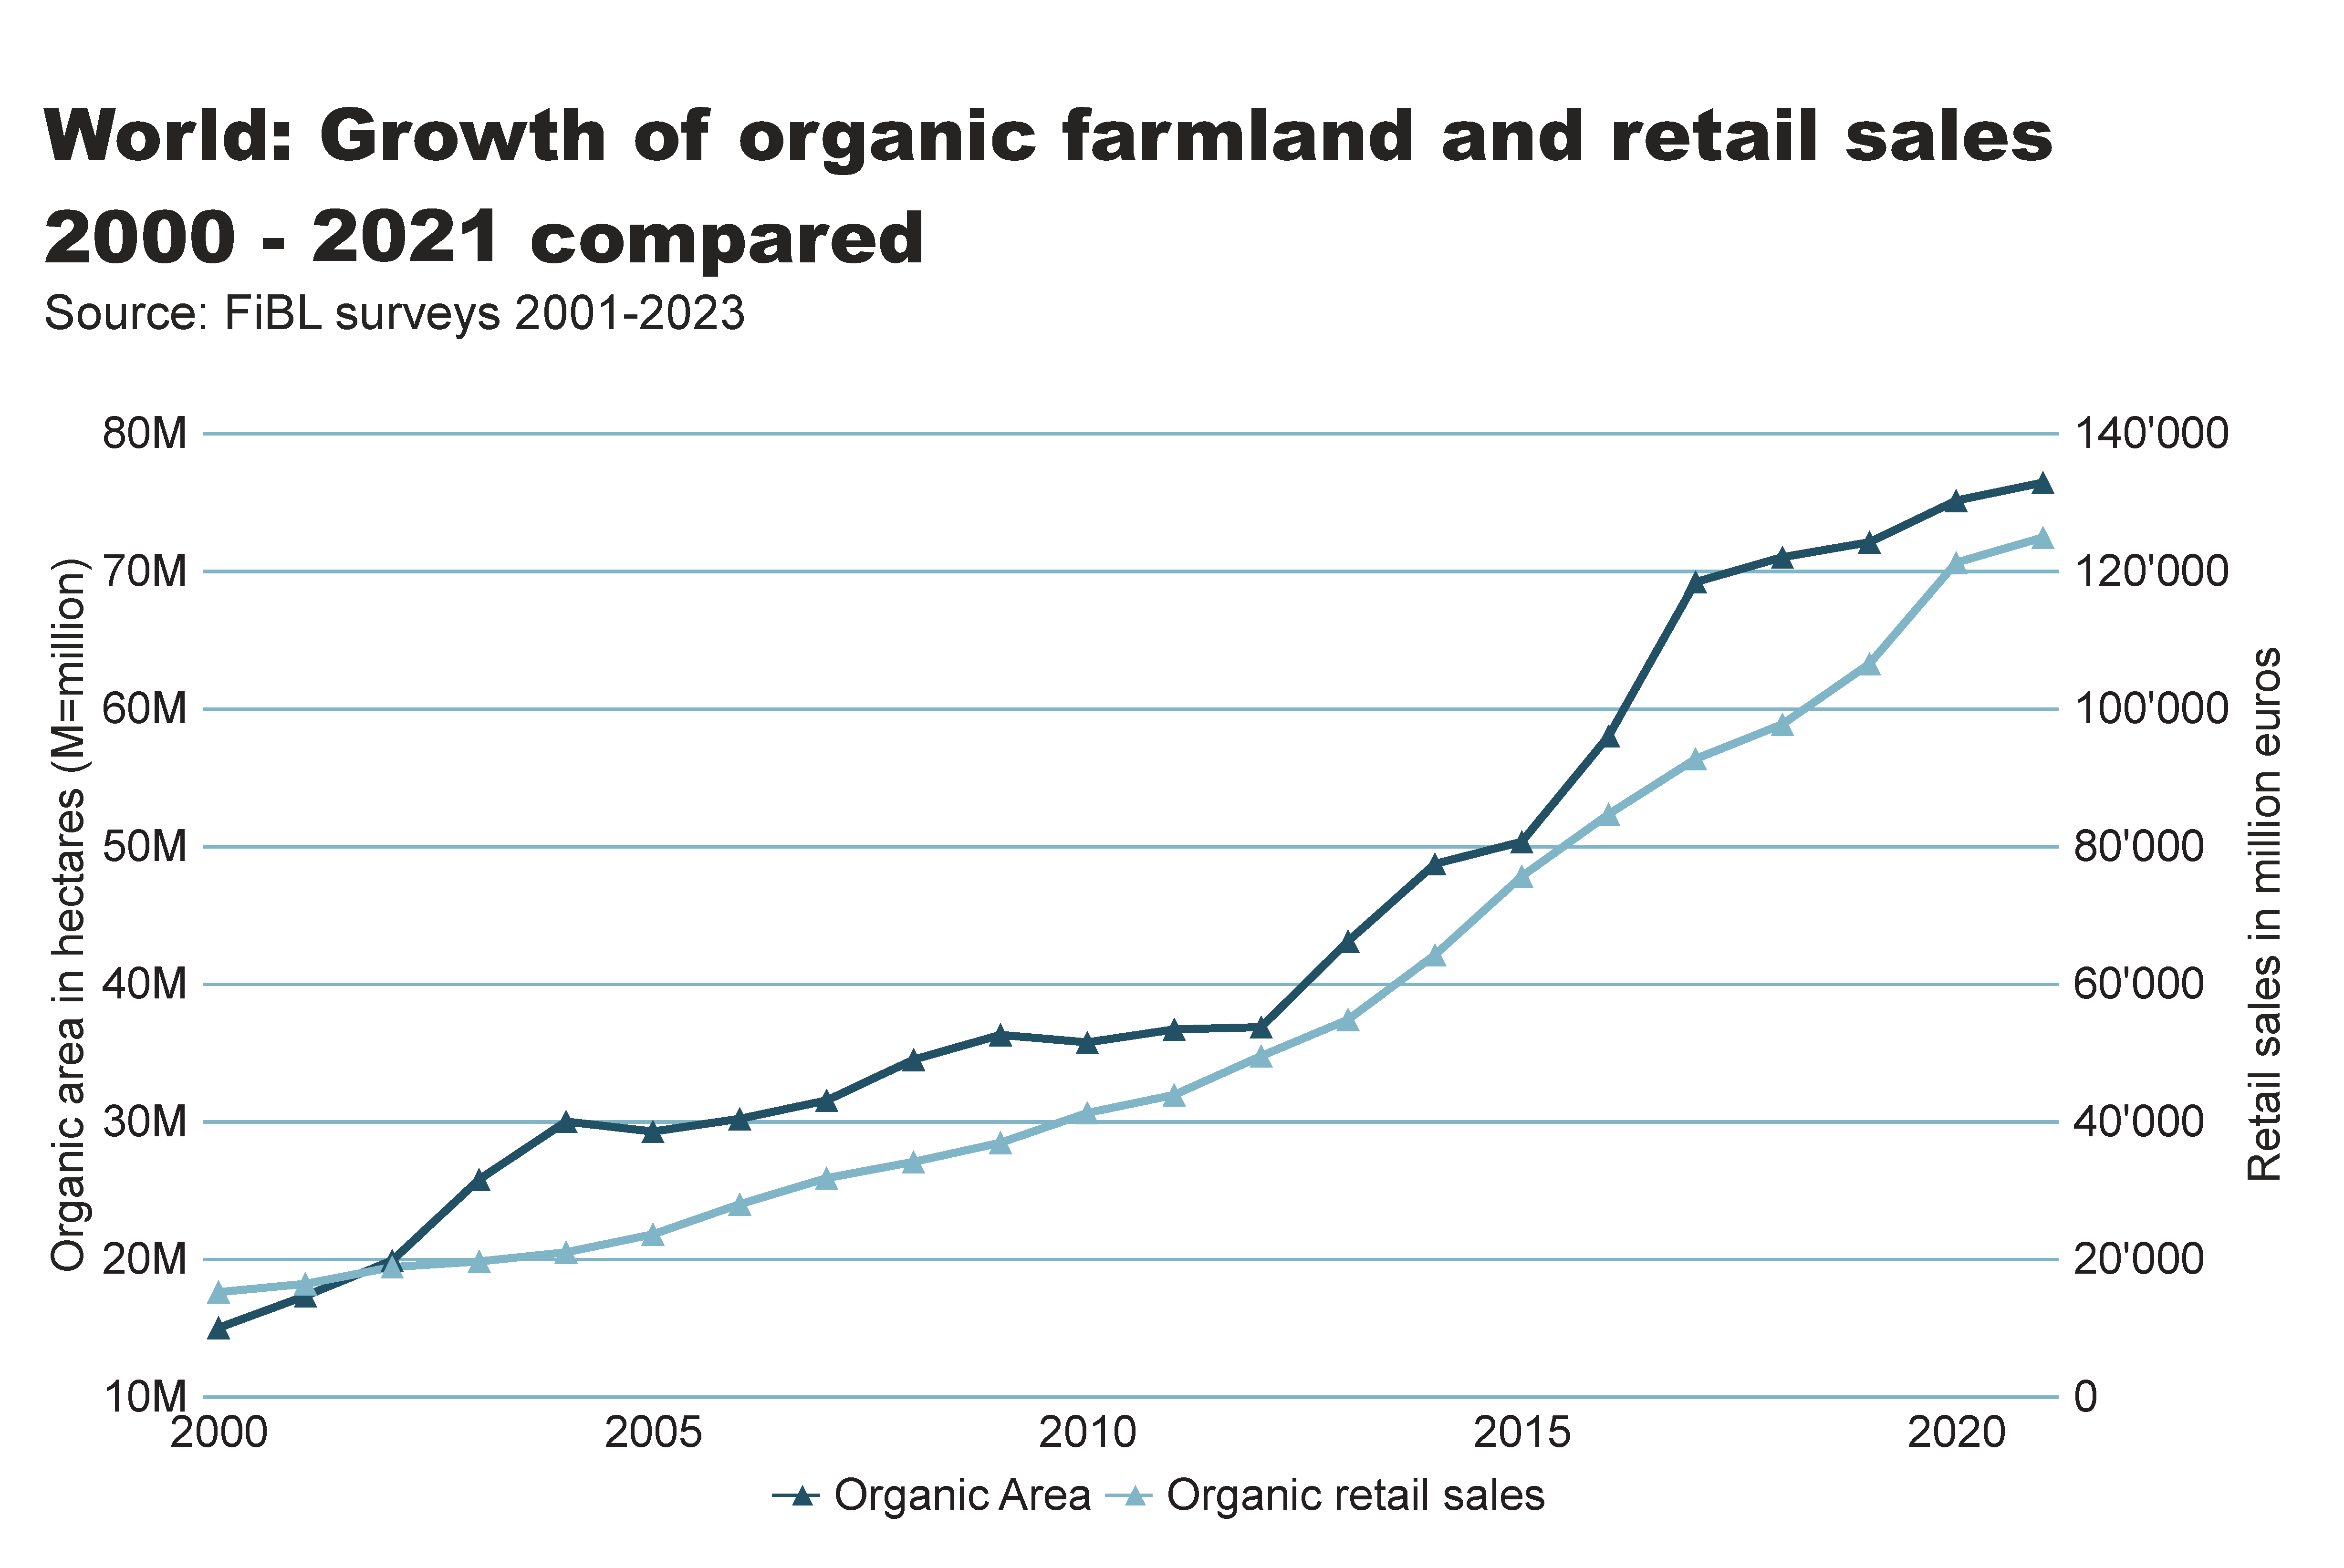
World_land_retail_growth
Notes:
textbox
No alt text provided
lineChart
No alt text provided
card
No alt text provided

Slide 39
Organic farming in developing countries and emerging markets
The Development Assistance Committee (DAC) of the Organisation for Economic Co-operation and Development (OECD) is a forum to discuss issues surrounding aid, development and poverty reduction in developing countries. The recipients of Official Development Assistance (ODA) according to the DAC list are studied in this section.
More than 3.2 million organic producers from the countries on this list were counted (88 percent of all organic producers).
More than a fifth of the world’s organic agricultural land, 17.0 million hectares, is located in countries on this list.
Almost half of the agricultural land of the countries on the DAC list is located in Latin American countries (6.9 million hectares), with Asia (6.4 million) and Africa (2.6 million) in second and third place.
The countries with the largest areas of organic agricultural land are Argentina, China and India, in that order. Not surprisingly, all of them are large countries.
The country list of the Development Assistance Committee DAC is available on the OECD website at http://www.oecd.org/dac/stats/daclist.htm

Slide 40
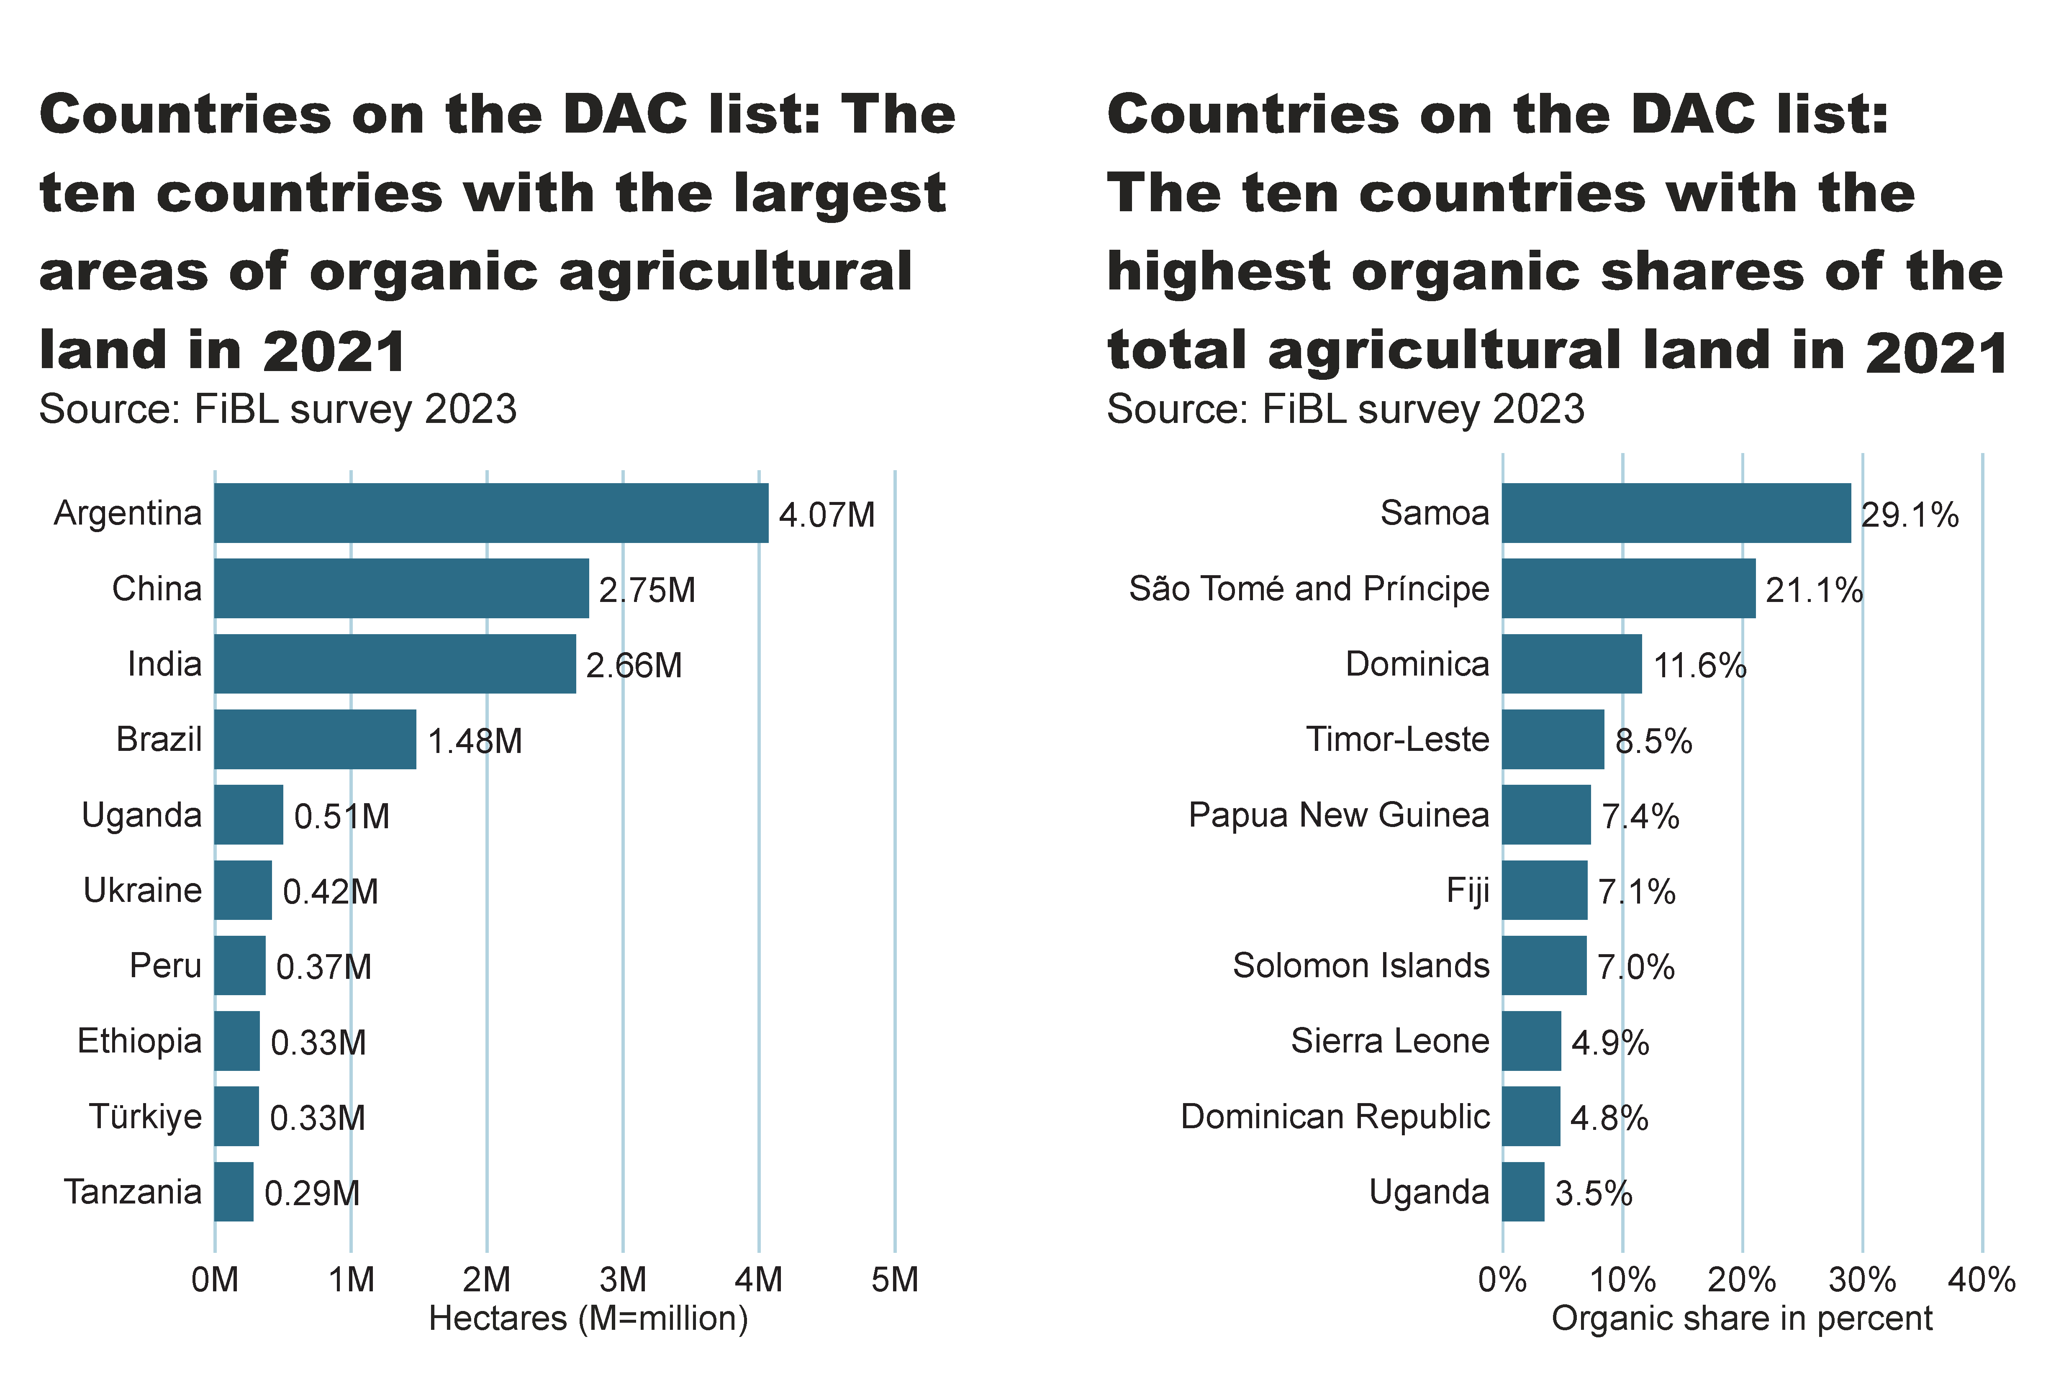
DAC_land_area_share_country
Notes:
textbox
No alt text provided
card
No alt text provided
clusteredBarChart
No alt text provided
textbox
No alt text provided
card
No alt text provided
clusteredBarChart
No alt text provided

Slide 41
More information
More information (PDF, data sources, graphs) at: http://www.organic-world.net/yearbook/yearbook-2023.html
Contact Helga Willer Research Institute of Organic Agriculture FiBL 5070 Frick Switzerland helga.willer@fibl.org

Slide 42
Disclaimer
All of the results contained in this slide show have been compiled by the Research Institute of Organic Agriculture FiBL. However, the possibility of mistakes cannot be ruled out entirely. Therefore, FiBL is not subject to any obligation and makes no guarantees whatsoever regarding any of the statements or results in this work; neither does FiBL accept responsibility or liability for any possible mistakes, nor for any consequences of actions taken by readers based on statements or advice contained therein.
This document has been produced with the support of the Swiss State Secretariat for Economic Affairs (SECO), the Sustainability Fund of Coop Switzerland, NürnbergMesse, IFOAM – Organics International. The views expressed herein can in no way be taken to reflect the official opinions of SECO, Coop, NürnbergMesse or IFOAM – Organics International.

Slide 43
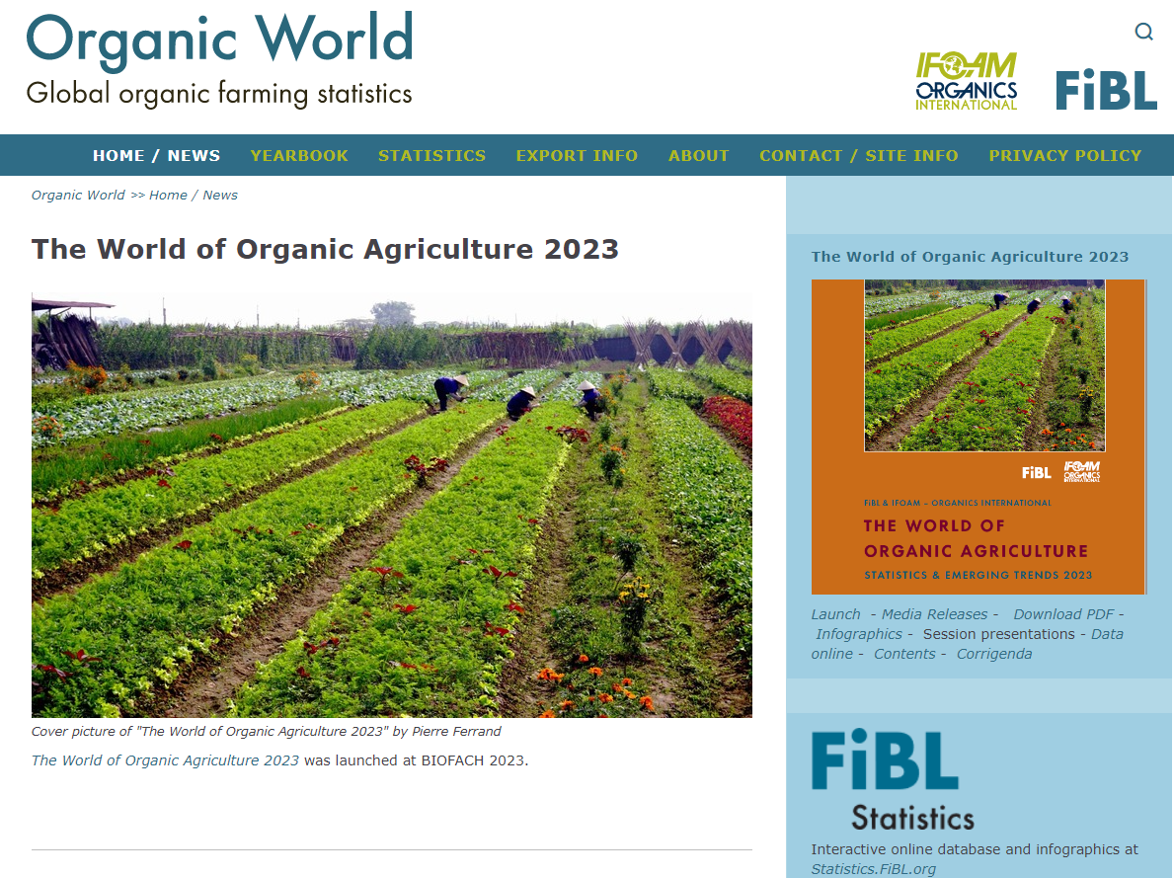
Presentations on www.organic-world.net

Slide 44
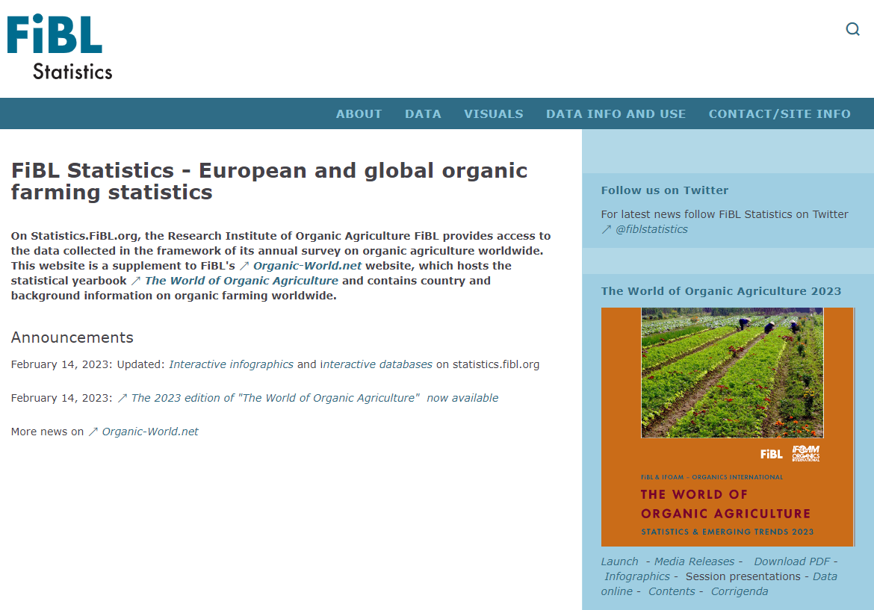
Statistics.FiBL.org

Slide 45
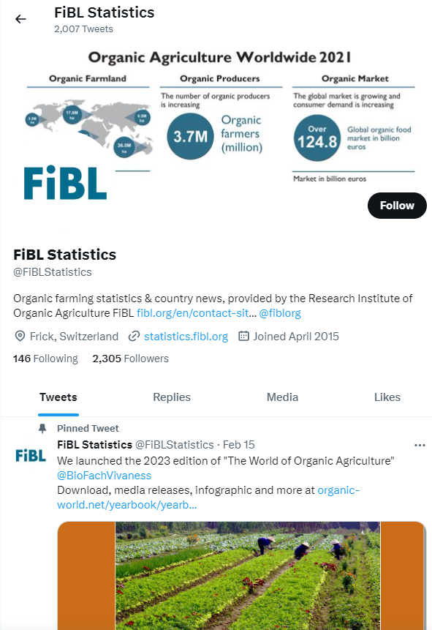
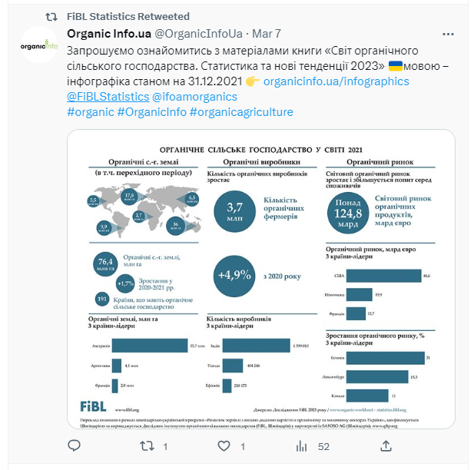
www.twitter.com/fiblstatistics

Slide 46
Contact
Helga Willer Research Institute of Organic Agriculture FiBL Ackerstrasse 113, Box 219 5070 Frick Switzerland
Phone +41 62 865 72 72 Phone +41 62 865 72 07 (direct)
info.suisse@fibl.org, helga.willer@fibl.org www.fibl.org, www.organic-world.net, https://statistics.fibl.org

Slide 47
FiBL online
www.fibl.org
www.bioaktuell.ch
fiblfilm
@fiblorg
@FiBLaktuell
linkedin.com/company/fibl

