Slide 1
Organic Agriculture Worldwide 2021: Key results from the FiBL survey on organic agriculture worldwide 2023
Part 3: Organic agriculture in the regions
Jan Trávníček, Bernhard Schlatter and Helga Willer
© FiBL, April 2023

Slide 2
Organic Agriculture Worldwide: Key results from the FiBL survey on organic agriculture worldwide 2023 Part 3: Organic agriculture in the regions
Data compiled by the Research Institute of Organic Agriculture FiBL, Frick, Switzerland, based on national data sources and data from certifiers.
Data as published February 2023 in The World of Organic Agriculture. Statistics and Emerging Trends 2023.* Frick and Bonn, www.organic-world.net
For updates, check www.organic-world.net
This presentation is available online at: https://www.organic-world.net/yearbook/yearbook-2023/presentations.html
Texts and graphs: Helga Willer, Bernhard Schlatter, Jan Trávníček and Claudia Meier, Research Institute of Organic Agriculture FiBL, Frick, Switzerland
Contact: Helga Willer, helga.willer@fibl.org, Research Institute of Organic Agriculture FiBL, Frick, Switzerland
© Research Institute of Organic Agriculture FiBL, Frick, Switzerland, February 2023
*Citation: Willer, Helga, Jan Trávníček, Claudia Meier and Bernhard Schlatter (Eds.) (2023): The World of Organic Agriculture. Statistics and Emerging Trends 2023. Research Institute of Organic Agriculture FiBL, Frick, and IFOAM – Organics International, Bonn.
Notes:
FiBL
11.07.2023
www.fibl.org
2

Slide 3
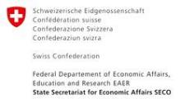
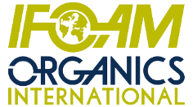
Acknowledgements
The Swiss State Secretariat of Economic Affairs (SECO)
Coop Sustainability Fund
NürnbergMesse, the organizers of BIOFACH
IFOAM – Organics International
More than 200 experts from all parts of the world contributed to the FiBL survey 2023.

Slide 4
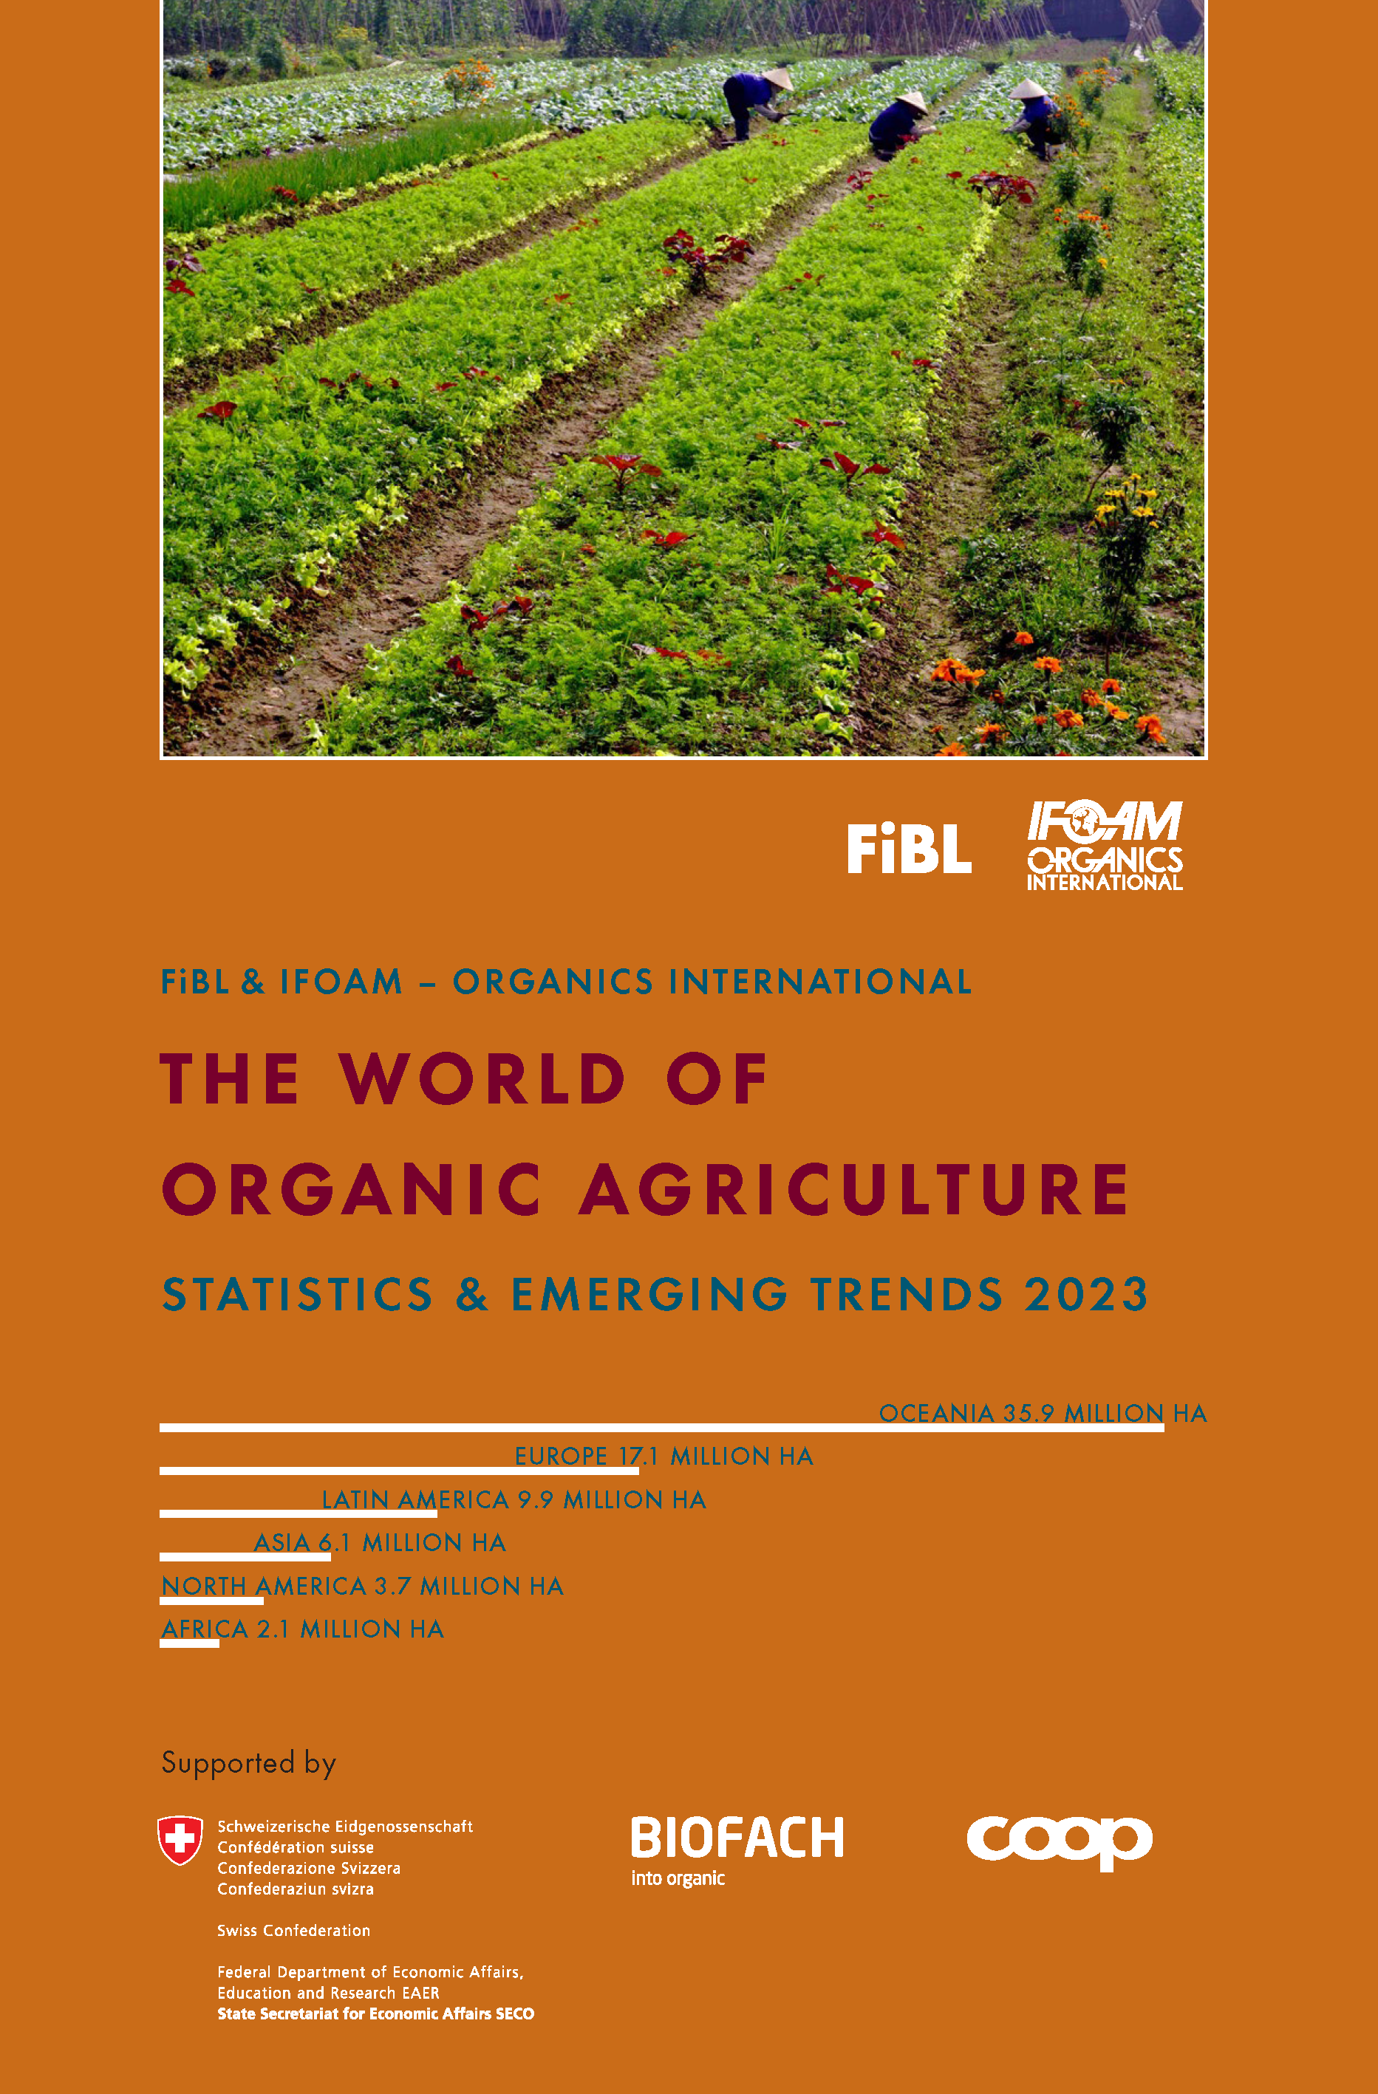
The World of Organic Agriculture 2023
The 24th edition of «The World of Organic Agriculture», was published by FiBL and IFOAM – Organics International in February 2023.
Data tables
Country and continent reports
Markets, standards and policy support
The book can be ordered or downloaded at (item number 1254): https://www.fibl.org/en/shop-en
www.organic-world.net
https://statistics.fibl.org

Slide 5
About this presentation
In three presentations, the key results of the FiBL survey on organic agriculture worldwide 2023 are summarized (data 2021). Apart from the global data, key results on crop and on regional data are presented.
More information is available at www.organic-world.net
The following three presentations are available at https://www.organic-world.net/yearbook/yearbook-2023/presentations.html:
Part 1: Global data 2021 and survey background
Part 2: Land use and key crops in organic agriculture 2021
Part 3: Organic agriculture in the regions 2021

Slide 6
The 24th survey on organic agriculture world-wide
The 24th survey on organic agriculture worldwide was carried out by the Research Institute of Organic Agriculture FiBL in cooperation with partners from all around the world. The results were published jointly by FiBL and IFOAM – Organics International.
The survey was carried out between July 2022 and February 2023.
Data were received from 191 countries.
Data was provided by over 200 country experts (representatives from NGOs, certification bodies, governments, researchers).
The following data was collected: area data (including land use and crop details); producers, other operator types; domestic market values; export and import data; livestock data (animal heads and production in metric tons).
The results are published in the yearbook “The World of Organic Agriculture 2023” and on www.organic-world.net.

Slide 7
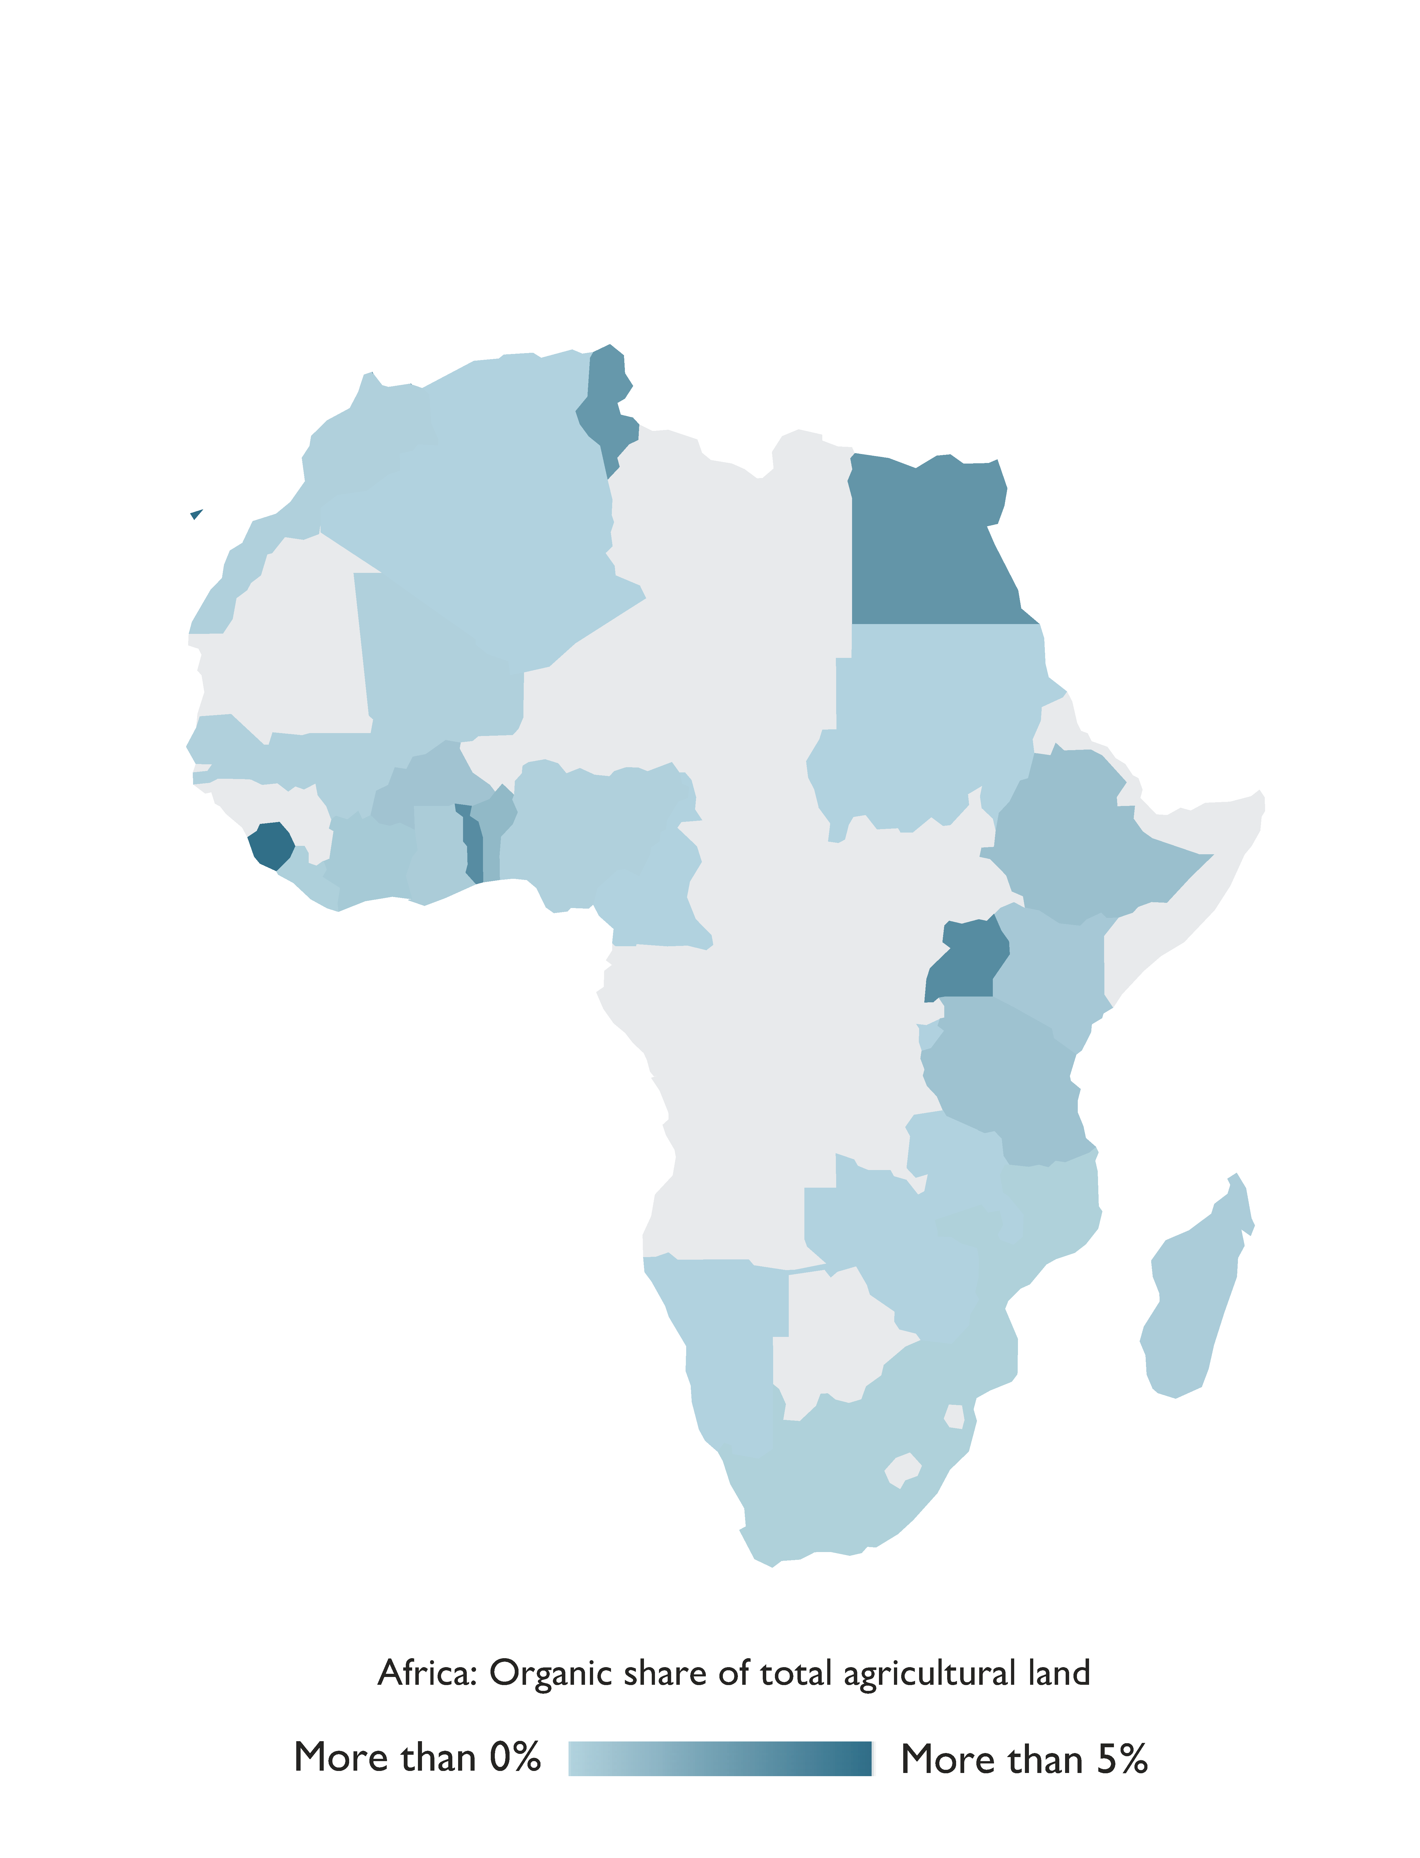
Africa

Slide 8
Organic agriculture in Africa 2021
There were nearly 2.7 million hectares of certified organic agricultural land in Africa in 2021.
Africa reported almost 393´000 hectares more than in 2020, a 17.3 percent increase, and nearly 1´123´000 producers.
Uganda was the country with the largest organic area (more than 505´000 hectares in 2021), as well as the largest number of organic producers (over 400´000).
The country with the highest percentage of land devoted to organic farming in the region was the island state of São Tomé and Príncipe, with 21.1 percent of its agricultural area dedicated to organic crops.
The majority of certified organic products in Africa are destined for export markets. Key crops are coffee. cocoa, textile crops, olives, nuts and oilseeds.
Five countries in Africa have legislation on organic agriculture, and seven countries are drafting legislation. Six countries have a national standard but lack legislation on the definition of organic farming (East African Organic Product Standard).
Source: FiBL survey 2023

Slide 9
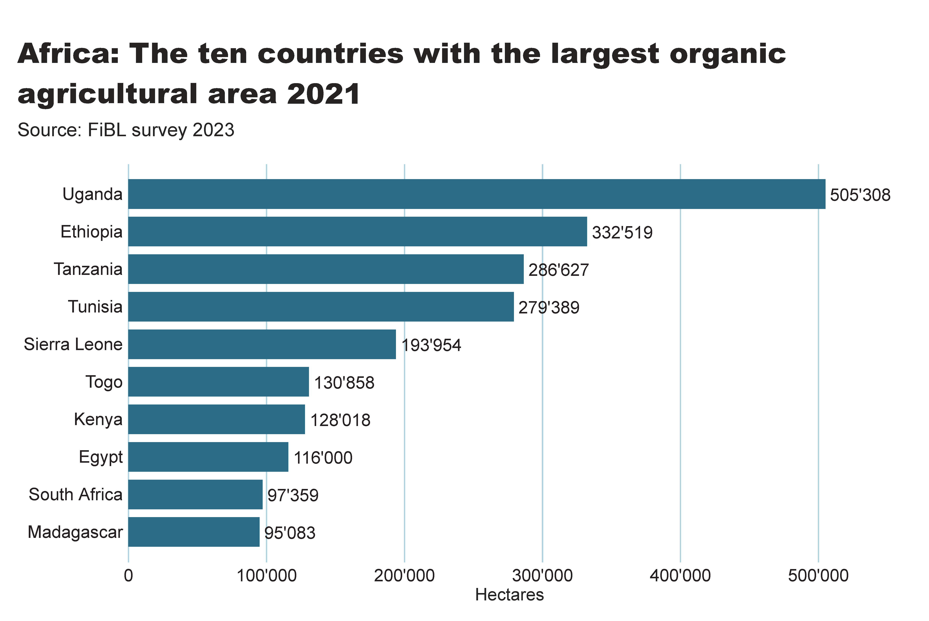
africa_land_country
Notes:
textbox
No alt text provided
Source: FiBL survey 2022
No alt text provided
card
No alt text provided

Slide 10
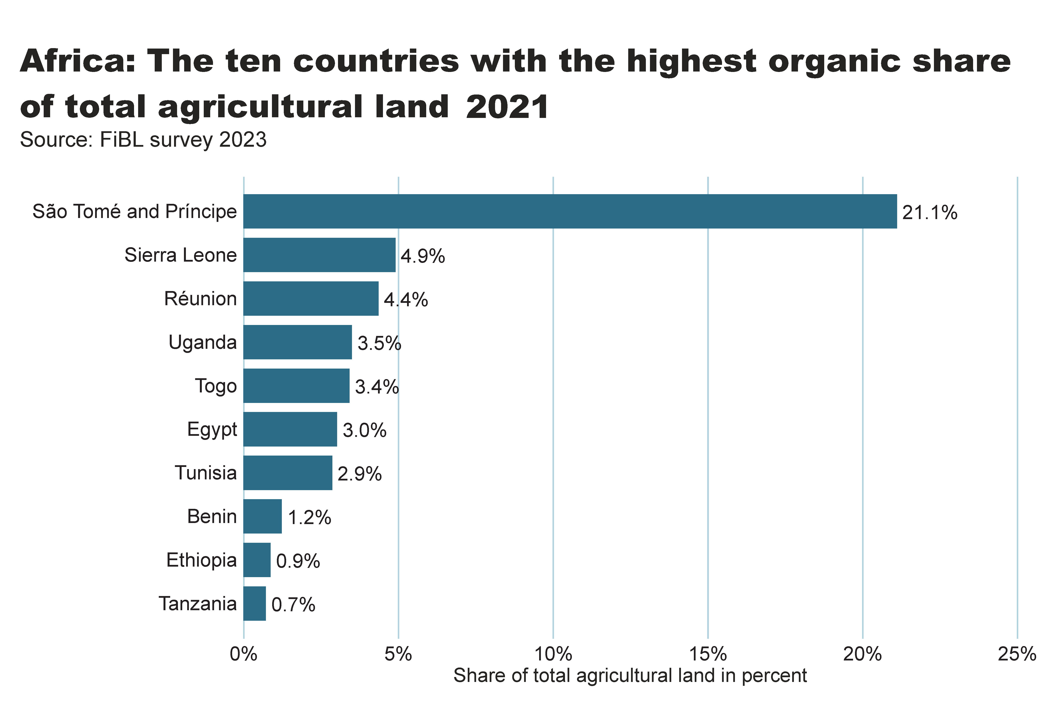
Africa_land_share
Notes:
textbox
No alt text provided
card
No alt text provided
barChart
No alt text provided

Slide 11
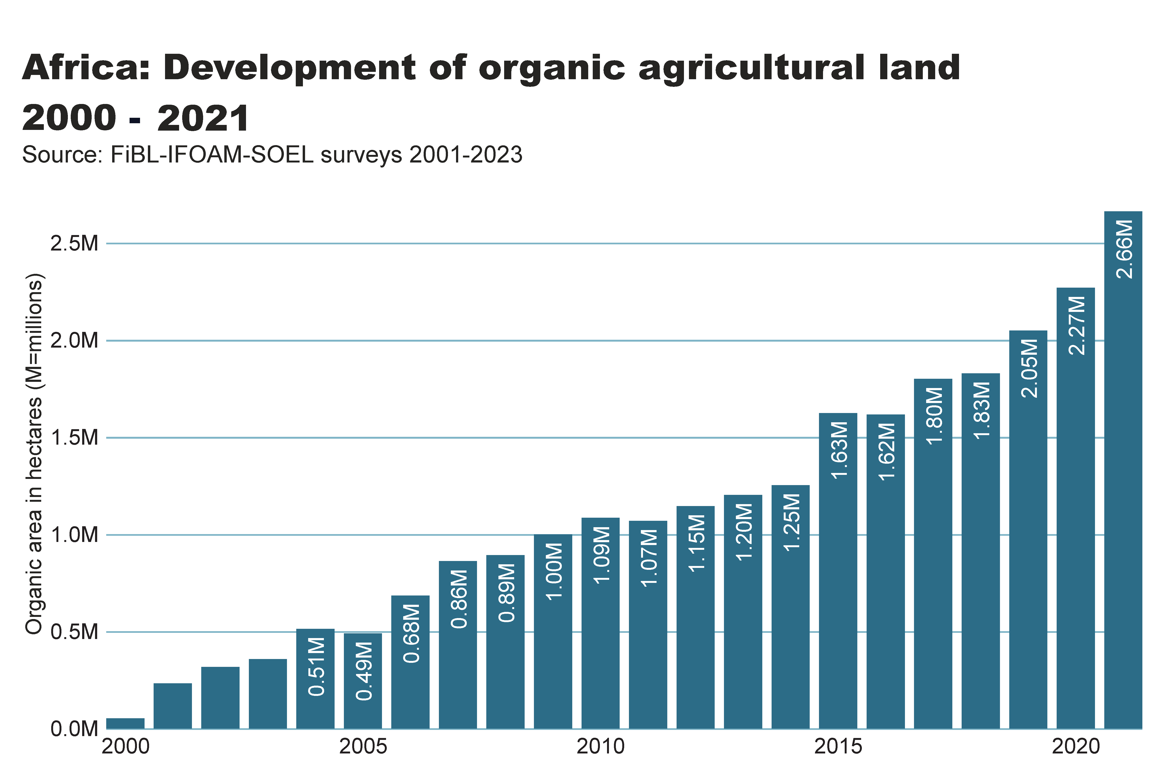
africa_land_growth
Notes:
textbox
No alt text provided
card
No alt text provided
lineClusteredColumnComboChart
No alt text provided

Slide 12
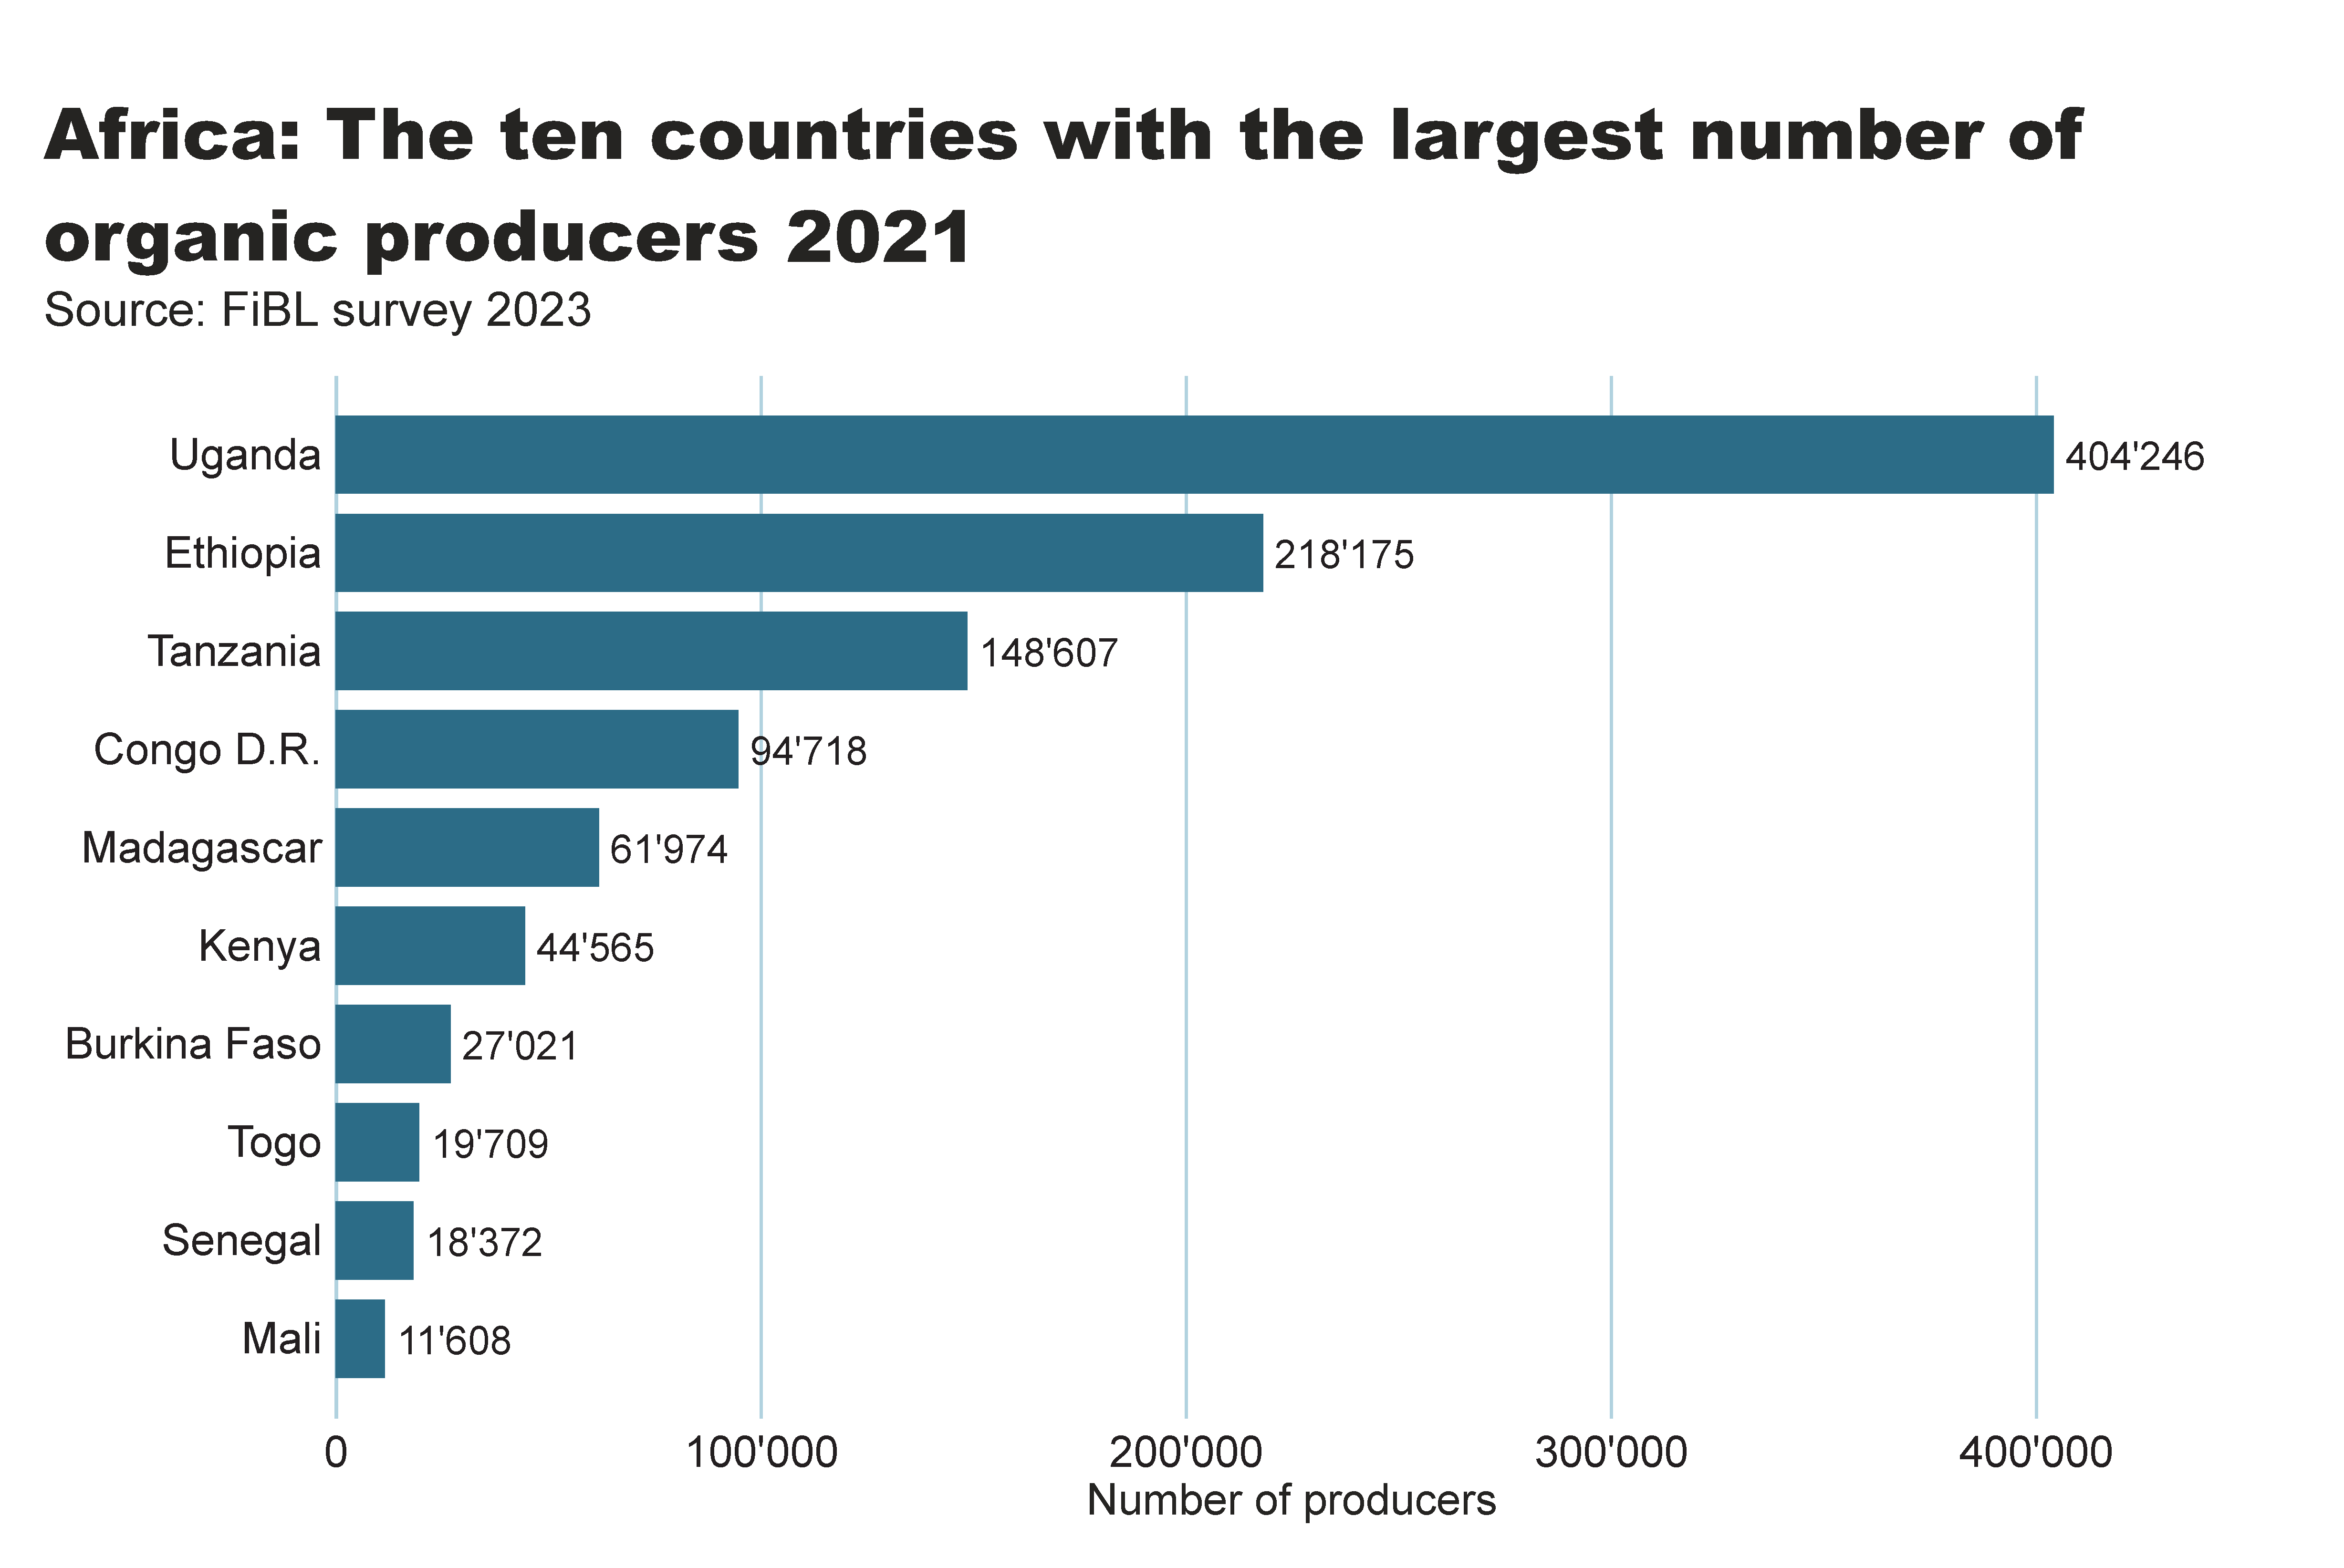
africa_producers_country
Notes:
textbox
No alt text provided
card
No alt text provided
barChart
No alt text provided

Slide 13
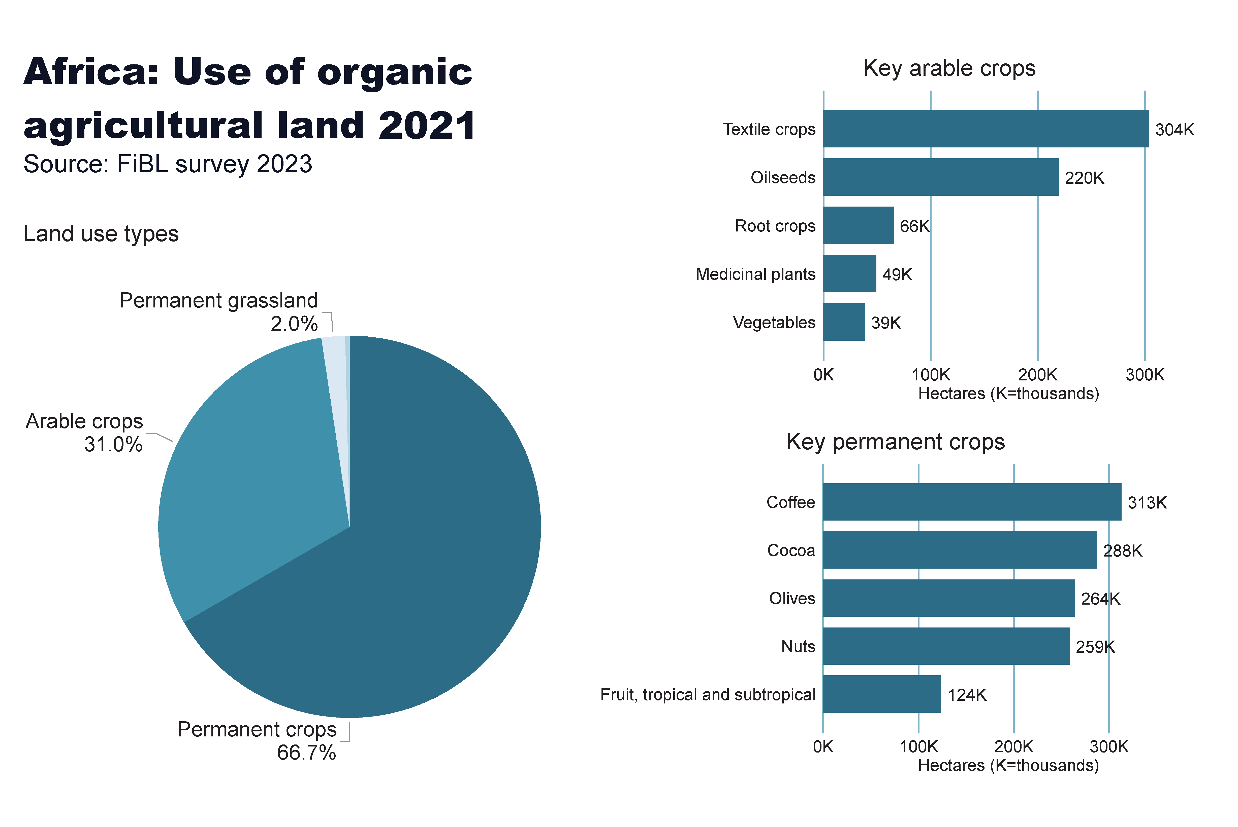
Africa_land_use
Notes:
Land use types
No alt text provided
card
No alt text provided
Key arable crops
No alt text provided
Key permanent crops
No alt text provided
textbox
No alt text provided

Slide 14
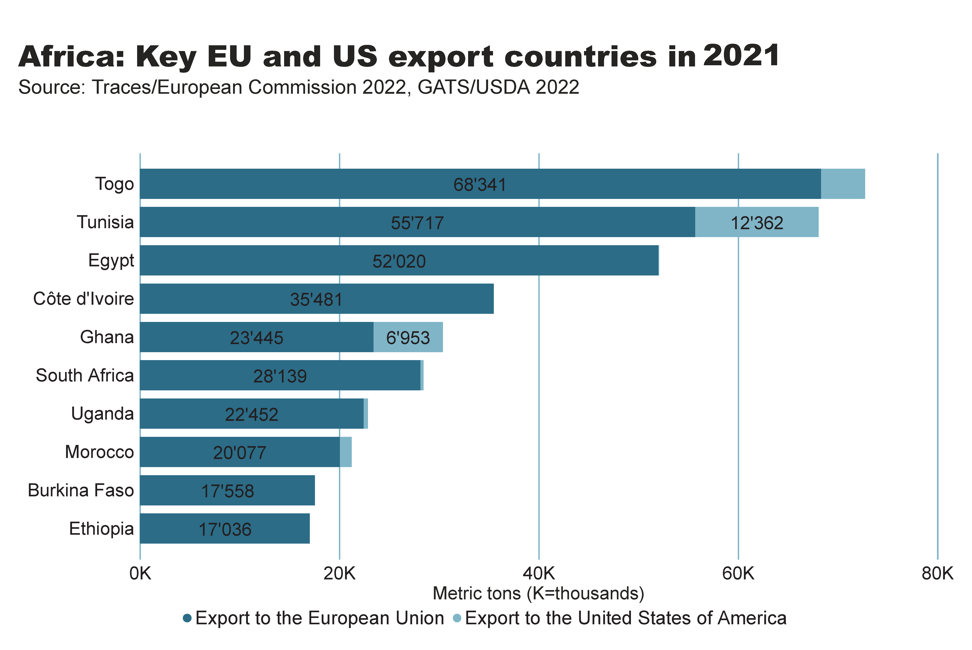

Slide 15
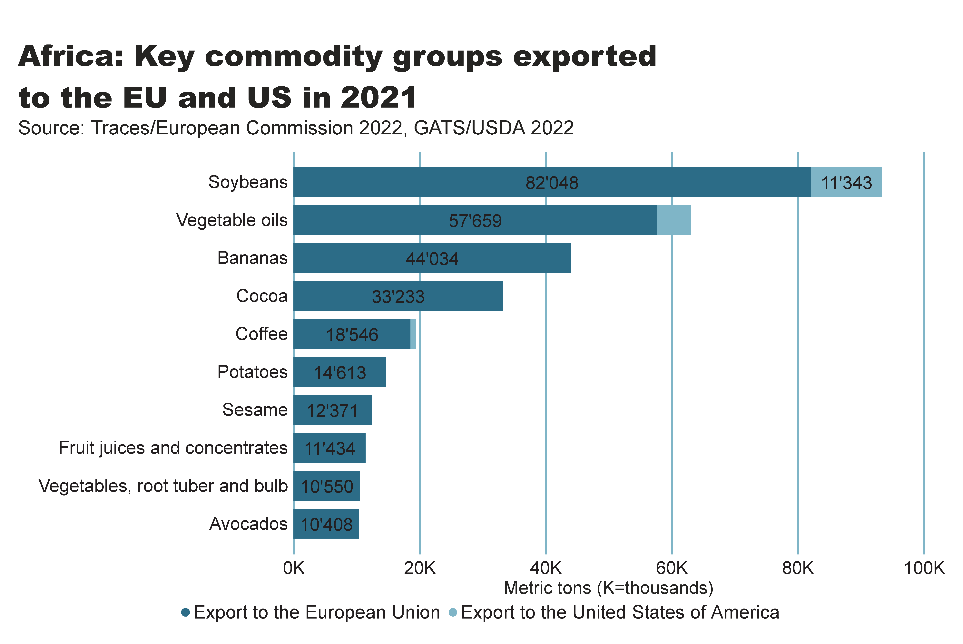

Slide 16
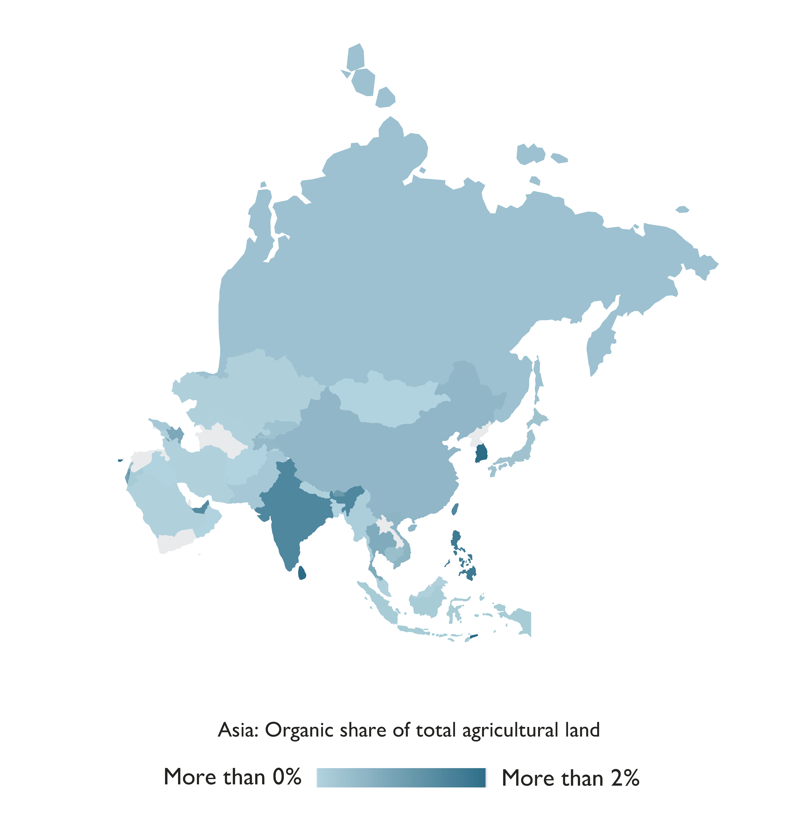
Asia

Slide 17
Organic Agriculture in Asia 2021
The total area dedicated to organic agriculture in Asia was more than 6.5 million hectares in 2021.
The leading countries by area were China (2.75 million hectares) and India (over 2.66 million hectares).
Timor-Leste had the highest proportion of organic agricultural land (8.5 percent).
There were nearly 1.8 million producers, most of whom were in India.
Twenty-two countries in the region have legislation on organic agriculture, and six countries are drafting legislation.
Source: FiBL survey 2023

Slide 18
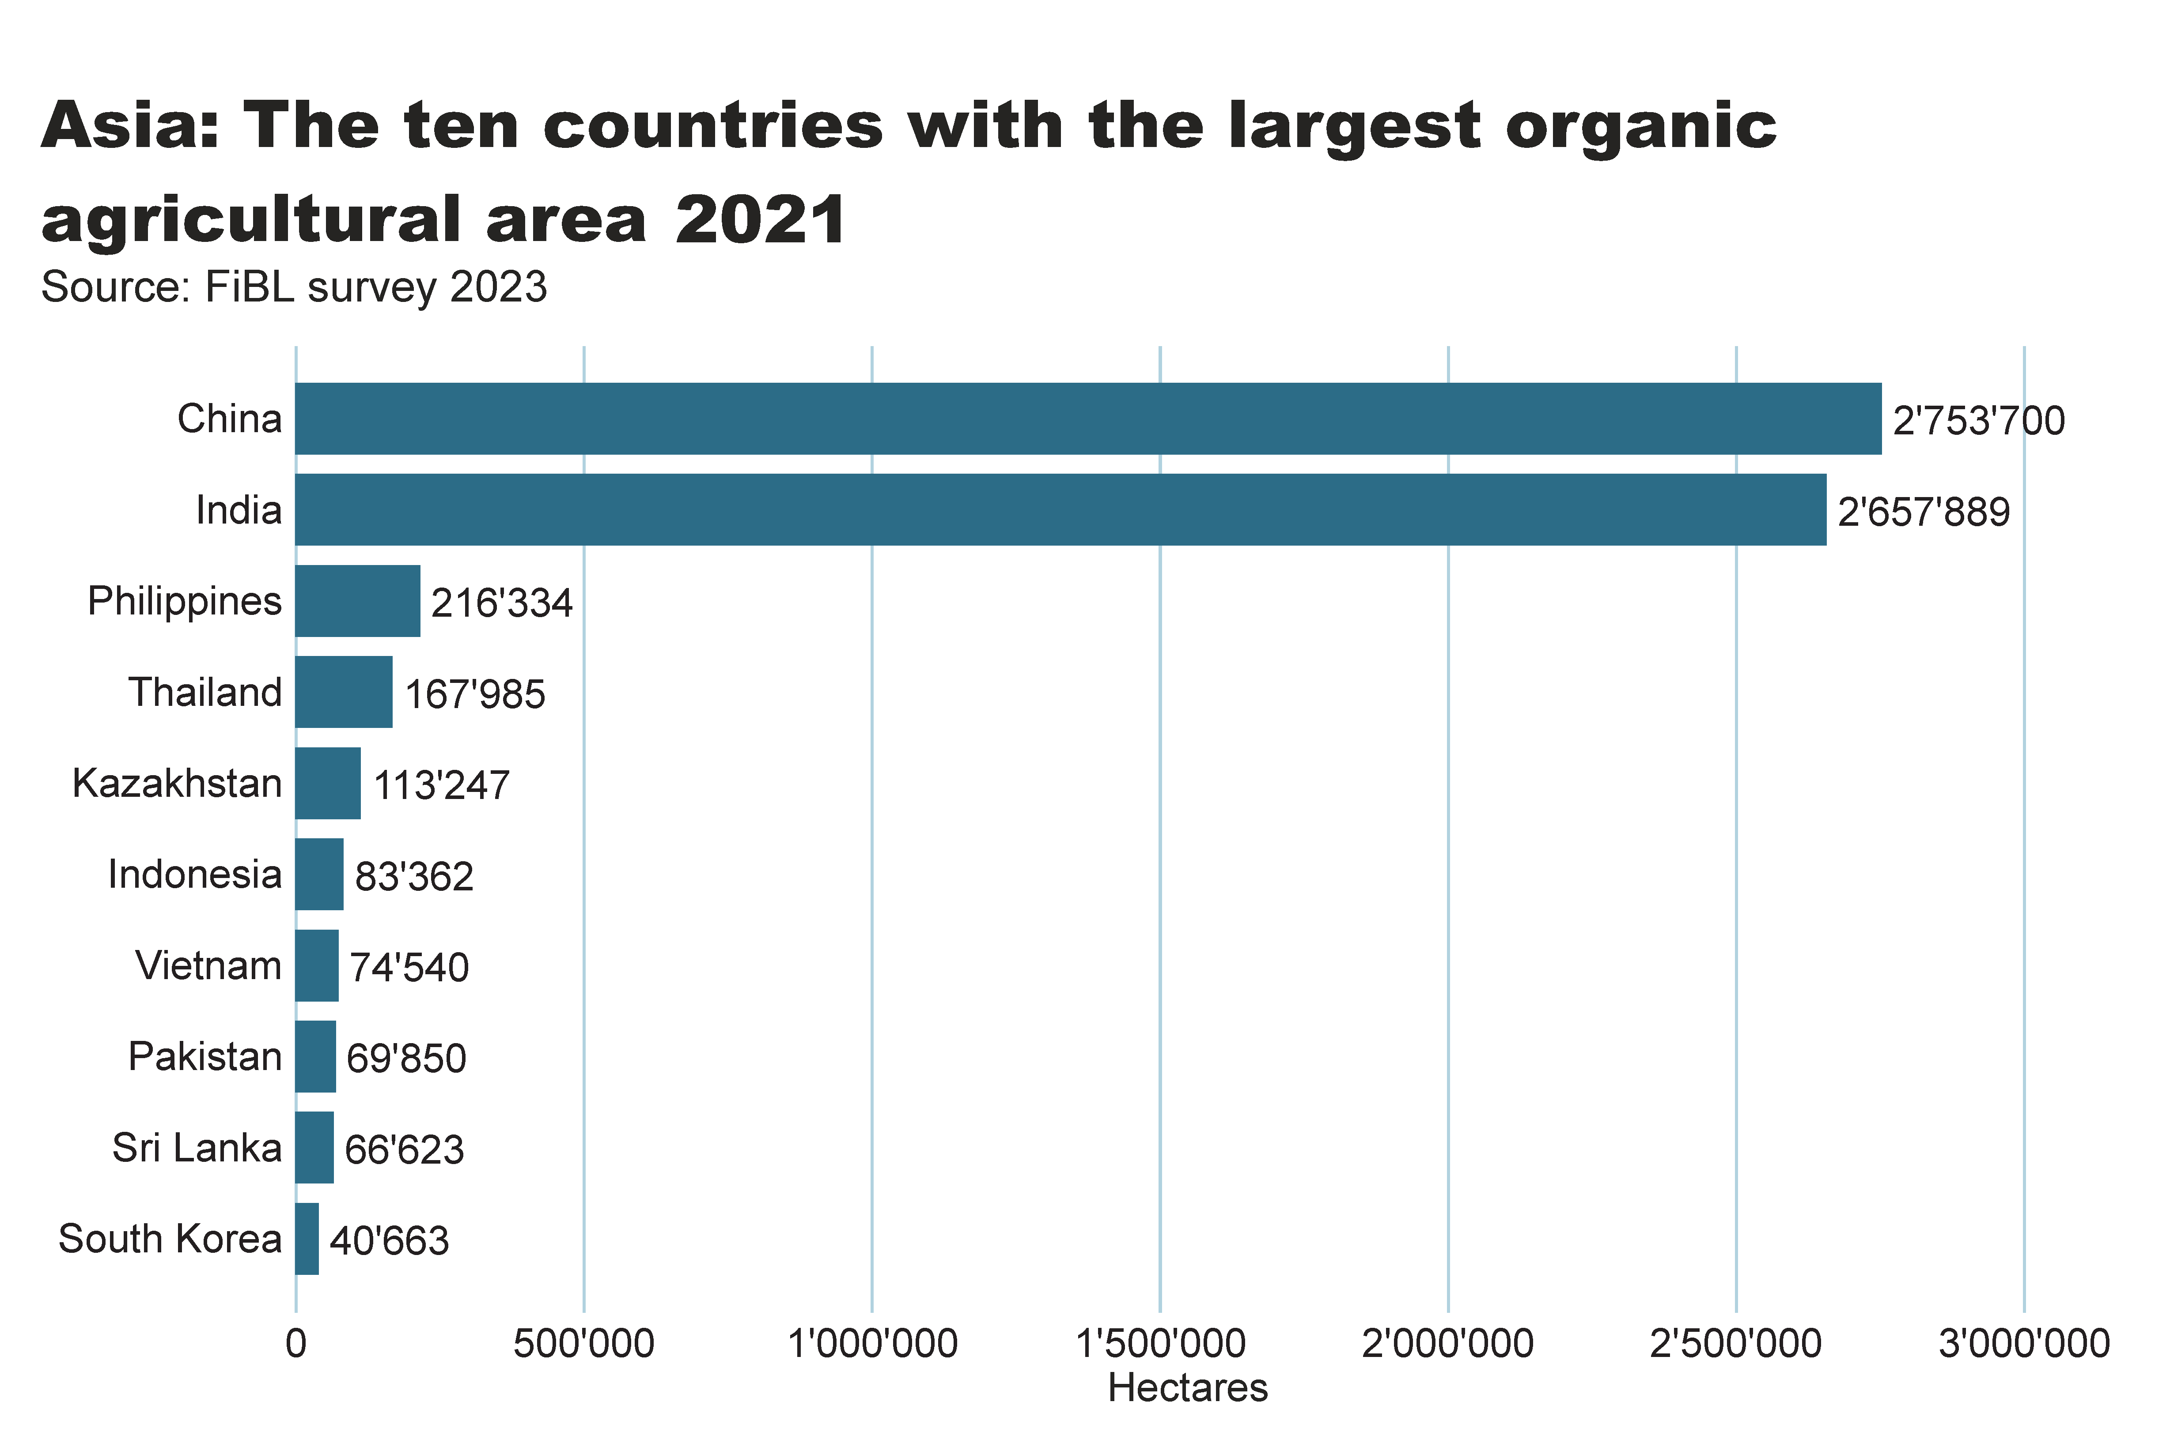
Asia_land_country
Notes:
clusteredBarChart
No alt text provided
textbox
No alt text provided
card
No alt text provided

Slide 19
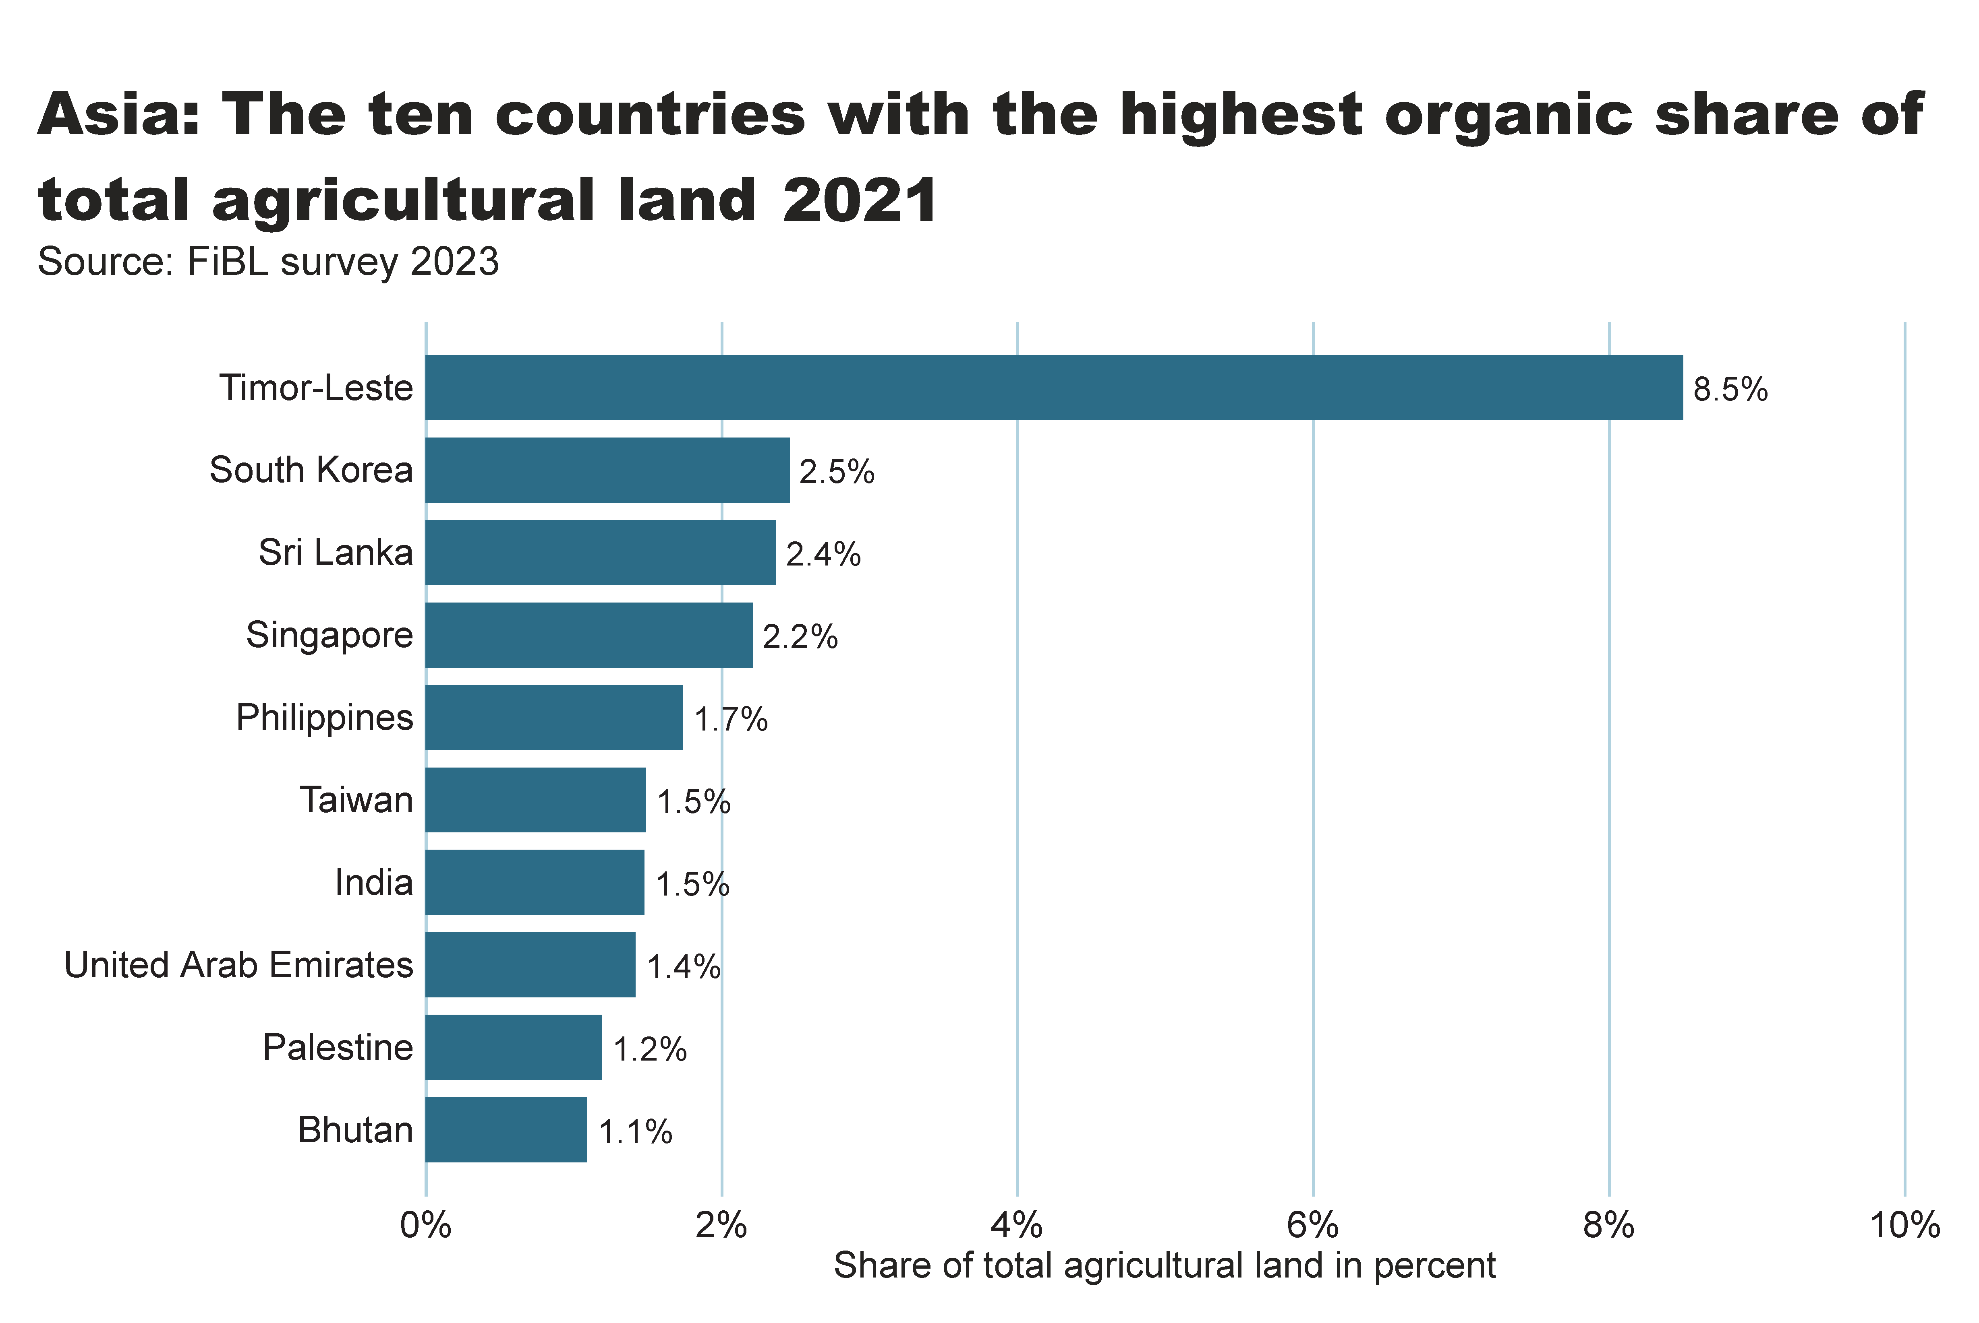
Asia_land_share_country
Notes:
textbox
No alt text provided
Source: FiBL survey 2022
No alt text provided
card
No alt text provided

Slide 20
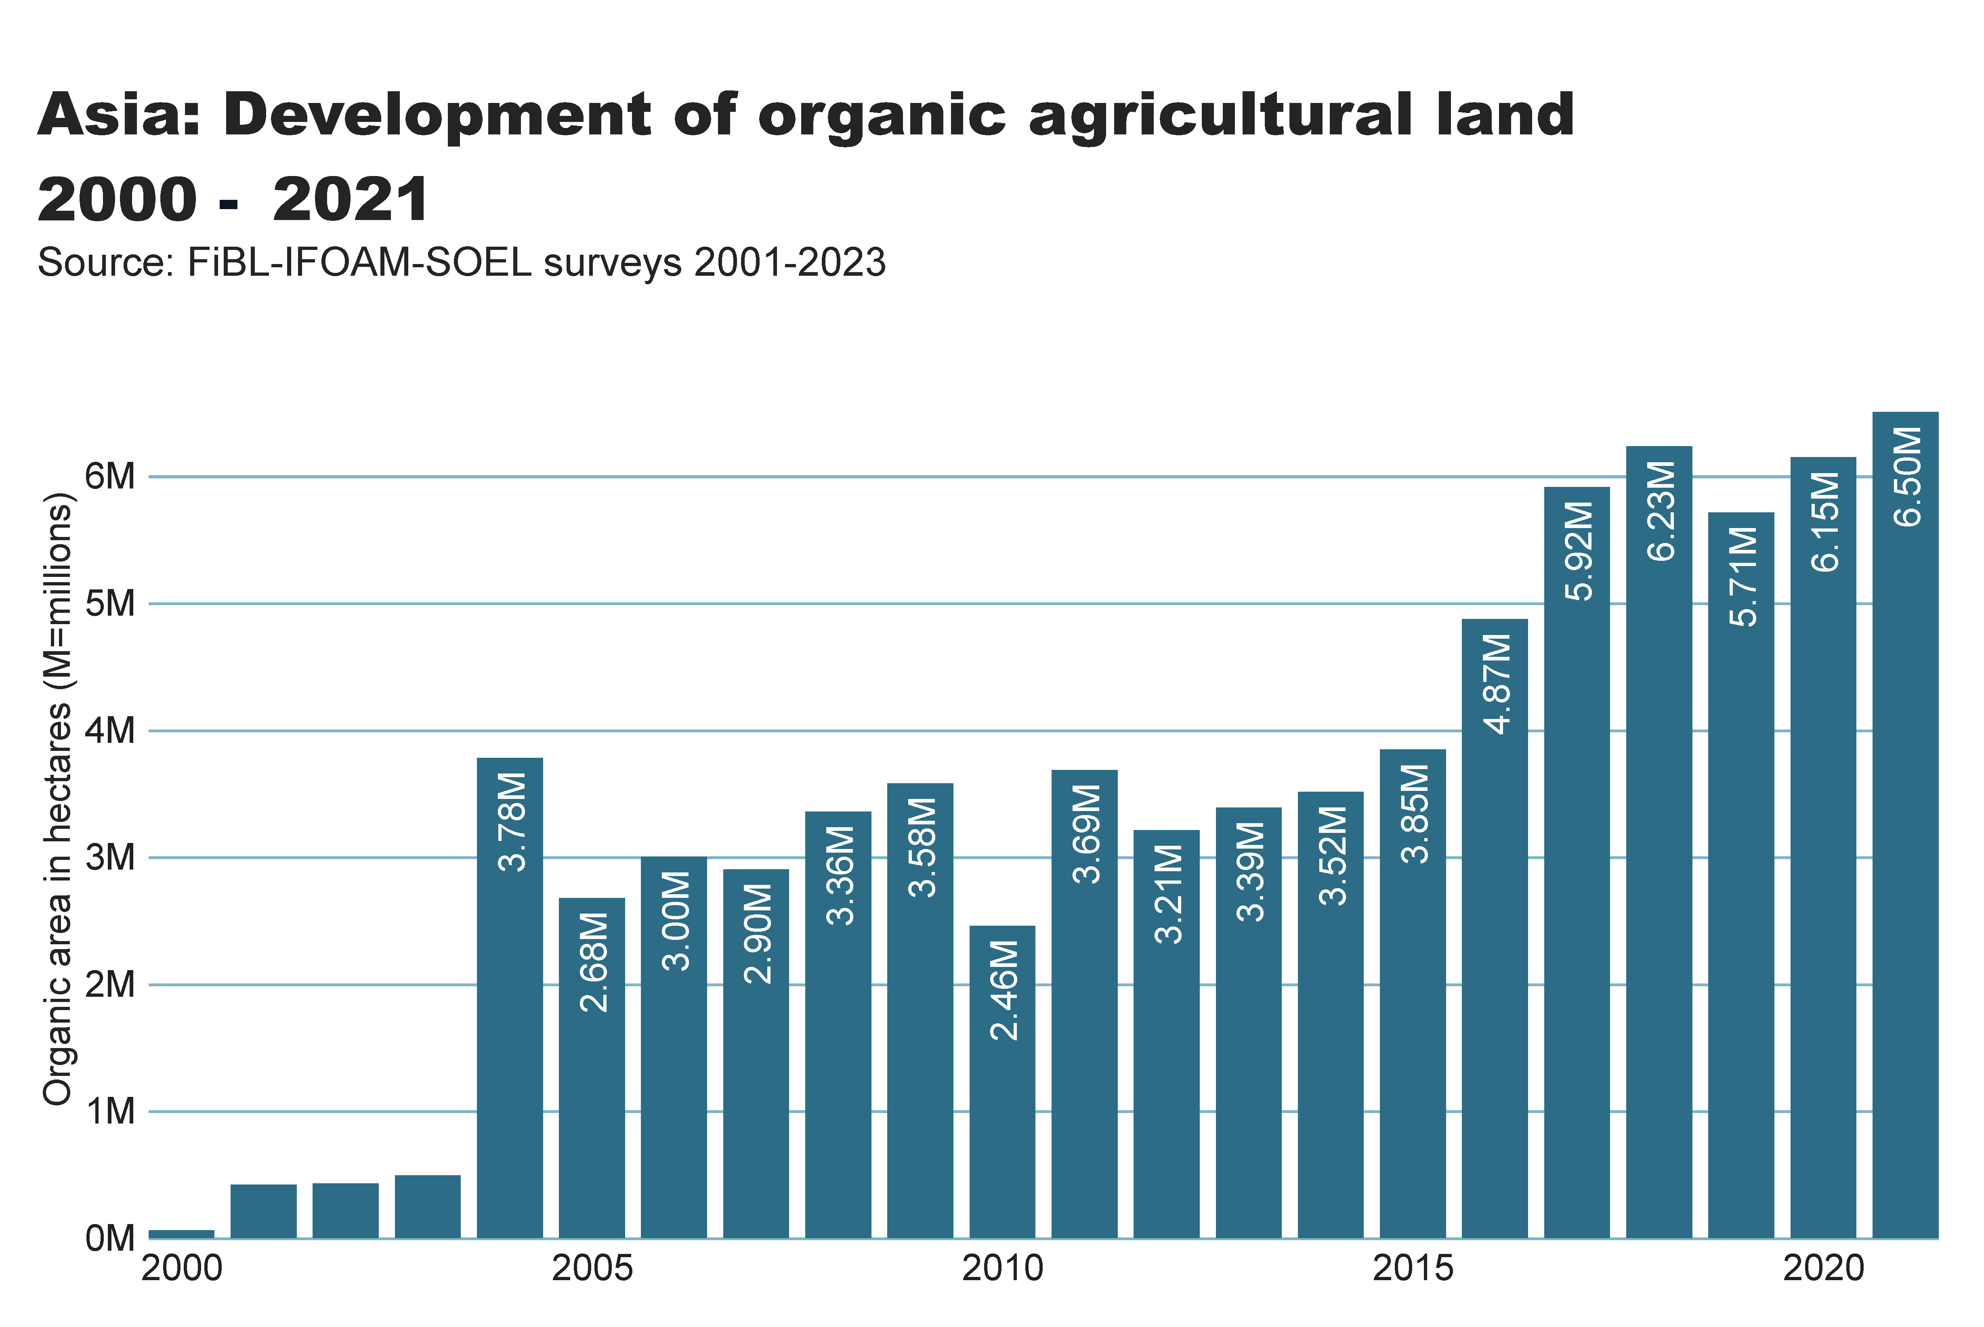
asia_land_growth
Notes:
textbox
No alt text provided
card
No alt text provided
Source: FiBL-IFOAM-SOEL surveys 2001-2022
No alt text provided

Slide 21
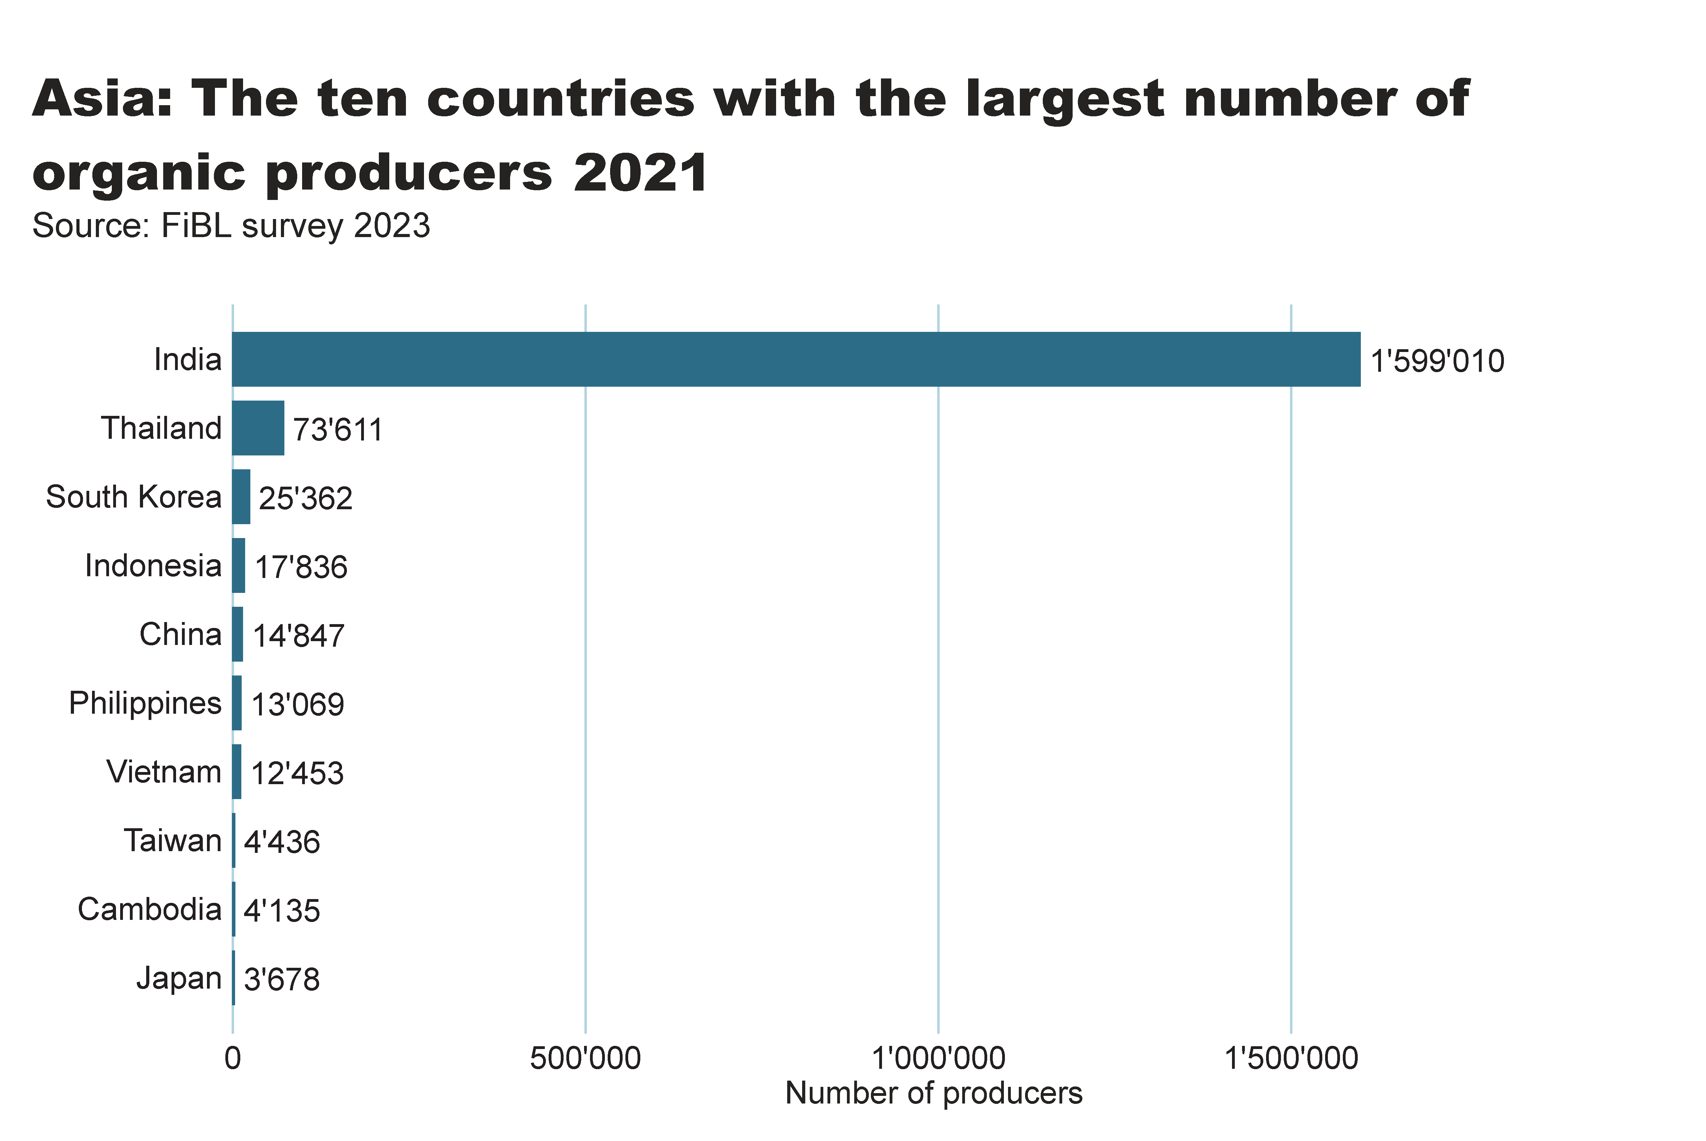
Asia_producers_country
Notes:
textbox
No alt text provided
card
No alt text provided
barChart
No alt text provided

Slide 22
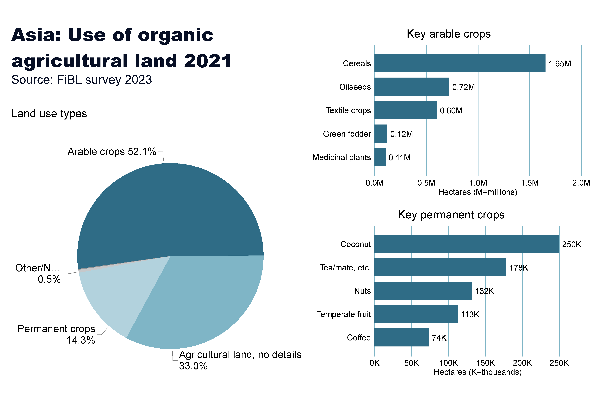
Asia_land_use
Notes:
Land use types
No alt text provided
card
No alt text provided
Key arable crops
No alt text provided
Key permanent crops
No alt text provided
textbox
No alt text provided

Slide 23
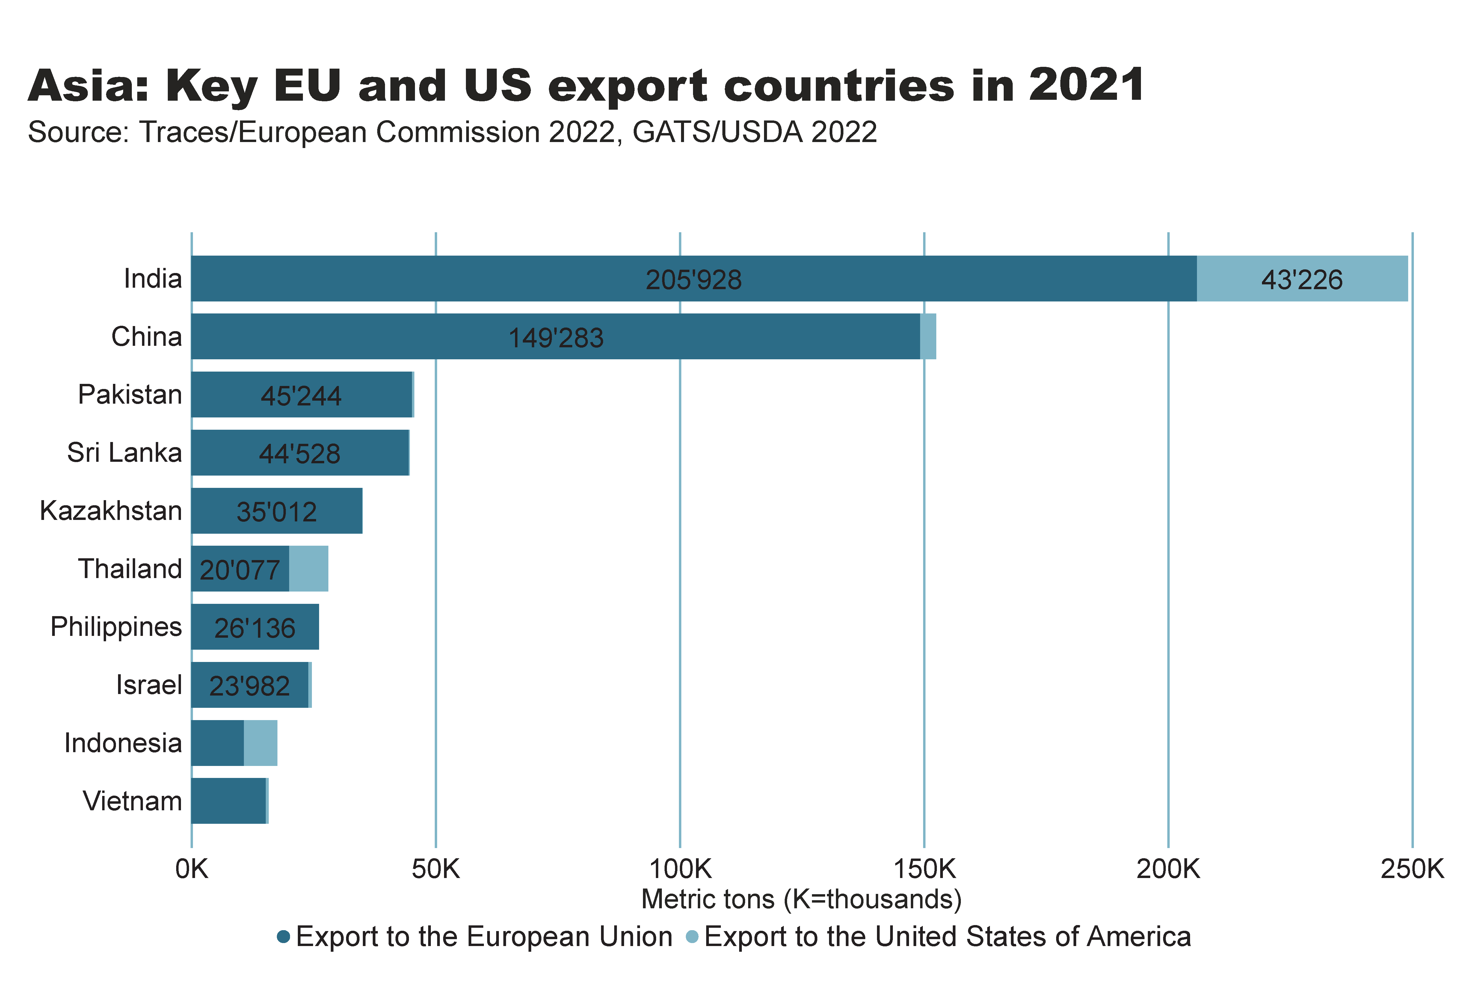
Asia_producers_country
Notes:
textbox
No alt text provided
card
No alt text provided
barChart
No alt text provided

Slide 24
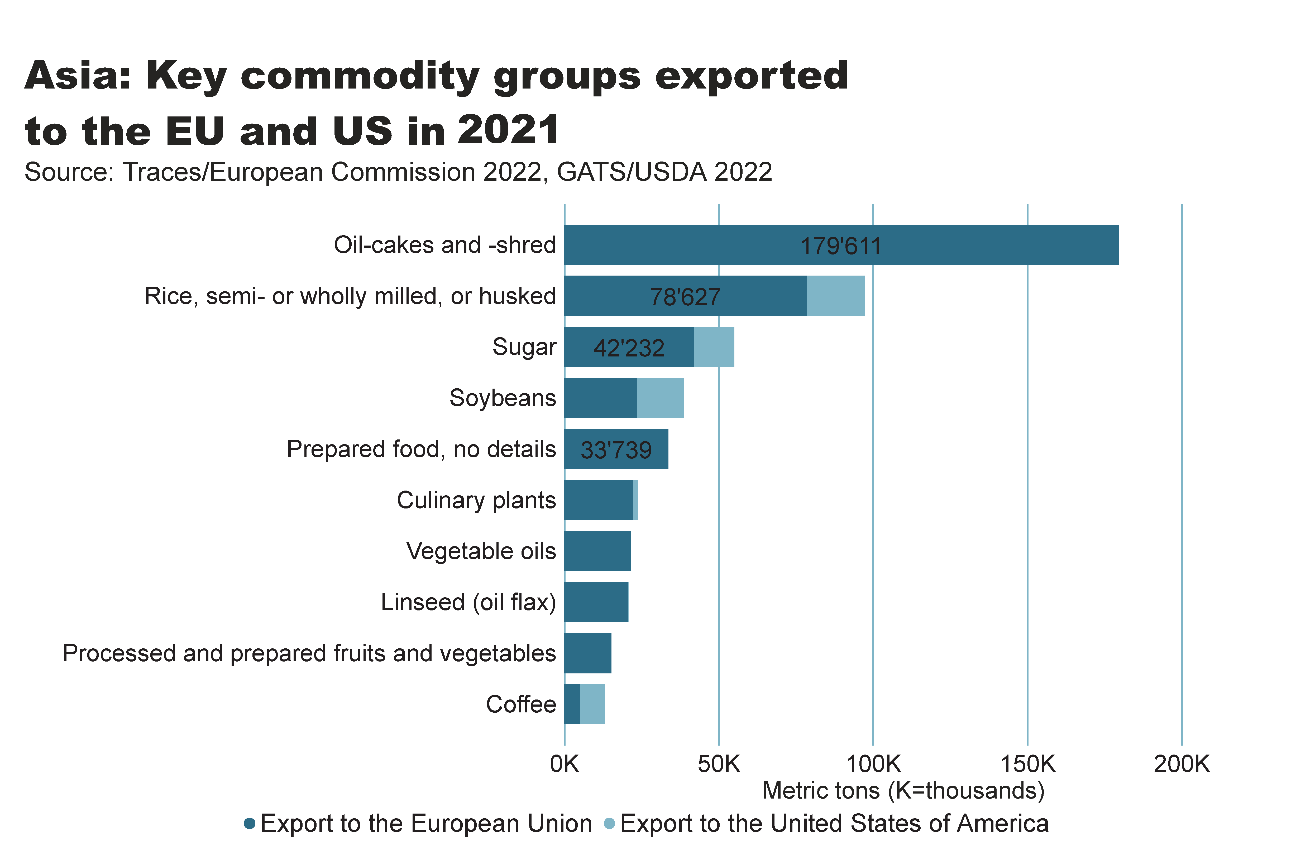
Asia_producers_country
Notes:
textbox
No alt text provided
card
No alt text provided
barChart
No alt text provided

Slide 25
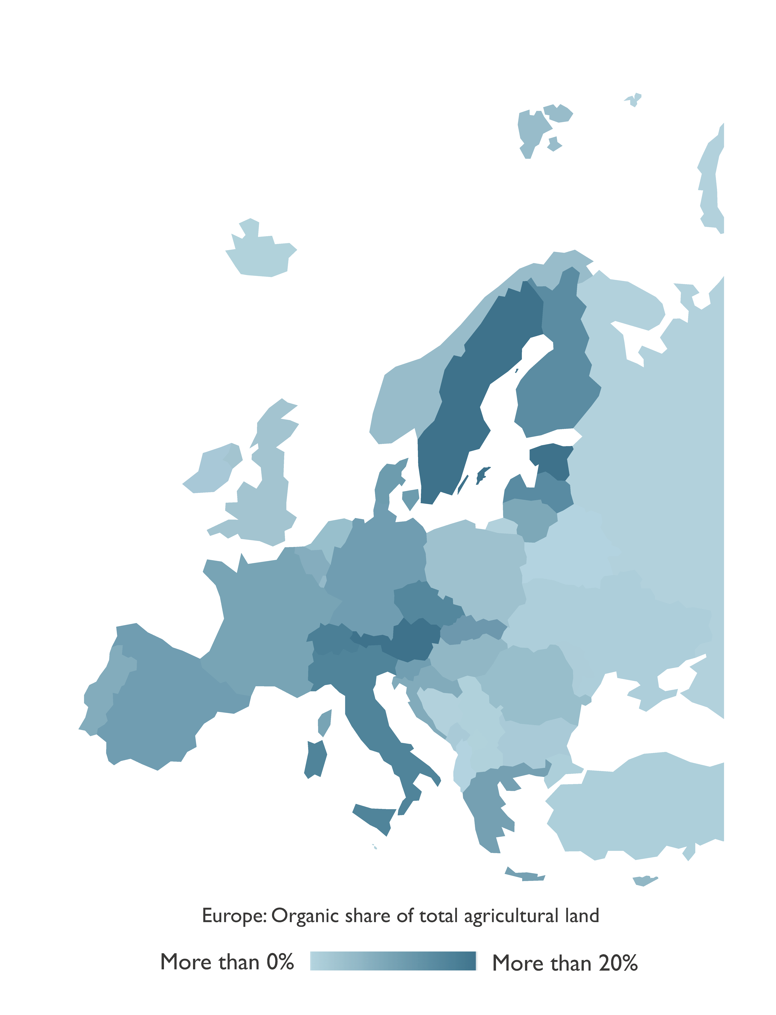
Europe: Organic agricultural land 2021
Source: FiBL survey 2023, based on national sources and Eurostat.

Slide 26
Organic agriculture in Europe: Key data 2021
As of the end of 2021, 18 million hectares of agricultural land in Europe (European Union: 15.6 million hectares) were managed organically by almost 440’000 producers (European Union: almost 380’000).
In Europe, 3.6 percent of the agricultural area was organic (European Union: 9.6 percent).
Organic farmland has increased by almost 0.8 million hectares compared to 2020.
The countries with the largest organic agricultural areas were France (2.8 million hectares), Spain (2.6 million hectares) and Italy (2.2 million hectares).
In 15 countries, at least 10 percent of the farmland was organic: Liechtenstein had the lead (40.2 percent), followed by Austria (26.5 percent) and Estonia (23.0 percent).
Retail sales of organic products totalled 54.5 billion euros in 202´1 (European Union: 46.7 billion euros), an increase of 4 percent compared to 2021.
The largest market for organic products in 2021 was Germany, with retail sales of 15.9 billion euros, followed by France (12.7 billion euros) and Italy (3.9 billion euros)
In Europe, 43 countries have legislation on organic agriculture.
Source: FiBL survey 2023, based on national sources and Eurostat.

Slide 27
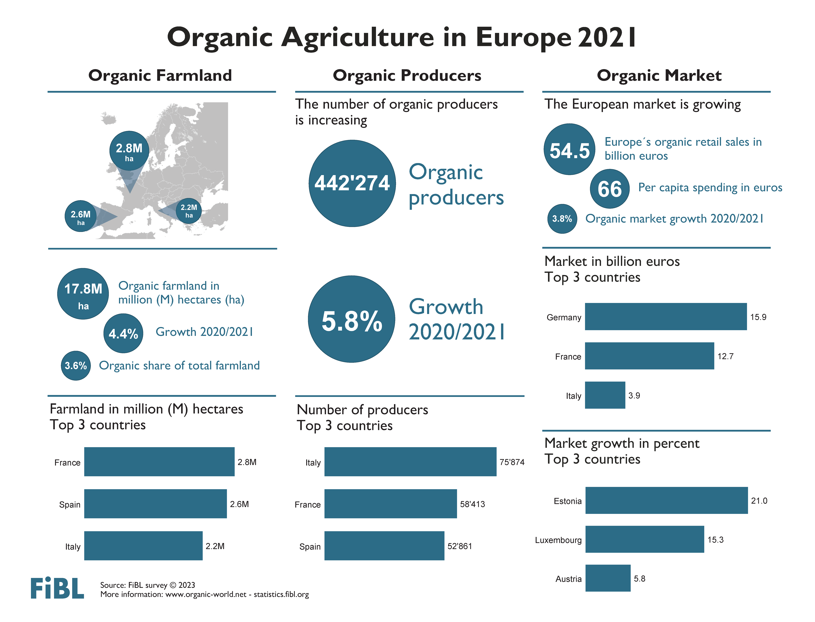

Slide 28
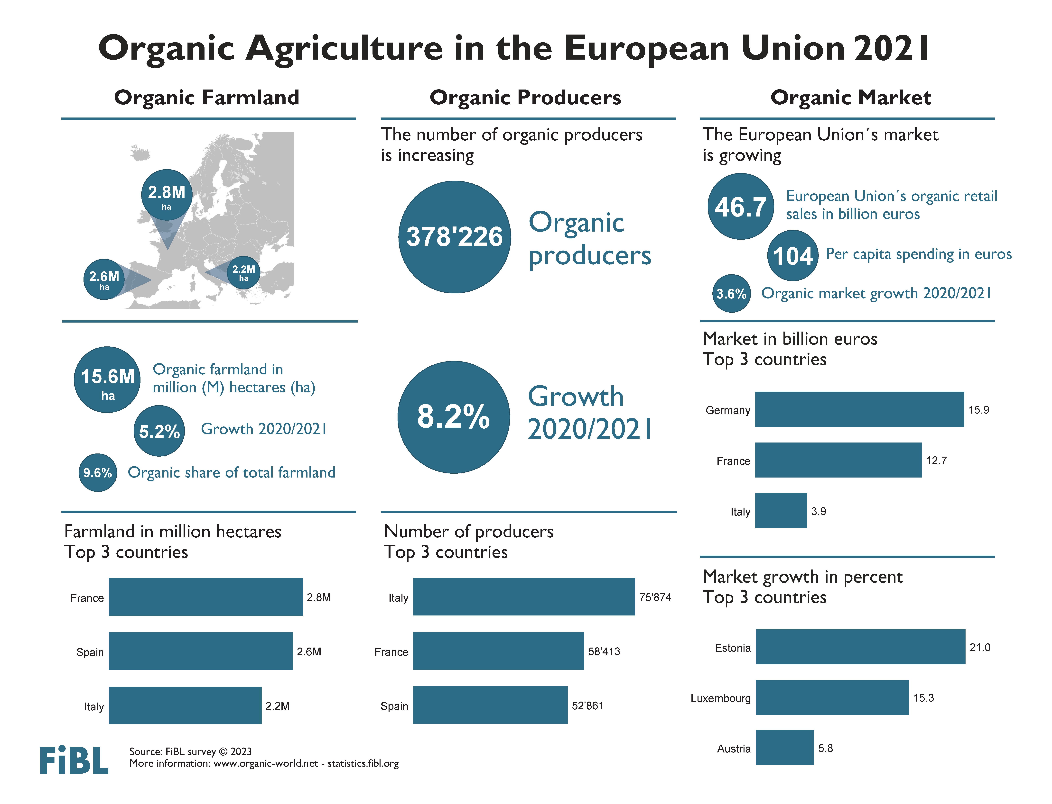

Slide 29
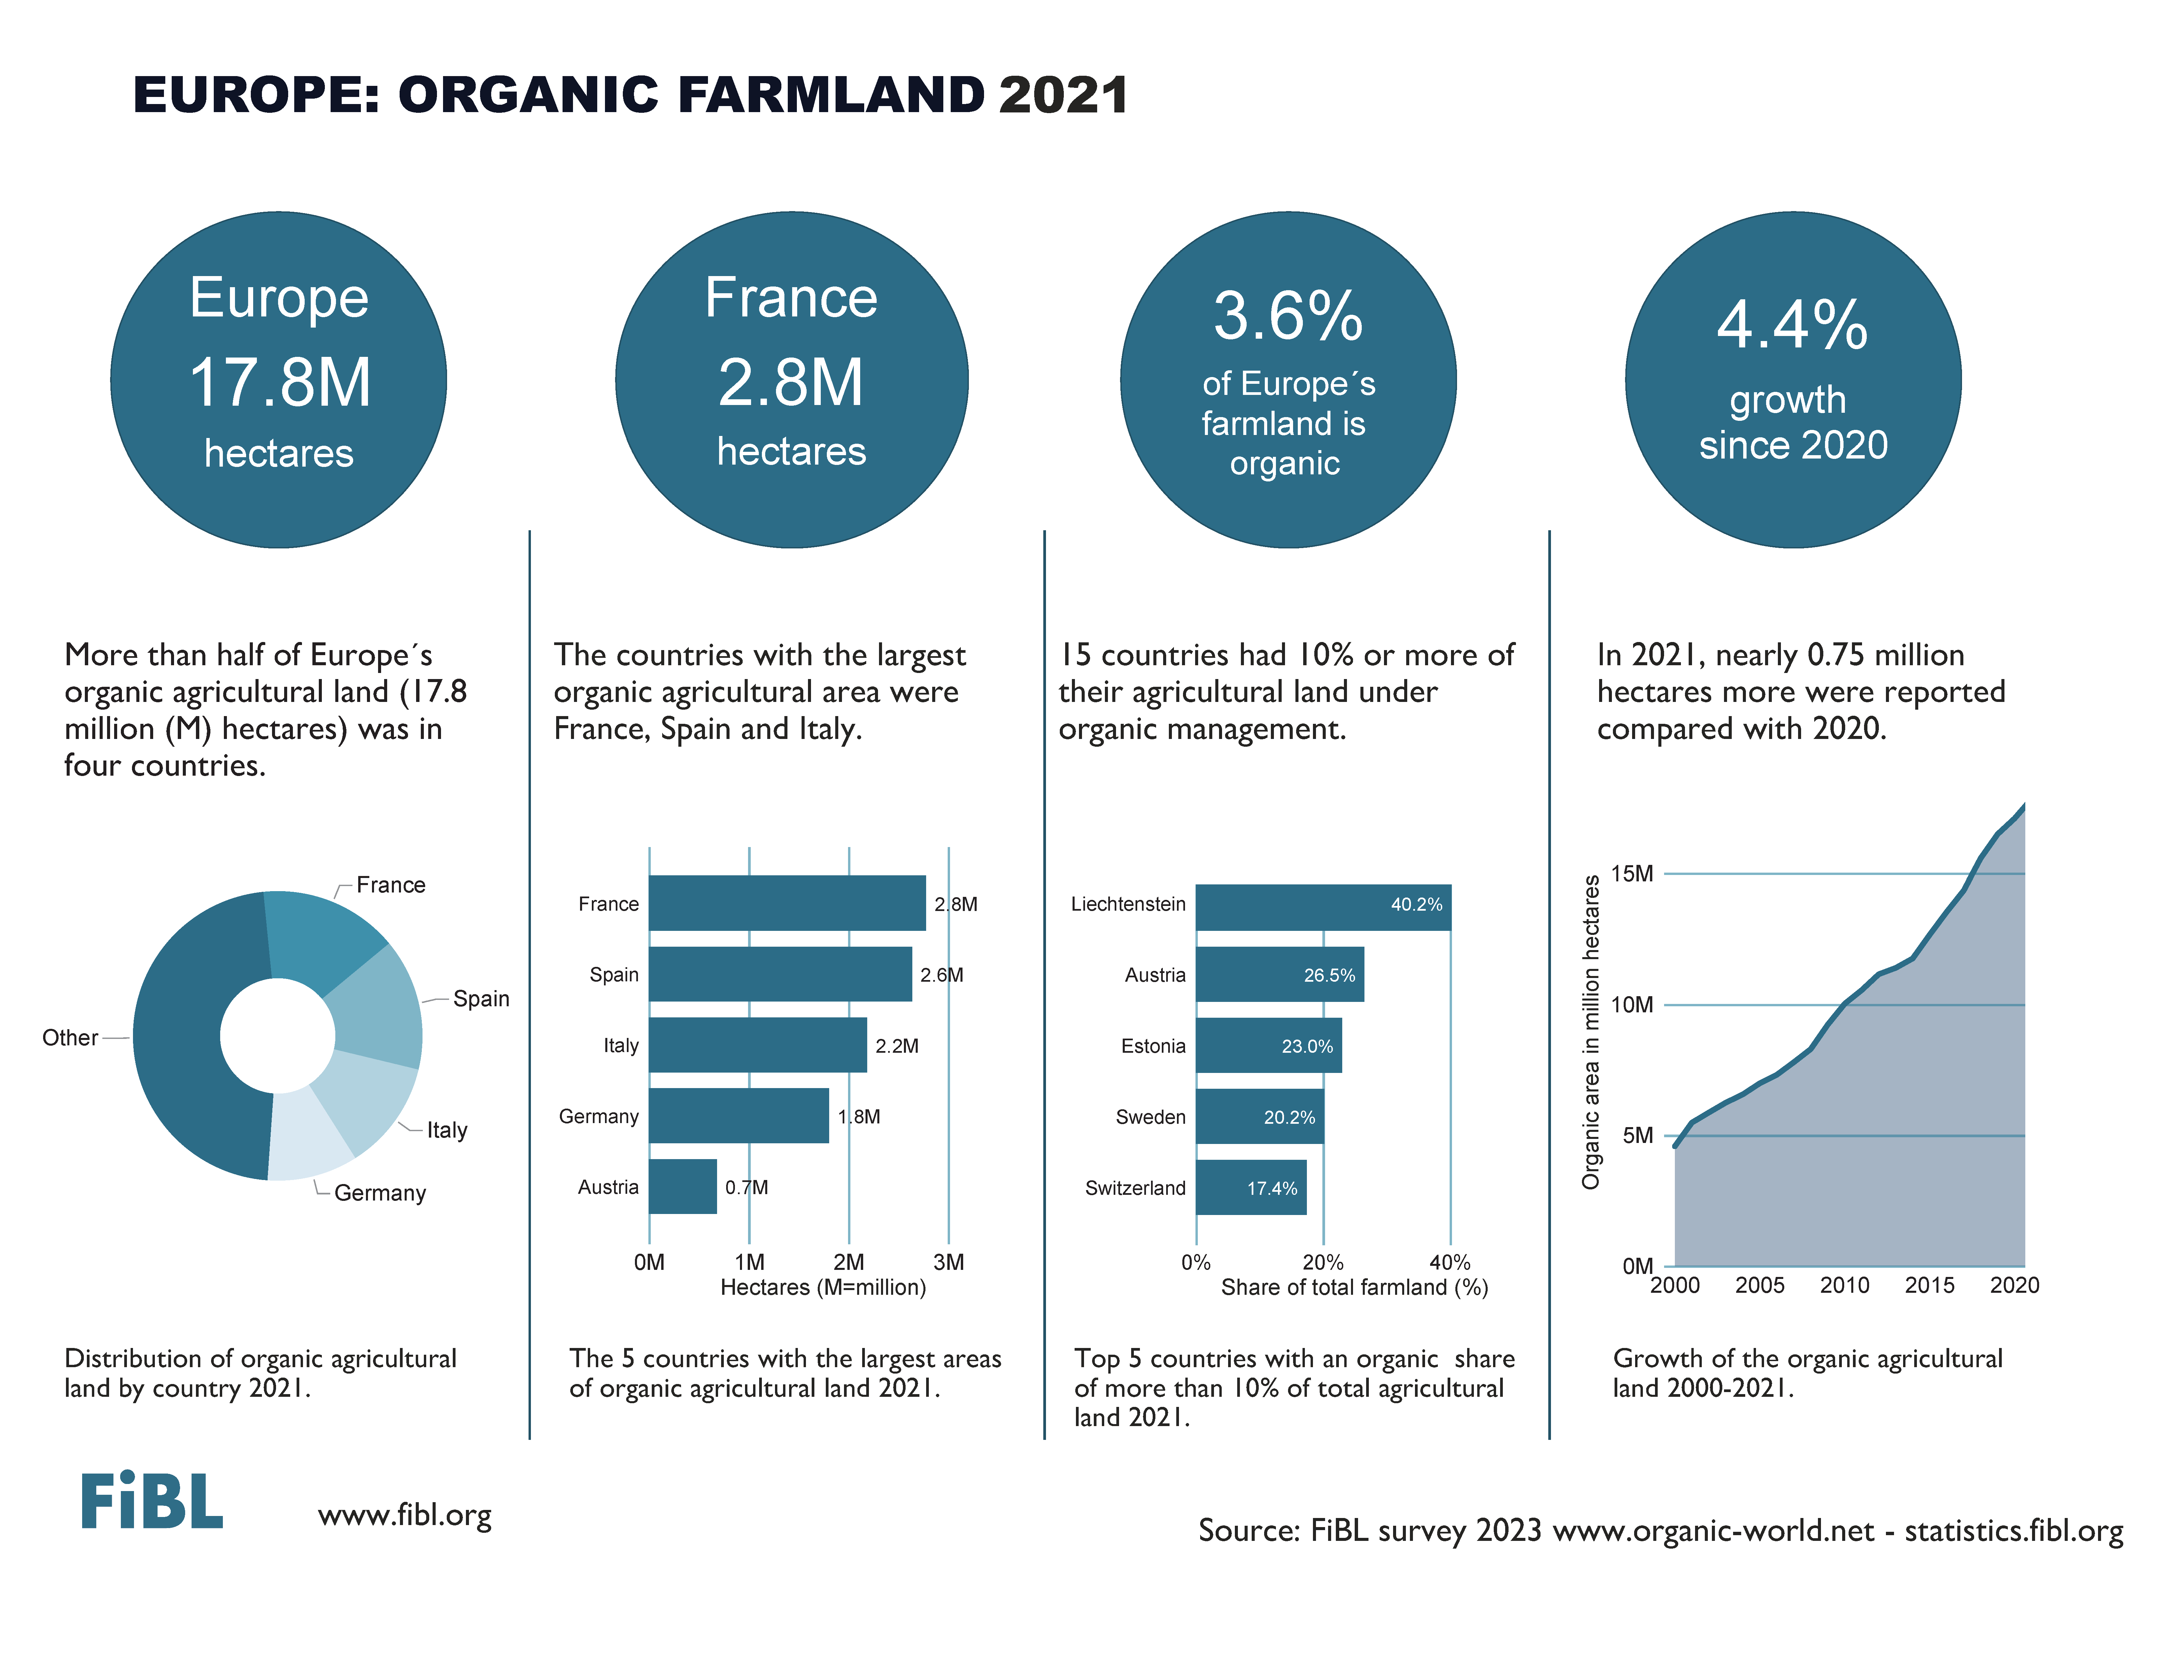

Slide 30
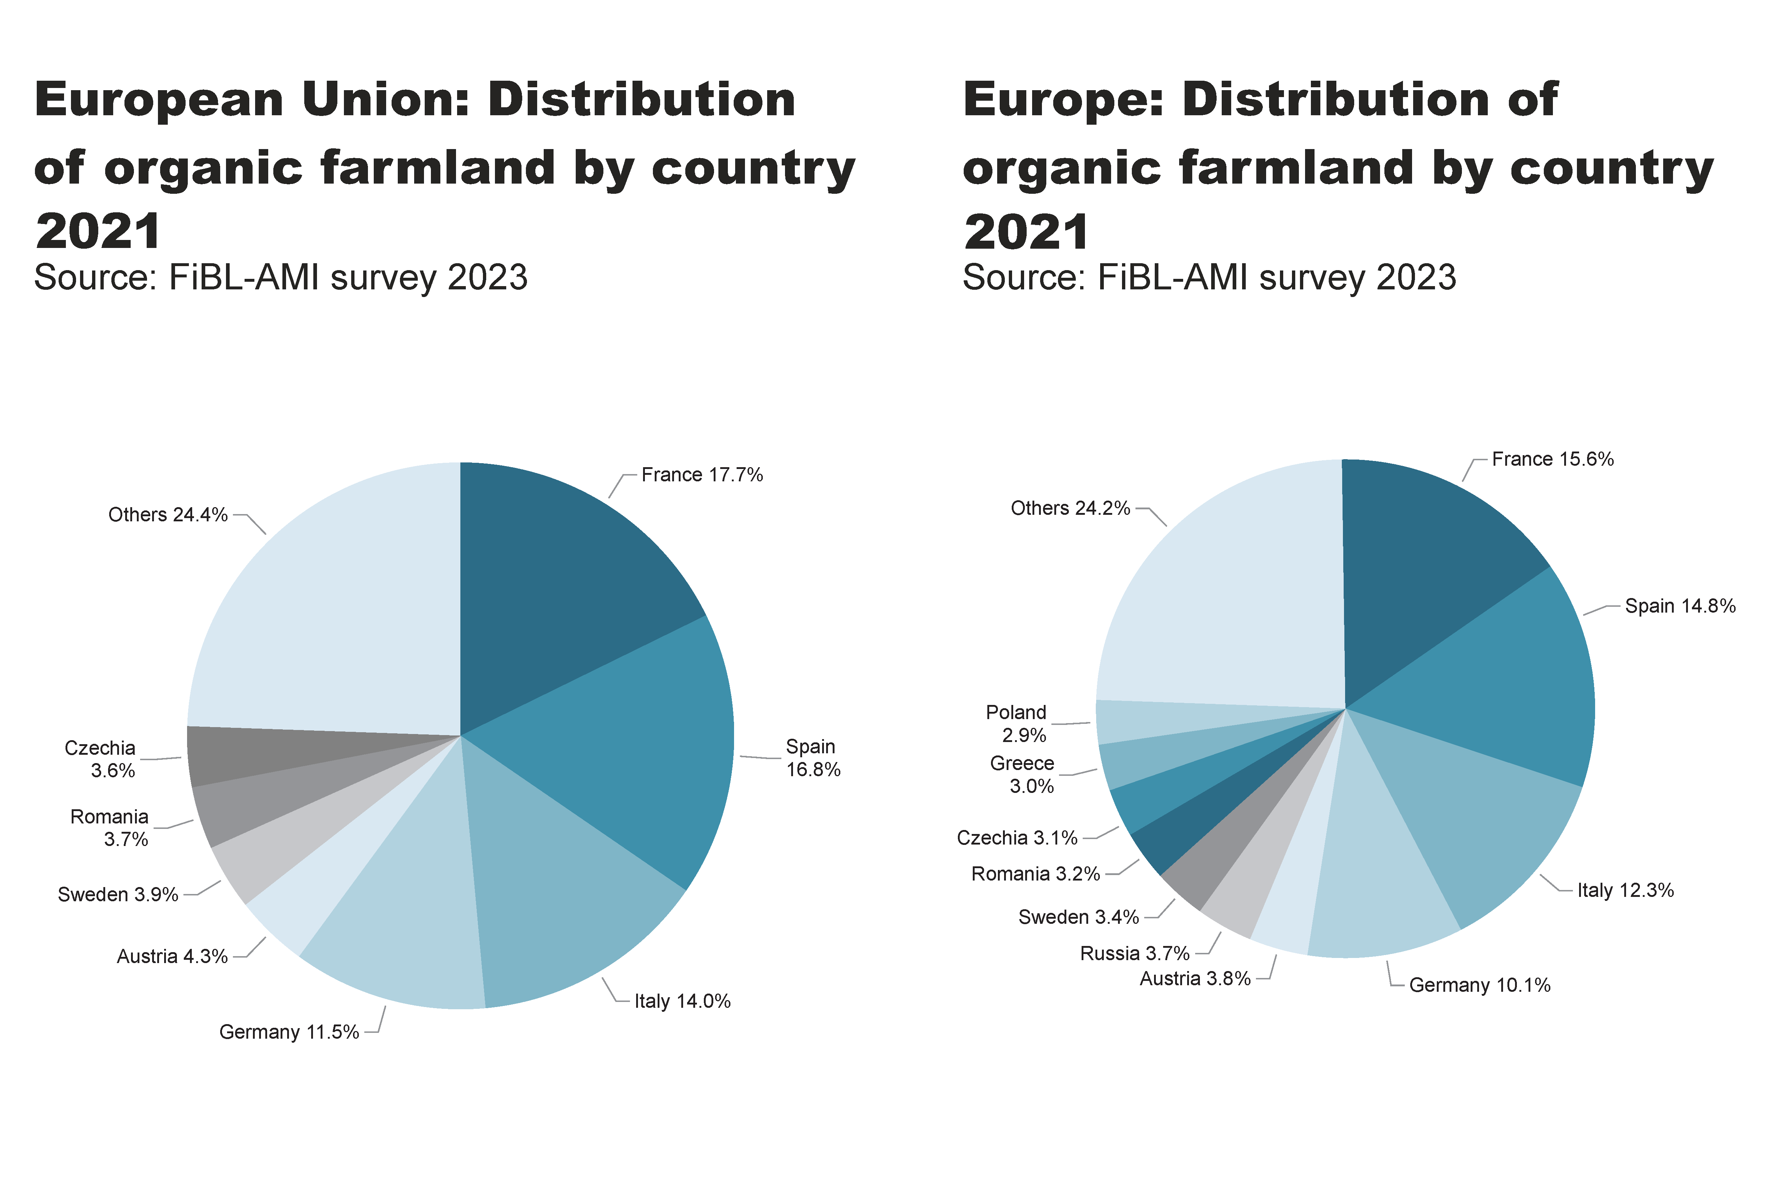
EU_Europe_land_distribution_country
Notes:
pieChart
No alt text provided
textbox
No alt text provided
card
No alt text provided
pieChart
No alt text provided
textbox
No alt text provided
card
No alt text provided

Slide 31
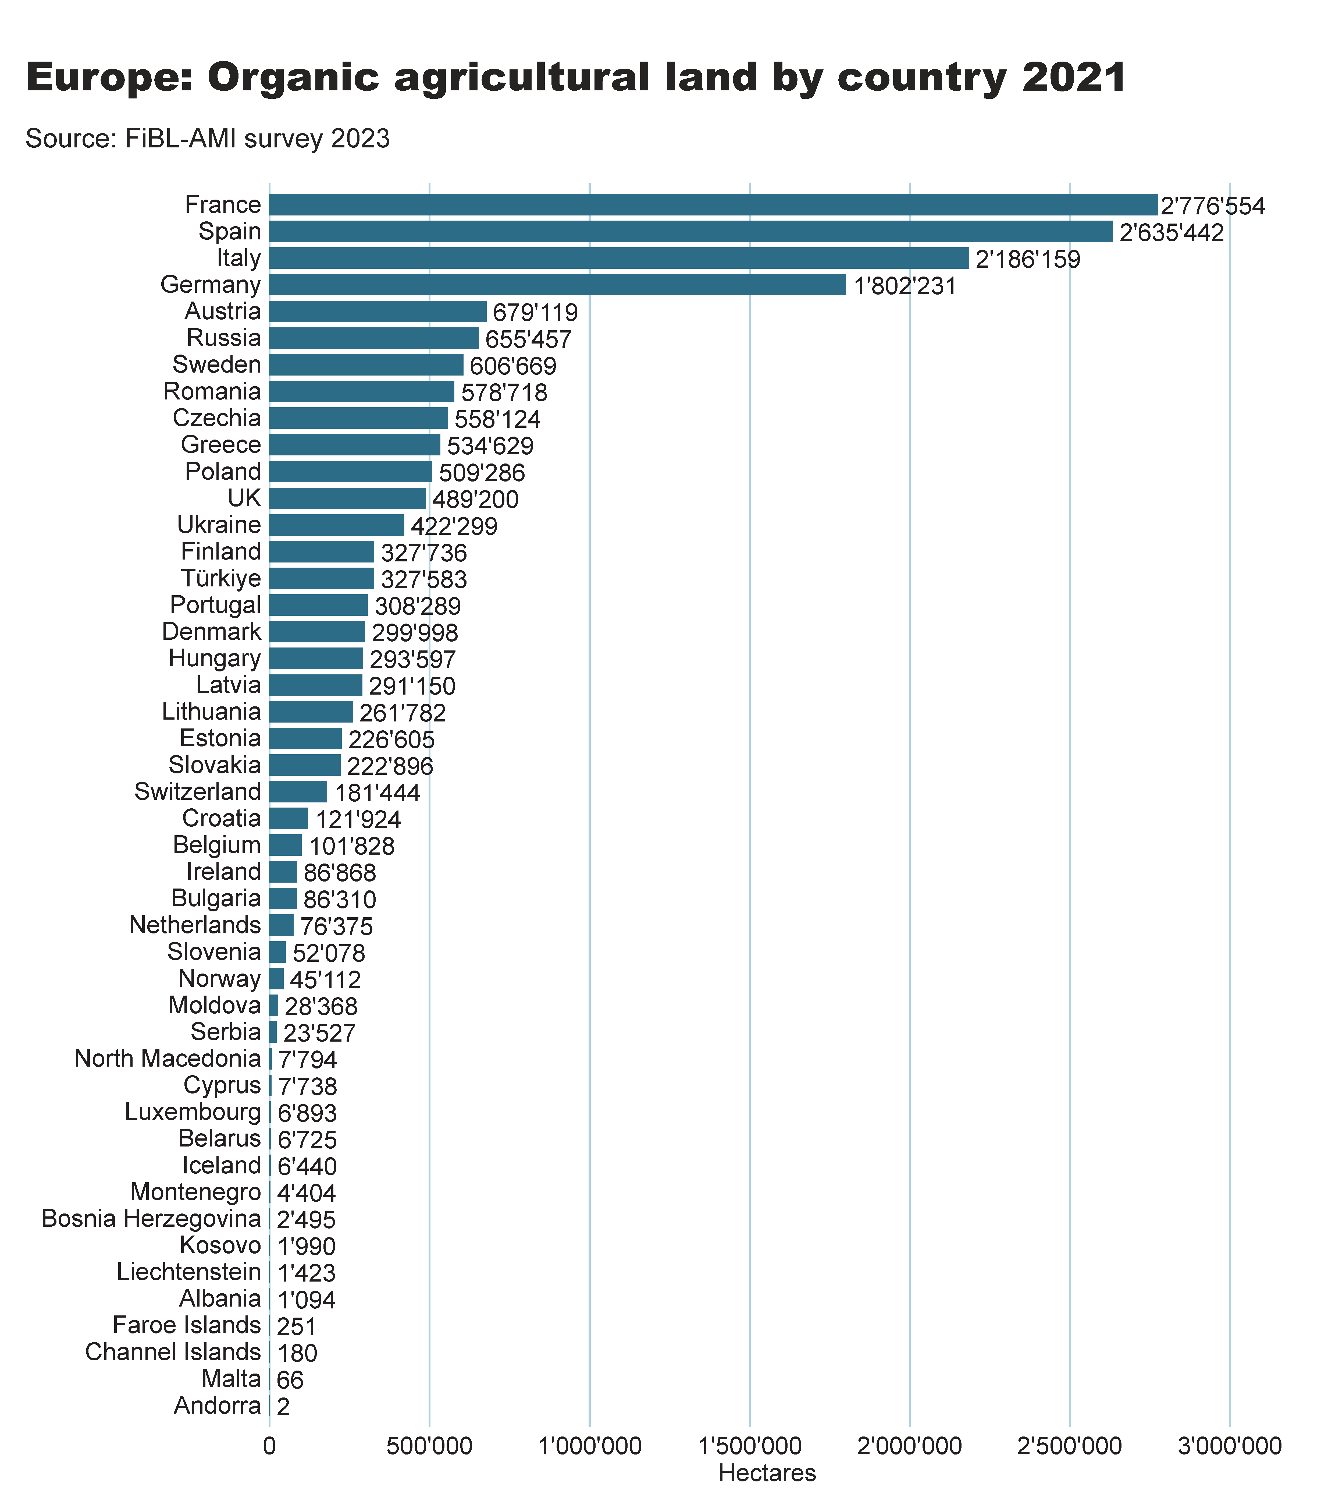
Europe_land_by_country
Notes:
clusteredBarChart
No alt text provided
textbox
No alt text provided
card
No alt text provided

Slide 32
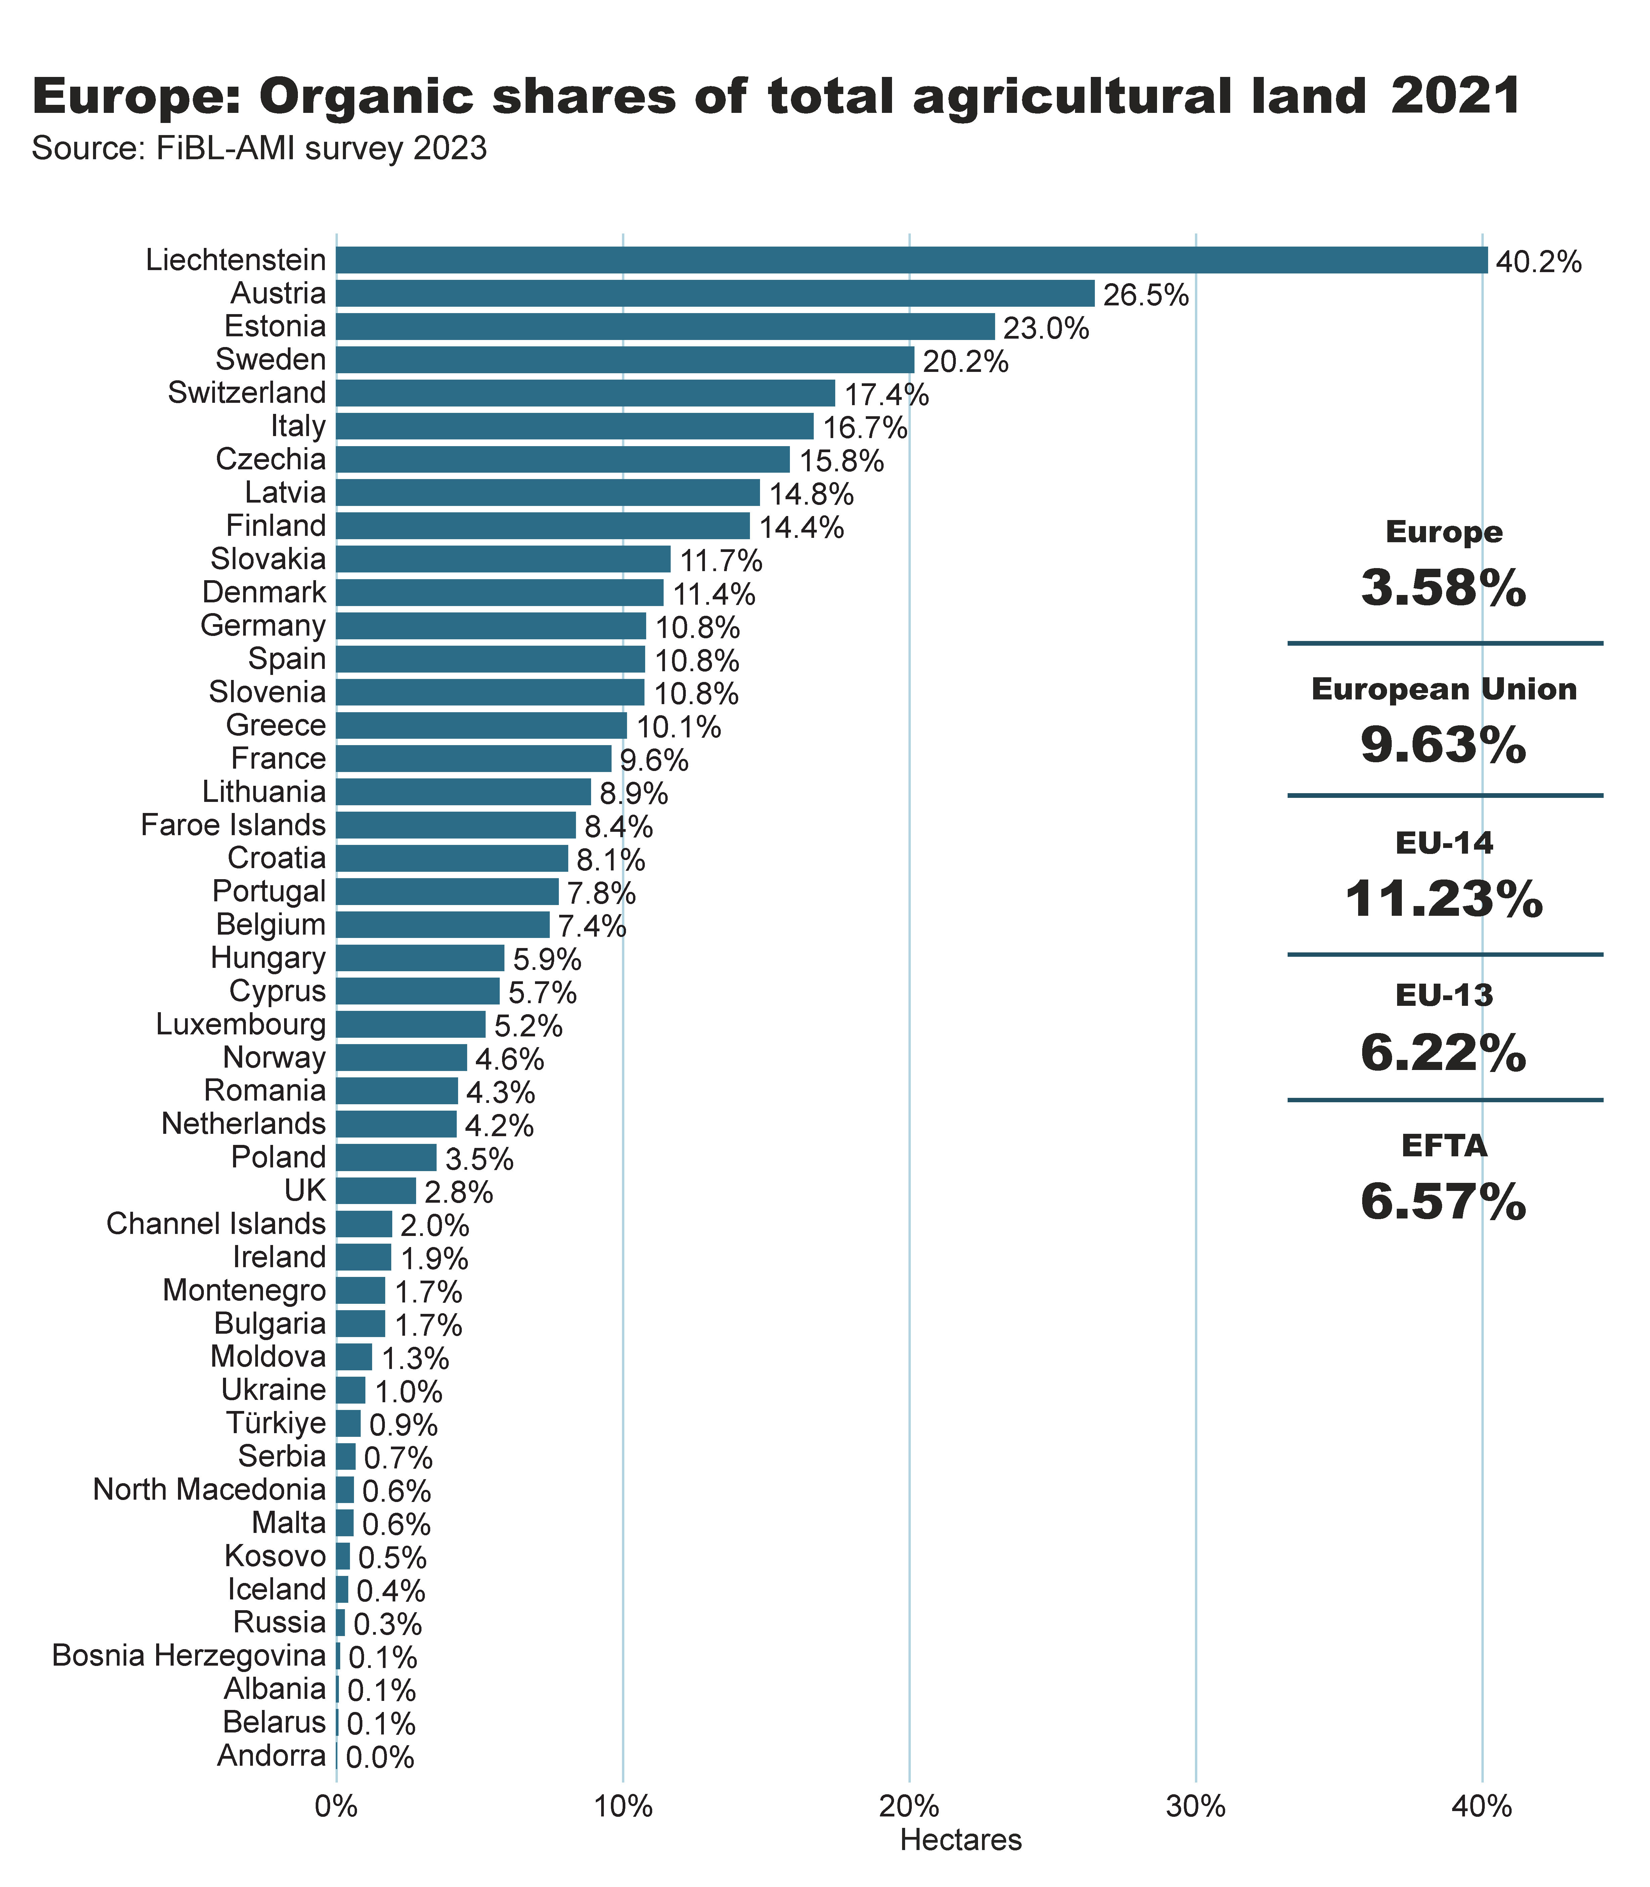
Europe_land_share_country
Notes:
clusteredBarChart
No alt text provided
textbox
No alt text provided
card
No alt text provided
European Union
No alt text provided
Europe
No alt text provided
EFTA
No alt text provided
EU-14
No alt text provided
EU-13
No alt text provided
shape
No alt text provided
shape
No alt text provided
shape
No alt text provided
shape
No alt text provided

Slide 33
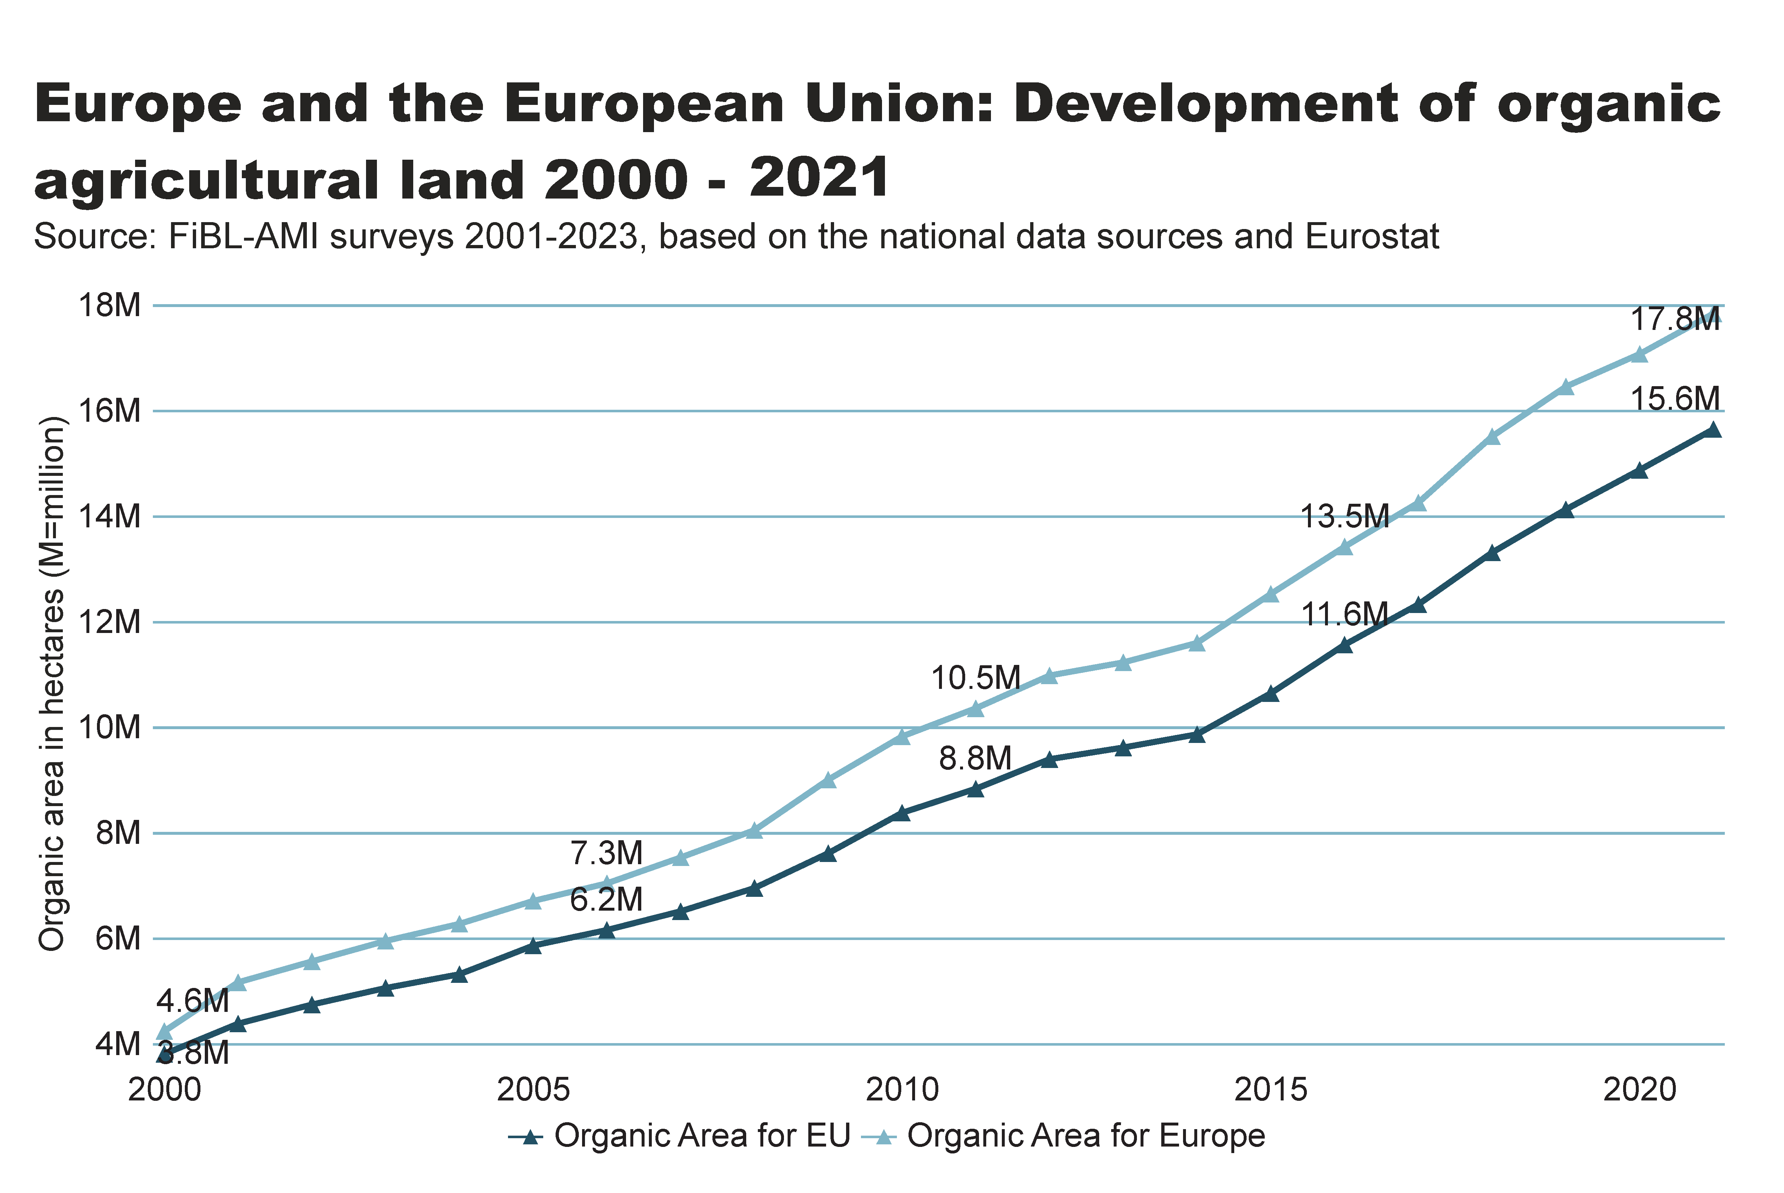
Europe_EU_growth_land
Notes:
textbox
No alt text provided
lineChart
No alt text provided
card
No alt text provided

Slide 34
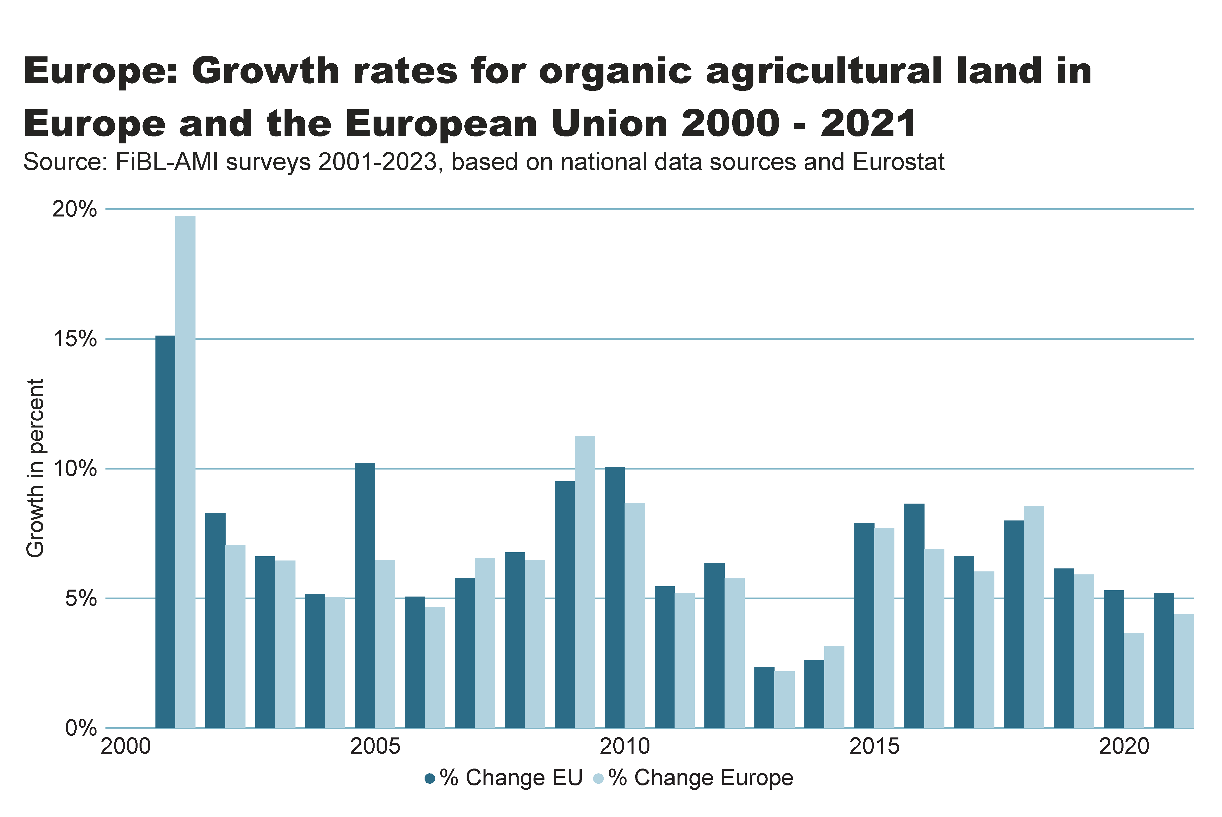
Europe_growth_percent
Notes:
textbox
No alt text provided
clusteredColumnChart
No alt text provided
card
No alt text provided

Slide 35
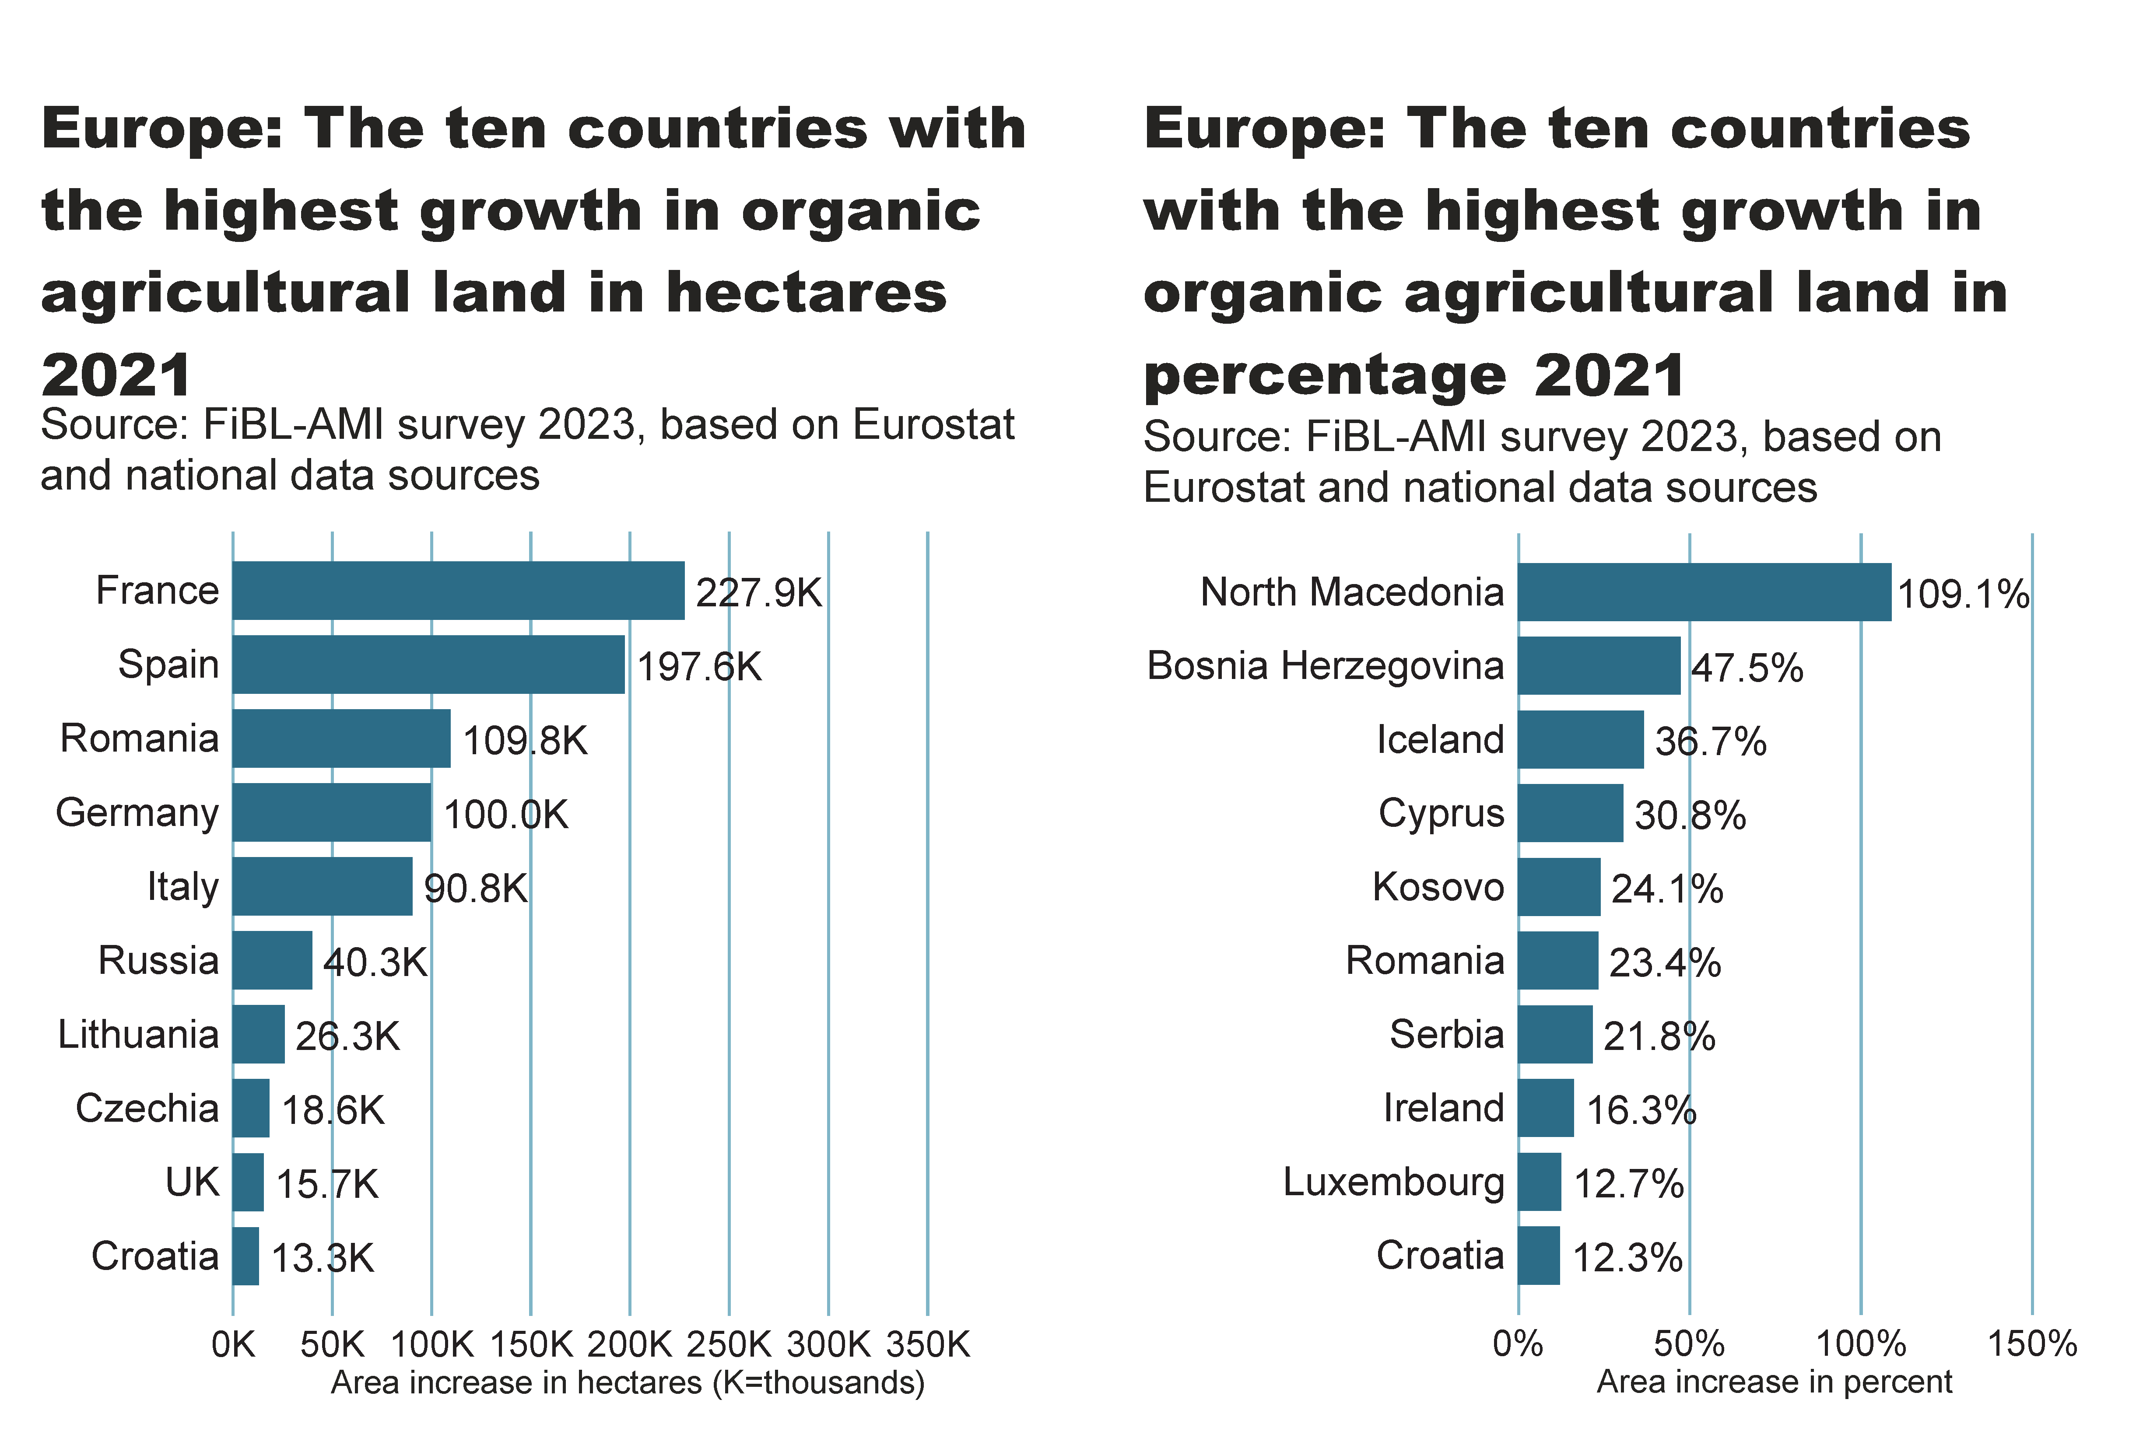
Europe_top10_land_growth_area+share
Notes:
textbox
No alt text provided
card
No alt text provided
barChart
No alt text provided
textbox
No alt text provided
card
No alt text provided
barChart
No alt text provided

Slide 36
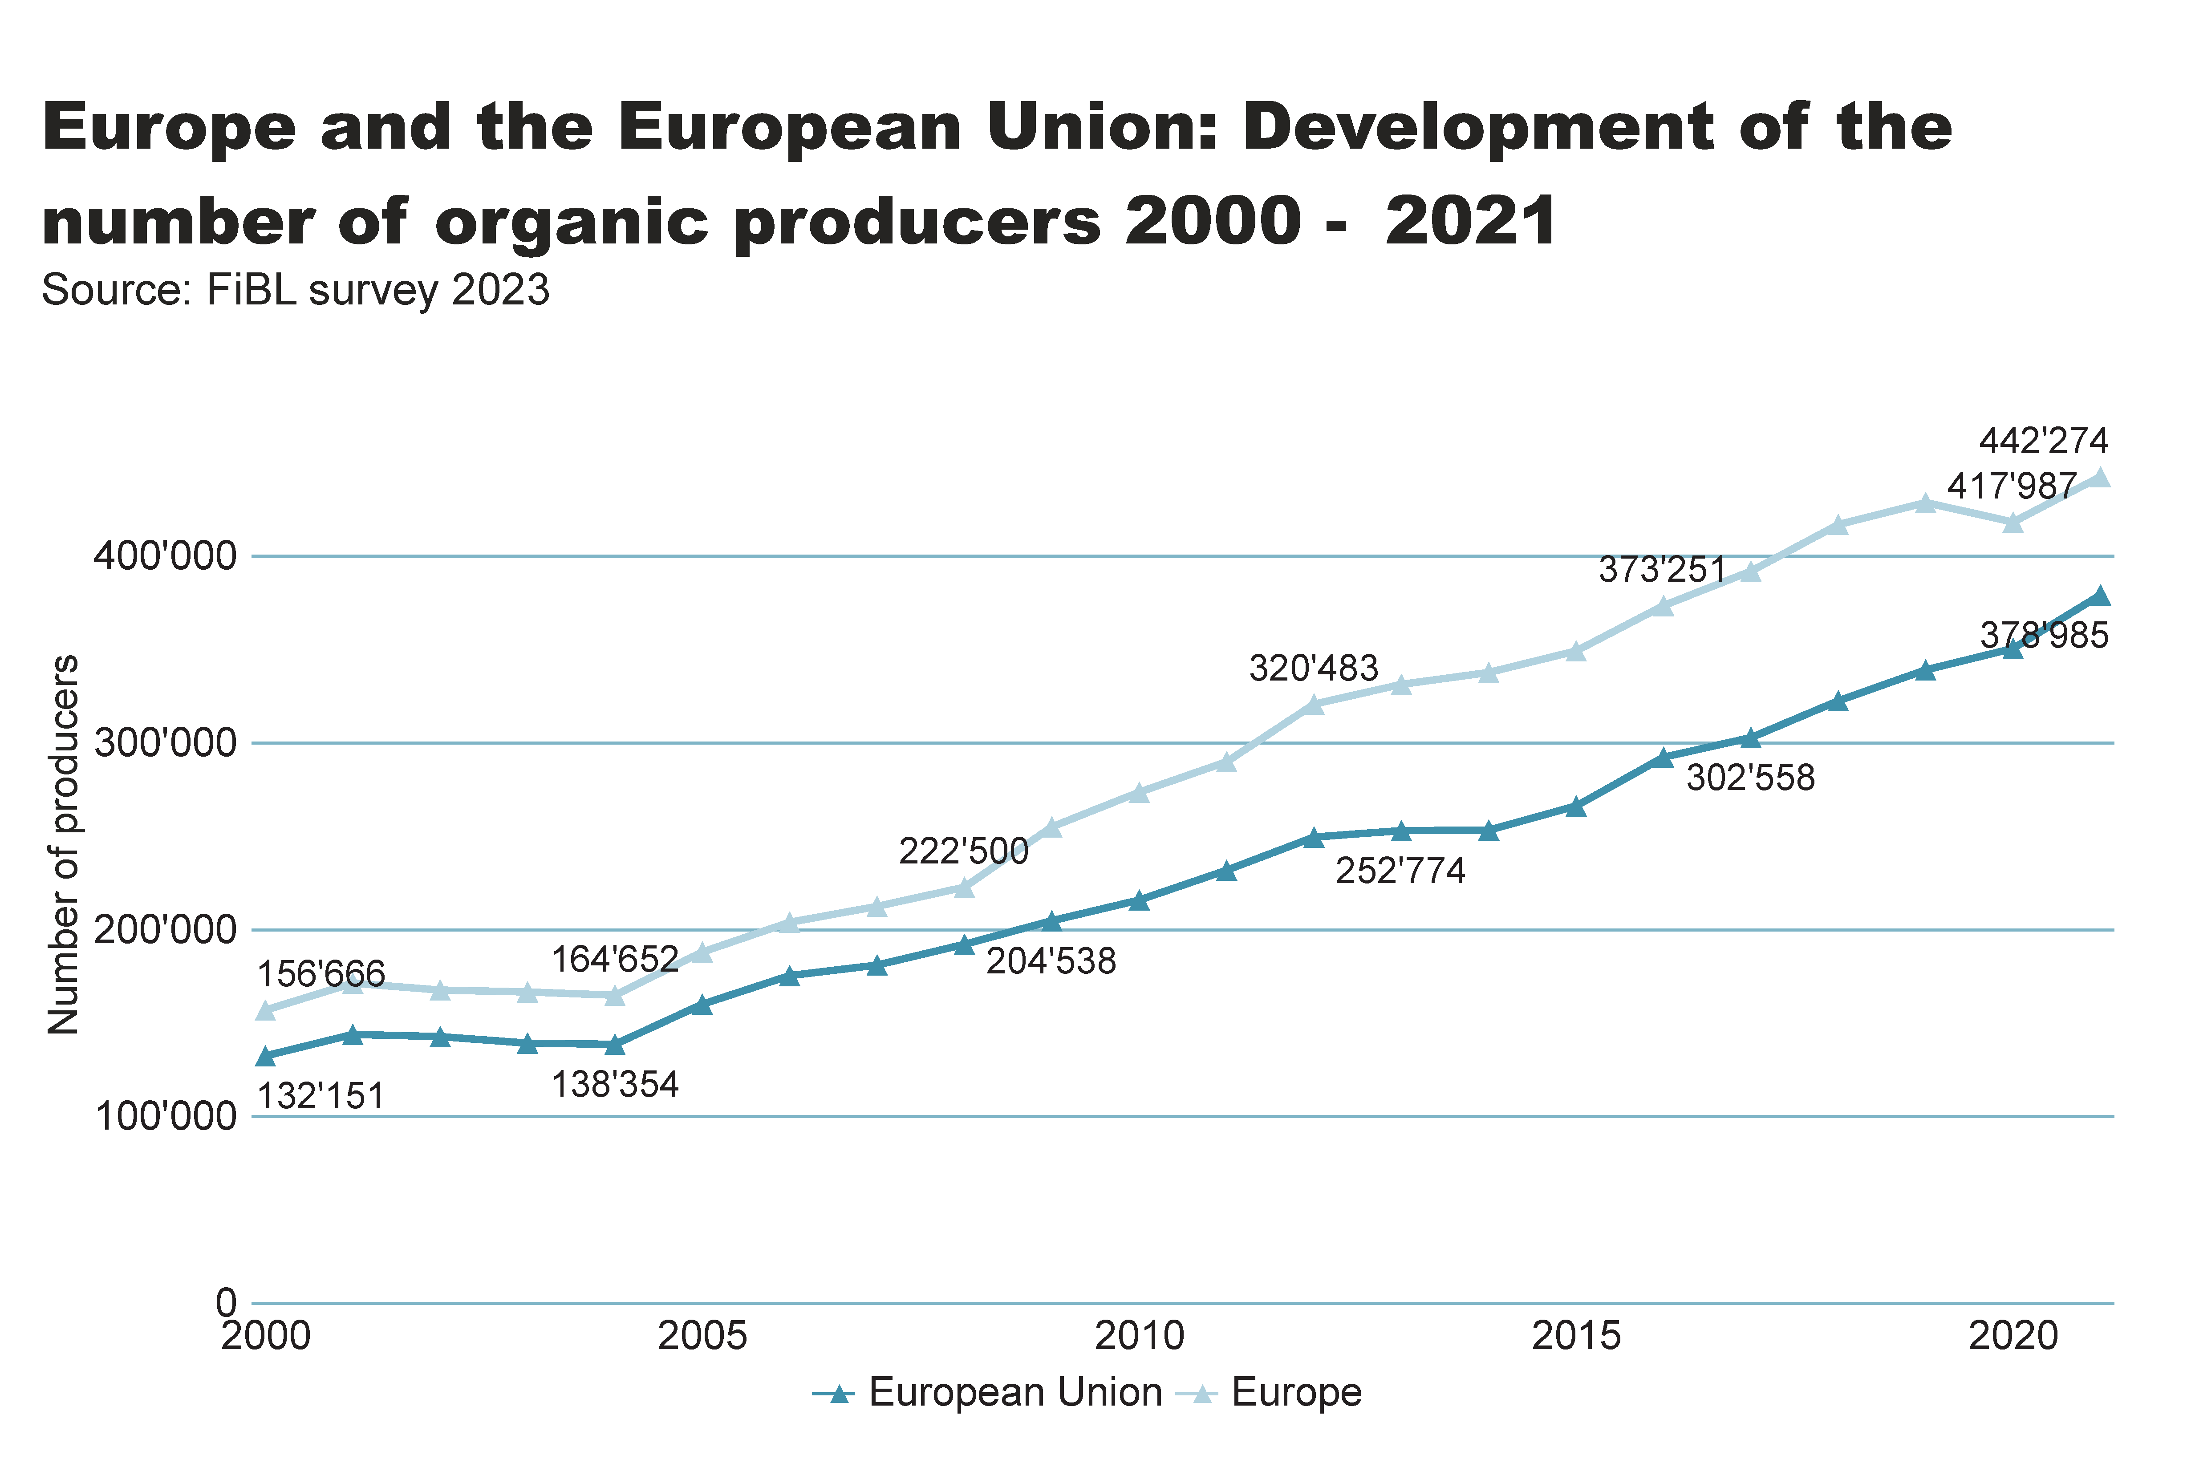
Europe_EU_growth_producers
Notes:
textbox
No alt text provided
lineChart
No alt text provided
card
No alt text provided

Slide 37
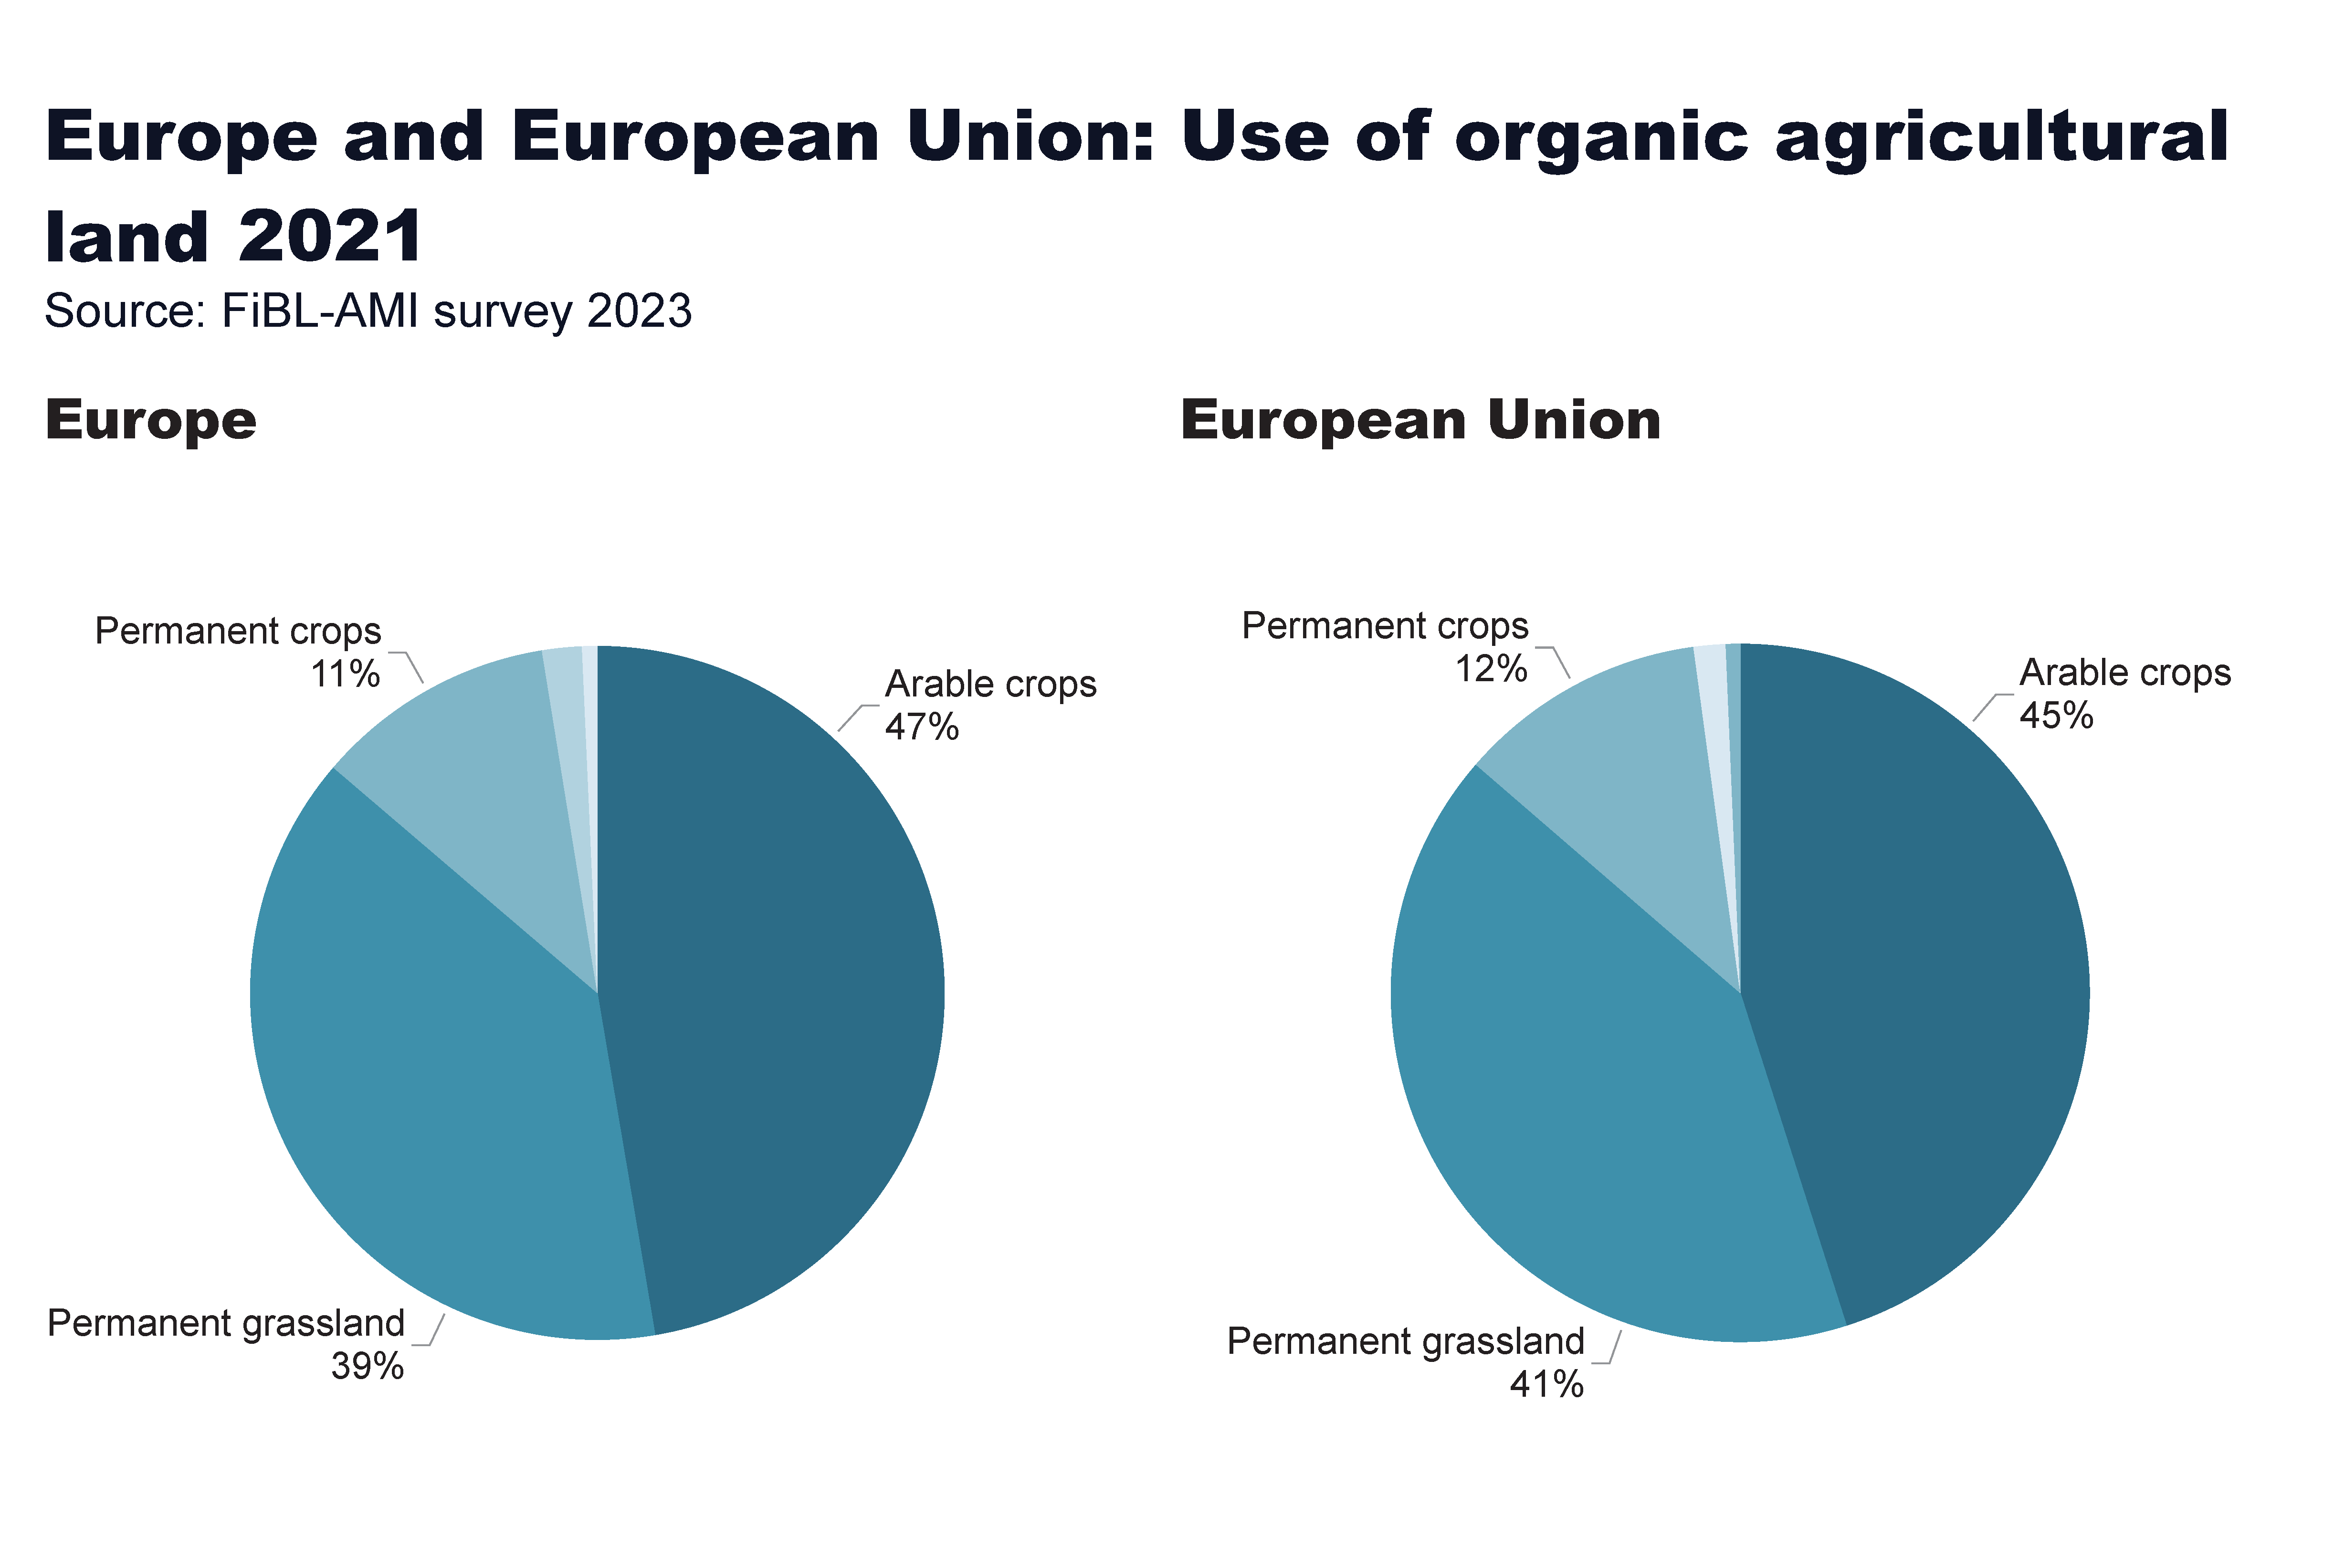
Europe_land_use
Notes:
European Union
No alt text provided
card
No alt text provided
Europe
No alt text provided
textbox
No alt text provided

Slide 38
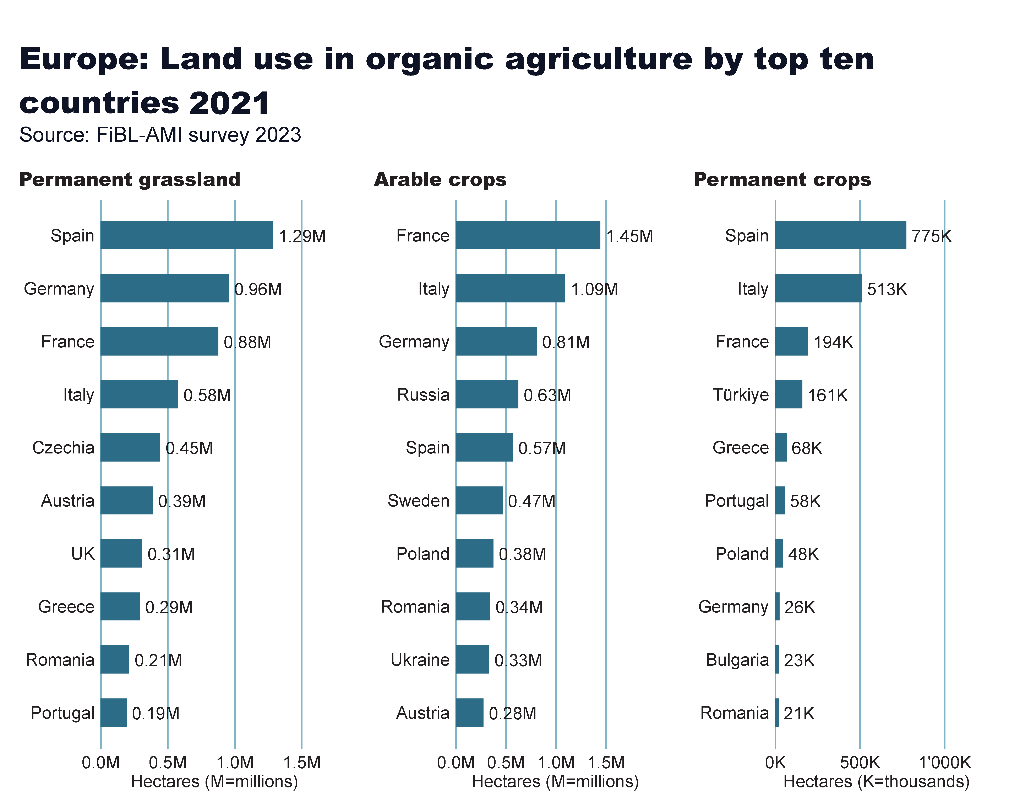
Europe_land_use_by_culture
Notes:
Arable crops
No alt text provided
textbox
No alt text provided
card
No alt text provided
Permanent crops
No alt text provided
Permanent grassland
No alt text provided

Slide 39
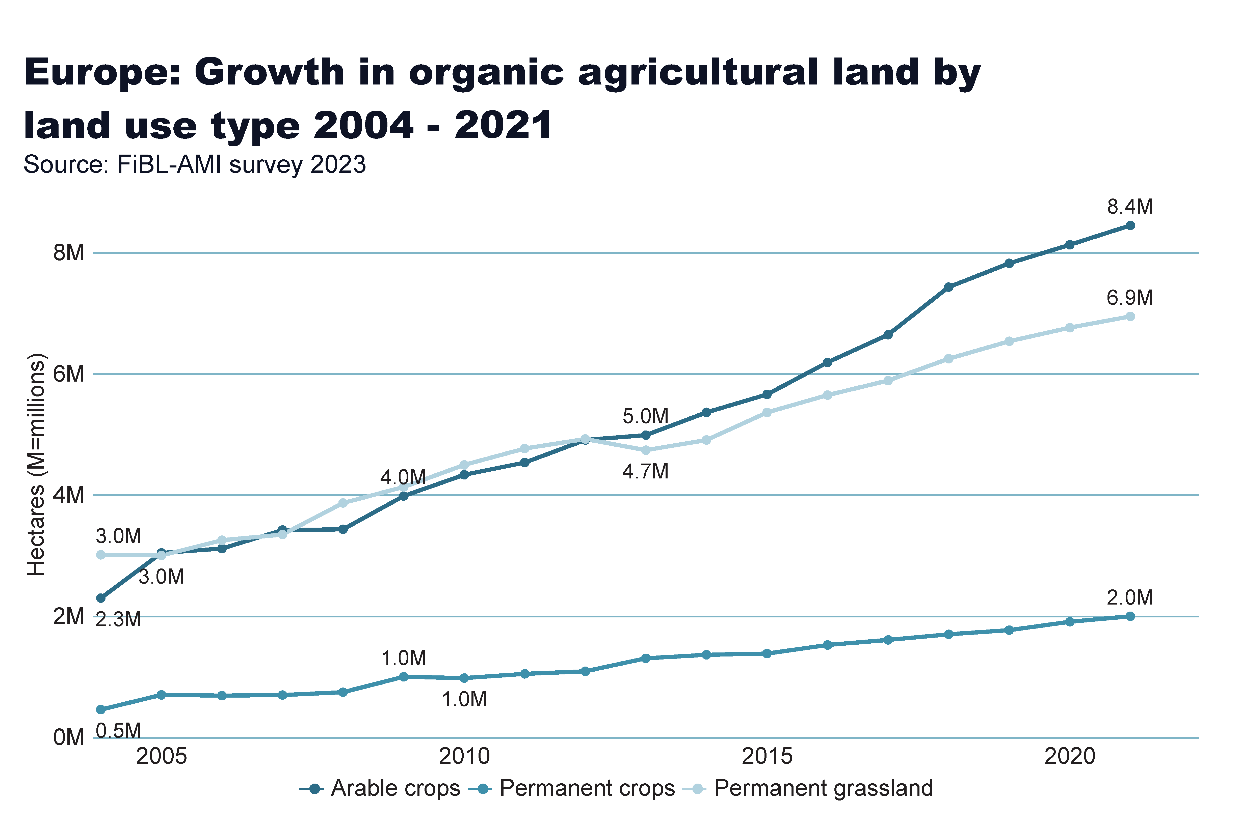
Europe_land_use_development
Notes:
Arable land
No alt text provided
textbox
No alt text provided
card
No alt text provided

Slide 40
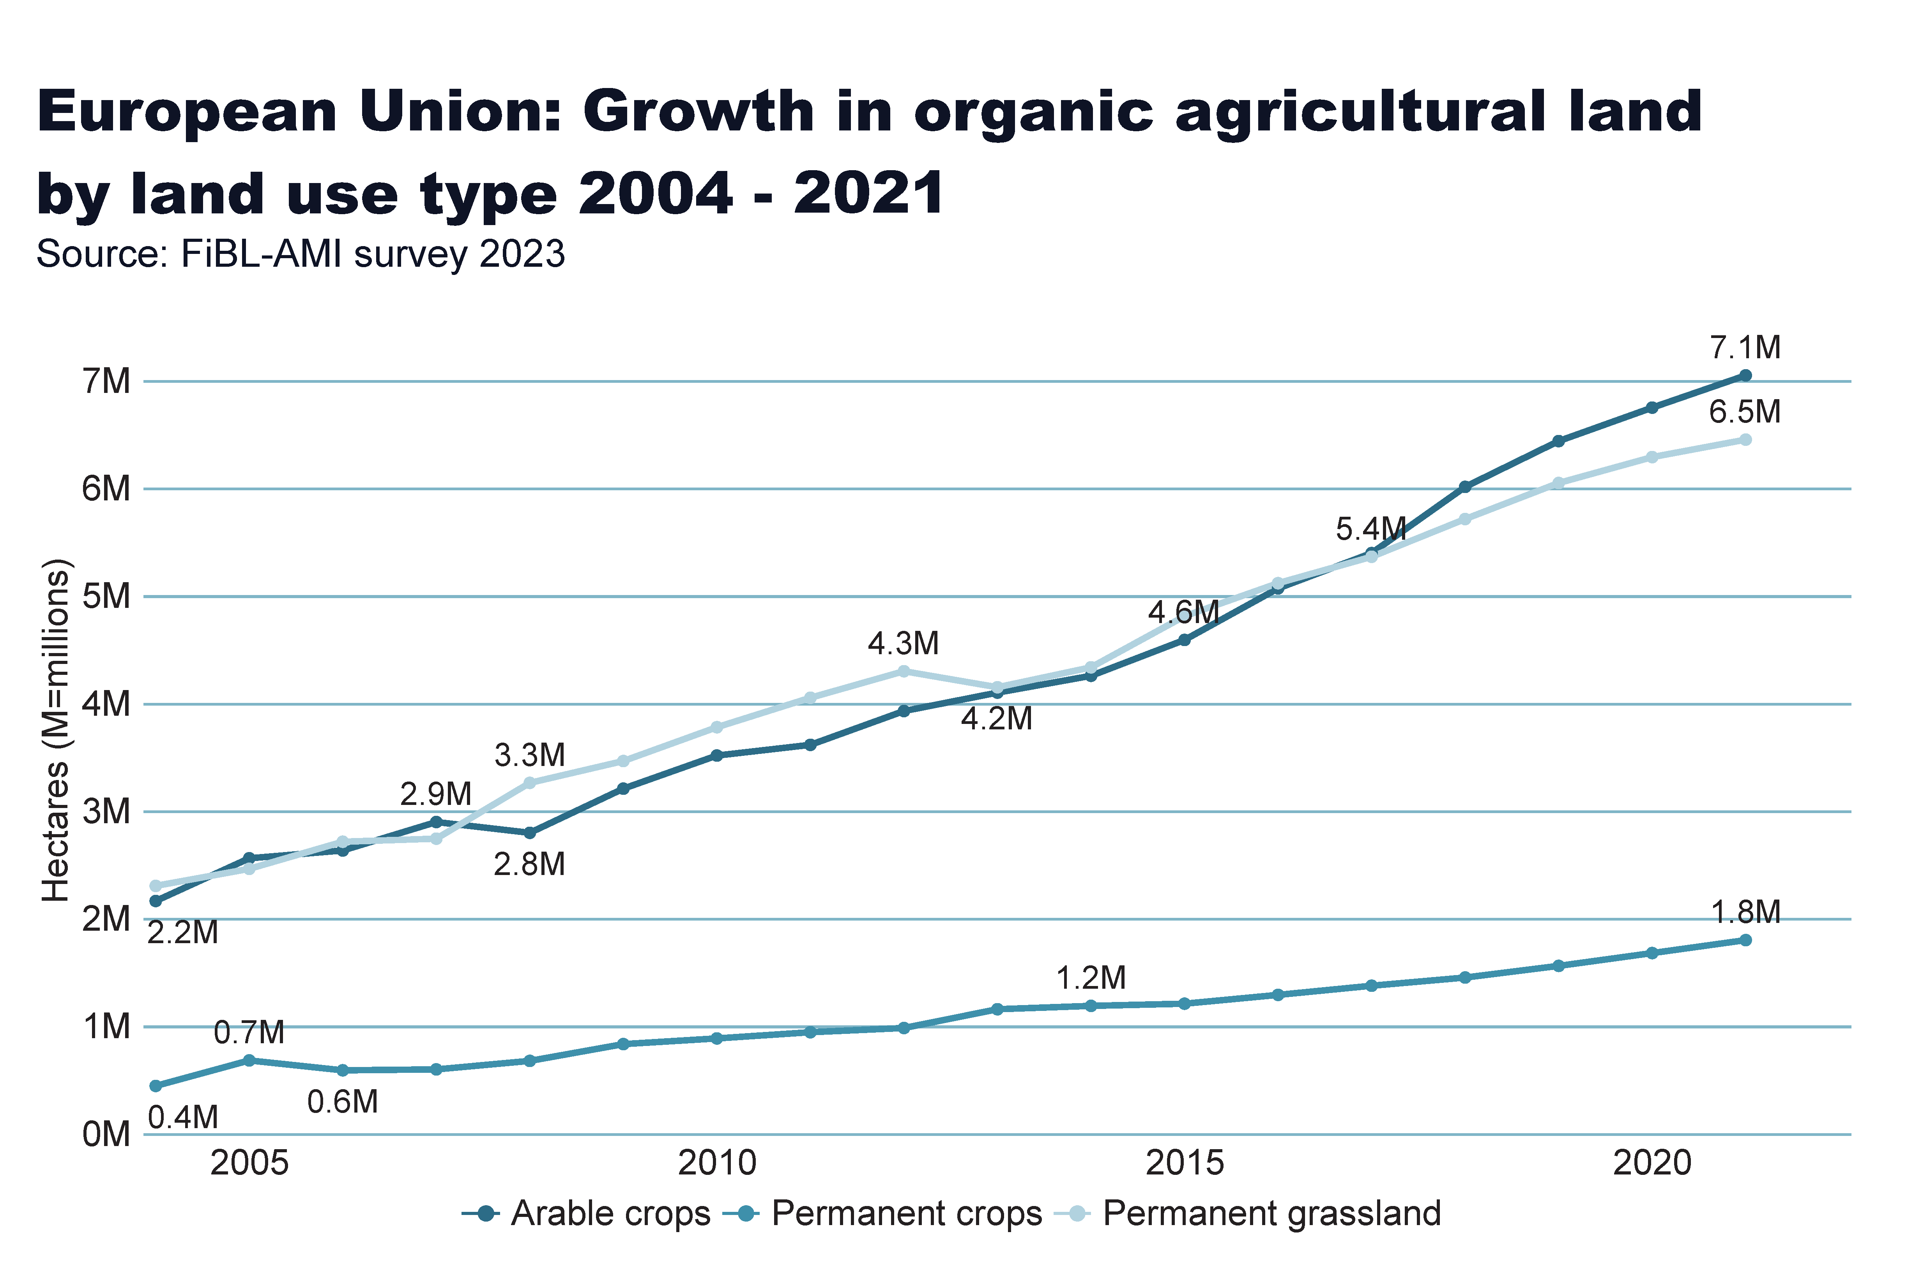
European_Union_land_use_by_culture
Notes:
Arable land
No alt text provided
textbox
No alt text provided
card
No alt text provided

Slide 41
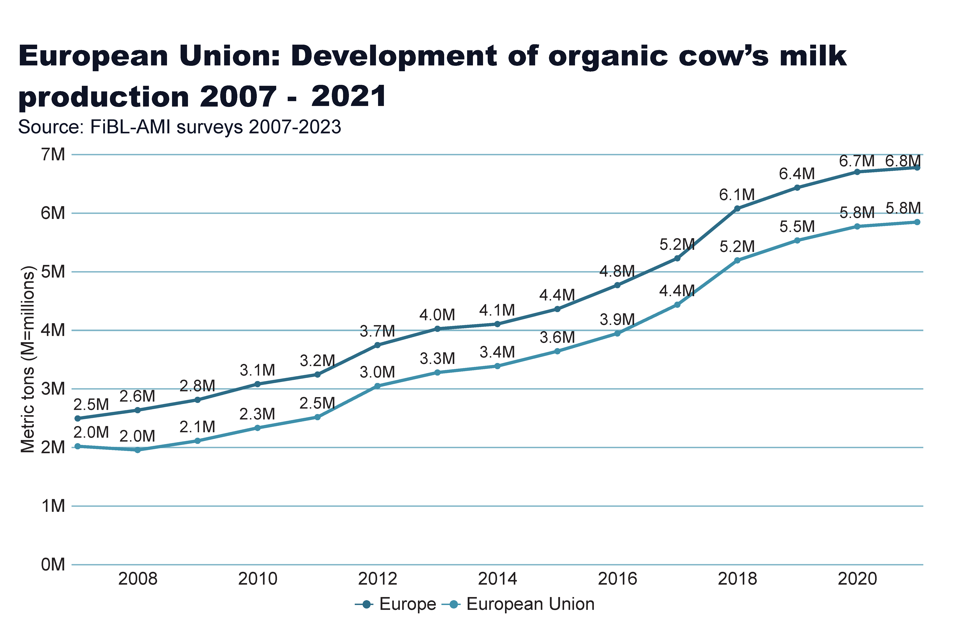
milk
Notes:
Arable land
No alt text provided
textbox
No alt text provided
card
No alt text provided

Slide 42
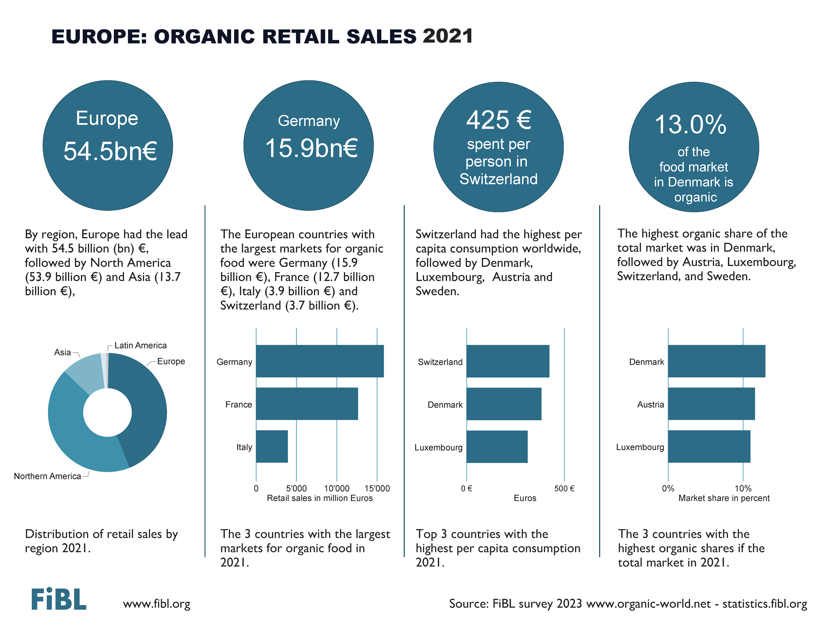

Slide 43
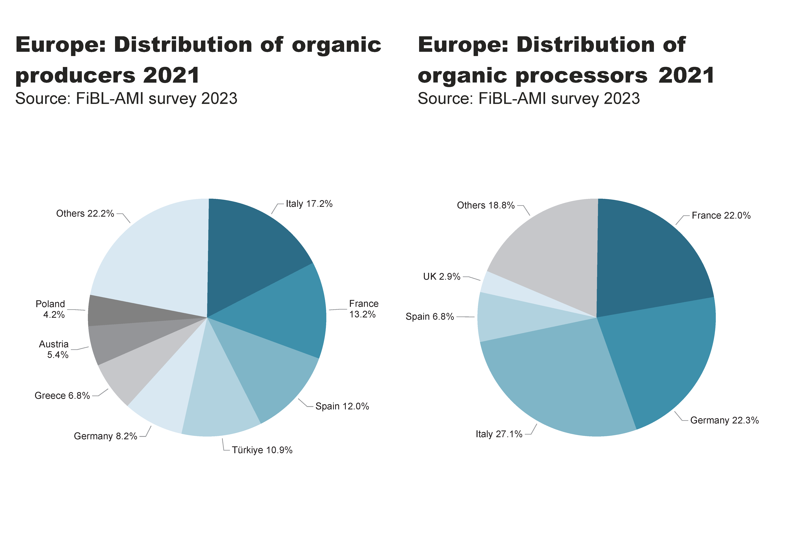
EU_producers, processors_distribution
Notes:
pieChart
No alt text provided
textbox
No alt text provided
card
No alt text provided
pieChart
No alt text provided
textbox
No alt text provided
card
No alt text provided

Slide 44
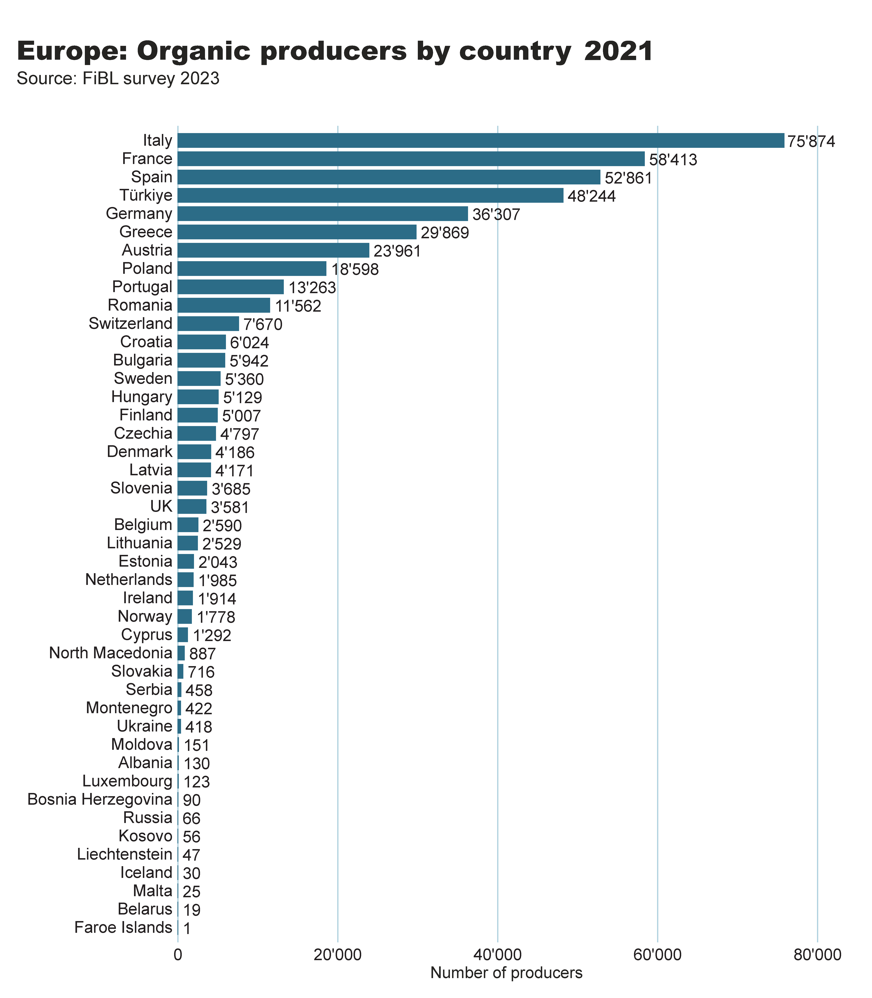
Europe_producers_by_country
Notes:
clusteredBarChart
No alt text provided
textbox
No alt text provided
card
No alt text provided

Slide 45
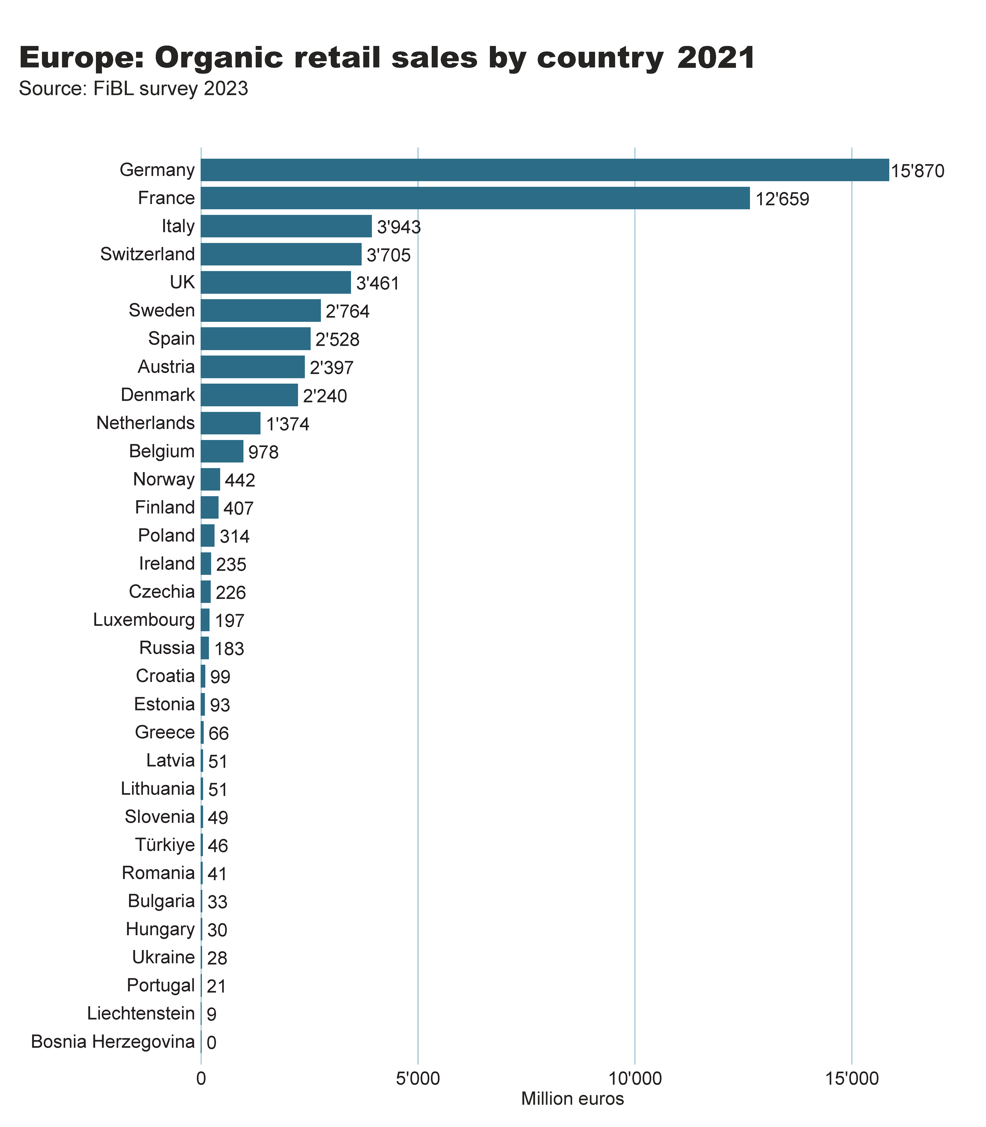
Europe_retail_sales_by_country
Notes:
clusteredBarChart
No alt text provided
textbox
No alt text provided
card
No alt text provided

Slide 46
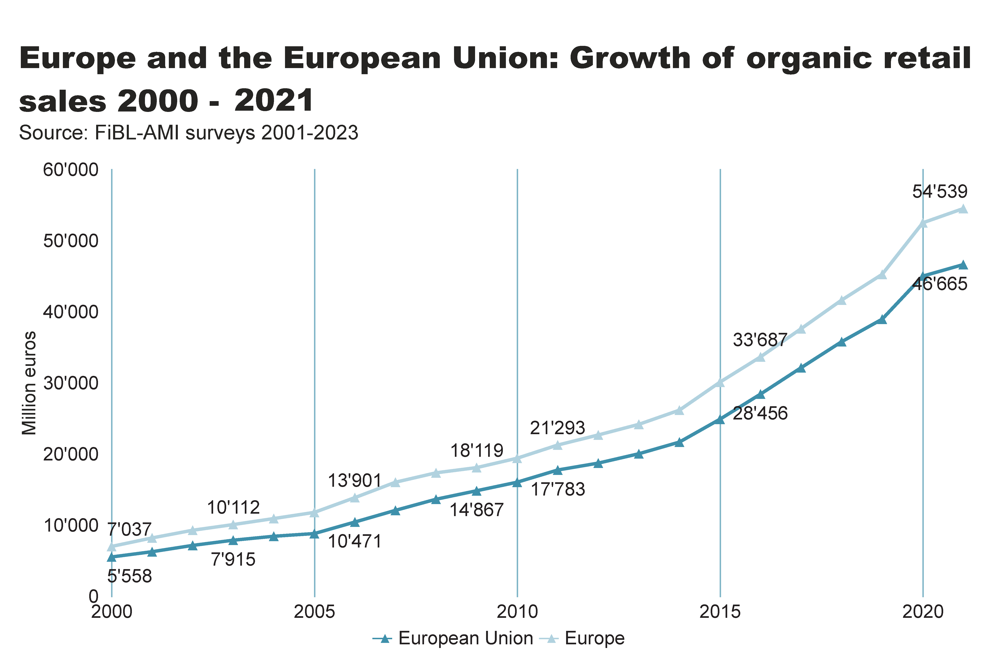
Europe_EU_growth_retail
Notes:
textbox
No alt text provided
lineChart
No alt text provided
card
No alt text provided

Slide 47
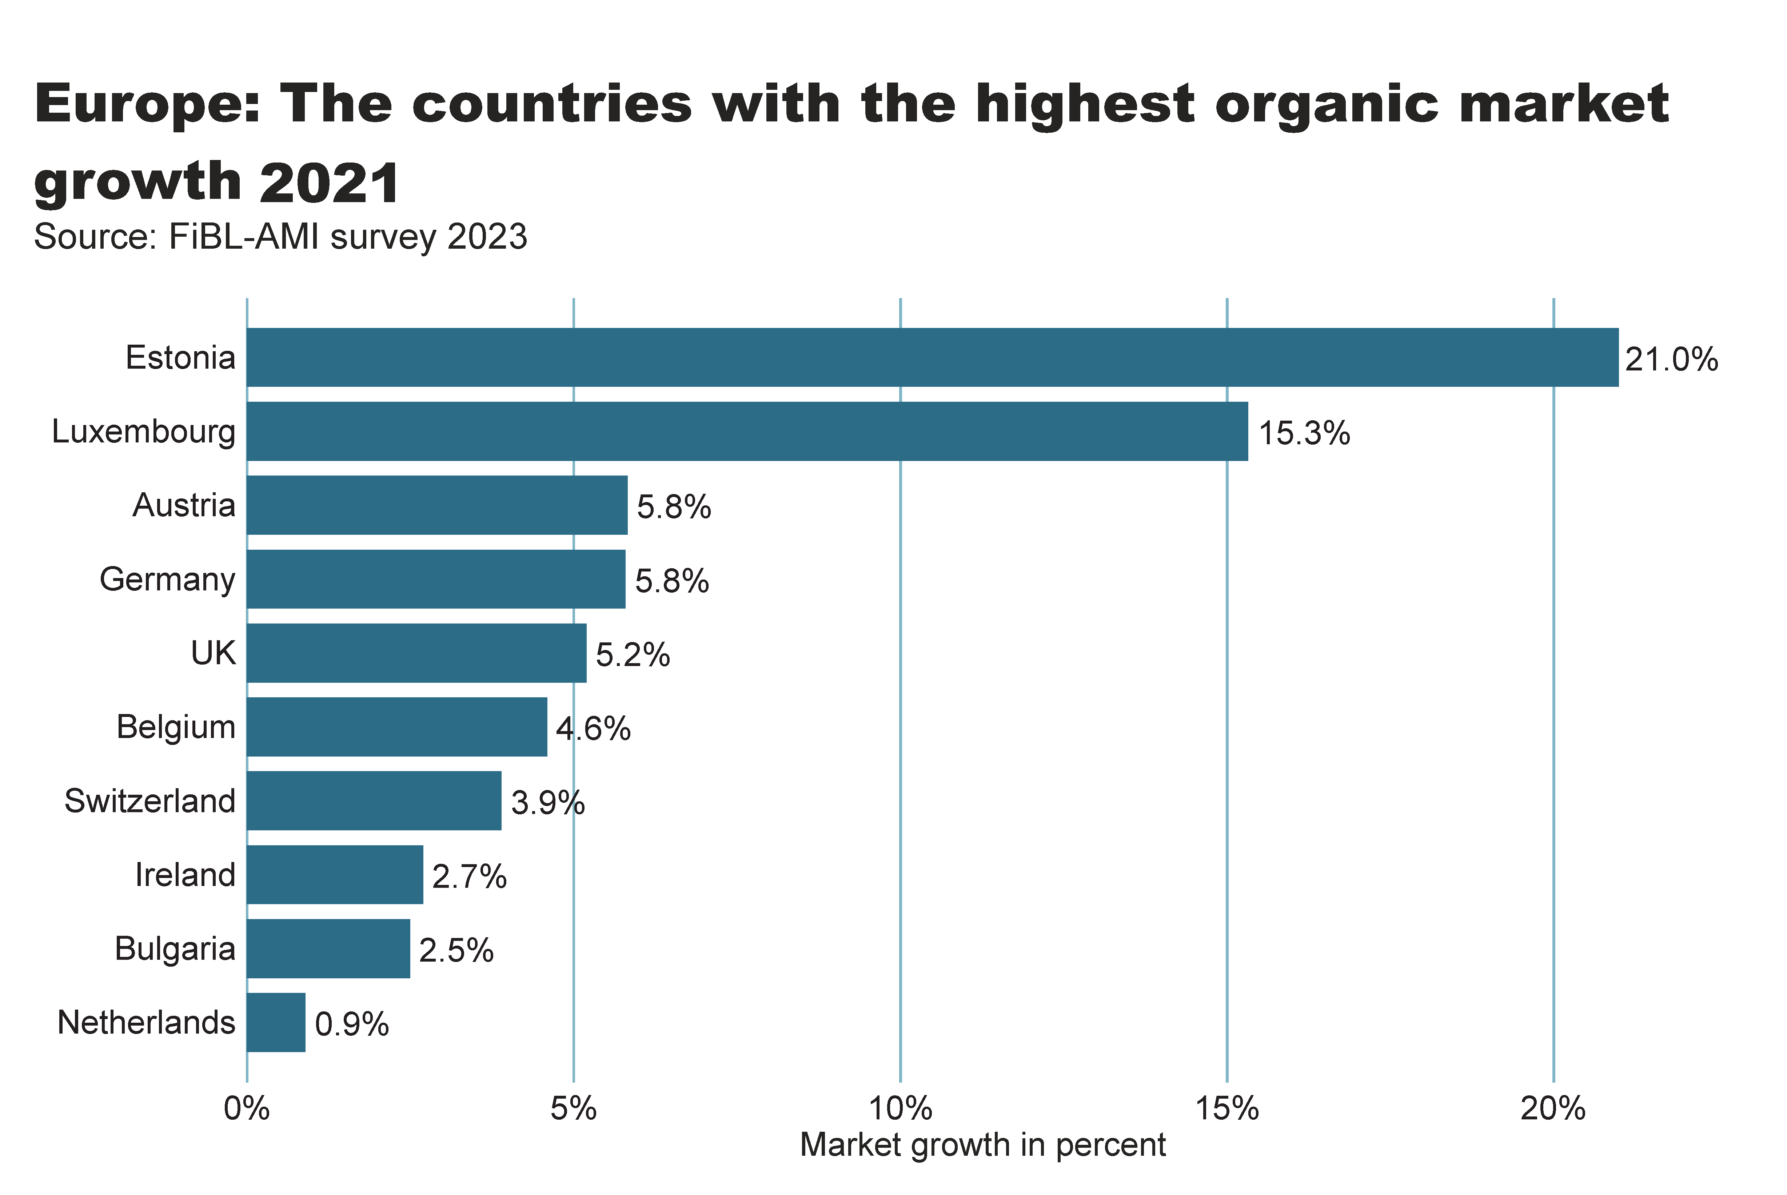
Europe_retail_growth
Notes:
textbox
No alt text provided
card
No alt text provided
clusteredBarChart
No alt text provided

Slide 48
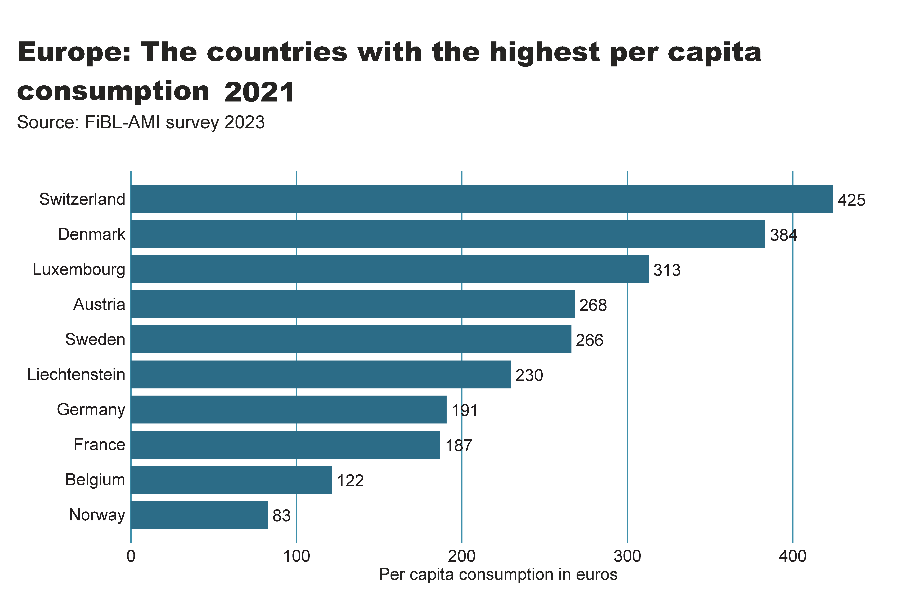
Europe_retail_per_capita
Notes:
textbox
No alt text provided
card
No alt text provided
clusteredBarChart
No alt text provided

Slide 49
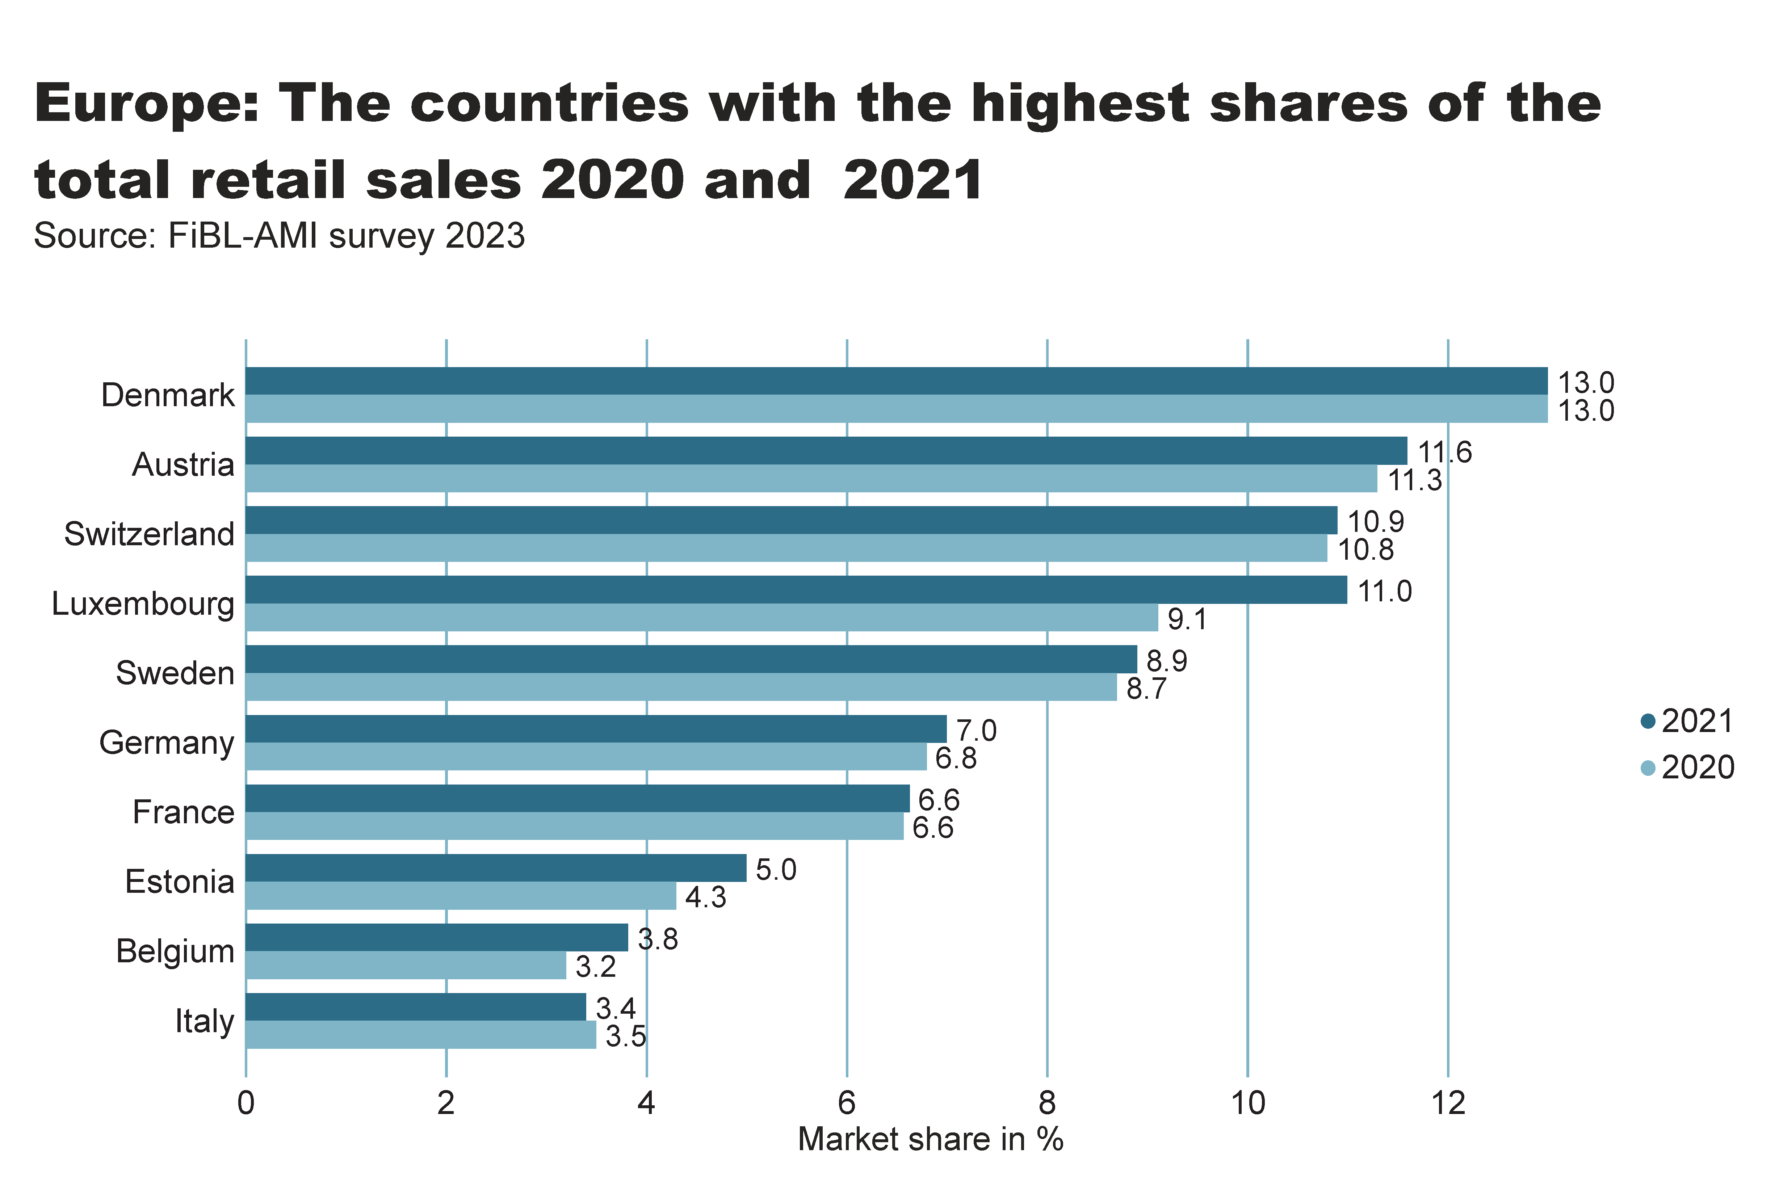
Europe_retail_share
Notes:
textbox
No alt text provided
card
No alt text provided
clusteredBarChart
No alt text provided

Slide 50
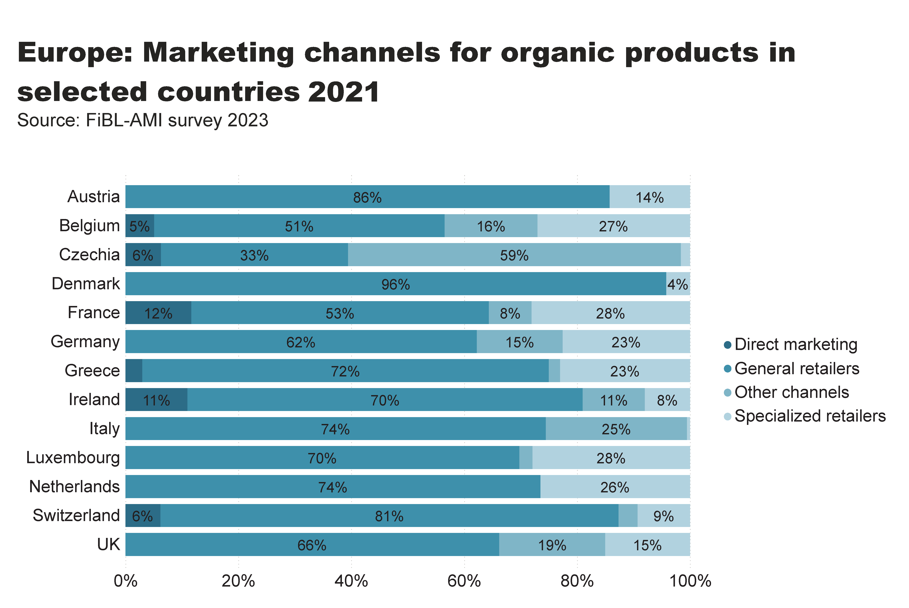
Europe_retail_by_channel
Notes:
textbox
No alt text provided
card
No alt text provided
hundredPercentStackedBarChart
No alt text provided

Slide 51
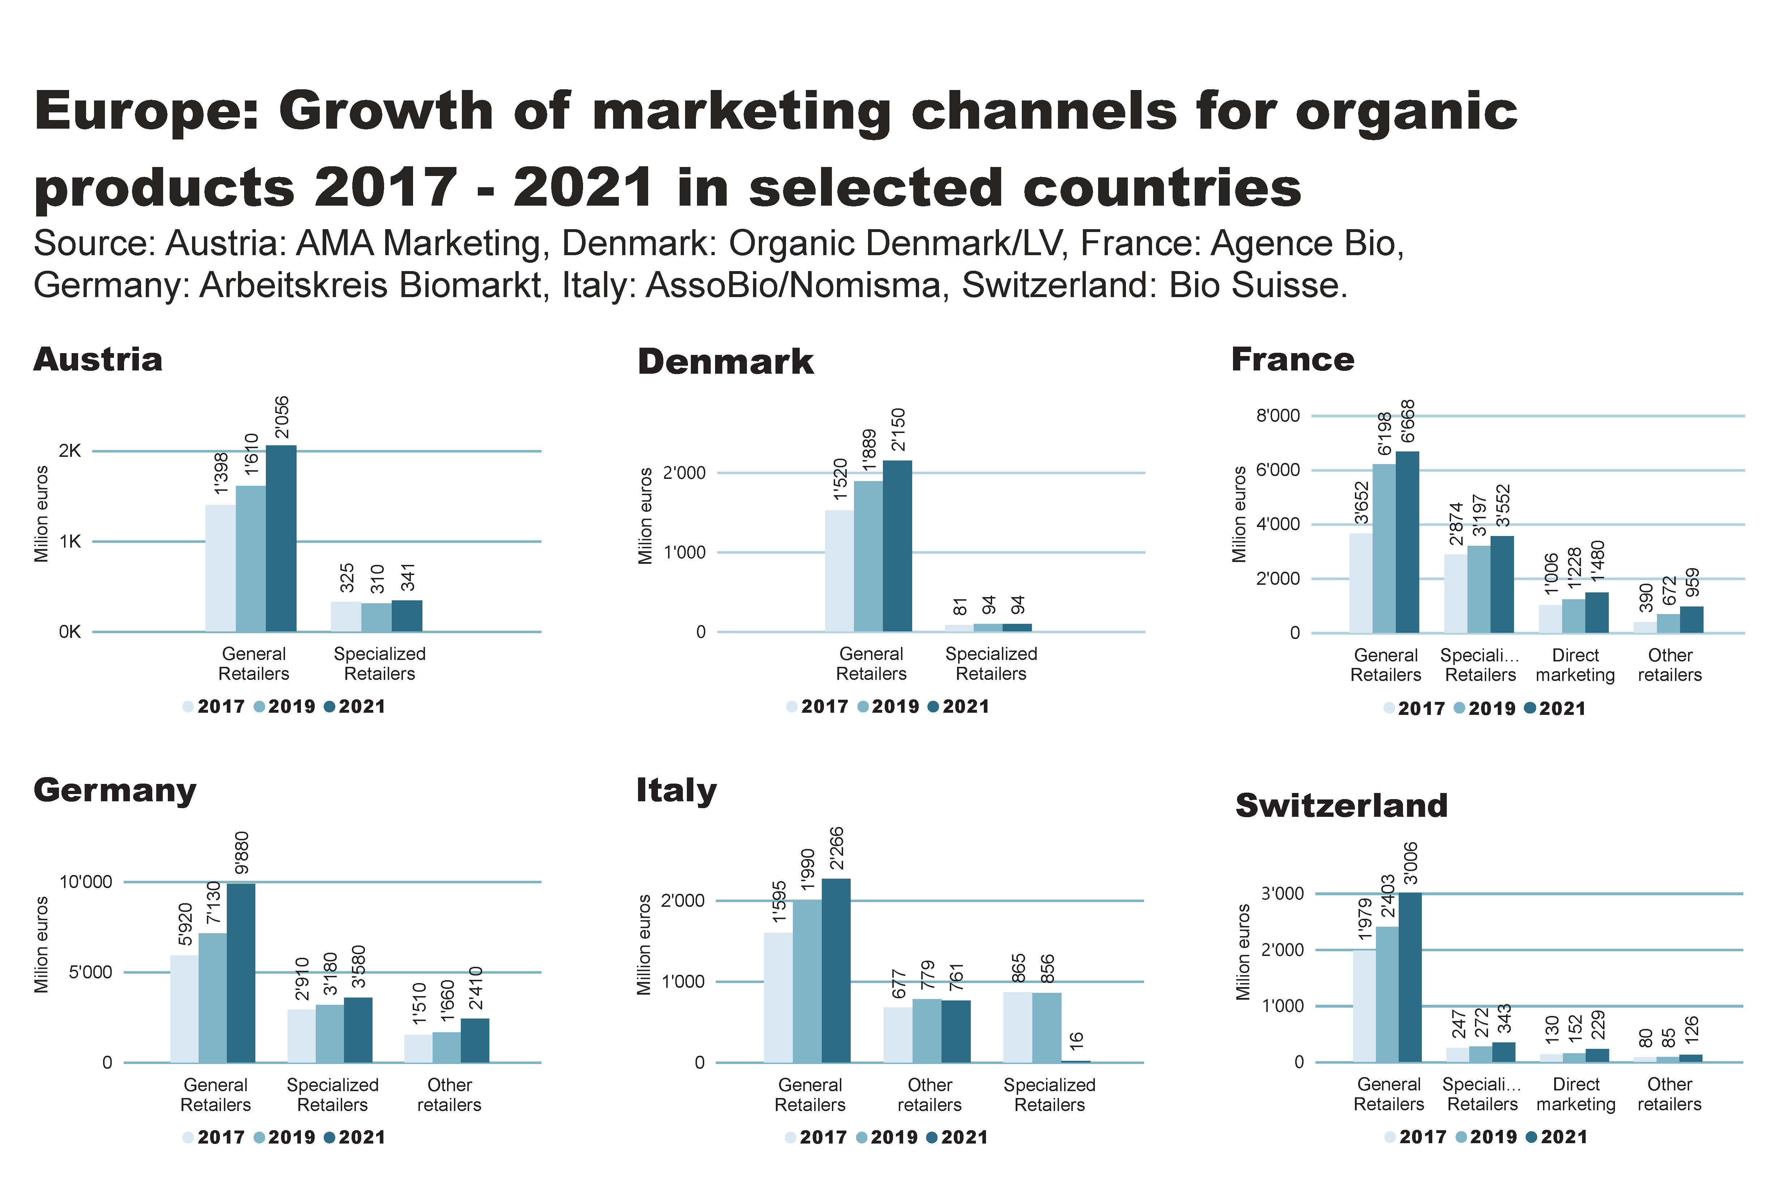
Europe_retail_by_channel_by_country
Notes:
textbox
No alt text provided
Austria
No alt text provided
Denmark
No alt text provided
France
No alt text provided
Germany
No alt text provided
Italy
No alt text provided
Switzerland
No alt text provided

Slide 52
Organic imports volumes up by 2.8 percent in 2021
Total imports of organic agri-food products in the EU have increased from 2.79 million metric tons in 2020 to 2.87 million metric tons in 2021 (+2.8 percent).
Data on imports from the UK are, however, not available for 2020 as it was de facto an EU Member State during the transition period following its departure from the EU on 31 January 2020. Excluding imports from the UK in 2021, EU imports of organic products declined by 1 percent compared to 2020, to 2.76 million metric tons.
The main imports in terms of volume were cereals, cocoa beans, coffee as well as fruit and vegetables and meat (other primary products). Commodities and other primary products each accounted for 44 percent of total organic imports.
Imports of commodities in terms of volume, however, have decreased by 5.3 percent to 1.27 million metric tons, mainly due to a trend of diminishing supply of oilcakes from China, wheat from Ukraine and sugar from Brazil and India.
On the other hand, imports of other primary products in terms of volume have increased by 5.7 percent to 1.25 million metric tons, mainly due to growth in the demand for tropical fruit, and in particular bananas.
Imports of tropical fruit – the largest product group – have increased by 7.0 percent to 903’000 metric tons, of which imports of bananas were up by 6.2 percent to 721’000 metric tons.
Imports of higher value products were significantly smaller, but nevertheless have shown high growth rates: imports of processed products (mainly juices, olive oil) have increased by 7.0 percent to 212’000 metric tons. Imports of food preparations and beverages more than doubled (+120 percent each) to 98’000 and 3’700 metric tons respectively.
Source: European Commission/Traces 2023

Slide 53
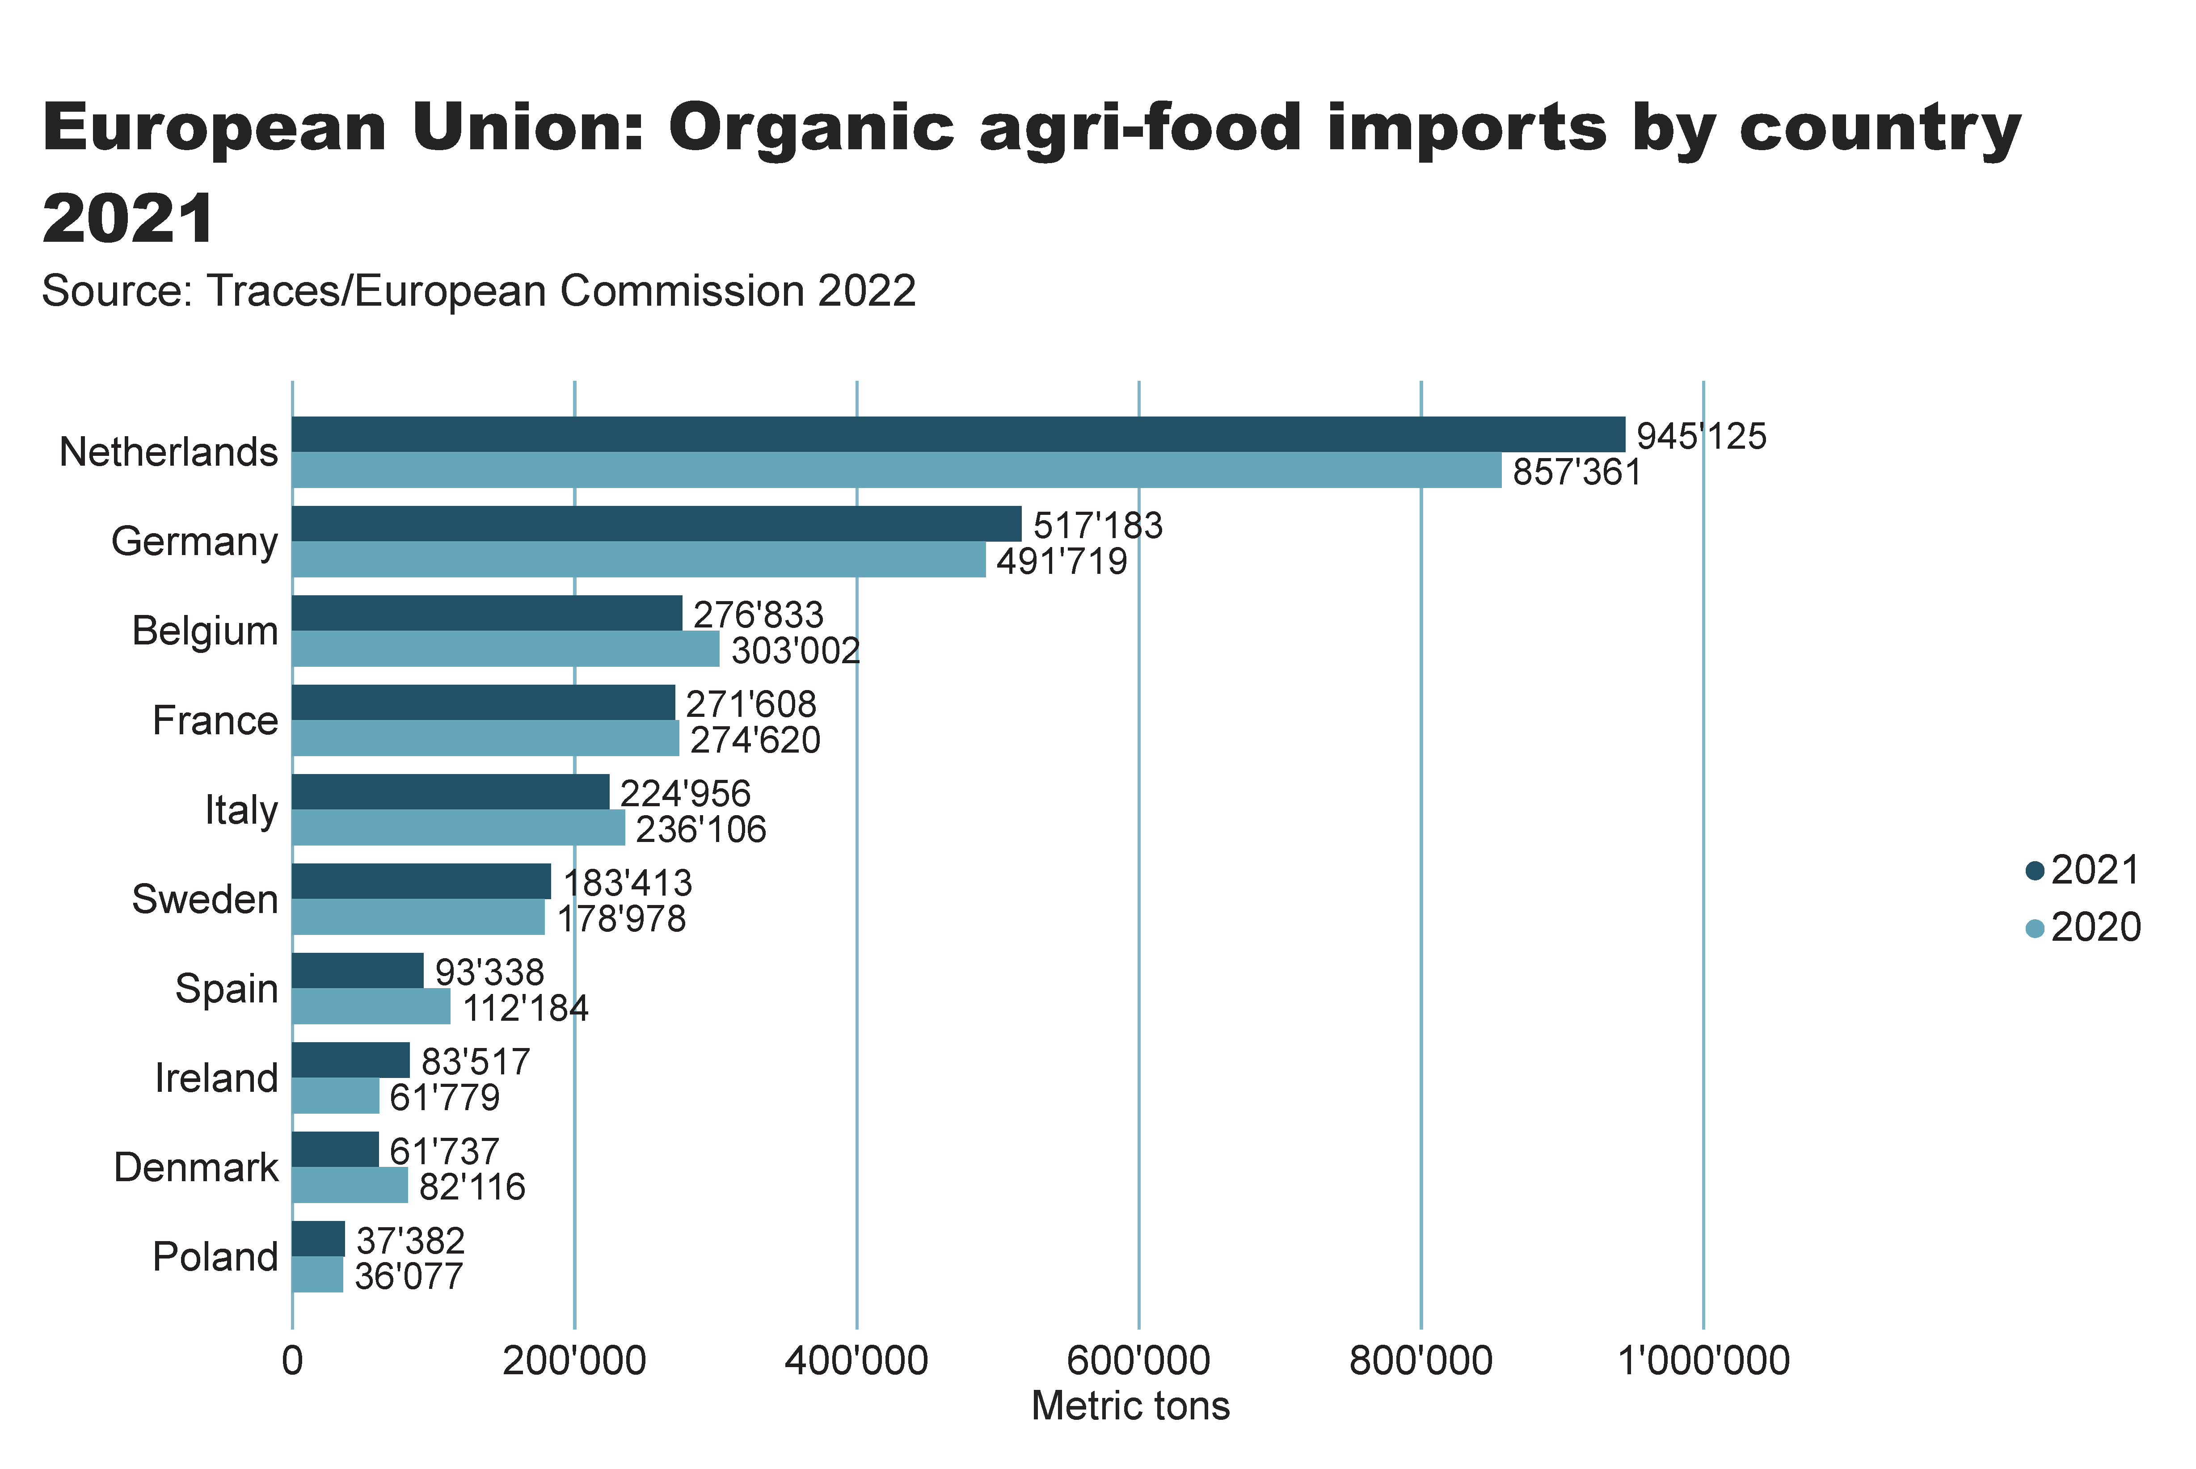
Europe_import_country
Notes:
textbox
No alt text provided
card
No alt text provided
clusteredBarChart
No alt text provided

Slide 54
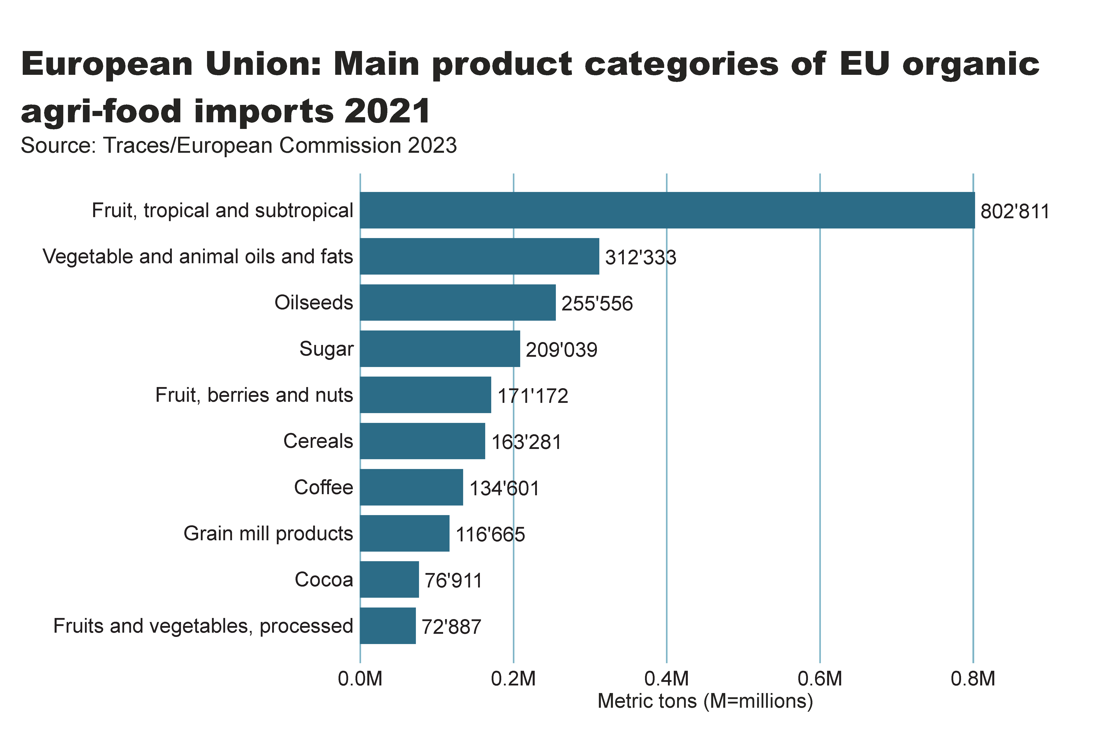
EU_import_by_food_product
Notes:
clusteredBarChart
No alt text provided
textbox
No alt text provided
card
No alt text provided

Slide 55
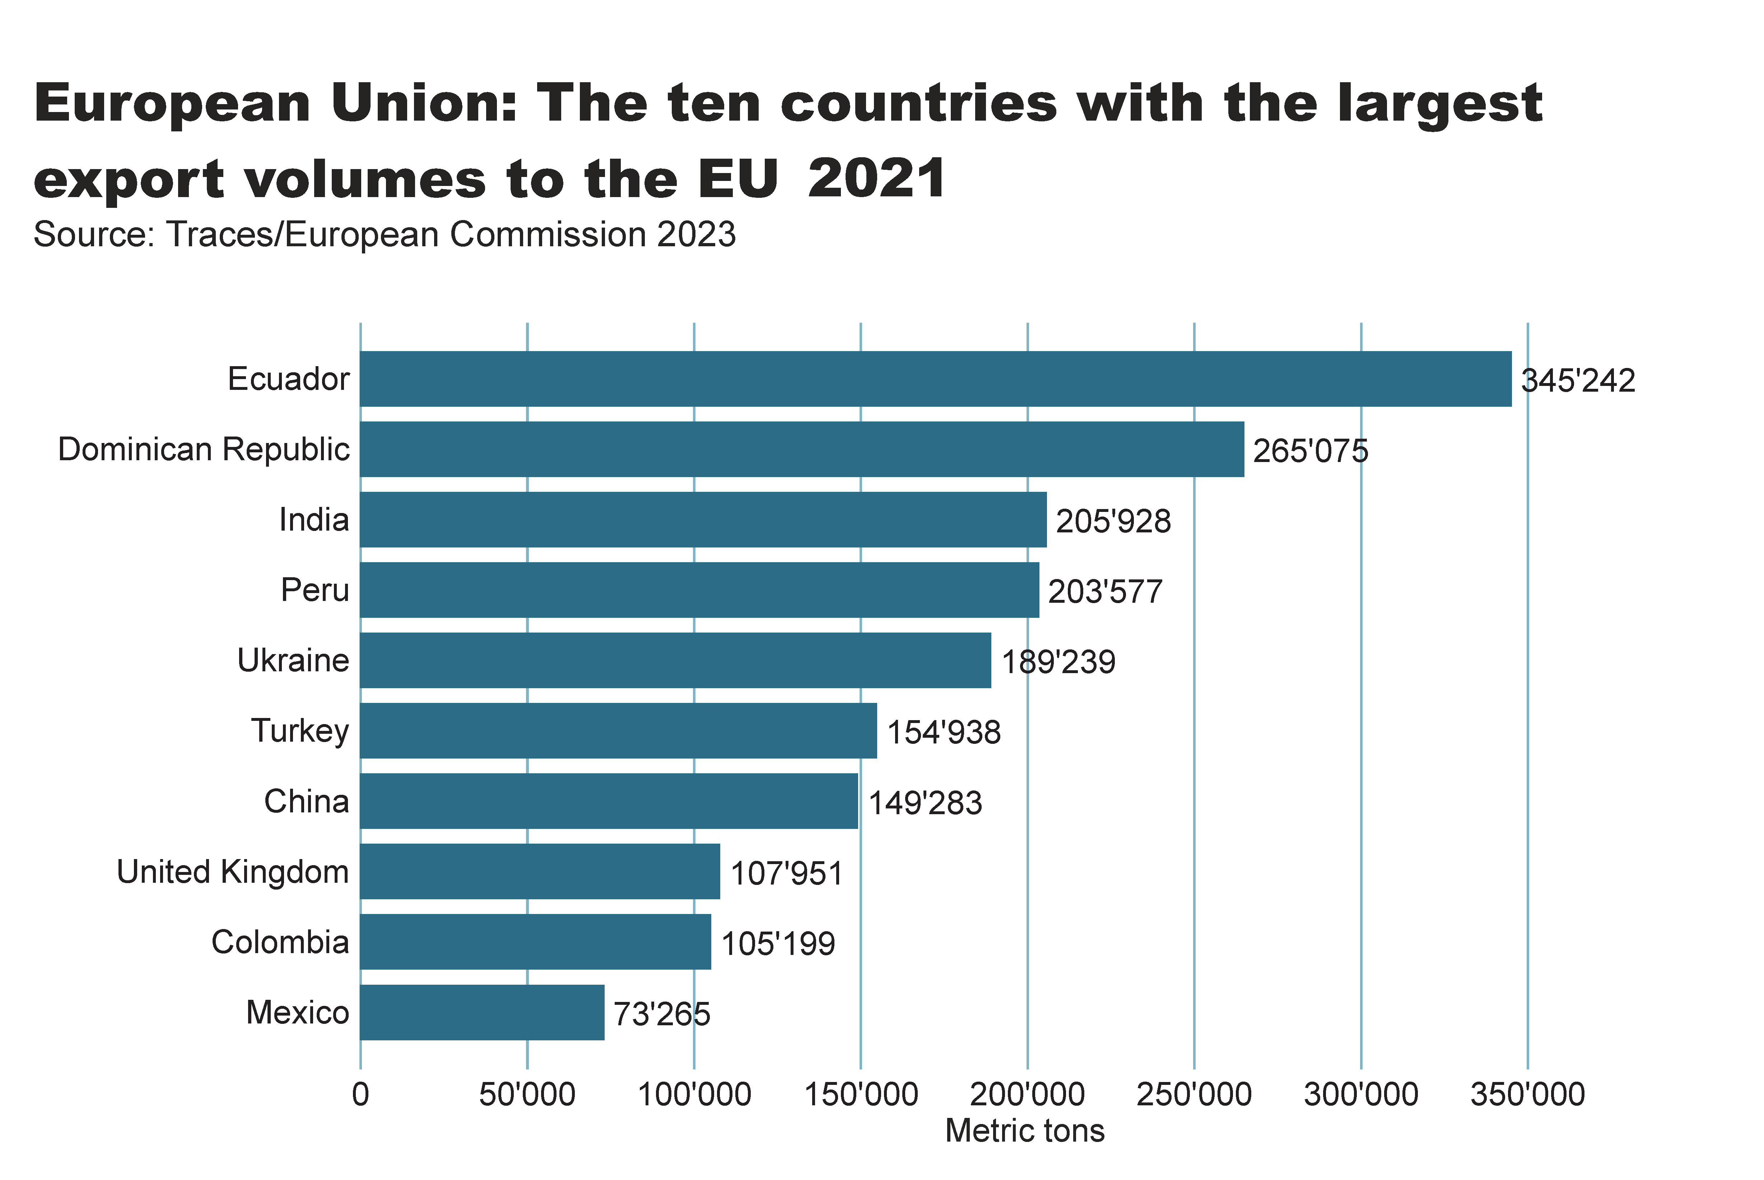
EU_import_by_exporter
Notes:
clusteredBarChart
No alt text provided
textbox
No alt text provided
card
No alt text provided

Slide 56
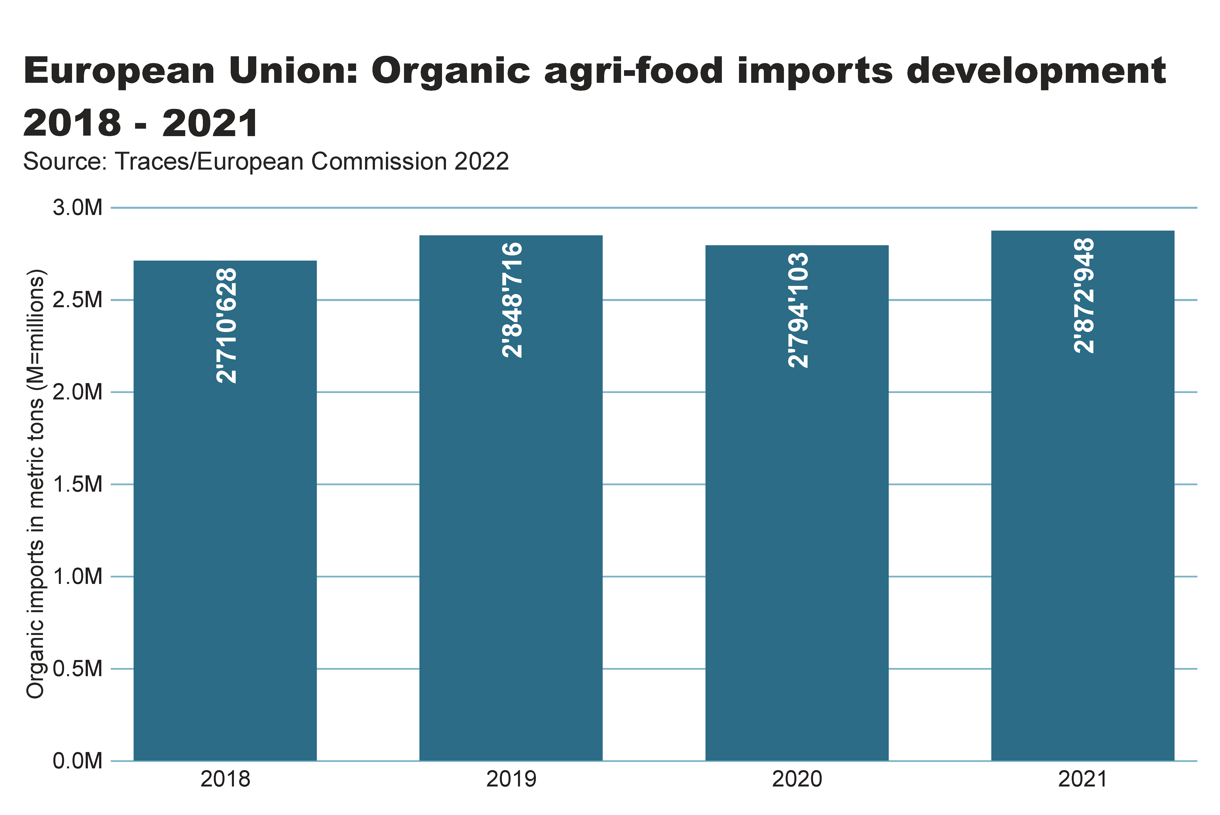
Europe_imports development
Notes:
textbox
No alt text provided
columnChart
No alt text provided
card
No alt text provided

Slide 57
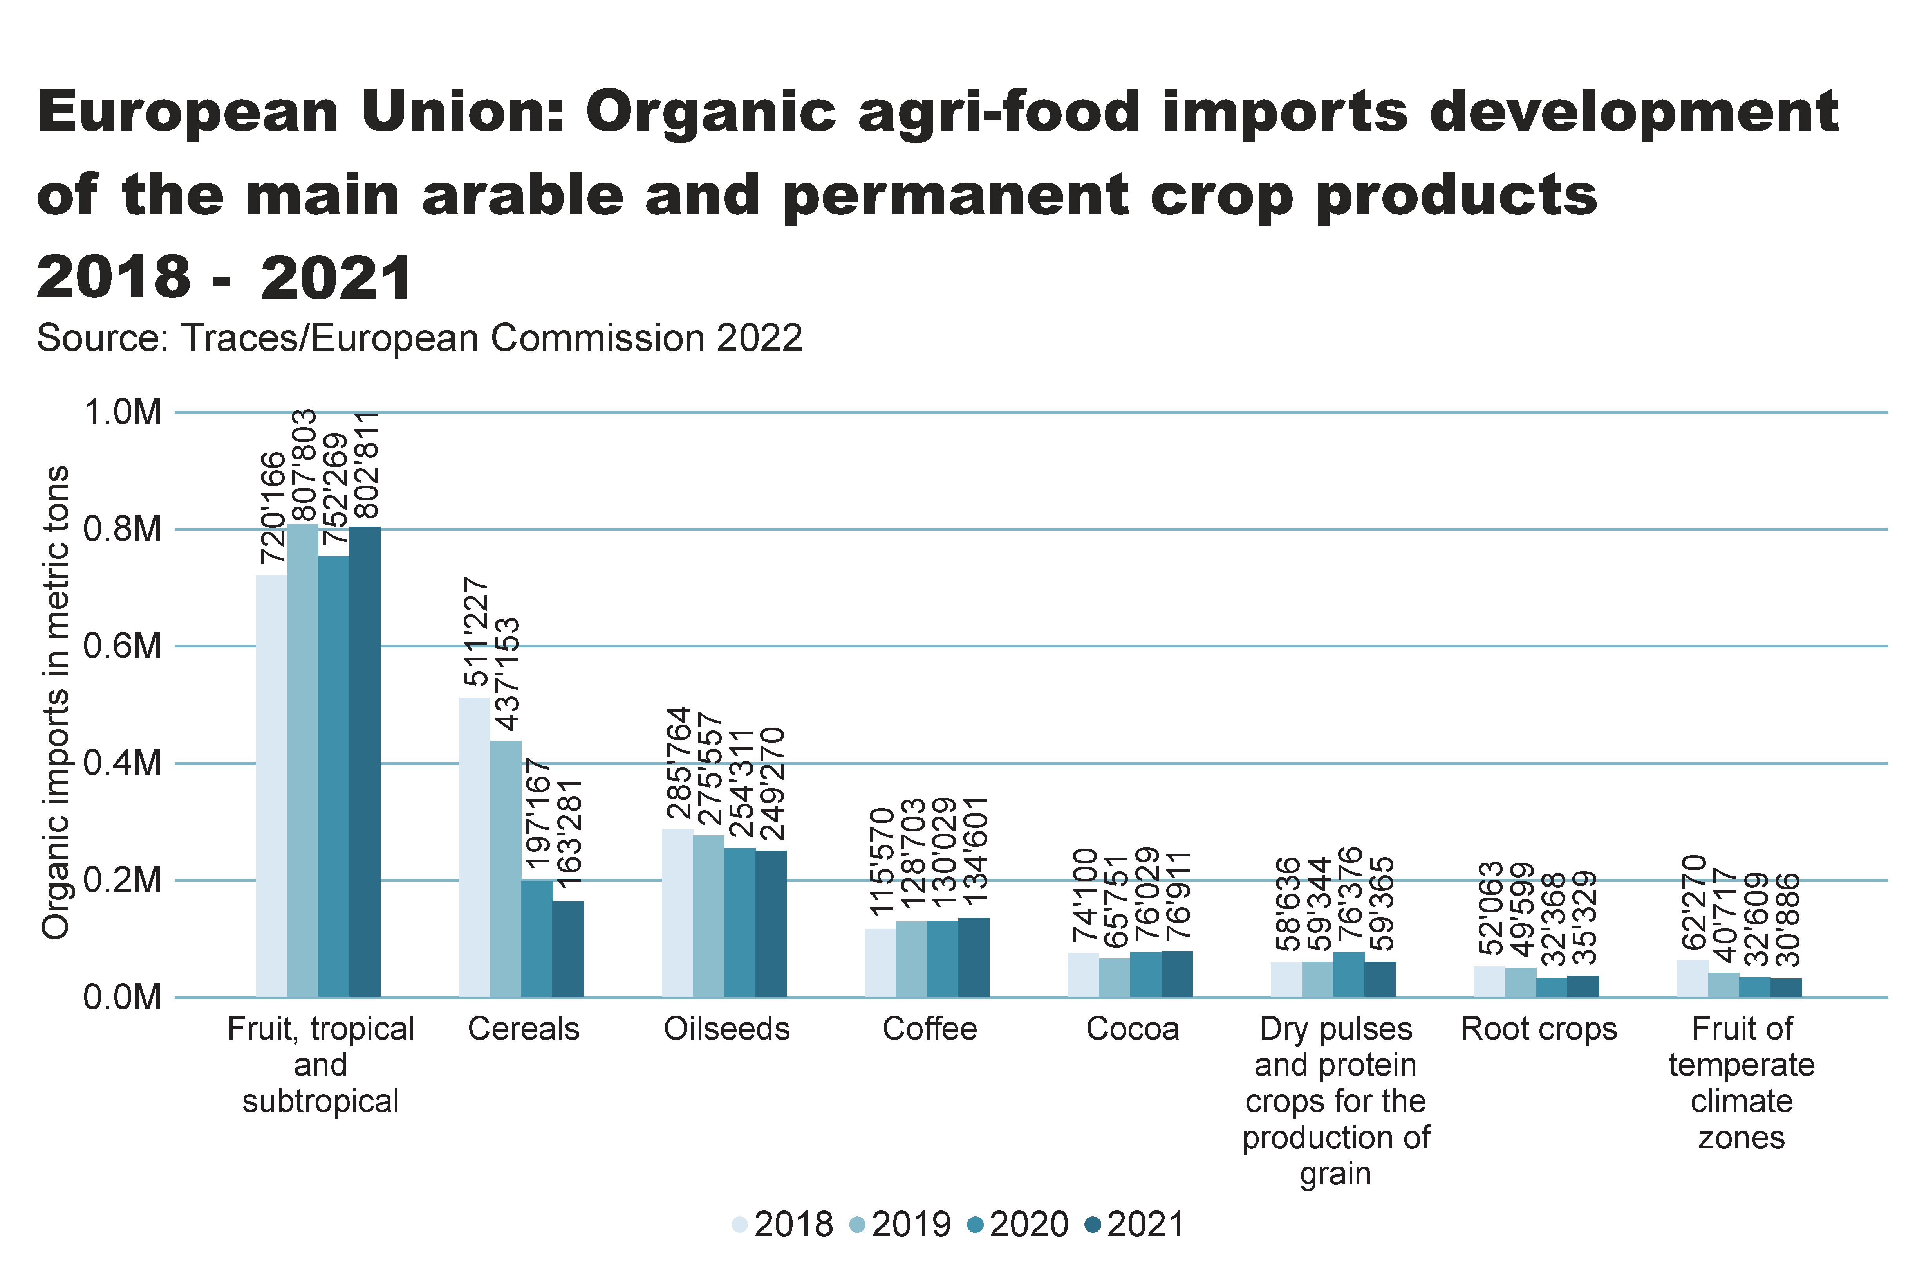
Europe_imports development_Arable_products
Notes:
textbox
No alt text provided
clusteredColumnChart
No alt text provided
card
No alt text provided

Slide 58
Latin America and the Caribbean

Slide 59
Latin America and Caribbean: Key figures 2020
In Latin America and the Caribbean, nearly 9.9 million hectares were managed organically in 2021.
With almost 4’075’000 hectares, Argentina had the largest farmland area under organic management, followed by Uruguay (almost 2’742’000 hectares), Brazil (over 1’482’000 hectares) and Peru (almost 375’000 hectares).
The country with the highest organic area share was Uruguay, with a share of 19.6 percent, followed by French Guyana (11.9 percent) and Dominica (11.6 percent).
Many Latin American countries remain important exporters of organic products such as coffee, cocoa and bananas.
In Argentina and Uruguay, temperate fruit and meat are key export commodities.
Brazil has the largest domestic market for organic products in Latin America.
Nineteen countries in the region have legislation on organic agriculture, and two countries are drafting such legislation.
Source: FiBL survey 2023

Slide 60
LA_land_country
Notes:
clusteredBarChart
No alt text provided
textbox
No alt text provided
card
No alt text provided

Slide 61
LA_land_share_country
Notes:
textbox
No alt text provided
barChart
No alt text provided
card
No alt text provided

Slide 62
LA_land_growth
Notes:
textbox
No alt text provided
lineClusteredColumnComboChart
No alt text provided
card
No alt text provided

Slide 63
LA_producers_country
Notes:
textbox
No alt text provided
card
No alt text provided
barChart
No alt text provided

Slide 64
LA_land_use
Notes:
Land use types
No alt text provided
card
No alt text provided
Key arable crops
No alt text provided
Key permanent crops
No alt text provided
textbox
No alt text provided

Slide 65
North America

Slide 66
Organic Agriculture in North America: Key figures 2021
North America had nearly 3.5 million hectares of organic farmland in 2021.
Organic farmland in North America constituted 0.8 percent of the continent’s total agricultural land and was thus below the global organic area share of 1.6 percent in 2021.
The US reported a share of 0.6 percent, followed by Canada with a 2.1 percent share.
Almost 40 percent of the organic farmland in North America was used for arable crops (1.5 million hectares). Among the key crops were cereals (661’473 hectares), oilseeds (160’199 hectares) and dry pulses (111’703 hectares).
Permanent crops accounted for approximately 10 percent of total organic land in North America in 2021. Among the key crops were berries (49’746 hectares), grapes (28’736 hectares) and temperate fruit (19’184 hectares).
Organic retail sales for North America reached 53.9 billion euros in 2021. The USA, which is the largest single market in the world (followed by the European Union), reported retail sales of 48.6 billion euros, whereas Canada had 5.3 billion euros.
Source: USDA and COTA 2022

Slide 67
NA_land_country
Notes:
clusteredBarChart
No alt text provided
textbox
No alt text provided
card
No alt text provided

Slide 68
NA_land_share_country
Notes:
textbox
No alt text provided
Source: COTA and USDA, 2022
No alt text provided
card
No alt text provided

Slide 69
NA_land_growth
Notes:
textbox
No alt text provided
lineClusteredColumnComboChart
No alt text provided
card
No alt text provided

Slide 70
NA_producers_country
Notes:
textbox
No alt text provided
card
No alt text provided
barChart
No alt text provided

Slide 71
NA_land_use
Notes:
Land use types
No alt text provided
card
No alt text provided
Key arable crops
No alt text provided
Key permanent crops
No alt text provided
textbox
No alt text provided

Slide 72
Oceania

Slide 73
Organic agriculture in Oceania: Key figures 2021
This region includes Australia, New Zealand and the Pacific Islands states.
Altogether, there were over 18’000 producers on nearly 36 million hectares, constituting 9.7 percent of the region’s agricultural land and half the world’s organic land.
More than 99 percent of the organic land in the region is in Australia (35.7 million hectares, mostly extensive grazing land), followed by Papua New Guinea (over 88’000 hectares) and new Zealand (over 79’000 hectares).
The highest organic shares of all national agricultural land were in Samoa (29.1 percent), followed by Australia (9.9 percent) and Papua New Guinea (7.4. percent
Four countries in Oceania have legislation on organic agriculture, and twelve countries have a national standard but no organic legislation.
FiBL survey 2023

Slide 74
Oceania_land_country
Notes:
clusteredBarChart
No alt text provided
textbox
No alt text provided
card
No alt text provided

Slide 75
Oceania_land_share_country
Notes:
textbox
No alt text provided
barChart
No alt text provided
card
No alt text provided

Slide 76
Oceania_land_growth
Notes:
textbox
No alt text provided
lineClusteredColumnComboChart
No alt text provided
card
No alt text provided

Slide 77
Oceania_producers_country
Notes:
textbox
No alt text provided
card
No alt text provided
barChart
No alt text provided

Slide 78
Oceania_land_use
Notes:
Land use types
No alt text provided
card
No alt text provided
Key arable crops
No alt text provided
Key permanent crops
No alt text provided
textbox
No alt text provided

Slide 79
More information
More information (PDF, data sources, graphs) at: http://www.organic-world.net/yearbook/yearbook-2023.html
Contact Helga Willer Research Institute of Organic Agriculture FiBL 5070 Frick Switzerland helga.willer@fibl.org

Slide 80
Disclaimer
All of the results contained in this slide show have been compiled by the Research Institute of Organic Agriculture FiBL. However, the possibility of mistakes cannot be ruled out entirely. Therefore, FiBL is not subject to any obligation and makes no guarantees whatsoever regarding any of the statements or results in this work; neither does FiBL accept responsibility or liability for any possible mistakes, nor for any consequences of actions taken by readers based on statements or advice contained therein.
This document has been produced with the support of the Swiss State Secretariat for Economic Affairs (SECO), the Sustainability Fund of Coop Switzerland, NürnbergMesse, IFOAM – Organics International. The views expressed herein can in no way be taken to reflect the official opinions of SECO, Coop, NürnbergMesse or IFOAM – Organics International.

Slide 81
Presentations on www.organic-world.net

Slide 82
Statistics.FiBL.org

Slide 83
www.twitter.com/fiblstatistics

Slide 84
Contact
Helga Willer Research Institute of Organic Agriculture FiBL Ackerstrasse 113, Box 219 5070 Frick Switzerland
Phone +41 62 865 72 72 Phone +41 62 865 72 07 (direct)
info.suisse@fibl.org, helga.willer@fibl.org www.fibl.org, www.organic-world.net, https://statistics.fibl.org

Slide 85
FiBL online
www.fibl.org
www.bioaktuell.ch
fiblfilm
@fiblorg
@FiBLaktuell
linkedin.com/company/fibl

