Slide 1
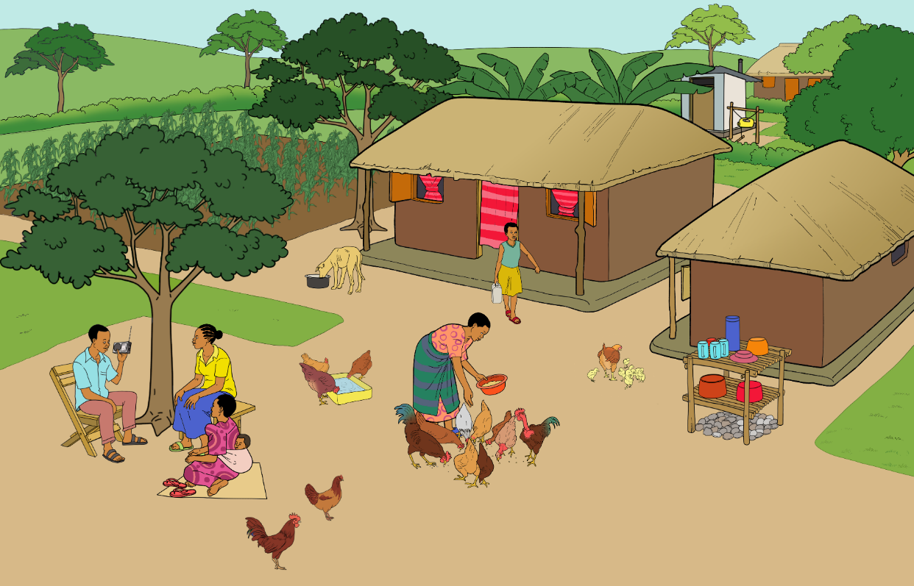
Traditional free-range poultry production
During the day, chickens move around freely outside
Overnight, chickens are kept in a chicken house or the people’s house
Chickens scavenge for food and are fed outside
Indigenous and locally adapted breeds are used

Slide 2
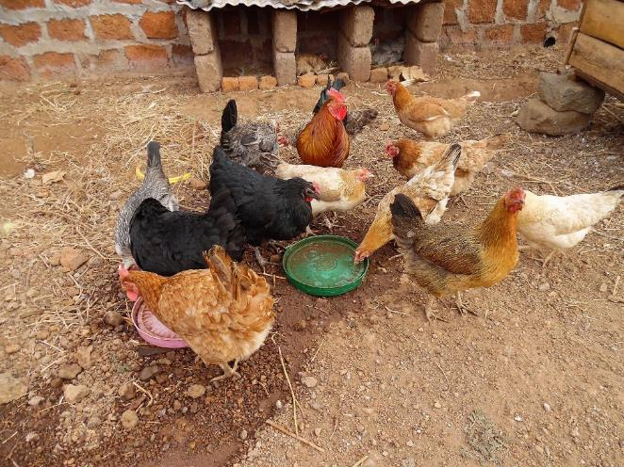
Traditional free-range poultry production
Advantages:
Low feed costs: Chickens find most of their feed by scavenging
Natural behaviour
Natural reproduction
Disadvantages:
Risk of predation (higher losses)
Only possible with a low number of chickens
Often lack of vaccination (higher losses)
Challenges:
Vaccination of the chicks at the right age

Slide 3
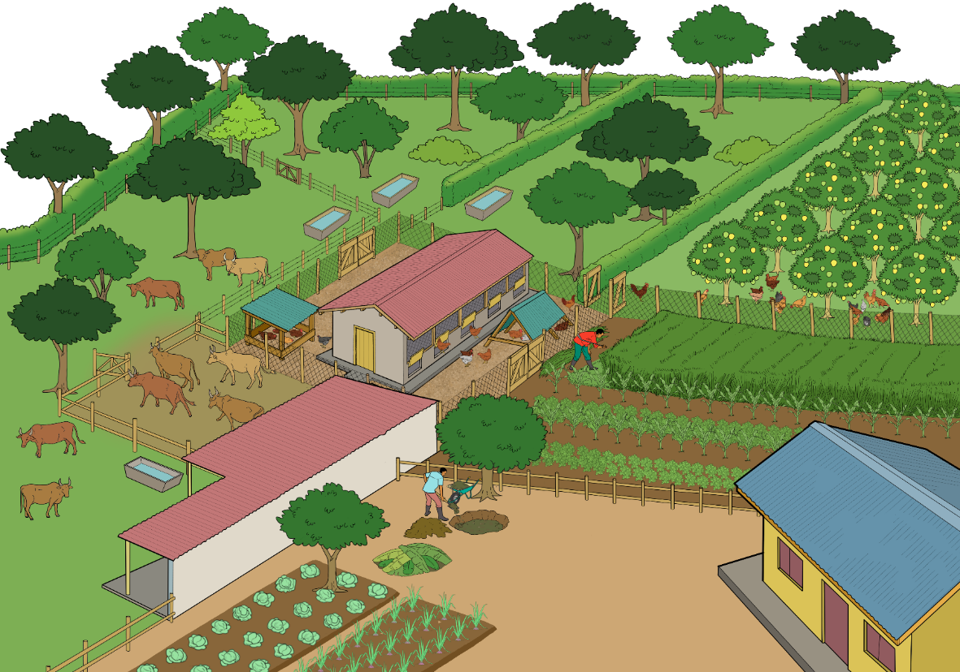
Semi-intensive free-range production system
A fence protects the chickens from predators and thieves
The outdoor run around the chicken house is complemented by several pasture areas
The main feeders are in the chicken house
The pop-holes are closed during the night
An intermediate outdoor area surrounds the chicken house
The chickens may regularly also have access to other parts of the farm to scavenge for food

Slide 4
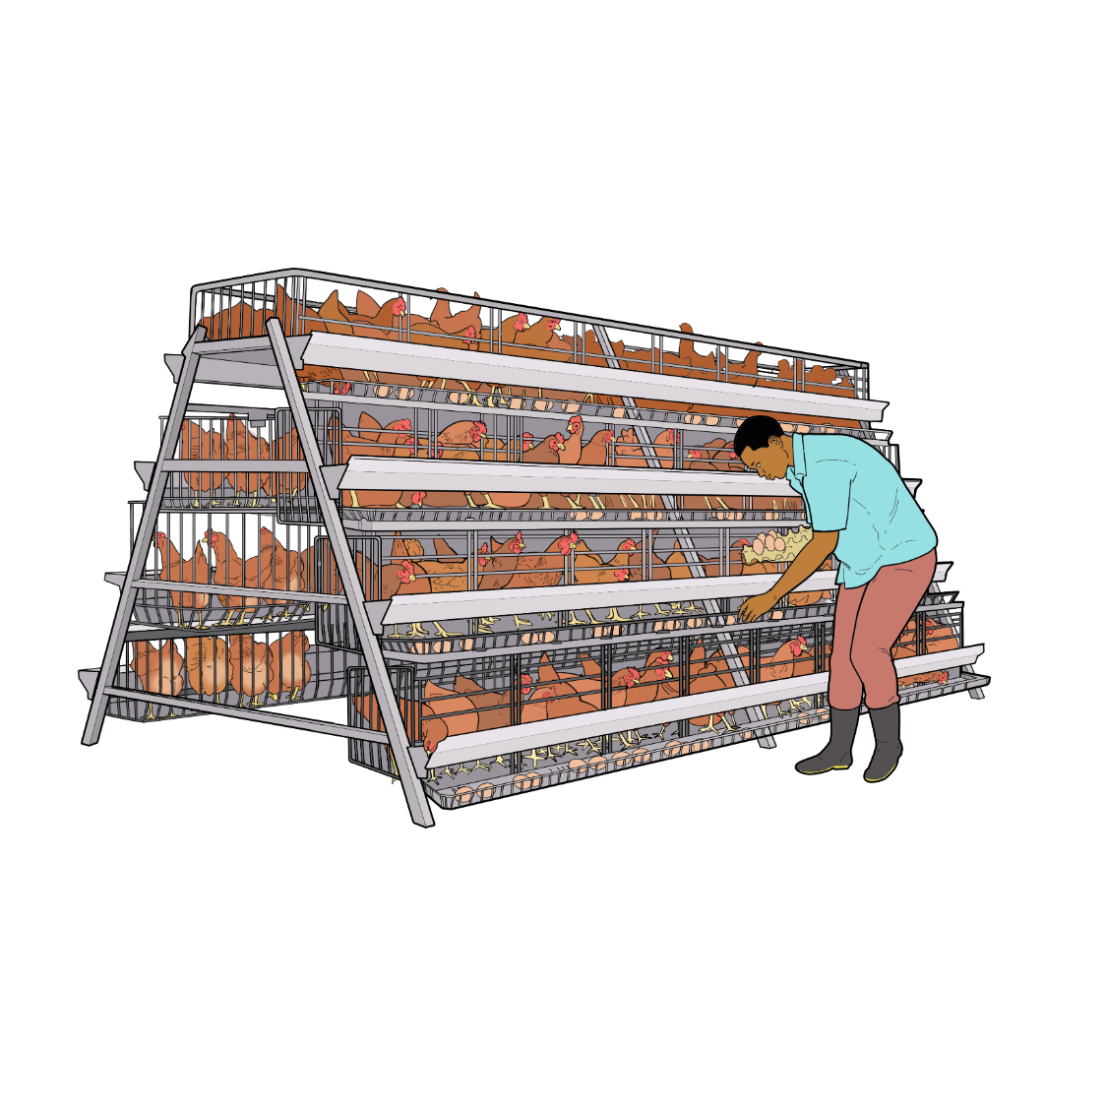
Intensive production system
Not allowed by organic regulations!
Natural behaviours like scratching, foraging and dustbathing cannot be performed adequately
The chickens are kept in cages all day with very little space
The beaks are usually trimmed

Slide 5
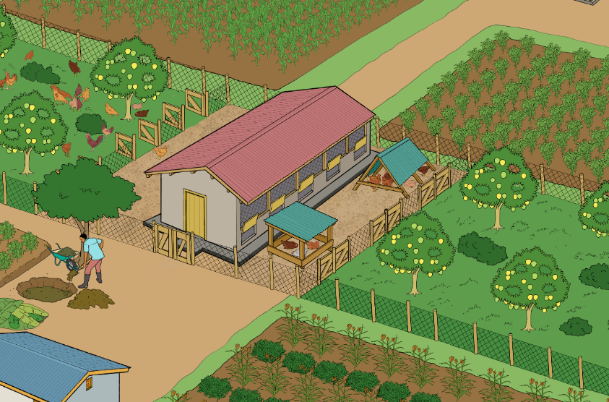
Focal points of organic poultry production
Organic poultry production does not aim for maximum performance, but to balance sustainable and environmentally friendly production of healthy food while accounting for animal welfare.
Limited flock size
No use of synthetic chemicals
No preventive use of antibiotics
Preferential use of robust breeds
Use of organically grown feed
Roosting in a house with daily access to an outdoor area
Recycling of chicken droppings as fertiliser for crops

Slide 6
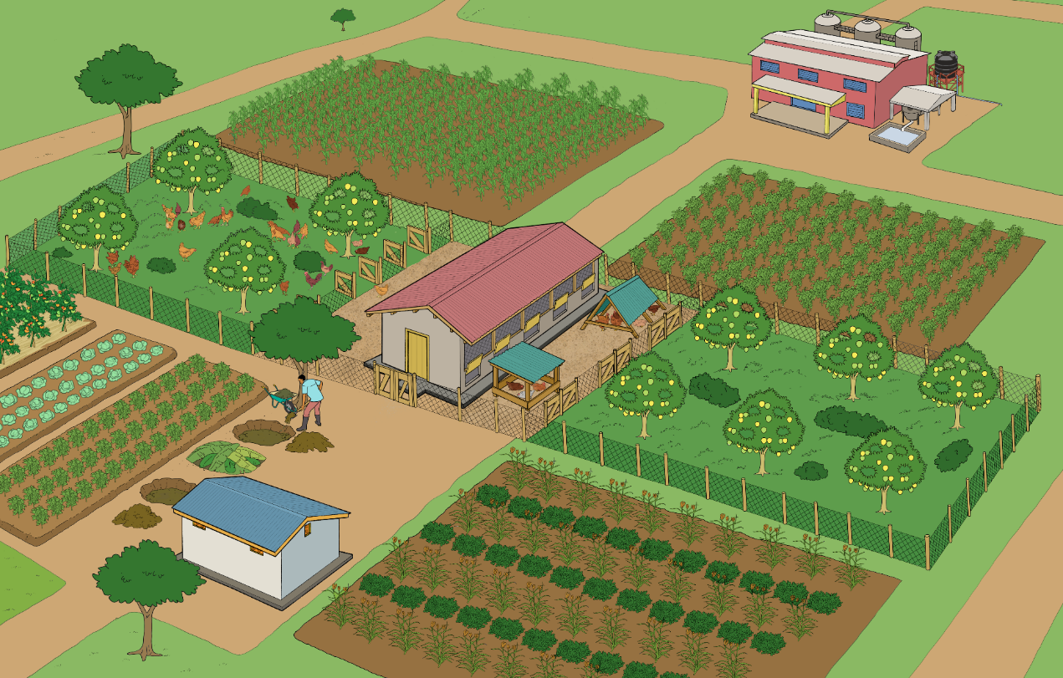
Integrating poultry into the farm cycle
Residues from processing are bought and fed to chickens
Chickens produce manure
Crop residues and harvest from the fields are fed to chickens
Manure is composted
Ripe compost is added to the fields to promote crop growth and soil fertility
Crops are harvested

Slide 7
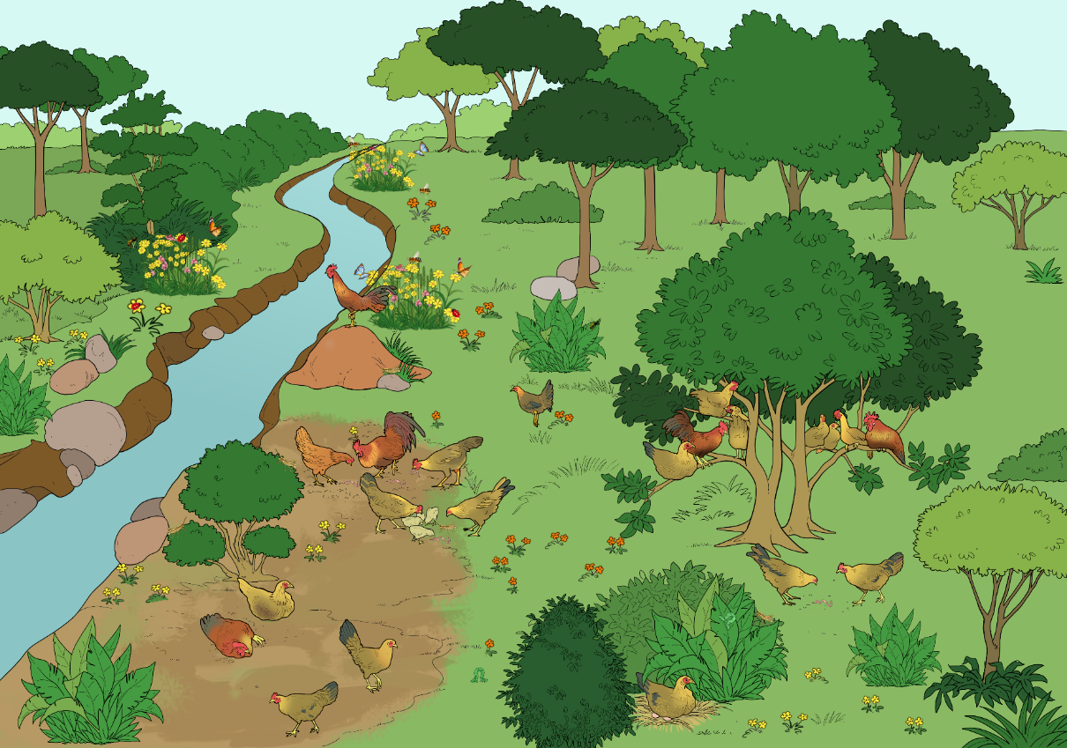
Behaviour of chickens in a natural habitat
Rooster watching out for predators
Hens and rooster perching on high branches
Hens scratching and searching for berries, seeds, caterpillars and insects
Hens dustbathing in sandy ground
Hens in hidden nests under bushes

Slide 8
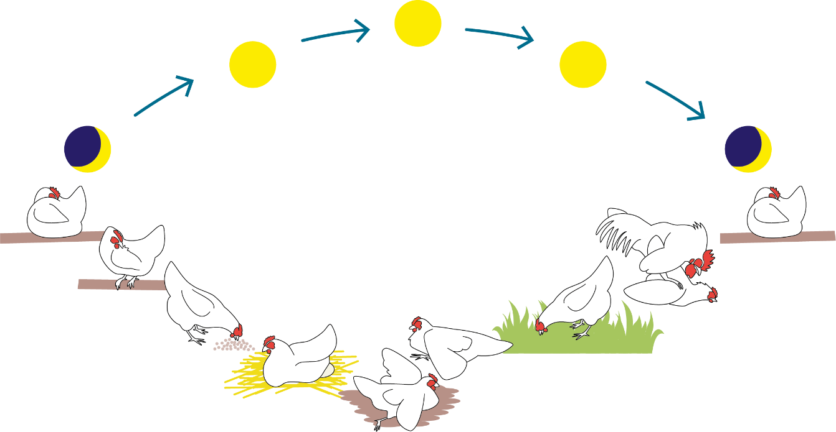
The daily routine of chickens
Noon
Morning
Evening
Night
Night
Sleeping
Sleeping
Cleaning
Mating
Foraging
Foraging
Sunbathing
Egg laying
Sand bathing
Source: Jan Hulsen. Chicken Signals. Practical guide to animal-friendly chicken husbandry. 2010, modified by FiBL

Slide 9
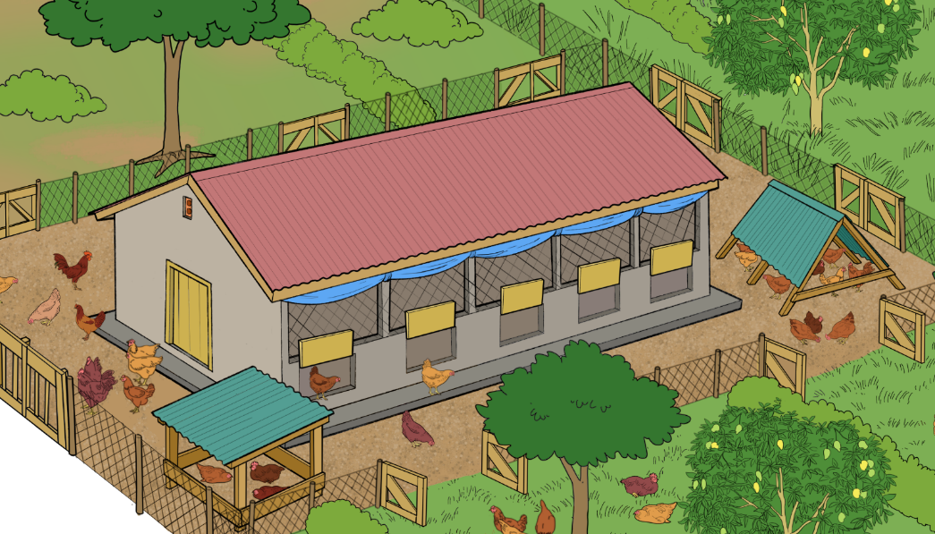
Open-sided housing
North
East
Overhang of 1 meter
Wide enough for at least two chickens
West
15 cm above the floor
20 cm above the floor
South
Large openings (protected with wire mesh) on both long sides of the building for sufficient aeration
House placed in east-west direction to minimise direct sunlight
Roof overhang of one meter for good protection from rain and direct sunlight
Raised pop holes (at least 20 cm above the floor) and door (at least 15 cm above the floor) to prevent flooding and allow easy opening of the door above the litter

Slide 10
Recommendations for organic poultry housing (1)
 | Laying hens | Layer pullets (11 to 18 weeks) | Chicks (until week 10) | Broilers
Stocking rate (animals per m² usable area) | Up to 5 | Up to 8 | Up to 14 | Up to 20 kg per m²
Proportion of littered scratch area (of usable area) | At least 1/3 | At least 1/3 | At least 1/3 | At least 2/3
Outside area (m² per animal) | At least 5 | At least 1 | At least 0.2 | At least 2
Nest area | Max. 5 hens per single nest; at least 120 cm² per hen in group nests | - | - | -
Perches (cm perch per animal) | At least 18 | At least 15 | At least 8 | At least 6 cm per kg live weight
Horizontal distance between between the perches (cm) | 30 | 25 | 20 | 20 to 25
Diameter of the perches (cm) | 3.5 to 5 | Same as adults or smaller | Same as adults or smaller | 3.5 to 5

Slide 11
Recommendations for organic poultry housing (2)
 | Laying hens | Layer pullets (11 to 18 weeks) | Chicks until week 10) | Broilers
Optimal temperature in °C | 18 to 22 | From week 8: 18 to 22 | Until week 8: 21 to 34 (2 °C decreasing per week of age) | Start at 32 °C, decrease to 20 °C in small steps in 5 to 7 weeks, depend. on weight gain
Required feeding place in cm (hand operated) | At least 16 per animal | At least 10 to 16 per animal | At least 3 per animal | 2.5 to 4 per kg live weight
Required feeding place in cm (mecha-nical; chain feeding) | At least 8 | At least 6 | At least 3 | At least 2
Required feeding place in cm (round feeder) | At least 3 | At least 3 | At least 2 | At least 1.5
Required place on round or lengthwise drinker in cm | At least 2.5 | At least 2 | At least 1 | At least 1
Required drinking troughs | At least 1 cup per 20 chickens | At least 1 cup per 25 chickens | At least 1 cup per 25 chickens | At least 1 cup per 25 chickens

Slide 12
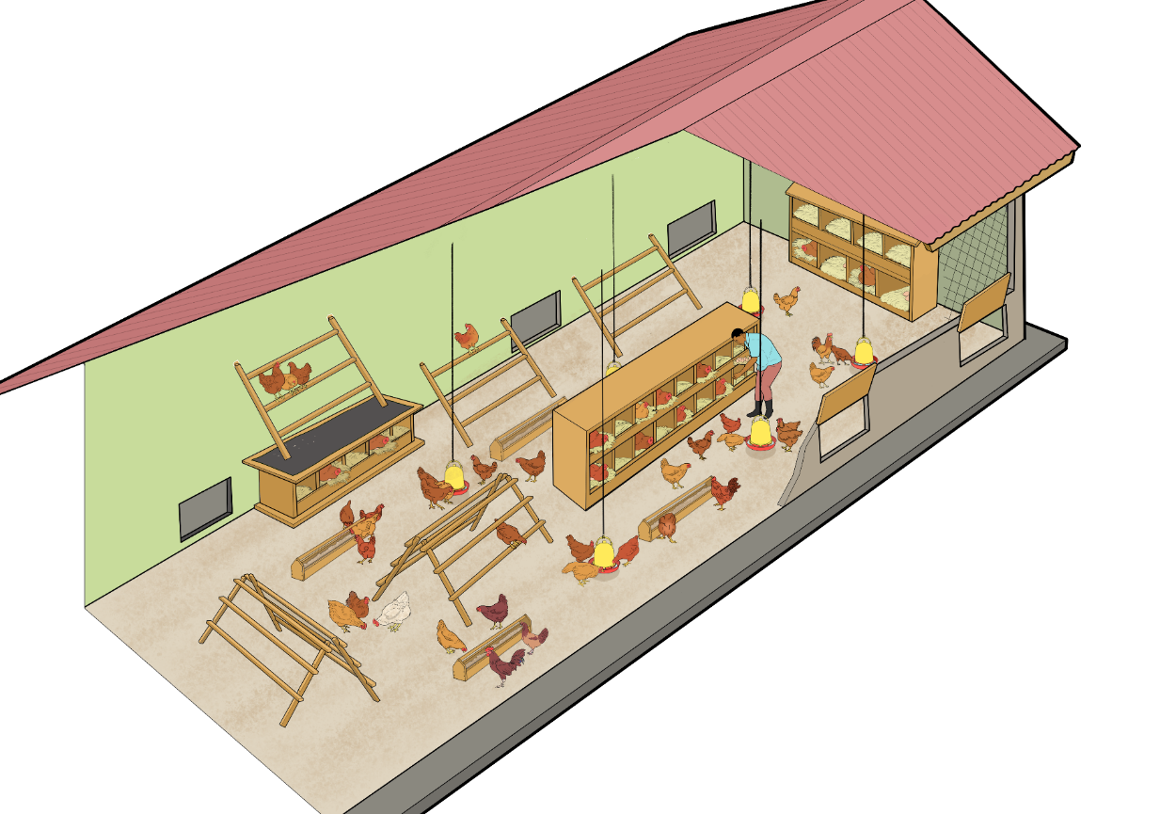
Species-appropriate furnishing of the poultry house
Perches at the wall
Nests
Pop holes to the outdoor area
Hanging feeders and drinkers
A-shape perches in the middle of the house
Feeders on the ground

Slide 13
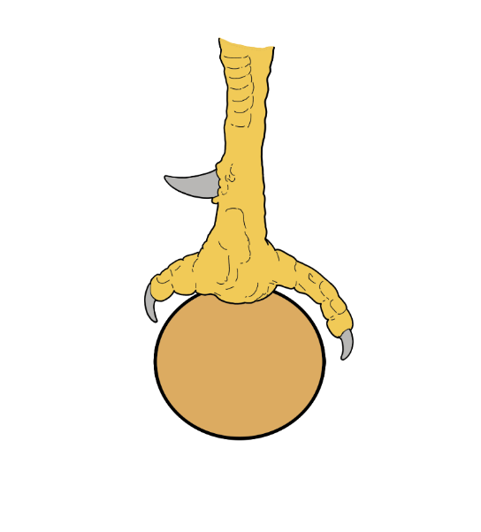
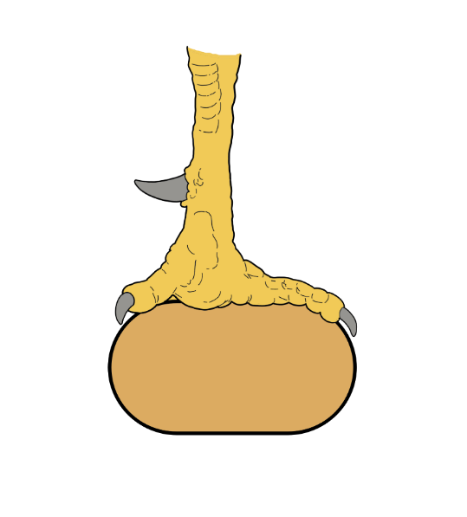
Appropriate shape of the perches
Diameter too small: The claws cannot grip properly and there is much pressure concentrated on the foot.
The claws find a good grip and the pressure is well spread across the foot.

Slide 14
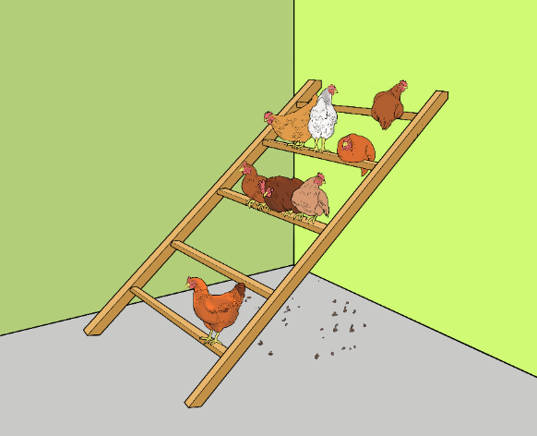
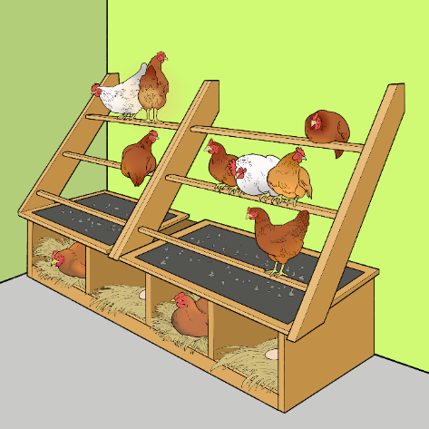
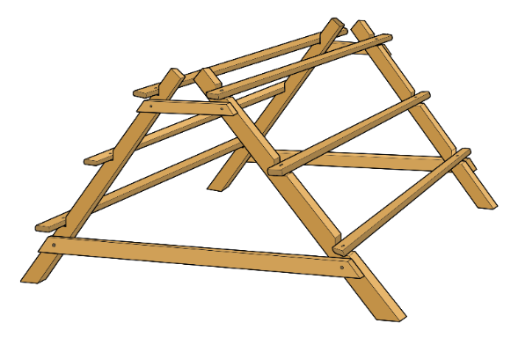
Types of perches
Attached to a wall
Above the laying nests (with a dropping board)
Free-standing

Slide 15
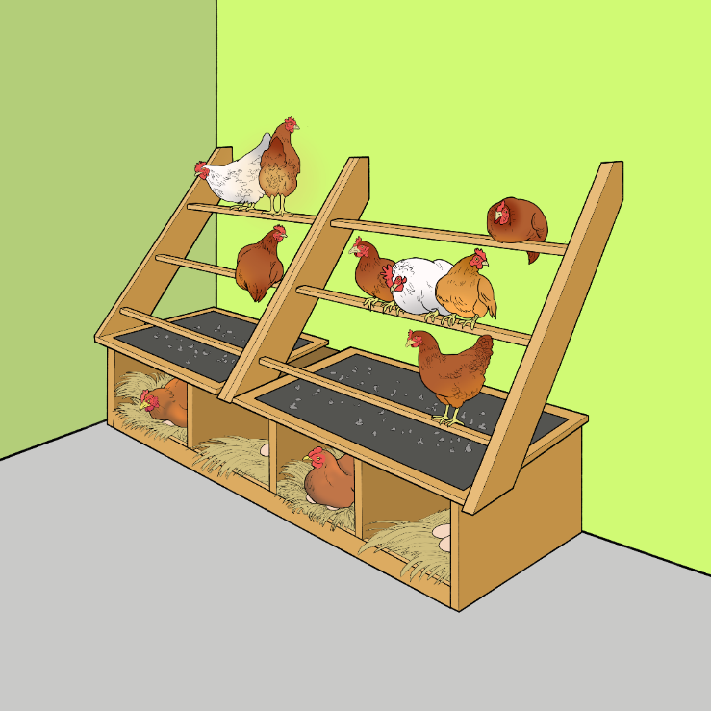
Proper installation of perches
Angled so that droppings do not fall on lower sitting chickens
Distance between the perches of 30 to 50 cm
Distance between the first perch and the wall of at least 20 cm
Dropping board below the perches to collect the droppings and use them as fertiliser for crops
Nests underneath the perches for laying eggs

Slide 16
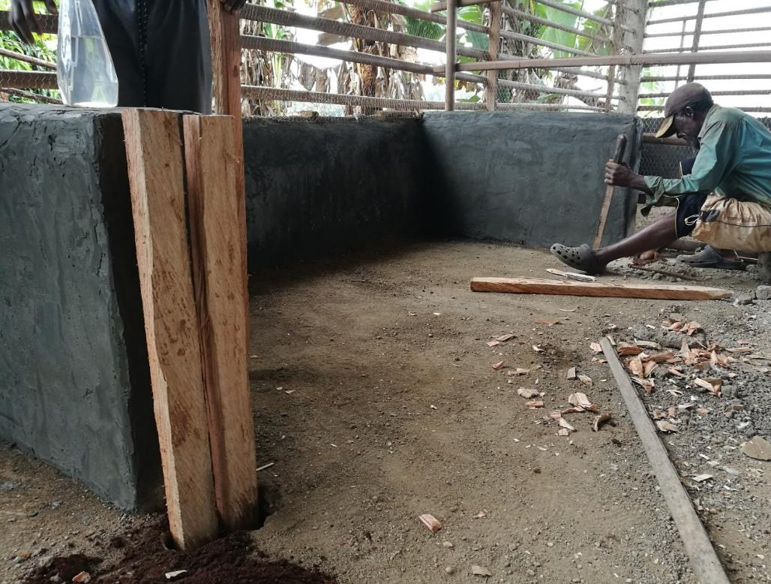
How to build a dropping pit (1)
Build the outer walls of the dropping pit (40 to 90 cm high)
The front wall will be made of removable boards for easy cleaning
Wooden posts are fixed to the floor to keep the front boards in place
Photo: Christiane Keppler

Slide 17
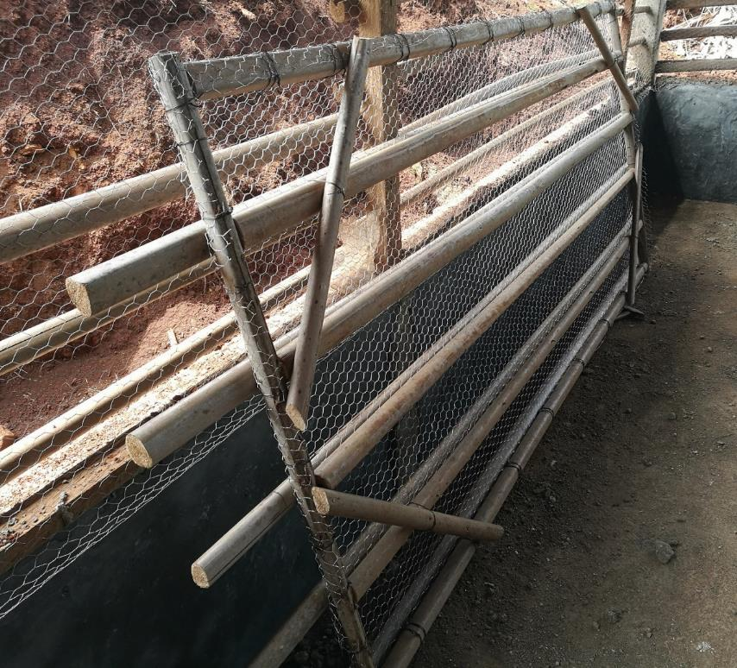
How to built a dropping pit (2)
Build a cover with wire mesh for the pit
Mount perches at a distance of 30 cm from each other on the upper side of the cover
Photo: Christiane Keppler

Slide 18
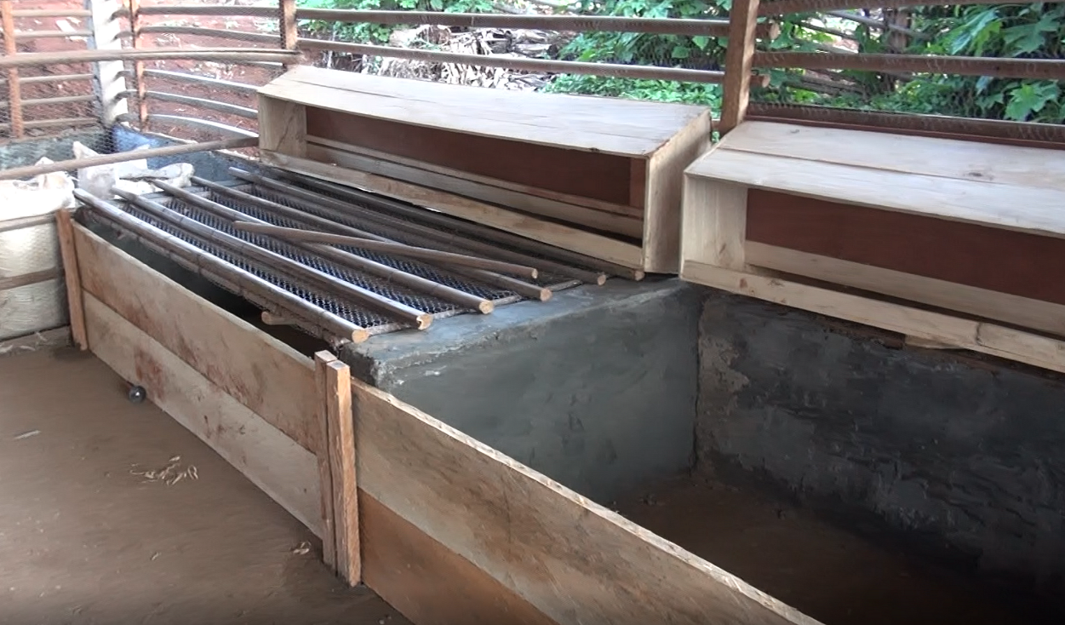
How to built a dropping pit (3)
Place the wire mesh cover with the perches onto the dropping pit
The edge of the dropping pit is a good place for nests
Put the front wall boards in place
Photo: Christiane Keppler

Slide 19
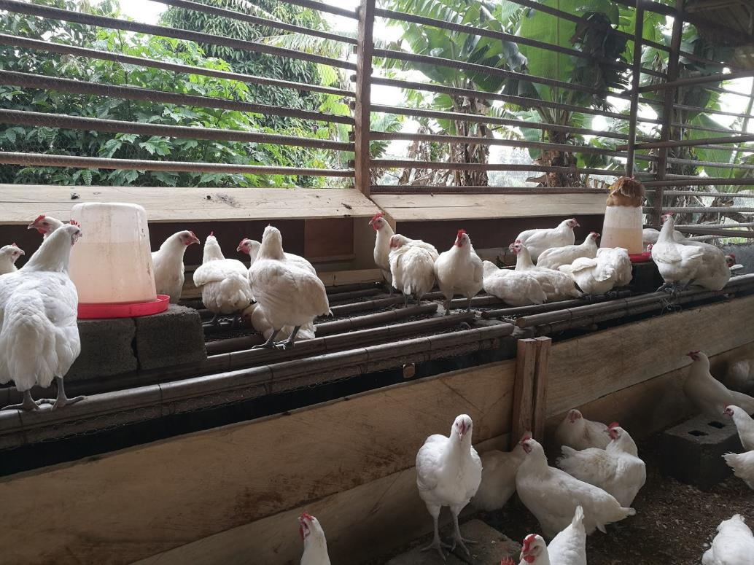
How to built a dropping pit (4)
Drinkers can be placed on elevated surfaces, if enough space remains for all hens on the perches
Photo: Christiane Keppler

Slide 20
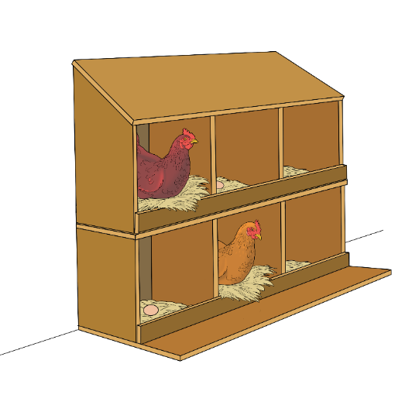
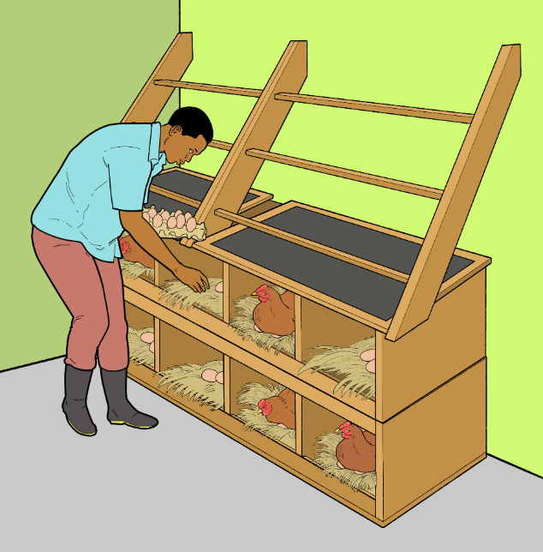
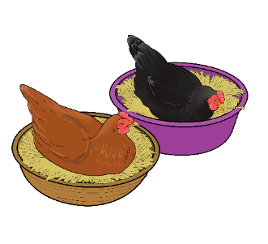
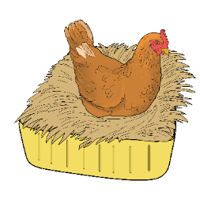
Types of nests
Nests in a shelf
Nests in a shelf below perches
Single nests filled with straw

Slide 21
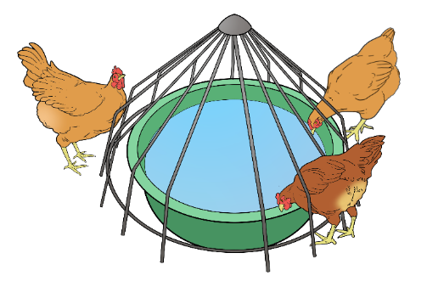
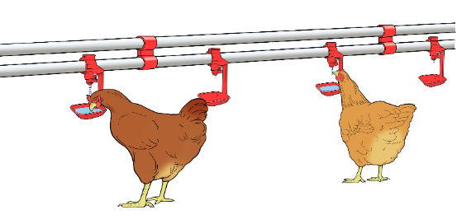
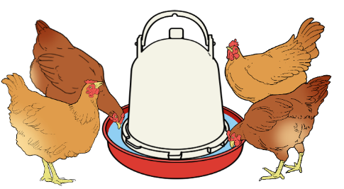
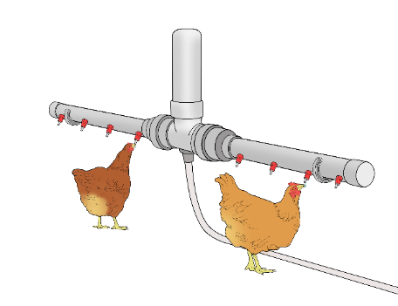
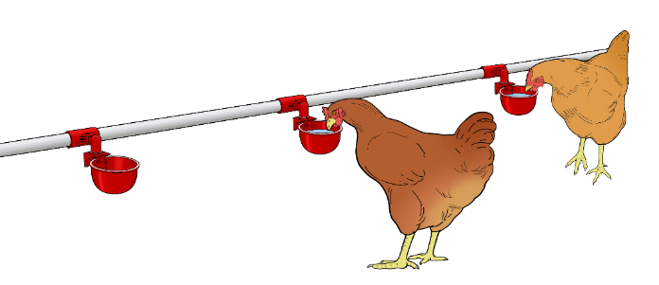
Types of drinkers
Nipple cup drinker
Water basin with grill
Self-regulating drinker
Nipple drinker
Not recommended for use alone: Additional drinkers with open water surface should be available
Cup drinker

Slide 22
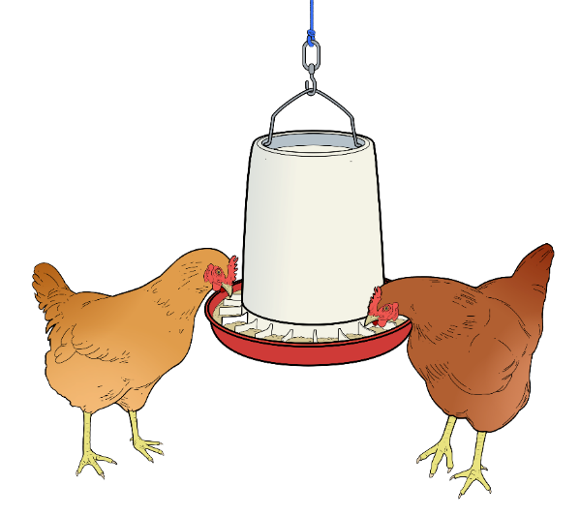
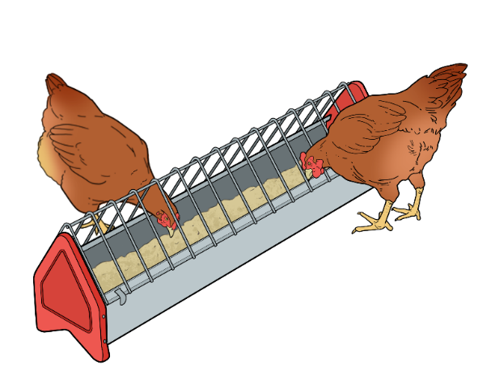
Types of feeders
Round feeder (suspended or placed on a flat stone)
Linear feeder

Slide 23
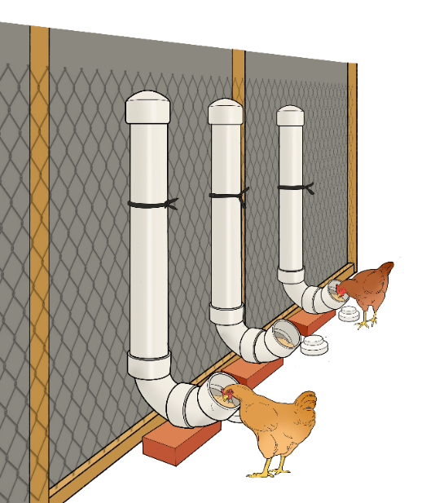
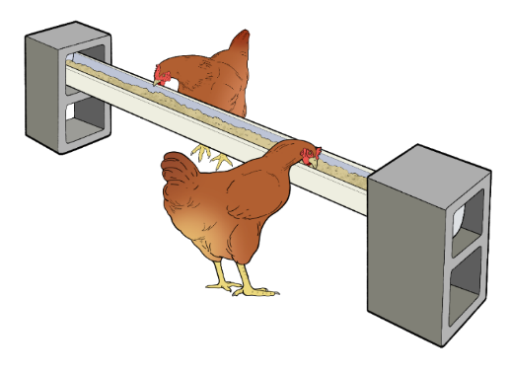
Self-made feeders
Self-made linear feeder
Self-made vertical feeders
Not recommended because it provides only very few feeding places

Slide 24
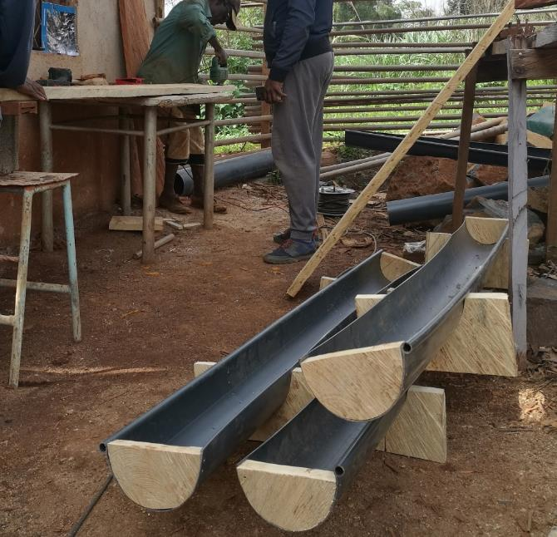
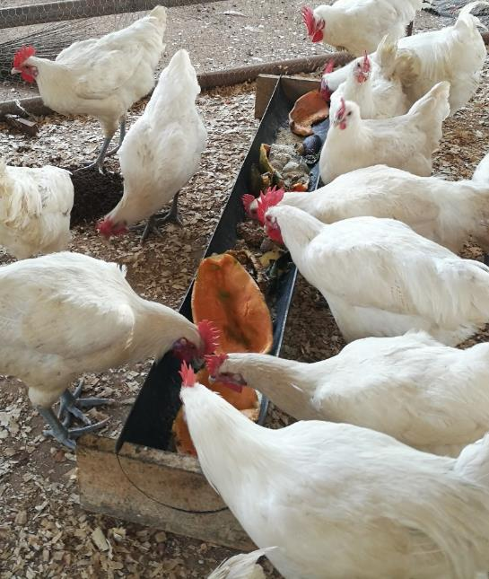
How to build linear feeders
Cut rain gutters into pieces of appropriate length (e.g. 120 to 180 cm)
Close the ends with pieces of wood
Photos: Christiane Keppler
Use the wooden counterparts as bases for the troughs

Slide 25
Cleaning and disinfection
Frequency | Measure
Daily | Empty and clean feeding and watering troughs. Remove wet and dirty bedding. Add dry bedding as necessary.
Weekly | Thoroughly clean and dry feeding and watering troughs (more frequently for chicks).
Monthly | Dust cracks and crevices with diatomaceous earth powder.
At the end of an “all-in/all-out” cycle, after a disease outbreak, or at least twice yearly | Fully clean and disinfect the chicken house.

Slide 26
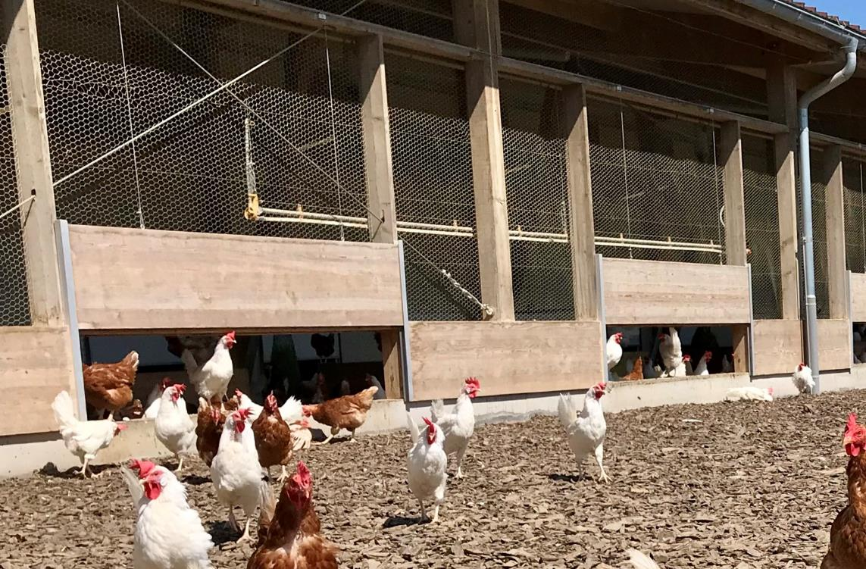
Pop holes
A rain gutter keeps the outdoor area close to the building dry and prevents chickens from carrying wet dirt inside
The pop holes must be wide enough to be used simultaneously by several chickens
Photo: Thomas Alföldi (FiBL)

Slide 27
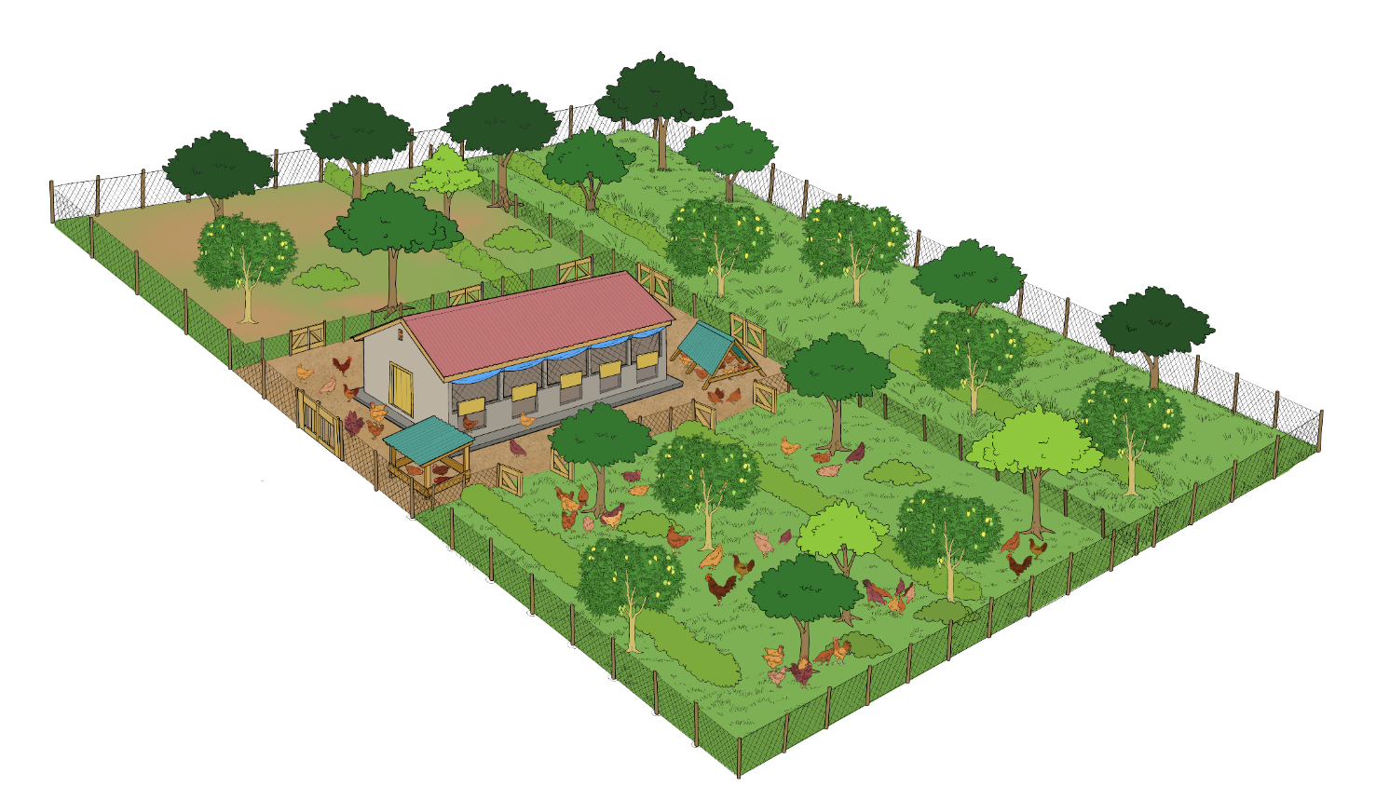
Setup of the pasture area
The pasture is divided into several sections, and chickens are allowed to graze on only one at a time
The chickens are moved into the next section when the grass is short, which allows the grass in the other sections to recover from grazing
Bushes and trees in the outdoor area allow the chickens to feel safe as they can hide
Shelters in the outdoor run offer protection and shade
The fence is buried in the ground to prevent predators from digging underneath

Slide 28
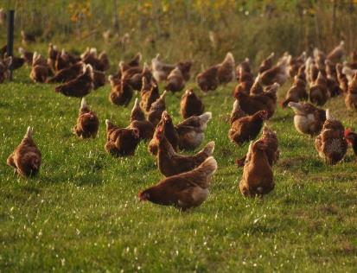
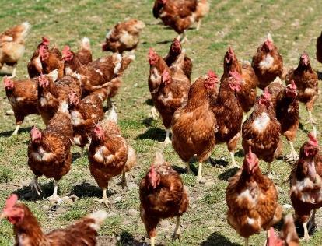
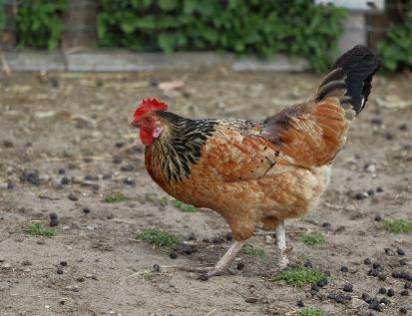
Management of the pasture area
Green run with sufficient food (grass, herbs, insects, etc.)
Strongly used green run with only remains of grass and herbs
Green run with bare soil that does provide no food or occupation to the hens. Valuable fertiliser will get lost when it rains and there is an increased risk of erosion.

Slide 29
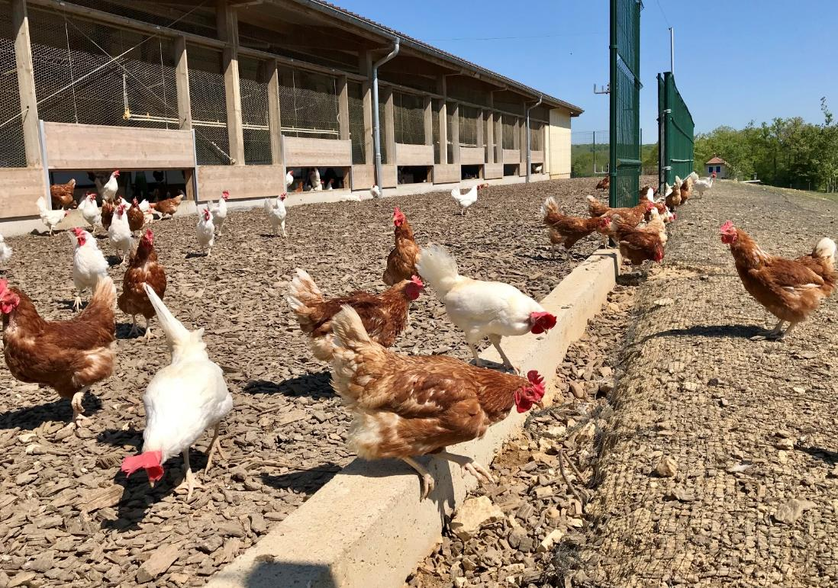
Chicken run
The area close to the hen house should be covered with recyclable material that can be composted and used as fertiliser
Photo: Thomas Alföldi (FiBL)

Slide 30
Alternatives to an exclusive chicken pasture
Instead of running in an exclusive chicken pasture, chickens can forage in...
Agroforestry systems
Orchards
Fields after harvest
Cattle pastures or pastures of other herbivores

Slide 31
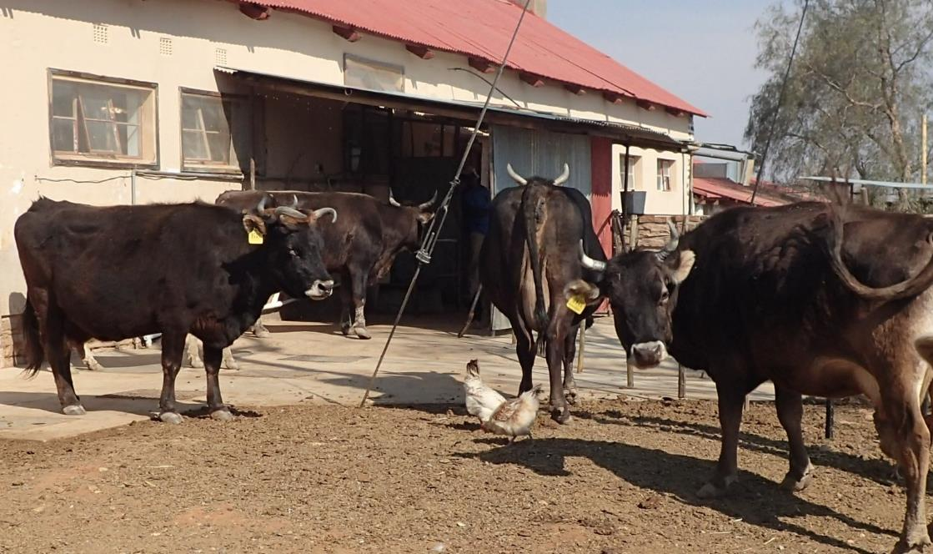
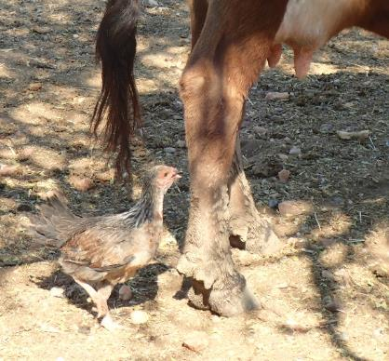
Hens foraging in cattle paddock
Hens feel protected from predators when close to herbivores
Photos: Christiane Keppler
Chickens feed on insects and mites attracted by herbivores

Slide 32
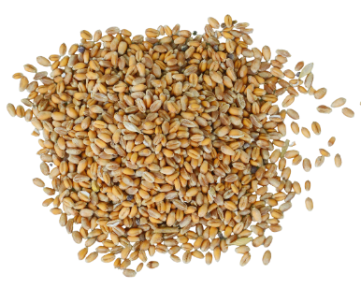
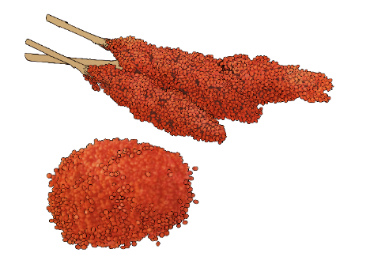
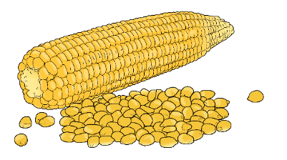
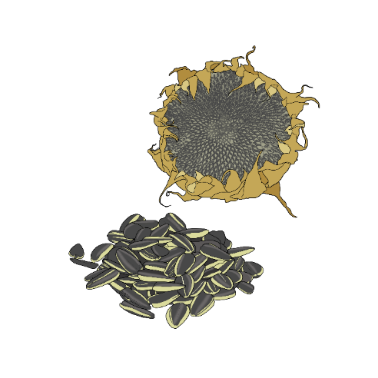
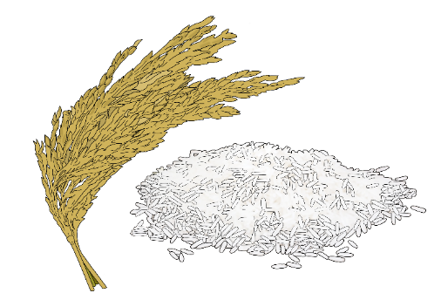
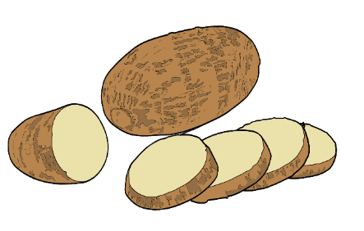
Plant-based feed components rich in energy
Wheat
Maize
Sorghum and millet
Rice
Sunflower
Yam

Slide 33
Common feed high in carbohydrates
Feed | Carbohydrates | Proteins | Fats | Minerals | Vitamins
Barley | +++ | + | + | + | +
Beans | +++ | +++ | + | + | ++
Maize | +++ | + | + | + | +
Millet | +++ | + | + | + | +
Oats | +++ | + | + | + | +
Peas | +++ | +++ | + | + | ++
Potatoes | +++ | + | – | + | +
Rice | +++ | + | + | + | +
Rye | +++ | + | – | + | +
Sorghum grain | +++ | + | + | + | +
Wheat | +++ | ++ | + | ++ | +
 | +++ high content, ++ medium content, + low content, - none Source: Ahlers C. et al., 2009, Improving village chicken production, p. 55, modified by FiBL

Slide 34
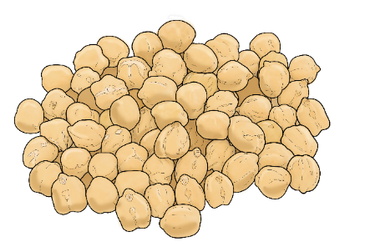
Plant-based protein-rich poultry feed components
Cowbeans
Mungbeans
Chick peas
Soy beans
Cassava leaves
Cereal sprouts
Lucerne pellets

Slide 35
Animal-based protein-rich poultry feed components
Termites
Worms
Insects
Insect larvae
Soldier fly meal
Fish
Fishmeal

Slide 36
Common protein-rich feed sources
Feed | Carbo- hydrates | Proteins | Fats | Minerals | Vitamins
Beans | +++ | +++ | + | + | ++
Cereal grains (sprouted) | +++ | ++ | + | + | +
Fish | + | +++ | ++ | +++ | +++
Groundnuts | ++ | +++ | +++ | + | +
Insects | ++ | +++ | ++ | +++ | +++
Insect larvae | ++ | +++ | ++ | +++ | ++
Leaves (various) | + | ++ | – | +++ | +++
Lupins | + | +++ | + | + | ++
Oilseed cakes | ++ | +++ | ++ | ++ | ++
Peas | +++ | +++ | + | + | ++
Rapeseed | ++ | +++ | +++ | ++ | ++
Soybeans | ++ | +++ | +++ | + | ++
Sunflower seed | + | +++ | +++ | ++ | +
Termites | ++ | +++ | ++ | +++ | +++
Worms | ++ | +++ | ++ | +++ | +++
+++ high content, ++ medium content, + low content, – none Source: Ahlers C. et al., 2009, Improving village chicken production, p. 55, , modified by FiBL

Slide 37
Notes on specific feed sources
Feed | Notes
Beans (e.g. soybeans, cowbeans, mungbeans) | Should be broken into pieces small enough to be swallowed easily by the chickens (but not ground to powder). Can be fed as sprouts (after sprouting under moist conditions for a few days; attention: avoid moulding, as mould is a health risk and can be poisonous). Soybeans must be heat treated before feeding, as untreated beans can be poisonous to chickens.
Cereal grains (sprouted) | Higher protein content and more vitamins after sprouting Avoid moulding during sprouting!
Leaves | Cassava and bean leaves have particularly high protein contents.
Insects (e.g. termites, ants, worms) | More insects if co-grazed with ruminants or if cow dung is dispersed in the poultry pasture Creating natural insect habitats like brush piles to the poultry pasture area can attract insects. Dispersal of the brush piles eases the access to the insects.
Oilseed cakes (e.g. cotton, sunflower, copra, sesame, palm kernel cakes) | Can be bought in case of a lack of other protein sources.

Slide 38
Common feed high in fats
Feed | Carbo-hydrates | Proteins | Fats | Minerals | Vitamins
Animal fats | – | – | +++ | – | –
Groundnuts | ++ | +++ | +++ | + | +
Plant oil | – | – | +++ | – | –
Soybeans | ++ | +++ | +++ | + | ++
Rapeseeds | ++ | +++ | +++ | ++ | ++
Sunflower seeds | + | +++ | +++ | ++ | +
 | +++ high content, ++ medium content, + low content, - none Source: Ahlers C. et al., 2009, Improving village chicken production, p. 55, modified by FiBL

Slide 39
Common feed high in minerals
Feed | Carbo- hydrates | Proteins | Fats | Minerals | Vitamins
Bones | – | – | – | +++ | –
Eggshells | – | – | – | +++ | –
Fish | + | +++ | ++ | +++ | +++
Fruit | + | + | + | +++ | +++
Insects | ++ | +++ | ++ | +++ | +++
Insect larvae | ++ | +++ | ++ | +++ | ++
Snail shells | – | – | – | +++ | –
Termites | ++ | +++ | ++ | +++ | +++
Tree and plant leaves | + | + | – | +++ | +++
Worms | ++ | +++ | ++ | +++ | +++
 | +++ high content, ++ medium content, + low content, - none Source: Ahlers C. et al., 2009, Improving village chicken production, p. 55, modified by FiBL

Slide 40
Common feed high in vitamins
Feed | Carbohydrates | Proteins | Fats | Minerals | Vitamins
Fish | + | +++ | ++ | +++ | +++
Fruit | + | + | + | +++ | +++
Insects | ++ | +++ | ++ | +++ | +++
Termites | ++ | +++ | ++ | +++ | +++
Tree and plant leaves | + | + | – | +++ | +++
Worms | ++ | +++ | ++ | +++ | +++
 | +++ high content, ++ medium content, + low content, - none Source: Ahlers C. et al., 2009, Improving village chicken production, p. 55, modified by FiBL

Slide 41
General nutrition guidelines for poultry
 | Carbohydrates (%) |  | Protein (%) | Fat (%) | Minerals (%) | Vitamins (%)
 | Quick energy | Fiber |  |  | Ca : P
Broiler (meat production)
Starter (1–3 weeks) | 68 - 69 | 2 - 3 | 22 | 5 | 1 : 1 | <1
Grower (4–6 weeks) | 68 - 69 | 3 | 20 | 6 | 1 - 2 : 1 | <1
Finisher (7+ weeks) | 70 - 71 | 3 | 18 | 6 | 1 - 2 : 1 | <1
Pullet (young hen)
Starter (1–6 weeks) | 70 - 71 | 3 - 4 | 20 | 4 | 1 : 1 | <1
Grower (7–18 weeks) | 69 - 74 | 3 - 7 | 17 | 4 | 1 - 2 : 1 | <1
Egg laying hen
Egg laying hen (19+ weeks) | 63 - 73 | 3 - 8 | 16 - 18 | 4 | 3 - 6 : 1 | <1
Source: Nutrition for the backyard flock, Larry Vest and Nick Dale, UGA Department of Poultry Science, Leaflet 396. https://extension.uga.edu/publications/detail.html?number=C954&title=Nutrition%20for%20the%20Backyard%20Flock

Slide 42
Appropriate stomach gravel sizes for poultry
Appropriate stone size by age of bird:
1st to 2nd week:
1 g per animal (diameter 1 - 2 mm)
3rd to 8th week:
2 g per animal (diameter 2 - 4 mm)
From 9th week:
3 g per animal per month (2 - 5 mm)
Stomach gravel

Slide 43
Advantages of roughages in poultry feeding
Benefits of offering cut plant material:
Satisfies the chickens’ instinctive need to eat structured feed and prevents boredom (and thus feather pecking and cannibalism).
Has a positive effect on the development and health of the gizzard and intestine (from the fibre).
Increases the utilisation of amino acids in the feed, reducing the nitrogen content in the urine and manure.
Keeps manure more firm, which keeps the litter dry and reduces infection pressure.
Roughage

Slide 44
Example of a feed ration for laying hens
Layer mash contains a suitable protein to energy ratio. It is the most commonly used feed for laying hens.
Stomach gravel breaks down the feed in the chicken stomach. If the chickens cannot find proper gravel outdoor, stomach gravel must be provided. Diameter 1 to 5 mm, depending on the age.
Layer mash
Stomach gravel
Roughage like hay, grass, alfalfa pellets or silage keeps the animals occupied. This can also add more protein to the ration.
Shell grit or other mineral sources should be provided to ensure sufficient mineral uptake. Diameter 1 to 5 mm, depending on the age.
Roughage
Enough clean water is important to keep the birds healthy.
Shell grit
Water

Slide 45
Types of feeding (1)
Type of feeding | Description | Best for… | Advantages | Disadvantages
Complete feed at free choice (ad libitum) | Permanently available feed mix containing all nutrients in the right proportions | Chicks Flocks of same age and similar performance | Simple Time-efficient Balanced nutrition | Some feed waste probable Selective consumption of feed components (can lead to imbalanced nutrition) in case of over-supply (solution: daily refilling of slightly more than the recommended daily ratio, so that chickens consume all components before the refill)
Cafeteria | Mixes of feed stuffs rich in carbohydrate, protein and calcium permanently available in separate containers. The animals choose according to their demands. | Flocks with mixed ages and/or with access to good quality pasture | Can be cost-saving. Allows birds at different life stages to fully meet their nutritional needs with one type of feeding. | While most birds only eat what they need, some birds may overeat and become too fat.

Slide 46
Types of feeding (2)
Type of feeding | Description | Best for… | Advantages | Disadvantages
Controlled (rationed) | Calculated daily feed allocation for the number, age and type of birds, and feeding of the exact amount | Flocks with birds of same age and type, where the farmer is very familiar with the nutritional needs, and keeps detailed records (eggs, weights, etc.) | Can be cost-saving Can prevent birds from becoming too fat in certain life stages because of overeating. | As the laying period progresses, the animals have more variable nutritional needs; the most productive birds may suffer from deficiencies and produce less. Requires close monitoring of the birds and record keeping; therefore time-consuming
Restrictive feeding | Purposely calculated reduction of the daily feed ration (in quantity, nutritional density (i.e. more fiber added) or duration of availability) to avoid overeating and birds becoming too fat or broody. | Birds with decreased or changed nutritional needs due to life stage Very efficient birds Dual purpose hens in egg production if they tend to become broody. | Can be cost-saving. Prevents birds from becoming too large. | Risk of underfeeding or deficiency, if a key nutritional component in the diet is forgotten.

Slide 47
Synchronisation of moulting
FiBL Moulting Program
Day | Light (hrs) | Laying hen feed (% of daily amount) | Bran | Running yard | Pasture
1 | 8 | Let the chickens empty the feeders, no new food | none | open | closed
2 to 14 | 8 | 0 | ad libitum | open | closed
15 | If the laying rate has not dropped to zero, continue with the regime from day 14. Only continue with the program, when egg production has ceased.
 | 9 | 50 | Let chickens empty the bran feeders, no new bran | open | closed
16 | 9 | 50 | Let chickens empty the bran feeders, no new bran | open | closed
17 | 9 | ad libitum | none | open | open
18 to 20 | 10 | ad libitum | none | open | open
21 to 23 | 11 | ad libitum | none | open | open
24 to 26 | 12 | ad libitum | none | open | open
27 – ? | 14* | ad libitum | none | open | open
* Further increase depending on the usual lighting programme.
Photo: Aviforum, Switzerland

Slide 48
Organic approach to animal health
The animal health strategy in organic farming is based on long and medium-term prevention of diseases. For disease treatment, complementary medicine methods are to be used preferentially.
very short term
Conventional medicine
in an emergency
short term
Complementary medicine methods
curative
medium-term
Optimisation of environmental conditions and animal management
preventive
long-term
Species- and location-appropriate animal breeding
preventive

Slide 49
Pillars of flock health and disease prevention
Breed known for their good health and productivity; healthy birds
Proper nutrition, clean water, little stress
Biosecurity measures that minimise the entry and spread of diseases
Clean and dry environment free of mould and droppings
Vaccination program for the farm
Housing with good ventilation, sufficient space, and an outdoor area allowing natural behaviour
“All-in/all-out” management
Quick and appropriate action in case of problems

Slide 50
Practical steps to creating a biosecure farm (1)
Establish a burn pile away from the chicken area to dispose of birds who have died of disease and contaminated bedding to avoid disease spread.
Create a sales and storage area outside the poultry area to prevent disease spread via clothing, boots and hands of visitors.
Add bedding, droppings, and the unusable parts of healthy birds from slaughter to the compost to add nutrients for crops.
Store any equipment that is used at the market (cages, egg trays, etc.) in this area, as they are difficult to clean and may carry disease.
If not practicing all-in/all-out, keep new birds separate from the main flock for 30 days. This prevents disease entry or spread via infected birds.

Slide 51
Practical steps to creating a biosecure farm (2)
Install hand washing stations with water and soap at the entry to each chicken house
Clean up spilled feed or standing water promptly to avoid attracting wild animals that may carry disease
Overall: Purchase healthy eggs / chicks / birds from a farm with good management, hygiene and vaccination practices
A perimeter fence helps to prevent disease entry via vehicles, guests, and other domestic and wild animals
Provide one pair of clean rubber shoes / boots at the entry of the chicken house for each worker and guest

Slide 52
How to catch chickens
Using a hook when catching chickens can make it much more easy and less stressful for animals and people.
Chicken are best picked up from behind by grasping the body of the animal with the hands from both sides.

Slide 53
How to hold chickens
Holding chickens properly

Slide 54
How to build a catching grid
Attach wire mesh to a (metal) frame
Attach several frames to each other
Photos: Christiane Keppler

Slide 55
How to use a catching grid
Don’t push the chickens too close together as they easily suffocate.
Corner the chickens with the catching grid
Pick up the chickens individually for inspection
Photo: Christiane Keppler

Slide 56
Characteristics of a healthy chicken
General attitude: alert, strong, eager to eat, normal growth for age (pullets and broilers), normal egg production for age (layers), normal weight for age, has no visible wounds or injuries.
Mental state and ease of movement: alert, coordinated, can walk and stand with ease
Comb (top of head) and wattles (under chin): bright uniform colour, fleshy and soft to the touch
Breathing: normal rate with no apparent effort, closed beak, silent breathing without sneezing or coughing
Nostrils and beak: clean with no discharge (like watery or runny nose), no unpleasant smell at nostril
Feathers: glossy and bright, no breaks or bald patches, no mites or lice
Eyes and sinuses (the area bet-ween the eye and the beak): clear and bright with no discharge (i.e. no watery eyes), not swollen
Eggs (if laying): normal in size, with hard shells without folds or deposits, and with yolk of an intensive colour
Crop (round sack felt underneath the skin to the right of the breast-bone): before feeding feels almost flat, after feeding feels full and firm
Vent or cloaca: clean, moist, and light pink; surrounding feathers clean and dry; without visible mites or lice
Legs and scales: scales are smooth and even-coloured
Droppings: should not be completely liquid (diarrhea) or contain blood; should not contain worms
Feet: skin under the feet should be uniform, with no discolorations, breaks in the skin, or ulcers

Slide 57
Characteristics of a sick chicken
General attitude: depressed, weak, reluctant to eat, standing alone with retracted neck and ruffled feathers, slow growth for age (pullets and broilers), reduced egg production for age (layers), weight loss, with visible wounds or injuries
Note: Sick chickens only show one or a few of the described symptoms! They rarely have all symptoms at once.
Mental state and ease of movement: maybe not knowing where it is, gazing at the sky or with a twisted neck, walking with a limp or difficulty, or not able to stand
Comb (top of head) and wattles (under the chin): dull colour, maybe with spots or scabs, dry and flat to the touch
Breathing: faster than normal rate, with effort, noisy, open beak, sneezing or coughing
Feathers: dirty and dull, broken feathers or bald patches visible, visible evidence of mites or lice
Nostrils and beak: watery or runny nose (may be clear or yellow-ish discharge), maybe unpleasant smell at the nostril
Vent or cloaca: enlarged or bloody, surrounding feathers wet/dirty, evidence of mites or visible lice
Eyes and sinuses (area between eye and beak): watery or runny eyes (may be clear or yellowish discharge), swollen sinuses (may be severe enough that the bird cannot open its eyes)
Droppings: maybe completely liquid (diarrhea), foamy, containing blood or worms
Crop (round sack felt underneath the skin to the right of the breastbone): hard after feeding in the evening, mushy and smelling like sour milk
Legs and scales: scales rough and raised
Feet: skin under the feet discoloured, with breaks in the skin or ulcers
Eggs (if laying): maybe of abnormal in size, with soft shells with folds or deposits, and yolk may have a dull colour
Photo: Christiane Keppler

Slide 58
Normal and abnormal poultry droppings
Normal: healthy chicken
Abnormal: diarrhoea
Abnormal: contains blood
Abnormal: diarrhoea with blood
Abnormal: foamy
Abnormal: with undigested feed
Photos: Christiane Keppler

Slide 59
Respiratory system
Air sacs
Functions
Allows the bird to breathe. Air enters the bird`s beak and nose, then follows the trachea to the lungs and the air sacs.
Disease symptoms
Difficulty breathing, possibly fast breathing and with open beak Sneezing or coughing
Lungs
Trachea

Slide 60
Digestive system
Functions
Allows the bird to eat and digest food. The food enters the beak, travels down the esophagus to the crop (a holding sac). In the gizzard (the stomach), the food is ground with the help of small stones. In the intestines, nutrients are absorbed. Digestion ends with the excretion of the droppings at the cloaca.
Disease symptoms
Crop is hard or emits a foul odor (impaction or sour crop). Loss of weight or diarrhea due to problems in the intestines. Heavy infestation with endoparasites visible as worm eggs or worms, or coccidian oocysts in the droppings.
Esophagus
Gizzard
Beak
Crop
Cloaca
Intestines

Slide 61
Nervous system
Brain
Functions
Allows the bird to be alert and conscious, react to its environment. It also controls and coordinates muscle movements. The nervous system is controlled by the brain, which receives messages from nerves.
Disease symptoms
Lack of orientation Disturbed muscle activity (neck bent backwards, difficulties walking)
Nerves

Slide 62
Musculoskeletal system
Bones
Functions
Skeletal structure of the body for support Muscles and joints for movement
Disease symptoms
Difficulty or inability to move Affected (i.e. swollen) joints Affected (i.e. thickened or broken) bones
Joints (not shown)
Muscles (not shown)

Slide 63
Integumentary system
Feathers
Functions
Encompasses the bird’s external body, including skin, feathers, beak, and legs.
Disease symptoms
Itching skin Wounds or damages to the skin Loss of feathers or reduced feather health Uneven and raised scales on the legs/feet
Skin
Beak
Legs

Slide 64
Reproductive system
Ovary
Functions
Allows female birds to create and lay eggs. It begins at the ovary. The egg is assembled as it travels down the oviduct. After 24 hours, a complete egg is laid through the cloaca.
Disease symptoms
Reduced egg production Reduced egg quality (irregular or no shells, deposits on the shell, or with abnormal contents)
Oviduct

Slide 65
Feather pecking and cannibalism
Feather pecking can lead to cannibalism, which leads to high losses (dead birds). Cannibalism can also occur without feather pecking, as vent pecking or toe pecking.
Feather pecking and cannibalism result from foraging behaviour (search for food). There is no aggressive motivation.
Requirements for prevention:
Good nutrition
Occupation of the hens
Early detection of problems
Quick countermeasures
Photos: Christiane Keppler

Slide 66
Signs of feather pecking and cannibalism
On observing any of these signs, action is needed!
Small pecking wounds (often hidden underneath the feathers)
Photo: Christine Brenninkmeyer
Bleeding wounds: immediately catch the chicken and keep it separately from the others
No feathers in the litter: feather eating due to lack of roughage
Bald patches (often hidden underneath longer feathers)
Photos: Christiane Keppler

Slide 67
How to prevent feather pecking and cannibalism
Choosing chicken breeds with a low tendency for feather pecking and cannibalism
Keeping the chickens busy
Giving the chickens daily access to the outdoor run
Buying young hens from flocks without pecking
Avoiding high stocking densities
Avoiding nutritional deficiencies and imbalances
Ensuring availability of roughage at any time
Ensuring that the hens use the nests for laying eggs
Seeking help from a poultry expert
Photo: Christiane Keppler

Slide 68
Viruses
What it is and how disease is caused | Importance in poultry | Examples | Importance in humans (zoonoses)
Submicroscopic infectious agents Enter the body through nose, beak, eyes, breaks in the skin (cuts), or with an insect sting Reproduce in the cells of the infected bird | Cause some of the most important diseases Are easily introduced to a flock (e.g. on clothes) Can spread quickly and cause high death rates in a flock . Must be prevented by vaccines and biosecurity, as there is no cure. | Newcastle Disease Infectious Bursal Disease (IBD) (Gumboro) Infectious Bronchitis (IB) Infectious Laryngotracheitis (ILT) Marek’s Disease Fowl Pox Avian influenza (AI, zoonotic) | Not common, but can occur (e.g. avian influenza “bird flu”). Can cause severe disease and death.

Slide 69
Bacteria and protozoa
What it is and how disease is caused | Importance in poultry | Examples | Importance in humans (zoonoses)
Microscopic organisms Enter the body through nose, mouth, eyes, breaks in the skin (cuts). Inside the body, they reproduce quickly. Produce toxins that damage the cells of the infected bird. | Can spread quickly and cause high death rates in flocks Coccidiosis is one of the most important poultry diseases after viral diseases. Some bacterial diseases can be prevented with vaccines (Coccidiosis). Most bacteria must be prevented with proper husbandry and biosecurity. Most are curable with antibiotics. | Protozoa: Coccidia (a very small endoparasite) Bacteria: Salmonella (zoonotic) E. coli (zoonotic) | Most common cause of bird-human (zoonotic) disease Infections of humans mostly through contaminated meat or eggs, or after contact with droppings and not washing hands before eating. Mostly mild symptoms in humans (diarrhea and intestinal upset), but can occasionally be severe and lead to death (e.g. Salmonellosis).

Slide 70
Parasites
What and how disease is caused | Importance in poultry | Examples | Importance in humans (zoonoses)
Visible by eye Internal parasites (endoparasites): Live inside the body of the birds Are taken up as eggs when foraging for food External parasites (ectoparasites): Live in the environment and/or on the birds Feed on the blood of the birds by biting them | Internal parasites can cause weight loss, diarrhea, and death External parasites can cause itching, blood loss, and death External parasites can also affect humans (zoonotic) | Internal parasites: Helminths Coccidia External parasites: Fleas (zoonotic) Ticks (zoonotic) Mites (some zoonotic) Lice | Internal parasites of poultry and poultry lice do not affect humans The external parasites usually prefer the bird hosts, but can also bite humans, causing itching, redness, and potentially spreading dangerous disease.

Slide 71
Fungi
What and how disease is caused | Importance in poultry | Examples | Importance in humans (zoonoses)
Decomposing organisms thriving in wet and dirty environments Produce microscopic spores that enter the body through mouth and nose and then go into the airways Damage airway cells, causing symptoms | Can cause high death rates in flocks, especially among young animals. Must be prevented by husbandry and biosecurity, as they cannot be cured. | Aspergillosis (brooder pneumonia) (zoonotic) | Spores can affect humans when breathed-in. Humans with weakened immune systems can develop severe pneumonia, which can lead to death.

Slide 72
Traditional breeds
Breed | Origin | Performance and traits
African Naked Neck | Africa | robust, especially in high temperature regions, good weight gain, egg production and egg quality
Australorp | Australia | good meat chicken with good laying performance; not good at flying
Boschveld | South Africa | robust and disease tolerant, low nutritional needs; good layer
Bresse | France | dual-purpose with good meat quality; early onset of lay, eggs rather small
Kuroiler | India | good egg production and weight gain
New Hamphire | North America | fast growing and early onset of lay
Noiler | Nigeria | good weight gain
Orpington | England | heavy dual-purpose, tendency to become broody
Ovambo | Namibia | high egg and meat production; small and agile
Potchefstroom Koekoek | South Africa | dual-purpose, well suited for free range; sufficiently broody
Rhode Island Red | North America | good dual purpose; early start of laying between 18 and 24 weeks of age
Shika-Brown | Nigeria | good egg production
Silky chicken | China | very good for brooding eggs and good mothers; small, not a good layer, rather low production
White Rock | North America | dual-purpose with good meat quality

Slide 73
Requirements for raising chicks (1)
Thoroughly cleaned and disinfected stable before placing the chicks
Fresh air is important, without draught or high temperature fluctuations
Dry conditions at all times
Blocked corners to prevent smothering
Heat source + dry litter = fire risk! Keep at a safe distance from each other!
Temperature is around 34 ºC in the first few days
Feeders and drinkers are adjusted to the chicken`s size
Small perches or similar installations should be provided from the first day on
Photo: Christiane Keppler

Slide 74
Requirements for raising chicks (2)
The chicks can be confined to a smaller part of the stable for the first week (brooder guard)
Chicks need perches from the first week of age
The height of feeders and drinkers is adjusted to the chick’s size
Brooder guards must have round corners
Photos: Christiane Keppler

Slide 75
How to assess the temperature for chicks
Chicks away from the heat source and/or with open beaks and spread wings
Chicks in clusters and close to the heat source
X
Too cold
X
Too hot
Chicks cluster on one side
Chicks more or less evenly distributed (no clustering)
X
Drafty
Right Temperaure
Litter material catches fire easily! Keep that in mind when installing heat sources

Slide 76
Offering occupation to chicks and chickens (1)
Providing occupation from the start helps to prevent feather pecking.
Straw
Green plants as fresh feed
Perches
Dust bath (sand) with entry holes on both sides
Dry litter
Photo: Christiane Keppler

Slide 77
Offering occupation to chicks and chickens (2)
A clean plastic bucket filled with a thick layer of sand can serve as a small dust bath.
A peck stone is a good occupation and rounds-off the beak.
Photo: Christiane Keppler

Slide 78
How to build an indoor dust bath
Take a mortar bucket.
Cut two holes in it on opposite sides.
The holes should be about 6 cm above the bucket floor.
Holes must be large enough for a hen!
Fill with a thick layer of sand.
A dust bath with sand should be offered from the beginning.
Only use buckets with holes to allow chickens to escape at the bottom when other chickens enter at the top. Chickens at the bottom may be crushed otherwise!
Photos: Christiane Keppler

Slide 79
Products from poultry
Eggs
Chicken meat
Additional products:
Poultry litter
Manure as fertiliser
Chicks and other live animals

Slide 80
Transport of living poultry
All animals should be in the cage.
X X
Large numbers of chickens can be transported on a van. However, good aeration must be assured for the chickens in the center!
Transporting chickens on a motorcycle
How to ensure animal welfare during transport:
Load and drive in the dark.
Ensure good aeration during transport. Accumulated heat can lead to overheating and death of the chickens. Dead birds cannot be sold anymore.
The time period from loading to slaughter should be not more 8 hours.
Transport healthy animals only.
Drive carefully and steadily.
If chickens are injured or die, try to identify the reasons.
Transport container for chickens

Slide 81
Checklist on expected costs (1)
Initial investments
Poultry house: walls, floor, roof, electricity, lighting, perches, manure management, nest boxes, feeders, drinkers, bedding Poultry run: fencing, bedding, structures like covered sand baths Pasture system: fencing, tree and bush planting, additional shelters Storage area: cool storage for eggs, egg trays, cold storage for meat, etc. Market sales equipment: egg trays, crates, etc. Transport equipment for live animals: crates, etc. Egg incubation equipment (if desired) Chick rearing equipment: enclosure, heating system, lights, small feeders and drinkers Biosecurity: hand washing stations and clean boots in each house, perimeter fence around chicken area, burn pit, compost pit, quarantine house for new birds, storage and sales area outside the chicken area Cleaning supplies: broom, scraper, garden sprayer, organic approved chemicals and substances First aid supplies: disinfectant, place to separate injured birds

Slide 82
Checklist on expected costs (2)
Ongoing operational costs
Animals: eggs, chicks, pullets, adult birds, etc. Feed: base feed, vitamins, minerals; own crops that are used for feed need to be taken into account in the budget, too Water Bedding and litter Veterinary care: vaccines, visit and medication costs Transport Slaughter and processing Marketing Labour Technical advice: extension services, organic groups Building and equipment maintenance Loan repayment and interest Other unforeseen costs: always budget some room for these

Slide 83
Participatory Guarantee Systems (PGS)
Strengths
All stakeholders can get involved (farmers, consumers, business) and can manage and change the system, leading to shared responsibilities and active participations in the guarantee system;
May innovate an appropriate guarantee mechanism, helping to reduce guarantee costs;
Facilitates knowledge exchange among producers and stakeholders, contributing to a better understanding and appreciation of organic agriculture;
Enables small producers to access organic markets (through being certified) and consumers to access local food/organic products at reasonable prices.
Limitations
It relies on the participation of local producers and supporters, most of whom doing the works as volunteers, it thus takes a longer time and may have high hidden costs (non-monetary);
It is a self-guarantee system (by either first or second party), thus recognition is low compared to third party certification.
Products can be marketed locally or at the most within the country, not internationally;
Each group may have different standards, as well as their own PGS seals, causing confusion among consumers;
The system is based on trust among different stakeholders, if trust is undermined (e.g. poor relationships), it can also affect the PGS.

