Slide 1
Profitability on ecological organic farms in the Tropics
Major factors to achieve good profits
Event, date, presenter, email, etc.

Slide 2
Table of contents
Profitability
Introduction
Key findings
How can organic farms be profitable?
Factors to consider
Labor costs
Organic inputs
Organic best practices
Post-harvest practices
Market access
Notes:
This factsheet introduces how organic famers can achieve a good profitability, highlighting some of the major factors from the experiences of the research related to profitability: labour, organic inputs, best practices and market access. The information is based on long-term experiments and on-farm research conducted in the scope of three projects across different countries in Africa, as well as Bolivia and India.

Slide 3
Introducing profitability on ecological organic farms
Organic farming is often perceived as less profitable, but research has shown that well-managed organic farms’ profitability can match or exceed conventional, due to:
lower costs for external market purchased inputs, and
higher market value of organic produce
Simply speaking: farm profitability is the achieved yields and the prices for marketable products minus variable production costs
Notes:
Profitability is a key factor affecting the choices of farmers. Ecological organic farming provides many benefits for health, environment and social welfare, but is generally perceived as not as profitable as conventional due to the lower yields and high labour costs. However, current research has demonstrated that farm profitability on actively-managed organic farms can match or exceed those of conventional. In organic systems, lower costs for external, market purchased inputs and higher market value of organic produce can often compensate the economic loss due to lower yield.
What is productivity? In this factsheet, we define the profitability of a production system as the gross margins and return on economic and labour investments of a farm. Simply speaking, the achieved yields and the prices for marketable products minus variable production costs. Return on investment shows how much profit was earned per labour hour or money invested.

Slide 4
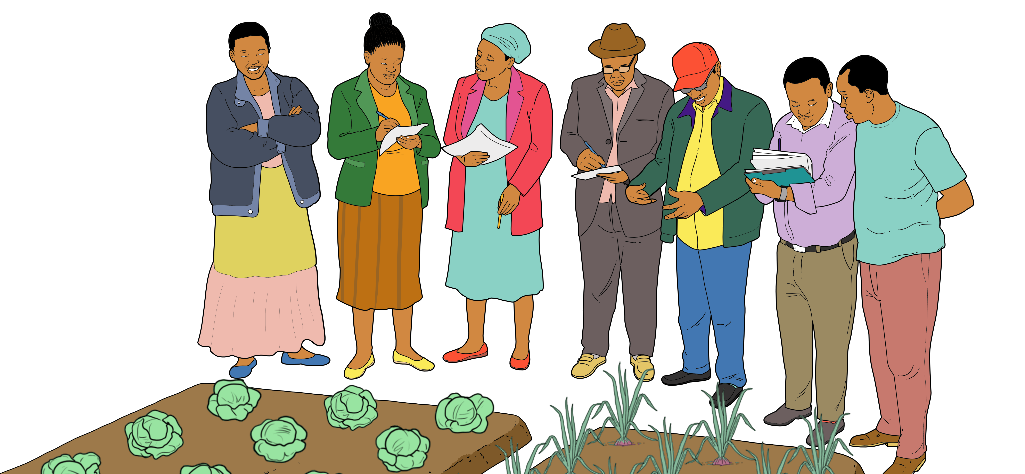
Key findings from the research
Profitability depends mainly on productivity – holistic management needed
Organic systems can be as or more profitable than conventional systems
No silver bullet: various measures can increase profit
Farm diversity can ensure economic resilience
Notes:
Key messages from the research
Profitability of organic system was found to be mainly influenced by crop productivity.
With a holistic, active management approach and implementing good agricultural practices, ecological organic farms can match or exceed the yields of conventional systems and, therefore, be profitable.
There is no silver bullet for increasing profitability among organic smallholder farmers – profit increasing activities can be associated with labour input, crop type and best practices.
Farm diversification can help to ensure economic resilience, e.g., diverse production through crop rotations, mixed cropping, etc.

Slide 5
How can organic farms be profitable?
Expect initial yield losses (~5-20%) after conversion
~5 years after conversion to organic to get best return on investments
Focus on long-term health and productivity
Organic production has lower costs for external, market purchased inputs
Organic products have higher market value
Choose crops that perform well in organic systems and have a good market
Notes:
During the initial years of converting from conventional to ecological organic production, farmers can expect a decrease in yields, often estimated between 5 and 20% - as the soil recovers fertility and farmers learn new holistic management techniques. This required a bit of patience, as on average, farmers converting to organic production need around five years to get the best return for their investment. Farmers transitioning their farms to ecological management are advised to start small, converting their farm piece by piece.
Organic farms with active ecological management can outperform farms with non-active management and match or exceed conventional farms, with high input and capital demands. Conventional systems require more market-purchased inputs and therefore have the potential to make capital-poor families more vulnerable to cycles of debt. In ecological organic systems, lower costs for external, market purchased inputs and higher market value of organic produce can compensate the economic loss due to lower yields of some crops with do not perform as well in organic systems, e.g., wheat, brassicas. The return on investment, in terms of both production and labour costs, makes organic arable systems a more suitable choice for smallholder farmers who have limited capital for investments.
In Kenya, from year three of active organic production, the profitability of the organic system was similar to conventional (without the organic price premium). With 25 to 50% premium prices on organic products, profitability in the actively-managed organic system was higher than the profit from the conventional system.
To optimise profitability, focus on crops that perform particuarly well in organic systems - see the 'Productivity' factsheet, pg. 5 and 6 - and those crops which have a good organic market in your region or for export, detailed in the following section.

Slide 6
Major factors to consider regarding farm profitability
Labour costs
Organic inputs
Organic best
practices
Post-harvest
Market access
Notes:
Ecological organic systems take a holistic system approach, considering long-term farm sustainability, diversity, quality and health of the system. This is in contrast to the standard approach which focuses on short-term efficiency, yields and income. The holistic organic approach requires a focus on the health and productivity of the whole farm system over the long-term using organic best practices. Refer to the ‘Ecological approach’ factsheet, video, etc. to go deeper into this topic. This difference in approach means organic farmers face different challenges regarding productivity and profitability. For example, on ecological organic farms labour is a major factor contributing to production costs, (e.g., labour for fertiliser preperation, as was found in SysCom Kenya). In conventional systems, production costs are mainly determined by the costs for external inputs. It is essential to keep good farm records, in order to see which crops are most successful and adapt accordingly. In this section, some important factors regarding profitability on organic farms are explained.

Slide 7
Labour costs
Often higher in organic – how can organic farmers ensure returns on investment?
Labour demands, e.g., for compost preparation, contribute strongly to production costs in organic systems
Organic systems can achieve higher returns on production costs (SysCom India) and equal returns on labour (SysCom Bolivia)
Agroforestry systems – although more labour intensive, return on labour was almost double in the agroforestry systems compared to monocultures
Notes:
Labour costs are often higher in organic – how can organic farmers ensure returns on labour investments? Return on labour measures the gain or loss generated per unit of labour used.
We found that labour demands, e.g., for compost preparation and weeding, contribute strongly to production costs in organic systems. However, this higher investment does not need to result in a loss of profitability. In fact, organic systems can achieve higher returns on production costs (SysCom India, ProEcoAfrica in Kenya) and equal returns on labour (SysCom Bolivia, some ProEcoAfrica cases in Ghana and Kenya), making it a suitable option, particularly for capital-poor smallholders.

Slide 8
Organic inputs
Ecological organic does not mean low input - on the contrary! Organic farmers do not rely on external inputs but utilises on-farm resources to recycle nutrients locally.
Organic farmers should produce self-made inputs from composts to biorationals (e.g. botanical pesticides)
made from locally available, sustainable resources – safe for human health and the environment
labour intensive, but more economical
Organic composts can increase fertility and thus reduce risks
Notes:
Organic inputs Ecological organic does not mean low input – on the contrary! Organic farmers do not rely on external inputs to feed their soil and protect their plants but rather utilise on-farm resources to recycle nutrients locally – this is the holistic ecological approach.
Organic farms should produce self-made inputs, from composts to biorationals (e.g., botanicals). Although the preparation of these inputs is labour-intensive, input costs are reduced significantly. Additionally, self-made inputs are made from locally available and sustainable resources, and are safe for farmers, their communities and the environment, when produced and handled correctly. The use of organic composts also protects soils. We found that after six years of active organic management, using high-quality, self-made composts, soil fertility was built at a faster rate compared to conventional soils. This approach can better support sustainable soil fertility management and crop production in sub-Saharan Africa compared to high or low-input conventional production systems. See the ‘Soil fertility and health’ factsheet, poster, video, etc. to go deeper into this topic > Link.

Slide 9
Organic best practices
Profitability is directly dependent on productivity. Improved on-farm practices through a holistic ecological approach are the key.
Healthy soil, healthy crops
Use local adapted seeds
Prevent pests and diseases
Plan, learn and experiment
Cultivate a diversity of crops
Integrate agroforestry systems
Go deeper into best practices in the ‘Productivity’ topic
Notes:
Farm profitability is directly dependent on productivity. In well-managed organic systems, farm productivity can match or exceed conventional systems. Improved on-farm practices through a holistic ecological approach are the key. Some major considerations are outlined here, to go deeper into the topic refer to the 'Productivity' factsheet:
Healthy soil, healthy crops: focus on the longterm build up of soil fertility, organic matter and biological activity, e.g., apply high-quality organic inputs, adjust the timing of input application, intercrop complimentary crops, and mulch or hoe at the right time (e.g., fruit setting).
Use locally adapted varieties and livestock races
Prevent pest and disease attacks: integrate pest and disease management on your farm. Refer to the 'Pest and disease' factsheet to get more information.
Plan, learn and experiment: Establish a flexible plan that allows for experiments, test and adapt farming practices gradually.
Cultivate a diversity of crops: this can increase the overall farm productivity and contribute to improved nutrition and higher incomes. Intercropping is an example of this, however, it is important to find mixtures that complement one another.
Agroforestry: In addition to the economic benefits, the total system benefits realised in agroforestry systems are much higher.

Slide 10
Post-harvest
The profitability of farms is further affected by post-harvest handling operations and management practices, e.g., sorting, cleaning, and grading.
Shading and cooling: important for products which are sensitive to heat
Transportation and distance to markets are important factors
Prevent pest and disease damage to harvested products: ensure proper storage, protection from rodents, etc.
Some postharvest operations are labour intensive = costly – hence reducing profitability
Notes:
Profitability of farms is further affected by post-harvest handling operations and management practices, e.g., sorting, cleaning, grading, processing, packaging, storing and transportation. Good post-harvest practices can help to maintain or enhance the quality and profitability of farm produce.
Some major factors to consider:
• Shading and cooling are especially important for products which are sensitive to heat or high temperatures, e.g., fruit and vegetables.
• Transportation and distance to markets are important factors. Some organic buyers, e.g., Kenyan organic macadamia nut farmers, provide local collection points, reducing transportation costs to farmers and ensuring quality checks.
• Pest and disease damage to harvested products can lead to significant losses. Organic farmers must continue best practices even after the harvest to maintain high product quality.
• Good clean storage facilities are important for harvested products.
• Some post-harvest operations are labour intensive, costly and hence reduce profitability.

Slide 11
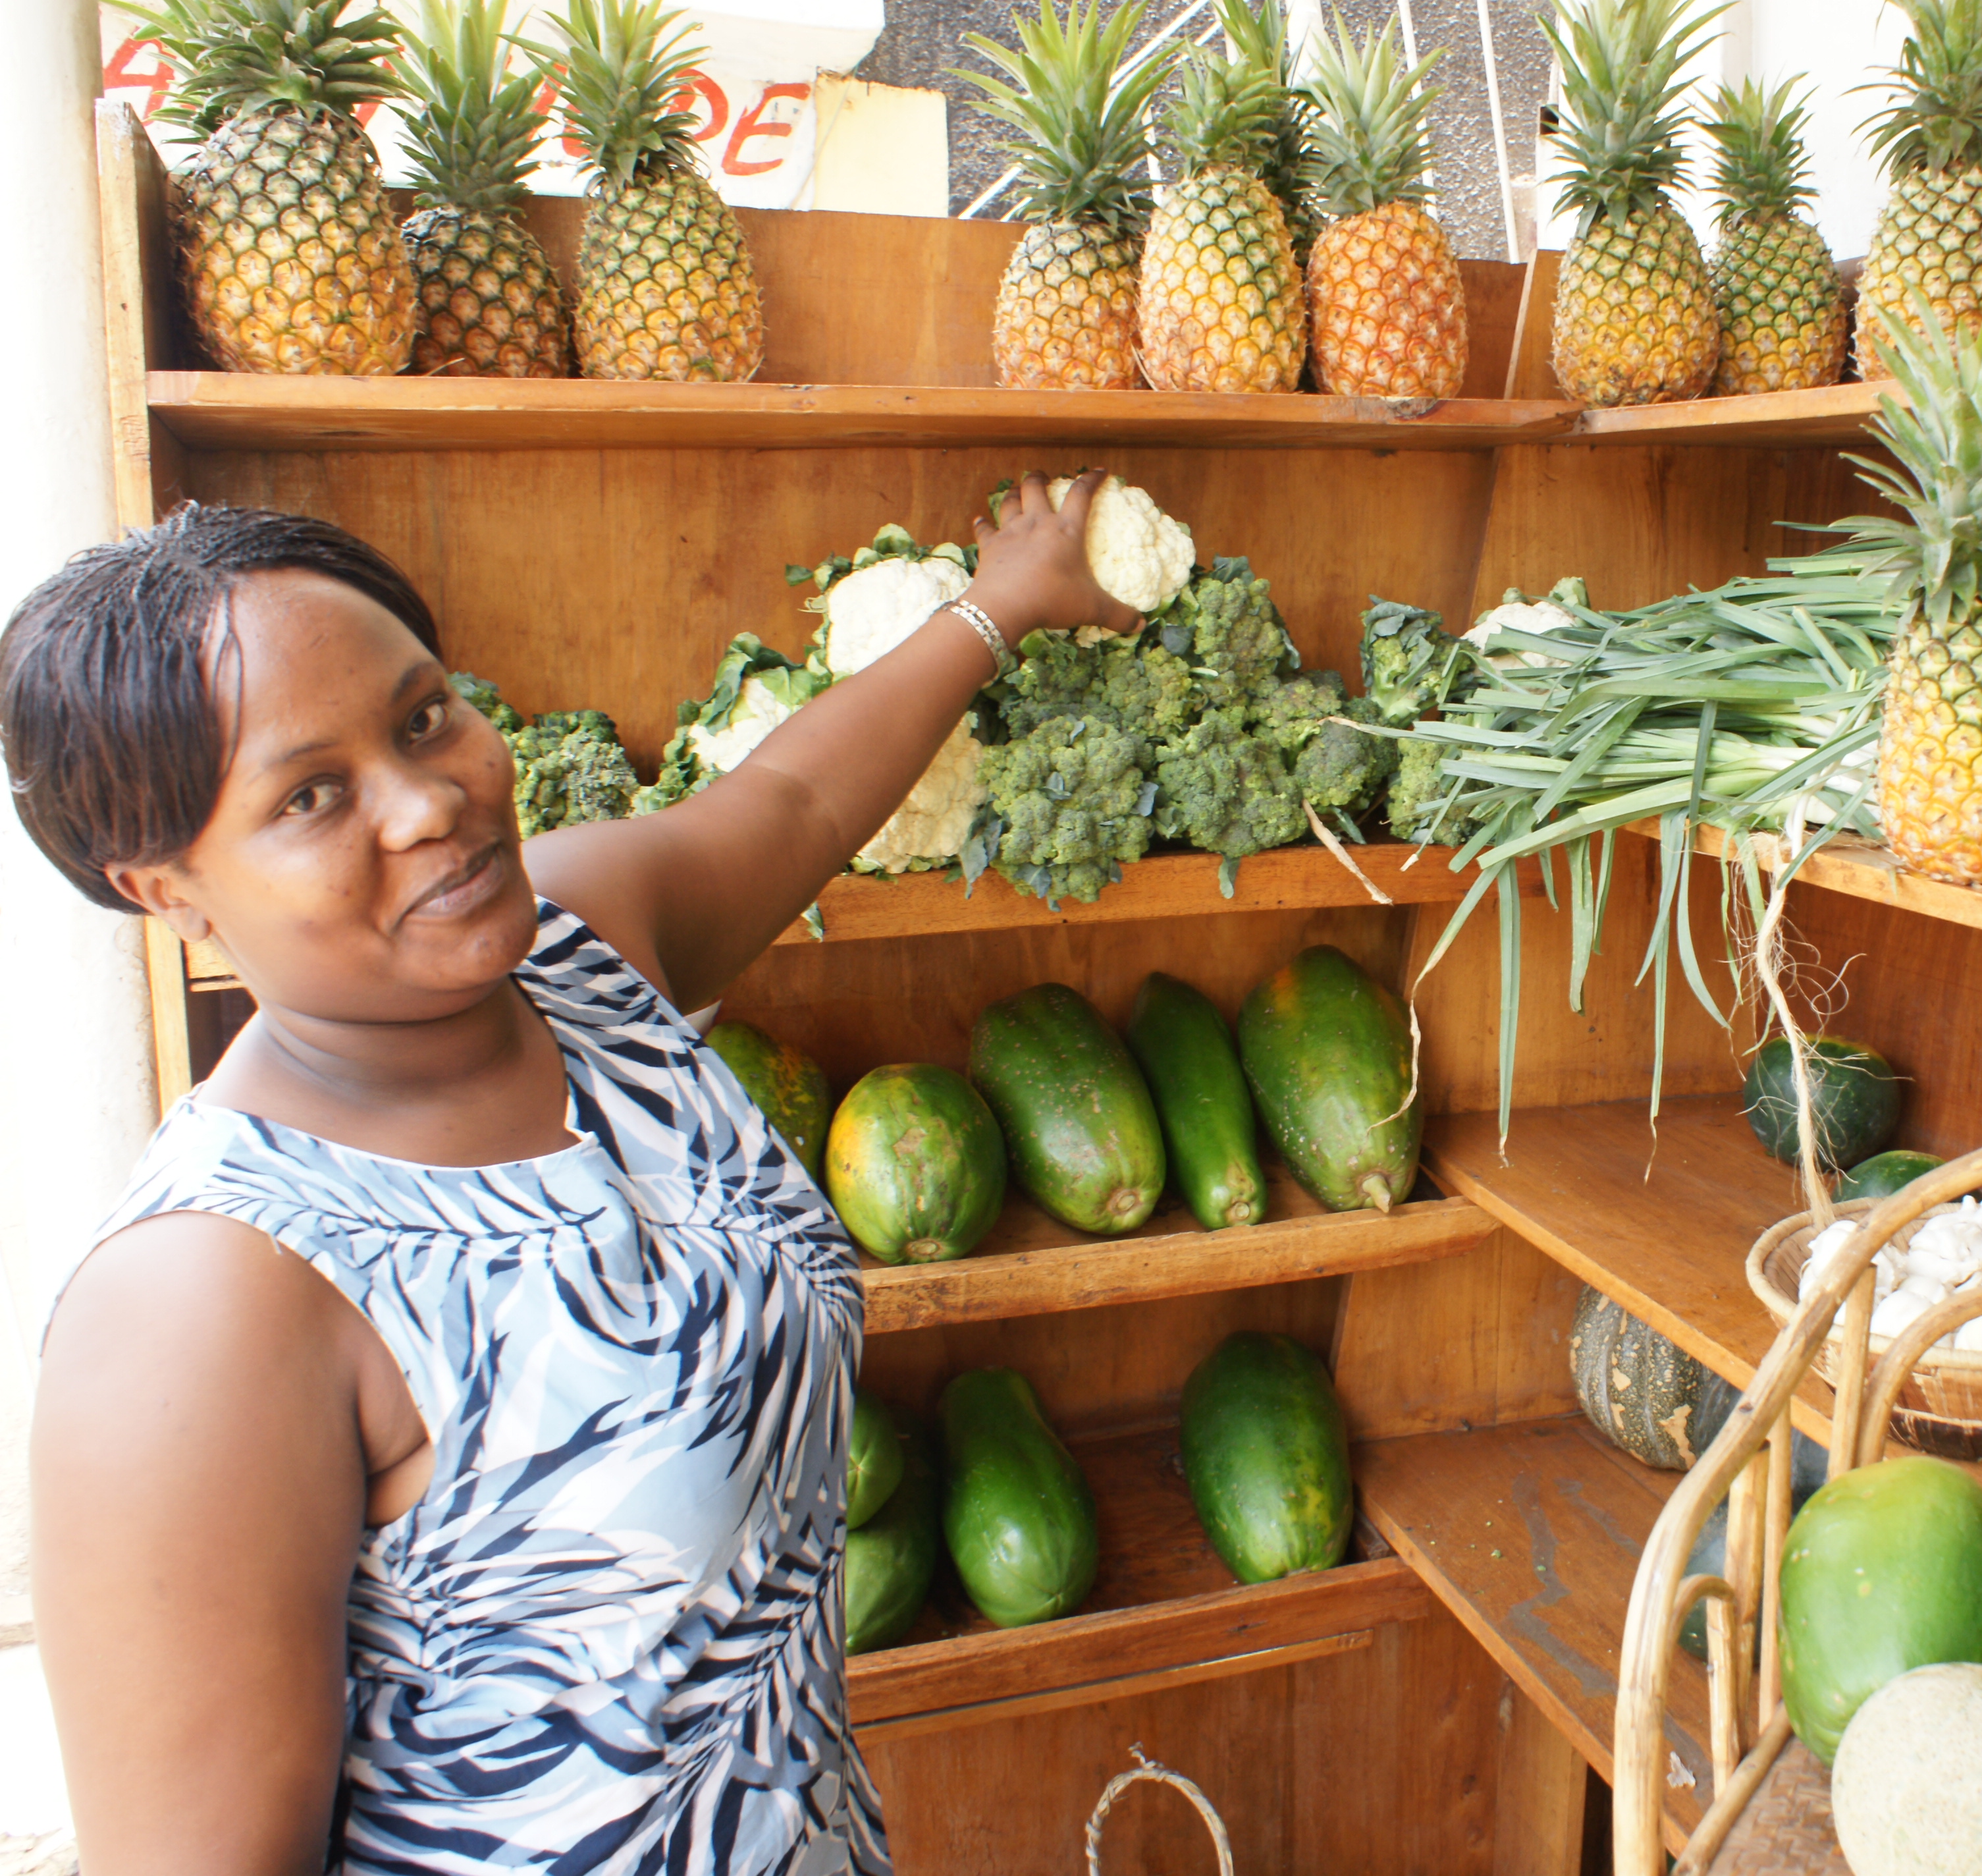
Market access
Organic products can receive a premium price if marketed properly - it is economically advantageous to grow crops with an organic market in your region, or for export.
Organic farmers can achieve ~30% higher profitability compared to conventional systems – however, price premiums are often only available for cash crops destined for export market, e.g., cocoa, cotton
Design diverse crop rotation or agroforestry systems: with products destined for the market and self-consumption.
Know the market and prices
Organise into cooperatives
Notes:
Organic products can receive a premium price if marketed properly - it is, therefore, advantagious for farm profitability to choose crops with an organic market in your region, or for export.
With good organic management and organic price premiums, organic farmers can achieve ~30 % higher profitability compared to conventional systems. However, price premiums are often only available for cash crops destined for export market, e.g., cocoa, cotton, and not for all crops in the rotation.
Design a diverse crop rotation or agroforestry system which includes products destined for the market (as organic to capitalise on the price premium) and crops for home-consumption. Knowing the market is important, but diversity also helps you to be able to react if the market changes.
Organising into cooperatives is also helpful to have more power in negotiations, but also for organic certification. Cooperatives also provide access to knowledge exchange, training and other services.
In agroforestry systems, e.g., cacao as cash crop, by-products compensate for lower income from cocoa. So, monocultures produce higher cocoa yields, but agroforestry systems achieve higher total productivity, as well as a higher diversity of products.

Slide 12
Take-home messages
Well-managed organic farms’ profitability can match or exceed conventional, due to:
lower costs for external market purchased inputs, and
higher market value of organic produce
~5 years after conversion to organic, farmers will get best return on investments
Major consideration to achieve good profitability:
Labour costs
Organic inputs
Organic best practices
Post-harvest
practices
Market access

Slide 13
Contact
Name of institution and contact person
Address
Phone
E-mail
Website
Institution logo

Slide 14
Further information
This PowerPoint is a part of a series of knowledge products; corresponding products about the same topic, e.g., a factsheet, poster and video can be found here [Link]
Further topics are covered in the series, including: - Ecological approach [Link] - Pest and disease [Link] - Productivity [Link] - Soil [Link] - Biodiversity and adaptation [Link]
The purpose of this series is to educate African farmers and advisors on research results related to organic farming. The outcomes of the SysCom and ProEcoAfrica projects were analysed and communicated in the series. For further information on these projects refer to the corresponding project brief [Link].

Slide 15
Imprint
Publisher: Research Institute of Organic Agriculture FiBL, Switzerland
Authors: Lauren ­Dietemann, Irene Kadzere, Akanksha Singh (all FiBL)
Contact: beate.huber@fibl.org
Contributors: Noah Adamtey, Laura Armengot, David Bautze, Eva Goldmann, Christian Grovermann, Irene Kadzere, Elsa Kanner, Johanna Rueegg, Madelaine Rueger, Sophie Thanner, Gilles Weidmann (all FiBL)
Editor: Lauren Dietemann (FiBL)
Layout: Madelaine Rueger (FiBL)
Photos: See factsheet imprint
Illustrations: Deogratius G Okudi (Uganda)
Knowledge product funders
Projects involved
Project funders

