Slide 1
Ilse A. Rasmussen
Organic Plus 28th June, 2019

Slide 2
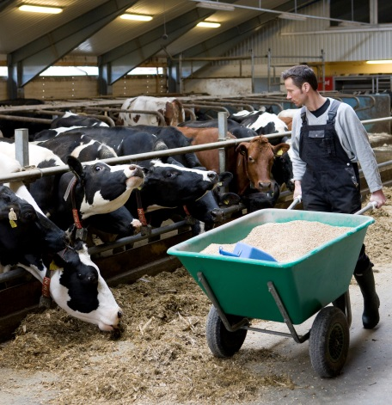
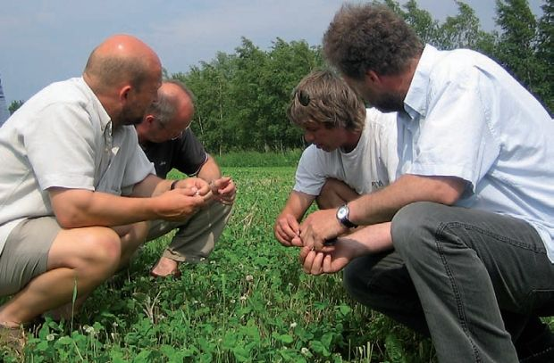
Research
Practise
Advising
Teaching
Notes:
Organic Eprints kan bruges i mange sammenhænge

Slide 3
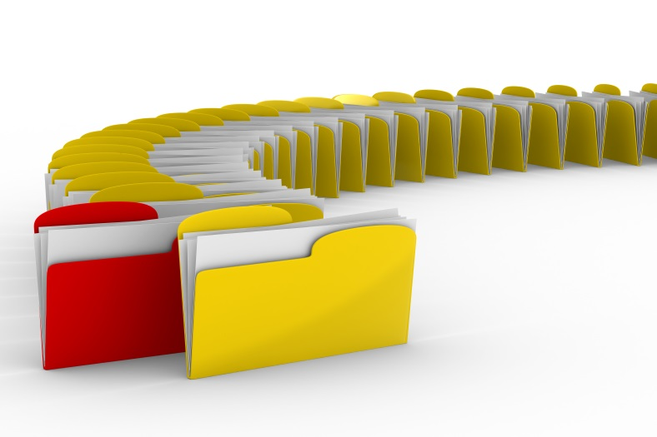
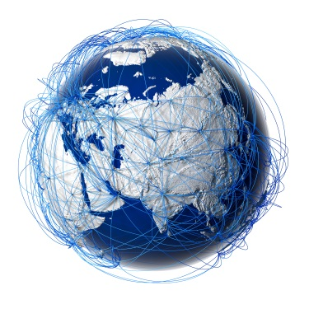
Archive with publications on research and dissemination about organic food systems
Open Access
Danish initiative 2002
International
Open Aire compliant (H2020-requirement)

Slide 4
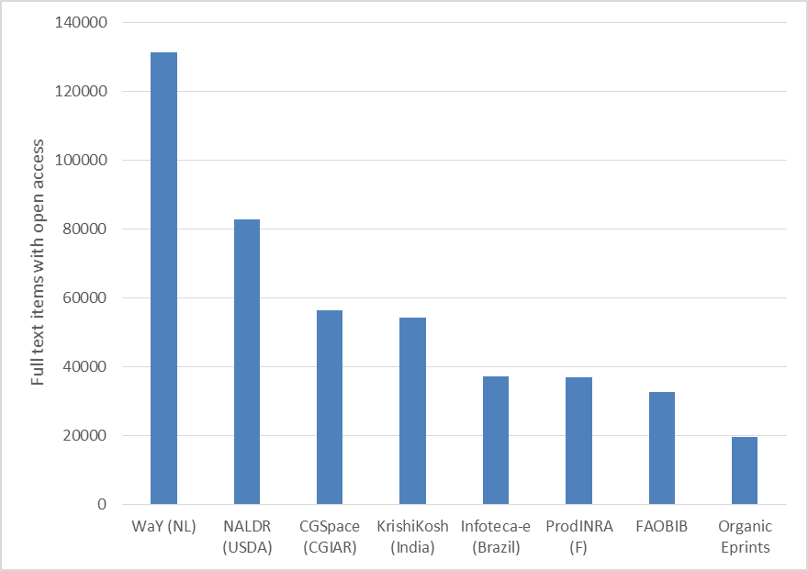
Organic Eprints is the 8th largest archive on agriculture in the world.
Organic Eprints is the only archive on organic agriculture in the world (that we know of).
Notes:
Og de andre er om landbrug generelt – ikke økologisk!

Slide 5
– - an Open Access archive
for organic research
Over 22,000 eprints
Free to use
Papers with copyright can have “restricted access”
Users can “request a copy”
This is allowed under copyright
Search machines cannot read papers with restricted access
Notes:
For de artikler, der ikke er direkte Open Access, f.eks. Fra videnskabelige tidskrifter, er der mulighed for ved klik på en knap at sende en mail til forfatteren og bede om en kopi. Forfatteren skal bare trykke godkend, så får vedkommende en kopi, og dette er tilladt ift copyright. Artikler med “restricted access” kan ikke søges/læses af søgemaskiner, heller ikke tidskrifternes.

Slide 6
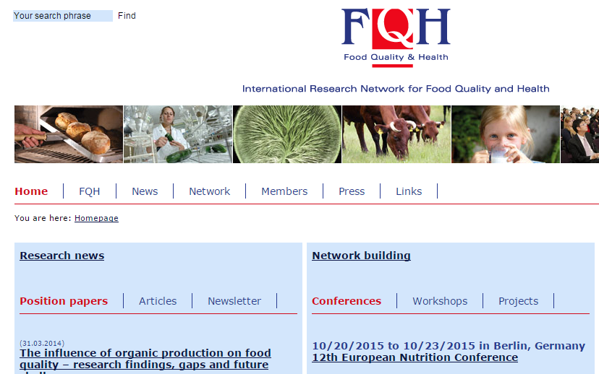
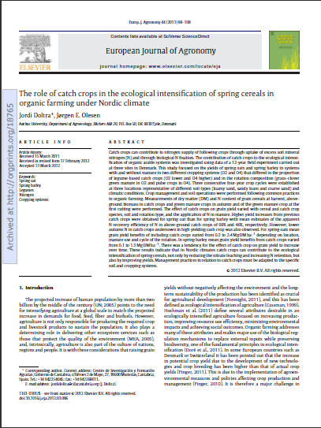
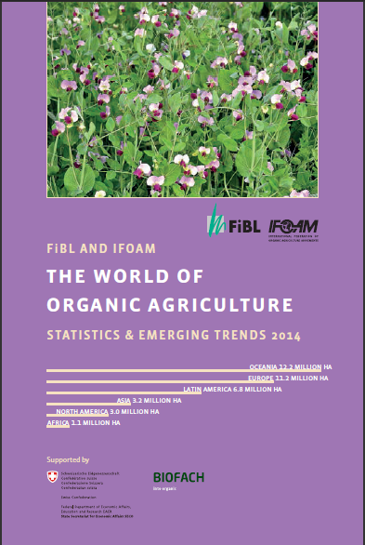
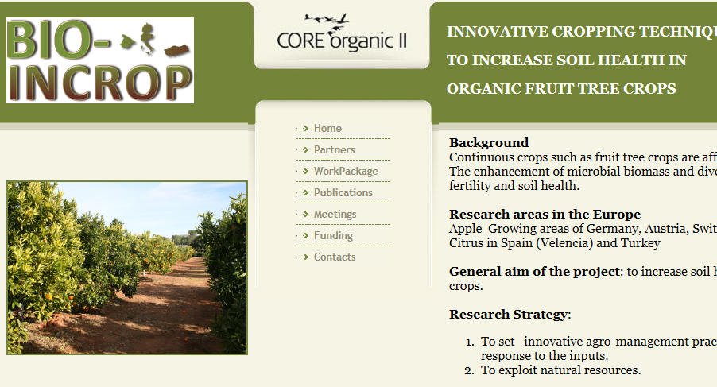
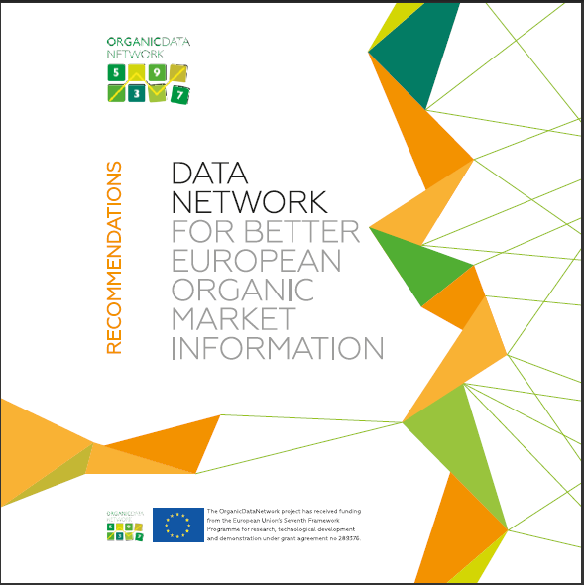
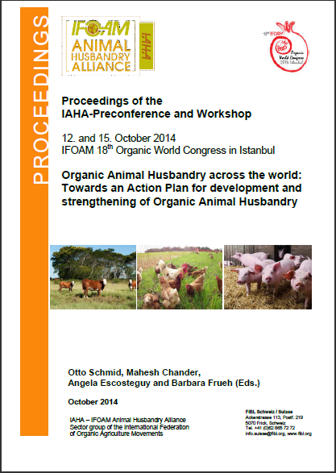
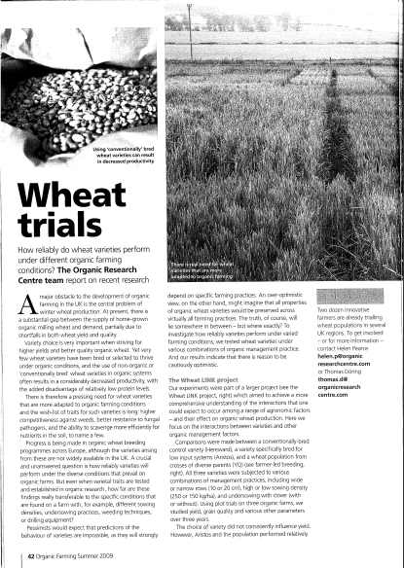
Organic Eprints – contents
Scientific articles,
Books, book chapters, theses
Reports, report chapters
Videos, educational material
Articles in agricultural magazines
and newspapers
Conference proceedings, presentations, posters
Project descriptions and results (e.g. status reports)
Desctipions of organisations and facilites
… and more

Slide 7
What are the advantages?
For authors:
Better dissemination
More visibility
More citations
For users:
Easy access to papers
Direct download
”Grey” litterature (conference papers etc.)
FREE!
For administrators:
Better overview over project publications
Notes:
Brugere – stor fordel i u-lande, at man gratis kan downloade artikler, som ellers koster dyrt for universitetsbiblioteker o.lign. (og som de mange steder ikke har adgang til)
Administratorer – det er jo os her I DK, men det kan jo også være donorer til u-lande, som gerne vil holde øje med output fra projektet – f.eks. ProGrov som har uddannelse med.

Slide 8
Organic Eprints – making research accessible
Mandatory to deposit all publications in Organic Eprints:
All Danish research & innovation projects
CORE Organic projects
Organic research centres (FiBL (CH), NORSØK (NO))

Slide 9
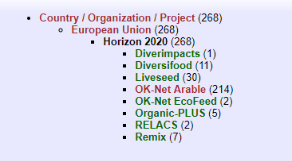
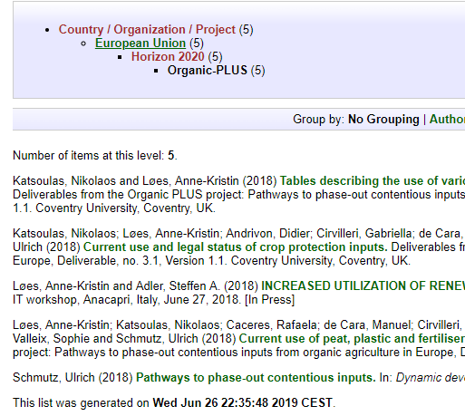
Organic Plus in Organic Eprints

Slide 10
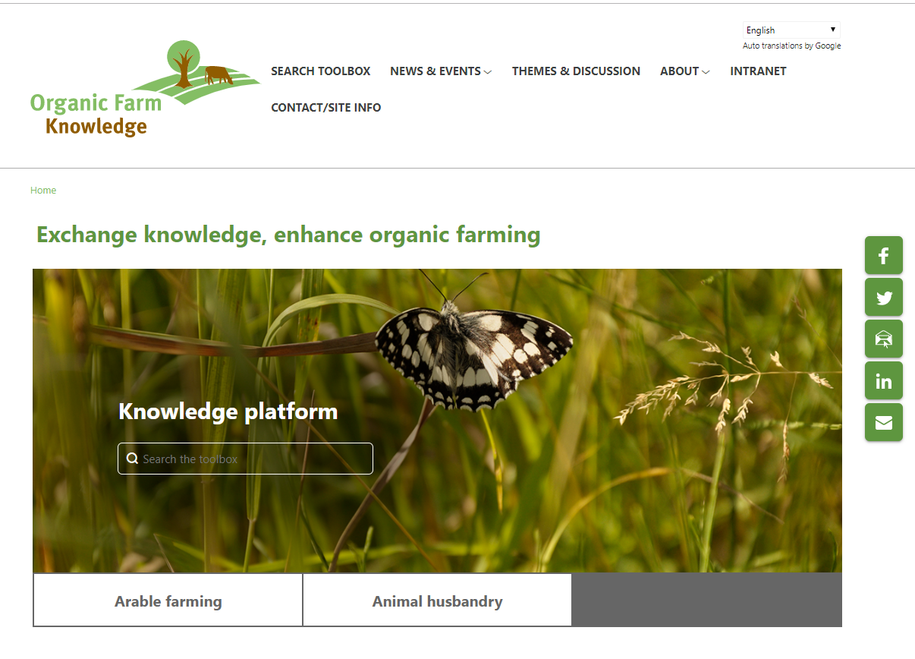
Organic Farmknowledge

Slide 11
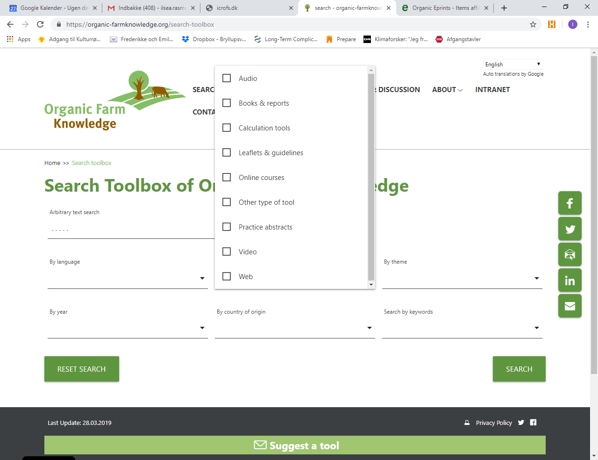

Slide 12
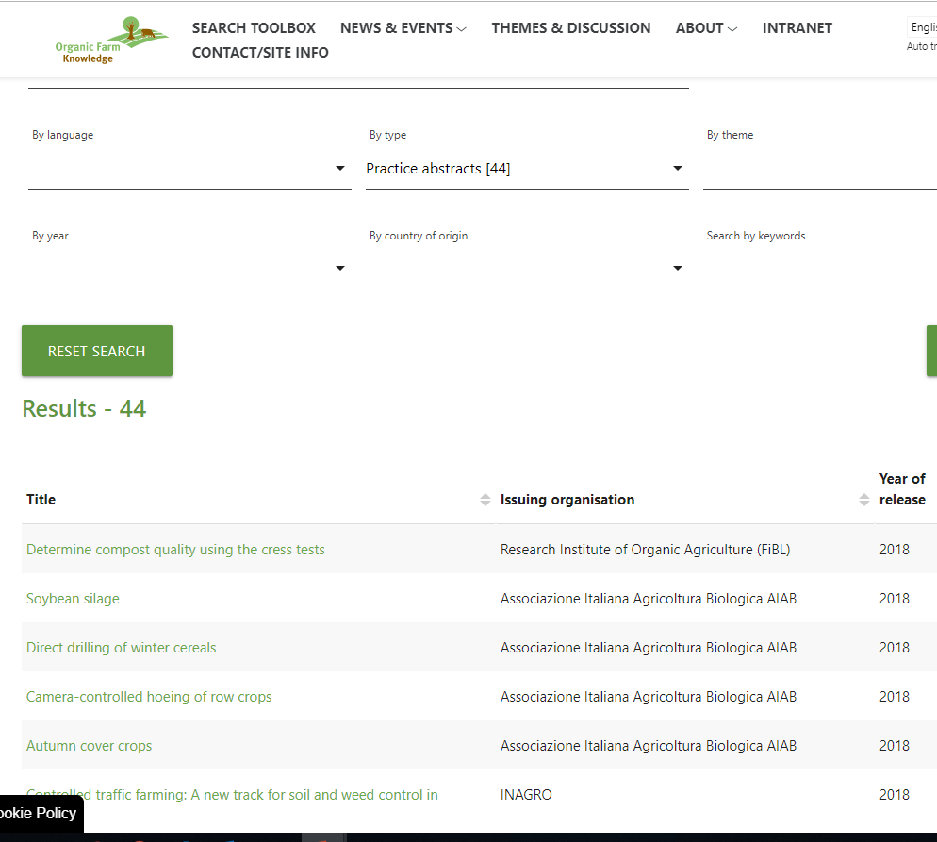

Slide 13
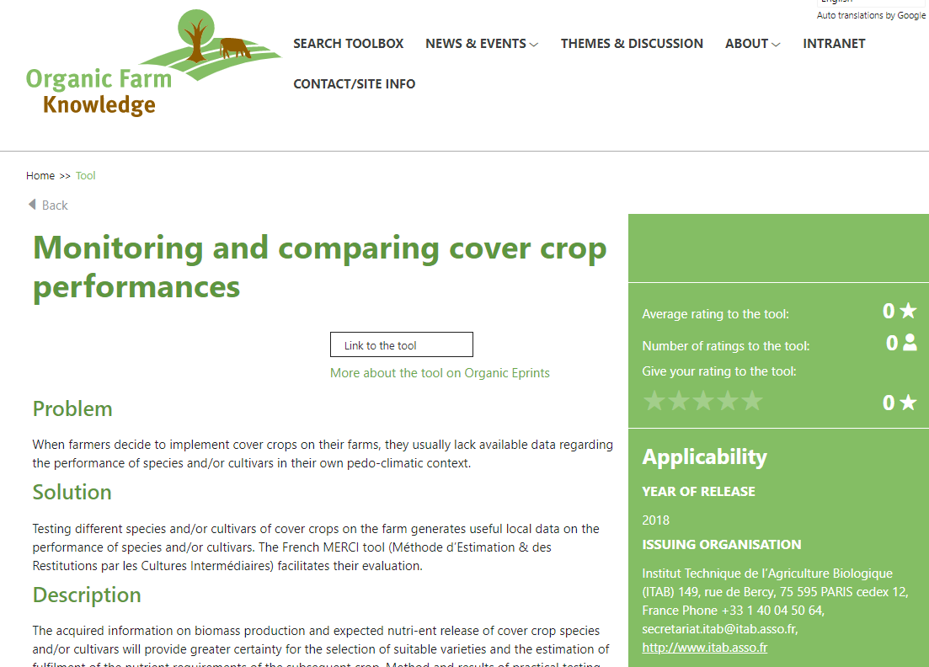

Slide 14
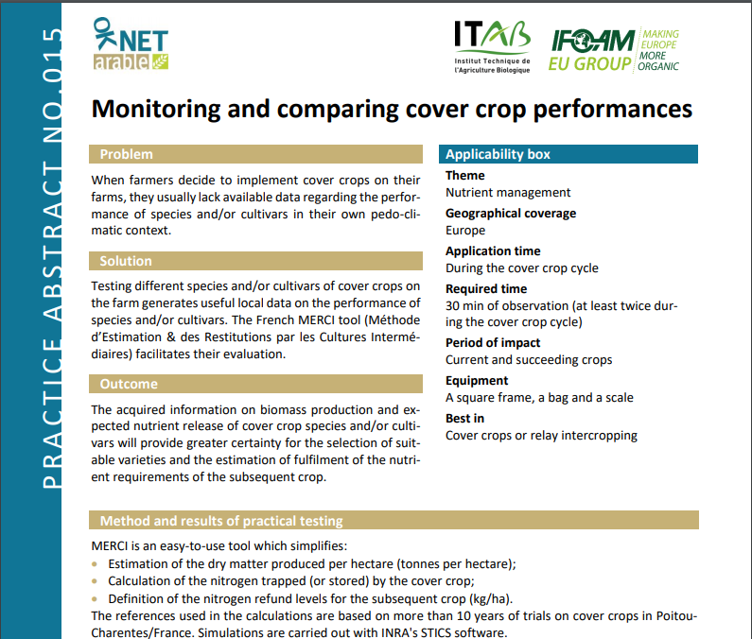

Slide 15
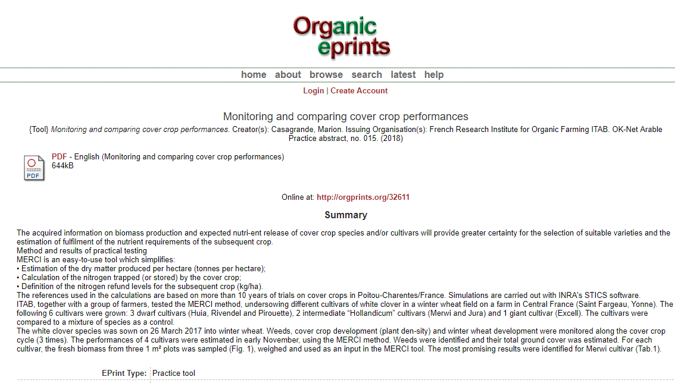

Slide 16
http://orgprints.org/
https://organic-farmknowledge.org/
Ilsea.rasmussen@icrofs.org

