Slide 1
Open research repository for organic agriculture
Ilse A. Rasmussen
Allan Leck Jensen International Centre for Research in Organic Food Systems (ICROFS)

Slide 2
Organic Eprints - facts
www.orgprints.org
The largest archive in the World of publications on research in organic agriculture and food
A subject (vs. institutional) archive
Started by Hugo Alroe in 2002 based on EPrints (now version 3.3.10)
More than 17,000 eprints about organic agriculture
More than 240,000 visits per month
Open, free of charge

Slide 3
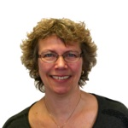
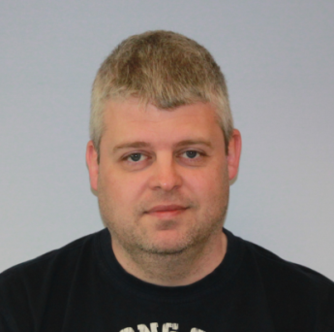
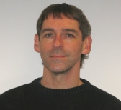
Organic Eprints – development team
Ilse A. Rasmussen (‘Administrator’) Knows about research and development in organic agriculture
Dennis Christensen (‘ICT nerd’) Knows about EPrints, Linux, Perl, Web servers
Allan Leck Jensen (‘Interpreter’) Knows about ICT systems, databases, informatics

Slide 4
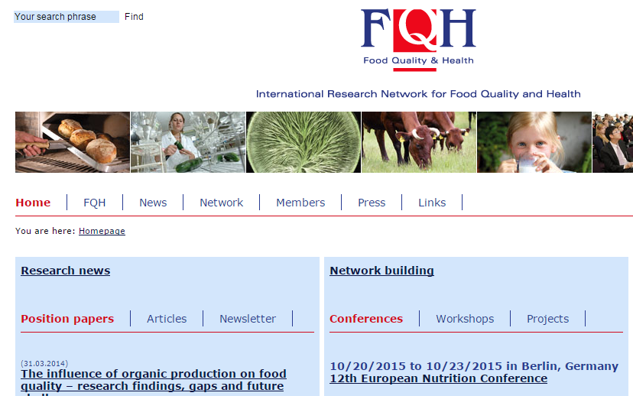
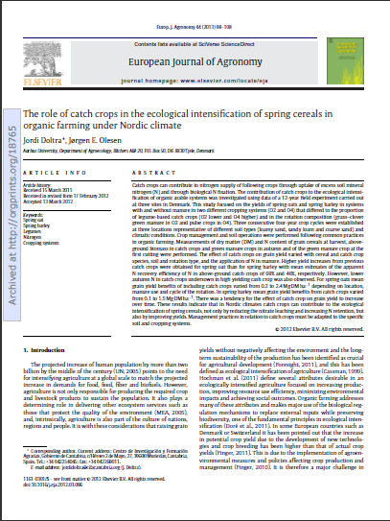
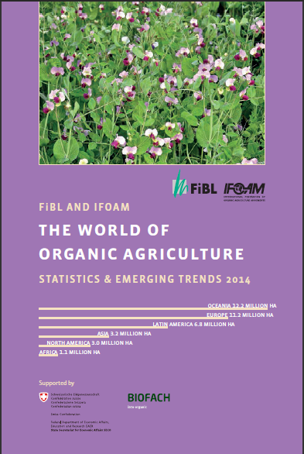
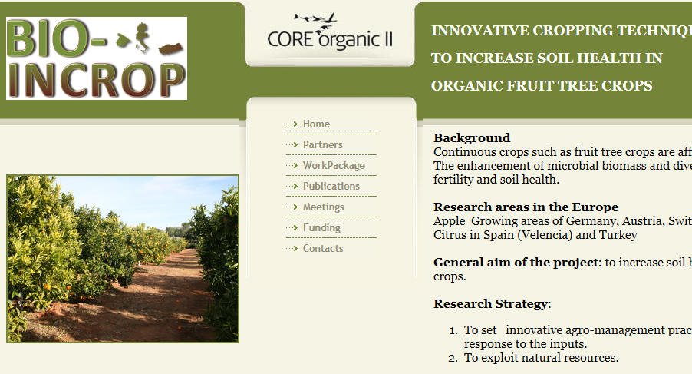
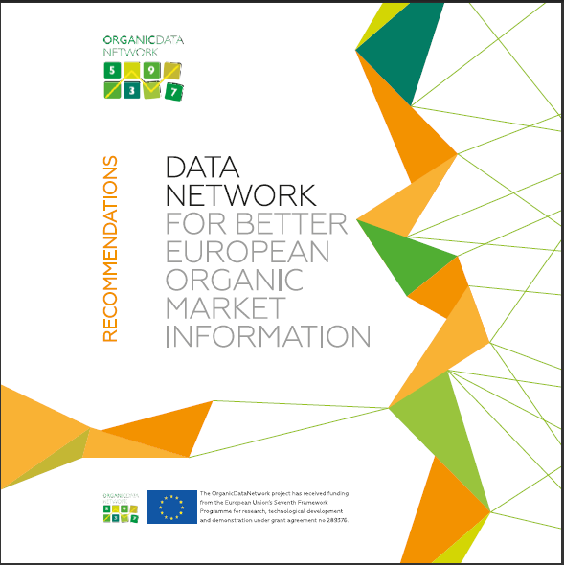
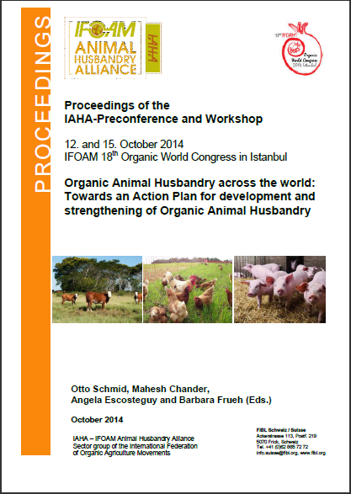
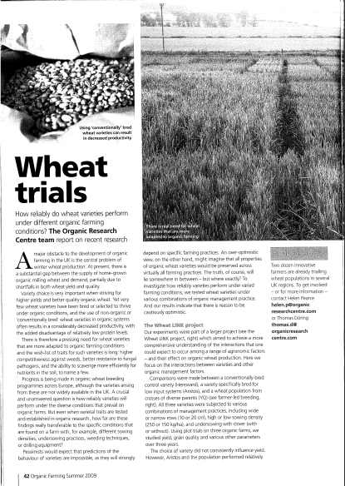
Organic Eprints – contents
Scientific and popular articles, also unpublished
Books, book chapters, theses
Reports, report chapters
Videos, educational material
Agricultural magazines and newspapers
Conference proceedings, presentations, posters
Project descriptions and results (e.g. status reports)
Desctipions of organisations and facilites
… and more

Slide 5
Organic Eprints - advantages
For users:
Easy access to papers
One comprehensive source
Direct download
”Grey” litterature (conference papers etc.)
FREE!
For project funders and administrators:
Better overview over project publications
For authors:
Better dissemination
More citations

Slide 6
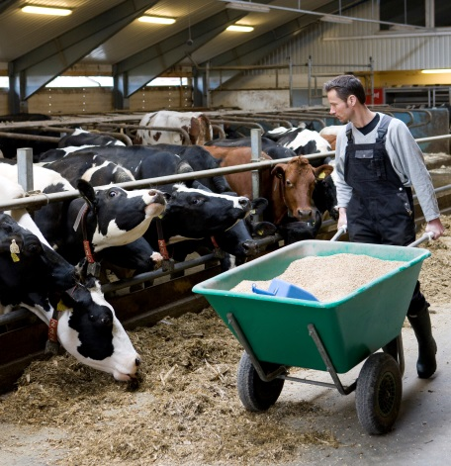
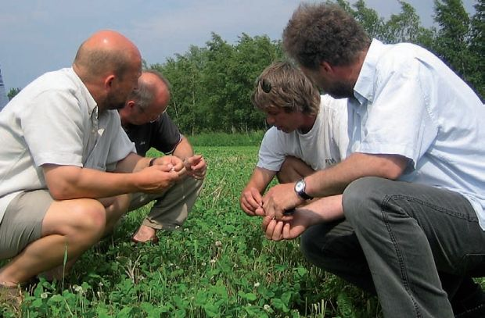
Research
Practice
Advice
Education

Slide 7
Development

Slide 8
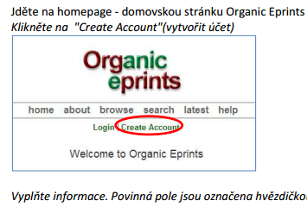
Organic Eprints - languages
Language is an issue for the many users
Web site versions in English and German
User manuals in
English,
Spanish,
Portuguese,
Czech,
Turkish
The English screen is explained, here in Czech

Slide 9
ICROFS
Int’l Centre for Research in Organic Food Systems
Coordinates research programmes, both Danish and European
Participates in research projects
Disseminates research results and knowledge
Development of Organic Eprints is funded and developed by the participation of ICROFS in research projects and by basic funding from the Danish Ministery of Food, Agriculture and Fisheries.

Slide 10
Adaptions of EPrints in Organic Eprints
Organisational structure
Integration of a third-party thesaurus (AGROVOC)
OpenAire compliant

Slide 11
1. Organisational structure
ICROFS International Centre for Research in Organic Food Systems: Main administration, hosting
FiBL Research Institute of Organic Agriculture, Germany and Switzerland: Maintenance and helpdesk of German version
26 national editors Local helpdesk, editors of local eprints

Slide 12
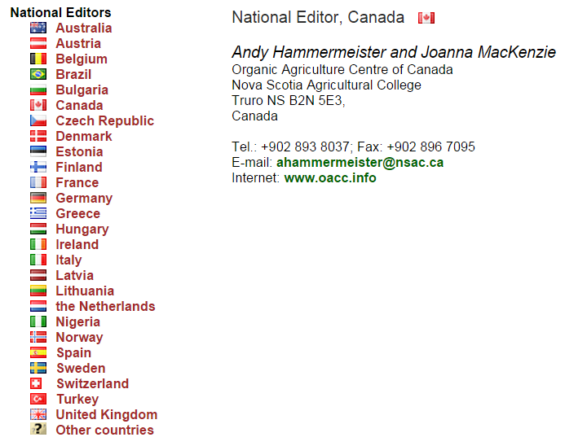
National editors
Europe (21)
Australia
Brazil
Canada
Nigeria
Turkey … more wanted

Slide 13
Role of national editors
Each national editor has an editorial profile, e.g. national editor of Nigeria, Dr. Timothy Olabiyi:
Check bibliographic information of eprints with affiliation matching editorial profile
Author is responsible for the quality, not editor
Accept or reject eprint for publication in ‘live archive’
Local promotion and helpdesk
Voluntary, unpaid by Organic Eprints.

Slide 14
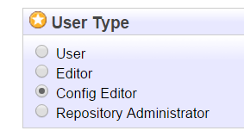
User types and their rights
User (ordinary registered users)
Saved searches
Deposit own eprints to the ‘Workarea’
Editor (the national editors)
Same as User
Review depending on ‘Editorial profile’
Config Editor (new user type, 6 persons from FiBL & ICROFS)
Same as Editor
Edit user rights, subject hierarchy and website phrases
Repository Administrator (Dennis)
Everything

Slide 15
2. AGROVOC vocabulary
Multilingual agricultural thesaurus published by the UN Food and Agriculture Orgnization (FAO)
23 languages
More than 32,000 concepts about food and agriculture

Slide 16
Long term objective
A Spanish person searching for ‘Zanahoria’ and a Russion person searching for ‘морковь (овощи)’ will get the same eprints about ‘carrots’
First step: AGROVOC tagging of new eprints
Second step: Tagging of old eprints (automatic?)
Third step: Integration in search

Slide 17
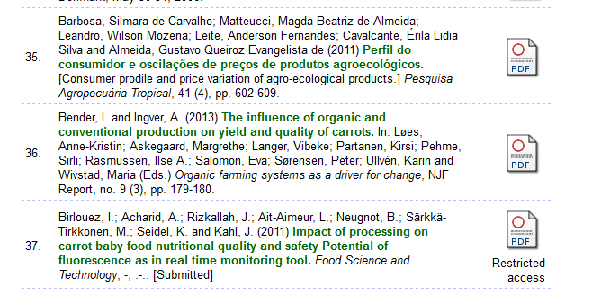
Search for eprints

Slide 18
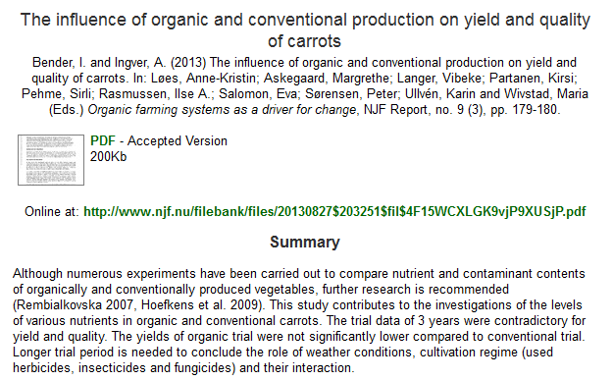
Open a selected eprint

Slide 19
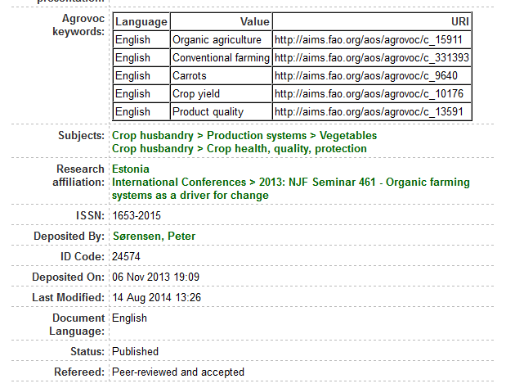
Agrovoc keywords

Slide 20
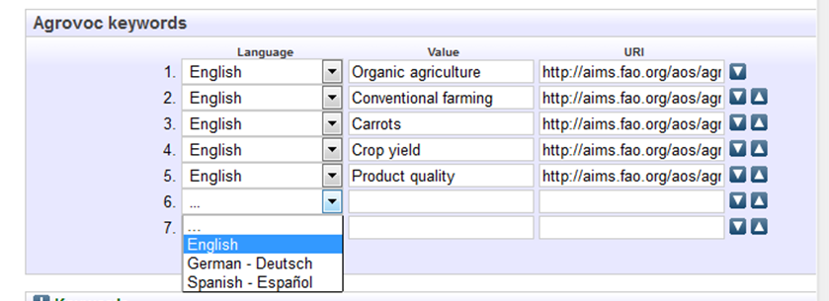
Adding Agrovoc keywords

Slide 21
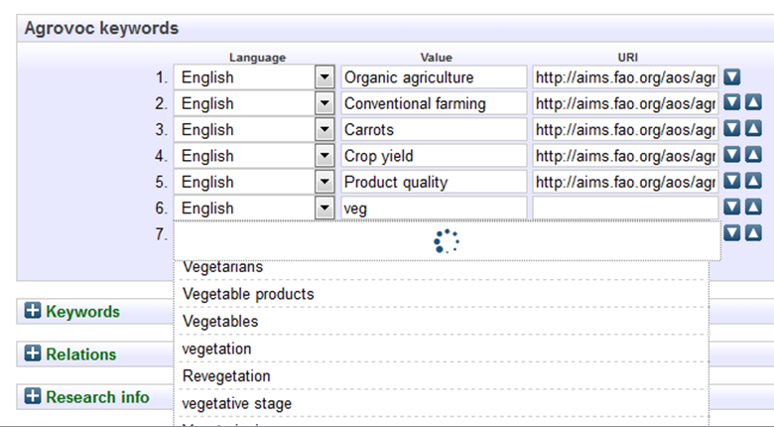
Adding Agrovoc keywords

Slide 22
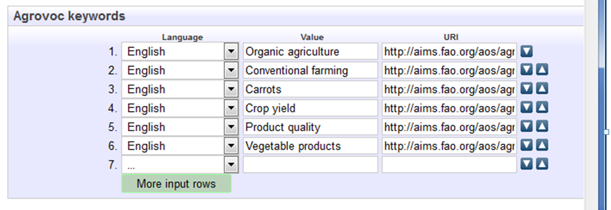
Adding Agrovoc keywords

Slide 23
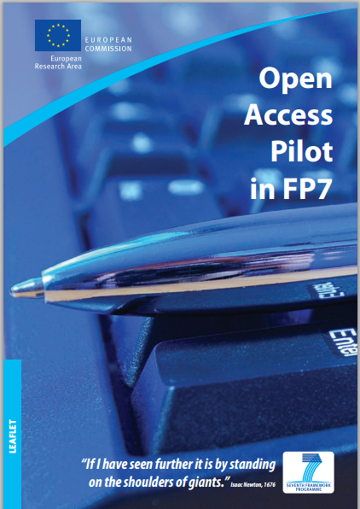
3. OpenAIRE compliant
Open Access Infrastructure for Research in Europe
The European Commission’s 7th Framework Programme (FP7) funded European Research and Technological Development from 2007 until 2013 ($56,000,000,000 over 7 years)
FP7 demand to deposit publications of funded projects in Open Access archives
Organic Eprints is OpenAire compliant

Slide 24
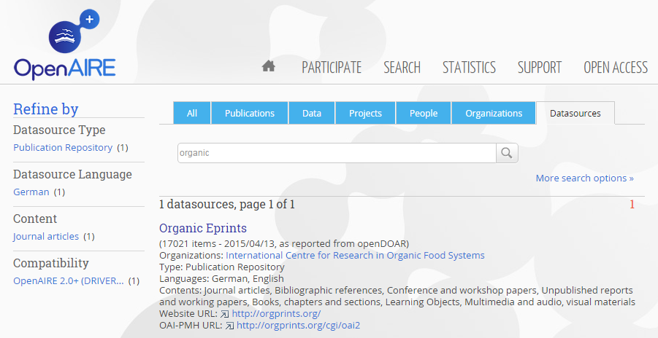
3. OpenAIRE compliant
Open Access Infrastructure for Research in Europe
Part of an open network of research repositories

Slide 25
Copyright issues

Slide 26
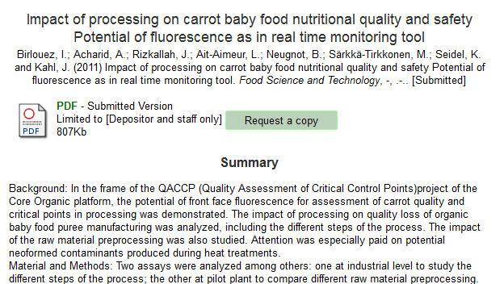
Copyright issues

Slide 27
Current and future work
Organic Agriware: Added value by combining metadata from different agricultural data sources (incl. Organic Eprints) in mobile app
OK-Net Arable: Platform of the best tools for organic agriculture in Europe (management and education)

Slide 28
Current and future work
Simpler search facility, custum tailered to various user types. E.g. weed management researchers, Italian tomato farmers, etc.
Modules for external integration (e.g. list of latest eprints of certain topic)
Improved import and export facility (e.g. batch import)

Slide 29
Thank you for your attention!
We are interested in your experiences and ideas!

Slide 30
Standards
OAI-PMH (open archives initiative - protocol for metadata harvesting). We use OAI 2.0: http://orgprints.org/cgi/oai2?verb=Identify
Metadata formats:
didl, mets, oai_bibl, oai_dc, rdf, uketd_dc, voa3r_dcds

Slide 31
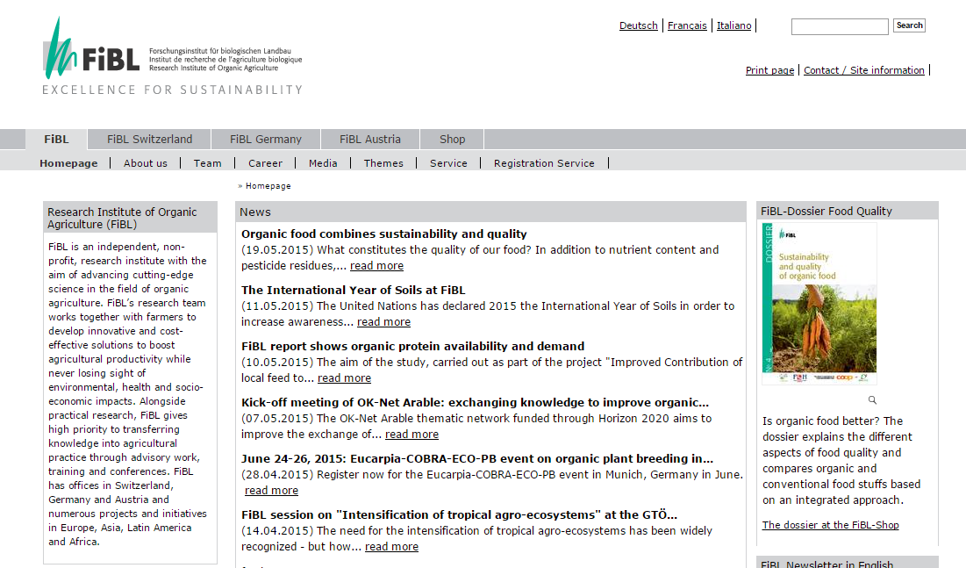
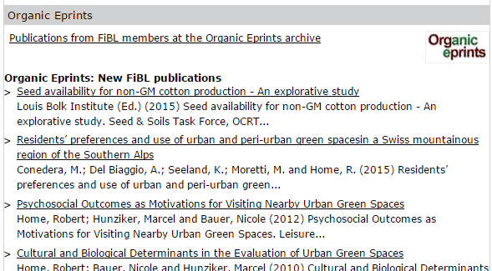
External – RSS with latest FiBL eprints

Slide 32
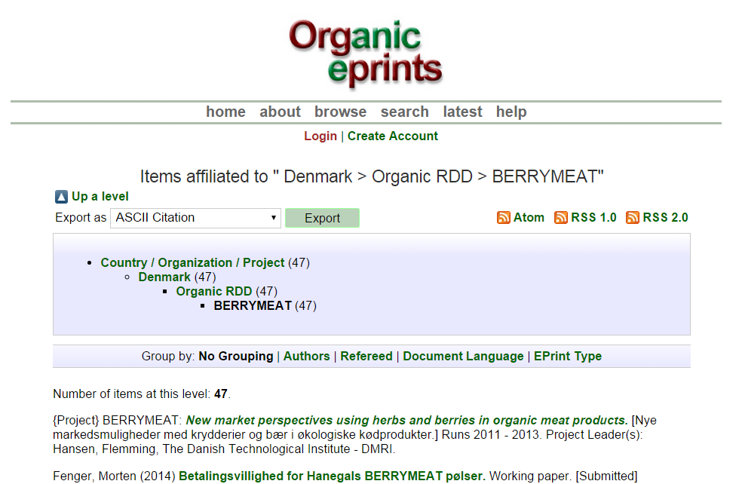
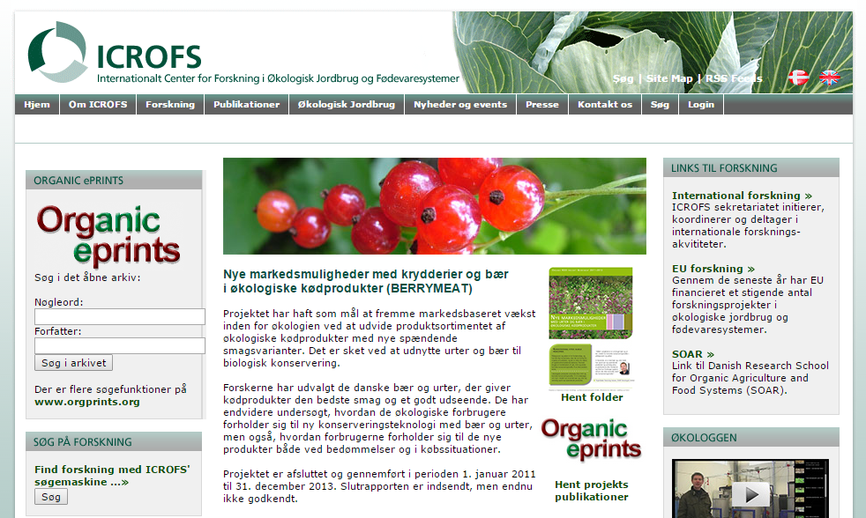
External – List of project publications

Slide 33
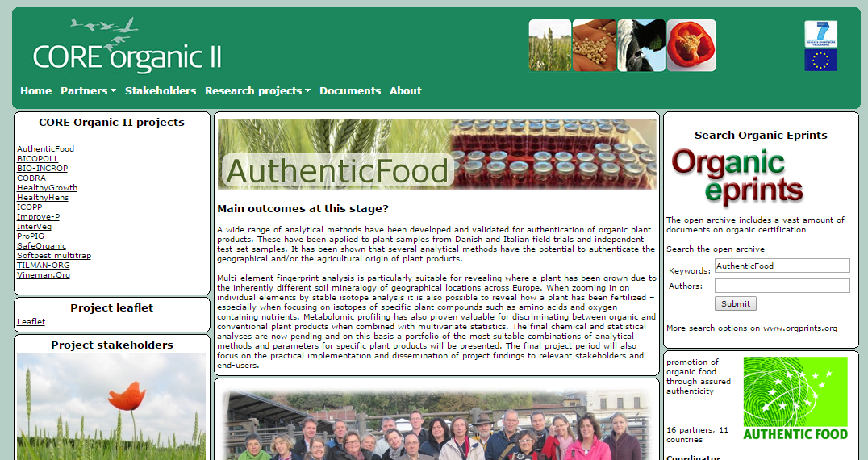
External – Search plugin

Slide 34
Export and import standards

