Slide 1




Marine-derived fertilisers: significant possibilities, and some challenges to solve
Møre og Romsdal
county municipality
RESTOR
The NorthWest, verdiskapingsdagen September 2, 2021
Anne-Kristin Løes

Slide 2
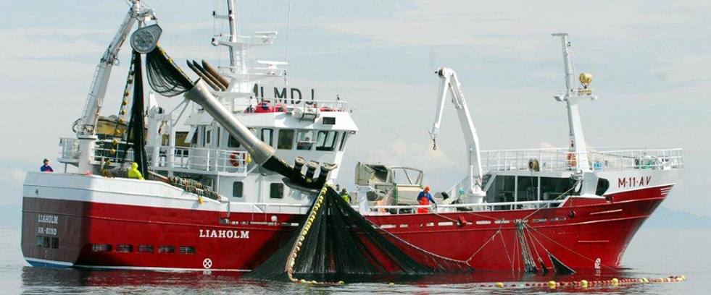
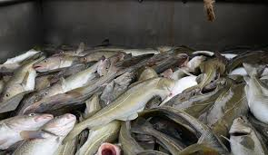
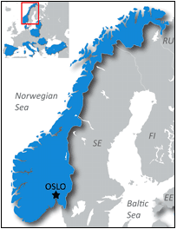
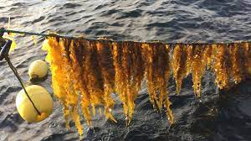
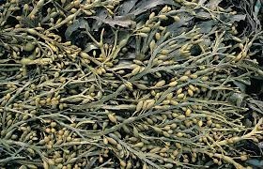

Norway has a long coastline
Fish capture: 2.5mill tons live weight/year (white fish, herring ++)
Aquaculture: 1.5 mill tons/year (mainly salmon)

Slide 3
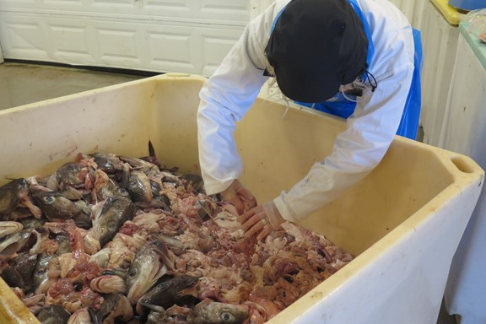
Significant volumes of organic material are poorly utilised
…. product development aims at pharmacy, food and pet food… fertilisers are cheap

Slide 4

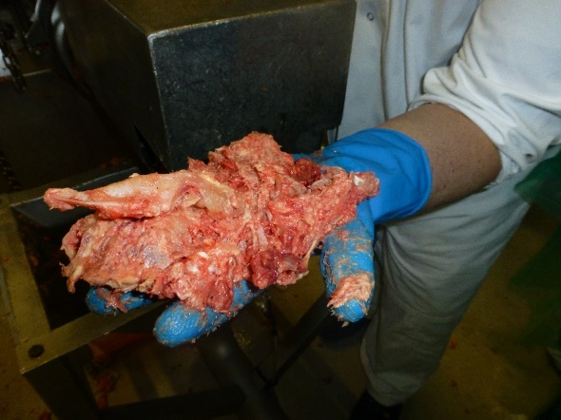
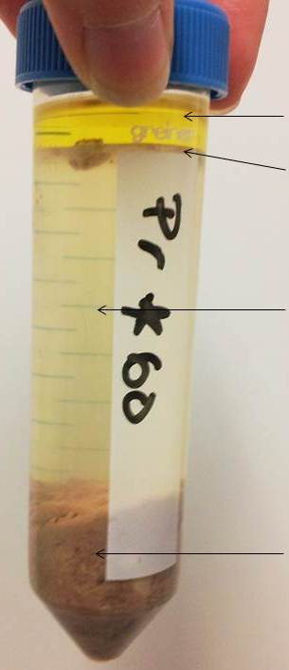
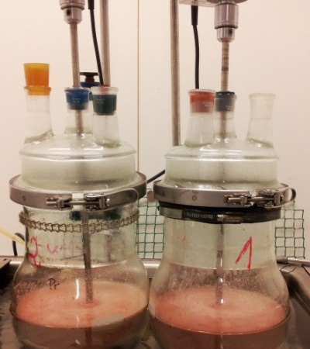
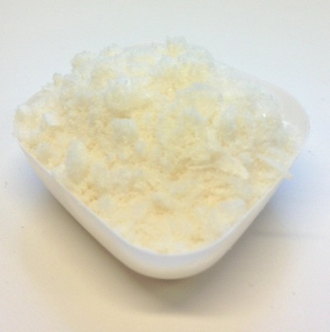
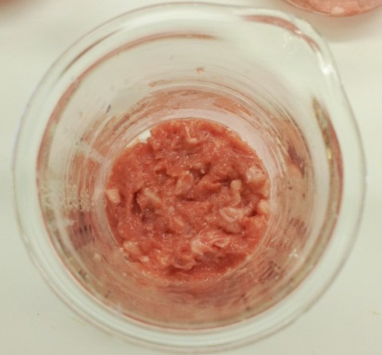
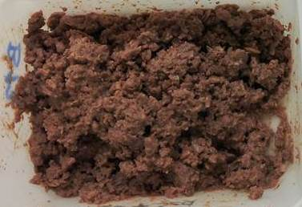
Starting point for NORSØK:
Bioeconomy project CYCLE 2013-2016 (SINTEF Ocean):
Hydrolysis of animal co-products,
(here chicken bones, from mechanically separated meat production)
Oil
CPH
Chicken protein hydrolysate
Raw material and water(1:1)
0.1 % enzyme (dry weight enzyme/wet weight raw material)
50 °C, 120 min
Raw material
17 % lipids
16 % proteins
5 % ash
63 % moisture
Sediments

Slide 5
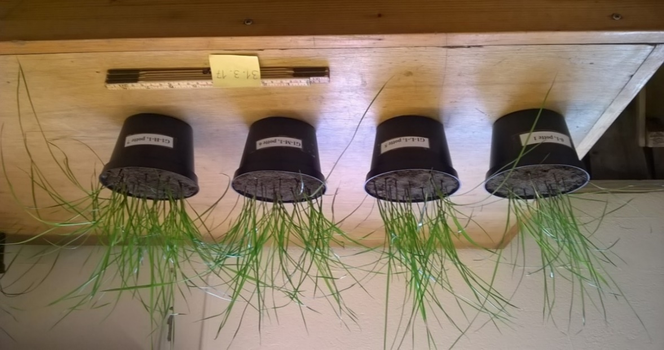
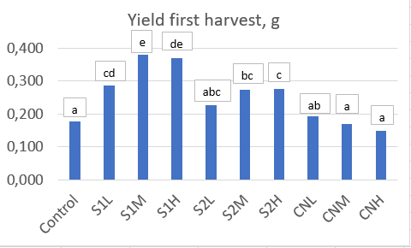
2017: Very rapid growth effect of animal residues (slaughtered laying hens)
Mean yields of ryegrass, g DM/pot (n= 5/treatment), plants cut at 4 cm
S1= Sediment 1 finely grinded
S2= Sediment 2 less finely grinded
CN= CaNO₃
L = low, M= medium, H= high N
as 200, 400, 600 kg N/ha
Seeds germinated on March 14, 2017; 1st harvest March 31, 2017

Slide 6
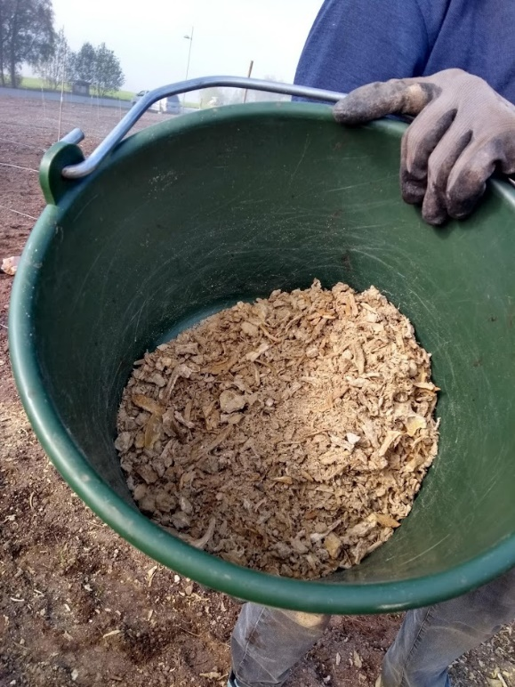
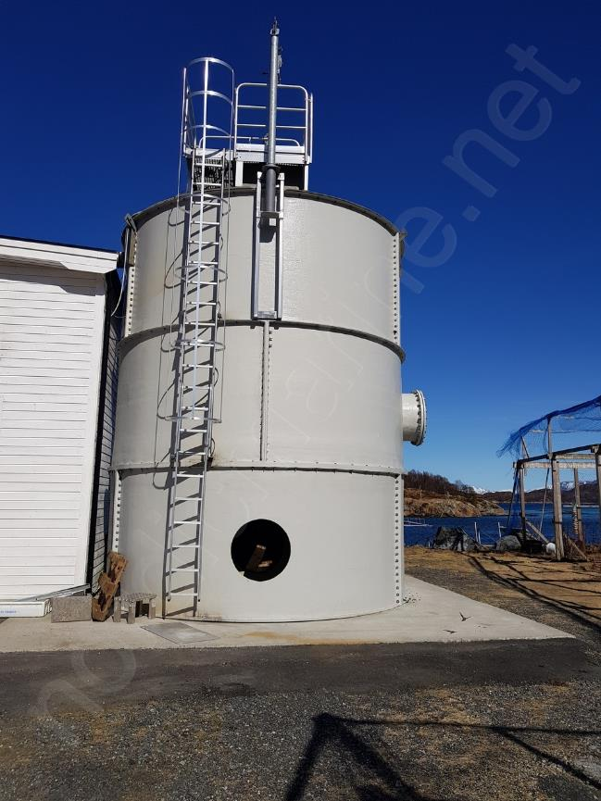
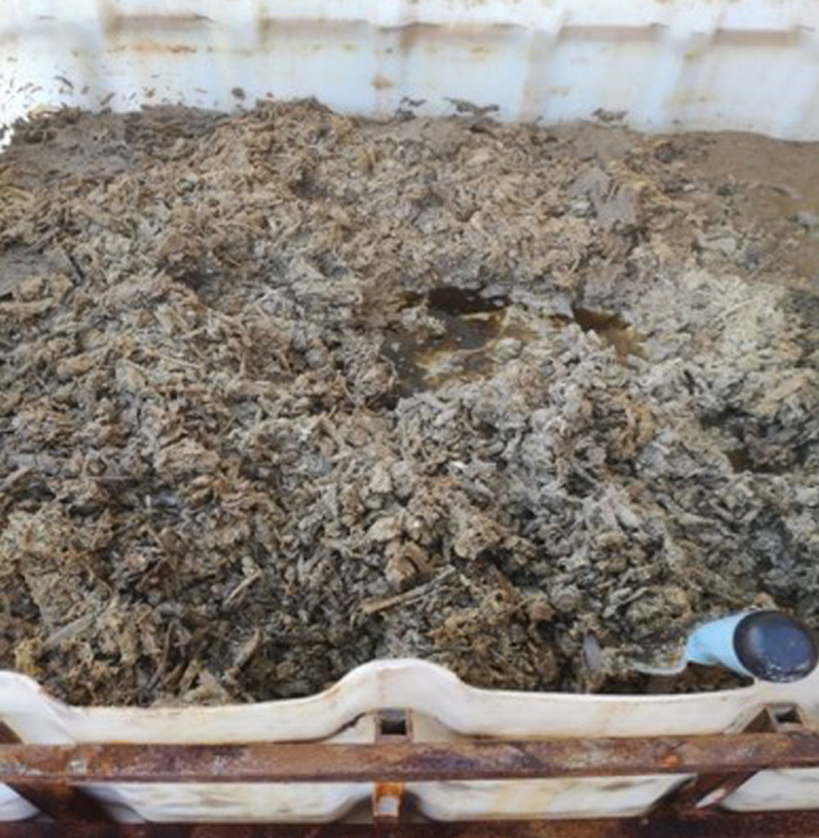
Sediments from grinded fish residues conserved by formic acid (pH < 4)
Sediments in IBC (1m³), ca. 50% DM
Air-dried and sieved sediments
for field application
Industry scale
tank for hydrolysis
Lab scale

Slide 7

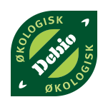

A rich source of P, Ca, N – but little K, Mg
pH | 4.9
DM, % | 80
N % of DM | 4.1
P % of DM | 9.3
Ca % of DM | 16
K % of DM | 0.1
Mg % of DM | 0.08
S % of DM | 0.2
100 kg would contain
3.3 kg N
7.4 kg P
12.8 kg Ca
0.08 kg K
Crop plants demand N, P, K, Ca, Mg, S
and a range of micro-nutrients
Norwegian Food Safety authority specifies that fish and formic acid are permitted inputs as long as fish is of category 3 (hence, not dead fish from aquaculture, which is cat.2)

Slide 8
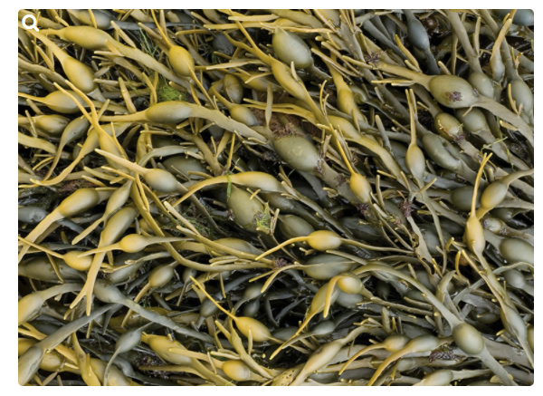
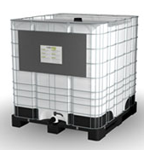
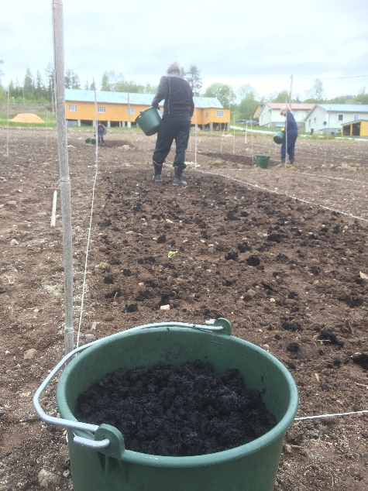

Rockweed contains significant K, S, Mg
pH | 9.6
DM, % | 30
N % of DM | 1.5
P % of DM | 0.3
Ca % of DM | 6.8
K % of DM | 13
Mg % of DM | 2.5
S % of DM | 1.5
Product for sale:
AlgaFert Base, pH 5
From the plant: About 15 tons/week of algae fibre,
currently incinerated
Liquid fertilisers are permitted but not fibre residues due to extraction with HNO₃

Slide 9
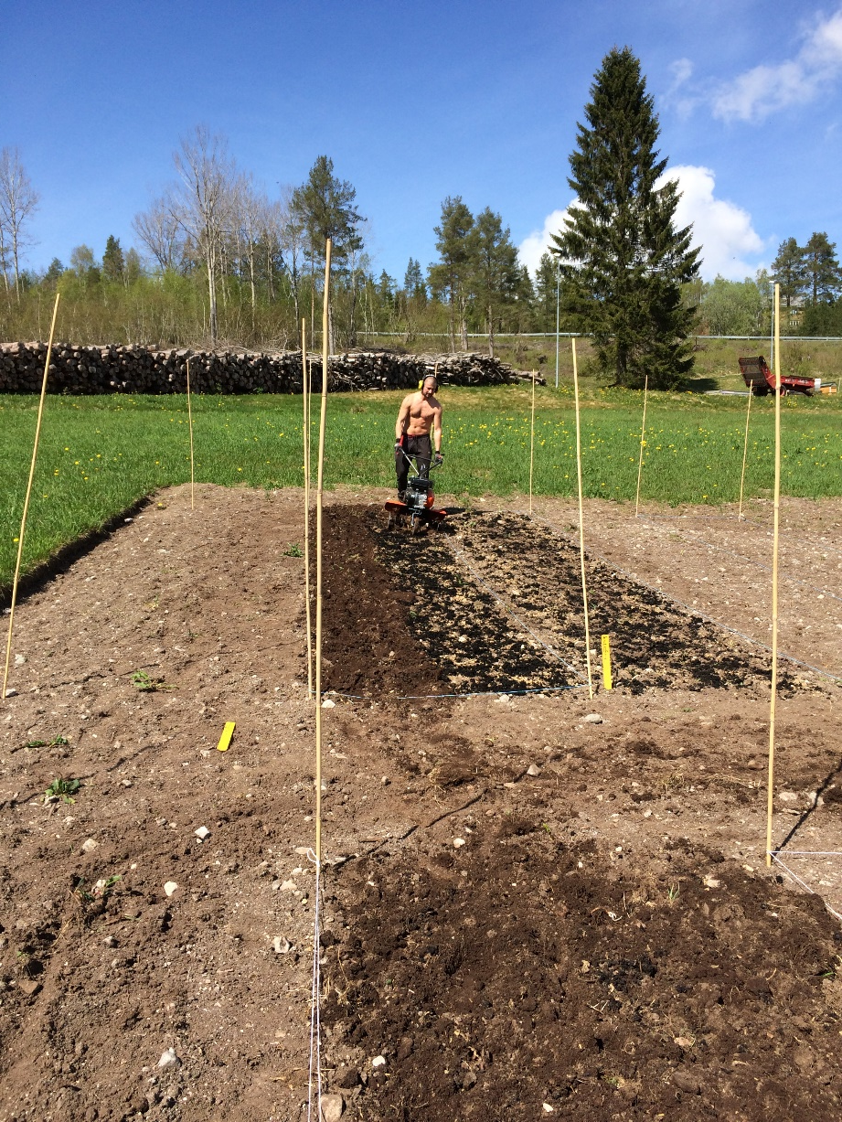

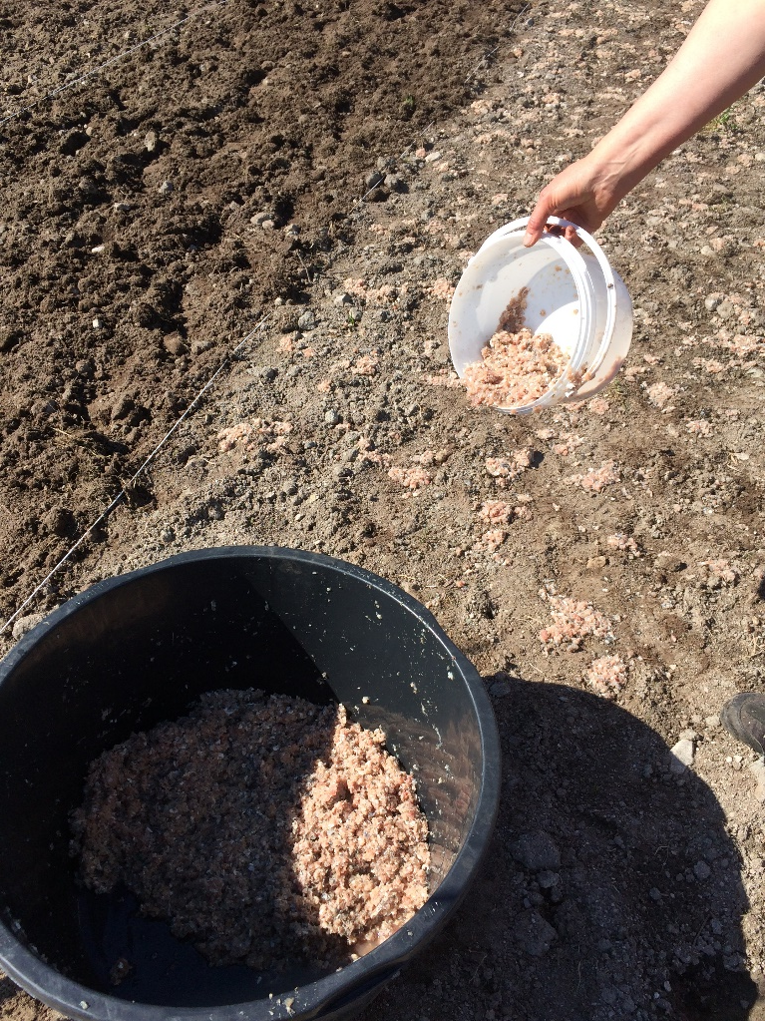
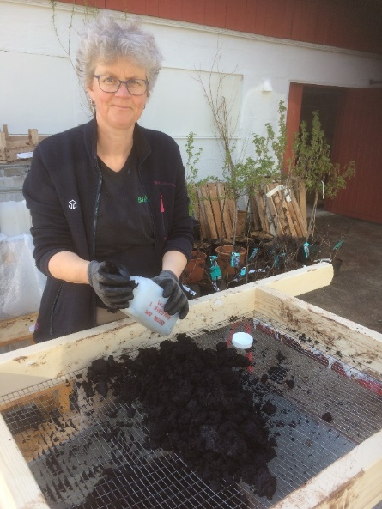
Field experiment with ryegrass 2020 (4 cuts)
Cultivator used to incorporate fertilisers in soil
Fresh, ground fishbones (F)
Dried fishbones conserved by formic acid (FB)
Clumps of algae fibre made smaller (AF)

Slide 10
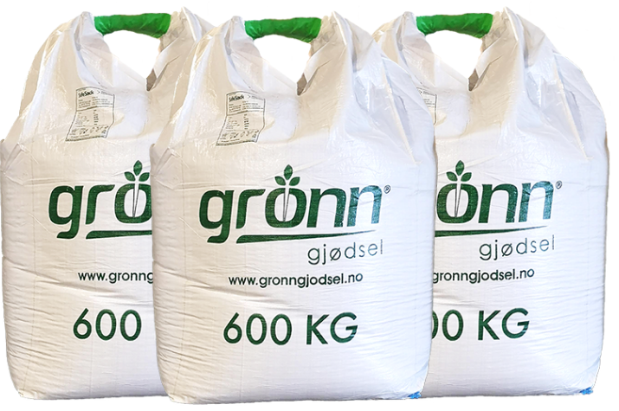
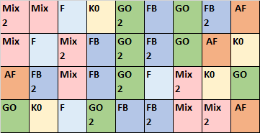
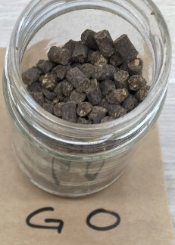
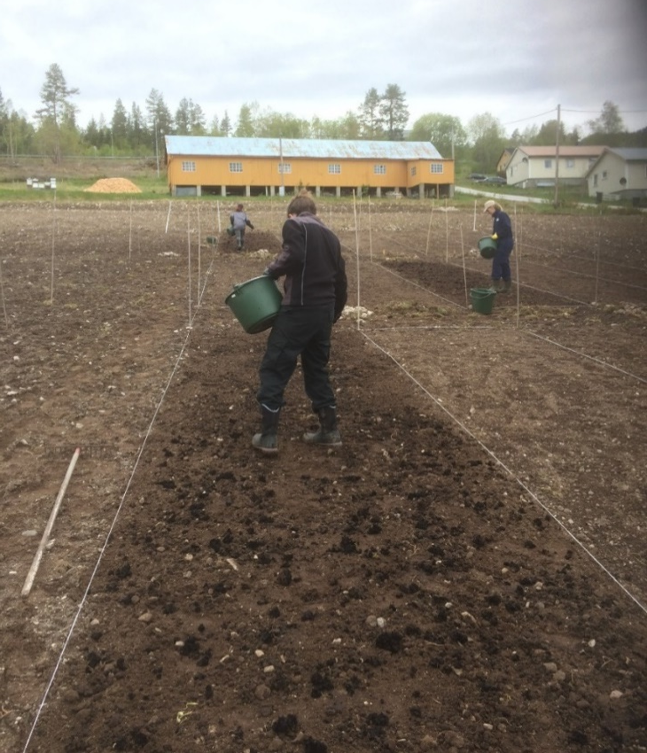
Control: Enriched poultry manure, well balanced fertiliser («Green Organic», GO)
9 treatments, 4 replicates
Control, 5 types of fertiliser, 2 N levels
300 or 600 kg N/ha in acid-conserved fish bones (FB), Mix (algae fibre + FB), poultry manure Green Organic (GO)
Algae fibre (AF) and fresh ground fishbones (F) only 300 kg N/ha

Slide 11
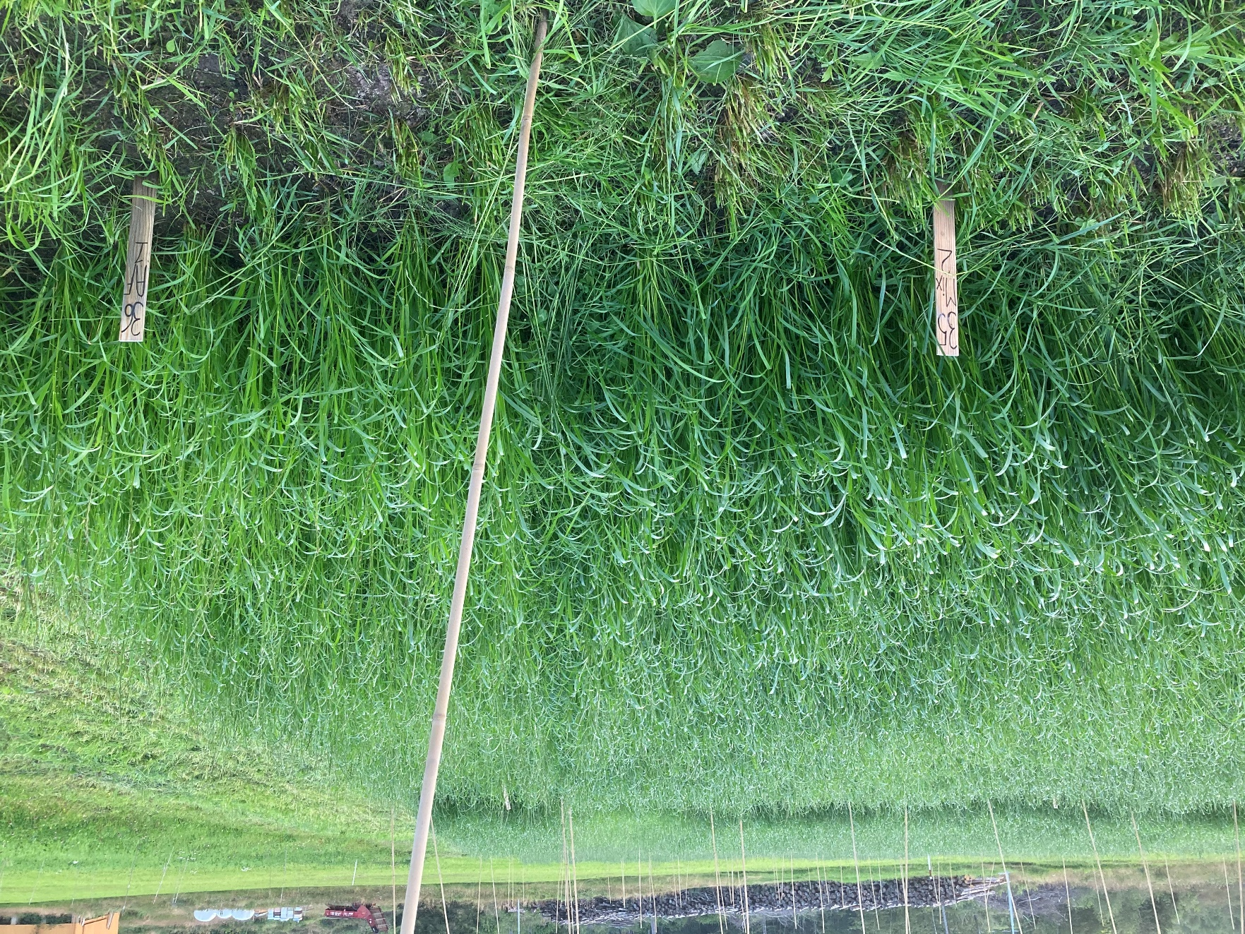
Ryegrass experimentready for 3rd cut, August 13, 2020
Mix
AF

Slide 12
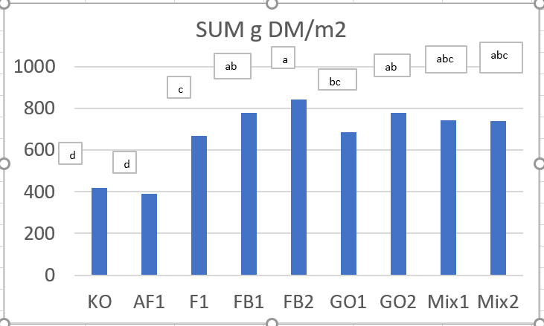
Ryegrass experiment, sum of 4 cuts 2020, yields 4 - 8 t DM/ha
K0= no fertiliser
AF= 300 kg N/ha in algae fibre
F1= 300 kg N/ha in fresh ground fish bones
FB1, 2 = 300 and 600 kg N/ha in acid-conserved fish bones
GO1, 2 = 300 and 600 kg N/ha in poultry manure
Mix 1, 2 = 300 and 600 kg N/ha in AF+ FB where 30% N is from AF and 70% from FB

Slide 13
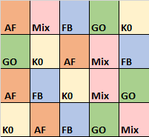
Residual effects in perennial ley, 2021
Fertilisers applied in 2019:
K0= no fertiliser
AF= 160 kg N/ha in algae fibre
FB = 160 kg N/ha in acid-conserved fishbones
GØ = 160 kg N/ha in poultry manure
FBAF = 1600 kg N/ha in AF+ FB where 30% N is from AF and 70% from FB
Kg TS/m2= tonn TS/daa

Slide 14
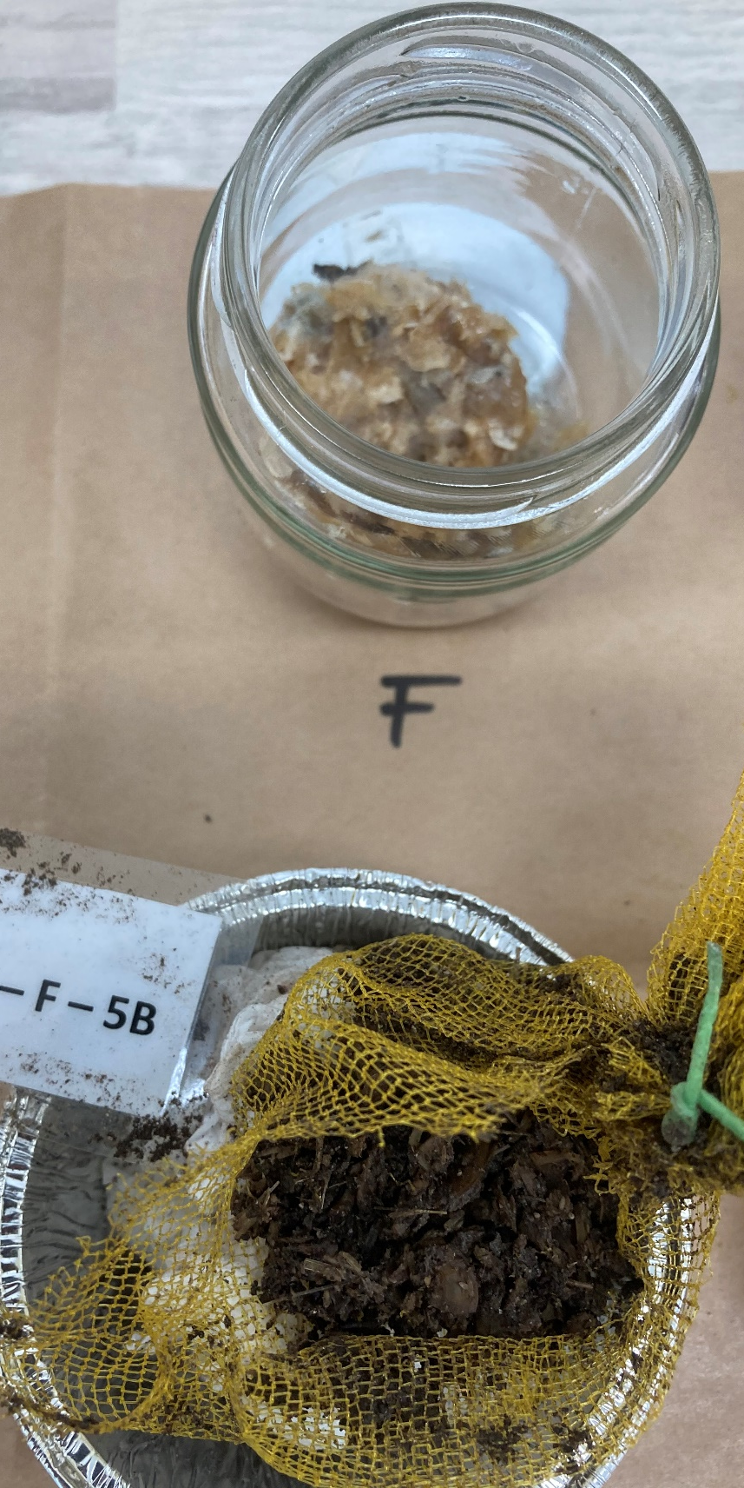
Some conclusions:
600 kg N/ha is too high in a field experiment with ryegrass
Very rapid growth effect of acid-conserved fish bones
Less rapid, but positive growth effect of fresh fish bones (popular feed for soil animals!)
Initiation of positive growth effect of algae fiber after about 3 months (May-August)

Slide 15
Challenges – chemical composition: Potentially toxic elements
Potentially toxic element, mg/kg TS | Algae fibre | Acid-conserved fish bones | Grinded fresh fish bones | Limit in EU regulation Annex 1 | Poultry manure «Green Organic»
As | 33 | 1.3 | 6.9 | No limit in Ann. 1 General EU reguletion 40? | 0.15
Cd | 0.9 | <0.10 | 0.02 | 0.7 | <0.1
Cr | 3.8 | <0.3 | 0.68 | 70 | 4
Cu | 9.4 | 7.3 | 1.8 | 70 | 23
Hg | 0.08 | 0.09 | <0.7 | 0.4 | 0.01
Ni | <1.5 | <1.5 | 2.1 | 25 | 1.6
Pb | <0.3 | <0.3 | 0.34 | 45 | 0.71
Zn | 94 | 100 | 67 | 200 | 170

Slide 16
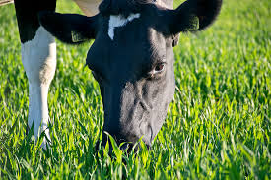
Challenges – chemical composition:
Mineral balance- feed quality
Fish bones = N, P, Ca fertiliser; not well balanced for crop needs
Horticulture or meadow purpose? (early spring applicaton)
AF not permitted for use in organic growing (Cd, possibly As, contains residues of HNO₃
AF has high concentrations of K: what about feed quality? High uptake of K decreased uptake of Ca in pot exp with ryegrass

Slide 17
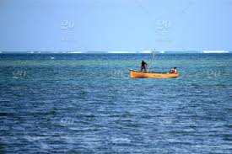
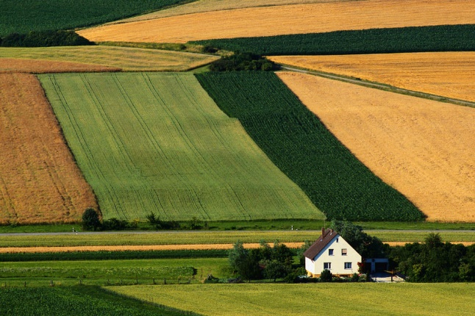
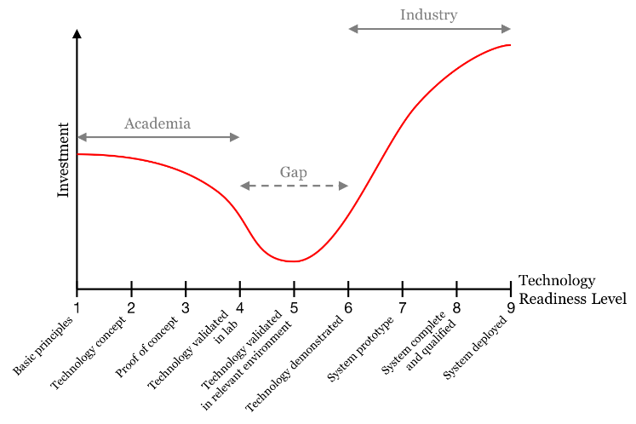
Challenges – accessability, logistics
Competition for residual materials: From gate fee to purchase
Industry will always search for products with higher profits
Low interest for making recycled fertilisers in the home country of Yara
Long distance from sea to farmland; two highly different cultures
Lots of practical issues still to be solved (innovational «valley of death»)
Good fishing places are top secret ……and nobody sees what the sea hides
Agricultural practice is visible for all

Slide 18

Pathways to phase-out contentious inputs from organic agriculture in Europe
This project has received funding from the European Union’s Horizon 2020 impact and innovation programme under grant agreement No. 774340

