Slide 1
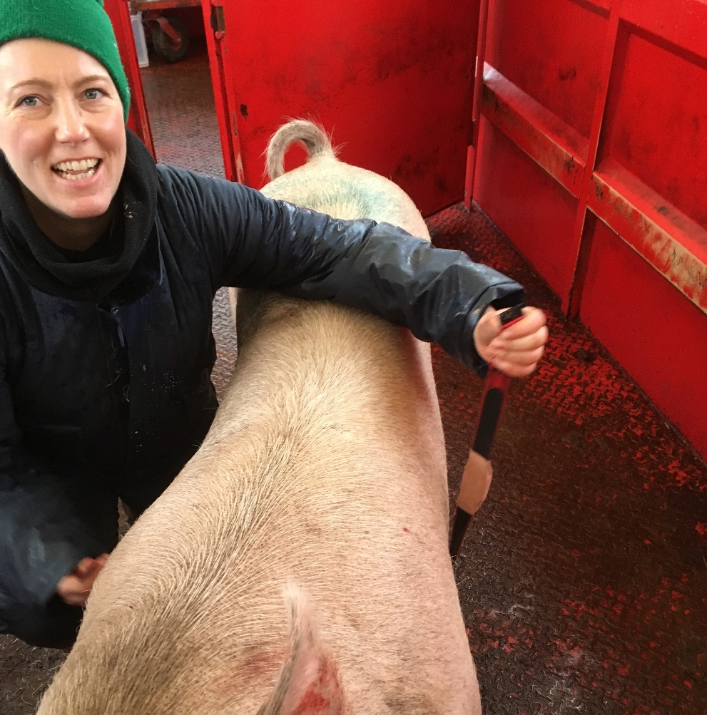
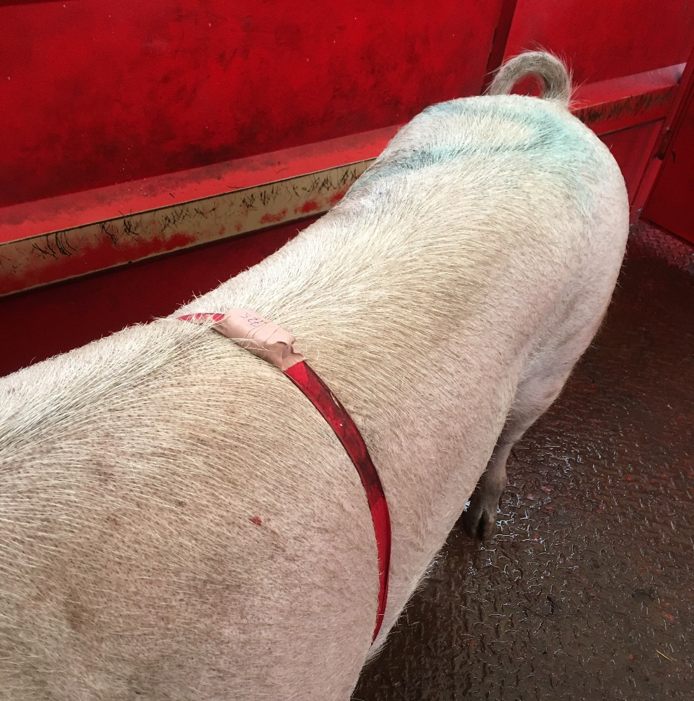
Heat production in free-range sows estimated by heart rate recordings
U. Krogh*, M. Eskildsen*, M. T. Sørensen*, H. Jørgensen*, P. K. Theil
UffeKrogh@anis.au.dk
* Department of Animal Science, Aarhus University Foulum, Denmark
INTRODUCTION
Background
Heat production (HP) of free-range sows is affected by factors such as activity level and environmental temperature.
Conventional methods to estimate HP, such as indirect calorimetry, are not applicable in free-range sows.
At sub-maximal levels of exercise, oxygen consumption, is the single most important factor of heat production. Therefore, the linear relationship between heart rate (HR) and oxygen consumption may be used to estimate heat production.
Objectives
To establish the relationship between sow heart rate and heat production in confined sows (EXP-1).
To estimate heat production of free-range sows using the established HR-HP relationship (EXP-2).
METHODS
Experiment-1 (HR–HP relationship)
Sow HR and HP was measured in 8 second parity confined sows on day 30, 60, 80 and 104 in gestation and day 10, 14 and 24 in lactation.
Sow HR was measured using surgically inserted HR-implants.
Sow HP was estimated by indirect calorimetry using respiration chambers.
Experiment-2 (Sow activity and estimated HP)
Sow activity (HR and distance covered) was measured in 41 free-range second parity sows (2 groups from May to September 2016) using an activity tracking and HR device (Polar team pro, Polar®, Denmark),
Activity was measured on day 60 and 100 in gestation and on day 5, 20 and 40 in lactation.
The HR-HP relationship established in EXP-1 was used to estimate heat production of free-range sows in EXP-2.
RESULTS EXP-1 (HR–HP relationship)
The linear relationships between HR (Beats per minute) and HP (MJ/day) were:
Gestation: HP (R² = 0.62) = 0.323 (±0.025; P < 0.001) × HR, bpm – 2.4 (±2.3; P = 0.33)
Lactation: HP (R² = 0.25) = 0.118 (± 0.034; P = 0.003) × HR, bpm + 26.7 (± 3.4; P < 0.001)
SOW ACTIVITY
Figure 1. The activity tracking and heart rate devices was fastened to the sow (Polar team pro, Polar®, Denmark) and data were continuously logged.
RESULTS EXP-2 (Heart rate, distance covered and estimated heat production)
 |  | Gestation |  |  | Lactation |  |  |  | SEM |  | P-val
Heart rate, BPM |  | Day 60 | Day 100 |  | Day 5 | Day 20 | Day 40
 | Not moving¹ | 83^{d} | 94^{c} |  | 92^{c} | 97^{b} | 101ª |  | 1.4 |  | < 0.001
 | Walking² | 110^{c} | 120^{b} |  | 139ª | 140ª | 139ª |  | 2.4 |  | < 0.001
 | 24 hour-mean³ | 91^{d} | 99^{c} |  | 98^{c} | 108^{b} | 113ª |  | 1.5 |  | < 0.001
Distance covered, km/day⁴ |  | 3.4ª | 2.4^{b} |  | 1.1^{c} | 2.0^{b} | 2.3^{b} |  | 0.17 |  | < 0.001
Estimated heat production, MJ/d⁵ |  | 27^{d} | 30^{c} |  | 38^{b} | 39ª | 40ª |  | 0.3 |  | < 0.001
¹ | Heart rate during 1-minutes intervals where the distance covered was zero.
² | Heart rate during 1-minutes intervals where the distance covered was greater than10 meter/minutes.
³ | Daily mean heart rate estimated as the weighted average of the recorded heart rate during day time (sunrise to sunset) and heart rate at night (sunset to sunrise). The heart rate at night was assumed to be identical to the heart rate when the sow was relaxing (i.e. not moving).
⁴ | Distance covered estimated using the recorded distance during day time multiplied by the day length (h) to recording time (h) ratio.
⁵ | Heat production estimated using the established relationships between heart rate and heat production in gestation and lactation.
CONCLUSION
A linear relation between heart rate and heat production (indirect calorimetry) was observed.
The daily distance covered by free-range sows ranged between 1.1 and 3.4 km/day, with the lowest distance in early lactation.
Heat production of free-range sows increased by 48% from day 60 of gestation to day 40 in lactation.

