Slide 1
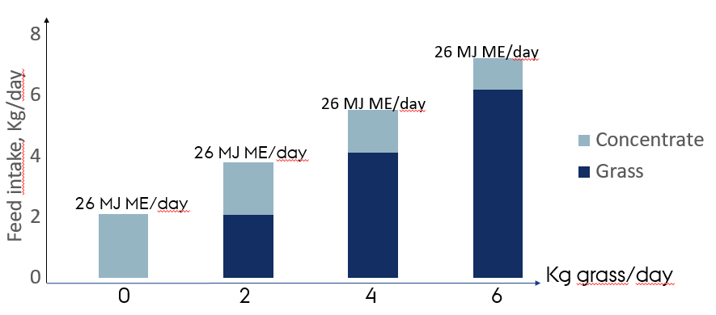
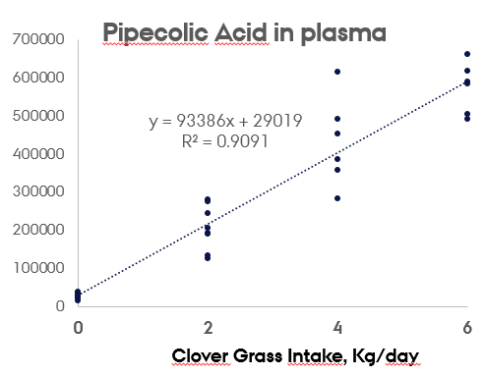
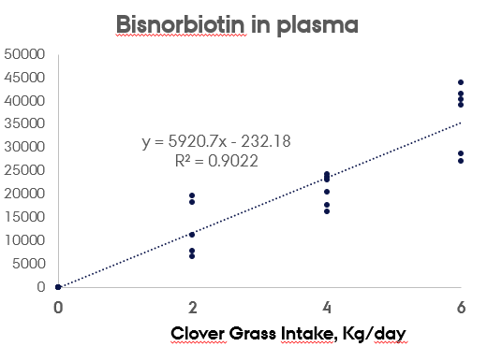
Grass intake of sows quantified by plasma metabolites
M. Eskildsen*, J. V. Nørgaard, M.S Hedeman, P. K. Theil
Maria.Eskildsen@anis.au.dk
* Department of Animal Science, Aarhus University Foulum, Denmark
INTRODUCTION
Background
Outdoor sows ingest grass during the summer, but the digestibility and intake of grass is unknown. Currently, feed for outdoor sows is therefore formulated based on nutrient recommendations for indoor sows even though the energy- and protein requirements differ substantially between these production systems.
Ignoring the energy and nutrients supplied from grazing may lead to poor feed efficiency and nitrogen leaching..
Objectives
To build a prediction model based on biomarkers in blood and urine.to quantify daily grass intake in sows with access to pasture.
Thereby it is possible to improve feed formulation and reduce the environmental load of outdoor pig production
METHODS
Total urine and feces was collected during two balance periods of five days from sixteen multiparous dry sows. Sows were fed similar amounts of net energy including daily rations of 0, 2, 4, or 6 kg of freshly cut clover grass . Blood and urine samples were collected and analyzed for plasma metabolites using LCMS.
RESULTS (Nitrogen Utilization)
There was a highly significant increase in nitrogen intake and nitrogen in feces and -urine with increasing grass intake
RESULTS (Plasma Nutrients)
 | Grass, Kg
 | 0 | 2 | 4 | 6 | SEM | Grass p
N intake, g/day | 43.6 | 50.3 | 58.5 | 65.2 | 3.8 | <0.001
N in feces, g/day | 8.3 | 10.4 | 12.7 | 16.8 | 1.5 | 0.003
N in urine g/day | 27.3 | 33.0 | 34.1 | 48.4 | 2.6 | <0.001
N deposition, g/day | 6.5 | 6.9 | 9.7 | 0.3 | 2.7 | 0.24
N utilization, % | 14.9 | 13.9 | 17.3 | 5.2 | 6.2 | 0.53
 | Grass Intake, Kg/day |  |  |  |  | Grass
 | 0 | 2 | 4 | 6 | SEM | p
Glukose, mM | 4.53 | 4.59 | 4.29 | 4.18 | 0.15 | 0.16
Lactate, mM | 2.03 | 1.26 | 1.35 | 1.89 | 0.47 | 0.54
Urea, mM | 2.64 | 4.05 | 3.59 | 4.39 | 0.38 | 0.04
Creatinine, M | 159.25 | 142.83 | 147.62 | 124.79 | 12.05 | 0.26
Pipecolic Acid | 28324 | 206159 | 435776 | 599990 | 34313 | <0.0001
Bisnorbiotin | 0 | 12144 | 21946 | 38767 | 2319 | <0.0001
RESULTS (Linear relationship between plasma Pipecolic acid/Bisnorbiotin (arbitrary units) and the daily intake of freshly cut clover grass in sows)
CONCLUSION
Digestibility of dry matter, organic matter, nitrogen and energy in grass was high (64 to 72%)
Grass intake in sows was found to be highly correlated with plasma Pipecolic acid (Y = 0.93X+0.29; r=0.91) and with plasma Bisnorbiotin (Y = 5921X-232; r=0.90).

