Slide 1
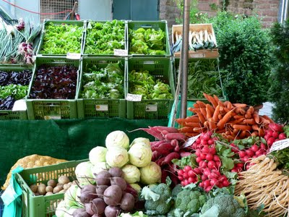
Local and/or organic: A study on consumer preferences for organic food and food from different origins
C. Feldmann & U. Hamm

Slide 2
Background
Increasing discussions on organic and local food
complementary trends
or substitutional quality attributes?
Gracia et al. (2014): both food quality attributes are substitutes (study on eggs in Spain)
Costanigro et al. (2014): both food quality attributes are complementary (study on apples in the USA)
Need for further research to clarify this discussion

Slide 3
Research objectives
Consumers’ choices between products from different origins and production processes
Differences between urban and rural consumers and differences between consumers in North, East, West, and South Germany (very different regions with regard to purchase power, organic consumption, and regional identity)
Compare purchase preferences and WTP values for four different products
Influences on consumer preferences (through e.g. habits, attitudes towards local and organic food, and socio-demographic data)
Information on whether consumers face a trade-off when choosing between a local and an organic product

Slide 4
General information on study
Combination of consumer survey and choice experiment
641 interviews of consumers in eight supermarkets in four regions of Germany (urban – rural; North – East – South – West)
Computer-assisted self-interviewing (CASI)
631 responses, appropriate for analysis of choice experiment
Four products: apples, butter, flour, and steak
Design based on coefficients from pretest
Four blocks (one for each product) à 16 choice sets
16 choice sets per respondent (four sets per product)

Slide 5
Sociodemographic data
 |  |  |  |  | All
Gender | N |  |  |  | 631
 | Female |  |  |  | 414
 | Male |  |  |  | 217
Age | N |  |  |  | 630
 | 18-30 years |  |  |  | 122
 | 31-45 years |  |  |  | 198
 | 46-60 years |  |  |  | 229
 | >60 years |  |  |  | 88
 | Mean age (years) |  |  |  | 44.5
Education |  | N |  |  | 631
 | No formal qualification |  |  |  | 2
 | Secondary/Intermediate |  |  |  | 255
 | College/University qualification |  |  |  | 174
 | College/University degree |  |  |  | 200
Household size |  |  | N |  | 631
 |  | Mean |  |  | 2.7
Household net income (monthly) |  |  |  | N | 631
 |  | < 600 € |  |  | 19
 |  | 600 € to <1,200 € |  |  | 59
 |  | 1,200 € to<1,800 € |  |  | 96
 |  | 1,800 € to <2,400 € |  |  | 91
 |  | 2,400 € to <3,000 € |  |  | 82
 |  | 3,000 € to <3,600 € |  |  | 54
 |  | 3,600 € to <4,200 € |  |  | 50
 |  | 4,200 € to <4,800 € |  |  | 29
 |  | 4,800 € to <5,400 € |  |  | 27
 |  | 5,400 € to <6,000 € |  |  | 21
 |  | 6,000 € or more |  |  | 25
 |  | No comment |  |  | 78
Compared to German average:
More female than male shoppers
Slightly lower mean age
Slightly better education
Similar income
Higher average household size

Slide 6
Design of choice experiment
Attributes: origin, type of production, price
Origin: local, from Germany, from a neighbouring country, from a non-EU country
Type of production: organic, non-organic
Price: four levels
Prices and importing countries for different products used in choice experiment
Attribute level | Apples | Flour | Butter | Steak
Price 1 | 2,49 | 0,69 | 1,29 | 3,49
Price 2 | 2,99 | 0,99 | 1,49 | 4,49
Price 3 | 3,49 | 1,29 | 1,69 | 5,49
Price 4 | 3,99 | 1,59 | 1,89 | 6,49
Neighb. countries | Austria | Italy | Denmark | France
Non-EU countries | Argentina | Kazakstan | New Zealand | Australia

Slide 7
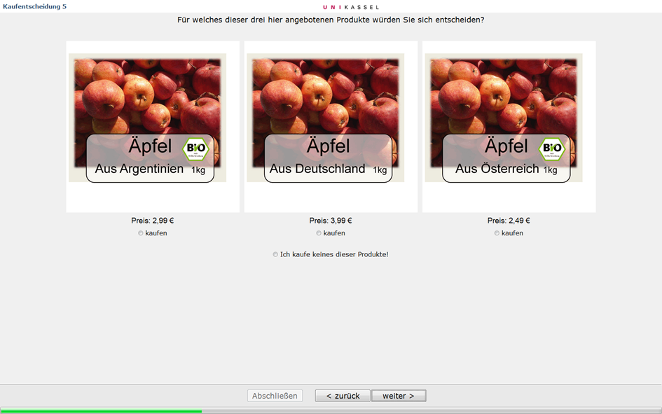
Example of a choice-set for apples (CASI)

Slide 8
Methodological approach
Choice experiment
Attribute-based survey method
Consumer preferences and utility (consumers choose the most preferred alternative from a set of hypothetical products)
Relevance of different product attributes in comparison
Choice sets are composed of three product alternatives, varying in three attributes
Including a no-buy option and a binding purchase decision
Theoretical framework
Characteristics theory of value (Lancaster 1966)
Random utility theory (Thurstone 1922); basic form: U_{i}= V_{i} + Ɛ_{i}

Slide 9
Random parameters logit models (RPL)
Better model fit than multinomial logit models (MNL)
Individual models for all four products
Halton draws, 1000 pts
Fixed parameters, whenever standard deviations or standard errors were insignificant
Price was treated as non-random

Slide 10
RPL models
 | Apples |  | Butter |  | Flour |  | Steaks
 | Coefficient | Standard error | Coefficient | Standard error | Coefficient | Standard error | Coefficient | Standard error
Price | -1,4609 | 0,0958** | -4,6950 | 0,2725** | -3,3135 | 0,2924** | -0,7601 | 0,0567**
Local | 4,7228 | 0,2349** | 4,5067 | 0,2190** | 6,4853 | 0,3505** | 4,3746 | 0,2402**
Germany | 4,4463 | 0,2199** | 3,6945 | 0,1881** | 5,6878 | 0,3175** | 3,0182 | 0,1847**
Neighb. country | 1,2556 | 0,2022** | 1,2632 | 0,1759** | 1,7050 | 0,2481** | 0,3774 | 0,1617*
Organic | 2,6810 | 0,3748** | 5,7365 | 0,4280** | 0,7771 | 0,3440* | 2,4015 | 0,2713**
Non-organic | 2,4467 | 0,3434** | 5,5368 | 0,4234** | 0,4633 | 0,3449 | 1,6207 | 0,2510**
No. of ob-servations | 2524 |  | 2524 |  | 2524 |  | 2524
LL function | -2.183,06 |  | -2.191,96 |  | -1.773,86 |  | -2.381,18
Pseudo R² | 0,376 |  | 0,374 |  | 0,493 |  | 0,319
Halton draws, Pts | 1000 |  | 1000 |  | 1000 |  | 1000
Statistical significance at level **<0.01, *<0.05
Fixed parameters are marked grey, random parameters are not marked.

Slide 11
Results ǀ
Negative sign for price coefficients, relative importance of price varies between models
Small impact of the parameter ‚organic‘, exception: steaks
Order of origin parameters in all models: local > from Germany > from a neighbouring country > from a non-EU country
Differences between coefficients for ‚local‘ and other origin attributes vary between models (e.g. local –Germany → very small for apples, larger for steaks)
Product-specific differences in preference structures

Slide 12
RPL models for apples (rural versus urban)
Rural: less than 30.000 inhabitants
Urban: more than 30.000 inhabitants
 | Apples
 | Rural |  | Urban
Price | -1,65168 | 0,1459** | -1,37549 | 0,1316**
Local | 4,90898 | 0,3495** | 4,82346 | 0,3485**
German | 4,67762 | 0,3308** | 4,51133 | 0,3297**
Neighbour | 0,97724 | 0,2956** | 1,44791 | 0,3162**
Organic | 3,27944 | 0,5408** | 2,27805 | 0,5402**
Non-organic | 3,23781 | 0,5053** | 1,89801 | 0,4932**
Number of observations | 1348 |  | 1176
Log Likelihood function | -1153,666 |  | -1019,257
Pseudo-R² | 0,3826 |  | 0,3748
Halton draws Pts | 1000 |  | 1000
Statistical significance at level **<0.01, *<0.05
Fixed parameters are marked grey, random parameters are not marked.

Slide 13
Results ‖
Differences in preference structure due to places of origin
Smaller positive influence of ‚organic‘ as compared to other coefficients for rural consumers
Smaller positive influence of ‚from a neighbouring country‘ as compared to other coefficients for rural consumers
Differences are reflected in survey responses
Rural consumers regard ‚organic‘ as less important than urban consumers
Rural consumers have significantly less trust in products from neighbouring countries than urban consumers
Rural consumers stay significantly longer in one region than urban consumers → may influence attitude towards local food (cf. Wägeli & Hamm, 2013)

Slide 14
Discussion of further models
Interactions, e.g. local x organic, local x non-organic or non-EU x organic (+ marginal effects)
Comparison of four products
Comparison of processed vs. unprocessed and animal vs. plant products
Heterogeneity in means of random parameters to determine influences related to socio-demographic data and attitudes

Slide 15
Information on further research:
http://www.uni-kassel.de/fb11agrar/en/sections/agricultural-and-food-marketing/research.html

Slide 16
Additional slides…

Slide 17
RPL models for butter (rural versus urban)
 | Butter
 | Rural |  | Urban
Organic | 4,98572 | 0,5289** | 6,5205 | 0,6707**
Non-organic | 4,91511 | 0,5309** | 6,24752 | 0,6699**
Local | 4,38265 | 0,2685** | 4,60259 | 0,3530**
German | 3,67577 | 0,2371** | 3,65195 | 0,2853**
Neighbour | 1,24755 | 0,2191** | 1,44784 | 0,2406**
Price | -4,28014 | 0,5309** | -5,12133 | 0,4312**
Number of observations | 1348 |  | 1176
Log Likelihood function | -1157,259 |  | -1028,996
Pseudo-R² | 0,3807 |  | 0,3688
Halton draws | 1000 |  | 1000

Slide 18
RPL models for flour (rural versus urban)
 | Flour
 | Rural |  | Urban
Organic | 0,81266 | 0,3839* | 0,63776 | 0,4605
Non-organic | 0,71378 | 0,3709 | 0,2988 | 0,4449
Local | 4,97533 | 0,3280** | 5,74872 | 0,4153**
German | 4,47022 | 0,3167** | 5,04129 | 0,3989**
Neighbour | 1,01739 | 0,2746** | 1,57733 | 0,3306**
Price | -2,66609 | 0,2989** | -2,91443 | 0,3596**
Number of observ. | 1348 |  | 1176
Log Likelihood function | -988,7 |  | -842,032
Pseudo-R² | 0,4709 |  | 0,4835
Halton draws, Pts | 1000 |  | 1000

Slide 19
RPL models for steaks (rural versus urban)
 | Steaks
 | Rural |  | Urban
Organic | 1,89662 | 0,3586** | 2,90169 | 0,4120**
Non-organic | 1,3174 | 0,3297** | 1,89381 | 0,3811**
Local | 4,43875 | 0,3297** | 4,14808 | 0,3363**
German | 3,00984 | 0,2375** | 2,91984 | 0,2849**
Neighbour | -0,09191 | 0,2382 | 0,77762 | 0,2296**
Price | -0,64948 | 0,0744** | -0,87497 | 0,0864**
Number of observations | 1348 |  | 1176
Log Likelihood function | 1202,883 |  | -1161,633
Pseudo-R² | 0,3563 |  | 0,2875
Halton draws, Pts | 1000 |  | 1000

Slide 20
Interactions for apples
 | Apples
 | Coefficient | St. error | Coefficient | St. error | Coefficient | St. error
Organic | 2,8680 | 0,3968** | 2,7256 | 0,3758** | 1,7376 | 0,4696**
Non-organic | 2,4176 | 0,3646** | 2,2780 | 0,3470** | 1,5912 | 0,4380**
Local | 5,1285 | 0,2686** | 4,4929 | 0,2440** | 5,1681 | 0,3620**
Germany | 4,6284 | 0,2371** | 4,4881 | 0,2231** | 4,9413 | 0,3547**
Neighbour | 1,3039 | 0,2068** | 1,2779 | 0,2026** | 1,8688 | 0,3471**
Organic x Local | -0,6149 | 0,1730**
Non-organic x Local |  |  | 0,5515 | 0,1513**
Organic x Non-EU |  |  |  |  | 1,0331 | 0,4124**
Price | -1,5015 | 0,1040** | -1,4417 | 0,0967** | -1,3550 | 0,0867**
No. of observations | 2524 |  | 2524 |  | 2524
LL function | -2169,867 |  | -2174,6990 |  | -2181,5690
Pseudo R² | 0,3799 |  | 0,3785 |  | 0,3765
Halton draws, Pts | 1000 |  | 1000 |  | 1000

Slide 21
Interactions for butter
 | Butter
 | Coefficient | St. error | Coefficient | St. error | Coefficient | St. error
Organic | 5,6016 | 0,4243** | 5,8851 | 0,4552** | 6,4956 | 0,4992**
Non-organic | 5,4110 | 0,4550** | 5,6708 | 0,4820** | 6,2260 | 0,4786**
Local | 4,4414 | 0,2173** | 4,5242 | 0,2789** | 4,0532 | 0,2576**
Germany | 3,6133 | 0,1792** | 3,7054 | 0,1898** | 3,1740 | 0,2403**
Neighbour | 1,3166 | 0,1596** | 1,2327 | 0,1778** | 0,6076 | 0,2697*
Organic x Local | -0,0364 | 0,2306
Non-organic x Local |  |  | 0,0867 | 0,2423**
Organic x Non-EU |  |  |  |  | -0,8930 | 0,3008**
Price | -4,5797 | 0,2763** | -4,7748 | 0,2985** | -4,8244 | 0,2805**
No. of observations | 2524 |  | 2524 |  | 2524
LL function | -2194,4120 |  | -2189,7640 |  | -2188,0090
Pseudo R² | 0,3728 |  | 0,3742 |  | 0,3747
Halton draws, Pts | 1000 |  | 1000 |  | 1000

Slide 22
Interactions for flour
 | Flour
 | Coefficient | St. error | Coefficient | St. error | Coefficient | St. error
Organic | 0,7695 | 0,2974** | 0,4581 | 0,2795 | 0,1204 | 0,3236
Non-organic | 0,4529 | 0,4529 | -0,0065 | 0,275 | 0,0628 | 0,3036
Local | 5,5162 | 0,3066** | 4,5793 | 0,2292** | 4,4388 | 0,2613**
Germany | 4,7224 | 0,2492** | 4,07922 | 0,1952** | 3,8361 | 0,2511**
Neighbour | 1,2636 | 0,2109** | 1,2499 | 0,2064** | 1,2227 | 0,2620**
Organic x Local | -0,3142 | 0,2471
Non-organic x Local |  |  | 0,857 | 0,3594*
Organic x Non-EU |  |  |  |  | 0,7197 | 0,3194*
Price | -2,7468 | 0,2313** | -2,3075 | 0,2042** | -2,2492 | 0,1734**
No. of observations | 2524 |  | 2524 |  | 2524
LL function | -1833,248 |  | -1873,961 |  | -1949,038
Pseudo R² | 0,4761 |  | 0,4644 |  | 0,443
Halton draws, Pts | 1000 |  | 1000 |  | 1000

Slide 23
Interactions for steaks
 | Steaks
 | Coefficient | St. error | Coefficient | St. error | Coefficient | St. error
Organic | 2,8578 | 0,3095** | 2,8578 | 0,3095** | 3,2628 | 0,4349**
Non-organic | 1,6808 | 0,2763** | 1,6808 | 0,2763** | 2,2695 | 0,3859**
Local | 5,013 | 0,3087** | 4,3578 | 0,2696** | 4,583 | 0,3580**
Germany | 3,1624 | 0,2002** | 3,1624 | 0,2002** | 3,1575 | 0,3021**
Neighbour | -0,6979 | 0,3169* | -0,6979 | 0,3169* | -0,8839 | 0,4025*
Organic x Local | -0,6552 | 0,2030**
Non-organic x Local |  |  | 0,6552 | 0,2030**
Organic x Non-EU |  |  |  |  | -2,5564 | 0,6488**
Price | -0,8393 | 0,0654** | -0,8393 | 0,0654** | -0,9157 | 0,0732**
No. of observations | 2524 |  | 2524 |  | 2524
LL function | -2359,454 |  | -2359,454 |  | -2336,406
Pseudo R² | 0,3257 |  | 0,3257 |  | 0,3323
Halton draws, Pts | 1000 |  | 1000 |  | 1000

