Slide 1
Utilization of duckweed as fish meal replacement in common carp (Cyprinus carpio)
(Verwertung von Wasserlinsen als Fischmehlersatz durch Karpfen (Cyprinus carpio))
*Stadtlander T., Surber J., Pietsch C., Tschudi F., Sigrist M., Seitz A., Kreuzer M., Leiber F.
03.03.2020
timo.stadtlander@fibl.org

Slide 2
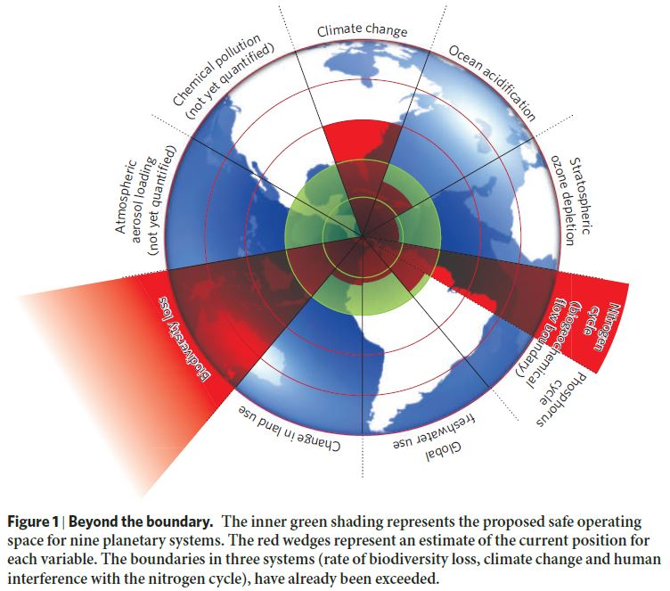
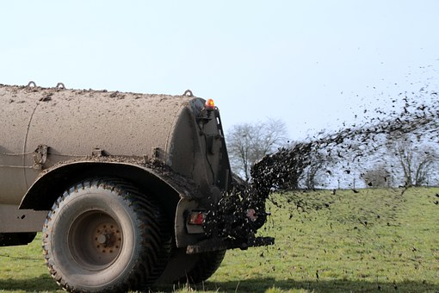
Introduction
N-fertilizer: ~110 mio. t. N yr⁻¹ (Lu & Tian 2017)
(Rockström et al. = 121 mio. t.)
Import of protein-rich feedstuffs leads to:
animal wastes
(frequently in excess of surrounding agricultural area)
„Planetary Boundaries“ (Rockström et al. 2009)

Slide 3
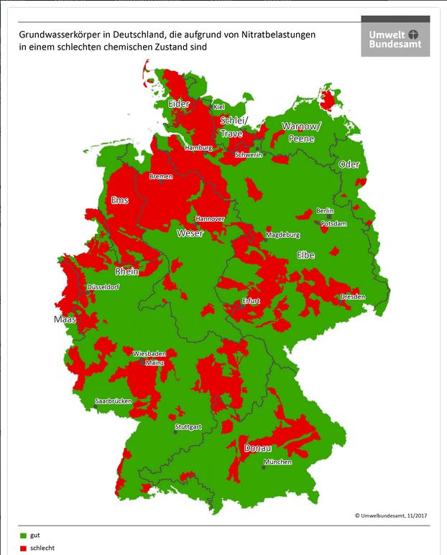
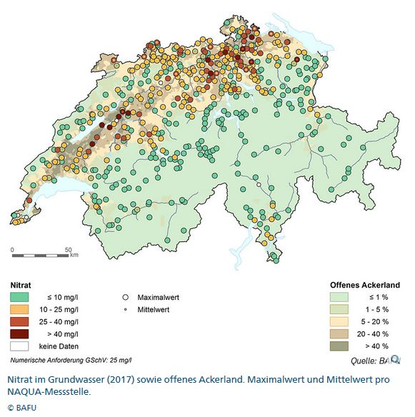
Introduction
NO₃- limits in groundwater:
Germany: 50 mg/l
Switzerland: 25 mg/l

Slide 4
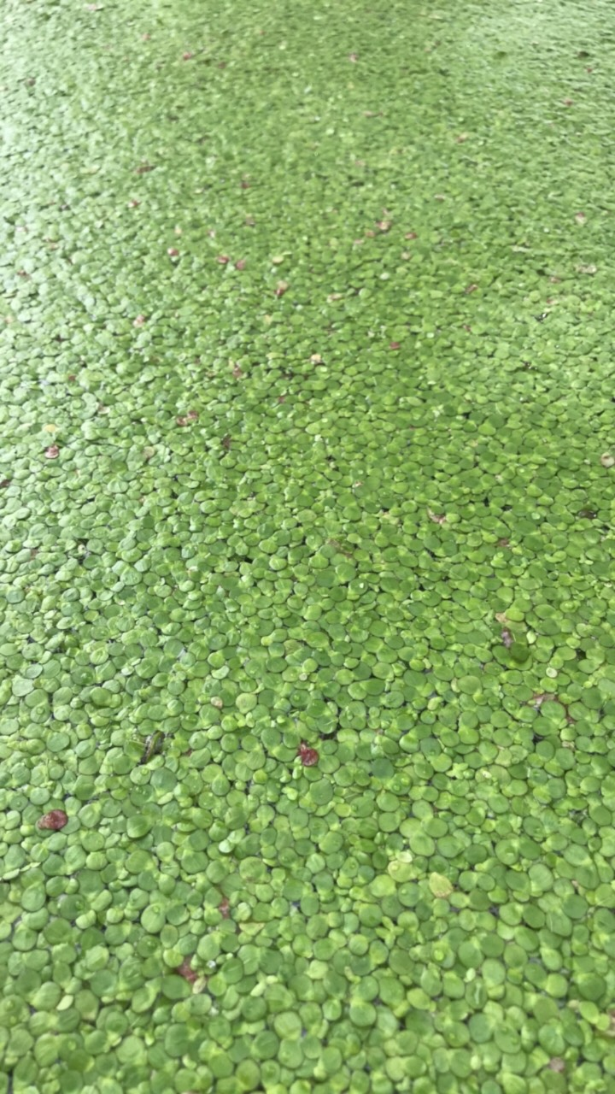
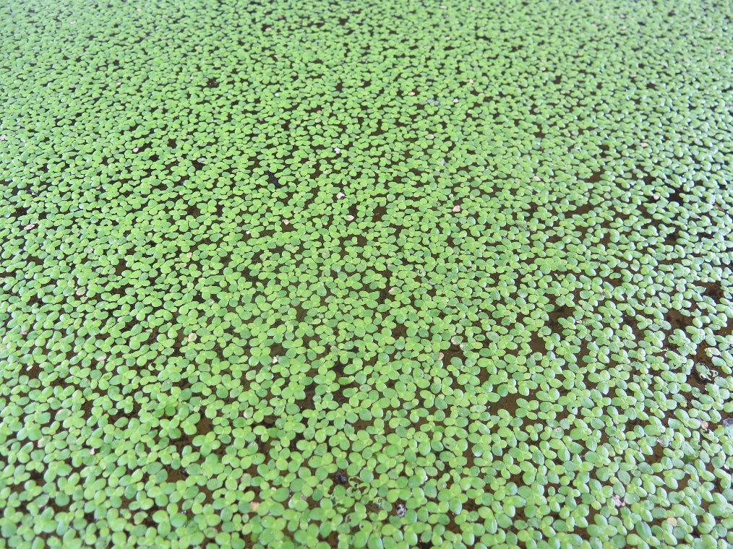
Introduction
Duckweed: 5 Genera, ~35-40 species in family Lemnaceae (Les et al. 2002)
Lemna 14 species
Spirodela 2 species
Landoltia 1 species
Wolffia 11 species
Wolfiella 10 species
Spirodela polyrhiza

Slide 5
Introduction
Duckweed is highly efficient to assimilate NH₄ and PO₄ → diluted slurry as substrate
Duckweed produces very high biomasses (Leng et al 1995):
Sub-optimum conditions: ~10-20 t DM/ha/yr
Optimum conditions: 20-70 t DM/ha/yr
Duckweed CP positively correlated with N (preferrably NH₄-N) and between 20% and 40% of DM
Soy yield: 2.33 t DM ha⁻¹ a⁻¹ and 38% CP → 0.89 t soy protein ha⁻¹ a⁻¹
Duckweed harvest: 27.3 t DM ha⁻¹ a⁻¹ and 26.5% CP → 7.23 t duckweed protein ha⁻¹ a⁻¹
(Xu et al. 2012)

Slide 6
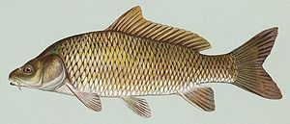
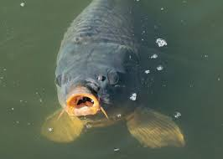
Introduction
Cyprinidae (carp-like fish):
Globally most important farmed fishes
2017 = 28 mio. t. cyprinidae, 53.4 mio. t. total pisces
Herbivorous and omnivorous
Trophic levels between 2 and 3
Main species:
common carp (Cyprinus carpio)
grass carp (Ctenopharyngodon idella)
silver carp (Hypophthalmychthys molitrix)
bighead carp (Hypophthalmychthys nobilis)

Slide 7
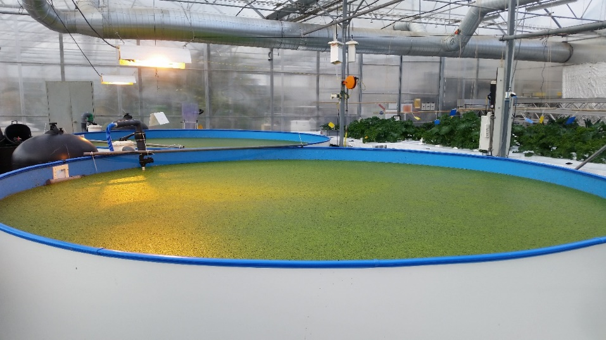
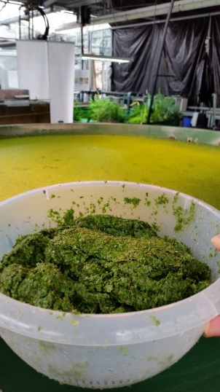
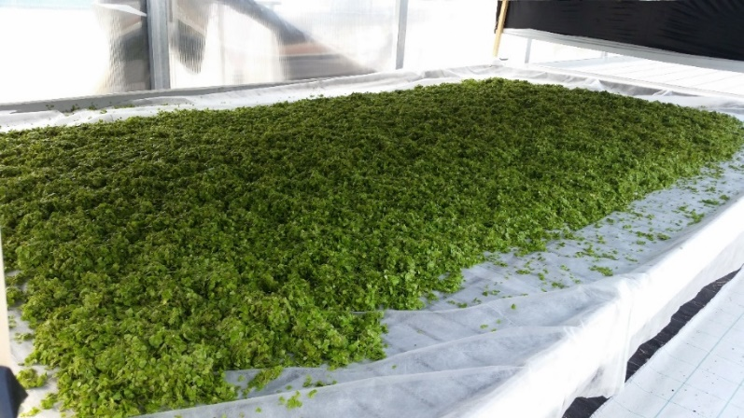
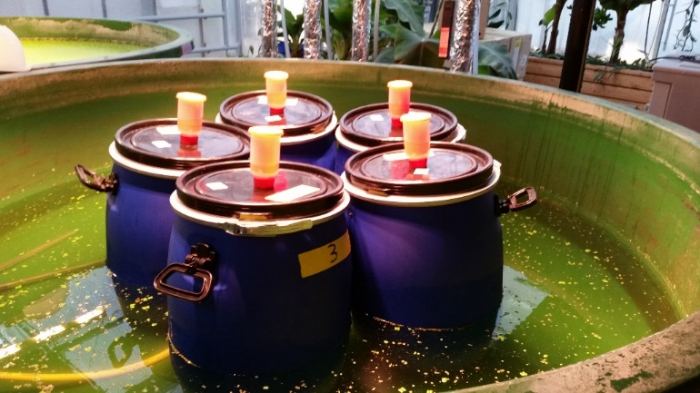
Material & Methods
harvest
Duckweed dried (DWD)
Duckweed fermented (DWF)

Slide 8
Material & Methods
High fish meal (40%) experimental diets
(~470 g/kg DM crude protein, ~125 g/kg DM crude lipids):
g/kg DM | Control | DWD15 | DWD30 | DWD45 | DWF15 | DWF30 | DWF45
Fish meal | 400 | 340 | 280 | 220 | 340 | 280 | 220
PBM | 252.6 | 252.6 | 252.6 | 252.6 | 252.6 | 252.6 | 252.6
DWD | 0 | 115.7 | 231.4 | 347.0 | 0 | 0 | 0
DWF | 0 | 0 | 0 | 0 | 131.5 | 262.9 | 394.4
Sunflower oil | 59.5 | 60.5 | 61.6 | 62.6 | 60.0 | 60.4 | 60.8
Potato starch | 185.0 | 140.0 | 95.0 | 50.0 | 130.0 | 70.0 | 15.0
α-cellulose | 82.9 | 71.2 | 59.5 | 47.8 | 66.0 | 54.1 | 37.2
Vitamin and mineral premix | 20.0 | 20.0 | 20.0 | 20.0 | 20.0 | 20.0 | 20.0
PBM = poultry by-product meal
DWD = dried duckweed
DWF = fermented duckweed
15, 30 and 45 = % of fish meal protein replacement

Slide 9
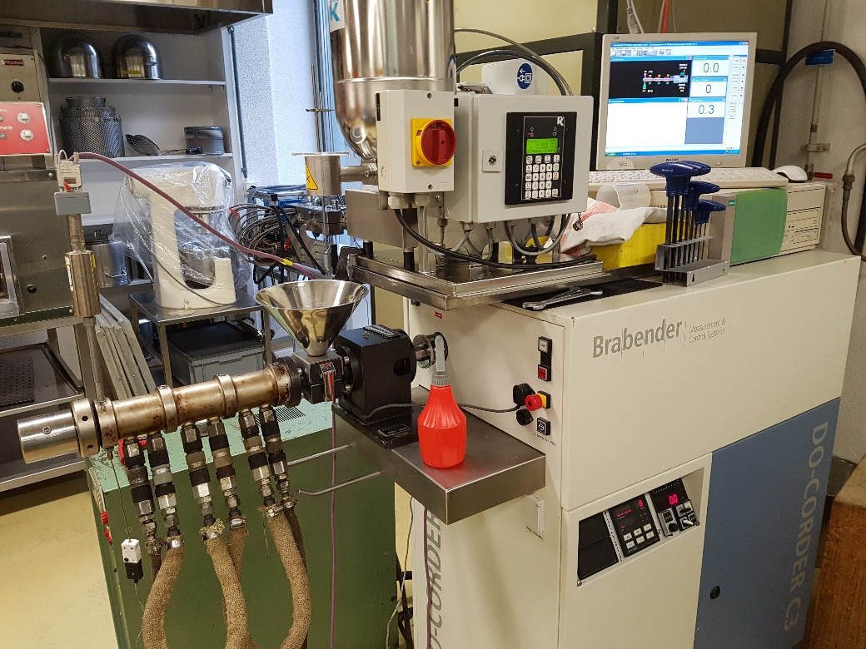
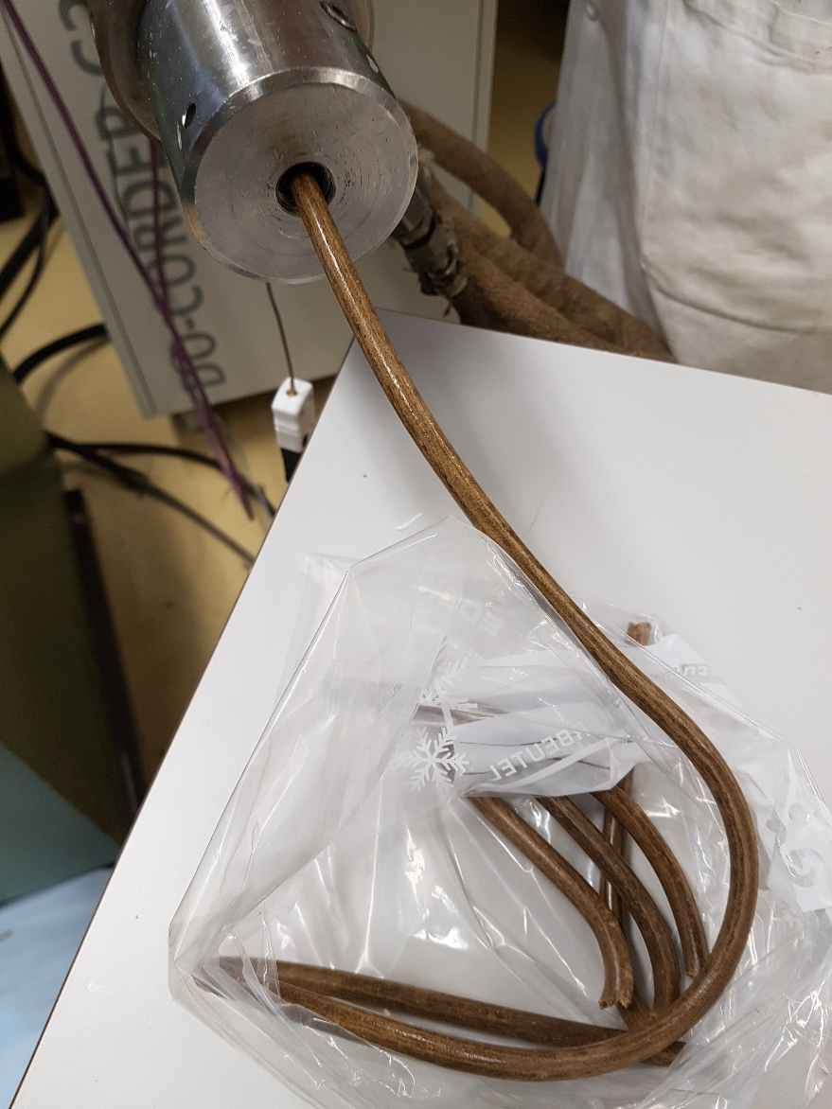
Material & Methods
Feed extruded in single-screw extruder at ETH Zurich (Laboratory of Food and Materials)
Afterwards crumbled and sieved
0.8-1.2 mm fraction used for feeding

Slide 10
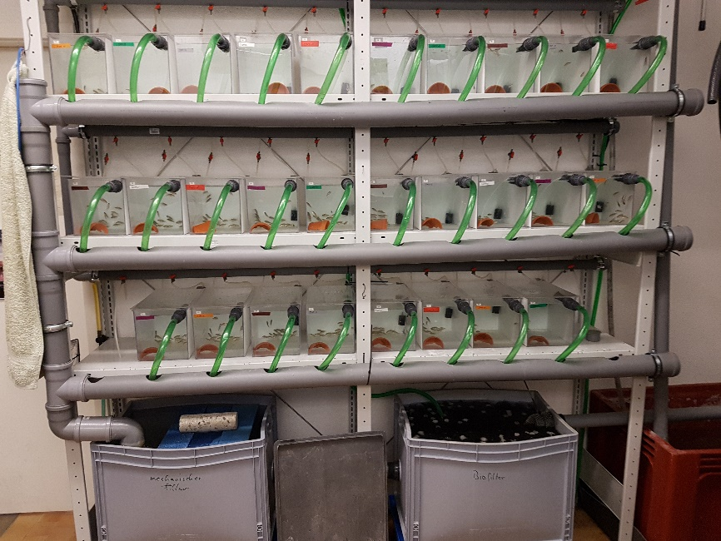
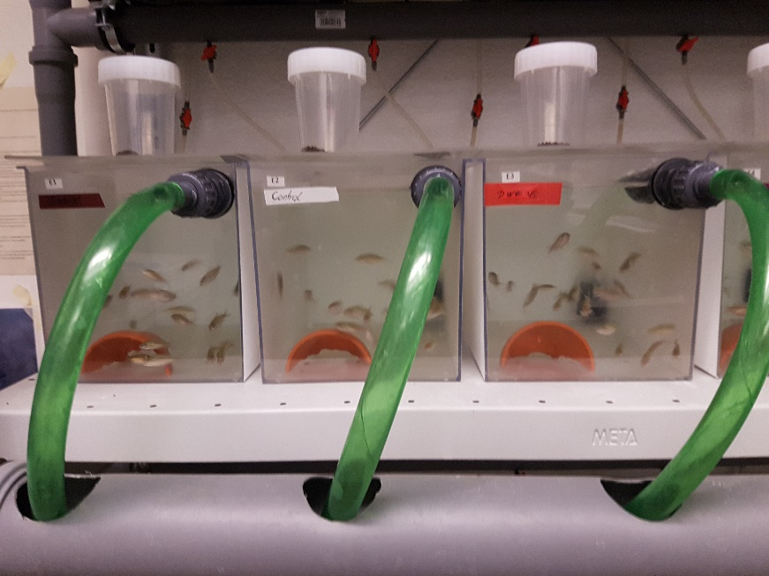
Material & Methods
Recirculation system (200 L water exchange/day)
28 aquaria á 10 L
7 treatments á 4 replicates
20 fish per aquarium
5% of body mass/day feed
Hand feeding
1/week group-weighing
2 weeks adaptation
6 weeks experimental feeding

Slide 11
Results
Proximate composition of the different experimental diets
 | Control | DWD15 | DWD30 | DWD45 | DWF15 | DWF30 | DWF45
Dry matter | 93.4 | 94.2 | 95.1 | 95.5 | 94.6 | 95.8 | 97.0
Crude protein | 48.0 | 47.7 | 46.7 | 48.0 | 47.2 | 46.4 | 46.1
Crude lipids | 12.1 | 12.1 | 12.1 | 12.6 | 12.6 | 13.0 | 14.1
Crude ash | 13.0 | 13.6 | 14.0 | 15.1 | 13.1 | 12.9 | 12.9
Crude fibre | 6.5 | 5.6 | 10.2 | 12.7 | 6.7 | 8.7 | 10.8
Gross energy (kj g⁻¹ DM) | 20.4 | 20.4 | 20.2 | 20.1 | 20.5 | 20.7 | 20.8
NFE¹ | 20.4 | 21.0 | 17.0 | 11.5 | 20.4 | 19.0 | 16.0

Slide 12
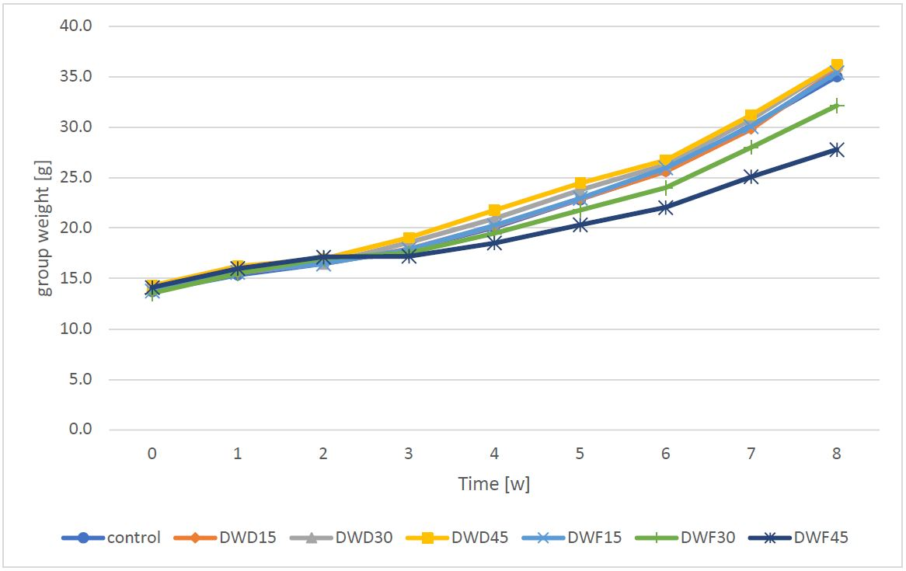
Results
adaptation
start experimental feeding

Slide 13
Results
Growth and feed conversion
 | Fish fed with
 | Control | DWD15 | DWD30 | DWD45 | DWF15 | DWF30 | DWF45
Initial group weight (g) | 15.4 ± 1.26 | 15.6 ± 0.77 | 15.9 ± 1.05 | 16.2 ± 1.33 | 15.6 ± 0.93 | 15.5 ± 0.63 | 16.0 ± 0.89
Final group weight (g) | 35.0 ± 4.32ª | 35.7 ± 2.19ª | 36.1 ± 3.82ª | 36.2 ± 3.87ª | 35.4 ± 1.07ª | 32.1 ± 0.95^{ab} | 27.8 ± 1.52^{b}
Weight gain (g) | 19.7 ± 3.16ª | 20.1 ± 1.53ª | 20.3 ± 2.92ª | 20.0 ± 2.56ª | 19.8 ± 1.22ª | 16.6 ± 0.50ª | 11.8 ± 1.18^{b}
Percent weight gain (%) | 128 ± 11.6ª | 129 ± 6.35ª | 128 ± 12.4ª | 123 ± 6.17ª | 127 ± 12.9ª | 107 ± 4.28ª | 74 ± 8.08^{b}
SGR (% day⁻¹) | 1.68 ± 0.10ª | 1.69 ± 0.06ª | 1.68 ± 0.11ª | 1.63 ± 0.06ª | 1.67 ± 0.12ª | 1.49 ± 0.04ª | 1.13 ± 0.10^{b}
FCR (g g⁻¹) | 3.56 ± 0.24ª | 3.47 ± 0.16ª | 3.55 ± 0.24ª | 3.67 ± 0.15ª | 3.54 ± 0.25ª | 3.97 ± 0.10ª | 5.20 ± 0.44^{b}
PPV (%) | 8.23 ± 0.55ª | 8.24 ± 0.35ª | 8.49 ± 0.55ª | 8.09 ± 0.32ª | 8.31 ± 0.56ª | 7.58 ± 0.18ª | 5.91 ± 0.46^{b}

Slide 14
Conclusion
Dried duckweed can be used to replace up to 45% of fish meal protein in a high fish meal diet (40%) without negative impacts on growth and feed conversion in common carp
Fermented duckweed can only be used to replace up to 30% of fish meal protein without negative effects on growth and feed conversion in common carp
Reasons for differing effects remain unknown so far

Slide 15
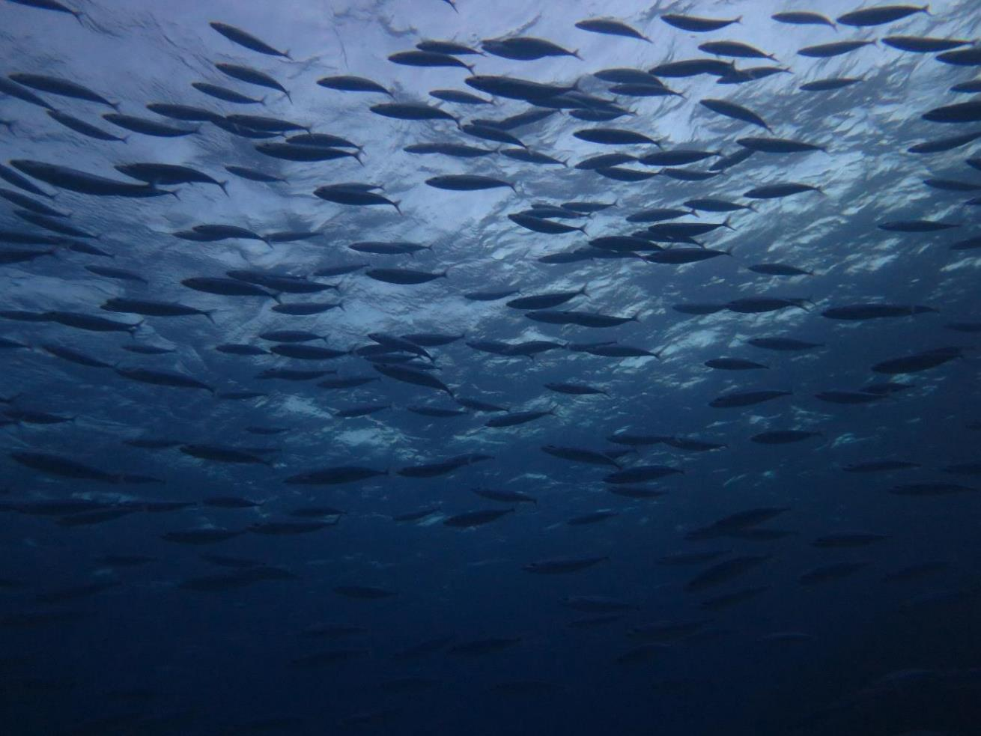
Thank you for your attention!

Slide 16
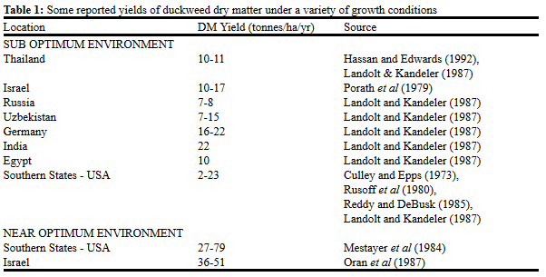
Introduction
High biomass production:
Leng et al. (1995)

