Slide 1
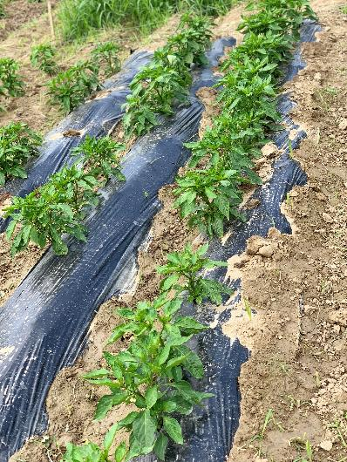
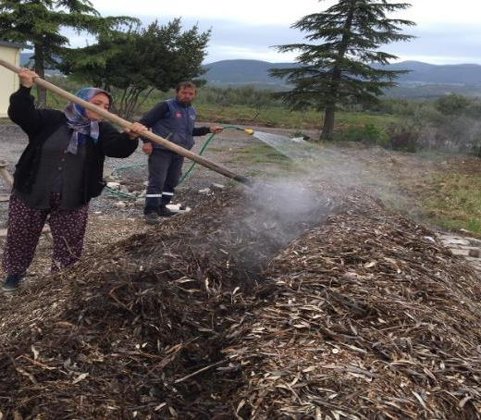
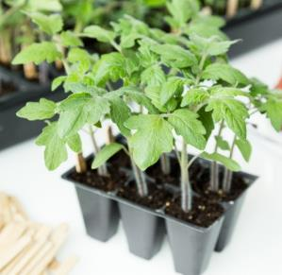
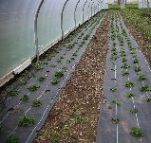
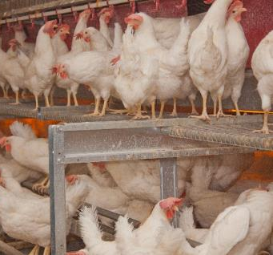
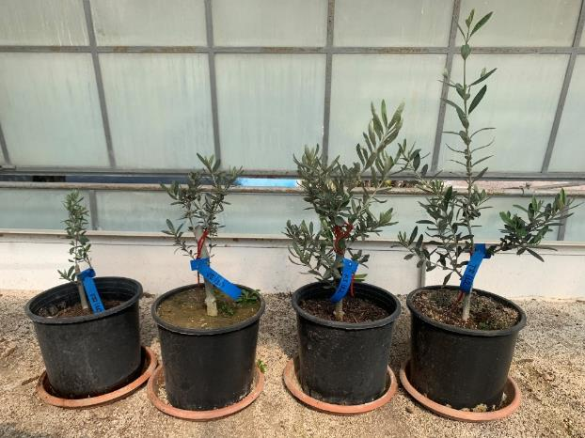
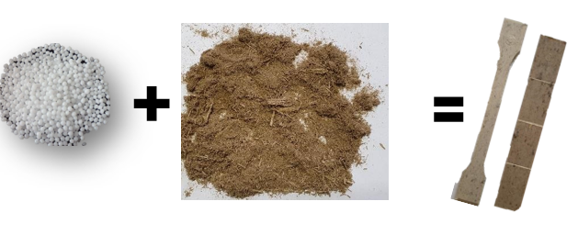
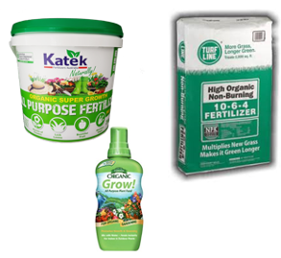
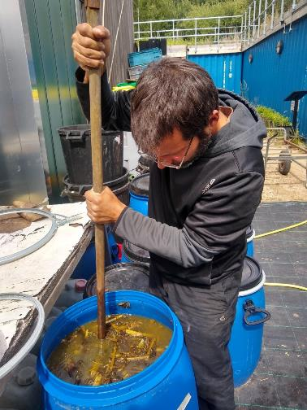

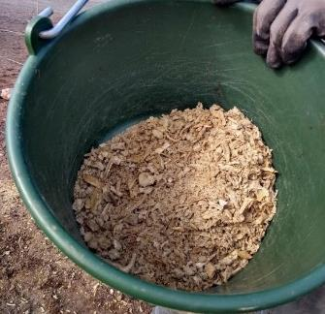


PEAT, PLASTIC AND FERTILISERS IN ORGANIC GROWING - CURRENT USE, FUTURE OPTIONS
Future alternatives
Current inputs
Completely degradable plastic can be made from potato starch
High use of peat in greenhouses and for transplants
High use of plastic for mulching, covering and accessories
High use of fertilisers derived from conventional farming
Mature compost may replace peat
Degradable biopolymer + plant fibre as filler = degradable material for pots etc.
Recycled fertilisers from society, clever utilisation of legumes, and marine-derived materials may replace conventional fertilisers
Anne-Kristin LØES
Norwegian Centre for Organic Agriculture
GA 774340
https://organic-plus.net/

