Slide 1
What do organic farmers use for fertilisation? Examples of innovative fertilisers
OWC 2021 webinar September 8, 2021; 15:30-17:00 CET Anne-Kristin Løes
This project has received funding from the European Union’s Horizon 2020 research and innovation programme under grant agreement No. 774340

Slide 2
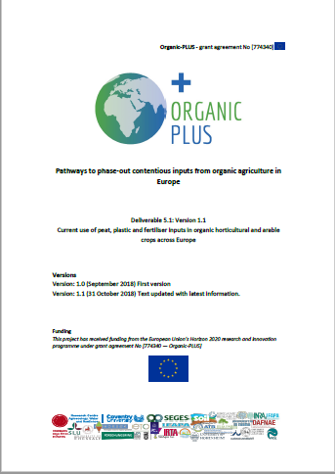
Organic-PLUS: Pathways to phase-out contentious inputs from organic agriculture in Europe
WP5, SOIL: HOW TO PHASE OUT
Peat
Plastic
Conventional + animal-derived fertility inputs
Conventional straw
Autumn 2018:
Mapping inputs of peat, plastic and fertilisers in organic growing across Europe

Slide 3
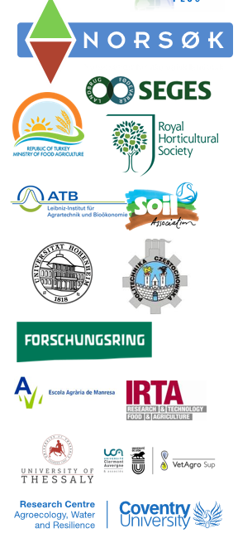
WP5 participants, working on fertilisers
Anne-Kristin Løes, NORSØK, NOrway (lead)
Casper Laursen, Frank Oudshoorn, SEGES, Denmark
Ralf Pecenka, Christian Dittrich, ATB, Germany
Lucas Knebl, Christopher Brock, FORI, Germany
Sabine Zikeli, Carolin Weiler, UoH, Germany
Krystyna Malinska, Danuta Drozdz, Przemek Postawa, Tomasz Stachowiak, CUT, Poland
Sophie Valleix, Heloise Bugaut, VetAgroSup, France
Rafaela Caceres, IRTA, Spain
Gloria Colom Puigbo, EAM, Spain
Gabriella Cervillieri, UNICTI, Italy
Nikolaos Katsoulas, UTH, Greece
Alev Kir et al, MFAL, Turkey
Francis Rayns, Judith Conroy, Dennis Touliatos, CU, UK
Ben Raskin, Hugh Blogg, Soil Association, UK
Margi L. Turner, RHS, UK

Slide 4
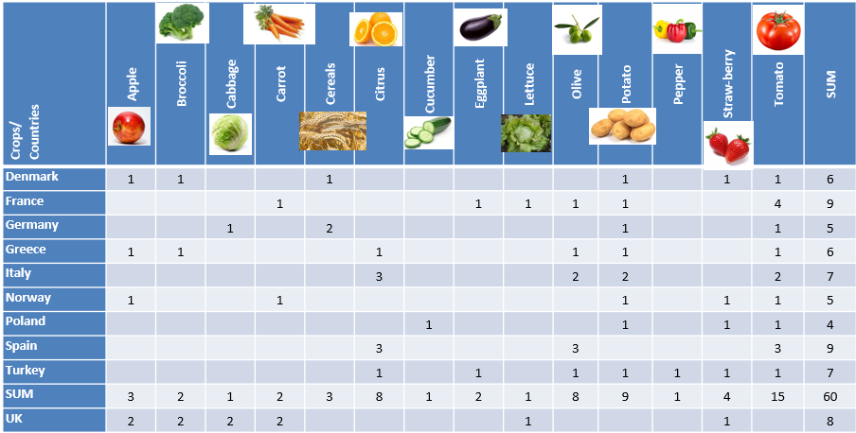
All inputs applied (including plant protection) in 14 important crops across 10 countries, expert survey

Slide 5
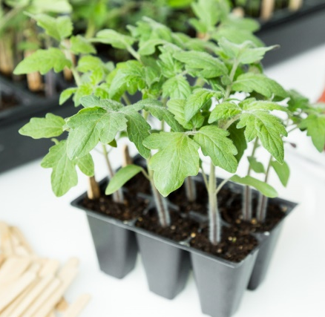
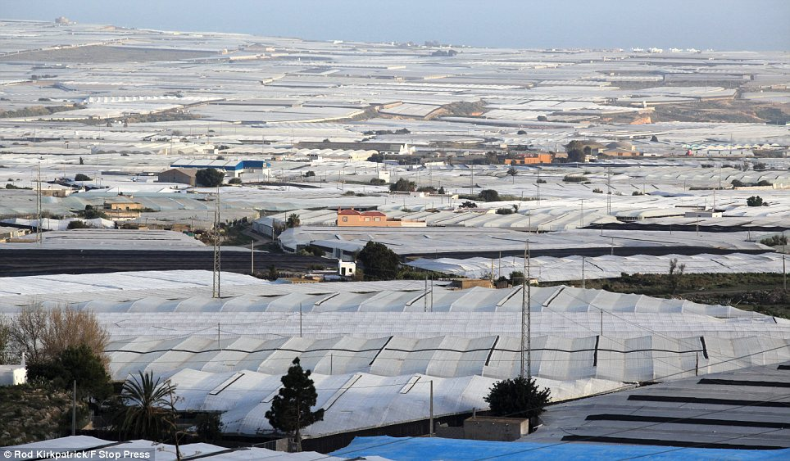
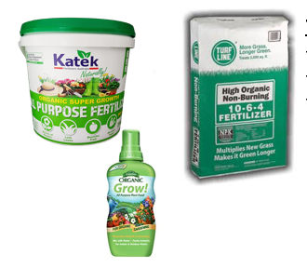
Results of input mapping excercise
Organic horticulture is highly specialized
Organic growers use as much plastic and peat as conventional
Broad use of conventional poultry manure + food-industry waste (vinasse, meat-and-bone meal)
Broad range of plant-based and animal-derived commercial fertilisers, varying between countries
Bulky products, often nationally produced; industry structure rapidly changing
Information about raw materials difficult to reveal

Slide 6
More about fertiliser inputs
Some countries use a lot of commercial certified organic fertilizers, others much less
Residues from sugar or starch production very common ingredient (plant-derived)
Horn grit, meat and bone meal, blood meal and feather meals not much observed
Animal hides important raw material for organic N fertilisers; often imported from Asia
Seaweed products quite common; fish-based products only mentioned in UK
Non-organic manure very common: pelletized dry poultry manure; (pig) slurry, digestate
Some certification bodies phase out contentious fertilizers, e.g. BioAustria rank fertilisers by source of origin, processing, risk of pollutants and fertilizer effect and aims at phasing out
* “Biosol” (Sandoz product 6-8% tot N, granules made from Penicillium chrysogenum)
* Pellets from fur and bristles (“Haarmehlpellets”)
* Particles of horn (“Horngries, Hornmehl, Hornspäne”)

Slide 7
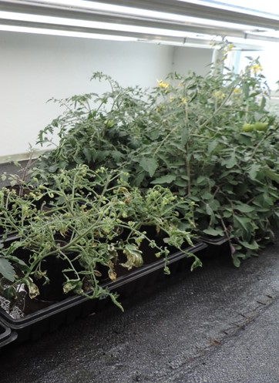
We have reasons to get rid of conventional animal-derived manure, but also…
..risk of poor development in sensitive crops with fertilisers containing residues of herbicides (clopyralid, aminopyralid)
Liquid mineral fertiliser
Liquid fertiliser from vinasse
About 120 products listed as permitted for use by Debio (Norwegian cert. body)

Slide 8
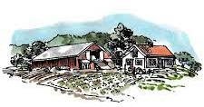
Less dependency on conventionally produced materials = increased recycling of nutrients from the society?
In Organic-PLUS, we develop system approaches,
and test alternative fertilisers with regional availability

Slide 9
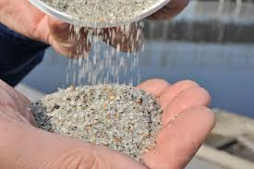
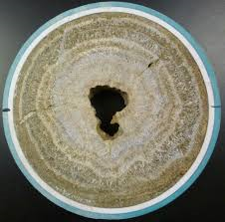
Nutrients from sewage – proposed by EGTOP in 2016 - permitted in organic agriculture in EU in 2022
Struvite = plant available, not water soluble; MgNH₄PO₃
Calcined phosphate from burning of sewage sludge
Notes:
På lang sikt må fosfor som fjernes fra økologisk dyrka jord erstattes igjen, for at fruktbarheten skal bevares. Den største delen av fosforet som er tilgjengelig utenom konvensjonell husdyrgjødsel befinner seg i human gjødsel. Skal økologisk landbruk frigjøre seg fra bruken av konvensjonell husdyrgjødsel kommer vi neppe utenom å resirkulere fosfor fra urin og avføring, men det trenger selvsagt ikke bety at salaten og reddikene skal gjødsles med folkemøkk. Man kan ha egne vekstskifter for tilførsel av slam og egne for matvekster, eller man kan framstille produkter som er helt fri for sjukdomsframkallende organismer, medisinrester og så videre.

Slide 10
System approaches: URBAN; VEGAN; NONCON

Slide 11
Alternative fertiliser typology Green = tested in Organic-PLUS
URBAN | VEGAN (PLANT-BASED) | NONCON | TO BE PHASED OUT
Digestate from biogas production (source-separated organic household waste) | Legume pellets (from lupine) Bean powder | Tofu whey (certified organic) | Animal-derived products (horn meal, blood meal…)
Industrial food waste e.g. from breweries (CaCO₃ to filter proteins) | Cut-and-carry green manure: fresh, silage, digested | Seaweed products | Conventional animal manure
Digestate from mixed biogas plants (animal manure, plant materials, non-animal food waste, NO SEWAGE SLUDGE, NO FISH WASTE | Liquid manure from locally available plant material (nettle, comfrey) | Marine animal-derived products (not conventional raised fish) | Plant-based fertilisers from conventional crops
Struvite |  |  | Rock phosphate
Calcined phosphate

Slide 12
Activities and results
SYSTEM APPROACH | URBAN | VEGAN (PLANT-BASED) |  |  | NONCON
FERTILISER TYPE | Digestate from organic household waste | Lupine pellets, bean powder | Cut-and-carry green manure: silage vs. digested | Liquid manure from locally available plant material (nettle, comfrey) | Tofu whey | Seaweed products (brown algae) | Fish bones
EXPERI-MENTAL DESIGN | Large-scale field exps. barley on 10 organic farms across Denmark (SEGES) | Field exp. early cabbage, spinach, winter wheat (UoH); | Field exp. early cabbage, spinach, winter wheat (UoH) | Greenhouse tomatoes (CU) | Field exp. early cabbage, spinach, winter wheat (UoH) | Field exp. oats, leek, ryegrass; residual effects in potato + perennial ley (NORSØK) | Field exp. oats, leek, ryegrass; residual effects in potato + perennial ley (NORSØK)
YIELD EFFECT | Yields comparable to pig slurry | Yields comparable to horn grit? | Variable; N release dig > silage | Too fertile soil; no clear effect of fertilisers | Yields comp. to horn grit | No rapid effect; HIGH residual effect | Very rapid growth effect; some residual effect
WARNING/RISK | Plastic residues | High cost | Timing of N release; dig. = high cost | Cheap materials, but demands labor! | Low DM%! Certification issues; need for regulation! | Arsenic, cadmium, high Na, K | Approved in organic growing in Norway Material competition

Slide 13
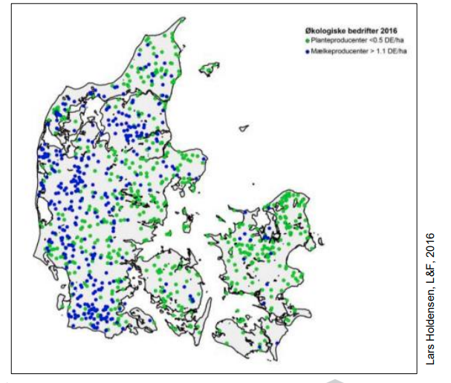
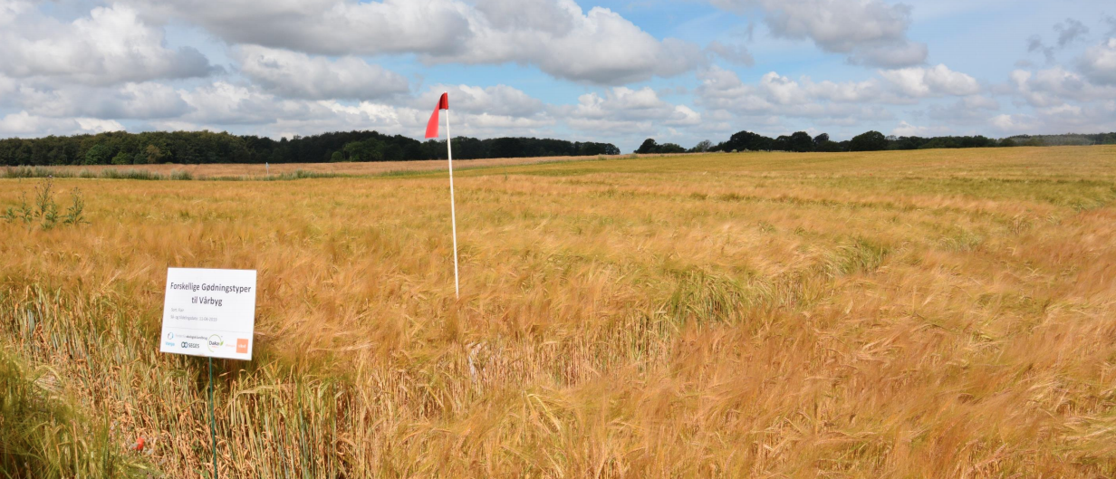
Anaerobically digested source-separated organic household waste (food waste) vs. conventional pig slurry
Casper Laursen, SEGES
Large-scale field experiments in spring barley
10 locations in Denmark 2019+2020
Organic farms, sites open to public

Slide 14
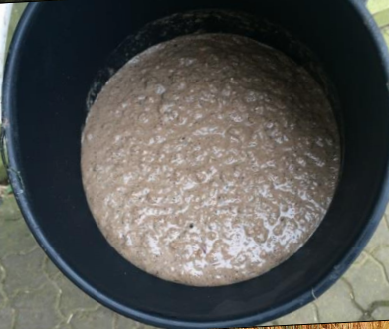
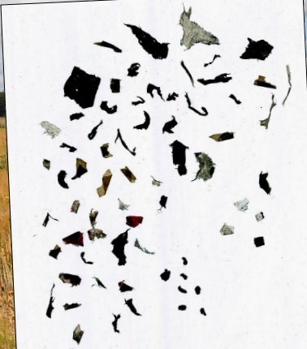
Digested household waste
Treatments:
Pig slurry, 4.5% DM
Meat and bone meal «Øgro» 10-3-1
Mixed household waste + pig slurry, 12.5% HW
Digested household waste from VARGA and DAKA; about 3% DM
Comparable yields, 5.7 tons of grain/ha
Much less potentially toxic elements in HW than slurry: 0.12 mg Cd/kg DM vs. 0.37
Plastic residues: Danish limit = 8.6 m²/hectare
One type had 3 m²/hectare = 0.01% of DM; still very negatively interpreted by farmers

Slide 15
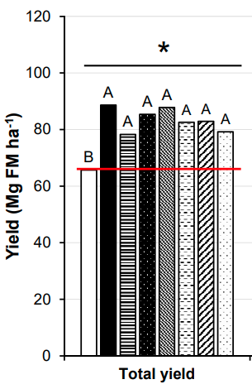
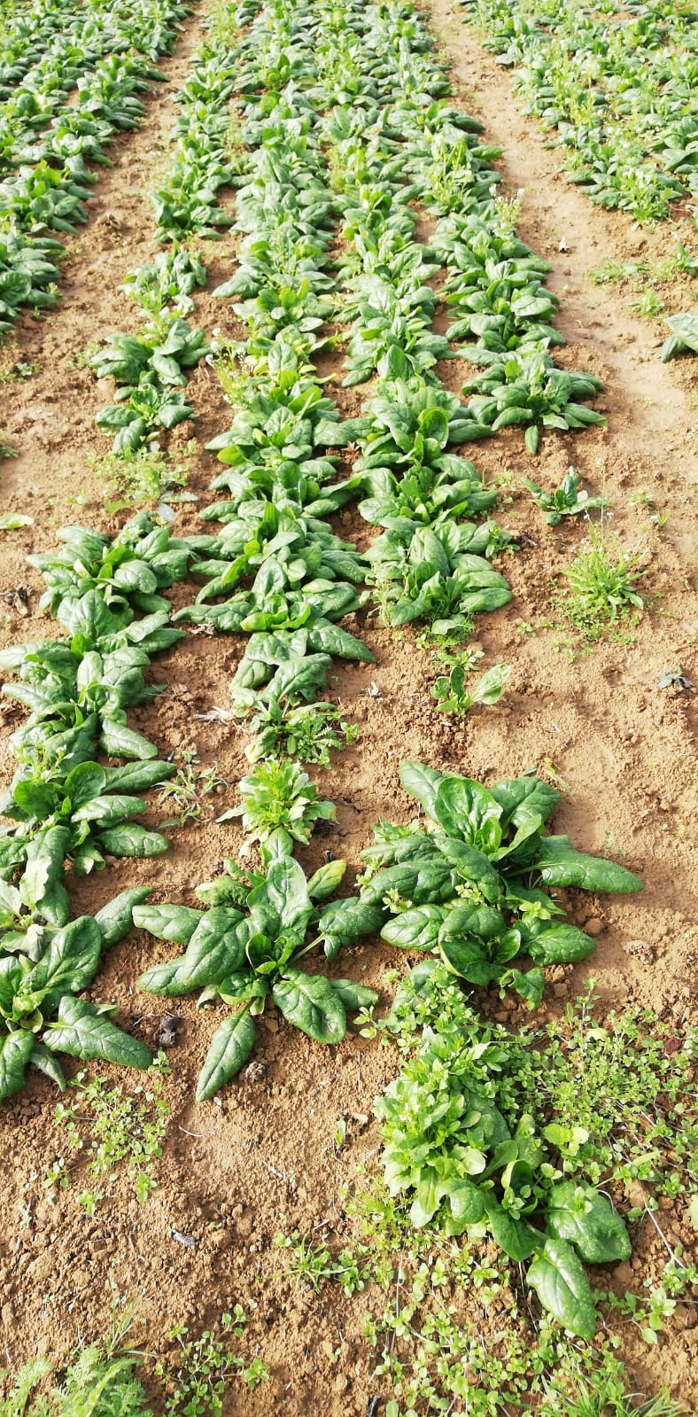
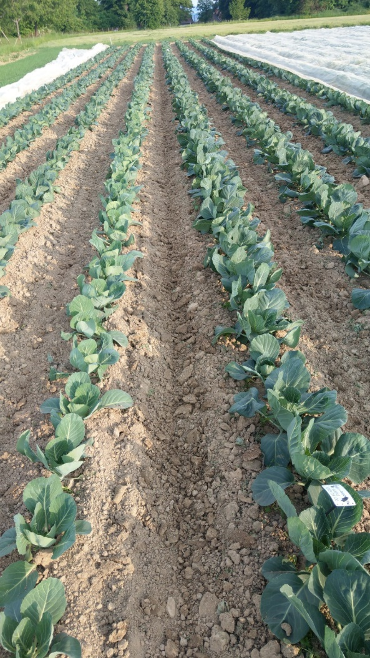
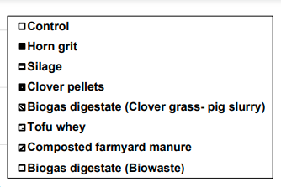
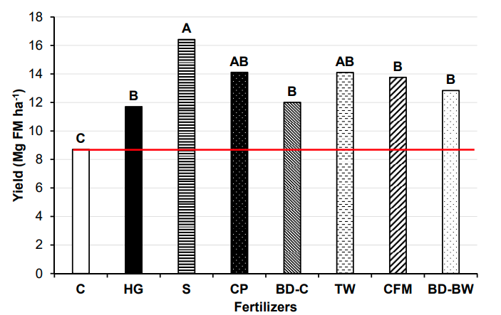
Early cabbage
Spinach (residual effect I)
Early cabbage
Mg = 1000 kg
Silage Horn grit
Carolin Weiler, S. Zikeli

Slide 16
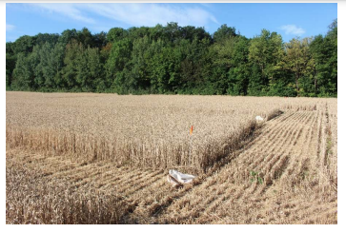
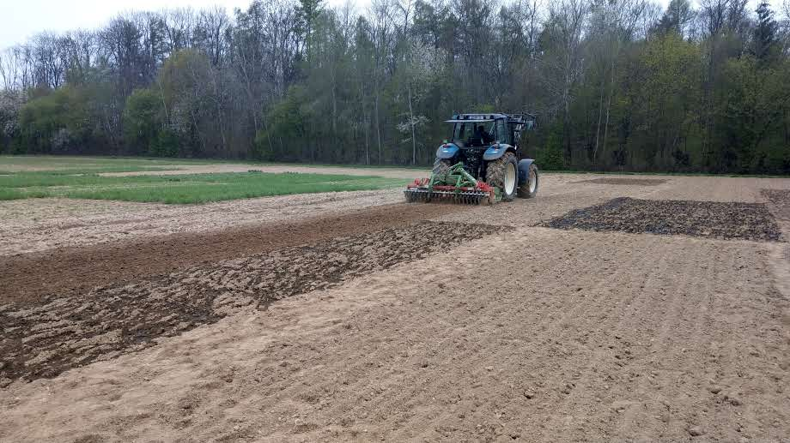
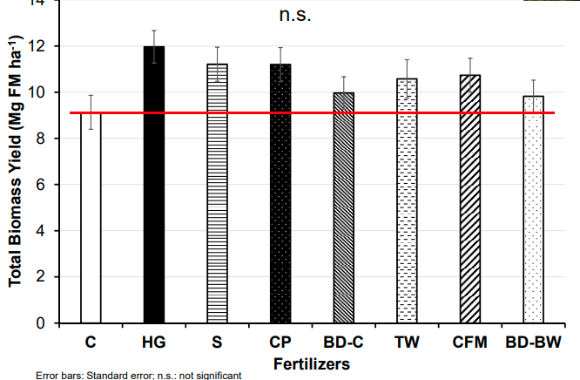
Winter wheat, residual effect II
Preparation of field plots
Casper Laursen, SEGES
Casper Laursen, SEGES

Slide 17
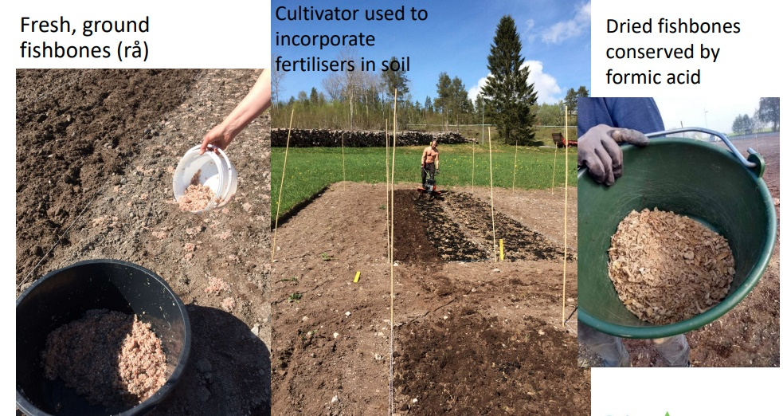
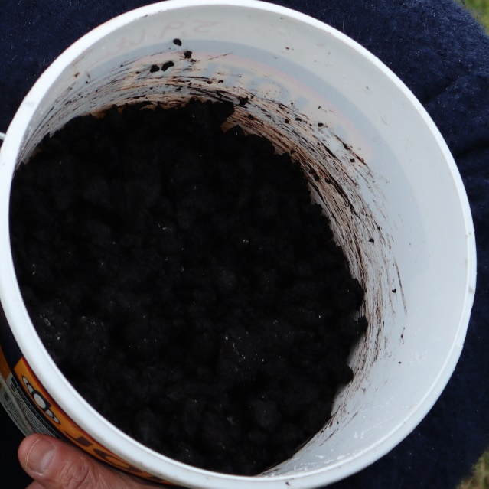
Very rapid growth effect of fishbones
Strong residual effect (increased growth) of seaweed residues
More research required
Competition for materials
Seaweeed residues (algae fibre)

