Slide 1
Diversified farming systems for improved sustainability of agriculture: potentialities and challenges
Guillaume Martin, Kerstin Barth, Mathilde Blanc, Bertrand Dumont, Severin Hübner, Marie-Angélina Magne, Claire Mosnier,
Riccardo Primi, Lisa Schanz, Steffen Werne,
Christoph Winckler

Slide 2
Diversified farming systems
“We refer to a farming system as “diversified” when it intentionally includes functional biodiversity at multiple spatial and/or temporal scales, through practices developed via traditional and/or agroecological scientific knowledge. Farmers manage this functional biodiversity to generate critical ecosystem services to agriculture” (Kremen et al., 2012)

Slide 3
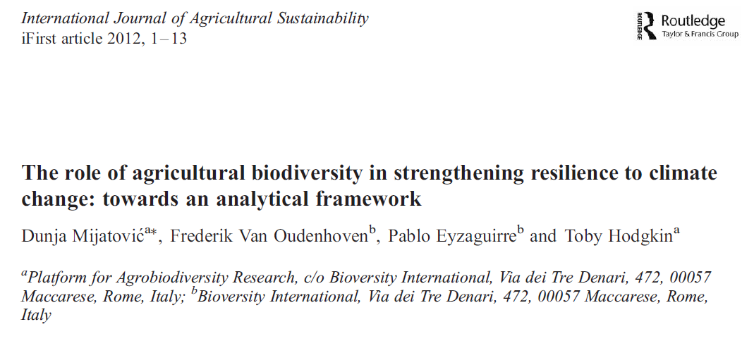
Diversified farming systems to solve the problems of modern agriculture

Slide 4
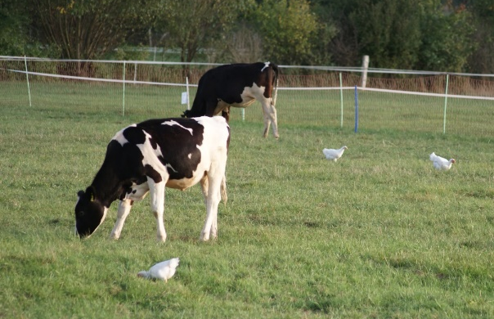
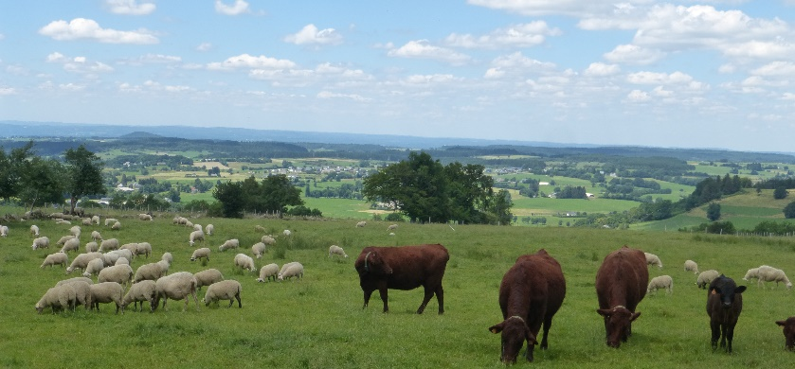
Multi-species livestock farming (MSLF)
Keeping two or more animal species or breeds (e.g. dairy cattle and beef cattle) simultaneously on the same farm is a diversification option that has received little attention to date.
Most studies of MSLF are
  partial (e.g. deal only with grazing management)
  focus on specific dimensions of farm sustainability (e.g. parasite management)
  and address low organizational levels (i.e. within the farm)
Holistic assessment of potential benefits of MSLF for farm sustainability is lacking

Slide 5
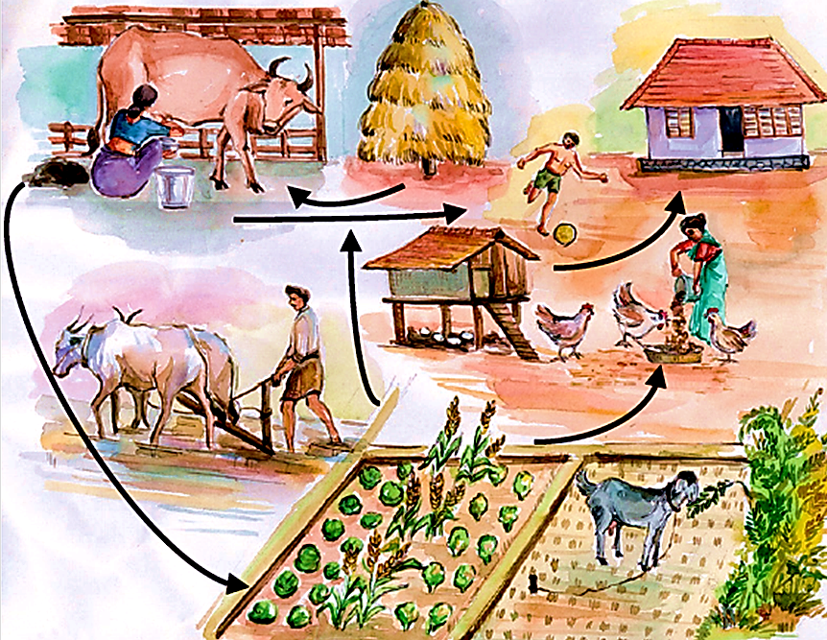
Objectives
We synthesized potential benefits and limitations of MSLF for farm sustainability from existing literature and listed research challenges related to it
Source: TECA, FAO

Slide 6
Benefits and limitations for farm sustainability
No empirical study
It may imply a higher total workload and management complexity for the farmer (Kingwell, 2011)
Yet the actual workload per worker may not increase if diversification is accompanied by re-organization of work and/or by improved management of production processes (Darnhofer et al., 2010; Hostiou, 2013).
Dietary overlap between sheep and cattle remains low unless forage availability becomes too low (Walker, 1994)
Herbage-use efficiency increased: herbage intake was 9-10 t DM/ha when co-grazing heifers and sows vs. 5.7-8.8 t DM/ha when mono-grazing (Sehested et al., 2004)
Resource-use efficiency and conservation
Achievement of potential benefits very much depends on the management practices implemented e.g.
An appropriate stocking rate at grazing
A relevant combination of livestock species
Lambs have fewer gastrointestinal nematodes when co-grazed with cattle (Marley et al., 2006)
Inter-species transmission has been described, however: e.g. bovine-specific Haemonchus placei can infest sheep
(Riggs, 2001)
Human welfare
Animal health and welfare
Farm sustainability
The ADG sheep greater in mixed grazing (+14.5 g/day)
The ADG cattle similar in mixed and mono-grazing
ADG per ha in mixed grazing was higher by 28.6% compared with sheep alone and by 25.1% compared with cattle alone
(d’Alexis et al., 2014)
A way to mitigate risks (Bowman and Zilberman, 2013) that can both increase mean profit and decrease profit variability (Diakite et al., 2019)
Farmers may perform less well when managing more complex systems
Profitability
Productivity
Notes:
Combining different livestock species on the same pasture, simultaneously or sequentially, takes advantage of the host specificity of most gastrointestinal nematodes
trade-offs exist between (i) economic gains due to complementarity (economies of scope) between enterprises and risk-reducing effects and (ii) economic losses due to lower economies of scale and allocation of some farm resources to a less profitable enterprise

Slide 7
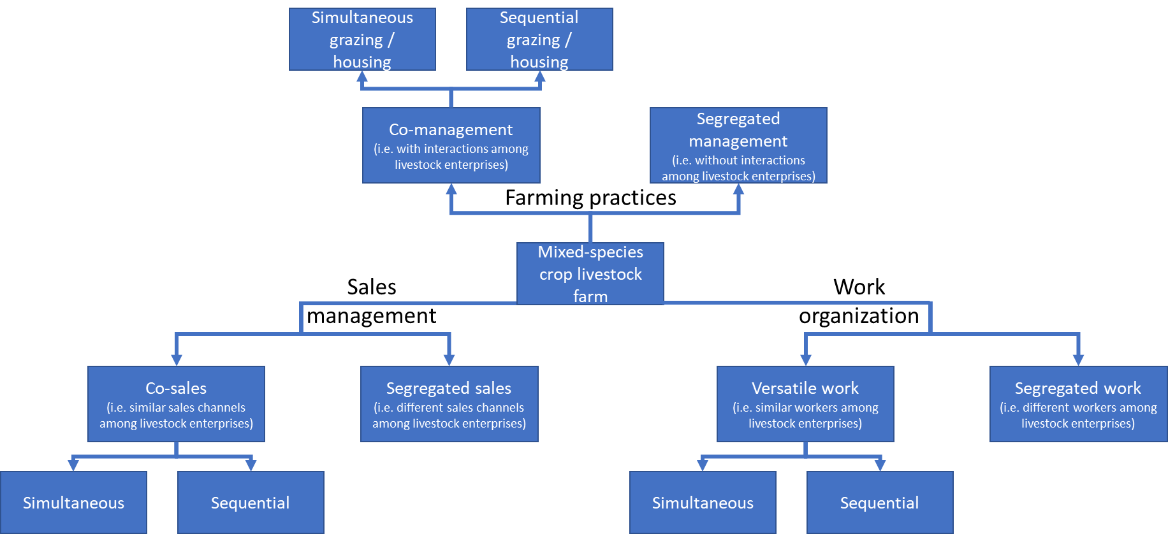
Characterize better farm management in MSLF
The management dimension is often poorly understood
This is a central dimension for scaling-up MSLF

Slide 8
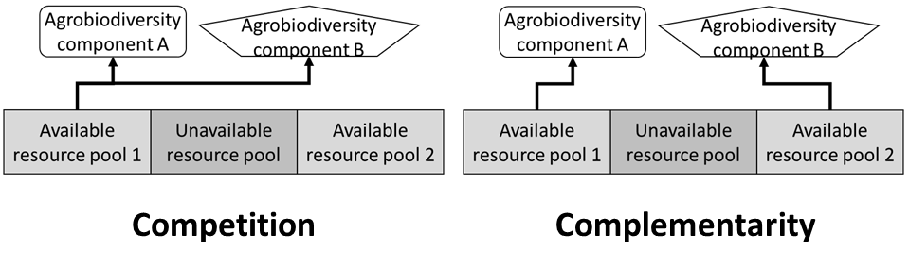
Explore further the complementarity of livestock species
Maladaptiveness of some species combinations ➔ dietary overlap, parasite susceptibility or disease transfer among species
Systems analysis of usual combinations (e.g. cattle-sheep) are lacking
Some species combinations remain largely ignored, mainly those of ruminants and monogastrics
Adapted from Hinsinger et al. (2011)

Slide 9
Assess and explain the sustainability of MSLF
A holistic assessment is essential to develop consistent recommendations for improving MSLF
Sustainability assessment methods are already available in the literature: SAFA (FAO, 2013), IDEA (Zham et al., 2008; 2019) and RISE (HAFL, 2014)…
Most of these methods build on assumptions about farm sustainability and practices
These assumptions need to be reconsidered, since it is currently unknown whether they apply to MSLF
Modeling developments are needed to simulate different livestock species in one farming system, especially species previously overlooked (e.g. goats, broilers).

Slide 10
Characterize conditions for success of and obstacles to MSLF
Lock-ins occur when relationships among environments, organizations, technologies, knowledge and values create strong interdependencies among stakeholders in a sector (Kallis and Norgaard, 2010).
Lock-ins apply at all levels of agricultural products, from production to consumption.
Characterizing conditions for success of and obstacles to multi-species livestock farming is a precondition to its wider development.
Socio-technical analysis will identify stakeholders active along the value chain, their respective objectives, work habits and constraints.
Increasing understanding should help prioritize actions and organize them into pathways toward diversification of livestock farms.

Slide 11
Many thanks for your attention!
The authors acknowledge the financial support for the MIX-ENABLE project provided by transnational funding bodies, being partners of the H2020 ERA net project, CORE Organic Cofund, and the cofund from the European Commission.

