Slide 1
Worm control strategies
Spiridoula Athanasiadou
Notes:
Need fresh version of this from Andrew

Slide 2

Discussion
Overview
Background
Approaches for worm control with reduced reliance on wormers
  protein supplementation
  Chicory
  targeted selected treatment
Outcomes from European
project
Take home messages
Notes:
2

Slide 3
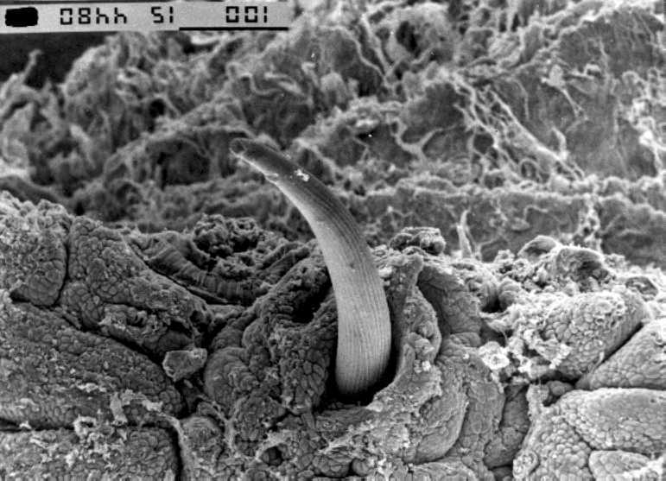
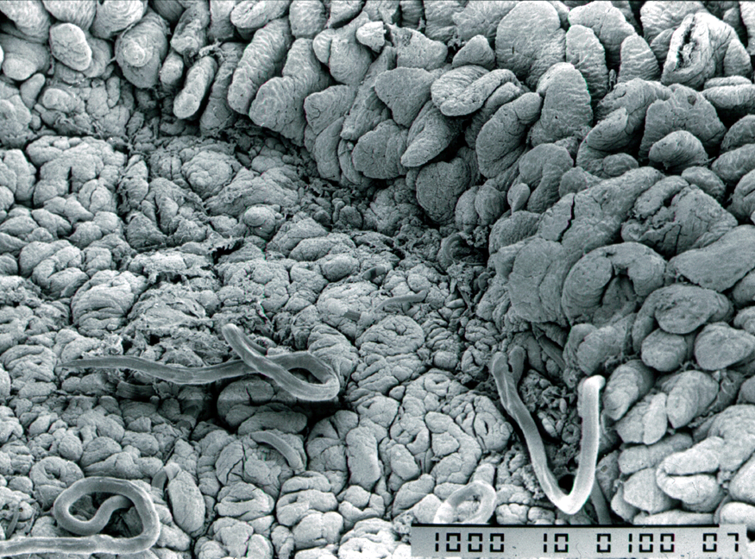
Worm damage and lamb growth
Worm infections reduce performance
  reduced food intake
  impaired food digestion
  protein leakage (needs replenishment)
  gut damage (needs repair)
Less nutrients left for growth
Disrupted stomach function
Gut damage in small intestine
Notes:
3

Slide 4
Discussion
Worm challenge is expensive
Regular worming improves lamb growth
Drenched, challenged lambs still lose out
Reduce challenge to improve productivity
Notes:
4

Slide 5
Basket of options
Reduce worm challenge? Reduce egg output!
Worm control with reduced reliance on wormers
  protein supplementation
  bioactive forage
  targeted selected treatment
  breeding
  vaccination
  biological control
  grazing management
Notes:
5

Slide 6
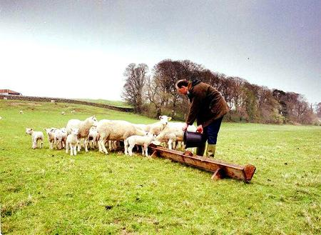
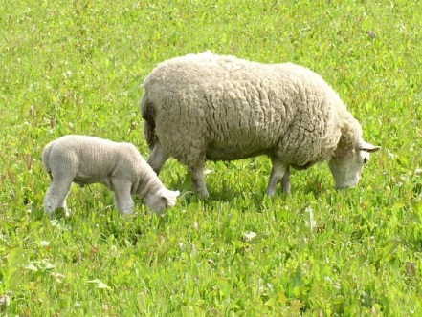
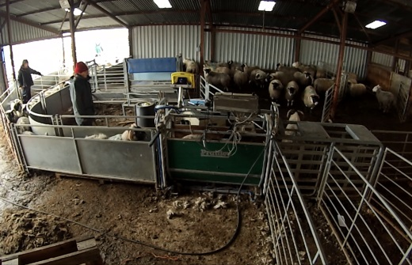
Basket of options
Reduce worm challenge? Reduce egg output!
Worm control with reduced reliance on wormers
  protein supplementation
  bioactive forage
  targeted selected treatment
  breeding
  vaccination
  biological control
  grazing management
Notes:
6

Slide 7
Ewe protein supplementation

Slide 8
Ewe protein supplementation
Periparturient relaxation of immunity (PPRI)
  is sensitive to protein scarcity
  plays an important role in parasite epidemiology

Slide 9
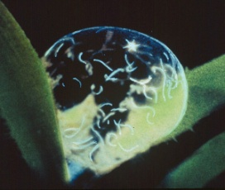
Ewe protein supplementation
Periparturient relaxation of immunity (PPRI)
  is sensitive to protein scarcity
  plays an important role in parasite epidemiology
A single lactating, underfed susceptible ewe could be a source of infection for many lambs
  Egg excretion over 14 days: 17,000,000 eggs
  If 25% successfully hatch: 4,300,000 larvae
  If 25% migrate to leaf area: 1,125,000 larvae
  Sub-clinical larvae exposure: 5,000 larvae/day
One ewe could infect 16 lambs for 14 days

Slide 10
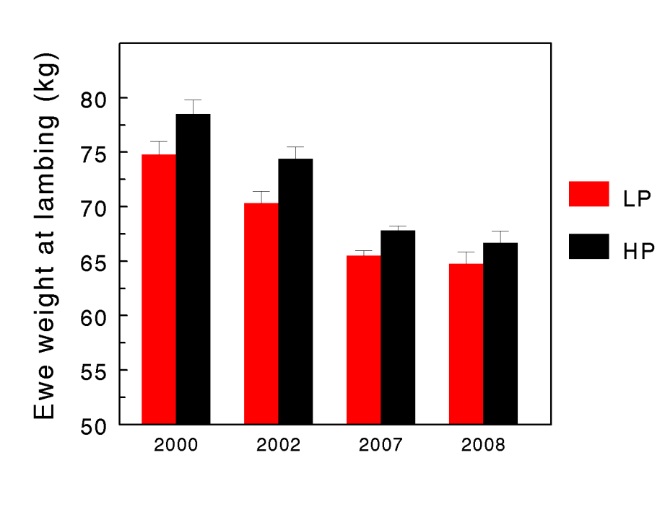
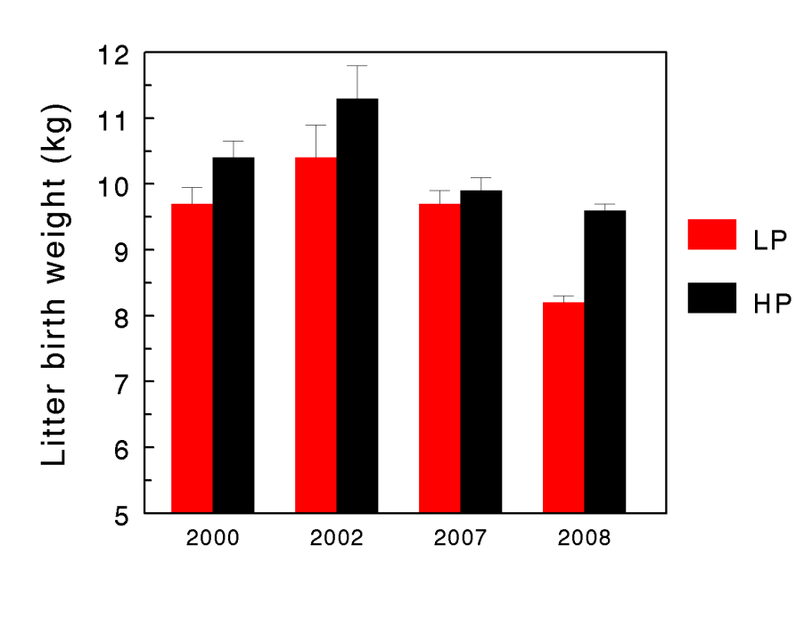
Discussion
Overcoming protein scarcity
Late pregnancy supplementation with high quality, by-pass protein
  Heavier lambs and ewes at lambing
  Reduced worm egg counts and worm burdens
Notes:
10

Slide 11
Benefits of maternal MP supply
High quality, by-pass protein supplementation:
  Fewer worms, faster growth
  Reduced drug input
Kidane et al., 2010; Houdijk et al 2012

Slide 12
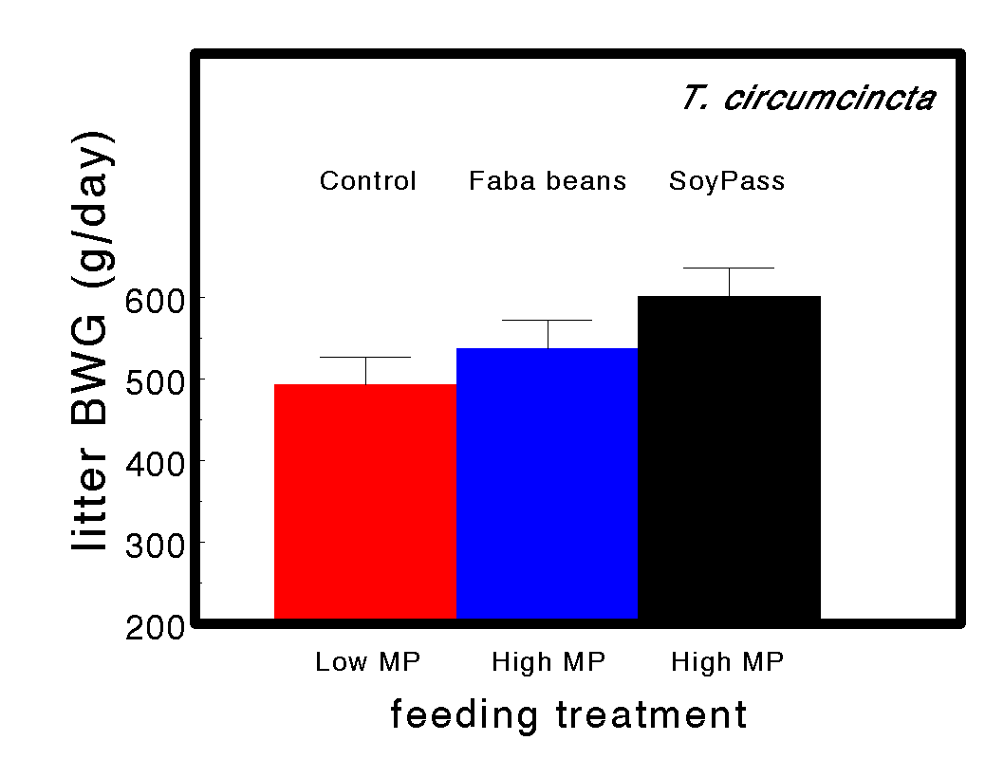
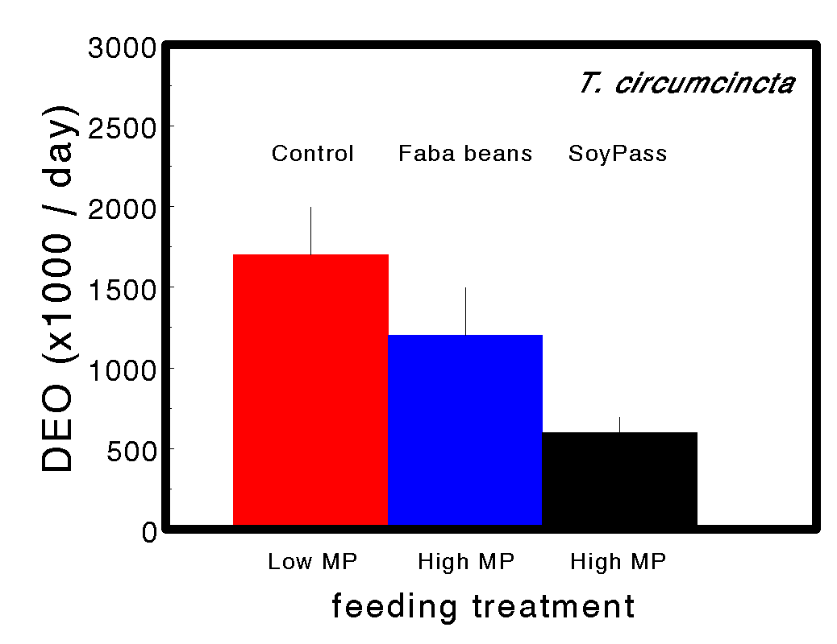
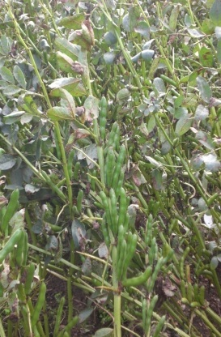
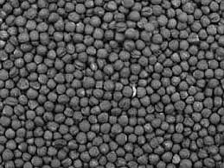
Alternatives to by-pass soya?
Sakkas et al (2012)
Unprocessed faba beans could not replace by-pass soya bean meal (SoyPass)
Home-grown by-pass rapeseed meal is investigated as alternative to soya

Slide 13
Conclusions 1: Ewe protein supply
Protein scarcity may be a reason for elevated FEC in periparturient ewes
Protein supplementation:
  reduced worm burdens and worm egg output
  reduce drench use
  increased ewe and lamb performance
Target most susceptible ewes:
  thin, multiple rearing (especially gimmers)
  single-rearing ewes may not benefit from protein supplementation
Notes:
13

Slide 14

Bioactive forages

Slide 15
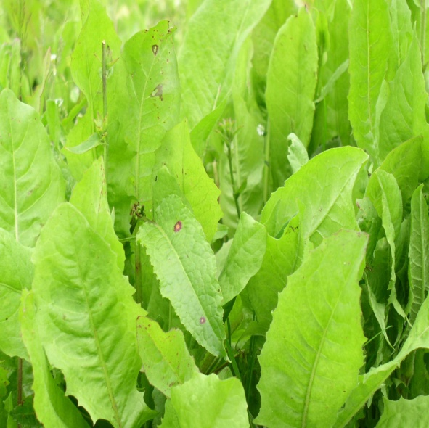
Discussion
Chicory
Highly palatable
Good nutritional value
Readily grown in Scotland
  Deep tap root
  Well drained soils
  Medium to high fertility
  pH: 5.5-6.0 is best; 4.8-6.5 is tolerated
Anti-parasitic properties
Notes:
15

Slide 16
Nutritive value
Chicory Grass/clover
DM (g/kg) 120 180
CP (g/kg DM) 137 95
Ca 10.7 5.6
Na 6.2 4.4
Mg 3.4 1.7
K 27.3 15.6
P 5.6 3.3
S 2.9 2.1
Zn (mg/kg DM) 65 22
Cu 9.2 6.2
Mn 191 129
Fe 234 109

Slide 17


Anti-parasitic benefits of chicory
Multiple benefits:
  Fewer worms, faster growth
  Reduced drug input
  Reduced challenge

Slide 18
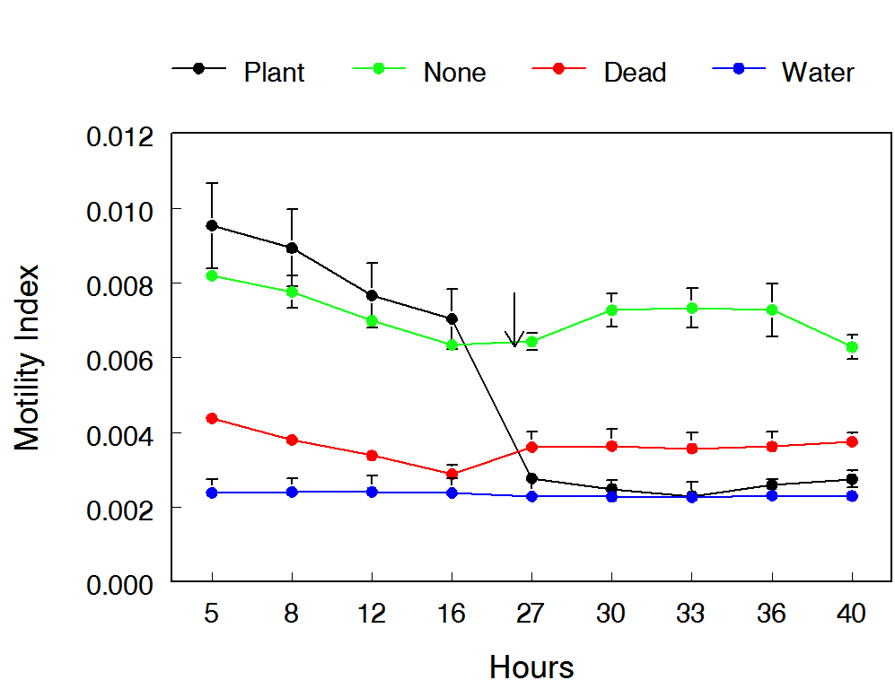
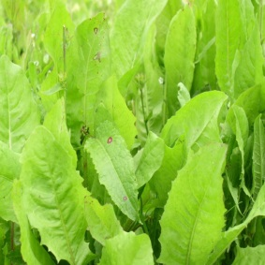
Do we know how chicory works?
Kills parasites
  direct anti-parasitic properties
Boost immunity
  improved host immune responses towards incoming and established worms
Does not allow larvae migartio
  broad-leaved structure reduces larval migration and hence larval uptake during grazing
Athanasiadou et al (2012)
Notes:
18

Slide 19
Conclusions 2: Chicory
Bioactive forage like chicory can assist to reduce the degree of gastrointestinal nematode parasitism
Potential benefits from chicory arise from:
  reduced worm burdens and worm egg output
  reduce drench use
  increased lamb performance
Understanding mechanisms may allow to identify other plants with similar properties which may be used for finishing lambs
Notes:
19

Slide 20

Targeted selected treatment

Slide 21


Discussion
Targeted selected treatment (TST)
Only worm lambs that do not thrive
Compare target with actual weights
  Reached target weight: no dose
  Below expected weight: dose
This approach is expected to reduce worm usage and resistance build up
Slower build up of resistant worms
Fiona Kenyon (Moredun)
Notes:
21

Slide 22

Discussion
Targeted selected treatment (TST)
Algorithm developed by Moredun RI and Lincoln University (“Happy Factor*”)
Based on body weight change
  Algorithm calculates predicted lamb weights
    At or above predicted weight: no treatment
    Below predicted weight: treatment based on size
      Big lambs: high dose
      Medium lambs: medium dose
      Small lambs: low dose
  Make use of EID
Notes:
22

Slide 23
Conclusions 3: TST
Using the targeted selected treatment to base drench decision can greatly reduce drench input without impacting growth performance
This helps to slow down development of drench resistance (data not shown)
Make additional use of regular lamb weighing
Make EID work for you
Safe costs by drenching according to need
Notes:
23

Slide 24
Rules of thumb messages
Ewe protein supplementation:
  50 g by-pass soya per lamb carried
  100 g by-pass soya per lamb reared
Chicory:
  Include 60-70% in grass mix to get growth benefits
  Rotate over pure stands to get anti-parasitic benefits
  Remember managing chicory differs from grass! If you can work with chicory, then chicory can work for you.
TST:
  Drench lambs only when they do not grow to target
  Use EID to reduce wormer costs
Notes:
24

Slide 25
ProPara aim
Generate information and novel tools that can be readily used by organic farmers to improve animal health and welfare
UK contribution
Perform on farm trials where alternative strategies of GIN control are put to test by organic farmers

Slide 26
Basket of options trial
Organic sheep farmers are given options to consider for sustainable worm control
Suggested strategies to reduce worm burdens:
- Drench if FEC are rising
- Protein supplementation (DUP) around parturition and/or lactation
- Grazing on bioactive forages, e.g. chicory
- TSTs.
The participating farmer can select one or more of these options, use it in one group, and then compare the results with another group managed in a “usual” manner.

Slide 27
Farmer 1: FEC vs weight gain
Currently
- Ewes: mob FEC and “blanket drenching” although he leaves 10% undrenched
- Lambs: drenching based on mob FEC if suspected problems
Farmer monitors lamb weights at 2-3 occasions.
- 1st 42-84 day old,
- 2nd 21 weeks old
- Likely a third weighing sometime between the two above
He also measures DM of grass.

Slide 30
Conclusion
Drenching on weight gain does not always target the animals with high FEC
Small scale experiment

Slide 31
Farmer 2: Protein supplementation
Current parasite control strategies: clean grazing, drenching following mob FEC
Pre Lambing he feeds a home made mix consisting of:
Organic HiPro Soya 50g/Lamb (oil 2.10%, Fibre 3.60%, Protein 47.5%, Ash 6.50%)
Organic Molasses 8g/lamb
Organic Oats 50g/lamb
Minerals 10g/lamb
Ad lib Grass and Hi mag mineral buckets.
2 weeks before official lambing date and 6 weeks of lambing as above but in addition ad lib Silage
Post Lambing n=10 ewes were supplemented with 100g organic soya per lamb (treated group). Control group stayed unsupplemented (n=10)

Slide 33
Preliminary conclusion
Soya supplementation has reduced FEC in ewes
Small scale experiment, but encouraging
Unclear if there was an effect on lamb performance

Slide 34
Farmer 3: Low Input. Source of protein Soya vs Sopralin
Soya and sopralin both high in protein, but sopralin higher in DUP
Aim was to test the effect of protein source on FEC and weight gain of ewes
Supplementation about 100g/day per lamb
N=10

Slide 37
Preliminary conclusion
A diet rich in DUP did not seem to infer any additional benefits to FEC and performance of ewes
Small scale experiment

Slide 38

Acknowledgements
Funders
  EU
  Scottish Government
  Defra (CORE Organic Plus)
  BBSRC, DFID
  EBLEX, QMS, LMC, HCC
Colleagues, authors and co-authors
  SRUC / SAC: Alem Kidane, Ouranios Tzamaloukas, Panagiottis Sakkas, Jos Houdijk, Ilias Kyriazakis, Elly Navajas, Claire Morgan-Davies
  Moredun: Bob Coop, Frank Jackson, John Huntley, Fiona Kenyon, Dave McBean
  Bristol University: Geoff Nute, Ian Richardson
  Hawassa University: Ketema Tolossa, Adugna Tolera, Etana Debela
Notes:
The Langhill selection lines of dairy cattle have allowed us to dissect, in detail, many traits of biological importance in dairy cattle (production AND fitness traits)
However, the bringing in new tools and scientific disciplines have allowed us to explore these data in a new way, bringing about a rebirth in the value of the cows for research
Genomic data helping us explore the genetic differences between the lines (working to identify selection signature differences between the lines)
A more detailed understanding of potential differences in immune function between the lines and diets
Not only a relevant for new scientific exploration but also of value to the wider global dairy industry by pooling data from key international resource populations for more rare phenotypes such as dry matter intake
Not just a 2*2 experiment any more!

Slide 39
Thanks for your attention
Spiridoula.athanasiadou@sruc.ac.uk

Slide 40
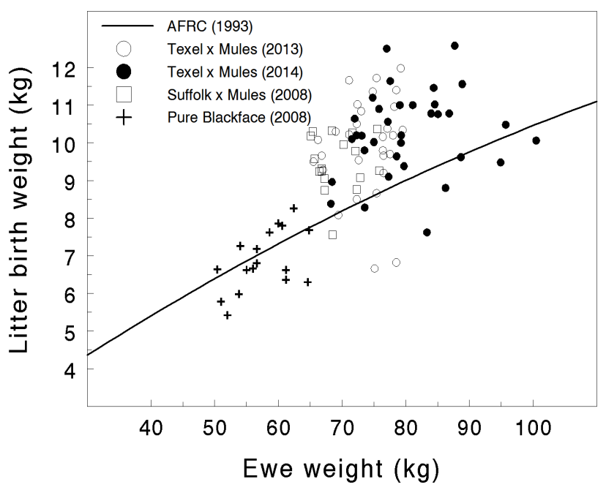
How much MP do ewes need?
Optimal MP supply to wormy ewes:
  use AFRC (1993) formulae for current breeds with bigger lambs driving greater milk production levels
  heavier lambs at weaning
  reduced worm risk
Increased MP feeding level
  20-25% more than AFRC (1993)
  focus on DUP
  remember that for AFRC (1993) data worm challenge was carefully excluded

