Slide 1
Advanced system in wheat
Combination of agronomical levers
WP 2
“Wheat-based cropping system”
FRANCE

Slide 2
Background
In PURE, in wheat-based cropping systems three were compared : current, intermediate, advanced
The Advanced system is led without pesticide at all, and no fertilizer.
The rules are extreme beyond the organic ones.
But the learning on weeds control is useful for building our advices for farmers.

Slide 3
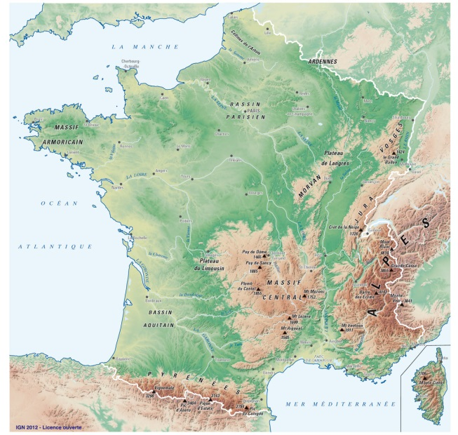
Background(2)
ON Station Experiment Boigneville (FR)
In the system, agronomical levers can control weeds in the plots without extra time of work on the year.
Nevertheless, there are some shadows : perennials have been selected in this system (Cirsium arvense or Rumex crispus). Manual weeding is tested against young Rumex, “ecimeuse” against thisles
More over yields are above the conventional ones.

Slide 4
First tool : The crop rotation 2 winter wheats in a 6 year-rotation
The alfalfa is efficient to control annual weeds and also tend to reduce Cirsium arvense but not totally
Rumex have to be controlled in the crops (manually, or with specific materials)
Grasses are controlled with the crop sequence and with mechanical control in the crops and in the intercrops
alfalfa
alfalfa
Winter Wheat
Spring flax
Winter faba bean
Winter Wheat
Arvalis Institut du Vegetal

Slide 5
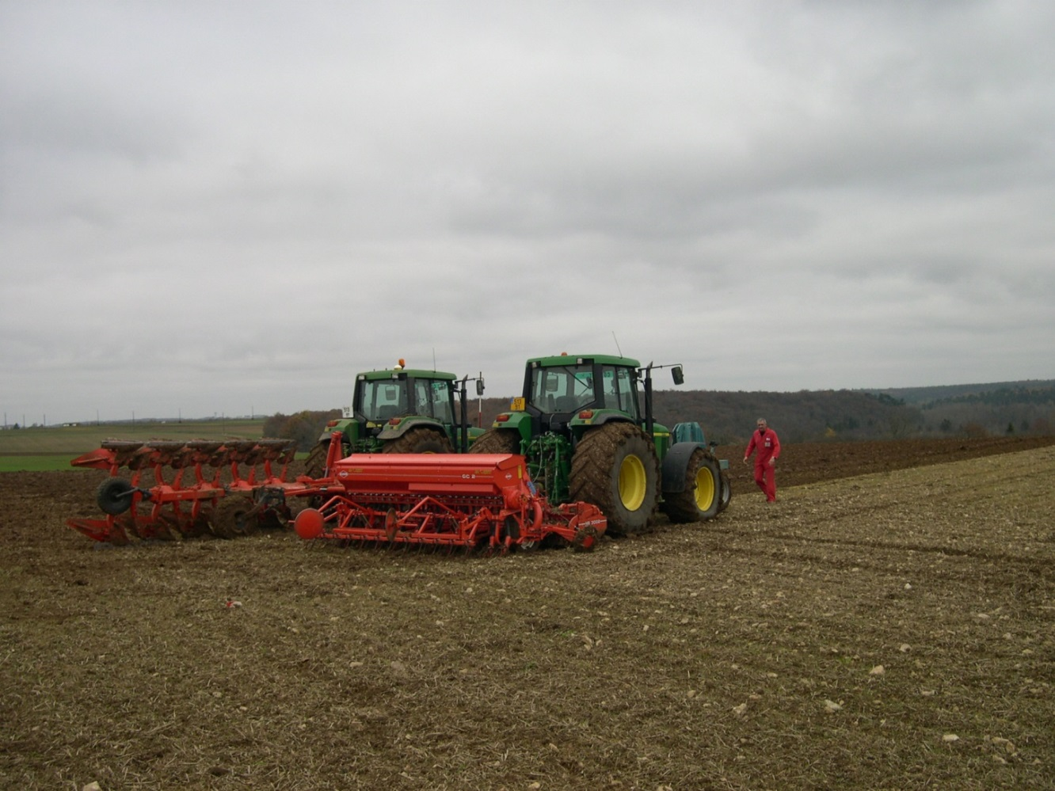
Second tool : delay in sowing period for winter wheat and faba beans
Sowing dates are delayed by 2 weeks maximum for winter wheat.
A compromise between climatic and soil conditions, yield potential for the crop and avoidance of weed development.
Before sowing we make a false seed-bed
We always plough before sowing ; in our experiment, this tool is still needed.
Arvalis Institut du Vegetal

Slide 6
Second tool : delay in sowing period for winter wheat and faba beans
In winter, winter wheat develops slowly but so do the weeds…
We increase the seed density to compensate plant loss in spring due to mechanical weeding. And also compensate reduced tillering du to delayed date of sowing
In 2013/2014 : the warm weather make weeds develop very early.
We adapted the decision : we hoed as soon as we could have done
Arvalis Institut du Vegetal

Slide 7
Third Tool : Mechanical weeding on Winter Wheats
On Winter Wheat wWe use both hoe and harrow 1 to 4 times in a year.
We combine the two tolls :
-First the hoe make get a fine-textured soil
Then we pass with harrow to break small clods.
The hoe and the harrow are also used on the flax and the faba bean
Arvalis Institut du Vegetal
Winter Wheat at Tillering stage – date :
We pass fo the first timle with the Hoe – soil should be
Hoe of 3 m guided with camera – x km/h, x /ha
The wheat should be sown with gps to make guided hoeing possible

Slide 8
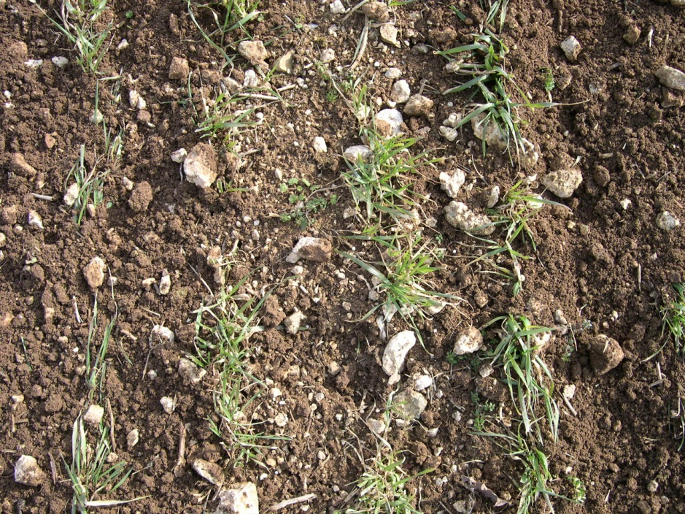
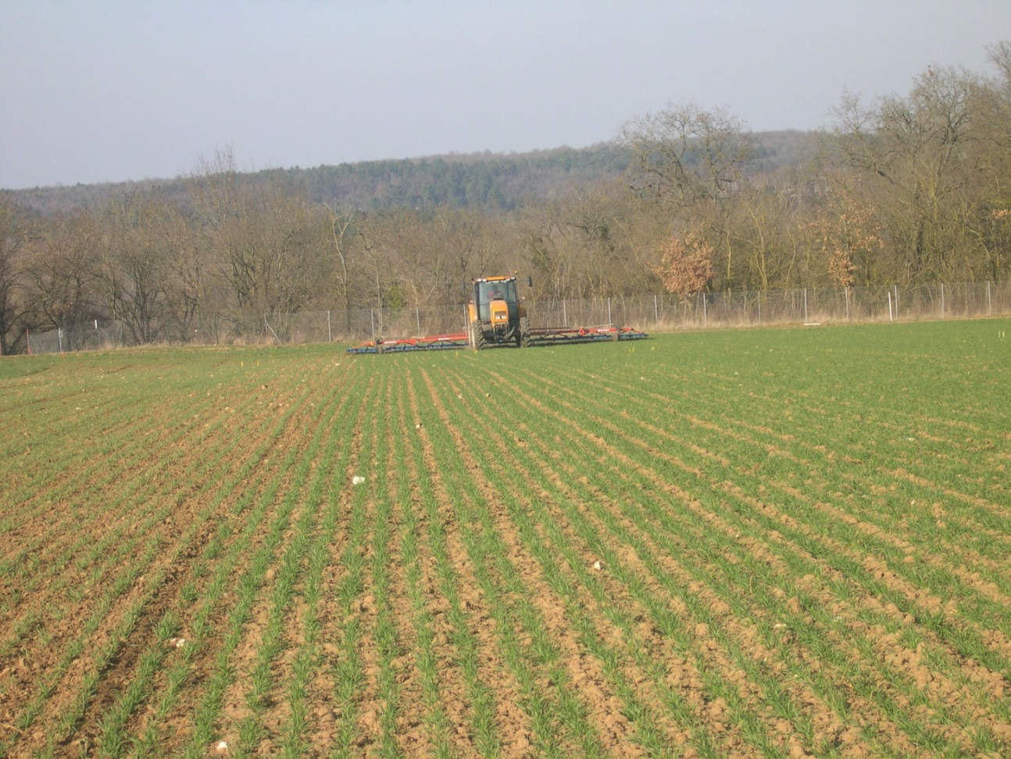
We increase sowing density of 15% to compensate plant loss
Arvalis Institut du Vegetal
Arvalis Institut du Vegetal
Winter Wheat at Tillering stage – date : 4 to 8 years after the hoe, we pass with harrow : to break les mottes et détruire les adventivces au stade fil
Cette technique favorse de nouvelles germinations : il est important de rintervenir tant que le blé n’est pas trop avancé (2 nœuds environ)
Arvalis Institut du Vegetal

Slide 9
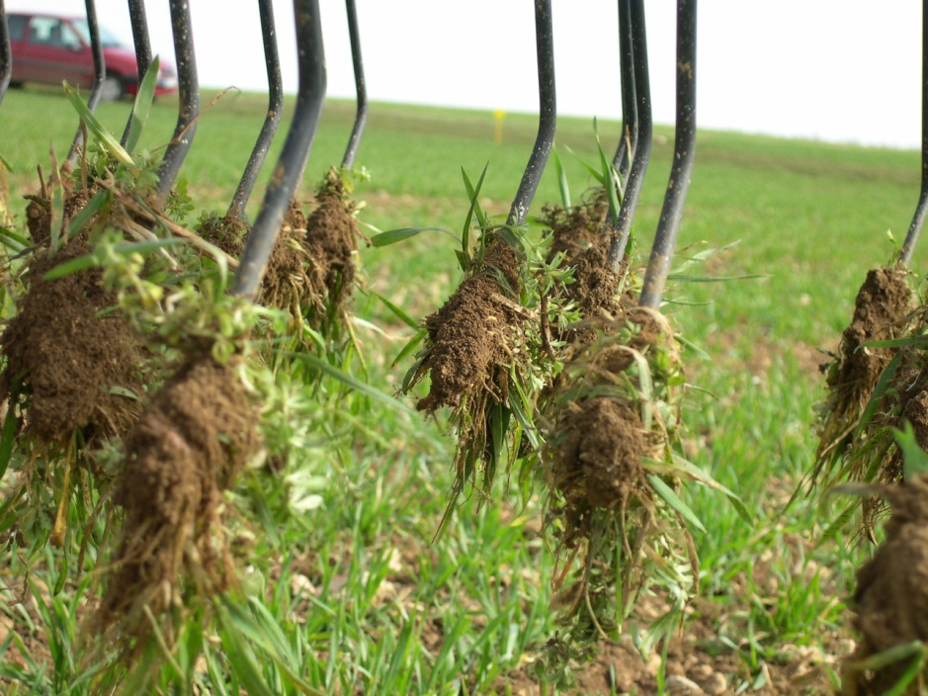
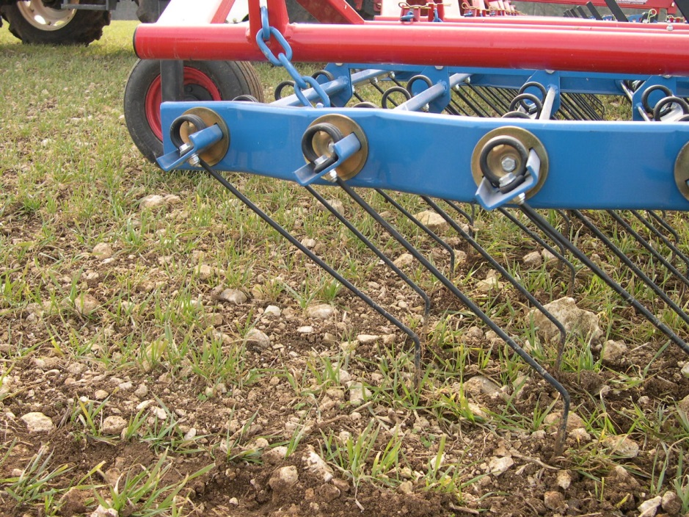
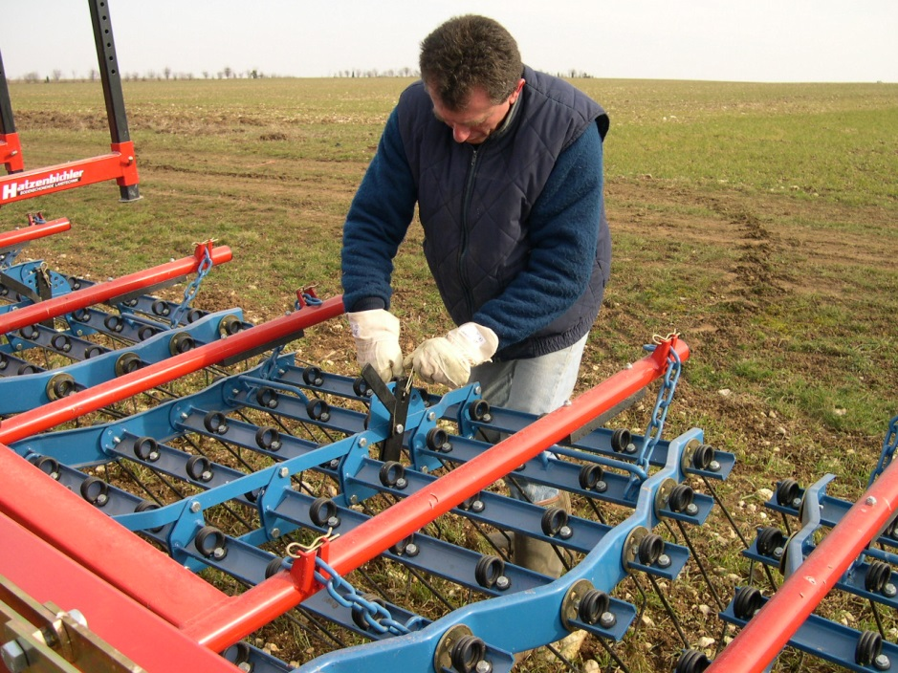
Third Tool : Mechanical weeding
Arvalis Institut du Vegetal
Arvalis Institut du Vegetal
Adjustement of the finger of the harrow - agressivity depend on the orientation of the finger
The IPM tool needs to respect right weather conditions and to adjust the material as soon as needed .
Arvalis Institut du Vegetal

Slide 10
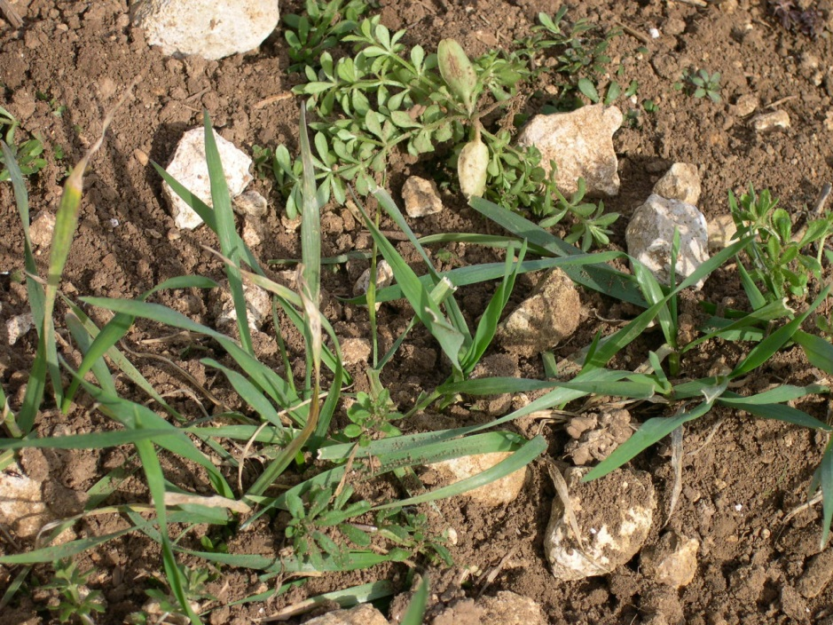
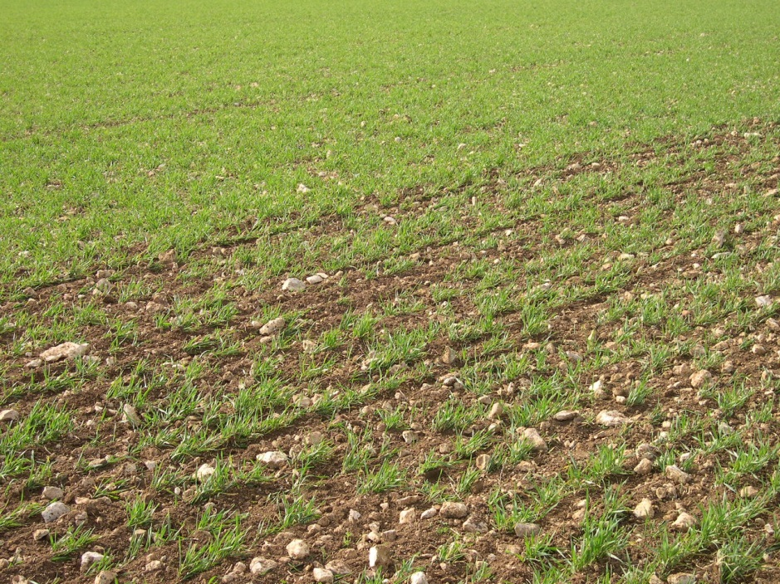
Mechanical weeding is efficient on dicots at “white wire stage”
On developed weeds, results are worse because (here : Galium aparine) the plant remains on slods of soil
Arvalis Institut du Vegetal
Arvalis Institut du Vegetal

Slide 11
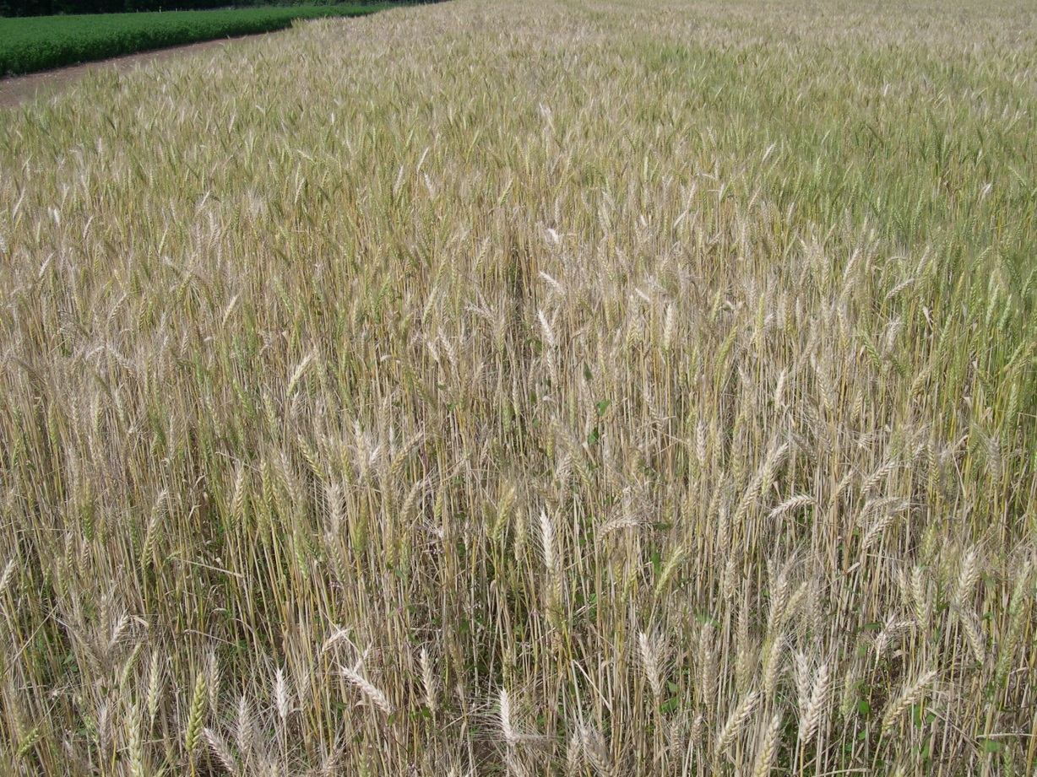
At harvest time…
Arvalis Institut du Vegetal
Arvalis Institut du Vegetal
Weeds are generally well controlled in the wheat in the advanced system
We have remaining Galium aparine most of the time.

