Slide 1
Weed harrowing in spring cereals
WP2, Innovative IPM solutions for winter wheat based rotations

Slide 2
Motivations for employing mechanical weed control
Non-chemical weed management tactics are important for the implementation of the intentions of IPM crop protection programmes in arable crops
Mechanical weed control methods lead to less reliance on herbicides and reduce adverse side-effects from herbicide use
Weed harrowing with flex tine harrows has shown promise for mechanical weed control in spring sown cereals. In PURE the harrow was used in oat.

Slide 3
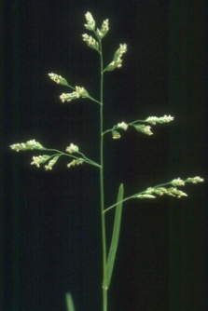
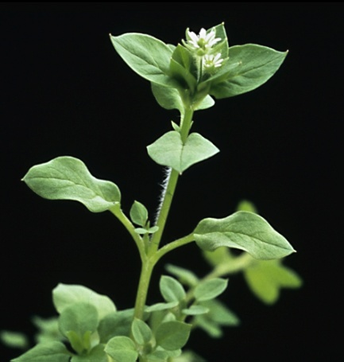
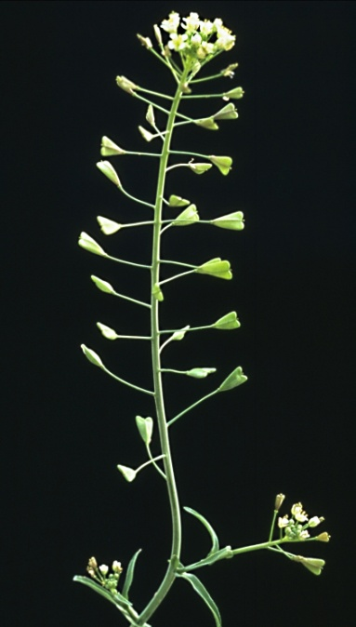
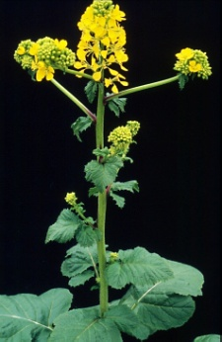
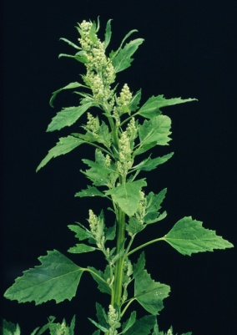
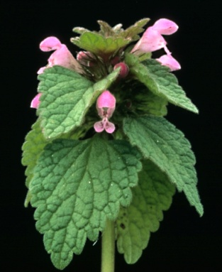
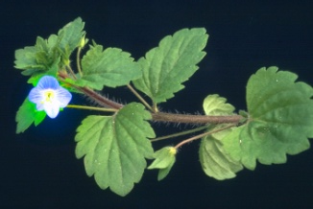
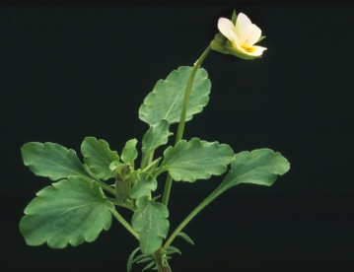
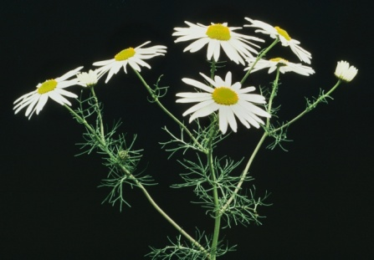
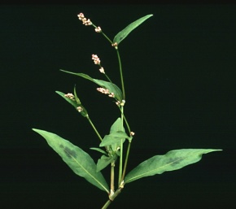
Examples of principal weed species causing problems in spring oat in Northern Europe
Poa annua
Sinapis arvensis
Stellaria media
Capsella bursa-pastoris
Chenopodium album
Veronica persica
Lamium purpureum
Viola arvensis
Persicaria maculosa
Tripleurospermum perforatum

Slide 4
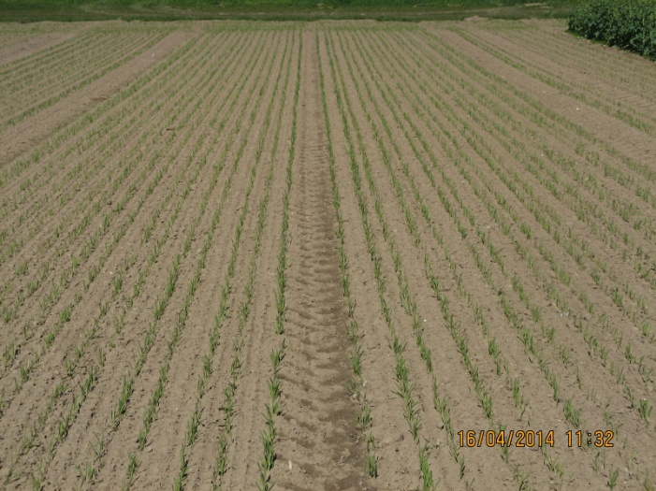
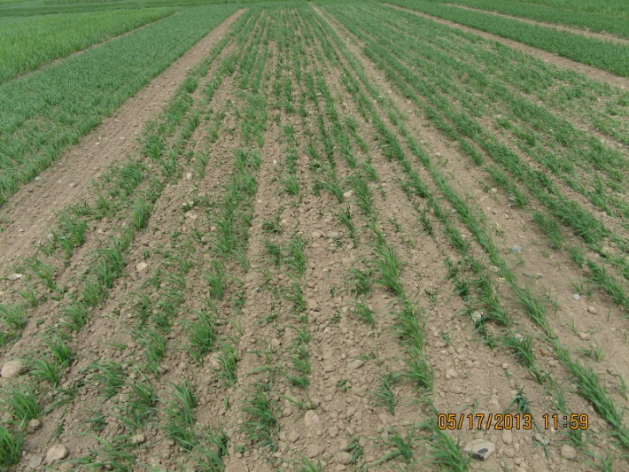
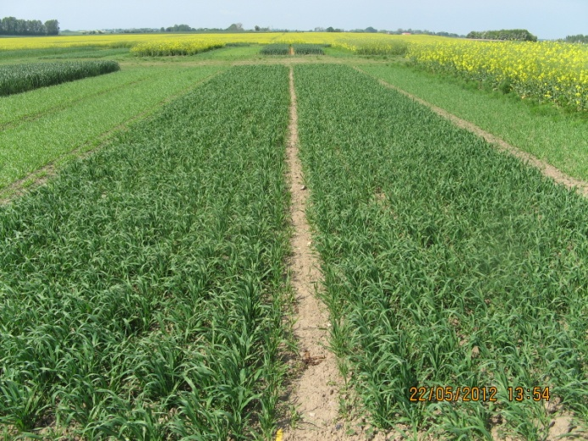
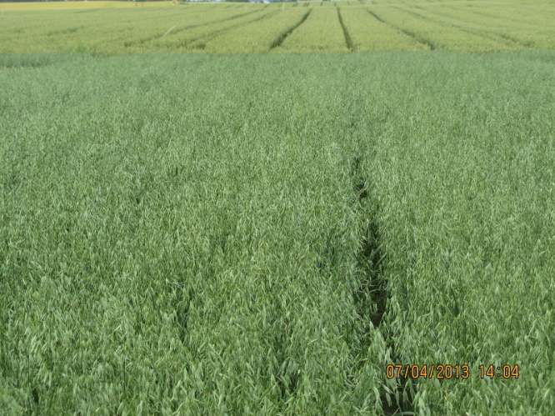
Weed harrowing in oat requires a well established and anchored crop
Well established oat (PURE, Flakkebjerg DK)
Oat just after post-emergence weed harrowing (PURE, Flakkebjerg DK)
Nicely recovered oat crop after two passes of weed harrowing (PURE, Flakkebjerg DK)
Vigorous and almost weed-free oat crop (PURE, Flakkebjerg DK)

Slide 5
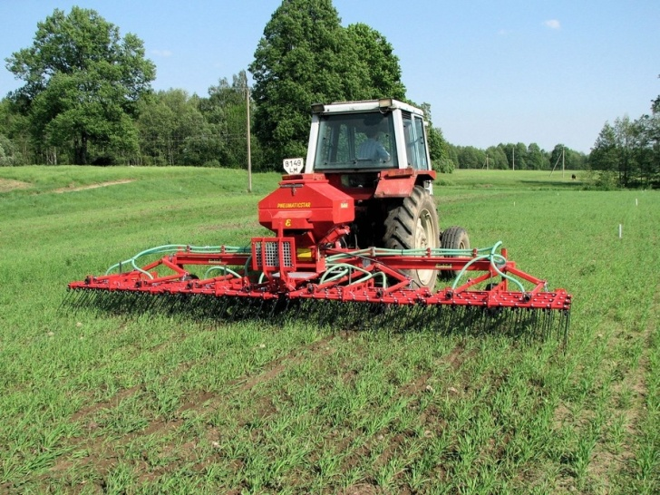
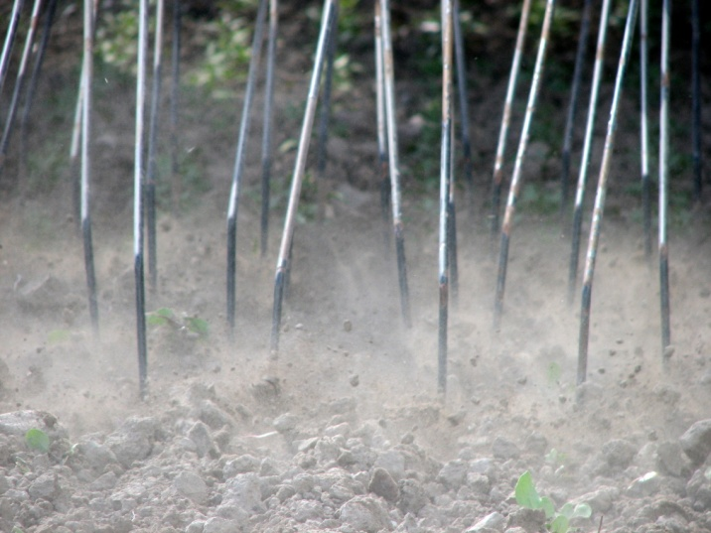
The implement for weed harrowing
Flex tine weed harrowing in spring cereals. (Photo: Jesper Rasmussen)
Flex tines in action. (Photo: Jesper Rasmussen)
Video of flex tine weed harrowing in various crops can be seen on:
https://www.youtube.com/watch?v=cDKGS2-_BX8#t=33

Slide 6
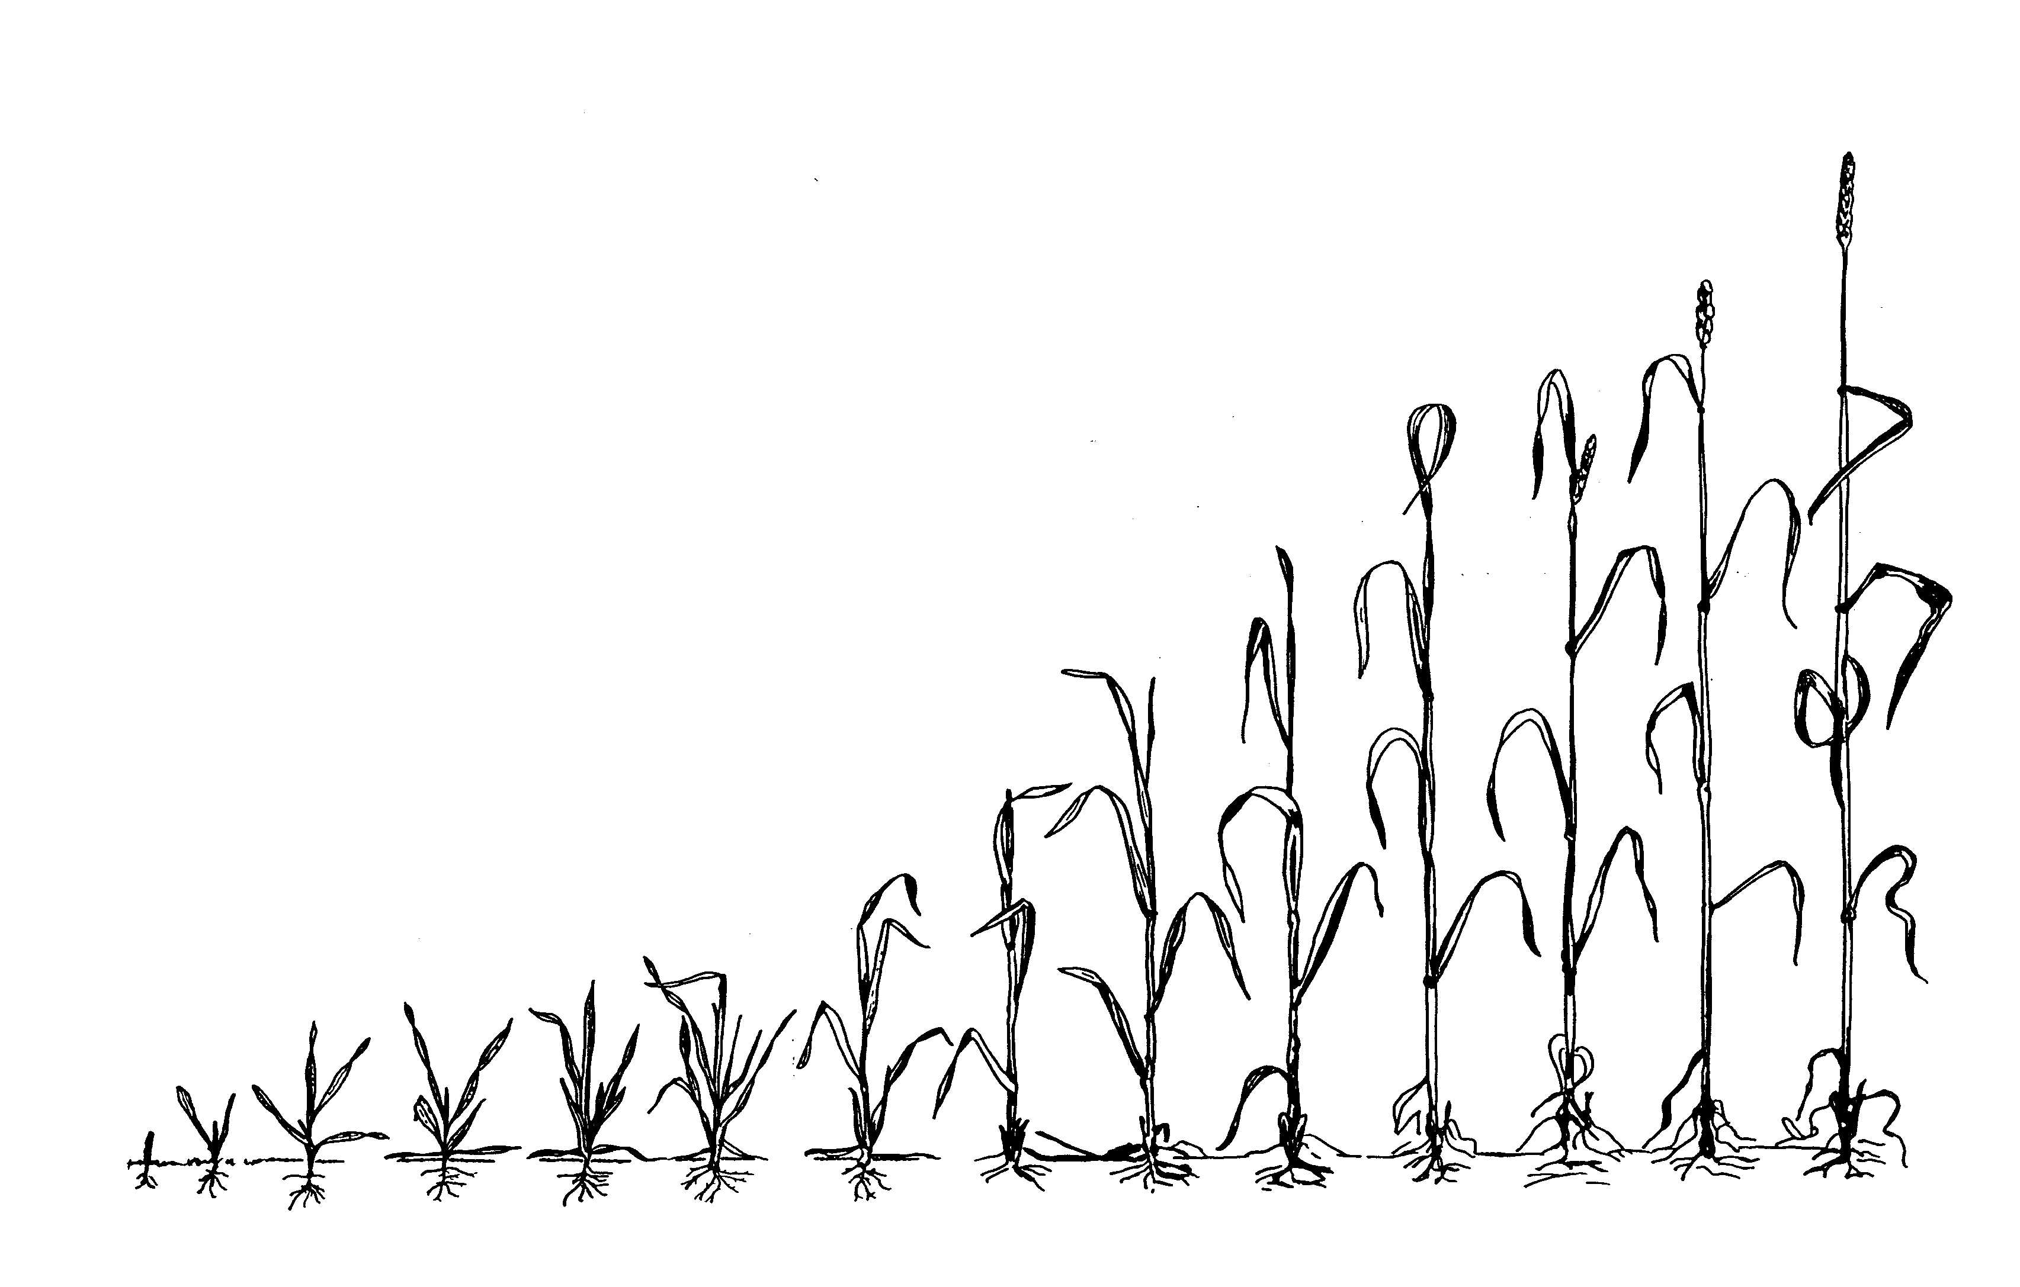
Strategy for weed harrowing in spring cereals: one pass pre-emergence plus one pass post-emergence
Pre-emergence harrowing 2-3 days before crop emergence. The crop must be sown 4-5 cm deep to avoid severe impacting from the tines. Tine working depth: not more than 2 cm.
Post-emergence harrowing at the 2-4 crop leaves stage. Preferably weed growth stage max. 1-2 true leaves. Avoid covering more than 20-30% of the crop leaves with soil.

Slide 7
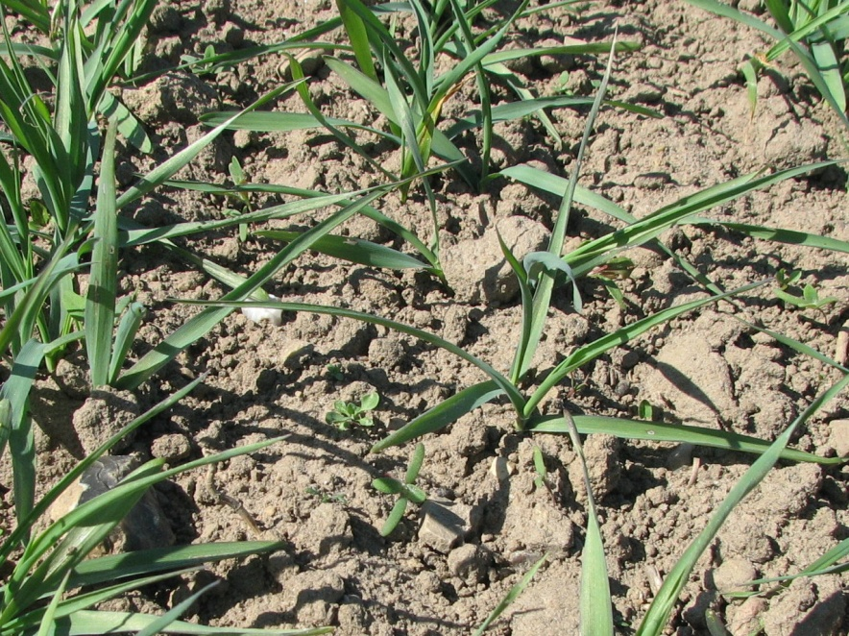
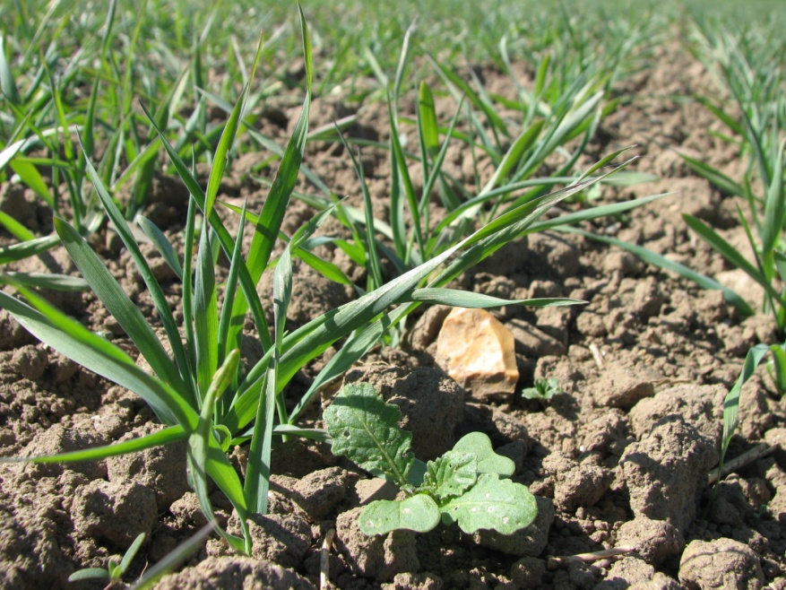
The importance of selectivity
Large crop plants and small weeds are crucial for a high selectivity when using weed harrowing. Left: weeds are small relative to the crop and efficient mechanical weed control is possible with minor crop damage (high selectivity). Right: there is a large weed plant (Sinapis arvensis), which is not possible to control without significant crop damage (low selectivity). (Photos: Jesper Rasmussen).

Slide 8
Preconditions for successful weed harrowing in spring cereals
Careful seedbed preparation to minimise unevenness on the soil surface
Avoid stony soils, especially stones bigger than a golf ball
Ensure good and fast crop establishment
Weed species with a tall and erect growth habit such as grasses, Galeopsis species, Sinapis arvensis and other crucifers, should only occur in moderate numbers: < 100 plants m⁻². If so, supplementary chemical control might be needed
Ensure that weeding times are kept – delays can be crucial
Target the treatments against weeds at the cotyledon growth stage and up to max. 2 true leaves stage; after which effectiveness declines rapidly
Other measures to suppress surviving weeds, such as fertilizer placement and competitive varieties, can improve the overall result of weed harrowing

Slide 9
Conclusion
Weed harrowing is a relevant non-chemical weed control method for usage in IPM programmes for spring cereals. In spring oat, a well planned weed harrowing strategy can control 60-80% of the annual weeds, usually with no need for supplementary chemical control.
Successful weed harrowing in oat in the long-termed PURE experiment at Flakkebjerg, Denmark. Only negligible weed biomass is left after treatment

